Slide 1

Patents 2
Talk 13
LAW 422 002
Intellectual Property Law
Allard School of Law, UBC
Spring, 2024
Jon Festinger K.C.
Adjunct Professor, UBC Allard
Of Counsel, Chandler Fogden Lyman
https://iplaw.allard.ubc.ca/

Slide 2
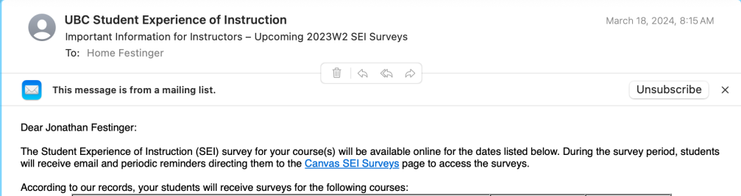
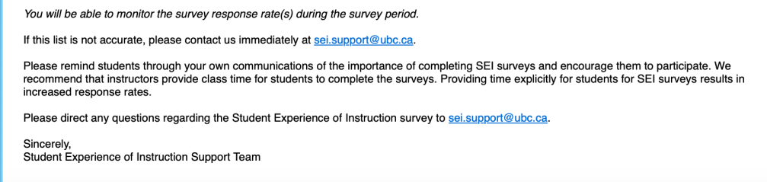
Please do if you have not already…

Slide 3
GO TO CANVAS SEI SURVEYS PAGE
1. LAW 422 002 - Intellectual Property
March 30, 2024, to April 15, 2024
2. LAW 570C 002 - Intellectual Property
March 30, 2024, to April 15, 2024

Slide 4
Logistics

Slide 5
Exam
Wednesday April 17, 2024
9:00 AM
Rooms: ????

Slide 6
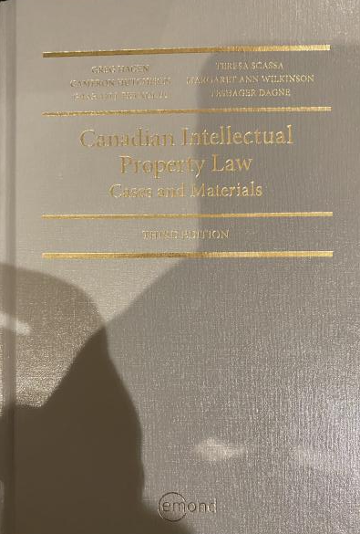
Text

Slide 7
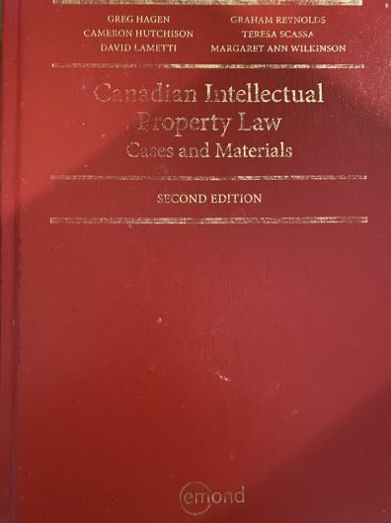
Former Text

Slide 8
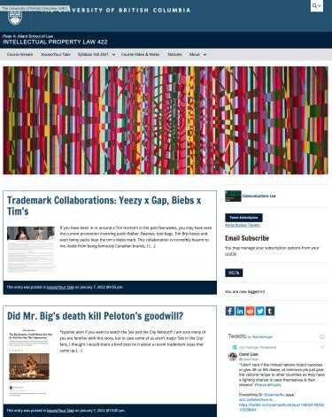
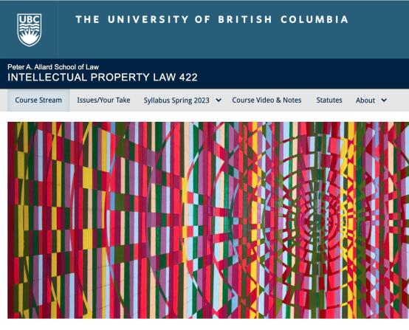
Course Website
https://iplaw.allard.ubc.ca/

Slide 9
PLEASE
SIGN UP

Slide 10
For full privileges on the website
1. Please create an account at http://cms.ubc.ca/ using your CWL.
2. Once you create an account and sign in at http://cms.ubc.ca/ you can click your name in the top right. Halfway down the following page will be your WordPress email address.
3. Send me your WordPress email address at jon.festinger@ubc.ca or at jon_festinger@thecdm.ca
4. Then, I will invite you to participate with authoring privileges via your WordPress email address.

Slide 11

Have responded to everyone?
+
…to some who didn’t ask?

Slide 12
Why post?
Engaging and engaging others is the key.
Because you don’t love speaking up in class.
Because you just saw or realized something, and you’ll never remember it unless you post it now.

Slide 13
Tips:
Don’t feel your posts have to be perfect. Engaging and engaging others is the key.

Slide 14
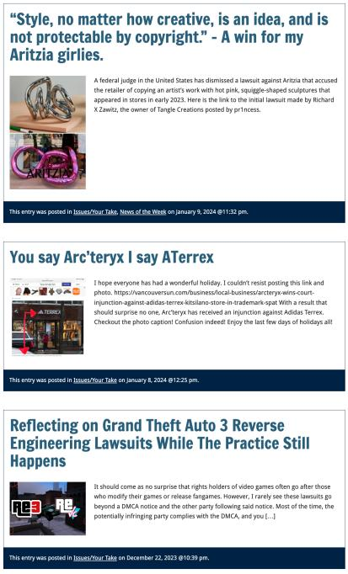

Slide 15

Anything & everything can be done via email if you prefer

Slide 16


Adding Images

Slide 17



Slide 18
Adding Links

Slide 19
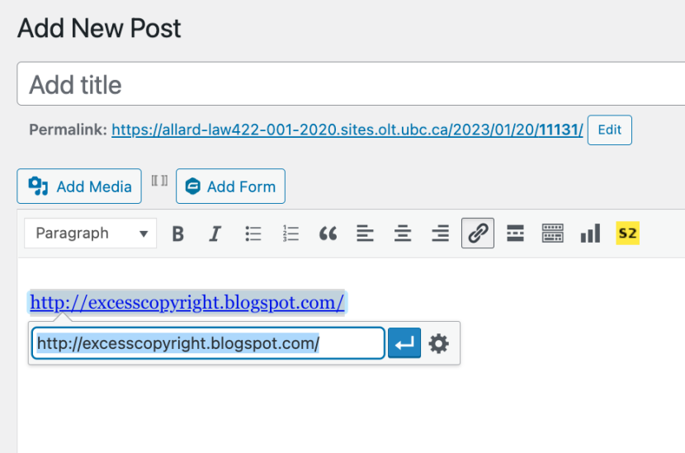


Slide 20


Adding a “Featured Image”

Slide 21


Slide 22
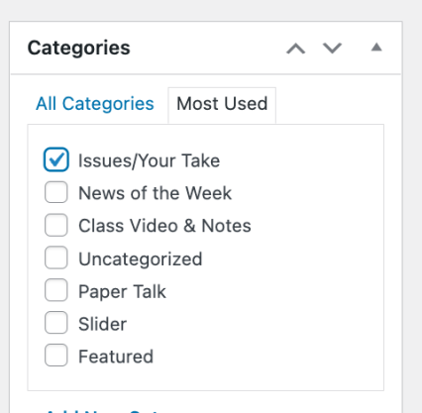

Setting Categories

Slide 23
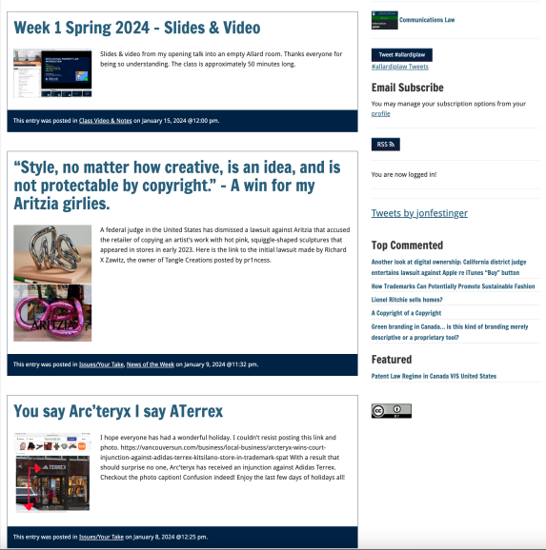
Creative Commons License

Slide 24
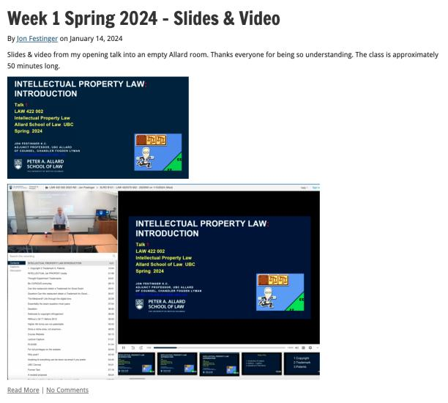
Lecture Capture

Slide 25
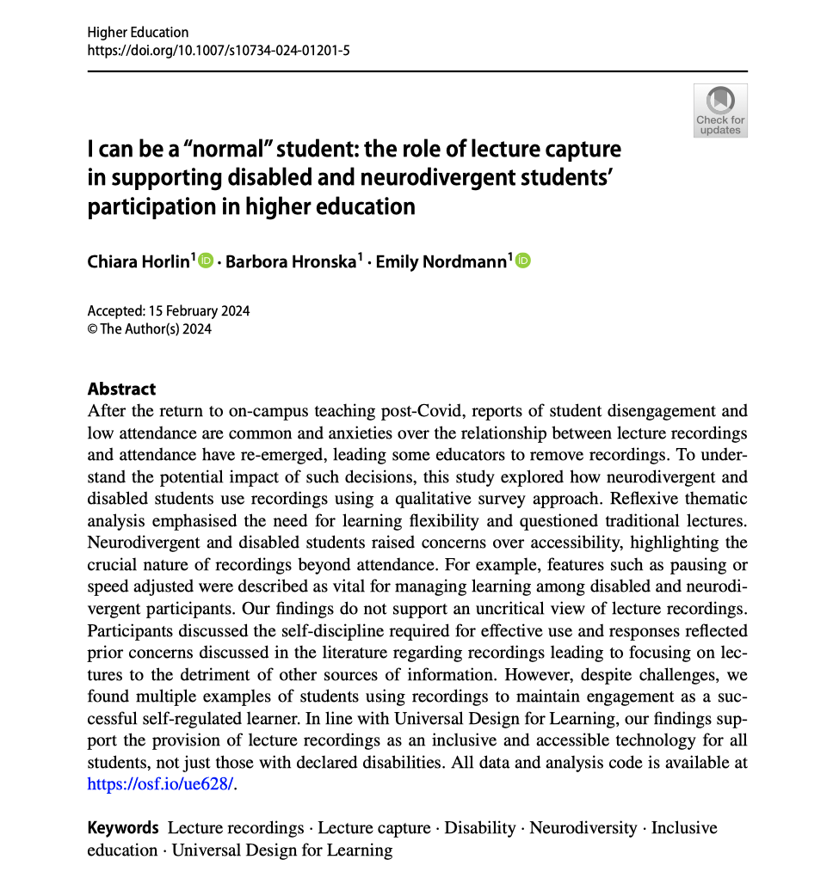

Slide 26
Syllabus

Slide 27
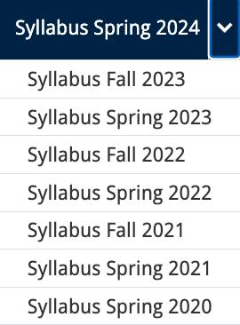




Slide 28
Features of this Course
70% Exam not 100%
IP Law “In Context”
Website

Slide 29
Let’s talk about…
The 30%

Slide 30
A modest proposal…
Approximately 1000 words (or equivalent) per person
written, video, podcast, in-class presentation (?), interpretive dance
Website or not
Groups or individually
LLM Students – one extra post

Slide 31
Past Presentations: Most are on the course website…

Slide 32
Generative A.I. Policy
1. It is source material, therefore
must be cited
2. You are responsible for the quality
of your source material, so check…
If it is wrong, you are wrong
If it plagiarized, you’ve plagiarized

Slide 33

Office “Hours”: Ideally Tuesdays just after class but am flexible…
Email: jon.festinger@ubc.ca; jfestinger@telus.net
Office: 449
Phone:
c. 604-837-6426
(please text if urgent)

Slide 34
Entirely optional but please…
…email me a short bio of yourself referencing:
Anything at all you want to say about yourself
Your academic interests
What you might like to get out of this course (I.E., interest in a type of patent, or a copyright issue etc.)
Favorite Intellectual Property (ies) - current or all-time

Slide 35
Zoom Q&A Sessions
(Study Groups Preferred If Possible)

Slide 36
QUESTIONS?
THOUGHTS?
DISCUSSION?

Slide 37

Pause

Slide 38
Posts of
the Week

Slide 39
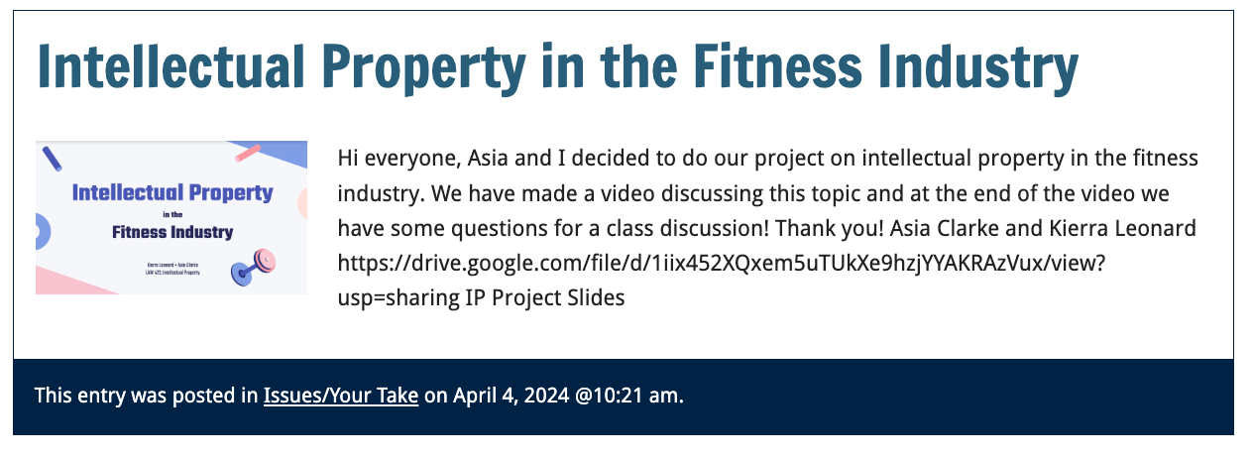

Slide 40
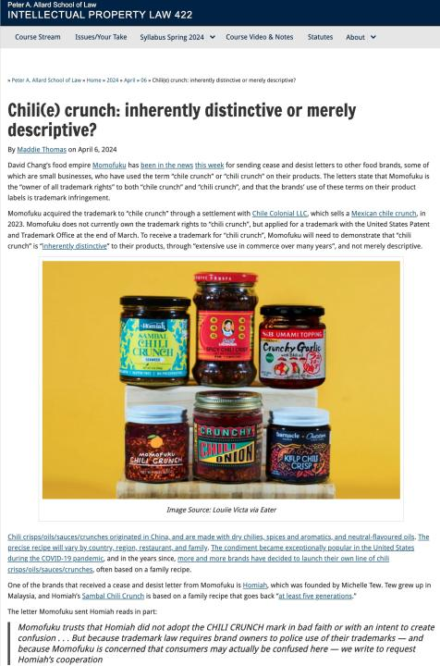

Slide 41
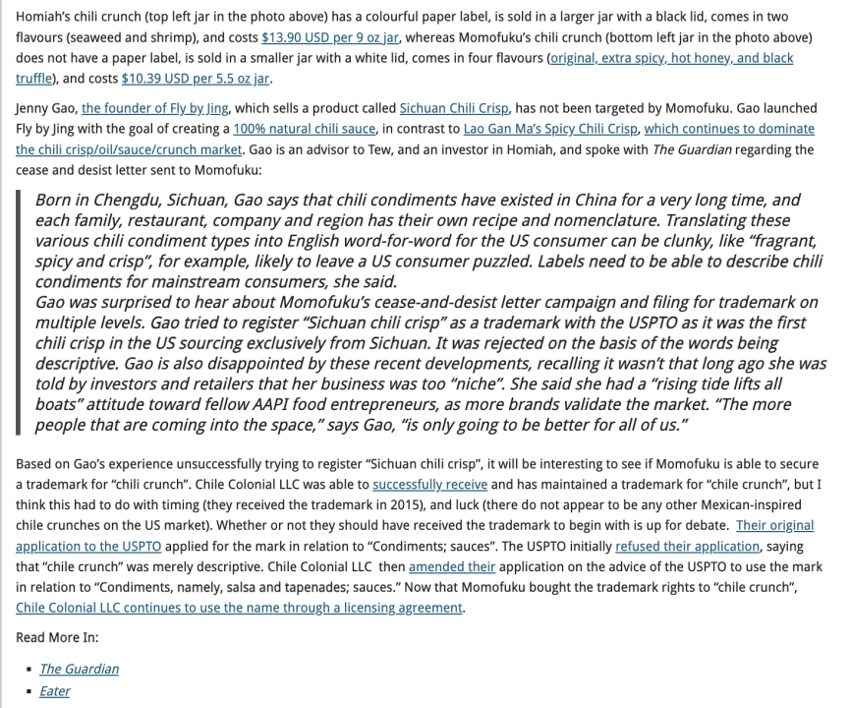

Slide 42
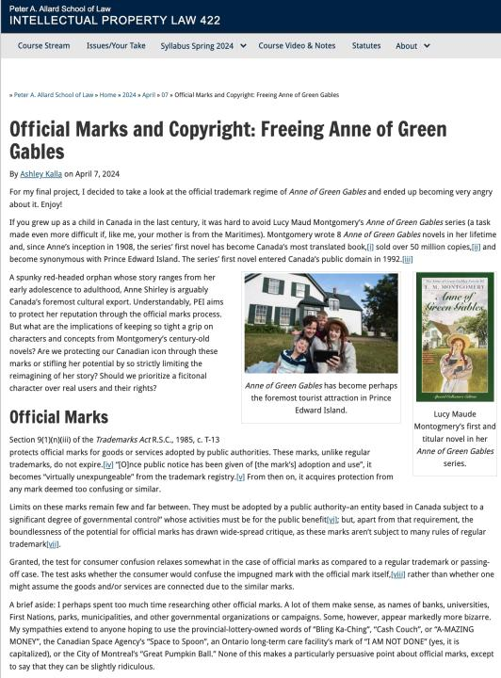

Slide 43
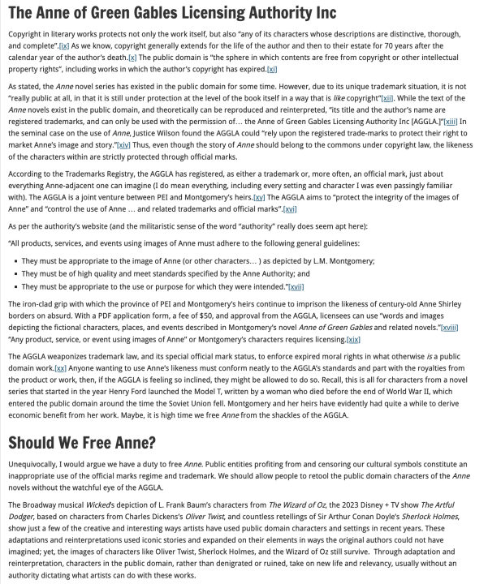

Slide 44
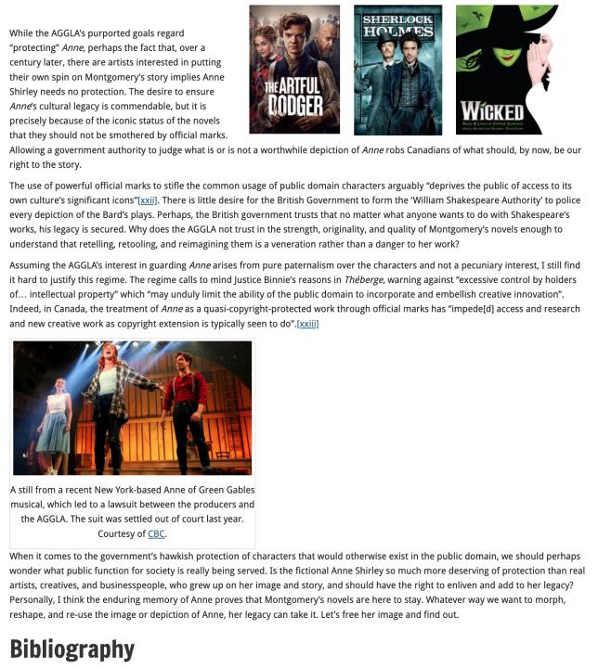

Slide 45
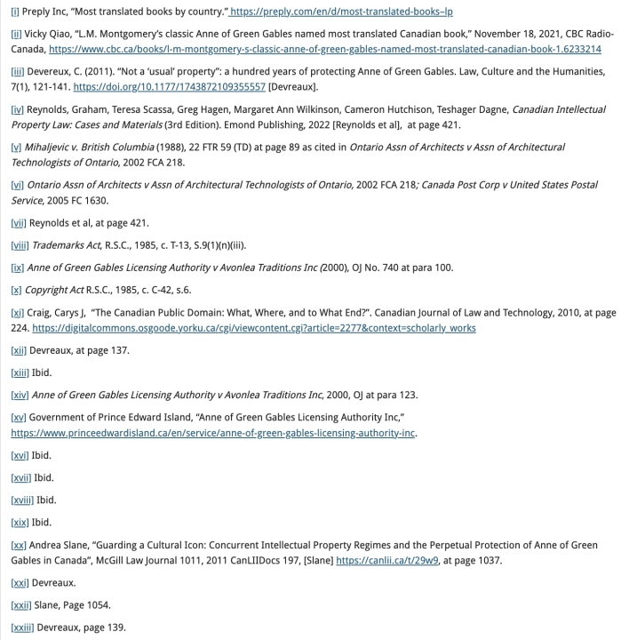

Slide 46
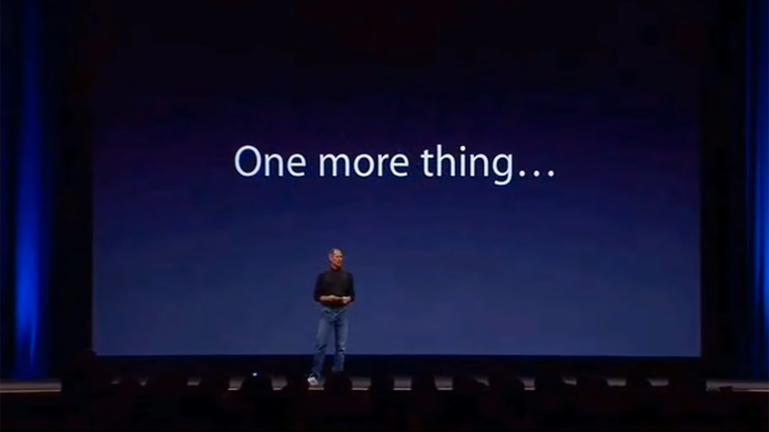

Slide 47
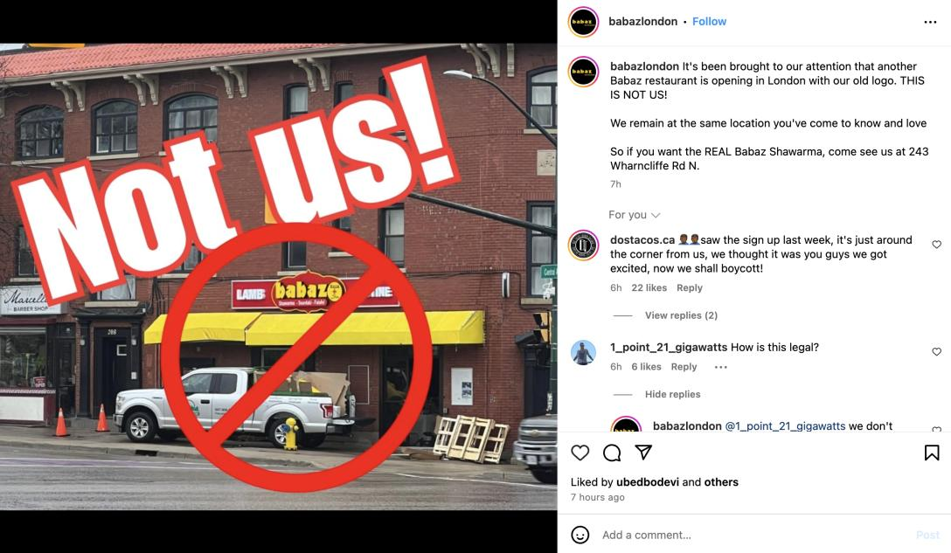

Slide 48
QUESTIONS?
THOUGHTS?
DISCUSSION?

Slide 49
Pause

Slide 50

Random Notes

Slide 51
worst brand
decisions

Slide 52
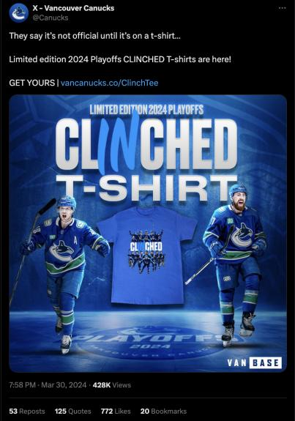
Just because you have a brand,
doesn’t mean you must always use it!

Slide 53


Slide 54
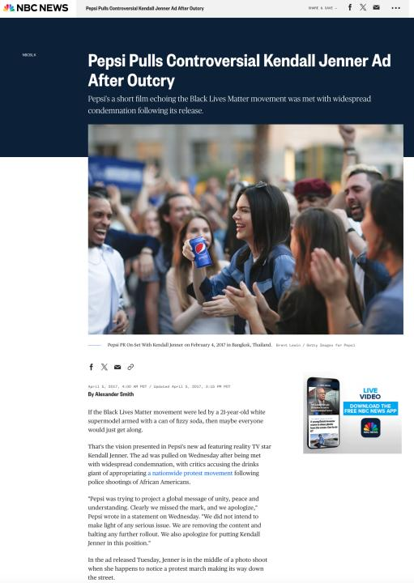

Slide 55
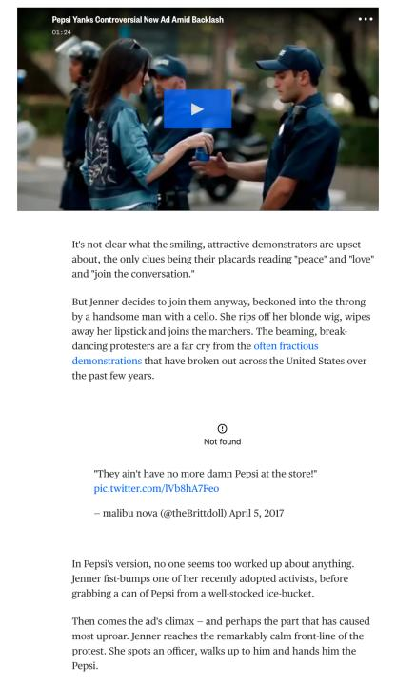

Slide 56
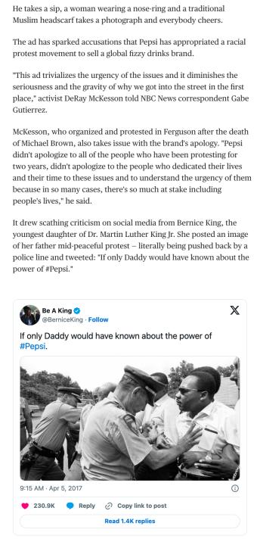

Slide 57
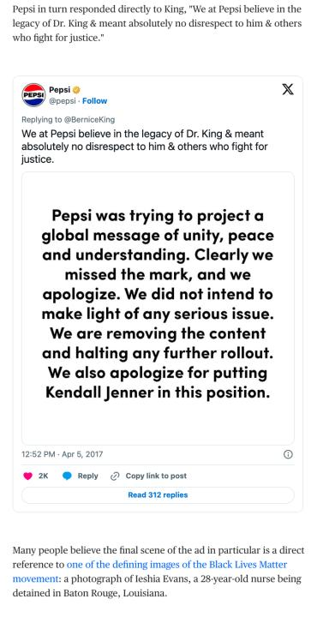

Slide 58
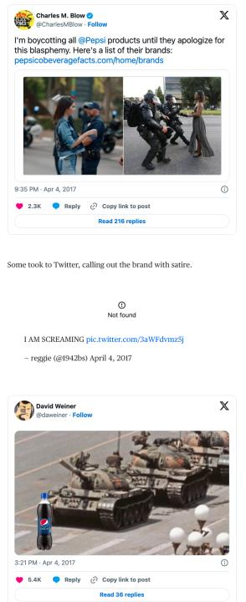

Slide 59
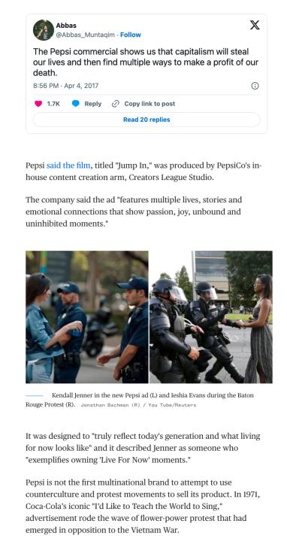

Slide 60
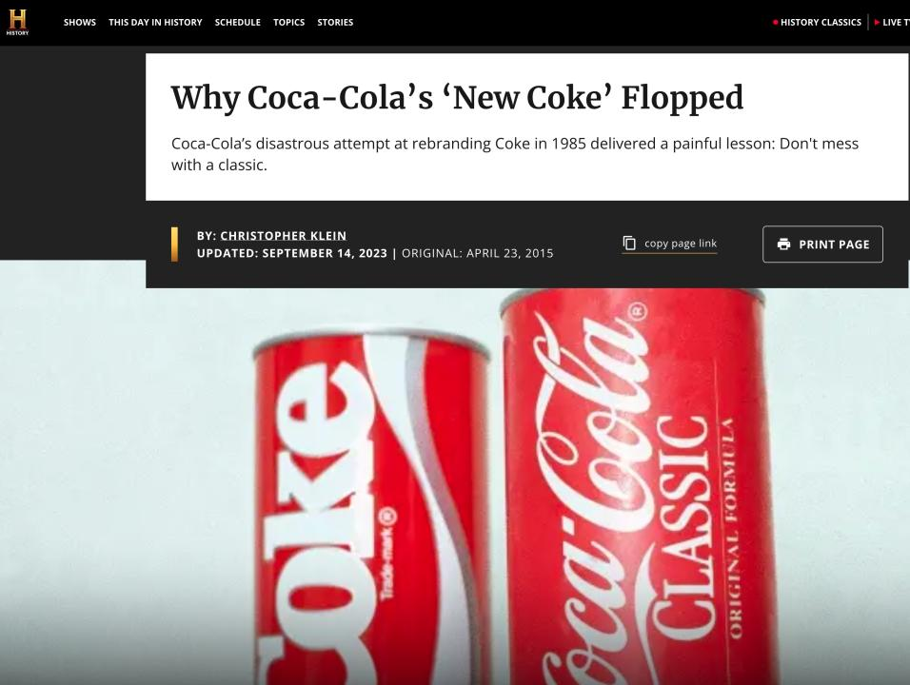

Slide 61
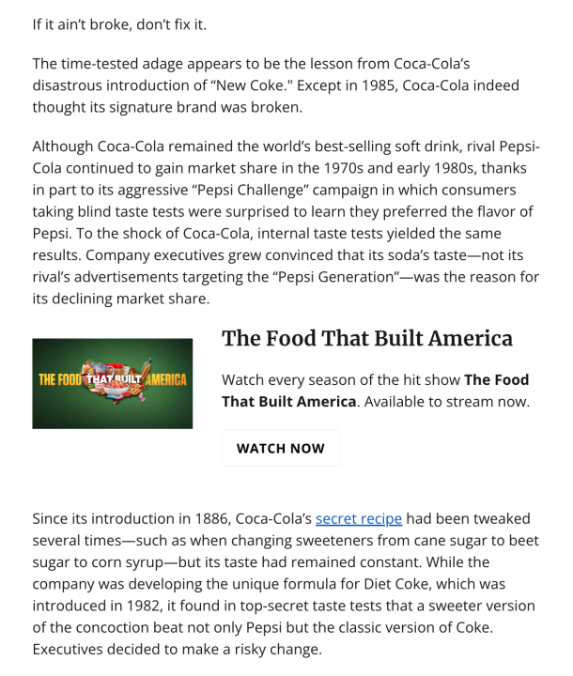

Slide 62
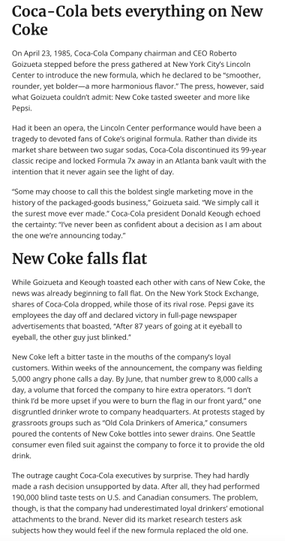

Slide 63
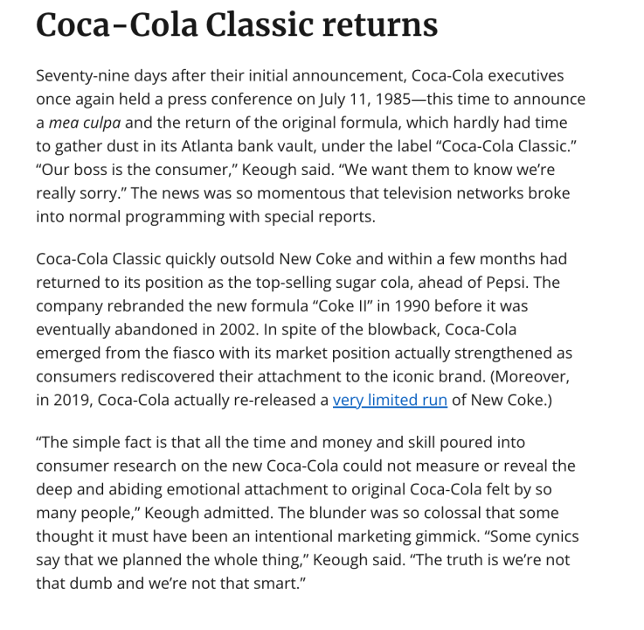

Slide 64
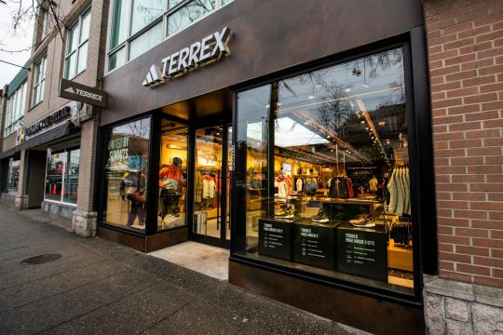
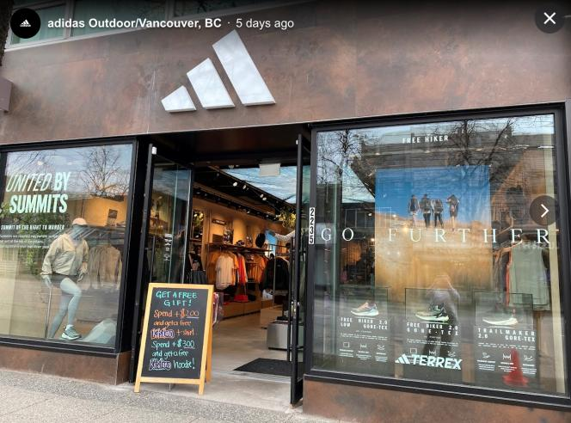

Slide 65
QUESTIONS?
THOUGHTS?
DISCUSSION?

Slide 66
Pause

Slide 67
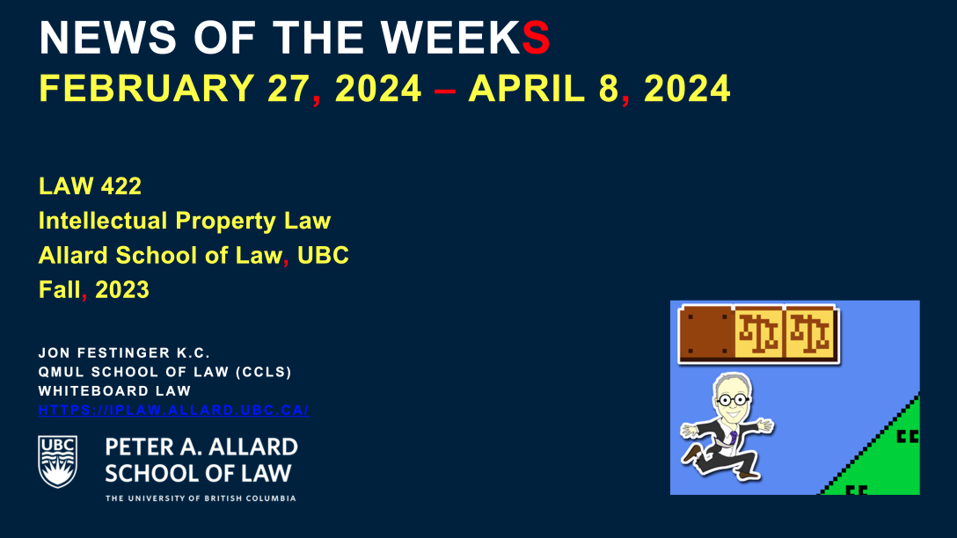

Slide 68
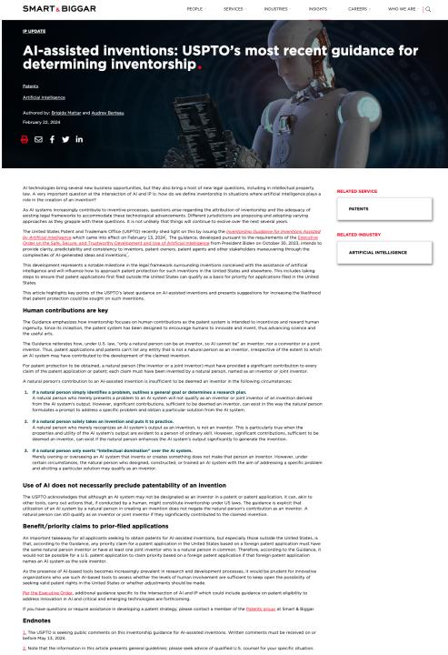

Slide 69
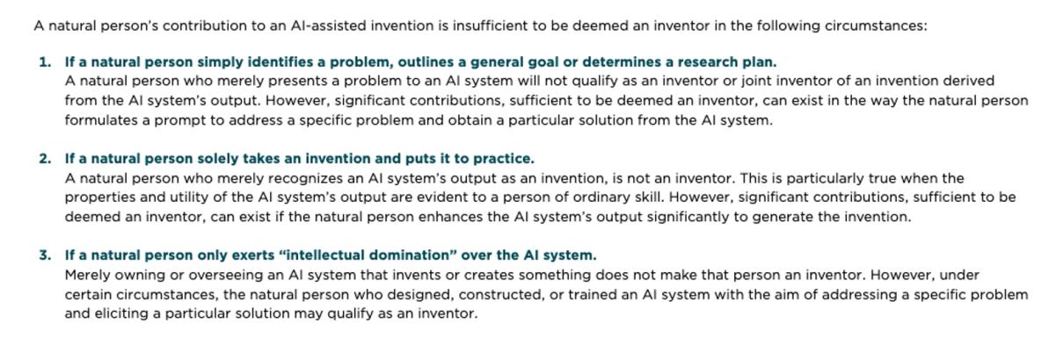

Slide 70
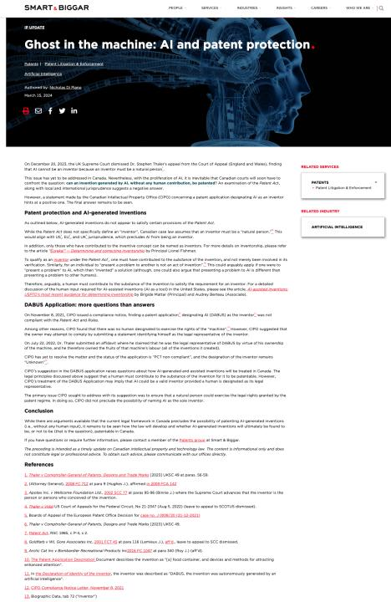

Slide 71
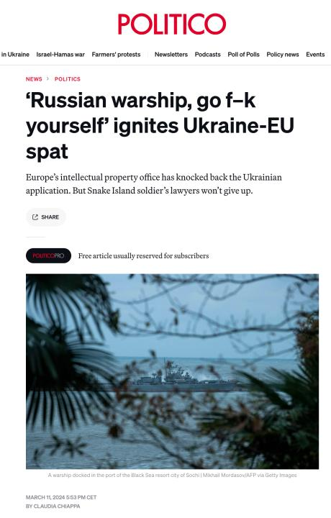

Slide 72
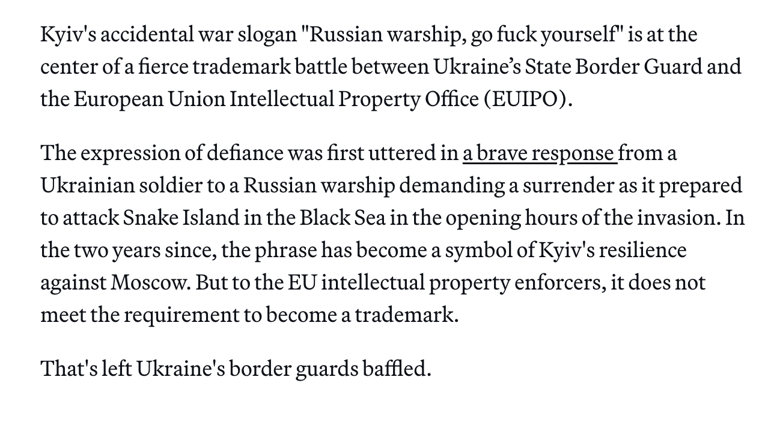

Slide 73
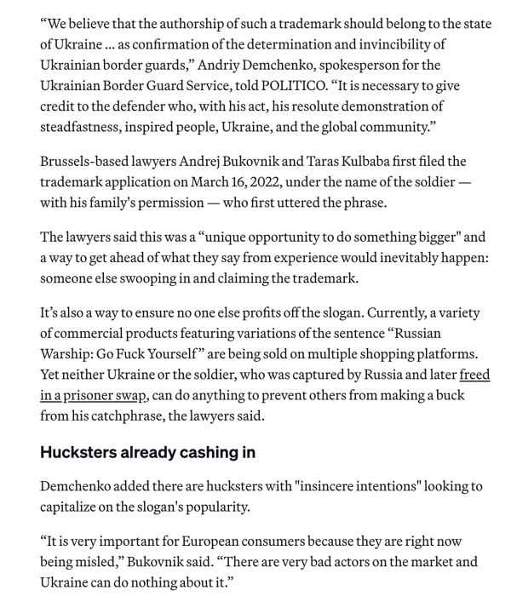

Slide 74
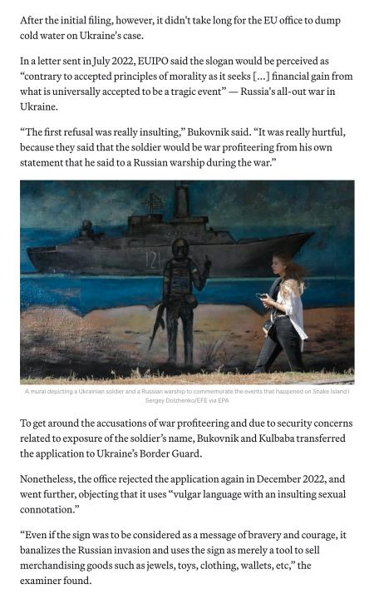

Slide 75
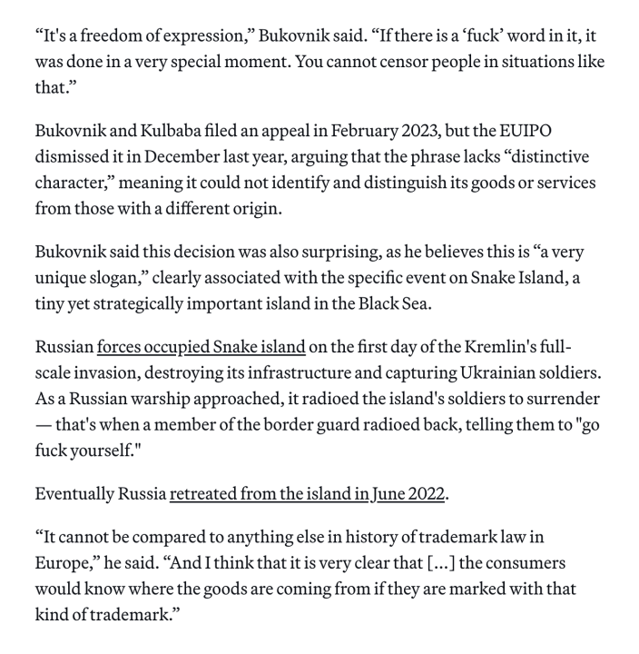

Slide 76
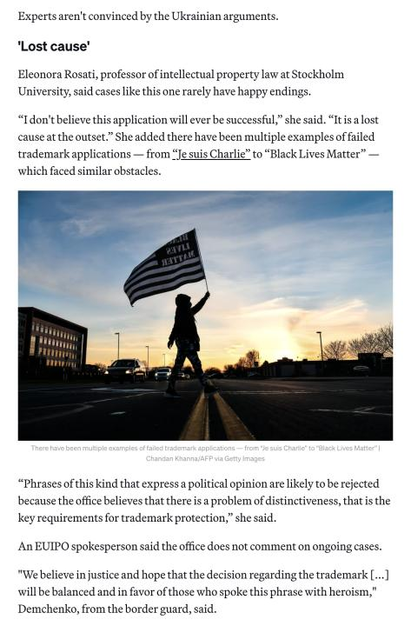

Slide 77
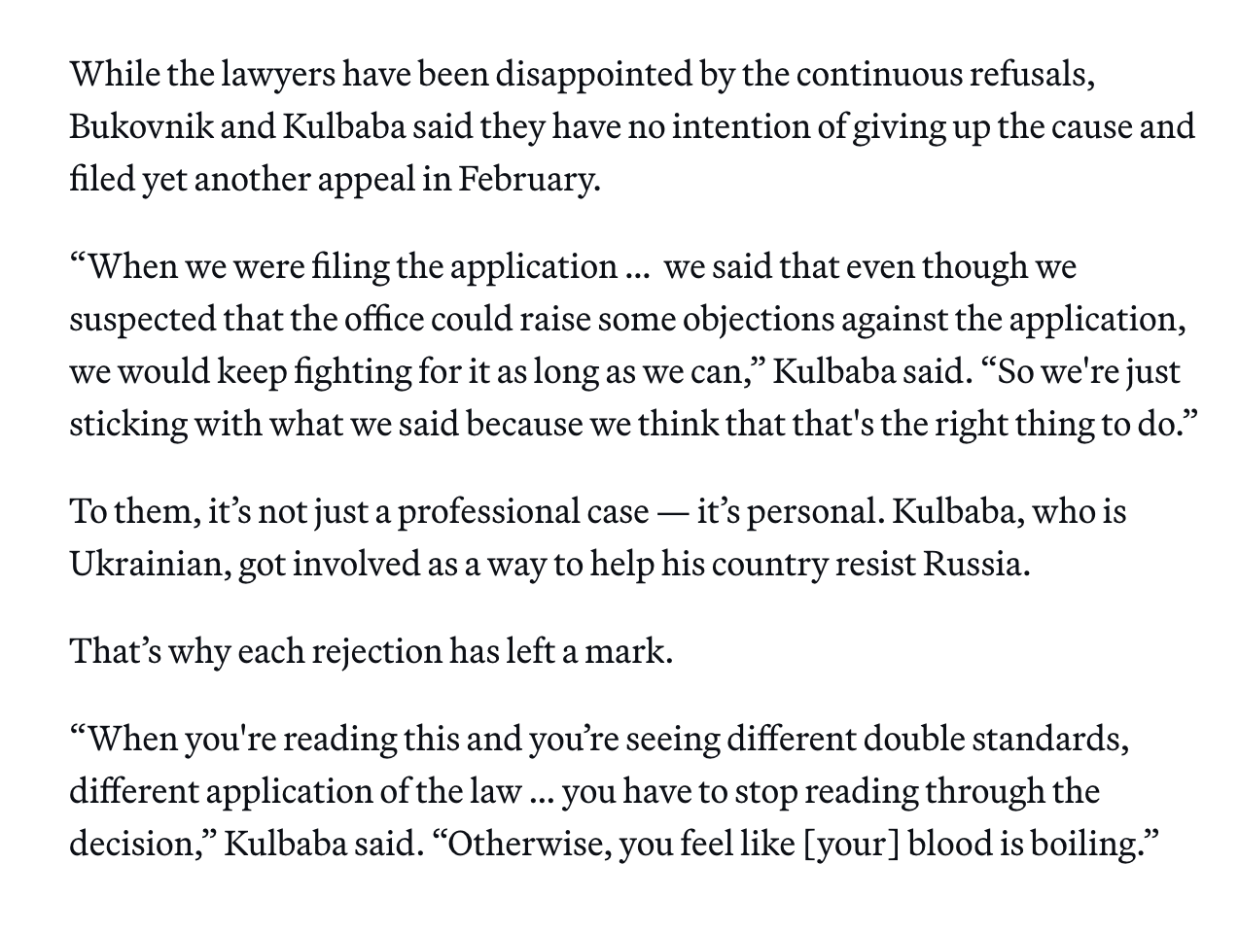

Slide 78
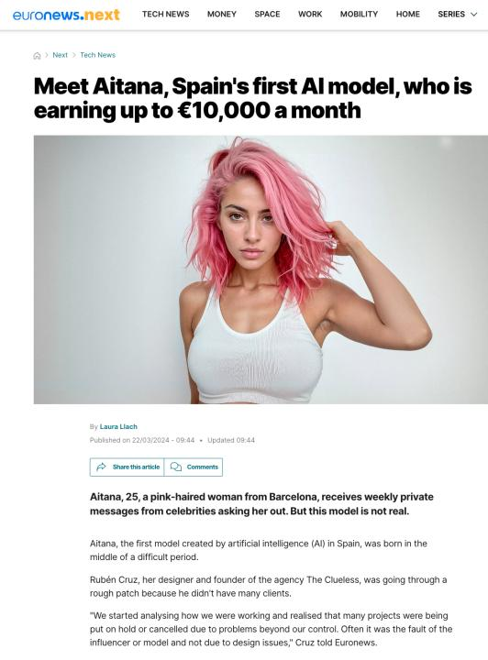

Slide 79
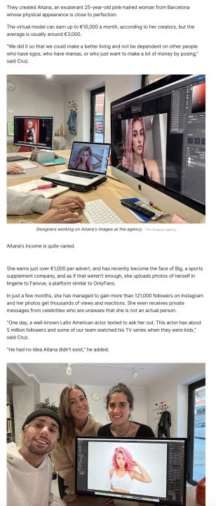

Slide 80
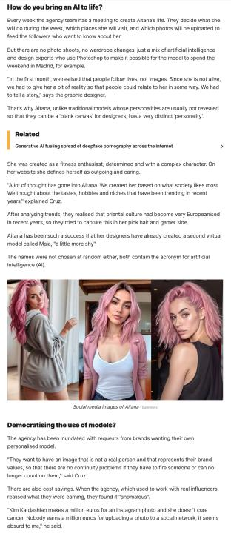

Slide 81


Slide 82


Slide 83
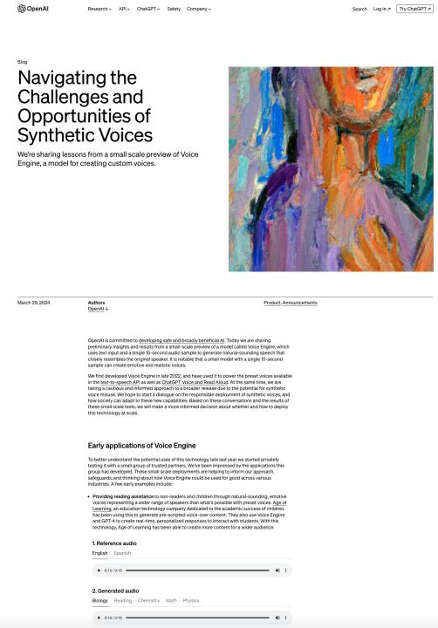

Slide 84


Slide 85


Slide 86

Where we have been…

Slide 87

In Week 12 Slides!

Slide 88
QUESTIONS?
THOUGHTS?
DISCUSSION?

Slide 89
Pause

Slide 90


Slide 91
Intellectual Property Law is about:
What kinds of creations of the mind can one have rights in?
Who can have those rights?
What kinds of rights are there; and how are those rights enforced?

Slide 92

Patents

Slide 93

https://iplaw.allard.ubc.ca/2020/06/01/gowlings-roch-ripley-r-nelson-godfrey-on-patent-remedies-etc/

Slide 94
Core Human Concept
Creativity (Copyright)
Origin (Trademarks/P.O.)
Innovation (Patents)

Slide 95
Core Legal Mechanism
Fixation (Copyright)
Use (Trademarks/P.O.)
Usability (Patents)

Slide 96
Core Public Right
User’s Rights (Copyright)
Consumer Rights
(Trademarks/P.O.)
Anti-Monopoly (Patents)

Slide 97

Meta Perspective
Earth from 3.7 Billion Miles Away (1990 Voyager 1)

Slide 98

Storytelling

Slide 99
Patents
First…
Introduction to patents
Patentable subject matter
  Invention
    Composition of matter; manufacture; machine; art; process; improvement
Non-patentable subject matter
    Mere scientific principles or abstract theorem; professional arts; higher life forms; methods of medical or surgical treatment

Slide 100
Patents
Federal Government:
Authority over patents: s. 91(22), Constitution Act, 1867
Authority exercised in part through the enactment of the Patent Act, RSC, c. P-4
Definition of patent:
a limited term monopoly for an invention; the right, given to an inventor by the government, to exclude others from making, using or selling one’s invention from the day the patent is granted.
“…to advance research and development and to encourage broader economic activity” (Free World Trust, 2000 SCC)

Slide 101
Patents
”Patentee” can only get a patent for “inventions” (s. 2)
Also, patent only granted if your invention is novel, useful, and non-obvious (ss. 2, 28.3)
Term of protection: 20 years (ss. 44, 46)
Contrast with confidential information

Slide 102
Patents
At its core, the patent system is a bargain between the inventor and the public:
One party discloses an invention in exchange for a 20 year monopoly period in which to make, use, and sell the invention
See Teva Canada Ltd. v. Pfizer Canada, Inc.
  FACTS: Teva had challenged the validity of Pfizer’s patent for Viagra.

Slide 103
The Patent Bargain
Teva Canada Ltd. v. Pfizer Canada, Inc.
FACTS: Teva had challenged the validity of Pfizer’s patent for Viagra.
“[N]ot intended as an accolade or civic award for ingenuity. It is a method by which inventive solutions to practical problems are coaxed into the public domain by the promise of a limited monopoly for a limited time.”
Patent specification = heart of the disclosure requirement
Patent system is a “quid pro quo”

Slide 104
Patents
Invention = … any new and useful art, process, machine, manufacture or composition of matter, or any new and useful improvement in any art, process, machine, manufacture or composition of matter (s. 2, Patent Act)
Contrast to Copyright where “mods” are discouraged rather than encouraged

Slide 105
Patents
Novelty and usefulness
(see s. 2, Patent Act)
Non-obviousness
(see s. 28.3, Patent Act)

Slide 106


Slide 107

Now, to our regularly
scheduled programming…

Slide 108

On with the show…

Slide 109
Patents
Harvard College (SCC):
Majority
  Invention defined broadly, should be interpreted broadly; but is not unlimited
  Some subject matter is outside the scope of protection
Commissioner has no discretion to refuse a patent on the basis of public policy considerations independent of express provisions of the Act

Slide 110
My comments on majority decision in Harvard College
(have edited out regrettably inappropriate comments)
“…I have spent way too much arguing in my head with Mr. Justice Bastarache’s every word in Harvard Mouse.” – email to Prof. Graham Reynolds, 8.15.20.
My original (unexpurgated but decontextualized) marginal notes in the textbook version of the case:
  ”STRAINED WOULD BE AN UNDERSTATEMENT. INTELLECTUALLY HONEST?”
  Huh?
  Huh?
  Worst writing in the history of the Court (SCC)???
  It doesn’t?
  So what?
  So strained!!!
  ???
  Huh!
  Really?
  Huh – non sequitur
  LWTF? How? Wha..?
  B…Turns a preference for parliamentary clarity into a requirement for it – wrongly.
None of the above means I’m right, just that I had a similar reaction to some of you.

Slide 111
But…
Isn’t majority just limiting patents and saying that patents are too broad? I want to limit copyright similarly so benefits can accrue to everyone (for example – mods).
Isn’t the prohibition from patenting higher life forms equivalent to being anti-slavery?
I tend to be “species’ centric” in suggesting A.I.’s can’t create copyright material. If that’s ok what’s wrong with species-centric in this situation?

Slide 112
Patents
Composition of matter
The category ‘composition of matter’ refers to combinations of ingredients, whether combined as a chemical union or a physical mixture, and includes chemical compounds, compositions and substances (12.02.05, “MOPOP” – Manual of Patent Office Practice)

Slide 113
Patents
Composition of matter – Harvard College
Defined more narrowly than “all compositions of two or more substances and … all composite articles”
Does not include higher life form like the oncomouse
Statutory interpretation principles used to support this determination
Other factors that suggest that higher life forms are not compositions of matter
  Recourse to dictionary definitions
  “Combine” – but elements require no human intervention
  “Composition of matter” seems inadequate as a description of a higher life form

Slide 114
Patents
Manufacture
Majority (Harvard College)
  Manufacture = non-living mechanistic product or process
MOPOP (Manual of Patent Office Practice)
  The process of making (by hand, by machine, industrially, by mass production…) technical articles or material (in modern use on a large scale) by the application of physical labour or mechanical power; or the article or material made by such a process” (MOPOP 12.02.04).

Slide 115


Slide 116
Patents
Higher life forms
Post Harvard College:
  Patent applications cannot include claims to higher life forms (i.e., seeds, plants, non-human animals) or to humans
  Can patent isolated genes and cells (cell lines, cell cultures)
  Fertilized eggs?
    CIPO practice notice – fertilized egg is considered to be a higher life form because it can develop into a higher life form

Slide 117
Patents
Higher life forms
But … Monsanto Canada Inc. v. Schmeiser (2004)
  Schmeiser infringed Monsanto’s patented modified canlola gene by growing and harvesting his canola plants containing the patented gene.

Slide 118
Patents
Machine
  The mechanical embodiment of any function or mode of operation designed to accomplish a particular effect (MOPOP, s. 12.02.03)
  Example: Amazon.com, Inc. v. Canada (Attorney General), [2010] FC 1011, where certain patent claims disclosed ‘a machine … used to implement Amazon.com’s one-click ordering system”

Slide 119
Patents
Art
The application of knowledge to effect a desired result; must be defined in a way that gives practical effect to the knowledge.
Claimed as a method or a use
  Method – involves directing the person skilled in the art to take a step/series of steps to arrive at the desired result
  Use – defined in terms of the means to be applied; the “how” is left to the common general knowledge of the “person skilled in the art”

Slide 120
Art (as use)
  The application of certain means to achieve a specific result
  I.e.: the use of a known drug applied to treat a known disease

Slide 121
Patents
Art (as method)
Method
  An act or series of acts performed by some … object and producing in that object some change of either character or condition” (citing to Lawson – cited in Amazon.com, Inc.(MOPOP, 12.02.01)
  Test cited in Amazon:
    Not a disembodied idea; must have method of practical application
    A new and inventive method of applying skill and knowledge
    Has a commercially useful result

Slide 122
Patents
Art (as method)
  Claim 1 of Patent 2682261 – requesting prior art
  from the public in exchange for a reward
NB: fine arts are excluded from patentability
(inventions must apply to fields of technology)

Slide 123
Patents
Process
“A process can be considered to be a mode or method of operation by which a result or effect is produced by physical or chemical action, by the operation or application of some element or power of nature or one substance to another”
(MOPOP – Manual Of Patent Office Practice )
A process through which a known method is applied to known materials is patentable (Commissioner of Patents v. Ciba Ltd., 1959 SCC)

Slide 124
Patents
Process
Claim 1 of Patent 2697087 – PROCESS OF
REMOVING CALCIUM AND OBTAINING SULFATE
SALTS FROM AN AQUEOUS SUGAR SOLUTION

Slide 125
Patents
Improvements
Most inventions are improvements of other
inventions
Not an improvement? A “pioneering” invention
A patent on the improvement does not give
the right to make, sell, or use the original
invention (s. 32, Patent Act)

Slide 126
Patents
Mere scientific principle or abstract theorem
Starting point: s. 27(8), Patent Act
This section interpreted as excluding, from patentability, natural phenomena and laws of nature (Arbour J., Schmeiser)
Are human gene patents patentable subject matter?

Slide 127
Patents
Mere scientific principle or abstract theorems
Historically – computer programs are not patentable because they are mathematical algorithms (unpatentable per s. 27(8)) (see Schlumberger Ltd. v. Canada (Patent Commissioner), 1982
But…see Motorola Inc., in which Motorola succeeded in patenting a mathematical algorithm by claiming it as part of a machine (the computer)

Slide 128
Patents
Patentability of business methods
Canada (Attorney General) v. Amazon.com, Inc., 2011 FCA 328
  FACTS: one-click online purchase method
  (1) No case law to support claim of tradition of excluding business methods from patentability
  (2) To avoid patenting a mere idea or discovery, the claimed invention must have some “physical existence” that “manifests a discernible effect or change”. This is not met merely by virtue of the fact that the claimed invention has a “practical application”.

Slide 129
Patents
Professional Arts v. Professional Skills
  Professional skills are considered not to
  be patentable on the basis that they
  reflect the personal knowledge and
  capacities that one would expect from
  any-one skilled in their field
  See Lawson

Slide 130
QUESTIONS?
THOUGHTS?
DISCUSSION?

Slide 131
Pause

Slide 132
Patent Requirements
Next…
Requirements of patentability:
  Novelty
  Non-obviousness
  Utility

Slide 133
Patents
Novelty and usefulness
(see s. 2, Patent Act)
Non-obviousness
(see s. 28.3, Patent Act)

Slide 134
Patents
Novelty
Also referred to as “anticipation” (prior action that prevents the action of another)
Has the invention been disclosed in some way prior to the date of the patent claim?
See s. 28.2, Patent Act
Underlying policy reason?

Slide 135
Patents
Novelty
Prior art: Material which may disclose the invention which you’re claiming
Can use this to establish that an invention existed before the patent claim
See s. 28.2 outline of what constitutes prior art for the purpose of assessing novelty

Slide 136
Patents
Novelty
Filing date v. claim date
  Filing date: date on which the Commissioner receives certain documents, information and fees (s. 28(1))
  Claim date: each claim has a claim date; establishes the date for determining the patentability of the invention defined by the claim

Slide 137
Patents
Novelty
The claim date is normally the filing date (s. 28.1)
…except where the person who has filed the application has previously filed an application for a patent which discloses the subject-matter defined in the claim
  For example: Amy invents a widget; files on January 1, 2019. Amy files again, on October 15, 2019, for the same widget. Earlier date can be an advantage to Amy if there is a competitive “rush to file’

Slide 138
Patents
Novelty
s. 28.1(1)(a)(i): Claim date could be the date of a previously filed application in Canada where the filing date of the most recent application is within 12 months from the date of the filing date of the previously filed application
How? Make a request for priority under s. 28.4(1) on the basis of a previously filed application

Slide 139
Patents
Novelty
s. 28.1(1)(a)(ii): Foreign filings section
  If a person has filed an application for the same invention in another treaty country, then under s. 28.1(1)(b) and (c), if the 2nd filing is within 12 months of the first filing, and if the applicant has made a request for priority on the basis of the previously regularly filed application, then the first date can be the claim date

Slide 140
Patents
Novelty
When does prior art amount to disclosure (rendering what is being applied for not new/novel)?
  S. 28.2(1)(d): where someone else has filed an application for a patent in Canada with a filing date after your claim date; where that other party has another date prior to the claim date of your application that they can rely upon under s. 28.1; where this date is within twelve months of their Canadian filing date; and where the other party has requested priority based on their earlier filing date.

Slide 141
Patents
Novelty
Example: (s. 28.2(1)(d))
  February 16, 2018: B files for a patent in Germany
  March 2, 2018: A files in US.
  June 23, 2018: A files in Canada and makes a request for priority based on the earlier filing date.
  August 5, 2018: B files in Canada and makes a request for priority based on the earlier filing date.
In this case, although B’s Canadian filing date is after A’s, her claim date is prior to A’s claim date. A’s patent will be void for lack of novelty.

Slide 142
Patents
When has anticipation occurred?
Lack of novelty is only found when your invention has been disclosed in a single publication/use
This publication must disclose the invention without “mosaicing” references
Mosaicing = collect a file of references and say that these references, taken together, disclose the subject matter
Commonly occurs through publication…

Slide 143
Patents
Other ways through which disclosure can occur
Display of the invention in a public place
Sale of the invention
Use of the invention
Conference presentation
Disclosure online
Filing of earlier patent application
NB: in Canada or elsewhere… (s. 28.2)

Slide 144
Patents
Novelty was refined in Apotex v. Sanofi-Synthelabo (SCC, 2008)
Two-part test: There is no novelty where there is (1) prior disclosure and (2) enablement
(1) Prior disclosure:
  The prior [publication/sale/use/patent] must disclose subject matter which, if performed, would necessarily result in infringement of that patent. At this stage, the skilled person is simply [analyzing] the prior [publication/sale/use/patent] for the purposes of understanding it. There is no room for trial and error or experimentation by the skilled person.

Slide 145
Patents
Novelty
(2) Enablement (see paras. 26-27, 37 in Apotex)
  Would the person skilled in the art have been able to perform the invention without undue burden?
    If inventive steps are required, the prior art will not be considered to be enabling
    Routine trials are acceptable
    The skilled person can use common general knowledge to supplement the information in the prior art or prior disclosed materials
    Obvious errors or omissions in prior art will not prevent enablement.

Slide 146
QUESTIONS?
THOUGHTS?
DISCUSSION?

Slide 147
Pause

Slide 148
Patents
Double patenting/evergreening
[63] … The inventor is only entitled to “a” patent for each invention: Patent Act , s. 36(1). If a subsequent patent issues with identical claims, there is an improper extension of the monopoly (Binnie J., Whirlpool Corp., SCC, 2000)
Look only at the claims (not the disclosure), as it is the claims that define the monopoly

Slide 149
Patents
Double patenting/evergreening
Same invention double patenting
  Identical or coterminous claims
Obviousness double patenting
  Prohibits the issuance of a second patent with claims that are not patentably distinct” from those of the earlier patent.

Slide 150
Patents: Doublepatenting/evergreening
Whirlpool Corp. v. Camco Inc. 2000 SCC 67 Binnie J.:
“[66] … In Commissioner of Patents v. Farbwerke Hoechst Aktiengesellschaft Vormals Meister Lucius & Bruning , [1964] S.C.R. 49, the issue was whether Farbwerke Hoechst could obtain a patent for a medicine that was a diluted version of a medicine for which it had already obtained a patent. The claims were neither identical nor conterminous. Judson J. nevertheless held the subsequent patent to be invalid, explaining at p. 53:
  A person is entitled to a patent for a new, useful and inventive medicinal substance but to dilute that new substance once its medical uses are established does not result in further invention. The diluted and undiluted substance are but two aspects of exactly the same invention. In this case, the addition of an inert carrier, which is a common expedient to increase bulk, and so facilitate measurement and administration, is nothing more than dilution and does not result in a further invention over and above that of the medicinal itself.”

Slide 151
Patents
Double patenting/evergreening
Rennie J.A.’s judgment in Mylan Pharmaceuticals distinguishes between invalidity on the basis of obviousness and “obviousness-type double patenting” (OTDP).
Key point: in an OTDP challenge, “only the earlier patent can be cited as rendering the impugned patent not patentably distinct; any other prior art is only relevant insofar as it contributes to the common general knowledge of the skilled person.”

Slide 152


A “Prior Art” story
Magnavox v. Mattel 1982 U.S. Dist. LEXIS 13773 (N.D. Ill.)

Slide 153
Chronology
1962: Spacewar! released on DEC PDP-1 mainframe @ MIT
...’507 from experiments done by Rusch, employee of Sanders Associates in 1967/68
1971: Sanders & Magnavox enter into exclusive license
1972: Magnavox Odyssey introduced (analog circuitry)
1975: Atari introduces Pong game console for home use (analog)
1976: General Instruments introduces TV game microprocessor (digital circuitry)
Magnavox sues Atari for patent violation & infringing concept of electronic ping pong (settled by Atari becoming Magnavox exclusive licensee)
1978: Magnavox Odyssey 2 has a microprocessor (digital)
1979: Mattel introduces Intellivision with General Instruments microprocessor (digital). Magnavox sues Mattel.

Slide 154

Court decided…
No distinction between analog and digital: “I regard analog and digital circuitry as two means which are interchangeable largely, which are equivalent, and which are, therefore, essentially the same means for achieving substantially the same results in substantially the same way.”
So far, so good…

Slide 155

But…OOPS!

Slide 156
Result: Creation of a meaningless
Computer Game/TV Console Divide
Mattel argued its console was not based on ’507 but on computer prior art, Space War!
Court noted PDP-1 was 6’ tall by 7’ wide, & cost approximately $120K. Court found for Magnavox: “…it is clear from the evidence that Mattel did not in fact follow the prior art but, instead, followed developments in the television game industry, an industry which was created because of the work done at Sanders in developing the first television games and an industry which expanded and developed and become economically viable largely because of television games which followed the teachings of the ’507 Patent.”

Slide 157
QUESTIONS?
THOUGHTS?
DISCUSSION?

Slide 158
Pause

Slide 159
Patents
Now…
Requirements of patentability:
  Novelty
  Non-obviousness
  Utility

Slide 160
Patents
Obviousness
Policy reason behind this requirement?
See s. 28.3

Slide 161
Patents
Obviousness
Policy reason behind this requirement?
See s. 28.3

Slide 162
Invention must not be obvious
28.3 The subject-matter defined by a claim in an application for a patent in Canada must be subject-matter that would not have been obvious on the claim date to a person skilled in the art or science to which it pertains, having regard to
(a) information disclosed before the one-year period immediately preceding the filing date or, if the claim date is before that period, before the claim date by the applicant, or by a person who obtained knowledge, directly or indirectly, from the applicant in such a manner that the information became available to the public in Canada or elsewhere; and
(b) information disclosed before the claim date by a person not mentioned in paragraph (a) in such a manner that the information became available to the public in Canada or elsewhere.

Slide 163
Patents
Obviousness
Who is the “Test Person”?
  Unimaginative skilled technician
Question to ask:
  Would the person skilled in the relevant art
  and science, based on their skill and knowledge but
  without a scintilla of imagination, have been led to
  this invention

Slide 164
Patents
Novelty and obviousness, distinguished
Novelty: Can’t “mosaic”
Obviousness: Could the unimaginative skilled person have taken all of the pieces and, using reasonable deduction, have arrived at this invention?

Slide 165
Patents
Apotex v. Sanofi-Synthelabo (2008, SCC)
Refinement of the test for obviousness to obvious to try
  Was the invention “obvious to try”?
  For a finding that an invention was “obvious to try”, there must be evidence to convince a judge on a balance of probabilities that it was more or less self-evident to try and obtain the invention (para. 66).

Slide 166
Patents
Obviousness inquiry (para. 67, Apotex):
(a) Identify the notional ‘person skilled in the art’
(b) Identify the relevant common general knowledge of that person
Identify the inventive concept of the claim in question or construe it
Identify what, if any, differences between the matter cited as forming part of the ‘state of the art’ and the inventive concept of the claim as construed
Viewed without any knowledge of the alleged invention as claimed, do those differences constitute steps which would have been obvious to the person skilled in the art or do they require any degree of invention?

Slide 167
Patents
Obvious to try factors:
  Is it more or less self-evident that what is being tried ought to work?
  What is the extent, nature and amount of effort required to carry out the invention?
  Is there a motive provided in the prior art to find the solution the patent addresses?
  Look at the history of the invention. Did inventor reach the invention quickly, easily, directly and relatively inexpensively?

Slide 168


Slide 169
QUESTIONS?
THOUGHTS?
DISCUSSION?

Slide 170
Pause

Slide 171
Patents
Next…
Requirements of patentability:
  Novelty
  Non-obviousness
  Utility

Slide 172
Patents
An invention must be useful to be patented. There is no definition of “utility” in the Patent Act.
Teva Canada Ltd v. Pfizer Canada Inc, 2012 SCC 60 at para 38, the Supreme Court of Canada stated: “all that is required to meet the utility requirement in s. 2 is that the invention described in the patent do what the patent says it will do, that is, that the promise of the invention be fulfilled.”

Slide 173
Patents
Utility
Laboratoires Servier, Adir, Oril Industries, Servier Canada Inc v Apotex Inc, 2008 FC 825, Snider J.: “[270] Beyond this general statement of the law, there are a number of other guiding posts:
• Where the specification does not promise a specific result, no particular level of utility is required - a “mere scintilla” of utility will suffice…However, as stated in Consolboard, above, where the specification sets out an explicit “promise,” utility must be measured against that promise;
• Utility does not depend upon marketability…; In other words, in assessing whether an invention has utility, the issue is not whether the invention is sufficiently useful as to be able to support commercialization, unless commercial utility is specifically promised;
• The relevant date has been held to be the filing of the Canadian patent application…; and
• Where a claim is to a class of compounds, lack of utility of one or more of the compounds will invalidate all of the compounds of that particular claim…”

Slide 174
Patents
Utility: Apotex Inc v. Wellcome Foundation Ltd, 2002 SCC 77, Binnie J:
“[3] In my view, for the reasons which follow, the inventive use of AZT was made by the five Glaxo/Wellcome scientists named in the patent on or before March 16, 1985, the priority date of the patent. It was sufficient that at that time the Glaxo/Wellcome scientists disclosed in the patent a rational basis for making a sound prediction that AZT would prove useful in the treatment and prophylaxis of AIDS, which it did. For the Commissioner of Patents to have allowed Glaxo/Wellcome a patent based on speculation would have been unfair to the public. For him to have required Glaxo/Wellcome to demonstrate AZT’s efficacy through the clinical tests required by the Minister of Health for approval of a new drug for medical prescription would have been unfair to Glaxo/Wellcome. The disclosure made in the patent was and is of real use and benefit to millions of HIV and AIDS sufferers around the world (irrespective of Glaxo/Wellcome’s pricing policy for AZT, which it must be acknowledged has generated serious controversy in some countries, particularly in the developing world). The fact remains that Glaxo/Wellcome, by making the disclosure, has fulfilled its side of the bargain with the public, and is by law entitled to legal protection for what it has disclosed.”

Slide 175
Patents
Utility: The “Public Interest” cuts both ways…
“…[36] It is not surprising that the appellants, being generic drug manufacturers, would like to obtain at least a percentage of the AZT market in Canada. To do so they must somehow have the patent declared invalid. Yet their challenge, understandably motivated by the hope of private profit, raises broader issues of public interest.”

Slide 176
Patents
Utility: The Doctrine of “Sound Prediction”
Apotex Inc v. Wellcome Foundation Ltd, 2002 SCC 77, Binnie J:
“[70] The doctrine of sound prediction has three components. Firstly, as here, there must be a factual basis for the prediction…Secondly, the inventor must have at the date of the patent application an articulable and “sound” line of reasoning from which the desired result can be inferred from the factual basis…Thirdly, there must be proper disclosure. Normally, it is sufficient if the specification provides a full, clear and exact description of the nature of the invention and the manner in which it can be practised….It is generally not necessary for an inventor to provide a theory of why the invention works…In this sort of case, however, the sound prediction is to some extent the quid pro quo the applicant offers in exchange for the patent monopoly. Precise disclosure requirements in this regard do not arise for decision in this case because both the underlying facts…and the line of reasoning…were in fact disclosed…”

Slide 177
QUESTIONS?
THOUGHTS?
DISCUSSION?

Slide 178
Pause

Slide 179
Patents
Next…
Requirements of patentability:
  Novelty
  Non-obviousness
  Utility

Slide 180
Patents
Utility: The Doctrine of “Sound Prediction”
Apotex Inc v. Wellcome Foundation Ltd, 2002 SCC 77, Binnie J:
“[70] The doctrine of sound prediction has three components. Firstly, as here, there must be a factual basis for the prediction…Secondly, the inventor must have at the date of the patent application an articulable and “sound” line of reasoning from which the desired result can be inferred from the factual basis…Thirdly, there must be proper disclosure. Normally, it is sufficient if the specification provides a full, clear and exact description of the nature of the invention and the manner in which it can be practised….It is generally not necessary for an inventor to provide a theory of why the invention works…In this sort of case, however, the sound prediction is to some extent the quid pro quo the applicant offers in exchange for the patent monopoly. Precise disclosure requirements in this regard do not arise for decision in this case because both the underlying facts…and the line of reasoning…were in fact disclosed…”

Slide 181
Patents
“…[66] The doctrine of “sound prediction” balances the public interest in early disclosure of new and useful inventions, even before their utility has been verified by tests (which in the case of pharmaceutical products may take years) and the public interest in avoiding cluttering the public domain with useless patents, and granting monopoly rights in exchange for misinformation.”

Slide 182
Dr. Janet (not Jane) Ridout
“…[13]…On December 5, 1984, Dr. Jane Rideout, the team member who had recommended testing AZT, sent a note to the Glaxo/Wellcome patent group stating: “Ethically the MD’s at BW [Glaxo/Wellcome] cannot suppress the activity of such a compound for very long”. By that, she meant that HIV/AIDS sufferers should not be deprived of potential relief through unnecessary delay, scientific timidity, or corporate dithering. Work on a patent application began soon afterwards.
[14] Dr. Rideout shared the view that further work was essential. She added, in her note to the Glaxo/Wellcome patent group, that a patent should only be pursued “if [AZT is] active against HIV” and “if all of this holds up [i.e., if activity is shown against HIV]” (emphasis added).”

Slide 183




Slide 184
QUESTIONS?
THOUGHTS?
DISCUSSION?

Slide 185
Pause

Slide 186
On with the show…

Slide 187
Patents
Remaining Outline
Miscellaneous patent law topics
  Patent rights, term and ownership
  Post-grant issues
  Infringement
  Defences to infringement and abuse of rights

Slide 188
Patents
Patent Term
  20 years from the filing date of the patent (s. 44), so long as maintenance fees continue to be paid (s. 46).
Assignment of the right to obtain a patent (see s. 49). Assignment should be in writing (s. 31(2))
Patent Act does not expressly deal with who owns patent between employer/employee (unlike Copyright Act)

Slide 189
Patents
Exclusive Rights of the patent owner (s. 42, Patent Act)
  Right to make the invention
  Right to construct the invention
  Right to use the invention
These rights “generally protect [the] business interests” of the patentee (para. 36, Monsanto v. Schmeiser )

Slide 190
Patents
Monsanto Canada, Inc. v. Schmeiser
Facts: Involves genetically altered canola seed
Did Schmeiser infringe Monsanto’s patent by “making” the gene or cell? (undecided)
Did Schmeiser “use” the gene and cell? (see para. 28)
  Q: Did the Defendant’s activity deprive the inventor in whole or in part, directly or indirectly, of the full enjoyment of the patent monopoly?
  Patent holder is entitled to protection even in the absence of commercial exploitation

Slide 191
Patents
Monsanto Canada, Inc. v. Schmeiser
"Use" applies both to patented products
and processes, and also to their output …
This expansive doctrine applies, however,
only if the patent plays an important part in
production (para. 41 – from Prof. Vaver)

Slide 192
Patents
Monsanto Canada, Inc. v. Schmeiser
Defendant infringes a patent when the Defendant manufactures, seeks to use, or uses a patented part contained within something that is not patented, provided the patented part is significant or important
Here: the patented genes compose the entire structure of the plant (analogy – Lego blocks)

Slide 193
Patents
Monsanto Canada, Inc. v. Schmeiser
Stand-by utility:
  A person has the invention and isn’t using it, but can in the future if they need to (ex fire extinguisher)
  Did the Defendant intend to exploit the invention of the need arose?
  A business that possesses a patented product for trade may be presumed to either have used it or to intend to use it.
  As a presumption, can be rebutted
See para. 58 for principles of use

Slide 194
Patents
Monsanto Canada, Inc. v. Schmeiser Para. 58 principles of use:
“1. “Use” or “exploiter”, in their ordinary dictionary meaning, denote utilization with a view to production or advantage.
2. The basic principle in determining whether the defendant has “used” a patented invention is whether the inventor has been deprived, in whole or in part, directly or indirectly, of the full enjoyment of the monopoly conferred by the patent.
3. If there is a commercial benefit to be derived from the invention, it belongs to the patent holder.
4. It is no bar to a finding of infringement that the patented object or process is a part of or composes a broader unpatented structure or process, provided the patented invention is significant or important to the defendant’s activities that involve the unpatented structure.
5. Possession of a patented object or an object incorporating a patented feature may constitute “use” of the object’s stand-by or insurance utility and thus constitute infringement.
6. Possession, at least in commercial circumstances, raises a rebuttable presumption of “use”.
7. While intention is generally irrelevant to determining whether there has been “use” and hence infringement, the absence of intention to employ or gain any advantage from the invention may be relevant to rebutting the presumption of use raised by possession.”

Slide 195
Patents
Monsanto Canada, Inc. v. Schmeiser found:
Saving and planting seed, then harvesting and selling the resultant plants, constitutes “utilization” of the patented material within the meaning of s. 42.
Mr. Schmeiser deprived Monsanto of the full enjoyment of its monopoly.

Slide 196
Patents
Patentability of life
Monsanto does not reverse Harvard College with respect to the patentability of life explained:
  Majority of the SCC noted that all members of the Court in the Harvard Mouse case said, in obiter, that a fertilized, genetically altered oncomouse egg would be patentable subject matter, regardless of its development into a mouse (at para. 3, per Binnie J. for the minority; at para. 162, per Bastarache J. for the majority).
  So, an egg was patentable even if it grows into a mouse.
  By analogy, a gene is patentable even if it grows into a plant

Slide 197
Patents
Patentability of life questions…
Should farmers have a right/privilege to save seed and replant?
If so, how should this right/privilege be protected at law?

Slide 198


Slide 199


Slide 200


Slide 201


Slide 202


Slide 203


Slide 204

https://youtu.be/BwgnXZ98AfI

Slide 205


Slide 206


Slide 207


Slide 208


Slide 209


Slide 210
QUESTIONS?
THOUGHTS?
DISCUSSION?

Slide 211
Pause

Slide 212
Patents: Post-grant Issues
A. Patent rights, once granted, can be lost (see s. 60(1))
Who is an “interested person” under s. 60(1):
  Actual or potential infringers
  Anyone dealing with the same/similar kind of thing as the Defendant and is in competition.
  Where a person is using or wants to use an invention in respect of which another person claims to have a patent
    Per Purcell Systems, Inc. v. Argus Technologies, 2008 FC 1210.
One-way patents can be invalidated = new prior art (s. 48.1(1))

Slide 213
Patents: Post-grant Issues
A. Patent rights, once granted, can be lost.
S. 48.1(1) provides that: “Any person may request a re-examination of any claim of a patent by filing with the Commissioner prior art, consisting of patents, applications for patents open to public inspection and printed publications, and by paying a prescribed fee.”

Slide 214
Patents: Post-grant Issues
B. Patent rights, once granted, can be modified…
See s. 48(1), which permits parts of a patent to be disclaimed
  S. 48(1)(a): Claim is overbroad when it is more than what was invented
  S. 48(1)(b): Claim is overbroad if it claims subject matter to which the patentee had no lawful right

Slide 215
Patents: Post-grant Issues
C. Patent rights, once granted, can be dedicated to the public
See Parke-Davis Division v. Canada (Minister of Health), 2002 FCA 454 @ para 84 “… Although there is no provision in the Patent Act which governs the termination of patent rights by dedication to public use, we are not persuaded that such a thing is impossible as a matter of law. Assuming it is possible, publication of a dedication notice in the Canadian Patent Office Record is certainly a method by which a dedication to public use can be accomplished.”
FCA also found that a valid dedication cannot be revoked.

Slide 216
QUESTIONS?
THOUGHTS?
DISCUSSION?

Slide 217
Pause

Slide 218
Patents: Patent infringement
Infringement = doing anything that the patentee has the exclusive right to do (s. 42)
Making, constructing, using the invention, selling it to be others to be used
*Actions must take place in Canada to be infringing
Limitation period = 6 years from the act of infringement (s. 55.01, Patent Act)

Slide 219
Patents: Patent infringement
Criminal liability
Making false representations in relation to the Patent Act (s. 76)
Falsely marking your goods as those of the patentee (s. 75)
Violating obligations with respect to patented medicines (s. 76.1)

Slide 220
Patents: Defences to patent infringement
Your invention doesn’t fall within the patent’s claims
The patent is not valid (see ss. 59, 60; n.b.: s. 43(2))
Licence
Limitation period (see s. 55.01)
Exception relating to regulatory approval (s. 55.2(1))
Experimental use exceptions (s. 55.2(6), s. 55.3)

Slide 221
Patents: Defences to patent infringement
Term of the patent had expired
Existing uses defence (s. 56 (as amended in 2018)
Act committed outside of Canada
Repair of the patented article
  MacLennan v. Produits Gilbert Inc., 2008 FCA 35
Patent exhaustion
Abuse of rights/compulsory licence (s. 65)
Exceptions relating to Access to Medicines Regime
Patents used in vessels, aircraft, etc.

Slide 222
Patents: Defences to patent infringement redux
1) Claims construction
Argue that invention does not fall within the patent’s claims; thus is not infringing
2) Argue that the patent is not valid
s. 59: The defendant, in any action for infringement of a patent may plead as matter of defence any fact or default which by this Act or by law renders the patent void, and the court shall take cognizance of that pleading and of the relevant facts and decide accordingly. [I.e. not patentable subject matter; not novel, useful, non-obvious; misrepresentations in application; insufficient disclosure]
But … One potential stumbling block for this defence is the fact that the patent benefits from a presumption of validity (s. 43(2) of the Patent Act).
A finding of invalidity (for anticipation, obviousness or lack of utility or because the patent covers unpatentable subject-matter) is a reversal of the Patent Office determination that the patent should be granted. In raising this defence, you would usually have to adduce new evidence that the patent examiner did not consider or show that the Commissioner applied the wrong test or erroneous data. This defence is expressly mentioned in s. 59.
An alternative is for a defendant to make a counterclaim under s 60(1) (quoted above) and s 60(2) for impeachment and a declaration of invalidity.

Slide 223
Patents: Defences to patent infringement redux
3) Licence
A third defence is that you had a licence to use the invention. If you had a license to use the invention, then you had permission from the owner, and as a result – use of the invention would not be infringing
4) Limitation period expired
55.01 No remedy may be awarded for an act of infringement committed more than six years before the commencement of the action for infringement.
Accordingly, the patentee has 6 years from the act of infringement to bring a suit … As a defence, you could argue that the limitation period has expired.

Slide 224
Patents: Defences to patent infringement redux
5) Exception relating to regulatory approval
55.2(1) It is not an infringement of a patent for any person to make, construct, use or sell the patented invention solely for uses reasonably related to the development and submission of information required under any law of Canada, a province or a country other than Canada that regulates the manufacture, construction, use or sale of any product. [i.e. Food and Drugs Act]
This provision is relied on most frequently in the pharmaceutical industry – i.e. where a generic pharmaceutical company makes a pharmaceutical preparation prior to the expiry of the brand name patent. This is one sector in which there is a very long regulatory approval process to bring a product to market.
Generic drug manufacturers widely rely upon s. 55.2(1) as they prepare to bring generic products to market as soon as patents on brand name drugs have expired.
Under this provision, a generic drug manufacturer, for example, could develop a generic version of a medicine and take whatever steps were necessary to meet the regulatory requirements pertaining to the sale of the drug before the expiry of the relevant patent.
This section, which is known as the “early working” exception, was challenged as a violation of Canada’s obligations under TRIPS. But it was held to be valid as long as it’s not limited to one sector, as long as it’s technologically neutral
Another provision which was challenged at the same time was s. 55.2(2) which was known as the “stockpiling exception”. It provides for the manufacturing and stockpiling of pharmaceutical products without the consent of the patent holder for a period of six months prior to the expiration of the patent term. This provision was found invalid as it related specifically to the pharmaceutical sector.

Slide 225
Patents: Defences to patent infringement redux
6) Experimental use exceptions
55.2(6) For greater certainty, subsection (1) does not affect any exception to the exclusive property or privilege granted by a patent that exists at law in respect of acts done privately and on a non-commercial scale or for a non-commercial purpose or in respect of any use, manufacture, construction or sale of the patented invention solely for the purpose of experiments that relate to the subject-matter of the patent.
This is a narrowly worded provision which reflects a common law exemption, dating back to the 19th century, which permitted patents to be used not only for experiments but for private amusement or for making models
Key is non-commercial purposes; has been interpreted not to extend to research performed in university labs (not considered to be motivated by non-commercial purposes)
s. 55.3(1) provides that: “[a]n act committed for the purpose of experimentation relating to the subject-matter of a patent is not an infringement of the patent.”
The Governor in Council is also empowered under this section to:
(2) … make regulations respecting
(a) factors that the court may consider, must consider or is not permitted to consider in determining whether an act is, or is not, committed for the purpose [OF EXPERIMENTATION]; and
(b) circumstances in which an act is, or is not, committed for the purpose [OF EXPERIMENTATION].

Slide 226
Patents: Defences to patent infringement redux
7) Term of the patent had expired
8) Existing Uses defence
This defence, contained in s. 56, deals with situations where a person has acquired the subject matter defined in the claim before the claim date. This defence is now much more detailed than it was previously.
  56 (1) Subject to subsection (2), if — before the claim date of a claim in a patent — a person, in good faith, committed an act that would otherwise constitute an infringement of the patent in respect of that claim, or made serious and effective preparations to commit such an act, it is not an infringement of the patent or any certificate of supplementary protection that sets out the patent, in respect of that claim, if the person commits the same act on or after that claim date.
Questions that could arise…
What constitutes good faith?
Was the act the same act?
See also s. 56(2) – (11)

Slide 227
Patents: Defences to patent infringement redux
9) Act committed outside of Canada
If the alleged infringing act occurred outside Canada, then it will also not be infringement under Canada’s Patent Act.
10) Repair of the patented article
If you are a purchaser of a patented article, you may repair the components without infringing the patent.
As stated by Fox in Canadian Patent Law and Practice, this right is based on the fact that the patent holder is presumed to permit this type of activity (mentioned in MacLennan v. Produits Gilbert Inc., 2008 FCA 35).
There is a limitation…that extensive repairs or changes that amount to reconstructing the article substantially, however, infringe the patentee’s right to make or construct the invention.

Slide 228
Patents: Defences to patent infringement redux
11) Patent exhaustion
Under this doctrine, the patentee is taken to impliedly renounce their exclusive right of using and selling the patented article once it has been sold.
So, once the article is sold – it can be used by the purchasing party or sold on to another party without this being an infringing act.

Slide 229
Patents: Defences to patent infringement redux
12) Abuse of rights / compulsory licence
Patent Act gives the Commissioner of Patents authority to grant a licence to another person’s patent rights when there has been an abuse of patent rights in s. 65.
65(1) states that the Attorney General of Canada or any interested person may apply – at any time after 3 years from the grant of the patent – to the Commissioner alleging that there has been abuse of the patentee’s exclusive rights.
65(2) sets out the critera for patent abuse:
(c) if the demand for the patented article in Canada is not being met to an adequate extent and on reasonable terms;
(d) if, by reason of the refusal of the patentee to grant a licence or licences on reasonable terms, the trade or industry of Canada or the trade of any person or class of persons trading in Canada, or the establishment of any new trade or industry in Canada, is prejudiced, and it is in the public interest that a licence or licences should be granted;
(e) if any trade or industry in Canada, or any person or class of persons engaged therein, is unfairly prejudiced by the conditions attached by the patentee, whether before or after the passing of this Act, to the purchase, hire, licence or use of the patented article or to the using or working of the patented process; or
(f) if it is shown that the existence of the patent, being a patent for an invention relating to a process involving the use of materials not protected by the patent or for an invention relating to a substance produced by such a process, has been utilized by the patentee so as unfairly to prejudice in Canada the manufacture, use or sale of any materials.
s. 66 authorizes the Patent Commissioner to take certain steps in cases of abuse. These include – the grant of a licence.

Slide 230
Patents: Defences to patent infringement redux
13) Exceptions re access to pharmaceuticals for developing countries
The Patent Act contains exceptions that relate to Canada’s Access to Medicines Regime. These are set out in ss 21.01 to 21.2, under the heading the Use of Patents for International Humanitarian Purposes to Address Public Health Problems.
14) Patents used in vessels, aircraft, etc.
s. 23 of the Patent Act, states that…No patent shall extend to prevent the use of any invention in any ship, vessel, aircraft or land vehicle of any country entering Canada temporarily or accidentally, if the invention is employed exclusively for the needs of the ship, vessel, aircraft or land vehicle, and not so used for the manufacture of any goods to be sold within or exported from Canada.

Slide 231
Patents: Jurisdiction
Infringement actions can be brought in Federal Court or the relevant provincial court (s. 54)
Federal Court has exclusive jurisdiction to impeach a patent, annul a patent, and have an entry in the patent registry varied (s. 20 (also see s. 60))

Slide 232
QUESTIONS?
THOUGHTS?
DISCUSSION?

Slide 233
Pause

Slide 234
Patents
Rita, an American engineer living in Brooklyn, New York, invents, on March 17, 2019, a new type of spring. She files for a patent in the United States on March 19, 2019. Rita files for a patent in Canada on September 19, 2019. Graham, a Canadian inventor living in Hope, BC, independently arrives at the same invention on August 2, 2018. Graham files a patent application in Canada on August 8, 2018. Is Graham entitled to the Canadian patent in the circumstances described above? Why or why not?

Slide 235

Patents
You have been asked by Industry Canada to reform the novelty and non-obviousness requirements as set out in the Patent Act. Which reforms would you recommend, and why?

Slide 236
QUESTIONS?
THOUGHTS?
DISCUSSION?

Slide 237
Pause

Slide 238
Exam Prep.

Slide 239


Slide 240
Final Exam
Wednesday, April 17, 2024
@ 9 AM PST
422.002/570C.002 INTELLECTUAL PROPERTY
Computers = Room ?
Hand-writers = Room ?

Slide 241
Studying Priorities
Exam only on what we have done:
Slides relate directly to textbook & Syllabus
Added material or “context” in Slides not in textbook (not optional)
Added “context” from News of the Week (optional – but does often supply fact situations useful in exploring consequences in Canadian law or that could serve as the basis of an exam question)

Slide 242
Common Exam Mistakes

Slide 243
The Biggest Mistake
Never, ever, ever, ever, leave a question without some attempt at an answer
Takes the marking pencil out of my hands
I desperately do not want to give you a zero on that question or part of a question, so please write something

Slide 244
The Rest
General mistakes
Mistakes on fact pattern questions
Mistakes on open-ended questions
What distinguishes the best exams

Slide 245
1. General mistakes:
Don’t assume you are being tricked. Take exam @face value;
Not managing your time;
Misreading the question.
2. Mistakes on fact pattern questions:
Jumping right into what you see as the main issue; there may be other issues.
Stating the law and then forgetting to apply it to the facts;
Talking about statutes generally without mentioning sections; or talking about principles without stating what case(s) they came from;
not stating conclusion in direct answer to the question asked.

Slide 246
3. Mistakes on open-ended questions
Frame your arguments
Think abstract – not a philosophical ramble
Being too narrow, not using a broad enough range of materials
4. What distinguishes the best exams
Spots all the issues in the question
Will apply cases and address grey areas
Cites statutory provisions if appropriate
Responds to question asked
Raises and considers counter arguments

Slide 247


Slide 248


Slide 249


Slide 250


Slide 251


Slide 252


Slide 253


Slide 254


Slide 255


Slide 256


Slide 257


Slide 258
Finis

Slide 259
THANK YOU!

Slide 260


Slide 261
Good Luck
With All Your
Exams & Papers

Slide 262
SEE (some of) YOU NEXT YEAR!

Slide 263
Don’t be a stranger

Slide 264

Sicily

Slide 265


Slide 266

Always include a cat picture

Slide 267
In learning you will teach
And in teaching you will learn
Phil Collins' Son of Man (1999)

