Slide 1

Patents 1
Talk 12
LAW 422 002
Intellectual Property Law
Allard School of Law, UBC
Spring, 2024
Jon Festinger K.C.
Adjunct Professor, UBC Allard
Of Counsel, Chandler Fogden Lyman
https://iplaw.allard.ubc.ca/

Slide 2
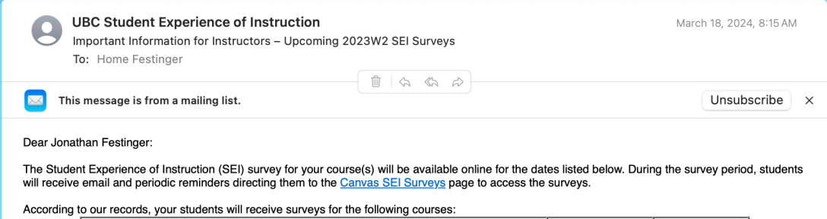
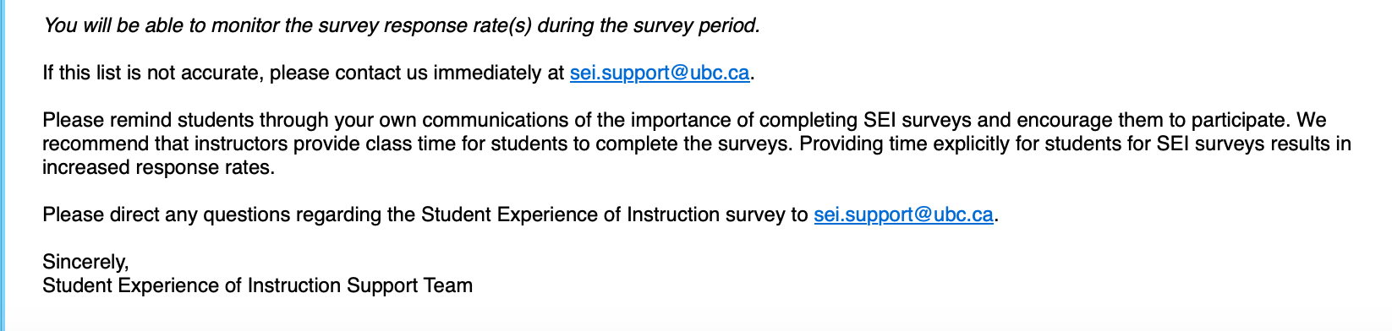

Slide 3
GO TO CANVAS SEI SURVEYS PAGE
1. LAW 422 002 - Intellectual Property
March 30, 2024, to April 15, 2024
2. LAW 570C 002 - Intellectual Property
March 30, 2024, to April 15, 2024

Slide 4
Logistics

Slide 5
Exam
Wednesday April 17, 2024
9:00 AM
Rooms: ????

Slide 6
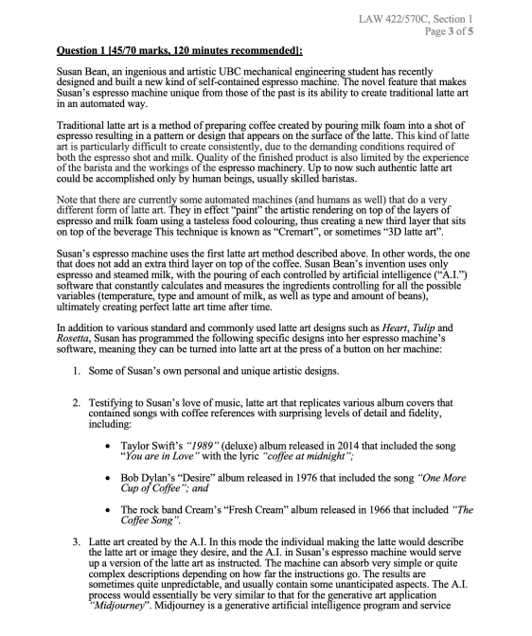

Slide 7
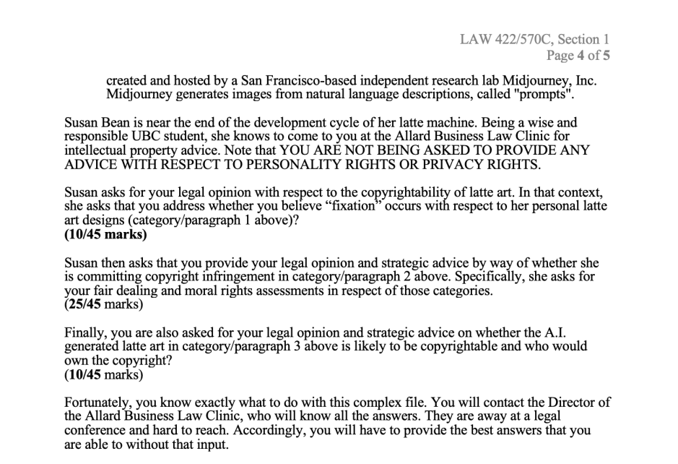

Slide 8
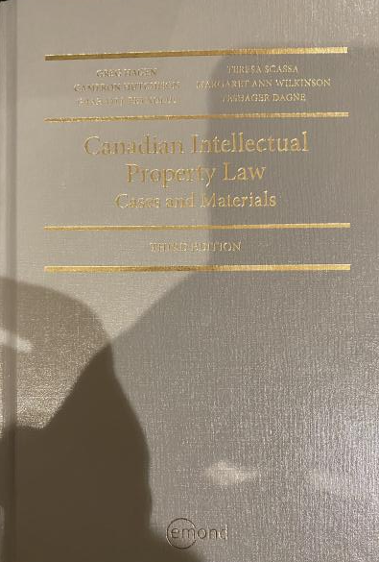
Text

Slide 9
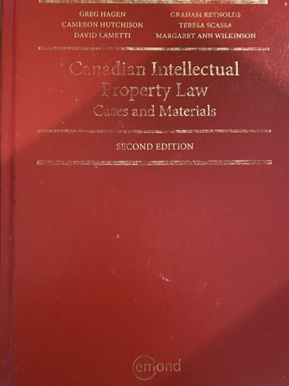
Former Text

Slide 10
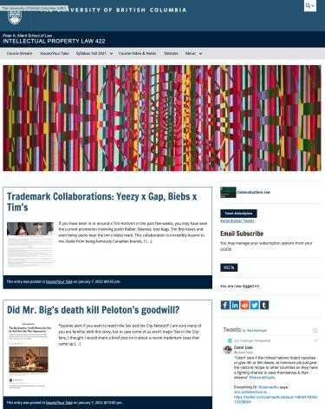
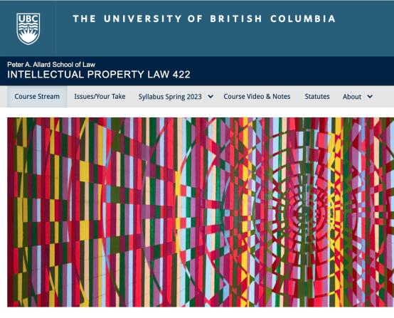
Course Website
https://iplaw.allard.ubc.ca/

Slide 11
PLEASE
SIGN UP

Slide 12
For full privileges on the website
1. Please create an account at http://cms.ubc.ca/ using your CWL.
2. Once you create an account and sign in at http://cms.ubc.ca/ you can click your name in the top right. Halfway down the following page will be your WordPress email address.
3. Send me your WordPress email address at jon.festinger@ubc.ca or at jon_festinger@thecdm.ca
4. Then, I will invite you to participate with authoring privileges via your WordPress email address.

Slide 13

Have responded to everyone?
+
…to some who didn’t ask?

Slide 14
Why post?
Engaging and engaging others is the key.
Because you don’t love speaking up in class.
Because you just saw or realized something, and you’ll never remember it unless you post it now.

Slide 15
Tips:
Don’t feel your posts have to be perfect. Engaging and engaging others is the key.

Slide 16
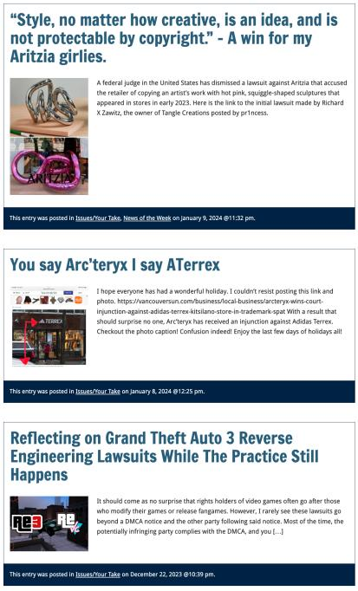

Slide 17

Anything & everything can be done via email if you prefer

Slide 18
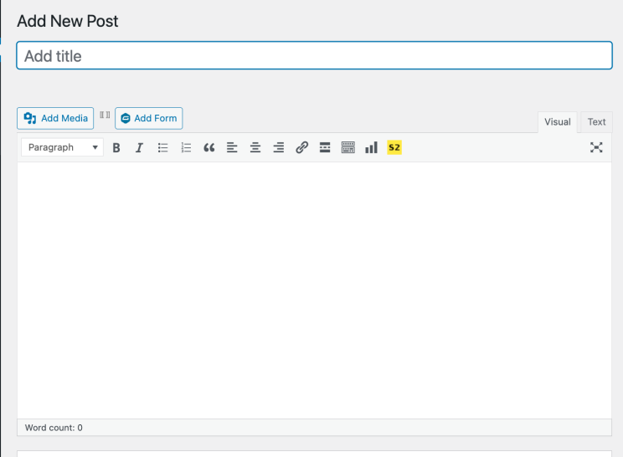

Adding Images

Slide 19



Slide 20
Adding Links

Slide 21
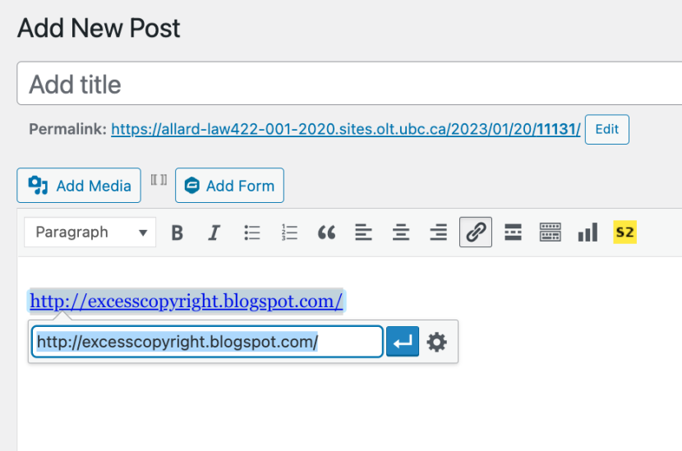


Slide 22
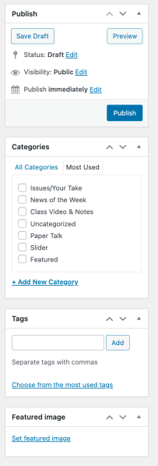

Adding a “Featured Image”

Slide 23


Slide 24
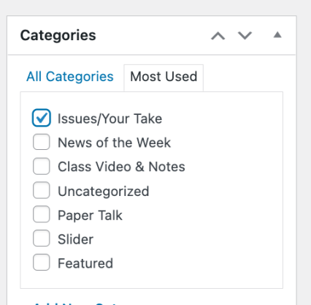

Setting Categories

Slide 25
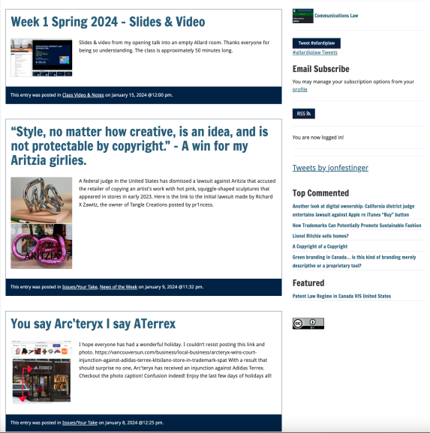
Creative Commons License

Slide 26
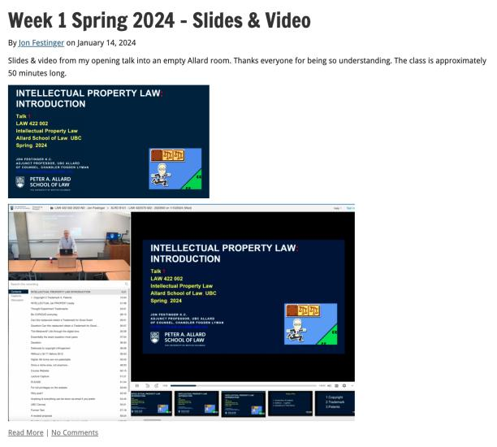
Lecture Capture

Slide 27
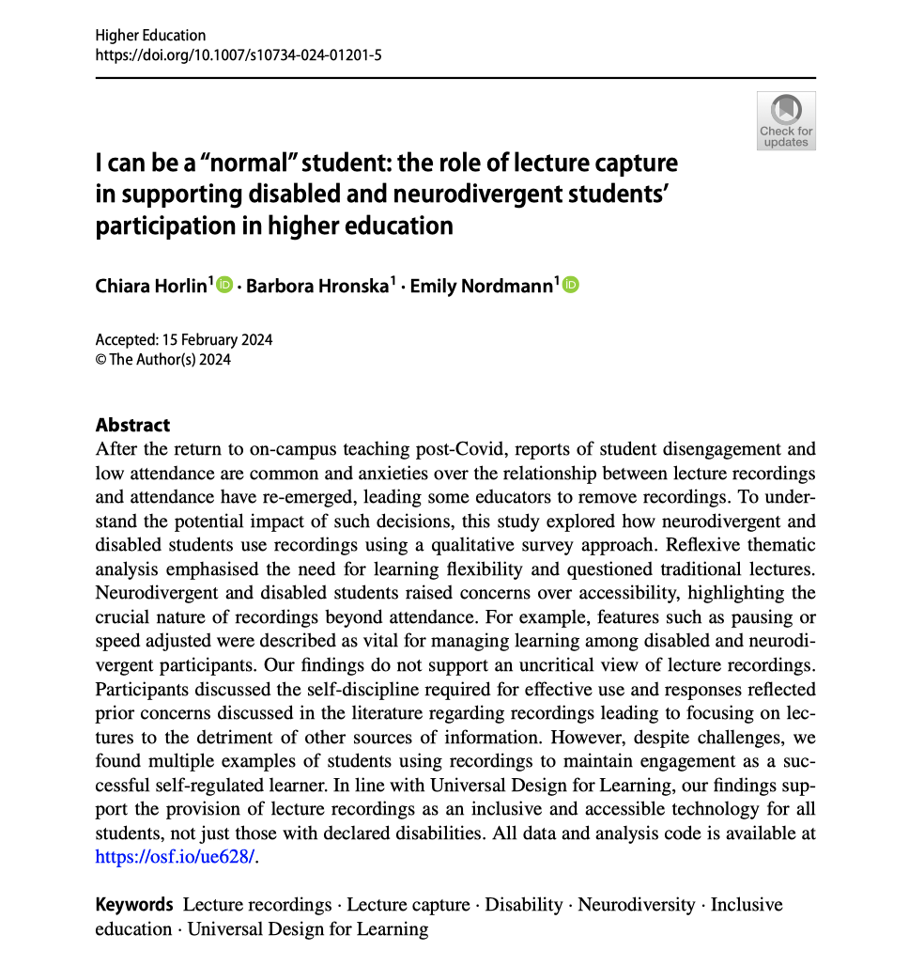

Slide 28
Syllabus

Slide 29
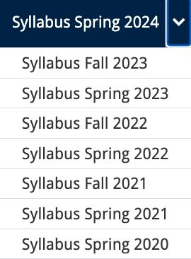




Slide 30
Features of this Course
70% Exam not 100%
IP Law “In Context”
Website

Slide 31
Let’s talk about…
The 30%

Slide 32
A modest proposal…
Approximately 1000 words (or equivalent) per person
written, video, podcast, in-class presentation (?), interpretive dance
Website or not
Groups or individually
LLM Students – one extra post

Slide 33
Past Presentations: Most are on the course website…

Slide 34
Generative A.I. Policy
1. It is source material, therefore
must be cited
2. You are responsible for the quality
of your source material, so check…
If it is wrong, you are wrong
If it plagiarized, you’ve plagiarized

Slide 35

Office “Hours”: Ideally Tuesdays just after class but am flexible…
Email: jon.festinger@ubc.ca; jfestinger@telus.net
Office: 449
Phone:
c. 604-837-6426
(please text if urgent)

Slide 36
Entirely optional but please…
…email me a short bio of yourself referencing:
Anything at all you want to say about yourself
Your academic interests
What you might like to get out of this course (I.E., interest in a type of patent, or a copyright issue etc.)
Favorite Intellectual Property (ies) - current or all-time

Slide 37
Zoom Q&A Sessions
(Study Groups Preferred If Possible)

Slide 38
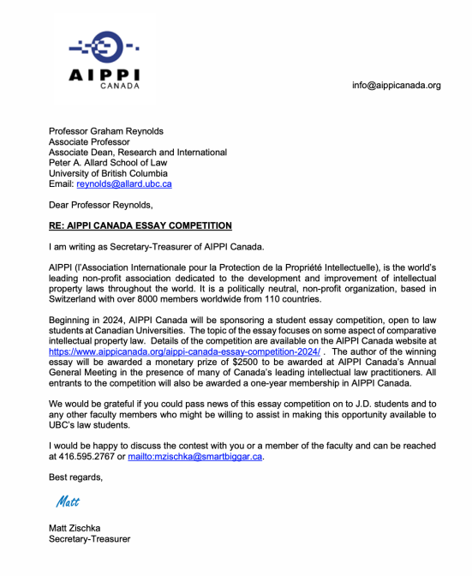

Slide 39
QUESTIONS?
THOUGHTS?
DISCUSSION?

Slide 40

Pause

Slide 41
Posts of
the Week

Slide 42
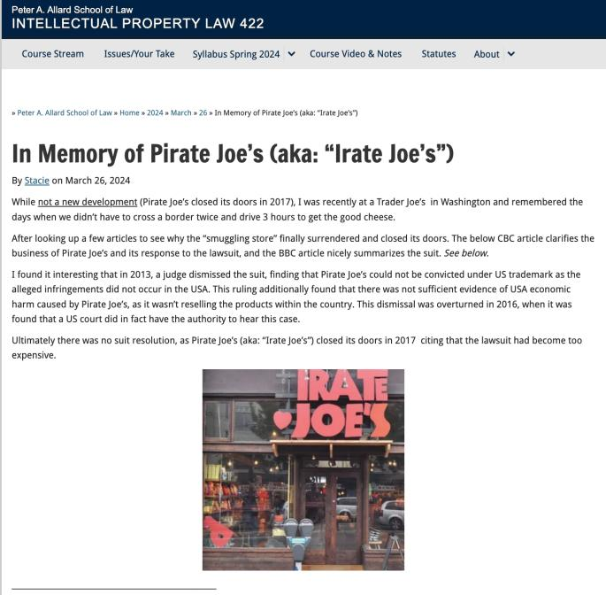

Slide 43
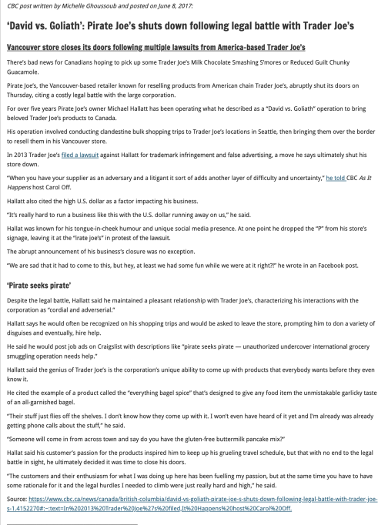

Slide 44
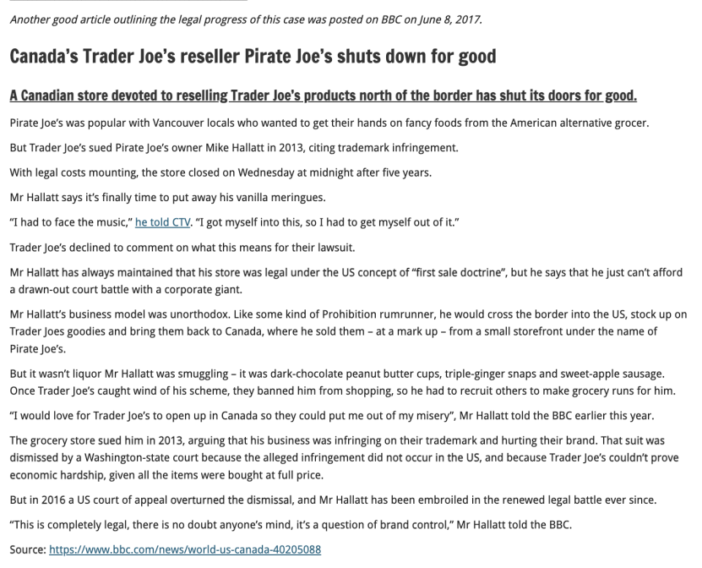

Slide 45
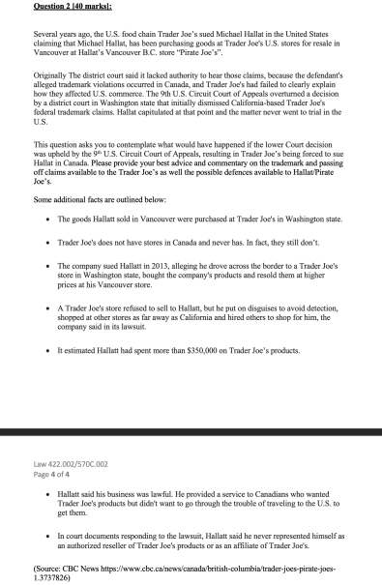
Reminiscent of 2021-22 Make-Up Exam

Slide 46
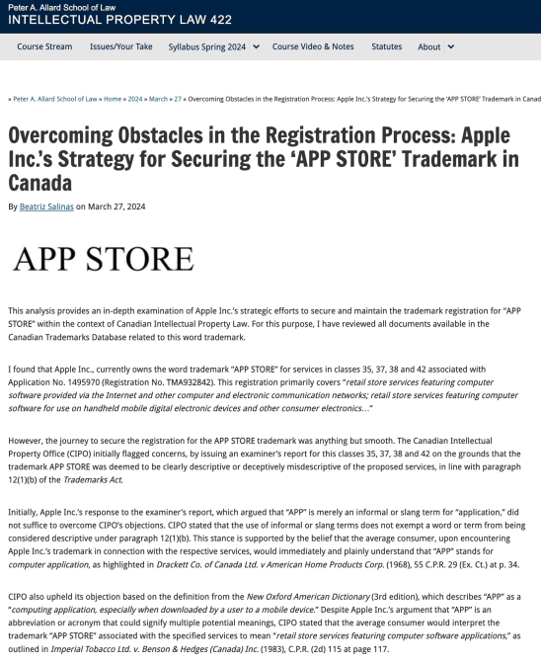

Slide 47
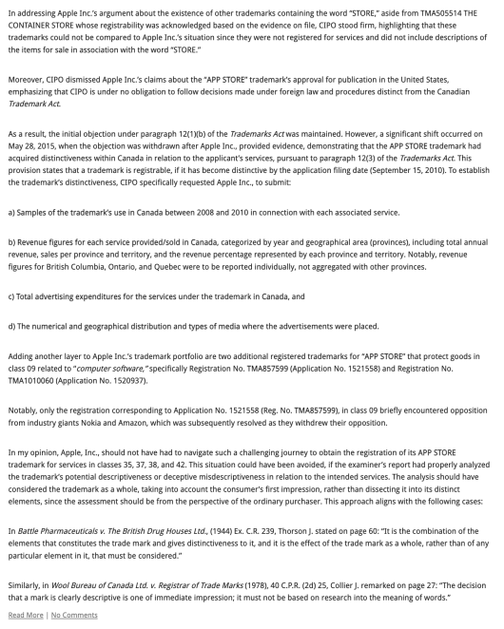

Slide 48
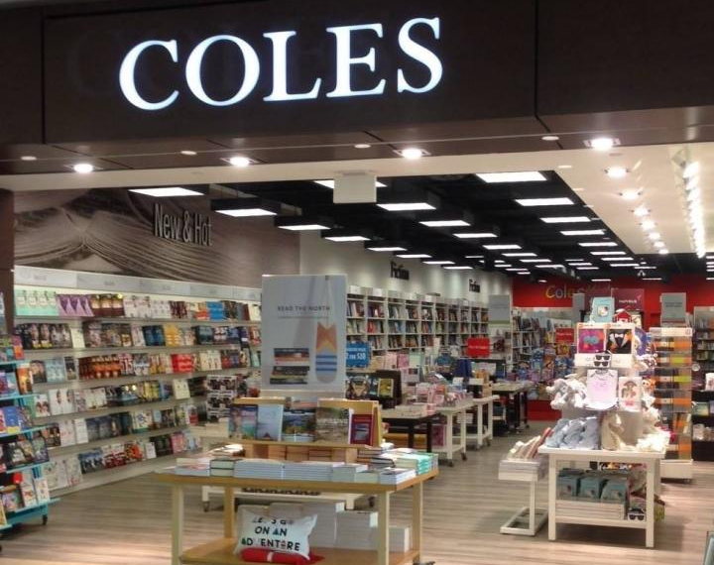
Acquiring distinctiveness reminiscent of…

Slide 49

Also Last Week’s
Random Notes 5

Slide 50
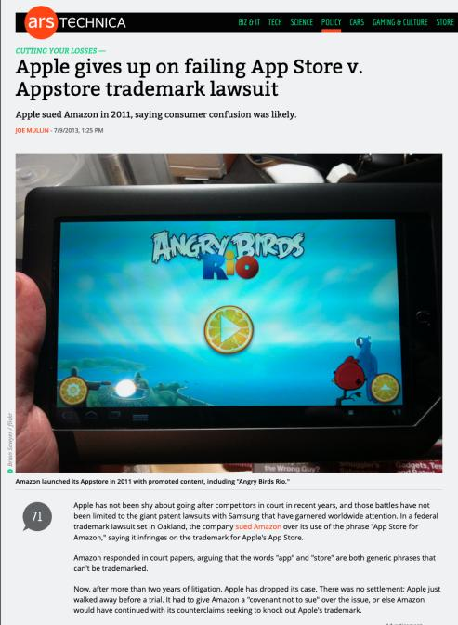

Slide 51
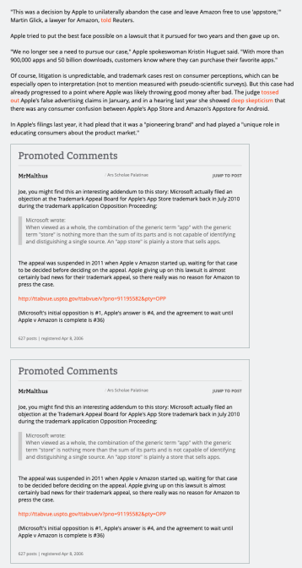

Slide 52
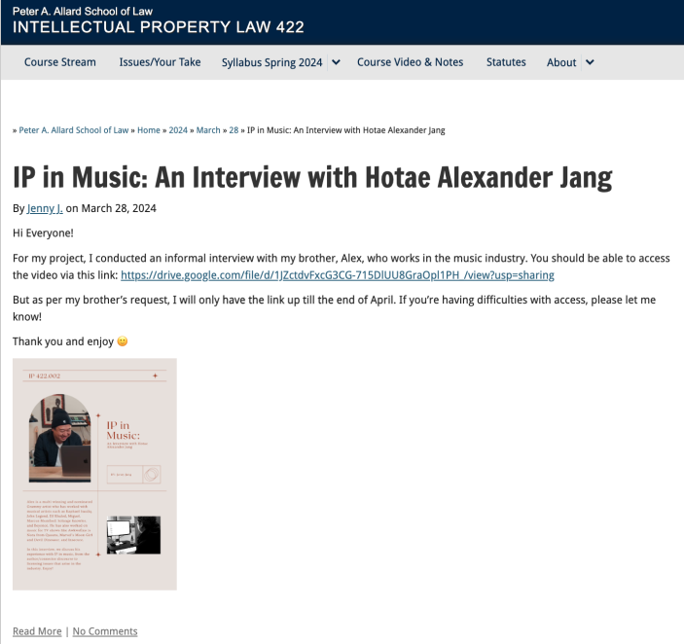

Slide 53
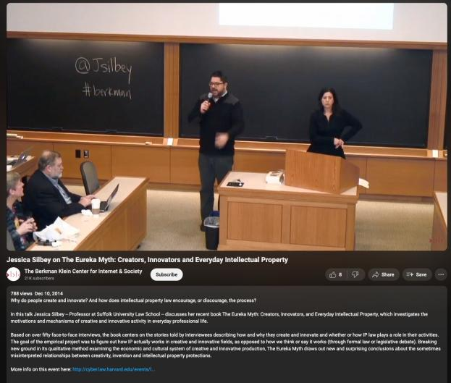
Reminiscent of…
https://youtu.be/yoaFcsK5OSo?si=7UMhLuQXvLXVhksF

Slide 54
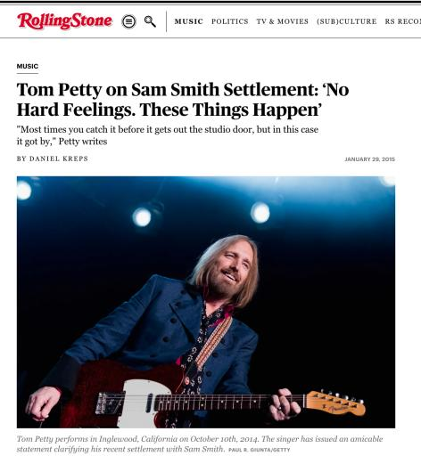
N.B.: Sam Smith’s “Stay With Me”
v. Tom Petty’s “I Won’t Back Down”

Slide 55
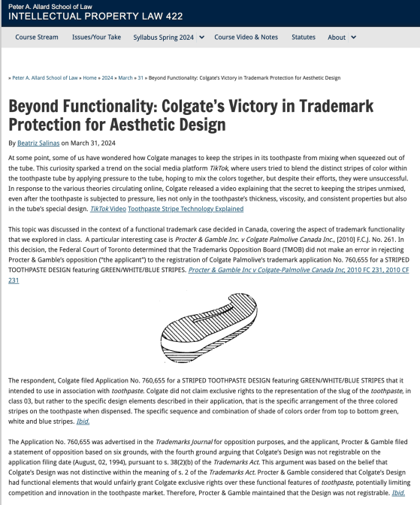

Slide 56
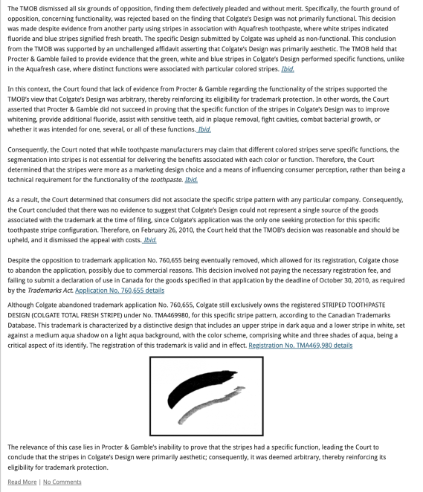

Slide 57
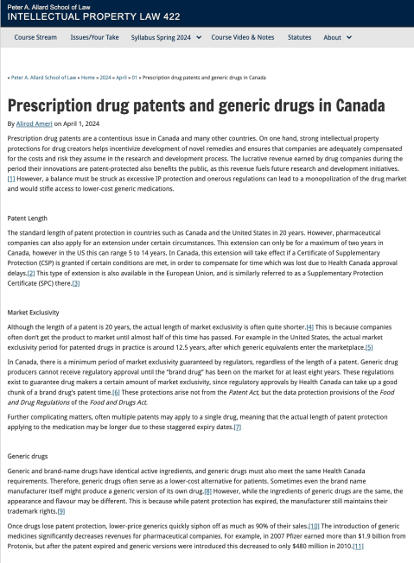

Slide 58
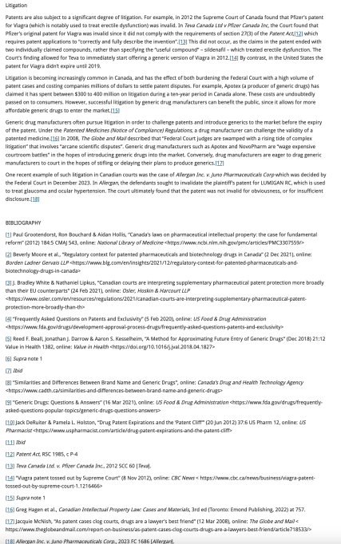

Slide 59
QUESTIONS?
THOUGHTS?
DISCUSSION?

Slide 60
Pause

Slide 61

Where we have been…

Slide 62
Intellectual Property Law is about:
What kinds of creations of the mind can one have rights in?
Who can have those rights?
What kinds of rights are there; and how are those rights enforced?

Slide 63

COMPLETE REVIEW
Trademarks

Slide 64
Trademarks
What is a Trademark ™?
  A mark used by a person for the purpose
  of distinguishing that person’s goods or
  services from those of others in the
  marketplace
Various types of marks
  Ordinary (word & design), certification,
  collective, official, distinguishing guise

Slide 65

Trademarks
Ordinary marks
  Distinguish the products or services of a specific firm or individual

Slide 66
Trademarks v. Passing Off*
Why would you want to register your TM?
Why not just rely on passing off?
TM = no proof of goodwill required. Only proof of use.
Registration of a mark provides national protection
Registered marks are presumed valid for Canada for all the wares and services for which they are registered.
s. 22 of the TMA protects against mark dilution.
In situations where a mark is deemed invalid, a passing off action might still succeed.
* You will see this slide again later

Slide 67
Trademarks
Certification marks
  Identify wares or services which meet defined standards.
  Can be used by anyone who complies with the standards defined by the owner of the certification mark; and who is licensed by the owner
  Owned by one person but licensed to others
  Defined in s. 2 of the TMA

Slide 68

Trademarks
Collective marks
  Signs that distinguish the geographical origin, material, mode of manufacture or other common characteristics of goods or services of enterprises using the collective mark
  Function: inform public about certain features of the product
  Owned by an entity; members of this entity are entitled to use the mark.

Slide 69

Trademarks
A purely functional design may not be the basis of a TM, registered or unregistered
  See Kirkbi v. Ritvik (SCC)

Slide 70
Old Concept of Marks
Ordinary marks
  S. 2: definition of trade-mark (in part): (a) a mark that is used by a person for the purpose of distinguishing or so as to distinguish goods or services manufactured, sold, leased, hired or performed by him from those manufactured, sold, leased, hired or performed by others.

Slide 71
Trademarks
Ordinary marks
Amended definition (2014 - in effect 2019):
  TM: A sign or combination of signs that is used or proposed to be used by a person for the purpose of distinguishing or so as to distinguish their goods and services from those of others.
  Sign: Includes a word, a personal name, a design, a letter, a numeral, a colour, a figurative element, a three-dimensional shape, a hologram, a moving image, a mode of packaging goods, a sound, a scent, a taste, a texture, and the positioning of a sign.

Slide 72
Trademarks
S. 12(1): A TM is registrable if it is not:
  (a) Primarily merely a name or surname of an individual living or who has died within 30 years
  (b) Clearly descriptive or deceptively misdescriptive in English or French of the character/quality of wares/services or of the conditions of production/persons employed in their production/place of origin

Slide 73
Trademarks
S. 12(1): TM is registrable if it is not:
  (c) Name in any language of any of the wares or services in connection with which it is used
  (d) Confusing with a registered TM (confusing defined in s. 6(2); factors in s. 6(5))
  (e) Mark prohibited by s. 9 or 10…
  S. 12(2): not registrable if its features are dictated primarily by a utilitarian function
  S. 12(3): If not registrable due to (1)(a) or (b), is registrable if has … become distinctive at the date of filing an application for registration (see also s. 32)

Slide 74
Trademarks
Ordinary marks
Amended definition (2014 - in effect 2019):
  TM: A sign or combination of signs that is used or proposed to be used by a person for the purpose of distinguishing or so as to distinguish their goods and services from those of others.
  Sign: Includes a word, a personal name, a design, a letter, a numeral, a colour, a figurative element, a three-dimensional shape, a hologram, a moving image, a mode of packaging goods, a sound, a scent, a taste, a texture, and the positioning of a sign.

Slide 75
Trademarks
Canada (Registrar of TMs) v. Coles Book Stores, [1974] SCR 438
  1) Is the mark a word?
    Standard Oil Co. v. Canada (Registrar of TM), [1968] 2 Ex C.R. 523.
  2) Is it primarily merely a name or surname of an individual who is living or who has died within the previous 30 years?

Slide 76
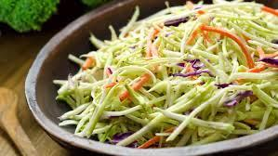
“Cole” as in “slaw” argument failed

Slide 77
“In the case at bar, the evidence clearly establishes that “Coles” is a surname that is well-known to the general public of Canada. On the other hand, the dictionary meanings of the word “cole” and in its plural form “coles”, particularly as found in the Oxford English Dictionary, are largely obsolete. A customer in need of a cabbage does not ask for a “cole”. The only common use of the word that I can think of is in the word “coleslaw”. The inference I draw from the evidence concerning the dictionary definitions of the word “cole” is that it is a word of rare, if not obsolete, usage and would be little known to the general public of Canada. I do not agree with the conclusion of the learned judge of the Exchequer Court that the principal character of the word “Coles” is “equally that of a surname and of a dictionary word in the English language.” My only possible conclusion in this case is that a person in Canada of ordinary intelligence and of ordinary education in English or French would immediately respond to the trade mark “Coles” by thinking of it as a surname and would not be likely to know that “Coles” has a dictionary meaning.”

Slide 78
Trademarks
Test to Apply: Would a person in Canada
of ordinary intelligence and of ordinary
education in English or French be just as
likely, if not more likely, to respond to the
word by thinking of it as a brand or a
mark of a business than as a name/surname?

Slide 79
Trademarks
Unilever Canada Inc. v. Superior Quality Foods Inc. (2007), 62 CPR (4th) 75, [2007] TMOB No. 66
Facts: Superior Quality Foods, Inc. filed an application to register the TM BETTER THAN BOULLION for use in association w. soups and soup bases.
Issue: s. 12(1)(b) …Is the mark clearly descriptive or deceptively misdescriptive in the English or French language of the character or quality of the wares or services in association with which it is used or proposed to be used or of the conditions of or the persons employed in their production or of their place of origin.

Slide 80
Trademarks
Unilever Canada Inc. v. Superior Quality Foods Inc. (2007), 62 CPR (4th) 75, [2007] TMOB No. 66
Clearly descriptive = does the mark tell potential dealers/purchasers of the goods/services what the goods and services are, or describe them or describe a property which is commonly associated with them?

Slide 81
Trademarks
  Unilever Canada Inc. v. Superior Quality Foods Inc. (2007), 62 CPR (4th) 75, [2007] TMOB No. 66
  Deceptively misdescriptive = would dealers/purchasers of the goods be deceived by the misdescription into purchasing goods or ordering services which different in character or quality from those expected?

Slide 82
Trademarks
  Unilever Canada Inc. v. Superior Quality Foods Inc. (2007), 62 CPR (4th) 75, [2007] TMOB No. 66
S. 12(1)(b):
  Point of View?: That of the average purchaser of the wares
  Consider the mark in its entirety (not dissected into constituent elements)
  Consider thee mark as a matter of immediate impression

Slide 83
Trademarks
  Unilever Canada Inc. v. Superior Quality Foods Inc. (2007), 62 CPR (4th) 75, [2007] TMOB No. 66
S. 12(1)(b):
  Clearly = easy to understand, self-evidence, plain
  Character = feature, trait, characteristic of wares
  Quality = degree of excellence; laudatory description (i.e., expressing praise)

Slide 84
Trademarks
  Unilever Canada Inc. v. Superior Quality Foods Inc. (2007), 62 CPR (4th) 75, [2007] TMOB No. 66
Decision: “The Mark … clearly describe[s] as a matter of first impression that the Applicant’s soups and soup bases are ‘better than boullion’, a laudatory description that is contrary to s. 12(1)(b)”
Policy justification: This is an ordinary, grammatical phrase that others in the industry should be able to use to fairly describe their products. / different decision - “the vocabulary of the English language is common property: it belongs to all” (Eastman Photographic Materials Company Ltd. v. Comptroller-General of Patents, Designs and Trade Marks, [1898] A.C. 571 (H.L.), Lord Herschell at page 580 ”

Slide 85
Trademarks
General Foods Ltd. v. Carnation Co. (1978), 45 CPR (2d) 282 (TMOB)
Can GFL register the TM “Instant Breakfast” for use in association with wares described as “fortified powder food for mixing with milk”?
S. 12(1): TM is registrable if it is not (c) Name in any language of any of the wares or services in connection with which it is used
Also s.30(a) of the Trademarks Act in setting specifics for TM applications requires that applications must contain “a statement in ordinary commercial terms of the specific goods or services in association with which the mark has been or is proposed to be used.”
Are the words “fortified powder food for mixing with milk” ordinary commercial terms? Board held no. Statement in ordinary commercial terms for the product would be “instant breakfast”.
Accordingly, application to register the TM Instant Breakfast, which is also the name of the wares in English was found not registrable per s. 12(1)(c).

Slide 86
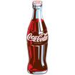
Trademarks - changes
Distinguishing guise provisions repealed in 2019
  The shape or design of the product or packaging that effectively distinguishes the product from others. In order for a distinguishing guise to be registered, it must be proven that it has become distinctive through usage.
  S. 13 Trademarks Act REPEALED
  Example: shape of Coca-Cola bottle

Slide 87
Instead of “distinguishing guise”
s. 2 …“sign includes a word, a personal name, a design, a letter, a numeral, a colour, a figurative element, a three-dimensional shape, a hologram, a moving image, a mode of packaging goods, a sound, a scent, a taste, a texture and the positioning of a sign;”

Slide 88
Trademarks
Distinguishing guise
Now that distinguishing guises have ceased to exist as a separate category of TM, similar limitations to those set out in the previous s. 13(1) will be carried over elsewhere, and will apply to all marks

Slide 89
Trademarks
Distinguishing guise
New 12(2): A trademark is not registrable if, in relation to the goods or services in association with which it is used or proposed to be used, its features are dictated primarily by a utilitarian function
New 18.1: The registration of a trademark may be expunged by the Federal Court on the application of any interested person if the Court decides that the registration is likely to unreasonably limit the development of any art or industry
20(1.2): The registration of a trademark does not prevent a person from using any utilitarian feature embodied in the trademark

Slide 90
Trademarks
Glaxo Wellcome Inc. v. Novopharm Ltd (2000)
Glaxo sought registration the distinguishing guise for a six sided tablet, shaped as a shield.
Principles
  Not required to show that most adult Canadians recognize the applicant’s distinguishing guise
  Although the shape of a product can constitute a mark, the mark is usually weak
  The standard of proof in distinguishing guise cases under is the same as in other registration cases
  Relevant period of time for distinctiveness → date of application

Slide 91
Trademarks : Special Marks
S. 9 Trademarks Act
Two categories of prohibited marks
  Absolute prohibitions
  Official marks (9(1)(n)(iii))
What policy reasons could justify including
a type of symbol/mark on the list of absolute
prohibitions?

Slide 92
Trademarks
S. 9(1)(n)(iii):
  Allows entities which are “public authorities”
  to request the Registrar of Trade-marks to
  give public notice of their adoption and use of
  particular names or symbols. These marks
  are referred to as “official marks”.
  Once notice is given, these official marks are
  also removed from the general realm of trade
  and commerce.

Slide 93
Trademarks
S. 9(1)(n)(iii) is controversial
S. 9(1) prohibits anyone else from adopting an official mark. This prohibition is absolute.
None of the usual formalities for the adoption of official marks
No opposition proceeding; no scrutiny by Registrar
Mark can be descriptive; not required to be distinctive of wares, services
No need to renew; no provisions to remove unused marks

Slide 94
Trademarks
Ontario Ass’n of Architects v. Ontario Assn of Architectural Technologists, [2003] 1 F.C. 331 (FCA)
Public notice was given that the Association of Architectural Technologists of Ontario, a self-regulatory professional body and Ontario non-for-profit corporation without share capital, adopted and used as official marks for services – the words ARCHITECTURAL TECHNICIAN, ARCHITECTE-TECHNICIEN, ARCHITECTURAL TECHNOLOGIST, ARCHITECTE-TECHNOLOGUE. As a result, members of the appellant, the Ontario Association of Architects ("OAA"), can be prevented from using these words in connection with their professional services - unless they had started to use them before April 28, 1999, the date when the Registrar gave public notice in the Trade-marks Journal of their adoption and use by the AATO as official marks.

Slide 95
Trademarks
Ontario Ass’n of Architects v. Ontario Assn of Architectural Technologists, [2003] 1 F.C. 331 (FCA)
Defining characteristics of public authority =
  Degree of government control [para. 57-64]
  Extent to which the body’s activities benefit the public [para. 65-73]

Slide 96
Trademarks
1. Significant degree of governmental control
More rigorous part of test
Consider body’s objects, duties and powers, including distribution of its assets
Need some ongoing government supervision of the activities of the body claiming to be a public authority; sufficient to allow the government to exercise a degree of ongoing influence in the body’s governance and decision-making.

Slide 97
Trademarks
2. Public benefit
Broadly interpreted by the courts – some aspect for public benefit? Considered to act for public benefit.
In this case the Architectural Technologists set & enforce standards of professional competence & ethical conduct of its members.
As a result, FCA held that the Technologists regulate part of the practice of the profession. The lower court judge concluded that these activities benefit the public, and the FCA agreed.

Slide 98
Trademarks
A TM owner who has a registered mark that resembles an official mark effectively has their rights frozen at the time of publication of the official mark
  See Royal Roads University v. R. (2003), 27 CPR (4th) 240 (F.C.)

Slide 99
Trademarks : Special Marks
S. 9 Trademarks Act
Two categories of prohibited marks
  Absolute prohibitions
  Official marks (9(1)(n)(iii))
What policy reasons could justify including
a type of symbol/mark on the list of absolute
prohibitions?

Slide 100
Trademarks
“170 The PEI government has significant influence and control with respect to the Anne Authority. The PEI government has members on the Anne Authority committee. The PEI branch of that committee controls all licensing in Prince Edward Island. One of the prime objectives, from the government perspective, was to protect the local craft industry in the Province, freeing it from costly licenses but maintaining a uniform-quality Anne image. The Province is partnered with the Heirs, who share a philanthropical and financial objective with respect to protecting and promoting a licensed Anne image. Applying the combined test of control, influence and purpose to promote the public good, I conclude that the Anne Authority is a public authority. If it was necessary to determine the issue, I would in all of the circumstances conclude that the Anne Authority is a public authority. Therefore, the Assignment Agreement that conveyed rights from the PEI government to the Anne Authority would be valid.”
(Anne of Green Gables Licensing Authority Inc. v. Avonlea Traditions Inc. (2000), 4 C.P.R. (4th) 289

Slide 101
Trademarks : Use
USE IT
OR
LOSE IT?

Slide 102
Trademarks
“Use”
First use … entitles you to register a TM but amended provisions now allow for filing without intended use.
Failure to use … basis for expungement of TM
Unauthorized use … could lead to infringement actions

Slide 103
Trademarks
4. (1) A trade-mark is deemed to be used in association with goods if, at the time of the transfer of the property in or possession of the goods, in the normal course of trade, it is marked on the goods themselves or on the packages in which they are distributed or it is in any other manner so associated with the goods that notice of the association is then given to the person to whom the property or possession is transferred.
(2) A trade-mark is deemed to be used in association with services if it is used or displayed in the performance or advertising of those services.

Slide 104
Trademarks
Syntex Inc. v. Apotex Inc., [1984] 2 FC 1012 (FCA)
Did the Defendants Apotex “use” the TM of the Plaintiffs Syntex (see ss. 2, 4 TMA)?
  4. (1) A trade-mark is deemed to be used in association with goods if, at the time of the transfer of the property in or possession of the goods, in the normal course of trade, it is marked on the goods themselves or on the packages in which they are distributed / or it is in any other manner so associated with the goods that notice of the association is then given to the person to whom the property or possession is transferred.

Slide 105
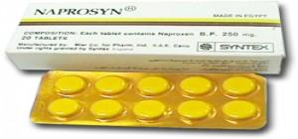
Trademarks
Syntex Inc. v. Apotex Inc., [1984] 2 FC 1012 (FCA)
Court said on this point… “It seems to me that the respondents (Syntex) face considerable difficulty in establishing at trial that the presence of the trade mark “Naprosyn” in the appellant’s flyer constituted a “use” that is contrary to subsection 22(1) of the Trade Marks Act”

Slide 106
Trademarks
Specialty Software Inc. v. Bewatec Kommunikationstechnik GMBH 2016 FC 223
Specialty Software Inc. registered the TM “MEDINET” in association w. computer software programs.
Mark was registered in relation to wares, not services.
…2013 – Bewatec attempted to have this mark expunged from the register.
To avoid expungement, Specialty had to show evidence of its use of the mark between November 22, 2010, and November 22, 2013.
Ultimately, Specialty provided evidence of use. But was this use in relation to wares?
Speciality used to sell its software on disks. Now, clients obtain access to the software over the Internet.

Slide 107
Trademarks
4 (1) A trade-mark is deemed to be used in association with goods if, at the time of the transfer of the property in or possession of the goods, in the normal course of trade, it is marked on the goods themselves or on the packages in which they are distributed or it is in any other manner so associated with the goods that notice of the association is then given to the person to whom the property or possession is transferred.
Is there a “good” here? If so, what is the good?
The good is the license to use the software.
The property is the right or the entitlement to enjoy the use of the license.
The transfer occurred through the granting of access in the form of login credentials.
The mark is visible throughout this process.
The disk, then, is just one means by which a transfer can occur. It can also occur through other ways (i.e., granting of access in the form of login credentials).

Slide 108
Trademarks
Has a TM been used within the meaning of s. 4(1) “in the normal course of trade” where goods are given away for free, as opposed to being sold?
See Distrimedic Inc. v. Dispill Inc., 2013 FC 1043 [302] … The expression "in the normal course of trade"…requires some payment or exchange, which excludes the use of a trade-mark in situations where the wares are given away for free or donated.

Slide 109
Trademarks
4(2) A trade-mark is deemed to be used in association with services if it is used or displayed in the performance or advertising of those services.

Slide 110
Trademarks
Gesco Industries Inc v. Sim & McBurney (2000) 9 CPR (4th) 480 (FCA)
The Registrar of Trademarks had expunged Gesco's registration of the trademark "Stainshield" for use in association with the services of stain resistant treatment for carpets and rugs.
The Registrar determined that Gesco failed to submit any evidence of use of the trademark.
Gesco appealed the Registrar's decision.
FCA held that when a trademark is used in association with services, the use does not have to occur in the normal course of trade.

Slide 111
Trademarks
Gesco Industries Inc v. Sim & McBurney (2000) 9 CPR (4th) 480 (FCA)
Rothstein J. defines services broadly.
He accepts the reasoning of Strayer J in this regard: [para 10]
No definition of services is given in the Trademarks Act because of the “plethora of services that the human mind is capable of conceiving”
Term should be liberally construed
Each case decided on its own facts, giving proper regard to judicial precedent.
Nothing to suggest that services with respect to which a TM may be established are limited to those which are not incidental or ancillary to the sale of goods.
So … services can include services incidental or ancillary to the sale of goods

Slide 112
Trademarks v. Passing Off
Why would you want to register your TM?
Why not just rely on passing off?
TM = no proof of goodwill required. Only proof of use.
Registration of a mark provides national protection
Registered marks are presumed valid for Canada for all the wares and services for which they are registered.
s. 22 of the TMA protects against mark dilution.
In situations where a mark is deemed invalid, a passing off action might still succeed.

Slide 113
Trademarks: Transfer & Licensing
As a TM owner, you can transfer your TM.
Per s. 50 TMA you can also permit another person to use your mark without impairing the distinctiveness of the mark provided that:
    A licence exists
    Certain controls are in place over the quality of the wares What is sufficient control?
See also s. 48, TMA

Slide 114
Trademarks
Tommy Hilfiger Licensing Inc v. Produits de Qualité, 2005 FC 10
Court concluded that the Service Agreements signed by THLI allowed it to maintain sufficient control over the quality of the goods to avoid any potential confusion as to source
THLI’s service agreements required it to:
  Coordinate design and execution of licensed products.
  Review samples of licensed products.
  Plan and coordinate construction of licensees’ dedicated Tommy Hilfiger showrooms.
  Coordinate product launches.
  Plan and execute advertising and promotional plans and programs.

Slide 115
Trademark transferable
48 (1) A trademark, whether registered or unregistered, is transferable, and deemed always to have been transferable, either in connection with or separately from the goodwill of the business and in respect of either all or some of the goods or services in association with which it has been used.
Where two or more persons interested
(2) Nothing in subsection (1) prevents a trademark from being held not to be distinctive if as a result of a transfer thereof there subsisted rights in two or more persons to the use of confusing trademarks and the rights were exercised by those persons.

Slide 116
Trademarks
How to remove existing Trademarks from the register:
  S. 45: Expungement or amendment on the basis of non-use
  S. 57: Striking or amending a Trademark…

Slide 117
Trademarks
45. (1) The Registrar may at any time and, at the written request made after three years from the date of the registration of a trade-mark by any person who pays the prescribed fee shall, unless the Registrar sees good reason to the contrary, give notice to the registered owner of the trade-mark requiring the registered owner to furnish within three months an affidavit or a statutory declaration showing, with respect to each of the goods or services specified in the registration, whether the trade-mark was in use in Canada at any time during the three year period immediately preceding the date of the notice and, if not, the date when it was last so in use and the reason for the absence of such use since that date.

Slide 118
Trademarks
45. (3) Where, by reason of the evidence furnished to the Registrar or the failure to furnish any evidence, it appears to the Registrar that a trademark, either with respect to all of the goods or services specified in the registration or with respect to any of those goods or services, was not used in Canada at any time during the three year period immediately preceding the date of the notice and that the absence of use has not been due to special circumstances that excuse the absence of use, the registration of the trademark is liable to be expunged or amended accordingly.

Slide 119
Trademarks
57 (1) The Federal Court has exclusive original jurisdiction, on the application of the Registrar or of any person interested, to order that any entry in the register be struck out or amended on the ground that at the date of the application the entry as it appears on the register does not accurately express or define the existing rights of the person appearing to be the registered owner of the trademark.

Slide 120
Trademarks
UNICAST SA v. South Asian Broadcasting Corporation Inc. - Conclusion
The fact that a trade-mark appears on a website that may be displayed on a computer screen in Canada is not sufficient to constitute use and advertising in Canada (for the purposes of s. 4(2) of the TMA).

Slide 121
Trademarks
UNICAST SA v. South Asian Broadcasting Corporation Inc.
[47] To go against this logical interpretation of the law would lead to some twisted and unfortunate consequences none of which could have been Parliament’s intent in drafting the Act. For example, should we follow the Applicant…, any foreign trade-mark holder could request and obtain the expungement of a bona fide Canadian trade-mark based on previous use through the Web even if this foreign trade-mark owner had basically nothing to do with Canada and no physical presence in the country. How could it be logical to interpret the applicable legal scheme as putting every single Canadian trade-mark owner at risk of having its trade-mark taken away by another trade-mark that has no nexus to Canada?.. It would be illogical and impossible to take this approach.

Slide 122
Trademarks
45. (3) Where, by reason of the evidence furnished to the Registrar or the failure to furnish any evidence, it appears to the Registrar that a trade-mark, either with respect to all of the goods or services specified in the registration or with respect to any of those goods or services, was not used in Canada at any time during the three year period immediately preceding the date of the notice and that the absence of use has not been due to special circumstances that excuse the absence of use, the registration of the trade-mark is liable to be expunged or amended accordingly.

Slide 123
Trademarks
Scott Paper Limited v. Smart & Biggar, 2008 FCA 129 Conclusion
Fact that registered owner may have plans to resume use of mark is not sufficient to excuse non-use.

Slide 124
Trademarks
Scott Paper Limited v. Smart & Biggar, 2008 FCA 129
The general rule is that the absence of use is penalized by expungement
There is an exception to the general rule where the absence of use is due to special circumstances.
Special circumstances alleged by Scott Paper are the plans for resumption of use of the mark …
Pelletier JA clarifies that this is not sufficient to excuse non-use…“the 13 year absence of use was due to a deliberate decision not to use the mark”.
And … “a registrant’s intention to resume use of a mark which has been absent from the marketplace, even when steps have been taken to actualize those plans, cannot amount to special circumstances which excuse the non-use of the TM. The plans for future use do not explain the period of non-use and … cannot amount to special circumstances”

Slide 125
Trademarks
S. 57 TMA → Can strike or amend a TM on the register on the basis that it “does not accurately express or define the existing rights of the [registered owner] of the mark.” (read w. s. 18)
If the TM was not registrable at the date of registration [18(1)(a)]
If the TM is not distinctive at the time proceedings bringing the validity of the registration into question are commenced [18(1)(b)]
If the TM has been abandoned [18(1)(c)]
If the applicant for registration was not the person entitled to secure the registration [18(1)(d)]
The application for registration was filed in bad faith

Slide 126
Trademarks
57 (1) The Federal Court has exclusive original jurisdiction, on the application of the Registrar or of any person interested, to order that any entry in the register be struck out or amended on the ground that at the date of the application the entry as it appears on the register does not accurately express or define the existing rights of the person appearing to be the registered owner of the trademark.

Slide 127
Trademarks
When registration invalid
18 (1) The registration of a trademark is invalid if
  (a) the trademark was not registrable at the date of registration;
  (b) the trademark is not distinctive at the time proceedings bringing the validity of the registration into question are commenced;
  (c) the trademark has been abandoned;
  (d) subject to section 17, the applicant for registration was not the person entitled to secure the registration; or
  (e) the application for registration was filed in bad faith.
Exception
(2) No registration of a trademark that had been so used in Canada by the registrant or his predecessor in title as to have become distinctive at the date of registration shall be held invalid merely on the ground that evidence of the distinctiveness was not submitted to the competent authority or tribunal before the grant of the registration.

Slide 128
Trademarks: Registration invalid if…
1) If the TM was not registrable at the date of registration [18(1)(a)]
  See ss. 9, 10, 12, 13
2) If the TM is not distinctive at the time proceedings bringing the validity of the registration into question are commenced [18(1)(b)]
  See for example the discussion on TMs becoming generic. Also ss. 48-50 TMA

Slide 129
12 (1) Subject to subsection (2), a trademark is registrable if it is not
(a) a word that is primarily merely the name or the surname of an individual who is living or has died within the preceding thirty years;
(b) whether depicted, written or sounded, either clearly descriptive or deceptively misdescriptive in the English or French language of the character or quality of the goods or services in association with which it is used or proposed to be used or of the conditions of or the persons employed in their production or of their place of origin;
(c) the name in any language of any of the goods or services in connection with which it is used or proposed to be used;
(d) confusing with a registered trademark;
(e) a sign or combination of signs whose adoption is prohibited by section 9 or 10;

Slide 130
Trademarks: Registration invalid if…
3) If the TM has been abandoned [18(1)(c)]
  Read in conjunction w. s. 45 of the TMA
4) If the applicant for registration was not the person entitled to secure the registration [18(1)]
  See ss. 16, 17 of the TMA
5) If the application for registration was filed in bad faith

Slide 131
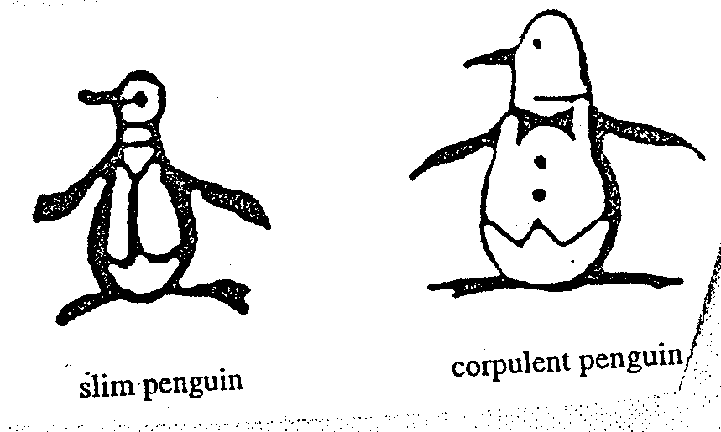
Trademarks
Promafil Canada Ltée v. Munsingwear Inc. (1992), 44 CPR (3d) 59, [1992] FCJ 611 (FCA).
Original Penguin
Revised Penguin

Slide 132
Trademarks
Promafil Canada Ltée v. Munsingwear Inc. (1992), 44 CPR (3d) 59, [1992] FCJ 611 (FCA).
Main issue was whether by registering one mark, and using another, is the first mark abandoned?
To show abandonment:
  Must show registered TM no longer in use in Canada
  Need to show intention to abandon mark.
Amendment:
  Can amend mark provided that the amendment does not materially alter the character of the mark. Can have variations on the same mark (both can be used). All law requires is that there is maintenance of recognizability to avoid confusion of unaware purchasers. (Promafil)

Slide 133
Trademarks
Promafil Canada Ltée v. Munsingwear Inc. (1992), 44 CPR (3d) 59, [1992] FCJ 611 (FCA).
At some point, a variation in a mark may be significant enough to constitute a new mark
One question to ask: Has the mark varied so much as to confuse the consumer as to the source of the ware?
Ongoing use of new mark could be abandonment of old mark.
Take technology into account (reason for improvement of mark).

Slide 134
Trademarks
Promafil Canada Ltée v. Munsingwear Inc.
FCA (MacGuigan JA) held:
Here differences are only petty and when used concurrently, one is still the variation of the other. A modified variant can co-exist with original…
The second design doesn’t have to replace the first design. There can be variations on the same design. The law can tolerate multiple variations of the same mark. Though, every variation is playing with fire…
If variation is too different then it would be a new mark or non-use of registered mark…
The key is to maintain recognisability and avoid confusion of unaware purchasers. If the same dominant features of the design are maintained, and the differences are petty – the unaware purchaser will not be misled.

Slide 135
Trademarks: Confusion
Doctrine of confusion – Critical Concept
Important in the context of registrability
(see ss. 12, 16)
Also important in infringement actions (see s. 20)
Core provision: s. 6 TMA (specifically
s. 6(2) and 6(5))

Slide 136
Trademarks : Confusion
TM is not registrable if it is confusing with a registered TM (12(1)(d)) or TMs or Trade-Names (“TN’s”) that had been previously used or made known (see s. 16)
Confusion is also an important part of infringement actions. An action in infringement can be successfully brought where there is unauthorized use of a mark that is confusing with a registered TM.

Slide 137
Trademarks : Confusion
6. (2) The use of a trade-mark causes confusion with another trade-mark if the use of both trade-marks in the same area would be likely to lead to the inference that the goods or services associated with those trade-marks are manufactured, sold, leased, hired or performed by the same person, whether or not the goods or services are of the same general class.

Slide 138
Trademarks : Confusion
What to be considered
6. (5) In determining whether trade-marks or trade-names are confusing, the court or the Registrar, as the case may be, shall have regard to all the surrounding circumstances including
  (a) the inherent distinctiveness of the trade-marks or trade-names and the extent to which they have become known;
  (b) the length of time the trade-marks or trade-names have been in use;
  (c) the nature of the goods, services or business;
  (d) the nature of the trade; and
  (e) the degree of resemblance between the trade-marks or trade-names in appearance or sound or in the ideas suggested by them.

Slide 139
Trademarks: Confusion
S & S Productions Inc. v. Possum Lodges (Messier), [2006] TMOB No. 144
Applicant – Messier ; Opponent – S & S Productions, Producers The Red Green Show on television
Messier filed an application to register the Trademark Possum Lodges based upon proposed use in association with “sale and rental of recreational lodging, namely, cabins, camps, lodges, campsites and cottages; time-sharing of recreational real estate; … restaurants”
Application was opposed by S & S Productions on basis of s. 38(2)(b) that the TM is not registrable because under s. 12(1)(d) it is confusing with their TM’s Possum Lodge and International Possum Brotherhood and design.

Slide 140
Trademarks: Application of s. 6
To assess confusion, go back to s. 6(5)…
Question that needs to be asked is (2)…would the use of both trade-marks in the same area…be likely to lead to the inference that the goods or services associated with those trade-marks are manufactured, sold, leased, hired or performed by the same person?
Application of s. 6(5) factors:
(a) the inherent distinctiveness of the trade-marks or trade-names and the extent to which they have become known
(b) The extent to which each trade-mark has become known
(b) the length of time the trade-marks or trade-names have been in use
(c) the nature of the goods, services or business; (d) nature of the trade…
(d) the nature of the trade
(e) the degree of resemblance between the trade-marks or trade-names in appearance or sound or in the ideas suggested by them

Slide 141
Trademarks: Application of s. 6
Marks which are inherently distinctive are unique marks – they intrinsically serve to identify a particular source of a product.
Examples are words or symbols invented or coined for the purpose of functioning as a TM (i.e., Exxon). Have no other significance than as a TM. They don’t suggest any characteristic of the goods or services they identify (Kodak cameras; Clorox bleach).
Marks have high inherent distinctiveness if they only communicate the message that they are identifying or signifying the source of the product.
Coined terms with design elements are generally seen as having high degrees of inherent distinctiveness.
Marks have lower inherent distinctiveness if they are descriptive or suggestive of a parties’ respective wares or services. (Marks made up of ordinary words, for instance, have lower inherent distinctiveness than marks made up of coined words and design elements).

Slide 142
Trademarks: Application of s. 6
The Applicant failed in their duty to select a name with care to avoid any confusion. Does the decision make sense?
Note the language … “assume there was some connection between the Applicant’s [goods and services]” and those of the Opponent.
Compare this with the language of s. 6(2) …
The use of a trade-mark causes confusion with another trade-mark if the use of both trade-marks in the same area would be likely to lead to the inference that the goods or services associated with those trade-marks are manufactured, sold, leased, hired or performed by the same person, whether or not the goods or services are of the same general class.
Fundamental tension
How much protection TM owners should receive, and how much protection owners of well-known or famous TMs should receive?

Slide 143

Trademarks: Confusion
Mattel v. 3894207 Canada Inc., 2006 SCC 22
The Numbered Company wanted to register TMs in connection with its small chain of Montreal suburban Barbie’s restaurants.
Mattel opposed the application on the basis that use of the name would create confusion with respect to its Mark BARBIE.

Slide 144
Trademarks: Confusion
Mattel v. 3894207 Canada Inc., 2006 SCC 22
Binnie J.:
  Some TMs are so well-known that use in connection with any wares or services would generate confusion.
  In those circumstances, no need to establish a connection between the goods and/or services for a finding of confusion to be made out (cf. Pink Panther case)
Who is the test person for the purpose of the confusion analysis?
How were the s. 6(5) factors applied?

Slide 145
Trademarks : Confusion
Mattel v. 3894207 Canada Inc., 2006 SCC 22
Main issue is whether Mattel can use TM law to prevent people from using the name Barbie (a common name) in relation to services (like restaurants) very different from dolls and other wares aimed at 3-11 year old girls.
Based on the TMA, is the Defendant’s use of the mark Barbie confusing with the registered mark BARBIE?
Applicant has onus to show that there is not a reasonable likelihood of confusion between the two marks.
Confusion is caused if the use of both TMs leads the consumer to believe that the wares and services are supplied by the same person: s. 6(2) TMA.
Factors in determining whether TMs are confusing in s. 6(5) TMA.

Slide 146
Trademarks: Confusion
Mattel v. 3894207 Canada Inc., 2006 SCC 22
In applying the criteria set out in s. 6(5) of the TMA, TM Opposition Board found no real connection between the two marks. Barbie’s fame was limited to dolls and dolls’ accessories. Therefor, Mattel’s opposition was rejected & registration allowed.
Federal Court (Rouleau J) observed that we cannot automatically presume that there will be confusion just because the BARBIE mark is famous.
Test is reasonable likelihood of confusion, using the factors set out in s. 6(5).
The fame of a mark can’t simply obliterate the other factors. Need to look at all the factors in s. 6(5)
One of the key factors in s. 6(5) in this case is the striking difference between the wares. Appeal dismissed accordingly; Mattel loses.
Federal Court of Appeal agreed with Rouleau J & dismissed the appeal. Mattel loses again.

Slide 147
Trademarks : Confusion
Mattel v. 3894207 Canada Inc., 2006 SCC 22
In Supreme Court of Canada…Binnie J. did find that some trade-marks are so well known that use in connection with any wares or services would generate confusion. Other brands are product specific.
Example given of a brand that may not be product specific? Virgin – used in connection with such a wide variety of wares and services that it knows virtually no bounds.
Example given of a brand that may be product specific? Apple = well-known TMs associated separately with computers, record label, automobile glass.
In discussing the role to be played by fame in confusion cases, the SCC had to address another case; the Pink Panther case of the Ont. CA.

Slide 148
Trademarks: Confusion
In that case Pink Panther Beauty Corp. wanted to register the TM Pink Panther in association with beauty products. United Artists Corp., owner of the famous Pink Panther mark registered in association with the entertainment business objected, arguing that consumers would be confused.
Would consumers think that these goods came from the same source?
Ont. CA held in the Pink Panther case that it was unlikely consumers would be confused; PINK PANTHER beauty parlour patron would not be likely to think that the hairdressing services she received were provided by United Artists Studios.
The aspect of the Pink Panther decision the SCC chose to address was Linden JA’s statement for the majority that for confusion to occur, there must be some resemblance or linkage between the two products (i.e., Barbie doll and Barbie’s restaurant); and that only in exceptional circumstances can confusion be found when there is no connection between the products or services.

Slide 149
Trademarks : Confusion
Binnie J. of SCC in Mattel rejected Linden JA’s statement that for confusion to occur, there must be some resemblance or linkage between the two products (i.e., Barbie doll and Barbie’s restaurant); and that only in exceptional circumstances can confusion be found when there is no connection between the products or services.
Test articulated by SCC was that for famous and non-famous marks alike, whether there is confusion in the s. 6(2) sense, is determined by if the consumer thinks that the goods come from the same source. This question has must be analyzed in all the circumstances (as set out in s. 6(5) and beyond).
The nature of the wares is important:
  It is one of the criteria in 6(5)
  In cases involving famous marks it is likely to be an important factor (i.e., Barbie doll and Barbie’s restaurants), as fame can possibly carry the mark across product lines.
SCC emphasized in Mattel is that you do not have to establish a connection between the goods and/or services for a finding of confusion to be made out.

Slide 150
Trademarks: Confusion – Test Person
Important question: From what perspective should consumer confusion be analyzed? Who is the test person for the purpose of the confusion analysis?
Addressed by SCC in Mattel. A few “test people” were rejected:
  The careful and diligent purchaser
  The “moron in a hurry”
SCC adopted the ordinary hurried purchaser and looked at the probability of the average person with average intellect acting with ordinary caution being deceived. Points to consider:
  Give the average consumer some credit – don’t assume that they’re totally devoid of intelligence, normal powers of recollection, or are totally unaware or uninformed.
  More care taken/attention given to big purchases (car as opposed to toy)

Slide 151
Trademarks: Confusion
Masterpiece Inc. v. Alavida Lifestyles Inc, 2011 SCC 27
Issue: Whether the trade-mark “Masterpiece Living”, proposed and subsequently registered by Alavida Lifestyles Inc. (“Alavida”), a company entering the retirement residence industry in Ontario, was [at the time it applied for registration – namely December 1, 2005] confusing with the unregistered trade-marks or trade-name previously used by Masterpiece Inc. in the retirement residence industry in Alberta (marks which included “Masterpiece the Art of Living”, “Masterpiece and the Art of Retirement Living”, and a stylized word “Masterpiece” alongside a butterfly logo).

Slide 152
Trademarks: Confusion
Masterpiece Inc. v. Alavida Lifestyles Inc., 2011 SCC 27: The facts
Decision clarifies several issues related to the confusion analysis.
Question dealt with in this case is [para2] whether the trade-mark “Masterpiece Living”, proposed and subsequently registered by Alavida Lifestyles Inc. (“Alavida”), a company entering the retirement residence industry in Ontario, was [at the time it applied for registration – namely December 1, 2005] confusing with the unregistered trade-marks or trade-name previously used by another company, Masterpiece Inc. in the retirement residence industry in Alberta (marks which included “Masterpiece the Art of Living”, “Masterpiece and the Art of Retirement Living”, and a stylized word “Masterpiece” alongside a butterfly logo).
Shortly after Alavida’s application, Masterpiece Inc. also started to use the TM “Masterpiece Living”.
January 2006 – Masterpiece Inc. applied to register Masterpiece as a TM; June 2006, it applied to register the TM Masterpiece Living. Both applications were denied on the basis that they were confusing with Alavida’s TM “Masterpiece Living”
Masterpiece Inc. then started this application to expunge Alavida’s registration of the term “Masterpiece Living”.

Slide 153
Trademarks: Confusion
1) Is geography relevant when performing a confusion analysis?
The location where a mark is used is not relevant when considering the likelihood of confusion between a mark that is registered (or for which an application for registration has been made) and a prior unregistered mark.

Slide 154
Trademarks : Confusion
  2) How to assess the resemblance between a proposed use TM and an existing unregistered TM?
  Separate analyses with respect to each of TMs, TNs (paras. 42-48)
  Factor with greatest impact on confusion analysis = degree of resemblance (paras. 49-50)
  Focus on full scope of possible uses of registered TM, not actual use (paras. 51-59)

Slide 155
Trademarks : Confusion
  2) How to assess the resemblance between a proposed use TM and an existing unregistered TM? (con’d)
  Unregistered marks? Consider how they have actually been used (para. 60)
  In assessing resemblance, consider whether a part of the mark is particularly striking or unique (paras. 60-65)

Slide 156
Trademarks: Confusion
3) When Considering the “Nature of the Trade” Under Section 6(5) of the Act, What Effect Does the Nature and Cost of the Wares or Services Have on the Confusion Analysis?
  The test is one of first impression (even if consumers shopping for expensive wares or services might be more alert, aware of TMs)
  Careful research which may later remedy confusion does not mean that no confusion ever existed or that it will not continue to exist in the minds of consumers who did not carry out that research. (para. 72)

Slide 157
Trademarks: Confusion
4) Relevance of expert evidence
Necessity & relevance of expert evidence should be questioned before such evidence is admitted (para. 99)
Judges should use their own common sense to determine whether the casual consumer would likely be confused in cases of wares or services being marketed to the general public (para. 92)
Surveys can be valuable (para. 93)

Slide 158
Trademarks: Confusion
Masterpiece Inc. v. Alavida Lifestyles Inc., 2011 SCC 27: Outcome
Para. 104: “a casual consumer observing the Alavida trade-mark and having no more than an imperfect recollection of Masterpiece Inc.’s trade-mark would likely be confused into thinking that the source of the services associated with the Alavida trade-mark was one and the same as the source of the services associated with the Masterpiece Inc. trade-mark”
Rothstein J. held that “no other circumstances reduce[d] this likelihood of confusion to the point that confusion is not likely to occur” (consideration of some circumstances – i.e. nature of the services involved enhanced the likelihood of confusion).
Rothstein J. therefore concluded that Alavida was not the person entitled to secure the registration of its TM under s. 18(1) on the basis that it wasn’t entitled under 16(3) to register its mark (Masterpiece Inc’s use preceded Alavida’s proposed use); and ordered the Registrar to expunge this registration.

Slide 160
Trademarks: Infringement
Four main provisions in the TMA that address TM infringement
  S. 7: provides protection against passing off; applies to both registered and unregistered marks
  S. 19: governs use of precise TM registered for same wares and services
  S. 20: deals with confusing uses of TMs
  S. 22: governs uses that depreciate value of goodwill
Only S. 7 provides protection for UNREGISTERED MARKS – s. 7. This section applies to both registered and unregistered marks and provides protection against passing off. It can be understood as the codification of the two main types of passing off…
The other three provisions – ss. 19, 20, and 22 - ONLY apply to registered TMs.

Slide 161
Trademarks: Infringement
  S. 19: governs use of precise TM registered for
  same wares and services
  Subject to ss. 21, 32, 67
  S. 21:
    Honest, concurrent use of the mark
    Allows the court to carve out space for
    a party’s continuing use of a mark
    Compromise provision

Slide 162
Trademarks: Infringement
Rights conferred by registration
19 Subject to sections 21, 32 and 67, the
registration of a trademark in respect of any
goods or services, unless shown to be invalid,
gives to the owner of the trademark the exclusive
right to the use throughout Canada of the
trademark in respect of those goods or services.

Slide 163
Trademarks: Infringement
S. 19 gives the owner of a TM the exclusive right to use, throughout Canada, the TM in association with those wares and services for which it is registered.
S. 19 only applies where someone uses EXACTLY THE SAME TM; and uses it in association with one of the wares or services for which the original mark is registered.
For example, say that Coca Cola is registered only for soda drinks
If someone uses the TM Coca Cola with respect to couches, this would not be covered by s. 19.
As well, if someone uses the TM Cocca Colla (two cs, two ls) with respect to soda drinks, that would not be covered by s. 19.
Only if a second person used the TM Coca Cola (same TM) with respect to soda drinks (same wares and services) that S. 19 would be infringed.
In S. 19, it states that the rights conferred are subject to S. 21, 32, and 67...
Examine S. 21 which exception refers to the Honest, Concurrent use of the mark.

Slide 164
Trademarks: Infringement
When registration invalid
18 (1) The registration of a trademark is invalid if
  (a) the trademark was not registrable at the date of registration;
  (b) the trademark is not distinctive at the time proceedings bringing the validity of the registration into question are commenced;
  (c) the trademark has been abandoned;
  (d) subject to section 17, the applicant for registration was not the person entitled to secure the registration; or
  (e) the application for registration was filed in bad faith.

Slide 165
Trademarks: Infringement
When registration incontestable
17 (2) In proceedings commenced after the expiration of five years from the date of registration of a trademark or from July 1, 1954, whichever is the later, no registration shall be expunged or amended or held invalid on the ground of the previous use or making known referred to in subsection (1), unless it is established that the person who adopted the registered trademark in Canada did so with knowledge of that previous use or making known.

Slide 166
Trademarks: Infringement
Concurrent use of confusing marks
21 (1) If, in any proceedings respecting a registered trademark the registration of which is entitled to the protection of subsection 17(2), it is made to appear to the Federal Court that one of the parties to the proceedings, other than the registered owner of the trademark, had in good faith used a confusing trademark or trade name in Canada before the filing date of the application for that registration, and the Court considers that it is not contrary to the public interest that the continued use of the confusing trademark or trade name should be permitted in a defined territorial area concurrently with the use of the registered trademark, the Court may, subject to any terms that it considers just, order that the other party may continue to use the confusing trademark or trade name within that area with an adequate specified distinction from the registered trademark.

Slide 167
Trademarks: Infringement
  S. 20: deals with confusing uses of TMs.
  Covers two types of situations:
Where it is not the identical TM that has been used,
but one that is confusing with the registered TM;
(Cocca Colla for soft drinks)
2. Where it is the identical TM but one used with
respect to different wares or services. I.e., Coca
Cola for chairs - something Coca Cola [original
company] is not registered for)

Slide 168
Trademarks: Infringement
Final section dealing with TM infringement of registered marks is S. 22.
S. 22 governs use of a mark that has the effect of depreciating the value of the goodwill of that mark (no confusion is necessary).
Leading case is Veuve Cliquot but first case to deal with s. 22 is Clairol but first…
Clairol International Corp. v. Thomas Supply & Equipment Co., [1968] 2 Ex. C.R. 552

Slide 169
Trademarks: Infringement
Clairol International Corp. v. Thomas Supply & Equipment [1968] 2 Ex. C.R. 552
Clairol owns the TMs Miss Clairol and Hair Color Bath; both registered for use in association with hair tinting and coloring preparations.
Revlon, attempting to increase market share, devised two different ways by which users of products of competitors could successfully choose the same product shades.
On packages for Revlon Color Silk, Revlon put comparison charts indicating the equivalent Clairol products.
They also created brochures featuring the comparison charts.
Two of the plaintiff Clairol’s arguments were that the use of their trademarks in the color comparison charts infringed s. 19 and s. 22 of the Trademarks Act.

Slide 170
Trademarks: Infringement
Clairol International Corp. v. Thomas Supply
& Equipment [1968] 2 Ex. C.R. 552
Is there “use” as a
“trademark” here with
respect to the packages?

Slide 171
Trademarks: Infringement
Clairol International Corp. v. Thomas Supply & Equipment [1968] 2 Ex. C.R. 552
No, there is not. Clear that Revlon is not trying to pretend that it is a Clairol product, just trying to show what the right Revlon product to purchase is if you usually buy Clairol
Accordingly, the test for s. 19 infringement not made out.
The brochures are also fine.

Slide 172
Trademarks: Infringement
Clairol International Corp. v. Thomas Supply & Equipment (1968)
This is the first time a s. 22 issue was before the court. [Exact s. 22 test will come from Veuve, but this is useful for historical purposes, and to see the stance taken by this Court on comparative advertising].
22. (1) No person shall use a trade-mark registered by another person in a manner that is likely to have the effect of depreciating the value of the goodwill attaching thereto.
How far is this section meant to extend?
Written broadly enough to capture negative comments made in conversation about a specific product.
The court acknowledges that this section is worded broadly but says that it’s unlikely that there is any attempt to suppress critical expression.
*One key is that the court reads in an implied limitation in this section…use in the course of trade.
But even with this implied limitation, this is still potentially a very broad right. It could cover comparison price charts or discussion by sales-clerks of competing products.
We see the court reiterate that purpose of s. 22 is not to stop legitimate comparisons.

Slide 173
Trademarks: Infringement
Clairol International Corp. v. Thomas Supply & Equipment (1968)
In evaluating use in s. 22 the court in Clairol held that we again need to go to s. 4 of the TMA
The TM must be “used” by the Defendant in association with their own wares and services.
Court already found the Clairol marks were “used” in accordance with wares on the package, but not on brochures.
So, the TM is used on the package, so the first part of the s. 22 analysis was met (as the analysis was structured in this case).
NB: Do not need to apply the second part of the “use” test; not a requirement under s. 22 for the mark to have been “used” as a TM.

Slide 174
Trademarks: Infringement
Clairol International Corp. v. Thomas Supply & Equipment (1968):
How might depreciating goodwill occur?
Court says that the value of goodwill can be depreciated in two ways:
  (1) Reduce the esteem in which the mark is held
  (2) By enticing customers away.
That said, it is legitimate for businesses to attract consumers from competitors BUT they must do so by honest means
s. 22 sets some limits on what those honest means are. You can put information on your wares for the purpose of telling customers about your own wares in order to get them to buy your goods in preference to those of the owner of a particular TM.

Slide 175
Trademarks: Infringement
What you can not do, however, is put your competitor’s TM on your goods to entice customers away.
That is what happened in this situation.
The competitor’s TMs were used on the package to suggest to customers that they could easily make the switch.
This was found by the court to be a violation of s. 22.
The use on the brochures is not a violation of s. 22; in putting the marks on the brochures, the Defendant isn’t using the mark in association with its wares.
As a result, Revlon can make brochures that give the comparison between the two products; they just can not put the Clairol marks or the chart on their product boxes.

Slide 176
Trademarks: Infringement
What is the impact of Clairol on comparative advertising?
Case suggests we CAN have comparative advertising with respect to products, but not services.
With respect to wares (products), you can mention opposing TMs in ads, or put them on charts and in displays. In doing so, you’re not “using” the TM according to the Trademarks Act; and s. 22 doesn’t kick in since the TM isn’t being “used”.
Result of CLAIROL seems to be that if your TM is registered in association with services, and if you produce an advertisement that uses your competitor’s marks = you are infringing s. 22 because of s. 4(2) which clarifies that use in association with services includes ads.
This is not the law today, though…

Slide 177
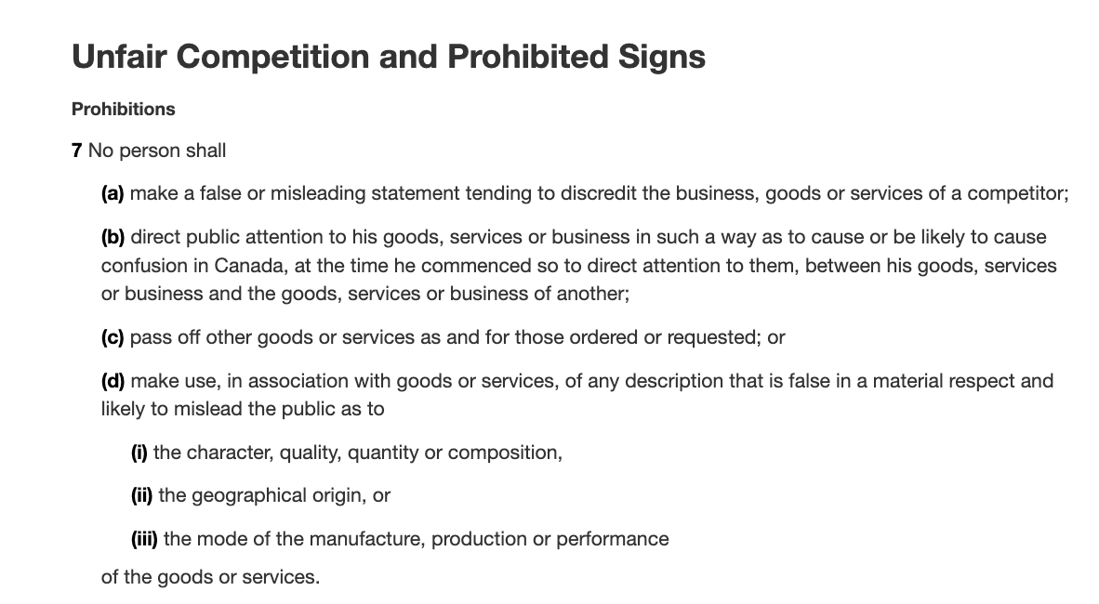
Context

Slide 178
Trademarks : Infringement – the law today
Future Shop v. A&B Sound, [1994] 8 W.W.R. 376
Facts: A&B Sound creates price comparison ads
The public has an interest in comparative advertising
Is the use of the competitor's trademark for a purpose which stresses the similarities or the differences with the trademarked competition ok?
  Similarities?: Not ok - S. 22 infringed.
  Differences?: Ok - S. 22 not infringed.

Slide 179
Trademarks: Infringement – the law today
Future Shop v. A&B Sound, [1994] 8 W.W.R. 376
A & B sound put up price comparison ads in which they effectively stated; here are our products and prices, here are Future Shop’s prices.
Future shop sued for TM infringement. It said that using their mark which was registered for services in comparative advertising is a violation of s. 22.
Based on Clairol it seemed like Future Shop’s argument was sound, and that the use of mark, registered for services, in comparative advertising, is a violation of s. 22.
HOWEVER:
Court held that granting an injunction in this case would deprive the defendant of the option of continuing to pursue its strategy of seeking to attract customers by highlighting its low prices in comparison with those of the plaintiff by fair and accurate ads.
Also, the public has an interest in comparative advertising to the extent that the comparative information offered in those ads helped consumers make better choices.

Slide 180
Trademarks: Infringement – the law today
SUMMARY
1. Emphasizing differences in services and products is fine according to s. 22.
2. It is when trying to appropriate the value of goodwill by emphasizing the similarities between products, the use would run afoul of s. 22.

Slide 181
Trademarks: Infringement
Veuve Clicquot Ponsardin v. Boutiques Cliquot (SCC, 2006)
Facts: Champagne house objects to use of similar
name by women’s wear store
The mere mental association of the two marks does
not necessarily give rise to a likelihood of depreciation
S. 22 = “super weapon” - Needs to be kept in check
Courts should separate anti-dilution claims into
discrete elements; require proof for each element

Slide 182
Trademarks: Infringement
Veuve Clicquot Ponsardin v. Boutiques Cliquot (SCC, 2006)
Word Cliquot does not appear on any of the clothing in the Cliquot boutiques. It appears only on exterior signs, bags, wrapping, business cards, and invoices.
Appellants’ and respondents’ marks have co-existed for about 10 years.
Veuve Clicquot claims BOTH that:
  Consumers will be confused that the women’s clothing and the champagne originate from the same source, thereby infringing the registered TMs of the appellant contrary to s. 20 of the TMA; AND
  That the use by the Respondents depreciates the value of the goodwill attached to the appellants’ marks, contrary to s. 22 of the Act.

Slide 183
Trademarks: Infringement
Veuve Clicquot Ponsardin v. Boutiques Cliquot (SCC, 2006)
Crucial point in the Veuve Clicquot case is Binnie J.’s statement that the mere mental association of the two marks does not necessarily give rise to a likelihood of depreciation. There are other steps to the test…
There are also some other important remarks on this provision should be interpreted:
S. 22 is sometimes referred to as a “super weapon” which, in the interest of fair competition, needs to be kept in check
A super weapon because conceivably could apply in a wide range of situations to constrain individual behaviour and constrain competition. Recall that the main purpose of TM law is not to protect the mark itself. It’s to protect the mark as representative of source.

Slide 184
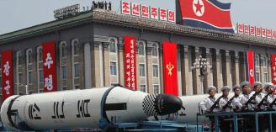
Trademarks: Infringement
Veuve Clicquot Ponsardin v. Boutiques Cliquot (SCC, 2006)
How does the SCC keep this “super weapon” in check?
SCC says - because of its status as a super weapon, any…
  Dilution should be proved by evidence
  Courts should separate any anti-dilution claim into its discrete elements and require proof for each of those elements.

Slide 185
Trademarks: Infringement
Veuve Clicquot Ponsardin v. Boutiques Cliquot (SCC, 2006)
THE TEST FOR S. 22…Test to use when evaluating s. 22 claims.
S. 22 has four elements
1) That a claimant's registered trade-mark was used by the defendant in connection with wares or services in a way that gives notice of the association; does not matter whether or not those wares and services are competitive with those of the claimant.
2) That the claimant's registered trade-mark is sufficiently well known to have significant goodwill attached to it. Canada’s dilution/depreciation provision doesn’t require the mark to be famous (difference between US, European laws)
3) The claimant’s mark used in a manner likely to have an effect on that goodwill (i.e. linkage)
4) Likely effect would be to depreciate the value of its goodwill

Slide 186
Trademarks: Infringement
Veuve Clicquot Ponsardin v. Boutiques Cliquot (SCC, 2006)
1) Was the Plaintiff’s registered TM “used” in connection with the Defendant’s wares or services in a way that gives notice of the association?
“Use” as defined in s. 4
Would the casual observer recognize the mark used by the Defendant as the mark of the P?

Slide 187
Trademarks: Infringement
Veuve Clicquot Ponsardin v. Boutiques Cliquot (SCC, 2006)
2) Is the Plaintiff’s registered TM sufficiently well-known to have significant goodwill attached to it?
Goodwill = positive association that attracts customers towards its owner’s wares or services
How to determine how much goodwill exists in a mark [see para. 54]

Slide 188
Trademarks: Infringement
Veuve Clicquot Ponsardin v. Boutiques Cliquot (SCC, 2006)
3) Is the Plaintiff’s mark used in a manner likely to have an effect on that goodwill?
Plaintiff must prove a connection or linkage made by consumers between the Plaintiff’s goodwill and the defendant’s use

Slide 189
Trademarks: Infringement
Veuve Clicquot Ponsardin v. Boutiques Cliquot (SCC, 2006)
4) Is the likely effect to depreciate the value of the goodwill?
Depreciate = lower the value of; to disparage, belittle, underrate
  Lower value:
    Loss of distinctiveness
    Dilution (blurring of brand image)
Disparage = tarnish; creation of negative associations

Slide 190
Trademarks: Infringement
Conclusion on s. 19, 20, 22
In these cases, we see the Courts interpreting s. 19, 20, 22 in a narrow fashion, restricting the ambit of the sections to the context of commercial competition.
This leaves magazines, unions, and individuals generally free to criticize companies without the fear of trade-mark consequences. The courts are reluctant to use TM law to shut down the ability of people to protest.
In Clairol, when court talks about goodwill, depreciation is found on basis that customers will be diverted to the opposing party (appropriated) as opposed to simply driven away.
Absent a commercially competitive context it is much less likely that there will be depreciation in the value of goodwill. Other parties are not taking goodwill away for their own use.

Slide 191
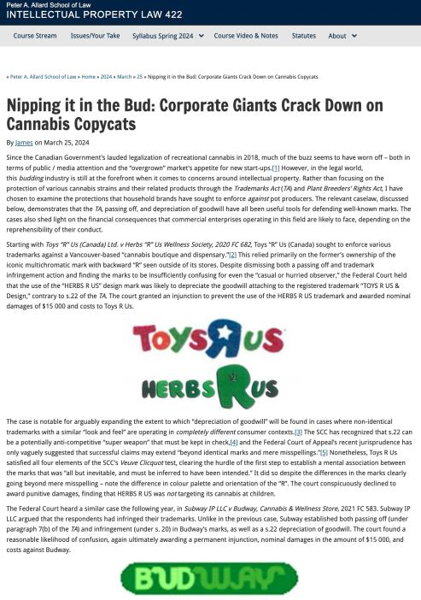

Slide 192
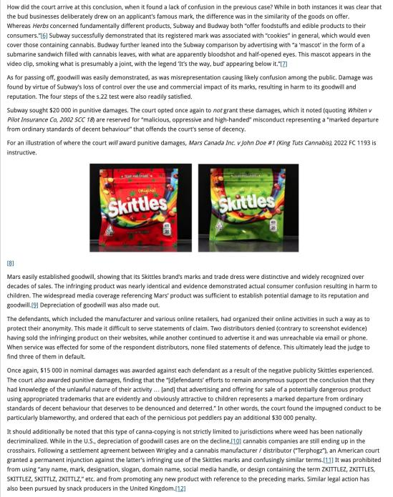

Slide 193
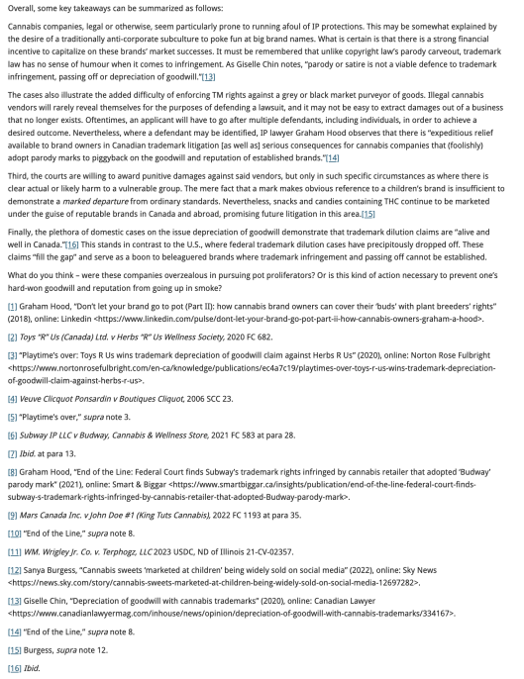

Slide 194
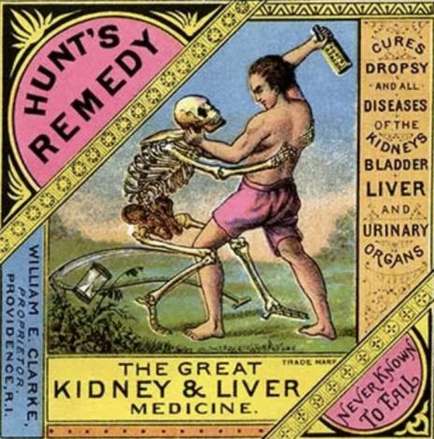
Trademarks: Remedies

Slide 195
Trademarks: Remedies
Remedies
See s. 53.2 (read together w. s. 2, “interested person”)
Including:
  Injunctions (interlocutory or permanent)
  Damages compensating for lost sales, damage to goodwill, loss of control of reputation
  Accounting of profits (alternative to damages)
  Destruction of offending materials
  Removal of mark from wares
  Concealment of mark on wares
  Punitive damages (in certain circumstances)

Slide 196
Trademarks: Remedies
The primary remedies provision in the TMA is s. 53.2. This provision needs to be read together with s. 2 – for the definition of an “interested person”.
Remedies available include:
  Injunctions (interlocutory or permanent)
  Damages
    To compensate for harm suffered:
      Lost sales
      Damage to goodwill
      Loss of control of reputation
  (or) Accounting of profits
  Order for the destruction or other disposition of offending materials
  Removal of offending mark from wares
  Permanent concealment of mark on wares
  Punitive damages in certain circumstances

Slide 197
Trademarks: Remedies
Defences to TM infringement
1) Challenge the validity of the other party’s TM
  See s. 18
2) A Defendant had used, in good faith, a confusing Trade Name in Canada prior to the filing of the Plaintiff’s application for registration of TM
  See s. 21
3) Mark should be cancelled where non-use
4) Defences set out in s. 20 (bona fide…)

Slide 198
Trademarks: Remedies
Defences to TM infringement
A defendant could challenge the validity of the other party’s TM: S. 18 is the provision to rely on if this defence is to be raised (TM registered).
  s. 18(1)(a): Invalid if the TM was not registrable at the date of registration (ss. 9, 10, 12, 13)
  s. 18(1)(b): Invalid if the TM is not distinctive at the time of the challenge (become generic – see Champagne case)
  s. 18(1)(c): Invalid if it has been abandoned (see the corpulent penguin case for the test for abandonment)
  s. 18(1)(d): Invalid if the applicant was not the person entitled to register the mark [refer back to s. 16, but note the limitation in s. 17]

Slide 199
Trademarks: Remedies
Defendant had used in good faith a confusing Trade Name in Canada before the date of the filing of the Plaintiff’s application for registration (s. 21)
The Plaintiff’s mark should be cancelled because of non-use (see S. 45)
Certain defences contained in s. 20 can be invoked where a TM owner alleges that the Defendant has infringed their TM by using a confusing mark.
  I.e.: (1.1) The registration of a trade-mark does not prevent a person from making, in a manner that is not likely to have the effect of depreciating the value of the goodwill attaching to the trade-mark,
    (a) any bona fide use of his or her personal name as a trade-name; or (b) any bona fide use, other than as a trade-mark, of the geographical name of his or her place of business or of any accurate description of the character or quality of his or her goods or services.

Slide 200


Slide 201
End of Complete
Trademarks Review

Slide 202
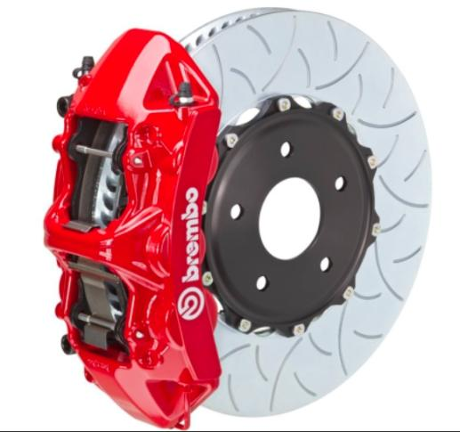

Slide 203

Now, to our regularly
scheduled programming…

Slide 204

On with the show…

Slide 205
Continuing
Trademarks

Slide 206
Really Random Notes

Slide 207
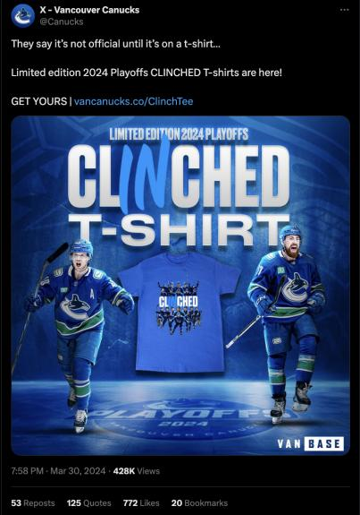
Just because you have a brand,
doesn’t mean you must always use it!

Slide 208
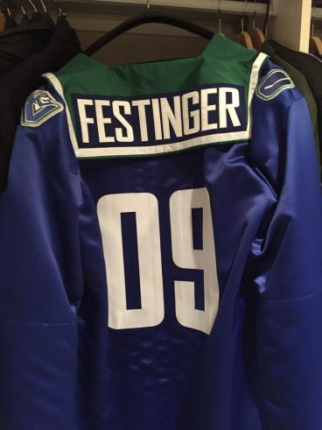
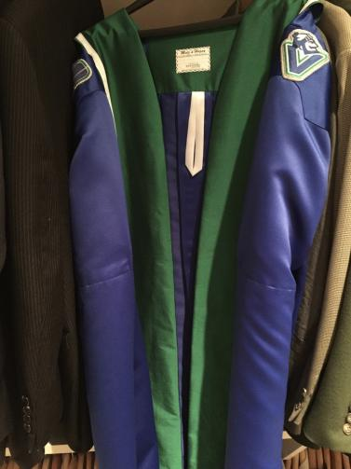
Was this properly authorized?

Slide 209
QUESTIONS?
THOUGHTS?
DISCUSSION?

Slide 210
Pause

Slide 211
Trademarks: Infringement
Four main provisions in the TMA that address TM infringement
  S. 7: provides protection against passing off; applies to both registered and unregistered marks
  S. 19: governs use of precise TM registered for same wares and services
  S. 20: deals with confusing uses of TMs
  S. 22: governs uses that depreciate value of goodwill
Only S. 7 provides protection for UNREGISTERED MARKS – s. 7. This section applies to both registered and unregistered marks and provides protection against passing off. It can be understood as the codification of the two main types of passing off…
The other three provisions – ss. 19, 20, and 22 - ONLY apply to registered TMs.

Slide 212
Trademarks: Infringement
  S. 19: governs use of precise TM registered for
  same wares and services
  Subject to ss. 21, 32, 67
  S. 21:
    Honest, concurrent use of the mark
    Allows the court to carve out space for
    a party’s continuing use of a mark
    Compromise provision

Slide 213
Trademarks: Infringement
Rights conferred by registration
19 Subject to sections 21, 32 and 67, the
registration of a trademark in respect of any
goods or services, unless shown to be invalid,
gives to the owner of the trademark the exclusive
right to the use throughout Canada of the
trademark in respect of those goods or services.

Slide 214
Trademarks: Infringement
S. 19 gives the owner of a TM the exclusive right to use, throughout Canada, the TM in association with those wares and services for which it is registered.
S. 19 only applies where someone uses EXACTLY THE SAME TM; and uses it in association with one of the wares or services for which the original mark is registered.
For example, say that Coca Cola is registered only for soda drinks
If someone uses the TM Coca Cola with respect to couches, this would not be covered by s. 19.
As well, if someone uses the TM Cocca Colla (two cs, two ls) with respect to soda drinks, that would not be covered by s. 19.
Only if a second person used the TM Coca Cola (same TM) with respect to soda drinks (same wares and services) that S. 19 would be infringed.
In S. 19, it states that the rights conferred are subject to S. 21, 32, and 67...
Examine S. 21 which exception refers to the Honest, Concurrent use of the mark.

Slide 215
Trademarks: Infringement
For example: Company X has the common law trademark PRAIRIE for luggage. They have been in business in Manitoba and Sask. since 1980 but haven’t registered their mark
1990 Company Y comes along and would like to use the TM PRAIRIE. They do a registered search, find nothing similar, and register the same TM without knowing that X has been in business in Manitoba & Sask. with that trademark.
Company X not aware that company Y registered this mark until 1998, when it is sued for TM infringement by Company Y. But X was using the mark since 1980!
X’s response is to challenge the registration of the mark under s. 18. Specifically X cites the “entitled to register” section of s. 18 , saying that Company Y isn’t entitled to register the mark because Y’s mark was confusing with X’s mark, which X had used prior to the time Y applied to register.

Slide 216
Trademarks: Infringement
Argument will fail.
Defence, in s. 18, is no longer available because it has been more than 5 years since the mark was registered
17(2) says you have 5 years to object to the registration of a mark on the basis of your prior use of the mark.
s. 21 allows the court to carve out space for X’s continuing use of the mark. However the catch is that there has to be an “adequate specified distinction from the registered TM”, as the court may order.
So, the Court indeed allows X use the mark, but they have to distinguish it in some way to ensure the public is not confused as to source.
S. 21 has been described by commentators as the compromise provision. Through it, the court will find some way for both parties to use the TMs.

Slide 217
Trademarks: Infringement
When registration invalid
18 (1) The registration of a trademark is invalid if
  (a) the trademark was not registrable at the date of registration;
  (b) the trademark is not distinctive at the time proceedings bringing the validity of the registration into question are commenced;
  (c) the trademark has been abandoned;
  (d) subject to section 17, the applicant for registration was not the person entitled to secure the registration; or
  (e) the application for registration was filed in bad faith.

Slide 218
Trademarks: Infringement
When registration incontestable
17 (2) In proceedings commenced after the expiration of five years from the date of registration of a trademark or from July 1, 1954, whichever is the later, no registration shall be expunged or amended or held invalid on the ground of the previous use or making known referred to in subsection (1), unless it is established that the person who adopted the registered trademark in Canada did so with knowledge of that previous use or making known.

Slide 219
Trademarks: Infringement
Concurrent use of confusing marks
21 (1) If, in any proceedings respecting a registered trademark the registration of which is entitled to the protection of subsection 17(2), it is made to appear to the Federal Court that one of the parties to the proceedings, other than the registered owner of the trademark, had in good faith used a confusing trademark or trade name in Canada before the filing date of the application for that registration, and the Court considers that it is not contrary to the public interest that the continued use of the confusing trademark or trade name should be permitted in a defined territorial area concurrently with the use of the registered trademark, the Court may, subject to any terms that it considers just, order that the other party may continue to use the confusing trademark or trade name within that area with an adequate specified distinction from the registered trademark.

Slide 220
Trademarks: Infringement
  S. 20: deals with confusing uses of TMs.
  Covers two types of situations:
Where it is not the identical TM that has been used,
but one that is confusing with the registered TM;
(Cocca Colla for soft drinks)
2. Where it is the identical TM but one used with
respect to different wares or services. I.e., Coca
Cola for chairs - something Coca Cola [original
company] is not registered for)

Slide 221
Trademarks: Infringement
Final section dealing with TM infringement of registered marks is S. 22.
S. 22 governs use of a mark that has the effect of depreciating the value of the goodwill of that mark (no confusion is necessary).
Leading case is Veuve Cliquot but first case to deal with s. 22 is Clairol but first…
Clairol International Corp. v. Thomas Supply & Equipment Co., [1968] 2 Ex. C.R. 552

Slide 222
Trademarks: Infringement
Clairol International Corp. v. Thomas Supply & Equipment [1968] 2 Ex. C.R. 552
Facts: Revlon creates comparison charts…
To infringe s. 19: (see ss. 2, 4)
  1) The mark has to be “used” (see ss. 2, 4)
  2) Also “used” as a TM = must be used for the purposes of distinguishing wares and services → used as an indicator of source
  3) Applies only where someone uses the mark as registered; in association with goods or services for which it is registered

Slide 223
Trademarks: Infringement
Clairol International Corp. v. Thomas Supply & Equipment [1968] 2 Ex. C.R. 552
Clairol owns the TMs Miss Clairol and Hair Color Bath; both registered for use in association with hair tinting and coloring preparations.
Revlon, attempting to increase market share, devised two different ways by which users of products of competitors could successfully choose the same product shades.
On packages for Revlon Color Silk, Revlon put comparison charts indicating the equivalent Clairol products.
They also created brochures featuring the comparison charts.
Two of the plaintiff Clairol’s arguments were that the use of their trademarks in the color comparison charts infringed s. 19 and s. 22 of the Trademarks Act.

Slide 224
Trademarks: Infringement
Clairol International Corp. v. Thomas Supply & Equipment [1968] 2 Ex. C.R. 552
Deals with the question “what does the word “USE” mean in s. 19?”
Look first to s. 2 of the Act for a definition of “use” in relation to a TM. “Use” is defined in s. 2 as “any use that by Section 4 is deemed to be a use in association with wares or services”.
Look to s. 4 which is very specific about use
s. 4(1) deals with use in association with wares; s. 4(2) deals with use in association with services.
In this case, there are no services at issue, only wares, actual boxes of hair dye. Did Revlon use Clairol’s marks in association with their own wares within the meaning of s. 4(1)?
Per s. 4(1), a TM is used in association with wares if, the TM is marked on the product or package at time of transfer of possession or is in any other manner so associated with the wares that notice of the association is given to the person to whom the property is transferred.
In this situation Clariol’s TMs are marked on the boxes, so on the package at the time of the transfer of possession.

Slide 225
Trademarks: Infringement
Clairol International Corp. v. Thomas Supply & Equipment [1968] 2 Ex. C.R. 552
However, this is not the end of the issue.
S. 19 talks about when a TM is used: In order to ensure that this section is not interpreted in an overly broad manner, the court holds that we cannot look only at the word “use”, but also at the definition of TM.
In order to infringe s. 19, the mark must be used (s. 2, then s. 4 (1 or 2) depending on whether the Defendant uses the mark in association with their own wares or services.
The mark also must be used as a TM. This essentially means that the mark must be used in a way that would indicate that the company behind the TM is the SOURCE of the product.
As well, this section applies only where someone uses the mark as registered; in association with goods or services for which it is registered

Slide 226
Trademarks: Infringement
Clairol International Corp. v. Thomas Supply
& Equipment [1968] 2 Ex. C.R. 552
Is there “use” as a
“trademark” here with
respect to the packages?

Slide 227
Trademarks: Infringement
Clairol International Corp. v. Thomas Supply & Equipment [1968] 2 Ex. C.R. 552
No, there is not. Clear that Revlon is not trying to pretend that it is a Clairol product, just trying to show what the right Revlon product to purchase is if you usually buy Clairol
Accordingly, the test for s. 19 infringement not made out.
The brochures are also fine.

Slide 228
Trademarks : Infringement
Clairol International Corp. v. Thomas Supply & Equipment (1968)
S. 22:
  The defendant must have used the mark as set out in s. 2 and 4 of the Act.
  If there is “use”, then the test becomes whether the use is likely to depreciate the value of the goodwill attaching to the mark (i.e. by reducing the esteem in which the mark is held; or enticing customers away)

Slide 229
Trademarks: Infringement
Clairol International Corp. v. Thomas Supply & Equipment (1968)
This is the first time a s. 22 issue was before the court. [Exact s. 22 test will come from Veuve, but this is useful for historical purposes, and to see the stance taken by this Court on comparative advertising].
22. (1) No person shall use a trade-mark registered by another person in a manner that is likely to have the effect of depreciating the value of the goodwill attaching thereto.
How far is this section meant to extend?
Written broadly enough to capture negative comments made in conversation about a specific product.
The court acknowledges that this section is worded broadly but says that it’s unlikely that there is any attempt to suppress critical expression.
*One key is that the court reads in an implied limitation in this section…use in the course of trade.
But even with this implied limitation, this is still potentially a very broad right. It could cover comparison price charts or discussion by sales-clerks of competing products.
We see the court reiterate that purpose of s. 22 is not to stop legitimate comparisons.

Slide 230
Trademarks: Infringement
Clairol International Corp. v. Thomas Supply & Equipment (1968)
In evaluating use in s. 22 the court in Clairol held that we again need to go to s. 4 of the TMA
The TM must be “used” by the Defendant in association with their own wares and services.
Court already found the Clairol marks were “used” in accordance with wares on the package, but not on brochures.
So, the TM is used on the package, so the first part of the s. 22 analysis was met (as the analysis was structured in this case).
NB: Do not need to apply the second part of the “use” test; not a requirement under s. 22 for the mark to have been “used” as a TM.

Slide 231
Trademarks: Infringement
Clairol International Corp. v. Thomas Supply & Equipment (1968)
The second part of the s. 22 test is whether the TM used in matter likely to depreciate the goodwill in the mark?
This brings up the question of what is to be regarded as the goodwill attaching to a TM? The definition given by the court is: the goodwill attaching to the TM is that portion of goodwill that consists of the whole advantage that may have been built up by years of honest work/trade, or money promoting the mark.
To depreciate the value of this goodwill, then, is to reduce the advantage of the reputation/connection

Slide 232
Trademarks: Infringement
Clairol International Corp. v. Thomas Supply & Equipment (1968):
How might depreciating goodwill occur?
Court says that the value of goodwill can be depreciated in two ways:
  (1) Reduce the esteem in which the mark is held
  (2) By enticing customers away.
That said, it is legitimate for businesses to attract consumers from competitors BUT they must do so by honest means
s. 22 sets some limits on what those honest means are. You can put information on your wares for the purpose of telling customers about your own wares in order to get them to buy your goods in preference to those of the owner of a particular TM.

Slide 233
Trademarks: Infringement
What you can not do, however, is put your competitor’s TM on your goods to entice customers away.
That is what happened in this situation.
The competitor’s TMs were used on the package to suggest to customers that they could easily make the switch.
This was found by the court to be a violation of s. 22.
The use on the brochures is not a violation of s. 22; in putting the marks on the brochures, the Defendant isn’t using the mark in association with its wares.
As a result, Revlon can make brochures that give the comparison between the two products; they just can not put the Clairol marks or the chart on their product boxes.

Slide 234
Trademarks: Infringement
What is the impact of Clairol on comparative advertising?
Case suggests we CAN have comparative advertising with respect to products, but not services.
With respect to wares (products), you can mention opposing TMs in ads, or put them on charts and in displays. In doing so, you’re not “using” the TM according to the Trademarks Act; and s. 22 doesn’t kick in since the TM isn’t being “used”.
Result of CLAIROL seems to be that if your TM is registered in association with services, and if you produce an advertisement that uses your competitor’s marks = you are infringing s. 22 because of s. 4(2) which clarifies that use in association with services includes ads.
This is not the law today, though…

Slide 235
QUESTIONS?
THOUGHTS?
DISCUSSION?

Slide 236
Pause

Slide 237
Context

Slide 238
Trademarks : Infringement – the law today
Future Shop v. A&B Sound, [1994] 8 W.W.R. 376
Facts: A&B Sound creates price comparison ads
The public has an interest in comparative advertising
Is the use of the competitor's trademark for a purpose which stresses the similarities or the differences with the trademarked competition ok?
  Similarities?: Not ok - S. 22 infringed.
  Differences?: Ok - S. 22 not infringed.

Slide 239
Trademarks: Infringement – the law today
Future Shop v. A&B Sound, [1994] 8 W.W.R. 376
A & B sound put up price comparison ads in which they effectively stated; here are our products and prices, here are Future Shop’s prices.
Future shop sued for TM infringement. It said that using their mark which was registered for services in comparative advertising is a violation of s. 22.
Based on Clairol it seemed like Future Shop’s argument was sound, and that the use of mark, registered for services, in comparative advertising, is a violation of s. 22.
HOWEVER:
Court held that granting an injunction in this case would deprive the defendant of the option of continuing to pursue its strategy of seeking to attract customers by highlighting its low prices in comparison with those of the plaintiff by fair and accurate ads.
Also, the public has an interest in comparative advertising to the extent that the comparative information offered in those ads helped consumers make better choices.

Slide 240
Trademarks: Infringement – the law today
It appeared after Clairol, that if you run a service and produce an ad which refers to competitor’s marks, s. 22 would be infringed because use in association with services includes ads.
Court in Future Shop v. A&B Sound holds that this is not the case, that the previous principle is too broad and is detrimental to commerce and to the public interest.
The question, depending on the evidence in any particular case, is whether the use of the competitor's trademark is for a purpose which stresses the similarities or the differences with the trademarked competition.
If the purpose is to stress the similarities, then you are appropriating the value of the goodwill associated with the TM, contrary to s. 22.
If the purpose is to stress the differences with the trademark, then the use is for the purpose of distancing the trademarked ware or service and s. 22 is not offended.
Court in Future Shop v. A&B Sound held that we should still allow comparison; and that we should protect freedom of expression.

Slide 241
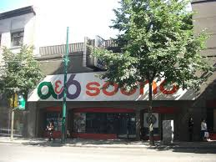
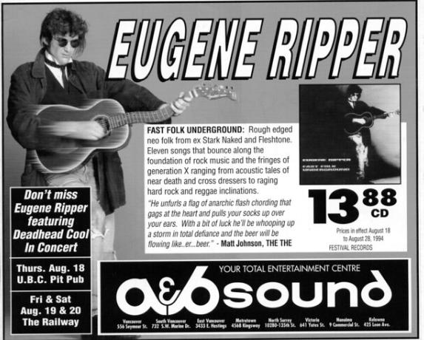

Slide 242


Slide 243
Trademarks: Infringement – the law today
SUMMARY
1. Emphasizing differences in services and products is fine according to s. 22.
2. It is when trying to appropriate the value of goodwill by emphasizing the similarities between products, the use would run afoul of s. 22.

Slide 244
QUESTIONS?
THOUGHTS?
DISCUSSION?

Slide 245
Pause

Slide 246


Slide 247


Slide 248


Slide 249
Trademarks: Infringement
Questions to Ponder
Is it important, in constructing a legal regime around trademarks, to preserve space for comparative advertising?
What limits, if any, should be placed on comparative advertising?
How do you feel about the balance struck by the courts in this regard?

Slide 250
QUESTIONS?
THOUGHTS?
DISCUSSION?

Slide 251
Pause

Slide 252

How is S. 22 TMA like this Guy?

Slide 253
Trademarks: Infringement
Veuve Clicquot Ponsardin v. Boutiques Cliquot (SCC, 2006)
Facts: Champagne house objects to use of similar
name by women’s wear store
The mere mental association of the two marks does
not necessarily give rise to a likelihood of depreciation
S. 22 = “super weapon” - Needs to be kept in check
Courts should separate anti-dilution claims into
discrete elements; require proof for each element

Slide 254
Trademarks: Infringement
Veuve Clicquot Ponsardin v. Boutiques Cliquot (SCC, 2006)
“Veuve Clicquot”:
  One of the world’s great champagne houses
  Numerous marks registered in Canada, and used in connection with products in Canada since at least 1899
  Part of the Louis Vuitton luxury goods group
“Cliquot”:
  Name of six women’s wear shops in Quebec & eastern Ontario
  TMs registered are Cliquot, Cliquot “Un Monde a Part”; also “Cliquot” is trade name
  Sell clothing that is “marketed as good value”; that “appeals to the career woman rather than grandes dames” [interesting play on words given the TM registration, by Veuve Clicquot, of La Grande Dame]

Slide 255
Trademarks: Infringement
Veuve Clicquot Ponsardin v. Boutiques Cliquot (SCC, 2006)
Word Cliquot does not appear on any of the clothing in the Cliquot boutiques. It appears only on exterior signs, bags, wrapping, business cards, and invoices.
Appellants’ and respondents’ marks have co-existed for about 10 years.
Veuve Clicquot claims BOTH that:
  Consumers will be confused that the women’s clothing and the champagne originate from the same source, thereby infringing the registered TMs of the appellant contrary to s. 20 of the TMA; AND
  That the use by the Respondents depreciates the value of the goodwill attached to the appellants’ marks, contrary to s. 22 of the Act.

Slide 256
Trademarks: Infringement
Veuve Clicquot Ponsardin v. Boutiques Cliquot (SCC, 2006)
Trial Judge found that there was little (if any) confusion as to source.
Trial Judge also found that the use, by the respondents, of the words Cliquot or Cliquot un monde a part, did not violate s. 22 of the Act.
Federal CA agreed, as did the SCC.
S. 22 analysis:
The s. 22 remedy was introduced as part of the 1953 amendments to the Trade-Marks Act. Justification was that TM would be less valuable to the owner if it were used by others in connection with a wide variety of other goods even in situations where there was no confusion.
Canada is not the only country to have such a remedy. It can also be found in the US, UK, Europe.

Slide 257
Trademarks: Infringement
Veuve Clicquot Ponsardin v. Boutiques Cliquot (SCC, 2006)
Crucial point in the Veuve Clicquot case is Binnie J.’s statement that the mere mental association of the two marks does not necessarily give rise to a likelihood of depreciation. There are other steps to the test…
There are also some other important remarks on this provision should be interpreted:
S. 22 is sometimes referred to as a “super weapon” which, in the interest of fair competition, needs to be kept in check
A super weapon because conceivably could apply in a wide range of situations to constrain individual behaviour and constrain competition. Recall that the main purpose of TM law is not to protect the mark itself. It’s to protect the mark as representative of source.

Slide 258
Trademarks: Infringement
Veuve Clicquot Ponsardin v. Boutiques Cliquot (SCC, 2006)
How does the SCC keep this “super weapon” in check?
SCC says - because of its status as a super weapon, any…
  Dilution should be proved by evidence
  Courts should separate any anti-dilution claim into its discrete elements and require proof for each of those elements.

Slide 259
Trademarks: Infringement
Veuve Clicquot Ponsardin v. Boutiques Cliquot (SCC, 2006)
1) Was the Plaintiff’s registered TM “used” in connection with the Defendant’s wares or services in a way that gives notice of the association?
2) Is the Plaintiff’s registered TM sufficiently well-known to have significant goodwill attached to it?
3) Is the Plaintiff’s mark used in a manner likely to have an effect on that goodwill?
4) Is the likely effect to depreciate the value of the goodwill?

Slide 260
Trademarks: Infringement
Veuve Clicquot Ponsardin v. Boutiques Cliquot (SCC, 2006)
THE TEST FOR S. 22…Test to use when evaluating s. 22 claims.
S. 22 has four elements
1) That a claimant's registered trade-mark was used by the defendant in connection with wares or services in a way that gives notice of the association; does not matter whether or not those wares and services are competitive with those of the claimant.
2) That the claimant's registered trade-mark is sufficiently well known to have significant goodwill attached to it. Canada’s dilution/depreciation provision doesn’t require the mark to be famous (difference between US, European laws)
3) The claimant’s mark used in a manner likely to have an effect on that goodwill (i.e. linkage)
4) Likely effect would be to depreciate the value of its goodwill

Slide 261
Trademarks: Infringement
Veuve Clicquot Ponsardin v. Boutiques Cliquot (SCC, 2006)
1) Was the Plaintiff’s registered TM “used” in connection with the Defendant’s wares or services in a way that gives notice of the association?
“Use” as defined in s. 4
Would the casual observer recognize the mark used by the Defendant as the mark of the P?

Slide 262
Trademarks: Infringement
Veuve Clicquot Ponsardin v. Boutiques Cliquot (SCC, 2006)
1) Use of the claimant’s registered mark
“Use” defined in s. 4
“Use”, if for wares, marked on the wares themselves or on packaging or in any other manner so associated with the wares that notice of the association is given
Important to note that the fact that Cliquot was spelled differently does not by itself mean that the TM was not used. What matters is would the casual observer recognize the mark used by the Respondent as the mark of the Appellant (IE Coke, Koke).
Trial Judge held that a consumer who saw the word cliquot used in the D’s stores WOULD NOT MAKE ANY ASSOCIATION with the Plaintiff’s mark. Accordingly, there is NO USE for services pursuant to s. 4.
Without a link between the respondents’ store and the Veuve Clicquot mark, the Veuve Clicquot mark cannot be depreciated.
S. 22 claim fails at the first step.
However, the Court thankfully (for us) goes through the rest of the analysis, partly because s. 22 just doesn’t get litigated very often.

Slide 263
Trademarks: Infringement
Veuve Clicquot Ponsardin v. Boutiques Cliquot (SCC, 2006)
2) Is the Plaintiff’s registered TM sufficiently well-known to have significant goodwill attached to it?
Goodwill = positive association that attracts customers towards its owner’s wares or services
How to determine how much goodwill exists in a mark [see para. 54]

Slide 264
Trademarks: Infringement
Veuve Clicquot Ponsardin v. Boutiques Cliquot (SCC, 2006)
2) Proof of goodwill
“Goodwill” isn’t defined in the Act, but generally means the positive association that attracts customers towards its owner’s wares or services rather than those of its competitors
For s. 22 to apply there needs to be the existence of goodwill capable of depreciation by a “non-confusing use”.
“[54] While “fame” is not a requirement of s. 22, a court required to determine the existence of goodwill capable of depreciation by a “non-confusing” use (as here) will want to take that approach into consideration, as well as more general factors such as the degree of recognition of the mark within the relevant universe of consumers, the volume of sales and the depth of market penetration of products associated with the claimant’s mark, the extent and duration of advertising and publicity accorded the claimant’s mark, the geographic reach of the claimant’s mark, its degree of inherent or acquired distinctiveness, whether products associated with the claimant’s mark are confined to a narrow or specialized channel of trade, or move in multiple channels, and the extent to which the mark is identified with a particular quality.”
In this case there is a substantial amount of goodwill that attaches to the Veuve Clicquot mark. This goodwill extends beyond wine and champagne.

Slide 265
Trademarks: Infringement
Veuve Clicquot Ponsardin v. Boutiques Cliquot (SCC, 2006)
3) Is the Plaintiff’s mark used in a manner likely to have an effect on that goodwill?
Plaintiff must prove a connection or linkage made by consumers between the Plaintiff’s goodwill and the defendant’s use

Slide 266
Trademarks: Infringement
Veuve Clicquot Ponsardin v. Boutiques Cliquot (SCC, 2006)
3) Likely connection or linkage made by consumers between claimant’s goodwill and defendants’ use?
Trial Judge found that the somewhat hurried consumer does not associate what is displayed in the Respondents' stores with the mark of Veuve Clicquot. As a result, there can be no impact on the goodwill attached to VEUVE CLICQUOT.
AND any linkage does have to be proved. That is why the section does not read: No person shall use a [famous] trade-mark registered by another person [because to do so] is likely to have the effect of depreciating the value of the goodwill attaching thereto.
The complainant must prove a connection or linkage made by consumers between the claimant’s goodwill and the defendants’ use.

Slide 267
Trademarks: Infringement
Veuve Clicquot Ponsardin v. Boutiques Cliquot (SCC, 2006)
4) Is the likely effect to depreciate the value of the goodwill?
Depreciate = lower the value of; to disparage, belittle, underrate
  Lower value:
    Loss of distinctiveness
    Dilution (blurring of brand image)
Disparage = tarnish; creation of negative associations

Slide 268
Trademarks: Infringement
Veuve Clicquot Ponsardin v. Boutiques Cliquot (SCC, 2006)
Likelihood of depreciation
Veuve Clicquot is a famous mark with significant goodwill is attached to it in the luxury goods trade
Word “depreciate” is used in its ordinary dictionary meaning of "lower the value of" as well as to "disparage, belittle, underrate"
  Value can be lowered in a variety of ways:
  Loss of distinctiveness: Value can be lowered in situations where the mark is used by different users (either by company itself licensing too widely. For example, the Pierre Cardin brand moved down market through overuse of licensing; or through others using).
  Dilution: Meaning a blurring of brand image. Dilution works its harm not by causing confusion in consumers’ minds regarding the source of a good or a service, but by creating an association in consumers’ minds between a mark and a different good or service. I.e. Tiffany ex ample → Mass. court, in dealing with a local restaurant calling itself Tiffany, talked about the risk of erosion of the public's identification of the mark uniquely with the plaintiff's jewellery and luxury business, diminishing its distinctiveness, uniqueness, effectiveness and prestigious connotations

Slide 269
Trademarks: Infringement
Veuve Clicquot Ponsardin v. Boutiques Cliquot (SCC, 2006)
Likelihood of depreciation (con’d)
  Disparagement or tarnishing of a TM is where the Defendant creates negative association for the mark.
    Thurlow J. considered this was the case in the Clairol case
    Examples given was Dallas Cowboy Cheerleaders Inc. v. Pussycat Cinema Ltd. as well as other cases involving sexually explicit or pornographic businesses in the US [para. 66]
  Depreciation not limited to BLURRING and TARNISHMENT in Canada. It is not enough to show that depreciation COULD occur – must prove that it’s LIKLELY to occur.
In this case the Court found that a casual consumer would not associate the name of the respondents’ stores with the house of Veuve Clicquot. Accordingly, the necessary elements for a s. 22 depreciation claim were not established.

Slide 270
Trademarks: Infringement
Conclusion on s. 19, 20, 22
In these cases, we see the Courts interpreting s. 19, 20, 22 in a narrow fashion, restricting the ambit of the sections to the context of commercial competition.
This leaves magazines, unions, and individuals generally free to criticize companies without the fear of trade-mark consequences. The courts are reluctant to use TM law to shut down the ability of people to protest.
In Clairol, when court talks about goodwill, depreciation is found on basis that customers will be diverted to the opposing party (appropriated) as opposed to simply driven away.
Absent a commercially competitive context it is much less likely that there will be depreciation in the value of goodwill. Other parties are not taking goodwill away for their own use.

Slide 274
QUESTIONS?
THOUGHTS?
DISCUSSION?

Slide 275
Pause

Slide 276
Trademarks: Remedies

Slide 277
Trademarks: Remedies
Remedies
See s. 53.2 (read together w. s. 2, “interested person”)
Including:
  Injunctions (interlocutory or permanent)
  Damages compensating for lost sales, damage to goodwill, loss of control of reputation
  Accounting of profits (alternative to damages)
  Destruction of offending materials
  Removal of mark from wares
  Concealment of mark on wares
  Punitive damages (in certain circumstances)

Slide 278
Trademarks: Remedies
The primary remedies provision in the TMA is s. 53.2. This provision needs to be read together with s. 2 – for the definition of an “interested person”.
Remedies available include:
  Injunctions (interlocutory or permanent)
  Damages
    To compensate for harm suffered:
      Lost sales
      Damage to goodwill
      Loss of control of reputation
  (or) Accounting of profits
  Order for the destruction or other disposition of offending materials
  Removal of offending mark from wares
  Permanent concealment of mark on wares
  Punitive damages in certain circumstances

Slide 279
Trademarks: Remedies
Defences to TM infringement
1) Challenge the validity of the other party’s TM
  See s. 18
2) A Defendant had used, in good faith, a confusing Trade Name in Canada prior to the filing of the Plaintiff’s application for registration of TM
  See s. 21
3) Mark should be cancelled where non-use
4) Defences set out in s. 20 (bona fide…)

Slide 280
Trademarks: Remedies
Defences to TM infringement
A defendant could challenge the validity of the other party’s TM: S. 18 is the provision to rely on if this defence is to be raised (TM registered).
  s. 18(1)(a): Invalid if the TM was not registrable at the date of registration (ss. 9, 10, 12, 13)
  s. 18(1)(b): Invalid if the TM is not distinctive at the time of the challenge (become generic – see Champagne case)
  s. 18(1)(c): Invalid if it has been abandoned (see the corpulent penguin case for the test for abandonment)
  s. 18(1)(d): Invalid if the applicant was not the person entitled to register the mark [refer back to s. 16, but note the limitation in s. 17]

Slide 281
Trademarks: Remedies
Defendant had used in good faith a confusing Trade Name in Canada before the date of the filing of the Plaintiff’s application for registration (s. 21)
The Plaintiff’s mark should be cancelled because of non-use (see S. 45)
Certain defences contained in s. 20 can be invoked where a TM owner alleges that the Defendant has infringed their TM by using a confusing mark.
  I.e.: (1.1) The registration of a trade-mark does not prevent a person from making, in a manner that is not likely to have the effect of depreciating the value of the goodwill attaching to the trade-mark,
    (a) any bona fide use of his or her personal name as a trade-name; or (b) any bona fide use, other than as a trade-mark, of the geographical name of his or her place of business or of any accurate description of the character or quality of his or her goods or services.

Slide 282

Trademarks: Remedies
Assume Trader Joe’s TM is registered in Canada – as of 2011.
Is Pirate Joe’s infringing Trader Joe’s registered TM? s. 19, 20, 22…

Slide 283
Trademarks: Remedies – Q&A
Do you think the provisions in the TMA provide
sufficient protection against infringement for TM
owners?
2. Do you think the provisions in the TMA overprotect
TM owners?
  In answering these questions please think of specific
  legislative reforms that in your view would make the
  degree of protection available to TM owners more
  appropriate.

Slide 284
QUESTIONS?
THOUGHTS?
DISCUSSION?

Slide 285
Pause

Slide 286
Trademarks
Review

Slide 287
Trademarks: Infringement
– the law today
SUMMARY
1. Emphasizing differences in services and products is fine according to s. 22.
2. It is when trying to appropriate the value of goodwill by emphasizing the similarities between products, the use would run afoul of s. 22.

Slide 288
Trademarks: Infringement
Veuve Clicquot Ponsardin v. Boutiques Cliquot (SCC, 2006)
How does the SCC keep this “super weapon” in check?
SCC says - because of its status as a super weapon, any…
  Dilution should be proved by evidence
  Courts should separate any anti-dilution claim into its discrete elements and require proof for each of those elements.

Slide 289
Trademarks: Remedies
Remedies
See s. 53.2 (read together w. s. 2, “interested person”)
Including:
  Injunctions (interlocutory or permanent)
  Damages compensating for lost sales, damage to goodwill, loss of control of reputation
  Accounting of profits (alternative to damages)
  Destruction of offending materials
  Removal of mark from wares
  Concealment of mark on wares
  Punitive damages (in certain circumstances)

Slide 290
Trademarks
Are the provisions of the TMA allowing for challenges to TM registration:
Weighted too heavily in favour of persons that have registered marks (or are applying to have a mark registered)?
Weighted too heavily in favour of persons wishing to oppose or invalidate a registration?
Adequately balanced between both parties (and the public interest more broadly)?

Slide 291

Trademarks Review

Slide 292

Trademarks Review

Slide 293
Trademarks Review
The Kitasoo Band Council approaches you and would like to register the mark SPIRIT BEAR as an official mark. Do you anticipate any issues with the registration of this mark?

Slide 294
Trademarks Review
The Kitasoo Band Council approaches you and would like to register the mark SPIRIT BEAR as an official mark. Do you anticipate any issues with the registration of this mark?

Slide 295

Trademarks Review

Slide 296
Trademarks Review
Is a TM registered in association with
goods and not services “used” when it
is reproduced, by a competitor, on a
brochure placed next to both the
product on which the TM is marked
and the competitor’s product?

Slide 297
Trademarks Review
Do you think the provisions in the TMA
provide adequate protection against
infringement for TM owners? If so, why? If
not, what changes would you make to the
TMA to increase protection against
infringement?

Slide 298
Trademarks Review
Does the TMA sufficiently balance the
property rights of TM owners with the
speech rights of non-TM-owning parties?

Slide 299

Trademarks Review

Slide 300

Trademarks Review

Slide 301

Trademarks Review

Slide 302
Trademarks Review
Does TM law in Canada adequately balance
between the rights of TM owners and the
rights of the public to make use of marks
capable of being protected under TM law?

Slide 303
QUESTIONS?
THOUGHTS?
DISCUSSION?

Slide 304
Pause

Slide 305


Slide 307

Patents

Slide 308

Guest Speaker

Slide 309

https://iplaw.allard.ubc.ca/2020/06/01/gowlings-roch-ripley-r-nelson-godfrey-on-patent-remedies-etc/

Slide 310
QUESTIONS?
THOUGHTS?
DISCUSSION?

Slide 311
Pause

Slide 312

Perspective
Earth from 900 Million Miles Away (2013 Cassini)

Slide 313
Creativity (Copyright)
Origin (Trademarks/P.O.)
Innovation (Patents)

Slide 314
Fixation (Copyright)
Use (Trademarks/P.O.)
Usability (Patents)

Slide 315
User’s Rights (Copyright)
Consumer Rights
(Trademarks/P.O.)
Anti-Monopoly (Patents)

Slide 316

Meta Perspective
Earth from 3.7 Billion Miles Away (1990 Voyager 1)

Slide 317

Storytelling

Slide 318
QUESTIONS?
THOUGHTS?
DISCUSSION?

Slide 319
Pause

Slide 320
Patents
First…
Introduction to patents
Patentable subject matter
  Invention
    Composition of matter; manufacture; machine; art; process; improvement
Non-patentable subject matter
    Mere scientific principles or abstract theorem; professional arts; higher life forms; methods of medical or surgical treatment

Slide 321
Patents
Federal Government:
Authority over patents: s. 91(22), Constitution Act, 1867
Authority exercised in part through the enactment of the Patent Act, RSC, c. P-4
Definition of patent:
a limited term monopoly for an invention; the right, given to an inventor by the government, to exclude others from making, using or selling one’s invention from the day the patent is granted.
“…to advance research and development and to encourage broader economic activity” (Free World Trust, 2000 SCC)

Slide 322
Patents
”Patentee” can only get a patent for “inventions” (s. 2)
Also, patent only granted if your invention is novel, useful, and non-obvious (ss. 2, 28.3)
Term of protection: 20 years (ss. 44, 46)
Contrast with confidential information

Slide 323

The Patent Bargain
Patent system is a “quid pro quo”

Slide 324
Patents
At its core, the patent system is a bargain between the inventor and the public:
One party discloses an invention in exchange for a 20 year monopoly period in which to make, use, and sell the invention
See Teva Canada Ltd. v. Pfizer Canada, Inc.
  FACTS: Teva had challenged the validity of Pfizer’s patent for Viagra.

Slide 325
The Patent Bargain
Teva Canada Ltd. v. Pfizer Canada, Inc.
FACTS: Teva had challenged the validity of Pfizer’s patent for Viagra.
“[N]ot intended as an accolade or civic award for ingenuity. It is a method by which inventive solutions to practical problems are coaxed into the public domain by the promise of a limited monopoly for a limited time.”
Patent specification = heart of the disclosure requirement
Patent system is a “quid pro quo”

Slide 326
The Business Context: perceptions of value
In 2015, intangible assets accounted for 87% of the value of Standard & Poor’s 500 (tracking 500 companies with the largest market capitalization listed on the New York Stock Exchange (Ocean Tomo 2015)
Are patents overvalued generally?
Does start-up perception that patents are “necessary” result in overly general or irrelevant “false flag” patents that simply go unchallenged in the short-term.
E.g., = Cool product with patent, but patent is purely ancillary and has nothing to do with the key features that differentiate the product in the market
Likewise, query practical uses of “patent pending”.

Slide 327

Patents

Slide 328

Trolls
https://www.youtube.com/watch?v=sG9UMMq2dz4

Slide 329
Patents
Is a patent a good bargain?
Might we be better off with longer patent
protection?
Without any sort of patent protection?

Slide 330
Patents
Invention = … any new and useful art, process, machine, manufacture or composition of matter, or any new and useful improvement in any art, process, machine, manufacture or composition of matter (s. 2, Patent Act)
Contrast to Copyright where “mods” are discouraged rather than encouraged

Slide 331
Patents
Novelty and usefulness
(see s. 2, Patent Act)
Non-obviousness
(see s. 28.3, Patent Act)

Slide 332
Patents
Invention = … any new and useful art, process, machine, manufacture or composition of matter, or any new and useful improvement in any art, process, machine, manufacture or composition of matter (s. 2, Patent Act)
Contrast to Copyright where “mods” are discouraged rather than encouraged

Slide 333
Patents
Harvard College (SCC):
Majority
  Invention defined broadly, should be interpreted broadly; but is not unlimited
  Some subject matter is outside the scope of protection
Commissioner has no discretion to refuse a patent on the basis of public policy considerations independent of express provisions of the Act

Slide 334
QUESTIONS?
THOUGHTS?
DISCUSSION?

Slide 335
Pause

Slide 337



Slide 338
SEE YOU NEXT WEEK!

Slide 339

Always include a cat picture

Slide 340
In learning you will teach
And in teaching you will learn
Phil Collins' Son of Man (1999)

