Slide 1

Trademarks 1
Talk 9
LAW 422 002
Intellectual Property Law
Allard School of Law, UBC
Spring, 2024
Jon Festinger K.C.
Adjunct Professor, UBC Allard
Of Counsel, Chandler Fogden Lyman
https://iplaw.allard.ubc.ca/

Slide 2
Logistics

Slide 3


Slide 4
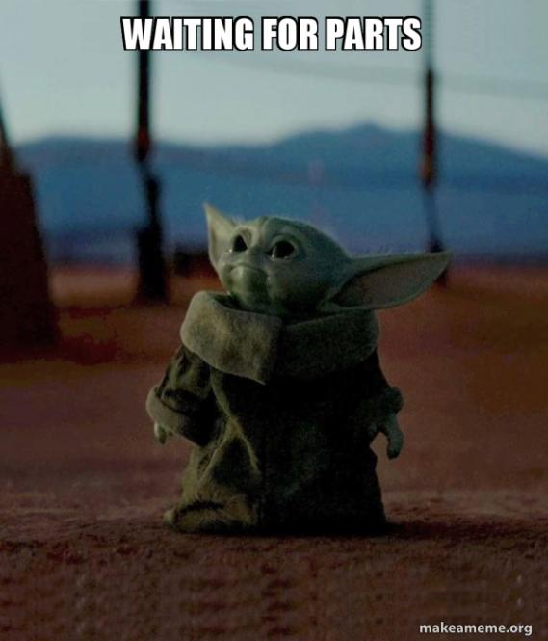

Slide 5
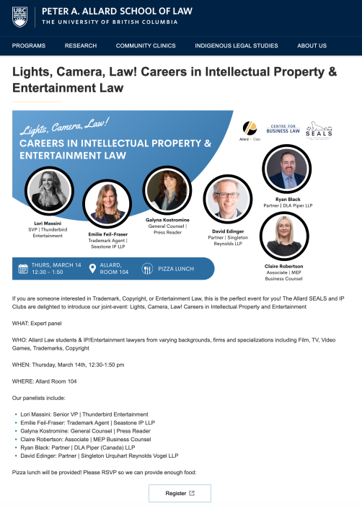

Slide 6
Exam
Wednesday April 17, 2024
Rooms: ????

Slide 7
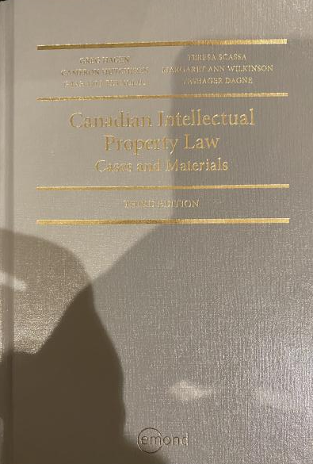
Text: Let me know if any issues @ Bookstore

Slide 8
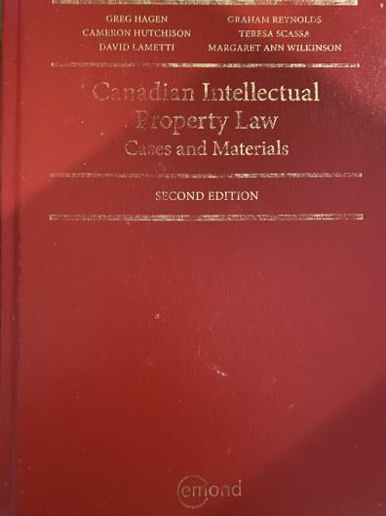
Former Text

Slide 9
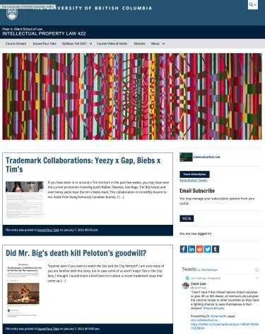

Course Website
https://iplaw.allard.ubc.ca/

Slide 10
PLEASE
SIGN UP

Slide 11
For full privileges on the website
1. Please create an account at http://cms.ubc.ca/ using your CWL.
2. Once you create an account and sign in at http://cms.ubc.ca/ you can click your name in the top right. Halfway down the following page will be your WordPress email address.
3. Send me your WordPress email address at jon.festinger@ubc.ca or at jon_festinger@thecdm.ca
4. Then, I will invite you to participate with authoring privileges via your WordPress email address.

Slide 12

Have responded to everyone?
+
…to some who didn’t ask?

Slide 13
Why post?
Engaging and engaging others is the key.
Because you don’t love speaking up in class.
Because you just saw or realized something, and you’ll never remember it unless you post it now.

Slide 14
Tips:
Don’t feel your posts have to be perfect. Engaging and engaging others is the key.

Slide 15
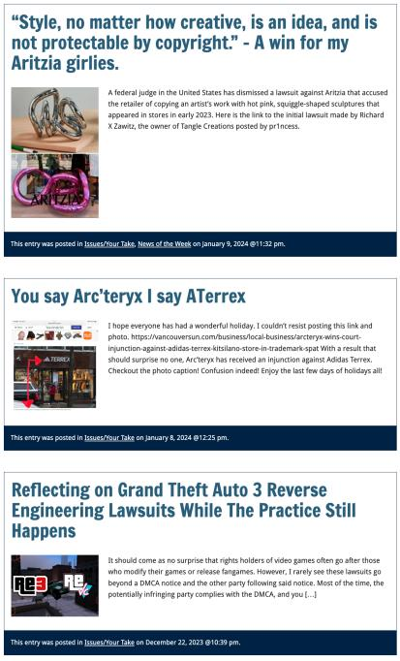

Slide 16

Anything & everything can be done via email if you prefer

Slide 17


Adding Images

Slide 18



Slide 19
Adding Links

Slide 20
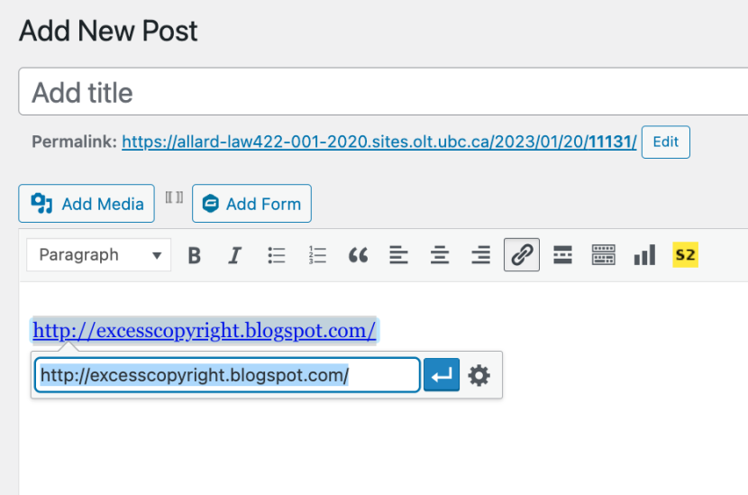


Slide 21


Adding a “Featured Image”

Slide 22


Slide 23
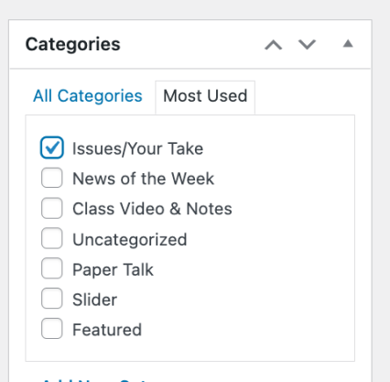

Setting Categories

Slide 24
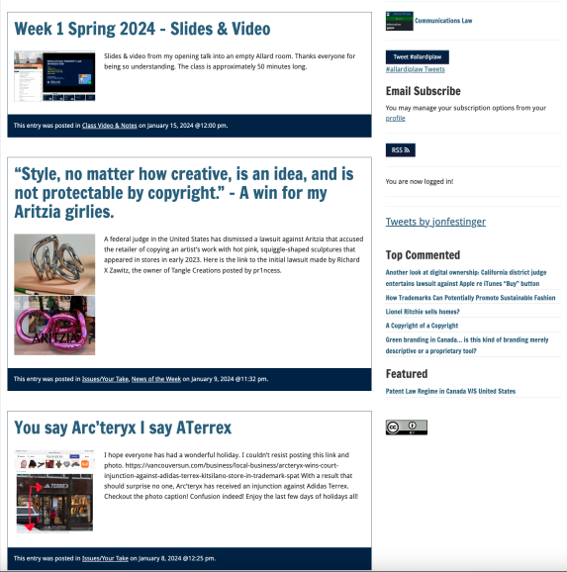
Creative Commons License

Slide 25
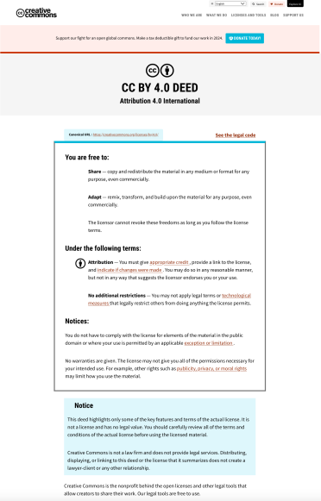
What CTLT will do…

Slide 26
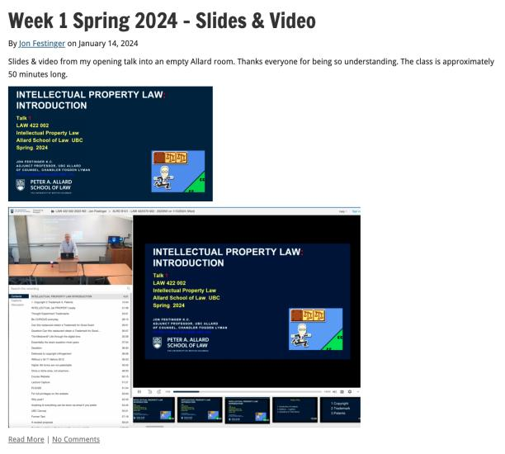
Lecture Capture

Slide 27
Syllabus

Slide 28





Slide 29
Features of this Course
70% Exam not 100%
IP Law “In Context”
Website

Slide 30
Let’s talk about…
The 30%

Slide 31
A modest proposal…
Approximately 1000 words (or equivalent) per person
written, video, podcast, in-class presentation (?), interpretive dance
Website or not
Groups or individually
LLM Students – one extra post

Slide 32
Past Presentations: Most are on the course website…

Slide 33
Generative A.I. Policy
1. It is source material, therefore
must be cited
2. You are responsible for the quality
of your source material, so check…
If it is wrong, you are wrong
If it plagiarized, you’ve plagiarized

Slide 34

Office “Hours”: Ideally Tuesdays just after class but am flexible…
Email: jon.festinger@ubc.ca; jfestinger@telus.net
Office: 449
Phone:
c. 604-837-6426
(please text if urgent)

Slide 35
Entirely optional but please…
…email me a short bio of yourself referencing:
Anything at all you want to say about yourself
Your academic interests
What you might like to get out of this course (I.E., interest in a type of patent, or a copyright issue etc.)
Favorite Intellectual Property (ies) - current or all-time

Slide 36
Zoom Q&A Sessions
(Study Groups Preferred If Possible)

Slide 37
QUESTIONS?
THOUGHTS?
DISCUSSION?

Slide 38

Pause

Slide 39
Posts of
the Weeks

Slide 40
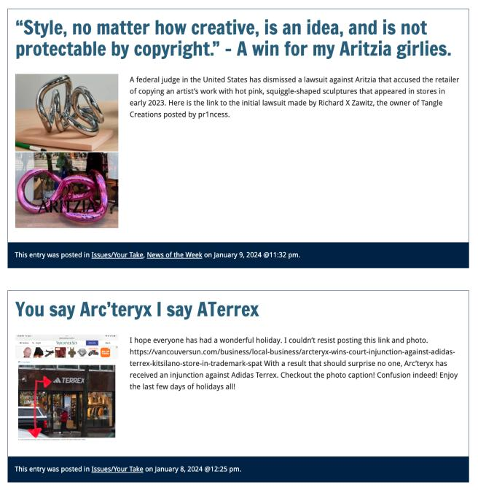

Slide 41
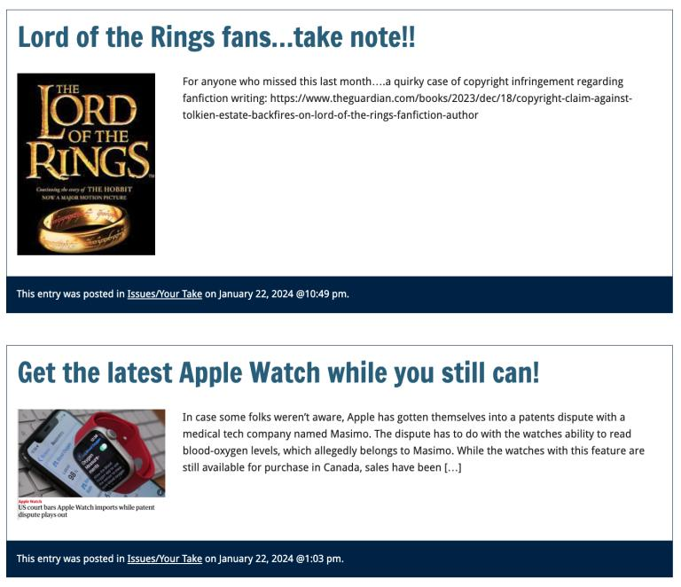

Slide 42
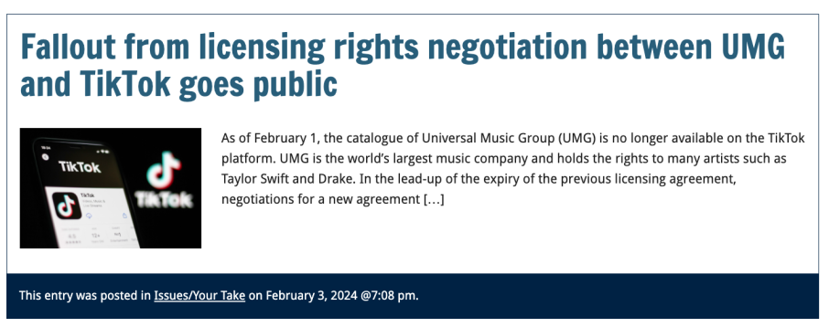
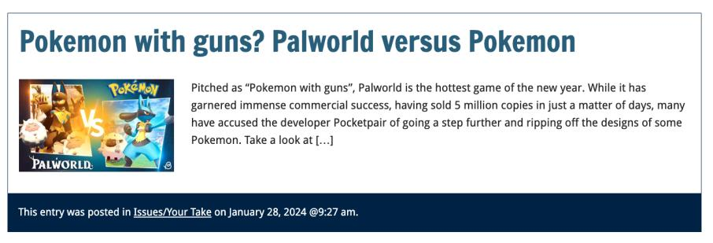

Slide 43
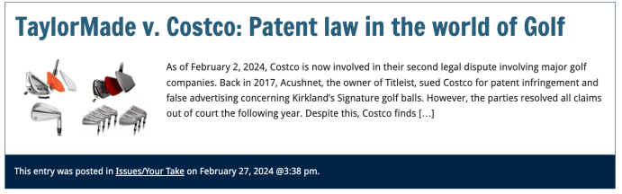
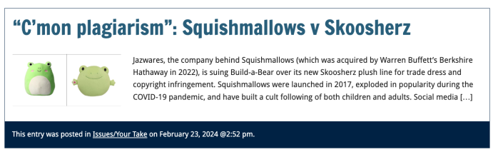
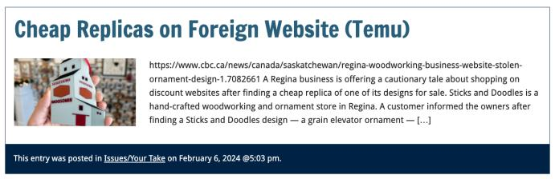

Slide 44
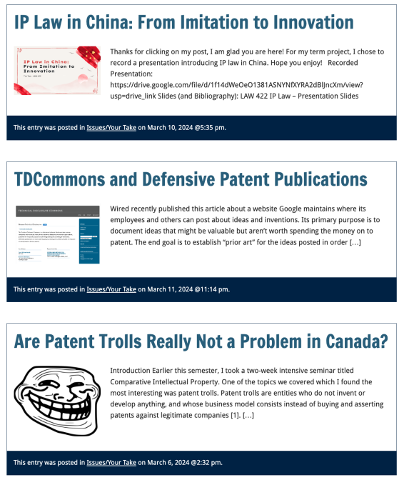

Slide 45
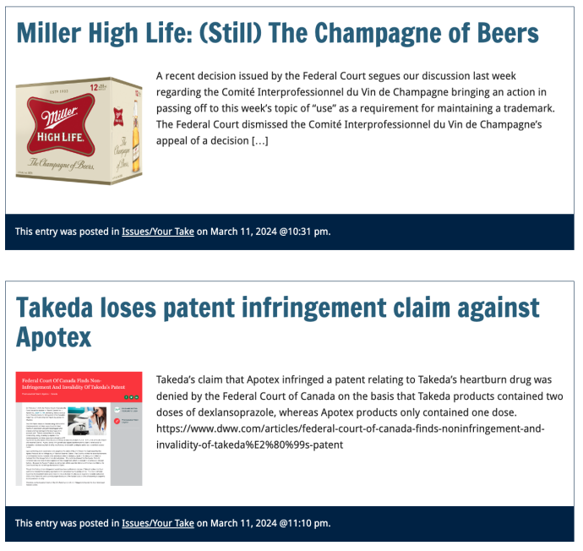

Slide 46
QUESTIONS?
THOUGHTS?
DISCUSSION?

Slide 47
Pause

Slide 48

Where we have been…

Slide 49
Intellectual Property Law is about:
What kinds of creations of the mind can one have rights in?
Who can have those rights?
What kinds of rights are there; and how are those rights enforced?

Slide 50
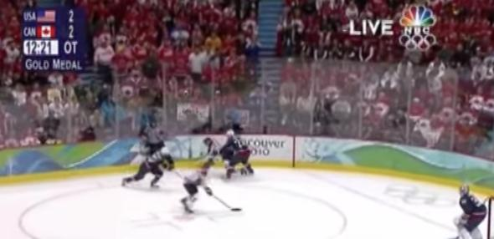
“Passing Off”
Complete Review
The Golden Goal – Jerome Iginla
passing off to Sidney Crosby

Slide 51
Passing off
Three (3) necessary components of
a passing-off action:
  1. The existence of goodwill +
  2. Deception of the public due to a
  misrepresentation +
  3. Actual or potential damage to the
  plaintiff

Slide 52
Passing off in contrast to Trademarks: Think…
LOCATION, LOCATION, LOCATION
LOCAL, LOCAL, LOCAL
WHERE ARE THE GOODS KNOWN +/or SOLD

Slide 53
Passing off in contrast to Trademarks: Think…
Temporal dimension
How much time should the protection last beyond closing/unavailability if it can be recovered?
Fun brand cases
Genericization

Slide 54
Conceptual Frameworks
Think “the marketplace”
Think BRANDS
Associate BRANDS with REPUTATION (“goodwill”)
“USE” is the key concept in both passing off & trademarks
“Use It or Lose It” = historical, underlying concept (not quite as literal anymore in Canada per recent Trademark reform)
Not as overtly about “intellectual effort” as copyright
No “Public Domain” per se

Slide 55
Passing off
Tort action available in certain circumstances of unfair competition
Common Law (where no statute)
Both a common law tort and a statutory cause of action under the Canadian Trade-marks Act
No one may pass off their goods as those of another
General remedy for two categories of deception in the commercial context:
  Company B represents products as being those of Company A to take advantage of Company A’s goodwill and reputation e.g. Coke v. Cola Joe
  Goods of Trader A supplied to party who has ordered goods of Trader B. Purchasing party led to believe they have received goods of Trader B.

Slide 56
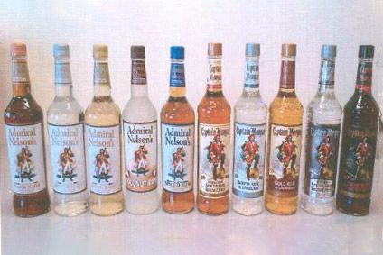
Category 1

Slide 57


Category 2

Slide 58
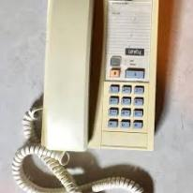
Category 2
Orkin Exterminating v. Pestco (1985 Ont. CA)
People called what they thought was the ORKIN phone number, but then were actually connected with Pestco, and led or allowed to believe that ORKIN has taken care of their pest problem.

Slide 59
Passing off: Goodwill
Goodwill
The benefit and advantage of the good name, reputation, and connection of a business
Where the trade-mark or get-up is associated in the mind of the purchasing public with the plaintiff's goods, or with one trade source.
Get-up: The whole visible external appearance of goods

Slide 60
Passing off
Note is that passing off is generally seen as an action available between commercial competitors.
The Supreme Court of Canada, however, in Ciba‑Geigy Canada Ltd. v. Apotex Inc., [1992] 3 S.C.R. 12 emphasized that there is a consumer protection dimension to the tort. Gonthier J. notes that however one looks at the passing-off action, its purpose is clearly to protect all persons affected by the product.
“All persons” being the competitor and the people who buy the product
“People” who buy the product includes the first person who buys the product [who may be a wholesaler], all other intermediate purchasers, and the ultimate consumer.

Slide 61
Passing off: Where does goodwill come from?
Goodwill has said to come from the fact that the trade-mark or get-up is associated in the mind of the purchasing public with the plaintiff’s goods, or with one trade source, whether or not the public can identify that source.
A GET-UP can be defined as: The whole visible external appearance of goods/ specifically … in the form in which they are likely to be seen by the public before purchase.
If the goods are sold in packages, then the get-up is the way the package looks – the appearance of the package taken as a whole.
If the goods are not sold in packaging – the get-up is the way the good looks - the visible external appearance of the goods themselves.

Slide 62
Passing off: Where does goodwill come from?
How would you go about establishing the existence of goodwill? What sorts of information would you want to have?
Evidence of length of time in business
Strength of market for product/service
Strength of association between name/mark/product and company as source.

Slide 63
The existence of goodwill 1
The existence of goodwill, though sometimes easy to establish, is a crucial element of the tort of passing off.
Protection against passing off ONLY where goodwill or reputation has been established.
A co. whose goods or services are well known in NS, but not in BC, will not be protected at Common Law from another company offering similarly named or branded products or services in BC. This is because confusion or misrepresentation is the essence of the tort of passing off.

Slide 64
The existence of goodwill 2
In other words where the Plaintiff’s product or service is unknown in a certain region, it will be hard for the Plaintiff to argue that customers were misled into thinking they were purchasing the P’s products when they were purchasing those of the defendant.
Goodwill is oddly “regional”, though one can string together regions to become national or even international.
Protection against passing off is available only where there is goodwill or reputation – IE only where the alleged offence occurs within a territory where there is goodwill.

Slide 65
Passing off: Shared Goodwill
Institut national des appellations d’origine des vins…v. Andres Wines Ltd (continued)
Main question: Should the concept of “shared goodwill” should be accepted in Canada?
The court recognized that to accept “shared goodwill” would be to expand the tort of passing off.
Parenthetically note as we explore the extent to which the tort of passing off has expanded over time – and whether or not this is a good thing for Canadian businesses and society?

Slide 66
Passing off: Shared Goodwill Summary
Institut National:
Plaintiff entitled to bring an action in passing off when the alleged misrepresentation relates, not to the goods or services of a particular trader, but to a kind or quality of goods produced by a group of traders.

Slide 67
Passing off: Foreign goodwill
Orkin Exterminating Co. Inc. v. Pestco Co. of Canada Ltd (1985), 50 OR (2d) 726
Court found that a company whose goods or services are well known in the U.S., but not in Canada, will not be protected at common law from another company offering similarly named or branded products or services in Canada.
Reason is because confusion or misrepresentation is the essence of the tort.
Where Plaintiff’s product or service is unknown in a certain region, it is hard to argue that customers were misled into thinking they were purchasing the Plaintiff’s products.
That said however, goodwill can exist outside the area where a company carries on a business.

Slide 68
Passing off: Foreign goodwill
So how might foreign reputation be built up?
Canadians travelling in the United States were exposed to Orkin's extensive advertising and use of its trademarks ;
Canadians in Canada were exposed to Orkin's advertising and articles appearing in American publications circulated here & Orkin’s ads appearing on TV and radio broadcast from American stations but received in Canada;
Thousands of Canadians had used Orkin services on a regular basis in connection with property owned or rented by them in the United States;
Orkin provides services to companies, in the U.S., which have operations in Canada
Orkin's international reputation in the pest control field resulted in the Canadian government seeking its advice as a consultant respecting the control of pests for the Exposition in Montreal in the mid-1970’s
Moreover the fact that Pestco, in 1967, chose to use the name Orkin in Ontario is evidence from which it may be inferred that the name Orkin had commercial value at that time in Ontario. This, according to the Court, is an important indication of goodwill in a “foreign” territory.

Slide 69
Passing off: Foreign goodwill
Sadhu Singh Hamdard Trust v. Navsun Holdings Ltd. (2016)
Case explores the related questions of:
  1. Whether an entity that does minimal business in Canada but that has a website accessible to (and accessed by) Canadians can establish sufficient goodwill for a successful action in passing off in a Canadian court? &
  2. How can such a company demonstrate its reputation?

Slide 70
Passing off: Foreign goodwill
Sadhu Singh Hamdard Trust v. Navsun Holdings Ltd. (2016) (continued)
Federal Court dismissed Hamdard Trust’s claim for passing off, finding that it had failed to establish any of the elements for a claim of passing off.
Federal Court of Appeal set aside that decision, finding that the lower court made several palpable and overriding errors in evaluating the evidence on each element of the test.

Slide 71
Passing off: Foreign goodwill
Sadhu Singh Hamdard Trust v. Navsun Holdings Ltd. (2016) (continued)
Number of Ajit Daily subscribers in Canada? 7 in 2010.
FCA determined that the Federal Court erred in law by analyzing the existence of goodwill solely from the perspective of those who were shown to have read the Ajit Daily in Canada.
Instead, the FCA indicated the question is simply: Does the Plaintiff’s TM have a reputation in the jurisdiction, even if the TM is not used by the Plaintiff in the jurisdiction?

Slide 72
Passing off: Entities doing minimal business in Canada
Sadhu Singh Hamdard Trust v. Navsun Holdings Ltd. (2016)
Does Plaintiff’s TM have a reputation in the jurisdiction, even if that TM is not used in the jurisdiction?
Larger question: Should an entity that does minimal business in Canada but that has a website accessible to (and accessed by) Canadians be able to establish sufficient goodwill to make out a successful action in passing off in a Canadian court?

Slide 73
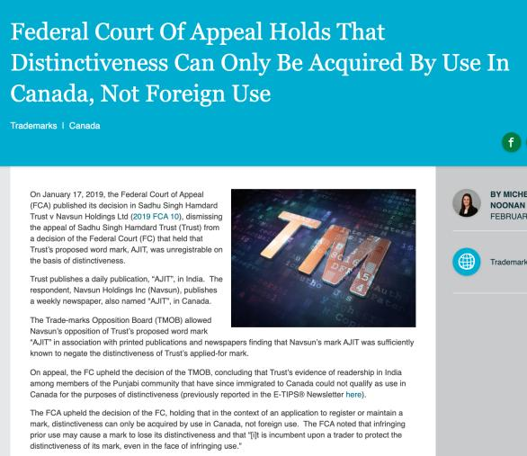
But Trademarks?

Slide 74
To what extent can goodwill be acquired in a purely descriptive product name?
Risky to use purely descriptive terms for a mark.
Risk is of not acquiring goodwill or reputation in the product simply because the name describes the good itself.
Goodwill – or secondary meaning – can be acquired through a product’s name, or through a product’s appearance…
A product that has a particularly distinctive appearance might come to be associated by consumers with one trade source. Then a competitor who copies the product appearance might be liable for passing off.
Challenge in these cases is that the Plaintiff must show that the appearance of the product has acquired a secondary meaning – that it comes from one trade source.

Slide 75
Passing off: Ray Plastics
Product was a combination snowbrush, ice scraper and squeegee called “Snow Trooper”: Black nylon scraper is 27" in overall length, has 3 rows of bristles, 5/8" hardwood painted black, and a traditional yellow brush
uncommon appearance…
very successful seller at Canadian Tire, K Mart, Zellers and Pro Hardware in 1982 and 1983.
Constructed by Raywares, a division of Ray Plastics Limited.
One of Raywares’ main competitors was Brushcraft, a division of Dustbane.
At the initiative of Canadian Tire, Brushcraft produced a similar product to the Snow Trooper for the years 1984 and following.
This product was described as "virtually identical", and "a virtual clone" to the Snow Trooper.

Slide 76
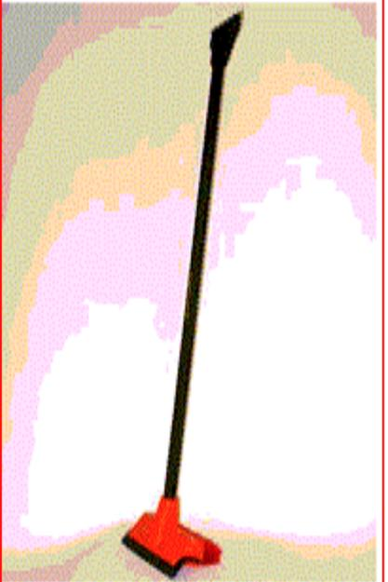

Slide 77
Passing off: Ray Plastics
Court notes that where the appearance is in some way novel or striking or unusual, it is easier to conclude that there has come to be an association of that appearance with a single trade source
The Snow Trooper get-up is very distinctive.
Other factors that the court found significant in this case:
1) Ray Plastics had done extensive advertising over two years with respect to the Snow Trooper.
2) Sales figures
3) There was evidence of intentional, direct copying. The court found that evidence of intentional, direct copying establishes a prima facie case of secondary meaning.
SO the goodwill/secondary meaning found to exist in the product appearance of the snow trooper.

Slide 78
Passing off: Ray Plastics
A product that is particularly distinctive in its appearance may come to be associated by consumers with a particular trade source
If the product appearance is an inherent feature of the product, it can’t be relied on as a TM

Slide 79
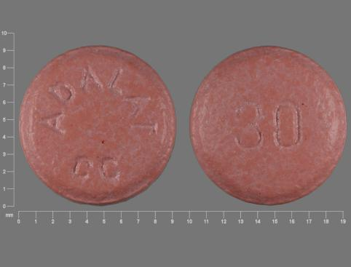
Passing off: Novopharm v. Bayer Inc. (2000)

Slide 80
Passing off: Novopharm v. Bayer Inc. (2000)
Question is whether a manufacturer of a pharmaceutical in pill, capsule or tablet form can claim goodwill or reputation in the shape, size or colour of the tablet?
Many prescription drugs are not sold in packages, they are dispensed by pharmacists in plain plastic vials.
“If patients identified the plaintiff's product by its appearance, the marketing by the defendant of tablets that were confusingly similar in appearance would prevent patients from exercising consumer choice by specifying which product they wished to have prescribed.” (para 90) / could also have negative health impacts.

Slide 81
Passing off: Novopharm v. Bayer Inc. (2000)
Key points (simplified):
Pink round small tablets are commonplace in the marketplace
Only product in the market? Not by itself conclusive of goodwill/distinctiveness
Appearance of a pharma product often associated with therapeutic purposes instead of single manufacturer
Physicians/pharmacists rely primarily on labels

Slide 82
Passing off: Novopharm v. Bayer Inc. (2000)
Court also highlighted two competing public policy considerations:
Reducing the price of medication by not limiting competition through the grant of a monopoly in the product’s appearance
Maximizing consumers’ freedom of choice to prefer a brand:
  Some patients may experience adverse side effects from one product but not from another, even though they are interchangeable.
  Not all manufacturers exercise the same level of quality control. In this case, a consumer may want to ensure that they receive the brand name product.
Way the tension between these competing public policy considerations is resolved in passing off is through the requirement that in order to bring a successful passing off action, evidence must be presented before the court that clearly establishes on a balance of probabilities that a significant number of consumers associate the appearance of the product with a single trade source. Did not happen in Novopharm v. Bayer.

Slide 83
Summary
In passing off cases dealing with product appearance or product packaging Plaintiff must establish that the certain product feature or packaging is distinctive of a particular trade or commercial source.
If not established, then secondary meaning has not been established either, and there is no goodwill or reputation that the defendant can exploit.
Key from casebook: “IF the product appearance is an inherent feature of the product – i.e. ex given – shape and configuration of a Lego block – then it can’t be relied on as a TM.”
Why? See Kirkbi AG v. Ritvik Holdings, 2005 SCC.

Slide 84
Passing off: Kirkbi AG v. Ritvik Holdings, 2005 SCC
If the product appearance is an inherent feature of the product, it can’t be relied on as a TM.
Because that would give a monopoly over the manufacture of the product.

Slide 85
Losing Reputation or Goodwill: HOW?
3 ways top lose goodwill or reputation:
Acquiescence over time to competitors using identical or similar get-up so that it’s no longer distinctive of the Plaintiff as a trade source
When a plaintiff goes out of business and is no longer using a particular name…fades away…
When the mark becomes generic…

Slide 86
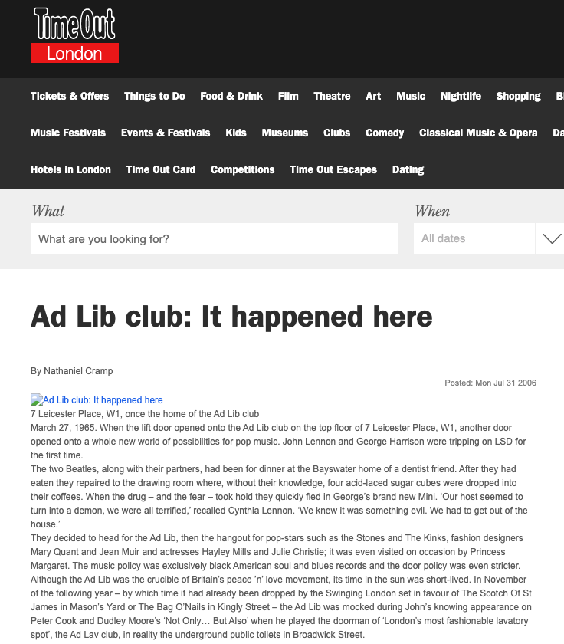

Slide 87
Passing off: Ad-Lib Club Limited
It had been five years since Ad-Lib carried on the business of a club. Court still determined that Ad-Lib had goodwill in its name because:
Defendants must have chosen the name Ad-Lib Club by reason of the reputation acquired by Ad-Lib (the Plaintiff). No evidence filed showing any other reason for the selection of the name.
Based on various news articles, members of the public clearly seemed to see the new club as a continuation of the Plaintiff’s club.
Accordingly, Ad-Lib, the Plaintiff company, still has goodwill and was entitled to exploit it and protect it.

Slide 88
Overall principle
An enterprise can eventually lose its goodwill, after a period of time, if it shuts down. After a period of non-use, a name or product appearance will lose its “mojo” (not a technical term) and no longer be distinctive of a certain trade source.

Slide 89



Passing off: Genericization

Slide 90
Passing off: Genericization
Institut national des appellations d’origine des vins…v. Andres Wines Ltd
To wine experts Champagne has one meaning , sparking wine product originating from a particular part of the Champagne District of France, produced from grapes grown there by methods dictated by French law.
Defendant Andres claims the term champagne has become generic.
Evidence to support this argument?
Evidence that both nationally and internationally the term has for many years been used in connection with different commercial products to suggest high quality or excellence – thus diluting the distinctiveness of the term.

Slide 91
Passing off: Genericization
Institut national des appellations d’origine des vins…v. Andres Wines Ltd
Plaintiff’s presented Survey evidence supporting the Plaintiff’s view that a meaningful percentage of the population associate champagne with France.
Court says that the word champagne has acquired generic attributes - used widely to describe a style or type of wine.Notes that also used to denote unique character, high quality and excellence.
Court holds that the word champagne has at most become “semi-generic”
Court not persuaded that the word Champagne has become diluted (pardon the pun) to the extent that it just refers to a class or genus of products. Still can refer to a particular merchant (group) & their product
It, in part, is still considered and accepted as referring to a particular type of sparking wine produced in France.
Conclusion is that CHAMPAGNE HAS NOT YET fallen into complete generic use.

Slide 92
Passing off: Preventing Genericization
How can companies prevent their product name or company name from becoming a generic term?
Ad campaigns…
Lawsuits for passing off.
Lobbying for changes to laws.

Slide 93
Passing off
Deception of the public due to a misrepresentation
Means misrepresentation
  Fundamental core feature of the tort of passing off
  Plaintiff must be able to establish that the defendant misrepresented his or her wares or services as those of the plaintiff in a manner that was likely to cause consumer confusion.
  Not necessary to establish actual confusion. Injunction to prevent anticipated confusion which would occur if a product were allowed to enter the market is possible.

Slide 94
Passing off
Back to: Institut national des appellations d’origine des vins…v. Andres Wines Ltd
Established that Plaintiff’s have goodwill in “champagne”
Thereafter in order to succeed Plaintiff must establish:
  That Defendant’s misrepresented their products as being Champagne (sparkling wines known as champagne and produced in France);
  That this misrepresentation is calculated or likely to deceive the public into thinking that the Canadian product is champagne;
  And that this conduct HAS or is LIKELY to injure the goodwill of the plaintiffs’ business (DAMAGE).
NOT ENOUGH for P to establish that the Defendants were BENEFITING from the use of the term champagne (which was established in the case). MERELY TAKING A BENEFIT DOES NOT CONSTITUTE TORT OF PASSING OFF.
Must prove misrepresentation leading to actual or potential confusion.
Court in Institut national held that there wasn’t a misrepresentation leading to confusion.
Canadian champagne is a distinct Canadian product not likely to be confused or even compared with French Champagne.

Slide 95
Passing off
Back to: Institut national des appellations d’origine des vins…v. Andres Wines Ltd
Canadian champagne producers wanting to establish there is no misrepresentation leading to confusion could show:
Marketing - They had marketed Canadian champagne in Ontario for many years;
Labelling - Word Canadian displayed as prominently as the word “Champagne” on Defendant’s products, in compliance with government directives, so as to clearly identify the products as Canadian;
Physical separation in Liquor Control Board of Ontario (LCBO) stores – for many years, the Canadian product has been physically separated from French champagnes in L.C.B.O. stores and listed separately by them..
ALSO evidence confirming that Canadian champagne has attained a reputation of its own in Ontario.
ALSO the Court found there was no confusion due to the nature of the wine consumer.

Slide 96
Passing off
Institut national des appellations d’origine des vins…v. Andres Wines Ltd
The Court said that the general public in Ontario is knowledgeable about wine products due to increased public exposure, educational exercises or publications on the subject, mass media ads that prevail on a daily basis [different than the situation in the UK in a case that dealt with Spanish Champagne - where it was found that customers would be confused, would think that the use of the term Spanish champagne is the same as French champagne].
The Court also found that the purchaser who is ignorant about wines and wishes to buy a bottle of champagne for a special occasion (aware of the general reputation of champagne) may choose a Canadian champagne under the mistaken belief that he is buying the champagne of high repute.
That said, consumers ignorant about wine would likely realize the difference between Canadian Champagne and Champagne from France either by the clear labelling of both, or the difference in listing and physical location at the L.C.B.O. stores, or, finally, by the vast price differential between the products.

Slide 97
Passing off: Recap
  Not enough for Plaintiff to establish Defendant was benefiting from using the term or name
  Need to prove misrepresentation leading to actual or potential confusion
  Misrepresentation may take a variety of forms
  Misrepresentation may be willful, negligent or careless (Kirkbi v. Ritvik)

Slide 98
Passing off: The Test Person
“The test person” is used in assessing confusion or the likelihood of confusion is crucial to the passing off analysis.
Can vary depending on the nature of the goods or services at issue. So in a case involving lemon juice in a squeeze bottle (RECKITT & COLMAN) the test person was the “shopper in a hurry”
Case suggests that if the product is an inexpensive mass market item, one usually part of a shopping trip for multiple items, where the consumer is likely to take it quickly from the shelf and toss it in their shopping cart, then similarities in product appearance are more likely to lead to confusion.
If the item in question is a luxury item, the consumer may well take more time to inspect the item, including the label, brand name, product literature. As a result, similarities in product appearance are less likely to lead to confusion.

Slide 99
Passing off
British Columbia Automobile Assn. v. Office and Professional Employees' International Union, Local 378, 2001 BCSC 156 (B.C.S.C.)
During a labour dispute, Union creates various versions of websites similar to the BCAA’s website in appearance and uses the BCAA’s trademarks in its domain name and meta tags
Union used the domain names “bcaaonstrike” and “bcaabacktowork” - Websites www.bcaaonstrike.com and www.bcaabacktowork.com
Passing off?
Sigurdson J. finds context (labour dispute) significant to determination…

Slide 100
Passing off
British Columbia Automobile Assn. v. Office and Professional Employees' International Union, Local 378, 2001 BCSC 156 (B.C.S.C.)
First website looked very similar to the 1997 BCAA site
The phrase “Greetings BCAA is on strike” is on the website
Similarities with BCAA website design; colour, size of font, placement of logos
Had CAA and BCAA logos on site
Initial meta tags duplicated the 1997 content.
Was there a misrepresentation leading to confusion in this website?
Yes. With all the similarities, there was misrepresentation that the site was connected to the plaintiff’s site
Who is the test person for internet web sites?
Union argued that the test is a reasonably prudent user. Rejected [Note the broader concept of test person]
Was the “casual or hurried observer” [para. 212]

Slide 101
Passing off
British Columbia Automobile Assn. v. Office and Professional Employees' International Union, Local 378, 2001 BCSC 156 (B.C.S.C.)
Second website
Changes made.
Union removed CAA logo, changed BCAA
Moved Greetings message so that most of it couldn’t be seen on a standard screen
Passing off?
No. Reduced possibility of confusion

Slide 102
Passing off
British Columbia Automobile Assn. v. Office and Professional Employees' International Union, Local 378, 2001 BCSC 156 (B.C.S.C.)
Third site
Relates to the domain names bcaaonstrike.com and bcaabacktowork.com and the use of the meta tags
Held: NO passing off… No misrepresentation that the Union site is a site of the plaintiff, or a site that is endorsed by, affiliated with or connected to the plaintiff; Judge says there is no confusion or possibility of confusion in the minds of an internet web user that the site is associated with or the property of the BC Automobile Association.
Sigurdson J. held that in the context of a labour relations campaign, the fact that the Union is using similar meta tags and domain names (bcaabacktowork v. bcaa) is not as significant. Particularly because there is far less of a likelihood of confusion.
No evidence of actual confusion. Now, this is not a required element, but it’s a factor.
Ultimately , passing off w. first website; not 2nd or 3rd website.

Slide 103
Passing off
British Columbia Automobile Assn. v. Office and Professional Employees' International Union, Local 378, 2001 BCSC 156 (B.C.S.C.)
Three more points:
Note Sigurdson J.’s statement that a reasonable balance has to be struck between the legitimate protection of a party’s intellectual property and a citizen’s or a Union’s Charter right to freedom of expression.
Sigurdson J. notes that the prominence to be given to a disclaimer must, to some extent, depend on the likelihood of a false impression being conveyed to the public if there is no disclaimer. The greater the likelihood the more prominent must be the disclaimer. There will be some situations where no disclaimer will be adequate.
There was no evidence of actual confusion. Now, this is not a required element, but it’s a factor.
Ultimately , passing off with respect to the first website; not 2nd or 3rd website.

Slide 104
Passing off
British Columbia Automobile Assn. v. Office and Professional Employees' International Union, Local 378, 2001 BCSC 156 (B.C.S.C.)
The Court, in BCAA, noted two broad categories of passing off:
  1) Where competitors are engaged in a common field of activity, and the Plaintiff has alleged that the Defendant has named, packaged or described its product or business in a manner likely to lead the public to believe the Defendant’s product or business is that of the Plaintiff
  2) Where the Defendant has promoted his product or business in such a way as to create the false impression that his product or business is in some way approved, authorized or endorsed by the Plaintiff or that there is some business connection between the Defendant and the Plaintiff. In this way a Defendant may hope to “cash in” on the goodwill of the Plaintiff
Accordingly, a large part of the issue comes to revolve around confusion as to source: Were customers confused into thinking that the OPEIU site was the BCAA site? Or were customers were confused into thinking that the OPEIU site was approved, authorized or endorsed by the Plaintiff – or that there is a business connection between the Defendant and the Plaintiff (which in a sense there was).

Slide 105
Passing off: Initial Interest Confusion
British Columbia Automobile Assn. v. Office and Professional Employees' International Union, Local 378, 2001 BCSC 156 (B.C.S.C.)
The Court in BCAA also brought up another type of confusion known “initial interest confusion” which is a somewhat controversial issue in passing off and TM law.
The “initial interest confusion” doctrine has received limited attention from Canadian courts, but a lot more attention in the U.S.
Initial interest confusion refers to the use of another's trade-mark in a manner calculated to capture initial consumer attention even though no actual sale is completed as a result of the confusion (Brookfield Communications Inc. v. West Coast Entertainment Corp., 174 F.3d 1036 (9th Cir. 1999).
This test of confusion carries with it a lower threshold than the traditional test of confusion in passing off (confusion as to source - your product is their product); confusion as to association, endorsement, approval.
Initial interest confusion simply considers whether the defendant's use of the plaintiff's mark evoked "initial interest” in a potential customer, even if it did not result in a sale.
A bit vague and amorphous. So vague that it potentially serves as a potent weapon for keeping legitimate competitors out of the market.

Slide 106
Passing off: Initial Interest Confusion Recap
The Court in BCAA brought up another type of confusion known “initial interest confusion” which is a somewhat controversial issue in passing off and TM law.
The “initial interest confusion” doctrine has received limited attention from Canadian courts, but a lot more attention in the U.S.
Initial interest confusion refers to the use of another's trade-mark in a manner calculated to capture initial consumer attention even though no actual sale is completed as a result of the confusion (Brookfield Communications Inc. v. West Coast Entertainment Corp., 174 F.3d 1036 (9th Cir. 1999).
This test of confusion carries with it a lower threshold than the traditional test of confusion in passing off (confusion as to source - your product is their product); confusion as to association, endorsement, approval.
Initial interest confusion simply considers whether the defendant's use of the plaintiff's mark evoked “initial interest” in a potential customer, even if it did not result in a sale.
A bit vague and amorphous. So vague that it potentially serves as a potent weapon for keeping legitimate competitors out of the market.
Does this possible doctrine expand passing off too much?

Slide 107
Passing off: Initial interest confusion SUMMARY
Refers to the use of another's trade-mark in a manner calculated to capture initial consumer attention even though no actual sale is completed as a result of the confusion
Can serve as a potent weapon for keeping legitimate competitors out of the market
Limited attention in Canada; much more in US
Should it be allowed or discouraged in Canada?

Slide 108
Passing off: Damage
Several types of possible damage in the context of a passing off action …
Loss of goodwill and reputation
Where a competitor passes off an inferior product as the plaintiff’s product. Dissatisfied customers who think they have purchased from the plaintiff may decide never to purchase from them again, and to tell their friends not to.

Slide 109
Passing off: Damage
Cases that fit?
Spalding v. Gamage where Gamage took a product of the Plaintiff’s that had been discontinued (a soccer ball discarded by Spalding as waste material and excluded from public sale) and marketed it an “improved” Spalding product.
Institut National
Ray Plastics
A competing product which is identical or confusingly similar to the Plaintiff’s product cuts into sales.
Two primary types of damages that are pled in passing off cases:
1. Loss of goodwill
2. Loss of trade
[Pages 400 & 401 address defenses and remedies to passing off]

Slide 110
Passing off: Defences
Plaintiff has failed to make out one of the elements of the tort
Use of one’s own name in business [within limits]
  Surname, not given name or nickname
  Using name honestly, without intent to trade on goodwill or reputation of another business
  Might have to use it in a way that is not confusing with an already existing business under that name
Defendant holds a TM registration for the mark it is using
  Molson Canada v. Oland Breweries Ltd. (2002), 19 CPR (4th) 201 (ONCA) → “a complete answer” to a claim in passing off
Plaintiff has acquiesced in use of mark

Slide 111
Passing off: Remedies
Damages
  For actual harm suffered
  For harm to reputation or goodwill (courts must fix “proper and reasonable amount”)
Permanent injunctions
Order for disgorgement of profits (as alternative to damages)
Delivery up or destruction of wares or materials with the offending mark
Punitive damages (to punish egregious conduct)

Slide 112
QUESTIONS?
THOUGHTS?
DISCUSSION?

Slide 113
Pause

Slide 114
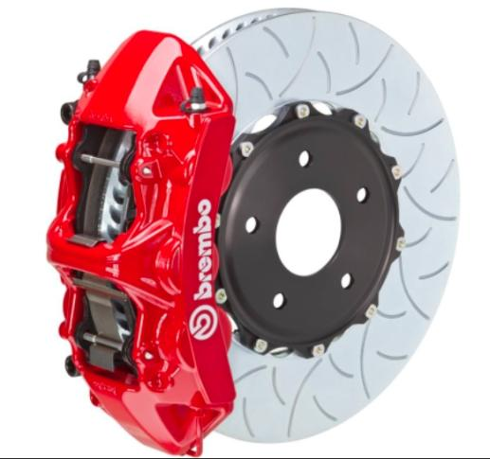

Slide 115


Slide 116

Now, to our regularly
scheduled programming…

Slide 117

Random Notes 1

Slide 118
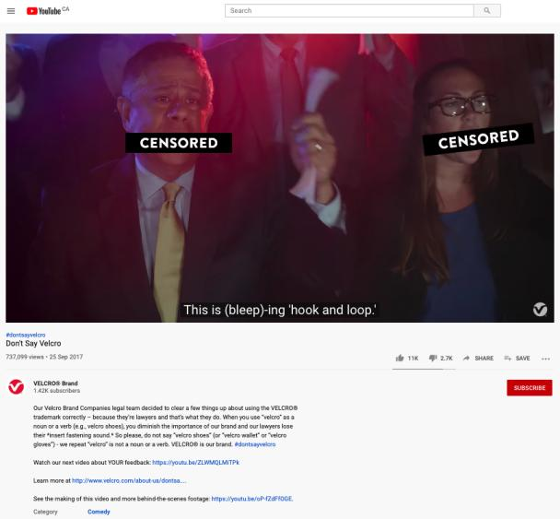
https://youtu.be/rRi8LptvFZY

Slide 119
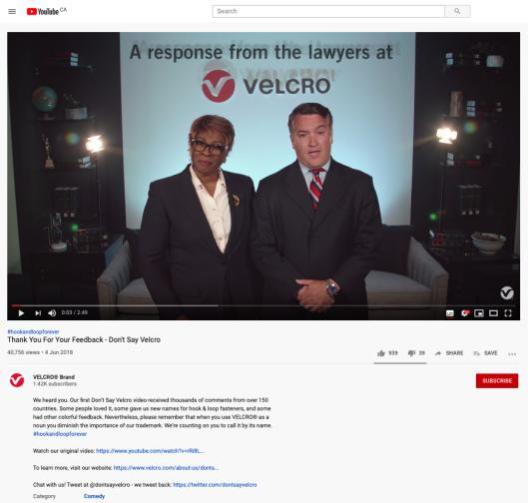
Follow-up
https://youtu.be/ZLWMQLMiTPk

Slide 120
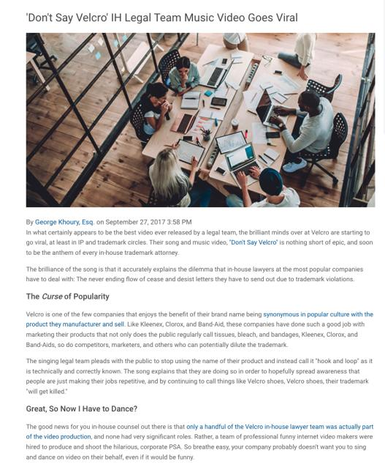

Slide 121
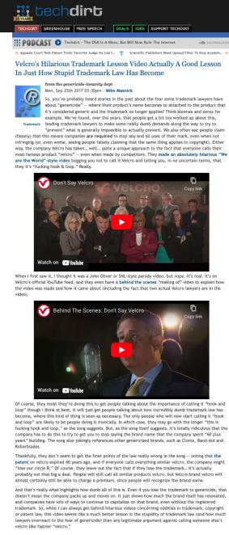

Slide 122
QUESTIONS?
THOUGHTS?
DISCUSSION?

Slide 123
Pause

Slide 124
Passing off Basics
Three (3) necessary components of a passing-off action:
  1. The existence of goodwill (done)
  2. Deception of the public due to a misrepresentation
  3. Actual or potential damage to the plaintiff

Slide 125
Passing off
Deception of the public due to a misrepresentation
Means misrepresentation
  Fundamental core feature of the tort of passing off
  Plaintiff must be able to establish that the defendant misrepresented his or her wares or services as those of the plaintiff in a manner that was likely to cause consumer confusion.
  Not necessary to establish actual confusion. Injunction to prevent anticipated confusion which would occur if a product were allowed to enter the market is possible.

Slide 126
Passing off
Back to: Institut national des appellations d’origine des vins…v. Andres Wines Ltd
Established that Plaintiff’s have goodwill in “champagne”
Thereafter in order to succeed Plaintiff must establish:
  That Defendant’s misrepresented their products as being Champagne (sparkling wines known as champagne and produced in France);
  That this misrepresentation is calculated or likely to deceive the public into thinking that the Canadian product is champagne;
  And that this conduct HAS or is LIKELY to injure the goodwill of the plaintiffs’ business (DAMAGE).
NOT ENOUGH for P to establish that the Defendants were BENEFITING from the use of the term champagne (which was established in the case). MERELY TAKING A BENEFIT DOES NOT CONSTITUTE TORT OF PASSING OFF.
Must prove misrepresentation leading to actual or potential confusion.
Court in Institut national held that there wasn’t a misrepresentation leading to confusion.
Canadian champagne is a distinct Canadian product not likely to be confused or even compared with French Champagne.

Slide 127
Passing off
Back to: Institut national des appellations d’origine des vins…v. Andres Wines Ltd
Canadian champagne producers wanting to establish there is no misrepresentation leading to confusion could show:
Marketing - They had marketed Canadian champagne in Ontario for many years;
Labelling - Word Canadian displayed as prominently as the word “Champagne” on Defendant’s products, in compliance with government directives, so as to clearly identify the products as Canadian;
Physical separation in Liquor Control Board of Ontario (LCBO) stores – for many years, the Canadian product has been physically separated from French champagnes in L.C.B.O. stores and listed separately by them..
ALSO evidence confirming that Canadian champagne has attained a reputation of its own in Ontario.
ALSO the Court found there was no confusion due to the nature of the wine consumer.

Slide 128
Passing off
Institut national des appellations d’origine des vins…v. Andres Wines Ltd
The Court said that the general public in Ontario is knowledgeable about wine products due to increased public exposure, educational exercises or publications on the subject, mass media ads that prevail on a daily basis [different than the situation in the UK in a case that dealt with Spanish Champagne - where it was found that customers would be confused, would think that the use of the term Spanish champagne is the same as French champagne].
The Court also found that the purchaser who is ignorant about wines and wishes to buy a bottle of champagne for a special occasion (aware of the general reputation of champagne) may choose a Canadian champagne under the mistaken belief that he is buying the champagne of high repute.
That said, consumers ignorant about wine would likely realize the difference between Canadian Champagne and Champagne from France either by the clear labelling of both, or the difference in listing and physical location at the L.C.B.O. stores, or, finally, by the vast price differential between the products.

Slide 129
Passing off: Recap
  Not enough for Plaintiff to establish Defendant was benefiting from using the term or name
  Need to prove misrepresentation leading to actual or potential confusion
  Misrepresentation may take a variety of forms
  Misrepresentation may be willful, negligent or careless (Kirkbi v. Ritvik)

Slide 130
Passing off: The Test Person 1
“The test person” is used in assessing confusion or the likelihood of confusion is crucial to the passing off analysis.
Can vary depending on the nature of the goods or services at issue. So in a case involving lemon juice in a squeeze bottle (RECKITT & COLMAN) the test person was the “shopper in a hurry”
Case suggests that if the product is an inexpensive mass market item, one usually part of a shopping trip for multiple items, where the consumer is likely to take it quickly from the shelf and toss it in their shopping cart, then similarities in product appearance are more likely to lead to confusion.
If the item in question is a luxury item, the consumer may well take more time to inspect the item, including the label, brand name, product literature. As a result, similarities in product appearance are less likely to lead to confusion.

Slide 131
Passing off: The Test Person 2
Why is the test person so important to the passing off analysis?
Impacts the confusion/misrepresentation requirement.
If you attribute knowledge, sophistication to the test person = less likely to be confused
If you say that the test person is in a hurry, not a lot of time = more likely to be confused.
Varying interpretations of the “test person” could either expand or narrow the tort of passing off. As a corollary, it either increases, or restricts competition.

Slide 132

What would a detailed case review reveal?

Slide 133
Passing off
British Columbia Automobile Assn. v. Office and Professional Employees' International Union, Local 378, 2001 BCSC 156 (B.C.S.C.)
During a labour dispute, Union creates various versions of websites similar to the BCAA’s website in appearance and uses the BCAA’s trademarks in its domain name and meta tags
Union used the domain names “bcaaonstrike” and “bcaabacktowork” - Websites www.bcaaonstrike.com and www.bcaabacktowork.com
Passing off?
Sigurdson J. finds context (labour dispute) significant to determination…

Slide 134
Passing off
British Columbia Automobile Assn. v. Office and Professional Employees' International Union, Local 378, 2001 BCSC 156 (B.C.S.C.)
First website looked very similar to the 1997 BCAA site
The phrase “Greetings BCAA is on strike” is on the website
Similarities with BCAA website design; colour, size of font, placement of logos
Had CAA and BCAA logos on site
Initial meta tags duplicated the 1997 content.
Was there a misrepresentation leading to confusion in this website?
Yes. With all the similarities, there was misrepresentation that the site was connected to the plaintiff’s site
Who is the test person for internet web sites?
Union argued that the test is a reasonably prudent user. Rejected [Note the broader concept of test person]
Was the “casual or hurried observer” [para. 212]

Slide 135
Passing off
British Columbia Automobile Assn. v. Office and Professional Employees' International Union, Local 378, 2001 BCSC 156 (B.C.S.C.)
Second website
Changes made.
Union removed CAA logo, changed BCAA
Moved Greetings message so that most of it couldn’t be seen on a standard screen
Passing off?
No. Reduced possibility of confusion

Slide 136
Passing off
British Columbia Automobile Assn. v. Office and Professional Employees' International Union, Local 378, 2001 BCSC 156 (B.C.S.C.)
Third site
Relates to the domain names bcaaonstrike.com and bcaabacktowork.com and the use of the meta tags
Held: NO passing off… No misrepresentation that the Union site is a site of the plaintiff, or a site that is endorsed by, affiliated with or connected to the plaintiff; Judge says there is no confusion or possibility of confusion in the minds of an internet web user that the site is associated with or the property of the BC Automobile Association.
Sigurdson J. held that in the context of a labour relations campaign, the fact that the Union is using similar meta tags and domain names (bcaabacktowork v. bcaa) is not as significant. Particularly because there is far less of a likelihood of confusion.
No evidence of actual confusion. Now, this is not a required element, but it’s a factor.
Ultimately , passing off w. first website; not 2nd or 3rd website.

Slide 137
Passing off
British Columbia Automobile Assn. v. Office and Professional Employees' International Union, Local 378, 2001 BCSC 156 (B.C.S.C.)
Three more points:
Note Sigurdson J.’s statement that a reasonable balance has to be struck between the legitimate protection of a party’s intellectual property and a citizen’s or a Union’s Charter right to freedom of expression.
Sigurdson J. notes that the prominence to be given to a disclaimer must, to some extent, depend on the likelihood of a false impression being conveyed to the public if there is no disclaimer. The greater the likelihood the more prominent must be the disclaimer. There will be some situations where no disclaimer will be adequate.
There was no evidence of actual confusion. Now, this is not a required element, but it’s a factor.
Ultimately , passing off with respect to the first website; not 2nd or 3rd website.

Slide 138
Questions to Contemplate?
If protestors can picket or leaflet outside a storefront, should they not be allowed to protest an online virtual storefront? Is there anything wrong with a “virtual picket line”? Are there particular norms that a “virtual picket line” should be obligated to adhere to?

Slide 139
Passing off
British Columbia Automobile Assn. v. Office and Professional Employees' International Union, Local 378, 2001 BCSC 156 (B.C.S.C.)
The Court, in BCAA, noted two broad categories of passing off:
  1) Where competitors are engaged in a common field of activity, and the Plaintiff has alleged that the Defendant has named, packaged or described its product or business in a manner likely to lead the public to believe the Defendant’s product or business is that of the Plaintiff
  2) Where the Defendant has promoted his product or business in such a way as to create the false impression that his product or business is in some way approved, authorized or endorsed by the Plaintiff or that there is some business connection between the Defendant and the Plaintiff. In this way a Defendant may hope to “cash in” on the goodwill of the Plaintiff
Accordingly, a large part of the issue comes to revolve around confusion as to source: Were customers confused into thinking that the OPEIU site was the BCAA site? Or were customers were confused into thinking that the OPEIU site was approved, authorized or endorsed by the Plaintiff – or that there is a business connection between the Defendant and the Plaintiff (which in a sense there was).

Slide 140
Passing off: Initial Interest Confusion 1
British Columbia Automobile Assn. v. Office and Professional Employees' International Union, Local 378, 2001 BCSC 156 (B.C.S.C.)
The Court in BCAA also brought up another type of confusion known “initial interest confusion” which is a somewhat controversial issue in passing off and TM law.
The “initial interest confusion” doctrine has received limited attention from Canadian courts, but a lot more attention in the U.S.
Initial interest confusion refers to the use of another's trade-mark in a manner calculated to capture initial consumer attention even though no actual sale is completed as a result of the confusion (Brookfield Communications Inc. v. West Coast Entertainment Corp., 174 F.3d 1036 (9th Cir. 1999).
This test of confusion carries with it a lower threshold than the traditional test of confusion in passing off (confusion as to source - your product is their product); confusion as to association, endorsement, approval.
Initial interest confusion simply considers whether the defendant's use of the plaintiff's mark evoked "initial interest” in a potential customer, even if it did not result in a sale.
A bit vague and amorphous. So vague that it potentially serves as a potent weapon for keeping legitimate competitors out of the market.

Slide 141
Passing off: Initial Interest Confusion 2
British Columbia Automobile Assn. v. Office and Professional Employees' International Union, Local 378, 2001 BCSC 156 (B.C.S.C.)
The “initial confusion” doctrine was expressly adopted in Brookfield Communications Inc v. West Coast Entertainment Corp (9th Cir. 1999) 174 F.3d 1036, 1061-66.
Case mentioned in BCAA v. OPEIU.
In Brookfield, two online retailers with tangentially related products went to battle over the defendant's use of plaintiff's trademark in defendant's internet website "metatags." (Metatags being computerized code words that play some role in attracting internet search engines to a website.)
Rather than applying a traditional analysis, the court applied the Initial Interest Confusion Doctrine, finding that the use of plaintiff's mark could result in the improper initial interest in defendant's site, and therefore trademark infringement. In so doing the Court used the following analogy…

Slide 142
“Using another's trademark in one's metatags is much like posting a sign with another's trademark in front of one's store. Suppose West Coast's competitor (let's call it "Blockbuster") puts up a billboard on a highway reading--"West Coast Video: 2 miles ahead at Exit 7"--where West Coast is really located at Exit 8 but Blockbuster is located at Exit 7. Customers looking for West Coast's store will pull off at Exit 7 and drive around looking for it. Unable to locate West Coast, but seeing the Blockbuster store right by the highway entrance, they may simply rent there. Even consumers who prefer West Coast may find it not worth the trouble to continue searching for West Coast since there is a Blockbuster right there. Customers are not confused in the narrow sense: they are fully aware that they are purchasing from Blockbuster and they have no reason to believe that Blockbuster is related to, or in any way sponsored by, West Coast. Nevertheless, the fact that there is only initial consumer confusion does not alter the fact that Blockbuster would be misappropriating West Coast's acquired goodwill.”

Slide 143
Passing off: Initial Interest Confusion 3
British Columbia Automobile Assn. v. Office and Professional Employees' International Union, Local 378, 2001 BCSC 156 (B.C.S.C.)
Any issues with the analogy in Brookfield Communications Inc v. West Coast Entertainment Corp ?
Big difference between driving around aimlessly looking for a video store, and simply hitting the ‘go-back’ button on your laptop. We are accustomed to false starts on the web and are unlikely to be dissuaded when they end up at the wrong site.
Departure from the core principal of trademark law – finds infringement where there is only a fleeting confusion which is dispelled before any purchase.
Can there really be a policy justification for finding infringement where the consumer is not confused at the time of purchase?

Slide 144
Passing off: Initial Interest Confusion 4
British Columbia Automobile Assn. v. Office and Professional Employees' International Union, Local 378, 2001 BCSC 156 (B.C.S.C.)
With respect to “Initial Interest Confusion” doctrine in Brookfield Communications Inc v. West Coast Entertainment Corp isn't more information, and competition between vendors, in the consumer's best interest? Until clear policy and evaluative standard are articulated, the Doctrine can only lead to problems. Doctrine mostly used in U.S.A*…but has been raised in Canada. Though mentioned in BCAA, it was not part of analysis.
*For example, the Initial Interest Confusion Doctrine has been used to curtail parodies, (See Dr. Seuss, supra.) criticism about the trademark owners, (OBH, Inc. v. Spotlight Magazine, Inc. (W.D.N. 4 2000) 86 F.Supp.2d 176; J.K. Harris & Co. v. Kassell (N.D. Cal. 2002) 2002 WL 1303124, rev'd (N.D. Cal.2003) 253 F.Supp.2d 1120)), directory information about used equipment dealers, (Caterpillar Inc. v. Telescan Techs, LLC ((C.D. Ill2002) 2000 U.S. Dist Lexis 3477; PACCAR Inc. v. Telescan Techs, LLC (6th Cir. 2003) 319 F.3d 246), and promotions by third party vendors of after-market servicing. See Promatek Indus. Ltd. v. Equitrac Corp. (7th Cir. 2002) 300 F.3d 808.

Slide 145
Passing off: Initial Interest Confusion 5
British Columbia Automobile Assn. v. Office and Professional Employees' International Union, Local 378, 2001 BCSC 156 (B.C.S.C.)
The “initial confusion” doctrine was expressly adopted in Brookfield Communications Inc v. West Coast Entertainment Corp (9th Cir. 1999) 174 F.3d 1036, 1061-66.
Case mentioned in BCAA v. OPEIU.
In Brookfield, two online retailers with tangentially related products went to battle over the defendant's use of plaintiff's trademark in defendant's internet website "metatags." (Metatags being computerized code words that play some role in attracting internet search engines to a website.)
Rather than applying a traditional analysis, the court applied the Initial Interest Confusion Doctrine, finding that the use of plaintiff's mark could result in the improper initial interest in defendant's site, and therefore trademark infringement. In so doing the Court used the following analogy…

Slide 146
Passing off: Initial Interest Confusion 6
Law Society of British Columbia v. Canada Domain Name Exchange Corp., [2002] B.C.J. No. 1909 (B.C.S.C.) 1
Defendant resolved the domain names lawsocietyofbc.ca & lsbc.ca to websites displaying adult content.
Court found Defendant had used the disputed domain names to attract the public to its websites for the purpose of generating income.
The Court held there was passing off.
Although there was no mention of initial interest confusion, the Court did find that the disputed domain names were being used to divert Internet traffic to the Defendant's websites, the contents of which would immediately dispel confusion among Internet users looking for the Plaintiff Law Society*.
Finding does appear compatible with the doctrine of initial interest confusion.
* Ya think?

Slide 147
Passing off: Initial Interest Confusion 7
Law Society of British Columbia v. Canada Domain Name Exchange Corp. 2
Court finds that in registering the domain name including the LSBC, Defendants made a false representation that they are associated or connected with the LSBC.
Rather than make a decision on the basis of initial interest confusion, the court in effect manages to fit this fact situation within the second type of passing off, being where a Defendant has promoted his product or business in such a way as to create the false impression that their product or business is in some way approved, authorized or endorsed by the Plaintiff or that there is some business connection between the Defendant and Plaintiff.
Is the Court’s characterization somewhat tenuous? False representation only made at point of registration; confusion dispelled by consumers, the “test people” – as soon as they find adult content on what they thought was the Law Society site
Reminder that initial interest confusion hasn’t been formally accepted in Canadian courts (alluded to in LSBC v. CDNEC; mentioned in BCAA). Watch for it.

Slide 148
Passing off: Initial Interest Confusion Recap
The Court in BCAA brought up another type of confusion known “initial interest confusion” which is a somewhat controversial issue in passing off and TM law.
The “initial interest confusion” doctrine has received limited attention from Canadian courts, but a lot more attention in the U.S.
Initial interest confusion refers to the use of another's trade-mark in a manner calculated to capture initial consumer attention even though no actual sale is completed as a result of the confusion (Brookfield Communications Inc. v. West Coast Entertainment Corp., 174 F.3d 1036 (9th Cir. 1999).
This test of confusion carries with it a lower threshold than the traditional test of confusion in passing off (confusion as to source - your product is their product); confusion as to association, endorsement, approval.
Initial interest confusion simply considers whether the defendant's use of the plaintiff's mark evoked “initial interest” in a potential customer, even if it did not result in a sale.
A bit vague and amorphous. So vague that it potentially serves as a potent weapon for keeping legitimate competitors out of the market.
Does this possible doctrine expand passing off too much?

Slide 149
Passing off: Initial interest confusion SUMMARY
Refers to the use of another's trade-mark in a manner calculated to capture initial consumer attention even though no actual sale is completed as a result of the confusion
Can serve as a potent weapon for keeping legitimate competitors out of the market
Limited attention in Canada; much more in US
Should it be allowed or discouraged in Canada?

Slide 150
QUESTIONS?
THOUGHTS?
DISCUSSION?

Slide 151
Pause

Slide 152

On with the show…

Slide 153
Passing off: Damage
Several types of possible damage in the context of a passing off action …
Loss of goodwill and reputation
Where a competitor passes off an inferior product as the plaintiff’s product. Dissatisfied customers who think they have purchased from the plaintiff may decide never to purchase from them again, and to tell their friends not to.

Slide 154
Passing off: Damage
Cases that fit?
Spalding v. Gamage where Gamage took a product of the Plaintiff’s that had been discontinued (a soccer ball discarded by Spalding as waste material and excluded from public sale) and marketed it an “improved” Spalding product.
Institut National
Ray Plastics
A competing product which is identical or confusingly similar to the Plaintiff’s product cuts into sales.
Two primary types of damages that are pled in passing off cases:
1. Loss of goodwill
2. Loss of trade
[Pages 400 & 401 address defenses and remedies to passing off]

Slide 155
Passing off: Damage Summary
  Final element that a Plaintiff must establish in a passing off action
  In the case of an application for an injunction, the Plaintiff need only show a likelihood of damage
  Types of recognized damage:
    Loss of goodwill and reputation
    Cases → Spalding v. Gamage (1915, UK)
    Loss of trade

Slide 156
Passing off: Defences
Plaintiff has failed to make out one of the elements of the tort
Use of one’s own name in business [within limits]
  Surname, not given name or nickname
  Using name honestly, without intent to trade on goodwill or reputation of another business
  Might have to use it in a way that is not confusing with an already existing business under that name
Defendant holds a TM registration for the mark it is using
  Molson Canada v. Oland Breweries Ltd. (2002), 19 CPR (4th) 201 (ONCA) → “a complete answer” to a claim in passing off
Plaintiff has acquiesced in use of mark

Slide 157
Passing off: Remedies
Damages
  For actual harm suffered
  For harm to reputation or goodwill (courts must fix “proper and reasonable amount”)
Permanent injunctions
Order for disgorgement of profits (as alternative to damages)
Delivery up or destruction of wares or materials with the offending mark
Punitive damages (to punish egregious conduct)

Slide 158
QUESTIONS?
THOUGHTS?
DISCUSSION?

Slide 159
Pause

Slide 160
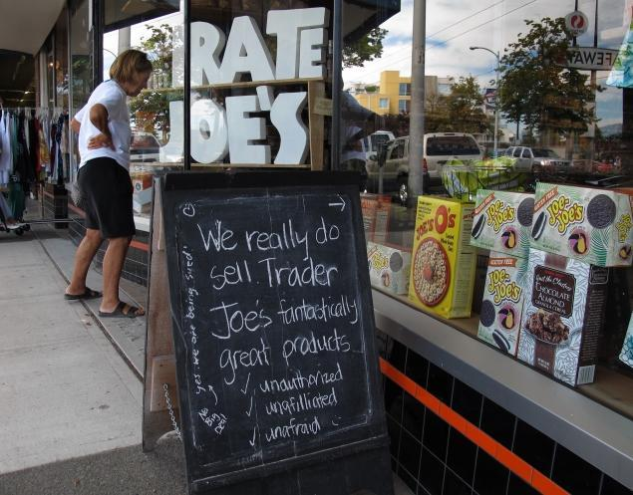
Passing off

Slide 161
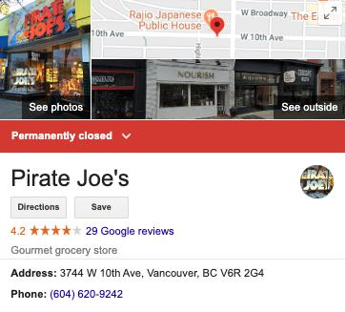

Slide 162
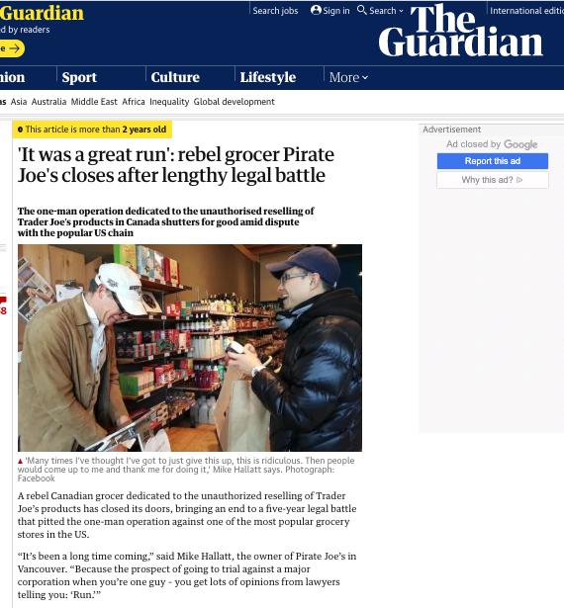

Slide 163
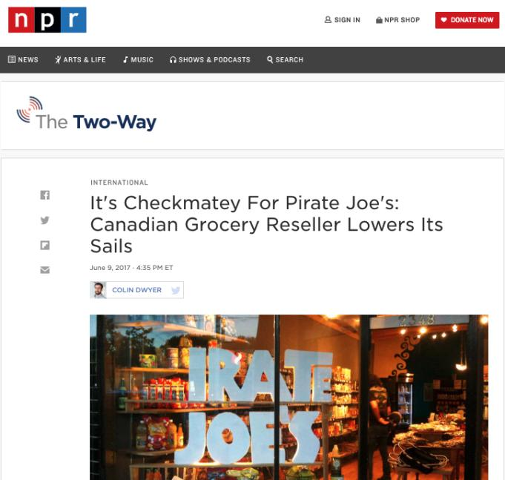

Slide 164
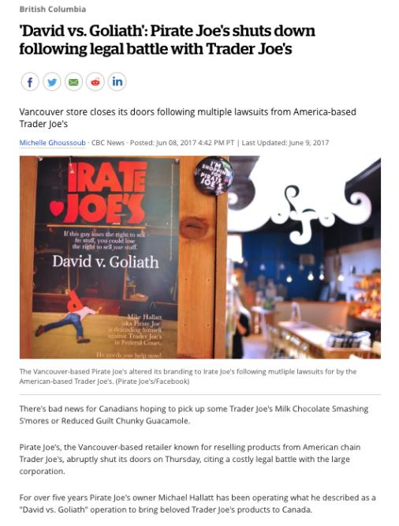

Slide 165
How far should the tort of passing off be permitted to expand?

Slide 166
QUESTIONS?
THOUGHTS?
DISCUSSION?

Slide 167
Pause

Slide 168
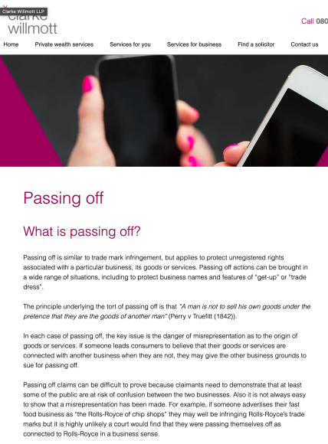

Passing-off…elsewhere

Slide 169
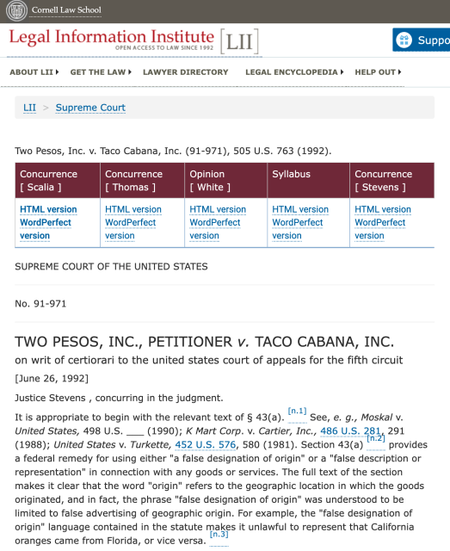


Slide 170
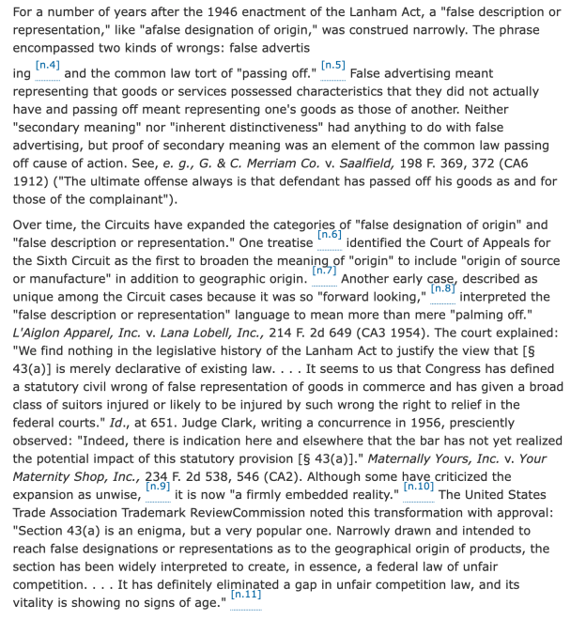

Slide 171
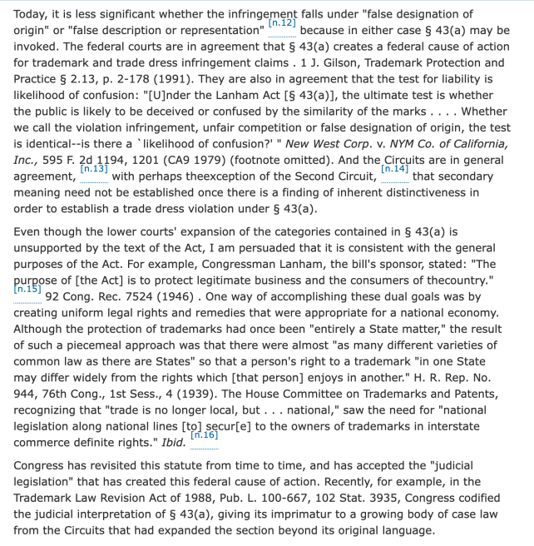

Slide 172
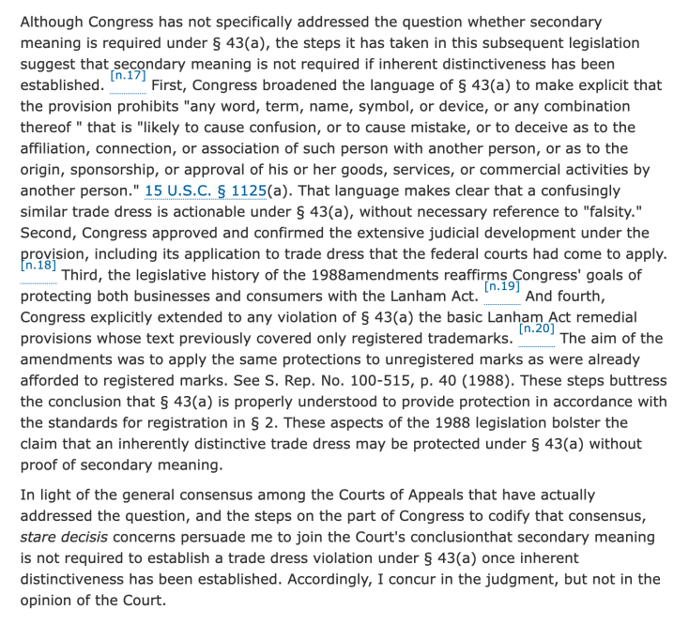

Slide 173
QUESTIONS?
THOUGHTS?
DISCUSSION?

Slide 174
Pause

Slide 175
Random Notes 2

Slide 176
Is cultural appropriation
really a passing off/trademark
issue?

Slide 177
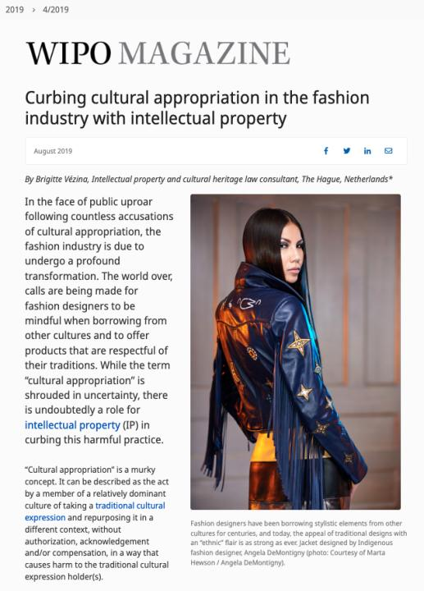

Slide 178
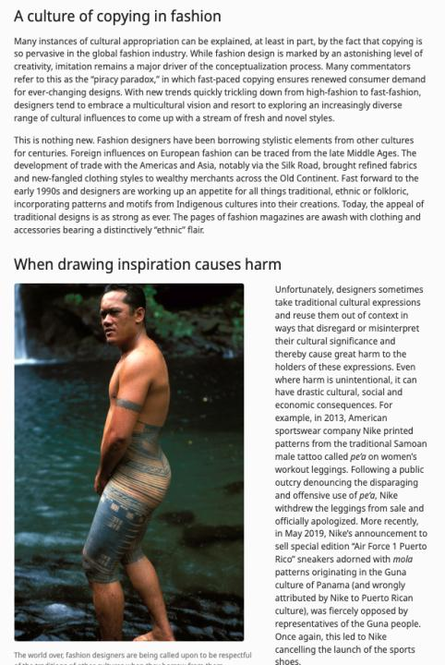

Slide 179
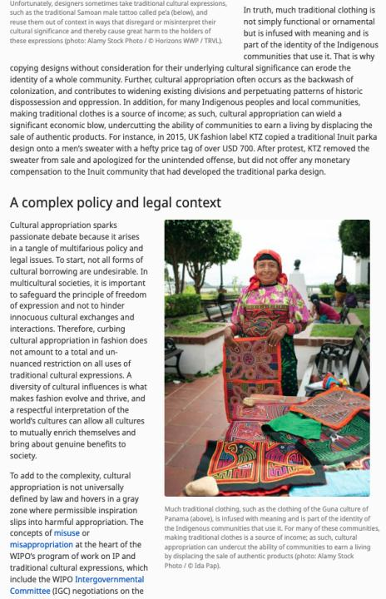

Slide 180
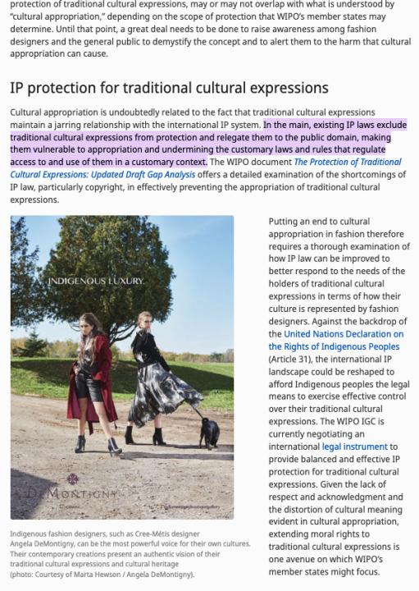

Slide 181
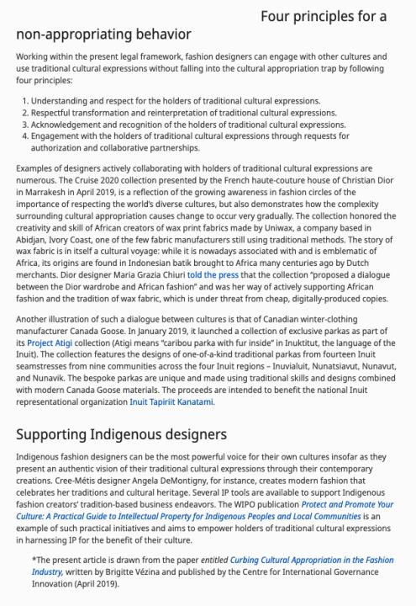

Slide 182
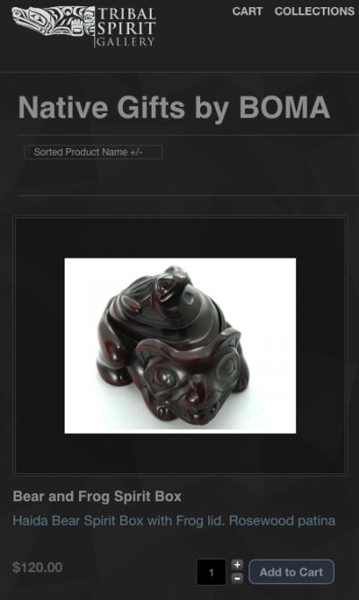

Slide 183
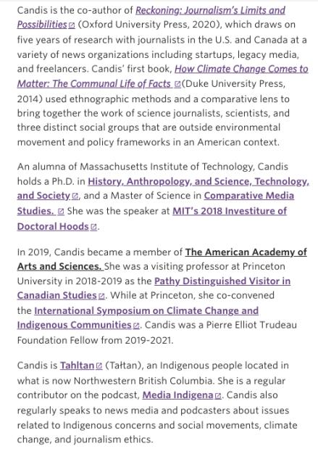


Slide 184
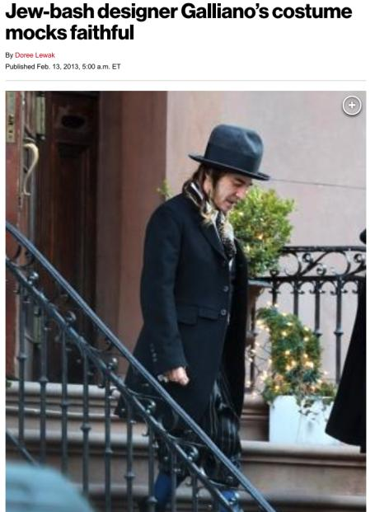


Slide 185

From Prof. Reynolds

Slide 186


Slide 187


Slide 188
QUESTIONS?
THOUGHTS?
DISCUSSION?

Slide 189
Pause

Slide 191
Random Notes 3

Slide 192


Slide 193


Slide 194


Slide 195


Slide 196


Slide 197

2235 W.4th Ave..

Slide 198


Slide 199




Slide 200


Slide 201


Slide 202
QUESTIONS?
THOUGHTS?
DISCUSSION?

Slide 203
Pause

Slide 204
On with the show…

Slide 205

Now
Trademarks

Slide 206


Slide 207


Slide 208


Slide 209


Slide 210


Slide 211


Slide 212


Slide 213
Trademarks
What is a Trademark ™?
  A mark used by a person for the purpose
  of distinguishing that person’s goods or
  services from those of others in the
  marketplace
Various types of marks
  Ordinary (word & design), certification,
  collective, official, distinguishing guise

Slide 214

Trademarks
Ordinary marks
  Distinguish the products or services of a specific firm or individual

Slide 215
Playing with concepts
Confusion = Passing Off
Distinguishing = Trademarks

Slide 216
Trademarks v. Passing Off*
Why would you want to register your TM?
Why not just rely on passing off?
TM = no proof of goodwill required. Only proof of use.
Registration of a mark provides national protection
Registered marks are presumed valid for Canada for all the wares and services for which they are registered.
s. 22 of the TMA protects against mark dilution.
In situations where a mark is deemed invalid, a passing off action might still succeed.
* You will see this slide again later

Slide 217
Trademarks
Certification marks
  Identify wares or services which meet defined standards.
  Can be used by anyone who complies with the standards defined by the owner of the certification mark; and who is licensed by the owner
  Owned by one person but licensed to others
  Defined in s. 2 of the TMA

Slide 218

Trademarks
Certification marks

Slide 219


Can you think of other certification marks?

Slide 220

Trademarks
Collective marks
  Signs that distinguish the geographical origin, material, mode of manufacture or other common characteristics of goods or services of enterprises using the collective mark
  Function: inform public about certain features of the product
  Owned by an entity; members of this entity are entitled to use the mark.

Slide 221

Trademarks
A purely functional design may not be the basis of a TM, registered or unregistered
  See Kirkbi v. Ritvik (SCC)

Slide 222
Old Concept of Marks
Ordinary marks
  S. 2: definition of trade-mark (in part): (a) a mark that is used by a person for the purpose of distinguishing or so as to distinguish goods or services manufactured, sold, leased, hired or performed by him from those manufactured, sold, leased, hired or performed by others.

Slide 223
QUESTIONS?
THOUGHTS?
DISCUSSION?

Slide 224
Pause

Slide 225


Slide 227

Trademarks 2

Slide 228
SEE YOU NEXT WEEK!

Slide 229

Always include a cat picture

Slide 230
In learning you will teach
And in teaching you will learn
Phil Collins' Son of Man (1999)

