Slide 1

Passing-Off 2
Talk 8
LAW 422 002
Intellectual Property Law
Allard School of Law, UBC
Spring, 2024
Jon Festinger K.C.
Adjunct Professor, UBC Allard
Of Counsel, Chandler Fogden Lyman
https://iplaw.allard.ubc.ca/

Slide 2
Logistics

Slide 3


Slide 4
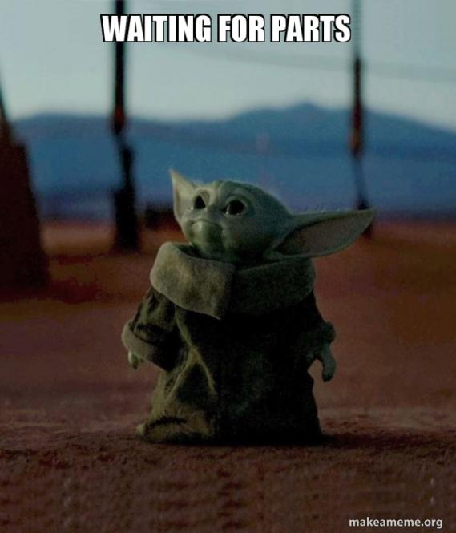

Slide 5
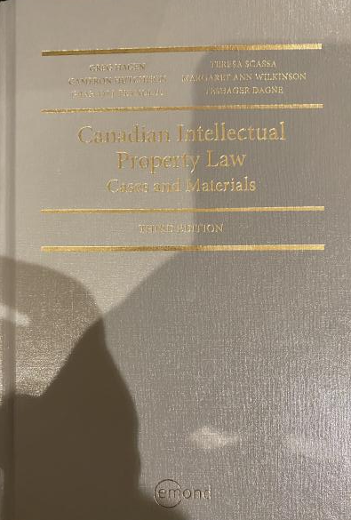
Text: Let me know if any issues @ Bookstore

Slide 6
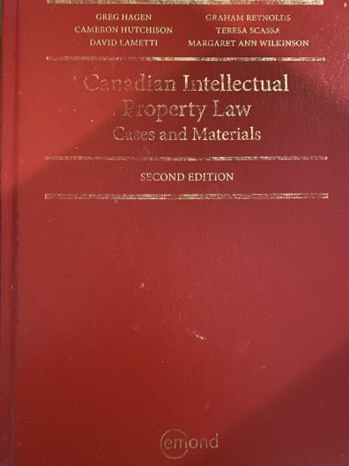
Former Text

Slide 7
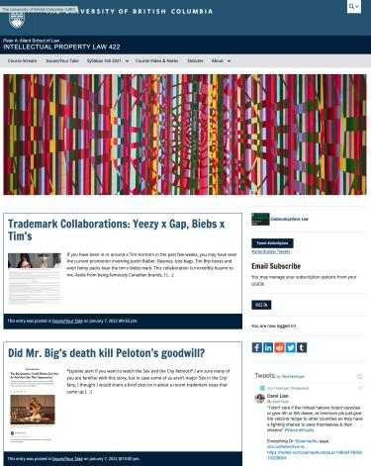

Course Website
https://iplaw.allard.ubc.ca/

Slide 8
PLEASE
SIGN UP

Slide 9
For full privileges on the website
1. Please create an account at http://cms.ubc.ca/ using your CWL.
2. Once you create an account and sign in at http://cms.ubc.ca/ you can click your name in the top right. Halfway down the following page will be your WordPress email address.
3. Send me your WordPress email address at jon.festinger@ubc.ca or at jon_festinger@thecdm.ca
4. Then, I will invite you to participate with authoring privileges via your WordPress email address.

Slide 10

Have responded to everyone?
+
…to some who didn’t ask?

Slide 11
Why post?
Engaging and engaging others is the key.
Because you don’t love speaking up in class.
Because you just saw or realized something, and you’ll never remember it unless you post it now.

Slide 12
Tips:
Don’t feel your posts have to be perfect. Engaging and engaging others is the key.

Slide 13
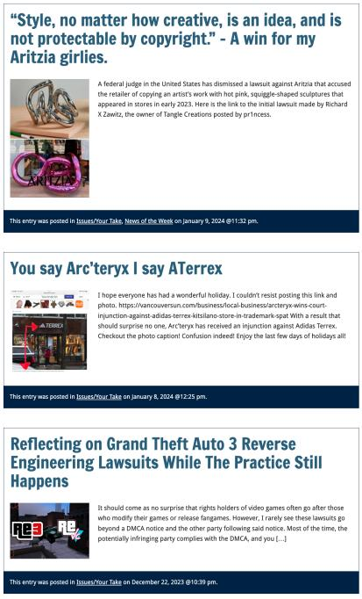

Slide 14

Anything & everything can be done via email if you prefer

Slide 15
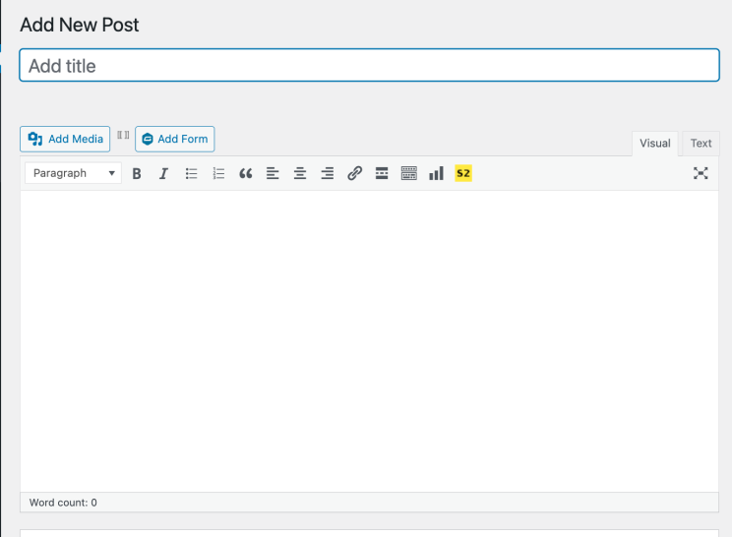

Adding Images

Slide 16



Slide 17
Adding Links

Slide 18
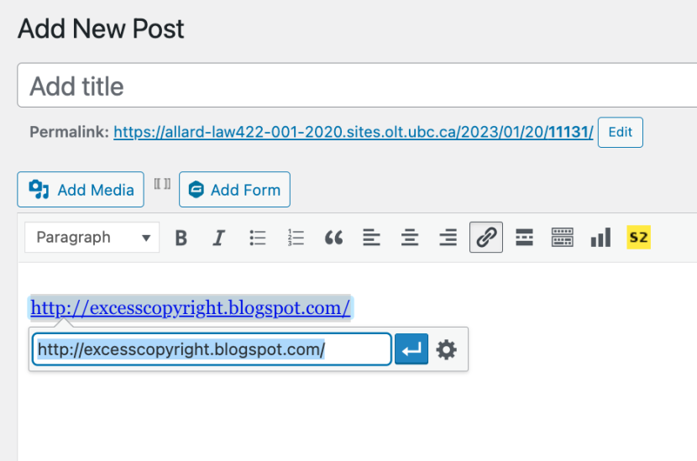


Slide 19


Adding a “Featured Image”

Slide 20


Slide 21
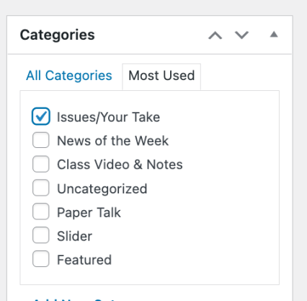

Setting Categories

Slide 22
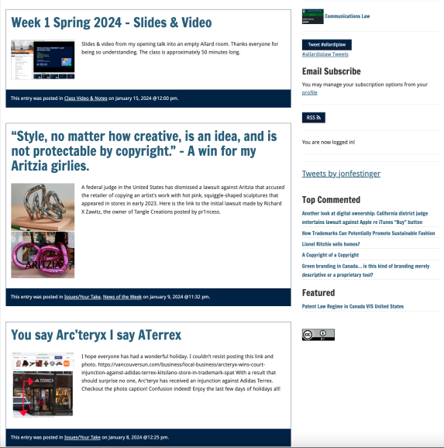
Creative Commons License

Slide 23

What CTLT will do…

Slide 24
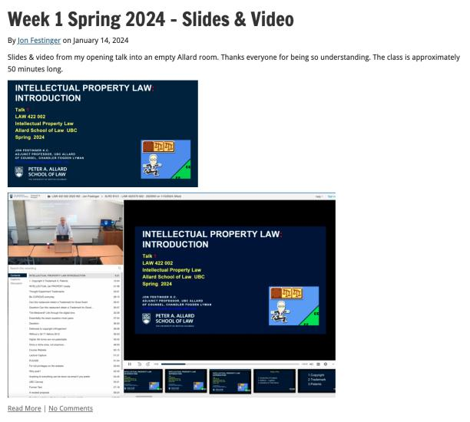
Lecture Capture

Slide 25
Syllabus

Slide 26





Slide 27
Features of this Course
70% Exam not 100%
IP Law “In Context”
Website

Slide 28
Let’s talk about…
The 30%

Slide 29
A modest proposal…
Approximately 1000 words (or equivalent) per person
written, video, podcast, in-class presentation (?), interpretive dance
Website or not
Groups or individually
LLM Students – one extra post

Slide 30
Past Presentations: Most are on the course website…

Slide 31
Generative A.I. Policy
1. It is source material, therefore
must be cited
2. You are responsible for the quality
of your source material, so check…
If it is wrong, you are wrong
If it plagiarized, you’ve plagiarized

Slide 32

Office “Hours”: Ideally Tuesdays just after class but am flexible…
Email: jon.festinger@ubc.ca; jfestinger@telus.net
Office: 449
Phone:
c. 604-837-6426
(please text if urgent)

Slide 33
Entirely optional but please…
…email me a short bio of yourself referencing:
Anything at all you want to say about yourself
Your academic interests
What you might like to get out of this course (I.E., interest in a type of patent, or a copyright issue etc.)
Favorite Intellectual Property (ies) - current or all-time

Slide 34
Zoom Q&A Sessions
(Study Groups Preferred If Possible)

Slide 35
QUESTIONS?
THOUGHTS?
DISCUSSION?

Slide 36

Pause

Slide 37

Random Notes 1

Slide 38
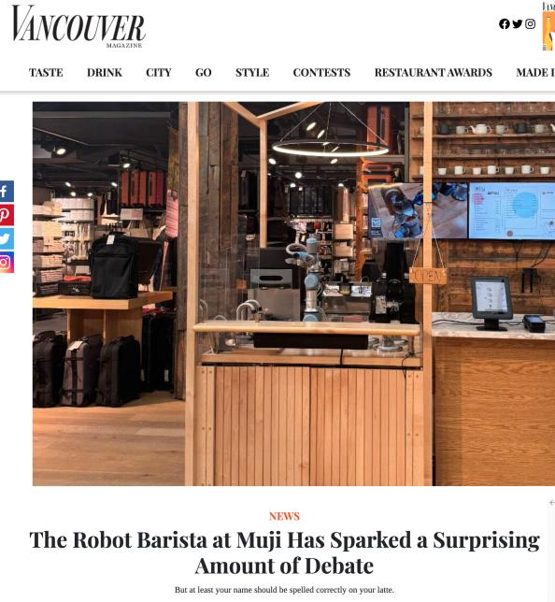

Slide 39
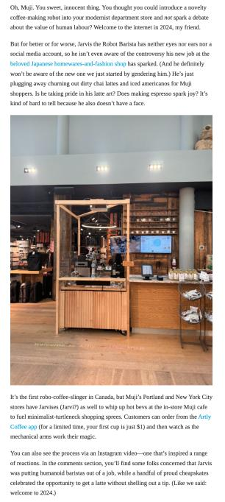

Slide 40
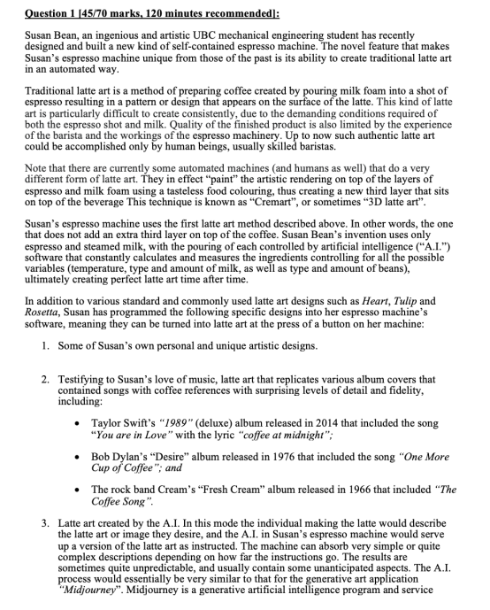

Slide 41
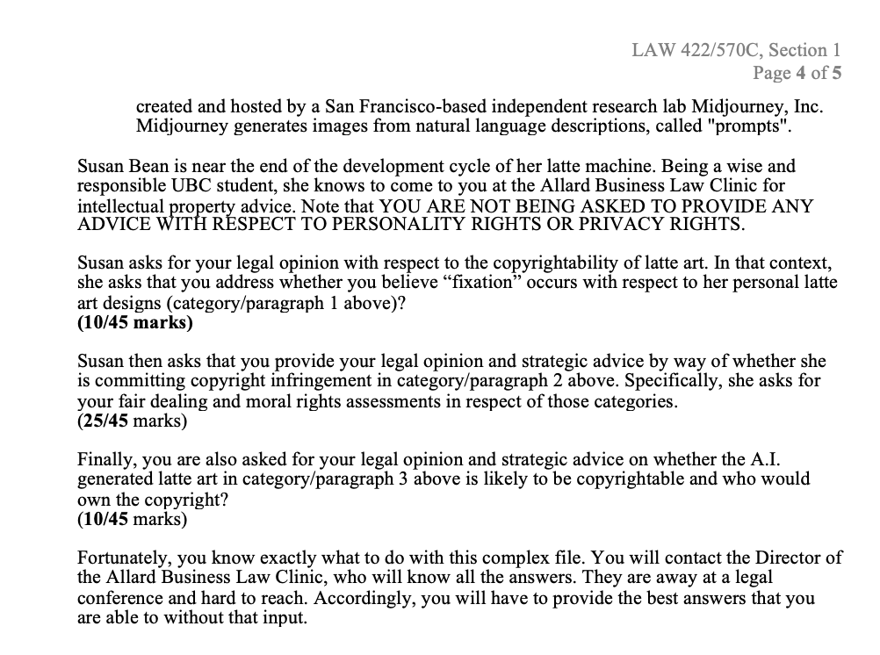

Slide 42
News of
the Week

Slide 43

On Website!!!

Slide 44
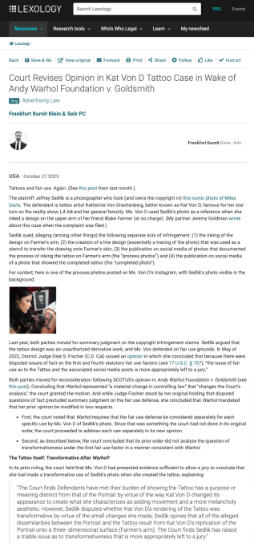

Slide 45
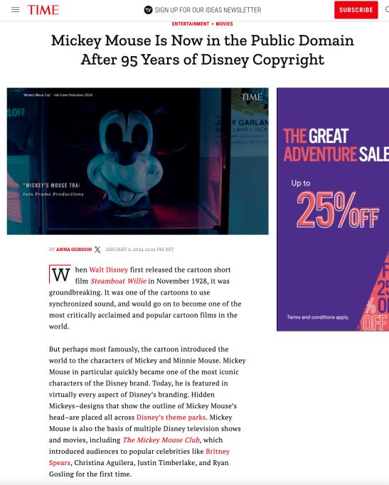

Slide 46
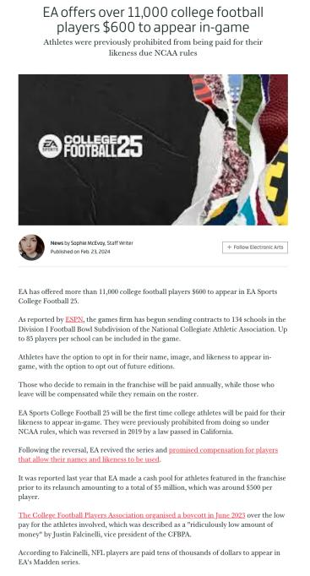

Slide 47
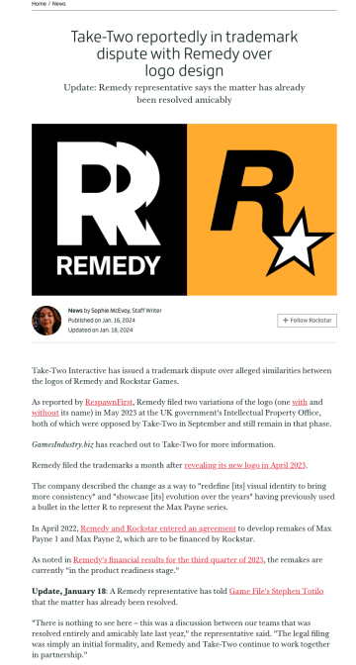

Slide 48
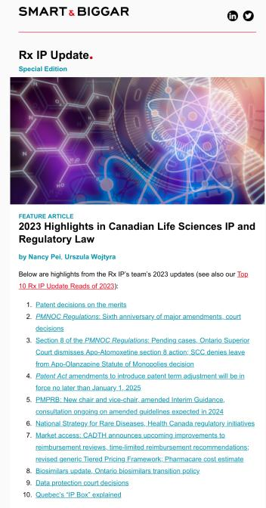

Slide 49
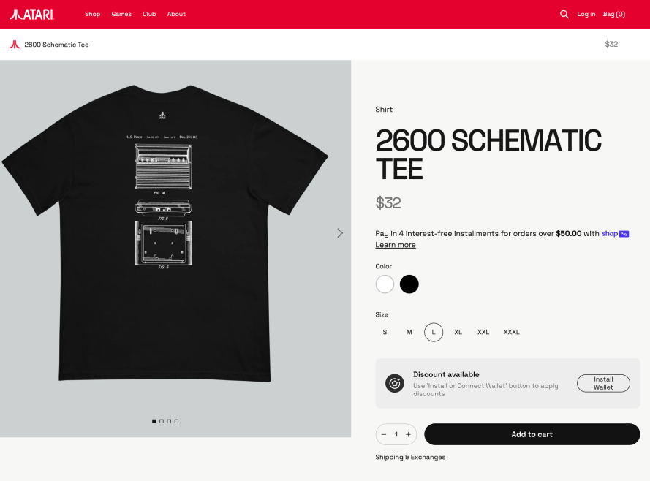

Slide 50
A.I. & Other

Slide 51
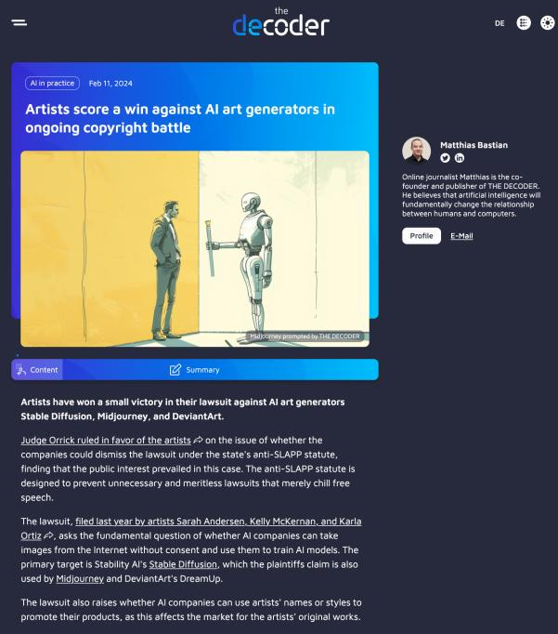

Slide 52
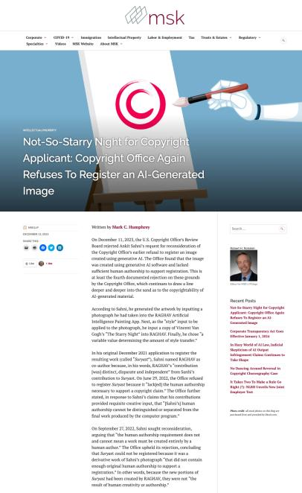

Slide 53
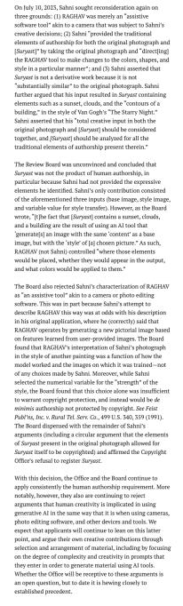

Slide 54
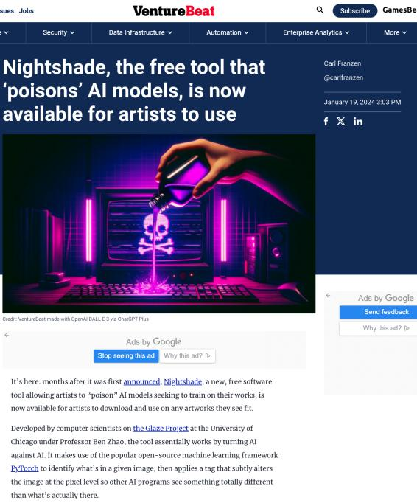

Slide 55
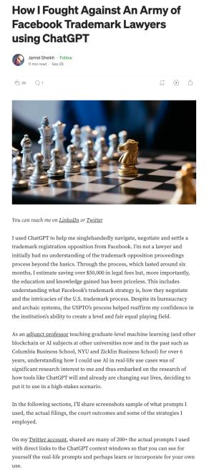

Slide 56
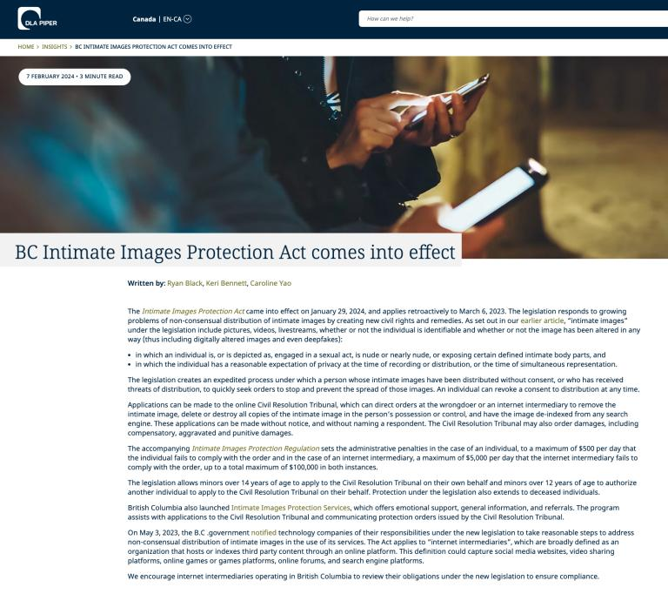

Slide 57
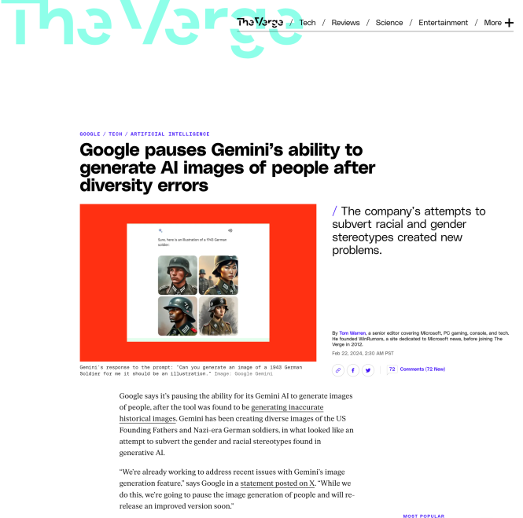

Slide 58
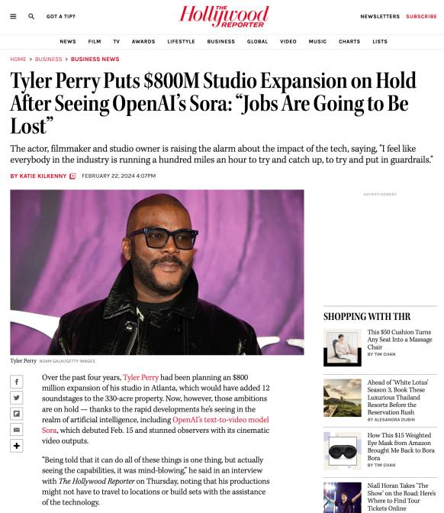

Slide 59
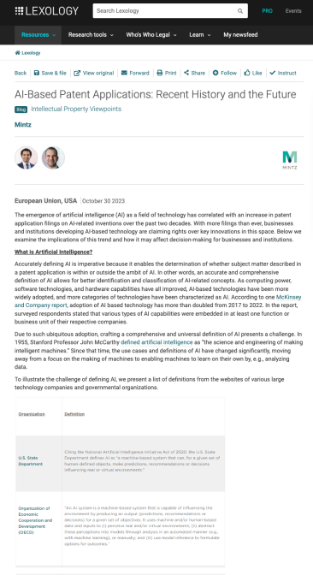

Slide 60
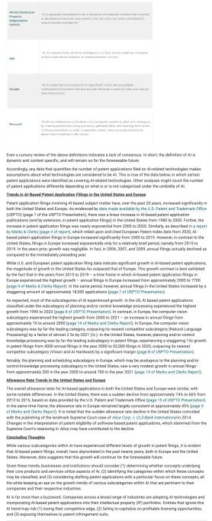

Slide 61
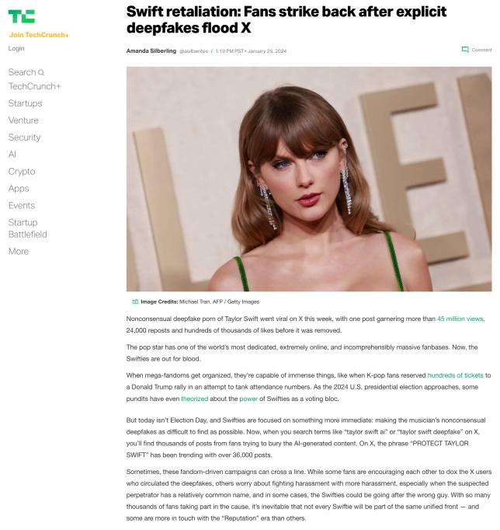

Slide 62
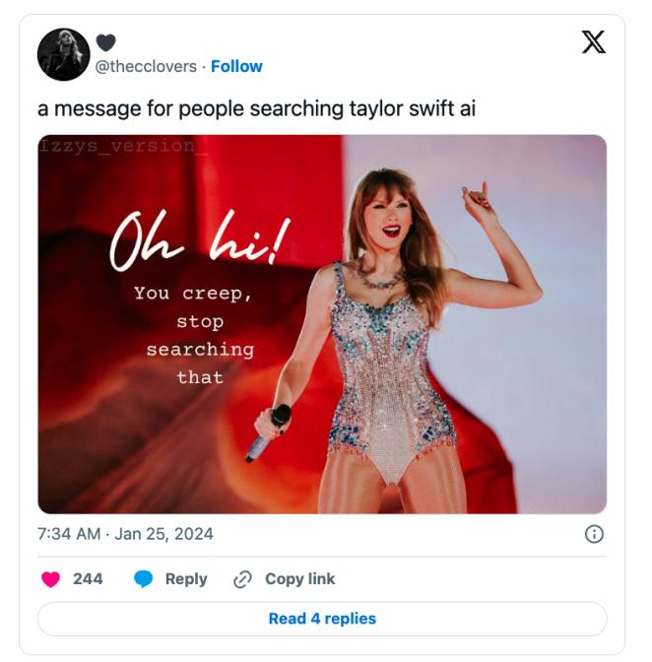

Slide 63
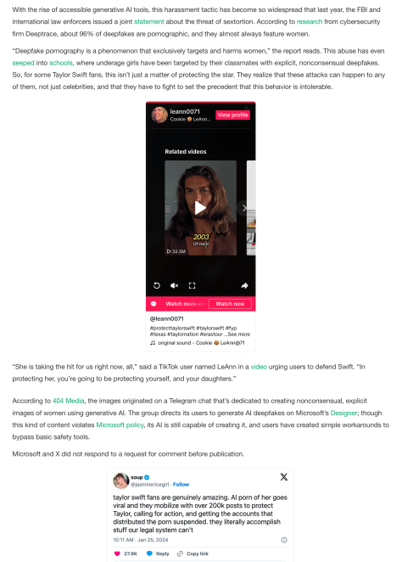

Slide 64
QUESTIONS?
THOUGHTS?
DISCUSSION?

Slide 65
Pause

Slide 66

Where we have been…

Slide 67
Intellectual Property Law is about:
What kinds of creations of the mind can one have rights in?
Who can have those rights?
What kinds of rights are there; and how are those rights enforced?

Slide 68
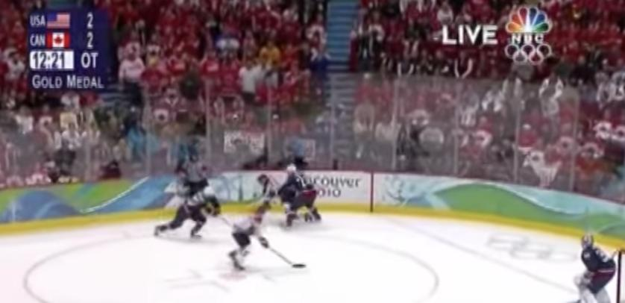
“Passing Off”
The Golden Goal – Jerome Iginla
passing off to Sidney Crosby

Slide 69
Passing off
Three (3) necessary components of
a passing-off action:
  1. The existence of goodwill +
  2. Deception of the public due to a
  misrepresentation +
  3. Actual or potential damage to the
  plaintiff

Slide 70
Passing off in contrast to Trademarks: Think…
LOCATION, LOCATION, LOCATION
LOCAL, LOCAL, LOCAL
WHERE ARE THE GOODS KNOWN +/or SOLD

Slide 71
Passing off in contrast to Trademarks: Think…
Temporal dimension
How much time should the protection last beyond closing/unavailability if it can be recovered?
Fun brand cases
Genericization

Slide 72
Conceptual Frameworks
Think “the marketplace”
Think BRANDS
Associate BRANDS with REPUTATION (“goodwill”)
“USE” is the key concept in both passing off & trademarks
“Use It or Lose It” = historical, underlying concept (not quite as literal anymore in Canada per recent Trademark reform)
Not as overtly about “intellectual effort” as copyright
No “Public Domain” per se

Slide 73
Passing off
Tort action available in certain circumstances of unfair competition
Common Law (where no statute)
Both a common law tort and a statutory cause of action under the Canadian Trade-marks Act
No one may pass off their goods as those of another
General remedy for two categories of deception in the commercial context:
  Company B represents products as being those of Company A to take advantage of Company A’s goodwill and reputation e.g. Coke v. Cola Joe
  Goods of Trader A supplied to party who has ordered goods of Trader B. Purchasing party led to believe they have received goods of Trader B.

Slide 74
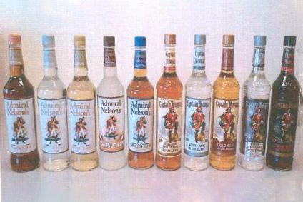
Category 1

Slide 75
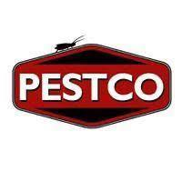

Category 2

Slide 76

Category 2
Orkin Exterminating v. Pestco (1985 Ont. CA)
People called what they thought was the ORKIN phone number, but then were actually connected with Pestco, and led or allowed to believe that ORKIN has taken care of their pest problem.

Slide 77
Passing off: Goodwill
Goodwill
The benefit and advantage of the good name, reputation, and connection of a business
Where the trade-mark or get-up is associated in the mind of the purchasing public with the plaintiff's goods, or with one trade source.
Get-up: The whole visible external appearance of goods

Slide 78
Passing off
Note is that passing off is generally seen as an action available between commercial competitors.
The Supreme Court of Canada, however, in Ciba‑Geigy Canada Ltd. v. Apotex Inc., [1992] 3 S.C.R. 12 emphasized that there is a consumer protection dimension to the tort. Gonthier J. notes that however one looks at the passing-off action, its purpose is clearly to protect all persons affected by the product.
“All persons” being the competitor and the people who buy the product
“People” who buy the product includes the first person who buys the product [who may be a wholesaler], all other intermediate purchasers, and the ultimate consumer.

Slide 79
Passing off: Where does goodwill come from?
Goodwill has said to come from the fact that the trade-mark or get-up is associated in the mind of the purchasing public with the plaintiff’s goods, or with one trade source, whether or not the public can identify that source.
A GET-UP can be defined as: The whole visible external appearance of goods/ specifically … in the form in which they are likely to be seen by the public before purchase.
If the goods are sold in packages, then the get-up is the way the package looks – the appearance of the package taken as a whole.
If the goods are not sold in packaging – the get-up is the way the good looks - the visible external appearance of the goods themselves.

Slide 80
Passing off: Where does goodwill come from?
How would you go about establishing the existence of goodwill? What sorts of information would you want to have?
Evidence of length of time in business
Strength of market for product/service
Strength of association between name/mark/product and company as source.

Slide 81


Slide 82
QUESTIONS?
THOUGHTS?
DISCUSSION?

Slide 83
Pause

Slide 84
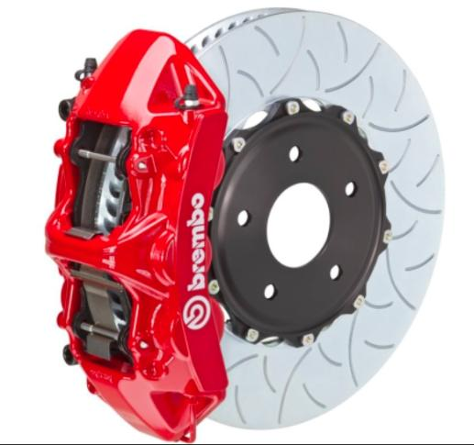

Slide 85
Random Notes 2

Slide 86
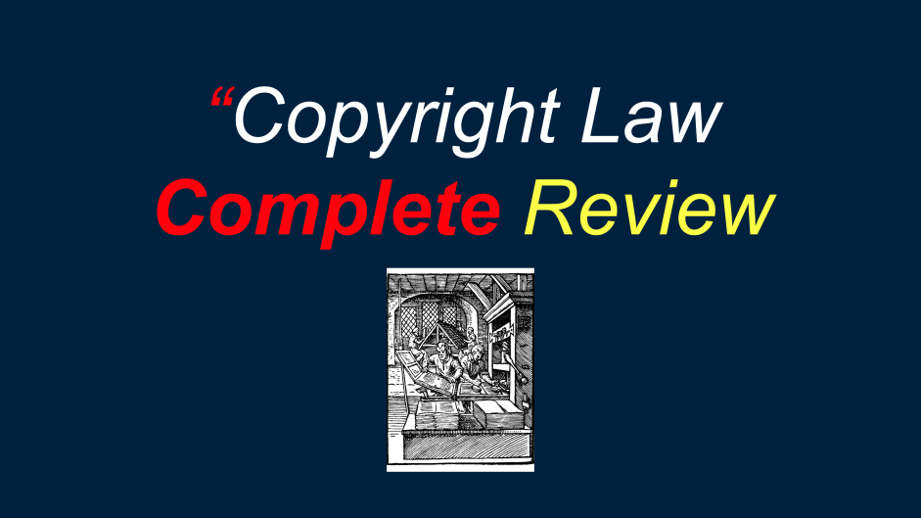
In last Week’s Slides

Slide 87

Copyright consequences?
1. When Festinger stops teaching, Allard decides to continue offering the IP Law course by re-using the Zoom recordings of the lectures; or
2. Allard feeds Festinger’s >1000 hours of video teachinginto a generative A.I. & creates an aging, balding, somewhat overweight, digital teaching avatar named Fon Jestinger

Slide 88
Non-Copyright consequences
PRIVACY ACT [RSBC 1996] CHAPTER 373
3 (2) It is a tort, actionable without proof of
damage, for a person to use the name or portrait
of another for the purpose of advertising or
promoting the sale of, or other trading in,
property or services, unless that other, or a person
entitled to consent on the other's behalf, consents
to the use for that purpose.

Slide 89
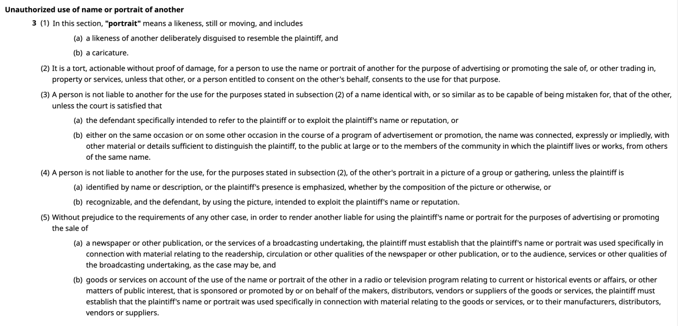

Slide 90
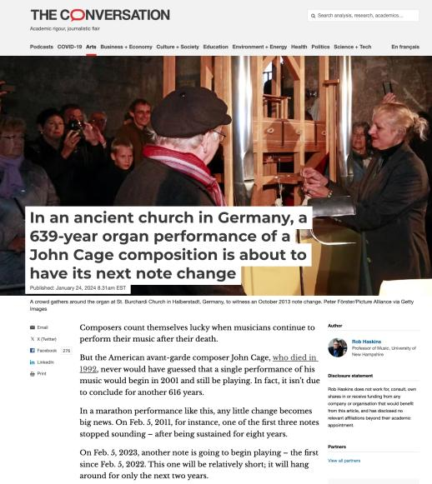
From News of the Week

Slide 91
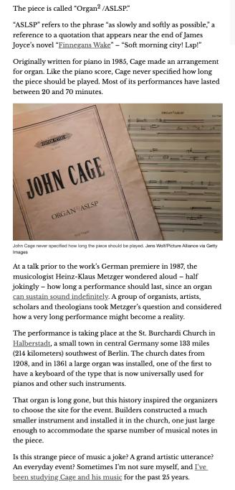

Slide 92

Now, to our regularly
scheduled programming…

Slide 93
Passing off: Where does goodwill come from?
How would you go about establishing the existence of goodwill? What sorts of information would you want to have?
Evidence of length of time in business
Strength of market for product/service
Strength of association between name/mark/product and company as source.

Slide 94
The existence of goodwill 1
The existence of goodwill, though sometimes easy to establish, is a crucial element of the tort of passing off.
Protection against passing off ONLY where goodwill or reputation has been established.
A co. whose goods or services are well known in NS, but not in BC, will not be protected at Common Law from another company offering similarly named or branded products or services in BC. This is because confusion or misrepresentation is the essence of the tort of passing off.

Slide 95
The existence of goodwill 2
In other words where the Plaintiff’s product or service is unknown in a certain region, it will be hard for the Plaintiff to argue that customers were misled into thinking they were purchasing the P’s products when they were purchasing those of the defendant.
Goodwill is oddly “regional”, though one can string together regions to become national or even international.
Protection against passing off is available only where there is goodwill or reputation – IE only where the alleged offence occurs within a territory where there is goodwill.

Slide 96
Passing off: Shared Goodwill
Institut national des appelations d’origine des vins…v. Andres Wines Ltd (1987), 60 OR (2d) 316 aff’d Ont. CA (1990) 74 OR (2d) 203, leave to appeal to SCC refused.
Ont. Superior Court considered whether anyone was entitled to bring an action in passing off when the alleged misrepresentation related, not to the goods or services of ONE particular trader, but to a kind or quality of goods produced by a group of traders using the appellation “Champagne” which is also a district in France.
Plaintiff (I.N.A.O.) was a trade organization effectively representing winemakers in that district as they are the French public institute in charge of the defence of geographical indications.

Slide 97
Passing off: Shared Goodwill
Institut national des appellations d’origine des vins…v. Andres Wines Ltd (continued)
Note previous definition of goodwill as the benefit and advantage of the good name, reputation, and connection of a business. Seems overtly to meet the criteria?
Specific legal question is: Can goodwill exist not just with respect to one business, but with respect to a kind of goods produced by a group of traders?
Geographical indications are place names (in some countries also words associated with a place) used to identify the origin and quality, reputation or other characteristics of products
Geographical indications other than Champagne?

Slide 98
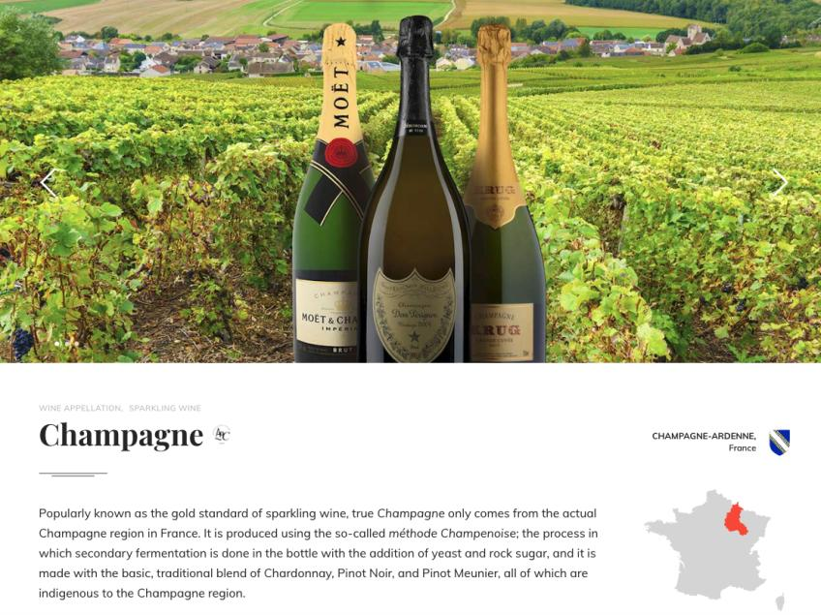

Slide 99
Tequila (town in Mexico)
Roquefort (commune in southern France)
Scotch whiskey
Parma ham
Montreal Bagel v. NY Bagel?
Chicago Deep Dish Pizza?
????

Slide 100
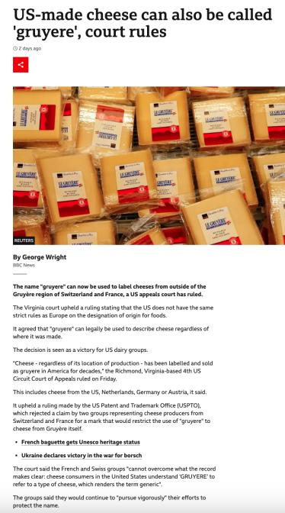

Slide 101
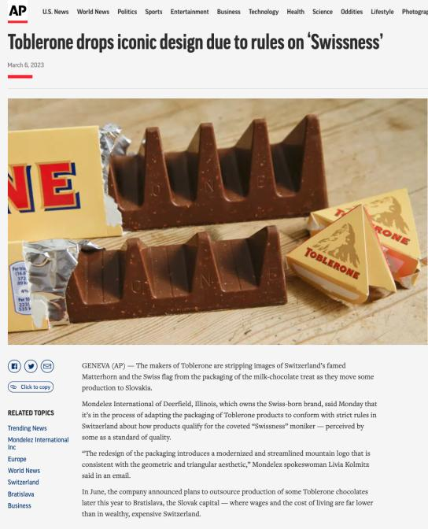

Slide 102
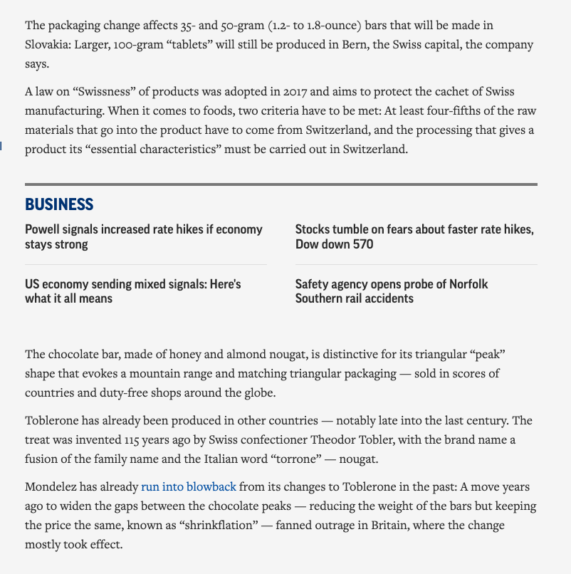

Slide 103
Passing off: Shared Goodwill
Institut national des appelations d’origine des vins…v. Andres Wines Ltd (continued)
Plaintiff seeking injunction to prevent Canadian wineries from selling their wine under a name which incorporates the word “champagne” (Canadian Champagne). The sparkling wine called “Champagne” is a product of the Champagne district of France.
Paras 8 – 12 go into detail on the history of Champagne; interesting stuff.
The laws of France provide for and protect all producers of sparking wine whose grapes, area of growth, method of production, marketing and standards meet the stringent regulations in France:
  Grapes - limited to Chardonnay, Pinot Noir and Meunier
  Area of growth - white chalky terrain with certain prevailing temperatures
  Method of production - various acceptable planting and harvesting techniques; double fermentation process in bottles or in cuve close

Slide 104
Passing off: Shared Goodwill
Institut national des appellations d’origine des vins…v. Andres Wines Ltd (continued)
These laws permit producers who meet the stringent regulations to advertise and market their sparkling wines as “champagne”. If these stringent regulations are not met, producers have to call their drink sparkling wine.
Over centuries, considerable and economically significant goodwill has been created in the name Champagne; both in France and internationally.
Each producer, including the plaintiff champagne houses, has a shared vested interest in the national and international goodwill and reputation of the name champagne.
Not yet existing future qualifying producers also share in the benefits derived from the goodwill attached to the named product. So this is not a closed category; other producers who will meet the requirements will also be able to share in the goodwill.

Slide 105
Passing off: Shared Goodwill
Institut national des appellations d’origine des vins…v. Andres Wines Ltd (continued)
Main question: Should the concept of “shared goodwill” should be accepted in Canada?
The court recognized that to accept “shared goodwill” would be to expand the tort of passing off.
Parenthetically note as we explore the extent to which the tort of passing off has expanded over time – and whether or not this is a good thing for Canadian businesses and society?

Slide 106
Passing off: Shared Goodwill
Institut national des appellations d’origine des vins…v. Andres Wines Ltd (continued)
As mentioned, the court recognized that to accept “shared goodwill” would be to expand the tort of passing off.
The classic form of the tort of passing off involves Business A leading the public to believe that his goods were in fact those of Business B.
Not the claim here. Plaintiffs not alleging Defendants passing off their goods as the product of any one of the 16 champagne houses in France.
So not business A is leading the public to believe that goods were those of business B
Rather, the basis of I.N.A.O.’s claim is Defendants are passing off their wine as “champagne”, where according to I.N.A.O’s own definition, it is not champagne.

Slide 107
Passing off: Shared Goodwill
Institut national des appellations d’origine des vins…v. Andres Wines Ltd (continued)
The claim here is still based on damage to goodwill. It’s not however based on the damage to goodwill of one business.
Rather, the claim is based on the alleged damage to the goodwill which each qualifying producer shares jointly with the other qualifying producers.
In this case, the court decided to extend the nature of the passing off action, holding that the fact that the plaintiffs are asserting a shared right to use the name champagne does not disentitle them to protect the name Champagne by a passing off action.

Slide 108
Passing off: Shared Goodwill
Institut national des appellations d’origine des vins…v. Andres Wines Ltd (continued)
Clear from case is Court’s unwillingness to limit the principles of passing off to only those situations where there is a direct or indirect connection between the goods of the plaintiffs and the defendants and where ownership of the goodwill in a mark resides in one plaintiff only.
The concept of shared goodwill was indirectly approved of by the SCC in Consumers Distributing Co v. Seiko Time Canada Ltd. (1984).

Slide 109
Passing off: Shared Goodwill Summary
Institut National:
Plaintiff entitled to bring an action in passing off when the alleged misrepresentation relates, not to the goods or services of a particular trader, but to a kind or quality of goods produced by a group of traders.

Slide 110
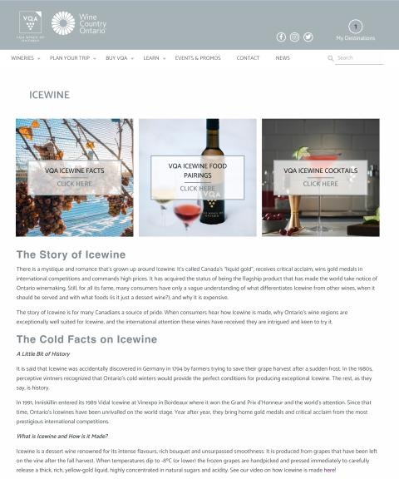
What about ice-wine?

Slide 111
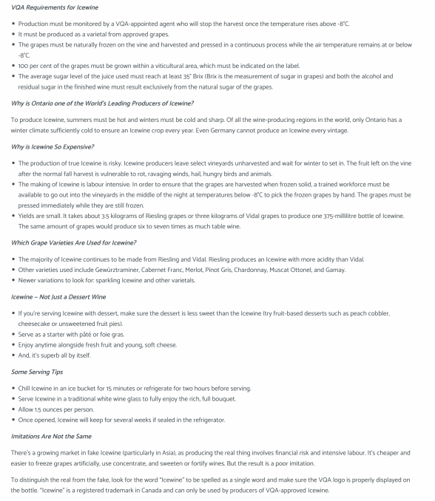

Slide 112
QUESTIONS?
THOUGHTS?
DISCUSSION?

Slide 113
Pause

Slide 114
Passing off: Foreign goodwill
Law protects through passing off action a company's property in its business or goodwill.
Goodwill is the benefit and advantage of the good name, reputation, and connection of a business.
Back to Orkin Exterminating Co. Inc. v. Pestco Co. of Canada Ltd (1985), 50 OR (2d) 726 [not required reading but on p344 CB]
Question dealt with is whether a company that doesn’t do business in Canada has goodwill in Canada for the purposes of a passing off action?

Slide 115
Passing off: Foreign goodwill
Orkin Exterminating Co. Inc. v. Pestco Co. of Canada Ltd (1985), 50 OR (2d) 726 (continued)
Court found that a company whose goods or services are well known in the U.S., but not in Canada, will not be protected at common law from another company offering similarly named or branded products or services in Canada.
Reason is because confusion or misrepresentation is the essence of the tort.
Where Plaintiff’s product or service is unknown in a certain region, it is hard to argue that customers were misled into thinking they were purchasing the Plaintiff’s products.
That said however, goodwill can exist outside the area where a company carries on a business.

Slide 116
Passing off: Foreign goodwill
So how might foreign reputation be built up?
Canadians travelling in the United States were exposed to Orkin's extensive advertising and use of its trademarks ;
Canadians in Canada were exposed to Orkin's advertising and articles appearing in American publications circulated here & Orkin’s ads appearing on TV and radio broadcast from American stations but received in Canada;
Thousands of Canadians had used Orkin services on a regular basis in connection with property owned or rented by them in the United States;
Orkin provides services to companies, in the U.S., which have operations in Canada
Orkin's international reputation in the pest control field resulted in the Canadian government seeking its advice as a consultant respecting the control of pests for the Exposition in Montreal in the mid-1970’s
Moreover the fact that Pestco, in 1967, chose to use the name Orkin in Ontario is evidence from which it may be inferred that the name Orkin had commercial value at that time in Ontario. This, according to the Court, is an important indication of goodwill in a “foreign” territory.

Slide 117
Passing off: Foreign goodwill
Sadhu Singh Hamdard Trust v. Navsun Holdings Ltd. (2016)
Case explores the related questions of:
  1. Whether an entity that does minimal business in Canada but that has a website accessible to (and accessed by) Canadians can establish sufficient goodwill for a successful action in passing off in a Canadian court? &
  2. How can such a company demonstrate its reputation?

Slide 118
Passing off: Foreign goodwill
Sadhu Singh Hamdard Trust v. Navsun Holdings Ltd. (2016) (continued)
[4] Hamdard Trust is the owner and publisher of an Indian Punjabi-language daily newspaper called the “Ajit Daily”. This paper has been published in India since 1955 and is well-known among the Punjabi population in India. An online version has been available since 2002. Only a small number of subscriptions have been sold in Canada, but several of the affiants whose affidavits were before the Federal Court on the summary trial motion lived in Canada and deposed or confirmed in cross-examination that they were aware of the Ajit Daily and its reputation as an important Punjabi paper in India.

Slide 119
Passing off: Foreign goodwill
Sadhu Singh Hamdard Trust v. Navsun Holdings Ltd. (2016) (continued)
[5] The Bains Defendants own and publish a Canadian Punjabi-language newspaper called the “Ajit Weekly”, a free newspaper that has been published in Canada since 1993 and that is distributed at the front of supermarkets and other stores. An online version has been available since 1998. The Ajit Weekly has carried advertisements that Hamdard Trust believes are offensive to some of the Ajit Daily readership.
[6] There has been considerable litigation between Hamdard Trust and the Bains Defendants over the use of the Ajit name and the stylized depiction of the name on the masthead of the Ajit Weekly, which Hamdard Trust alleges constitutes an unauthorized copying of the Ajit Daily trade-mark.
In this case …
[19] Hamdard Trust alleges that in misappropriating the Ajit Daily logo the Bains Defendants were engaged in passing off.

Slide 120
Passing off: Foreign goodwill
Sadhu Singh Hamdard Trust v. Navsun Holdings Ltd. (2016) (continued)
Federal Court dismissed Hamdard Trust’s claim for passing off, finding that it had failed to establish any of the elements for a claim of passing off.
Federal Court of Appeal set aside that decision, finding that the lower court made several palpable and overriding errors in evaluating the evidence on each element of the test.

Slide 121
Passing off: Foreign goodwill
Sadhu Singh Hamdard Trust v. Navsun Holdings Ltd. (2016) (continued)
Number of Ajit Daily subscribers in Canada? 7 in 2010.
FCA determined that the Federal Court erred in law by analyzing the existence of goodwill solely from the perspective of those who were shown to have read the Ajit Daily in Canada.
Instead, the FCA indicated the question is simply: Does the Plaintiff’s TM have a reputation in the jurisdiction, even if the TM is not used by the Plaintiff in the jurisdiction?

Slide 122
Passing off: Foreign goodwill
Sadhu Singh Hamdard Trust v. Navsun Holdings Ltd. (2016) (continued)
There was evidence that the Plaintiff’s TM had a reputation in the jurisdiction:
  1. The Ajit Daily enjoyed a reputation in the eyes of several affiants in Canada as a well-known Punjabi-language newspaper published in India
  2.A number of Canadians accessed the Ajit Daily’s online version by visiting its website.
  3. There were seven subscribers to the paper.
Court noted that if a wider reputation had been established, it would have been enough to establish the goodwill to meet the first step in the test for passing off.

Slide 123
Q.: Should an entity doing minimal business in Canada but having an accessible website that is accessed by Canadians be able to establish sufficient goodwill to make out a successful action in passing off in a Canadian court? If so, how might such a company demonstrate its reputation?

Slide 124
Passing off: Entities doing minimal business in Canada
Sadhu Singh Hamdard Trust v. Navsun Holdings Ltd. (2016)
Does Plaintiff’s TM have a reputation in the jurisdiction, even if that TM is not used in the jurisdiction?
Larger question: Should an entity that does minimal business in Canada but that has a website accessible to (and accessed by) Canadians be able to establish sufficient goodwill to make out a successful action in passing off in a Canadian court?

Slide 125
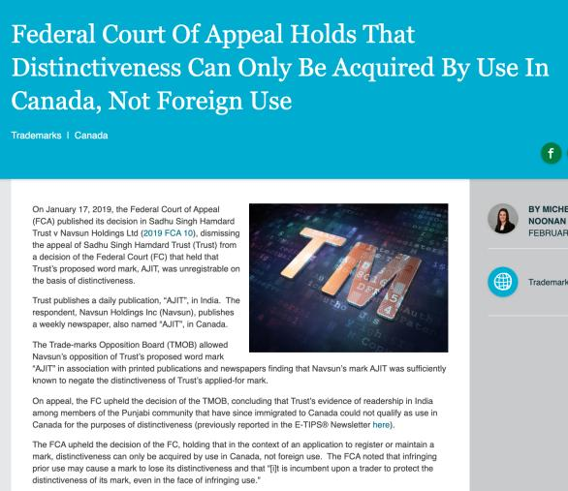
But Trademarks?

Slide 126
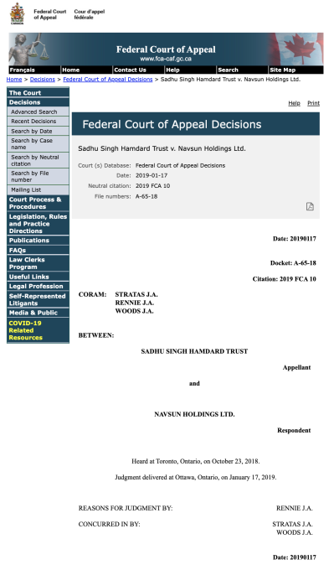

Slide 127
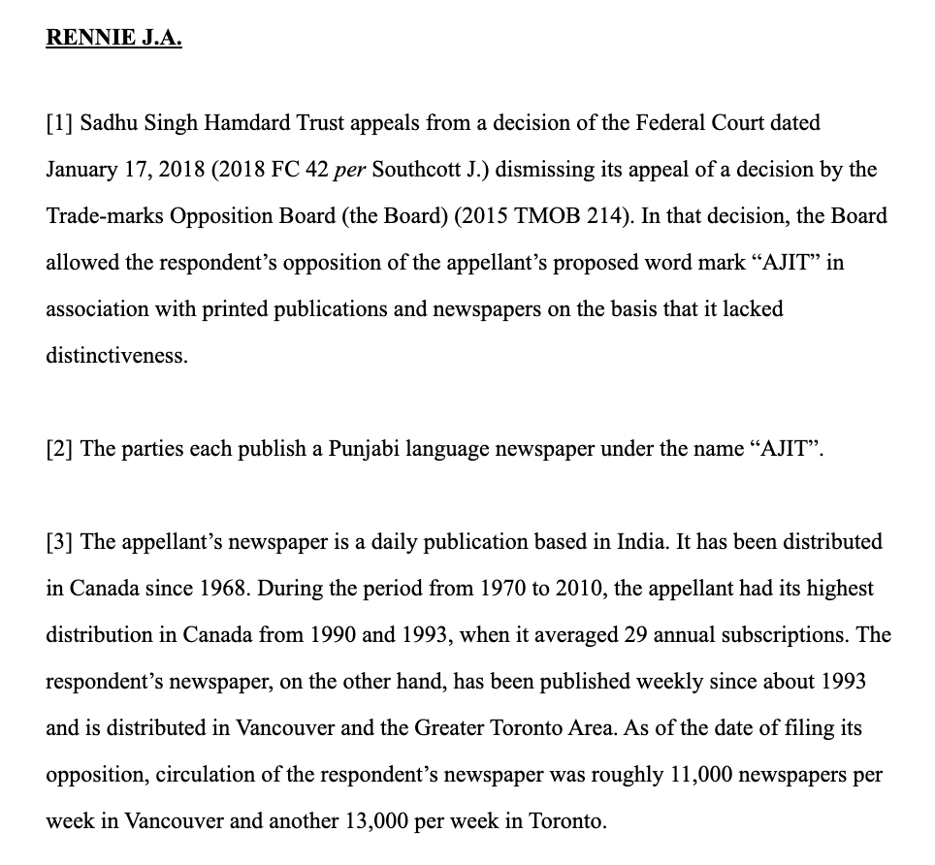

Slide 128


Slide 129


Slide 130


Slide 131


Slide 132


Slide 133
QUESTIONS?
THOUGHTS?
DISCUSSION?

Slide 134
Pause

Slide 135
To what extent can goodwill be acquired in a purely descriptive product name?
Risky to use purely descriptive terms for a mark.
Risk is of not acquiring goodwill or reputation in the product simply because the name describes the good itself.
Goodwill – or secondary meaning – can be acquired through a product’s name, or through a product’s appearance…
A product that has a particularly distinctive appearance might come to be associated by consumers with one trade source. Then a competitor who copies the product appearance might be liable for passing off.
Challenge in these cases is that the Plaintiff must show that the appearance of the product has acquired a secondary meaning – that it comes from one trade source.

Slide 136
Passing off: Ray Plastics
Product was a combination snowbrush, ice scraper and squeegee called “Snow Trooper”: Black nylon scraper is 27" in overall length, has 3 rows of bristles, 5/8" hardwood painted black, and a traditional yellow brush
uncommon appearance…
very successful seller at Canadian Tire, K Mart, Zellers and Pro Hardware in 1982 and 1983.
Constructed by Raywares, a division of Ray Plastics Limited.
One of Raywares’ main competitors was Brushcraft, a division of Dustbane.
At the initiative of Canadian Tire, Brushcraft produced a similar product to the Snow Trooper for the years 1984 and following.
This product was described as "virtually identical", and "a virtual clone" to the Snow Trooper.

Slide 137


Slide 138
Passing off: Ray Plastics
Ray Plastics sued Dustbane for passing off.
Issue: Did goodwill exist?
Ray needed to prove that potential buyers believe that the goods being sold – here Brushcraft’s snowbrush, are either those of Ray or come from the same source as the “originals”
Court notes that in discussing passing off in cases of “appearance” or get-up, …what you have to establish is that consumers, by virtue of the appearance of the product – regard it as coming from one trade source; OR that the product appearance has developed a secondary meaning – that it comes from one trade source.
Important: The consumer doesn’t have to know which company produces the original product. Just need to establish that … consumers believe that the Snowbrush made by Dustbane comes from the same source as the Snow Trooper.
It’s easier to establish this reputation or secondary meaning with a distinctive product.

Slide 139
Passing off: Ray Plastics
Court notes that where the appearance is in some way novel or striking or unusual, it is easier to conclude that there has come to be an association of that appearance with a single trade source
The Snow Trooper get-up is very distinctive.
Other factors that the court found significant in this case:
1) Ray Plastics had done extensive advertising over two years with respect to the Snow Trooper.
2) Sales figures
3) There was evidence of intentional, direct copying. The court found that evidence of intentional, direct copying establishes a prima facie case of secondary meaning.
SO the goodwill/secondary meaning found to exist in the product appearance of the snow trooper.

Slide 140
Passing off: Ray Plastics
A product that is particularly distinctive in its appearance may come to be associated by consumers with a particular trade source
If the product appearance is an inherent feature of the product, it can’t be relied on as a TM

Slide 141
QUESTIONS?
THOUGHTS?
DISCUSSION?

Slide 142
Pause

Slide 143


Slide 145

Passing off: Novopharm v. Bayer Inc. (2000)

Slide 146
Passing off: Novopharm v. Bayer Inc. (2000)
Question is whether a manufacturer of a pharmaceutical in pill, capsule or tablet form can claim goodwill or reputation in the shape, size or colour of the tablet?
Many prescription drugs are not sold in packages, they are dispensed by pharmacists in plain plastic vials.
“If patients identified the plaintiff's product by its appearance, the marketing by the defendant of tablets that were confusingly similar in appearance would prevent patients from exercising consumer choice by specifying which product they wished to have prescribed.” (para 90) / could also have negative health impacts.

Slide 147
Passing off: Novopharm v. Bayer Inc. Court 1
Issue was whether consumers, by virtue of the appearance of the pill, regard it as coming from one trade source?
Points made by the court in answering this question:
Pink round small tablets are commonplace in the pharmaceutical market. (40 medications available in Canada for treatment of high blood pressure and angina that were pink in colour – Macdonald (Pharmacist)). Accordingly, Bayer has a heavy burden to discharge to prove that they have a secondary meaning (that ordinary consumers associate them with a single trade source).
The fact that in 1992 Adalat was the only extended-release nifedipine product on the market does not necessarily mean that consumers have identified its appearance with a single source.

Slide 148
Passing off: Novopharm v. Bayer Inc. Court 2
Issue was whether consumers, by virtue of the appearance of the pill, regard it as coming from one trade source?
Points made by the court in answering this question:
Consumers often identify the appearance of a pharmaceutical product with its therapeutic purposes, instead of with a single manufacturer. I.e. “Colour/shape = pill I take for condition X; as opposed to colour/shape = same manufacturer.”
Evidence did not prove that physicians or pharmacists to any significant degree identified Adalat by colour or shape (they relied primarily on labels).
Bayer was unable to establish that patients associate pink round angina pills with the brand name Adalat.

Slide 149
Passing off: Novopharm v. Bayer Inc. (2000)
Key points (simplified):
Pink round small tablets are commonplace in the marketplace
Only product in the market? Not by itself conclusive of goodwill/distinctiveness
Appearance of a pharma product often associated with therapeutic purposes instead of single manufacturer
Physicians/pharmacists rely primarily on labels

Slide 150
Passing off: Novopharm v. Bayer Inc. (2000)
Court also highlighted two competing public policy considerations:
Reducing the price of medication by not limiting competition through the grant of a monopoly in the product’s appearance
Maximizing consumers’ freedom of choice to prefer a brand:
  Some patients may experience adverse side effects from one product but not from another, even though they are interchangeable.
  Not all manufacturers exercise the same level of quality control. In this case, a consumer may want to ensure that they receive the brand name product.
Way the tension between these competing public policy considerations is resolved in passing off is through the requirement that in order to bring a successful passing off action, evidence must be presented before the court that clearly establishes on a balance of probabilities that a significant number of consumers associate the appearance of the product with a single trade source. Did not happen in Novopharm v. Bayer.

Slide 151
Summary
In passing off cases dealing with product appearance or product packaging Plaintiff must establish that the certain product feature or packaging is distinctive of a particular trade or commercial source.
If not established, then secondary meaning has not been established either, and there is no goodwill or reputation that the defendant can exploit.
Key from casebook: “IF the product appearance is an inherent feature of the product – i.e. ex given – shape and configuration of a Lego block – then it can’t be relied on as a TM.”
Why? See Kirkbi AG v. Ritvik Holdings, 2005 SCC.

Slide 152
Passing off: Kirkbi AG v. Ritvik Holdings, 2005 SCC
If the product appearance is an inherent feature of the product, it can’t be relied on as a TM.
Because that would give a monopoly over the manufacture of the product.

Slide 153
QUESTIONS?
THOUGHTS?
DISCUSSION?

Slide 154
Pause

Slide 155


U.S. Copyright analogy 1:
Golden Tee v. PGA Tour Golf
Defendant PGA Tour Golf WINS

Slide 156

U.S. Trademark analogy:
ESS Entertainment & Rock Star
The Play Pen & The Pig Pen
Defendant Rock Star (Pig Pen) WINS

Slide 157


Slide 158
QUESTIONS?
THOUGHTS?
DISCUSSION?

Slide 159
Pause

Slide 160
Losing Reputation or Goodwill: HOW?
3 ways top lose goodwill or reputation:
Acquiescence over time to competitors using identical or similar get-up so that it’s no longer distinctive of the Plaintiff as a trade source
When a plaintiff goes out of business and is no longer using a particular name…fades away…
When the mark becomes generic…

Slide 161


Slide 162
Passing off: Ad-Lib Club Limited
By 1964, the Ad-Lib Club was a widely known & popular night club in London, U.K., that had established a substantial goodwill attached to the name.
Forced to close in 1966 due to noise violations. After that it was looking for alternative premises to re-open.
Then, 1970 – on the same premises – it seemed as if the Ad-Lib Club is re-opening. Article stated: “The AD-LIB, first and most successful of London’s swinging discotheques of the 1960s will reopen this month”.
Ad-Lib, after seeing this article, asked the court for an injunction that would prevent the Defendant from passing off the Defendant’s business as the business of the Plaintiff.
The judge noted that in 1965, the Ad-Lib Club had substantial goodwill in its name. However, Ad-Lib closed in 1966.

Slide 163
Passing off: Ad-Lib Club Limited
It had been five years since Ad-Lib carried on the business of a club. Court still determined that Ad-Lib had goodwill in its name because:
Defendants must have chosen the name Ad-Lib Club by reason of the reputation acquired by Ad-Lib (the Plaintiff). No evidence filed showing any other reason for the selection of the name.
Based on various news articles, members of the public clearly seemed to see the new club as a continuation of the Plaintiff’s club.
Accordingly, Ad-Lib, the Plaintiff company, still has goodwill and was entitled to exploit it and protect it.

Slide 164
Passing off: Principles from Ad-Lib Club
Where someone stops carrying on a business, they keep, for a period of time, the goodwill attached to that business.
As long as that goodwill remains, the person should be able to enforce his rights in respect to any name attached to that goodwill.
When goodwill expires is a question of fact.

Slide 165
Overall principle
An enterprise can eventually lose its goodwill, after a period of time, if it shuts down. After a period of non-use, a name or product appearance will lose its “mojo” (not a technical term) and no longer be distinctive of a certain trade source.

Slide 166


Slide 167


Slide 168


Slide 169
QUESTIONS?
THOUGHTS?
DISCUSSION?

Slide 170
Pause

Slide 171



Passing off: Genericization

Slide 172

Passing off: Genericization
Back to: Institut national des appellations d’origine des vins…v. Andres Wines Ltd

Slide 173
Passing off: Genericization
Institut national des appellations d’origine des vins…v. Andres Wines Ltd
To wine experts Champagne has one meaning , sparking wine product originating from a particular part of the Champagne District of France, produced from grapes grown there by methods dictated by French law.
Defendant Andres claims the term champagne has become generic.
Evidence to support this argument?
Evidence that both nationally and internationally the term has for many years been used in connection with different commercial products to suggest high quality or excellence – thus diluting the distinctiveness of the term.

Slide 174

1934

Slide 175
Passing off: Genericization
Institut national des appellations d’origine des vins…v. Andres Wines Ltd
Champagne of ginger ales
Used to describe a colour
Foreign production of sparking wine under the label champagne – with a qualification that the product’s origin is not France.
Canadian Champagne, Spanish Champagne, US, Argentina, Brazil, India, Australia.
Term also misused by certain champagne houses.
Dictionary definitions show the diluted term.
Used the Google Search Engine to search for “the champagne of”….
This evidence supports the Defendant’s view – that the word champagne has assumed generic characteristics.

Slide 176
Passing off: Genericization
Institut national des appellations d’origine des vins…v. Andres Wines Ltd
Plaintiff’s countered this evidence by Survey evidence supporting the Plaintiff’s view that a meaningful percentage of the population associate champagne with France.
Court says that the word champagne has acquired generic attributes - used widely to describe a style or type of wine.Notes that also used to denote unique character, high quality and excellence.
Court holds that the word champagne has at most become “semi-generic”
Court not persuaded that the word Champagne has become diluted (pardon the pun) to the extent that it just refers to a class or genus of products. Still can refer to a particular merchant (group) & their product
It, in part, is still considered and accepted as referring to a particular type of sparking wine produced in France.
Conclusion is that CHAMPAGNE HAS NOT YET fallen into complete generic use.

Slide 177
Passing off: Genericization
Product names becoming generic:
  Q: Does the word refer merely to a class or genus of products?
  Examples of product names that have become generic?
  Institut National - Has “champagne” now become a generic term?
  Xerox was in danger

Slide 178
Passing off: Preventing Genericization
How can companies prevent their product name or company name from becoming a generic term?
Ad campaigns…
Lawsuits for passing off.
Lobbying for changes to laws.

Slide 179
Speaking of “Champagne”…
With respect to the Champagne industry the French Champagne industry has tried to protect the name champagne through lobbying efforts & legal actions since the early 1900’s
In 2003 they started to use consumer advertising to protect the name champagne from use by foreign wine producers or makers of non-wine products.
For example…

Slide 180


Slide 181

????????????????????????

Slide 182
Google is an internet search engine. Also a news aggregator, map provider, storehouse for images, library…
Is it a verb? (Googling, being Googled).
At least one lexicography site received a letter in response to the addition of the word “google” (as a verb) asking the site manager to delete the definition or “revise it to take account of the trademark status of Google”
Aside from sending letters from their legal department, Google places policies for third party use of its trademark on the web
http://www.google.com/permissions/trademark/rules.html
… use the Google Brand Search Engine to find “Rules for proper usage”
Has the word Google become generic?

Slide 183


Slide 184

Corporate Strategy & Strategic Replacement?

Slide 185


Slide 186

https://youtu.be/rRi8LptvFZY

Slide 187

Follow-up
https://youtu.be/ZLWMQLMiTPk

Slide 188


Slide 189


Slide 190
QUESTIONS?
THOUGHTS?
DISCUSSION?

Slide 191
Pause

Slide 194


Trademarks

Slide 195
SEE YOU NEXT WEEK!

Slide 196

Always include a cat picture

Slide 197
In learning you will teach
And in teaching you will learn
Phil Collins' Son of Man (1999)

