Slide 1

Trademarks 3
Talk 11
LAW 422 002
Intellectual Property Law
Allard School of Law, UBC
Spring, 2024
Jon Festinger K.C.
Adjunct Professor, UBC Allard
Of Counsel, Chandler Fogden Lyman
https://iplaw.allard.ubc.ca/

Slide 2
Logistics

Slide 3
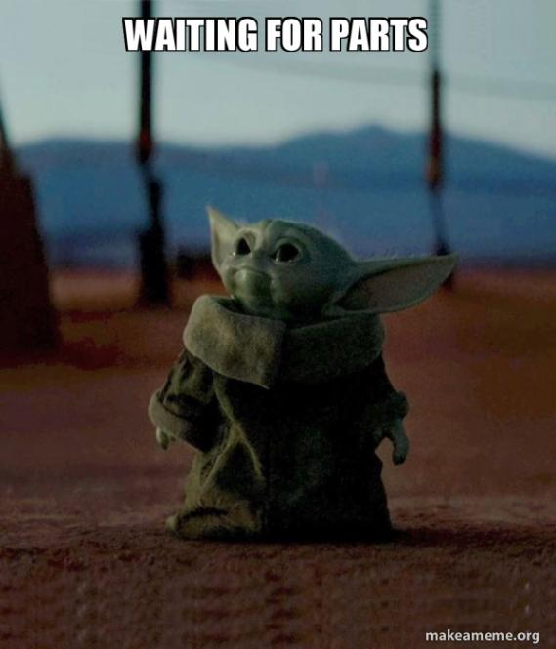

Slide 4
Exam
Wednesday April 17, 2024
9:00 AM
Rooms: ????

Slide 5
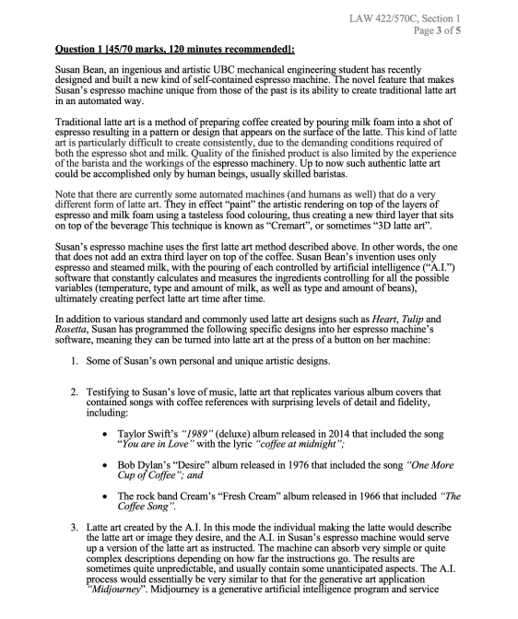

Slide 6
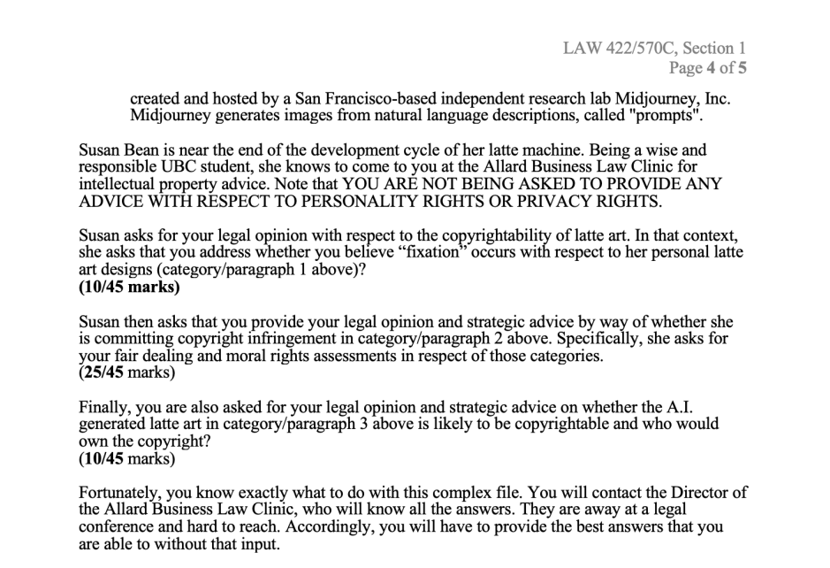

Slide 7
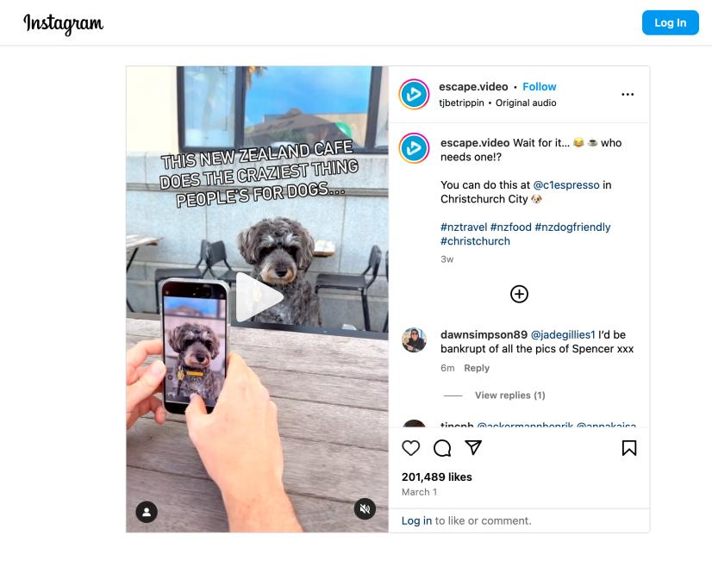

Slide 8
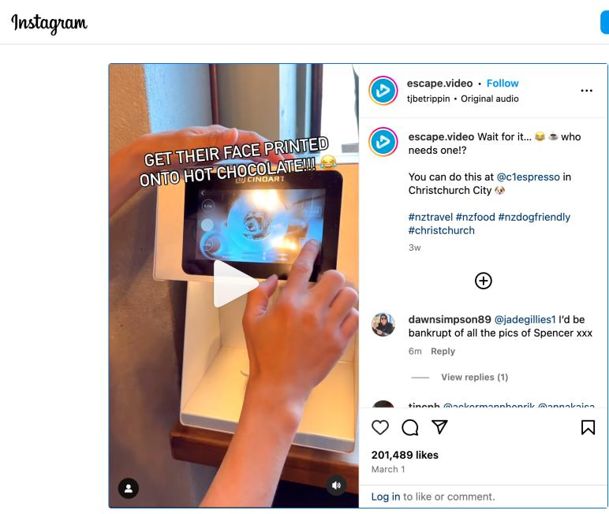

Slide 9
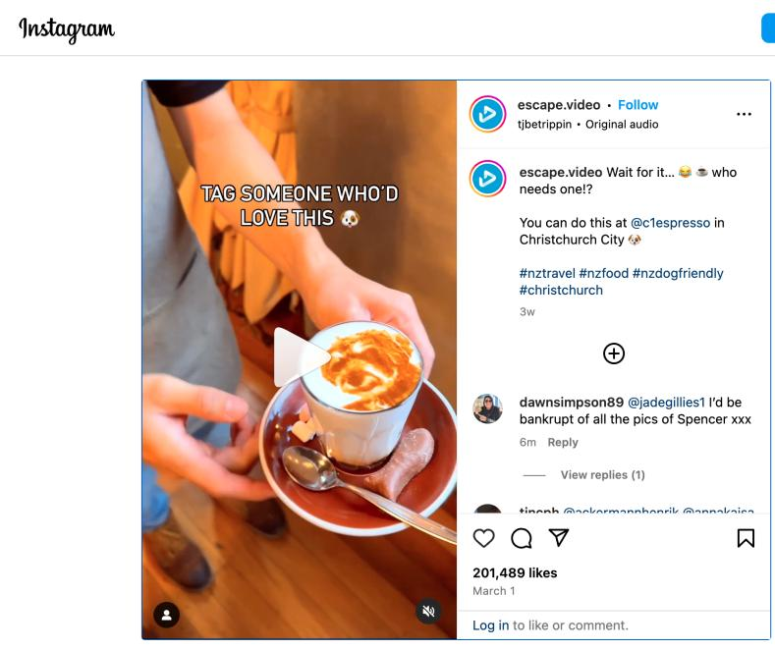

Slide 10
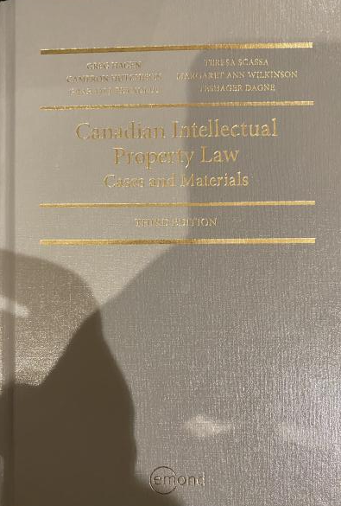
Text: Let me know if any issues @ Bookstore

Slide 11
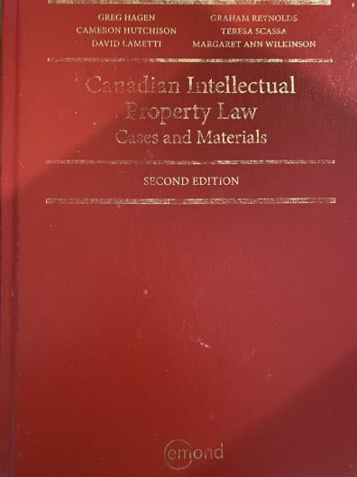
Former Text

Slide 12
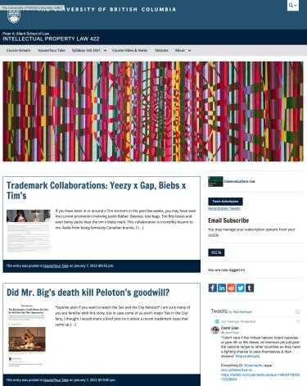
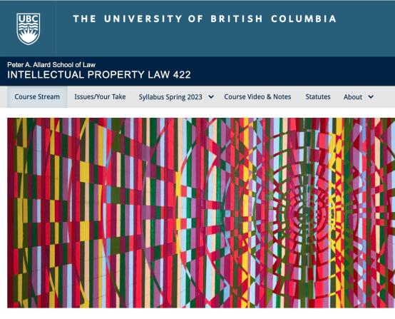
Course Website
https://iplaw.allard.ubc.ca/

Slide 13
PLEASE
SIGN UP

Slide 14
For full privileges on the website
1. Please create an account at http://cms.ubc.ca/ using your CWL.
2. Once you create an account and sign in at http://cms.ubc.ca/ you can click your name in the top right. Halfway down the following page will be your WordPress email address.
3. Send me your WordPress email address at jon.festinger@ubc.ca or at jon_festinger@thecdm.ca
4. Then, I will invite you to participate with authoring privileges via your WordPress email address.

Slide 15

Have responded to everyone?
+
…to some who didn’t ask?

Slide 16
Why post?
Engaging and engaging others is the key.
Because you don’t love speaking up in class.
Because you just saw or realized something, and you’ll never remember it unless you post it now.

Slide 17
Tips:
Don’t feel your posts have to be perfect. Engaging and engaging others is the key.

Slide 18
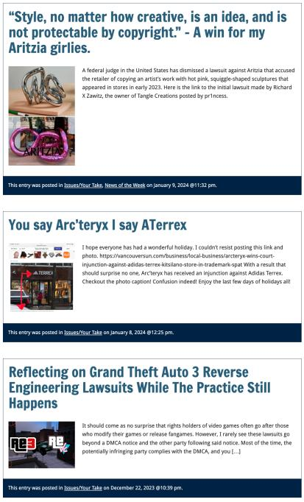

Slide 19

Anything & everything can be done via email if you prefer

Slide 20
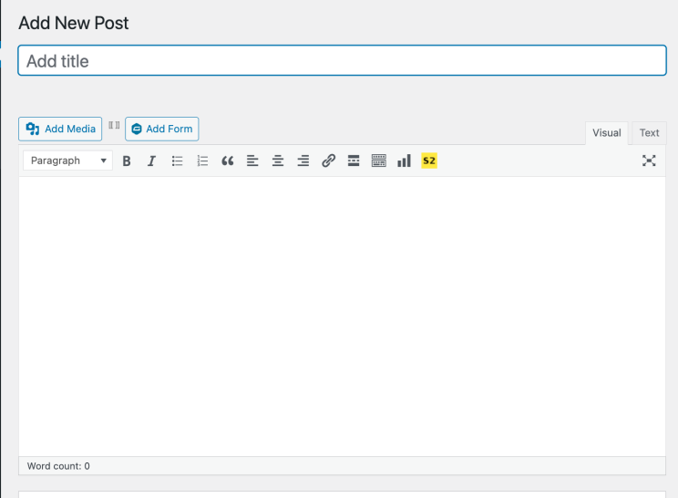

Adding Images

Slide 21



Slide 22
Adding Links

Slide 23
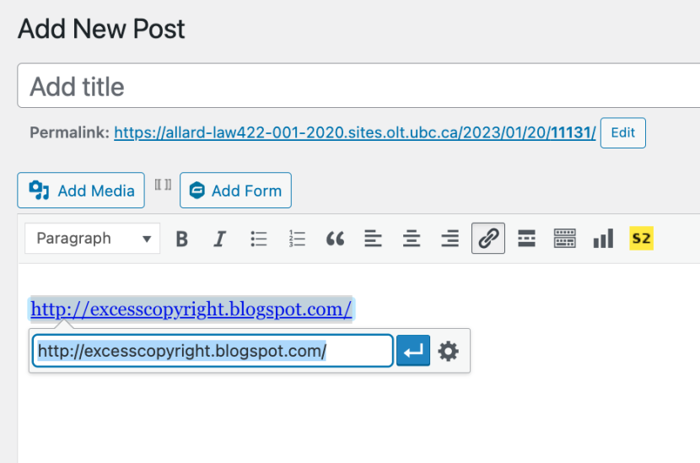


Slide 24
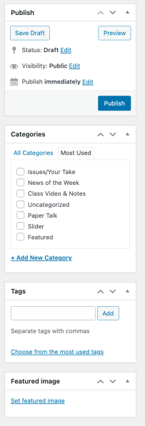

Adding a “Featured Image”

Slide 25


Slide 26
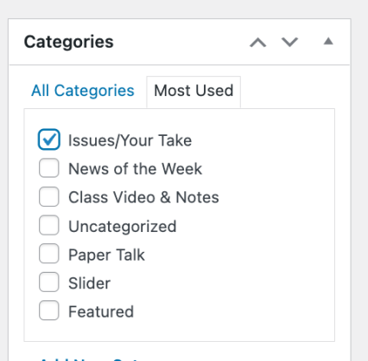

Setting Categories

Slide 27
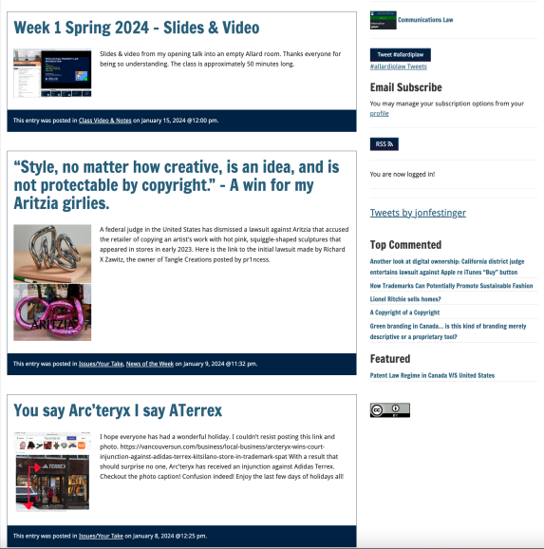
Creative Commons License

Slide 28
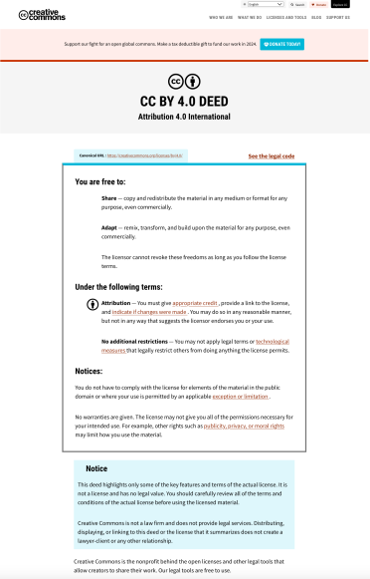
What CTLT will do…

Slide 29
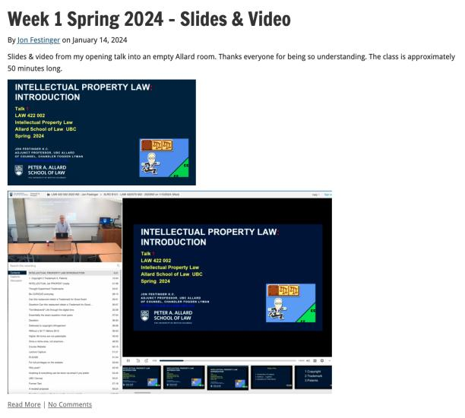
Lecture Capture

Slide 30
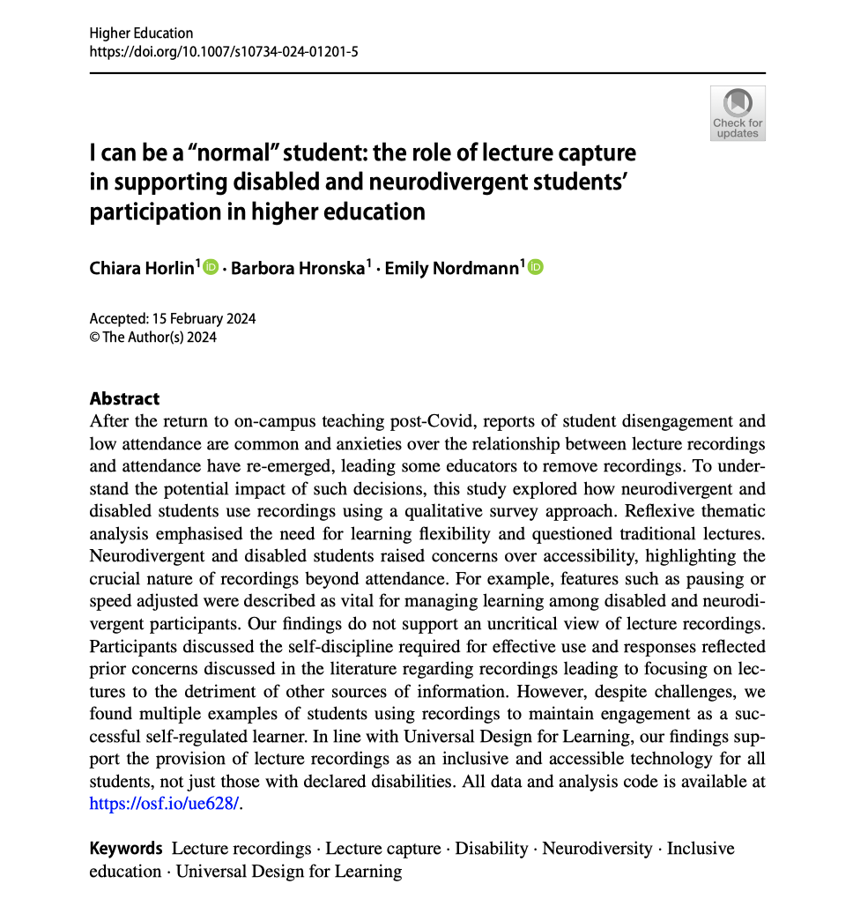

Slide 31
Syllabus

Slide 32
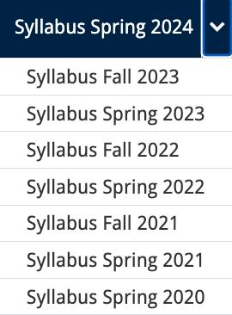




Slide 33
Features of this Course
70% Exam not 100%
IP Law “In Context”
Website

Slide 34
Let’s talk about…
The 30%

Slide 35
A modest proposal…
Approximately 1000 words (or equivalent) per person
written, video, podcast, in-class presentation (?), interpretive dance
Website or not
Groups or individually
LLM Students – one extra post

Slide 36
Past Presentations: Most are on the course website…

Slide 37
Generative A.I. Policy
1. It is source material, therefore
must be cited
2. You are responsible for the quality
of your source material, so check…
If it is wrong, you are wrong
If it plagiarized, you’ve plagiarized

Slide 38

Office “Hours”: Ideally Tuesdays just after class but am flexible…
Email: jon.festinger@ubc.ca; jfestinger@telus.net
Office: 449
Phone:
c. 604-837-6426
(please text if urgent)

Slide 39
Entirely optional but please…
…email me a short bio of yourself referencing:
Anything at all you want to say about yourself
Your academic interests
What you might like to get out of this course (I.E., interest in a type of patent, or a copyright issue etc.)
Favorite Intellectual Property (ies) - current or all-time

Slide 40
Zoom Q&A Sessions
(Study Groups Preferred If Possible)

Slide 41
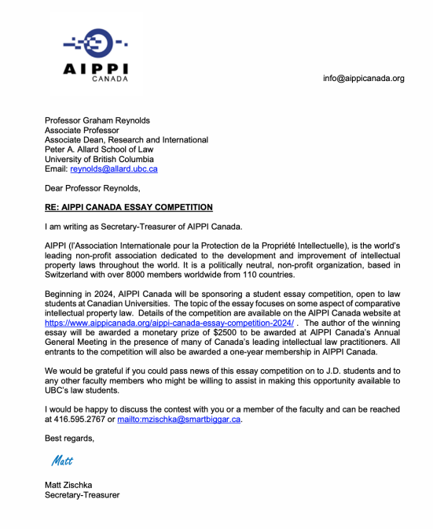

Slide 42
QUESTIONS?
THOUGHTS?
DISCUSSION?

Slide 43

Pause

Slide 44
Posts of
the Week

Slide 45
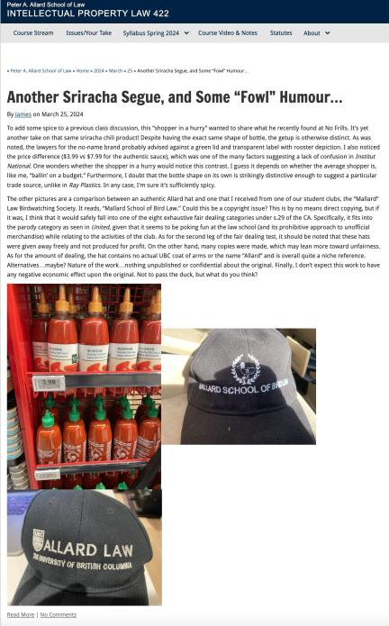

Slide 46
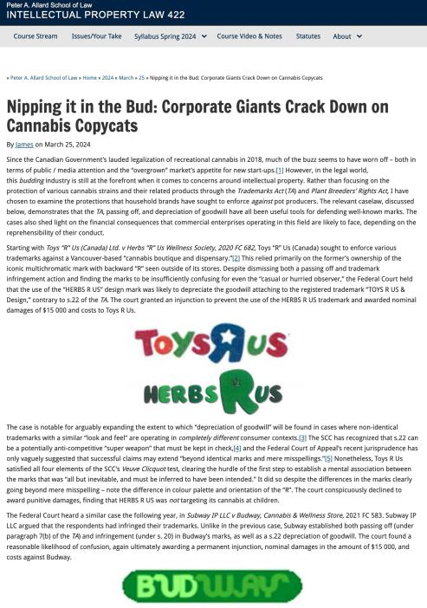

Slide 47
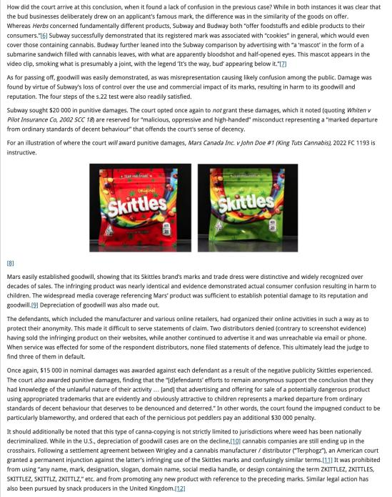

Slide 48
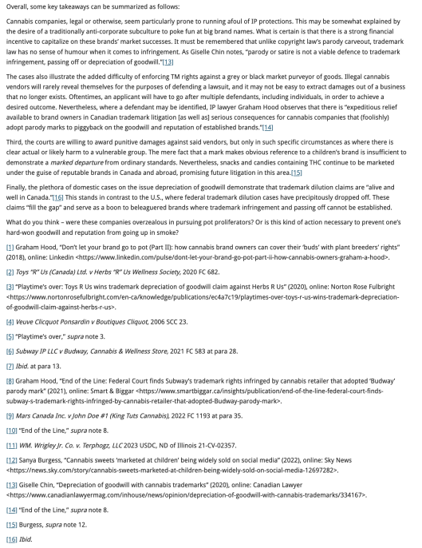

Slide 49
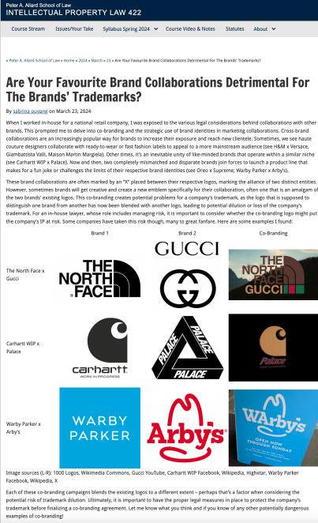

Slide 50
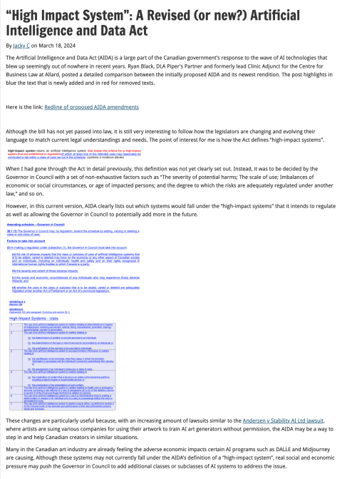

Slide 51
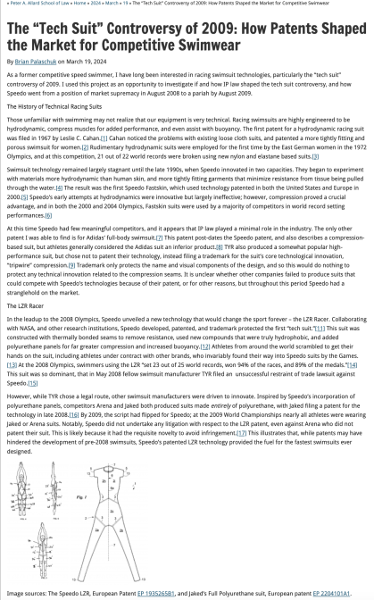

Slide 52
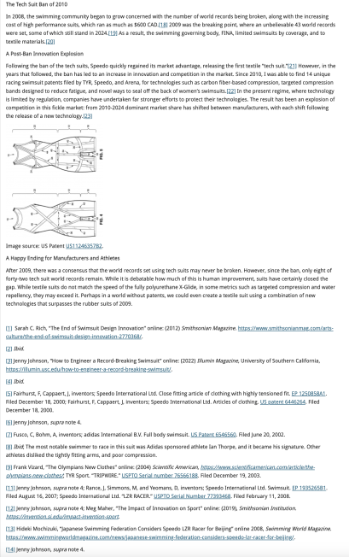

Slide 53
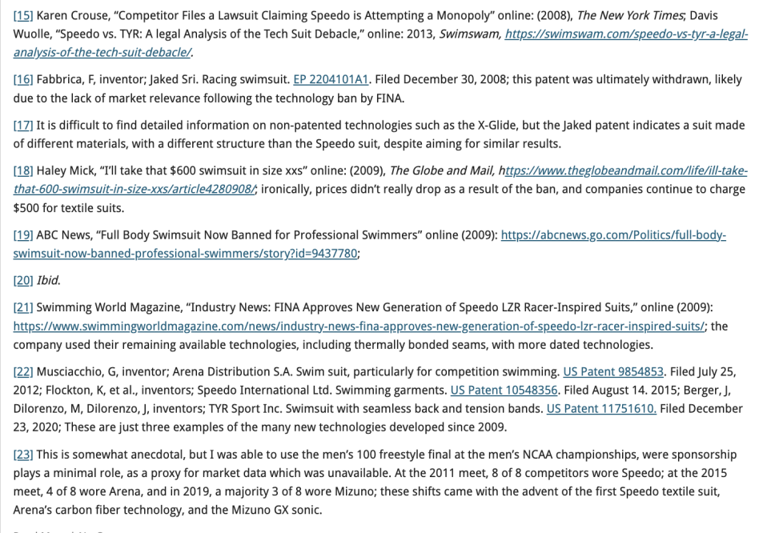

Slide 54
QUESTIONS?
THOUGHTS?
DISCUSSION?

Slide 55
Pause

Slide 56

Where we have been…

Slide 57
Intellectual Property Law is about:
What kinds of creations of the mind can one have rights in?
Who can have those rights?
What kinds of rights are there; and how are those rights enforced?

Slide 58
Trademarks
What is a Trademark ™?
  A mark used by a person for the purpose
  of distinguishing that person’s goods or
  services from those of others in the
  marketplace
Various types of marks
  Ordinary (word & design), certification,
  collective, official, distinguishing guise

Slide 59

Trademarks
Ordinary marks
  Distinguish the products or services of a specific firm or individual

Slide 60
Trademarks v. Passing Off*
Why would you want to register your TM?
Why not just rely on passing off?
TM = no proof of goodwill required. Only proof of use.
Registration of a mark provides national protection
Registered marks are presumed valid for Canada for all the wares and services for which they are registered.
s. 22 of the TMA protects against mark dilution.
In situations where a mark is deemed invalid, a passing off action might still succeed.
* You will see this slide again later

Slide 61
Trademarks
Certification marks
  Identify wares or services which meet defined standards.
  Can be used by anyone who complies with the standards defined by the owner of the certification mark; and who is licensed by the owner
  Owned by one person but licensed to others
  Defined in s. 2 of the TMA

Slide 62

Trademarks
Collective marks
  Signs that distinguish the geographical origin, material, mode of manufacture or other common characteristics of goods or services of enterprises using the collective mark
  Function: inform public about certain features of the product
  Owned by an entity; members of this entity are entitled to use the mark.

Slide 63

Trademarks
A purely functional design may not be the basis of a TM, registered or unregistered
  See Kirkbi v. Ritvik (SCC)

Slide 64
Old Concept of Marks
Ordinary marks
  S. 2: definition of trade-mark (in part): (a) a mark that is used by a person for the purpose of distinguishing or so as to distinguish goods or services manufactured, sold, leased, hired or performed by him from those manufactured, sold, leased, hired or performed by others.

Slide 65
Trademarks
Ordinary marks
Amended definition (2014 - in effect 2019):
  TM: A sign or combination of signs that is used or proposed to be used by a person for the purpose of distinguishing or so as to distinguish their goods and services from those of others.
  Sign: Includes a word, a personal name, a design, a letter, a numeral, a colour, a figurative element, a three-dimensional shape, a hologram, a moving image, a mode of packaging goods, a sound, a scent, a taste, a texture, and the positioning of a sign.

Slide 66
Trademarks
S. 12(1): A TM is registrable if it is not:
  (a) Primarily merely a name or surname of an individual living or who has died within 30 years
  (b) Clearly descriptive or deceptively misdescriptive in English or French of the character/quality of wares/services or of the conditions of production/persons employed in their production/place of origin

Slide 67
Trademarks
S. 12(1): TM is registrable if it is not:
  (c) Name in any language of any of the wares or services in connection with which it is used
  (d) Confusing with a registered TM (confusing defined in s. 6(2); factors in s. 6(5))
  (e) Mark prohibited by s. 9 or 10…
  S. 12(2): not registrable if its features are dictated primarily by a utilitarian function
  S. 12(3): If not registrable due to (1)(a) or (b), is registrable if has … become distinctive at the date of filing an application for registration (see also s. 32)

Slide 68
Trademarks
Ordinary marks
Amended definition (2014 - in effect 2019):
  TM: A sign or combination of signs that is used or proposed to be used by a person for the purpose of distinguishing or so as to distinguish their goods and services from those of others.
  Sign: Includes a word, a personal name, a design, a letter, a numeral, a colour, a figurative element, a three-dimensional shape, a hologram, a moving image, a mode of packaging goods, a sound, a scent, a taste, a texture, and the positioning of a sign.

Slide 69
Trademarks
Canada (Registrar of TMs) v. Coles Book Stores, [1974] SCR 438
  1) Is the mark a word?
    Standard Oil Co. v. Canada (Registrar of TM), [1968] 2 Ex C.R. 523.
  2) Is it primarily merely a name or surname of an individual who is living or who has died within the previous 30 years?

Slide 70
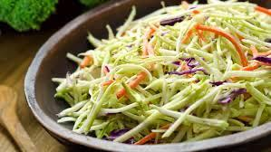
“Cole” as in “slaw” argument failed

Slide 71
“In the case at bar, the evidence clearly establishes that “Coles” is a surname that is well-known to the general public of Canada. On the other hand, the dictionary meanings of the word “cole” and in its plural form “coles”, particularly as found in the Oxford English Dictionary, are largely obsolete. A customer in need of a cabbage does not ask for a “cole”. The only common use of the word that I can think of is in the word “coleslaw”. The inference I draw from the evidence concerning the dictionary definitions of the word “cole” is that it is a word of rare, if not obsolete, usage and would be little known to the general public of Canada. I do not agree with the conclusion of the learned judge of the Exchequer Court that the principal character of the word “Coles” is “equally that of a surname and of a dictionary word in the English language.” My only possible conclusion in this case is that a person in Canada of ordinary intelligence and of ordinary education in English or French would immediately respond to the trade mark “Coles” by thinking of it as a surname and would not be likely to know that “Coles” has a dictionary meaning.”

Slide 72
Trademarks
Test to Apply: Would a person in Canada
of ordinary intelligence and of ordinary
education in English or French be just as
likely, if not more likely, to respond to the
word by thinking of it as a brand or a
mark of a business than as a name/surname?

Slide 73
Trademarks
Unilever Canada Inc. v. Superior Quality Foods Inc. (2007), 62 CPR (4th) 75, [2007] TMOB No. 66
Facts: Superior Quality Foods, Inc. filed an application to register the TM BETTER THAN BOULLION for use in association w. soups and soup bases.
Issue: s. 12(1)(b) …Is the mark clearly descriptive or deceptively misdescriptive in the English or French language of the character or quality of the wares or services in association with which it is used or proposed to be used or of the conditions of or the persons employed in their production or of their place of origin.

Slide 74
Trademarks
Unilever Canada Inc. v. Superior Quality Foods Inc. (2007), 62 CPR (4th) 75, [2007] TMOB No. 66
Clearly descriptive = does the mark tell potential dealers/purchasers of the goods/services what the goods and services are, or describe them or describe a property which is commonly associated with them?

Slide 75
Trademarks
  Unilever Canada Inc. v. Superior Quality Foods Inc. (2007), 62 CPR (4th) 75, [2007] TMOB No. 66
  Deceptively misdescriptive = would dealers/purchasers of the goods be deceived by the misdescription into purchasing goods or ordering services which different in character or quality from those expected?

Slide 76
Trademarks
  Unilever Canada Inc. v. Superior Quality Foods Inc. (2007), 62 CPR (4th) 75, [2007] TMOB No. 66
S. 12(1)(b):
  Point of View?: That of the average purchaser of the wares
  Consider the mark in its entirety (not dissected into constituent elements)
  Consider thee mark as a matter of immediate impression

Slide 77
Trademarks
  Unilever Canada Inc. v. Superior Quality Foods Inc. (2007), 62 CPR (4th) 75, [2007] TMOB No. 66
S. 12(1)(b):
  Clearly = easy to understand, self-evidence, plain
  Character = feature, trait, characteristic of wares
  Quality = degree of excellence; laudatory description (i.e., expressing praise)

Slide 78
Trademarks
  Unilever Canada Inc. v. Superior Quality Foods Inc. (2007), 62 CPR (4th) 75, [2007] TMOB No. 66
Decision: “The Mark … clearly describe[s] as a matter of first impression that the Applicant’s soups and soup bases are ‘better than boullion’, a laudatory description that is contrary to s. 12(1)(b)”
Policy justification: This is an ordinary, grammatical phrase that others in the industry should be able to use to fairly describe their products. / different decision - “the vocabulary of the English language is common property: it belongs to all” (Eastman Photographic Materials Company Ltd. v. Comptroller-General of Patents, Designs and Trade Marks, [1898] A.C. 571 (H.L.), Lord Herschell at page 580 ”

Slide 79
Trademarks
General Foods Ltd. v. Carnation Co. (1978), 45 CPR (2d) 282 (TMOB)
Can GFL register the TM “Instant Breakfast” for use in association with wares described as “fortified powder food for mixing with milk”?
S. 12(1): TM is registrable if it is not (c) Name in any language of any of the wares or services in connection with which it is used
Also s.30(a) of the Trademarks Act in setting specifics for TM applications requires that applications must contain “a statement in ordinary commercial terms of the specific goods or services in association with which the mark has been or is proposed to be used.”
Are the words “fortified powder food for mixing with milk” ordinary commercial terms? Board held no. Statement in ordinary commercial terms for the product would be “instant breakfast”.
Accordingly, application to register the TM Instant Breakfast, which is also the name of the wares in English was found not registrable per s. 12(1)(c).

Slide 80
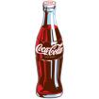
Trademarks - changes
Distinguishing guise provisions repealed in 2019
  The shape or design of the product or packaging that effectively distinguishes the product from others. In order for a distinguishing guise to be registered, it must be proven that it has become distinctive through usage.
  S. 13 Trademarks Act REPEALED
  Example: shape of Coca-Cola bottle

Slide 81
Instead of “distinguishing guise”
s. 2 …“sign includes a word, a personal name, a design, a letter, a numeral, a colour, a figurative element, a three-dimensional shape, a hologram, a moving image, a mode of packaging goods, a sound, a scent, a taste, a texture and the positioning of a sign;”

Slide 82
Trademarks
Distinguishing guise
Now that distinguishing guises have ceased to exist as a separate category of TM, similar limitations to those set out in the previous s. 13(1) will be carried over elsewhere, and will apply to all marks

Slide 83
Trademarks
Distinguishing guise
New 12(2): A trademark is not registrable if, in relation to the goods or services in association with which it is used or proposed to be used, its features are dictated primarily by a utilitarian function
New 18.1: The registration of a trademark may be expunged by the Federal Court on the application of any interested person if the Court decides that the registration is likely to unreasonably limit the development of any art or industry
20(1.2): The registration of a trademark does not prevent a person from using any utilitarian feature embodied in the trademark

Slide 84
Trademarks
Glaxo Wellcome Inc. v. Novopharm Ltd (2000)
Glaxo sought registration the distinguishing guise for a six sided tablet, shaped as a shield.
Principles
  Not required to show that most adult Canadians recognize the applicant’s distinguishing guise
  Although the shape of a product can constitute a mark, the mark is usually weak
  The standard of proof in distinguishing guise cases under is the same as in other registration cases
  Relevant period of time for distinctiveness → date of application

Slide 85
Trademarks : Special Marks
S. 9 Trademarks Act
Two categories of prohibited marks
  Absolute prohibitions
  Official marks (9(1)(n)(iii))
What policy reasons could justify including
a type of symbol/mark on the list of absolute
prohibitions?

Slide 86
Trademarks
S. 9(1)(n)(iii):
  Allows entities which are “public authorities”
  to request the Registrar of Trade-marks to
  give public notice of their adoption and use of
  particular names or symbols. These marks
  are referred to as “official marks”.
  Once notice is given, these official marks are
  also removed from the general realm of trade
  and commerce.

Slide 87
Trademarks
S. 9(1)(n)(iii) is controversial
S. 9(1) prohibits anyone else from adopting an official mark. This prohibition is absolute.
None of the usual formalities for the adoption of official marks
No opposition proceeding; no scrutiny by Registrar
Mark can be descriptive; not required to be distinctive of wares, services
No need to renew; no provisions to remove unused marks

Slide 88
Trademarks
Ontario Ass’n of Architects v. Ontario Assn of Architectural Technologists, [2003] 1 F.C. 331 (FCA)
Public notice was given that the Association of Architectural Technologists of Ontario, a self-regulatory professional body and Ontario non-for-profit corporation without share capital, adopted and used as official marks for services – the words ARCHITECTURAL TECHNICIAN, ARCHITECTE-TECHNICIEN, ARCHITECTURAL TECHNOLOGIST, ARCHITECTE-TECHNOLOGUE. As a result, members of the appellant, the Ontario Association of Architects ("OAA"), can be prevented from using these words in connection with their professional services - unless they had started to use them before April 28, 1999, the date when the Registrar gave public notice in the Trade-marks Journal of their adoption and use by the AATO as official marks.

Slide 89
Trademarks
Ontario Ass’n of Architects v. Ontario Assn of Architectural Technologists, [2003] 1 F.C. 331 (FCA)
Defining characteristics of public authority =
  Degree of government control [para. 57-64]
  Extent to which the body’s activities benefit the public [para. 65-73]

Slide 90
Trademarks
1. Significant degree of governmental control
More rigorous part of test
Consider body’s objects, duties and powers, including distribution of its assets
Need some ongoing government supervision of the activities of the body claiming to be a public authority; sufficient to allow the government to exercise a degree of ongoing influence in the body’s governance and decision-making.

Slide 91
Trademarks
2. Public benefit
Broadly interpreted by the courts – some aspect for public benefit? Considered to act for public benefit.
In this case the Architectural Technologists set & enforce standards of professional competence & ethical conduct of its members.
As a result, FCA held that the Technologists regulate part of the practice of the profession. The lower court judge concluded that these activities benefit the public, and the FCA agreed.

Slide 92
Trademarks
A TM owner who has a registered mark that resembles an official mark effectively has their rights frozen at the time of publication of the official mark
  See Royal Roads University v. R. (2003), 27 CPR (4th) 240 (F.C.)

Slide 93
QUESTIONS?
THOUGHTS?
DISCUSSION?

Slide 94
Pause

Slide 95


Slide 96
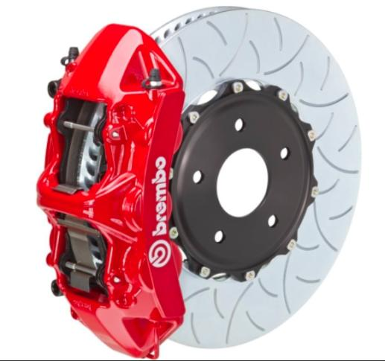

Slide 97

Random Notes 1

Slide 98
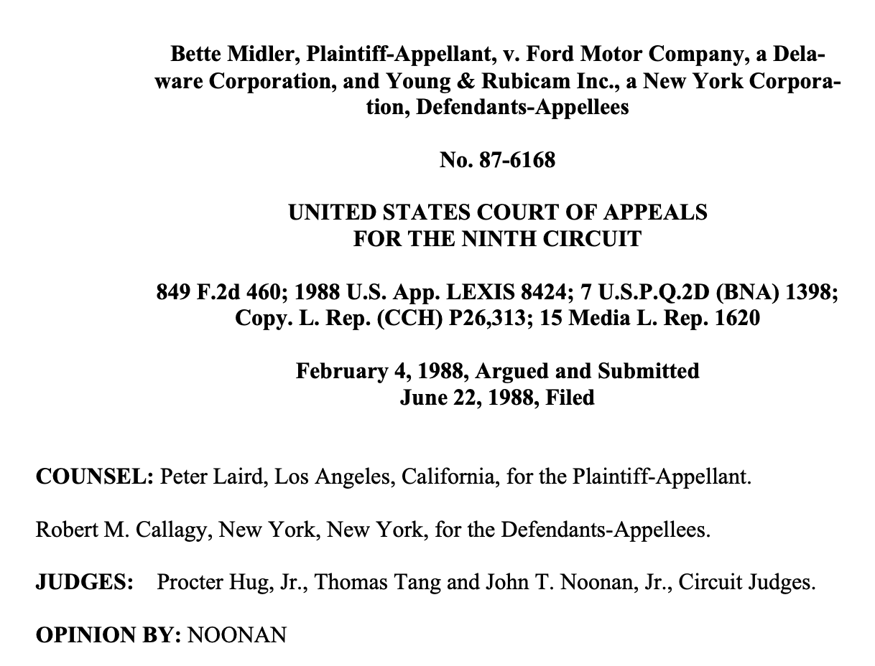

Slide 99
The appellate court ruled that the voice of someone famous as a singer is distinctive to their person and image and therefore, as a part of their identity, it is unlawful to imitate their voice without express consent and approval. The appellate court reversed the district court’s decision and ruled in favor of Midler, indicating her voice was protected against unauthorized use.

Slide 100
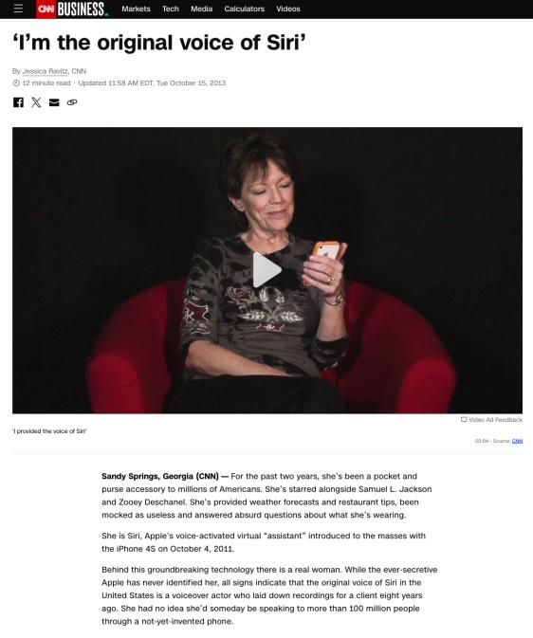

Slide 101
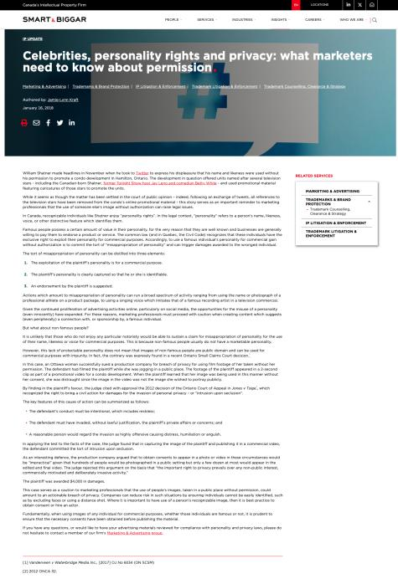

Slide 102
Random Notes 2

Slide 103
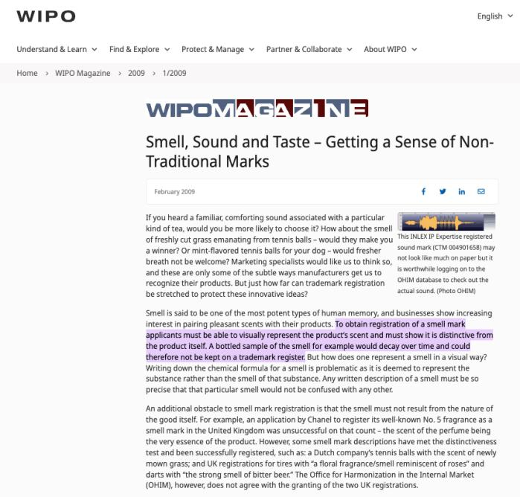

Slide 104
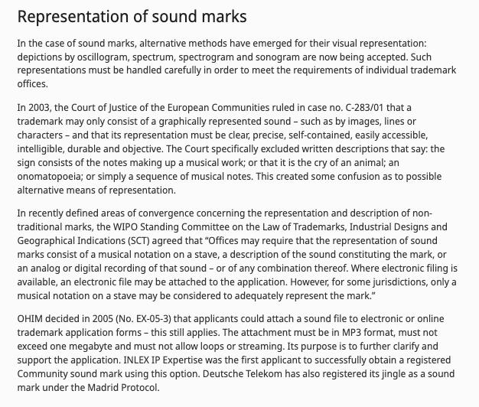

Slide 105
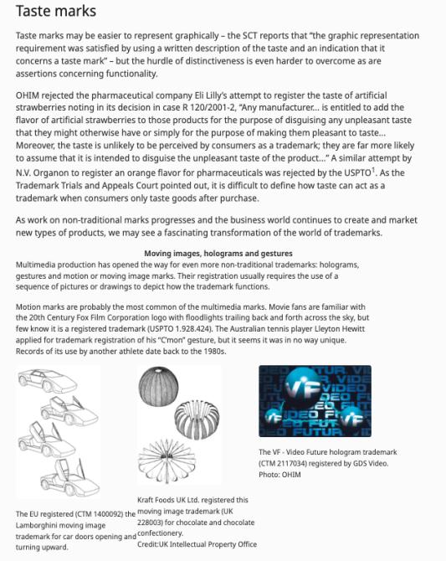

Slide 106
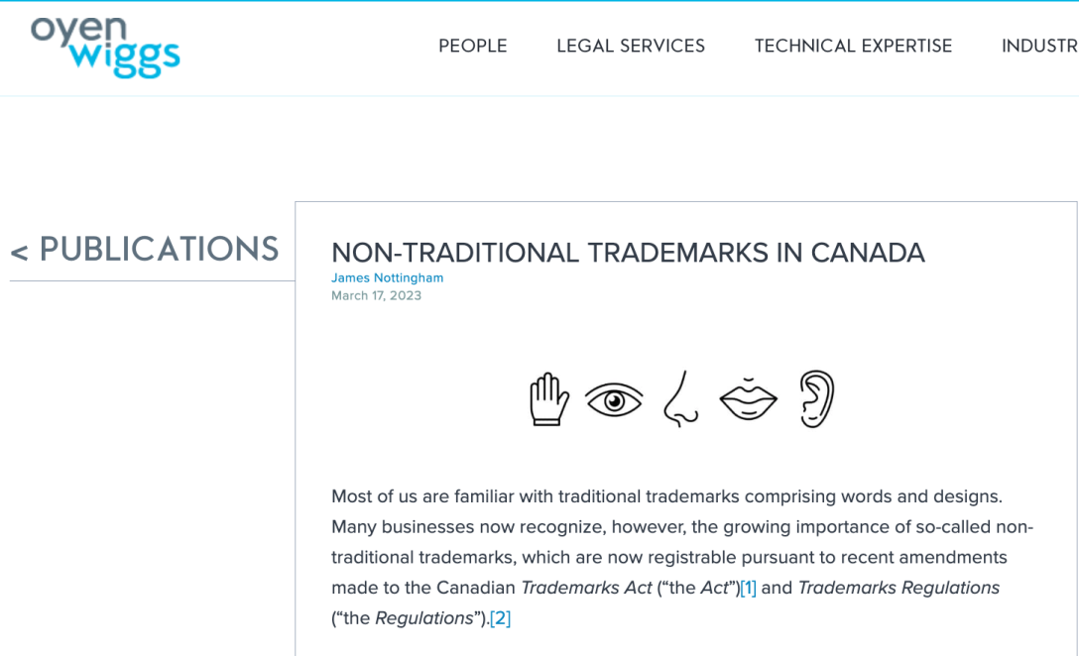

Slide 107
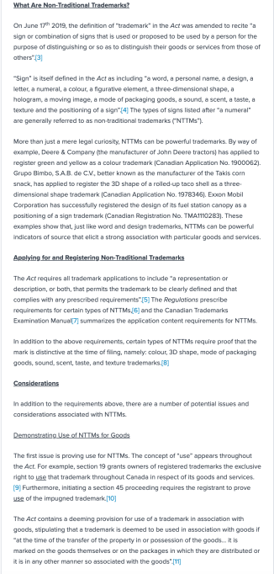

Slide 108
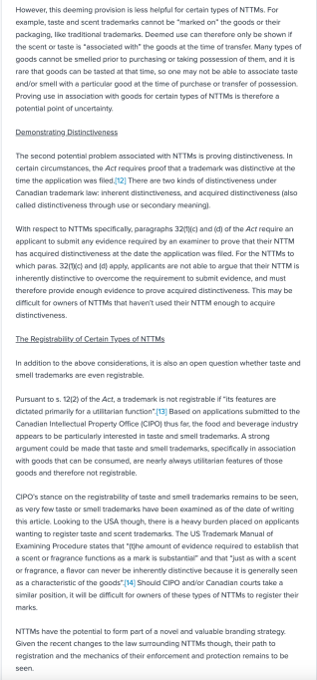

Slide 109
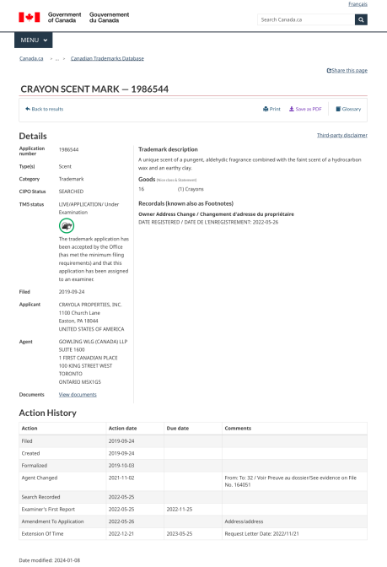

Slide 110
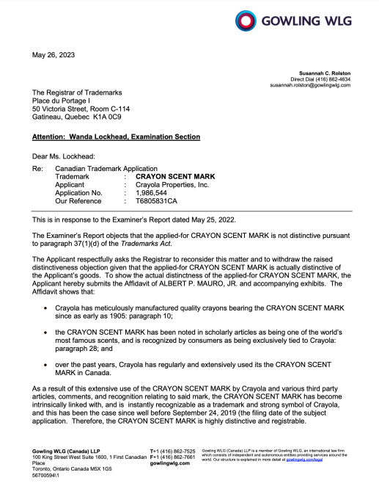

Slide 111
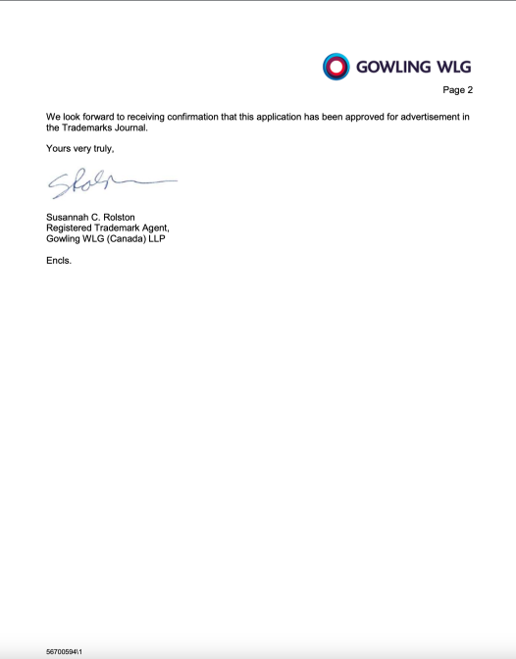

Slide 112
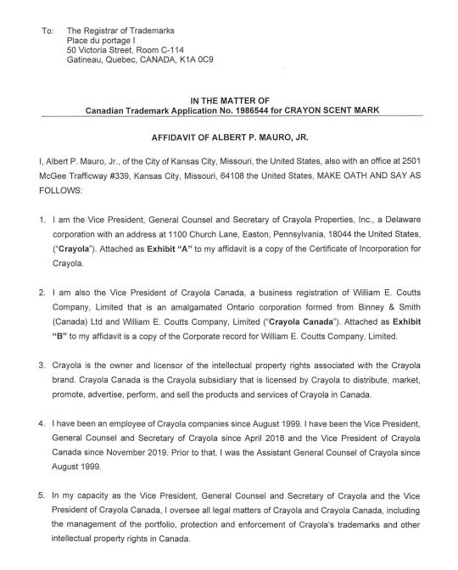

Slide 113
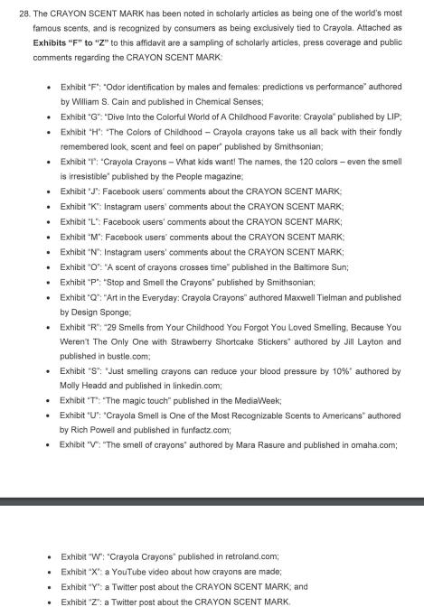

Slide 114
Random Notes 3

Slide 115
Copyright Act 1709 8 Anne c.21;
long title:
An Act for the Encouragement of Learning,
by vesting the Copies of Printed Books in the
Authors or purchasers of such Copies,
during the Times therein mentioned.

Slide 116
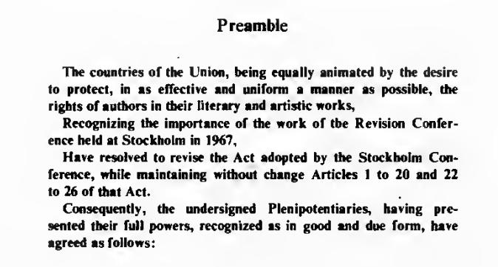
Berne Convention

Slide 117
Copyright Act R.S.C., 1985, c. C-42
An Act respecting copyright
Trademarks Act R.S.C., 1985, c. T-13
An Act relating to trademarks and unfair competition
Patent Act R.S.C., 1985, c. P-4
An Act respecting patents of invention

Slide 118
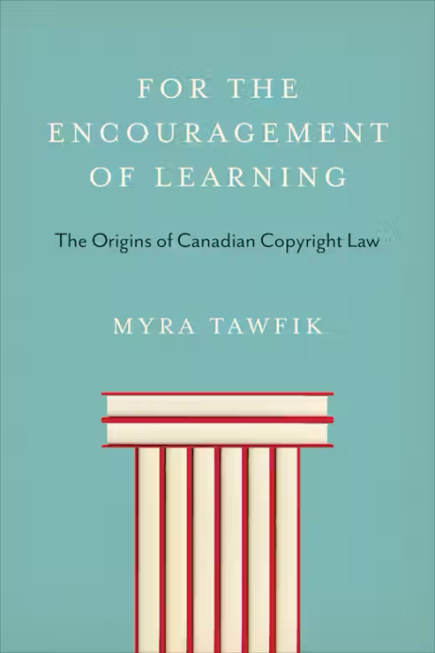

Slide 119
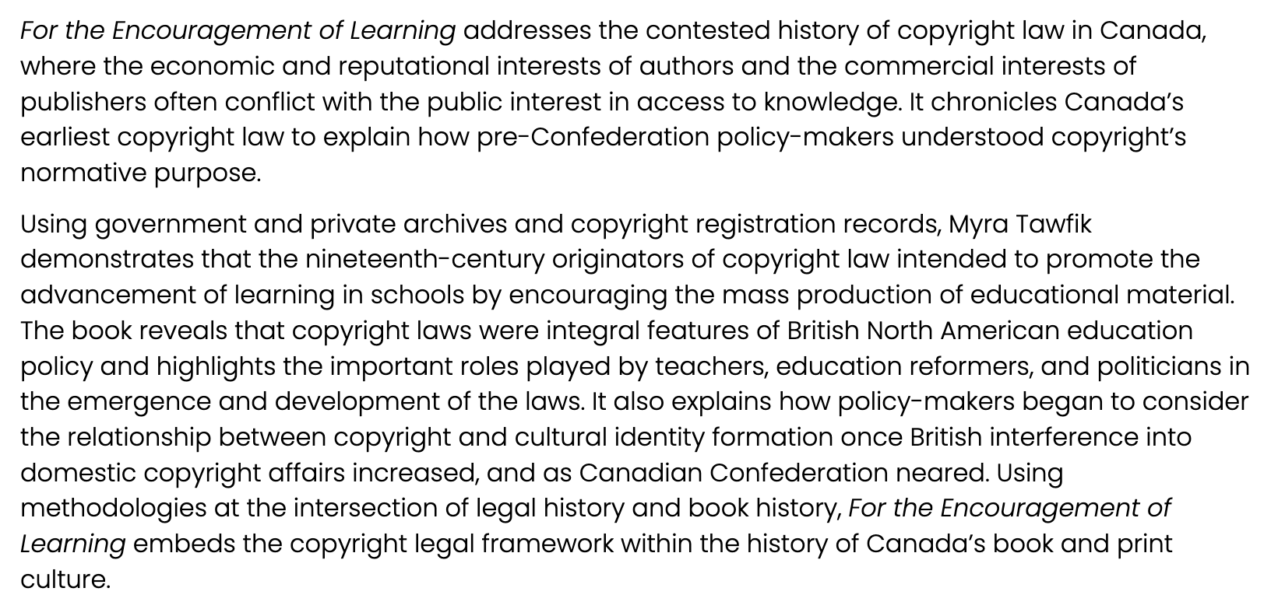

Slide 120
Random Notes 4

Slide 121


Slide 122


Slide 123
Random Notes 5

Slide 124




Slide 125


Slide 126


Slide 127


Slide 128


Slide 129
More to come?

Slide 130
QUESTIONS?
THOUGHTS?
DISCUSSION?

Slide 131
Pause

Slide 132

Now, to our regularly
scheduled programming…

Slide 133

On with the show…

Slide 134

Continuing
Trademarks

Slide 135
Trademarks : Special Marks
S. 9 Trademarks Act
Two categories of prohibited marks
  Absolute prohibitions
  Official marks (9(1)(n)(iii))
What policy reasons could justify including
a type of symbol/mark on the list of absolute
prohibitions?

Slide 136
Trademarks: Applying the provision
MARK/NUMBER
Land of Anne 907857
The Anne Collection 907535
Red-Haired Anne 909009
Rainbow Valley 909010
Gilbert Blythe 909011
Akage No Anne 909012
Avonlea 909013
Matthew Cuthbert 909014
Anne of Green Gables The Musical 909015
Anne with an "E" 909016
Marilla Cuthbert 909017
Josie Pye 909018
Road to Avonlea 909019
Kindred Spirits 909020
Rilla of Inglesides 909021
Anne of Avonlea 909022
Anne Shirley 909023
Diana Barry 909024

Slide 137

Trademarks

Slide 138

Trademarks

Slide 139
Trademarks
“170 The PEI government has significant influence and control with respect to the Anne Authority. The PEI government has members on the Anne Authority committee. The PEI branch of that committee controls all licensing in Prince Edward Island. One of the prime objectives, from the government perspective, was to protect the local craft industry in the Province, freeing it from costly licenses but maintaining a uniform-quality Anne image. The Province is partnered with the Heirs, who share a philanthropical and financial objective with respect to protecting and promoting a licensed Anne image. Applying the combined test of control, influence and purpose to promote the public good, I conclude that the Anne Authority is a public authority. If it was necessary to determine the issue, I would in all of the circumstances conclude that the Anne Authority is a public authority. Therefore, the Assignment Agreement that conveyed rights from the PEI government to the Anne Authority would be valid.”
(Anne of Green Gables Licensing Authority Inc. v. Avonlea Traditions Inc. (2000), 4 C.P.R. (4th) 289

Slide 140
QUESTIONS?
THOUGHTS?
DISCUSSION?

Slide 141
Pause

Slide 142
Random Notes 6

Slide 143

S. 9(1)(o): “Royal Canadian Mounted Police” or “R.C.M.P.”

Slide 144



Slide 145


Slide 146
QUESTIONS?
THOUGHTS?
DISCUSSION?

Slide 147
Pause

Slide 148
Random Notes 7

Slide 149


Slide 150


Slide 151


Slide 152
QUESTIONS?
THOUGHTS?
DISCUSSION?

Slide 153
Pause

Slide 154
On with the show…

Slide 155
Trademarks : Use
USE IT
OR
LOSE IT?

Slide 156
Trademarks
“Use”
First use … entitles you to register a TM but amended provisions now allow for filing without intended use.
Failure to use … basis for expungement of TM
Unauthorized use … could lead to infringement actions

Slide 157
Trademarks
4. (1) A trade-mark is deemed to be used in association with goods if, at the time of the transfer of the property in or possession of the goods, in the normal course of trade, it is marked on the goods themselves or on the packages in which they are distributed or it is in any other manner so associated with the goods that notice of the association is then given to the person to whom the property or possession is transferred.
(2) A trade-mark is deemed to be used in association with services if it is used or displayed in the performance or advertising of those services.

Slide 158
Trademarks
Syntex Inc. v. Apotex Inc., [1984] 2 FC 1012 (FCA)
Facts:
  Syntex was the registered owner of the TradeMark Naprosyn; has sold Naproxen under this name since 1974.
  Apotex took Apo-Naproxen as the brand name of its product; registered it as a TM in Canada.
  In 1982 Apotex distributed a one-page flyer to hospital and retail pharmacists in Canada designed to promote the sale of Apo-Naproxen. Naprosyn was referenced on this flyer… A note w. Naprosyn 250mg written on it is juxtaposed with two containers of Apo-Naproxen tablets.
  Also, a message …“Now pharmacists have a choice when filling a prescription for Naprosyn.”…

Slide 159
Trademarks
Syntex Inc. v. Apotex Inc., [1984] 2 FC 1012 (FCA)
Did the Defendants Apotex “use” the TM of the Plaintiffs Syntex (see ss. 2, 4 TMA)?
  4. (1) A trade-mark is deemed to be used in association with goods if, at the time of the transfer of the property in or possession of the goods, in the normal course of trade, it is marked on the goods themselves or on the packages in which they are distributed / or it is in any other manner so associated with the goods that notice of the association is then given to the person to whom the property or possession is transferred.

Slide 160
Trademarks
Syntex Inc. v. Apotex Inc., [1984] 2 FC 1012 (FCA)
  4. (1) A trade-mark is deemed to be used in association with goods if, at the time of the transfer of the property in or possession of the goods, in the normal course of trade, … it is in any other manner so associated with the goods that notice of the association is then given to the person to whom the property or possession is transferred.

Slide 161

Trademarks
Syntex Inc. v. Apotex Inc., [1984] 2 FC 1012 (FCA)
Court said on this point… “It seems to me that the respondents (Syntex) face considerable difficulty in establishing at trial that the presence of the trade mark “Naprosyn” in the appellant’s flyer constituted a “use” that is contrary to subsection 22(1) of the Trade Marks Act”

Slide 162
Trademarks
Specialty Software Inc. v. Bewatec Kommunikationstechnik GMBH 2016 FC 223
Specialty Software Inc. registered the TM “MEDINET” in association w. computer software programs.
Mark was registered in relation to wares, not services.
…2013 – Bewatec attempted to have this mark expunged from the register.
To avoid expungement, Specialty had to show evidence of its use of the mark between November 22, 2010, and November 22, 2013.
Ultimately, Specialty provided evidence of use. But was this use in relation to wares?
Speciality used to sell its software on disks. Now, clients obtain access to the software over the Internet.

Slide 163
Trademarks
Specialty Software Inc. v. Bewatec Kommunikationstechnik GMBH 2016 FC 223
Clients obtain access to software over the Internet (they had previously received a disk containing the software).
Does this mean that Specialty is providing a service as opposed to selling a product?
MyLife.com Inc v Grbic,2014 TMOB 175 (CanLII) says that providing free access to a website was a service.

Slide 164
Trademarks
4 (1) A trade-mark is deemed to be used in association with goods if, at the time of the transfer of the property in or possession of the goods, in the normal course of trade, it is marked on the goods themselves or on the packages in which they are distributed or it is in any other manner so associated with the goods that notice of the association is then given to the person to whom the property or possession is transferred.
Is there a “good” here? If so, what is the good?
The good is the license to use the software.
The property is the right or the entitlement to enjoy the use of the license.
The transfer occurred through the granting of access in the form of login credentials.
The mark is visible throughout this process.
The disk, then, is just one means by which a transfer can occur. It can also occur through other ways (i.e., granting of access in the form of login credentials).

Slide 165
Trademarks
Has a TM been used within the meaning of s. 4(1) “in the normal course of trade” where goods are given away for free, as opposed to being sold?
See Distrimedic Inc. v. Dispill Inc., 2013 FC 1043 [302] … The expression "in the normal course of trade"…requires some payment or exchange, which excludes the use of a trade-mark in situations where the wares are given away for free or donated.

Slide 166
Trademarks
4(2) A trade-mark is deemed to be used in association with services if it is used or displayed in the performance or advertising of those services.

Slide 167
Trademarks
Gesco Industries Inc v. Sim & McBurney (2000) 9 CPR (4th) 480 (FCA)
The Registrar of Trademarks had expunged Gesco's registration of the trademark "Stainshield" for use in association with the services of stain resistant treatment for carpets and rugs.
The Registrar determined that Gesco failed to submit any evidence of use of the trademark.
Gesco appealed the Registrar's decision.
FCA held that when a trademark is used in association with services, the use does not have to occur in the normal course of trade.

Slide 168
Trademarks
Gesco Industries Inc v. Sim & McBurney (2000) 9 CPR (4th) 480 (FCA)
Rothstein J. defines services broadly.
He accepts the reasoning of Strayer J in this regard: [para 10]
No definition of services is given in the Trademarks Act because of the “plethora of services that the human mind is capable of conceiving”
Term should be liberally construed
Each case decided on its own facts, giving proper regard to judicial precedent.
Nothing to suggest that services with respect to which a TM may be established are limited to those which are not incidental or ancillary to the sale of goods.
So … services can include services incidental or ancillary to the sale of goods

Slide 169
Trademarks
Gesco Industries Inc v. Sim & McBurney (2000) 9 CPR (4th) 480 (FCA)
Was the Stainshield TM, in this case, used in association with the services disclosed in the registration of the TM (namely services of stain resistant treatment for application to carpets and rugs)?
Yes; Stainshield TM displayed in the advertising of the treatment of some of Gesco’s lines of carpets and rugs.
Services may be ancillary to the wares, but this doesn’t mean the TM is not used in association with the services. [para 11]
Are there good policy reasons for “use” to be more permissive for services than for goods?

Slide 170
QUESTIONS?
THOUGHTS?
DISCUSSION?

Slide 171
Pause

Slide 172
Trademarks v. Passing Off
Why would you want to register your TM?
Why not just rely on passing off?
TM = no proof of goodwill required. Only proof of use.
Registration of a mark provides national protection
Registered marks are presumed valid for Canada for all the wares and services for which they are registered.
s. 22 of the TMA protects against mark dilution.
In situations where a mark is deemed invalid, a passing off action might still succeed.

Slide 173
Trademarks: Transfer & Licensing
As a TM owner, you can transfer your TM.
Per s. 50 TMA you can also permit another person to use your mark without impairing the distinctiveness of the mark provided that:
    A licence exists
    Certain controls are in place over the quality of the wares What is sufficient control?
See also s. 48, TMA

Slide 174


Trademarks
Tommy Hilfiger Licensing Inc v. Produits de Qualité, 2005 FC 10

Slide 175
Trademarks
Tommy Hilfiger Licensing Inc v. Produits de Qualité, 2005 FC 10
Plaintiff, Tommy Hilfiger Licensing Inc. (THLI), owned the trademarks relating to the Tommy Hilfiger brand which manufactured and sold clothing.
Defendant, Quality Goods I.M.D. Inc. (controlled by Harry Rosen), created the "Explore Canada" logo and began displaying it on its souvenir products.
THLI sued Quality alleging infringement of the THLI trademarks.
Defendants argued that the Hilfiger trademarks were invalid.
Court held that the Hilfiger trademarks were valid and that the defendants' Explore Canada logo was likely to cause confusion.

Slide 176
Trademarks
Tommy Hilfiger Licensing Inc v. Produits de Qualité, 2005 FC 10
Court concluded that the Service Agreements signed by THLI allowed it to maintain sufficient control over the quality of the goods to avoid any potential confusion as to source
THLI’s service agreements required it to:
  Coordinate design and execution of licensed products.
  Review samples of licensed products.
  Plan and coordinate construction of licensees’ dedicated Tommy Hilfiger showrooms.
  Coordinate product launches.
  Plan and execute advertising and promotional plans and programs.

Slide 177
Trademark transferable
48 (1) A trademark, whether registered or unregistered, is transferable, and deemed always to have been transferable, either in connection with or separately from the goodwill of the business and in respect of either all or some of the goods or services in association with which it has been used.
Where two or more persons interested
(2) Nothing in subsection (1) prevents a trademark from being held not to be distinctive if as a result of a transfer thereof there subsisted rights in two or more persons to the use of confusing trademarks and the rights were exercised by those persons.

Slide 178
Trademarks
How to remove existing Trademarks from the register:
  S. 45: Expungement or amendment on the basis of non-use
  S. 57: Striking or amending a Trademark…

Slide 179
Trademarks
45. (1) The Registrar may at any time and, at the written request made after three years from the date of the registration of a trade-mark by any person who pays the prescribed fee shall, unless the Registrar sees good reason to the contrary, give notice to the registered owner of the trade-mark requiring the registered owner to furnish within three months an affidavit or a statutory declaration showing, with respect to each of the goods or services specified in the registration, whether the trade-mark was in use in Canada at any time during the three year period immediately preceding the date of the notice and, if not, the date when it was last so in use and the reason for the absence of such use since that date.

Slide 180
Trademarks
45. (3) Where, by reason of the evidence furnished to the Registrar or the failure to furnish any evidence, it appears to the Registrar that a trademark, either with respect to all of the goods or services specified in the registration or with respect to any of those goods or services, was not used in Canada at any time during the three year period immediately preceding the date of the notice and that the absence of use has not been due to special circumstances that excuse the absence of use, the registration of the trademark is liable to be expunged or amended accordingly.

Slide 181
Trademarks
57 (1) The Federal Court has exclusive original jurisdiction, on the application of the Registrar or of any person interested, to order that any entry in the register be struck out or amended on the ground that at the date of the application the entry as it appears on the register does not accurately express or define the existing rights of the person appearing to be the registered owner of the trademark.

Slide 182
QUESTIONS?
THOUGHTS?
DISCUSSION?

Slide 183
Pause

Slide 184
Trademarks
UNICAST SA v. South Asian Broadcasting Corporation Inc. - Conclusion
The fact that a trade-mark appears on a website that may be displayed on a computer screen in Canada is not sufficient to constitute use and advertising in Canada (for the purposes of s. 4(2) of the TMA).

Slide 185
Trademarks
UNICAST SA v. South Asian Broadcasting Corporation Inc. 2014 FC 295 (CanLII)
Applicant claims, citing to a case called HomeAway.com, Inc. v. Hrdlicka, 2012 FC 1467, that a trade-mark which appears on a computer screen website in Canada, regardless where the information may have originated from or be stored, constitutes for Trade-Marks Act purposes, use and advertising in Canada.
Court rejects this argument, taking this opportunity to clarify and put HomeAway into context…
  “[46]…Although it is true that subsection 4(2) TMA provides that a “trade-mark is deemed to be used in association with services if it is used or displayed in the performance […] of those services”, the Courts and tribunals, including the Trade-marks Opposition Board, have nonetheless added that such services must be effectively offered to Canadians or performed in Canada (see for example Express File Inc. v HRB Royalty Inc., 2005 FC 542(CanLII) at para 20, [2005] FCJ No 667).”
Not enough for the mark to merely appear on a computer screen…

Slide 186
Trademarks
UNICAST SA v. South Asian Broadcasting Corporation Inc.
[47] To go against this logical interpretation of the law would lead to some twisted and unfortunate consequences none of which could have been Parliament’s intent in drafting the Act. For example, should we follow the Applicant…, any foreign trade-mark holder could request and obtain the expungement of a bona fide Canadian trade-mark based on previous use through the Web even if this foreign trade-mark owner had basically nothing to do with Canada and no physical presence in the country. How could it be logical to interpret the applicable legal scheme as putting every single Canadian trade-mark owner at risk of having its trade-mark taken away by another trade-mark that has no nexus to Canada?.. It would be illogical and impossible to take this approach.

Slide 187
Trademarks
UNICAST SA v. South Asian Broadcasting Corporation Inc.
[48] What is more, the Respondent quite rightly submits that this situation would be unthinkable should the roles in these proceedings be reversed. Would a Canadian trade-mark owner have the right to request from a foreign trade-mark owner that they stop using their trade-mark if this foreign owner’s presence in Canada is limited to the Internet? … Again, this suggestion is preposterous. The notion of performing the services is essential.
[49] Therefore, the Applicant shall have to prove having used its trade-mark with respect to services actually provided to Canadians or performed in Canada.

Slide 188
Remember Ajit Weekly/Ajit Daily cases: contrast passing off actions versus trademark actions on the point of evidence of use (trademark) versus evidence of goodwill (passing off).

Slide 189
Trademarks
45. (3) Where, by reason of the evidence furnished to the Registrar or the failure to furnish any evidence, it appears to the Registrar that a trade-mark, either with respect to all of the goods or services specified in the registration or with respect to any of those goods or services, was not used in Canada at any time during the three year period immediately preceding the date of the notice and that the absence of use has not been due to special circumstances that excuse the absence of use, the registration of the trade-mark is liable to be expunged or amended accordingly.

Slide 190
QUESTIONS?
THOUGHTS?
DISCUSSION?

Slide 191
Pause

Slide 192
Trademarks
Scott Paper Limited v. Smart & Biggar, 2008 FCA 129 Conclusion
Fact that registered owner may have plans to resume use of mark is not sufficient to excuse non-use.

Slide 193
Trademarks
Scott Paper Limited v. Smart & Biggar 2008 FCA 129
No evidence of any use of the registered TM “VANITY” by Scott Paper
Because of this (we know that the period of non-use is defined as the period between the date of acquisition of the TM by the registered owner, and the date of notice - approximately 13 years) … long period of non-use…
Confronted, Scott Paper states that they genuinely intend to use the TM, and have developed plans in this regard
The Senior Hearing Officer concluded that a 13 year period of deliberate non-use could be excused by a registrant’s intention to use the mark in the near future.
This decision was appealed & reversed.

Slide 194
Trademarks
Scott Paper Limited v. Smart & Biggar, 2008 FCA 129
The general rule is that the absence of use is penalized by expungement
There is an exception to the general rule where the absence of use is due to special circumstances.
Special circumstances alleged by Scott Paper are the plans for resumption of use of the mark …
Pelletier JA clarifies that this is not sufficient to excuse non-use…“the 13 year absence of use was due to a deliberate decision not to use the mark”.
And … “a registrant’s intention to resume use of a mark which has been absent from the marketplace, even when steps have been taken to actualize those plans, cannot amount to special circumstances which excuse the non-use of the TM. The plans for future use do not explain the period of non-use and … cannot amount to special circumstances”

Slide 195
Trademarks
Scott Paper Limited v. Smart & Biggar, 2008 FCA 129
General principles re special circumstances that excuse non-use
1) Onus on registered owner to establish special circumstances excusing non-use of the TM
2) Consider two factors:
  Length of time of non-use
  What were the reasons for the non-use? Were these reasons beyond the registered owner’s control?
3) Circumstances of non-use must be special (ie do not exist in the majority of cases)
4) Special circumstances are an exception to the general rule that a TM which is not used should be expunged

Slide 196
Trademarks
Should trade-marks be “use it or lose it”?
Would you make any changes/modifications to the provision addressing expungement for non-use?
3. Is “use it or lose it” something that you think should also be incorporated into patent or copyright legislation?

Slide 197
Trademarks
S. 57 TMA → Can strike or amend a TM on the register on the basis that it “does not accurately express or define the existing rights of the [registered owner] of the mark.” (read w. s. 18)
If the TM was not registrable at the date of registration [18(1)(a)]
If the TM is not distinctive at the time proceedings bringing the validity of the registration into question are commenced [18(1)(b)]
If the TM has been abandoned [18(1)(c)]
If the applicant for registration was not the person entitled to secure the registration [18(1)(d)]
The application for registration was filed in bad faith

Slide 198
Trademarks
57 (1) The Federal Court has exclusive original jurisdiction, on the application of the Registrar or of any person interested, to order that any entry in the register be struck out or amended on the ground that at the date of the application the entry as it appears on the register does not accurately express or define the existing rights of the person appearing to be the registered owner of the trademark.

Slide 199
Trademarks
When registration invalid
18 (1) The registration of a trademark is invalid if
  (a) the trademark was not registrable at the date of registration;
  (b) the trademark is not distinctive at the time proceedings bringing the validity of the registration into question are commenced;
  (c) the trademark has been abandoned;
  (d) subject to section 17, the applicant for registration was not the person entitled to secure the registration; or
  (e) the application for registration was filed in bad faith.
Exception
(2) No registration of a trademark that had been so used in Canada by the registrant or his predecessor in title as to have become distinctive at the date of registration shall be held invalid merely on the ground that evidence of the distinctiveness was not submitted to the competent authority or tribunal before the grant of the registration.

Slide 200
Trademarks: Registration invalid if…
1) If the TM was not registrable at the date of registration [18(1)(a)]
  See ss. 9, 10, 12, 13
2) If the TM is not distinctive at the time proceedings bringing the validity of the registration into question are commenced [18(1)(b)]
  See for example the discussion on TMs becoming generic. Also ss. 48-50 TMA

Slide 201
12 (1) Subject to subsection (2), a trademark is registrable if it is not
(a) a word that is primarily merely the name or the surname of an individual who is living or has died within the preceding thirty years;
(b) whether depicted, written or sounded, either clearly descriptive or deceptively misdescriptive in the English or French language of the character or quality of the goods or services in association with which it is used or proposed to be used or of the conditions of or the persons employed in their production or of their place of origin;
(c) the name in any language of any of the goods or services in connection with which it is used or proposed to be used;
(d) confusing with a registered trademark;
(e) a sign or combination of signs whose adoption is prohibited by section 9 or 10;

Slide 202
Trademarks: Registration invalid if…
3) If the TM has been abandoned [18(1)(c)]
  Read in conjunction w. s. 45 of the TMA
4) If the applicant for registration was not the person entitled to secure the registration [18(1)]
  See ss. 16, 17 of the TMA
5) If the application for registration was filed in bad faith

Slide 203
QUESTIONS?
THOUGHTS?
DISCUSSION?

Slide 204
Pause

Slide 205
Trademarks
Promafil Canada Ltée v. Munsingwear Inc. (1992), 44 CPR (3d) 59, [1992] FCJ 611 (FCA).
Promafil (P/R) is a French company; Munsingwear (D/A) a US company.
Mark of the appellant Munsingwear is a picture of a penguin. Adopted by Munsingwear in the US in the 1950s for use on golf shirts.
Munsingwear is not in business in Canada. Stanfield’s (a Canadian company based in Truro, NS) obtained a licence from Munsingwear to make and sell golf shirts in Canada with the Pengiuin mark.
Accordingly the penguin was used, but never registered…
Why not?

Slide 206
Trademarks
Promafil Canada Ltée v. Munsingwear Inc. (1992), 44 CPR (3d) 59, [1992] FCJ 611 (FCA).
Promafil sold wool in Canada with a penguin design. Munsingwear was concerned about the possible registrability of its mark given the presence of the French design.
In 1977, Munsingwear decided to attempt to register the TM with respect to shirts and shorts – but not for wool
Promafil opposed the registration.
Despite this, Munsingwear registration was accepted by the Registrar, who held that the mark for wool was not confusing with the mark for clothing.
A few years later, Munsingwear found out that Promafil was attempting to sell clothing with a penguin design mark.

Slide 207
Trademarks
Promafil Canada Ltée v. Munsingwear Inc. (1992), 44 CPR (3d) 59, [1992] FCJ 611 (FCA).
Stanfield had also expanded its products sold (to include sweaters and socks).
Because they had expanded their clothing products and because they realized that the mark they were then using (corpulent penguin) differed from the mark they had registered (slim penguin), Stanfield filed an additional application to register.
Promafil then brought an action to oppose the registration of the new design, and to and expunge the old design.
  They said that the new penguin design shouldn’t be registered because it was confusing
  The old penguin design should be expunged as abandoned

Slide 208

Trademarks
Promafil Canada Ltée v. Munsingwear Inc. (1992), 44 CPR (3d) 59, [1992] FCJ 611 (FCA).
Original Penguin
Revised Penguin

Slide 209
Trademarks
Promafil Canada Ltée v. Munsingwear Inc. (1992), 44 CPR (3d) 59, [1992] FCJ 611 (FCA).
Main issue was whether by registering one mark, and using another, is the first mark abandoned?
To show abandonment:
  Must show registered TM no longer in use in Canada
  Need to show intention to abandon mark.
Amendment:
  Can amend mark provided that the amendment does not materially alter the character of the mark. Can have variations on the same mark (both can be used). All law requires is that there is maintenance of recognizability to avoid confusion of unaware purchasers. (Promafil)

Slide 210
Trademarks
Promafil Canada Ltée v. Munsingwear Inc. (1992), 44 CPR (3d) 59, [1992] FCJ 611 (FCA).
At some point, a variation in a mark may be significant enough to constitute a new mark
One question to ask: Has the mark varied so much as to confuse the consumer as to the source of the ware?
Ongoing use of new mark could be abandonment of old mark.
Take technology into account (reason for improvement of mark).

Slide 211
Trademarks
Promafil Canada Ltée v. Munsingwear Inc.
FCA (MacGuigan JA) held:
Here differences are only petty and when used concurrently, one is still the variation of the other. A modified variant can co-exist with original…
The second design doesn’t have to replace the first design. There can be variations on the same design. The law can tolerate multiple variations of the same mark. Though, every variation is playing with fire…
If variation is too different then it would be a new mark or non-use of registered mark…
The key is to maintain recognisability and avoid confusion of unaware purchasers. If the same dominant features of the design are maintained, and the differences are petty – the unaware purchaser will not be misled.

Slide 212
QUESTIONS?
THOUGHTS?
DISCUSSION?

Slide 213
Pause

Slide 214

Trademarks: Doctrine of Confusion

Slide 215
Trademarks: Confusion
Doctrine of confusion – Critical Concept
Important in the context of registrability
(see ss. 12, 16)
Also important in infringement actions (see s. 20)
Core provision: s. 6 TMA (specifically
s. 6(2) and 6(5))

Slide 216
Trademarks : Confusion
TM is not registrable if it is confusing with a registered TM (12(1)(d)) or TMs or Trade-Names (“TN’s”) that had been previously used or made known (see s. 16)
Confusion is also an important part of infringement actions. An action in infringement can be successfully brought where there is unauthorized use of a mark that is confusing with a registered TM.

Slide 217
Trademarks : Confusion
6. (2) The use of a trade-mark causes confusion with another trade-mark if the use of both trade-marks in the same area would be likely to lead to the inference that the goods or services associated with those trade-marks are manufactured, sold, leased, hired or performed by the same person, whether or not the goods or services are of the same general class.

Slide 218
Trademarks : Confusion
What to be considered
6. (5) In determining whether trade-marks or trade-names are confusing, the court or the Registrar, as the case may be, shall have regard to all the surrounding circumstances including
  (a) the inherent distinctiveness of the trade-marks or trade-names and the extent to which they have become known;
  (b) the length of time the trade-marks or trade-names have been in use;
  (c) the nature of the goods, services or business;
  (d) the nature of the trade; and
  (e) the degree of resemblance between the trade-marks or trade-names in appearance or sound or in the ideas suggested by them.

Slide 219
QUESTIONS?
THOUGHTS?
DISCUSSION?

Slide 220
Pause

Slide 221

Brushtail Possum

Slide 222
Trademarks: Confusion
S & S Productions Inc. v. Possum Lodges (Messier), [2006] TMOB No. 144
Applicant – Messier ; Opponent – S & S Productions, Producers The Red Green Show on television
Messier filed an application to register the Trademark Possum Lodges based upon proposed use in association with “sale and rental of recreational lodging, namely, cabins, camps, lodges, campsites and cottages; time-sharing of recreational real estate; … restaurants”
Application was opposed by S & S Productions on basis of s. 38(2)(b) that the TM is not registrable because under s. 12(1)(d) it is confusing with their TM’s Possum Lodge and International Possum Brotherhood and design.

Slide 223

Trademarks: Confusion

Slide 224


Trademarks: Confusion

Slide 225

“The Red Green Show”

Slide 226
Trademarks: Application of s. 6
To assess confusion, go back to s. 6(5)…
Question that needs to be asked is (2)…would the use of both trade-marks in the same area…be likely to lead to the inference that the goods or services associated with those trade-marks are manufactured, sold, leased, hired or performed by the same person?
Application of s. 6(5) factors:
(a) the inherent distinctiveness of the trade-marks or trade-names and the extent to which they have become known
(b) The extent to which each trade-mark has become known
(b) the length of time the trade-marks or trade-names have been in use
(c) the nature of the goods, services or business; (d) nature of the trade…
(d) the nature of the trade
(e) the degree of resemblance between the trade-marks or trade-names in appearance or sound or in the ideas suggested by them

Slide 227
Trademarks: Application of s.6
To assess confusion, go back to s. 6(5)…
Question that needs to be asked is (2)…would the use of both trade-marks in the same area…be likely to lead to the inference that the goods or services associated with those trade-marks are manufactured, sold, leased, hired or performed by the same person?
Application of s. 6(5) factors:
  (a) The inherent distinctiveness of the trade-marks or trade-names and the extent to which they have become known

Slide 228
Trademarks: Application of s. 6
Marks which are inherently distinctive are unique marks – they intrinsically serve to identify a particular source of a product.
Examples are words or symbols invented or coined for the purpose of functioning as a TM (i.e., Exxon). Have no other significance than as a TM. They don’t suggest any characteristic of the goods or services they identify (Kodak cameras; Clorox bleach).
Marks have high inherent distinctiveness if they only communicate the message that they are identifying or signifying the source of the product.
Coined terms with design elements are generally seen as having high degrees of inherent distinctiveness.
Marks have lower inherent distinctiveness if they are descriptive or suggestive of a parties’ respective wares or services. (Marks made up of ordinary words, for instance, have lower inherent distinctiveness than marks made up of coined words and design elements).

Slide 229
Trademarks: Application of s. 6
In the Possum Lodges case both marks were said to be inherently distinctive with respect to their respective goods and services…(i.e., don’t really serve a descriptive function).
But Applicant Messier’s mark is less inherently distinctive because its second half describes its services i.e. lodging; lodges
  (b) The extent to which each trade-mark has become known
No evidence of use or promotion of Applicant’s mark while extensive use of Opponent’s Possum Lodge mark…which was much better known…
Possum Lodge figures prominently in “The Red Green Show”… (great description of Possum Lodge in para. 16 of decision…)

Slide 230
Trademarks: Application of s. 6
  (b) the length of time the trade-marks or trade-names have been in use
Applicant’s mark hadn’t yet been used/promoted while Opponent’s mark was used extensively in Canada since 1991
  (c) the nature of the goods, services or business; (d) nature of the trade
Is there a nexus or connection between the goods, services and business of the Applicant and the Opponent?
No overlap, but connection … Applicant’s business involves recreational accommodation; Opponent’s television show [para 21] “satirize[s] the stereotypical Canadian outdoorsman and sportsman”.

Slide 231
Trademarks: Application of s. 6
(e) the degree of resemblance between the trade-marks or trade-names in appearance or sound or in the ideas suggested by them
Essentially identical…
Conclusion
Applicant is required to show that there is not a reasonable likelihood of confusion between the marks
Could not do so: “[para 24] “the Applicant has not satisfied me that, on a balance of probabilities, a Canadian who has an imperfect recollection of the Opponent’s TM as associated with the Opponent’s show, would not, as a matter of first impression, assume that there was some connection between the Applicant’s POSSUM LODGES recreational lodging, real estate and restaurant services and the Opponent’s television show.”

Slide 232
Trademarks: Application of s. 6
The Applicant failed in their duty to select a name with care to avoid any confusion. Does the decision make sense?
Note the language … “assume there was some connection between the Applicant’s [goods and services]” and those of the Opponent.
Compare this with the language of s. 6(2) …
The use of a trade-mark causes confusion with another trade-mark if the use of both trade-marks in the same area would be likely to lead to the inference that the goods or services associated with those trade-marks are manufactured, sold, leased, hired or performed by the same person, whether or not the goods or services are of the same general class.
Fundamental tension
How much protection TM owners should receive, and how much protection owners of well-known or famous TMs should receive?

Slide 233
QUESTIONS?
THOUGHTS?
DISCUSSION?

Slide 234
Pause

Slide 235
On with the show…

Slide 236


Slide 237

Trademarks: Confusion
Mattel v. 3894207 Canada Inc., 2006 SCC 22
The Numbered Company wanted to register TMs in connection with its small chain of Montreal suburban Barbie’s restaurants.
Mattel opposed the application on the basis that use of the name would create confusion with respect to its Mark BARBIE.

Slide 238




Slide 239



Slide 240


Slide 241
Trademarks: Confusion
Mattel v. 3894207 Canada Inc., 2006 SCC 22
Binnie J.:
  Some TMs are so well-known that use in connection with any wares or services would generate confusion.
  In those circumstances, no need to establish a connection between the goods and/or services for a finding of confusion to be made out (cf. Pink Panther case)
Who is the test person for the purpose of the confusion analysis?
How were the s. 6(5) factors applied?

Slide 242

Trademarks: Confusion
Mattel v. 3894207 Canada Inc., 2006 SCC 22

Slide 243
Trademarks : Confusion
Mattel v. 3894207 Canada Inc., 2006 SCC 22
Main issue is whether Mattel can use TM law to prevent people from using the name Barbie (a common name) in relation to services (like restaurants) very different from dolls and other wares aimed at 3-11 year old girls.
Based on the TMA, is the Defendant’s use of the mark Barbie confusing with the registered mark BARBIE?
Applicant has onus to show that there is not a reasonable likelihood of confusion between the two marks.
Confusion is caused if the use of both TMs leads the consumer to believe that the wares and services are supplied by the same person: s. 6(2) TMA.
Factors in determining whether TMs are confusing in s. 6(5) TMA.

Slide 244
Trademarks: Confusion
Mattel v. 3894207 Canada Inc., 2006 SCC 22
In applying the criteria set out in s. 6(5) of the TMA, TM Opposition Board found no real connection between the two marks. Barbie’s fame was limited to dolls and dolls’ accessories. Therefor, Mattel’s opposition was rejected & registration allowed.
Federal Court (Rouleau J) observed that we cannot automatically presume that there will be confusion just because the BARBIE mark is famous.
Test is reasonable likelihood of confusion, using the factors set out in s. 6(5).
The fame of a mark can’t simply obliterate the other factors. Need to look at all the factors in s. 6(5)
One of the key factors in s. 6(5) in this case is the striking difference between the wares. Appeal dismissed accordingly; Mattel loses.
Federal Court of Appeal agreed with Rouleau J & dismissed the appeal. Mattel loses again.

Slide 245
Trademarks : Confusion
Mattel v. 3894207 Canada Inc., 2006 SCC 22
In Supreme Court of Canada…Binnie J. did find that some trade-marks are so well known that use in connection with any wares or services would generate confusion. Other brands are product specific.
Example given of a brand that may not be product specific? Virgin – used in connection with such a wide variety of wares and services that it knows virtually no bounds.
Example given of a brand that may be product specific? Apple = well-known TMs associated separately with computers, record label, automobile glass.
In discussing the role to be played by fame in confusion cases, the SCC had to address another case; the Pink Panther case of the Ont. CA.

Slide 246


Slide 247
Trademarks: Confusion
In that case Pink Panther Beauty Corp. wanted to register the TM Pink Panther in association with beauty products. United Artists Corp., owner of the famous Pink Panther mark registered in association with the entertainment business objected, arguing that consumers would be confused.
Would consumers think that these goods came from the same source?
Ont. CA held in the Pink Panther case that it was unlikely consumers would be confused; PINK PANTHER beauty parlour patron would not be likely to think that the hairdressing services she received were provided by United Artists Studios.
The aspect of the Pink Panther decision the SCC chose to address was Linden JA’s statement for the majority that for confusion to occur, there must be some resemblance or linkage between the two products (i.e., Barbie doll and Barbie’s restaurant); and that only in exceptional circumstances can confusion be found when there is no connection between the products or services.

Slide 248
Trademarks : Confusion
Binnie J. of SCC in Mattel rejected Linden JA’s statement that for confusion to occur, there must be some resemblance or linkage between the two products (i.e., Barbie doll and Barbie’s restaurant); and that only in exceptional circumstances can confusion be found when there is no connection between the products or services.
Test articulated by SCC was that for famous and non-famous marks alike, whether there is confusion in the s. 6(2) sense, is determined by if the consumer thinks that the goods come from the same source. This question has must be analyzed in all the circumstances (as set out in s. 6(5) and beyond).
The nature of the wares is important:
  It is one of the criteria in 6(5)
  In cases involving famous marks it is likely to be an important factor (i.e., Barbie doll and Barbie’s restaurants), as fame can possibly carry the mark across product lines.
SCC emphasized in Mattel is that you do not have to establish a connection between the goods and/or services for a finding of confusion to be made out.

Slide 249
Trademarks: Confusion
Pink Panther and Mattel are examples of courts dealing with the contemporary reality of famous brands attempting to protect themselves against every incursion on their goodwill to preserve their investment in their brands.
FCA in Pink Panther restricts the ability of companies to protect famous marks; companies can only object to others using famous marks where there is a connection/resemblance between the goods, services.
SCC held FCA was wrong as net of protection drawn too narrowly.
SCC focused on the issue of confusion as to whether the consumer was confused into thinking that the goods came from the same source.
The nature of the goods is a factor in this analysis; an important factor in some cases. But it is not the sole issue.
In Mattel the SCC attempts to ensure that the protection given to marks (famous or not) relates to the purpose of TM law; protecting against confusion as to source.

Slide 250
Trademarks: Confusion – Test Person
Important question: From what perspective should consumer confusion be analyzed? Who is the test person for the purpose of the confusion analysis?
Addressed by SCC in Mattel. A few “test people” were rejected:
  The careful and diligent purchaser
  The “moron in a hurry”
SCC adopted the ordinary hurried purchaser and looked at the probability of the average person with average intellect acting with ordinary caution being deceived. Points to consider:
  Give the average consumer some credit – don’t assume that they’re totally devoid of intelligence, normal powers of recollection, or are totally unaware or uninformed.
  More care taken/attention given to big purchases (car as opposed to toy)

Slide 251
Trademarks: Confusion – Test Person
In buying ordinary run-of-the-mill consumer wares and services, the consumer is of average intelligence, generally running behind schedule, and has more money to spend than time to pay a lot of attention to detail.
In appropriate markets, this person is functionally bilingual.
To this person, TMs make shopping faster and easier.
When the new trade-mark catches their eye, they will have only a general and not very precise recollection of the earlier trade-mark (as it would be remembered by persons possessed of an average memory with its usual imperfections).
The standard is not people who do not notice anything. Rather it is persons who take no more than ordinary care to observe what is staring them in the face.
If the ordinary casual consumer somewhat in a hurry is likely to be deceived about the origin of the wares or services, then the statutory test is met.

Slide 252
Trademarks: Confusion - s. 6(5) factors
(a) Inherent distinctiveness of the TM and the extent to which they have become known
Is Barbie inherently distinctive?
Marks which are inherently distinctive are unique marks; they intrinsically serve to identify a unique source of a product. They have no other meaning or significance other than as a TM.
Barbie is not inherently distinctive. Barbie is an everyday expression not developed by Mattel; would normally receive less protection than an invented/unique/non-descriptive word.
Policy reason for receiving less protection? To prevent fencing in or appropriating words of a general nature in English or French.
That said Mattel’s mark had achieved strong secondary meaning (acquired distinctiveness) as associated with dolls, doll accessories

Slide 253
Trademarks: Confusion - s. 6(5) factors
(b) Length of time the TM has been in use
Important in considering whether the mark has really become distinctive. Here, Mattel’s mark publicized widely since 1960s; numbered company’s since 1992. Deeper roots for Mattel’s mark, over much wider area.
(c) Nature of the wares, services or businesses
Long way from the initial rule of 1866 that if a business carries on a trade in linen and not iron and stamps a lion on their linen; another business can stamp a lion on iron. In this example the nature of the wares is crucial
Today a relatively strong mark can leap vast product line differences in a single bound because confusion can still be found where there is no connection. That said, fact that there may be vast product line differences remains a significant obstacle.
In Mattel the nature of the wares are very different: Dolls and doll’s accessories v. restaurants
Court also dealt with argument that “the natural tendency towards corporate diversification” would lead the consumer to assume that the products/businesses would be connected. SCC rejected that argument because the law of TMs is based on use. No evidence that Barbie mark is distinctive of anything other than dolls and doll accessories.

Slide 254
Trademarks: Confusion - s. 6(5) factors
(d) Nature of the trade
Parties operated in different channels of trade: wares v. services; in this case the wares and services do not intermingle.
(e) Degree of resemblance between the TM in appearance, sound, ideas suggested by them
Both marks use name Barbie; sound the same; numbered company’s applied for mark wraps name in design. Mattel’s mark does not. Considerable resemblance.
(f) Other surrounding circumstances
Evidence of actual confusion would have been helpful. Not absolutely necessary, but the lack of any evidence of actual confusion is another “circumstance” to be considered.

Slide 255
Trademarks: Confusion
Mattel argued as well that the # co. was a free rider; they adopted TM to pirate the goodwill of Mattel.
To support this argument, Mattel pointed to a later TM application by the # co. (abandoned), that included a waitress in the design…
SCC said that there may be some justice in this argument, but that intent isn’t relevant to the issue of confusion. It comes back to the fact that the test is whether the consumer would be confused.
Mattel lost yet again. SCC upheld the decision of the Board that there was no likelihood of confusion in the marketplace.
-----------------------------------------------
Thoughts on this decision? Agree with the outcome? Should famous marks receive more protection than permitted by the SCC’s articulation of this test? Should the SCC reinstitute the determination in Pink Panther that, absent exceptional circumstances, there must be a resemblance or linkage between the two products?

Slide 256
QUESTIONS?
THOUGHTS?
DISCUSSION?

Slide 257
Pause

Slide 258


Slide 259
Trademarks: Confusion
Masterpiece Inc. v. Alavida Lifestyles Inc, 2011 SCC 27
Issue: Whether the trade-mark “Masterpiece Living”, proposed and subsequently registered by Alavida Lifestyles Inc. (“Alavida”), a company entering the retirement residence industry in Ontario, was [at the time it applied for registration – namely December 1, 2005] confusing with the unregistered trade-marks or trade-name previously used by Masterpiece Inc. in the retirement residence industry in Alberta (marks which included “Masterpiece the Art of Living”, “Masterpiece and the Art of Retirement Living”, and a stylized word “Masterpiece” alongside a butterfly logo).

Slide 260
Trademarks: Confusion
Masterpiece Inc. v. Alavida Lifestyles Inc., 2011 SCC 27: The facts
Decision clarifies several issues related to the confusion analysis.
Question dealt with in this case is [para2] whether the trade-mark “Masterpiece Living”, proposed and subsequently registered by Alavida Lifestyles Inc. (“Alavida”), a company entering the retirement residence industry in Ontario, was [at the time it applied for registration – namely December 1, 2005] confusing with the unregistered trade-marks or trade-name previously used by another company, Masterpiece Inc. in the retirement residence industry in Alberta (marks which included “Masterpiece the Art of Living”, “Masterpiece and the Art of Retirement Living”, and a stylized word “Masterpiece” alongside a butterfly logo).
Shortly after Alavida’s application, Masterpiece Inc. also started to use the TM “Masterpiece Living”.
January 2006 – Masterpiece Inc. applied to register Masterpiece as a TM; June 2006, it applied to register the TM Masterpiece Living. Both applications were denied on the basis that they were confusing with Alavida’s TM “Masterpiece Living”
Masterpiece Inc. then started this application to expunge Alavida’s registration of the term “Masterpiece Living”.

Slide 261
Trademarks: Confusion
Masterpiece Inc. v. Alavida Lifestyles Inc, 2011 SCC 27
1) Is geography relevant when performing a confusion analysis?
2) How to assess the resemblance between a proposed use TM and an existing unregistered TM?
3) Impact of the nature and cost of wares and services on the confusion analysis
4) Relevance of expert evidence

Slide 262
Trademarks: Confusion
1) Is geography relevant when performing a confusion analysis?
The location where a mark is used is not relevant when considering the likelihood of confusion between a mark that is registered (or for which an application for registration has been made) and a prior unregistered mark.

Slide 263
Trademarks : Confusion
  2) How to assess the resemblance between a proposed use TM and an existing unregistered TM?
  Separate analyses with respect to each of TMs, TNs (paras. 42-48)
  Factor with greatest impact on confusion analysis = degree of resemblance (paras. 49-50)
  Focus on full scope of possible uses of registered TM, not actual use (paras. 51-59)

Slide 264
Trademarks : Confusion
  2) How to assess the resemblance between a proposed use TM and an existing unregistered TM? (con’d)
  Unregistered marks? Consider how they have actually been used (para. 60)
  In assessing resemblance, consider whether a part of the mark is particularly striking or unique (paras. 60-65)

Slide 265
Trademarks: Confusion
3) When Considering the “Nature of the Trade” Under Section 6(5) of the Act, What Effect Does the Nature and Cost of the Wares or Services Have on the Confusion Analysis?
  The test is one of first impression (even if consumers shopping for expensive wares or services might be more alert, aware of TMs)
  Careful research which may later remedy confusion does not mean that no confusion ever existed or that it will not continue to exist in the minds of consumers who did not carry out that research. (para. 72)

Slide 266
Trademarks: Confusion
4) Relevance of expert evidence
Necessity & relevance of expert evidence should be questioned before such evidence is admitted (para. 99)
Judges should use their own common sense to determine whether the casual consumer would likely be confused in cases of wares or services being marketed to the general public (para. 92)
Surveys can be valuable (para. 93)

Slide 267
Trademarks: Confusion – Digging Deeper
A few aspects of this decision worth highlighting:
The possible relevance of the location where a mark is used when engaging in the confusion analysis
The considerations applicable in assessing the resemblance between a proposed use TM and an existing unregistered TM
The impact of the nature and cost of the wares or services on the confusion analysis (particularly the nature of the trade consideration)
Relevance of expert evidence in TM/TN confusion cases.

Slide 268
Trademarks: Confusion
Masterpiece Inc. v. Alavida Lifestyles Inc., 2011 SCC 27
First: The SCC dealt with the issue of whether “the location where a mark is used is relevant when considering the likelihood of confusion between an applied for or registered TM and a prior unregistered TM or TN”
Or – is geography relevant when performing a confusion analysis?
SCC held that “geographical separation in the use of otherwise confusingly similar TN and TM does not play a role” in the Confusion analysis. The location where a mark is used is not relevant when considering the likelihood of confusion between a mark that is registered (or for which an application for registration has been made) and a prior unregistered mark.
The SCC reached this conclusion largely through statutory interpretation – particularly – the way ss. 6(2-4) are framed “if the use of both ... in the same area would be likely to lead to the inference”

Slide 269
Trademarks: Confusion
Masterpiece Inc. v. Alavida Lifestyles Inc., 2011 SCC 27
See para 30 of the decision…It is immediately apparent from these words, “if the use of both . . . in the same area”, that the test for confusion is based upon the hypothetical assumption that both trade-names and trade-marks are used “in the same area”, irrespective of whether this is actually the case. As a result, geographical separation in the use of otherwise confusingly similar trade-names and trade-marks does not play a role in this hypothetical test. This must be the case, because, pursuant to s. 19 TMA, subject to certain exceptions, registration gives the owner the exclusive right to the use of the trade-mark throughout Canada.
Accordingly, in the fact situation of this case there can be confusion between a prior unregistered mark and a registered mark, even if they operate in two different provinces (Alberta/Ontario). As the Canadian TM regime is national in scope, the owner of a registered TM is entitled to the exclusive use of that mark in association with the wares or services to which it is connected throughout Canada.

Slide 270
Trademarks: Confusion
  Second: How to assess the resemblance between a proposed use TM and an existing unregistered TM?
Focussing on certain aspects of the court’s decision can clarify additional points:
Paras 42-48: If the question is whether a TM for which a person has applied is confusing with any TM or TN (i.e. Masterpiece Living with Masterpiece the Art of Living, Masterpiece the Art of Retirement Living, and stylized Masterpiece w. butterfly logo) then separate analyses need to be undertaken with respect to each of the TMs and TNs. This was not done here.

Slide 271
Trademarks: Confusion
Paras. 49-50: Rothstein J. states that the degree of resemblance is often likely to have the greatest effect on the confusion analysis; that the other factors become significant only once the marks are found to be identical or very similar; and that it has been suggested that consideration of resemblance is where most confusion analyses should start.
Paras 51-59: When considering whether a TM for which a person has applied is confusing with any TM or TN, the entire scope of the exclusive rights that would be granted to it under its registration needs to be considered, and not the limited uses to which it may have been put after the registration date. This wasn’t done here. Rather, the focus was on Alavida’s actual use, rather than the full scope of its possible uses (i.e. altering the advertising to give Masterpiece more prominence, Living less prominence; changing the font or style of lettering).

Slide 272
Trademarks: Confusion
Para 60: For unregistered marks, one need to consider how they had actually been used.
Paras. 60-65: In assessing resemblance (defined as the quality of being either like or similar), first consider whether there is an aspect of a trade-mark that is particularly striking or unique. In this case Rothstein J., Masterpiece is the word that distinguishes Alavida and Masterpiece Inc. from other sources of retirement residence services. This is the dominant word in the TMs and is identical between the two.

Slide 273
Trademarks: Confusion
Third: When Considering the “Nature of the Trade” Under Section 6(5) of the Act, what Effect Does the Nature and Cost of the Wares or Services Have on the Confusion Analysis?
When addressing this issue the SCC’s starting point was Binnie J’s statement in Mattel that when buying a car or a refrigerator, more care will naturally be taken than when buying a doll or a mid-priced meal.
The SCC’s main concern in Masterpiece, though, is that Courts may assume that this “care” may include research or inquiries or care that may be taken AFTER the test consumer encounters the TM.
This an issue because the more discerning we make our fictional test consumer; the more we grant them the ability to be perceptive; to do research after the fact; to make complex and time-consuming inquiries; the more difficult it is to ever establish confusion with respect to expensive or costly items.

Slide 274
Trademarks: Confusion
The SCC notes in para. 72 that careful research which may later remedy confusion does not mean that no confusion ever existed, or that it will not continue to exist in the minds of consumers who did not carry out that research.
Consequently, the SCC affirms in this case that the test is still one of first impression: What is the first impression of a consumer when they encounter a TM in the context of making a costly or important purchase? It is not relevant what the consumer does AFTER the consumer encounters the mark; it’s also not relevant that with expensive goods, consumers are not likely to make choices based on first impressions.
Certainly, as the SCC notes in para 70, where consumers are shopping for expensive wares or services, while still having an imperfect recollection of a prior trade-mark, they are likely to be somewhat more alert and aware of the trade-mark associated with the wares or services they are examining and its similarity or difference with that of the prior trade-mark. BUT still, we are just looking at the question of what is the first impression of a consumer when they encounter a TM.

Slide 275
Trademarks: Confusion
Fourth: Relevance of expert evidence
Rothstein J. did not find the expert evidence in this case helpful.
He stated that where parties propose to introduce expert evidence, a trial judge should question the necessity and relevance of the evidence before admitting it (99).
He noted that “In cases of wares or services being marketed to the general public, such as retirement residences, judges should…use their own common sense, excluding influences of their ‘own idiosyncratic knowledge or temperament’ to determine whether the casual consumer would be likely to be confused.” (92)

Slide 276
Trademarks: Confusion
Rothstein J. did note however that surveys can be valuable, that they “have the potential to provide empirical evidence which demonstrates consumer reactions in the marketplace — exactly the question that the trial judge is addressing in a confusion case” (93)
Per Rothstein J. the problem with the survey in this case was that because Masterpiece Inc. had not yet established a presence in the community in which it operated, there were no casual or average consumers with ‘imperfect recollection’ of Masterpiece Inc.’s marks to test.
Rothstein J. went so far as to say that it is highly unlikely that party may devise a valid survey in a case where a trade-mark user has not established a sufficient presence in the marketplace for consumers to have formed an imperfect recollection of its trade-mark (97)

Slide 277
Trademarks: Confusion
Masterpiece Inc. v. Alavida Lifestyles Inc., 2011 SCC 27: Outcome
Para. 104: “a casual consumer observing the Alavida trade-mark and having no more than an imperfect recollection of Masterpiece Inc.’s trade-mark would likely be confused into thinking that the source of the services associated with the Alavida trade-mark was one and the same as the source of the services associated with the Masterpiece Inc. trade-mark”
Rothstein J. held that “no other circumstances reduce[d] this likelihood of confusion to the point that confusion is not likely to occur” (consideration of some circumstances – i.e. nature of the services involved enhanced the likelihood of confusion).
Rothstein J. therefore concluded that Alavida was not the person entitled to secure the registration of its TM under s. 18(1) on the basis that it wasn’t entitled under 16(3) to register its mark (Masterpiece Inc’s use preceded Alavida’s proposed use); and ordered the Registrar to expunge this registration.

Slide 278
QUESTIONS?
THOUGHTS?
DISCUSSION?

Slide 279
Pause

Slide 280
Trademarks: Infringement
  Focus on Infringement
  What rights do you have as TM owners?
  How are those rights infringed?
  What remedies do you have as TM owners?
  What defenses are available?

Slide 281
Random Notes 7

Slide 282

2023

Slide 283


Slide 284
Ten other I.P. Movies

Slide 285

2018
“Bunch O Balloons”

Slide 286

2017 “Trolls”

Slide 287

2016

Slide 288

2015

Slide 289

2015
“Self-Wringing
Mop”

Slide 290

2014

Slide 291

“Pirate Bay”
2013

Slide 292

2010

Slide 293

2008
“Intermittent
Wipers”

Slide 294

2008

Slide 295
+

Slide 296

Series
2022
“Spotify”

Slide 297

2020-2024

Slide 298

2014-2019

Slide 299
QUESTIONS?
THOUGHTS?
DISCUSSION?

Slide 300
Pause

Slide 301
Random Notes 8

Slide 302
WEIRD
Trademark Claims

Slide 303


Slide 304

Wichita Kansas

Slide 305


Slide 306


Slide 307


Slide 308


Slide 309
QUESTIONS?
THOUGHTS?
DISCUSSION?

Slide 310
Pause

Slide 313


Patents 1

Slide 314
SEE YOU NEXT WEEK!

Slide 315

Always include a cat picture

Slide 316
In learning you will teach
And in teaching you will learn
Phil Collins' Son of Man (1999)

