Slide 1

Trademarks 2
Talk 10
LAW 422 002
Intellectual Property Law
Allard School of Law, UBC
Spring, 2024
Jon Festinger K.C.
Adjunct Professor, UBC Allard
Of Counsel, Chandler Fogden Lyman
https://iplaw.allard.ubc.ca/

Slide 2
Logistics

Slide 3
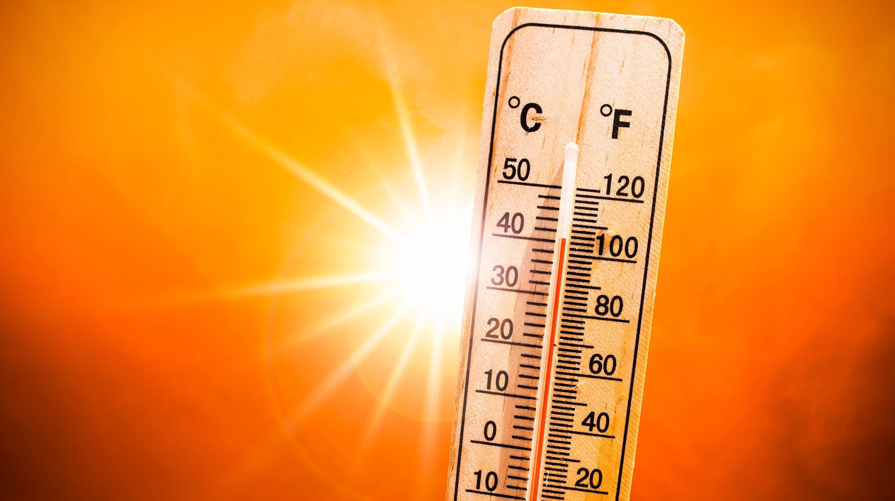

Slide 4
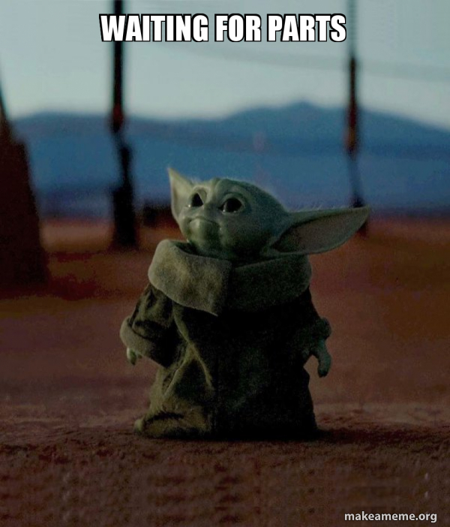

Slide 5
Exam
Wednesday April 17, 2024
9:00 AM
Rooms: ????

Slide 6
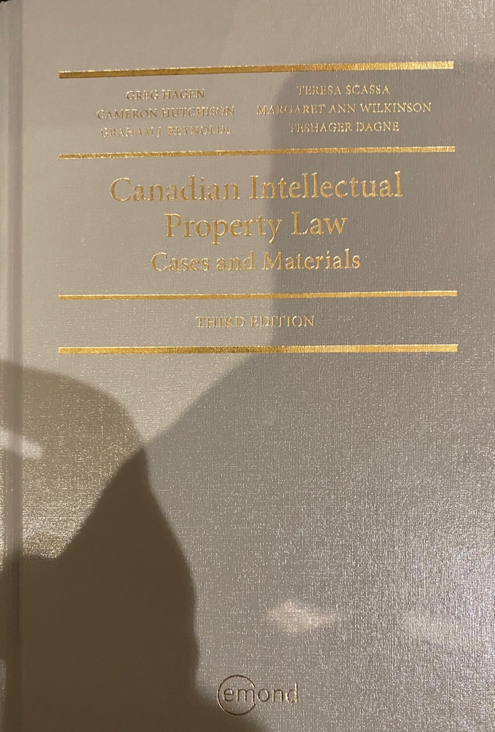
Text: Let me know if any issues @ Bookstore

Slide 7
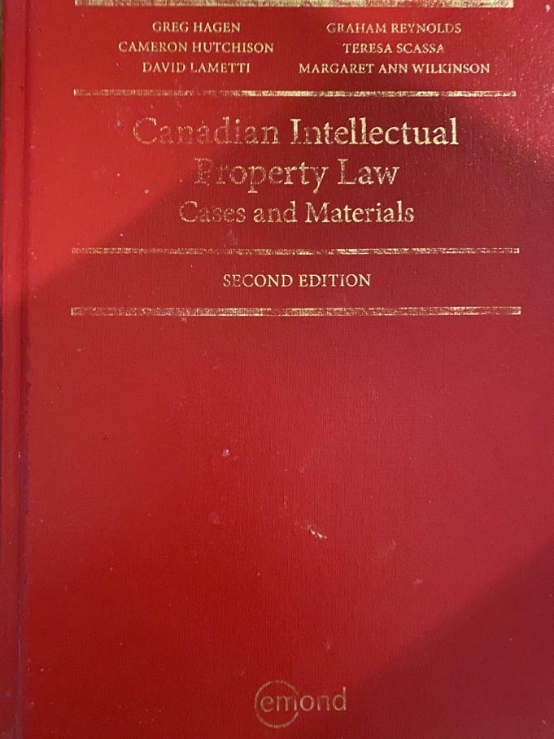
Former Text

Slide 8
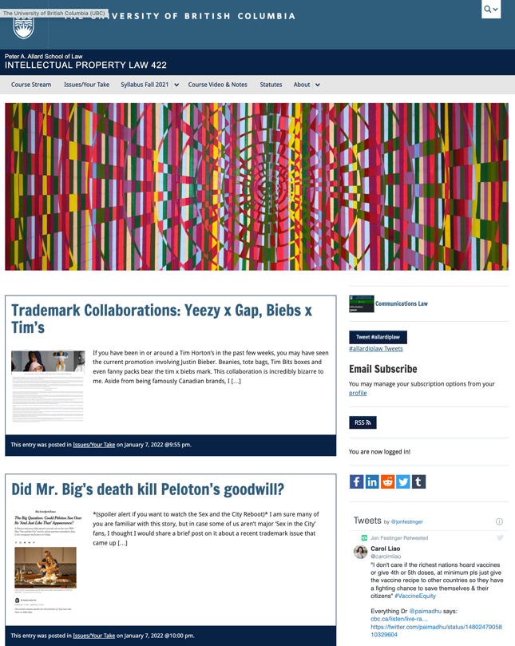
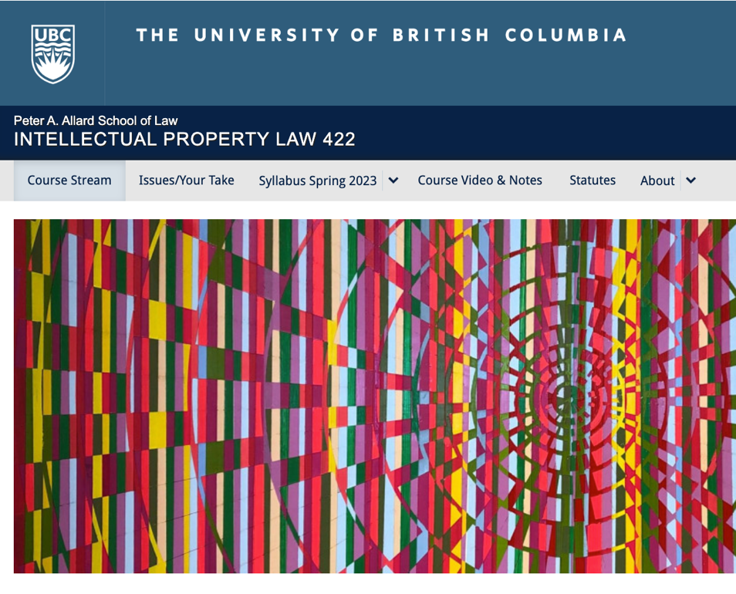
Course Website
https://iplaw.allard.ubc.ca/

Slide 9
PLEASE
SIGN UP

Slide 10
For full privileges on the website
1. Please create an account at http://cms.ubc.ca/ using your CWL.
2. Once you create an account and sign in at http://cms.ubc.ca/ you can click your name in the top right. Halfway down the following page will be your WordPress email address.
3. Send me your WordPress email address at jon.festinger@ubc.ca or at jon_festinger@thecdm.ca
4. Then, I will invite you to participate with authoring privileges via your WordPress email address.

Slide 11

Have responded to everyone?
+
…to some who didn’t ask?

Slide 12
Why post?
Engaging and engaging others is the key.
Because you don’t love speaking up in class.
Because you just saw or realized something, and you’ll never remember it unless you post it now.

Slide 13
Tips:
Don’t feel your posts have to be perfect. Engaging and engaging others is the key.

Slide 14
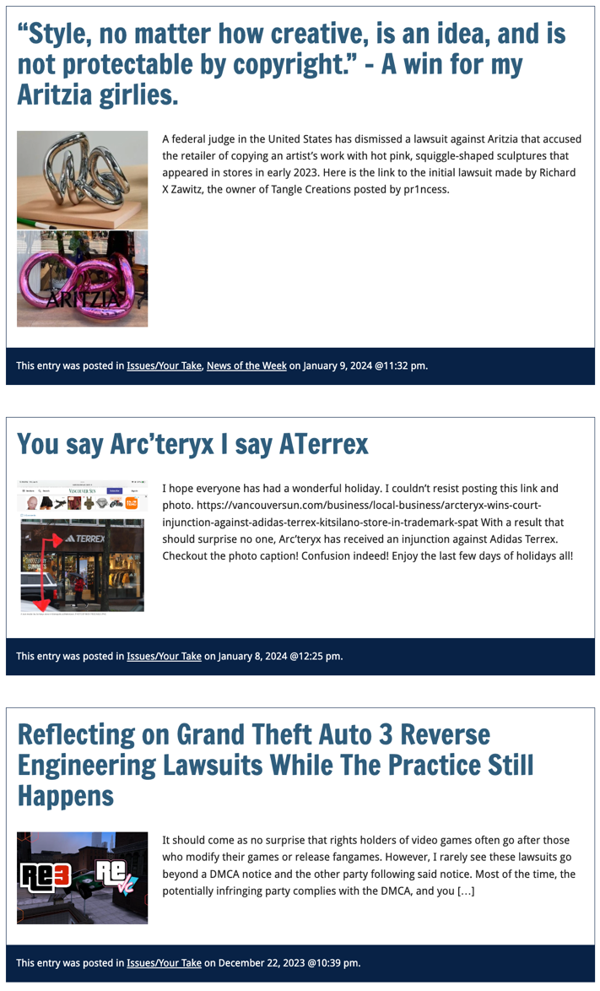

Slide 15

Anything & everything can be done via email if you prefer

Slide 16
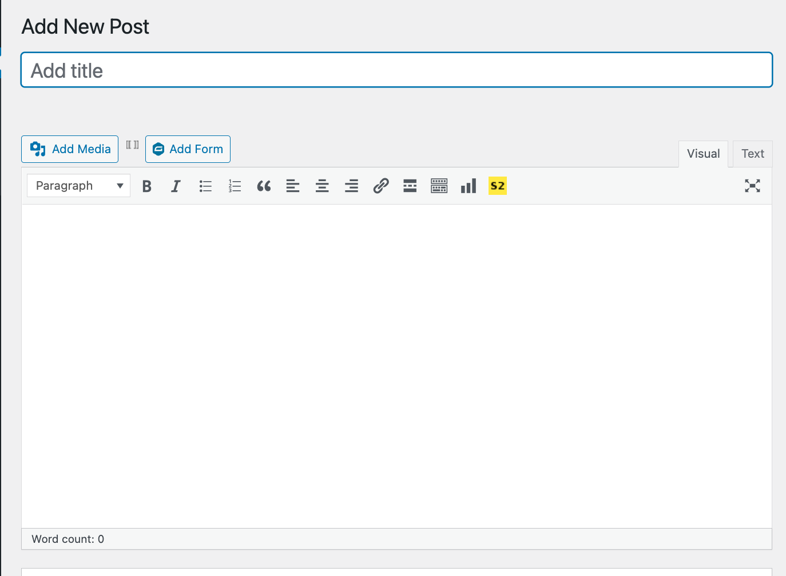

Adding Images

Slide 17



Slide 18
Adding Links

Slide 19
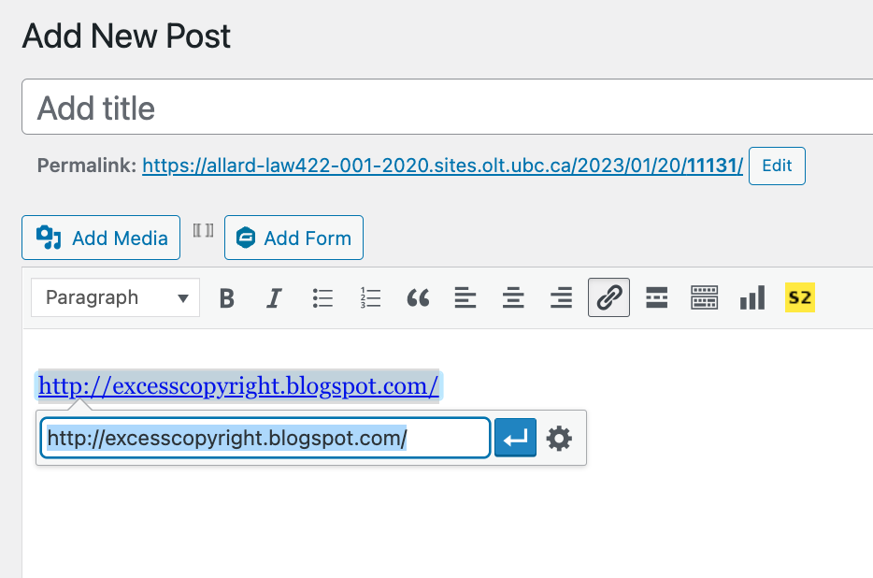


Slide 20
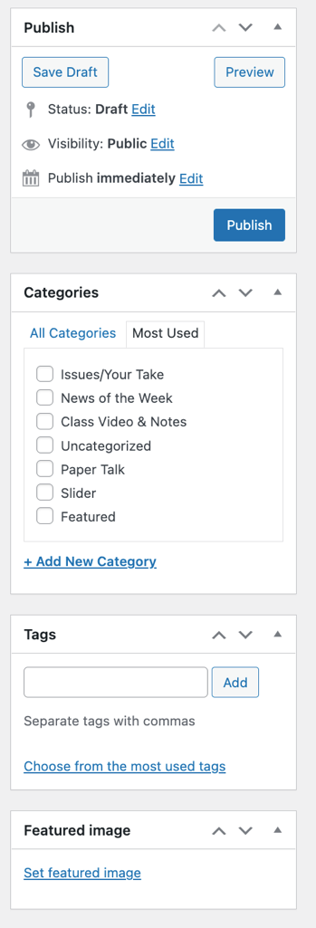
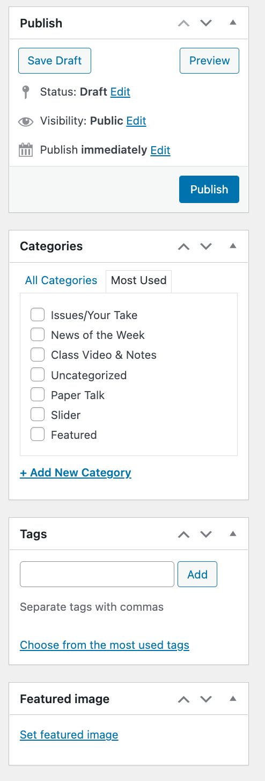

Adding a “Featured Image”

Slide 21


Slide 22
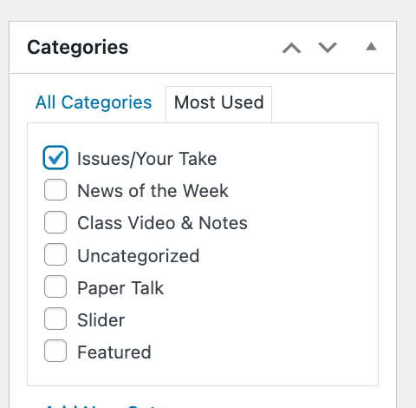

Setting Categories

Slide 23
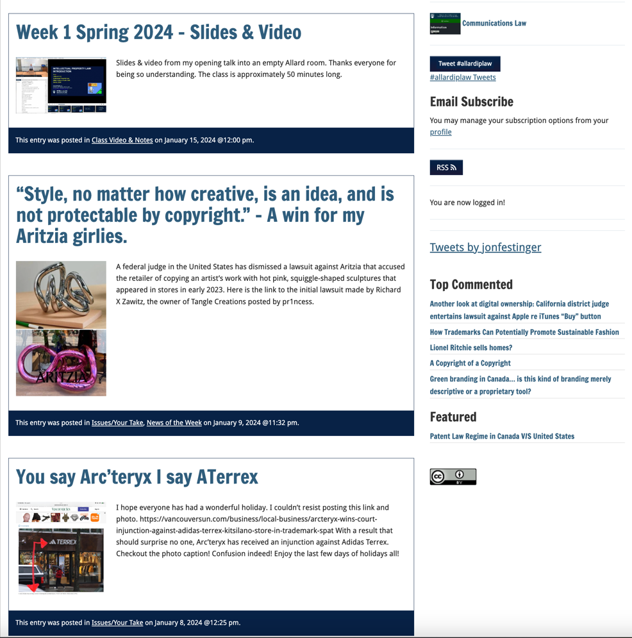
Creative Commons License

Slide 24
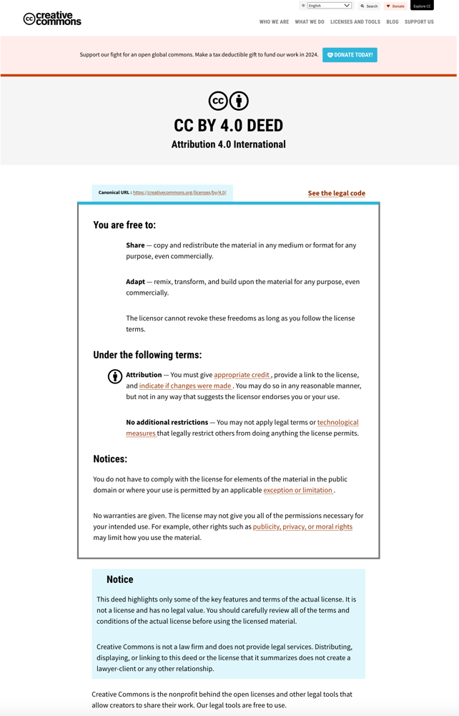
What CTLT will do…

Slide 25
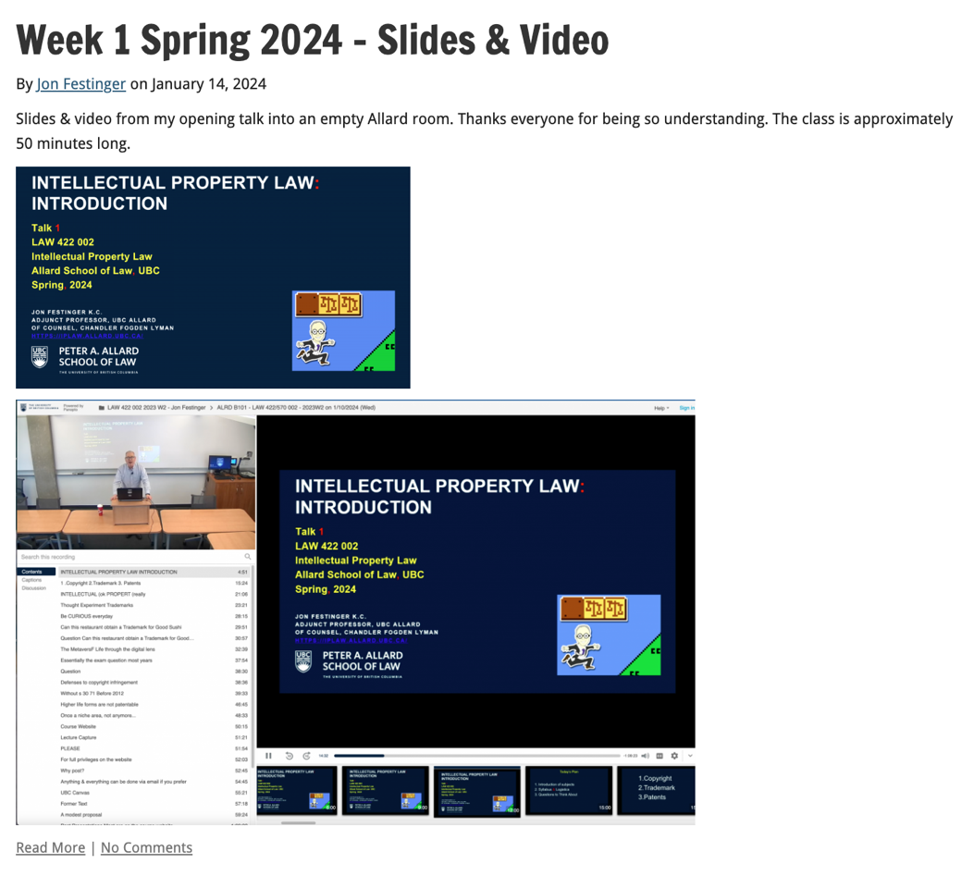
Lecture Capture

Slide 26


Slide 27
Syllabus

Slide 28
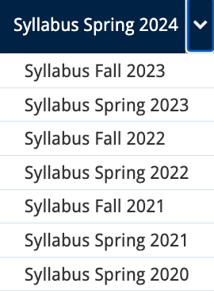




Slide 29
Features of this Course
70% Exam not 100%
IP Law “In Context”
Website

Slide 30
Let’s talk about…
The 30%

Slide 31
A modest proposal…
Approximately 1000 words (or equivalent) per person
written, video, podcast, in-class presentation (?), interpretive dance
Website or not
Groups or individually
LLM Students – one extra post

Slide 32
Past Presentations: Most are on the course website…

Slide 33
Generative A.I. Policy
1. It is source material, therefore
must be cited
2. You are responsible for the quality
of your source material, so check…
If it is wrong, you are wrong
If it plagiarized, you’ve plagiarized

Slide 34

Office “Hours”: Ideally Tuesdays just after class but am flexible…
Email: jon.festinger@ubc.ca; jfestinger@telus.net
Office: 449
Phone:
c. 604-837-6426
(please text if urgent)

Slide 35
Entirely optional but please…
…email me a short bio of yourself referencing:
Anything at all you want to say about yourself
Your academic interests
What you might like to get out of this course (I.E., interest in a type of patent, or a copyright issue etc.)
Favorite Intellectual Property (ies) - current or all-time

Slide 36
Zoom Q&A Sessions
(Study Groups Preferred If Possible)

Slide 37
QUESTIONS?
THOUGHTS?
DISCUSSION?

Slide 38

Pause

Slide 39
Posts of
the Week

Slide 40
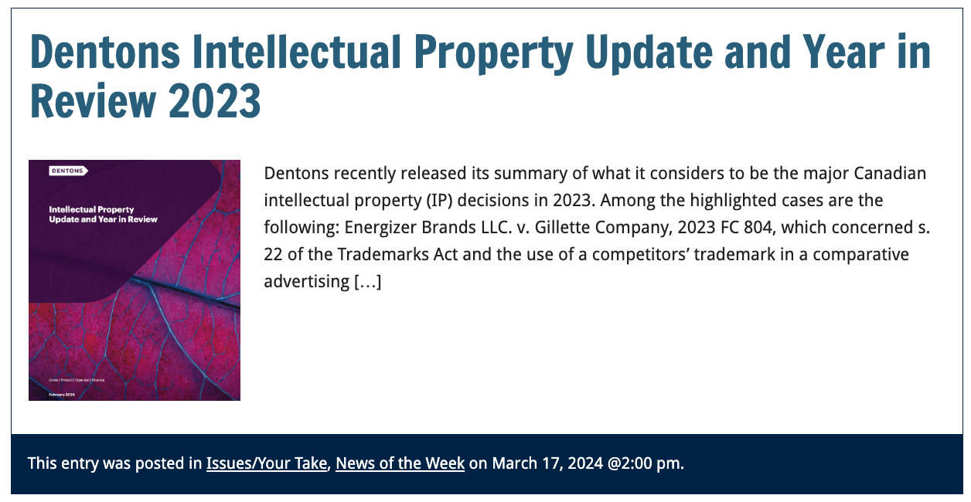

Slide 41
QUESTIONS?
THOUGHTS?
DISCUSSION?

Slide 42
Pause

Slide 43
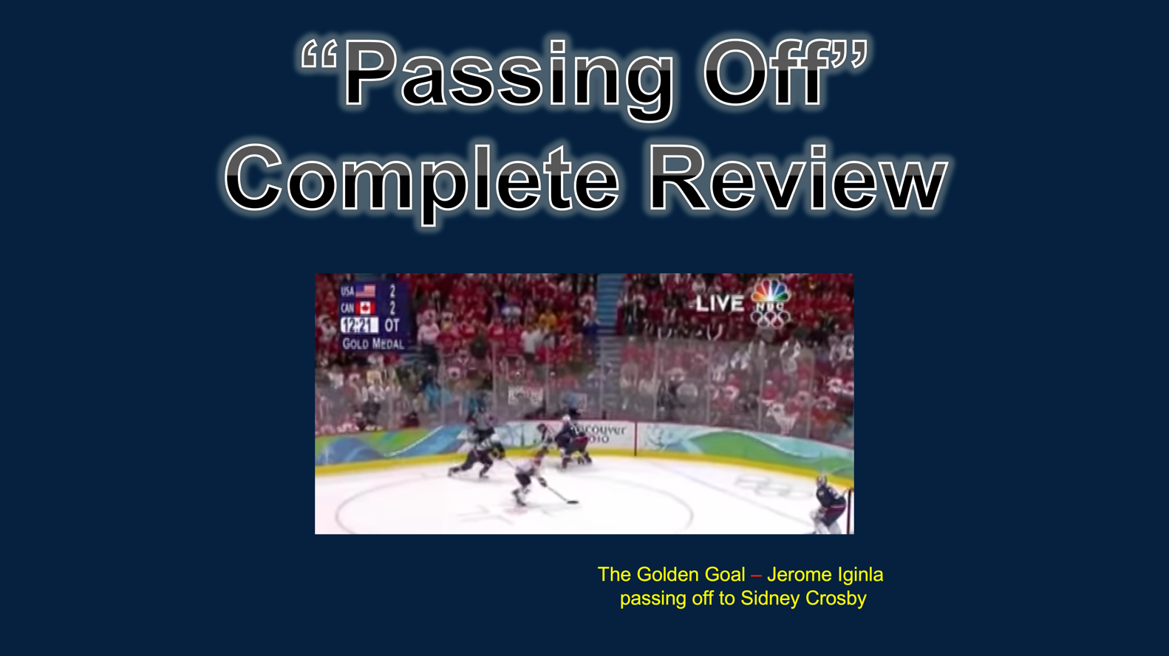
In last week’s posted slides…

Slide 44
QUESTIONS?
THOUGHTS?
DISCUSSION?

Slide 45
Pause

Slide 46

Where we have been…

Slide 47
Intellectual Property Law is about:
What kinds of creations of the mind can one have rights in?
Who can have those rights?
What kinds of rights are there; and how are those rights enforced?

Slide 48

Trademarks

Slide 49
Trademarks
What is a Trademark ™?
  A mark used by a person for the purpose
  of distinguishing that person’s goods or
  services from those of others in the
  marketplace
Various types of marks
  Ordinary (word & design), certification,
  collective, official, distinguishing guise

Slide 50

Trademarks
Ordinary marks
  Distinguish the products or services of a specific firm or individual

Slide 51
Trademarks v. Passing Off*
Why would you want to register your TM?
Why not just rely on passing off?
TM = no proof of goodwill required. Only proof of use.
Registration of a mark provides national protection
Registered marks are presumed valid for Canada for all the wares and services for which they are registered.
s. 22 of the TMA protects against mark dilution.
In situations where a mark is deemed invalid, a passing off action might still succeed.
* You will see this slide again later

Slide 52
Trademarks
Certification marks
  Identify wares or services which meet defined standards.
  Can be used by anyone who complies with the standards defined by the owner of the certification mark; and who is licensed by the owner
  Owned by one person but licensed to others
  Defined in s. 2 of the TMA

Slide 53

Trademarks
Collective marks
  Signs that distinguish the geographical origin, material, mode of manufacture or other common characteristics of goods or services of enterprises using the collective mark
  Function: inform public about certain features of the product
  Owned by an entity; members of this entity are entitled to use the mark.

Slide 54

Trademarks
A purely functional design may not be the basis of a TM, registered or unregistered
  See Kirkbi v. Ritvik (SCC)

Slide 55
QUESTIONS?
THOUGHTS?
DISCUSSION?

Slide 56
Pause

Slide 57

Random Notes

Slide 58
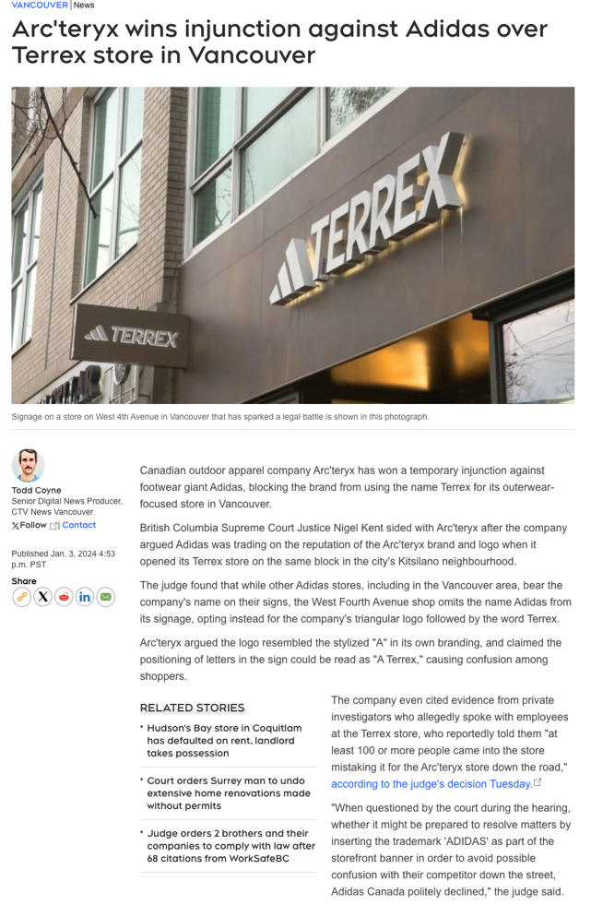
Any further thoughts?

Slide 59
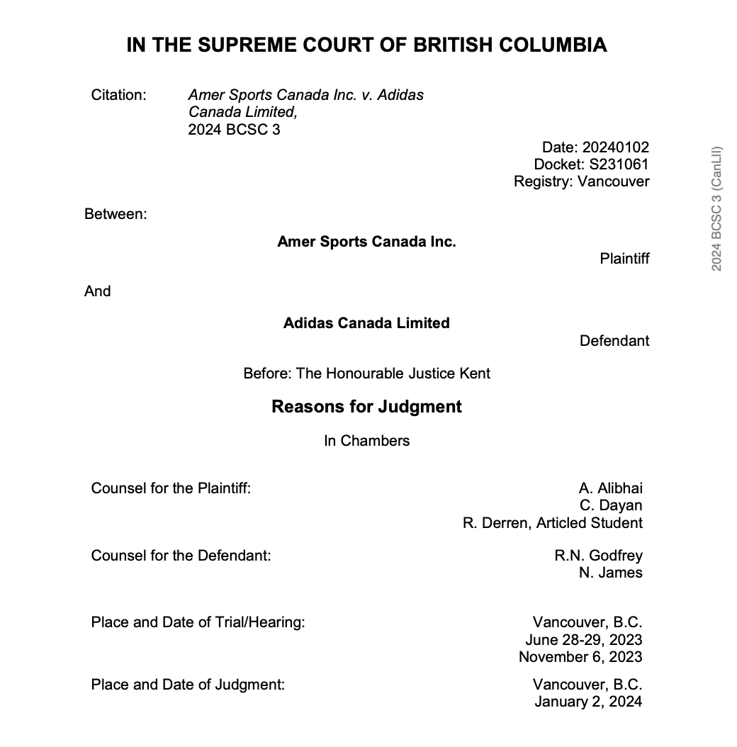

Slide 60
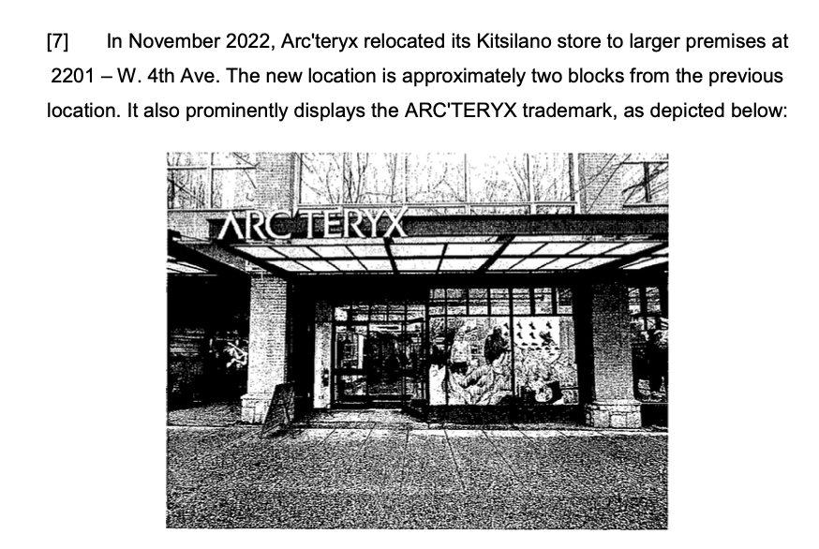

Slide 61
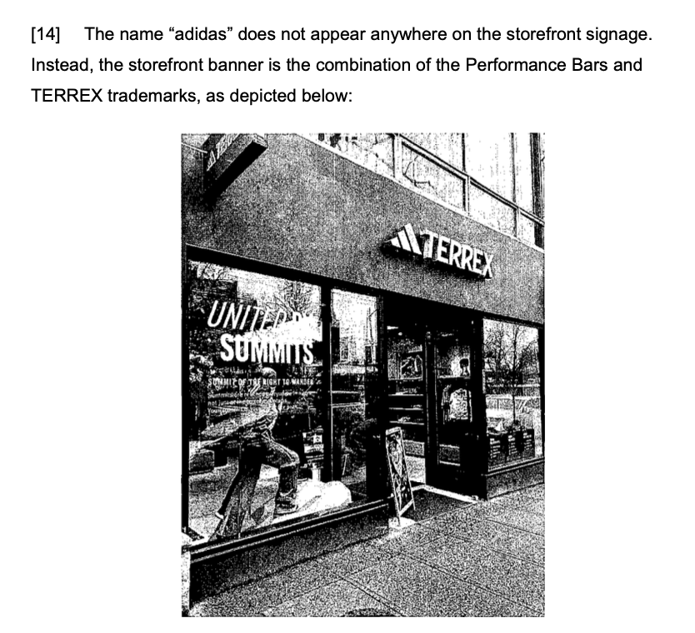
2235 W.4th Ave..

Slide 62
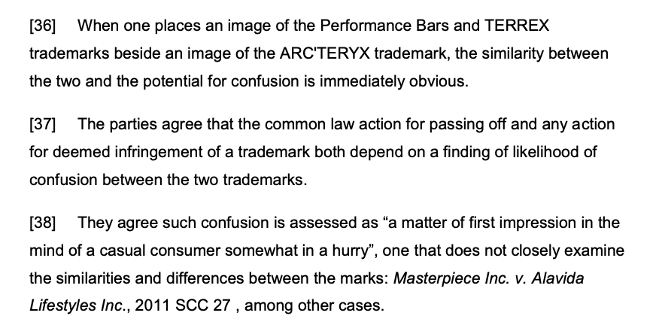



Slide 63
QUESTIONS?
THOUGHTS?
DISCUSSION?

Slide 64
Pause

Slide 65


Slide 66
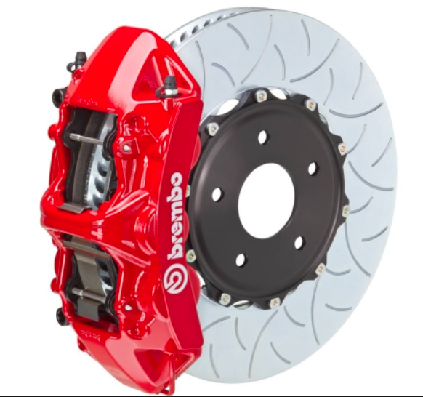

Slide 67

Now, to our regularly
scheduled programming…

Slide 68
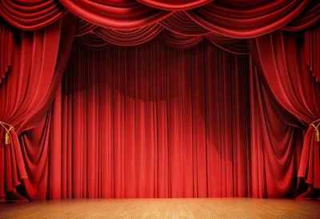
On with the show…

Slide 69
Continuing
Trademarks

Slide 70
Old Concept of Marks
Ordinary marks
  S. 2: definition of trade-mark (in part): (a) a mark that is used by a person for the purpose of distinguishing or so as to distinguish goods or services manufactured, sold, leased, hired or performed by him from those manufactured, sold, leased, hired or performed by others.

Slide 71
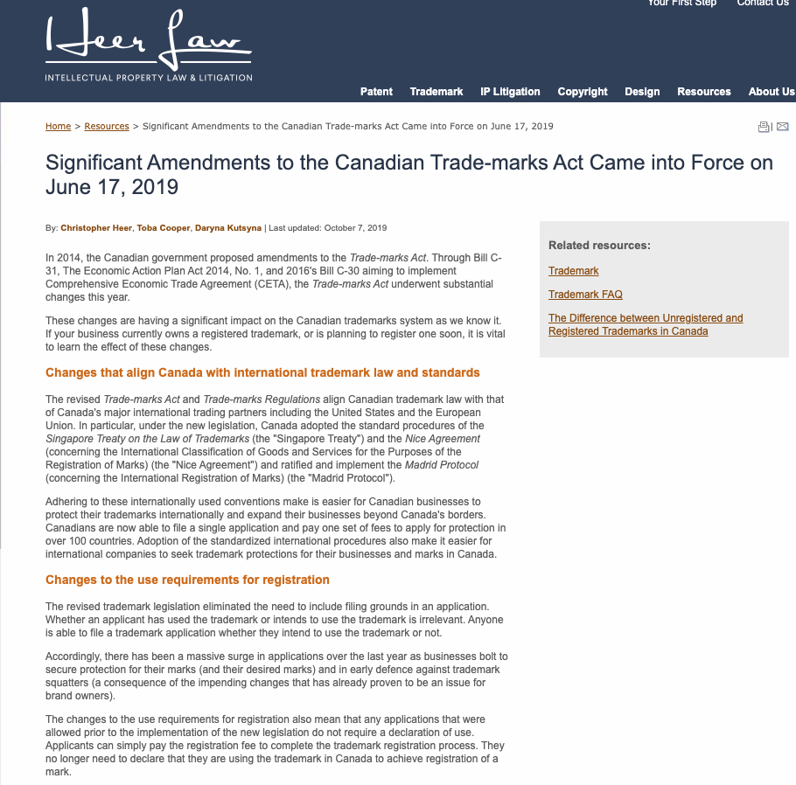

Slide 72
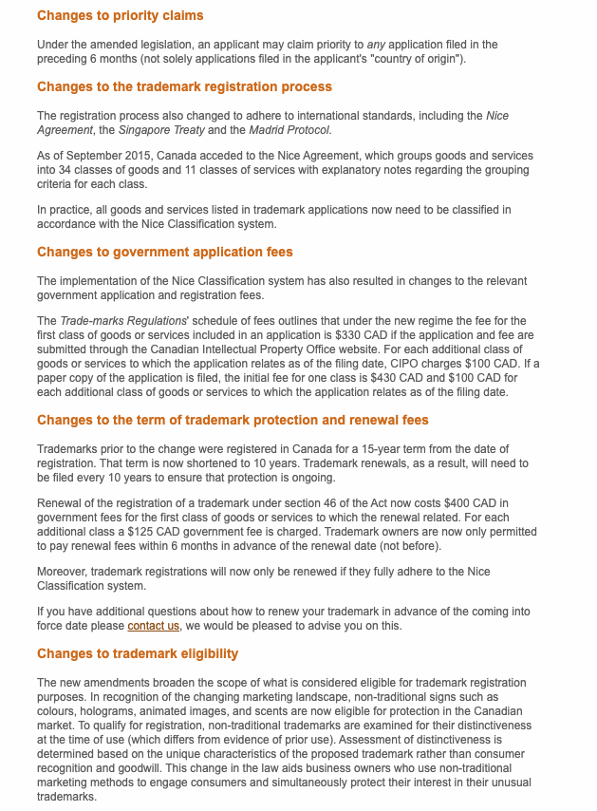

Slide 73
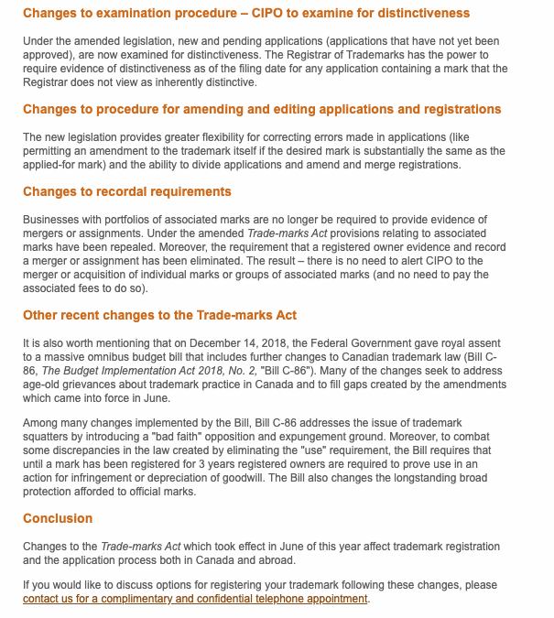

Slide 74
Trademarks
Ordinary marks
Amended definition (2014 - in effect 2019):
  TM: A sign or combination of signs that is used or proposed to be used by a person for the purpose of distinguishing or so as to distinguish their goods and services from those of others.
  Sign: Includes a word, a personal name, a design, a letter, a numeral, a colour, a figurative element, a three-dimensional shape, a hologram, a moving image, a mode of packaging goods, a sound, a scent, a taste, a texture, and the positioning of a sign.

Slide 75
Trademarks
S. 12(1): A TM is registrable if it is not:
  (a) Primarily merely a name or surname of an individual living or who has died within 30 years
  (b) Clearly descriptive or deceptively misdescriptive in English or French of the character/quality of wares/services or of the conditions of production/persons employed in their production/place of origin

Slide 76
Trademarks
S. 12(1): TM is registrable if it is not:
  (c) Name in any language of any of the wares or services in connection with which it is used
  (d) Confusing with a registered TM (confusing defined in s. 6(2); factors in s. 6(5))
  (e) Mark prohibited by s. 9 or 10…
  S. 12(2): not registrable if its features are dictated primarily by a utilitarian function
  S. 12(3): If not registrable due to (1)(a) or (b), is registrable if has … become distinctive at the date of filing an application for registration (see also s. 32)

Slide 77
QUESTIONS?
THOUGHTS?
DISCUSSION?

Slide 78
Pause

Slide 79
Trademarks
Ordinary marks
Amended definition (2014 - in effect 2019):
  TM: A sign or combination of signs that is used or proposed to be used by a person for the purpose of distinguishing or so as to distinguish their goods and services from those of others.
  Sign: Includes a word, a personal name, a design, a letter, a numeral, a colour, a figurative element, a three-dimensional shape, a hologram, a moving image, a mode of packaging goods, a sound, a scent, a taste, a texture, and the positioning of a sign.

Slide 80
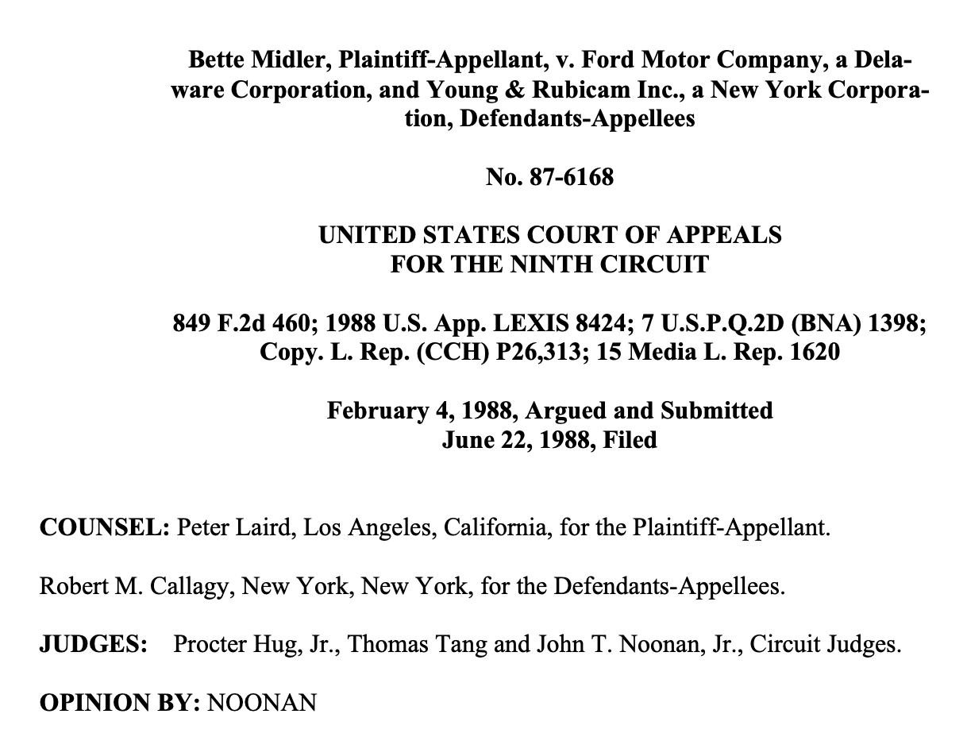

Slide 81
The appellate court ruled that the voice of someone famous as a singer is distinctive to their person and image and therefore, as a part of their identity, it is unlawful to imitate their voice without express consent and approval. The appellate court reversed the district court’s decision and ruled in favor of Midler, indicating her voice was protected against unauthorized use.

Slide 82
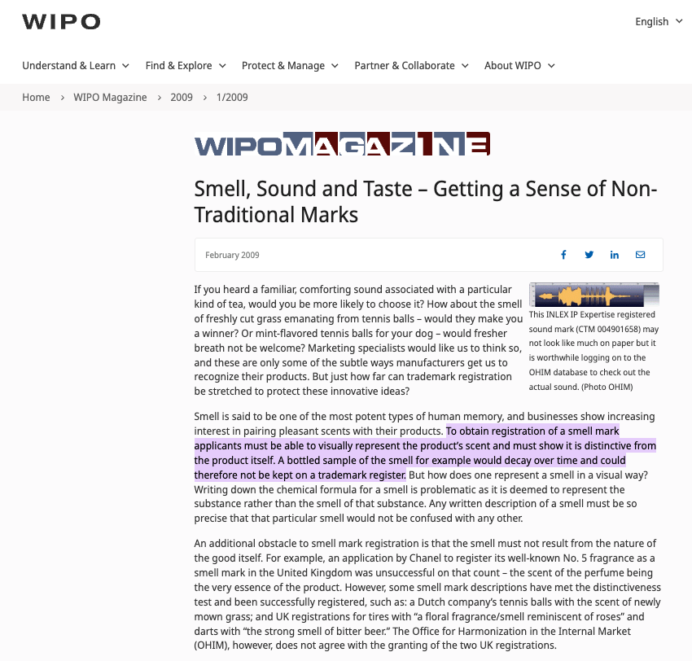

Slide 83
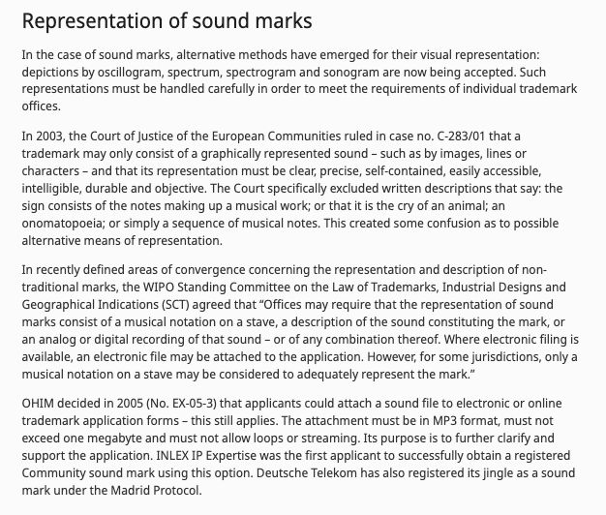

Slide 84
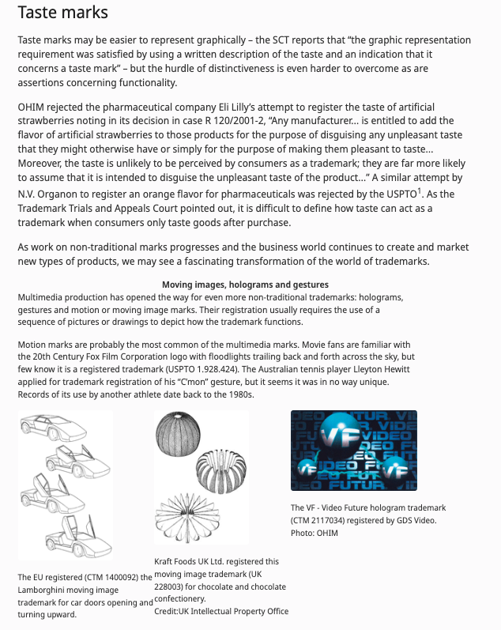

Slide 85

A Nazi Interlude

Slide 86


Slide 87


Slide 88
QUESTIONS?
THOUGHTS?
DISCUSSION?

Slide 89
Pause

Slide 90
Trademarks
Canada (Registrar of TMs) v. Coles Book Stores, [1974] SCR 438
  1) Is the mark a word?
    Standard Oil Co. v. Canada (Registrar of TM), [1968] 2 Ex C.R. 523.
  2) Is it primarily merely a name or surname of an individual who is living or who has died within the previous 30 years?

Slide 91
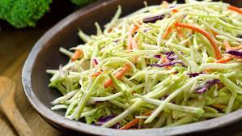
“Cole” as in “slaw” argument failed

Slide 92
“In the case at bar, the evidence clearly establishes that “Coles” is a surname that is well-known to the general public of Canada. On the other hand, the dictionary meanings of the word “cole” and in its plural form “coles”, particularly as found in the Oxford English Dictionary, are largely obsolete. A customer in need of a cabbage does not ask for a “cole”. The only common use of the word that I can think of is in the word “coleslaw”. The inference I draw from the evidence concerning the dictionary definitions of the word “cole” is that it is a word of rare, if not obsolete, usage and would be little known to the general public of Canada. I do not agree with the conclusion of the learned judge of the Exchequer Court that the principal character of the word “Coles” is “equally that of a surname and of a dictionary word in the English language.” My only possible conclusion in this case is that a person in Canada of ordinary intelligence and of ordinary education in English or French would immediately respond to the trade mark “Coles” by thinking of it as a surname and would not be likely to know that “Coles” has a dictionary meaning.”

Slide 93
Trademarks
Test to Apply: Would a person in Canada
of ordinary intelligence and of ordinary
education in English or French be just as
likely, if not more likely, to respond to the
word by thinking of it as a brand or a
mark of a business than as a name/surname?

Slide 95
Trademarks
Unilever Canada Inc. v. Superior Quality Foods Inc. (2007), 62 CPR (4th) 75, [2007] TMOB No. 66
Facts: Superior Quality Foods, Inc. filed an application to register the TM BETTER THAN BOULLION for use in association w. soups and soup bases.
Issue: s. 12(1)(b) …Is the mark clearly descriptive or deceptively misdescriptive in the English or French language of the character or quality of the wares or services in association with which it is used or proposed to be used or of the conditions of or the persons employed in their production or of their place of origin.

Slide 96
Trademarks
Unilever Canada Inc. v. Superior Quality Foods Inc. (2007), 62 CPR (4th) 75, [2007] TMOB No. 66
Clearly descriptive = does the mark tell potential dealers/purchasers of the goods/services what the goods and services are, or describe them or describe a property which is commonly associated with them?

Slide 97
Trademarks
  Unilever Canada Inc. v. Superior Quality Foods Inc. (2007), 62 CPR (4th) 75, [2007] TMOB No. 66
  Deceptively misdescriptive = would dealers/purchasers of the goods be deceived by the misdescription into purchasing goods or ordering services which different in character or quality from those expected?

Slide 98
Trademarks
  Unilever Canada Inc. v. Superior Quality Foods Inc. (2007), 62 CPR (4th) 75, [2007] TMOB No. 66
S. 12(1)(b):
  Point of View?: That of the average purchaser of the wares
  Consider the mark in its entirety (not dissected into constituent elements)
  Consider thee mark as a matter of immediate impression

Slide 99
Trademarks
  Unilever Canada Inc. v. Superior Quality Foods Inc. (2007), 62 CPR (4th) 75, [2007] TMOB No. 66
S. 12(1)(b):
  Clearly = easy to understand, self-evidence, plain
  Character = feature, trait, characteristic of wares
  Quality = degree of excellence; laudatory description (i.e., expressing praise)

Slide 100
Trademarks
  Unilever Canada Inc. v. Superior Quality Foods Inc. (2007), 62 CPR (4th) 75, [2007] TMOB No. 66
Decision: “The Mark … clearly describe[s] as a matter of first impression that the Applicant’s soups and soup bases are ‘better than boullion’, a laudatory description that is contrary to s. 12(1)(b)”
Policy justification: This is an ordinary, grammatical phrase that others in the industry should be able to use to fairly describe their products. / different decision - “the vocabulary of the English language is common property: it belongs to all” (Eastman Photographic Materials Company Ltd. v. Comptroller-General of Patents, Designs and Trade Marks, [1898] A.C. 571 (H.L.), Lord Herschell at page 580 ”

Slide 101
Trademarks
General Foods Ltd. v. Carnation Co. (1978), 45 CPR (2d) 282 (TMOB)
Can GFL register the TM “Instant Breakfast” for use in association with wares described as “fortified powder food for mixing with milk”?
S. 12(1): TM is registrable if it is not (c) Name in any language of any of the wares or services in connection with which it is used
Also s.30(a) of the Trademarks Act in setting specifics for TM applications requires that applications must contain “a statement in ordinary commercial terms of the specific goods or services in association with which the mark has been or is proposed to be used.”
Are the words “fortified powder food for mixing with milk” ordinary commercial terms? Board held no. Statement in ordinary commercial terms for the product would be “instant breakfast”.
Accordingly, application to register the TM Instant Breakfast, which is also the name of the wares in English was found not registrable per s. 12(1)(c).

Slide 102
Trademarks
What is the significance in the distinction between s. 12(1)(b) and 12(1)(c)? Why might this distinction have been formalized in the TMA?
12 (1) Subject to subsection (2), a trademark is registrable if it is not..
  (b) …either clearly descriptive or deceptively misdescriptive in the English or French language of the character or quality of the goods or services in association with which it is used…;
  (c) the name in any language of any of the goods or services in connection with which it is used or proposed to be used;

Slide 103
QUESTIONS?
THOUGHTS?
DISCUSSION?

Slide 104
Pause

Slide 105
Trademarks: Distinguishing guise no more

Slide 106
Trademarks - changes
Distinguishing guise provisions repealed in 2019
  The shape or design of the product or packaging that effectively distinguishes the product from others. In order for a distinguishing guise to be registered, it must be proven that it has become distinctive through usage.
  S. 13 Trademarks Act REPEALED
  Example: shape of Coca-Cola bottle

Slide 107
Instead of “distinguishing guise”
s. 2 …“sign includes a word, a personal name, a design, a letter, a numeral, a colour, a figurative element, a three-dimensional shape, a hologram, a moving image, a mode of packaging goods, a sound, a scent, a taste, a texture and the positioning of a sign;”

Slide 108
Trademarks
Distinguishing guise
Now that distinguishing guises have ceased to exist as a separate category of TM, similar limitations to those set out in the previous s. 13(1) will be carried over elsewhere, and will apply to all marks

Slide 109
Trademarks
Distinguishing guise
New 12(2): A trademark is not registrable if, in relation to the goods or services in association with which it is used or proposed to be used, its features are dictated primarily by a utilitarian function
New 18.1: The registration of a trademark may be expunged by the Federal Court on the application of any interested person if the Court decides that the registration is likely to unreasonably limit the development of any art or industry
20(1.2): The registration of a trademark does not prevent a person from using any utilitarian feature embodied in the trademark

Slide 110
Trademarks
Glaxo Wellcome Inc. v. Novopharm Ltd (2000)
Glaxo sought registration the distinguishing guise for a six sided tablet, shaped as a shield.
Principles
  Not required to show that most adult Canadians recognize the applicant’s distinguishing guise
  Although the shape of a product can constitute a mark, the mark is usually weak
  The standard of proof in distinguishing guise cases under is the same as in other registration cases
  Relevant period of time for distinctiveness → date of application

Slide 111
Trademarks : Special Marks
S. 9 Trademarks Act
Two categories of prohibited marks
  Absolute prohibitions
  Official marks (9(1)(n)(iii))
What policy reasons could justify including
a type of symbol/mark on the list of absolute
prohibitions?

Slide 112
Trademarks
S. 9(1)(n)(iii):
  Allows entities which are “public authorities”
  to request the Registrar of Trade-marks to
  give public notice of their adoption and use of
  particular names or symbols. These marks
  are referred to as “official marks”.
  Once notice is given, these official marks are
  also removed from the general realm of trade
  and commerce.

Slide 113
Trademarks
S. 9(1)(n)(iii) is controversial
S. 9(1) prohibits anyone else from adopting an official mark. This prohibition is absolute.
None of the usual formalities for the adoption of official marks
No opposition proceeding; no scrutiny by Registrar
Mark can be descriptive; not required to be distinctive of wares, services
No need to renew; no provisions to remove unused marks

Slide 114
Trademarks
Statutory requirements for public authorities
  Mark must have been adopted and used
  Adoption and use has to be by a public authority in Canada
  Adoption and use must be as an official mark for wares and services

Slide 115
Trademarks
Ontario Ass’n of Architects v. Ontario Assn of Architectural Technologists, [2003] 1 F.C. 331 (FCA)
Public notice was given that the Association of Architectural Technologists of Ontario, a self-regulatory professional body and Ontario non-for-profit corporation without share capital, adopted and used as official marks for services – the words ARCHITECTURAL TECHNICIAN, ARCHITECTE-TECHNICIEN, ARCHITECTURAL TECHNOLOGIST, ARCHITECTE-TECHNOLOGUE. As a result, members of the appellant, the Ontario Association of Architects ("OAA"), can be prevented from using these words in connection with their professional services - unless they had started to use them before April 28, 1999, the date when the Registrar gave public notice in the Trade-marks Journal of their adoption and use by the AATO as official marks.

Slide 116
Trademarks
Ontario Ass’n of Architects v. Ontario Assn of Architectural Technologists, [2003] 1 F.C. 331 (FCA)
Defining characteristics of public authority =
  Degree of government control [para. 57-64]
  Extent to which the body’s activities benefit the public [para. 65-73]

Slide 117
QUESTIONS?
THOUGHTS?
DISCUSSION?

Slide 118
Pause

Slide 119
Trademarks
1. Significant degree of governmental control
More rigorous part of test
Consider body’s objects, duties and powers, including distribution of its assets
Need some ongoing government supervision of the activities of the body claiming to be a public authority; sufficient to allow the government to exercise a degree of ongoing influence in the body’s governance and decision-making.

Slide 120
Trademarks
2. Public benefit
Broadly interpreted by the courts – some aspect for public benefit? Considered to act for public benefit.
In this case the Architectural Technologists set & enforce standards of professional competence & ethical conduct of its members.
As a result, FCA held that the Technologists regulate part of the practice of the profession. The lower court judge concluded that these activities benefit the public, and the FCA agreed.

Slide 121
Trademarks
A TM owner who has a registered mark that resembles an official mark effectively has their rights frozen at the time of publication of the official mark
  See Royal Roads University v. R. (2003), 27 CPR (4th) 240 (F.C.)

Slide 122
Trademarks: Applying the provision
MARK/NUMBER
Land of Anne 907857
The Anne Collection 907535
Red-Haired Anne 909009
Rainbow Valley 909010
Gilbert Blythe 909011
Akage No Anne 909012
Avonlea 909013
Matthew Cuthbert 909014
Anne of Green Gables The Musical 909015
Anne with an "E" 909016
Marilla Cuthbert 909017
Josie Pye 909018
Road to Avonlea 909019
Kindred Spirits 909020
Rilla of Inglesides 909021
Anne of Avonlea 909022
Anne Shirley 909023
Diana Barry 909024

Slide 123
QUESTIONS?
THOUGHTS?
DISCUSSION?

Slide 124
Pause

Slide 125
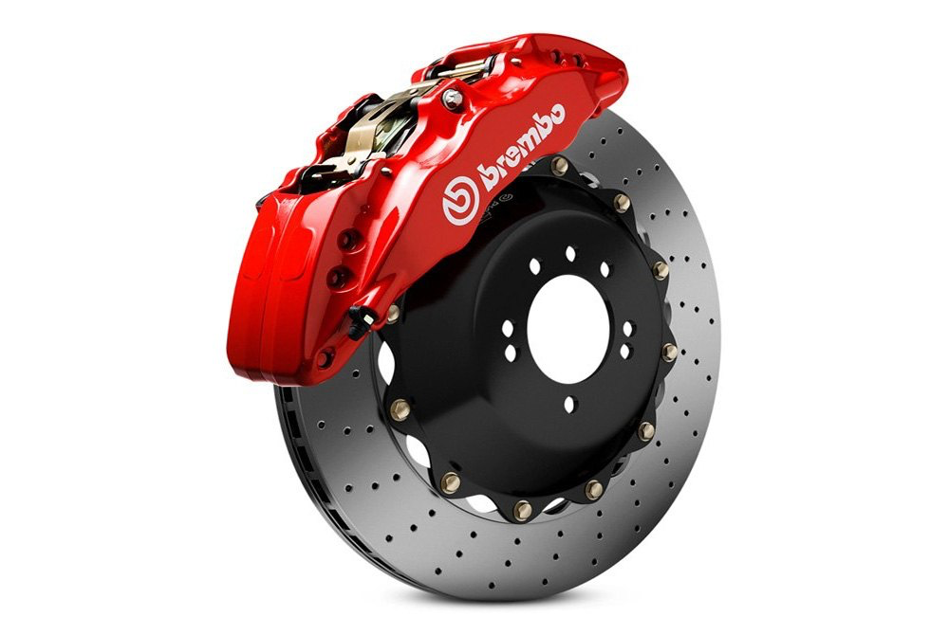

Slide 127

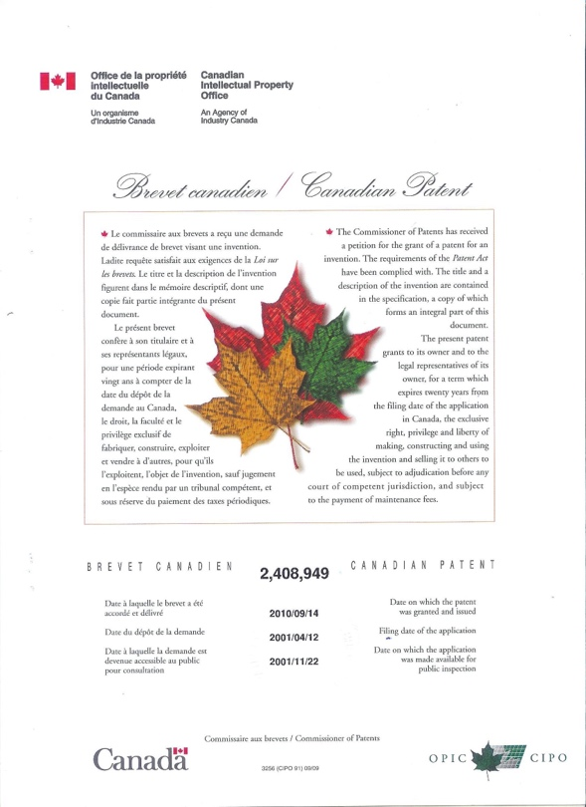
Patents 1

Slide 128
SEE YOU NEXT WEEK!

Slide 129

Always include a cat picture

Slide 130
In learning you will teach
And in teaching you will learn
Phil Collins' Son of Man (1999)

