Slide 1

Passing-Off 1
Talk 7
LAW 422 002
Intellectual Property Law
Allard School of Law, UBC
Spring, 2024
Jon Festinger K.C.
Adjunct Professor, UBC Allard
Of Counsel, Chandler Fogden Lyman
https://iplaw.allard.ubc.ca/

Slide 2
Logistics

Slide 3
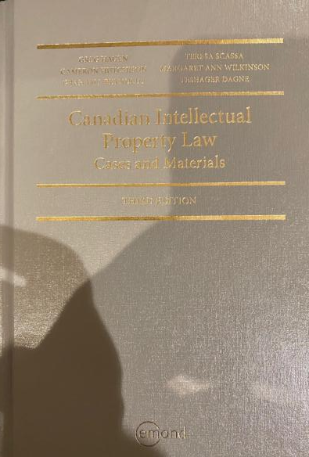
Text: Let me know if any issues @ Bookstore

Slide 4
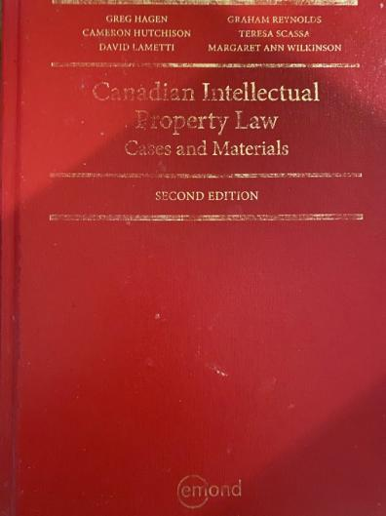
Former Text

Slide 5
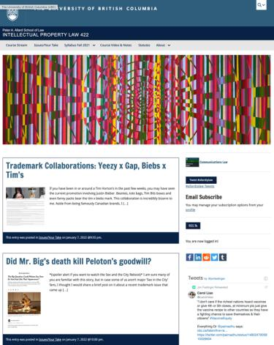
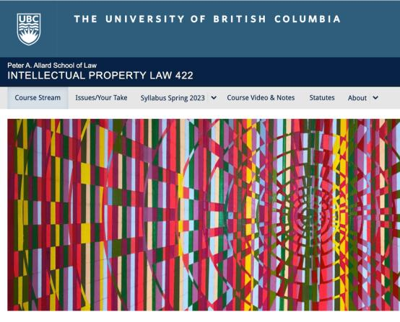
Course Website
https://iplaw.allard.ubc.ca/

Slide 6
PLEASE
SIGN UP

Slide 7
For full privileges on the website
1. Please create an account at http://cms.ubc.ca/ using your CWL.
2. Once you create an account and sign in at http://cms.ubc.ca/ you can click your name in the top right. Halfway down the following page will be your WordPress email address.
3. Send me your WordPress email address at jon.festinger@ubc.ca or at jon_festinger@thecdm.ca
4. Then, I will invite you to participate with authoring privileges via your WordPress email address.

Slide 8

Have responded to everyone?
+
…to some who didn’t ask?

Slide 9
Why post?
Engaging and engaging others is the key.
Because you don’t love speaking up in class.
Because you just saw or realized something, and you’ll never remember it unless you post it now.

Slide 10
Tips:
Don’t feel your posts have to be perfect. Engaging and engaging others is the key.

Slide 11
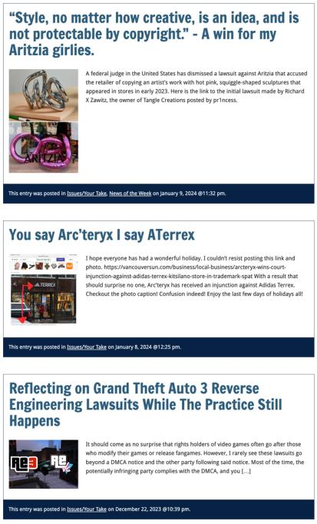

Slide 12

Anything & everything can be done via email if you prefer

Slide 13


Adding Images

Slide 14



Slide 15
Adding Links

Slide 16
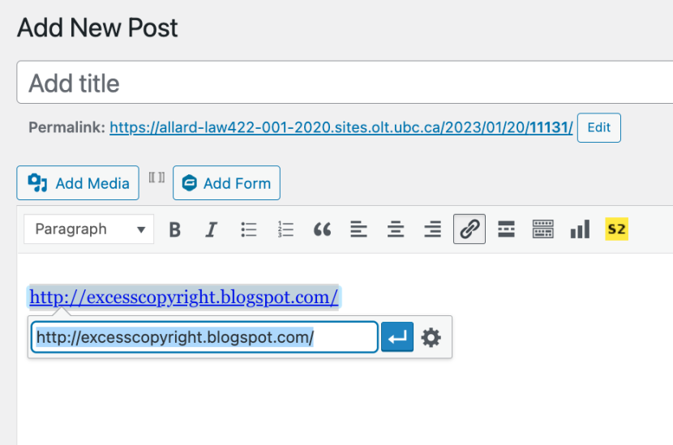


Slide 17



Adding a “Featured Image”

Slide 18


Slide 19
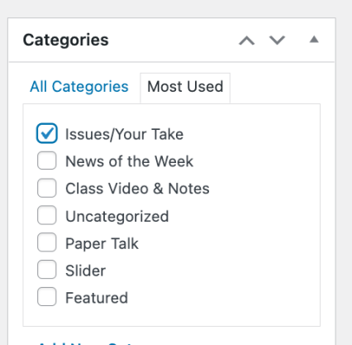

Setting Categories

Slide 20
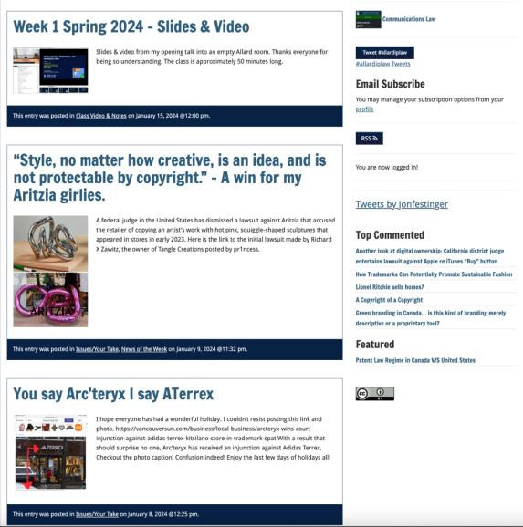
Creative Commons License

Slide 21
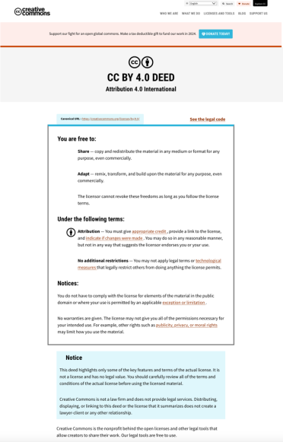
What CTLT will do…

Slide 22
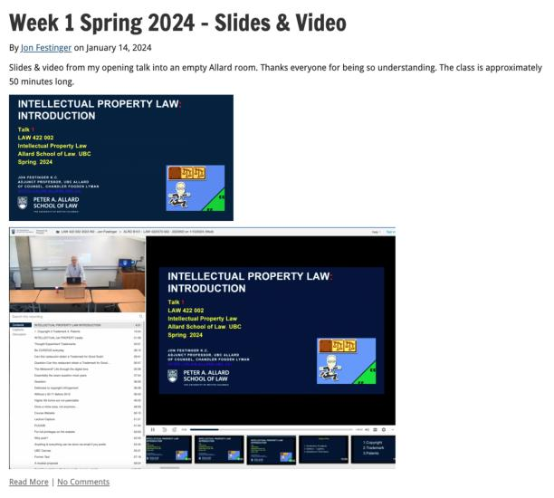
Lecture Capture

Slide 23
Syllabus

Slide 24
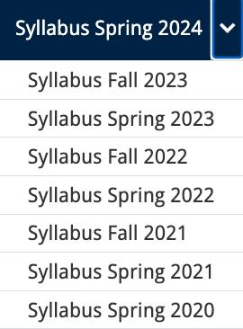




Slide 25
Features of this Course
70% Exam not 100%
IP Law “In Context”
Website

Slide 26
Let’s talk about…
The 30%

Slide 27
A modest proposal…
Approximately 1000 words (or equivalent) per person
written, video, podcast, in-class presentation (?), interpretive dance
Website or not
Groups or individually
LLM Students – one extra post

Slide 28
Past Presentations: Most are on the course website…

Slide 29
News of
the Week

Slide 30
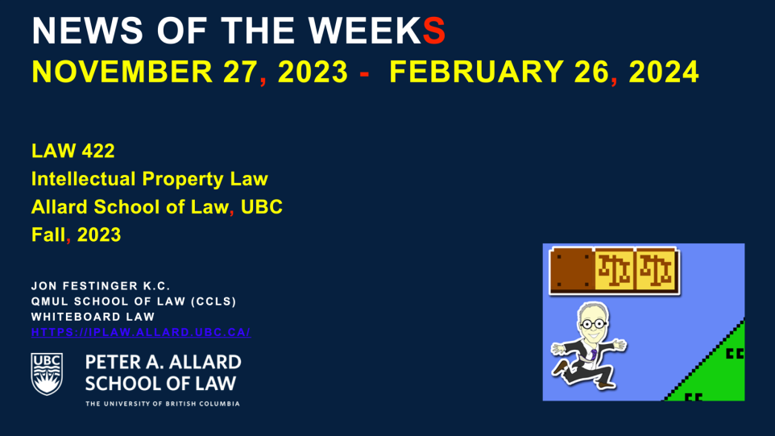
On Website!!!

Slide 31
Generative A.I. Policy
1. It is source material, therefore
must be cited
2. You are responsible for the quality
of your source material, so check…
If it is wrong, you are wrong
If it plagiarized, you’ve plagiarized

Slide 32

Office “Hours”: Ideally Tuesdays just after class but am flexible…
Email: jon.festinger@ubc.ca; jfestinger@telus.net
Office: 449
Phone:
c. 604-837-6426
(please text if urgent)

Slide 33
Entirely optional but please…
…email me a short bio of yourself referencing:
Anything at all you want to say about yourself
Your academic interests
What you might like to get out of this course (I.E., interest in a type of patent, or a copyright issue etc.)
Favorite Intellectual Property (ies) - current or all-time

Slide 34
Zoom Q&A Sessions
(Study Groups Preferred If Possible)

Slide 35
QUESTIONS?
THOUGHTS?
DISCUSSION?

Slide 36

Pause

Slide 37

Favorite I.P. Update

Slide 38

Where we have been…

Slide 39
Intellectual Property Law is about:
What kinds of creations of the mind can one have rights in?
Who can have those rights?
What kinds of rights are there; and how are those rights enforced?

Slide 40
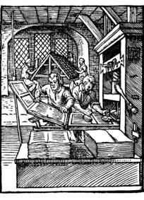
“Copyright Law Complete Review ”

Slide 41

Overview of copyright
Definition of copyright:
  Set of exclusive rights in works of expression; performers’ performances; sound recordings; and communication signals.
The Clash, Chateau Neuf, Oslo, Norway
21 May 1980 Helge Øverås

Slide 42
Overview of copyright
Justifications
Economic incentive for creation (then why does copyright continue after death)?
Societal “progress in the arts & sciences”
Natural rights to one’s own labour & personality (→ personality = privacy or IP)
Reinforces free expression?

Slide 43
Purpose of copyright in Canada?
Théberge:
  “[12] Generally speaking, Canadian copyright law has traditionally been more concerned with economic than moral rights.… The economic rights are based on a conception of artistic and literary works essentially as articles of commerce.” (Binnie J.)
But Cinar Corp. v. Robinson?
  [114] … the infringement of copyright in this case interfered with Robinson’s personal rights to inviolability and to dignity, recognized by ss. 1 and 4 of the [Quebec] Charter. (McLachlin CJ)

Slide 44
Overview of copyright
Purpose of copyright as articulated by the SCC
  Former approach: “author-centric”
  Shift in Théberge
    “balance between promoting the public interest in the encouragement and dissemination of works of the arts and intellect and obtaining a just reward for the creator“ (para. 30)
  Refined in Cinar Corporation v. Robinson, 2013 SCC 73
    Copyright Act “seeks to ensure that an author will reap the benefits of his efforts, in order to incentivize the creation of new works” (para. 23)

Slide 45
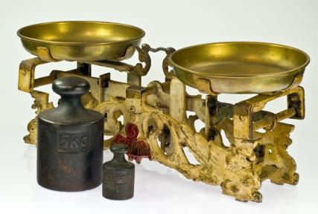
Théberge promotes “balance” between the public interest in connecting & just reward for the author

Slide 46
Overview of copyright
Legislative authority over copyright in Canada
  Federal Government (s. 91(23) Constitution Act, 1867)
  First Copyright Act (1921, Came Into Force 1924) largely a copy of the UK Copyright Act of 1911
  Modernization of Canadian copyright law: a work constantly in progress
  Bill C-11: Copyright Modernization Act (CIF 2012)
  Relatively recent copyright extension for sound recordings

Slide 47
What is copyrightable?
Subsistence of copyright
5. (1) Subject to this Act, copyright shall subsist in Canada, for the term hereinafter mentioned, in every original literary, dramatic, musical and artistic work if any one of the following conditions is met:
  (a) in the case of any work, whether published or unpublished, including a cinematographic work, the author was, at the date of the making of the work, a citizen or subject of, or a person ordinarily resident in, a treaty country;

Slide 48
What is copyrightable
Fixation
A requirement for the subsistence of copyright imposed by judicial interpretation
  “The work, to be capable of copyright protection, must be fixed in a tangible form” (Canadian Admiral Corp. v. Rediffusion Inc., [1954] Ex. CR 382, 20 CPR 75
Is the fixation requirement beneficial?
Does add some certainty + more works in public domain

Slide 49
Result of Fixation Requirement
Improvisational, performance art, kinetic pieces, open world massively multiplayer video game scenarios, are more at risk of not having copyright protection. See for example Komesaroff v. Mickle, [1988] R.P.C. 204 at 210 (Vict. S.C.), refusing protection to a moving sand sculpture.
Content in RAM computer memory?
Indigenous oral story-telling

Slide 50

Note Komesaroff v. Mickle
though cited often,
is not the world’s strongest precedent

Slide 51
What is copyrightable (Fixation)
Gould Estate et al v. Stoddart Publishing Co. Ltd et al (1996)
  Can copyright subsist in spoken words?
    Not necessarily – not every utterance made by individuals is a “valuable property right”
  A person’s oral statements are not literary creations and do not attract copyright protection

Slide 52
What is copyrightable: Originality
5. (1) Subject to this Act, copyright shall subsist in Canada, for the term hereinafter mentioned, in every original literary, dramatic, musical and artistic work if…

Slide 53
What is copyrightable
Originality in Canada
Pre-2004
  “Sweat of the brow”:
    Work receives copyright protection if it originates from an author and is more than a mere copy.
  “Creativity”
    A work must be the product of creativity in order to be original

Slide 54
What is copyrightable
Originality
CCH Canadian Ltd. v. Law Society of Upper Canada, 2004 SCC 13
  For a work to be original, you need an exercise of skill and judgment that is more than a purely mechanical exercise
  Skill = use of one’s knowledge, developed aptitude or practiced ability in producing the work
  Judgment = use of one’s capacity for discernment or ability to form an opinion or evaluation by comparing different possible options in producing the work

Slide 55
Meaning that…
Headnotes, case summaries, topical indexes & compilations of reported judicial decisions originating from their authors and are not simply copies. There is more than trivial skill & judgment in their creation (as every law student knows)
However, reported judicial decisions, by themselves, are not original works in which the publishers could claim copyright, even where typos and minor errors are fixed.

Slide 56
Can an A.I. pass the “McLachlin Test”?
Can an A.I. exercise “skill and judgment”?
Perhaps yes, if test is “ability to form an evaluation by comparing different possible options”…
But does this skill and judgment “necessarily involve intellectual effort”?
And more weirdly is what an A.I. does “so trivial that it could be characterized as a purely mechanical exercise”?

Slide 57
What is copyrightable
Facts and ideas
  Not entitled to copyright protection
  Kenrick & Co. v. Lawrence & Co. (1890)
    How is idea separated from expression in this decision?

Slide 58
What is copyrightable
Plaintiff printers drew a representation of hand holding a pencil completing a cross in a box as a method to instruct voters who couldn’t read on how to exercise their democratic franchise.
Plaintiffs duly registered their drawing under the copyright laws of the time.
Defendants created a similar but not identical drawing for the same purpose and were sued by the plaintiffs for infringement.
The plaintiffs action failed.

Slide 59
“It seems to me, therefore, that although every drawing of whatever kind may be entitled to registration, the degree and kind of protection given must vary greatly with the character of the drawing, and that with such a drawing as we are dealing with the copyright must be confined to that which is special to the individual drawing over and above the idea...there are scarcely more ways that one of drawing a pencil or the hand that holds it. If the particular arrangement of square, cross, hand, or pencil be relied upon it is nothing more than a claim of copyright for the subject, which in my opinion cannot possibly be supported.”

Slide 60
IDEA/EPRESSION
DICHOTOMY
Donoghue v. Allied Newspapers Limited (1938) Ch 106
Copyright owner is…"the person who has clothed the idea in form, whether by means of a picture, a play or a book"

Slide 61
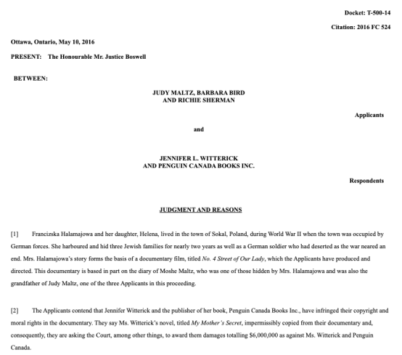
Footnote: No Copyright in Facts

Slide 62
“[47] Although the Documentary and the Book each recount some of the same facts of Francizska Halamajowa’s story, there is no substantial taking or use by the Respondents of anything owned by the Applicants because the use of common historical facts is not copyright infringement. The Respondents have not appropriated or taken a substantial portion of the Documentary’s originality. It is difficult to identify a single element taken that is not either something generic or merely a fact.”

Slide 63
What is copyrightable: Artistic Works
5. (1) Subject to this Act, copyright shall subsist in Canada, for the term hereinafter mentioned, in every original literary, dramatic, musical and artistic work if…

Slide 64
S. 2 Definitions
literary work includes tables, computer programs, and compilations of literary works; (oeuvre littéraire)
dramatic work includes
(a) any piece for recitation, choreographic work or mime, the scenic arrangement or acting form of which is fixed in writing or otherwise,
(b) any cinematographic work, and
(c) any compilation of dramatic works; (oeuvre dramatique)
musical work means any work of music or musical composition, with or without words, and includes any compilation thereof; (oeuvre musicale)
artistic work includes paintings, drawings, maps, charts, plans, photographs, engravings, sculptures, works of artistic craftsmanship, architectural works, and compilations of artistic works; (oeuvre artistique)

Slide 65
What is copyrightable
  University of London Press, Ltd. v. University Tutorial
  Press, Ltd. [1916] 2 Ch. 601
  Literary merit and quality are not factors
  when assessing if something is a literary work

Slide 66
Peterson J. “Assuming that they are ``literary work'’, the question then is whether they are original…Copyright Acts are not concerned with the originality of ideas, but with the expression of thought, and, in the case of ``literary work'’, with the expression of thought in print or writing…In the present case it was not suggested that any of the papers were copied… If an author, for purposes of copyright, must not draw on the stock of knowledge which is common to himself and others who are students of the same branch of learning, only those historians who discovered fresh historical facts could acquire copyright for their works…The objections with which I have dealt do not appear to me to have any substance, and, after all, there remains the rough practical test that what is worth copying is prima facie worth protecting. In my judgment, then, the papers set by Professor Lodge and Mr. Jackson are "original literary work" and proper subject for copyright under the Act of 1911.”

Slide 67

What is copyrightable
  Exxon Corp v. Exxon Insurance Consultants International Ltd., [1981] 3 All E.R. 241 (Ch.D)
  Plaintiff, Exxon Corp, had claimed the copyright of the word and went on to file an injunction to stop the defendant company from using the word 'Exxon'
  Some expression is not eligible for copyright protection because it is too minimal to satisfy the requirements of an “original literary work” under s. 2.
What about Twitter messages?

Slide 68
Exception
Francis Day and Hunter v. 20th Century Fox Corp, Ltd.
  NOTE: definition of a “work” in the Copyright Act - includes “the title thereof when such title is original and distinctive”

Slide 69
What is copyrightable: Dramatic Work
5. (1) Subject to this Act, copyright shall subsist in Canada, for the term hereinafter mentioned, in every original literary, dramatic, musical and artistic work if…

Slide 70
What is copyrightable
Dramatic work
  Must have a story, a thread of consecutively based events either narrated or presented by dialogue or action or both (Hutton v. CBC (1989))
  Or (based on s. 2):
    Choreography, mime and recitation piece with scenic arrangement or acting form fixed in writing or otherwise
    Cinematographic work
    Compilation of dramatic works

Slide 71
1994
Copyright Act was amended to provide:
  "dramatic work" includes
    (a) any piece for recitation, choreographic work or mime, the scenic arrangement or acting form of which is fixed in writing or otherwise,
    (b) any cinematographic work, and
    (c) any compilation of dramatic works;
[Cinematographic work – defined as “includ[ing] any work expressed by any process analogous to cinematography (motion-picture photography – tv, video, film, etc.), whether or not accompanied by a soundtrack” ]
[Choreographic work –defined as “includ[ing] any work of choreography, whether or not it has any story line;]

Slide 72
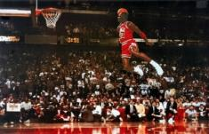
What is copyrightable
FWS Joint Sports Claimants v. Canada 1991 FCA (CB)
No copyright in a sporting event per se though television production of a sporting event is copyrightable
Unpredictable and incompatible with the notion of a choreographic piece of art?

Slide 73
What is copyrightable
Artistic works
  “artistic work” defined in s. 2 as including:
    paintings, drawings, maps, charts, plans, photographs, engravings, sculptures, works of artistic craftsmanship, architectural works, and compilations of artistic works.

Slide 74
What is copyrightable
Artistic works
DRG Inc. v. Datfile Ltd. [1988] 2 F.C. 243
  Two series of colour coded labels were registered under the Copyright Act. It was unsuccessfully argued that the registrations were not properly the subject of copyright.
  Court found that an artistic work is a work that finds expression in a visual medium.
  Artistic merit, artist’s intention to create “art” and the actual aesthetic value of the work are not pertinent to the question of whether a work meets the classification of “artistic work”

Slide 75
Copyrighting Data?
Geophysical Service Incorporated v. Encana Corporation, 2016 ABQB 230
It appears from the case that is not the raw data that is copyrightable as those would simply be facts, but how the data is presented.
  “[76] I find the seismic sections, i.e. the squiggly or zebra lines, fit within the definition of an artistic work, similar to a map, plan or chart, or a compilation of an artistic work, since the product is the result of selection or arrangement of the data, or sound recordings, from the geology of the subsurface.”
Do you agree? Alta. C.A. confirmed & SCC denied leave.

Slide 76
Rights of the copyright owner
Three fundamental rights:
Produce or reproduce
the work (3(1))
Perform the work
(including broadcasting rights) (3(1))
The right to publish (3(1))

Slide 77
Rights of the copyright owner
Produce … any translation (3(1)(a))
Convert dramatic work into non-dramatic work (3(1)(b)
Convert non-dramatic work into dramatic work (3(1)(c))
To make a sound recording, etc. of a literary, etc. work (3(1)(d))
Reproduce, etc. a literary, etc. work as a cinematographic work (3(1)(e))
Communicate a work to the public by telecommunication (3(1)(f))
Present an artistic work at a public exhibition…. (3(1)(g))
Rent out a computer program, etc. (3(1)(h))
Rent out a sound recording of a musical work … (3(1)(i))
Sell or transfer ownership of tangible object … (3(1)(j)
Authorize any of above acts (3(1))

Slide 78
Rights of the copyright owner
Term of copyright in Canada (ss. 6-12)
Anonymous or pseudonymous works
  70 years from end of the year in which the work was published; or 75 years from the end of the year in which it was made (whichever ends earlier) (s. 6.1)
Crown
  70 years from end of the calendar year in which the work is first published (s. 12)

Slide 79
Rights of the copyright owner
Who owns the rights? (ss. 13, 14)
s. 13(1): the author is the first owner of copyright
s. 13(3): employment exception
“13(3) Where the author of a work was in the employment of some other person under a contract of service or apprenticeship and the work was made in the course of his employment by that person, the person by whom the author was employed shall, in the absence of any agreement to the contrary, be the first owner of the copyright, but where the work is an article or other contribution to a newspaper, magazine or similar periodical, there shall, in the absence of any agreement to the contrary, be deemed to be reserved to the author a right to restrain the publication of the work, otherwise than as part of a newspaper, magazine or similar periodical”

Slide 80
Rights of the copyright owner
Employee or contractor?
Factors to consider: Who owns the tools; control or direction (relationship of subordination); whether the author assumes all or part of the business risk; degree of integration of the author into the business of the employer (Amusements Wiltron Inc. v. Mainville (1991) RJQ 1930, 40 CPR 3d 521 (Que SC))
Work performed in the course of employment?

Slide 81
Consultant/Independent Contractor
If as an independent contractor you are paid to develop a product, you as independent contractor remain the proprietor of the copyright on that work.
The person paying for the service (client) obtains a license to use the copyrighted work, unless the first copyright owner transfers her rights in writing.

Slide 82
Rights of the copyright owner
Who owns the rights? (ss. 13, 14)
ss. 13(4), 13(7): assignments, exclusive licences need to be in writing; non-exclusive licences don’t need to be in writing (Robertson v. Thomson)
Benefit of copyright registration: If an assignment or licence not registered, and the assignor or licensor subsequently assigns or licences the copyright interest – for valuable consideration – to a different assignee or licensee who didn’t have ACTUAL NOTICE of the prior assignment – the prior assignment/licence can be declared void (57(3)). So, if you’re an assignee, licensee – it is to your benefit to register the assignment of copyright or the licence granting you an interest (57(1)).

Slide 83
Rights of the copyright owner
Who owns the rights? (ss. 13, 14)
s. 14: reversionary interest - where an author has been the first owner of copyright in a work, even though they’ve transferred that interest during their lifetime, the copyright interest will revert to the author’s estate 25 years after the death of the author.

Slide 84
Copyright in works
3 (1) For the purposes of this Act, copyright, in relation to a work, means the sole right to produce or reproduce the work or any substantial part thereof in any material form whatever, to perform the work or any substantial part thereof in public or, if the work is unpublished, to publish the work or any substantial part thereof, and includes the sole right (to)…

Slide 85
Rights of the copyright owner
Reproduction
Apple Computer Inc. v. Mackintosh Computers Ltd. (Found in
Théberge)
  Opening words in s. 3 purposely drafted broadly enough
  to encompass new technologies which had not been
  thought of when the act was drafted
  Copy does not need to be in human readable form
  in order to be covered by copyright (must have
  readability)
  Copy of a copy is still a copy

Slide 86
Rights of the copyright owner
Reproduction
Théberge v. Galerie d’Art du Petit Champlain
Galerie d’Art purchased lawfully reproduced posters of Theberge’s paintings and used a chemical process that allowed them to lift the ink layer from the paper (leaving it blank) and to display it on canvas.
No additional copies yielded
Canvas painting more valuable than on paper

Slide 87
Rights of the copyright owner
Reproduction
Théberge v. Galerie d’Art du Petit Champlain
  Majority (Binnie J.): to have a reproduction, you need an increase in the number of copies. Could have prevented by contract. Moral rights remedy is not economic/financial.
  Dissent (Gonthier J.): all reproduction requires is re-fixation
  Whose reasoning is more persuasive? How would you have decided this case?

Slide 88
Rights of the copyright owner
Reproduction of “broadcast incidental copies”
CBC v. SODRAC 2003 Inc. [2015] 3 SCR 615
Should every instance of copying be considered to infringe the “reproduction” right?
Rothstein J. (majority):
  SCC’s understanding of the purpose of copyright has evolved; principle of technological neutrality now recognized to be a core copyright principle …
  But these principles don’t override express statutory terms.
  Broadcast-incidental copying activities engage the reproduction right
Abella J.’s dissent suggested Rothstein J. inappropriately “employs a literal approach to the interpretation of s. 3(1)(d), reading the words of the provision without the benefit of the purpose and context of the Act to ascertain its true meaning.”

Slide 89
Copyright in works
3 (1) For the purposes of this Act, copyright, in relation to a work, means the sole right to produce or reproduce the work or any substantial part thereof in any material form whatever, to perform the work or any substantial part thereof in public or, if the work is unpublished, to publish the work or any substantial part thereof, and includes the sole right…

Slide 90
Rights of the copyright owner
What is a substantial part of a work?
Cinar Corp. v. Robinson (2013, SCC)
Consider “cumulative effect of the features copied from
the work”.
Not limited to words on page or brushstrokes on the
canvas; determined in relation to originality of the work that
warrants protection
Need to balance between protecting authors and leaving
ideas/elements free for all to draw upon

Slide 91
Summary of Cinar
A substantial part of a work is a flexible notion. It is a matter of fact and degree.
Whether a part is substantial must be decided by its quality rather than its quantity: Ladbroke (Football), Ltd. v. William Hill (Football), Ltd., [1964] 1 All E.R. 465 (H.L.), at p. 481, per Lord Pearce.
“The question of whether there has been substantial copying focuses on whether the copied features constitute a substantial part of the plaintiff’s work - not whether they amount to a substantial part of the defendant’s work”
“the cumulative effect of the features copied from the work must be considered, to determine whether those features amount to a substantial part of [the Plaintiff’s] skill and judgment expressed in [their] work as a whole.”

Slide 92
Summary of Cinar
“A substantial part of a work is not limited to the words on the page or the brushstrokes on the canvas. The Act protects authors against both literal and non-literal copying, so long as the copied material forms a substantial part of the infringed work. “
“The need to strike an appropriate balance between giving protection to the skill and judgment exercised by authors in the expression of their ideas, on the one hand, and leaving ideas and elements from the public domain free for all to draw upon, on the other, forms the background against which the arguments of the parties must be considered.”
Might be appropriate to use expert evidence to assist the court with questions of substantiality. Here: “Expert evidence was necessary to assist the trial judge in distilling and comparing the “intelligible” aspects of the works at issue [atmosphere, dynamics, motifs, and structure], which he would not otherwise appreciate.”

Slide 93
S.3 Copyright Act
3 (1) For the purposes of this Act, copyright, in relation to a work, means the sole right to produce or reproduce the work or any substantial part thereof in any material form whatever, to perform the work or any substantial part thereof in public or, if the work is unpublished, to publish the work or any substantial part thereof, and includes the sole right
  (a) to produce, reproduce, perform or publish any translation of the work,…

Slide 94
Rights of the copyright owner
Right to perform a work in public
Canadian Admiral Corp. v. Rediffusion Inc., [1954] Ex. C.R. 382
  Exception given where audience is not part of author’s public
  Main case is Jennings v. Stephens [1936] 1 All E.R. 228 & 413 where 600 workers listened to broadcast music in a factory. Held that everything depends on the character of the audience – Is the audience part of the copyright owner’s public? If the audience considered in relation to the owner of the copyright can properly be described as the owner's "public" or part of his "public," then anyone who performs the work before that audience without the consent of the author would be infringing his copyright.

Slide 95
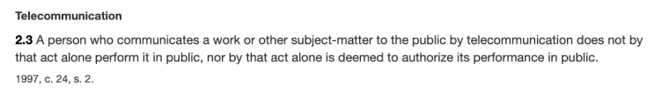
Rights of the copyright owner
Right to perform a work in public
Canadian Cable Television Association v. Canada (Copyright Board), [1993] 2 F.C. 138
  Held that a radio or television broadcast does amount to a performance of the work in public
  In public = openly, without concealment, and to the knowledge of all
  But consistent w. s. 2.3 of the Copyright Act?

Slide 96
Rights of the copyright owner
Right to perform a work in public
Canadian Cable Television Association v. Canada (Copyright Board), [1993] 2 F.C. 138
  Reference to “early conflicting decision” (Rediffusion)
  Letourneau J.: “I would have thought on a mere common sense basis that when the Prime Minister of Canada addresses the nation, either from his home or his private office, and reaches the citizens in their homes by means of radio and television, he appears in public and performs in public. I would have been content to leave it at that had it not been for early conflicting decisions on this issue.”

Slide 97
Rights of the copyright owner
Right to communicate a work to the public by telecommunication (s. 3(1)(f))
TV
Radio
Online
“3 (1) For the purposes of this Act, copyright, in relation to a work, means the sole right to produce or reproduce the work or any substantial part thereof in any material form whatever, to perform the work or any substantial part thereof in public or, if the work is unpublished, to publish the work or any substantial part thereof, and includes the sole right
(f) in the case of any literary, dramatic, musical or artistic work, to communicate the work to the public by telecommunication,…”

Slide 98
Rights of the copyright owner
Right to communicate a work to the
public by telecommunication (s. 3(1)(f))
CCH Canadian v. LSUC (2004)
  Faxed transmissions of a single copy
  of a work to a single individual is not a
  communication to the public
  Emanated from a single point;
  & intended to be received at a single point

Slide 99
Rights of the copyright owner
Right to communicate a work to the public by telecommunication (s. 3(1)(f))
CWTA v. SOCAN (2008)
  Is the transmission of a musical ringtone to a cellphone a ‘communication to the public by telecommunication’?

Slide 100
Rights of the copyright owner
Right to communicate a work to the public by telecommunication (s. 3(1)(f))
ESA v. SOCAN (2012)
  Does the Copyright Act require a second royalty to be paid when games are downloaded as opposed to sold in stores?
  Conclusion: Internet delivery of copies of video games containing musical works does not constitute a communication to the public.

Slide 101
Entertainment Software Association v. Society of Composers, Authors and Music Publishers of Canada (Pentalogy case)
  Issue is whether the Copyright Act requires a second royalty to be paid when games are downloaded as opposed to sold in store? A royalty is already paid to account for the reproduction of the musical work. However if a download of a video game is found to constitute a communication to the public by telecommunication IN ADDITION to a reproduction, then a second right would be engaged.
  Conclusion: SCC held that “the Internet delivery of copies of video games containing musical works” does not constitute a communication to the public – so doesn’t infringe s. 3(1)(f).

Slide 102
Rights of the copyright owner
Right to communicate a work to the public by
telecommunication (s. 3(1)(f))
Rogers Communications Inc. v. SOCAN 2012 SCC 35
  Does individual streaming, triggered by the
  individual actions of individual users,
  constitute “communication to the public” or a
  “private communication” ?

Slide 103
YES, IT IS
‘COMMUNICATION TO THE PUBLIC’
(despite what was said in CCH v. LSUC that transmission of a single copy to a single person isn’t a communication to the public - also think about it → CCH photocopy and fax facts are reasonably distinguishable)

Slide 104
Rights of the copyright owner
Right to communicate a work to the public by telecommunication (s. 3(1)(f))
Rogers Communications Inc. v. SOCAN (2012)
Reasoning/arguments employed to reach conclusion
  CCH distinguished; ruling limited to facts
  Other conclusion would lead to arbitrary, inconsistent results.
  Language of s. 3(1)(f)
  Legislative history
  Balance in copyright
  Developments at international level

Slide 105
Rights of the copyright owner
Right to communicate a work to the public by telecommunication (s. 3(1)(f))
S. 2.4(1.1) (amended)
  For the purposes of this Act, communication of a work or other subject-matter to the public by telecommunication includes making it available to the public by telecommunication in a way that allows a member of the public to have access to it from a place and at a time individually chosen by that member of the public.

Slide 106
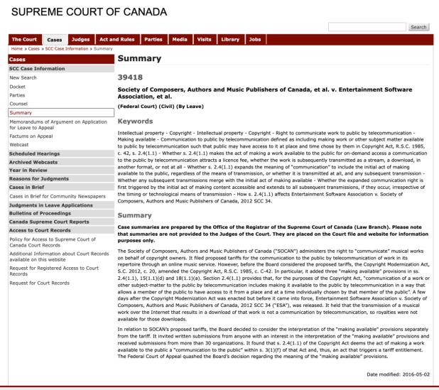
Cutting edge of issues argued over a year ago…
Does “on demand” streaming attract a copyright fee if never transmitted?

Slide 107
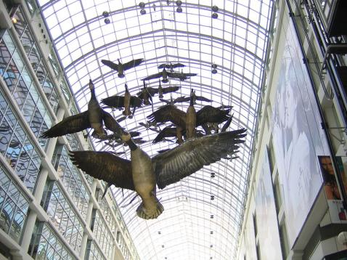
MORAL RIGHTS
Sections 14.1 and 14.2 of the Copyright Act
Snow v. Eaton Centre

Slide 108
Sections 14.1 and 14.2 of the Copyright Act
  the right to the integrity of the work; &
  the right, where reasonable in the circumstances, to be associated with the work as its author by name or under a pseudonym and the right to remain anonymous.
Section 34.2 of the Copyright Act - remedies for infringement of moral rights include injunctions, damages, and delivery up.
Moral rights can be waived, but not transferred.
Cases:
Snow v. Eaton Centre Ltd., (1982) 70 C.P.R. (2d) 105 (Ont. H.C.J.)
Ritchie v. Sawmill Creek Golf & Country Club Ltd., (2004) 189 O.A.C. 282
Wiseau Studio, LLC et al. v. Harper et al. 2020 ONSC 2504

Slide 109
Orphan Works
Circumstances in which licence may be issued by Board
77 (1) Where, on application to the Board by a person who wishes to obtain a licence to use
  (a) a published work, (b) a fixation of a performer’s performance, (c) a published sound recording, or (d) a fixation of a communication signal
in which copyright subsists, the Board is satisfied that the applicant has made reasonable efforts to locate the owner of the copyright and that the owner cannot be located, the Board may issue to the applicant a licence to do an act mentioned in section 3, 15, 18 or 21, as the case may be.
(2) A licence issued…is non-exclusive and is subject to such terms and conditions as the Board may establish.
(3) The owner of a copyright may, not later than five years after the expiration of a licence issued pursuant to subsection (1) in respect of the copyright, collect the royalties fixed in the licence or, in default of their payment, commence an action to recover them in a court of competent jurisdiction….

Slide 110

Independent Creation Doctrine - Canada

Slide 111
63 Many of the detailed similarities, in my view, can be traced to the common store of folklore about primitive species with human characteristics upon which Lucas was as free to draw as were Preston and Hurry. Yet drawing upon a common store of information does not in itself answer to the claim of infringement. It is the expression of ideas, not the ideas themselves, that is the subject of copyright. It is entirely possible that two or more authors, composers, dramatists or other artists may draw upon a common store of information for ideas and each may have copyright in his or her expression of those ideas. But if while drawing upon the common information base, one should copy the expression in literary or dramatic form of another author copyright may be infringed.

Slide 112
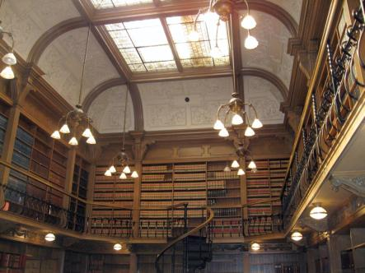
“Rights of Non-Copyright Owners: Fair Dealing etc.”

Slide 113
Users’ rights
Sequence of events in a copyright lawsuit
1) Unauthorized act occurs. Has an infringement prima facie occurred?
  27. (1) It is an infringement of copyright for any person to do, without the consent of the owner of the copyright, anything that by this Act only the owner of the copyright has the right to do.
2) Burden shifts to the Defense to establish a defense to copyright infringement.

Slide 114
Court needs to determine: Was something done that only the copyright owner has the right to do?
Reproduced a work in whole or in substantial part
Performed a work in public
Communicated a work to the public by telecommunication

Slide 115
Today: Two Defences to copyright infringement
Defence of public interest
Fair dealing

Slide 116
User rights: Public Interest Defence
Defence of public interest
R. v. Lorimer & Co. Ltd., [1984] 1 FC 1065
Defence of public interest argued – In the public interest that this information be disseminated as broadly as possible.
Court indicated that it has no doubt that a defence of public interest – as set out in the UK cases on which the Lorimer’s counsel relied – is available in proper circumstances against an assertion of Crown copyright.
But the facts don’t support the public interest defence here
  Great disclosure in report
  Free copies given out, put in libraries across the country
  No concern about the public not being informed
N.B. Act doesn’t mention “public interest”

Slide 117
User rights: Public Interest Defence
Defence of public interest
Lion Laboratories v Evans [1985] QB 526
Lion Laboratories manufactured and marketed the Lion Intoximeter which was used by the police for measuring blood alcohol levels of motorists.
Two ex-employees approached the Press with four documents taken from Lion.
Such reproduction was held to be justified, despite the nature of material, being confidential and protected by copyright.
Court agreed that the defence of public interest applied to the investigations regarding the accuracy of the equipment to avoid incorrect readings when used by the police on motorist.

Slide 118
Wrongdoing does not disqualify the public interest defence.
“I can see no sensible reason why this defence should be limited to cases in which there has been wrongdoing on the part of the plaintiffs.... No doubt it is in such circumstances that the defence will usually arise, but it is not difficult to think of instances where, although there has been no wrongdoing on the part of the plaintiff, it may be vital in the public interest to publish a part of his confidential information”

Slide 119
User rights: Fair Dealing
Fair dealing
Under fair dealing, individuals have the right to use a substantial part of another’s copyright-protected expression without that person’s permission, provided that the individual acts in furtherance of certain purposes, that the individual acts in a fair manner, and that - in some cases - certain attribution requirements are satisfied.
Broadest defence to copyright infringement set out in the Copyright Act.
If fair dealing is made out, an individual will not be found to have infringed copyright.
This defence exists in various forms in several jurisdictions – focus here is on the Canadian articulation of this defence.
We’ll start by looking at the language of the Copyright Act – and then we’ll look at how courts have interpreted these provisions.

Slide 120


Fair Dealing v. Fair Use

Slide 121
Users’ rights: Fair Dealing
29. Fair dealing for the purpose of research, private study, education, parody or satire does not infringe copyright.

Slide 122
Fair Dealing: Criticism or Review
29.1 Fair dealing for the purpose of criticism or review does not infringe copyright if the following are mentioned:
(a) the source; and
  (b) if given in the source, the name of the (i) author, in the case of a work

Slide 123
Fair Dealing: News Reporting
29.2 Fair dealing for the purpose of news reporting does not infringe copyright if the following are mentioned:
(a) the source; and
  (b) if given in the source, the name of the (i) author, in the case of a work

Slide 124
Eight fair dealing categories (exhaustive list)
Research
Private Study
Education
Parody
Satire
Criticism
Review
News reporting

Slide 125
What changed?
CCH v. LSUC (SCC) endorsed “users’ rights”
Flows from Théberge , where copyright was found not to be only about about rewarding and protecting authors; but focussed on the balancing between the public interest in encouraging and disseminating creative and intellectual works and securing a just reward for the author.
Move from defence to copyright action to a more positive articulated User Right.
Means User Right’s can be a sword? How would that work/what would that look like?

Slide 126
Users’ rights
Fair dealing in CCH:
An integral part of the Copyright Act - not just a defence
The fair dealing “exception”, like other exceptions in the Copyright Act, is a users’ right. In order to maintain the proper balance between the rights of a copyright owner and users’ interests, it must not be interpreted restrictively.
Always available. If other exceptions might also be available, argue fair dealing first, then turn to other exceptions and defences.
Two step process:
  1) Defence establishes the dealing was for one of the listed purposes.
  2) Defence establishes the dealing was fair.
Fair dealing category of research to be given a large and liberal interpretation in order to ensure users’ rights are not unduly constrained
Research is not limited to non-commercial or private contexts. Lawyers carrying on the business of law for profit are conducting research within the meaning of s. 29 of the Copyright Act.

Slide 127
User rights: “Fair” in Fair Dealing
CCH Canadian et al v. LSUC (2004)
Whether something is fair is a question of fact and depends on the facts of each case.
Factors that can be considered to help assess whether a dealing is fair:
  Purpose of the dealing
  Character of the dealing
  Amount of the dealing
  Were there alternatives to the dealing?
  Nature of the work
  Effect of the dealing on the work

Slide 128

The fairness stew

Slide 129
1. Purpose of the Dealing
Fair if for one of the allowable purposes under the Copyright Act
  S. 29 = research, private study, education, parody or satire
  S.29.1 = criticism or review
  S. 29.2 = news reporting
Some dealings may be more, or less, fair, than others - i.e., research for commercial purposes may not be as fair as research for charitable purposes

Slide 130
2. Character of the Dealing
How was the work dealt with? Multiple copies distributed, will tend towards being unfair, especially if more copies than necessary or otherwise gratuitous.
Single copy used for single legit purpose – easier to conclude it is fair.
Copies destroyed after use may also favour a finding of fairness.
Do consider customs, practices & norms in a particular industry or trade → However CBC v. SODRAC (SCC 2015) doesn’t – why not? CATEGORIES EXHAUSTIVE

Slide 131
3. Amount of the Dealing
You can deal fairly with a whole work (i.e., photographs)
Amount taken may be more, or less, fair depending on the purpose - i.e., research, may be essential to copy an entire academic article

Slide 132
4. Alternatives to the Dealing
Was there a non-copyrighted equivalent of the work that could have been used instead of the copyrighted work?
Was the dealing reasonably necessary to achieve the ultimate purpose?
Meaning not gratuitous.
I.e., Would a criticism have been equally effective if it did not actually reproduce the copyrighted work it was criticizing? If yes, that weighs against a finding of fairness.

Slide 133
5. Nature of the Work
If a work is unpublished, dealing might be fairer because its reproduction could lead to a wider public dissemination for the work
Confidential work? May be unfair in the circumstances.

Slide 134
6. Effect of the dealing on the work
Is the reproduced work likely to compete with the market of the original work?
Not the only factor - not the most important factor - but can sometimes seem like the most important factor in the cases

Slide 135
Users’ rights
SOCAN v. Bell (2012) - years later – What Is A “User’s Right”
Do iTunes previews constitute “fair dealing”?
If answer is no, those providing previews would be have to pay tariffs for each preview played as communication to the public by telecommunication
Note statements in paragraphs 8-10 regarding nature of copyright in Canada& significance of Théberge case
  Théberge: move away from author-centric approach to copyright
  Need to sensitively balance protection and access

Slide 136
Users’ rights
SOCAN v. Bell (2012) – continued
Users’ rights:
  Essential part of furthering public interest objectives of the Copyright Act
  One of the tools employed to achieve the proper balance between protection and access
  Fairness analysis: Where much of the heavy lifting is one in fair dealing
Fair dealing applied → iTunes previews

Slide 137
Users’ rights
Alberta (Education) v. Canadian Copyright Licensing Agency (Access Copyright) (2012)
Another “pentalogy” case
Main issue: Copies of works made at teachers’ initiatives with instructions to students that they read the material … fair dealing?
Category 4 of the proposed tariff dealt with copies of works made at the teachers’ initiative with instructions to students that they read the material. Teachers would photocopy short excerpts from textbooks and distribute those copies to students as a complement to the main textbook the students used.

Slide 138
Users’ rights
Alberta (Education) v. Canadian Copyright Licensing Agency (Access Copyright) (2012)
SCC’s judgment – Copyright Board’s decision was unreasonable – Category 4 dealings were fair dealings
1) Purpose of the dealing
Research or private study
“Private” – What does this mean? SCC – doesn’t require users to view works in “splendid isolation” – studying and learning are personal endeavours, whether engaged in with others or in solitude

Slide 139
Users’ rights
Alberta (Education) v. Canadian Copyright Licensing Agency (Access Copyright) (2012)
SCC’s judgment – Category 4 dealings were fair dealings
2) Fair? (SCC looks specifically at certain factors)
Purpose of the dealing
  What perspective used to determine whether dealing is a fair dealing = → THE USER
  Exception – where the copier hides behind the shield of the user’s allowable purpose to engage in a separate purpose that tends to make the dealing unfair – here, separate purpose also relevant (“course pack cases”)
  Teachers – there to facilitate research and private study of the students using the materials

Slide 140
Users’ rights
Alberta (Education) v. Canadian Copyright Licensing Agency (Access Copyright) (2012)
SCC’s judgment – Category 4 dealings were fair dealings
2) Fair? - continued
Amount of the dealing
  SCC – focus on the proportion between the excerpted copy and the entire work (not the overall quantity of what is disseminated)
Alternatives to the dealing
  SCC criticized as unrealistic the Board’s suggestion that an alternative to photocopying textbooks would be to buy original texts for each student.
  Copying short excerpts is reasonably necessary to achieve the ultimate purpose of the students’ research and private study

Slide 141
Users’ rights
Alberta (Education) v. Canadian Copyright Licensing Agency (Access Copyright) (2012)
SCC’s judgment – Category 4 dealings were fair dealings
2) Fair? - continued
Effect of the dealing on the work
  No evidence offered to link decline in textbook sales to photocopying done by teachers
  SCC – hard to see how copying competes with the market for textbooks, given the finding that the copying was limited to short excerpts of complementary texts

Slide 142
Abella J.
“ The test for fair dealing was articulated in CCH as involving two steps. The first is to determine whether the dealing is for the allowable purpose of “research or private study” under s. 29 , “criticism or review” under s. 29.1 , or “news reporting” under s. 29.2 of the Act. The second step of CCH assesses whether the dealing is “fair”. The onus is on the person invoking “fair dealing” to satisfy all aspects of the test. To assist in determining whether the dealing is “fair”, this Court set out a number of fairness factors: the purpose, character, and amount of the dealing; the existence of any alternatives to the dealing; the nature of the work; and the effect of the dealing on the work.”

Slide 143
Users’ rights: Another “at odds” case?
The Canadian Copyright Licensing Agency
v. York University, 2017 FC 669
Were York University’s Fair Dealing Guidelines fair?
Phelan J. concludes not
Is Phelan J.’s ruling consistent with the
SCC’s fair dealing jurisprudence?

Slide 144
Not Phelan It J.
[28] A further and final factor of the fairness of the Guidelines is that York has made no real effort to review, audit, or enforce its own Guidelines. As became evident, educational efforts on setting their copyright rules are insufficient because there was no effective compliance mechanism. Even professors operating outside of the Guidelines are not held accountable. The complete abrogation of any meaningful effort to ensure compliance with the Guidelines – as if the Guidelines put copyright compliance on autopilot – underscores the unfairness of York’s Guidelines.

Slide 145
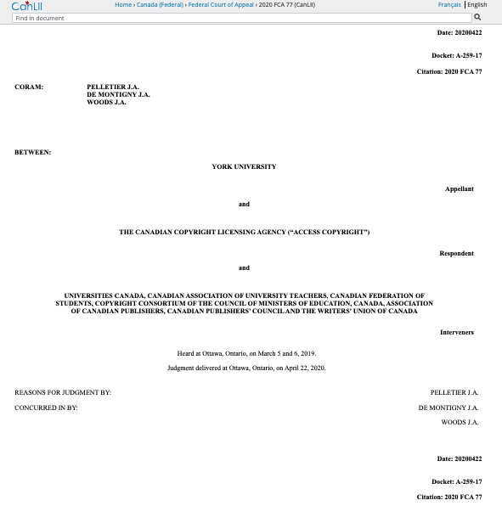
…Ignored (sort of) by…FCA
https://www.canlii.org/en/ca/fca/doc/2020/2020fca77/2020fca77.html

Slide 146
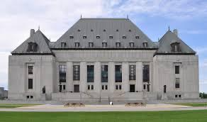
S.C.C. Decision

Slide 147
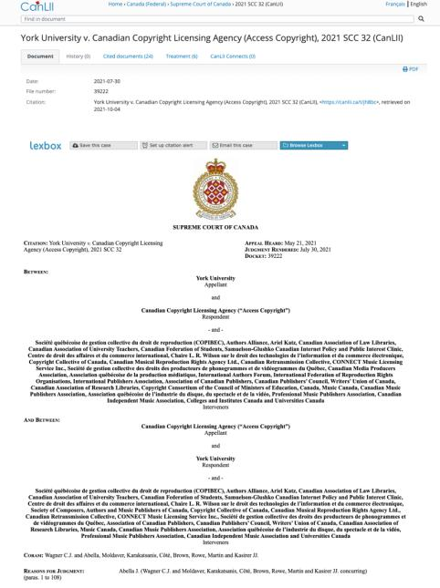

Slide 148
Abella J. “[20] The question on Access Copyright’s appeal is whether s. 68.2(1) of the Copyright Act empowers Access Copyright to enforce royalty payments set out in a Copyright Board approved tariff against a user who chooses not to be bound by a licence on the approved terms. More specifically, the issue is whether Access Copyright can extract from York the royalties set out in the interim tariff despite the fact that York chose not to be bound by a licence.
[28] The issue in this case is one of statutory interpretation, which, as this Court has repeatedly said, is an exercise in discerning legislative intent by looking at the grammatical and ordinary meaning of the text in the context of the statute’s scheme and objectives.
[39] As matter of legislative coherence, it would be incongruous if royalties fixed in the context of licence negotiations between a collective society and a specific user were voluntary, but those set in a general tariff were mandatory.

Slide 149
[71] …Instead of operating as a part of a scheme designed to control collective societies’ potentially unfair market power, Access Copyright’s interpretation would turn tariffs into a plainly anti‑competitive tool, boosting collective societies’ power to the detriment of users.
[83] …there is no live dispute between the parties. This is not an action for infringement, since Access Copyright has no standing to bring such an action. And the copyright owners who do have standing to bring an infringement action in respect of York’s copying activities are not parties to these proceedings and, as a result, have not had the opportunity to advance arguments or adduce evidence about how York’s Guidelines interact with and affect their copyrighted works...All of this makes consideration of the Guidelines in this case inappropriate.

Slide 150
[87] While I therefore agree that the requested Declaration should not be granted, this should not be construed as endorsing the reasoning of the Federal Court and Federal Court of Appeal on the fair dealing issue. There are some significant jurisprudential problems with those aspects of their judgments that warrant comment.
[88] In commenting on those errors, it is important to emphasize that our reasons do not decide the issue of fair dealing…While correcting the errors committed by the Federal Court and Court of Appeal favours the position argued before this Court by York, these reasons address only some of the factors that make up the fair dealing analysis, an analysis that requires consideration of facts and factors not addressed here.
[89] The main problem with their analysis was that they approached the fairness analysis exclusively from the institutional perspective. This error tainted their analysis of several fairness factors. By anchoring the analysis in the institutional nature of the copying and York’s purported commercial purpose, the nature of fair dealing as a user’s right was overlooked and the fairness assessment was over before it began.

Slide 151
[91] Accordingly, to understand and apply fair dealing doctrine requires first understanding the copyright balance. Copyright law has public interest goals. The relationship between members of the public and copyrighted works is not merely the “consequence of the author-work relationship”…
[92] Instead, increasing public access to and dissemination of artistic and intellectual works, which enrich society and often provide users with the tools and inspiration to generate works of their own, is a primary goal of copyright. “Excessive control by holders of copyrights and other forms of intellectual property may unduly limit the ability of the public domain to incorporate and embellish creative innovation in the long-term interests of society as a whole” (Théberge v. Galerie d’Art du Petit Champlain inc., 2002 SCC 34 (CanLII), [2002] 2 S.C.R. 336, at para. 32, per Binnie J.).

Slide 152
[102] In other words, contrary to the Federal Court of Appeal’s view, in the educational context it is not only the institutional perspective that matters. When teaching staff at a university make copies for their students’ education, they are not “hid[ing] behind the shield of the user’s allowable purpose in order to engage in a separate purpose that tends to make the dealing unfair”.
[103] It was therefore an error for the Court of Appeal, in addressing the purpose of the dealing, to hold that it is only the “institution’s perspective that matters” and that York’s financial purpose was a “clear indication of unfairness”…Funds “saved” by proper exercise of the fair dealing right go to the University’s core objective of education, not to some ulterior commercial purpose... The purpose of copying conducted by university teachers for student use is for the student’s education…

Slide 153
PARODY

Slide 154
Users’ rights: later decisions create doubt
United Airlines, Inc. v. Cooperstock, 2017 FC 616
United Airlines is a commercial airline that operates in and out of Canada. United has used several trademarks in association with its services & also claims copyright in several logos and designs.
Dr. Jeremy Cooperstock had a negative experience with United. He was vocal about his complaints and disappointed with what he felt were inadequate responses.
Cooperstock launched a website called “Poor Show” that set out information about his experience and United’s responses.
This website resonated with many who provided information regarding their negative experiences with United.
Cooperstock posted this correspondence on his “Poor Show” website.
In 1997, he shifted this content to the website UNTIED.com.

Slide 155
Users’ rights
United Airlines, Inc. v. Cooperstock, 2017 FC 616
First case to define the fair dealing category of parody:
  Two basic elements to parody: the evocation of an existing work while exhibiting noticeable differences and the expression of mockery or humour
  Not required to identify source of work being parodied
  Parody does not require that the expression of mockery or humour to be directed at the exact thing being parodied

Slide 156
Users’ rights: Parody found
United Airlines, Inc. v. Cooperstock, 2017 FC 616
Phelan J. relied on Deckmyn v. Vandersteen, a decision of the European Court of Justice, in defining parody for the purposes of the Canadian Copyright Act:
  [119] … Parody should be understood as having two basic elements: the evocation of an existing work while exhibiting noticeable differences and the expression of mockery or humour. I would also note that the fair dealing exception for the purpose of parody in s 29 of the Copyright Act does not require a user to identify the source of the work being parodied. In addition, in my view, parody does not require that the expression of mockery or humour to be directed at the exact thing being parodied. It is possible, for example, for a parody to evoke a work such as a logo while expressing mockery of the source company, or to evoke a well-known song while expressing mockery of another entity entirely.
  [120] In my view, UNTIED.com falls within the definition of parody described above: it evokes existing works (the United Website, the United Logo, and the Globe Design) while showing some differences (such as content and disclaimers), and it expresses mockery (and criticism) of the Plaintiff. Therefore, the first stage of the CCH test has been met in this case.

Slide 157
Users’ rights: Parody found BUT
United Airlines, Inc. v. Cooperstock, 2017 FC 616
Phelan J…
(3) Conclusion on Copyright Infringement
[141] Parody is not simply a defence to copyright infringement – it is also an aspect of free speech. However, like all free speech, it is not unrestricted. The Defendant’s website meets the first step of the CCH test, as it is for the allowable purpose of parody, but it does not meet the second step of the test. The questionable purpose of the dealing, amount of the dealing, and effect of the dealing all weigh in favour of the conclusion that this dealing is not fair.

Slide 158
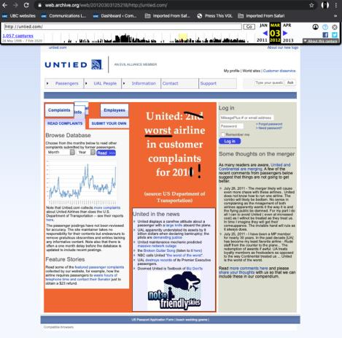
Site considered to be a parody, but not to be fair (fair dealing not made out)

Slide 159
Users’ rights
Common carrier exception (s. 2.4(1)(b)) similar but not the same as…
Applicable in the context of communication to the public by telecommunication
“Communication to the public by telecommunication
2.4 (1) For the purposes of communication to the public by telecommunication,
b) a person whose only act in respect of the communication of a work or other subject-matter to the public consists of providing the means of telecommunication necessary for another person to so communicate the work or other subject-matter does not communicate that work or other subject-matter to the public;…”

Slide 160
Policy behind s. 2.4(1)(b))
Historical question of whether internet service providers, as intermediaries, are participants in communicating some works to the public.
1988 amendments to the Copyright Act trying to clarify this point
The 1988 amendments specify participants in a telecommunication who provide “the means of telecommunication necessary”
Thus Intermediaries are deemed not to be communicators.

Slide 161
Users’ rights
Common carrier exception (s. 2.4(1)(b))
Applicable in the context of communication to the public by telecommunication
Main case interpreting this provision: SOCAN v. CAIP (2004 SCC – “Tariff 22”) re ISP LIABILITY
  1) Intermediaries are deemed by parliament NOT TO BE COMMUNICATING to the PUBLIC. This is not an “immunity” or “loophole”. IT IS AN EXEMPTION NOT AN EXCEPTION.

Slide 162
Users’ rights
Common carrier exception (s. 2.4(1)(b))
SOCAN v. CAIP (2004 SCC – “Tariff 22”) re ISP LIABILITY
2) As an EXEMPTION NOT AN EXCEPTION s.2.4(1)(b) SHOULD NOT BE READ NARROWLY. It is an important and integral element of the balancing of interests under the Copyright Act’s statutory scheme. In other words, it should read broadly as should “fair dealing” as well.

Slide 163
User rights
Common carrier exception (s. 2.4(1)(b)) SOCAN v. CAIP (2004 SCC – “Tariff 22”) re ISP LIABILITY
3) What is NECESSARY? If means are “reasonably useful and proper to achieve the benefits of enhanced economy and efficiency”. For example:
Routers, other hardware
Software connection equipment
Connectivity services
Hosting and other facilities
Services without which such communications would not occur
Caching (dictated by the need to deliver faster, less expensive, & more efficient services, & should not, when undertaken only for such technical reasons, attract copyright liability)

Slide 164
User rights
Common carrier exception (s. 2.4(1)(b))
SOCAN v. CAIP (2004 SCC – “Tariff 22”) re ISP LIABILITY
4) Key is content neutrality: So long as the intermediary is simply a conduit “Don’t shoot the messenger” – See SCC Para [92])
What is a “CONDUIT”?:
Means NO actual knowledge of infringing content;
Given the impracticality of monitoring the vast amount of material
→ vested interest in “see no evil” → Cambridge Analytica → who knew what, when?

Slide 165
User rights
Common carrier exception (s. 2.4(1)(b))
SOCAN v. CAIP (2004 SCC – “Tariff 22”) re ISP LIABILITY
5) Copyright liability attaches when intermediary:
Is not providing a means ‘necessary’ for another person to communicate the work
Ceases to be content neutral → If ISP provides content or creates links which triggers the telecommunication of copyright material from another resource → but liability only lost for that additional part, not everything
Does moderation change things? Curation? Promotion?...Or just “evidence of”…

Slide 166
User rights
Common carrier exception (s. 2.4(1)(b))
SOCAN v. CAIP (2004 SCC – “Tariff 22”) re ISP LIABILITY
5) Liability reattaches when intermediary ceases to be content neutral
What if ISP provides content? Yes, but almost certainly only for that content, not total loss of s. 2.4(1)(b)
Does moderation change things? Curation? Promotion?...Or just “evidence of”…

Slide 167
Users’ rights
Common carrier exception (s. 2.4(1)(b))
Bell Canada v. 1326030 Ontario Inc. (iTVBox.net)
2016 FC 612 affirmed 2017 FCA 55
Interlocutory Injunction application
“[8] The Plaintiffs specifically identified three types of pre-installed applications which they submit could be used to access copyrighted content:
A. KODI: with the proper add-on(s), the open-source media player KODI could be used to access online streaming websites;
B. Showbox: the media player software Showbox could be used to access online streaming websites and permanently download content such as television programming or motion pictures; and
C. Private IPTV Services: these are private Internet servers which re-transmit television broadcasts over the Internet, usually for a monthly fee.”

Slide 168
User rights
Common carrier exception (s. 2.4(1)(b))
Bell Canada v. 1326030 Ontario Inc. (iTVBox.net)
  Should the defendants in this case benefit from the common carrier exception?
…pre-loaded “plug and play” set-top boxes.
“[5] … electronic devices that can be connected to any standard television set in order to provide additional functionalities to that television, on which they have previously installed and configured a set of applications.”

Slide 169
Should the common carrier exception (s. 2.4(1)(b)) apply?
“[22] …This is not a case where the Defendants merely serve as the conduit, as was argued by Mr. Wesley. Rather, they deliberately encourage consumers and potential clients to circumvent authorized ways of accessing content – say, by a cable subscription or by streaming content from the Plaintiffs’ websites – both in the manner in which they promote their business, and by offering tutorials in how to add and use applications which rely on illegally obtained content. The statutory defence provided in paragraph 2.4(1)(b) of the Copyright Act does not apply to the Defendants who go above and beyond selling a simple “means of telecommunication”. They also engage in acts related to the content of the infringed communications (Society of Composers, Authors and Music Publishers of Canada v Canadian Assn of Internet Providers, 2004 SCC 45 at para 92). Consumers can consequently stream or download the Plaintiffs’ programs and store them on their device without authorization from the Plaintiffs. This constitutes prima facie copyright infringement pursuant to section 27 of the Copyright Act.”

Slide 170
N.B.: S. 31.1 Copyright Act (added to the Copyright Act, 2012 – complimentary to & broader than S. 2.4(1)(b)
While s. 2.4(1)(b) applies only to the right to communicate a work to the public, s. 31(2) right applies more broadly – to any rights that might have otherwise been infringed.

Slide 171
Now…A few more things
1. Non-commercial User-generated Content & Reproduction for Private purposes
2. Intersections of copyright and contract
3. TPMs
What are they?
Provisions dealing with TPMs
Exceptions to the TPM infringement provisions
Enforcement of TPMs
4. Rights management information
5. Notification letters
6. Remedies and procedures.

Slide 172
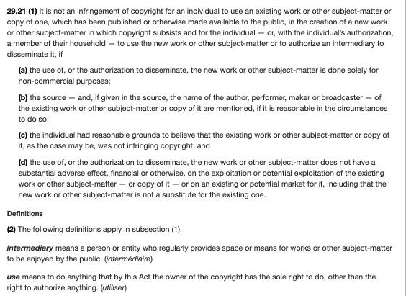
Non-commercial User-generated Content

Slide 173
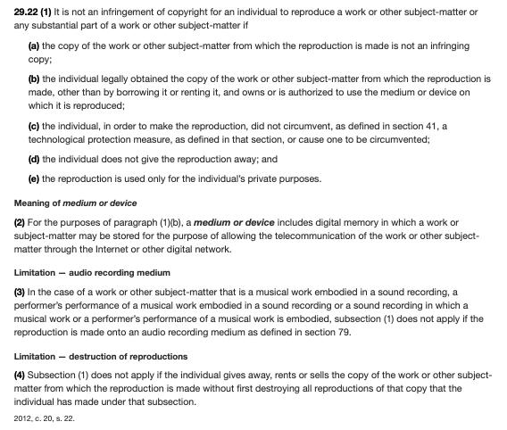
Reproduction for Private Purposes

Slide 174
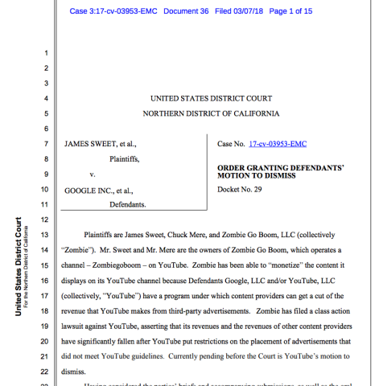
Courts Prioritize Contract
Over Copyright ?!

Slide 175
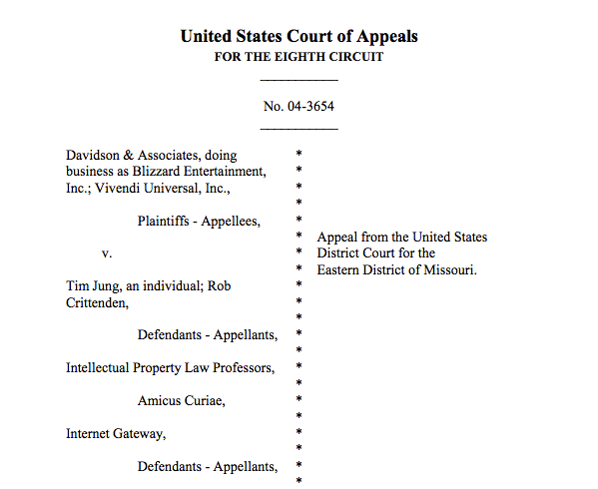
2005

Slide 176



Real world context: Law of…

Slide 177
Query: Can you contract out of your fair dealing “User’s Right”?

Slide 178
Does this help?
From CCH Canadian Ltd. v. Law Society of Upper Canada, [2004] 1 SCR 339
“49 As an integral part of the scheme of copyright law, the s. 29 fair dealing exception is always available. Simply put, a library can always attempt to prove that its dealings with a copyrighted work are fair under s. 29 of the Copyright Act. It is only if a library were unable to make out the fair dealing exception under s.29 that it would need to turn to s. 30.2 of the Copyright Act to prove that it qualified for the library exemption.”

Slide 179
Enforcement & Remedies
Primary remedies provision, Copyright Act
34. (1) Where copyright has been infringed, the owner of the copyright is, subject to this Act, entitled to all remedies by way of injunction, damages, accounts, delivery up and otherwise that are or may be conferred by law for the infringement of a right.
NB. These same remedies are available for infringements of moral rights. (34(2))

Slide 180
Enforcement & Remedies
Primary remedies provision, Copyright Act
S. 35(1) Copyright Act clarifies that where a person has infringed copyright, they are liable to pay both:
Damages suffered by the copyright owner due to the infringement &
Any profits made from the infringement not previously accounted for when calculating damages
Copyright owners also have the choice of, rather than recovering damages and profits, of recovering statutory damages.

Slide 181
Enforcement & Remedies
Statutory damages S. 38.1 Copyright Act
Note critical distinction between statutory damages for infringements for commercial purposes, and statutory damages for infringements for non-commercial purposes
  Commercial: $500-$20,000 per work infringed (s. 38.1(1)(a))
  Non-commercial: $100-$5,000 for all works infringed (s. 38.1(1)(b))

Slide 182
Statutory damages s. 38.1 (1) Copyright Act
Statutory damages
38.1 (1) Subject to this section, a copyright owner may elect, at any time before final judgment is rendered, to recover, instead of damages and profits referred to in subsection 35(1), an award of statutory damages for which any one infringer is liable individually, or for which any two or more infringers are liable jointly and severally,
  (a) in a sum of not less than $500 and not more than $20,000 that the court considers just, with respect to all infringements involved in the proceedings for each work or other subject-matter, if the infringements are for commercial purposes; and
  (b) in a sum of not less than $100 and not more than $5,000 that the court considers just, with respect to all infringements involved in the proceedings for all works or other subject-matter, if the infringements are for non-commercial purposes.

Slide 183
Statutory damages s. 38.1 Copyright Act
In exercising its discretion, the court is required to consider the factors set out in 38.1(5) of the Copyright Act including…
(d) in the case of infringements for non-commercial purposes, the need for an award to be proportionate to the infringements, in consideration of the hardship the award may cause to the defendant, whether the infringement was for private purposes or not, and the impact of the infringements on the plaintiff.

Slide 184
Notice & Notice
Under the notice-and-notice system, copyright owners are entitled to send infringement notices to Internet providers, who are legally required to forward the notifications to their subscribers. The notices must include details on the sender, the copyright works and the alleged infringement. If the Internet provider fails to forward the notification, it must explain why or face the prospect of damages that run as high as $10,000. Internet providers must also retain information on the subscriber for six months (or 12 months if court proceedings are launched).
Benefit for ISPs is safe harbour from liability
Cost to ISPs is processing and forwarding notices
The benefit for users is no legal penalties. Primarily designed as an educational tool. User’s personal information not disclosed to copyright owner
Should copyright owner wish to take legal action for copyright breach, they must go to court to obtain an order requiring the ISP to reveal the user’s identity. Canadian courts have been pretty strict regarding rules/limitations around these disclosures.
Law reform in 2012: liability for internet users for non-commercial infringement was capped at $5,000 for all infringements prior to the bringing of the action.

Slide 185
Notice & Notice Made Simple
The copyright owner’s representative identifies alleged unauthorized use or sharing of one of their works;
That representative sends a notice detailing this unauthorized activity to the associated ISP; and
The ISP must forward that notice to the user, in cases where a specific user account can be identified.

Slide 186
REFORMS: Addition of a provision regarding prohibited content in the Copyright Act
s. 41.25(3)
Prohibited content
(3) A notice of claimed infringement shall not contain
(a) an offer to settle the claimed infringement;
(b) a request or demand, made in relation to the claimed infringement, for payment or for personal information;
(c) a reference, including by way of hyperlink, to such an offer, request or demand; and
(d) any other information that may be prescribed by regulation.

Slide 187
Criminal enforcement
See ss. 42, 43 of the Copyright Act for criminal sanctions
For instance, s. 42(1):
42 (1) Every person commits an offence who knowingly
  (a) makes for sale or rental an infringing copy of a work or other subject-matter in which copyright subsists;
  (b) sells or rents out, or by way of trade exposes or offers for sale or rental, an infringing copy of a work or other subject-matter in which copyright subsists;
  (c) distributes infringing copies of a work or other subject-matter in which copyright subsists, either for the purpose of trade or to such an extent as to affect prejudicially the owner of the copyright;...

Slide 188
Criminal enforcement (con’d)
See ss. 42, 43 of the Copyright Act for criminal sanctions
For instance, s. 42(1):
42 (1) Every person commits an offence who knowingly
  …(d) by way of trade exhibits in public an infringing copy of a work or other subject-matter in which copyright subsists;
  (e) possesses, for sale, rental, distribution for the purpose of trade or exhibition in public by way of trade, an infringing copy of a work or other subject-matter in which copyright subsists;
  (f) imports, for sale or rental, into Canada any infringing copy of a work or other subject-matter in which copyright subsists; or
  (g) exports or attempts to export, for sale or rental, an infringing copy of a work or other subject-matter in which copyright subsists.
Summary conviction: $25,000 fine; 6 months imprisonment; or both
Indictment: $1,000,000 fine; 5 years imprisonment or both

Slide 189
Copyright Trolling/Lying in Wait
Section 35 never mentions good faith/bad faith but does mention “calculating the damages the court deems just”.
  35 (1) Where a person infringes copyright, the person is liable to pay such damages to the owner of the copyright as the owner has suffered due to the infringement and, in addition to those damages, such part of the profits that the infringer has made from the infringement and that were not taken into account in calculating the damages as the court considers just.
Section 38.1(5) dealing with statutory damages provides more leeway including among its factors (a) the good faith or bad faith of the defendant; (b) the conduct of the parties before and during the proceedings;

Slide 190
Enforcement & Remedies
Punitive and exemplary damages
Boudreau v. Lin
Standard for punitive/exemplary damages said to be flagrant behavior and callous disregard for the Plaintiff’s rights
Cinar Corporation v. Robinson
S. 49 of the Quebec Charter – “punitive damages may be awarded if there is an unlawful and intentional interference with any of the rights and freedoms that the Charter recognizes”.

Slide 191
Enforcement & Remedies
Limitation period for civil remedies: s. 43.1(1)
  Three years:
    From the time the act occurred (or)
    After the time when the Plaintiff knew or could reasonably have been expected to know of the act
  Does the limitation period apply to injunctive relief? → not decided in Warman v. Fournier

Slide 192
QUESTIONS?
THOUGHTS?
DISCUSSION?

Slide 193
Pause

Slide 194

Now, to our regularly
scheduled programming…

Slide 195
Now…A few more things
1. Non-commercial User-generated Content & Reproduction for Private purposes
2. Intersections of copyright and contract
3. TPMs
What are they?
Provisions dealing with TPMs
Exceptions to the TPM infringement provisions
Enforcement of TPMs
4. Rights management information
5. Notification letters
6. Remedies and procedures.

Slide 196
Non-commercial User-generated Content

Slide 197
Reproduction for Private Purposes

Slide 198
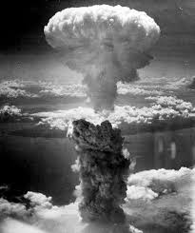
Contracts as the Real-World
Problems with Copyright

Slide 199

BECAUSE:
SLICE & DICE COPYRIGHT

Slide 200
Because (2):
Licensing v. Selling

Slide 201
CONTRACTS CAN CHANGE
{almost} EVERYTHING

Slide 202
Courts Prioritize Contract
Over Copyright ?!

Slide 203
2005

Slide 204
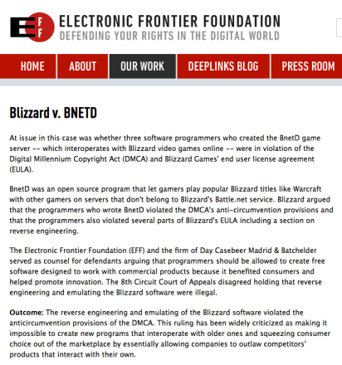

Slide 205
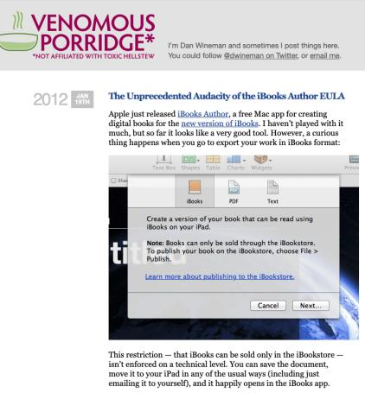
Apple’s 2012 mis-adventure

Slide 206
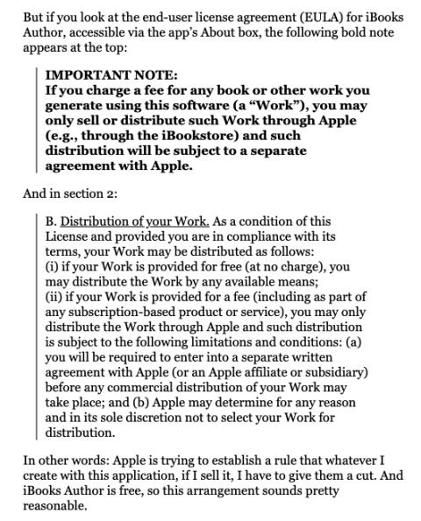

Slide 207
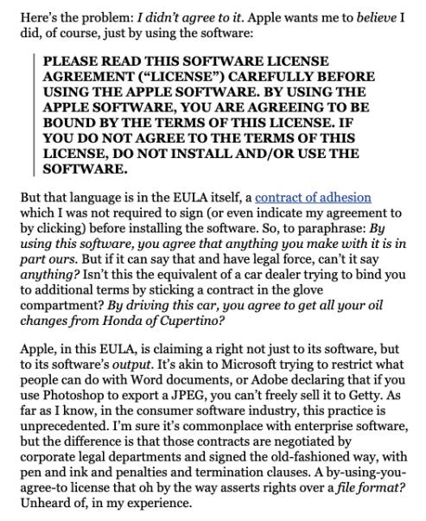

Slide 208
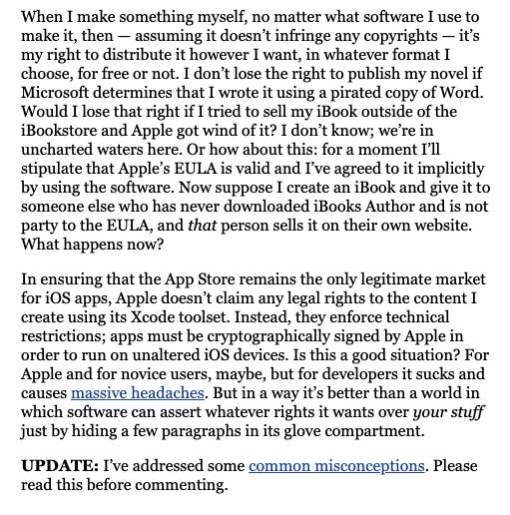

Slide 209

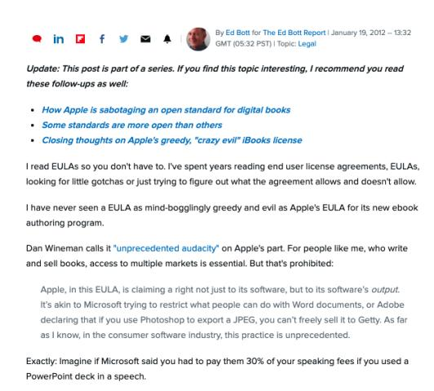

Slide 210
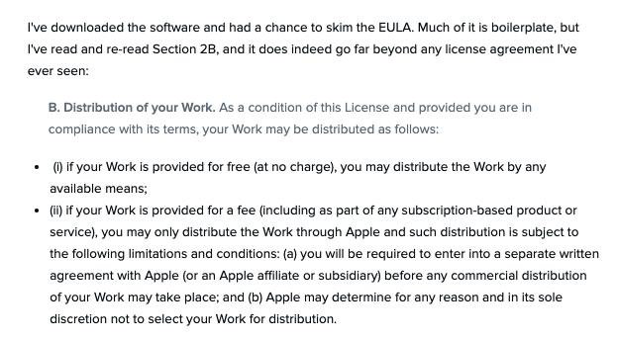

Slide 211
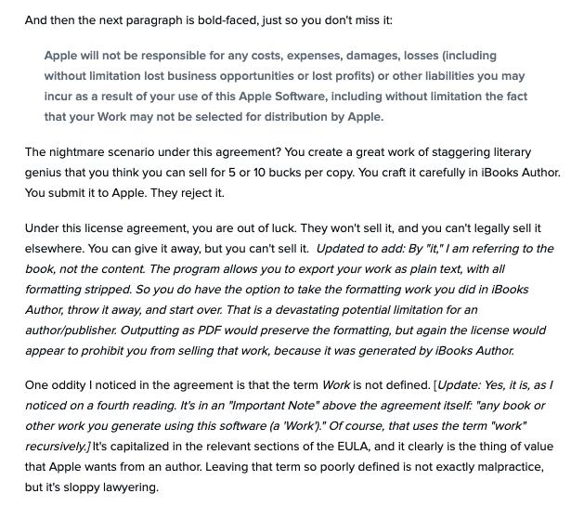

Slide 212
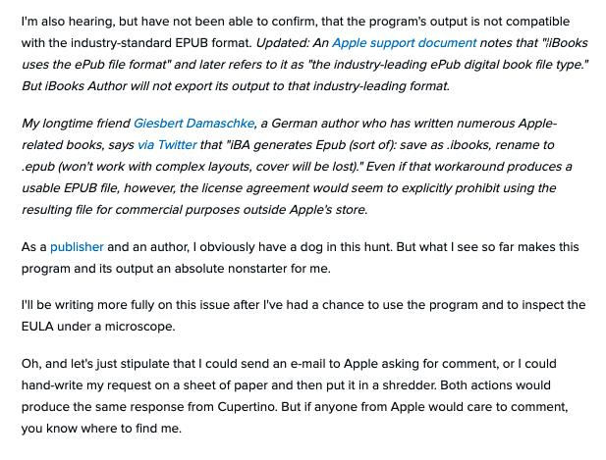

Slide 213
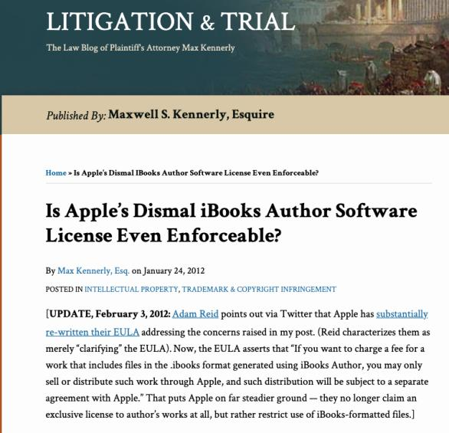

Slide 214
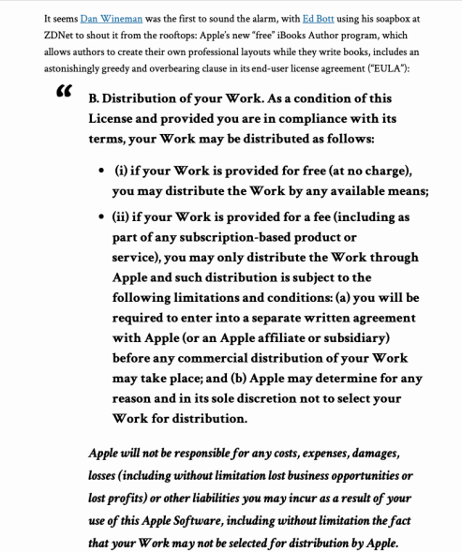

Slide 215
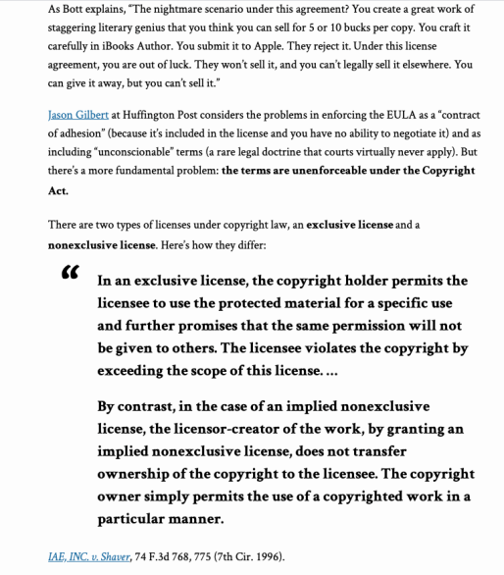

Slide 216
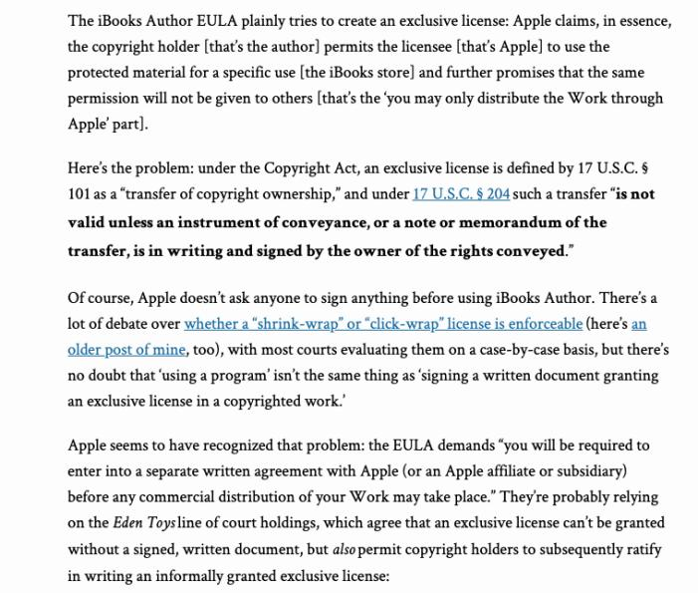

Slide 217
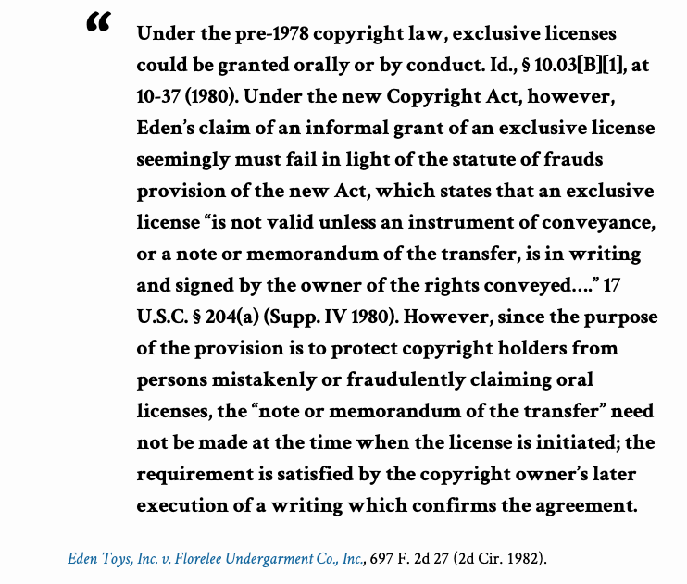

Slide 218
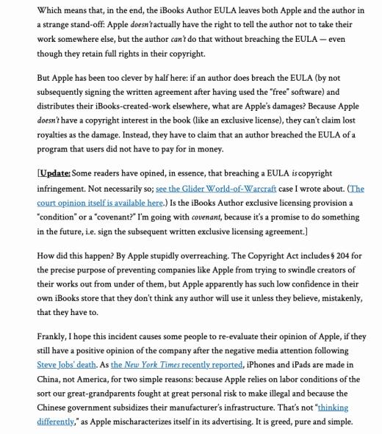

Slide 219
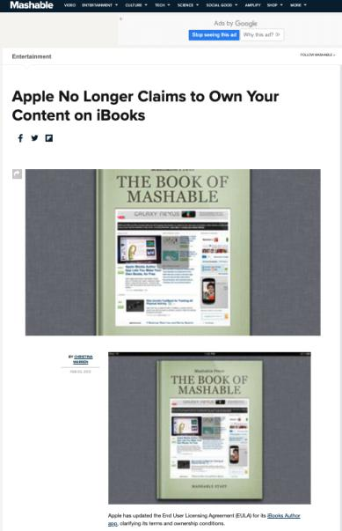

Slide 220
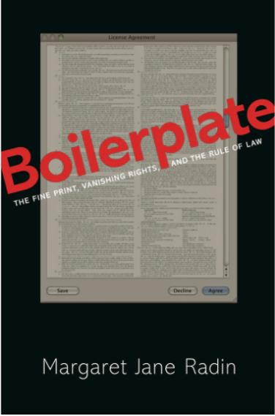

Slide 221
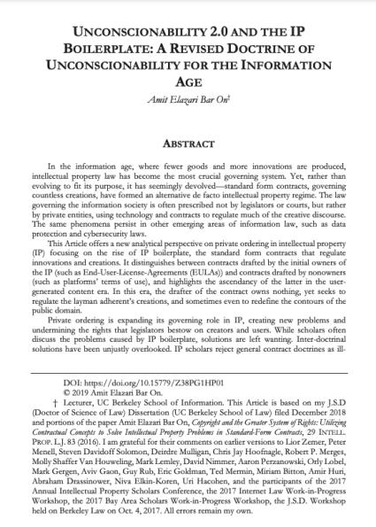

Slide 222
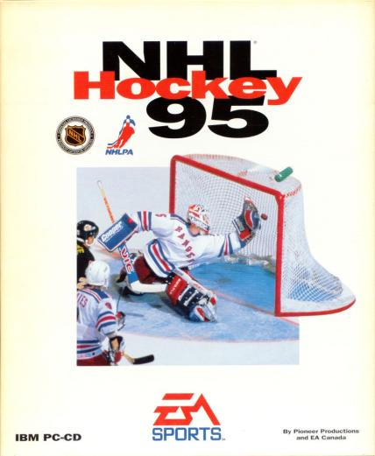
Before on-line NO EULA or ToS !

Slide 223
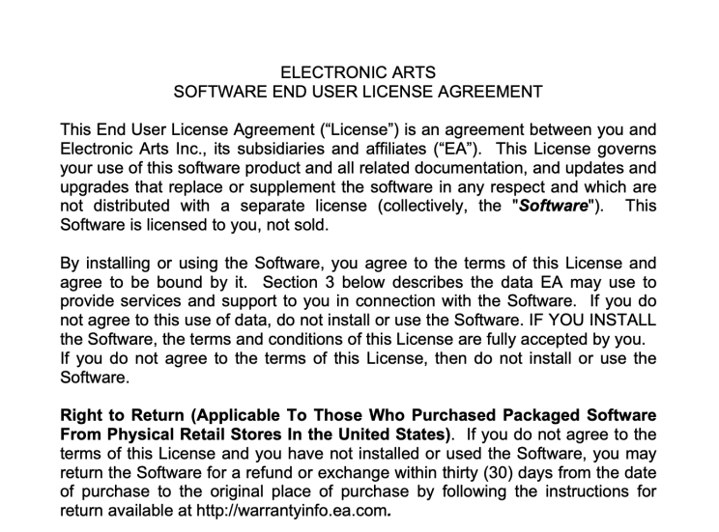
These days however…

Slide 224
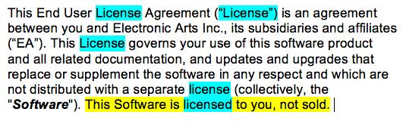
Can you tell it’s (perhaps) a license?

Slide 225

Reverse engineering OK in IP law but
not ok per this contract

Slide 226

Modifying Copyright through Contract 1

Slide 227

Modifying Copyright through Contract 2

Slide 228
Query: Can you contract out of your fair dealing “User’s Right”?

Slide 229
Does this help?
From CCH Canadian Ltd. v. Law Society of Upper Canada, [2004] 1 SCR 339
“49 As an integral part of the scheme of copyright law, the s. 29 fair dealing exception is always available. Simply put, a library can always attempt to prove that its dealings with a copyrighted work are fair under s. 29 of the Copyright Act. It is only if a library were unable to make out the fair dealing exception under s.29 that it would need to turn to s. 30.2 of the Copyright Act to prove that it qualified for the library exemption.”

Slide 230
Real world context: Law of…

Slide 231
Enforcement & Remedies
Which courts?
Conflicting application for copyright registration? Must go to Federal Court (per S. 20, Federal Courts Act)
Dispute turns on common law principles like contract? Looking for criminal remedies? Must go to the provincial courts.
Federal Court has concurrent jurisdiction where a remedy is sought respecting copyright (per s. 41.24, Copyright Act)

Slide 232


Slide 233
In other words,…
Generally, you can choose to enforce your copyright either in the Federal Court or the provincial courts (like the BC Supreme Court) per both in the Federal Courts Act, and s. 41.24 of the Copyright Act, provided you are not trying to resolve a conflicting application for registration of copyright, and so long as the dispute doesn’t turn on common law principles (but?)…

Slide 234
Enforcement & Remedies
Primary infringement section in Copyright Act:
27. (1) It is an infringement of copyright for any person to do, without the consent of the owner of the copyright, anything that by this Act only the owner of the copyright has the right to do.

Slide 235
Enforcement & Remedies
Secondary infringement section in Copyright Act:
27. (2) It is an infringement of copyright for any person to
  (a) sell or rent out, (b) distribute to such an extent as to affect prejudicially the owner of the copyright, (c) by way of trade distribute, expose or offer for sale or rental, or exhibit in public,…or (e) import into Canada for the purpose of doing anything referred to in paragraphs (a) to (c),
a copy of a work, sound recording or fixation of a performer’s performance or of a communication signal that the person knows or should have known infringes copyright or would infringe copyright if it had been made in Canada by the person who made it.

Slide 236
Enforcement & Remedies
Other ways through which copyright
owners can enforce/protect/guard against
copyright infringement:
Contracts
Technological protection measures
Rights management information
Notification letters

Slide 237
Notice & Notice
Under the notice-and-notice system, copyright owners are entitled to send infringement notices to Internet providers, who are legally required to forward the notifications to their subscribers. The notices must include details on the sender, the copyright works and the alleged infringement. If the Internet provider fails to forward the notification, it must explain why or face the prospect of damages that run as high as $10,000. Internet providers must also retain information on the subscriber for six months (or 12 months if court proceedings are launched).
Benefit for ISPs is safe harbour from liability
Cost to ISPs is processing and forwarding notices
The benefit for users is no legal penalties. Primarily designed as an educational tool. User’s personal information not disclosed to copyright owner
Should copyright owner wish to take legal action for copyright breach, they must go to court to obtain an order requiring the ISP to reveal the user’s identity. Canadian courts have been pretty strict regarding rules/limitations around these disclosures.
Law reform in 2012: liability for internet users for non-commercial infringement was capped at $5,000 for all infringements prior to the bringing of the action.

Slide 238
Notice & Notice Made Simple
The copyright owner’s representative identifies alleged unauthorized use or sharing of one of their works;
That representative sends a notice detailing this unauthorized activity to the associated ISP; and
The ISP must forward that notice to the user, in cases where a specific user account can be identified.

Slide 239
QUESTIONS?
THOUGHTS?
DISCUSSION?

Slide 240
Pause

Slide 241


Slide 242

Now…
“Remedies +”

Slide 243
Enforcement & Remedies
Which courts?
Conflicting application for copyright registration? Must go to Federal Court (per S. 20, Federal Courts Act)
Dispute turns on common law principles like contract? Looking for criminal remedies? Must go to the provincial courts.
Federal Court has concurrent jurisdiction where a remedy is sought respecting copyright (per s. 41.24, Copyright Act)

Slide 245
In other words,…
Generally, you can choose to enforce your copyright either in the Federal Court or the provincial courts (like the BC Supreme Court) per both in the Federal Courts Act, and s. 41.24 of the Copyright Act, provided you are not trying to resolve a conflicting application for registration of copyright, and so long as the dispute doesn’t turn on common law principles (but?)…

Slide 246
Enforcement & Remedies
Primary infringement section in Copyright Act:
27. (1) It is an infringement of copyright for any person to do, without the consent of the owner of the copyright, anything that by this Act only the owner of the copyright has the right to do.

Slide 247
Enforcement & Remedies
Secondary infringement section in Copyright Act:
27. (2) It is an infringement of copyright for any person to
  (a) sell or rent out, (b) distribute to such an extent as to affect prejudicially the owner of the copyright, (c) by way of trade distribute, expose or offer for sale or rental, or exhibit in public,…or (e) import into Canada for the purpose of doing anything referred to in paragraphs (a) to (c),
a copy of a work, sound recording or fixation of a performer’s performance or of a communication signal that the person knows or should have known infringes copyright or would infringe copyright if it had been made in Canada by the person who made it.

Slide 248
Enforcement & Remedies
Other ways through which copyright
owners can enforce/protect/guard against
copyright infringement:
Contracts
Technological protection measures
Rights management information
Notification letters

Slide 249
Enforcement & Remedies
Should users be able to bargain away through contract their fair dealing rights, or should these always be available?
Or asked another way - Should the law allow us to bargain away our “fair dealing/users rights” via mostly digital contracts (End User License Agreements etc.) that hardly ever, if ever, is actually read?
Note that in many ways it’s easier to sue pursuant to a contract than using the Copyright Act
OR SHOULD OUR “FAIR DEALING/USERS RIGHTS” ALWAYS BE AVAILABLE TO US? COULD THAT ONE DAY BECOME THE ADDITIONAL MEANING OF ‘USER RIGHTS’ OVER AND ABOVE FAIR DEALING?

Slide 250

Enforcement & Remedies – TPMs & RMI

Slide 251


Slide 252


Slide 253
TPM’s: Technological Protection Measures
S. 41 of the Copyright Act defines technological protection measure as:
“any effective technology, device or component that, in the ordinary course of its operation,
(a) controls access to a work, to a performer’s performance fixed in a sound recording or to a sound recording and whose use is authorized by the copyright owner;” [AKA an ACCESS control TPM]
“or (b) restricts the doing — with respect to a work, to a performer’s performance fixed in a sound recording or to a sound recording — of any act referred to in section 3, 15 or 18 and any act for which remuneration is payable under section 19.” [AKA a COPY control TPM]

Slide 254
Enforcement & Remedies
Technological Protection Measures
See ss. 41 for definitions
  Access control TPMs – I.e.: software requiring a password to be given to access a website; paywalls; time limits (24 hour movie rental)
  Copy control TPMs – I.e. Read only works (eBooks); download blocking (streaming content); copy blocking (digital music/movies); print blocking; labeling; watermarks.

Slide 255
TPM’s: Technological Protection Measures
S. 41 of the Copyright Act defines “circumvent”
Access Control TPM’s are circumvented by… descrambling a scrambled work; decrypting an encrypted work; otherwise avoiding, bypassing, removing, deactivating, or impairing the TPM (unless you’re doing so with the authority of the copyright owner).
Copy control TPM’s are circumvented by…avoiding, bypassing, removing, deactivating, or impairing the TPM.

Slide 256
TPM’s: Technological Protection Measures
EXAMPLES OF ACCESS CONTROL MEASURES INCLUDE:
Software requiring a password to access a website;
Paywalls or subscriptions;
Time limits (e.g. 48 hour movie rental on iTunes);
Limits on number of simultaneous users (library eBooks');
Encryption/scrambling (regional encoding on DVDs, blocking based on location);
Selective incompatibility (CD’s that will read in a standard CD player, but not in a computer CD drive).

Slide 257
TPM’s: Technological Protection Measures
EXAMPLES OF COPY CONTROL TPMS INCLUDE:
Read only works (eBooks’);
Download blocking (streaming content);
Copy blocking (digital music/movies);
Print blocking;
Labeling;
Watermarks.
Other prohibitions are targeted at those who make and distribute services and devices aimed at circumventing TPMs.

Slide 258
TPM’s: Technological Protection Measures – S. 41.1(1)(c)
41.1 (1) No person shall…
(c) manufacture, import, distribute, offer for sale or rental or provide — including by selling or renting — any technology, device or component if
(i) the technology, device or component is designed or produced primarily for the purposes of circumventing a technological protection measure,
(ii) the uses or purposes of the technology, device or component are not commercially significant other than when it is used for the purposes of circumventing a technological protection measure, or
(iii) the person markets the technology, device or component as being for the purposes of circumventing a technological protection measure or acts in concert with another person in order to market the technology, device or component as being for those purposes.

Slide 259
TPM’s: Technological Protection Measures - Exceptions
Eight exceptions to the anti-circumvention measures are set out in the Copyright Act, relating to:
  Law enforcement and national security
  Interoperability of computer programs
  Encryption research
  Protection of privacy
  Computer or network security
  Accommodation of persons with perceptual disabilities
  Broadcasting undertakings
  Radio apparatus
Should anything be added to the list?
What if you circumvent a TPM in order to do something that is covered by fair dealing?
What if you circumvent a TPM in order to do something that is covered by technological neutrality?

Slide 260

Enforcement & Remedies
https://www.canlii.org/en/ca/fct/doc/2017/2017fc246/2017fc246.pdf

Slide 261
Enforcement & Remedies
Nintendo of America Inc. v. King (2017)
  Explores the interoperability exception
  See, in particular, 41.12(3)
  Decision is wholesale adoption of Statement of Claim

Slide 262
Say what? [not in casebook]
[13] In the result, to fairly and appropriately acknowledge the precise, clear, well supported, and effectively uncontested final argument prepared by Counsel for the Applicant, with which I fully agree, I find that the Applicant is entitled to have the final argument, as stated below, as my reasons for decision in the present litigation.

Slide 263
Nintendo of America Inc. v. King (2017)
41.12(3)…
(3) Paragraph 41.1(1)(c) does not apply to a person who manufactures, imports or provides a technology, device or component for the purposes of circumventing a technological protection measure if the person does so for the purpose of making the computer program and any other computer program interoperable and
  (a) uses that technology, device or component only for that purpose; or
  (b) provides that technology, device or component to another person only for that purpose.

Slide 264
Nintendo of America Inc. v. King (2017)
Court (or should we say Nintendo’s counsel) held that the interoperability exception did not apply. Reasoning (in part):
Primary purpose of King’s devices was to enable users to play pirated copies of Nintendo Games
Although Respondent’s devices could be used for non-infringing activities (i.e. homebrew - third party software designed for use on Nintendo consoles but not necessarily owned or licensed by Nintendo) – the court noted that “the scale of such activities is dwarfed by the market for illicit and infringing activities”
There wasn’t any need for TPM circumvention to achieve interoperability since there are legitimate ways for developers to develop software without circumventing Nintendo’s TPMs
No evidence presented by King that their users tried making Nintendo’s consoles interoperable with homebrew software.

Slide 265
Enforcement & Remedies
Rights management information
  41.22 (1) No person shall knowingly remove
  or alter any rights management information
  in electronic form without the consent of the
  owner of the copyright in the work … if the
  person knows or should have known that the
  removal or alteration will facilitate or conceal
  any infringement of the owner’s copyright or
  adversely affect the owner’s right to remuneration
  under section 19.

Slide 266
Enforcement & Remedies: RMI
Rights management information is defined in 41.22 (4):
(4) In this section, rights management information means information that
  (a) is attached to or embodied in a copy of a work, a performer’s performance fixed in a sound recording or a sound recording, or appears in connection with its communication to the public by telecommunication; and
  (b) identifies or permits the identification of the work or its author, the performance or its performer, the sound recording or its maker or the holder of any rights in the work, the performance or the sound recording, or concerns the terms or conditions of the work’s, performance’s or sound recording’s use
RMI infringement entitles the plaintiff to the same range of remedies available for copyright infringement, including damages, injunctions etc.

Slide 267
Enforcement & Remedies
Notification letters
Notice and notice system: ss. 41.25-41.27,
Copyright Act
  Recent reforms: addition of provision outlining
  prohibited content
  See: http://www.ic.gc.ca/eic/site/oca-bc.nsf/eng
  /ca02920.html for primer on notice and notice

Slide 268
Enforcement & Remedies
Notification letters
  Another way copyright owners can deal with copyright infringement is by sending cease and desist letters to individuals that they have identified as having engaged in the unauthorized use of copyrighted expression.
  In 2012, Parliament formally instituted a notice and notice system. This system took effect in early 2015 (although it had been used for years previously).
  These statutory provisions are set out in ss. 41.25-41.27 of the Copyright Act.

Slide 269


Slide 270


Slide 271


Slide 272


Slide 273


Slide 274


Slide 275
Notice & Notice
Under the notice-and-notice system, copyright owners are entitled to send infringement notices to Internet providers, who are legally required to forward the notifications to their subscribers. The notices must include details on the sender, the copyright works and the alleged infringement. If the Internet provider fails to forward the notification, it must explain why or face the prospect of damages that run as high as $10,000. Internet providers must also retain information on the subscriber for six months (or 12 months if court proceedings are launched).
Benefit for ISPs is safe harbour from liability
Cost to ISPs is processing and forwarding notices
The benefit for users is no legal penalties. Primarily designed as an educational tool. User’s personal information not disclosed to copyright owner
Should copyright owner wish to take legal action for copyright breach, they must go to court to obtain an order requiring the ISP to reveal the user’s identity. Canadian courts have been pretty strict regarding rules/limitations around these disclosures.
Law reform in 2012: liability for internet users for non-commercial infringement was capped at $5,000 for all infringements prior to the bringing of the action.

Slide 276
Notice & Notice Made Simple
The copyright owner’s representative identifies alleged unauthorized use or sharing of one of their works;
That representative sends a notice detailing this unauthorized activity to the associated ISP; and
The ISP must forward that notice to the user, in cases where a specific user account can be identified.

Slide 277


Slide 278


Slide 279


Slide 280


Slide 281


Slide 282


Slide 283
Concerns with Notice & Notice
Since the system’s formal implementation there has been a “Flood” of copyright notices in Canada
Specific concern arose regarding inclusion of settlement demands within copyright notices {now dealt with by s. 41.25(3) Copyright Act – See next slide}
Some, including Geist, called for the government to prohibit the inclusion of such demands within copyright notices.
The Government clarified in 2015 that “there is no obligation for Canadians to pay these settlements” and that the current system is “not a notice-and-settlement regime.”

Slide 284
REFORMS: Addition of a provision regarding prohibited content in the Copyright Act
s. 41.25(3)
Prohibited content
(3) A notice of claimed infringement shall not contain
(a) an offer to settle the claimed infringement;
(b) a request or demand, made in relation to the claimed infringement, for payment or for personal information;
(c) a reference, including by way of hyperlink, to such an offer, request or demand; and
(d) any other information that may be prescribed by regulation.

Slide 285

Better than…

Slide 286


Slide 287

TekSavvy, Voltage, Rogers & downloaders (redux)…

Slide 288


Slide 289


Slide 290


Slide 291


Slide 292


Slide 293


Slide 294


Slide 295

Leave to Appeal to SCC???

Slide 296


Slide 297


Slide 298
QUESTIONS?
THOUGHTS?
DISCUSSION?

Slide 299
Pause

Slide 300
Criminal enforcement
See ss. 42, 43 of the Copyright Act for criminal sanctions
For instance, s. 42(1):
42 (1) Every person commits an offence who knowingly
  (a) makes for sale or rental an infringing copy of a work or other subject-matter in which copyright subsists;
  (b) sells or rents out, or by way of trade exposes or offers for sale or rental, an infringing copy of a work or other subject-matter in which copyright subsists;
  (c) distributes infringing copies of a work or other subject-matter in which copyright subsists, either for the purpose of trade or to such an extent as to affect prejudicially the owner of the copyright;...

Slide 301
Criminal enforcement (con’d)
See ss. 42, 43 of the Copyright Act for criminal sanctions
For instance, s. 42(1):
42 (1) Every person commits an offence who knowingly
  …(d) by way of trade exhibits in public an infringing copy of a work or other subject-matter in which copyright subsists;
  (e) possesses, for sale, rental, distribution for the purpose of trade or exhibition in public by way of trade, an infringing copy of a work or other subject-matter in which copyright subsists;
  (f) imports, for sale or rental, into Canada any infringing copy of a work or other subject-matter in which copyright subsists; or
  (g) exports or attempts to export, for sale or rental, an infringing copy of a work or other subject-matter in which copyright subsists.
Summary conviction: $25,000 fine; 6 months imprisonment; or both
Indictment: $1,000,000 fine; 5 years imprisonment or both

Slide 302
Enforcement & Remedies
Primary remedies provision, Copyright Act
34. (1) Where copyright has been infringed, the owner of the copyright is, subject to this Act, entitled to all remedies by way of injunction, damages, accounts, delivery up and otherwise that are or may be conferred by law for the infringement of a right.
NB. These same remedies are available for infringements of moral rights. (34(2))

Slide 303
Enforcement & Remedies
Primary remedies provision, Copyright Act
S. 35(1) Copyright Act clarifies that where a person has infringed copyright, they are liable to pay both:
Damages suffered by the copyright owner due to the infringement &
Any profits made from the infringement not previously accounted for when calculating damages
Copyright owners also have the choice of, rather than recovering damages and profits, of recovering statutory damages.

Slide 304
Enforcement & Remedies
Statutory damages S. 38.1 Copyright Act
Note critical distinction between statutory damages for infringements for commercial purposes, and statutory damages for infringements for non-commercial purposes
  Commercial: $500-$20,000 per work infringed (s. 38.1(1)(a))
  Non-commercial: $100-$5,000 for all works infringed (s. 38.1(1)(b))

Slide 305
Statutory damages s. 38.1 (1) Copyright Act
Statutory damages
38.1 (1) Subject to this section, a copyright owner may elect, at any time before final judgment is rendered, to recover, instead of damages and profits referred to in subsection 35(1), an award of statutory damages for which any one infringer is liable individually, or for which any two or more infringers are liable jointly and severally,
  (a) in a sum of not less than $500 and not more than $20,000 that the court considers just, with respect to all infringements involved in the proceedings for each work or other subject-matter, if the infringements are for commercial purposes; and
  (b) in a sum of not less than $100 and not more than $5,000 that the court considers just, with respect to all infringements involved in the proceedings for all works or other subject-matter, if the infringements are for non-commercial purposes.

Slide 306
Statutory damages s. 38.1 Copyright Act
In exercising its discretion, the court is required to consider the factors set out in 38.1(5) of the Copyright Act including…
(d) in the case of infringements for non-commercial purposes, the need for an award to be proportionate to the infringements, in consideration of the hardship the award may cause to the defendant, whether the infringement was for private purposes or not, and the impact of the infringements on the plaintiff.

Slide 307


Slide 308


Slide 309


Slide 310


Slide 311


Slide 312
QUESTIONS?
THOUGHTS?
DISCUSSION?

Slide 313
Pause

Slide 314


Slide 315
Copyright Trolling/Lying in Wait
Section 35 never mentions good faith/bad faith but does mention “calculating the damages the court deems just”.
  35 (1) Where a person infringes copyright, the person is liable to pay such damages to the owner of the copyright as the owner has suffered due to the infringement and, in addition to those damages, such part of the profits that the infringer has made from the infringement and that were not taken into account in calculating the damages as the court considers just.
Section 38.1(5) dealing with statutory damages provides more leeway including among its factors (a) the good faith or bad faith of the defendant; (b) the conduct of the parties before and during the proceedings;

Slide 316
Enforcement & Remedies
Punitive and exemplary damages
Boudreau v. Lin
Standard for punitive/exemplary damages said to be flagrant behavior and callous disregard for the Plaintiff’s rights
Cinar Corporation v. Robinson
S. 49 of the Quebec Charter – “punitive damages may be awarded if there is an unlawful and intentional interference with any of the rights and freedoms that the Charter recognizes”.

Slide 317
Enforcement & Remedies
Punitive and exemplary damages
Cinar Corporation v. Robinson (continued)
In Cinar: Rights to property, inviolability, dignity were at stake
Right to dignity (s. 4). In this case “Cinar, Weinberg, Charest and Izard consistently and contemptuously denied having access to Robinson’s work, and disparaged Robinson’s claims that they had copied his work”
Cinar, Weinberg, Charest and Izard found liable for punitive damages.
Had been intentional interference with protected rights under Charter
Amount of punitive/exemplary damages was $500,000, apportioned amongst the parties.

Slide 318
Enforcement & Remedies
Limitation period for civil remedies: s. 43.1(1)
  Three years:
    From the time the act occurred (or)
    After the time when the Plaintiff knew or could reasonably have been expected to know of the act
  Does the limitation period apply to injunctive relief? → not decided in Warman v. Fournier

Slide 319
Warman v. Fournier
Warman authored a speech which was reproduced on the Defendant’s website.
A few points about limitation periods from this case:
Warman knew about the infringement since Sept 2007. Case was heard in 2012. Claim was outside limitation period. Time barred from bringing the claim.
Argued that the limitation period doesn’t apply to injunctive relief. Court didn’t reach a decision on this issue but did note recent cases in which injunctions were sought, limitation periods were applied and the remedy was denied. Court said that at the very least, the limitation period should inform the exercise of the Court’s discretion to grant an injunction for copyright infringement.
In this case the court declined to exercise discretion to grant an injunction.

Slide 320
Enforcement & Remedies
Are the suite of remedies available to copyright owners under the Copyright Act sufficient?
Should copyright owners be able to restrict the Internet access of those who have either infringed their copyrights online or who they allege have done so?

Slide 321
QUESTIONS?
THOUGHTS?
DISCUSSION?

Slide 322
Pause

Slide 323

Random Final Notes

Slide 324


Slide 325


Slide 326


Slide 327


Slide 328


Slide 329


Slide 330


Slide 331


Slide 332


Slide 333


Slide 334


Slide 335


Slide 336


Slide 337


Slide 338
QUESTIONS?
THOUGHTS?
DISCUSSION?

Slide 339
Pause

Slide 340


Slide 341

https://youtu.be/Zlvgil4zNQk

Slide 342
QUESTIONS?
THOUGHTS?
DISCUSSION?

Slide 343
Pause

Slide 344

Novel (?) uses of copyright

Slide 345


Slide 346


Slide 347


Slide 348
“1. The central question in these appeals is whether the judge (Mr – now Lord - Justice Warby) was right to make orders for summary judgment in favour of the claimant, Meghan, Duchess of Sussex (the Duchess or the claimant) against the publishers of the Mail on Sunday newspaper and the MailOnline, Associated Newspapers Limited (Associated Newspapers or the defendant). Summary judgment was granted in respect of the Duchess’s claims for misuse of private information and infringement of copyright. The claims relate to the publication in a number of Mail articles (the Articles) of about half the contents of a 5-page handwritten letter (the Letter) which the Duchess had sent on 27 August 2018 to her father, Mr Thomas Markle (Mr Markle)…

Slide 349
3. In his judgment of 11 February 2021, the judge also held that the Duchess was entitled to summary judgment on the issues of subsistence and infringement of copyright in the Letter, but that the issue remained of whether a Mr Jason Knauf (Mr Knauf), a former member of the Kensington Palace Communications Team, was a co-author. After the judgment, it became clear that Mr Knauf had not co-authored the Letter and claimed no copyright in it, and the judge gave final summary judgment on the copyright claim in a further judgment of 12 May 2021…
9. As to copyright, Associated Newspapers’ two main grounds of appeal are that (i) the judge failed properly to evaluate the interference with article 10, saying that this was not one of the rare cases in which freedom of expression would outweigh copyright in the absence of a fair dealing defence, and (ii) the judge failed properly to evaluate the fair dealing defence, bearing in mind the limited scope of the copyright in the Letter and the wide scope of the concept of reporting current events.

Slide 350
Daddy, [1] It is with a heavy heart that I write this, not understanding why you have chosen to take this path, turning a blind eye to the pain you’re causing. The last time we spoke was 7 days before our wedding when Harry and I called you. This was followed by a turbulent and confusing week where we called you multiple times a day to try to understand what was happening. [2] From my phone alone, I called you over 20 times and you ignored my calls, opting instead to solely speak to tabloids - leaving me in the days before our wedding worried, confused, shocked, and absolutely blindsided. [3] Post wedding you then made a choice to begin an onslaught of media interviews, which are still ongoing. Your actions have broken mv heart into a million pieces - not simply because you have manufactured such unnecessary and unwarranted pain, but by making the choice to not tell the truth as you are puppeteered in this. Something I will never understand. [4] You’ve told the press that you called me to say you weren’t coming to the wedding - that didn’t happen because you never called. You’ve said I’ve never helped you financially and you’ve never asked me for help which is also untrue; you sent me an email last October that said, “if I’ve depended too much on you for financial help then I’m sorry but please if you could help me more, not as a bargaining chip for mv loyalty. You already have that whether you realize it or not.” [5] And while I still refuse to read any press, it was shared with me what you said about … [Here, the claimant complained that her father had been unjust in what he wrote about a relative, and the claimant’s behaviour towards that relative. She provided a detailed rebuttal]. [6] I have only ever loved, protected, and defended you, offering whatever financial support I could, worrying about your health be it your … [Here, the claimant referred to a number of health problems encountered by her father] …, and always asking how I could help. [7] So the week of the wedding to hear about you having a heart attack through a tabloid was horrifying. I called and texted you and desperately tried to find out about the medical treatment you would need and where you would be. I begged you to accept help - we sent someone to your home, tried to have them drive you to the hospital, to get the best care and protection for you, and instead of speaking to me to accept this or any help, you stopped answering your phone and chose to only speak to tabloids. I will never understand why especially with you knowing I have always looked out for your health. … [Here, the claimant wrote about the nature and content of conversations with her father over the past 10 years] [8] … in the last two years your obsession with tabloid media only exacerbated my worry for you, which is why I pleaded with you to stop reading the tabloids. On a daily basis you fixated and clicked on the lies they were writing about me, especially those manufactured by your other daughter, who I barely know. … [9] [The claimant wrote about her upbringing, her half-sister and their relationship] … Though you feel you did your best to stop her while you watched me silently suffer at the hand of her vicious lies, I crumbled inside. … [… The claimant described her feelings about her father’s health …] … [10] I … urged you day after day to stop reading the tabloids. But you couldn’t ­ and your fascination grew into paranoia (and then rage) of how you were being portrayed. You know how much anguish tabloid press has caused – lies simply for click bait. So to suffer through this media circus created by you is all the more devastating. You continue to be manipulated by the press, who are likely promising you the world to keep churning out these fictitious stories, yet still ridiculing you. The lies you have been paid to share about me, about our help for you, … [Reference was made to support the claimant says her father received] … - is staggering and confusing. [… Reference was made to the contents of correspondence sent by Mr Markle …] [11] We all rallied around to support and protect you from day one and this you know. So to hear about the attacks you’ve made at Harry in press, who was nothing but patient, kind, and understanding with you is perhaps the most painful of all. I will truly never understand it. [12] For some reason you choose to continue fabricating these stories, manufacturing this fictitious narrative, and entrenching yourself deeper into this web you’ve spun. The only thing that helps me sleep at night is the faith and knowing that a lie can’t live forever. [13] My hope is that you can take a moment to reflect on this. To remember our conversation seven days before the wedding when we asked you if the claims of you working with the paparazzi and press were true and told you if we tried to protect you from the story running (something we've never attempted to do for anyone - ourselves included) that we wouldn't be able to use that strength to protect our own children one day. Even knowing that, you said it wasn’t true. [14] I believed you, trusted you, and told you I loved vou. The next morning the CCTV footage came out. You haven’t reached out to me since the week of our wedding, and while you claim you have no way of contacting me, my number has remained the same. This you know. No texts, no missed calls, no outreach from you – just more global interviews you’re being paid to do to say harmful and hurtful things that are untrue. [15] If you love me, as you tell the press you do, please stop. Please allow us to live our lives in peace. Please stop lying, please stop creating so much pain, please stop exploiting mv relationship with mv husband, and please stop taking the bait from the press. I realize you are so far down this rabbit hole that you feel (or may feel) there is no way out, but if you take a moment to pause I think you’ll see that being able to live with a clear conscience is more valuable than any payment in the world. I ask for nothing other than peace, and I wish the same for you. Meg

Slide 351
The copyright claim
59. At [130]-[152] the judge dealt with the essential legal principles, the issues, originality and infringement, before turning to the fair dealing for the purpose of reporting current events and the public interest defences at [153]-[158], which are the subject of this appeal.
60. On fair dealing, the judge said that his previous analysis led “ineluctably to the conclusion that this defence could not succeed”. The defendant’s case identified 5 current events, broadly summarised, as: (i) the claimant’s relationship with her father, (ii) the People Article disclosing the existence of the Letter, (iii) Mr Markle’s reaction to the People Article, (iv) Mr Markle’s dispute with the version put into the public domain, and (v) his dispute with the version of the claimant’s conduct towards him. (ii)-(v) arguably qualified as public events. The only requirement of the defence which was satisfied was the acknowledgment of the author. Summary judgment dismissing fair dealing defences had been given in Hyde Park Residence Ltd v. Yelland [2001] Ch 143 (Hyde Park), Ashdown v. Telegraph Group Ltd [2001] EWCA Civ 1142 (Ashdown), and HRH Prince of Wales v. Associated Newspapers Ltd [2008] Ch 57. Guidance was to be found in Ashdown at [70] (approving an extract from Laddie, Prescott and Vitoria, The Modern Law of Copyright and Designs):
  … by far the most important factor is whether the alleged fair dealing is in fact commercially competing with the proprietor’s exploitation of the copyright work, a substitute for the probable purchase of authorised copies, and the like. If it is, the fair dealing defence will almost certainly fail. If it is not and there is a moderate taking and there are no special adverse factors, the defence is likely to succeed, especially if the defendant’s additional purpose is to right a wrong, to ventilate an honest grievance, to engage in political controversy, and so on. The second most important factor is whether the work has already been published or otherwise exposed to the public. If it has not, and especially if the material has been obtained by a breach of confidence or other mean or underhand dealing, the courts will be reluctant to say this is fair. However this is by no means conclusive, for sometimes it is necessary for the purposes of legitimate public controversy to make use of ‘leaked’ information. The third most important factor is the amount and importance of the work that has been taken. For, although it is permissible to take a substantial part of the work (if not, there could be no question of infringement in the first place), in some circumstances the taking of an excessive amount, or the taking of even a small amount if on a regular basis, would negative fair dealing.

Slide 352
61. The judge said that the Letter was not intended for commercial exploitation, but the defendant knew it was unpublished. Communicating the Letter to the defendant here may have been unlawful. The copying of large parts of the original literary content of Judgment the Letter infringed the claimant’s privacy rights and was irrelevant and disproportionate to any legitimate reporting purpose. The reproduction was essentially for the purpose of reporting the contents of the Letter, which was not a current event. The use made was not fair.
62. On public interest and article 10, section 171(3) of the Copyright Designs and Patents Act 1988 (CDPA) preserved the common law defence. The court refuses to allow its process to be used for purposes that are contrary to the public interest (see Hyde Park at [43]). The protection of freedom of speech under article 10 was one aspect of the public interest: “[f]reedom of expression would prevail, in the public interest, in “those rare cases where this right trumps” those conferred by the CDPA: Ashdown [58]”. The judge said that such cases will be few because: (i) copyright was itself a right protected by article 1 of the First Protocol to the ECHR, (ii) the protection of copyright was a legitimate aim capable of justifying an interference with freedom of expression, and the court had to strike a fair balance, (iii) it would be very rare for the public interest to justify the copying of the form of a work to which copyright attaches: Ashdown [59], and (iv) the fair dealing defence will normally itself properly reflect the public interest in freedom of expression: Ashdown [66].
63. The judge thought that this was not one of the rare cases referred to in Ashdown. There was “no basis on which the court could conclude that, although the copying of the work was not fair dealing for news reporting purposes, the public interest [required] the copyright to be overridden” for the reasons given under the heading of fair dealing.

Slide 353
Dealing with the issues
96. The public interest/article 10 copyright issue: Did the judge fail properly to evaluate the interference with article 10? 96. I am taking the article 10 defence first, because Mr Adrian Speck QC, who argued this part of the case for Associated Newspapers, put it first. Mr Speck criticised the judge for relying on Ashdown without mentioning the key differences between that case and this: there the justification for quoting from Mr Ashdown’s memorandum was to establish authenticity and to prove that the journalist actually had it in his possession, whereas there was no such issue here. Moreover, the Letter was not obtained improperly as it had been in Ashdown, so that the defendant did not need to show this to be a rare case as the judge had thought at [157]. The judge lumped freedom of speech together with fair dealing, and used his arguments on privacy to reject both, without even considering Mr Markle’s own right to free speech. The judge had also failed to evaluate the extent or weight of the copyright, in the sense of the intellectual creativity in the Letter. Had he done so, he would have realised that the Letter had a low level of copyright protection to put in the balance against the article 10 rights. It was wrong also to assume that using large parts of the Letter was more objectionable than using less, since using more allows fairer evaluation.
97. It is true that the judge dealt with the article 10 defence shortly at [157]-[158], having rejected the fair dealing defence broadly for the reasons that he rejected the defences to the privacy claim. It is true also that the balancing exercise between a copyright, which is a property right, on the one hand and freedom of speech on the other hand is not identical to the balancing exercise that the judge had undertaken between article 8 and article 10 rights. It is also true that the Letter contained some pre-existing facts which were not themselves protected by copyright.

Slide 354
98. In my judgment, however, the judge understood that “the nature and degree of the originality involved in a work can affect the availability of defences such as fair dealing, public interest, and … freedom of expression” [139]. Secondly, nothing advanced by Mr Speck suggested that there was any triable issue that would look different after a trial. The balancing exercise that had to be undertaken was between the claimant’s copyright in the Letter on the one hand and the article 10 rights of Mr Markle and Associated Newspapers. Whilst it is true that the judge did not expressly mention Mr Markle’s article 10 rights, that was the context to the exercise he was undertaking. Thirdly, I think that Mr Speck’s criticisms of the judge’s references to Ashdown were overstated. Indeed, at [39], Lord Phillips CJ said in Ashdown that: “in most circumstances, the principle of freedom of expression will be sufficiently protected if there is a right to publish information and ideas set out in another’s literary work, without copying the very words which that person has employed to convey the information or express the ideas. In such circumstances it will normally be necessary in a democratic society that the author of the work should have his property in his own creation protected”. At [58], Lord Phillips said “[w]e prefer the conclusion of Mance LJ [in Hyde Park at [82]] that the circumstances in which public interest may override copyright are not capable of precise categorisation or definition. Now that the Human Rights Act 1998 is in force, there is the clearest public interest in giving effect to the right of freedom of expression in those rare cases where this right trumps the rights conferred by the [CDPA]”. These dicta were relevant to what the judge had to decide, even bearing in mind the different factual context in Ashdown. Fourthly, I cannot see that the defendant has seriously impugned the balancing exercise that the judge carried out in what was a careful and detailed decision. I do not think it is a valid criticism to suggest that he did not set out all the arguments again under this heading, when he correctly explained the exercise he had to undertake and reached a clear conclusion. In the result, I also agree with the conclusion he reached.

Slide 355
7. The fair dealing copyright issue: Did the judge wrongly rely on his privacy analysis to reject the fair dealing defence?
  99. Associated Newspapers adopted similar arguments on the fair dealing defence to those advanced under article 10. As I said at [61] above, the judge’s main reason for rejecting the fair dealing defence was that the reproduction of the Letter was essentially for the purpose of reporting its contents, which were not a current event, and that the use made of the Letter was not fair.
  100. In Pro Sieben Media v. Carlton UK Television [1999] 1 WLR 605 (Pro Sieben), Robert Walker LJ explained at page 614 that: “Criticism or review” and “reporting current events” are expressions of wide and indefinite scope. Any attempt to plot their precise boundaries [was] doomed to failure. They [were] expressions which should be interpreted liberally…”. The judge identified 4 topics at [153] that he considered current events (the People Article’s description of the Letter, Mr Markle’s reaction to the People Article and his dispute with it and with the claimant’s view of her conduct towards him), and accepted that some other events might also arguably qualify. But the judge did not comment on the defendant’s pleading that the Letter and the claimant’s Judgment views had entered the public domain by wide reporting. It was, the defendant argued, impossible to evaluate the fairness of the publication summarily. Moreover, the judge failed to understand how liberally the concept of fair dealing was to be interpreted and elided the question of fairness with the question of what was, in the context, reporting current events. According to Mr Speck, the judge simply took too narrow a view of the public interest in the current events surrounding the estrangement of the claimant and Mr Markle. And the Articles did report some of the events that the judge had himself accepted were current events.

Slide 356
101. My reasons for rejecting this ground of appeal are similar to those expressed above in relation to the public interest defence. The judge did understand the nature and degree of the originality involved in the Letter, and that it could affect the fair dealing defence.
102. Secondly, once again, Mr Speck did not point to a triable issue in relation to fair dealing, save to say that the evaluation of fairness should be done after a trial. I cannot see why. The judge could evaluate the copyright in the letter and balance it with what the People Article had made into current events, so as to take a view about what those current events were and the fairness of allowing publication of what was reproduced in the Articles. The judge accepted the existence of the Letter and its description of its contents had been put into the public domain by the People Article. The extract he cited at [154] from Laddie, Prescott and Vitoria made clear that that the defence would often succeed if the defendant’s purpose was to right a wrong or to ventilate an honest grievance. The liberal reporting of current events adumbrated by Pro Sieben might, for completeness, have been mentioned by the judge, but does not really impact his reasoning at [155] and [156] to the effect that the defendant knew it was dealing with an unpublished work, it copied a large and important proportion of the work’s original literary content, most of which infringed the claimant’s privacy rights and was disproportionate to any legitimate reporting purpose. The fairness of the reproduction was, therefore, very limited. Most importantly, perhaps, the use made of the Letter was unfair, because it was not about reporting current events, but reporting the actual contents of the Letter to make the splash of publication already referred to.
103. Thirdly, I cannot see that the defendant has been able here, any more than under article 10, seriously to impugn the balancing exercise that the judge carried out between the copyright protection on the one hand and the fairness of publication on the other hand in the context of his determinations as to what were current events. In essence all that could be, and was, properly undertaken by reference to the People Article, the Letter and the Articles. I repeat that the judge’s decision, looked at as a whole, was careful and detailed.”

Slide 357
Conclusions
104. For the reasons I have given, I would admit the new evidence filed by both parties, and dismiss Associated Newspapers’ appeal on all the grounds for which permission was given.
105. I should not leave this case without reiterating the narrowness of the issues we have had to decide. The appeal was against the judge’s decision that it could be seen mainly on the basis of the central documents in the case (viz the People Article, the Letter, and the Articles themselves) that the claimant’s reasonable expectation of privacy and copyright in the Letter had been infringed. After careful consideration of his judgment, I agree with the views the judge expressed on these very confined, mostly factual, questions.
106. Essentially, whilst it might have been proportionate to disclose and publish a very small part of the Letter to rebut inaccuracies in the People Article, it was not necessary to deploy half the contents of the Letter as Associated Newspapers did. As the Articles themselves demonstrate, and as the judge found, the primary purpose of the Articles was not to publish Mr Markle’s responses to the inaccurate allegations against him in the People Article. The true purpose of the publication was, as the first 4 lines of the Articles said: to reveal for the first time [to the world] the “[t]he full content of a sensational letter written by [the Duchess] to her estranged father shortly after her wedding”. The contents of the Letter were private when it was written and when it was published, even if the claimant, it now appears, realised that her father might leak its contents to the media.

Slide 358


Slide 359


Slide 360


Slide 361


Slide 362


Slide 363


Slide 364
QUESTIONS?
THOUGHTS?
DISCUSSION?

Slide 365
Pause

Slide 366

Bridge to Passing-Off/Trademarks

Slide 367

Cars & Copyright
Note Ferrari Logo

Slide 368

Doesn’t Use Cooper name

Slide 369


Slide 370


Slide 371


Slide 372


Slide 373


Slide 374


Slide 375


Slide 376


Slide 377


Slide 378


Slide 379



Slide 380


Slide 381
QUESTIONS?
THOUGHTS?
DISCUSSION?

Slide 382
Pause

Slide 383
Copyright
Review

Slide 384
Copyright Review
Who owns the copyright in a painting
created by an inmate as part of a
prison employment program?
Discuss.

Slide 385

Copyright consequences?
1. When Festinger stops teaching, Allard decides to continue offering the IP Law course by re-using the Zoom recordings of the lectures; or
2. Allard feeds Festinger’s >1000 hours of video teachinginto a generative A.I. & creates an aging, balding, somewhat overweight, digital teaching avatar named Fon Jestinger

Slide 386

Copyright Review
Roy Lichtenstein, Whaam! (1963)

Slide 387

Copyright Review
Photo credit to AP

Slide 388

Copyright Review

Slide 389

Copyright Review
Photo credit Ángel Franco/New York Times

Slide 390

Copyright Review
L: Art Rogers, Puppies (1985) / R: Jeff Koons, String of Puppies (1988)

Slide 391
Copyright Review
In taking a picture of your partner at the Vancouver Art Gallery, you accidentally include, in the background of the picture, a work of art still under copyright. Is this infringement of copyright?

Slide 392
Copyright Review
Does Canadian copyright law adequately balance the rights of authors, the rights of copyright owners, and the rights of users? Discuss.

Slide 393
Copyright Review
The fair dealing defence should always be available. Do you agree or disagree with this statement? On what basis?

Slide 394
Copyright Review
Should copyright owners be able to restrict the Internet access of those who have either infringed their copyrights online or who they allege have done so?

Slide 395


Copyright Review

Slide 396

Copyright Review
Can there be a secondary infringement pursuant to s. 27. (2) if there was no primary infringement pursuant to s. 27. (1)???

Slide 397
A.I. Copyright Flowcharts

Slide 398


Slide 399


Slide 400


Slide 401


Slide 402


Slide 403


Slide 404
Flowcharts PDF
https://socialmedialaw.allard.ubc.ca/2024/02/26/week-5-spring-2024/

Slide 405
QUESTIONS?
THOUGHTS?
DISCUSSION?

Slide 406
Pause

Slide 407

“Passing Off”
The Golden Goal – Jerome Iginla
passing off to Sidney Crosby

Slide 408
From Copyright to Passing Off/Trademarks
©
™*
From Protecting Creativity to Protecting Use
*not official but useful

Slide 409
Passing off
Three (3) necessary components of
a passing-off action:
  1. The existence of goodwill +
  2. Deception of the public due to a
  misrepresentation +
  3. Actual or potential damage to the
  plaintiff

Slide 410

Paul André Crépeau (1926-2011)
“…the law of the marketplace…”

Slide 411
Passing off in contrast to Trademarks: Think…
LOCATION, LOCATION, LOCATION
LOCAL, LOCAL, LOCAL
WHERE ARE THE GOODS KNOWN +/or SOLD

Slide 412
Passing off in contrast to Trademarks: Think…
Temporal dimension
How much time should the protection last beyond closing/unavailability if it can be recovered?
Fun brand cases
Genericization

Slide 413
Conceptual Frameworks
Think “the marketplace”
Think BRANDS
Associate BRANDS with REPUTATION (“goodwill”)
“USE” is the key concept in both passing off & trademarks
“Use It or Lose It” = historical, underlying concept (not quite as literal anymore in Canada per recent Trademark reform)
Not as overtly about “intellectual effort” as copyright
No “Public Domain” per se

Slide 414
Passing off
Tort action available in certain circumstances of unfair competition
Common Law (where no statute)
Both a common law tort and a statutory cause of action under the Canadian Trade-marks Act
No one may pass off their goods as those of another
General remedy for two categories of deception in the commercial context:
  Company B represents products as being those of Company A to take advantage of Company A’s goodwill and reputation e.g. Coke v. Cola Joe
  Goods of Trader A supplied to party who has ordered goods of Trader B. Purchasing party led to believe they have received goods of Trader B.

Slide 415

Category 1

Slide 416


Category 2

Slide 417

Orkin Exterminating v. Pestco (1985 Ont. CA)
People called what they thought was the ORKIN phone number, but then were actually connected with Pestco, and led or allowed to believe that ORKIN has taken care of their pest problem.

Slide 418


Slide 419
Passing off
Three (3) necessary components of
a passing-off action:
  1. The existence of goodwill +
  2. Deception of the public due to a
  misrepresentation +
  3. Actual or potential damage to the
  plaintiff

Slide 420
Passing off: Goodwill
Goodwill
The benefit and advantage of the good name, reputation, and connection of a business
Where the trade-mark or get-up is associated in the mind of the purchasing public with the plaintiff's goods, or with one trade source.
Get-up: The whole visible external appearance of goods

Slide 421
Passing off
Note is that passing off is generally seen as an action available between commercial competitors.
The Supreme Court of Canada, however, in Ciba‑Geigy Canada Ltd. v. Apotex Inc., [1992] 3 S.C.R. 12 emphasized that there is a consumer protection dimension to the tort. Gonthier J. notes that however one looks at the passing-off action, its purpose is clearly to protect all persons affected by the product.
“All persons” being the competitor and the people who buy the product
“People” who buy the product includes the first person who buys the product [who may be a wholesaler], all other intermediate purchasers, and the ultimate consumer.

Slide 422
Ciba‑Geigy Canada Ltd. v. Apotex Inc.
“The plaintiff Ciba‑Geigy Canada Ltd. ("Ciba‑Geigy") is a pharmaceutical laboratory which since 1977 has manufactured and sold metoprolol tartrate ("metoprolol") in Canada under a licence from AB Hässle of Sweden. Metoprolol is included in the list contained in Schedule F of the Food and Drug Regulations of drugs which can only be sold on prescription. Since 1977 this beta-blocker product, the trade name of which is “Lopresor”, has been prescribed by doctors in Ontario and Canada for low or moderate hypertension; since 1981 it has been prescribed in Ontario for patients suffering from angina…
The respondents, Apotex Inc. (“Apotex”) and Novopharm Limited (“Novopharm”), obtained licences under the Patent Act, R.S.C., 1985, c. P-4 (formerly R.S.C. 1970, c. P-4), to manufacture and sell metoprolol in Canada.”

Slide 423
Ciba‑Geigy Canada Ltd. v. Apotex Inc.
Core Issue: Whether, in a passing‑off action dealing with the get‑up of a prescription drug, the public affected by the risk of confusion includes not only health care professionals but also the patients who consume the drugs?
If so: Appellants Ciba-Geigy Canada Ltd. who brought the original passing off action would succeed in appeal.
Finding: The patient who uses the product is also included in “the public affected by risk of confusion”.

Slide 424
Ciba‑Geigy Canada Ltd. v. Apotex Inc.
“(b) Protection of Customers
In the Anglo‑Saxon legal systems, "the person chiefly concerned is the competitor affected by the unfair act”…He is frequently in fact the first party affected by the practice or aware of it.
However, "[i]t should never be overlooked that . . . unfair competition cases are affected with a public interest. A dealer's good will is protected, not merely for his profit, but in order that the purchasing public may not be enticed into buying A's product when it wants B's product" (General Baking Co. v. Gorman, 3 F.2d 891 (1st Cir. 1925), at p. 893). Accordingly, "the power of the court in such cases is exercised, not only to do individual justice, but to safeguard the interests of the public" (Scandinavia Belting Co. v. Asbestos & Rubber Works of America, Inc., 257 F. 937 (2d Cir. 1919), at p. 941). The ordinary customer, the consumer, is at the heart of the matter here. According to the civilian lawyer Chenevard, supra, at p. 20, in a case of unfair competition it is "the buyer who is the first to be injured".

Slide 425



Slide 426
Passing off: Where does goodwill come from?
Goodwill has said to come from the fact that the trade-mark or get-up is associated in the mind of the purchasing public with the plaintiff’s goods, or with one trade source, whether or not the public can identify that source.
A GET-UP can be defined as: The whole visible external appearance of goods/ specifically … in the form in which they are likely to be seen by the public before purchase.
If the goods are sold in packages, then the get-up is the way the package looks – the appearance of the package taken as a whole.
If the goods are not sold in packaging – the get-up is the way the good looks - the visible external appearance of the goods themselves.

Slide 427
Passing off: Where does goodwill come from?
How would you go about establishing the existence of goodwill? What sorts of information would you want to have?
Evidence of length of time in business
Strength of market for product/service
Strength of association between name/mark/product and company as source.

Slide 428



Slide 429
Got To Here
Add fill copyright slides
into summary

Slide 430
QUESTIONS?
THOUGHTS?
DISCUSSION?

Slide 431
Pause

Slide 433


Trademarks

Slide 435
SEE YOU NEXT WEEK!

Slide 436

Always include a cat picture

Slide 437
In learning you will teach
And in teaching you will learn
Phil Collins' Son of Man (1999)

