Slide 1

Completing Copyright
Talk 6
LAW 422 002
Intellectual Property Law
Allard School of Law, UBC
Spring, 2024
Jon Festinger K.C.
Adjunct Professor, UBC Allard
Of Counsel, Chandler Fogden Lyman
https://iplaw.allard.ubc.ca/

Slide 2
Logistics

Slide 3
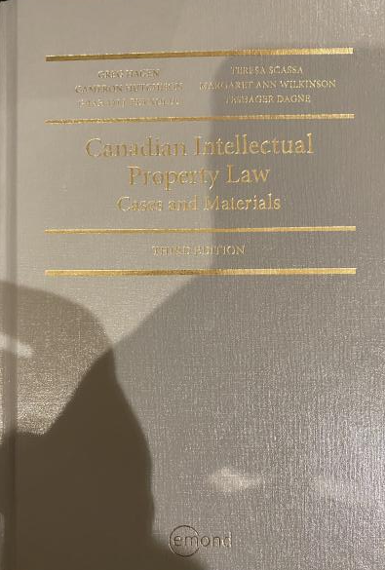
Text: Let me know if any issues @ Bookstore

Slide 4
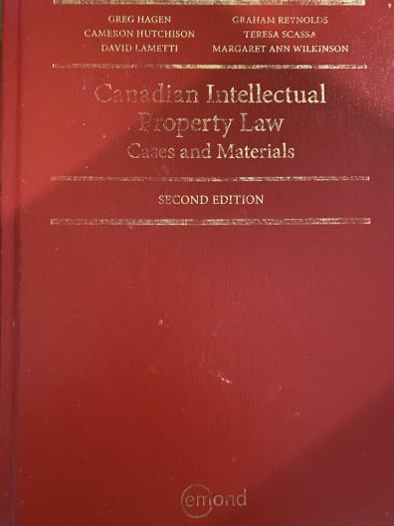
Former Text

Slide 5
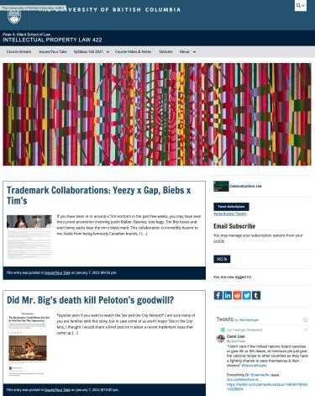
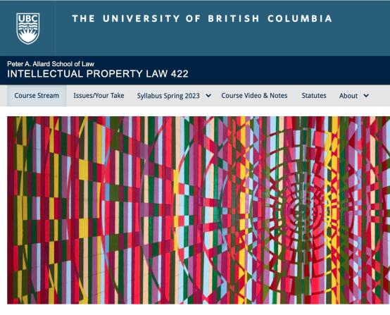
Course Website
https://iplaw.allard.ubc.ca/

Slide 6
PLEASE
SIGN UP

Slide 7
For full privileges on the website
1. Please create an account at http://cms.ubc.ca/ using your CWL.
2. Once you create an account and sign in at http://cms.ubc.ca/ you can click your name in the top right. Halfway down the following page will be your WordPress email address.
3. Send me your WordPress email address at jon.festinger@ubc.ca or at jon_festinger@thecdm.ca
4. Then, I will invite you to participate with authoring privileges via your WordPress email address.

Slide 8

Have responded to everyone?
+
…to some who didn’t ask?

Slide 9
Why post?
Engaging and engaging others is the key.
Because you don’t love speaking up in class.
Because you just saw or realized something, and you’ll never remember it unless you post it now.

Slide 10
Tips:
Don’t feel your posts have to be perfect. Engaging and engaging others is the key.

Slide 11
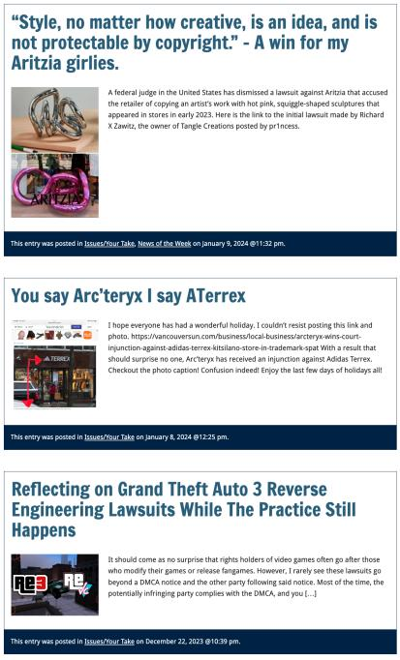

Slide 12

Anything & everything can be done via email if you prefer

Slide 13
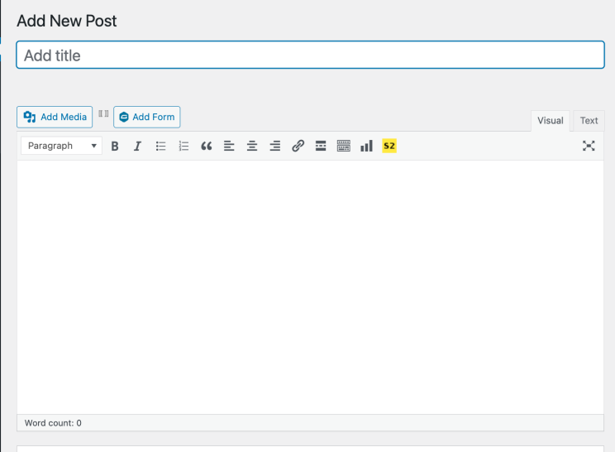

Adding Images

Slide 14



Slide 15
Adding Links

Slide 16
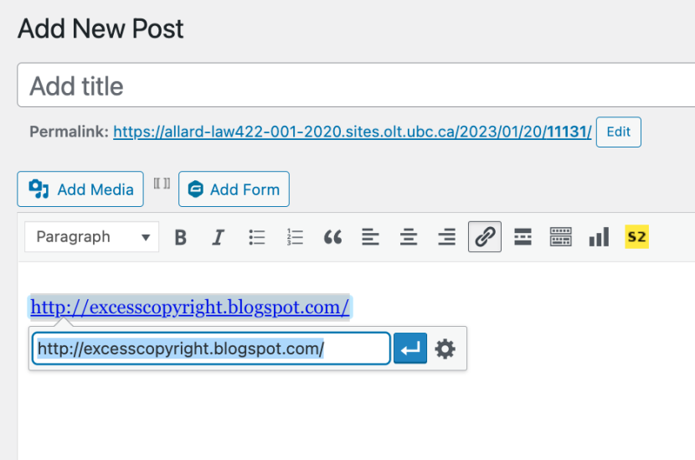


Slide 17


Adding a “Featured Image”

Slide 18


Slide 19
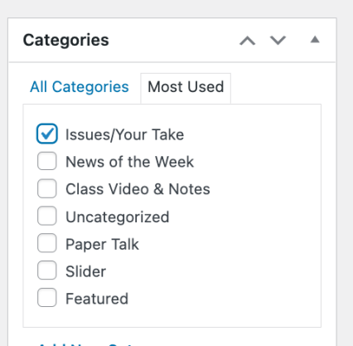

Setting Categories

Slide 20
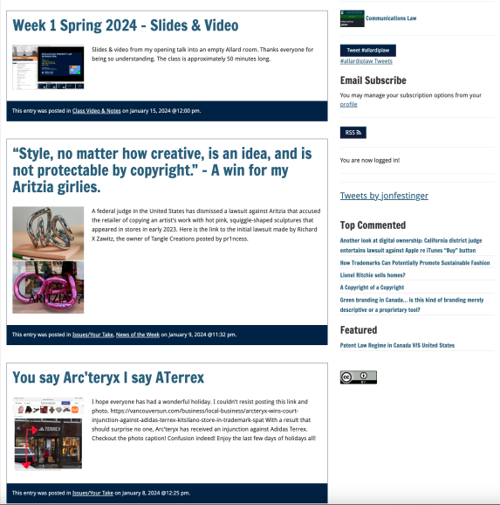
Creative Commons License

Slide 21
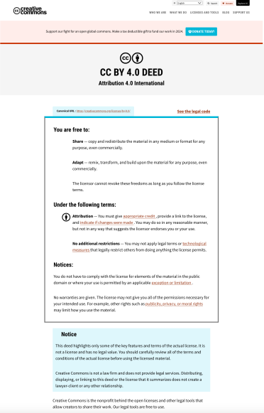
What CTLT will do…

Slide 22
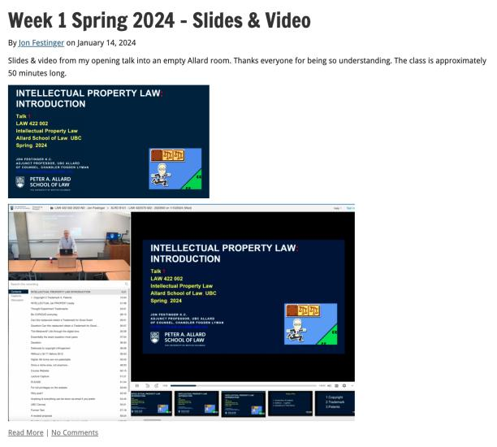
Lecture Capture

Slide 23
Syllabus

Slide 24
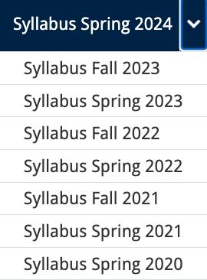




Slide 25
Features of this Course
70% Exam not 100%
IP Law “In Context”
Website

Slide 26
Let’s talk about…
The 30%

Slide 27
A modest proposal…
Approximately 1000 words (or equivalent) per person
written, video, podcast, in-class presentation (?), interpretive dance
Website or not
Groups or individually
LLM Students – one extra post

Slide 28
Past Presentations: Most are on the course website…

Slide 29
News of
the Week

Slide 30
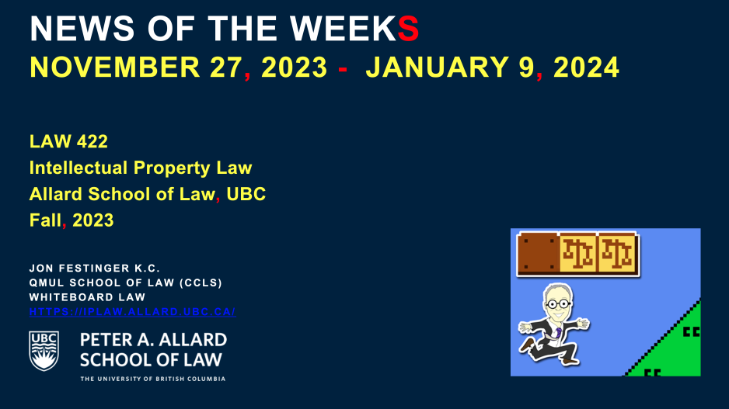
Coming Next Week!!!

Slide 31
Generative A.I. Policy
1. It is source material, therefore
must be cited
2. You are responsible for the quality
of your source material, so check…
If it is wrong, you are wrong
If it plagiarized, you’ve plagiarized

Slide 32

Office “Hours”: Ideally Tuesdays just after class but am flexible…
Email: jon.festinger@ubc.ca; jfestinger@telus.net
Office: 449
Phone:
c. 604-837-6426
(please text if urgent)

Slide 33
Entirely optional but please…
…email me a short bio of yourself referencing:
Anything at all you want to say about yourself
Your academic interests
What you might like to get out of this course (I.E., interest in a type of patent, or a copyright issue etc.)
Favorite Intellectual Property (ies) - current or all-time

Slide 34
QUESTIONS?
THOUGHTS?
DISCUSSION?

Slide 35

Pause

Slide 36

Where we have been…

Slide 37
Intellectual Property Law is about:
What kinds of creations of the mind can one have rights in?
Who can have those rights?
What kinds of rights are there; and how are those rights enforced?

Slide 38
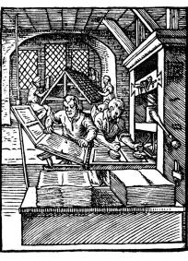
“Copyright Law Review to Date”

Slide 39

Overview of copyright
Definition of copyright:
  Set of exclusive rights in works of expression; performers’ performances; sound recordings; and communication signals.
The Clash, Chateau Neuf, Oslo, Norway
21 May 1980 Helge Øverås

Slide 40
Overview of copyright
Justifications
Economic incentive for creation (then why does copyright continue after death)?
Societal “progress in the arts & sciences”
Natural rights to one’s own labour & personality (→ personality = privacy or IP)
Reinforces free expression?

Slide 41
Purpose of copyright in Canada?
Théberge:
  “[12] Generally speaking, Canadian copyright law has traditionally been more concerned with economic than moral rights.… The economic rights are based on a conception of artistic and literary works essentially as articles of commerce.” (Binnie J.)
But Cinar Corp. v. Robinson?
  [114] … the infringement of copyright in this case interfered with Robinson’s personal rights to inviolability and to dignity, recognized by ss. 1 and 4 of the [Quebec] Charter. (McLachlin CJ)

Slide 42
Overview of copyright
Purpose of copyright as articulated by the SCC
  Former approach: “author-centric”
  Shift in Théberge
    “balance between promoting the public interest in the encouragement and dissemination of works of the arts and intellect and obtaining a just reward for the creator“ (para. 30)
  Refined in Cinar Corporation v. Robinson, 2013 SCC 73
    Copyright Act “seeks to ensure that an author will reap the benefits of his efforts, in order to incentivize the creation of new works” (para. 23)

Slide 43
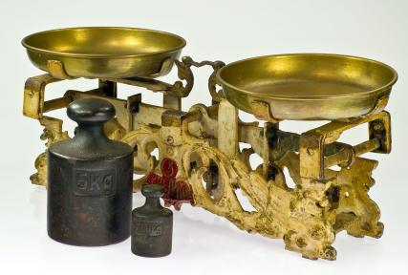
Théberge promotes “balance” between the public interest in connecting & just reward for the author

Slide 44
Overview of copyright
Legislative authority over copyright in Canada
  Federal Government (s. 91(23) Constitution Act, 1867)
  First Copyright Act (1921, Came Into Force 1924) largely a copy of the UK Copyright Act of 1911
  Modernization of Canadian copyright law: a work constantly in progress
  Bill C-11: Copyright Modernization Act (CIF 2012)
  Relatively recent copyright extension for sound recordings

Slide 45
What is copyrightable?
Subsistence of copyright
5. (1) Subject to this Act, copyright shall subsist in Canada, for the term hereinafter mentioned, in every original literary, dramatic, musical and artistic work if any one of the following conditions is met:
  (a) in the case of any work, whether published or unpublished, including a cinematographic work, the author was, at the date of the making of the work, a citizen or subject of, or a person ordinarily resident in, a treaty country;

Slide 46
What is copyrightable
Fixation
A requirement for the subsistence of copyright imposed by judicial interpretation
  “The work, to be capable of copyright protection, must be fixed in a tangible form” (Canadian Admiral Corp. v. Rediffusion Inc., [1954] Ex. CR 382, 20 CPR 75
Is the fixation requirement beneficial?
Does add some certainty + more works in public domain

Slide 47
Result of Fixation Requirement
Improvisational, performance art, kinetic pieces, open world massively multiplayer video game scenarios, are more at risk of not having copyright protection. See for example Komesaroff v. Mickle, [1988] R.P.C. 204 at 210 (Vict. S.C.), refusing protection to a moving sand sculpture.
Content in RAM computer memory?
Indigenous oral story-telling

Slide 48

Note Komesaroff v. Mickle
though cited often,
is not the world’s strongest precedent

Slide 49
What is copyrightable (Fixation)
Gould Estate et al v. Stoddart Publishing Co. Ltd et al (1996)
  Can copyright subsist in spoken words?
    Not necessarily – not every utterance made by individuals is a “valuable property right”
  A person’s oral statements are not literary creations and do not attract copyright protection

Slide 50
What is copyrightable: Originality
5. (1) Subject to this Act, copyright shall subsist in Canada, for the term hereinafter mentioned, in every original literary, dramatic, musical and artistic work if…

Slide 51
What is copyrightable
Originality in Canada
Pre-2004
  “Sweat of the brow”:
    Work receives copyright protection if it originates from an author and is more than a mere copy.
  “Creativity”
    A work must be the product of creativity in order to be original

Slide 52
What is copyrightable
Originality
CCH Canadian Ltd. v. Law Society of Upper Canada, 2004 SCC 13
  For a work to be original, you need an exercise of skill and judgment that is more than a purely mechanical exercise
  Skill = use of one’s knowledge, developed aptitude or practiced ability in producing the work
  Judgment = use of one’s capacity for discernment or ability to form an opinion or evaluation by comparing different possible options in producing the work

Slide 53
Meaning that…
Headnotes, case summaries, topical indexes & compilations of reported judicial decisions originating from their authors and are not simply copies. There is more than trivial skill & judgment in their creation (as every law student knows)
However, reported judicial decisions, by themselves, are not original works in which the publishers could claim copyright, even where typos and minor errors are fixed.

Slide 54
Can an A.I. pass the “McLachlin Test”?
Can an A.I. exercise “skill and judgment”?
Perhaps yes, if test is “ability to form an evaluation by comparing different possible options”…
But does this skill and judgment “necessarily involve intellectual effort”?
And more weirdly is what an A.I. does “so trivial that it could be characterized as a purely mechanical exercise”?

Slide 55
What is copyrightable
Facts and ideas
  Not entitled to copyright protection
  Kenrick & Co. v. Lawrence & Co. (1890)
    How is idea separated from expression in this decision?

Slide 56
What is copyrightable
Plaintiff printers drew a representation of hand holding a pencil completing a cross in a box as a method to instruct voters who couldn’t read on how to exercise their democratic franchise.
Plaintiffs duly registered their drawing under the copyright laws of the time.
Defendants created a similar but not identical drawing for the same purpose and were sued by the plaintiffs for infringement.
The plaintiffs action failed.

Slide 57
“It seems to me, therefore, that although every drawing of whatever kind may be entitled to registration, the degree and kind of protection given must vary greatly with the character of the drawing, and that with such a drawing as we are dealing with the copyright must be confined to that which is special to the individual drawing over and above the idea...there are scarcely more ways that one of drawing a pencil or the hand that holds it. If the particular arrangement of square, cross, hand, or pencil be relied upon it is nothing more than a claim of copyright for the subject, which in my opinion cannot possibly be supported.”

Slide 58
IDEA/EPRESSION
DICHOTOMY
Donoghue v. Allied Newspapers Limited (1938) Ch 106
Copyright owner is…"the person who has clothed the idea in form, whether by means of a picture, a play or a book"

Slide 59
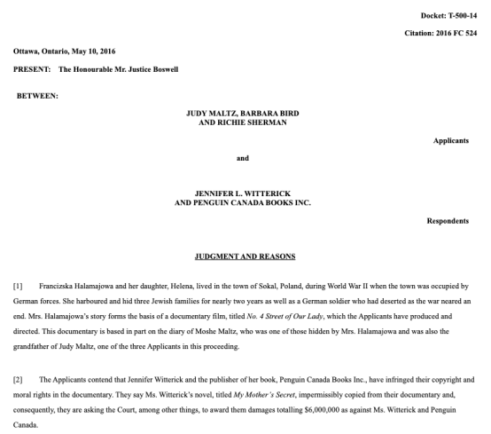
Footnote: No Copyright in Facts

Slide 60
“[47] Although the Documentary and the Book each recount some of the same facts of Francizska Halamajowa’s story, there is no substantial taking or use by the Respondents of anything owned by the Applicants because the use of common historical facts is not copyright infringement. The Respondents have not appropriated or taken a substantial portion of the Documentary’s originality. It is difficult to identify a single element taken that is not either something generic or merely a fact.”

Slide 61
What is copyrightable: Artistic Works
5. (1) Subject to this Act, copyright shall subsist in Canada, for the term hereinafter mentioned, in every original literary, dramatic, musical and artistic work if…

Slide 62
S. 2 Definitions
literary work includes tables, computer programs, and compilations of literary works; (oeuvre littéraire)
dramatic work includes
(a) any piece for recitation, choreographic work or mime, the scenic arrangement or acting form of which is fixed in writing or otherwise,
(b) any cinematographic work, and
(c) any compilation of dramatic works; (oeuvre dramatique)
musical work means any work of music or musical composition, with or without words, and includes any compilation thereof; (oeuvre musicale)
artistic work includes paintings, drawings, maps, charts, plans, photographs, engravings, sculptures, works of artistic craftsmanship, architectural works, and compilations of artistic works; (oeuvre artistique)

Slide 63
What is copyrightable
  University of London Press, Ltd. v. University Tutorial
  Press, Ltd. [1916] 2 Ch. 601
  Literary merit and quality are not factors
  when assessing if something is a literary work

Slide 64
Peterson J. “Assuming that they are ``literary work'’, the question then is whether they are original…Copyright Acts are not concerned with the originality of ideas, but with the expression of thought, and, in the case of ``literary work'’, with the expression of thought in print or writing…In the present case it was not suggested that any of the papers were copied… If an author, for purposes of copyright, must not draw on the stock of knowledge which is common to himself and others who are students of the same branch of learning, only those historians who discovered fresh historical facts could acquire copyright for their works…The objections with which I have dealt do not appear to me to have any substance, and, after all, there remains the rough practical test that what is worth copying is prima facie worth protecting. In my judgment, then, the papers set by Professor Lodge and Mr. Jackson are "original literary work" and proper subject for copyright under the Act of 1911.”

Slide 65

What is copyrightable
  Exxon Corp v. Exxon Insurance Consultants International Ltd., [1981] 3 All E.R. 241 (Ch.D)
  Plaintiff, Exxon Corp, had claimed the copyright of the word and went on to file an injunction to stop the defendant company from using the word 'Exxon'
  Some expression is not eligible for copyright protection because it is too minimal to satisfy the requirements of an “original literary work” under s. 2.
What about Twitter messages?

Slide 66
Exception
Francis Day and Hunter v. 20th Century Fox Corp, Ltd.
  NOTE: definition of a “work” in the Copyright Act - includes “the title thereof when such title is original and distinctive”

Slide 67
What is copyrightable: Dramatic Work
5. (1) Subject to this Act, copyright shall subsist in Canada, for the term hereinafter mentioned, in every original literary, dramatic, musical and artistic work if…

Slide 68
What is copyrightable
Dramatic work
  Must have a story, a thread of consecutively based events either narrated or presented by dialogue or action or both (Hutton v. CBC (1989))
  Or (based on s. 2):
    Choreography, mime and recitation piece with scenic arrangement or acting form fixed in writing or otherwise
    Cinematographic work
    Compilation of dramatic works

Slide 69
1994
Copyright Act was amended to provide:
  "dramatic work" includes
    (a) any piece for recitation, choreographic work or mime, the scenic arrangement or acting form of which is fixed in writing or otherwise,
    (b) any cinematographic work, and
    (c) any compilation of dramatic works;
[Cinematographic work – defined as “includ[ing] any work expressed by any process analogous to cinematography (motion-picture photography – tv, video, film, etc.), whether or not accompanied by a soundtrack” ]
[Choreographic work –defined as “includ[ing] any work of choreography, whether or not it has any story line;]

Slide 70
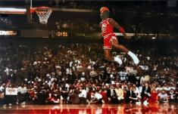
What is copyrightable
FWS Joint Sports Claimants v. Canada 1991 FCA (CB)
No copyright in a sporting event per se though television production of a sporting event is copyrightable
Unpredictable and incompatible with the notion of a choreographic piece of art?

Slide 71
What is copyrightable
Artistic works
  “artistic work” defined in s. 2 as including:
    paintings, drawings, maps, charts, plans, photographs, engravings, sculptures, works of artistic craftsmanship, architectural works, and compilations of artistic works.

Slide 72
What is copyrightable
Artistic works
DRG Inc. v. Datfile Ltd. [1988] 2 F.C. 243
  Two series of colour coded labels were registered under the Copyright Act. It was unsuccessfully argued that the registrations were not properly the subject of copyright.
  Court found that an artistic work is a work that finds expression in a visual medium.
  Artistic merit, artist’s intention to create “art” and the actual aesthetic value of the work are not pertinent to the question of whether a work meets the classification of “artistic work”

Slide 73
Copyrighting Data?
Geophysical Service Incorporated v. Encana Corporation, 2016 ABQB 230
It appears from the case that is not the raw data that is copyrightable as those would simply be facts, but how the data is presented.
  “[76] I find the seismic sections, i.e. the squiggly or zebra lines, fit within the definition of an artistic work, similar to a map, plan or chart, or a compilation of an artistic work, since the product is the result of selection or arrangement of the data, or sound recordings, from the geology of the subsurface.”
Do you agree? Alta. C.A. confirmed & SCC denied leave.

Slide 74
Rights of the copyright owner
Three fundamental rights:
Produce or reproduce
the work (3(1))
Perform the work
(including broadcasting rights) (3(1))
The right to publish (3(1))

Slide 75
Rights of the copyright owner
Produce … any translation (3(1)(a))
Convert dramatic work into non-dramatic work (3(1)(b)
Convert non-dramatic work into dramatic work (3(1)(c))
To make a sound recording, etc. of a literary, etc. work (3(1)(d))
Reproduce, etc. a literary, etc. work as a cinematographic work (3(1)(e))
Communicate a work to the public by telecommunication (3(1)(f))
Present an artistic work at a public exhibition…. (3(1)(g))
Rent out a computer program, etc. (3(1)(h))
Rent out a sound recording of a musical work … (3(1)(i))
Sell or transfer ownership of tangible object … (3(1)(j)
Authorize any of above acts (3(1))

Slide 76
Rights of the copyright owner
Term of copyright in Canada (ss. 6-12)
Anonymous or pseudonymous works
  70 years from end of the year in which the work was published; or 75 years from the end of the year in which it was made (whichever ends earlier) (s. 6.1)
Crown
  70 years from end of the calendar year in which the work is first published (s. 12)

Slide 77
Rights of the copyright owner
Who owns the rights? (ss. 13, 14)
s. 13(1): the author is the first owner of copyright
s. 13(3): employment exception
“13(3) Where the author of a work was in the employment of some other person under a contract of service or apprenticeship and the work was made in the course of his employment by that person, the person by whom the author was employed shall, in the absence of any agreement to the contrary, be the first owner of the copyright, but where the work is an article or other contribution to a newspaper, magazine or similar periodical, there shall, in the absence of any agreement to the contrary, be deemed to be reserved to the author a right to restrain the publication of the work, otherwise than as part of a newspaper, magazine or similar periodical”

Slide 78
Rights of the copyright owner
Employee or contractor?
Factors to consider: Who owns the tools; control or direction (relationship of subordination); whether the author assumes all or part of the business risk; degree of integration of the author into the business of the employer (Amusements Wiltron Inc. v. Mainville (1991) RJQ 1930, 40 CPR 3d 521 (Que SC))
Work performed in the course of employment?

Slide 79
Consultant/Independent Contractor
If as an independent contractor you are paid to develop a product, you as independent contractor remain the proprietor of the copyright on that work.
The person paying for the service (client) obtains a license to use the copyrighted work, unless the first copyright owner transfers her rights in writing.

Slide 80
Rights of the copyright owner
Who owns the rights? (ss. 13, 14)
ss. 13(4), 13(7): assignments, exclusive licences need to be in writing; non-exclusive licences don’t need to be in writing (Robertson v. Thomson)
Benefit of copyright registration: If an assignment or licence not registered, and the assignor or licensor subsequently assigns or licences the copyright interest – for valuable consideration – to a different assignee or licensee who didn’t have ACTUAL NOTICE of the prior assignment – the prior assignment/licence can be declared void (57(3)). So, if you’re an assignee, licensee – it is to your benefit to register the assignment of copyright or the licence granting you an interest (57(1)).

Slide 81
Rights of the copyright owner
Who owns the rights? (ss. 13, 14)
s. 14: reversionary interest - where an author has been the first owner of copyright in a work, even though they’ve transferred that interest during their lifetime, the copyright interest will revert to the author’s estate 25 years after the death of the author.

Slide 82
Copyright in works
3 (1) For the purposes of this Act, copyright, in relation to a work, means the sole right to produce or reproduce the work or any substantial part thereof in any material form whatever, to perform the work or any substantial part thereof in public or, if the work is unpublished, to publish the work or any substantial part thereof, and includes the sole right (to)…

Slide 83
Rights of the copyright owner
Reproduction
Apple Computer Inc. v. Mackintosh Computers Ltd. (Found in
Théberge)
  Opening words in s. 3 purposely drafted broadly enough
  to encompass new technologies which had not been
  thought of when the act was drafted
  Copy does not need to be in human readable form
  in order to be covered by copyright (must have
  readability)
  Copy of a copy is still a copy

Slide 84
Rights of the copyright owner
Reproduction
Théberge v. Galerie d’Art du Petit Champlain
Galerie d’Art purchased lawfully reproduced posters of Theberge’s paintings and used a chemical process that allowed them to lift the ink layer from the paper (leaving it blank) and to display it on canvas.
No additional copies yielded
Canvas painting more valuable than on paper

Slide 85
Rights of the copyright owner
Reproduction
Théberge v. Galerie d’Art du Petit Champlain
  Majority (Binnie J.): to have a reproduction, you need an increase in the number of copies. Could have prevented by contract. Moral rights remedy is not economic/financial.
  Dissent (Gonthier J.): all reproduction requires is re-fixation
  Whose reasoning is more persuasive? How would you have decided this case?

Slide 86
Rights of the copyright owner
Reproduction of “broadcast incidental copies”
CBC v. SODRAC 2003 Inc. [2015] 3 SCR 615
CBC argued that:
“A proper balancing of user and right-holder interests favours finding that broadcast-incidental copies do not engage the reproduction right”.
& “…the principle of technological neutrality is a means of protecting the proper balance between users and right holders in a digital environment”

Slide 87
Rights of the copyright owner
Reproduction of “broadcast incidental copies”
CBC v. SODRAC 2003 Inc. [2015] 3 SCR 615
Should every instance of copying be considered to infringe the “reproduction” right?
Rothstein J. (majority):
  SCC’s understanding of the purpose of copyright has evolved; principle of technological neutrality now recognized to be a core copyright principle …
  But these principles don’t override express statutory terms.
  Broadcast-incidental copying activities engage the reproduction right
Abella J.’s dissent suggested Rothstein J. inappropriately “employs a literal approach to the interpretation of s. 3(1)(d), reading the words of the provision without the benefit of the purpose and context of the Act to ascertain its true meaning.”

Slide 88
Copyright in works
3 (1) For the purposes of this Act, copyright, in relation to a work, means the sole right to produce or reproduce the work or any substantial part thereof in any material form whatever, to perform the work or any substantial part thereof in public or, if the work is unpublished, to publish the work or any substantial part thereof, and includes the sole right…

Slide 89
Rights of the copyright owner
What is a substantial part of a work?
Cinar Corp. v. Robinson (2013, SCC)
Consider “cumulative effect of the features copied from
the work”.
Not limited to words on page or brushstrokes on the
canvas; determined in relation to originality of the work that
warrants protection
Need to balance between protecting authors and leaving
ideas/elements free for all to draw upon

Slide 90
Summary of Cinar
A substantial part of a work is a flexible notion. It is a matter of fact and degree.
Whether a part is substantial must be decided by its quality rather than its quantity: Ladbroke (Football), Ltd. v. William Hill (Football), Ltd., [1964] 1 All E.R. 465 (H.L.), at p. 481, per Lord Pearce.
“The question of whether there has been substantial copying focuses on whether the copied features constitute a substantial part of the plaintiff’s work - not whether they amount to a substantial part of the defendant’s work”
“the cumulative effect of the features copied from the work must be considered, to determine whether those features amount to a substantial part of [the Plaintiff’s] skill and judgment expressed in [their] work as a whole.”

Slide 91
Summary of Cinar
“A substantial part of a work is not limited to the words on the page or the brushstrokes on the canvas. The Act protects authors against both literal and non-literal copying, so long as the copied material forms a substantial part of the infringed work. “
“The need to strike an appropriate balance between giving protection to the skill and judgment exercised by authors in the expression of their ideas, on the one hand, and leaving ideas and elements from the public domain free for all to draw upon, on the other, forms the background against which the arguments of the parties must be considered.”
Might be appropriate to use expert evidence to assist the court with questions of substantiality. Here: “Expert evidence was necessary to assist the trial judge in distilling and comparing the “intelligible” aspects of the works at issue [atmosphere, dynamics, motifs, and structure], which he would not otherwise appreciate.”

Slide 92
S.3 Copyright Act
3 (1) For the purposes of this Act, copyright, in relation to a work, means the sole right to produce or reproduce the work or any substantial part thereof in any material form whatever, to perform the work or any substantial part thereof in public or, if the work is unpublished, to publish the work or any substantial part thereof, and includes the sole right
  (a) to produce, reproduce, perform or publish any translation of the work,…

Slide 93
Rights of the copyright owner
Right to perform a work in public
Canadian Admiral Corp. v. Rediffusion Inc., [1954] Ex. C.R. 382
  Exception given where audience is not part of author’s public
  Main case is Jennings v. Stephens [1936] 1 All E.R. 228 & 413 where 600 workers listened to broadcast music in a factory. Held that everything depends on the character of the audience – Is the audience part of the copyright owner’s public? If the audience considered in relation to the owner of the copyright can properly be described as the owner's "public" or part of his "public," then anyone who performs the work before that audience without the consent of the author would be infringing his copyright.

Slide 94
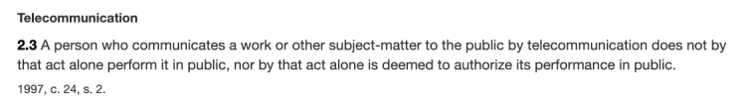
Rights of the copyright owner
Right to perform a work in public
Canadian Cable Television Association v. Canada (Copyright Board), [1993] 2 F.C. 138
  Held that a radio or television broadcast does amount to a performance of the work in public
  In public = openly, without concealment, and to the knowledge of all
  But consistent w. s. 2.3 of the Copyright Act?

Slide 95
Rights of the copyright owner
Right to perform a work in public
Canadian Cable Television Association v. Canada (Copyright Board), [1993] 2 F.C. 138
  Reference to “early conflicting decision” (Rediffusion)
  Letourneau J.: “I would have thought on a mere common sense basis that when the Prime Minister of Canada addresses the nation, either from his home or his private office, and reaches the citizens in their homes by means of radio and television, he appears in public and performs in public. I would have been content to leave it at that had it not been for early conflicting decisions on this issue.”

Slide 96
Rights of the copyright owner
Right to communicate a work to the public by telecommunication (s. 3(1)(f))
TV
Radio
Online
“3 (1) For the purposes of this Act, copyright, in relation to a work, means the sole right to produce or reproduce the work or any substantial part thereof in any material form whatever, to perform the work or any substantial part thereof in public or, if the work is unpublished, to publish the work or any substantial part thereof, and includes the sole right
(f) in the case of any literary, dramatic, musical or artistic work, to communicate the work to the public by telecommunication,…”

Slide 97
Rights of the copyright owner
Right to communicate a work to the
public by telecommunication (s. 3(1)(f))
CCH Canadian v. LSUC (2004)
  Faxed transmissions of a single copy
  of a work to a single individual is not a
  communication to the public
  Emanated from a single point;
  & intended to be received at a single point

Slide 98
Rights of the copyright owner
Right to communicate a work to the public by telecommunication (s. 3(1)(f))
CWTA v. SOCAN (2008)
  Is the transmission of a musical ringtone to a cellphone a ‘communication to the public by telecommunication’?

Slide 99
Rights of the copyright owner
Right to communicate a work to the public by telecommunication (s. 3(1)(f))
ESA v. SOCAN (2012)
  Does the Copyright Act require a second royalty to be paid when games are downloaded as opposed to sold in stores?
  Conclusion: Internet delivery of copies of video games containing musical works does not constitute a communication to the public.

Slide 100
Entertainment Software Association v. Society of Composers, Authors and Music Publishers of Canada (Pentalogy case)
  Issue is whether the Copyright Act requires a second royalty to be paid when games are downloaded as opposed to sold in store? A royalty is already paid to account for the reproduction of the musical work. However if a download of a video game is found to constitute a communication to the public by telecommunication IN ADDITION to a reproduction, then a second right would be engaged.
  Conclusion: SCC held that “the Internet delivery of copies of video games containing musical works” does not constitute a communication to the public – so doesn’t infringe s. 3(1)(f).

Slide 101
Rights of the copyright owner
Right to communicate a work to the public by
telecommunication (s. 3(1)(f))
Rogers Communications Inc. v. SOCAN 2012 SCC 35
  Does individual streaming, triggered by the
  individual actions of individual users,
  constitute “communication to the public” or a
  “private communication” ?

Slide 102
YES, IT IS
‘COMMUNICATION TO THE PUBLIC’
(despite what was said in CCH v. LSUC that transmission of a single copy to a single person isn’t a communication to the public - also think about it → CCH photocopy and fax facts are reasonably distinguishable)

Slide 103
Rights of the copyright owner
Right to communicate a work to the public by telecommunication (s. 3(1)(f))
Rogers Communications Inc. v. SOCAN (2012)
Reasoning/arguments employed to reach conclusion
  CCH distinguished; ruling limited to facts
  Other conclusion would lead to arbitrary, inconsistent results.
  Language of s. 3(1)(f)
  Legislative history
  Balance in copyright
  Developments at international level

Slide 104
Rights of the copyright owner
Right to communicate a work to the public by telecommunication (s. 3(1)(f))
S. 2.4(1.1) (amended)
  For the purposes of this Act, communication of a work or other subject-matter to the public by telecommunication includes making it available to the public by telecommunication in a way that allows a member of the public to have access to it from a place and at a time individually chosen by that member of the public.

Slide 105
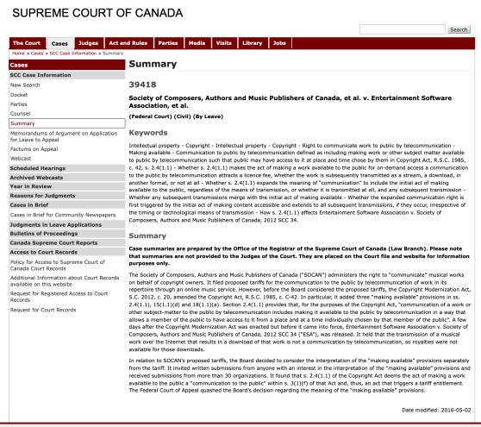
Cutting edge of issues argued over a year ago…
Does “on demand” streaming attract a copyright fee if never transmitted?

Slide 106
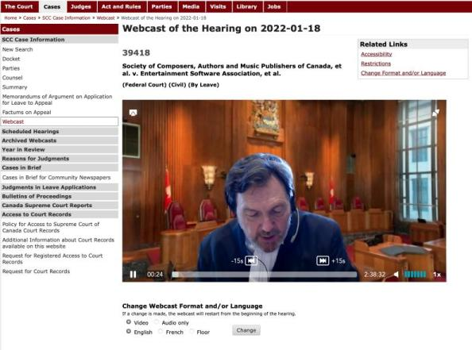
In this context…

Slide 107
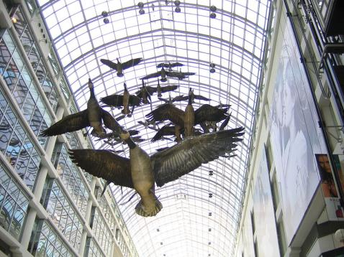
MORAL RIGHTS
Sections 14.1 and 14.2 of the Copyright Act
Snow v. Eaton Centre

Slide 108
Sections 14.1 and 14.2 of the Copyright Act
  the right to the integrity of the work; &
  the right, where reasonable in the circumstances, to be associated with the work as its author by name or under a pseudonym and the right to remain anonymous.
Section 34.2 of the Copyright Act - remedies for infringement of moral rights include injunctions, damages, and delivery up.
Moral rights can be waived, but not transferred.
Cases:
Snow v. Eaton Centre Ltd., (1982) 70 C.P.R. (2d) 105 (Ont. H.C.J.)
Ritchie v. Sawmill Creek Golf & Country Club Ltd., (2004) 189 O.A.C. 282
Wiseau Studio, LLC et al. v. Harper et al. 2020 ONSC 2504

Slide 109
Orphan Works
Circumstances in which licence may be issued by Board
77 (1) Where, on application to the Board by a person who wishes to obtain a licence to use
  (a) a published work, (b) a fixation of a performer’s performance, (c) a published sound recording, or (d) a fixation of a communication signal
in which copyright subsists, the Board is satisfied that the applicant has made reasonable efforts to locate the owner of the copyright and that the owner cannot be located, the Board may issue to the applicant a licence to do an act mentioned in section 3, 15, 18 or 21, as the case may be.
(2) A licence issued…is non-exclusive and is subject to such terms and conditions as the Board may establish.
(3) The owner of a copyright may, not later than five years after the expiration of a licence issued pursuant to subsection (1) in respect of the copyright, collect the royalties fixed in the licence or, in default of their payment, commence an action to recover them in a court of competent jurisdiction….

Slide 110

Independent Creation Doctrine - Canada

Slide 111
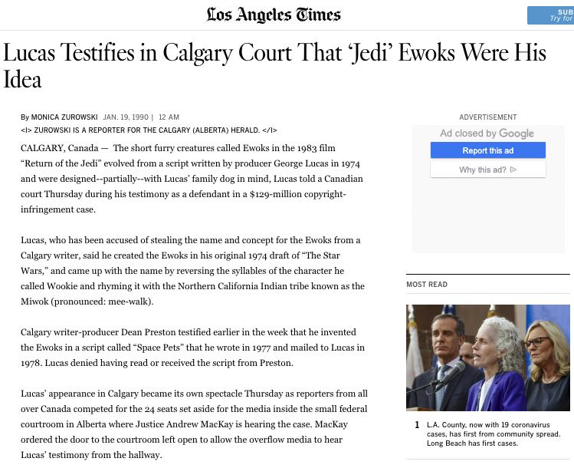

Slide 112
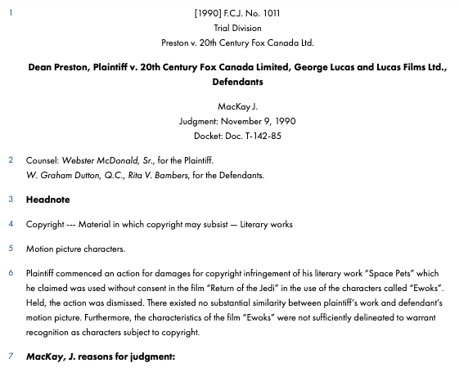

Slide 113
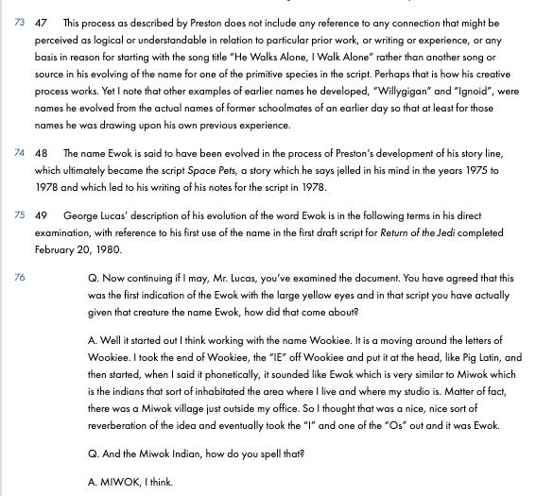

Slide 114
63 Many of the detailed similarities, in my view, can be traced to the common store of folklore about primitive species with human characteristics upon which Lucas was as free to draw as were Preston and Hurry. Yet drawing upon a common store of information does not in itself answer to the claim of infringement. It is the expression of ideas, not the ideas themselves, that is the subject of copyright. It is entirely possible that two or more authors, composers, dramatists or other artists may draw upon a common store of information for ideas and each may have copyright in his or her expression of those ideas. But if while drawing upon the common information base, one should copy the expression in literary or dramatic form of another author copyright may be infringed.

Slide 115
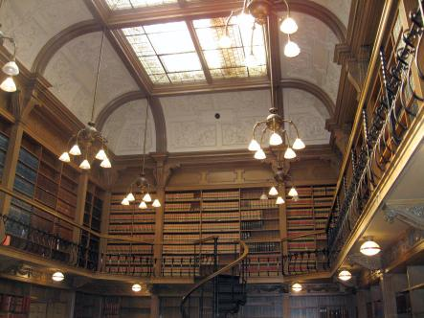
“Rights of Non-Copyright Owners: Fair Dealing etc.”

Slide 116
Users’ rights
Sequence of events in a copyright lawsuit
1) Unauthorized act occurs. Has an infringement prima facie occurred?
  27. (1) It is an infringement of copyright for any person to do, without the consent of the owner of the copyright, anything that by this Act only the owner of the copyright has the right to do.
2) Burden shifts to the Defense to establish a defense to copyright infringement.

Slide 117
Court needs to determine: Was something done that only the copyright owner has the right to do?
Reproduced a work in whole or in substantial part
Performed a work in public
Communicated a work to the public by telecommunication

Slide 118
Today: Two Defences to copyright infringement
Defence of public interest
Fair dealing

Slide 119
User rights: Public Interest Defence
Defence of public interest
R. v. Lorimer & Co. Ltd., [1984] 1 FC 1065
Defence of public interest argued – In the public interest that this information be disseminated as broadly as possible.
Court indicated that it has no doubt that a defence of public interest – as set out in the UK cases on which the Lorimer’s counsel relied – is available in proper circumstances against an assertion of Crown copyright.
But the facts don’t support the public interest defence here
  Great disclosure in report
  Free copies given out, put in libraries across the country
  No concern about the public not being informed
N.B. Act doesn’t mention “public interest”

Slide 120
User rights: Public Interest Defence
Defence of public interest
Lion Laboratories v Evans [1985] QB 526
Lion Laboratories manufactured and marketed the Lion Intoximeter which was used by the police for measuring blood alcohol levels of motorists.
Two ex-employees approached the Press with four documents taken from Lion.
Such reproduction was held to be justified, despite the nature of material, being confidential and protected by copyright.
Court agreed that the defence of public interest applied to the investigations regarding the accuracy of the equipment to avoid incorrect readings when used by the police on motorist.

Slide 121
Wrongdoing does not disqualify the public interest defence.
“I can see no sensible reason why this defence should be limited to cases in which there has been wrongdoing on the part of the plaintiffs.... No doubt it is in such circumstances that the defence will usually arise, but it is not difficult to think of instances where, although there has been no wrongdoing on the part of the plaintiff, it may be vital in the public interest to publish a part of his confidential information”

Slide 122
User rights: Fair Dealing
Fair dealing
Under fair dealing, individuals have the right to use a substantial part of another’s copyright-protected expression without that person’s permission, provided that the individual acts in furtherance of certain purposes, that the individual acts in a fair manner, and that - in some cases - certain attribution requirements are satisfied.
Broadest defence to copyright infringement set out in the Copyright Act.
If fair dealing is made out, an individual will not be found to have infringed copyright.
This defence exists in various forms in several jurisdictions – focus here is on the Canadian articulation of this defence.
We’ll start by looking at the language of the Copyright Act – and then we’ll look at how courts have interpreted these provisions.

Slide 123


Fair Dealing v. Fair Use

Slide 124
Users’ rights: Fair Dealing
29. Fair dealing for the purpose of research, private study, education, parody or satire does not infringe copyright.

Slide 125
Fair Dealing: Criticism or Review
29.1 Fair dealing for the purpose of criticism or review does not infringe copyright if the following are mentioned:
(a) the source; and
  (b) if given in the source, the name of the (i) author, in the case of a work

Slide 126
Fair Dealing: News Reporting
29.2 Fair dealing for the purpose of news reporting does not infringe copyright if the following are mentioned:
(a) the source; and
  (b) if given in the source, the name of the (i) author, in the case of a work

Slide 127
Eight fair dealing categories (exhaustive list)
Research
Private Study
Education
Parody
Satire
Criticism
Review
News reporting

Slide 128
What changed?
CCH v. LSUC (SCC) endorsed “users’ rights”
Flows from Théberge , where copyright was found not to be only about about rewarding and protecting authors; but focussed on the balancing between the public interest in encouraging and disseminating creative and intellectual works and securing a just reward for the author.
Move from defence to copyright action to a more positive articulated User Right.
Means User Right’s can be a sword? How would that work/what would that look like?

Slide 129
QUESTIONS?
THOUGHTS?
DISCUSSION?

Slide 130
Pause

Slide 131

Now, to our regularly
scheduled programming…

Slide 132
Continuing with…
“Rights of Non-Copyright Owners: Users Rights/Fair Dealing”

Slide 133
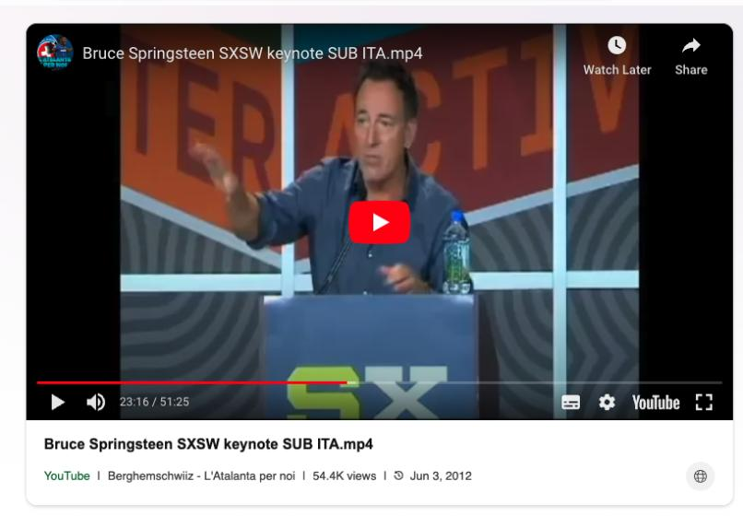
https://www.bing.com/videos/riverview/relatedvideo?&q=bruce+springsteen+sxsw+keynote+speech&&mid=18E121326672065CCBC618E121326672065CCBC6&&FORM=VRDGAR

Slide 134
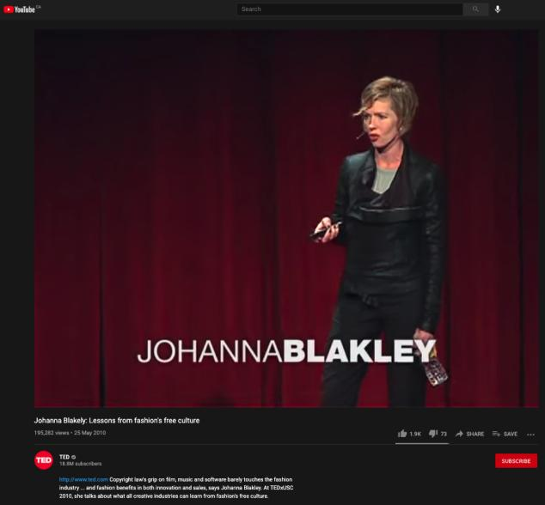
https://youtu.be/zL2FOrx41N0

Slide 135

Moving Forward

Slide 136
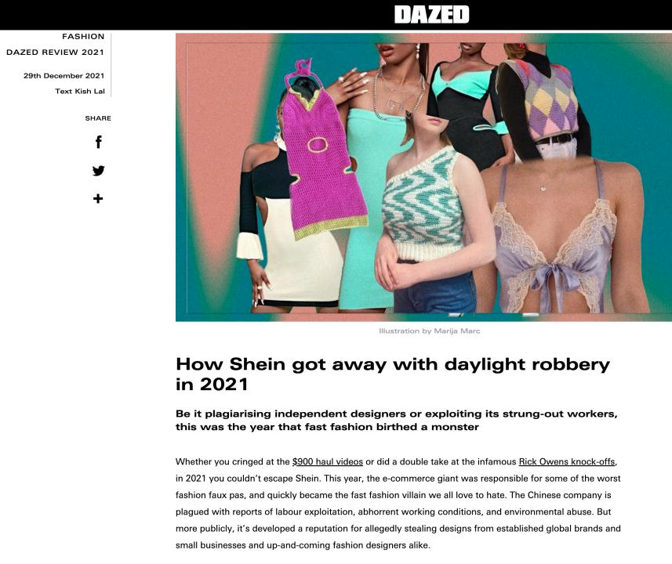

Slide 137
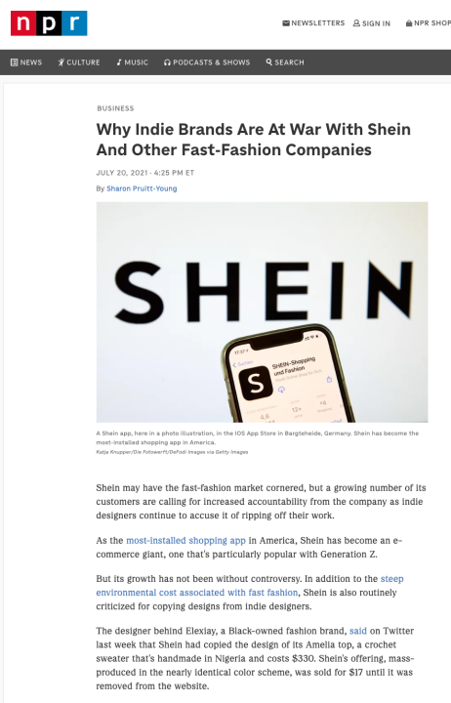

Slide 138
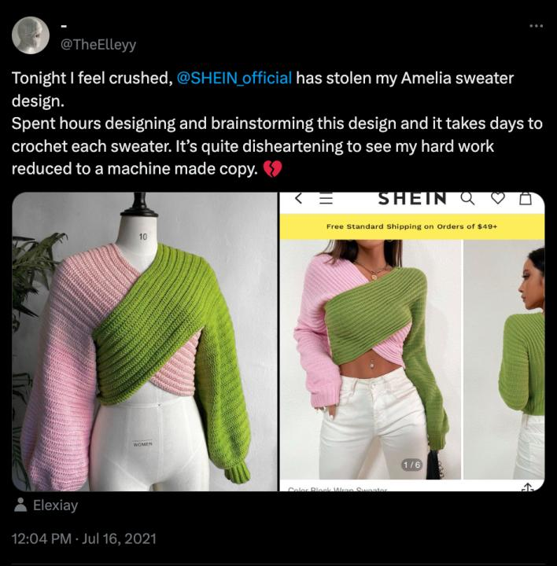

Slide 139


Slide 140


Slide 141

Emily Ratajkowski Instagram (posted 9.18.19)

Slide 142
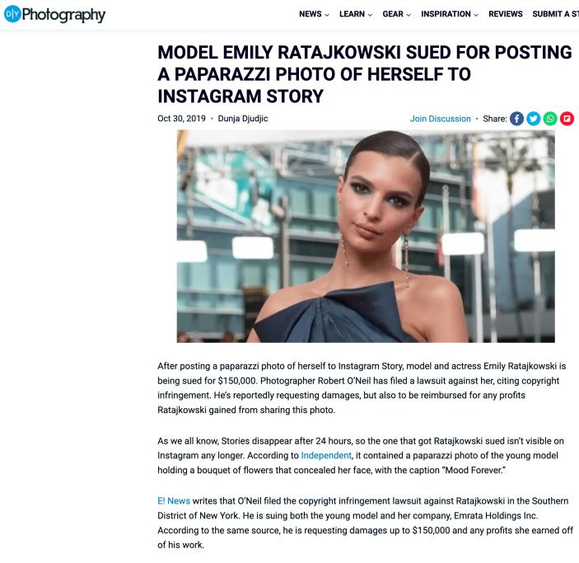

Slide 143
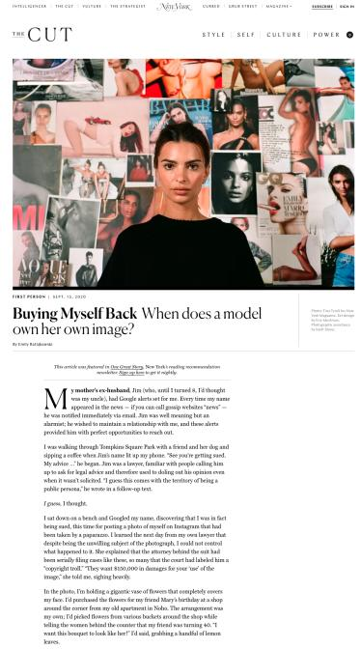

Slide 144
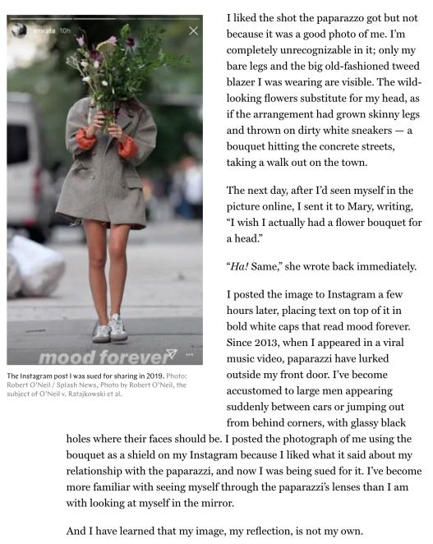

Slide 145
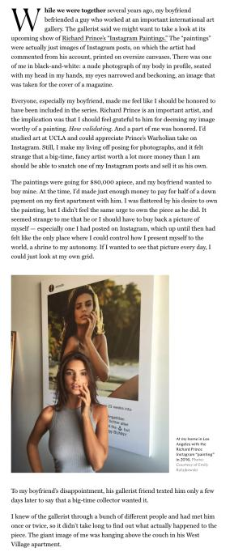

Slide 146
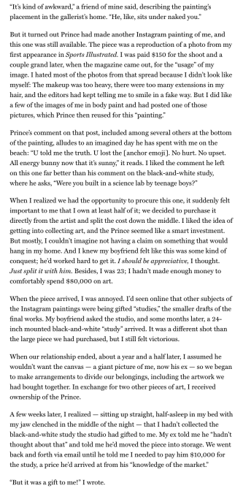

Slide 147
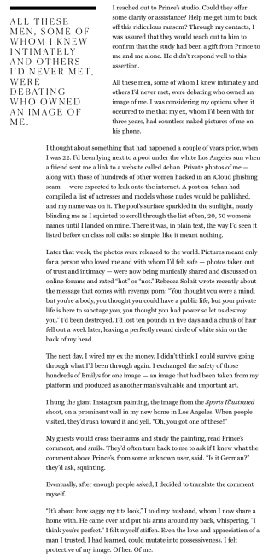

Slide 148
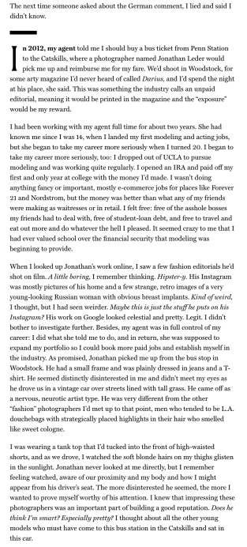

Slide 149
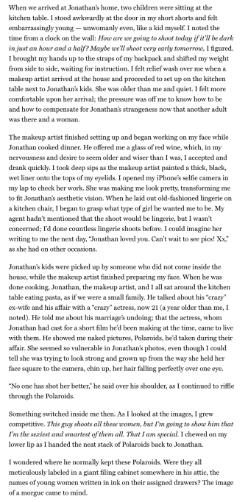

Slide 150
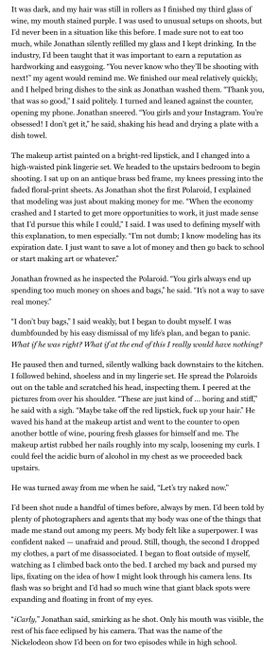

Slide 151
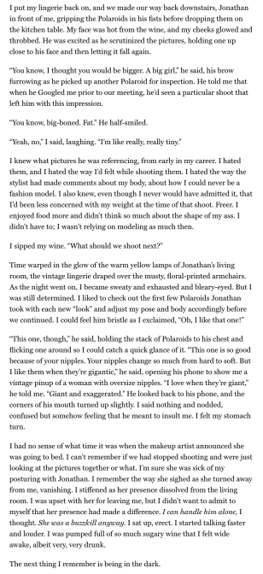

Slide 152
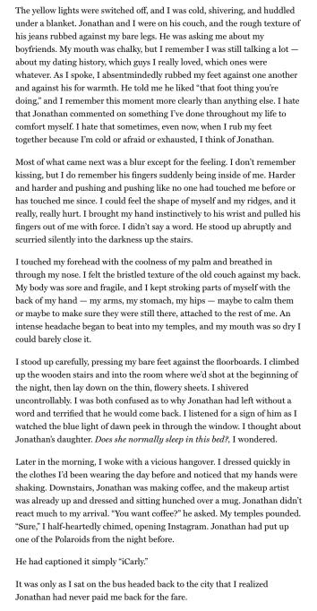

Slide 153
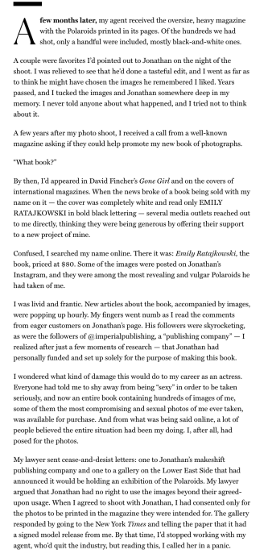

Slide 154
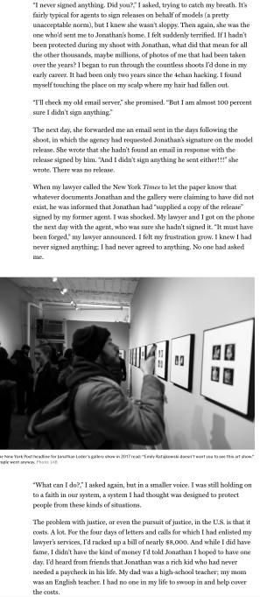

Slide 155
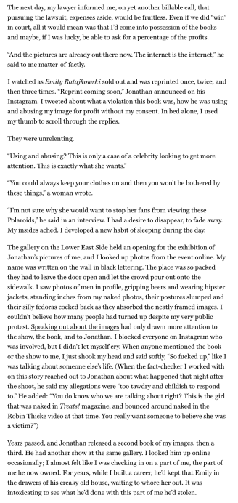

Slide 156
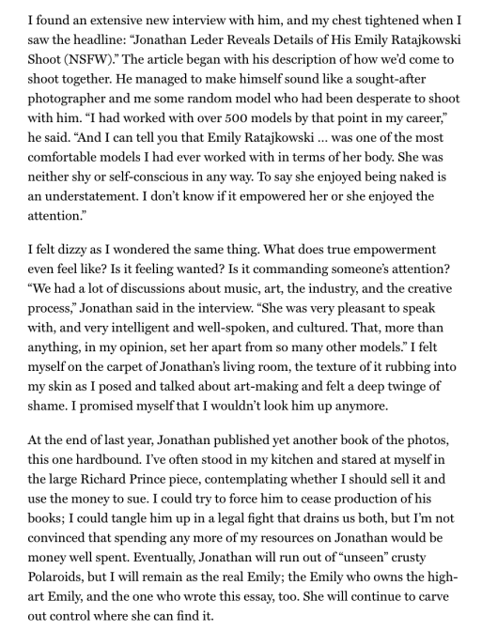

Slide 157
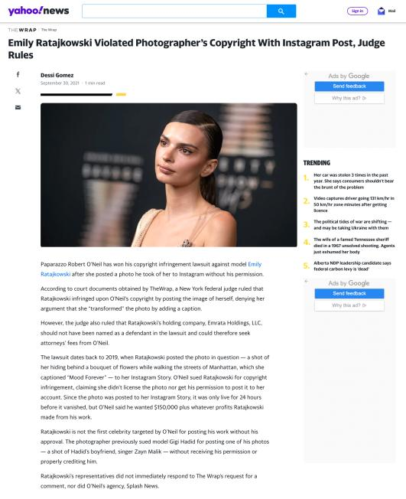






Slide 158
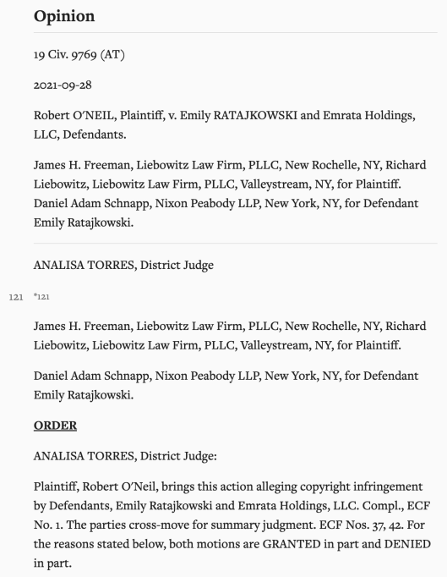

Slide 159
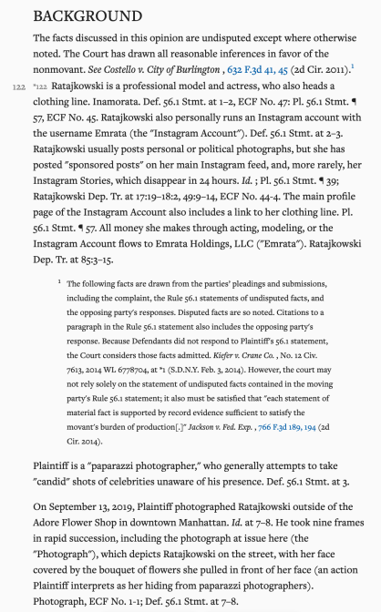

Slide 160
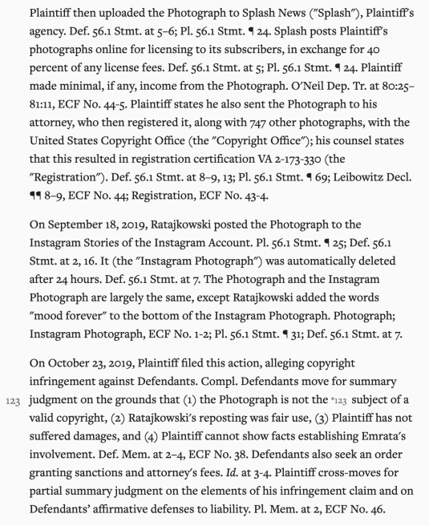

Slide 161
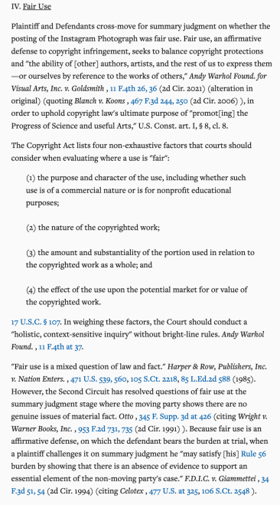

Slide 162


Slide 163


Slide 164


Slide 165


Slide 166


Slide 167


Slide 168


Slide 169


Slide 170


Slide 171


Slide 172


Slide 173


Slide 174


Slide 175


Slide 176
QUESTIONS?
THOUGHTS?
DISCUSSION?

Slide 177
Pause

Slide 178
QUESTIONS?
THOUGHTS?
DISCUSSION?

Slide 179
Pause

Slide 180
Back to CCH on USERS’ RIGHTS
CCH Canadian et al v. LSUC (2004)
LSUC operates the Great Library. Within it is a
custom photocopy service for lawyers who
can’t make it to the Library. There is also a
photocopy machine that the public can use.
CCH Canadian (legal publisher) and others
brought action against the LSUC for copyright
infringement.

Slide 181
Users’ rights
Fair dealing in CCH:
An integral part of the Copyright Act - not just a defence
The fair dealing “exception”, like other exceptions in the Copyright Act, is a users’ right. In order to maintain the proper balance between the rights of a copyright owner and users’ interests, it must not be interpreted restrictively.
Always available. If other exceptions might also be available, argue fair dealing first, then turn to other exceptions and defences.
Two step process:
  1) Defence establishes the dealing was for one of the listed purposes.
  2) Defence establishes the dealing was fair.
Fair dealing category of research to be given a large and liberal interpretation in order to ensure users’ rights are not unduly constrained
Research is not limited to non-commercial or private contexts. Lawyers carrying on the business of law for profit are conducting research within the meaning of s. 29 of the Copyright Act.

Slide 182
Summary of CCH on USERS’ RIGHTS
CCH Canadian et al v. LSUC (SCC 2004)
  Fair dealing is an integral part of the Copyright Act
  Fair dealing is a users’ right; must not be interpreted restrictively
  Two step process: purpose; fairneanalysis
  Categories must be given a large and liberal interpretation (i.e., research

Slide 183
User rights: “Fair” in Fair Dealing
CCH Canadian et al v. LSUC (2004)
Whether something is fair is a question of fact and depends on the facts of each case.
Factors that can be considered to help assess whether a dealing is fair:
  Purpose of the dealing
  Character of the dealing
  Amount of the dealing
  Were there alternatives to the dealing?
  Nature of the work
  Effect of the dealing on the work

Slide 184

The fairness stew

Slide 185
1. Purpose of the Dealing
Fair if for one of the allowable purposes under the Copyright Act
  S. 29 = research, private study, education, parody or satire
  S.29.1 = criticism or review
  S. 29.2 = news reporting
Some dealings may be more, or less, fair, than others - i.e., research for commercial purposes may not be as fair as research for charitable purposes

Slide 186
2. Character of the Dealing
How was the work dealt with? Multiple copies distributed, will tend towards being unfair, especially if more copies than necessary or otherwise gratuitous.
Single copy used for single legit purpose – easier to conclude it is fair.
Copies destroyed after use may also favour a finding of fairness.
Do consider customs, practices & norms in a particular industry or trade → However CBC v. SODRAC (SCC 2015) doesn’t – why not? CATEGORIES EXHAUSTIVE

Slide 187

Footnote: Criticisms of Majority in CBC v. SODRAC not related to fair dealing

Slide 188


Slide 189


Slide 190


Slide 191


Slide 192


Slide 193
3. Amount of the Dealing
You can deal fairly with a whole work (i.e., photographs)
Amount taken may be more, or less, fair depending on the purpose - i.e., research, may be essential to copy an entire academic article

Slide 194
4. Alternatives to the Dealing
Was there a non-copyrighted equivalent of the work that could have been used instead of the copyrighted work?
Was the dealing reasonably necessary to achieve the ultimate purpose?
Meaning not gratuitous.
I.e., Would a criticism have been equally effective if it did not actually reproduce the copyrighted work it was criticizing? If yes, that weighs against a finding of fairness.

Slide 195
5. Nature of the Work
If a work is unpublished, dealing might be fairer because its reproduction could lead to a wider public dissemination for the work
Confidential work? May be unfair in the circumstances.

Slide 196
6. Effect of the dealing on the work
Is the reproduced work likely to compete with the market of the original work?
Not the only factor - not the most important factor - but can sometimes seem like the most important factor in the cases

Slide 197
Users’ rights
CCH Canadian et al v. LSUC (2004) Fair dealing applied: LSUC’s custom photocopying service
The law society can rely on its general practice to establish fair dealing; doesn’t have to provide evidence that every patron used the material provided for in a fair dealing manner
Purpose of the dealing:
  Custom photocopying service clearly for purposes of research, review, private study
  Retrieval, reproduction and photocopying of legal works are necessary and essential elements of the research process

Slide 198
Users’ rights
CCH Canadian et al v. LSUC (2004) Fair dealing applied: LSUC’s custom photocopying service
Dealings were fair
  Purpose of the dealing:
    Reasonable safeguards in Access Policy to ensure that materials are being used for research and private study
  Character of the dealing:
    Single copies of works provided; no evidence multiple copies provided to multiple members of public
  Amount of the dealing:
    Access Policy limits the amount to be copied

Slide 199
Users’ rights
CCH Canadian et al v. LSUC (2004) Fair dealing applied: LSUC’s custom photocopying service
Dealings were fair
  Alternatives of the dealing:
    No apparent alternatives
    Can’t reasonably expect constituency to research on-site at the Great Library
    Insufficient resources to satisfy demand if everyone were permitted to borrow materials
    Availability of licence irrelevant to deciding whether a dealing has been “fair”
  Nature of the work:
    In the public interest that access to judicial decisions and other legal resources not be unjustifiably restrained
  Effect of the dealing on the work:
    No evidence shown that the market for the publishers’ works had decreased as a result of copies being made under the custom photocopying service.

Slide 200

Carpet Cosplay
Dragon Con Marriott hotel carpet Copyright design

Slide 201


Slide 202


Slide 203

Reflection Exercise
In your view would carpet cosplay be considered fair dealing in Canada? Why? Or Why not?

Slide 204


Slide 205
Users’ rights
SOCAN v. Bell (2012) - years later – What Is A “User’s Right”
Do iTunes previews constitute “fair dealing”?
If answer is no, those providing previews would be have to pay tariffs for each preview played as communication to the public by telecommunication
Note statements in paragraphs 8-10 regarding nature of copyright in Canada& significance of Théberge case
  Théberge: move away from author-centric approach to copyright
  Need to sensitively balance protection and access

Slide 206
Users’ rights
SOCAN v. Bell (2012) – continued
Users’ rights:
  Essential part of furthering public interest objectives of the Copyright Act
  One of the tools employed to achieve the proper balance between protection and access
  Fairness analysis: Where much of the heavy lifting is one in fair dealing
Fair dealing applied → iTunes previews

Slide 207
Users’ rights
SOCAN v. Bell (2012) – continued
Fair dealing applied → iTunes previews
1. Purpose of the dealing
Whose purpose? Predominant perspective here → ultimate users of the previews/purpose → help them research and identify musical works. Rejected alternative was service providers who sell downloads with a commercial motive.
There were reasonable safeguards to ensure dealing restricted to research purposes [lower quality, short clips]
2. Character of the dealing
Streamed, not downloaded; no permanent copy from preview; once heard, file automatically deleted from the user’s computer.

Slide 208
Users’ rights
SOCAN v. Bell (2012) – continued
Fair dealing applied → iTunes previews
3. Amount of preview
Amount assessed based on individual use, not the amount of the dealing in the aggregate.
Why not aggregate? Because of ease and magnitude of online dissemination, could lead to disproportionate findings of unfairness when compared with non-digital works
Small-ish proportion of whole song

Slide 209
Users’ rights
SOCAN v. Bell (2012) – continued
Fair dealing applied → iTunes previews
4. Alternatives to the dealing
No real alternatives to inform consumer what work sounds like; alternatives suggested are expensive, technologically complicated, and market inhibiting [Arguments rejected - could have used advertising, textual descriptions, album artwork, user-generated reviews, return policies]
5. Nature of the work
Reframed - “is the work one which should be widely disseminated” / significance?
Previews will assist in work being widely disseminated.

Slide 210
Users’ rights
SOCAN v. Bell (2012) – continued
6. Effect of the dealing on the work
Because of short duration, degraded quality previews do not compete with downloads of the works themselves.
Also increase sale and dissemination of copyrighted musical works (leading to more income from creators)
So…fair

Slide 211

Next case: Imagine a classroom selfie

Slide 212
Users’ rights
Alberta (Education) v. Canadian Copyright Licensing Agency (Access Copyright) (2012)
Another “pentalogy” case
Main issue: Copies of works made at teachers’ initiatives with instructions to students that they read the material … fair dealing?
Category 4 of the proposed tariff dealt with copies of works made at the teachers’ initiative with instructions to students that they read the material. Teachers would photocopy short excerpts from textbooks and distribute those copies to students as a complement to the main textbook the students used.

Slide 213
Users’ rights
Alberta (Education) v. Canadian Copyright Licensing Agency (Access Copyright) (2012)
Copyright Board’s decision?
  1) Had purpose of research or private study
  2) But not fair dealing
FCA’s decision?
  Conclusion that Category 4 copies were not fair dealing was reasonable

Slide 214
Users’ rights
Alberta (Education) v. Canadian Copyright Licensing Agency (Access Copyright) (2012)
SCC’s judgment – Copyright Board’s decision was unreasonable – Category 4 dealings were fair dealings
1) Purpose of the dealing
Research or private study
“Private” – What does this mean? SCC – doesn’t require users to view works in “splendid isolation” – studying and learning are personal endeavours, whether engaged in with others or in solitude

Slide 215
Users’ rights
Alberta (Education) v. Canadian Copyright Licensing Agency (Access Copyright) (2012)
SCC’s judgment – Category 4 dealings were fair dealings
2) Fair? (SCC looks specifically at certain factors)
Purpose of the dealing
  What perspective used to determine whether dealing is a fair dealing = → THE USER
  Exception – where the copier hides behind the shield of the user’s allowable purpose to engage in a separate purpose that tends to make the dealing unfair – here, separate purpose also relevant (“course pack cases”)
  Teachers – there to facilitate research and private study of the students using the materials

Slide 216
Users’ rights
Alberta (Education) v. Canadian Copyright Licensing Agency (Access Copyright) (2012)
SCC’s judgment – Category 4 dealings were fair dealings
2) Fair? - continued
Amount of the dealing
  SCC – focus on the proportion between the excerpted copy and the entire work (not the overall quantity of what is disseminated)
Alternatives to the dealing
  SCC criticized as unrealistic the Board’s suggestion that an alternative to photocopying textbooks would be to buy original texts for each student.
  Copying short excerpts is reasonably necessary to achieve the ultimate purpose of the students’ research and private study

Slide 217
Users’ rights
Alberta (Education) v. Canadian Copyright Licensing Agency (Access Copyright) (2012)
SCC’s judgment – Category 4 dealings were fair dealings
2) Fair? - continued
Effect of the dealing on the work
  No evidence offered to link decline in textbook sales to photocopying done by teachers
  SCC – hard to see how copying competes with the market for textbooks, given the finding that the copying was limited to short excerpts of complementary texts

Slide 218
Abella J.
“ The test for fair dealing was articulated in CCH as involving two steps. The first is to determine whether the dealing is for the allowable purpose of “research or private study” under s. 29 , “criticism or review” under s. 29.1 , or “news reporting” under s. 29.2 of the Act. The second step of CCH assesses whether the dealing is “fair”. The onus is on the person invoking “fair dealing” to satisfy all aspects of the test. To assist in determining whether the dealing is “fair”, this Court set out a number of fairness factors: the purpose, character, and amount of the dealing; the existence of any alternatives to the dealing; the nature of the work; and the effect of the dealing on the work.”

Slide 219
Abella J. understands pedagogy
[15] In my view, the key problem is in the way the Board approached the “purpose of the dealing” factor. The Board concluded that since the Category 4 copies were not made as a result of a student request, they were no longer for the purpose of research or private study at the second stage.
[23] In the case before us, however, there is no such separate purpose on the part of the teacher. Teachers have no ulterior motive when providing copies to students. Nor can teachers be characterized as having the completely separate purpose of “instruction”; they are there to facilitate the students’ research and private study. It seems to me to be axiomatic that most students lack the expertise to find or request the materials required for their own research and private study, and rely on the guidance of their teachers. They study what they are told to study, and the teacher’s purpose in providing copies is to enable the students to have the material they need for the purpose of studying. The teacher/copier therefore shares a symbiotic purpose with the student/user who is engaging in research or private study. Instruction and research/private study are, in the school context, tautological.

Slide 220
[27] With respect, the word “private” in “private study” should not be understood as requiring users to view copyrighted works in splendid isolation. Studying and learning are essentially personal endeavours, whether they are engaged in with others or in solitude. By focusing on the geography of classroom instruction rather than on the concept of studying, the Board again artificially separated the teachers’ instruction from the students’ studying.
[32] In my view, buying books for each student is not a realistic alternative to teachers copying short excerpts to supplement student textbooks. First, the schools have already purchased originals that are kept in the class or library, from which the teachers make copies. The teacher merely facilitates wider access to this limited number of texts by making copies available to all students who need them. In addition, purchasing a greater number of original textbooks to distribute to students is unreasonable in light of the Board’s finding that teachers only photocopy short excerpts to complement existing textbooks. Under the Board’s approach, schools would be required to buy sufficient copies for every student of every text, magazine and newspaper in Access Copyright’s repertoire that is relied on by a teacher. This is a demonstrably unrealistic outcome. Copying short excerpts, as a result, is reasonably necessary to achieve the ultimate purpose of the students’ research and private study.

Slide 221
QUESTIONS?
THOUGHTS?
DISCUSSION?

Slide 222
Pause

Slide 223
Users’ rights: Another “at odds” case?
The Canadian Copyright Licensing Agency
v. York University, 2017 FC 669
Were York University’s Fair Dealing Guidelines fair?
Phelan J. concludes not
Is Phelan J.’s ruling consistent with the
SCC’s fair dealing jurisprudence?

Slide 224
THE FAIR DEALING GUIDELINES
1. Teaching Staff* and Other Staff** may copy, in paper or electronic form, Short Excerpts (defined below) from a copyright protected work, which includes literary works, musical scores, sound recordings, and audiovisual works (collectively, a “Work” within the university environment for the purposes of research, private study, criticism, review, news reporting, education, satire or parody in accordance with these Guidelines. [Definitions omitted]
2. The copy must be a “Short Excerpt”, which means that it is either:
10% or less of a Work, or
No more than:
a) one chapter from a book;
b) a single article from a periodical;
c) an entire artistic work (including a painting, photograph, diagram, drawing, map, chart and plan) from a Work containing other artistic works;
d) an entire single poem or musical score from a Work containing other poems or musical scores; or
e) an entire entry from an encyclopedia, annotated bibliography, dictionary or similar reference work, whichever is greater.

Slide 225
THE FAIR DEALING GUIDELINES
“3. The Short Excerpt in each case must contain no more of the work than is required in order to achieve the fair dealing purpose;
4. A single copy of a short excerpt from a copyright-protected work may be provided or communicated to each student enrolled in a class or course:
a) as a class handout;
b) as a posting to a learning or course management system (e.g. Moodle or Quickr) that is password protected or otherwise restricted to students of the university; or
c) as part of a course pack.”

Slide 226
Not Phelan It J.
[28] A further and final factor of the fairness of the Guidelines is that York has made no real effort to review, audit, or enforce its own Guidelines. As became evident, educational efforts on setting their copyright rules are insufficient because there was no effective compliance mechanism. Even professors operating outside of the Guidelines are not held accountable. The complete abrogation of any meaningful effort to ensure compliance with the Guidelines – as if the Guidelines put copyright compliance on autopilot – underscores the unfairness of York’s Guidelines.

Slide 227

Significant Criticism…

Slide 228


Slide 229


Slide 230


Slide 231


Slide 232


Slide 233


Slide 234

…Ignored (sort of) by…FCA
https://www.canlii.org/en/ca/fca/doc/2020/2020fca77/2020fca77.html

Slide 235


Slide 236


Slide 237


Slide 238


Slide 239


Slide 240


Slide 241


Slide 242


Slide 243


Slide 244


Slide 245

S.C.C. Decision

Slide 246


Slide 247
Abella J. “[20] The question on Access Copyright’s appeal is whether s. 68.2(1) of the Copyright Act empowers Access Copyright to enforce royalty payments set out in a Copyright Board approved tariff against a user who chooses not to be bound by a licence on the approved terms. More specifically, the issue is whether Access Copyright can extract from York the royalties set out in the interim tariff despite the fact that York chose not to be bound by a licence.
[28] The issue in this case is one of statutory interpretation, which, as this Court has repeatedly said, is an exercise in discerning legislative intent by looking at the grammatical and ordinary meaning of the text in the context of the statute’s scheme and objectives.
[39] As matter of legislative coherence, it would be incongruous if royalties fixed in the context of licence negotiations between a collective society and a specific user were voluntary, but those set in a general tariff were mandatory.

Slide 248
[71] …Instead of operating as a part of a scheme designed to control collective societies’ potentially unfair market power, Access Copyright’s interpretation would turn tariffs into a plainly anti‑competitive tool, boosting collective societies’ power to the detriment of users.
[83] …there is no live dispute between the parties. This is not an action for infringement, since Access Copyright has no standing to bring such an action. And the copyright owners who do have standing to bring an infringement action in respect of York’s copying activities are not parties to these proceedings and, as a result, have not had the opportunity to advance arguments or adduce evidence about how York’s Guidelines interact with and affect their copyrighted works...All of this makes consideration of the Guidelines in this case inappropriate.

Slide 249
[87] While I therefore agree that the requested Declaration should not be granted, this should not be construed as endorsing the reasoning of the Federal Court and Federal Court of Appeal on the fair dealing issue. There are some significant jurisprudential problems with those aspects of their judgments that warrant comment.
[88] In commenting on those errors, it is important to emphasize that our reasons do not decide the issue of fair dealing…While correcting the errors committed by the Federal Court and Court of Appeal favours the position argued before this Court by York, these reasons address only some of the factors that make up the fair dealing analysis, an analysis that requires consideration of facts and factors not addressed here.
[89] The main problem with their analysis was that they approached the fairness analysis exclusively from the institutional perspective. This error tainted their analysis of several fairness factors. By anchoring the analysis in the institutional nature of the copying and York’s purported commercial purpose, the nature of fair dealing as a user’s right was overlooked and the fairness assessment was over before it began.

Slide 250
[91] Accordingly, to understand and apply fair dealing doctrine requires first understanding the copyright balance. Copyright law has public interest goals. The relationship between members of the public and copyrighted works is not merely the “consequence of the author-work relationship”…
[92] Instead, increasing public access to and dissemination of artistic and intellectual works, which enrich society and often provide users with the tools and inspiration to generate works of their own, is a primary goal of copyright. “Excessive control by holders of copyrights and other forms of intellectual property may unduly limit the ability of the public domain to incorporate and embellish creative innovation in the long-term interests of society as a whole” (Théberge v. Galerie d’Art du Petit Champlain inc., 2002 SCC 34 (CanLII), [2002] 2 S.C.R. 336, at para. 32, per Binnie J.).

Slide 251
[102] In other words, contrary to the Federal Court of Appeal’s view, in the educational context it is not only the institutional perspective that matters. When teaching staff at a university make copies for their students’ education, they are not “hid[ing] behind the shield of the user’s allowable purpose in order to engage in a separate purpose that tends to make the dealing unfair”.
[103] It was therefore an error for the Court of Appeal, in addressing the purpose of the dealing, to hold that it is only the “institution’s perspective that matters” and that York’s financial purpose was a “clear indication of unfairness”…Funds “saved” by proper exercise of the fair dealing right go to the University’s core objective of education, not to some ulterior commercial purpose... The purpose of copying conducted by university teachers for student use is for the student’s education…

Slide 252
QUESTIONS?
THOUGHTS?
DISCUSSION?

Slide 253
Pause

Slide 254
PARODY

Slide 255


Slide 256
Users’ rights: later decisions create doubt
United Airlines, Inc. v. Cooperstock, 2017 FC 616
United Airlines is a commercial airline that operates in and out of Canada. United has used several trademarks in association with its services & also claims copyright in several logos and designs.
Dr. Jeremy Cooperstock had a negative experience with United. He was vocal about his complaints and disappointed with what he felt were inadequate responses.
Cooperstock launched a website called “Poor Show” that set out information about his experience and United’s responses.
This website resonated with many who provided information regarding their negative experiences with United.
Cooperstock posted this correspondence on his “Poor Show” website.
In 1997, he shifted this content to the website UNTIED.com.

Slide 257
Users’ rights
United Airlines, Inc. v. Cooperstock, 2017 FC 616
First case to define the fair dealing category of parody:
  Two basic elements to parody: the evocation of an existing work while exhibiting noticeable differences and the expression of mockery or humour
  Not required to identify source of work being parodied
  Parody does not require that the expression of mockery or humour to be directed at the exact thing being parodied

Slide 258

RE: Parody does not require that the expression of mockery or humour to be directed at the exact thing being parodied - CONSIDER…

Slide 259


Slide 260


Slide 261

https://vimeo.com/61930750

Slide 262
Users’ rights: Parody found
United Airlines, Inc. v. Cooperstock, 2017 FC 616
Phelan J. relied on Deckmyn v. Vandersteen, a decision of the European Court of Justice, in defining parody for the purposes of the Canadian Copyright Act:
  [119] … Parody should be understood as having two basic elements: the evocation of an existing work while exhibiting noticeable differences and the expression of mockery or humour. I would also note that the fair dealing exception for the purpose of parody in s 29 of the Copyright Act does not require a user to identify the source of the work being parodied. In addition, in my view, parody does not require that the expression of mockery or humour to be directed at the exact thing being parodied. It is possible, for example, for a parody to evoke a work such as a logo while expressing mockery of the source company, or to evoke a well-known song while expressing mockery of another entity entirely.
  [120] In my view, UNTIED.com falls within the definition of parody described above: it evokes existing works (the United Website, the United Logo, and the Globe Design) while showing some differences (such as content and disclaimers), and it expresses mockery (and criticism) of the Plaintiff. Therefore, the first stage of the CCH test has been met in this case.

Slide 263
Users’ rights: Parody found BUT
United Airlines, Inc. v. Cooperstock, 2017 FC 616
Phelan J…
(3) Conclusion on Copyright Infringement
[141] Parody is not simply a defence to copyright infringement – it is also an aspect of free speech. However, like all free speech, it is not unrestricted. The Defendant’s website meets the first step of the CCH test, as it is for the allowable purpose of parody, but it does not meet the second step of the test. The questionable purpose of the dealing, amount of the dealing, and effect of the dealing all weigh in favour of the conclusion that this dealing is not fair.

Slide 264
1. “Questionable” purpose of the dealing
Court suggests “real purpose” was to defame or punish the Plaintiff, not to engage in parody. Suggested no humour to the site.
2. Amount of the dealing
Entirety of the home page of the United’s website was copied. Noted as well that consumers will usually have several interactions with digital platforms.
3. Effect of the dealing on the work
Suggested there was real ‘confusion’ caused by similarity between UNTIED.com & United Website??

Slide 265

Site considered to be a parody, but not to be fair (fair dealing not made out)

Slide 266
Pause: Think about that….
Parody must be fair?
Conflating the fair in “fair dealing” with the category?
Does “Fair Education” make sense or “Fair Research”?
Thought Categories must be given a large and liberal interpretation per CCH v. LSUC
Look to “fair” in fair comment defamation defense → can’t be with malice, but otherwise fair
Should the motive matter to parody?????
Research with malice compared to the same research done the same way but without malice?????

Slide 267

https://ccla.org/cclanewsite/wp-content/uploads/2018/07
/UA-v-Cooperstock-CCLA-Memo-of-Fact-Law-FINAL-July-3-2018.pdf

Slide 268

Anticipating Trademark Law

Slide 269


Slide 270
QUESTIONS?
THOUGHTS?
DISCUSSION?

Slide 271
Pause

Slide 272
Users’ rights
Common carrier exception (s. 2.4(1)(b)) similar but not the same as…
Applicable in the context of communication to the public by telecommunication
“Communication to the public by telecommunication
2.4 (1) For the purposes of communication to the public by telecommunication,
b) a person whose only act in respect of the communication of a work or other subject-matter to the public consists of providing the means of telecommunication necessary for another person to so communicate the work or other subject-matter does not communicate that work or other subject-matter to the public;…”

Slide 273
Policy behind s. 2.4(1)(b))
Historical question of whether internet service providers, as intermediaries, are participants in communicating some works to the public.
1988 amendments to the Copyright Act trying to clarify this point
The 1988 amendments specify participants in a telecommunication who provide “the means of telecommunication necessary”
Thus Intermediaries are deemed not to be communicators.

Slide 274
Policy behind s. 2.4(1)(b))
In part intermediaries are deemed not to be communicators to avoid unnecessary layering and possible effective duplication of copyright liability that would result from intermediary sales layers (“wholesalers”) also being liable for infringements.
Public policy decision to discourage lawsuits against intermediaries, encouraging them to expand and improve operations without the threat of infringement. Not doing so could chill growth in the communications sector where Canada (with some justification) has seen itself as a world leader.

Slide 275
Users’ rights
Common carrier exception (s. 2.4(1)(b))
Applicable in the context of communication to the public by telecommunication
Main case interpreting this provision: SOCAN v. CAIP (2004 SCC – “Tariff 22”) re ISP LIABILITY
  1) Intermediaries are deemed by parliament NOT TO BE COMMUNICATING to the PUBLIC. This is not an “immunity” or “loophole”. IT IS AN EXEMPTION NOT AN EXCEPTION.

Slide 276
Users’ rights
Common carrier exception (s. 2.4(1)(b))
SOCAN v. CAIP (2004 SCC – “Tariff 22”) re ISP LIABILITY
2) As an EXEMPTION NOT AN EXCEPTION s.2.4(1)(b) SHOULD NOT BE READ NARROWLY. It is an important and integral element of the balancing of interests under the Copyright Act’s statutory scheme. In other words, it should read broadly as should “fair dealing” as well.

Slide 277
User rights
Common carrier exception (s. 2.4(1)(b)) SOCAN v. CAIP (2004 SCC – “Tariff 22”) re ISP LIABILITY
3) What is NECESSARY? If means are “reasonably useful and proper to achieve the benefits of enhanced economy and efficiency”. For example:
Routers, other hardware
Software connection equipment
Connectivity services
Hosting and other facilities
Services without which such communications would not occur
Caching (dictated by the need to deliver faster, less expensive, & more efficient services, & should not, when undertaken only for such technical reasons, attract copyright liability)

Slide 278
User rights
Common carrier exception (s. 2.4(1)(b))
SOCAN v. CAIP (2004 SCC – “Tariff 22”) re ISP LIABILITY
4) Key is content neutrality: So long as the intermediary is simply a conduit “Don’t shoot the messenger” – See SCC Para [92])
What is a “CONDUIT”?:
Means NO actual knowledge of infringing content;
Given the impracticality of monitoring the vast amount of material
→ vested interest in “see no evil” → Cambridge Analytica → who knew what, when?

Slide 279
User rights
Common carrier exception (s. 2.4(1)(b))
SOCAN v. CAIP (2004 SCC – “Tariff 22”) re ISP LIABILITY
5) Copyright liability attaches when intermediary:
Is not providing a means ‘necessary’ for another person to communicate the work
Ceases to be content neutral → If ISP provides content or creates links which triggers the telecommunication of copyright material from another resource → but liability only lost for that additional part, not everything
Does moderation change things? Curation? Promotion?...Or just “evidence of”…

Slide 280
User rights
Common carrier exception (s. 2.4(1)(b))
SOCAN v. CAIP (2004 SCC – “Tariff 22”) re ISP LIABILITY
5) Liability reattaches when intermediary ceases to be content neutral
What if ISP provides content? Yes, but almost certainly only for that content, not total loss of s. 2.4(1)(b)
Does moderation change things? Curation? Promotion?...Or just “evidence of”…

Slide 281
In USA S.512 DMCA + S.230 Communications Decency Act
17 U.S. Code § 512.Limitations on liability relating to material online
(a)Transitory Digital Network Communications.—A service provider shall not be liable for monetary relief, or, except as provided in subsection (j), for injunctive or other equitable relief, for infringement of copyright by reason of the provider’s transmitting, routing, or providing connections for, material through a system or network controlled or operated by or for the service provider, or by reason of the intermediate and transient storage of that material in the course of such transmitting, routing, or providing connections, if—
(1)the transmission of the material was initiated by or at the direction of a person other than the service provider;
(2)the transmission, routing, provision of connections, or storage is carried out through an automatic technical process without selection of the material by the service provider;
(3)the service provider does not select the recipients of the material except as an automatic response to the request of another person;
(4)no copy of the material made by the service provider in the course of such intermediate or transient storage is maintained on the system or network in a manner ordinarily accessible to anyone other than anticipated recipients, and no such copy is maintained on the system or network in a manner ordinarily accessible to such anticipated recipients for a longer period than is reasonably necessary for the transmission, routing, or provision of connections; and
(5)the material is transmitted through the system or network without modification of its content.

Slide 282
In USA S.512 DMCA + S.230 Communications Decency Act
47 U.S. Code § 230 - Protection for private blocking and screening of offensive material
(a)Findings The Congress finds the following:
(1)The rapidly developing array of Internet and other interactive computer services available to individual Americans represent an extraordinary advance in the availability of educational and informational resources to our citizens.
(2)These services offer users a great degree of control over the information that they receive, as well as the potential for even greater control in the future as technology develops.
(3)The Internet and other interactive computer services offer a forum for a true diversity of political discourse, unique opportunities for cultural development, and myriad avenues for intellectual activity.
(4)The Internet and other interactive computer services have flourished, to the benefit of all Americans, with a minimum of government regulation.
(5)Increasingly Americans are relying on interactive media for a variety of political, educational, cultural, and entertainment services.

Slide 283
(b)Policy It is the policy of the United States —
(1)to promote the continued development of the Internet and other interactive computer services and other interactive media;
(2)to preserve the vibrant and competitive free market that presently exists for the Internet and other interactive computer services, unfettered by Federal or State regulation;
(3)to encourage the development of technologies which maximize user control over what information is received by individuals, families, and schools who use the Internet and other interactive computer services;
(4)to remove disincentives for the development and utilization of blocking and filtering technologies that empower parents to restrict their children’s access to objectionable or inappropriate online material; and
(5)to ensure vigorous enforcement of Federal criminal laws to deter and punish trafficking in obscenity, stalking, and harassment by means of computer.

Slide 284
(c)Protection for “Good Samaritan” blocking and screening of offensive material
  (1)Treatment of publisher or speaker
  No provider or user of an interactive computer service shall be treated as the publisher or speaker of any information provided by another information content provider.
  (2)Civil liability
  No provider or user of an interactive computer service shall be held liable on account of —
    (A) any action voluntarily taken in good faith to restrict access to or availability of material that the provider or user considers to be obscene, lewd, lascivious, filthy, excessively violent, harassing, or otherwise objectionable, whether or not such material is constitutionally protected; or
    (B) any action taken to enable or make available to information content providers or others the technical means to restrict access to material described in paragraph (1).

Slide 285
(d)Obligations of interactive computer service
A provider of interactive computer service shall, at the time of entering an agreement with a customer for the provision of interactive computer service and in a manner deemed appropriate by the provider, notify such customer that parental control protections (such as computer hardware, software, or filtering services) are commercially available that may assist the customer in limiting access to material that is harmful to minors. Such notice shall identify, or provide the customer with access to information identifying, current providers of such protections…

Slide 286
(f)Definitions As used in this section:
(1)Internet The term “Internet” means the international computer network of both Federal and non-Federal interoperable packet switched data networks.
(2)Interactive computer service The term “interactive computer service” means any information service, system, or access software provider that provides or enables computer access by multiple users to a computer server, including specifically a service or system that provides access to the Internet and such systems operated or services offered by libraries or educational institutions.
(3)Information content provider The term “information content provider” means any person or entity that is responsible, in whole or in part, for the creation or development of information provided through the Internet or any other interactive computer service.
(4)Access software provider The term “access software provider” means a provider of software (including client or server software), or enabling tools that do any one or more of the following:
(A)filter, screen, allow, or disallow content;
(B)pick, choose, analyze, or digest content; or
(C)transmit, receive, display, forward, cache, search, subset, organize, reorganize, or translate content.

Slide 287


Slide 288
QUESTIONS?
THOUGHTS?
DISCUSSION?

Slide 289
Pause

Slide 290
Users’ rights
Common carrier exception (s. 2.4(1)(b))
Bell Canada v. 1326030 Ontario Inc. (iTVBox.net)
2016 FC 612 affirmed 2017 FCA 55
Interlocutory Injunction application
“[8] The Plaintiffs specifically identified three types of pre-installed applications which they submit could be used to access copyrighted content:
A. KODI: with the proper add-on(s), the open-source media player KODI could be used to access online streaming websites;
B. Showbox: the media player software Showbox could be used to access online streaming websites and permanently download content such as television programming or motion pictures; and
C. Private IPTV Services: these are private Internet servers which re-transmit television broadcasts over the Internet, usually for a monthly fee.”

Slide 291



Slide 292

JumpTV
Formed as an internet television company in 2000
Limited in the services it could retransmit, namely
foreign third-language services for which it has secured
the necessary web rights
Was one of Canada’s largest internet television carriers
until acquired by NeuLion (Charles Wang) in 2008

Slide 293
iCrave TV
Canadian website, which operated from 1999 to 2000
Offered streaming Internet broadcasts of the conventional television stations, both Canadian and U.S., that were available as over-the-air signals in Toronto.
February 2000 US Dist. Ct. (Penn) issued a preliminary injunction against iCrave streaming into U.S.
Canadian courts did not have the opportunity to consider the matter because, in late February 2000, the company succumbed to legal pressure and agreed to discontinue its streaming operations in return for the withdrawal of all actions against it.

Slide 294

????????Trademark????????

Slide 295
User rights
Common carrier exception (s. 2.4(1)(b))
Bell Canada v. 1326030 Ontario Inc. (iTVBox.net)
  Should the defendants in this case benefit from the common carrier exception?
…pre-loaded “plug and play” set-top boxes.
“[5] … electronic devices that can be connected to any standard television set in order to provide additional functionalities to that television, on which they have previously installed and configured a set of applications.”

Slide 296


Slide 297
Users’ rights
Common carrier exception (s. 2.4(1)(b))
Bell Canada v. 1326030 Ontario Inc. (iTVBox.net)
2016 FC 612 affirmed 2017 FCA 55
Interlocutory Injunction application
“[8] The Plaintiffs specifically identified three types of pre-installed applications which they submit could be used to access copyrighted content:
A. KODI: with the proper add-on(s), the open-source media player KODI could be used to access online streaming websites;
B. Showbox: the media player software Showbox could be used to access online streaming websites and permanently download content such as television programming or motion pictures; and
C. Private IPTV Services: these are private Internet servers which re-transmit television broadcasts over the Internet, usually for a monthly fee.”

Slide 298
Motion for interlocutory injunction relief.
Defendants were individuals and businesses selling set-top boxes
on which they have previously installed and configured a set of
“plug & play” applications.
Plaintiffs argued was that these pre-installed applications could
be used to access copyrighted content.
Only one Defendant filed a record and appeared at the injunction
hearing.
Court satisfied that the Plaintiffs established a strong prima facie
case of copyright infringement and that an injunction would
prevent irreparable harm without unduely inconveniencing
the Defendants.

Slide 299


Slide 300


Slide 301


Slide 302


Slide 303
Should the common carrier exception (s.2.4(1)(b)) apply?
“Communication to the public by telecommunication
2.4 (1) For the purposes of communication to the public by telecommunication,
b) a person whose only act in respect of the communication of a work or other subject-matter to the public consists of providing the means of telecommunication necessary for another person to so communicate the work or other subject-matter does not communicate that work or other subject-matter to the public;…”

Slide 304
Should the common carrier exception (s. 2.4(1)(b)) apply?
“[22] …This is not a case where the Defendants merely serve as the conduit, as was argued by Mr. Wesley. Rather, they deliberately encourage consumers and potential clients to circumvent authorized ways of accessing content – say, by a cable subscription or by streaming content from the Plaintiffs’ websites – both in the manner in which they promote their business, and by offering tutorials in how to add and use applications which rely on illegally obtained content. The statutory defence provided in paragraph 2.4(1)(b) of the Copyright Act does not apply to the Defendants who go above and beyond selling a simple “means of telecommunication”. They also engage in acts related to the content of the infringed communications (Society of Composers, Authors and Music Publishers of Canada v Canadian Assn of Internet Providers, 2004 SCC 45 at para 92). Consumers can consequently stream or download the Plaintiffs’ programs and store them on their device without authorization from the Plaintiffs. This constitutes prima facie copyright infringement pursuant to section 27 of the Copyright Act.”

Slide 305
N.B.: S. 31.1 Copyright Act (added to the Copyright Act, 2012 – complimentary to & broader than S. 2.4(1)(b)
31 (1) In this section,
new media retransmitter means a person whose retransmission is lawful under the Broadcasting Act only by reason of the Exemption Order for New Media Broadcasting Undertakings issued by the Canadian Radio-television and Telecommunications Commission as Appendix A to Public Notice CRTC 1999-197, as amended from time to time;
Retransmitter means a person who performs a function comparable to that of a cable retransmission system, but does not include a new media retransmitter; signal means a signal that carries a literary, dramatic, musical or artistic work and is transmitted for free reception by the public by a terrestrial radio or terrestrial television station.

Slide 306
N.B.: S. 31.1 Copyright Act (added to the Copyright Act, 2012 – complimentary to & broader than S. 2.4(1)(b)
31 (2) It is not an infringement of copyright for a retransmitter to communicate to the public by telecommunication any literary, dramatic, musical or artistic work if
  (a) the communication is a retransmission of a local or distant signal;
  (b) the retransmission is lawful under the Broadcasting Act;
  (c) the signal is retransmitted simultaneously and without alteration, except as otherwise required or permitted by or under the laws of Canada;
  (d) in the case of the retransmission of a distant signal, the retransmitter has paid any royalties, and complied with any terms and conditions, fixed under this Act; and
  (e) the retransmitter complies with the applicable conditions, if any, referred to in paragraph (3)(b).

Slide 307
N.B.: S. 31.1 Copyright Act (added to the Copyright Act, 2012 – complimentary to & broader than S. 2.4(1)(b)
While s. 2.4(1)(b) applies only to the right to communicate a work to the public, s. 31(2) right applies more broadly – to any rights that might have otherwise been infringed.

Slide 308
SCOTUS & Media Technology:
One Wedding & Two Funerals

Slide 309

A time-shifted celebration…
https://www.oyez.org/cases/1982/81-1687

Slide 310


Slide 311

Killing peer-to-peer
https://www.oyez.org/cases/2004/04-480

Slide 312

Preceded by Napster (not in SCOTUS)

Slide 313

Another one bites the dust…
https://www.oyez.org/cases/2013/13-461

Slide 314

Recommended read…
https://www.vox.com/2018/11/7/18073200/aereo

Slide 315


Slide 316

TekSavvy, Voltage, Rogers & downloaders…

Slide 317


Slide 318


Slide 319


Slide 320


Slide 321


Slide 322


Slide 323


Slide 324
Users’ rights
1) Are there any defences not currently in the Copyright Act that you would like to see explicitly set out in the Act? Which ones and why?
2) Are there any defences currently in the Act that you feel are unnecessary or inappropriate, and that you would want to see removed? Which ones and why?

Slide 325
QUESTIONS?
THOUGHTS?
DISCUSSION?

Slide 326


Slide 328

Coming Soon
“Remedies”

Slide 329
SEE YOU IN TWO WEEKS!

Slide 330

Always include a cat picture

Slide 331
In learning you will teach
And in teaching you will learn
Phil Collins' Son of Man (1999)

