Slide 1

Rights of Copyright Owners 2
Talk 4
LAW 422 002
Intellectual Property Law
Allard School of Law, UBC
Spring, 2024
Jon Festinger K.C.
Adjunct Professor, UBC Allard
Of Counsel, Chandler Fogden Lyman
https://iplaw.allard.ubc.ca/

Slide 2
Logistics

Slide 3
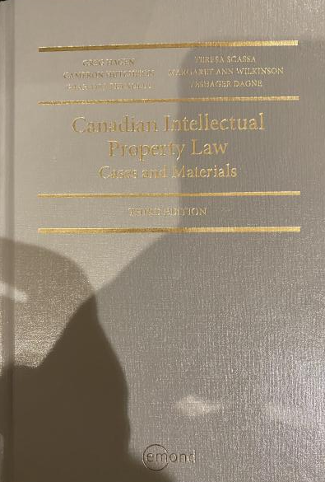
Text: Let me know if any issues @ Bookstore

Slide 4
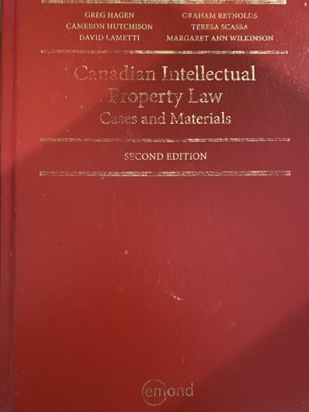
Former Text

Slide 5
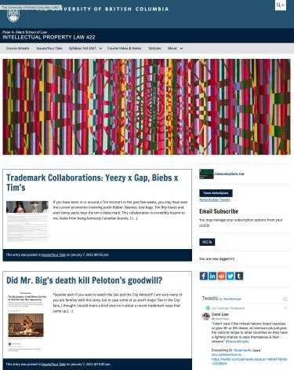
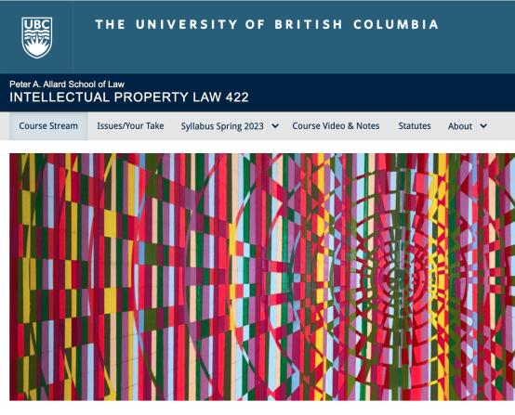
Course Website
https://iplaw.allard.ubc.ca/

Slide 6
PLEASE
SIGN UP

Slide 7
For full privileges on the website
1. Please create an account at http://cms.ubc.ca/ using your CWL.
2. Once you create an account and sign in at http://cms.ubc.ca/ you can click your name in the top right. Halfway down the following page will be your WordPress email address.
3. Send me your WordPress email address at jon.festinger@ubc.ca or at jon_festinger@thecdm.ca
4. Then, I will invite you to participate with authoring privileges via your WordPress email address.

Slide 8

Have responded to everyone?
+
…to some who didn’t ask?

Slide 9
Why post?
Engaging and engaging others is the key.
Because you don’t love speaking up in class.
Because you just saw or realized something, and you’ll never remember it unless you post it now.

Slide 10
Tips:
Don’t feel your posts have to be perfect. Engaging and engaging others is the key.

Slide 11
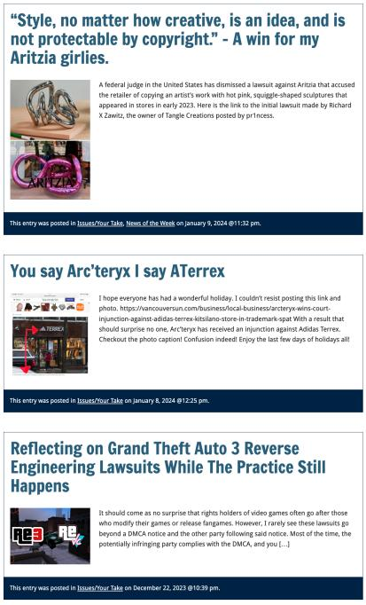

Slide 12

Anything & everything can be done via email if you prefer

Slide 13


Adding Images

Slide 14



Slide 15
Adding Links

Slide 16



Slide 17


Adding a “Featured Image”

Slide 18


Slide 19


Setting Categories

Slide 20


Slide 21
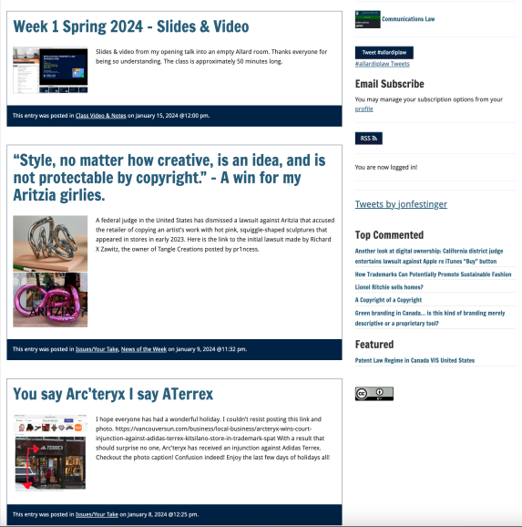
Creative Commons License

Slide 22
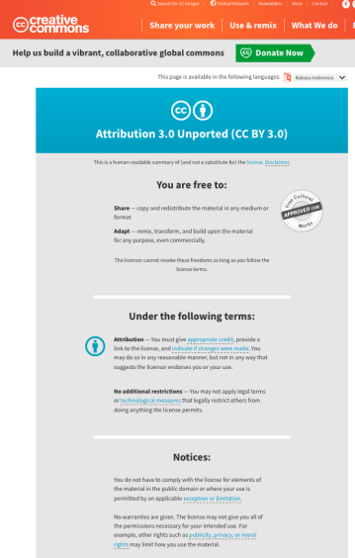
What I thought I would see…

Slide 23
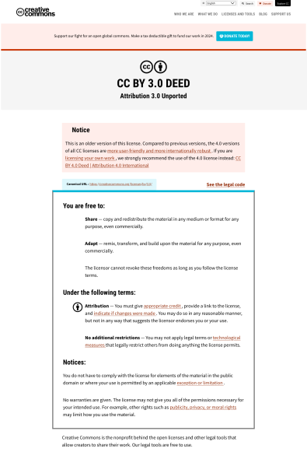
What I did see…

Slide 24
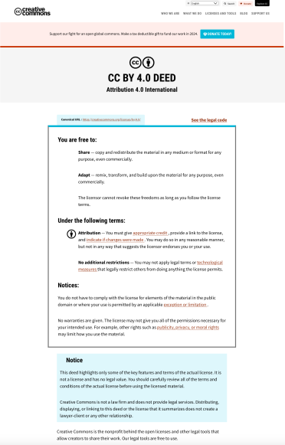
What CTLT will do…

Slide 25
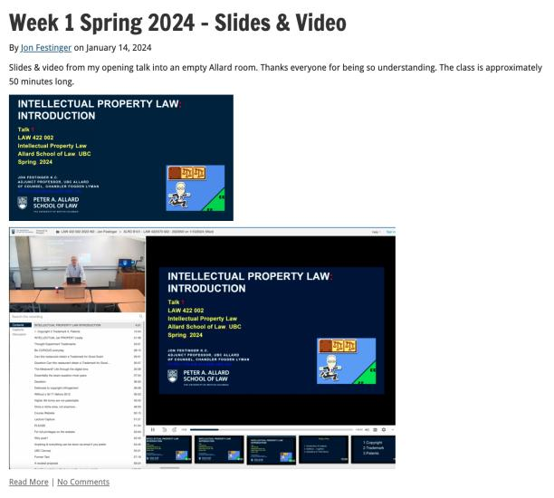
Lecture Capture

Slide 26
Syllabus

Slide 27
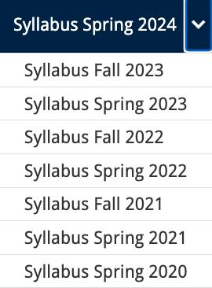




Slide 28
Features of this Course
70% Exam not 100%
IP Law “In Context”
Website

Slide 29
Let’s talk about…
The 30%

Slide 30
A modest proposal…
Approximately 1000 words (or equivalent) per person
written, video, podcast, in-class presentation (?), interpretive dance
Website or not
Groups or individually
LLM Students – one extra post

Slide 31
Past Presentations: Most are on the course website…

Slide 32
News of
the Week

Slide 33


Slide 34
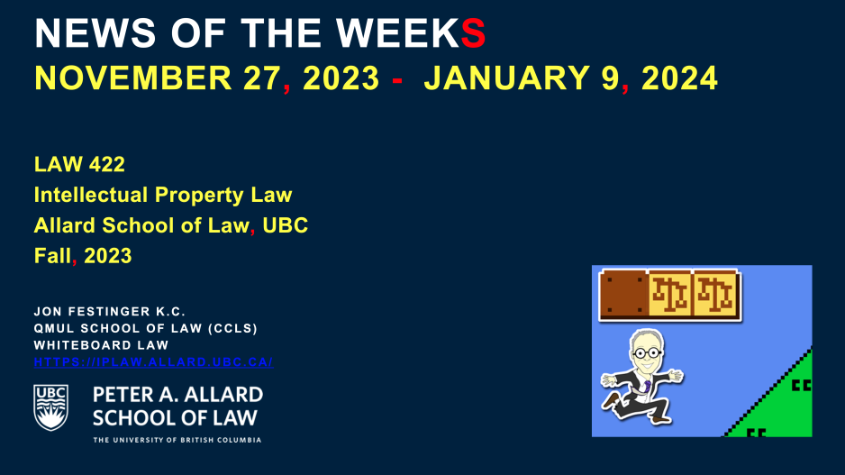
Coming This Week???

Slide 35
Generative A.I. Policy
1. It is source material, therefore
must be cited
2. You are responsible for the quality
of your source material, so check…
If it is wrong, you are wrong
If it plagiarized, you’ve plagiarized

Slide 36

Office “Hours”: Ideally Tuesdays just after class but am flexible…
Email: jon.festinger@ubc.ca; jfestinger@telus.net
Office: 449
Phone:
c. 604-837-6426
(please text if urgent)

Slide 37
QUESTIONS?
THOUGHTS?
DISCUSSION?

Slide 38

Pause

Slide 39
Now
You

Slide 40
Entirely optional but please…
…email me a short bio of yourself referencing:
Anything at all you want to say about yourself
Your academic interests
What you might like to get out of this course (I.E., interest in a type of patent, or a copyright issue etc.)
Favorite Intellectual Property (ies) - current or all-time

Slide 41

The
Unanswered
Question

Slide 42


Slide 43
QUESTIONS?
THOUGHTS?
DISCUSSION?

Slide 44
Pause

Slide 45

Where we have been…

Slide 46
Intellectual Property Law is about:
What kinds of creations of the mind can one have rights in?
Who can have those rights?
What kinds of rights are there; and how are those rights enforced?

Slide 47

Overview of copyright
Definition of copyright:
  Set of exclusive rights in works of expression; performers’ performances; sound recordings; and communication signals.
The Clash, Chateau Neuf, Oslo, Norway
21 May 1980 Helge Øverås

Slide 48
Overview of copyright
Justifications
Economic incentive for creation (then why does copyright continue after death)?
Societal “progress in the arts & sciences”
Natural rights to one’s own labour & personality (→ personality = privacy or IP)
Reinforces free expression?

Slide 49
Purpose of copyright in Canada?
Théberge:
  “[12] Generally speaking, Canadian copyright law has traditionally been more concerned with economic than moral rights.… The economic rights are based on a conception of artistic and literary works essentially as articles of commerce.” (Binnie J.)
But Cinar Corp. v. Robinson?
  [114] … the infringement of copyright in this case interfered with Robinson’s personal rights to inviolability and to dignity, recognized by ss. 1 and 4 of the [Quebec] Charter. (McLachlin CJ)

Slide 50
Overview of copyright
Purpose of copyright as articulated by the SCC
  Former approach: “author-centric”
  Shift in Théberge
    “balance between promoting the public interest in the encouragement and dissemination of works of the arts and intellect and obtaining a just reward for the creator“ (para. 30)
  Refined in Cinar Corporation v. Robinson, 2013 SCC 73
    Copyright Act “seeks to ensure that an author will reap the benefits of his efforts, in order to incentivize the creation of new works” (para. 23)

Slide 51
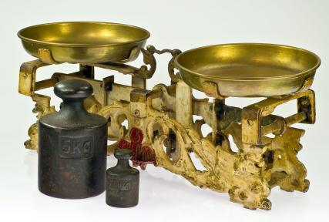
Théberge promotes “balance” between the public interest in connecting & just reward for the author

Slide 52
Overview of copyright
Legislative authority over copyright in Canada
  Federal Government (s. 91(23) Constitution Act, 1867)
  First Copyright Act (1921, Came Into Force 1924) largely a copy of the UK Copyright Act of 1911
  Modernization of Canadian copyright law: a work constantly in progress
  Bill C-11: Copyright Modernization Act (CIF 2012)
  Relatively recent copyright extension for sound recordings

Slide 53
What is copyrightable?
Subsistence of copyright
5. (1) Subject to this Act, copyright shall subsist in Canada, for the term hereinafter mentioned, in every original literary, dramatic, musical and artistic work if any one of the following conditions is met:
  (a) in the case of any work, whether published or unpublished, including a cinematographic work, the author was, at the date of the making of the work, a citizen or subject of, or a person ordinarily resident in, a treaty country;

Slide 54
What is copyrightable
Fixation
A requirement for the subsistence of copyright imposed by judicial interpretation
  “The work, to be capable of copyright protection, must be fixed in a tangible form” (Canadian Admiral Corp. v. Rediffusion Inc., [1954] Ex. CR 382, 20 CPR 75
Is the fixation requirement beneficial?
Does add some certainty + more works in public domain

Slide 55
Result of Fixation Requirement
Improvisational, performance art, kinetic pieces, open world massively multiplayer video game scenarios, are more at risk of not having copyright protection. See for example Komesaroff v. Mickle, [1988] R.P.C. 204 at 210 (Vict. S.C.), refusing protection to a moving sand sculpture.
Content in RAM computer memory?
Indigenous oral story-telling

Slide 56

Note Komesaroff v. Mickle
though cited often,
is not the world’s strongest precedent

Slide 57
What is copyrightable (Fixation)
Gould Estate et al v. Stoddart Publishing Co. Ltd et al (1996)
  Can copyright subsist in spoken words?
    Not necessarily – not every utterance made by individuals is a “valuable property right”
  A person’s oral statements are not literary creations and do not attract copyright protection

Slide 58
What is copyrightable: Originality
5. (1) Subject to this Act, copyright shall subsist in Canada, for the term hereinafter mentioned, in every original literary, dramatic, musical and artistic work if…

Slide 59
What is copyrightable
Originality in Canada
Pre-2004
  “Sweat of the brow”:
    Work receives copyright protection if it originates from an author and is more than a mere copy.
  “Creativity”
    A work must be the product of creativity in order to be original

Slide 60
What is copyrightable
Originality
CCH Canadian Ltd. v. Law Society of Upper Canada, 2004 SCC 13
  For a work to be original, you need an exercise of skill and judgment that is more than a purely mechanical exercise
  Skill = use of one’s knowledge, developed aptitude or practiced ability in producing the work
  Judgment = use of one’s capacity for discernment or ability to form an opinion or evaluation by comparing different possible options in producing the work

Slide 61
Meaning that…
Headnotes, case summaries, topical indexes & compilations of reported judicial decisions originating from their authors and are not simply copies. There is more than trivial skill & judgment in their creation (as every law student knows)
However, reported judicial decisions, by themselves, are not original works in which the publishers could claim copyright, even where typos and minor errors are fixed.

Slide 62
Can an A.I. pass the “McLachlin Test”?
Can an A.I. exercise “skill and judgment”?
Perhaps yes, if test is “ability to form an evaluation by comparing different possible options”…
But does this skill and judgment “necessarily involve intellectual effort”?
And more weirdly is what an A.I. does “so trivial that it could be characterized as a purely mechanical exercise”?

Slide 63
What is copyrightable
Facts and ideas
  Not entitled to copyright protection
  Kenrick & Co. v. Lawrence & Co. (1890)
    How is idea separated from expression in this decision?

Slide 64
What is copyrightable
Plaintiff printers drew a representation of hand holding a pencil completing a cross in a box as a method to instruct voters who couldn’t read on how to exercise their democratic franchise.
Plaintiffs duly registered their drawing under the copyright laws of the time.
Defendants created a similar but not identical drawing for the same purpose and were sued by the plaintiffs for infringement.
The plaintiffs action failed.

Slide 65
“It seems to me, therefore, that although every drawing of whatever kind may be entitled to registration, the degree and kind of protection given must vary greatly with the character of the drawing, and that with such a drawing as we are dealing with the copyright must be confined to that which is special to the individual drawing over and above the idea...there are scarcely more ways that one of drawing a pencil or the hand that holds it. If the particular arrangement of square, cross, hand, or pencil be relied upon it is nothing more than a claim of copyright for the subject, which in my opinion cannot possibly be supported.”

Slide 66
IDEA/EPRESSION
DICHOTOMY
Donoghue v. Allied Newspapers Limited (1938) Ch 106
Copyright owner is…"the person who has clothed the idea in form, whether by means of a picture, a play or a book"

Slide 67
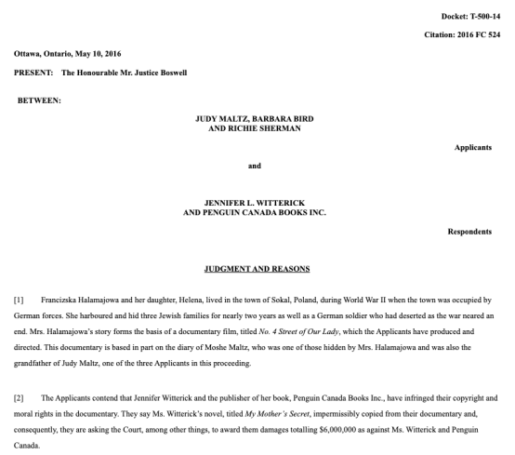
Footnote: No Copyright in Facts

Slide 68
“[47] Although the Documentary and the Book each recount some of the same facts of Francizska Halamajowa’s story, there is no substantial taking or use by the Respondents of anything owned by the Applicants because the use of common historical facts is not copyright infringement. The Respondents have not appropriated or taken a substantial portion of the Documentary’s originality. It is difficult to identify a single element taken that is not either something generic or merely a fact.”

Slide 69
What is copyrightable: Artistic Works
5. (1) Subject to this Act, copyright shall subsist in Canada, for the term hereinafter mentioned, in every original literary, dramatic, musical and artistic work if…

Slide 70
S. 2 Definitions
literary work includes tables, computer programs, and compilations of literary works; (oeuvre littéraire)
dramatic work includes
(a) any piece for recitation, choreographic work or mime, the scenic arrangement or acting form of which is fixed in writing or otherwise,
(b) any cinematographic work, and
(c) any compilation of dramatic works; (oeuvre dramatique)
musical work means any work of music or musical composition, with or without words, and includes any compilation thereof; (oeuvre musicale)
artistic work includes paintings, drawings, maps, charts, plans, photographs, engravings, sculptures, works of artistic craftsmanship, architectural works, and compilations of artistic works; (oeuvre artistique)

Slide 71
What is copyrightable
  University of London Press, Ltd. v. University Tutorial
  Press, Ltd. [1916] 2 Ch. 601
  Literary merit and quality are not factors
  when assessing if something is a literary work

Slide 72
Peterson J. “Assuming that they are ``literary work'’, the question then is whether they are original…Copyright Acts are not concerned with the originality of ideas, but with the expression of thought, and, in the case of ``literary work'’, with the expression of thought in print or writing…In the present case it was not suggested that any of the papers were copied… If an author, for purposes of copyright, must not draw on the stock of knowledge which is common to himself and others who are students of the same branch of learning, only those historians who discovered fresh historical facts could acquire copyright for their works…The objections with which I have dealt do not appear to me to have any substance, and, after all, there remains the rough practical test that what is worth copying is prima facie worth protecting. In my judgment, then, the papers set by Professor Lodge and Mr. Jackson are "original literary work" and proper subject for copyright under the Act of 1911.”

Slide 73

What is copyrightable
  Exxon Corp v. Exxon Insurance Consultants International Ltd., [1981] 3 All E.R. 241 (Ch.D)
  Plaintiff, Exxon Corp, had claimed the copyright of the word and went on to file an injunction to stop the defendant company from using the word 'Exxon'
  Some expression is not eligible for copyright protection because it is too minimal to satisfy the requirements of an “original literary work” under s. 2.
What about Twitter messages?

Slide 74
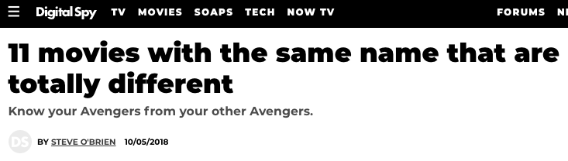
What is copyrightable
Francis Day and Hunter v. 20th Century Fox Corp, Ltd.
[1939] UKPC 68, [1940] AC 112, [1939] 4 DLR 353
(Privy Council on appeal from Ontario C.A.)
  Generally, there is no separate
  copyright in the title of a work

Slide 75
Exception
Francis Day and Hunter v. 20th Century Fox Corp, Ltd.
  NOTE: definition of a “work” in the Copyright Act - includes “the title thereof when such title is original and distinctive”

Slide 76

Note also Trademark alternative

Slide 77
What is copyrightable: Dramatic Work
5. (1) Subject to this Act, copyright shall subsist in Canada, for the term hereinafter mentioned, in every original literary, dramatic, musical and artistic work if…

Slide 78
What is copyrightable
Dramatic work
  Must have a story, a thread of consecutively based events either narrated or presented by dialogue or action or both (Hutton v. CBC (1989))
  Or (based on s. 2):
    Choreography, mime and recitation piece with scenic arrangement or acting form fixed in writing or otherwise
    Cinematographic work
    Compilation of dramatic works

Slide 79
1994
Copyright Act was amended to provide:
  "dramatic work" includes
    (a) any piece for recitation, choreographic work or mime, the scenic arrangement or acting form of which is fixed in writing or otherwise,
    (b) any cinematographic work, and
    (c) any compilation of dramatic works;
[Cinematographic work – defined as “includ[ing] any work expressed by any process analogous to cinematography (motion-picture photography – tv, video, film, etc.), whether or not accompanied by a soundtrack” ]
[Choreographic work –defined as “includ[ing] any work of choreography, whether or not it has any story line;]

Slide 80
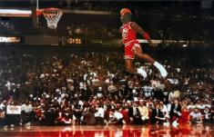
What is copyrightable
FWS Joint Sports Claimants v. Canada 1991 FCA (CB)
No copyright in a sporting event per se though television production of a sporting event is copyrightable
Unpredictable and incompatible with the notion of a choreographic piece of art?

Slide 81
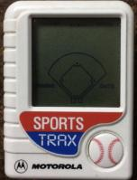
What is copyrightable
National Basketball Association v. Motorola, Inc., 105 F 3d. 841 (2nd Cir. 1997)
  You cannot have copyright in specific athletic feats
  Not in scores either

Slide 82
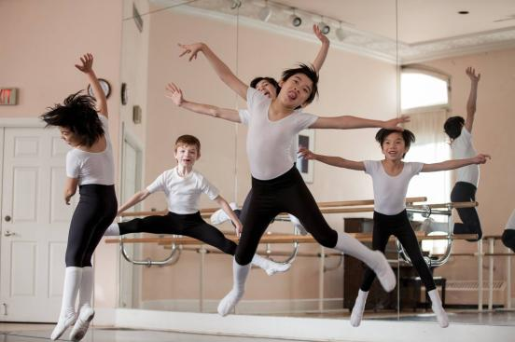
Dance & choreography is a very challenging area in practical terms

Slide 83
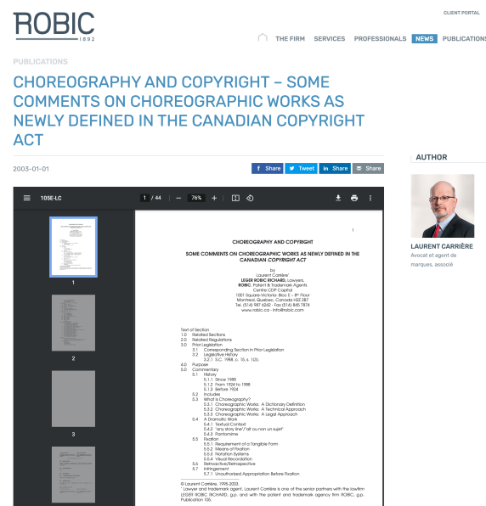

Slide 84
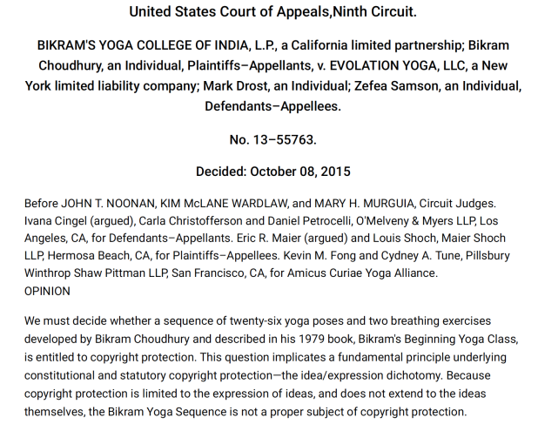
Related?…

Slide 85
What is copyrightable
Artistic works
  “artistic work” defined in s. 2 as including:
    paintings, drawings, maps, charts, plans, photographs, engravings, sculptures, works of artistic craftsmanship, architectural works, and compilations of artistic works.

Slide 86
What is copyrightable
Artistic works
DRG Inc. v. Datfile Ltd. [1988] 2 F.C. 243
  Two series of colour coded labels were registered under the Copyright Act. It was unsuccessfully argued that the registrations were not properly the subject of copyright.
  Court found that an artistic work is a work that finds expression in a visual medium.
  Artistic merit, artist’s intention to create “art” and the actual aesthetic value of the work are not pertinent to the question of whether a work meets the classification of “artistic work”

Slide 87
Copyrighting Data?
Geophysical Service Incorporated v. Encana Corporation, 2016 ABQB 230
It appears from the case that is not the raw data that is copyrightable as those would simply be facts, but how the data is presented.
  “[76] I find the seismic sections, i.e. the squiggly or zebra lines, fit within the definition of an artistic work, similar to a map, plan or chart, or a compilation of an artistic work, since the product is the result of selection or arrangement of the data, or sound recordings, from the geology of the subsurface.”
Do you agree? Alta. C.A. confirmed & SCC denied leave.

Slide 88

What is copyrightable
Is a fireworks display a dramatic work?

Slide 89
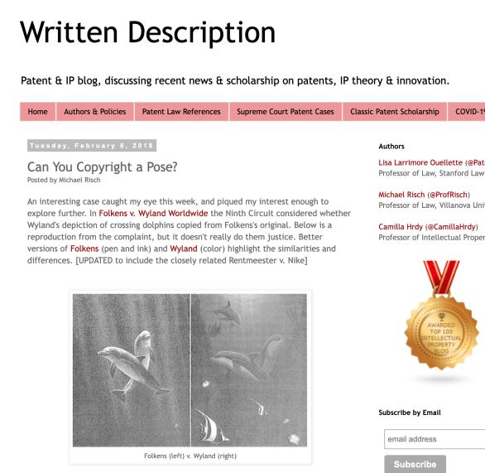
Poses

Slide 90
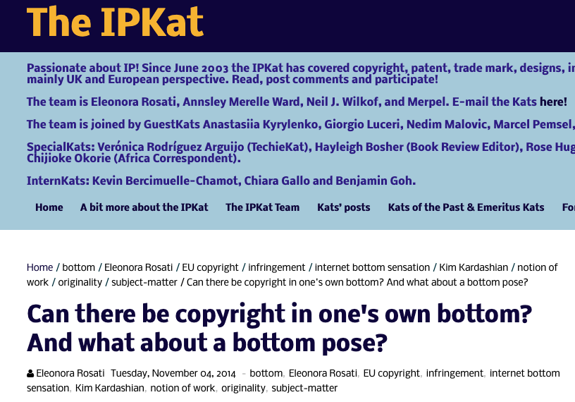

Slide 91
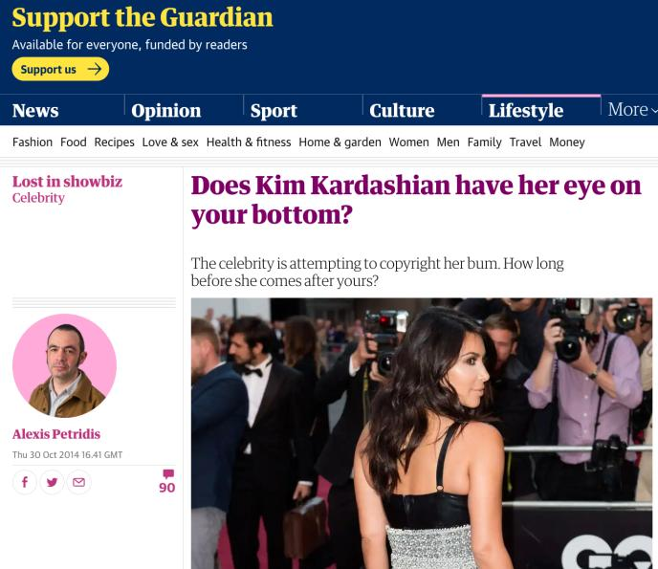
The original article…

Slide 92

Introducing
“Rights of Copyright Owners”
What rights should be part of the bundle of rights of copyright owners?

Slide 93
Rights of the copyright owner
Three fundamental rights:
Produce or reproduce
the work (3(1))
Perform the work
(including broadcasting rights) (3(1))
The right to publish (3(1))

Slide 94
Rights of the copyright owner
Produce … any translation (3(1)(a))
Convert dramatic work into non-dramatic work (3(1)(b)
Convert non-dramatic work into dramatic work (3(1)(c))
To make a sound recording, etc. of a literary, etc. work (3(1)(d))
Reproduce, etc. a literary, etc. work as a cinematographic work (3(1)(e))
Communicate a work to the public by telecommunication (3(1)(f))
Present an artistic work at a public exhibition…. (3(1)(g))
Rent out a computer program, etc. (3(1)(h))
Rent out a sound recording of a musical work … (3(1)(i))
Sell or transfer ownership of tangible object … (3(1)(j)
Authorize any of above acts (3(1))

Slide 95
Derivative Rights

Slide 96
Rights of the copyright owner
For how long should these
rights last?
What should be the term of
copyright?

Slide 97
Rights of the copyright owner
Term of copyright in Canada (ss. 6-12)
Anonymous or pseudonymous works
  70 years from end of the year in which the work was published; or 75 years from the end of the year in which it was made (whichever ends earlier) (s. 6.1)
Crown
  70 years from end of the calendar year in which the work is first published (s. 12)

Slide 98
History:
Canada–United States–Mexico Agreement (CUSMA)
CUSMA came into force July 1, 2020. Under CUSMA, copyright terms have been amended.
Canada had 2.5 years to revise legislation (the Copyright Act) to state the following:
  there is a general term of copyright protection of “life plus 70 years” for written works (increased from the current 50 years), and
  75 years for performances and sound recordings (increased from the current 70 years)
Came into force December 30, 2022

Slide 99
Rights of the copyright owner
Who owns the rights? (ss. 13, 14)
s. 13(1): the author is the first owner of copyright
s. 13(3): employment exception
“13(3) Where the author of a work was in the employment of some other person under a contract of service or apprenticeship and the work was made in the course of his employment by that person, the person by whom the author was employed shall, in the absence of any agreement to the contrary, be the first owner of the copyright, but where the work is an article or other contribution to a newspaper, magazine or similar periodical, there shall, in the absence of any agreement to the contrary, be deemed to be reserved to the author a right to restrain the publication of the work, otherwise than as part of a newspaper, magazine or similar periodical”

Slide 100
Rights of the copyright owner
Employee or contractor?
Factors to consider: Who owns the tools; control or direction (relationship of subordination); whether the author assumes all or part of the business risk; degree of integration of the author into the business of the employer (Amusements Wiltron Inc. v. Mainville (1991) RJQ 1930, 40 CPR 3d 521 (Que SC))
Work performed in the course of employment?

Slide 101
Consultant/Independent Contractor
If as an independent contractor you are paid to develop a product, you as independent contractor remain the proprietor of the copyright on that work.
The person paying for the service (client) obtains a license to use the copyrighted work, unless the first copyright owner transfers her rights in writing.

Slide 102
Rights of the copyright owner
Who owns the rights? (ss. 13, 14)
ss. 13(4): assignments; licenses
Assignment…parties can assign all or part of
the rights in a work; can licence uses of the
work; can do so either for the whole term of
the copyright, or for a shorter period.

Slide 103
Rights of the copyright owner
Who owns the rights? (ss. 13, 14)
ss. 13(4), 13(7): assignments, exclusive licences need to be in writing; non-exclusive licences don’t need to be in writing (Robertson v. Thomson)
Benefit of copyright registration: If an assignment or licence not registered, and the assignor or licensor subsequently assigns or licences the copyright interest – for valuable consideration – to a different assignee or licensee who didn’t have ACTUAL NOTICE of the prior assignment – the prior assignment/licence can be declared void (57(3)). So, if you’re an assignee, licensee – it is to your benefit to register the assignment of copyright or the licence granting you an interest (57(1)).

Slide 104
QUESTIONS?
THOUGHTS?
DISCUSSION?

Slide 105
Pause

Slide 106
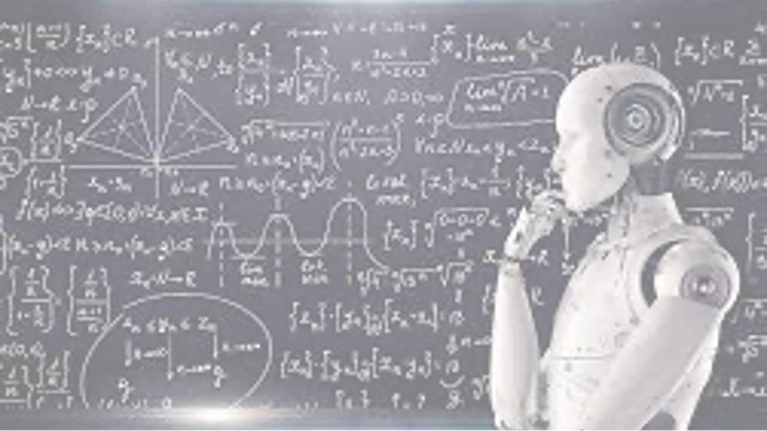
A.I.I.P.
Follow-up

Slide 107
History of
A.I.I.P.

Slide 108
Broadly, three sperate questions
Can an A.I. independently own I.P. it has created? This is effectively a “Robot’s Rights” issue and is for practical purposes remote from this course.
Does a work built or created by an A.I./Robot qualify for copyright or patent protection? This very much a live issue being debated in various jurisdictions.
What are the practical risks of A.I./Robot creation (which due to computational power can generate almost unlimited permutations very efficiently) on I.P. Law, if any?

Slide 109
So far?...
“What’s clear in AI is that
The ‘A’ is the computer
and the ‘I’ is a human”

Slide 110
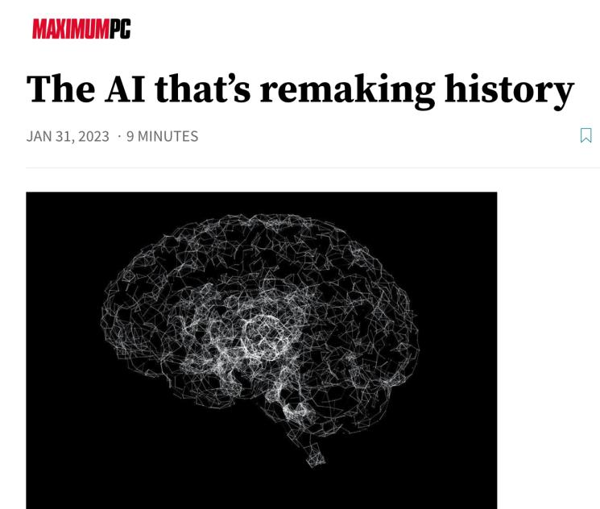

Slide 111
A.I. & Copyright
In CCH Canadian Ltd. v. Law Society of Upper Canada, 2004 SCC 13 McLachlin C.J. speaking to the standard of originality required for copyright stated:
  ”I conclude that the correct position falls between these extremes. For a work to be “original” within the meaning of the Copyright Act , it must be more than a mere copy of another work. At the same time, it need not be creative, in the sense of being novel or unique. What is required to attract copyright protection in the expression of an idea is an exercise of skill and judgment… This exercise of skill and judgment will necessarily involve intellectual effort.”
Query: Is any A.I. capable of judgment or intellectual effort or just their metaphorical cousin prediction?

Slide 112
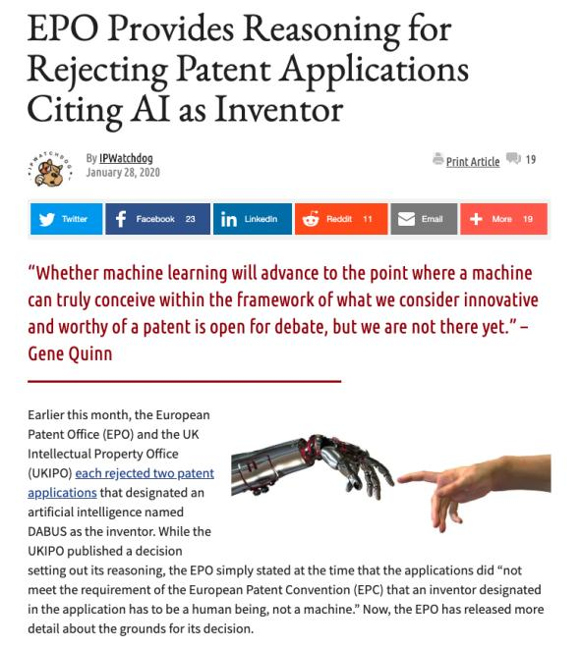

Slide 113
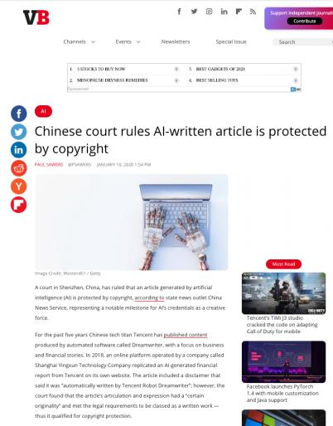
Question was: “Can Tencent have a copyright
in works generated by it’s A.I.?”

Slide 114
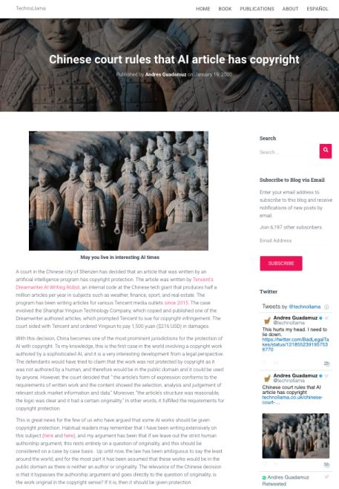

Slide 115
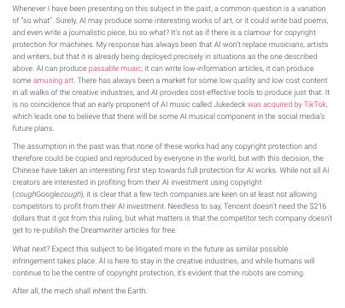

Slide 116


Slide 117
“The universe (which others call the Library) is composed of an indefinite and perhaps infinite number of hexagonal galleries, with vast air shafts between, surrounded by very low railings. From any of the hexagons one can see, interminably, the upper and lower floors. The distribution of the galleries is invariable.”

Slide 118
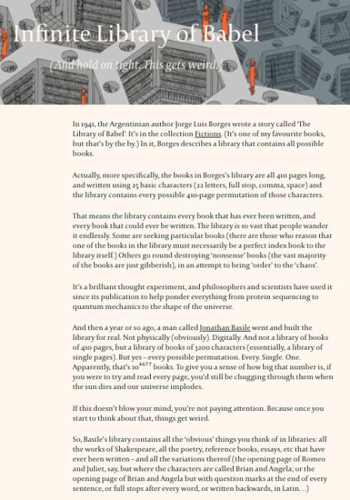

Slide 119
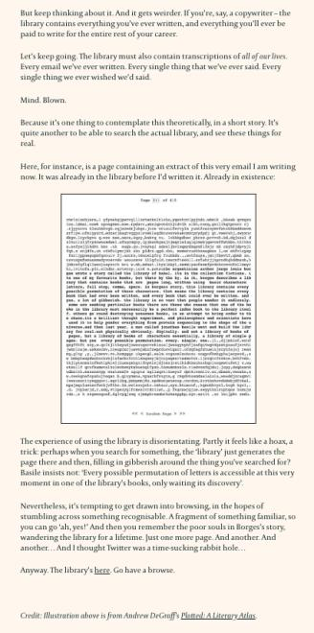

Slide 120
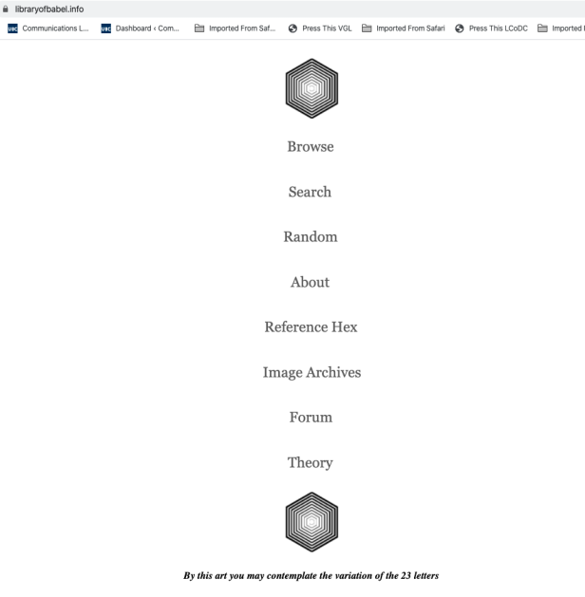

Slide 121
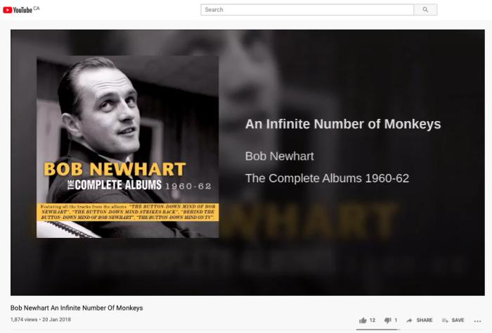
https://youtu.be/YGdMTLgU4hE

Slide 122
Monopoly in I.P. (especially in patents, particularly in drug patents) is a “thing”.
What of monopoly in I.P. through A.I. (Artificial Intelligence)?

Slide 123
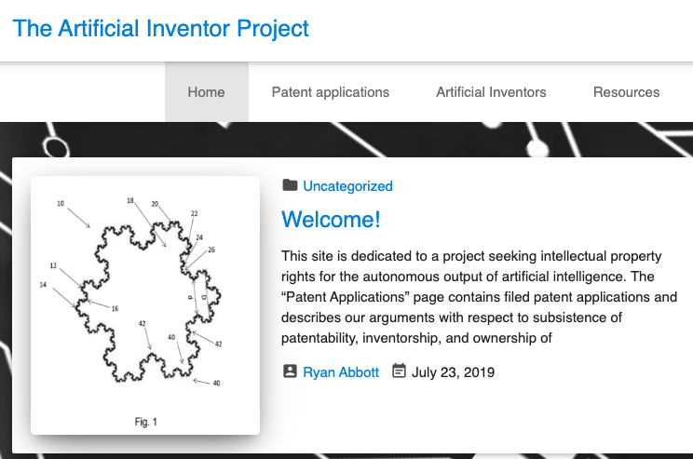

Slide 124
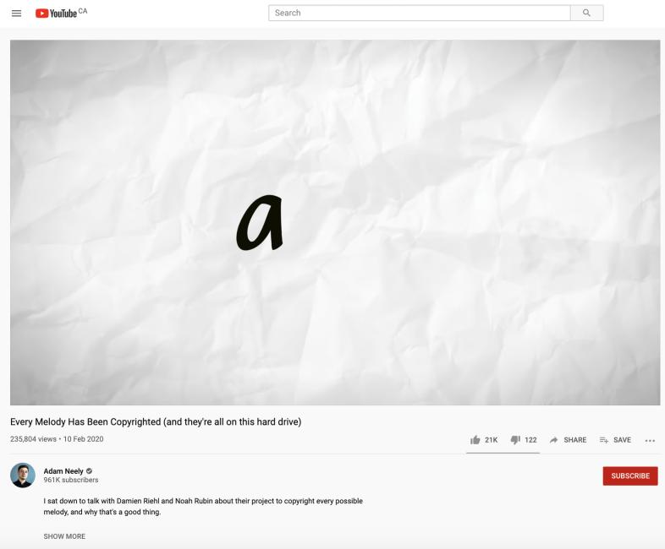

Slide 125
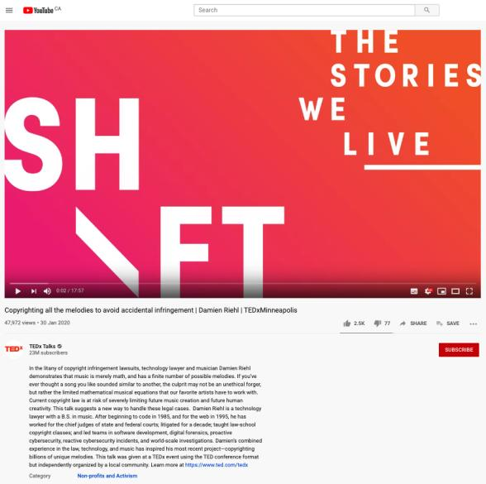

Slide 126
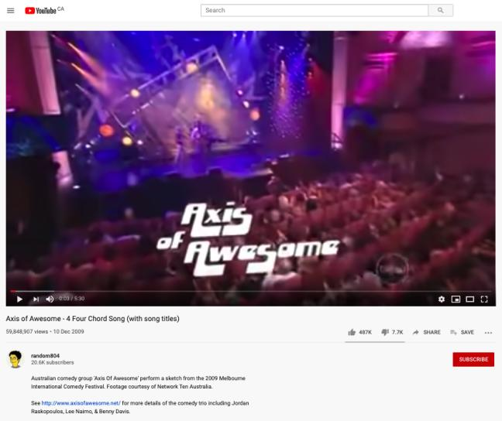
Core of the Issue

Slide 127
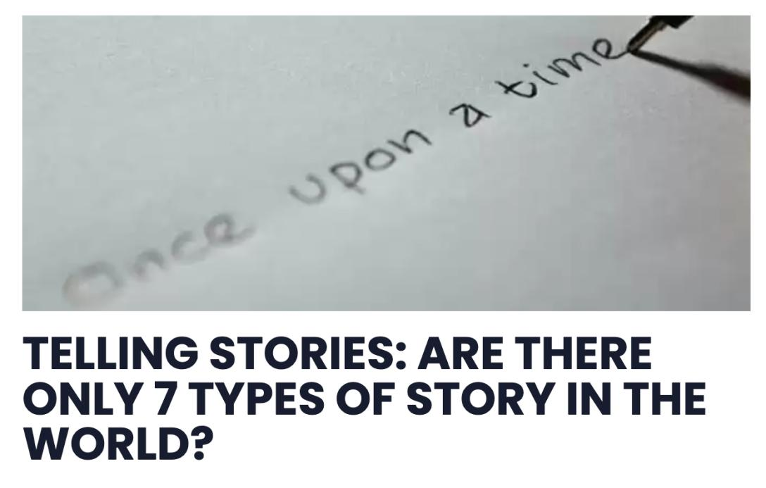

Slide 128
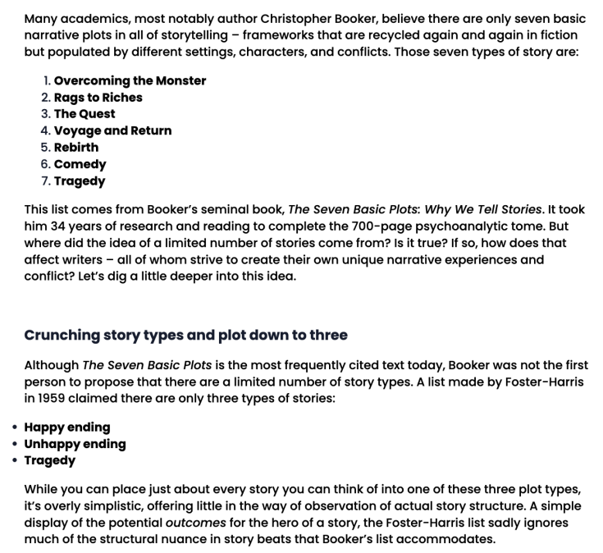

Slide 129
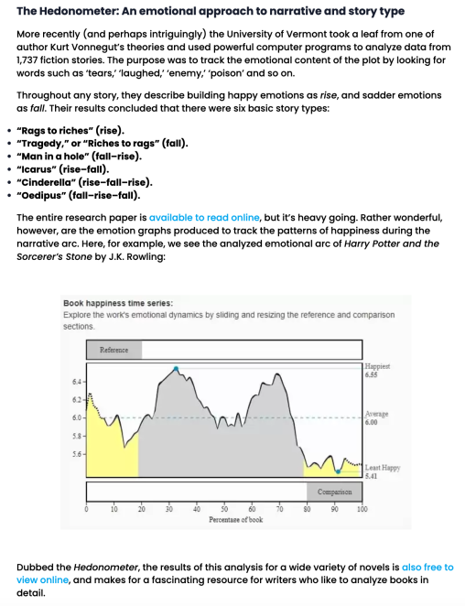

Slide 130
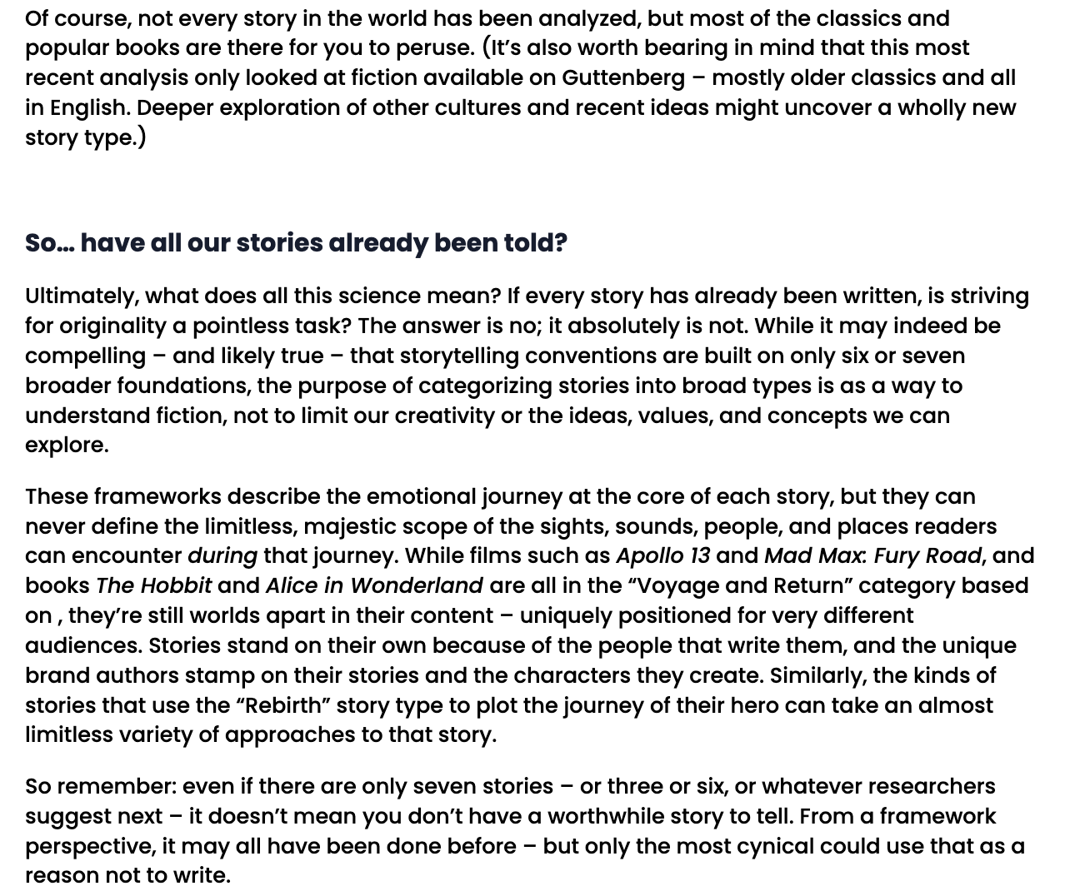

Slide 131
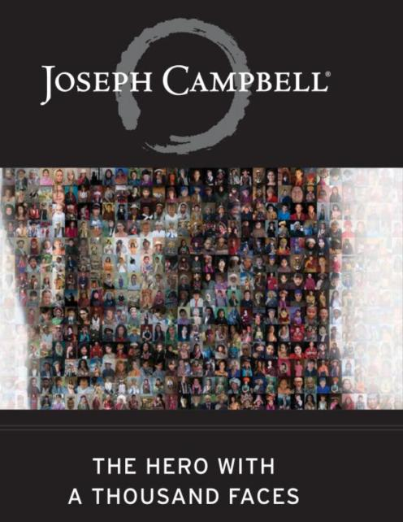

Slide 132
Solution?...
Doctrine of Independent Creation
To show infringement of copyright two elements must be present:
there must be sufficient objective similarity between the infringing work and the copyright work (or a substantial part of it).
the copyright work must be the source from which the infringing work was derived. Independent creation is a defence so long as there was no access to the copyright work or copying.

Slide 133
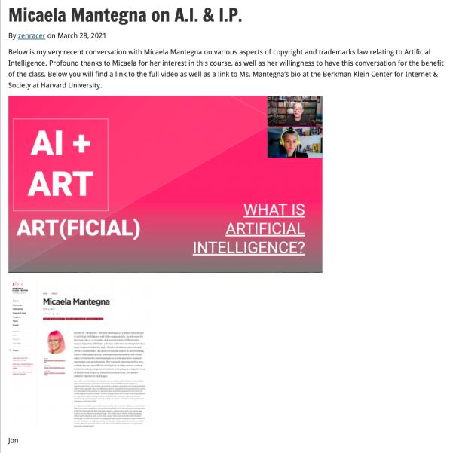

Slide 134
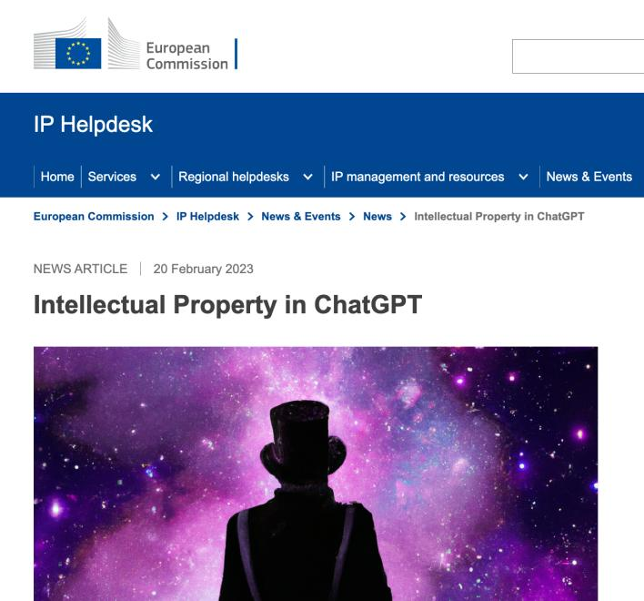

Slide 135
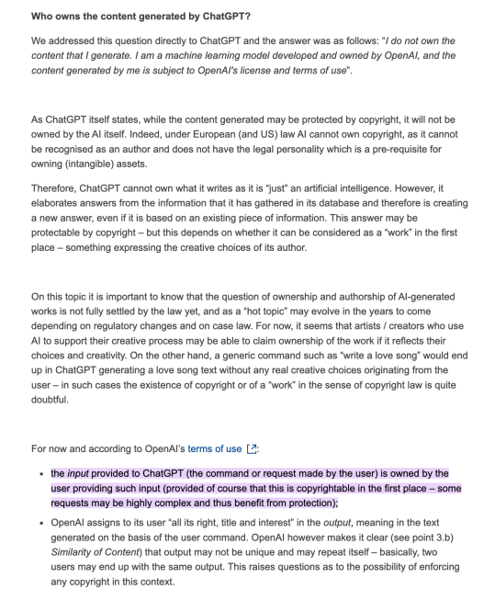

Slide 136
QUESTIONS?
THOUGHTS?
DISCUSSION?

Slide 137
Pause

Slide 138
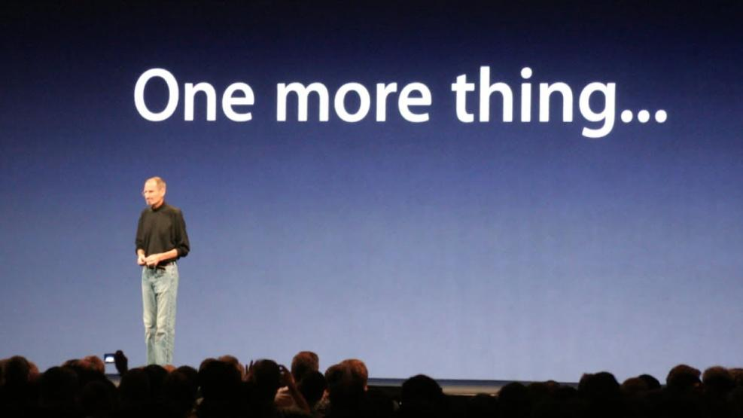

Slide 139
What is copyrightable
Is John Cage’s 4’33” a musical work?
  https://youtu.be/JTEFKFiXSx4

Slide 140
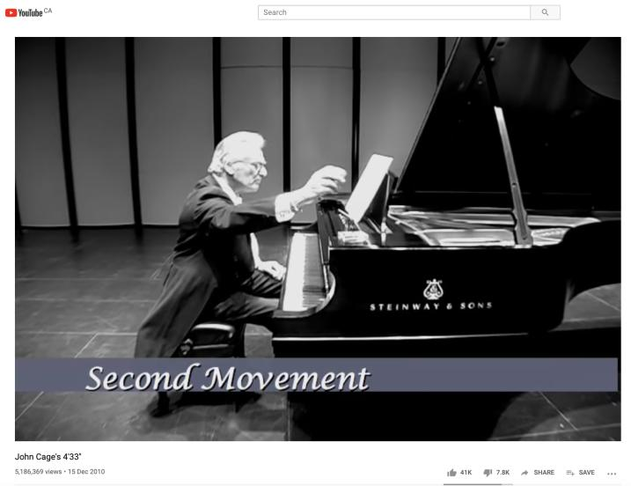

Slide 141
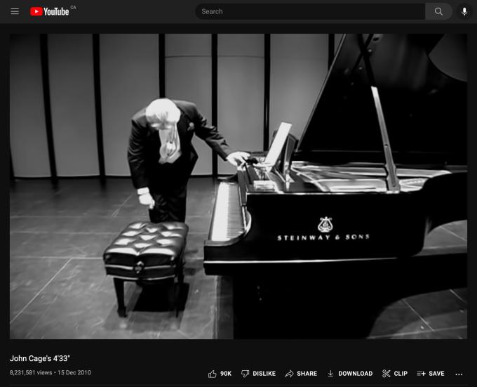
Accompanied by loud clapping…

Slide 142
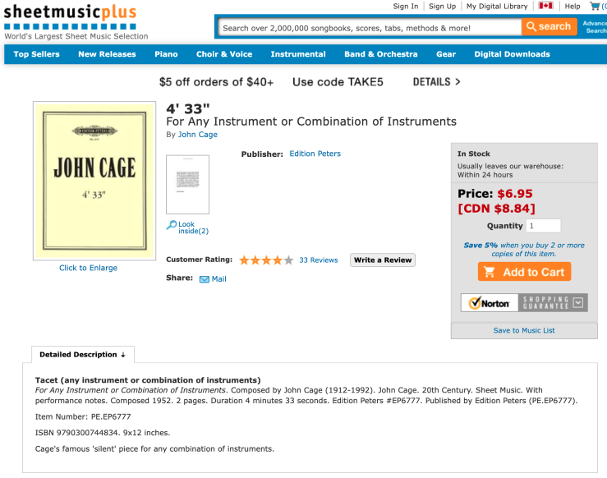

Slide 143
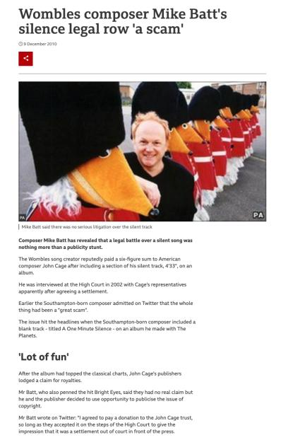

Slide 144

Begging the question…
Is John Cage’s 4’33” a musical work?

Slide 145


Latté Art?
“St. Catherine’s Street after a snowfall”
“Snowman”

Slide 146


Slide 147


Slide 148


Slide 149


Slide 150

Last Week’s Experiment
11:04:56 AM

Slide 151

11:10:12 AM

Slide 152

11:42:55 AM

Slide 153

12:21:51 PM

Slide 154


Slide 155


Slide 156


Slide 157
Note Komesaroff v. Mickle
though cited often,
is not the world’s strongest precedent

Slide 158


Slide 159
QUESTIONS?
THOUGHTS?
DISCUSSION?

Slide 160
Pause

Slide 161

Now, to our regularly
scheduled programming…

Slide 162
Rights of the copyright owner
Who owns the rights? (ss. 13, 14)
s. 14: reversionary interest - where an author has been the first owner of copyright in a work, even though they’ve transferred that interest during their lifetime, the copyright interest will revert to the author’s estate 25 years after the death of the author.

Slide 163
s. 14: Reversionary Interest (con’d)
copyright interest will revert to the author’s estate 25 years after the death of the author.
Surprising lack of Canadian cases
Note following slides asking that the right continue and providing reasons.

Slide 164


Slide 165


Slide 166


Slide 167


Slide 168
QUESTIONS?
THOUGHTS?
DISCUSSION?

Slide 169
Pause

Slide 170
Copyright in works
3 (1) For the purposes of this Act, copyright, in relation to a work, means the sole right to produce or reproduce the work or any substantial part thereof in any material form whatever, to perform the work or any substantial part thereof in public or, if the work is unpublished, to publish the work or any substantial part thereof, and includes the sole right (to)…

Slide 171
Rights of the copyright owner
Reproduction
Apple Computer Inc. v. Mackintosh Computers Ltd. (Found in
Théberge)
  Opening words in s. 3 purposely drafted broadly enough
  to encompass new technologies which had not been
  thought of when the act was drafted
  Copy does not need to be in human readable form
  in order to be covered by copyright (must have
  readability)
  Copy of a copy is still a copy

Slide 172
The Defendants argued that the copyright protection that the Plaintiff Apple had in their computer programs did not extend to a computer program when embodied in a chip:
Hexidecimal code version of the program is not a translation of the source code version.
Since there is a one-to-one relationship between the source program and its embodiment in the chip, there is a merger of the idea/expression of the idea which copyright doesn’t cover
The Copyright Act doesn’t cover computer programs in their chip form
Possibly compelling policy arguments for refusing to extend copyright protection in the present case (restrictions on commerce, possible overlap with patent law)

Slide 173
Court found for Apple; Found flexibility in the Act
Key wording to start from … s. 3: Copyright means the sole right to produce or reproduce the work or any substantial part thereof in any material form whatever.
Court looked to legislative history…
In the 1842 UK Copyright Act (which also applied in Canada), the analogous provision read as follows: ‘Copyright’ shall be construed to mean the sole and exclusive liberty of printing or otherwise multiplying copies of any … ‘book’.
Book = every volume, part or division of a volume, sheet of letter press, sheet of music, map, chart, or plan
This section was considered in 1899 in one of the earliest cases to question the suitability of Copyright Acts in the face of technological change …What was the technology in question? [A: Player piano]

Slide 174
Were piano rolls – perforated sheets created for use in player pianos – covered by the 1842 act?
No …‘Copyright’ shall be construed to mean the sole and exclusive liberty of printing or otherwise multiplying copies of any … ‘book’.
So, the Act was amended in 1911…Copyright means the right to produce and reproduce the work...in any material form whatsoever … (Also clarified that copyright shall subsist in records, perforated rolls, and other contrivances by means of which sounds may be mechanically reproduced).
Reed J agreed – In light of this discussion of the legislative history of this provision, that these opening words were purposely drafted broadly enough to encompass new technologies which had not been thought of when the Act was drafted
Also, the 1911 amendments did away with any requirement that in order to be covered by copyright the copy or reproduction of the work had to be in a human readable form
And that the 1911 amendments did away with any rule which would deny copyright protection to a work just because the copy could be characterized as being part of a machine (IE piano rolls)

Slide 175
All there has to be is:
Readability - a method by which the work in which copyright is claimed and the work which is alleged to infringe can be visually compared for the purpose of determining whether copying occurred. IE - for computer programs - print out, other documentary evidence
Another important point from this case: “A copy of a reproduction which reproduction exists in a different material form from the original is still an infringement of copyright in the original”
Prof Vaver phrases this as – a copy of a copy is still a copy.
So…the programs embodied in the chips were protected under the Copyright Act; and the Apple’s copyright was infringed….

Slide 176
QUESTIONS?
THOUGHTS?
DISCUSSION?

Slide 177
Pause

Slide 178
Rights of the copyright owner
Reproduction
Théberge v. Galerie d’Art du Petit Champlain
Galerie d’Art purchased lawfully reproduced posters of Theberge’s paintings and used a chemical process that allowed them to lift the ink layer from the paper (leaving it blank) and to display it on canvas.
No additional copies yielded
Canvas painting more valuable than on paper

Slide 179
Rights of the copyright owner
Reproduction
Théberge v. Galerie d’Art du Petit Champlain
  Majority (Binnie J.): to have a reproduction, you need an increase in the number of copies. Could have prevented by contract. Moral rights remedy is not economic/financial.
  Dissent (Gonthier J.): all reproduction requires is re-fixation
  Whose reasoning is more persuasive? How would you have decided this case?

Slide 180


Slide 181


Slide 182
Rights of the copyright owner: CBC v. SODRAC 2003 Inc.
[2015] 3 SCR 615
Reproduction of “broadcast incidental copies” - FACTS
“[9] A producer who wishes to use a musical work in an audiovisual program must incorporate that work into the production copy of the program, a process known in the industry as “synchronization.” … Once the synchronization process is complete, the final product is referred to as a “master” copy.…
[10] Once CBC is in possession of the master copy of a program, … the master copy is loaded into CBC’s digital content management system.… Digital systems generally involve the storage of copies as electronic files on hard drives. … CBC makes use of its digital content management system to perform a number of functions that help prepare a program for broadcast.
[11] These processes result in the creation of several copies, … [referred to by the parties] as “broadcast-incidental copies.” Broadcast-incidental copies may be made for several purposes[, including] to reformat the master copy to suit CBC’s technical requirements, or to edit the copy for timing, language or closed captioning purposes. One or more additional copies may also be made to allow for screening of the program by various teams within CBC before broadcast.”

Slide 183
Rights of the copyright owner
Reproduction of “broadcast incidental copies”
CBC v. SODRAC 2003 Inc. [2015] 3 SCR 615
CBC argued that:
“A proper balancing of user and right-holder interests favours finding that broadcast-incidental copies do not engage the reproduction right”.
& “…the principle of technological neutrality is a means of protecting the proper balance between users and right holders in a digital environment”

Slide 184
Rothstein J. for the majority
[47] … in neither case did the Court go so far as to allow these principles to override express statutory terms. The scope of a right under the Copyright Act is determined, first and foremost, by the Act itself. The principles at work in Théberge and ESA can inform the interpretation and application of the terms of the Act, but they cannot supplant them.
[49] The ordinary meaning of the text of the Copyright Act indicates that broadcast-incidental copying activities do engage the reproduction right. As this Court held in Bishop , the text of s. 3(1)(d) covers such activity by its terms. Making broadcast-incidental copies is the making of a “sound recording, cinematograph film or other contrivance by means of which the work may be mechanically reproduced or performed”: s. 3(1)(d). …
[50] The broader statutory context of the Act further provides strong indications that the legislature intended for broadcast incidental copies to engage the reproduction right. Most significantly, ss. 30.8 and 30.9 … , enacted as part of a series of amendments to the Act in 1997, establish specific circumstances in which “[i]t is not an infringement of copyright” to make copies to facilitate broadcasting: S.C. 1997, c. 24, s. 18(1).
[51] If it were true … that the Copyright Act should properly be read such that broadcast-incidental copying does not engage the reproduction right, there would have been no need for the legislature to enact ss. 30.8 and 30.9. Their existence is strong evidence that Parliament intended, as a baseline, that broadcast-incidental copies engage the reproduction right.

Slide 185
Rights of the copyright owner
Reproduction of “broadcast incidental copies”
CBC v. SODRAC 2003 Inc. [2015] 3 SCR 615
Should every instance of copying be considered to infringe the “reproduction” right?
Rothstein J. (majority):
  SCC’s understanding of the purpose of copyright has evolved; principle of technological neutrality now recognized to be a core copyright principle …
  But these principles don’t override express statutory terms.
  Broadcast-incidental copying activities engage the reproduction right
Abella J.’s dissent suggested Rothstein J. inappropriately “employs a literal approach to the interpretation of s. 3(1)(d), reading the words of the provision without the benefit of the purpose and context of the Act to ascertain its true meaning.”

Slide 186
Rights of the copyright owner
What constitutes taking a “substantial part” of a work?
  Applies to all rights, not just reproduction
  Cinar Corp. v. Robinson (2013, SCC)
    Matter of fact and degree; flexible notion
    Standard of review
    Decided by quality rather than quantity
    Q: “do the copied features constitute a substantial part of the plaintiff’s work?

Slide 187
Copyright in works
3 (1) For the purposes of this Act, copyright, in relation to a work, means the sole right to produce or reproduce the work or any substantial part thereof in any material form whatever, to perform the work or any substantial part thereof in public or, if the work is unpublished, to publish the work or any substantial part thereof, and includes the sole right…

Slide 188
“The issue of substantiality is one of mixed fact and law. Consequently, an appellate court should generally defer to the trial judge’s findings on substantiality, unless those findings are based on an error of law or palpable and overriding errors of fact”
“the cumulative effect of the features copied from the work must be considered, to determine whether those features amount to a substantial part of [the Plaintiff’s] skill and judgment expressed in [their] work as a whole.”
“A substantial part of a work is not limited to the words on the page or the brushstrokes on the canvas. The Act protects authors against both literal and non-literal copying, so long as the copied material forms a substantial part of the infringed work. “
“The need to strike an appropriate balance between giving protection to the skill and judgment exercised by authors in the expression of their ideas, on the one hand, and leaving ideas and elements from the public domain free for all to draw upon, on the other, forms the background against which the arguments of the parties must be considered.”

Slide 189
QUESTIONS?
THOUGHTS?
DISCUSSION?

Slide 190
Pause

Slide 191


Slide 192
Rights of the copyright owner
What is a substantial part of a work?
Cinar Corp. v. Robinson (2013, SCC)
Consider “cumulative effect of the features copied from
the work”.
Not limited to words on page or brushstrokes on the
canvas; determined in relation to originality of the work that
warrants protection
Need to balance between protecting authors and leaving
ideas/elements free for all to draw upon

Slide 193
Rights of the copyright owner
What is a substantial part of a work?
Cinar Corp. v. Robinson (2013, SCC)
Might be appropriate to rely on expert evidence:
  For expert evidence to be admitted at trial, it must (a) be relevant; (b) be necessary to assist the trier of fact; (c) not offend any exclusionary rule; and (d) involve a properly qualified expert: R. v. Mohan, [1994] 2 S.C.R. 9.
  These criteria apply to trials for copyright infringement, as they do in other intellectual property cases

Slide 194
Summary of Cinar
A substantial part of a work is a flexible notion. It is a matter of fact and degree.
Whether a part is substantial must be decided by its quality rather than its quantity: Ladbroke (Football), Ltd. v. William Hill (Football), Ltd., [1964] 1 All E.R. 465 (H.L.), at p. 481, per Lord Pearce.
“The question of whether there has been substantial copying focuses on whether the copied features constitute a substantial part of the plaintiff’s work - not whether they amount to a substantial part of the defendant’s work”
“the cumulative effect of the features copied from the work must be considered, to determine whether those features amount to a substantial part of [the Plaintiff’s] skill and judgment expressed in [their] work as a whole.”

Slide 195
Summary of Cinar
“A substantial part of a work is not limited to the words on the page or the brushstrokes on the canvas. The Act protects authors against both literal and non-literal copying, so long as the copied material forms a substantial part of the infringed work. “
“The need to strike an appropriate balance between giving protection to the skill and judgment exercised by authors in the expression of their ideas, on the one hand, and leaving ideas and elements from the public domain free for all to draw upon, on the other, forms the background against which the arguments of the parties must be considered.”
Might be appropriate to use expert evidence to assist the court with questions of substantiality. Here: “Expert evidence was necessary to assist the trial judge in distilling and comparing the “intelligible” aspects of the works at issue [atmosphere, dynamics, motifs, and structure], which he would not otherwise appreciate.”

Slide 196
Quotes from Cinar
“The issue of substantiality is one of mixed fact and law. Consequently, an appellate court should generally defer to the trial judge’s findings on substantiality, unless those findings are based on an error of law or palpable and overriding errors of fact”
“the cumulative effect of the features copied from the work must be considered, to determine whether those features amount to a substantial part of [the Plaintiff’s] skill and judgment expressed in [their] work as a whole.”
“A substantial part of a work is not limited to the words on the page or the brushstrokes on the canvas. The Act protects authors against both literal and non-literal copying, so long as the copied material forms a substantial part of the infringed work. “
“The need to strike an appropriate balance between giving protection to the skill and judgment exercised by authors in the expression of their ideas, on the one hand, and leaving ideas and elements from the public domain free for all to draw upon, on the other, forms the background against which the arguments of the parties must be considered.”

Slide 197
QUESTIONS?
THOUGHTS?
DISCUSSION?

Slide 198
Pause

Slide 199

Rights of the copyright owner
Right to perform a work in public
Where to draw the line between public and private?

Slide 200
S.3 Copyright Act
3 (1) For the purposes of this Act, copyright, in relation to a work, means the sole right to produce or reproduce the work or any substantial part thereof in any material form whatever, to perform the work or any substantial part thereof in public or, if the work is unpublished, to publish the work or any substantial part thereof, and includes the sole right
  (a) to produce, reproduce, perform or publish any translation of the work,…

Slide 201
Rights of the copyright owner
Right to perform a work in public
Canadian Admiral Corp. v. Rediffusion Inc., [1954] Ex. C.R. 382
  Did the Defendant Redifusion perform the work in public when it rediffused the football telecast to its subscribers in their homes, and their showrooms/sales offices?
  If the audience considered in relation to the owners of the copyright can properly be described as the owner’s ‘public’ or part of their ‘public’, then anyone who performs the work before that audience without the consent of the author would be infringing their copyright (Jennings v. Stephens)

Slide 202
Rights of the copyright owner
Right to perform a work in public
Canadian Admiral Corp. v. Rediffusion Inc., [1954] Ex. C.R. 382
  Exception given where audience is not part of author’s public
  Main case is Jennings v. Stephens [1936] 1 All E.R. 228 & 413 where 600 workers listened to broadcast music in a factory. Held that everything depends on the character of the audience – Is the audience part of the copyright owner’s public? If the audience considered in relation to the owner of the copyright can properly be described as the owner's "public" or part of his "public," then anyone who performs the work before that audience without the consent of the author would be infringing his copyright.

Slide 203
Net Result
A performance in public means a performance to an audience which is not domestic or quasi domestic in character. The answer depends “solely upon the character of the audience” and factors such as whether visitors are present, whether an entrance fee is charged, or the number of people in the audience are not pre-determined.

Slide 204
Rights of the copyright owner
Right to perform a work in public
Canadian Admiral Corp. v. Rediffusion Inc., [1954] Ex. C.R. 382: Exception given where audience is not part of author’s public
  Other cases cited: Duck v. Bates (1884)
    Play performed to nurses, attendants, doctors, students, some of their families at Guy’s Hospital. It was held to be a domestic or quasi-domestic performance – not a performance in public.
    Could argue that Duck defines Performance In Public in a more narrowly than does Jennings

Slide 205
Rights of the copyright owner
Right to perform a work in public
Canadian Admiral Corp. v. Rediffusion Inc., [1954] Ex. C.R. 382
  Even 1M private performances does not constitute performance in public
  Rediffusion (cable) to private homes not in public.
Berri Street showroom however was open to the public. Nothing of a domestic or quasi-domestic nature. As a result, it can be viewed as a performance in public.

Slide 206
Harms Inc. and Chappel & Co v. Martan’s Club (1927): Performance at the Embassy Club at which club members, potential members and some guests were present. Held to be a performance in public.
Performing Right Society Ltd. v. Hawthorn’s Hotel Ltd (1933): An orchestral trio played in the lounge of Hawthorn’s Hotel. In the lounge were several guests of the hotel, among others. This was a performance by the hotel orchestra in public – it was open to any members of the public who cared to be guests of the hotel – either by eating or dining there.
Performing Right Society Ltd v. Gillette Industries (1943): Defendants installed loudspeakers in their factory and broadcast music in various departments to about 600 workers. All strangers were excluded from the factory. Was in public.

Slide 207

Rights of the copyright owner
Right to perform a work in public
Canadian Cable Television Association v. Canada (Copyright Board), [1993] 2 F.C. 138
  Held that a radio or television broadcast does amount to a performance of the work in public
  In public = openly, without concealment, and to the knowledge of all
  But consistent w. s. 2.3 of the Copyright Act?

Slide 208
Rights of the copyright owner
Right to perform a work in public
Canadian Cable Television Association v. Canada (Copyright Board), [1993] 2 F.C. 138
  Reference to “early conflicting decision” (Rediffusion)
  Letourneau J.: “I would have thought on a mere common sense basis that when the Prime Minister of Canada addresses the nation, either from his home or his private office, and reaches the citizens in their homes by means of radio and television, he appears in public and performs in public. I would have been content to leave it at that had it not been for early conflicting decisions on this issue.”

Slide 209
Rights of the copyright owner
Right to communicate a work to the public by telecommunication (s. 3(1)(f))
TV
Radio
Online
“3 (1) For the purposes of this Act, copyright, in relation to a work, means the sole right to produce or reproduce the work or any substantial part thereof in any material form whatever, to perform the work or any substantial part thereof in public or, if the work is unpublished, to publish the work or any substantial part thereof, and includes the sole right
(f) in the case of any literary, dramatic, musical or artistic work, to communicate the work to the public by telecommunication,…”

Slide 210
Rights of the copyright owner
Right to communicate a work to the
public by telecommunication (s. 3(1)(f))
CCH Canadian v. LSUC (2004)
  Faxed transmissions of a single copy
  of a work to a single individual is not a
  communication to the public
  Emanated from a single point;
  & intended to be received at a single point

Slide 211
QUESTIONS?
THOUGHTS?
DISCUSSION?

Slide 212
Pause

Slide 214

Coming Soon
“Rights of Non-Copyright Owners: Fair Dealing/Users Rights”

Slide 215


What should non-copyright owners be allowed do with respect to copyrighted works?
Should you have the “right” to engage in a creative way with copyrighted works? What does this mean?

Slide 216
SEE YOU NEXT WEEK!

Slide 217

Always include a cat picture

Slide 218
In learning you will teach
And in teaching you will learn
Phil Collins' Son of Man (1999)

