Slide 1
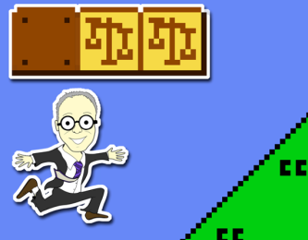
What is Copyrightable 2 &
Rights of Copyright Owners 1
Talk 3
LAW 422 002
Intellectual Property Law
Allard School of Law, UBC
Spring, 2024
Jon Festinger K.C.
Adjunct Professor, UBC Allard
Of Counsel, Chandler Fogden Lyman
https://iplaw.allard.ubc.ca/

Slide 2
Logistics

Slide 3
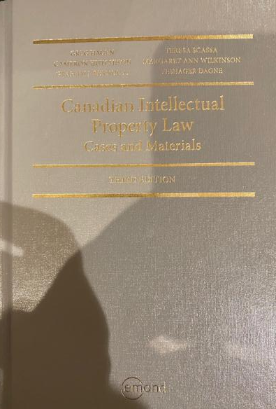
Text: Let me know if any issues @ Bookstore

Slide 4
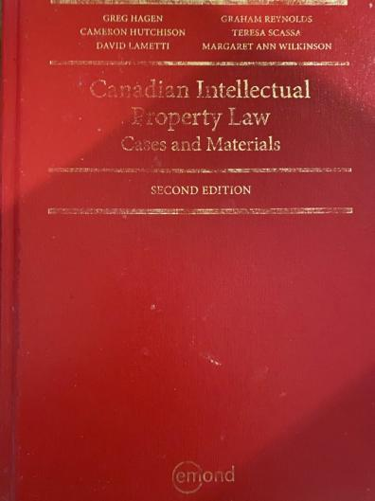
Former Text

Slide 5
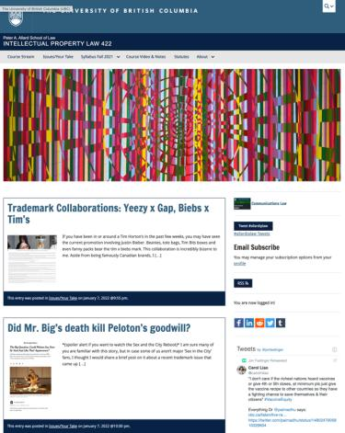
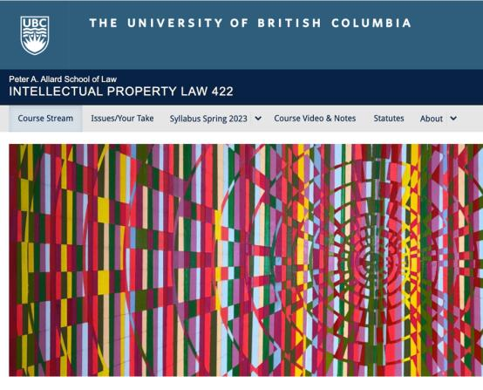
Course Website
https://iplaw.allard.ubc.ca/

Slide 6
PLEASE
SIGN UP

Slide 7
For full privileges on the website
1. Please create an account at http://cms.ubc.ca/ using your CWL.
2. Once you create an account and sign in at http://cms.ubc.ca/ you can click your name in the top right. Halfway down the following page will be your WordPress email address.
3. Send me your WordPress email address at jon.festinger@ubc.ca or at jon_festinger@thecdm.ca
4. Then, I will invite you to participate with authoring privileges via your WordPress email address.

Slide 8

Have responded to everyone…
+
…to some who didn’t ask

Slide 9
Why post?
Engaging and engaging others is the key.
Because you don’t love speaking up in class.
Because you just saw or realized something, and you’ll never remember it unless you post it now.

Slide 10
Tips:
Don’t feel your posts have to be perfect. Engaging and engaging others is the key.

Slide 11
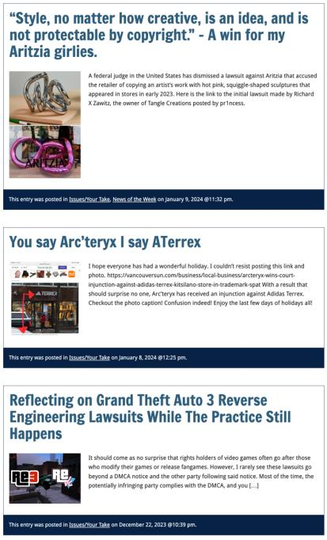

Slide 12

Anything & everything can be done via email if you prefer

Slide 13


Adding Images

Slide 14



Slide 15
Adding Links

Slide 16



Slide 17



Adding a “Featured Image”

Slide 18


Slide 19


Setting Categories

Slide 20
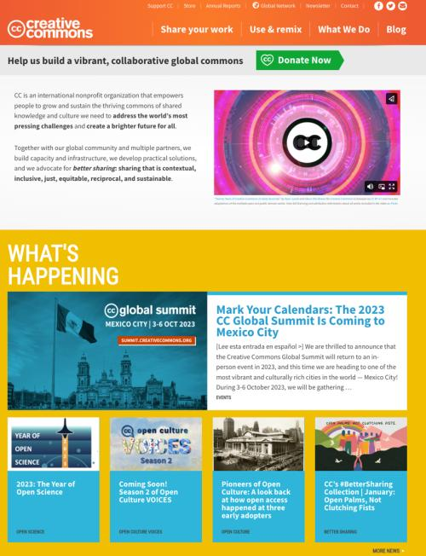

Slide 21
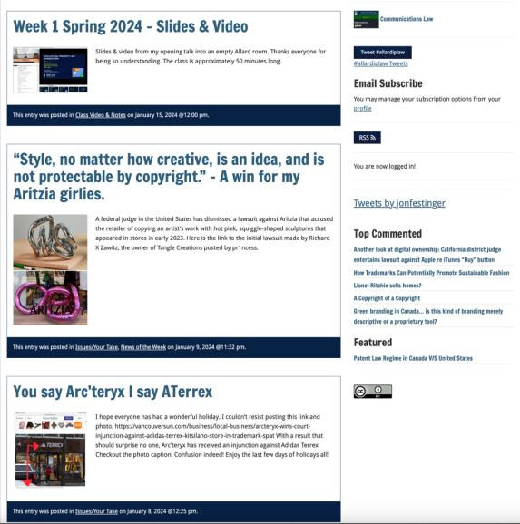
Creative Commons License

Slide 22
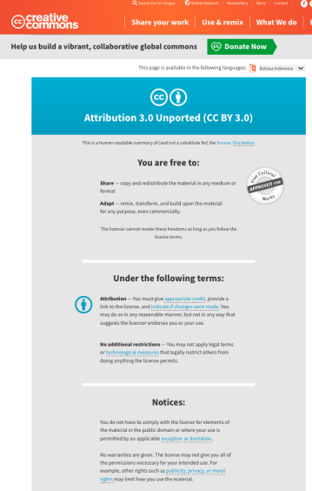
What I thought I would see…

Slide 23
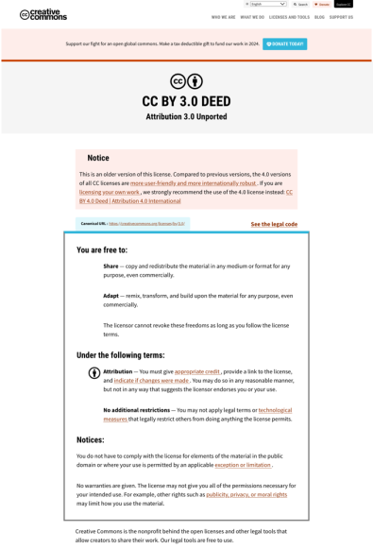
What I did see…

Slide 24
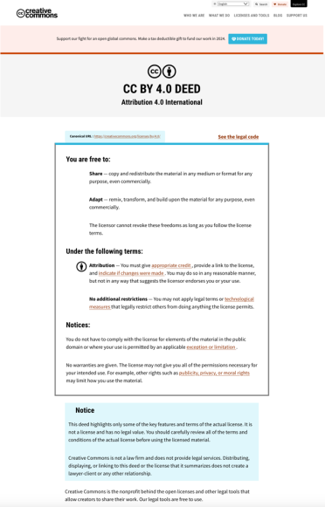
What CTLT will do…

Slide 25
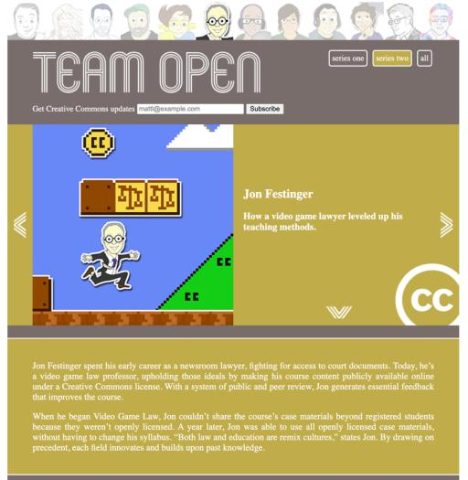

While I’m at it...A Mystery

Slide 26
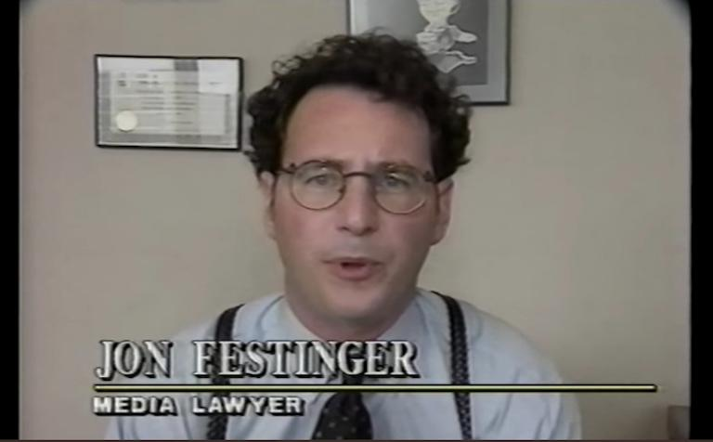


Slide 27
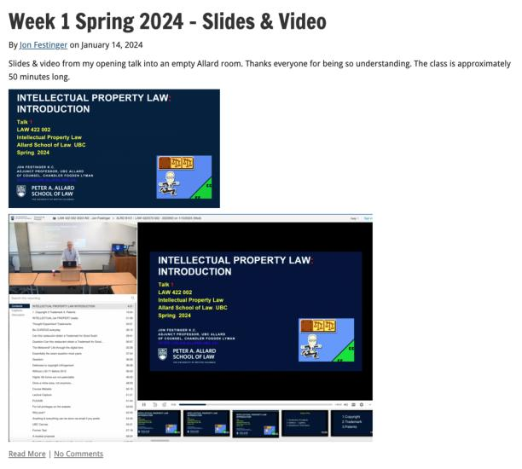
Lecture Capture

Slide 28
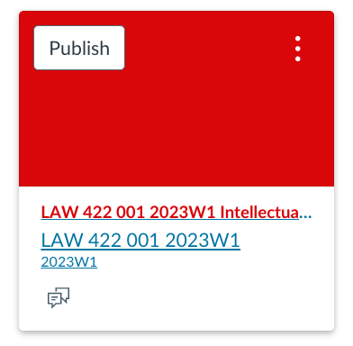
UBC Canvas?

Slide 29
Syllabus

Slide 30





Slide 31
Features of this Course
70% Exam not 100%
IP Law “In Context”
Website

Slide 32
Let’s talk about…
The 30%

Slide 33
A modest proposal…
Approximately 1000 words (or equivalent) per person
written, video, podcast, in-class presentation (?), interpretive dance
Website or not
Groups or individually
LLM Students – one extra post

Slide 34
Past Presentations: Most are on the course website…

Slide 35
News of
the Week

Slide 36


Slide 37
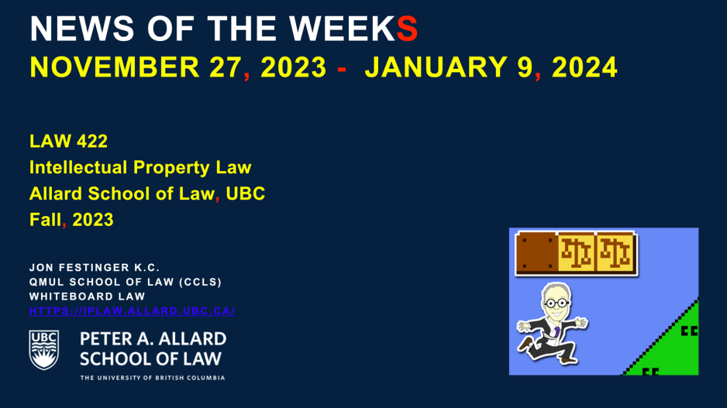
Coming This Week???

Slide 38


Slide 39
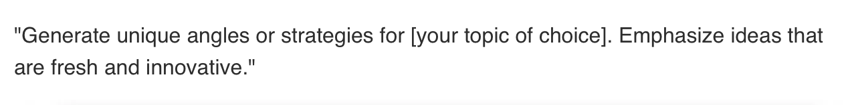
Generative A.I.
Policy?

Slide 40
Generative A.I. Policy
1. It is source material, therefore
must be cited
2. You are responsible for the quality
of your source material, so check…
If it is wrong, you are wrong
If it plagiarized, you’ve plagiarized

Slide 41


Slide 42
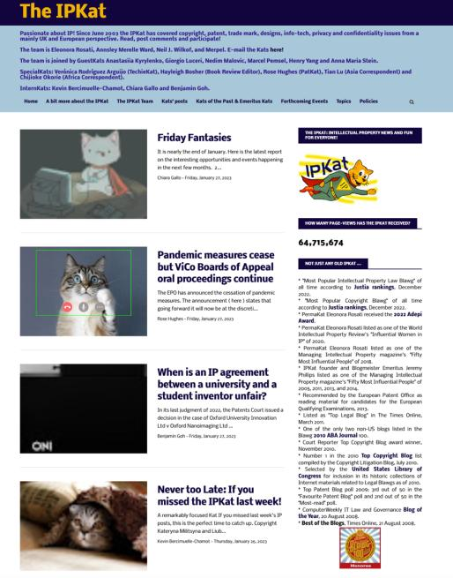

Slide 43
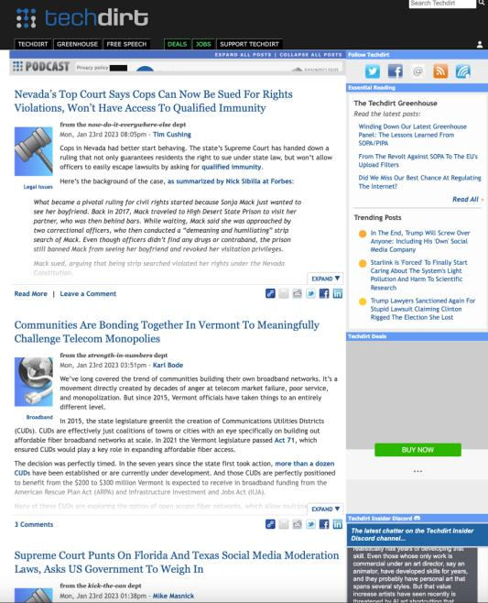

Slide 44
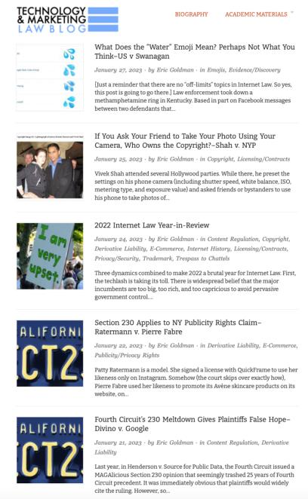

Slide 45
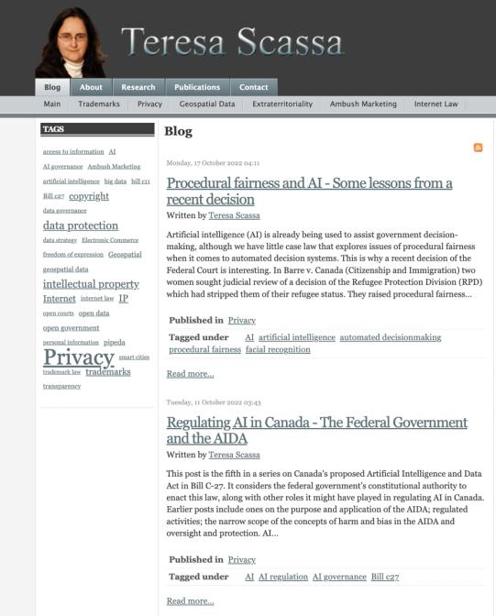

Slide 46
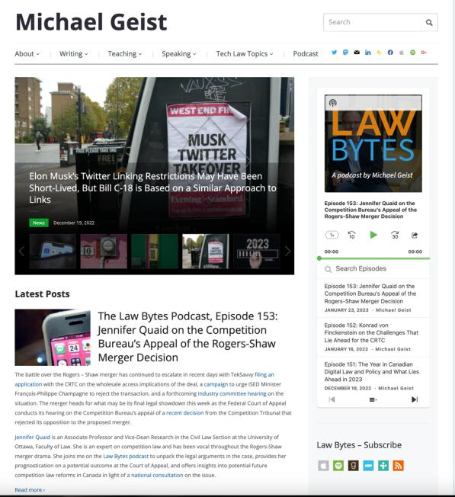

Slide 47
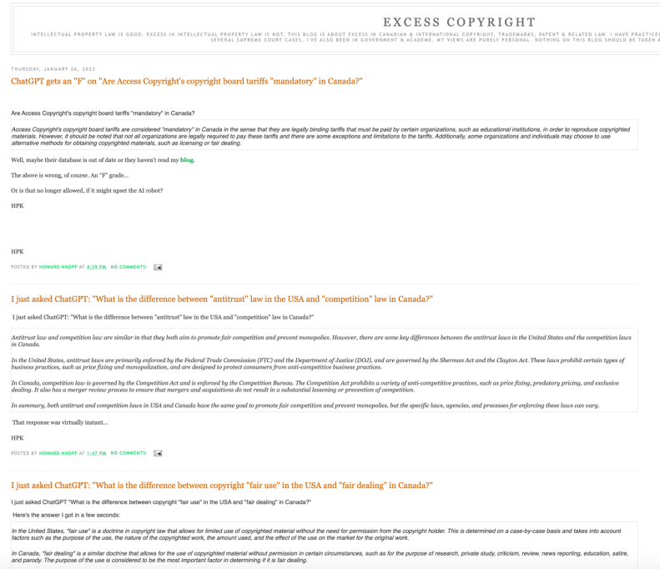

Slide 48
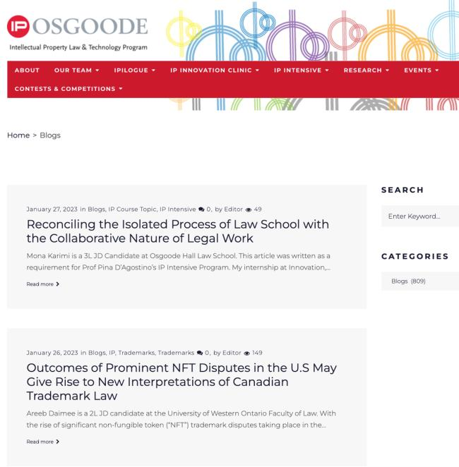

Slide 49
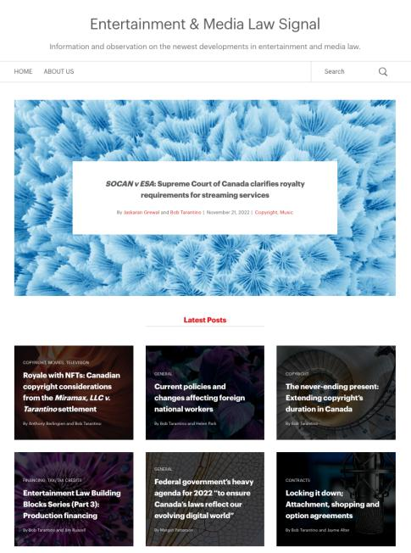

Slide 50
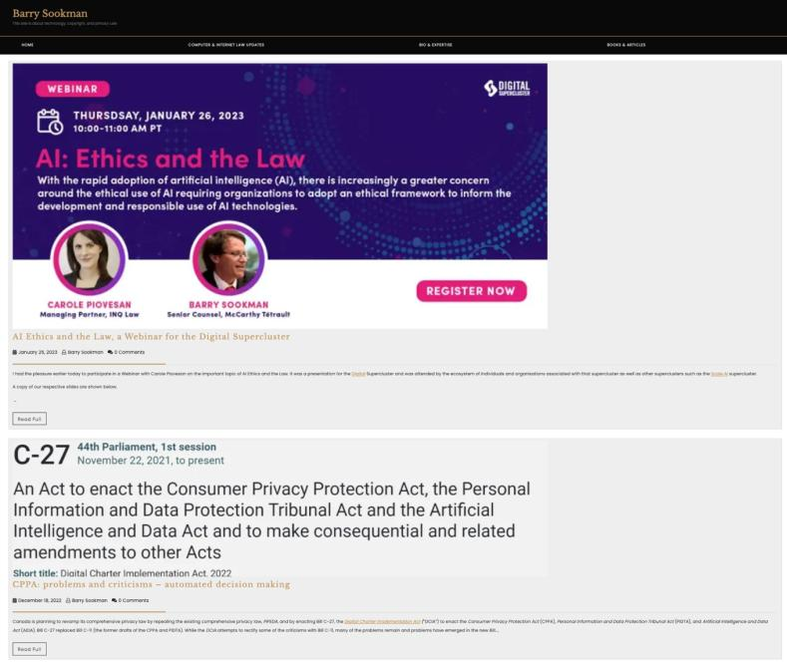

Slide 51
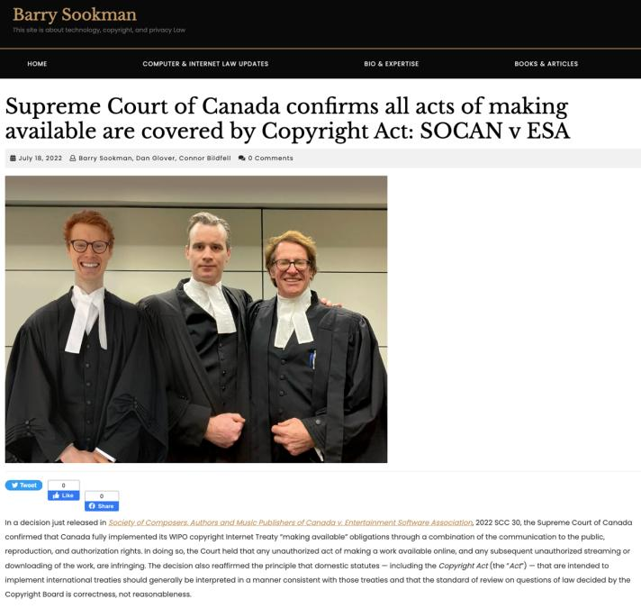

Slide 52


Slide 53
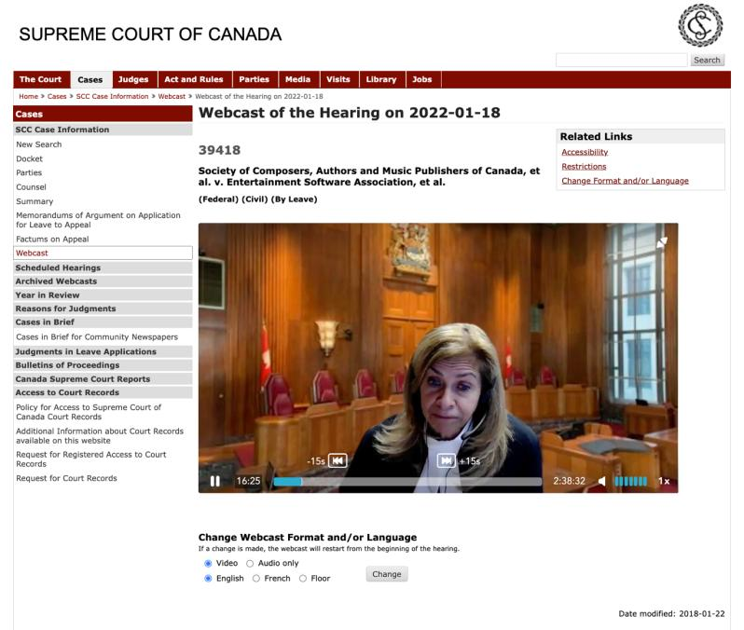

Slide 54
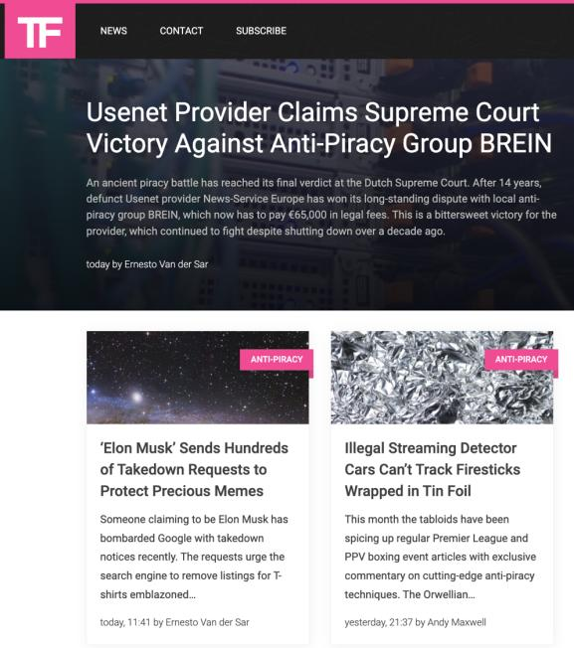

Slide 55
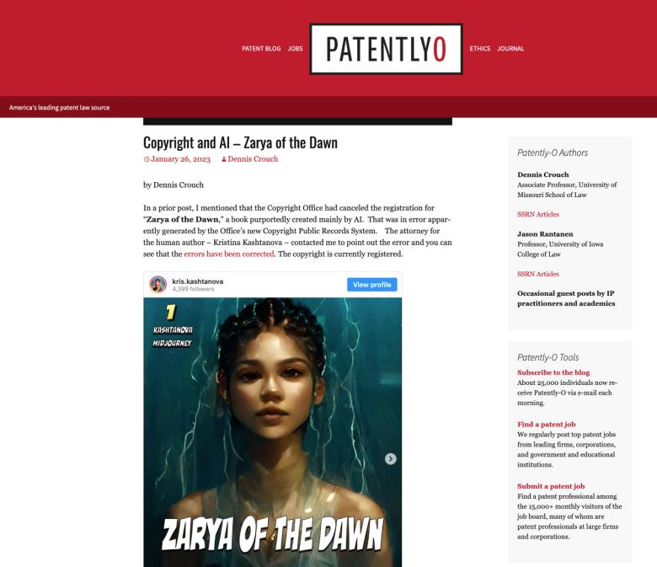

Slide 56
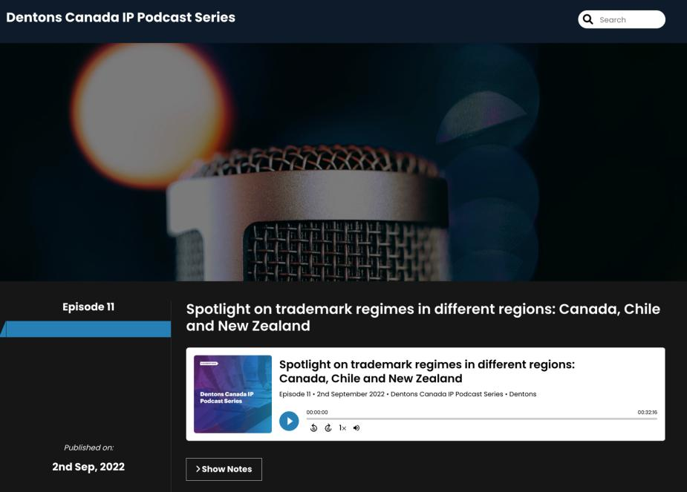

Slide 57

Office “Hours”: Ideally Tuesdays just after class but am flexible…
Email: jon.festinger@ubc.ca; jfestinger@telus.net
Office: 449
Phone:
c. 604-837-6426
(please text if urgent)

Slide 58
QUESTIONS?
THOUGHTS?
DISCUSSION?

Slide 59

Pause

Slide 60
Now
You

Slide 61
Entirely optional but please…
…email me a short bio of yourself referencing:
Anything at all you want to say about yourself
Your academic interests
What you might like to get out of this course (I.E., interest in a type of patent, or a copyright issue etc.)
Favorite Intellectual Property (ies) - current or all-time

Slide 62

Last Week’s
Unanswered
Question

Slide 63


Slide 64
QUESTIONS?
THOUGHTS?
DISCUSSION?

Slide 65
Pause

Slide 66

Where we have been…

Slide 67
Intellectual Property Law is about:
What kinds of creations of the mind can one have rights in?
Who can have those rights?
What kinds of rights are there; and how are those rights enforced?

Slide 68
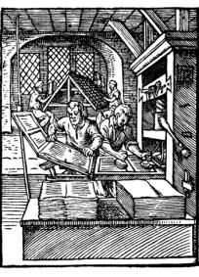
“Copyright Law”

Slide 69
Outline
1) Overview of copyright:
  A. Definition of copyright
  B. Purpose of copyright
  C. Origins of copyright
  D. Which level of government has legislative authority over copyright?

Slide 70
2) What is copyrightable?
  Subsistence of copyright in works
    Registration as a requirement for copyright protection?
    Fixation
    Originality
    Are facts and ideas protected?

Slide 71
  3) What does it mean to say that something is literary, artistic, dramatic, or musical?
  What should qualify as copyrightable “works”?

Slide 72
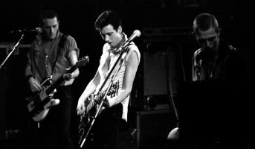
Overview of copyright
Definition of copyright:
  Set of exclusive rights in works of expression; performers’ performances; sound recordings; and communication signals.
The Clash, Chateau Neuf, Oslo, Norway
21 May 1980 Helge Øverås

Slide 73
Overview of copyright
Justifications
Economic incentive for creation (then why does copyright continue after death)?
Societal “progress in the arts & sciences”
Natural rights to one’s own labour & personality (→ personality = privacy or IP)
Reinforces free expression?

Slide 74
Purpose of copyright in Canada?
Théberge:
  “[12] Generally speaking, Canadian copyright law has traditionally been more concerned with economic than moral rights.… The economic rights are based on a conception of artistic and literary works essentially as articles of commerce.” (Binnie J.)
But Cinar Corp. v. Robinson?
  [114] … the infringement of copyright in this case interfered with Robinson’s personal rights to inviolability and to dignity, recognized by ss. 1 and 4 of the [Quebec] Charter. (McLachlin CJ)

Slide 75
Overview of copyright
Purpose of copyright as articulated by the SCC
  Former approach: “author-centric”
  Shift in Théberge
    “balance between promoting the public interest in the encouragement and dissemination of works of the arts and intellect and obtaining a just reward for the creator“ (para. 30)
  Refined in Cinar Corporation v. Robinson, 2013 SCC 73
    Copyright Act “seeks to ensure that an author will reap the benefits of his efforts, in order to incentivize the creation of new works” (para. 23)

Slide 76
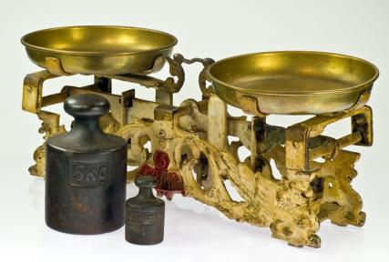
Théberge promotes “balance” between the public interest in connecting & just reward for the author

Slide 77
Overview of copyright
Legislative authority over copyright in Canada
  Federal Government (s. 91(23) Constitution Act, 1867)
  First Copyright Act (1921, Came Into Force 1924) largely a copy of the UK Copyright Act of 1911
  Modernization of Canadian copyright law: a work constantly in progress
  Bill C-11: Copyright Modernization Act (CIF 2012)
  Relatively recent copyright extension for sound recordings

Slide 78
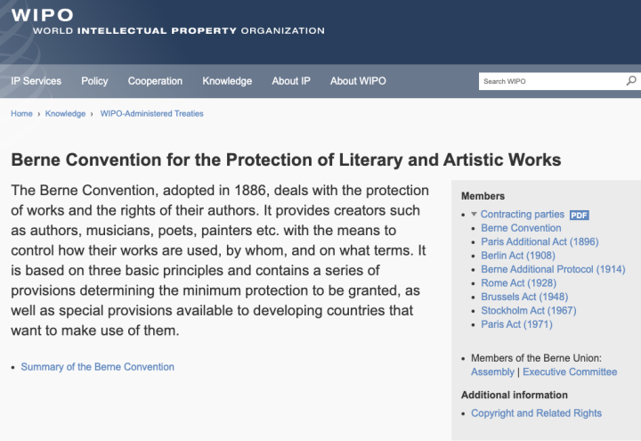
Role of International Treaties:

Slide 79
What is copyrightable?
Subsistence of copyright
5. (1) Subject to this Act, copyright shall subsist in Canada, for the term hereinafter mentioned, in every original literary, dramatic, musical and artistic work if any one of the following conditions is met:
  (a) in the case of any work, whether published or unpublished, including a cinematographic work, the author was, at the date of the making of the work, a citizen or subject of, or a person ordinarily resident in, a treaty country;

Slide 80
What is copyrightable
Fixation
A requirement for the subsistence of copyright imposed by judicial interpretation
  “The work, to be capable of copyright protection, must be fixed in a tangible form” (Canadian Admiral Corp. v. Rediffusion Inc., [1954] Ex. CR 382, 20 CPR 75
Is the fixation requirement beneficial?
Does add some certainty + more works in public domain

Slide 81
Result of Fixation Requirement
Improvisational, performance art, kinetic pieces, open world massively multiplayer video game scenarios, are more at risk of not having copyright protection. See for example Komesaroff v. Mickle, [1988] R.P.C. 204 at 210 (Vict. S.C.), refusing protection to a moving sand sculpture.
Content in RAM computer memory?
Indigenous oral story-telling

Slide 82
What is copyrightable (Fixation)
Gould Estate et al v. Stoddart Publishing Co. Ltd et al (1996)
  Can copyright subsist in spoken words?
    Not necessarily – not every utterance made by individuals is a “valuable property right”
  A person’s oral statements are not literary creations and do not attract copyright protection

Slide 83
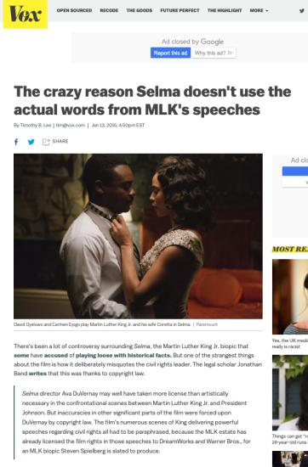
???????????????????????????

Slide 84
But…
Cinar Corporation v. Robinson, [2013] 3 S.C.R. 1168
[27] A substantial part of a work is not limited to the words on the page
or the brushstrokes on the canvas. The Act protects authors against both literal and
non-literal copying, so long as the copied material forms a substantial part of the
infringed work. As the House of Lords put it,
the “part” which is regarded as substantial can be a feature or combination of
features of the work, abstracted from it rather than forming a discrete part. . . .
[T]he original elements in the plot of a play or novel may be a substantial part, so
that copyright may be infringed by a work which does not reproduce a single
sentence of the original.
(Designers Guild Ltd. v. Russell Williams (Textiles) Ltd., [2001] 1 All E.R. 700, at p. 706, per
Lord Hoffmann; see also Nichols v. Universal Pictures Corporation, 45 F.2d 119 (2d Cir. 1930),
per Learned Hand J.)

Slide 85

Now, to our regularly
scheduled programming…

Slide 86
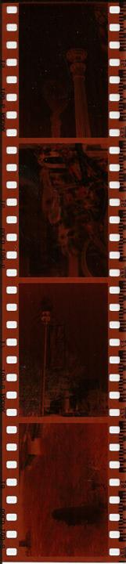
Continuing
Fixation

Slide 87
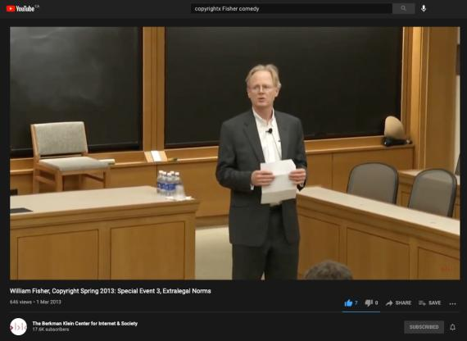
Comedy & Copyright
https://youtu.be/8U7bUo1vChs
Entirely optional

Slide 88
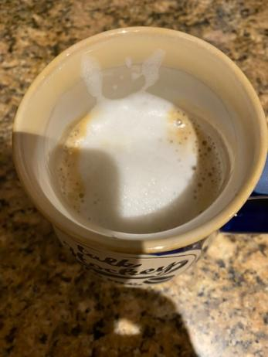
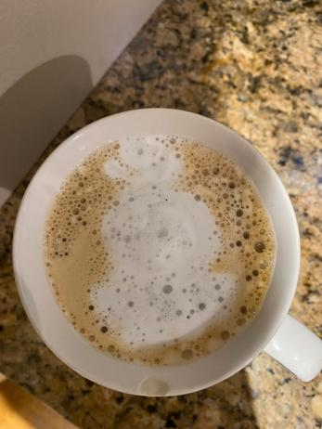
Latté Art?
“St. Catherine’s Street after a snowfall”
“Snowman”

Slide 89
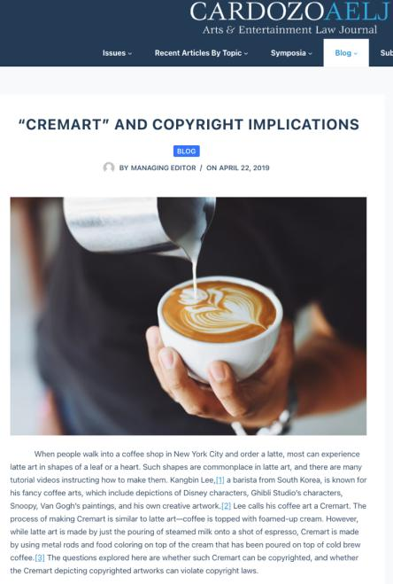

Slide 90
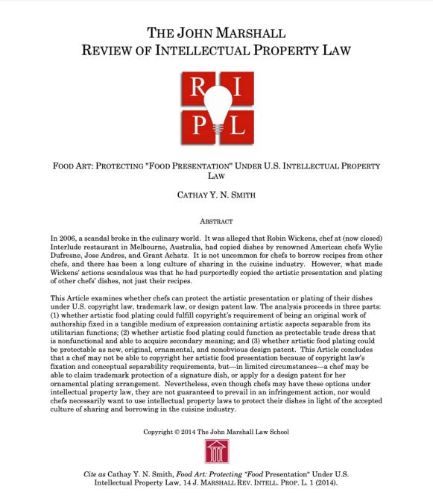

Slide 91
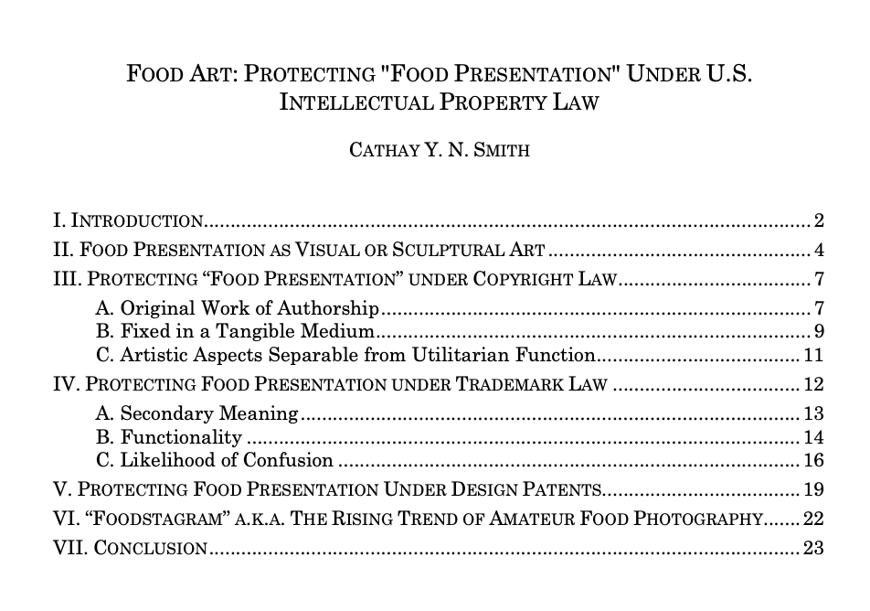

Slide 92
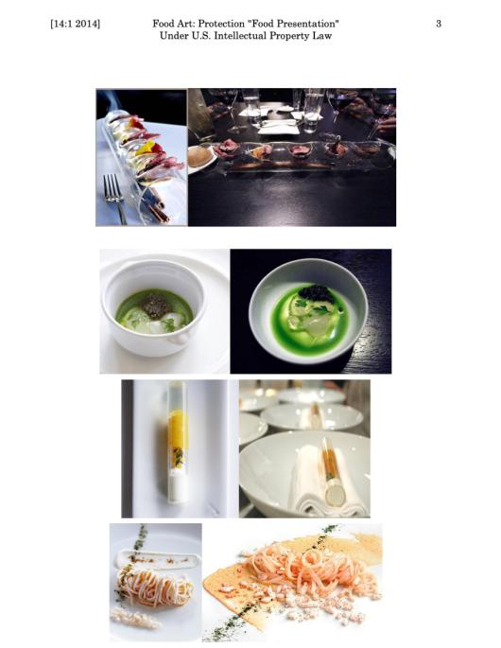

Slide 93
QUESTIONS?
THOUGHTS?
DISCUSSION?

Slide 94
Pause

Slide 95
What is copyrightable: Originality
5. (1) Subject to this Act, copyright shall subsist in Canada, for the term hereinafter mentioned, in every original literary, dramatic, musical and artistic work if…

Slide 96
What is copyrightable
Originality
  If copyright subsists “in every original… work”…
  How should originality be defined?

Slide 97
What is copyrightable
Originality in Canada
Pre-2004
  “Sweat of the brow”:
    Work receives copyright protection if it originates from an author and is more than a mere copy.
  “Creativity”
    A work must be the product of creativity in order to be original

Slide 98
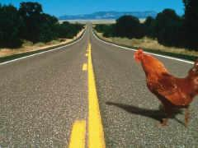
SCC takes the “middle way”

Slide 99
What is copyrightable
Originality
CCH Canadian Ltd. v. Law Society of Upper Canada, 2004 SCC 13
  For a work to be original, you need an exercise of skill and judgment that is more than a purely mechanical exercise
  Skill = use of one’s knowledge, developed aptitude or practiced ability in producing the work
  Judgment = use of one’s capacity for discernment or ability to form an opinion or evaluation by comparing different possible options in producing the work

Slide 100
McLachlin C.J.
[16] ”I conclude that the correct position falls between these extremes. For a work to be “original” within the meaning of the Copyright Act , it must be more than a mere copy of another work. At the same time, it need not be creative, in the sense of being novel or unique. What is required to attract copyright protection in the expression of an idea is an exercise of skill and judgment. By skill, I mean the use of one’s knowledge, developed aptitude or practised ability in producing the work. By judgment, I mean the use of one’s capacity for discernment or ability to form an opinion or evaluation by comparing different possible options in producing the work. This exercise of skill and judgment will necessarily involve intellectual effort. The exercise of skill and judgment required to produce the work must not be so trivial that it could be characterized as a purely mechanical exercise. For example, any skill and judgment that might be involved in simply changing the font of a work to produce “another” work would be too trivial to merit copyright protection as an “original” work.”

Slide 101
What is copyrightable
Originality
  McLachlin CJ arrived at her conclusion after considering:
    Plain meaning of original
    History of copyright
    Recent jurisprudence
    Purpose of the Copyright Act
    Workable, yet fair standard

Slide 102
Meaning that…
Headnotes, case summaries, topical indexes & compilations of reported judicial decisions originating from their authors and are not simply copies. There is more than trivial skill & judgment in their creation (as every law student knows)
However, reported judicial decisions, by themselves, are not original works in which the publishers could claim copyright, even where typos and minor errors are fixed.

Slide 103
What is copyrightable
What about A.I. mediated creativity ?

Slide 104
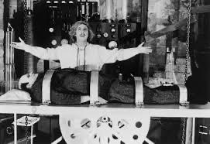
Must copyright be human?

Slide 105
Can an A.I. pass the “McLachlin Test”?
Can an A.I. exercise “skill and judgment”?
Perhaps yes, if test is “ability to form an evaluation by comparing different possible options”…
But does this skill and judgment “necessarily involve intellectual effort”?
And more weirdly is what an A.I. does “so trivial that it could be characterized as a purely mechanical exercise”?

Slide 106
Pause

Slide 107
Facts & Ideas are not copyrightable
IDEA/EPRESSION
DICHOTOMY

Slide 108
What is copyrightable
Facts and ideas
  Not entitled to copyright protection
  Kenrick & Co. v. Lawrence & Co. (1890)
    How is idea separated from expression in this decision?

Slide 109
What is copyrightable
Plaintiff printers drew a representation of hand holding a pencil completing a cross in a box as a method to instruct voters who couldn’t read on how to exercise their democratic franchise.
Plaintiffs duly registered their drawing under the copyright laws of the time.
Defendants created a similar but not identical drawing for the same purpose and were sued by the plaintiffs for infringement.
The plaintiffs action failed.

Slide 110
“It seems to me, therefore, that although every drawing of whatever kind may be entitled to registration, the degree and kind of protection given must vary greatly with the character of the drawing, and that with such a drawing as we are dealing with the copyright must be confined to that which is special to the individual drawing over and above the idea...there are scarcely more ways that one of drawing a pencil or the hand that holds it. If the particular arrangement of square, cross, hand, or pencil be relied upon it is nothing more than a claim of copyright for the subject, which in my opinion cannot possibly be supported.”

Slide 111
IDEA/EPRESSION
DICHOTOMY
Donoghue v. Allied Newspapers Limited (1938) Ch 106
Copyright owner is…"the person who has clothed the idea in form, whether by means of a picture, a play or a book"

Slide 112
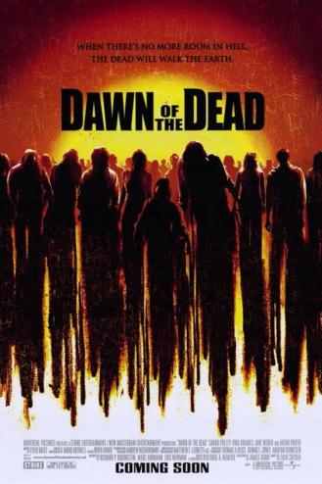
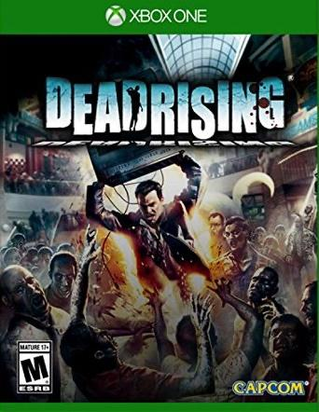
Footnote: Scenes a faire doctrine
- Zombie Horror Genre is = to an “Idea”

Slide 113
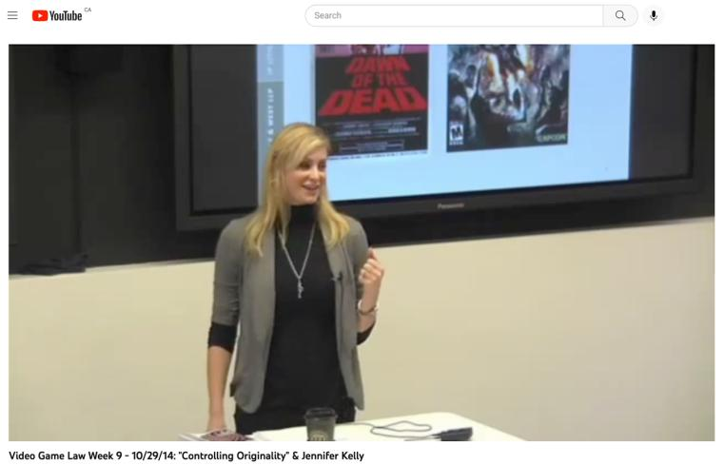
Jennifer Kelly, Capcom’s lawyer, talking about the case…
(@ 1:19:52)
https://youtu.be/I8IsvfLRaEc

Slide 114
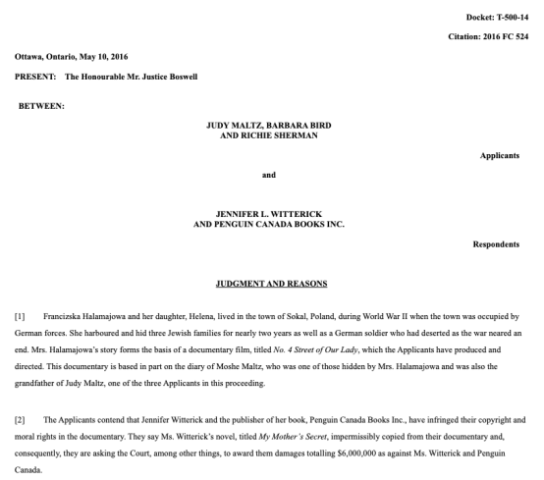
Footnote: No Copyright in Facts

Slide 115


Slide 116
“[47] Although the Documentary and the Book each recount some of the same facts of Francizska Halamajowa’s story, there is no substantial taking or use by the Respondents of anything owned by the Applicants because the use of common historical facts is not copyright infringement. The Respondents have not appropriated or taken a substantial portion of the Documentary’s originality. It is difficult to identify a single element taken that is not either something generic or merely a fact.”

Slide 117

Not facts per se – but adjacent…

Slide 118


Slide 119


Slide 120


Slide 121


Slide 122


Slide 123
QUESTIONS?
THOUGHTS?
DISCUSSION?

Slide 124
Pause

Slide 125

Continuing…
“What is
Copyrightable?”

Slide 126
What is copyrightable: Artistic Works
5. (1) Subject to this Act, copyright shall subsist in Canada, for the term hereinafter mentioned, in every original literary, dramatic, musical and artistic work if…

Slide 127
S. 2 Definitions
literary work includes tables, computer programs, and compilations of literary works; (oeuvre littéraire)
dramatic work includes
(a) any piece for recitation, choreographic work or mime, the scenic arrangement or acting form of which is fixed in writing or otherwise,
(b) any cinematographic work, and
(c) any compilation of dramatic works; (oeuvre dramatique)
musical work means any work of music or musical composition, with or without words, and includes any compilation thereof; (oeuvre musicale)
artistic work includes paintings, drawings, maps, charts, plans, photographs, engravings, sculptures, works of artistic craftsmanship, architectural works, and compilations of artistic works; (oeuvre artistique)

Slide 128

What is copyrightable
How might “literary work” be
defined?

Slide 129
What is copyrightable
  University of London Press, Ltd. v. University Tutorial
  Press, Ltd. [1916] 2 Ch. 601
  Literary merit and quality are not factors
  when assessing if something is a literary work

Slide 130



Slide 131
Peterson J. “Assuming that they are ``literary work'’, the question then is whether they are original…Copyright Acts are not concerned with the originality of ideas, but with the expression of thought, and, in the case of ``literary work'’, with the expression of thought in print or writing…In the present case it was not suggested that any of the papers were copied… If an author, for purposes of copyright, must not draw on the stock of knowledge which is common to himself and others who are students of the same branch of learning, only those historians who discovered fresh historical facts could acquire copyright for their works…The objections with which I have dealt do not appear to me to have any substance, and, after all, there remains the rough practical test that what is worth copying is prima facie worth protecting. In my judgment, then, the papers set by Professor Lodge and Mr. Jackson are "original literary work" and proper subject for copyright under the Act of 1911.”

Slide 132

What is copyrightable
  Exxon Corp v. Exxon Insurance Consultants International Ltd., [1981] 3 All E.R. 241 (Ch.D)
  Plaintiff, Exxon Corp, had claimed the copyright of the word and went on to file an injunction to stop the defendant company from using the word 'Exxon'
  Some expression is not eligible for copyright protection because it is too minimal to satisfy the requirements of an “original literary work” under s. 2.
What about Twitter messages?

Slide 133

BREAKOUT
Issue: The “creativity standard” in copyright.

Slide 134
Atari v. Oman - 1989/1992 USCA DC Cir.
“BREAKOUT's audiovisual display features a wall formed by red, amber, green, and blue layers of rectangles representing bricks. A player maneuvers a control knob that causes a rectangular-shaped representation of a paddle to hit a square-shaped representation of a ball against the brick wall. When the ball hits a brick, that brick disappears from its row, the player scores points, and a brick on a higher row becomes exposed. A "breakout" occurs when the ball penetrates through all rows of bricks and moves into the space between the wall and the top of the screen; the ball then ricochets in a zig-zag pattern off the sides of the screen and the top layer of the wall, removing bricks upon contact and adding more points to the player's score. Various tones sound as the ball touches different objects or places on the screen. The size of the paddle diminishes and the motion of the ball accelerates as the game is played.”
District court judge asked counsel for the Register, "If Picasso had painted a round object on a canvas, would you say because it depicts a familiar subject--namely, something that's round--it can't be copyrighted?”
Atari Games Corp. v. Oman, 979 F. 2d 242 - 1992 - ‎Court of Appeals, Dist. of Columbia Circuit
Atari Games Corp. v. Oman, 888 F. 2d 878 - 1989 - ‎Court of Appeals, Dist. of Columbia Circuit
Atari Games Corp. v. Oman, 693 F. Supp. 1204 - 1988 - ‎Dist. Court, Dist. of Columbia

Slide 135
Pause

Slide 136


Copyrightable?

Slide 137

What is copyrightable
Francis Day and Hunter v. 20th Century Fox Corp, Ltd.
[1939] UKPC 68, [1940] AC 112, [1939] 4 DLR 353
(Privy Council on appeal from Ontario C.A.)
  Generally, there is no separate
  copyright in the title of a work

Slide 138


Slide 139


Slide 140


Slide 141


Slide 142


Slide 143


Slide 144
Exception
Francis Day and Hunter v. 20th Century Fox Corp, Ltd.
  NOTE: definition of a “work” in the Copyright Act - includes “the title thereof when such title is original and distinctive”

Slide 145

Note also Trademark alternative

Slide 146
Pause

Slide 147
What is copyrightable: Dramatic Work
5. (1) Subject to this Act, copyright shall subsist in Canada, for the term hereinafter mentioned, in every original literary, dramatic, musical and artistic work if…

Slide 148
What is copyrightable
Dramatic work
  Must have a story, a thread of consecutively based events either narrated or presented by dialogue or action or both (Hutton v. CBC (1989))
  Or (based on s. 2):
    Choreography, mime and recitation piece with scenic arrangement or acting form fixed in writing or otherwise
    Cinematographic work
    Compilation of dramatic works

Slide 149
1994
Copyright Act was amended to provide:
  "dramatic work" includes
    (a) any piece for recitation, choreographic work or mime, the scenic arrangement or acting form of which is fixed in writing or otherwise,
    (b) any cinematographic work, and
    (c) any compilation of dramatic works;
[Cinematographic work – defined as “includ[ing] any work expressed by any process analogous to cinematography (motion-picture photography – tv, video, film, etc.), whether or not accompanied by a soundtrack” ]
[Choreographic work –defined as “includ[ing] any work of choreography, whether or not it has any story line;]

Slide 150

What is copyrightable
FWS Joint Sports Claimants v. Canada 1991 FCA (CB)
No copyright in a sporting event per se though television production of a sporting event is copyrightable
Unpredictable and incompatible with the notion of a choreographic piece of art?

Slide 151

What is copyrightable
National Basketball Association v. Motorola, Inc., 105 F 3d. 841 (2nd Cir. 1997)
  You cannot have copyright in specific athletic feats
  Not in scores either

Slide 152

Found no Copyright in…

Slide 153
WINTER, Circuit Judge: “What "authorship" there is in a sports event, moreover, must be open to copying by competitors if fans are to be attracted. If the inventor of the T-formation in football had been able to copyright it, the sport might have come to an end instead of prospering. Even where athletic preparation most resembles authorship--figure skating, gymnastics, and, some would uncharitably say, professional wrestling--a performer who conceives and executes a particularly graceful and difficult--or, in the case of wrestling, seemingly painful--acrobatic feat cannot copyright it without impairing the underlying competition in the future. A claim of being the only athlete to perform a feat doesn't mean much if no one else is allowed to try.”

Slide 154

Dance & choreography is very challenging area in practical terms

Slide 155


Slide 156


Slide 157


Slide 158


Slide 159


Slide 160

Related?…

Slide 161

Ballet Notation

Slide 162
What is copyrightable
Artistic works
  How should artistic be defined?
  Should artistic merit, the artist’s intention to create “art”, and the aesthetic value of the work be relevant to whether something meets the classification of artistic works?

Slide 163
What is copyrightable
Artistic works
  “artistic work” defined in s. 2 as including:
    paintings, drawings, maps, charts, plans, photographs, engravings, sculptures, works of artistic craftsmanship, architectural works, and compilations of artistic works.

Slide 164

What is copyrightable
Medium is the message,
not aesthetic value?

Slide 165

The Dream, Pablo Picasso, 1932

Slide 166
What is copyrightable
Artistic works
DRG Inc. v. Datfile Ltd. [1988] 2 F.C. 243
  Two series of colour coded labels were registered under the Copyright Act. It was unsuccessfully argued that the registrations were not properly the subject of copyright.
  Court found that an artistic work is a work that finds expression in a visual medium.
  Artistic merit, artist’s intention to create “art” and the actual aesthetic value of the work are not pertinent to the question of whether a work meets the classification of “artistic work”

Slide 167
Reed J.: [15] “Even if works of craftsmanship and architecture must be measured against some test of “artistic”-ness (as set out in the Hensher, Merlet or Hay cases) I do not accept that the category of artistic works in general must meet such a test. I do not accept that the word “artistic” in reference to “artistic works” is being used in the same sense as the word “artistic” in reference to “works of artistic craftsmanship”, that is, if in the latter case “artistic”-ness requires a determination along the lines of that attempted in Hensher, Merlet or Hay. In my view the phrase “artistic work” is used merely as a generic description of the type of works which follow. It is used as a general description of works which find expression in a visual medium as opposed to works of literary, musical or dramatic expression.”

Slide 168
What is copyrightable
Are raw and processed seismic data original artistic and literary works?
  See Geophysical Service Incorporated v. Encana Corporation, 2016 ABQB 230
    Eidsvik J. stated that “the raw seismic field data and written reports are a literary work or a compilation of a literary work” (para. 75) and that “the seismic sections…fit within the definition of an artistic work” (para 76).

Slide 169
Copyrighting Data?
Geophysical Service Incorporated v. Encana Corporation, 2016 ABQB 230
It appears from the case that is not the raw data that is copyrightable as those would simply be facts, but how the data is presented.
  “[76] I find the seismic sections, i.e. the squiggly or zebra lines, fit within the definition of an artistic work, similar to a map, plan or chart, or a compilation of an artistic work, since the product is the result of selection or arrangement of the data, or sound recordings, from the geology of the subsurface.”
Do you agree? Alta. C.A. confirmed & SCC denied leave.

Slide 170
Query?
How can we distinguish the GSI v Encana Corp case with the Kenrick & Co. v Lawrence & Co. case? Since both cases had limited ways to
present something.

Slide 171
Copyrighting Data?
Geophysical Service Incorporated v. Encana Corporation, 2016 ABQB 230
It appears from the case that is not the raw data that is copyrightable as those would simply be facts, but how the data is presented. Issue is whether data not copyrightable as fact.
Kenrick v Lawrence (1890) L.R. 25, Q.B.D. 99
Election check-mark case about the extent for which copyright protection is given for a work and at which point it crosses the line from "expression", which is protected, to "idea", which is not. Issue is Idea/Expression dichotomy where no copyright in an idea.

Slide 172
What is copyrightable
Musical works
  Any work of music or musical composition,
  with or without words (s. 2 CA)
  Prior to 1993, a musical work had to be
  “printed, reduced to writing or otherwise
  graphically produced or reproduced”
  in order to be protected.

Slide 173


Slide 174

SSRN

Slide 175

What is copyrightable
Is a fireworks display a dramatic work?

Slide 176


Slide 177


Slide 178


Slide 179


Slide 180


Slide 181


Slide 182
What is copyrightable
Is John Cage’s 4’33” a musical work?
  https://youtu.be/JTEFKFiXSx4

Slide 183


Slide 184

Accompanied by loud clapping…

Slide 185


Slide 186


Slide 187

Begging the question…
Is John Cage’s 4’33” a musical work?

Slide 188


Slide 189

Poses

Slide 190


Slide 191


Slide 192


Slide 193


Slide 194


Slide 195


Slide 196


Slide 197


Slide 198


Slide 199


Slide 200


Slide 201


Slide 202


Slide 203


Slide 204

The original article…

Slide 205


Slide 206


Slide 207


Slide 208

Clown Copyright

Slide 209


Slide 210


Slide 211
Finale: What is copyrightable?
Should additional categories of works be added to the Copyright Act? If so, what categories of works would you add, and why?
Should the concept of categories of works be discarded entirely? Why or why not?
Should “intentionality” (that you intend your work to be copyright) be added to the copyright act?

Slide 212
QUESTIONS?
THOUGHTS?
DISCUSSION?

Slide 213
Pause

Slide 214


Slide 215

Introducing
“Rights of Copyright Owners”
What rights should be part of the bundle of rights of copyright owners?

Slide 216

Proper mindset to approach from?

Slide 217
Rights of the copyright owner
Three fundamental rights:
Produce or reproduce
the work (3(1))
Perform the work
(including broadcasting rights) (3(1))
The right to publish (3(1))

Slide 218


Slide 219
Rights of the copyright owner
Produce … any translation (3(1)(a))
Convert dramatic work into non-dramatic work (3(1)(b)
Convert non-dramatic work into dramatic work (3(1)(c))
To make a sound recording, etc. of a literary, etc. work (3(1)(d))
Reproduce, etc. a literary, etc. work as a cinematographic work (3(1)(e))
Communicate a work to the public by telecommunication (3(1)(f))
Present an artistic work at a public exhibition…. (3(1)(g))
Rent out a computer program, etc. (3(1)(h))
Rent out a sound recording of a musical work … (3(1)(i))
Sell or transfer ownership of tangible object … (3(1)(j)
Authorize any of above acts (3(1))

Slide 220
Anything missing?
Anything you would like to get rid of?

Slide 221
QUESTIONS?
THOUGHTS?
DISCUSSION?

Slide 222
Pause

Slide 223
Derivative Rights

Slide 224

15 in One Slicer & Dicer

Slide 225

Can be problematic…

Slide 226


Slide 227


Slide 228
Rights of the copyright owner
For how long should these
rights last?
What should be the term of
copyright?

Slide 229
Options:
1. The Statute of Anne 1710 (UK) gave a limited term of protection to works of 28 years.
2. The Copyright Act 1842 (UK), for which a number of prominent authors lobbied, increased the term of protection to 42 years from publication, or seven years beyond the death of the author, whichever was the longer.
3. Berne Convention – life of the author plus 50 years.
4. USA approach: life of the author plus 70 years.
5. Renewable every 20 years (infinitely).
6. Renewable every 20 years (to a maximum).
7. Perpetual.

Slide 230
Rights of the copyright owner
Term of copyright in Canada (ss. 6-12)
General = Life of the author + 70 years from the end of the calendar year in which the author dies (s. 6)
Joint ownership?
    70 years runs from the end of the calendar
    year in which the last of the authors dies (s. 9)

Slide 231
History:
Canada–United States–Mexico Agreement (CUSMA)
CUSMA came into force July 1, 2020. Under CUSMA, copyright terms have been amended.
Canada had 2.5 years to revise legislation (the Copyright Act) to state the following:
  there is a general term of copyright protection of “life plus 70 years” for written works (increased from the current 50 years), and
  75 years for performances and sound recordings (increased from the current 70 years)
Came into force December 30, 2022

Slide 232
Rights of the copyright owner
Term of copyright in Canada (ss. 6-12)
Anonymous or pseudonymous works
  70 years from end of the year in which the work was published; or 75 years from the end of the year in which it was made (whichever ends earlier) (s. 6.1)
Crown
  70 years from end of the calendar year in which the work is first published (s. 12)

Slide 233
Crown need not keep track of the life spans of its employees in order to determine when copyright in any particular work expires.
Compare this to works created in the course of employment where employer owns copyright, but the term is the life of the author (or longest-living author in cases of multiple authorship) plus 50 years.

Slide 234
Rights of the copyright owner
Who owns the rights? (ss. 13, 14)
s. 13(1): the author is the first owner of copyright
s. 13(3): employment exception
“13(3) Where the author of a work was in the employment of some other person under a contract of service or apprenticeship and the work was made in the course of his employment by that person, the person by whom the author was employed shall, in the absence of any agreement to the contrary, be the first owner of the copyright, but where the work is an article or other contribution to a newspaper, magazine or similar periodical, there shall, in the absence of any agreement to the contrary, be deemed to be reserved to the author a right to restrain the publication of the work, otherwise than as part of a newspaper, magazine or similar periodical”

Slide 235
Rights of the copyright owner
Employee or contractor?
Factors to consider: Who owns the tools; control or direction (relationship of subordination); whether the author assumes all or part of the business risk; degree of integration of the author into the business of the employer (Amusements Wiltron Inc. v. Mainville (1991) RJQ 1930, 40 CPR 3d 521 (Que SC))
Work performed in the course of employment?

Slide 236
Consultant/Independent Contractor
If as an independent contractor you are paid to develop a product, you as independent contractor remain the proprietor of the copyright on that work.
The person paying for the service (client) obtains a license to use the copyrighted work, unless the first copyright owner transfers her rights in writing.

Slide 237
Amusements Wiltron Inc. v. Mainville (1991) RJQ 1930, 40 CPR 3d 521 (Que SC)
Courts apply similar criteria for distinguishing employees from independent contractors in the copyright context as they do for other areas of law (e.g., tax law)
In the copyright context, courts normally consider four factors to determine whether someone is an employee or an independent contractor:
  (1) ownership of the tools,
  (2) control or direction (relationship of subordination),
  (3) whether the author assumes all or part of the business risk (loss of profit), and
  (4) the degree of integration of the author into the business of the employer

Slide 238

Mattel v. MGA (Bratz dolls)

Slide 239
Whether Bratz dolls creator Carter Bryant came up with the idea while he was working for Mattel.
Mattel had claimed that the name and design of Bratz dolls were based on drawings done by Carter Bryant while he was under a contract that entitled the world's biggest toymaker to the copyright in his designs.
(Legal dispute launched in 2006…wrapped up in 2013…Bratz dolls back on shelves in 2015).

Slide 240


Slide 241
QUESTIONS?
THOUGHTS?
DISCUSSION?

Slide 242
Pause

Slide 243
Rights of the copyright owner
Who owns the rights? (ss. 13, 14)
ss. 13(4): assignments; licenses
Assignment…parties can assign all or part of
the rights in a work; can licence uses of the
work; can do so either for the whole term of
the copyright, or for a shorter period.

Slide 244
Rights of the copyright owner
Who owns the rights? (ss. 13, 14)
ss. 13(4), 13(7): assignments, exclusive licences need to be in writing; non-exclusive licences don’t need to be in writing (Robertson v. Thomson)
Benefit of copyright registration: If an assignment or licence not registered, and the assignor or licensor subsequently assigns or licences the copyright interest – for valuable consideration – to a different assignee or licensee who didn’t have ACTUAL NOTICE of the prior assignment – the prior assignment/licence can be declared void (57(3)). So, if you’re an assignee, licensee – it is to your benefit to register the assignment of copyright or the licence granting you an interest (57(1)).

Slide 245
QUESTIONS?
THOUGHTS?
DISCUSSION?

Slide 246
Pause

Slide 247


Slide 248

Coming Soon
“Rights of Non-Copyright Owners: Fair Dealing etc.”

Slide 249


What should non-copyright owners be allowed do with respect to copyrighted works?
Should you have the “right” to engage in a creative way with copyrighted works? What does this mean?

Slide 250
SEE YOU NEXT WEEK!

Slide 251

Always include a cat picture

Slide 252
In learning you will teach
And in teaching you will learn
Phil Collins' Son of Man (1999)

