Slide 1

What is Copyrightable?
Talk 2
LAW 422 002
Intellectual Property Law
Allard School of Law, UBC
Spring, 2024
Jon Festinger K.C.
Adjunct Professor, UBC Allard
Of Counsel, Chandler Fogden Lyman
https://iplaw.allard.ubc.ca/

Slide 2
Logistics

Slide 3
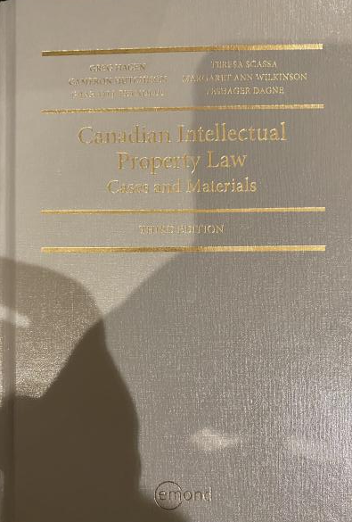
Text: Let me know if any issues @ Bookstore

Slide 4
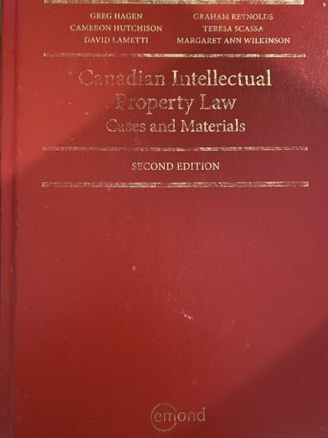
Former Text

Slide 5
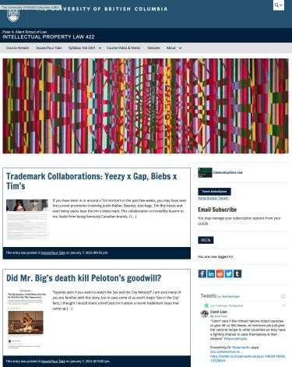
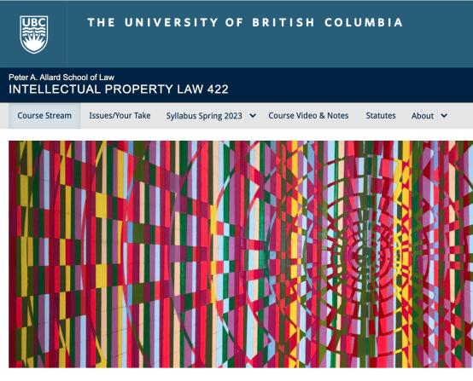
Course Website
https://iplaw.allard.ubc.ca/

Slide 6
PLEASE
SIGN UP

Slide 7
For full privileges on the website
1. Please create an account at http://cms.ubc.ca/ using your CWL.
2. Once you create an account and sign in at http://cms.ubc.ca/ you can click your name in the top right. Halfway down the following page will be your WordPress email address.
3. Send me your WordPress email address at jon.festinger@ubc.ca or at jon_festinger@thecdm.ca
4. Then, I will invite you to participate with authoring privileges via your WordPress email address.

Slide 8
Why post?
Engaging and engaging others is the key.
Because you don’t love speaking up in class.
Because you just saw or realized something, and you’ll never remember it unless you post it now.

Slide 9
Tips:
Don’t feel your posts have to be perfect. Engaging and engaging others is the key.

Slide 10
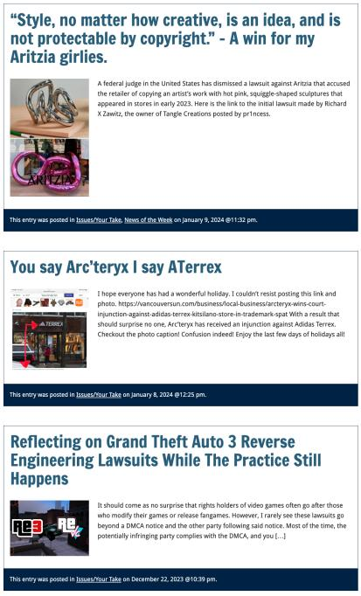

Slide 11

Anything & everything can be done via email if you prefer

Slide 12
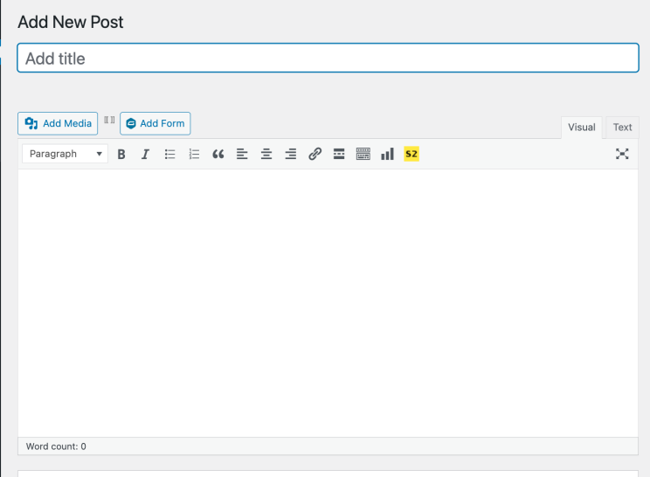

Adding Images

Slide 13



Slide 14
Adding Links

Slide 15
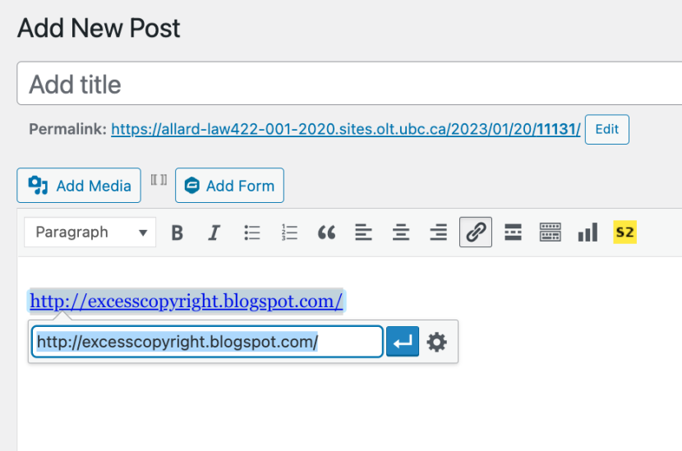


Slide 16


Adding a “Featured Image”

Slide 17


Slide 18
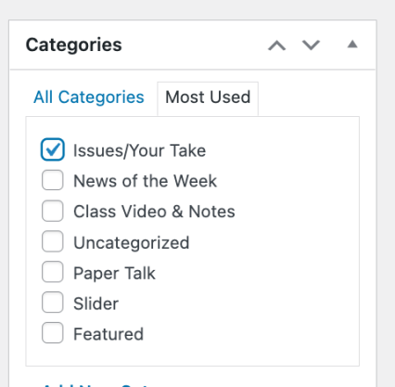

Setting Categories

Slide 19
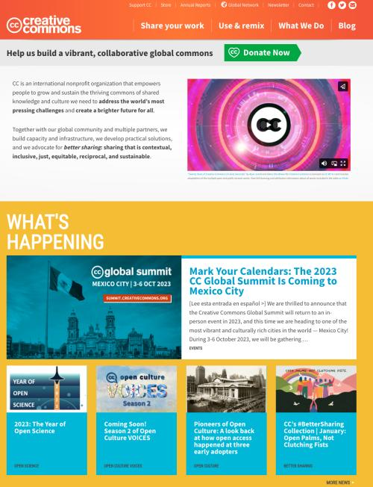

Slide 20
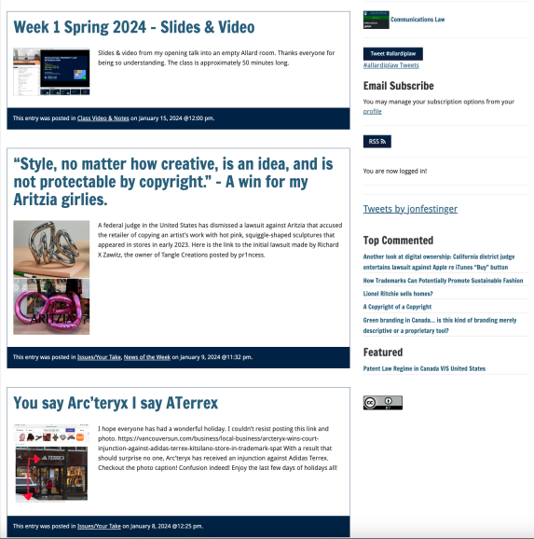
Creative Commons License

Slide 21
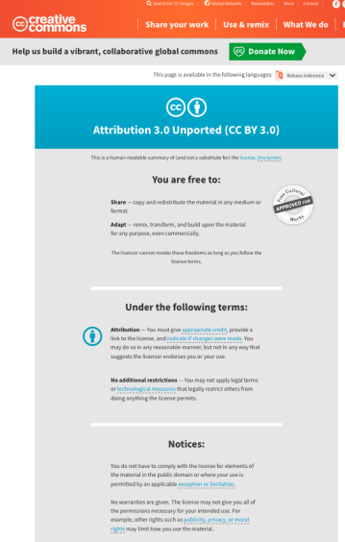
What I thought I would see…

Slide 22
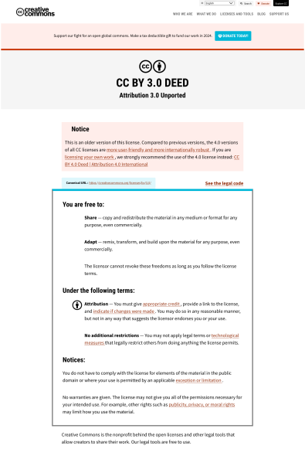
What I did see…

Slide 23
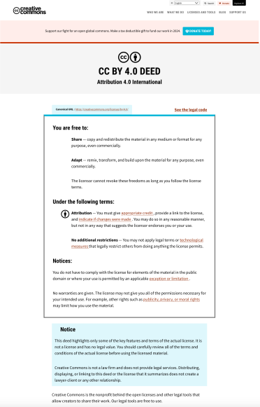
What CTLT will do…

Slide 24
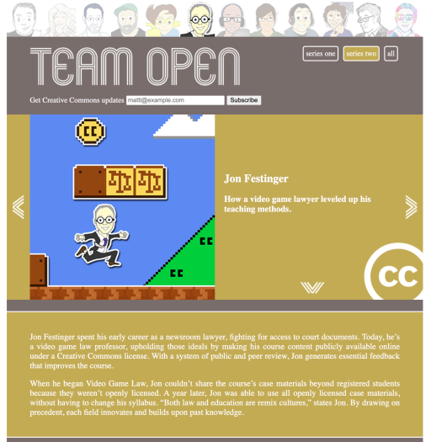

While I’m at it...A Mystery

Slide 25
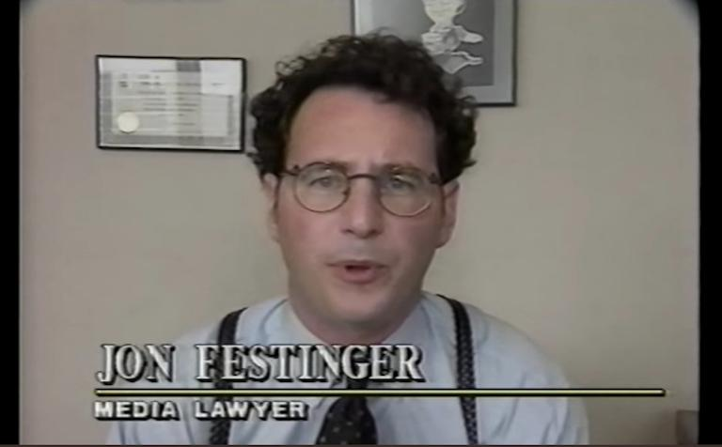


Slide 26
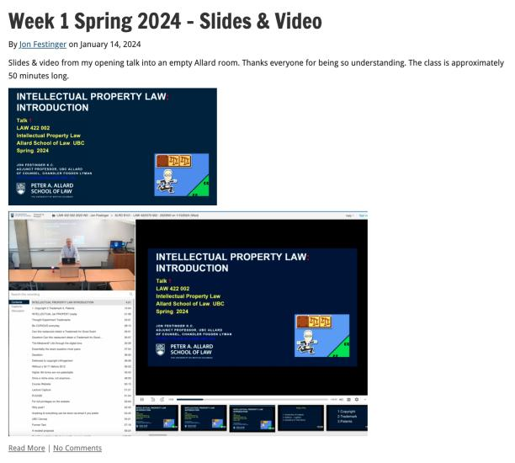
Lecture Capture

Slide 27
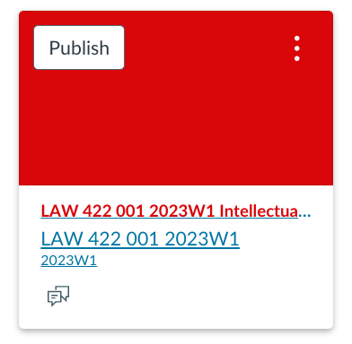
UBC Canvas?

Slide 28
Syllabus

Slide 29
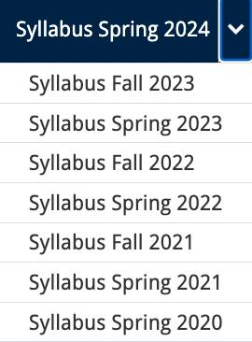




Slide 30
Features of this Course
70% Exam not 100%
IP Law “In Context”
Website

Slide 31
Let’s talk about…
The 30%

Slide 32
A modest proposal…
Approximately 1000 words (or equivalent) per person
written, video, podcast, in-class presentation (?), interpretive dance
Website or not
Groups or individually
LLM Students – one extra post

Slide 33
Past Presentations: Most are on the course website…

Slide 34
News of
the Week

Slide 35
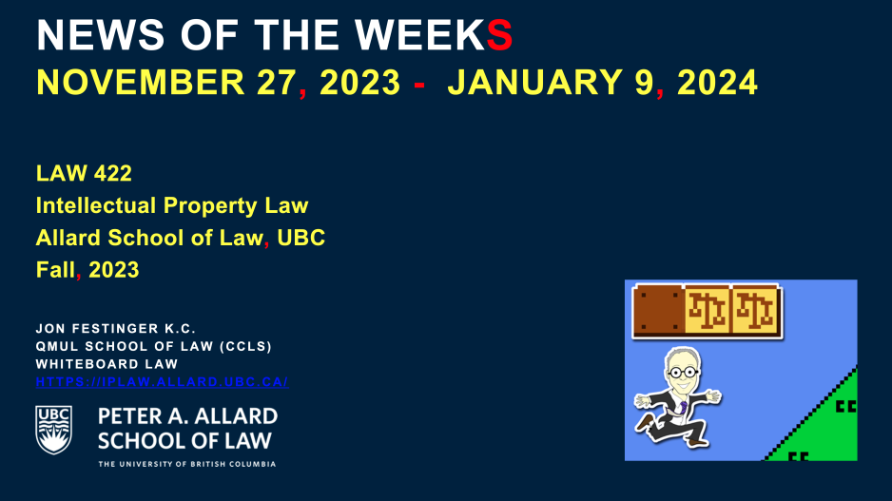
Coming This Week…

Slide 36
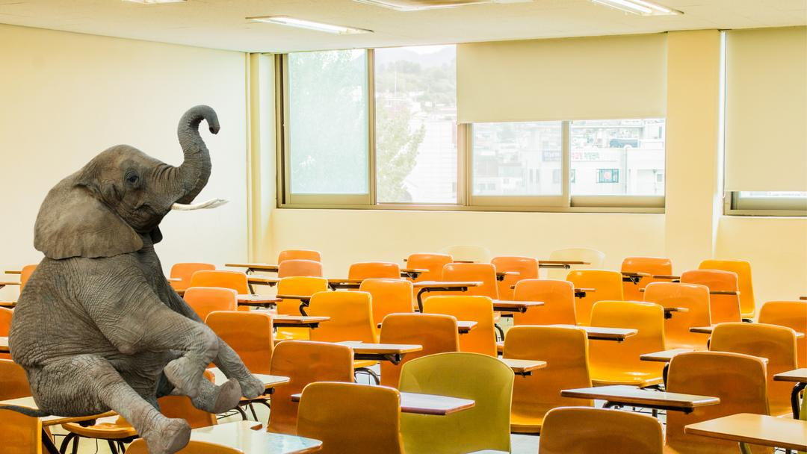

Slide 37
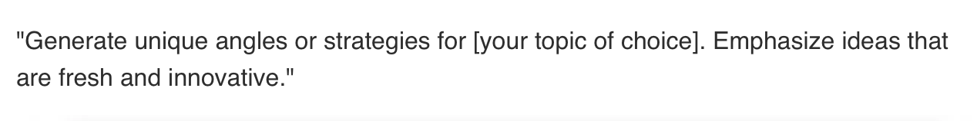
Generative A.I.
Policy?

Slide 38
Generative A.I. Policy
1. It is source material, therefore
must be cited
2. You are responsible for the quality
of your source material, so check…
If it is wrong, you are wrong
If it plagiarized, you’ve plagiarized

Slide 39


Slide 40
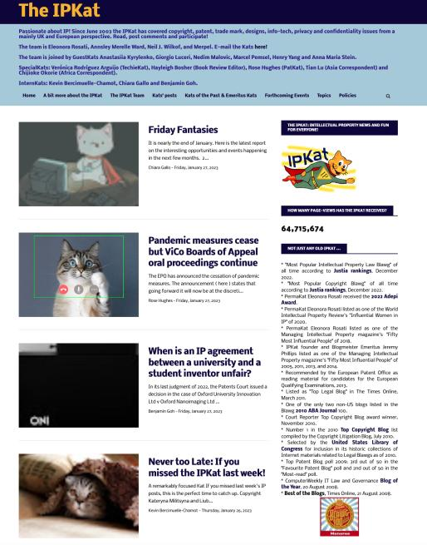

Slide 41
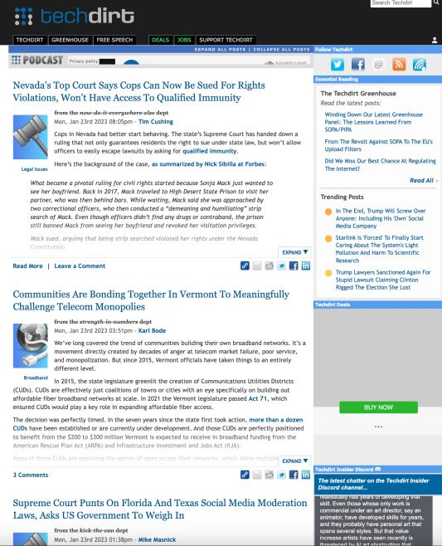

Slide 42
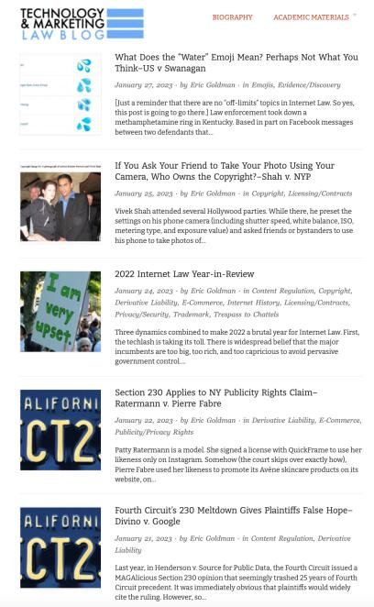

Slide 43
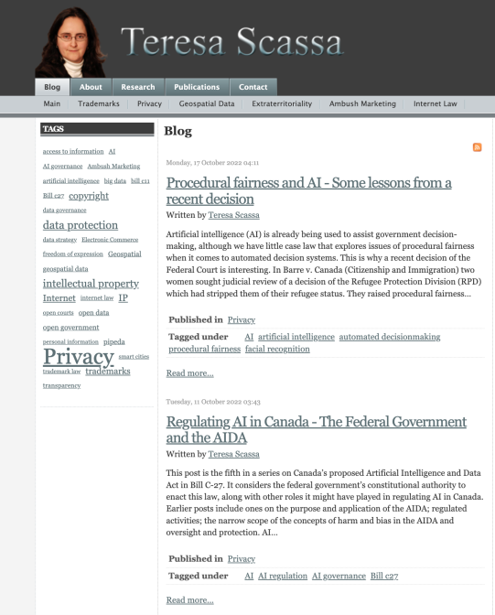

Slide 44
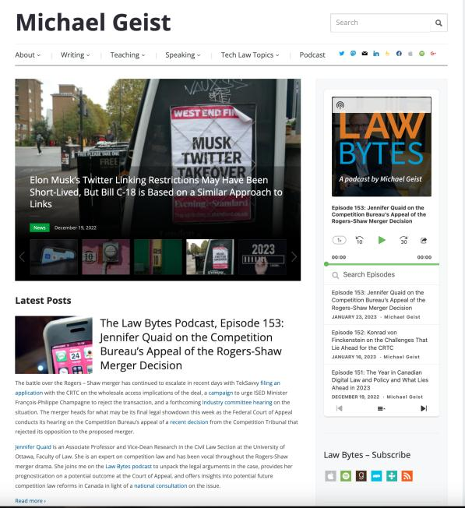

Slide 45
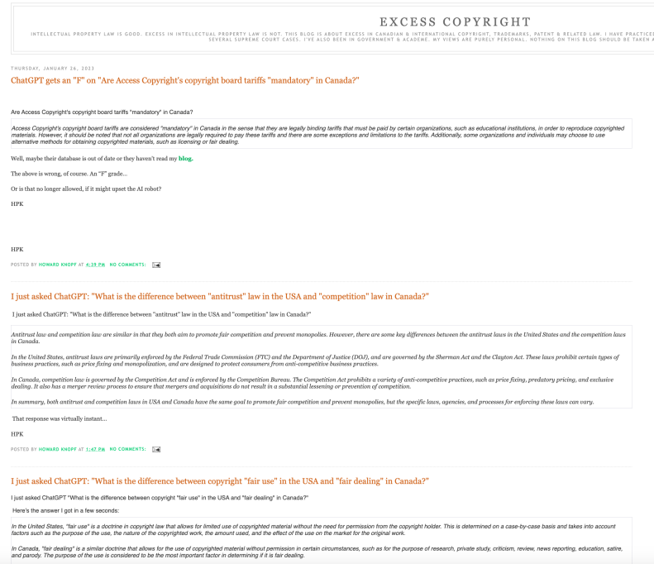

Slide 46
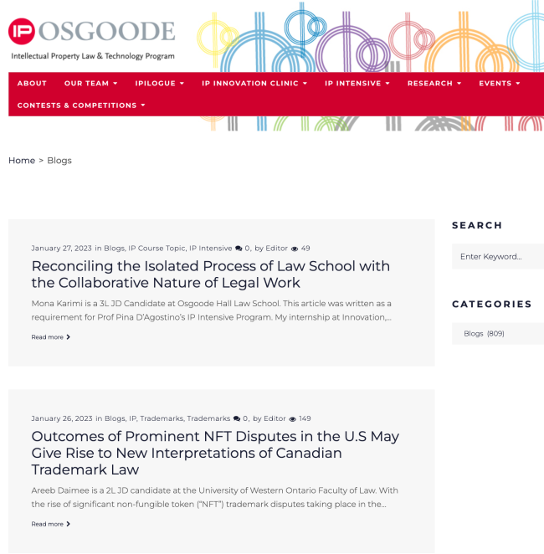

Slide 47
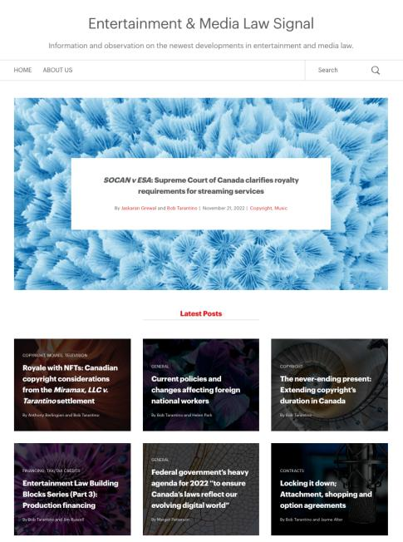

Slide 48
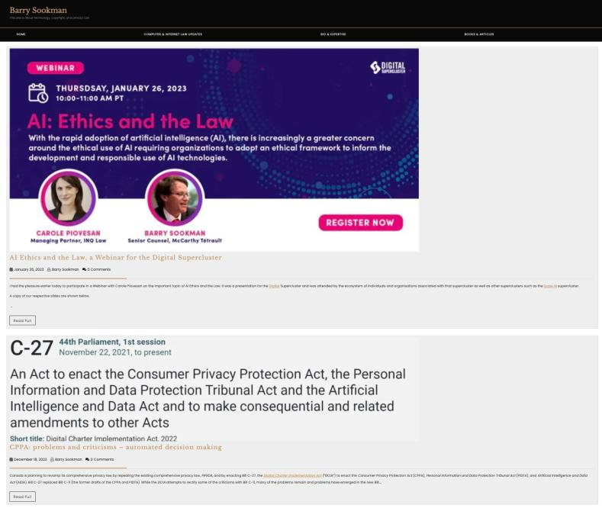

Slide 49
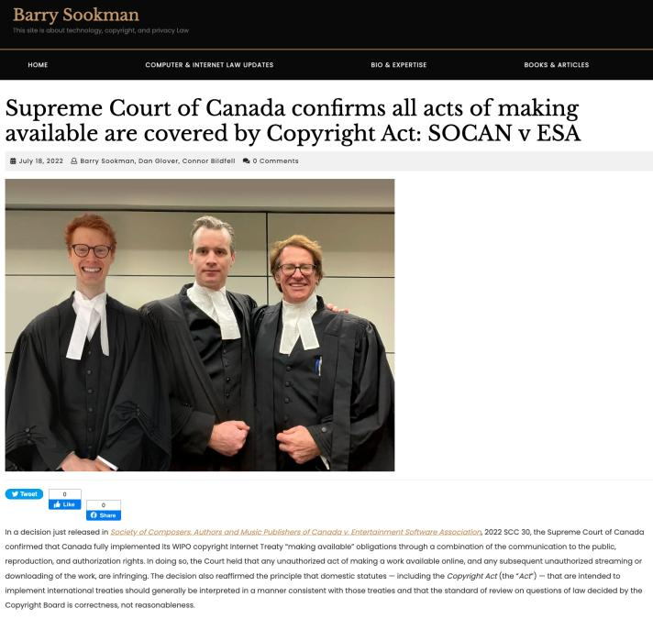

Slide 50
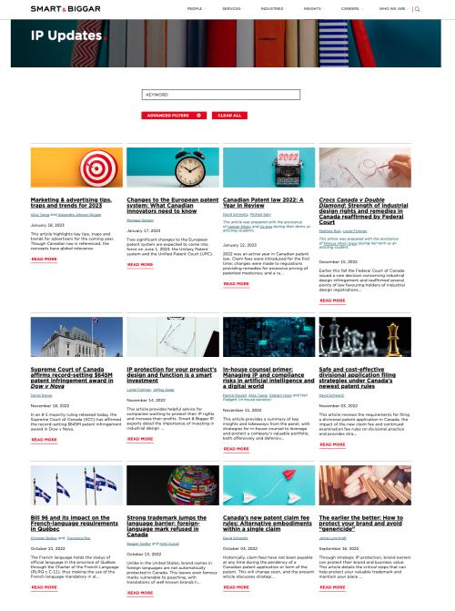

Slide 51
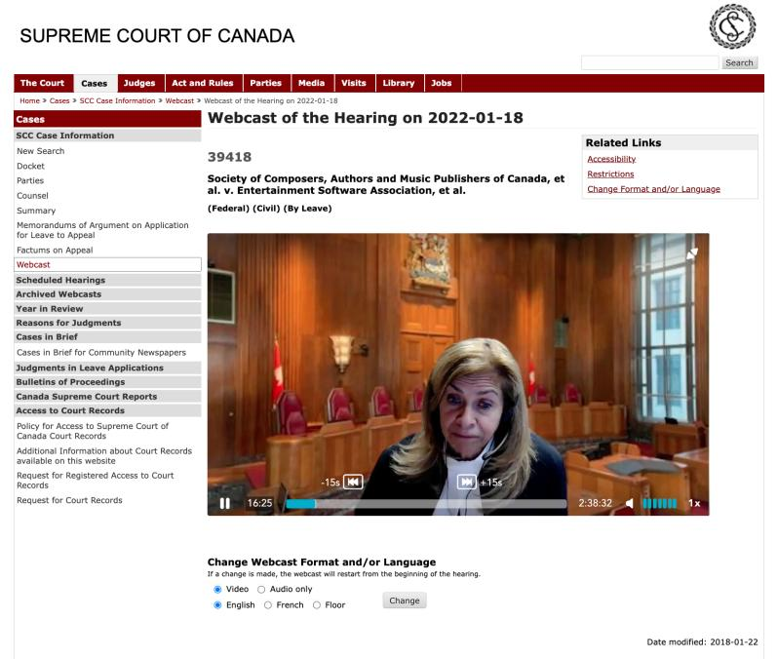

Slide 52
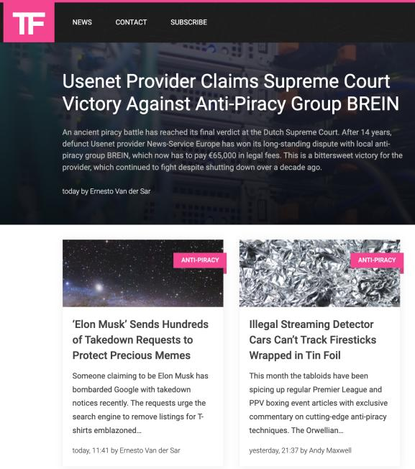

Slide 53
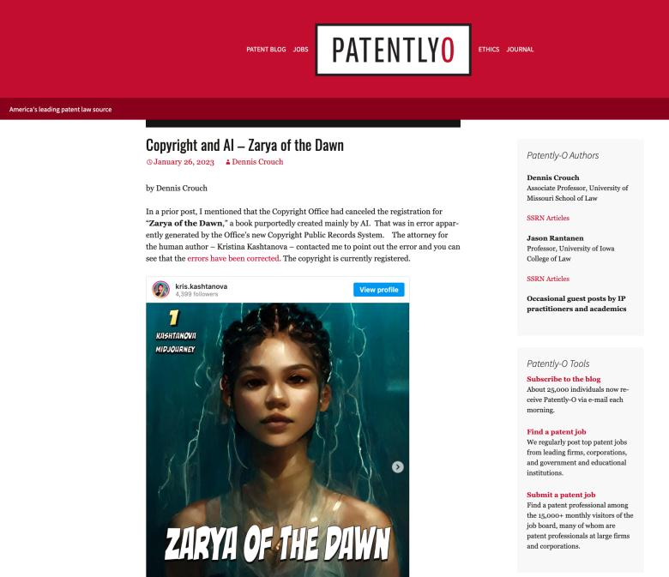

Slide 54
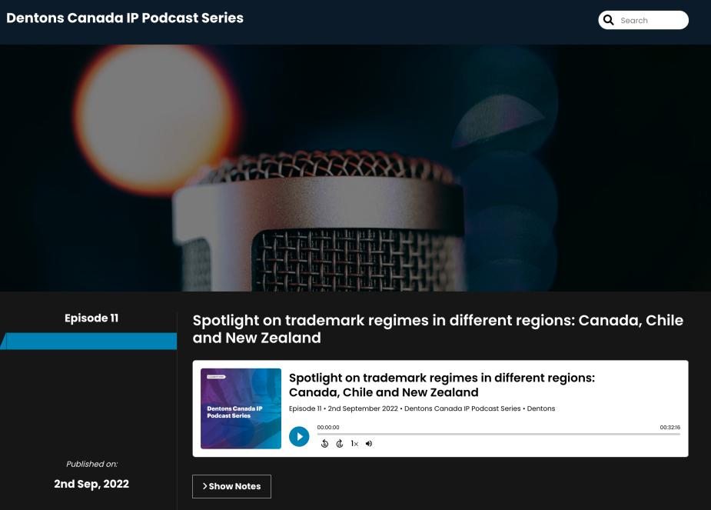

Slide 55

Office “Hours”: Ideally Tuesdays just after class but am flexible…
Email: jon.festinger@ubc.ca; jfestinger@telus.net
Office: 449
Phone:
c. 604-837-6426
(please text if urgent)

Slide 56
QUESTIONS?
THOUGHTS?
DISCUSSION?

Slide 57

Pause

Slide 58
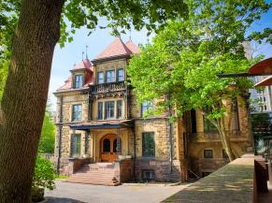


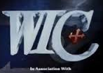
Me (IP history?)

Slide 59
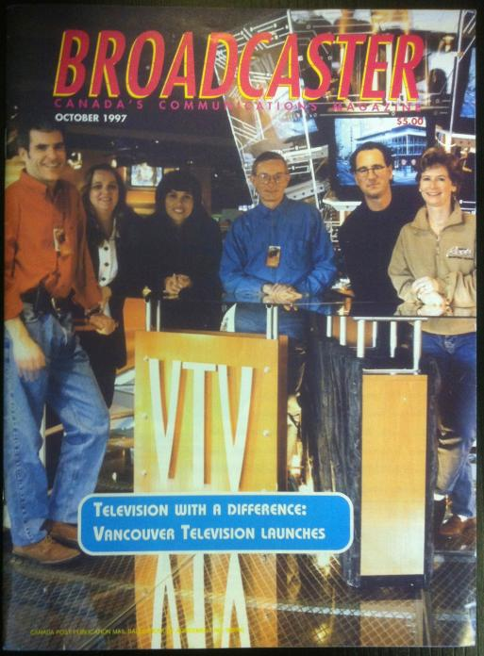

Slide 60
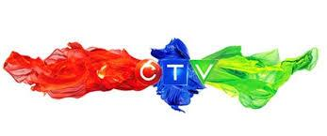

Slide 61
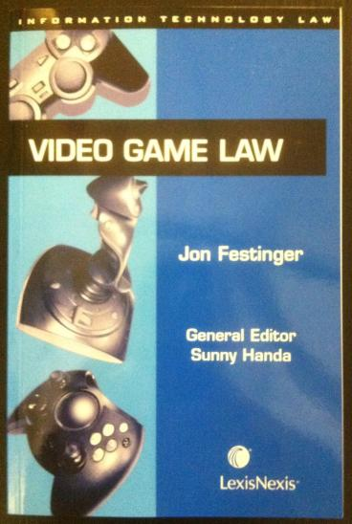
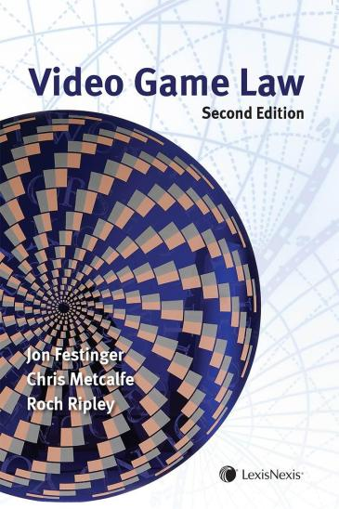

Slide 62
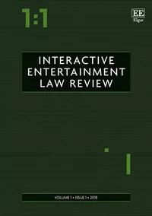

Slide 63
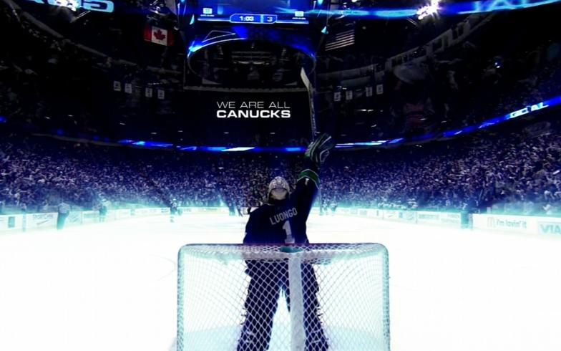

Slide 64
Favorite Intellectual Property (s)
(current or all-time)?

Slide 65
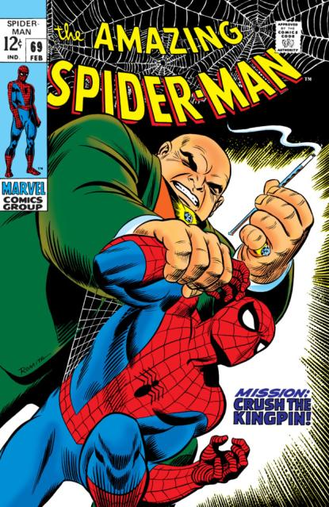

Slide 66
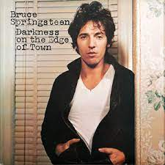

Slide 67
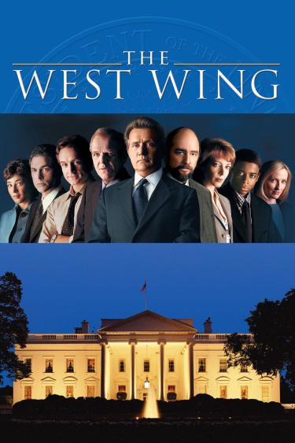

Slide 68
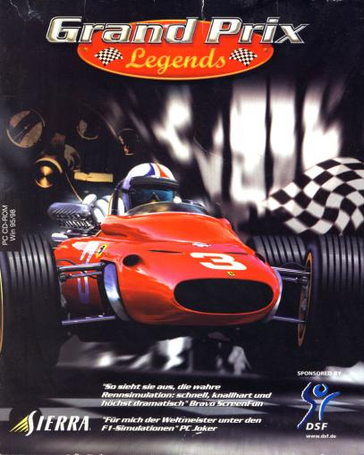

Slide 69
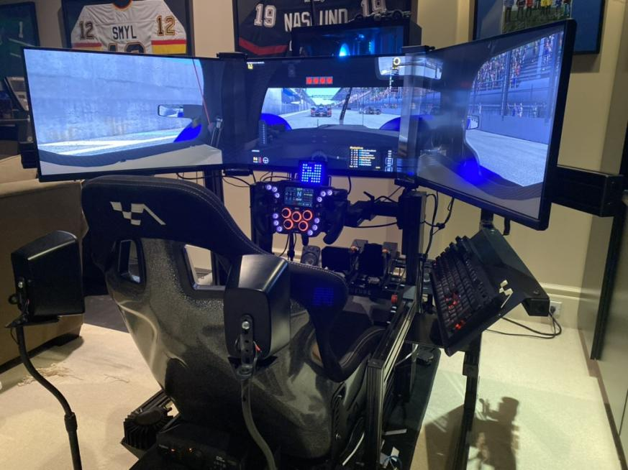

Slide 70
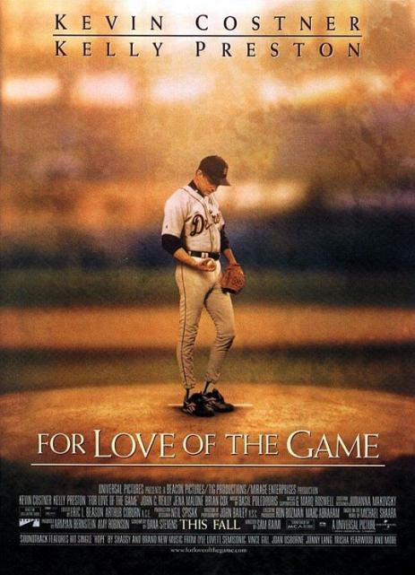

Slide 71

*

Slide 72

Andrew Garfield
Emma Stone

Slide 73


Slide 74


Slide 75


Slide 76


Slide 77

Life’s Symmetry Part 1

Slide 78


Life’s Symmetry Part 2

Slide 79
Now
You

Slide 80
Entirely optional but please…
…email me a short bio of yourself referencing:
Anything at all you want to say about yourself
Your academic interests
What you might like to get out of this course (I.E., interest in a type of patent, or a copyright issue etc.)
Favorite Intellectual Property (ies) - current or all-time

Slide 81

Where we have been…

Slide 82
Intellectual Property Law is about:
What kinds of creations of the mind can one have rights in?
Who can have those rights?
What kinds of rights are there; and how are those rights enforced?

Slide 83

Be CURIOUS everyday…

Slide 84
Question 1
Can this restaurant obtain a
Trademark for “Good Sushi”?
12 (1) … a trademark is registrable if it is not
(b) whether depicted, written or sounded, either clearly
descriptive or deceptively misdescriptive in the English or
French language of the character or quality of the goods or
services in association with which it is used or proposed to
be used or of the conditions of or the persons employed in t
heir production or of their place of origin;

Slide 85
Question 2

Slide 86

Essentially the exam question most years

Slide 87
Defenses to copyright infringement?
Temporary Reproductions for Technological Processes
30.71 It is not an infringement of copyright to make a reproduction of a work or other subject-matter if
(a) the reproduction forms an essential part of a technological process;
(b) the reproduction’s only purpose is to facilitate a use that is not an infringement of copyright; and
(c) the reproduction exists only for the duration of the technological process.

Slide 88
Without s.30.71 (Before 2012)
Fair Dealing (requires a category – education?)
Majority decision in Théberge v. Les Galleries d’Art du Petit Champlain Inc. [2002] 2 SCR 336
Technological neutrality doctrine of SCC
Canadian Admiral Corp. v. Rediffusion Inc. [1954] Ex. CR 382
Incidental Use/De Minimis? - S.30.7 Copyright Act
Retransmission, Network Services etc. (Copyright Act)
Contra
CBC v. SODRAC [2015] 3 S.C.R. 615

Slide 89
A.I.
Creation of the mind?

Slide 90


Slide 91


Slide 92


Slide 93


Slide 94


Slide 95
Question 3

Slide 96

What if someone invents a
process that would organically
grow an A.I. computer inside you?
Would that be patentable?

Slide 97

Higher life forms are not patentable

Slide 98


Slide 99


Slide 100
Pause

Slide 101
QUESTIONS?
THOUGHTS?
DISCUSSION?

Slide 102


Slide 103

Now, to our regularly
scheduled programming…

Slide 104

“Copyright Law”

Slide 105
Outline of Rest of Class
1) Overview of copyright:
  A. Definition of copyright
  B. Purpose of copyright
  C. Origins of copyright
  D. Which level of government has legislative authority over copyright?

Slide 106
Outline
2) What is copyrightable?
  Subsistence of copyright in works
    Registration as a requirement for copyright protection?
    Fixation
    Originality
    Are facts and ideas protected?

Slide 107
Outline
  3) What does it mean to say that something is literary, artistic, dramatic, or musical?
  What should qualify as copyrightable “works”?

Slide 108
Outline
  “Works” in today’s class,
  “Rights” in future classes

Slide 109
Pause

Slide 110

Overview of copyright
Definition of copyright:
  Set of exclusive rights in works of expression; performers’ performances; sound recordings; and communication signals.
The Clash, Chateau Neuf, Oslo, Norway
21 May 1980 Helge Øverås

Slide 111
Overview of copyright
Purpose of copyright:
  On what basis can copyright be justified?
    You have been asked by the leader of a newly independent country to advise her on whether her state should establish a copyright regime.
    On what basis might you justify the creation of such a system?

Slide 112
Overview of copyright
Justifications
Economic incentive for creation (then why does copyright continue after death)?
Societal “progress in the arts & sciences”
Natural rights to one’s own labour & personality (→ personality = privacy or IP)
Reinforces free expression?

Slide 113
Overview of copyright
Purpose of copyright
  Significant consequences flow from the adoption of one purpose of copyright or another, due to the prevailing approach to statutory interpretation in Canada (Driedger’s “modern approach”), under which provisions are interpreted purposively.

Slide 114
Pause

Slide 115
Please Self Identify
AUTHOR
or
CONNECTOR

Slide 116
Who is an AUTHOR?
“The creative is the place where no one else has ever been. You have to leave the city of your comfort and go into the wilderness of your intuition. What you’ll discover will be wonderful. What you’ll discover is yourself.”

Slide 117
Who is a CONNECTOR?
“Creativity is just connecting things. When you ask creative people how they did something, they feel a little guilty because they didn't really do it, they just saw something. It seemed obvious to them after a while. That's because they were able to connect experiences they've had and synthesize new things.”

Slide 118
Please Self Identify
AUTHOR
or
CONNECTOR

Slide 119

“Connecting”(remixing)
*“If you wish to make an apple pie from scratch, you must first invent the universe.” – Carl Sagan
* “Creativity is just connecting things. When you ask creative people how
they did something, they feel a little guilty because they didn't really do it, they
just saw something. It seemed obvious to them after a while. That's because
they were able to connect experiences they've had and synthesize new things.”
Steve Jobs in a Wired Magazine interview (Feb. 1996)
http://www.wired.com/wired/archive/4.02/jobs_pr.html
* “Creativity is contagious. Pass it on.” – Albert Einstein
* “All Creative Work is Derivative” – Nina Paley
http://blog.ninapaley.com/2010/02/09/all-creative-work-is-derivative/
* “The great driver of scientific and technological innovation [in the last 600 years has been] the increase in our ability to reach out and exchange ideas with other people, and to borrow other people’s hunches and combine them with our hunches and turn them into something new.” – Steven Johnson “Where Good Ideas Come From: The Natural History of Innovation”

Slide 120

The Romantic Author (The “Unique Gift”)
* “The creative is the place where no one else has ever been. You have to leave the city of your comfort and go into the wilderness of your intuition. What you’ll discover will be wonderful. What you’ll discover is yourself.”
* Personal creation mythology deeply rooted in our psyches’: “And G-d said: ‘Let us make man in our image, after our likeness;”(Genesis, Chap. 1 Verse 26)
* View of creativity as uniquely personal (or not) impacts beliefs about copyright & IP (e.g., film & music business – T.V. more flexible?) – consequences of “specialness”

Slide 121



The Result?
* Role and consequences of IP law aligning along according to personal belief: Do Copyright literalists’ adopt “self” generated model of creativity? Do “Connection-ists” adopt open source model?
* the “Hollywood Model” v. the “Remix Model”

Slide 122
Know Your
Bias!

Slide 123

https://www.ted.com/talks/steven_johnson_where_good_ideas_come_from
Entirely optional

Slide 124

Education as remixing

Slide 125



The Common Law as Remix

Slide 126
Pause

Slide 127
Origins of copyright
  Stationers Company…
  Statute of Anne (1709/10)
  Impact of French “droits d’auteur” system?
  Is Canadian copyright an amalgam of the UK and French approaches?

Slide 128
Overview of copyright (one perspective)
Origins of copyright:
  Stationers Company…
  Limited competition amongst themselves
  Received special privileges to “regulate and to censor works on the government’s behalf”.
  Negative reaction to this iron grip
  Statute of Anne (1709/10)

Slide 129
Overview of copyright
(another perspective)
STATUTE OF ANNE (1710)
AS FREE SPEECH

Slide 130

The Statute of Anne (1710) can be interpreted as the apotheosis in a trajectory of authorial freedom from censorship.

Slide 131


Slide 132
“For Books are not absolutely dead things, but doe contain a potencie of life in them to be as active as that soule was whose progeny they are; nay they do preserve as in a violl the purest efficacie and extraction of that living intellect that bred them…
And though all the windes of doctrin were let loose to play upon the earth, so Truth be in the field, we do injuriously, by licencing and prohibiting to misdoubt her strength. Let her and Falshood grapple; who ever knew Truth put to the wors, in a free and open encounter
Lords and Commons of England, consider what Nation it is whereof ye are, and whereof ye are the governours: a Nation not slow and dull, but of a quick, ingenious, and piercing spirit, acute to invent, suttle and sinewy to discours, not beneath the reach of any point the highest that human capacity can soar to.”

Slide 133
TRAJECTORY OF CREATIVE FREEDOMS
{KING..} Star Chamber (UK) abolished July 1641; {TO PARLIAMENT..} → Replacement of Royal censorship with Parliamentary censorship.
{TO REGULATOR..} “Licensing Order of 1643”: Parliament required authors to have a government license before a work could be published. Enforced by Stationers’ Company, a printers guild with the exclusive power to print literary works, and the responsibility to censor them, in return for monopoly on the printing trade.
{TO EXCLUSIVE GUILD..} “Licensing of the Press Act 1662” - "An Act for preventing the frequent Abuses in printing seditious treasonable and unlicensed Bookes and Pamphlets and for regulating of Printing and Printing Presses.”
{TO PUBLISHERS/AUTHORS..} “The Statute of Anne” 1710 moved control to publishers/authors…

Slide 134

Meanwhile in France
System was based on “les droits d’auteur” to protect the integrity of the authors work and personality, as well to reward the author for their labour
Antecedent of “droits moraux” (moral rights) as recognized by Canada.

Slide 135
Pause

Slide 136
Purpose of copyright in Canada?
Théberge:
  “[12] Generally speaking, Canadian copyright law has traditionally been more concerned with economic than moral rights.… The economic rights are based on a conception of artistic and literary works essentially as articles of commerce.” (Binnie J.)
But Cinar Corp. v. Robinson?
  [114] … the infringement of copyright in this case interfered with Robinson’s personal rights to inviolability and to dignity, recognized by ss. 1 and 4 of the [Quebec] Charter. (McLachlin CJ)

Slide 137
Overview of copyright
Purpose of copyright as articulated by the SCC
  Former approach: “author-centric”
  Shift in Théberge
    “balance between promoting the public interest in the encouragement and dissemination of works of the arts and intellect and obtaining a just reward for the creator“ (para. 30)
  Refined in Cinar Corporation v. Robinson, 2013 SCC 73
    Copyright Act “seeks to ensure that an author will reap the benefits of his efforts, in order to incentivize the creation of new works” (para. 23)

Slide 138
Overview of copyright
Théberge v. Galerie d’Art du Petit Champlain Inc. (2002)
  Whether transferring the work from paper to canvas violated the Copyright Act by creating an unauthorized reproduction? 4/7 SCC found there was no copy made, only ink had been transferred. Moral rights claim could have been made to prevent but not for economic compensation
Cinar Corporation v. Robinson, 2013
  In 1982, Robinson drew sketches of the characters for a proposed children's television series to be called The Adventures of Robinson Curiosity. Presented to Cinar and others unsuccessfully. In 1994 the first episode of Robinson Sucroe was broadcast in Quebec.

Slide 139


Slide 140

Théberge promotes “balance” between the public interest in connecting & just reward for the author

Slide 141

Why did the Canadian chicken cross the road?

Slide 142
Why weren’t the moral rights provisions of the
Copyright Act not directly argued in Theberge?
Binnie J. “10. More specifically, I think that if modification of these posters were to give rise to any legitimate objection on the part of the artist, it must be as a result of violation of his “moral” right to the integrity of his work. In that regard, however, my colleague Gonthier J. and I are in agreement that seizure before trial is not a remedy available in an action based on the alleged breach of the artist’s “moral” right in a work.”

Slide 143


Slide 144
“17. The important feature of moral rights in the present statute is that the integrity of the work is infringed only if the work is modified to the prejudice of the honour or reputation of the author (s. 28.2(1))…
20. The respondent made it clear in his evidence that his real complaint is more properly characterized as the alleged infringement of his “moral” rights and its potential impact on the market for his works…
21. Apart from the complaint of non-attribution (which is a moral rights issue), it seems the respondent as an artist simply wishes to stop the appellants from catering to the market for canvas-backed reproductions that apparently exists…

Slide 145
60. My view is that Parliament intended modification without reproduction to be dealt with under the provisions dealing with moral rights rather than economic rights. To adopt a contrary view, i.e., to treat the modification of the substrate here as the violation of an economic right, would allow copyright holders other than the artist to complain about modification (despite the non-assignability of moral rights). It would allow an artist who objected to a “modification” of an authorized reproduction both to sidestep the independent evaluation of a judge in unleashing a pre-judgment seizure in Quebec, and to sidestep at a trial anywhere in Canada the important requirement of showing prejudice to honour or reputation in order to establish an infringement of moral rights.

Slide 146
Pause

Slide 148
Overview of copyright
Legislative authority over copyright in Canada
  Federal Government (s. 91(23) Constitution Act, 1867)
  First Copyright Act (1921, Came Into Force 1924) largely a copy of the UK Copyright Act of 1911
  Modernization of Canadian copyright law: a work constantly in progress
  Bill C-11: Copyright Modernization Act (CIF 2012)
  Relatively recent copyright extension for sound recordings

Slide 149
Copyright is Federal
91. It shall be lawful for the Queen, by and with the Advice and Consent of the Senate and House of Commons, to make Laws for the Peace, Order, and good Government of Canada, in relation to all Matters not coming within the Classes of Subjects by this Act assigned exclusively to the Legislatures of the Provinces; and for greater Certainty, but not so as to restrict the Generality of the foregoing Terms of this Section, it is hereby declared that (notwithstanding anything in this Act) the exclusive Legislative Authority of the Parliament of Canada extends to all Matters coming within the Classes of Subjects next hereinafter enumerated; that is to say,…
22. Patents of Invention and Discovery.
23. Copyrights

Slide 150
Overview of copyright
Legislative authority over copyright in Canada
  No common law copyright in Canada
  Théberge:
    [5] Copyright in [Canada] is a creature of statute and the rights and remedies it provides are exhaustive.
    Also see s. 89, Copyright Act: “No person is entitled to copyright otherwise than under and in accordance with this Act…”
  Relevant statute: Copyright Act, RSC 1985, c. C-42 as amended.

Slide 151

Role of International Treaties:

Slide 152

168 parties to Berne; 161 members of WTO

Slide 153
Pause

Slide 154
What is copyrightable?
©

Slide 155
What is copyrightable?
Subsistence of copyright
5. (1) Subject to this Act, copyright shall subsist in Canada, for the term hereinafter mentioned, in every original literary, dramatic, musical and artistic work if any one of the following conditions is met:
  (a) in the case of any work, whether published or unpublished, including a cinematographic work, the author was, at the date of the making of the work, a citizen or subject of, or a person ordinarily resident in, a treaty country;

Slide 156
What is copyrightable?
Registration
  Not a condition for the subsistence of copyright
  Should it be?
  Possible to register your copyright (benefits to be discussed later in the term)

Slide 157
What is copyrightable
Fixation
A requirement for the subsistence of copyright imposed by judicial interpretation
  “The work, to be capable of copyright protection, must be fixed in a tangible form” (Canadian Admiral Corp. v. Rediffusion Inc., [1954] Ex. CR 382, 20 CPR 75
Is the fixation requirement beneficial?
Does add some certainty + more works in public domain

Slide 158
Result of Fixation Requirement
Improvisational, performance art, kinetic pieces, open world massively multiplayer video game scenarios, are more at risk of not having copyright protection. See for example Komesaroff v. Mickle, [1988] R.P.C. 204 at 210 (Vict. S.C.), refusing protection to a moving sand sculpture.
Content in RAM computer memory?
Indigenous oral story-telling

Slide 159
What is copyrightable (Fixation)
Gould Estate et al v. Stoddart Publishing Co. Ltd et al (1996)
  Can copyright subsist in spoken words?
    Not necessarily – not every utterance made by individuals is a “valuable property right”
  A person’s oral statements are not literary creations and do not attract copyright protection

Slide 160
What is copyrightable (Fixation)
Accordingly, oral statements, speeches (as such), interviews, or conversations are not literary creations (without fixation) and are not protected by copyright
Your notes are much more likely to be protected than my semi-improvised ramblings. Slides protected. Video “lecture capture” is protected (whose copyright?). See Walter v Lane [1900] AC 539

Slide 161

???????????????????????????

Slide 162
But…
Cinar Corporation v. Robinson, [2013] 3 S.C.R. 1168
[27] A substantial part of a work is not limited to the words on the page
or the brushstrokes on the canvas. The Act protects authors against both literal and
non-literal copying, so long as the copied material forms a substantial part of the
infringed work. As the House of Lords put it,
the “part” which is regarded as substantial can be a feature or combination of
features of the work, abstracted from it rather than forming a discrete part. . . .
[T]he original elements in the plot of a play or novel may be a substantial part, so
that copyright may be infringed by a work which does not reproduce a single
sentence of the original.
(Designers Guild Ltd. v. Russell Williams (Textiles) Ltd., [2001] 1 All E.R. 700, at p. 706, per
Lord Hoffmann; see also Nichols v. Universal Pictures Corporation, 45 F.2d 119 (2d Cir. 1930),
per Learned Hand J.)

Slide 163


Slide 164
QUESTIONS?
THOUGHTS?
DISCUSSION?

Slide 165
Pause

Slide 166

Coming Soon…
“Rights of Copyright Owners”
What rights should be part of the bundle of rights of copyright owners?

Slide 167
SEE YOU NEXT WEEK!

Slide 168

Always include a cat picture

Slide 169
In learning you will teach
And in teaching you will learn
Phil Collins' Son of Man (1999)

