Slide 1

Passing Off 2
Talk 8
LAW 422 001
Intellectual Property Law
Allard School of Law, UBC
Fall, 2023
Jon Festinger K.C.
Allard Law of Law, UBC
QMUL School of Law (CCLS)
Of Counsel, chandler, fogden, lyman
https://iplaw.allard.ubc.ca/

Slide 2
Special Guest Speaker

Slide 3
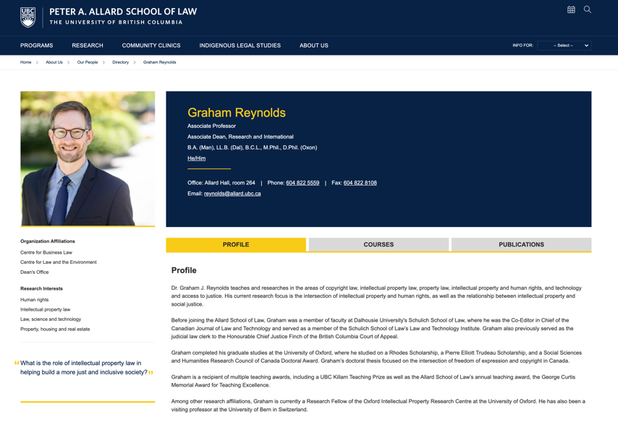
Prof. Graham Reynolds
on Indigenous Copyright

Slide 4
Logistics

Slide 5
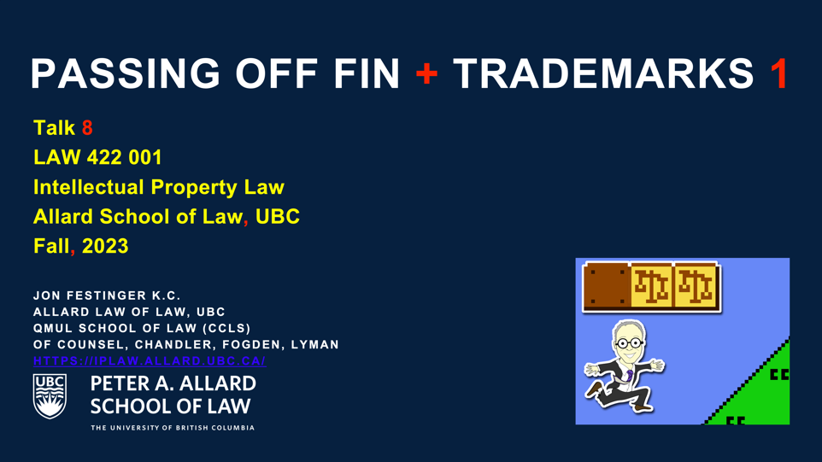
On Course Website (includes all of Trademarks)

Slide 6
NO CLASS NEXT WEEK
Monday, Nov.13 =
Remembrance Day +
Fall Term Break

Slide 7

Coming Soon!

Slide 8
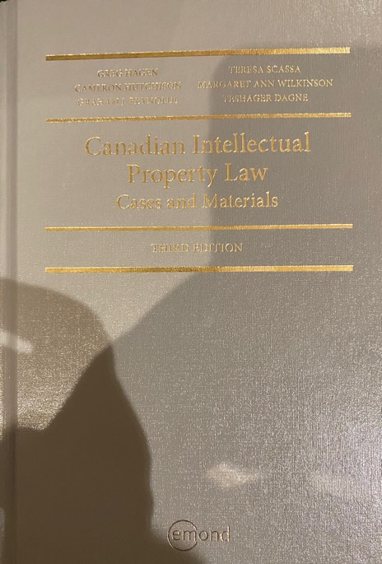
Text @ UBC Bookstore

Slide 9
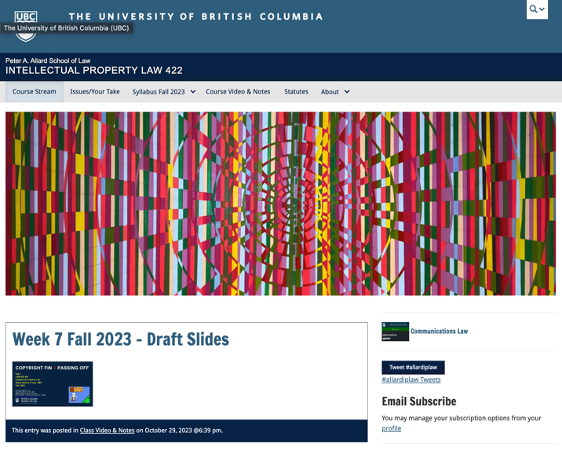
Course Website
https://iplaw.allard.ubc.ca/

Slide 10
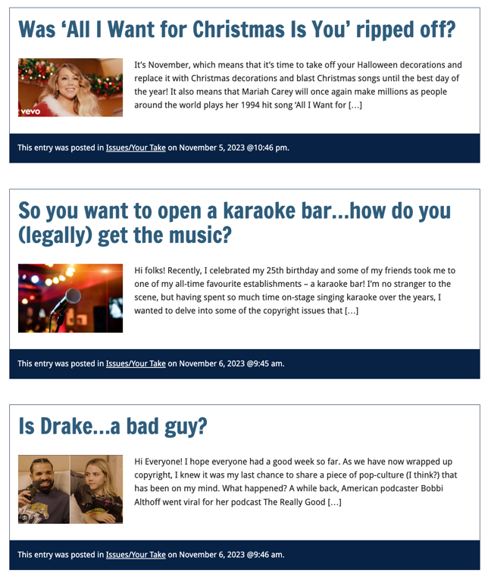

Slide 11
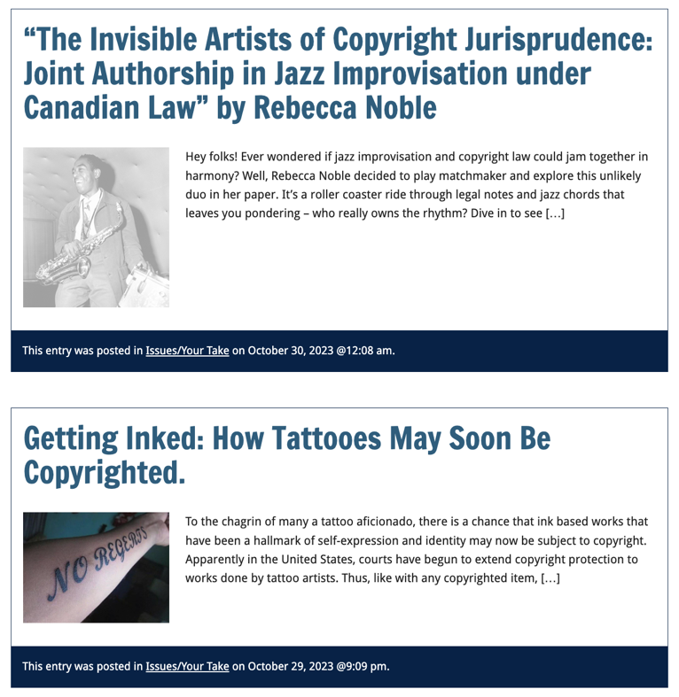

Slide 12
PLEASE
SIGN UP

Slide 13
For full privileges on the website
1. Please create an account at http://cms.ubc.ca/ using your CWL.
2. Once you create an account and sign in at http://cms.ubc.ca/ you can click your name in the top right. Halfway down the following page will be your WordPress email address.
3. Send me your WordPress email address at jon.festinger@ubc.ca or at jon_festinger@thecdm.ca
4. Then, I will invite you to participate with authoring privileges via your WordPress email address.

Slide 14


Slide 15
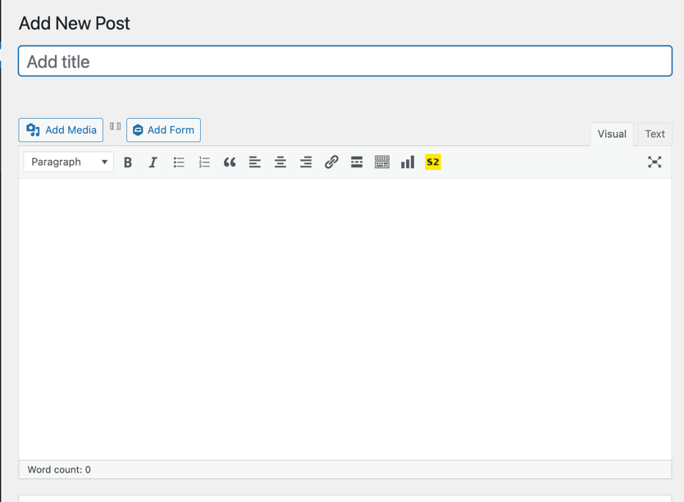


Adding Images

Slide 16




Slide 17

Adding Links

Slide 18
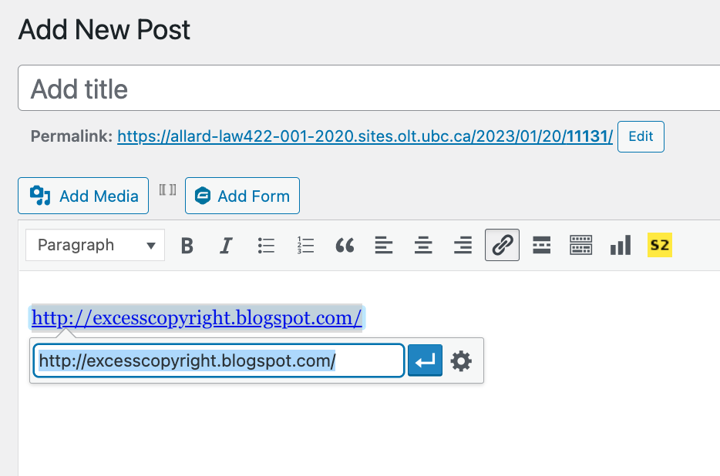


Slide 19



Adding a “Featured Image”

Slide 20



Slide 21
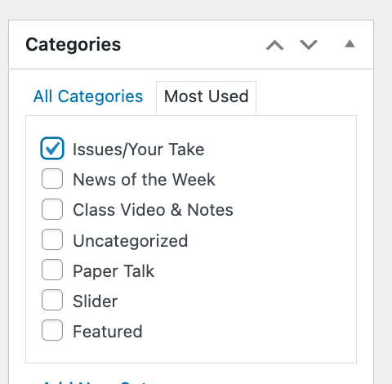

Setting Categories

Slide 22
Thank you for
your bios. & favorite I.P.’s
Much appreciated.

Slide 23
Let’s talk about…
The 30%
Paper/Presentation/Post = 20%
Participation = 10%

Slide 24
20% = a modest proposal…
750-1000 words (or equivalent) per person
written, video, podcast, in-class presentation (?), interpretive dance
Website or not
Groups or individually
LLM Students – one extra

Slide 25
DUE 11:59:59 PM
LAST DAY
OF THE TERM
(END OF EXAM PERIOD)

Slide 26
HOWEVER,…
ENCOURAGE POSTING
BEFORE END OF CLASSES
…YOUR CLASSMATES
WILL BENEFIT

Slide 27
Additional
Evaluation
(LLM students)

Slide 28
LLMCL Students Registered in the Class as such: Additional Task
750 – 1000 word post (or email)
???????????

Slide 29
Please use:
Jfestinger@telus.net
jon.festinger@ubc.ca

Slide 30
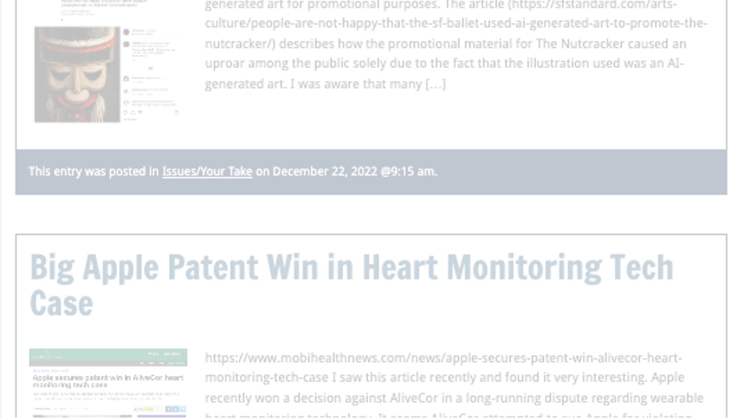
Past Presentations mostly all on the course website…

Slide 31
The 10%
Participation is broadly defined includes any or all:
class contributions however made
website contributions
email or other discussions with Instructor

Slide 32

Anything & everything can be done via email if you prefer

Slide 33
Final Exam
Tuesday, December 19, 2023
@ 9 AM PST
422.001/570C.001 INTELLECTUAL PROPERTY
Computers = Room ?
Hand-writers = Room ?

Slide 34
Zoom Q&A Sessions
(Study Groups Preferred If Possible)

Slide 35
QUESTIONS?
THOUGHTS?
DISCUSSION?

Slide 36

Pause

Slide 37

Random Notes

Slide 38
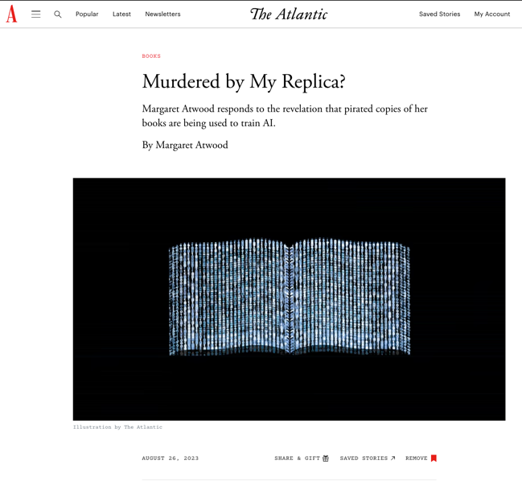
Any Thoughts?

Slide 39
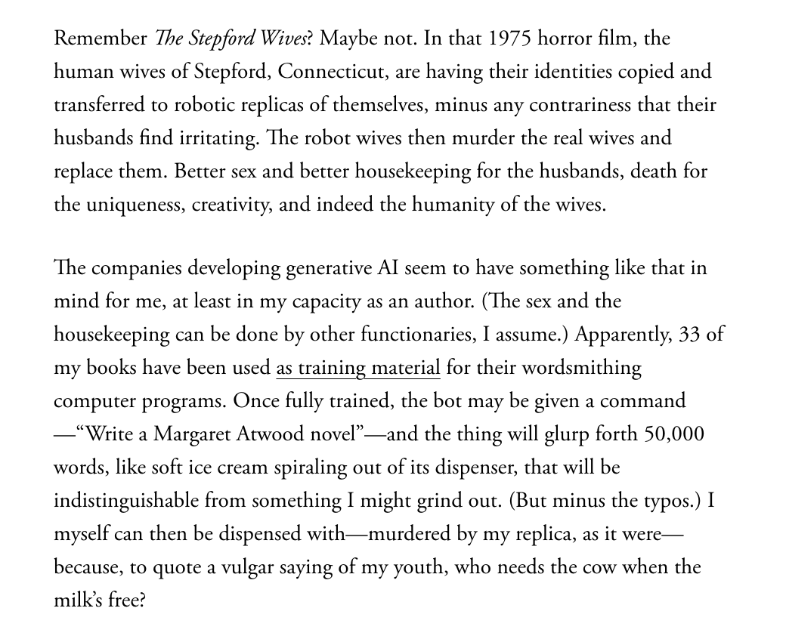

Slide 40
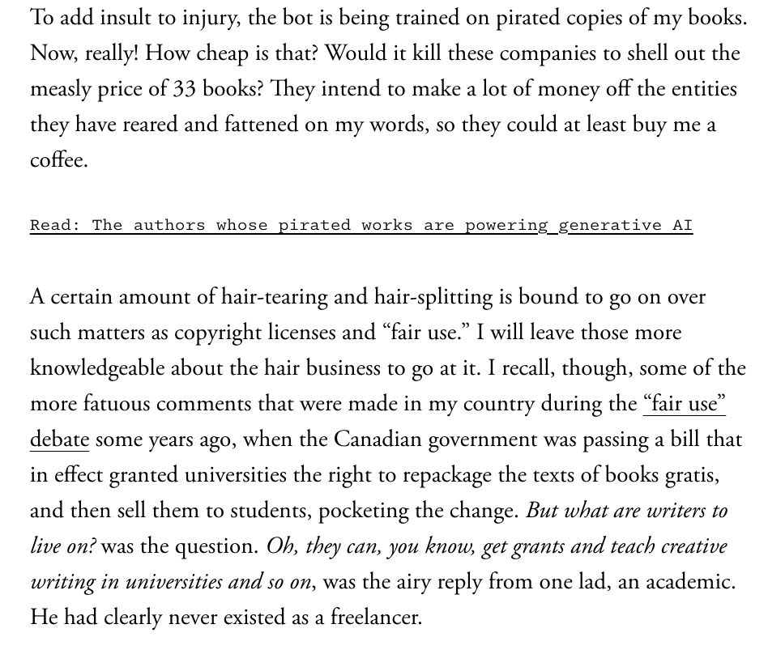

Slide 41
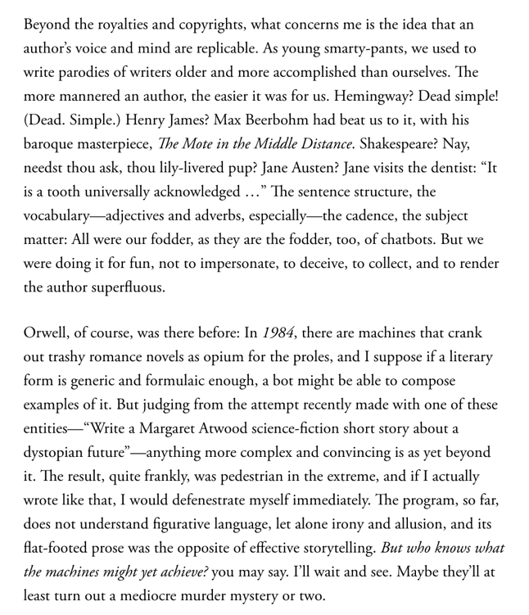

Slide 42
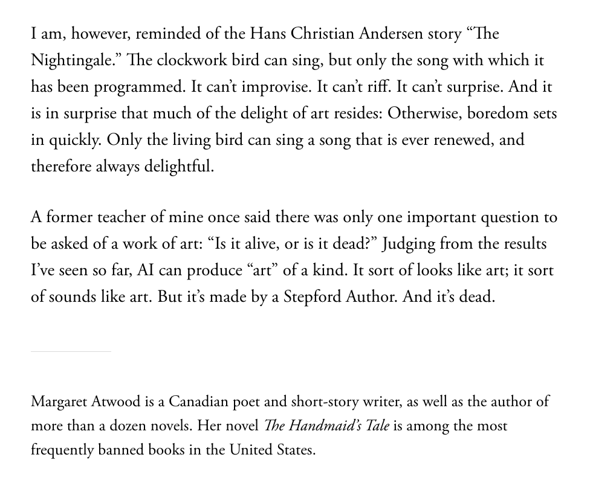

Slide 43
QUESTIONS?
THOUGHTS?
DISCUSSION?

Slide 44
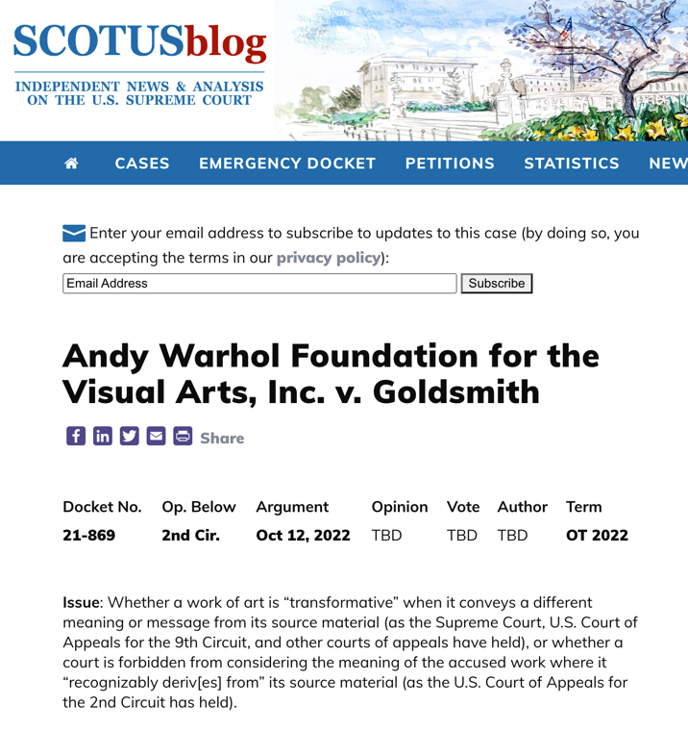

Slide 45
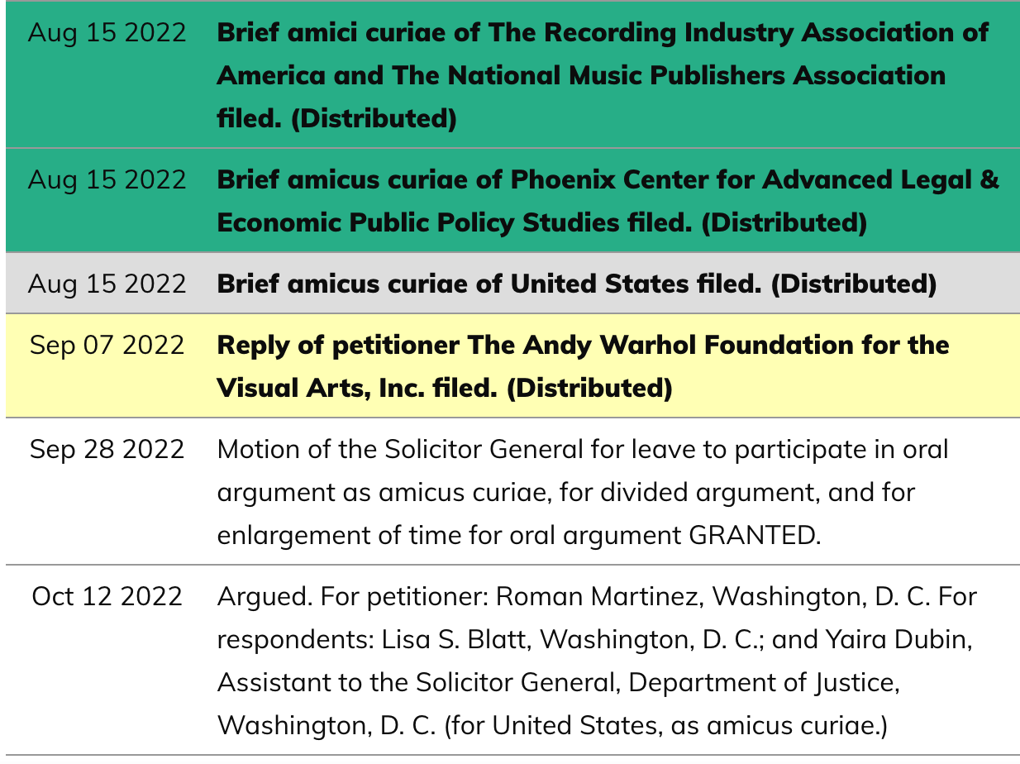

Slide 46
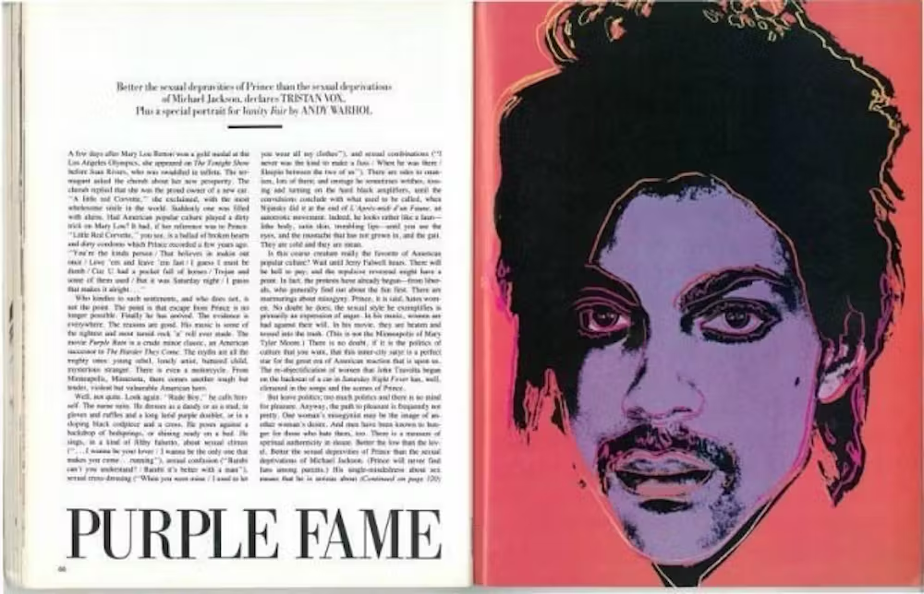

Slide 47
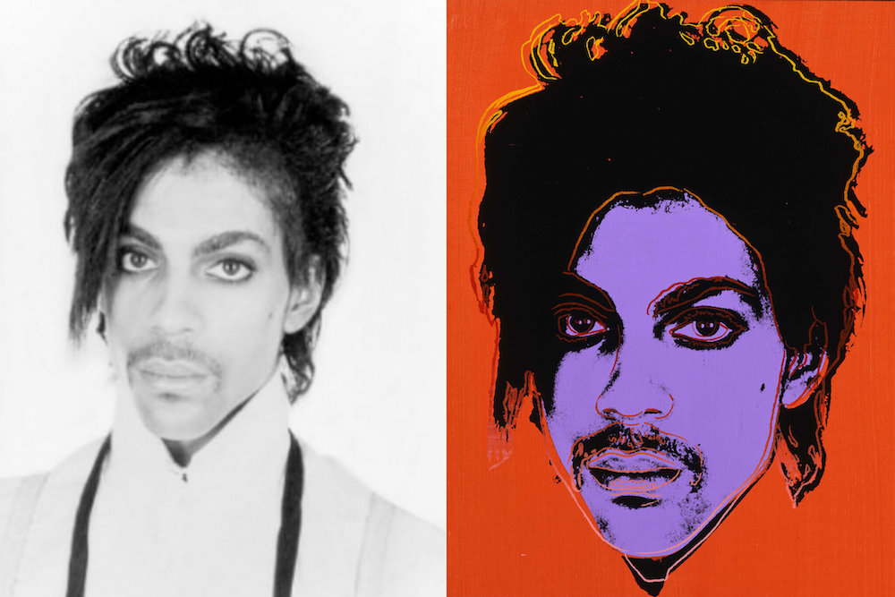

Slide 48
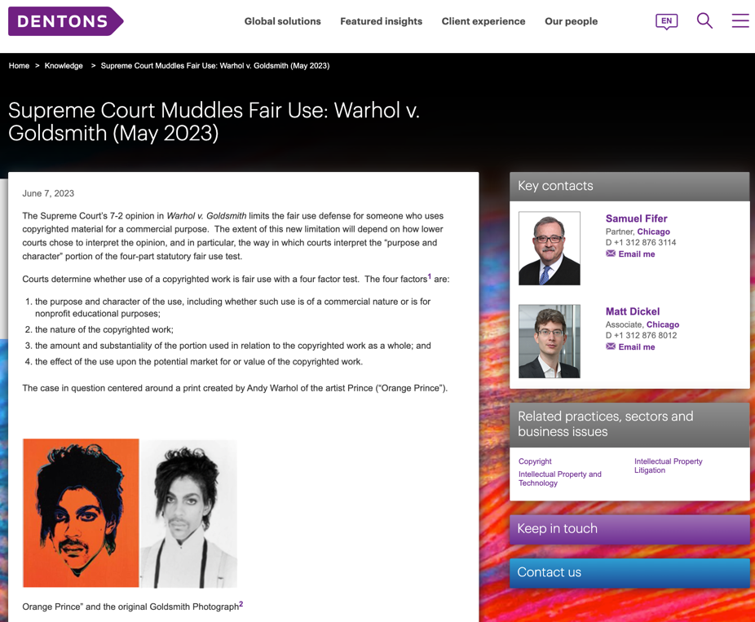

Slide 49
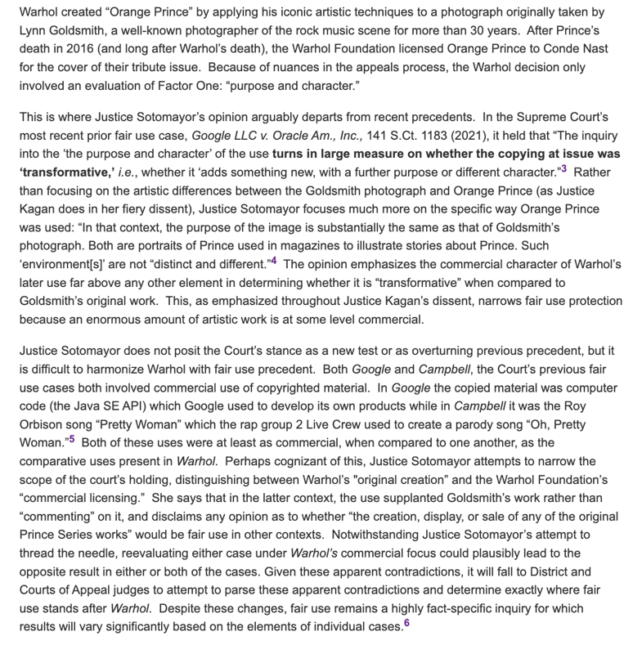

Slide 50
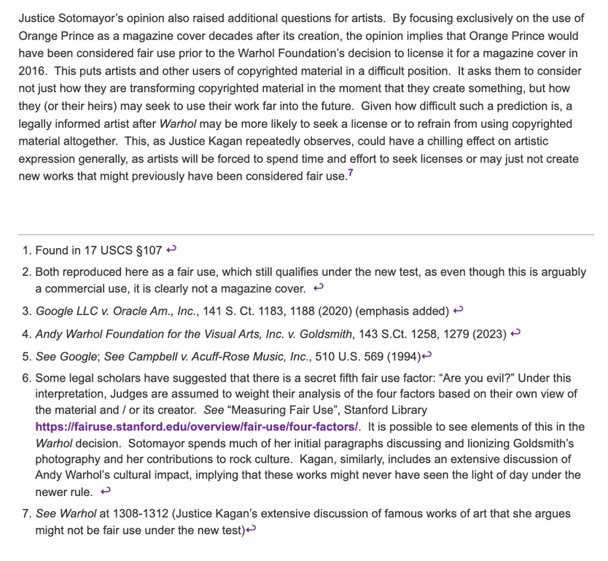

Slide 51
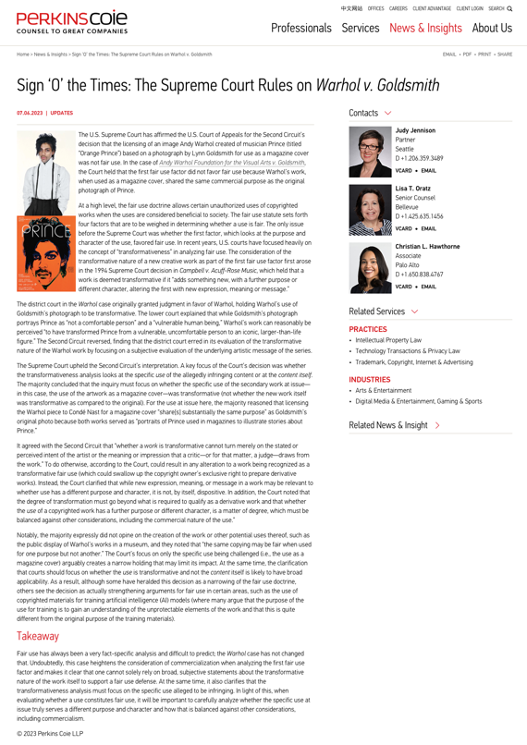

Slide 52
“In this case, however, Goldsmith’s
photograph of Prince, and AWF’s copying use of the photograph in an image licensed to a special edition magazine devoted to Prince, share substantially the same commercial purpose. AWF has offered no other persuasive justification for its
unauthorized use of the photograph.” *
* From headnote

Slide 53
QUESTIONS?
THOUGHTS?
DISCUSSION?

Slide 54
Pause

Slide 55

Where we have been…

Slide 56
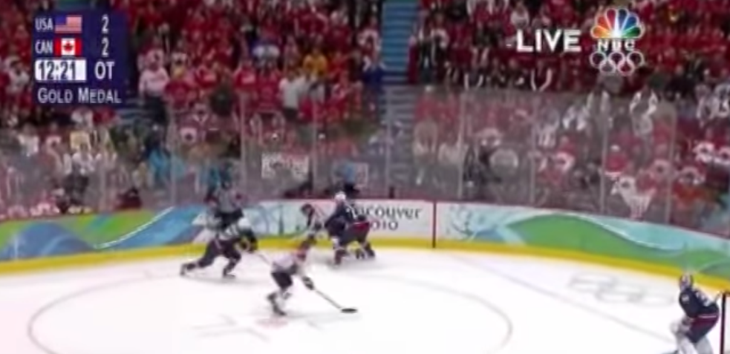
“Passing Off”
The Golden Goal – Jerome Iginla
passing off to Sidney Crosby

Slide 57
From Copyright to Passing Off/Trademarks
©
™*
From Protecting Creativity to Protecting Use
*not official but useful

Slide 58
Passing off
Three (3) necessary components of
a passing-off action:
  1. The existence of goodwill +
  2. Deception of the public due to a
  misrepresentation +
  3. Actual or potential damage to the
  plaintiff

Slide 59
Conceptual Frameworks
Think “the marketplace”
Think BRANDS
Associate BRANDS with REPUTATION (“goodwill”)
“USE” is the key concept in both passing off & trademarks
“Use It or Lose It” = historical, underlying concept (not quite as literal anymore in Canada per recent Trademark reform)
Not as overtly about “intellectual effort” as copyright
No “Public Domain” per se

Slide 60
Passing off
Tort action available in certain circumstances of unfair competition
Common Law (where no statute)
Both a common law tort and a statutory cause of action under the Canadian Trade-marks Act
No one may pass off their goods as those of another
General remedy for two categories of deception in the commercial context:
  Company B represents products as being those of Company A to take advantage of Company A’s goodwill and reputation e.g. Coke v. Cola Joe
  Goods of Trader A supplied to party who has ordered goods of Trader B. Purchasing party led to believe they have received goods of Trader B.

Slide 61
Passing off: Goodwill
Goodwill
The benefit and advantage of the good name, reputation, and connection of a business
Where the trade-mark or get-up is associated in the mind of the purchasing public with the plaintiff's goods, or with one trade source.
Get-up: The whole visible external appearance of goods

Slide 62
Passing off
Note is that passing off is generally seen as an action available between commercial competitors.
The Supreme Court of Canada, however, in Ciba‑Geigy Canada Ltd. v. Apotex Inc., [1992] 3 S.C.R. 12 emphasized that there is a consumer protection dimension to the tort. Gonthier J. notes that however one looks at the passing-off action, its purpose is clearly to protect all persons affected by the product.
“All persons” being the competitor and the people who buy the product
“People” who buy the product includes the first person who buys the product [who may be a wholesaler], all other intermediate purchasers, and the ultimate consumer.

Slide 63
Ciba‑Geigy Canada Ltd. v. Apotex Inc.
Core Issue: Whether, in a passing‑off action dealing with the get‑up of a prescription drug, the public affected by the risk of confusion includes not only health care professionals but also the patients who consume the drugs?
If so: Appellants Ciba-Geigy Canada Ltd. who brought the original passing off action would succeed in appeal.
Finding: The patient who uses the product is also included in “the public affected by risk of confusion”.

Slide 64
Passing off: Where does goodwill come from?
Goodwill has said to come from the fact that the trade-mark or get-up is associated in the mind of the purchasing public with the plaintiff’s goods, or with one trade source, whether or not the public can identify that source.
A GET-UP can be defined as: The whole visible external appearance of goods/ specifically … in the form in which they are likely to be seen by the public before purchase.
If the goods are sold in packages, then the get-up is the way the package looks – the appearance of the package taken as a whole.
If the goods are not sold in packaging – the get-up is the way the good looks - the visible external appearance of the goods themselves.

Slide 65
Passing off: Where does goodwill come from?
How would you go about establishing the existence of goodwill? What sorts of information would you want to have?
Evidence of length of time in business
Strength of market for product/service
Strength of association between name/mark/product and company as source.

Slide 66
Passing off: Shared Goodwill
Institut national des appellations d’origine des vins…v. Andres Wines Ltd (continued)
Note previous definition of goodwill as the benefit and advantage of the good name, reputation, and connection of a business. Seems overtly to meet the criteria?
Specific legal question is: Can goodwill exist not just with respect to one business, but with respect to a kind of goods produced by a group of traders?
Geographical indications are place names (in some countries also words associated with a place) used to identify the origin and quality, reputation or other characteristics of products
Geographical indications other than Champagne?

Slide 67
Passing off: Shared Goodwill
Institut national des appellations d’origine des vins…v. Andres Wines Ltd (continued)
Main question: Should the concept of “shared goodwill” should be accepted in Canada?
The court recognized that to accept “shared goodwill” would be to expand the tort of passing off.
Parenthetically note as we explore the extent to which the tort of passing off has expanded over time – and whether or not this is a good thing for Canadian businesses and society?

Slide 68
Passing off: Shared Goodwill
Institut national des appellations d’origine des vins…v. Andres Wines Ltd (continued)
Clear from case is Court’s unwillingness to limit the principles of passing off to only those situations where there is a direct or indirect connection between the goods of the plaintiffs and the defendants and where ownership of the goodwill in a mark resides in one plaintiff only.
The concept of shared goodwill was indirectly approved of by the SCC in Consumers Distributing Co v. Seiko Time Canada Ltd. (1984).

Slide 69
Passing off: Foreign goodwill
Orkin Exterminating Co. Inc. v. Petsco Co. of Canada Ltd (1985), 50 OR (2d) 726 (continued)
Court found that a company whose goods or services are well known in the U.S., but not in Canada, will not be protected at common law from another company offering similarly named or branded products or services in Canada.
Reason is because confusion or misrepresentation is the essence of the tort.
Where Plaintiff’s product or service is unknown in a certain region, it is hard to argue that customers were misled into thinking they were purchasing the Plaintiff’s products.
That said however, goodwill can exist outside the area where a company carries on a business.

Slide 70
Passing off: Foreign goodwill
Sadhu Singh Hamdard Trust v. Navsun Holdings Ltd. (2016)
Case explores the related questions of:
  1. Whether an entity that does minimal business in Canada but that has a website accessible to (and accessed by) Canadians can establish sufficient goodwill for a successful action in passing off in a Canadian court? &
  2. How can such a company demonstrate its reputation?

Slide 71
Passing off: Foreign goodwill
Sadhu Singh Hamdard Trust v. Navsun Holdings Ltd. (2016) (continued)
Federal Court dismissed Hamdard Trust’s claim for passing off, finding that it had failed to establish any of the elements for a claim of passing off.
Federal Court of Appeal set aside that decision, finding that the lower court made several palpable and overriding errors in evaluating the evidence on each element of the test.

Slide 72
Passing off: Foreign goodwill
Sadhu Singh Hamdard Trust v. Navsun Holdings Ltd. (2016) (continued)
Number of Ajit Daily subscribers in Canada? 7 in 2010.
FCA determined that the Federal Court erred in law by analyzing the existence of goodwill solely from the perspective of those who were shown to have read the Ajit Daily in Canada.
Instead, the FCA indicated the question is simply: Does the Plaintiff’s TM have a reputation in the jurisdiction, even if the TM is not used by the Plaintiff in the jurisdiction?

Slide 73
Q.: Should an entity doing minimal business in Canada but having an accessible website that is accessed by Canadians be able to establish sufficient goodwill to make out a successful action in passing off in a Canadian court? If so, how might such a company demonstrate its reputation?

Slide 74
To what extent can goodwill be acquired in a purely descriptive product name?
Risky to use purely descriptive terms for a mark.
Risk is of not acquiring goodwill or reputation in the product simply because the name describes the good itself.
Goodwill – or secondary meaning – can be acquired through a product’s name, or through a product’s appearance…
A product that has a particularly distinctive appearance might come to be associated by consumers with one trade source. Then a competitor who copies the product appearance might be liable for passing off.
Challenge in these cases is that the Plaintiff must show that the appearance of the product has acquired a secondary meaning – that it comes from one trade source.

Slide 75
Passing off: Ray Plastics
A product that is particularly distinctive in its appearance may come to be associated by consumers with a particular trade source
If the product appearance is an inherent feature of the product, it can’t be relied on as a TM

Slide 76

Now, continuing our regularly
scheduled programming…

Slide 77
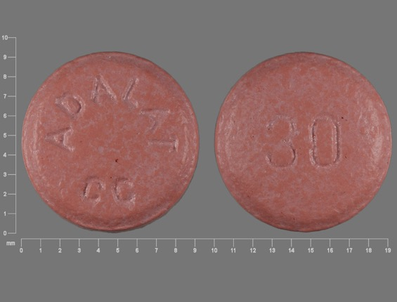
Passing off: Novopharm v. Bayer Inc. (2000)

Slide 78
Passing off: Novopharm v. Bayer Inc. (2000)
Question is whether a manufacturer of a pharmaceutical in pill, capsule or tablet form can claim goodwill or reputation in the shape, size or colour of the tablet?
Many prescription drugs are not sold in packages, they are dispensed by pharmacists in plain plastic vials.
“If patients identified the plaintiff's product by its appearance, the marketing by the defendant of tablets that were confusingly similar in appearance would prevent patients from exercising consumer choice by specifying which product they wished to have prescribed.” (para 90) / could also have negative health impacts.

Slide 79
Passing off: Novopharm v. Bayer Inc. Court 1
Issue was whether consumers, by virtue of the appearance of the pill, regard it as coming from one trade source?
Points made by the court in answering this question:
Pink round small tablets are commonplace in the pharmaceutical market. (40 medications available in Canada for treatment of high blood pressure and angina that were pink in colour – Macdonald (Pharmacist)). Accordingly, Bayer has a heavy burden to discharge to prove that they have a secondary meaning (that ordinary consumers associate them with a single trade source).
The fact that in 1992 Adalat was the only extended-release nifedipine product on the market does not necessarily mean that consumers have identified its appearance with a single source.

Slide 80
Passing off: Novopharm v. Bayer Inc. Court 2
Issue was whether consumers, by virtue of the appearance of the pill, regard it as coming from one trade source?
Points made by the court in answering this question:
Consumers often identify the appearance of a pharmaceutical product with its therapeutic purposes, instead of with a single manufacturer. I.e. “Colour/shape = pill I take for condition X; as opposed to colour/shape = same manufacturer.”
Evidence did not prove that physicians or pharmacists to any significant degree identified Adalat by colour or shape (they relied primarily on labels).
Bayer was unable to establish that patients associate pink round angina pills with the brand name Adalat.

Slide 81
Passing off: Novopharm v. Bayer Inc. (2000)
Key points (simplified):
Pink round small tablets are commonplace in the marketplace
Only product in the market? Not by itself conclusive of goodwill/distinctiveness
Appearance of a pharma product often associated with therapeutic purposes instead of single manufacturer
Physicians/pharmacists rely primarily on labels

Slide 82
Passing off: Novopharm v. Bayer Inc. (2000)
Court also highlighted two competing public policy considerations:
Reducing the price of medication by not limiting competition through the grant of a monopoly in the product’s appearance
Maximizing consumers’ freedom of choice to prefer a brand:
  Some patients may experience adverse side effects from one product but not from another, even though they are interchangeable.
  Not all manufacturers exercise the same level of quality control. In this case, a consumer may want to ensure that they receive the brand name product.
Way the tension between these competing public policy considerations is resolved in passing off is through the requirement that in order to bring a successful passing off action, evidence must be presented before the court that clearly establishes on a balance of probabilities that a significant number of consumers associate the appearance of the product with a single trade source. Did not happen in Novopharm v. Bayer.

Slide 83
Summary
In passing off cases dealing with product appearance or product packaging Plaintiff must establish that the certain product feature or packaging is distinctive of a particular trade or commercial source.
If not established, then secondary meaning has not been established either, and there is no goodwill or reputation that the defendant can exploit.
Key from casebook: “IF the product appearance is an inherent feature of the product – i.e. ex given – shape and configuration of a Lego block – then it can’t be relied on as a TM.”
Why? See Kirkbi AG v. Ritvik Holdings, 2005 SCC.

Slide 84
Passing off: Kirkbi AG v. Ritvik Holdings, 2005 SCC
If the product appearance is an inherent feature of the product, it can’t be relied on as a TM.
Because that would give a monopoly over the manufacture of the product.

Slide 85
QUESTIONS?
THOUGHTS?
DISCUSSION?

Slide 86
Pause

Slide 87

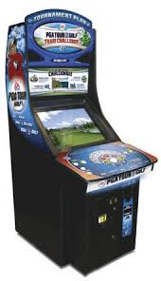
U.S. Copyright analogy 1:
Golden Tee v. PGA Tour Golf
Defendant PGA Tour Golf WINS

Slide 88

U.S. Trademark analogy:
ESS Entertainment & Rock Star
The Play Pen & The Pig Pen
Defendant Rock Star (Pig Pen) WINS

Slide 89
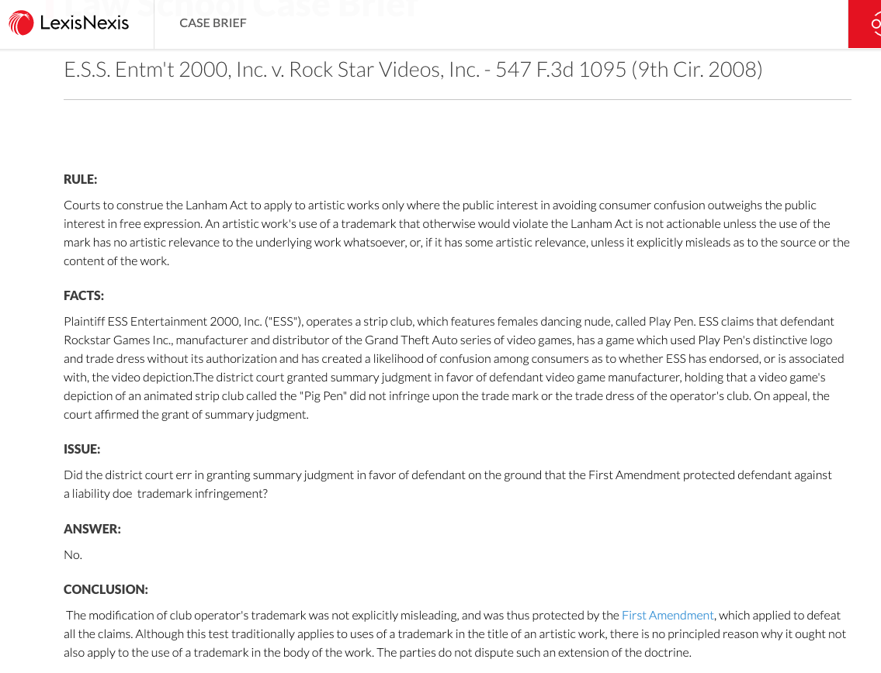

Slide 90
QUESTIONS?
THOUGHTS?
DISCUSSION?

Slide 91
Pause

Slide 92
Losing Reputation or Goodwill: HOW?
3 ways top lose goodwill or reputation:
Acquiescence over time to competitors using identical or similar get-up so that it’s no longer distinctive of the Plaintiff as a trade source
When a plaintiff goes out of business and is no longer using a particular name…fades away…
When the mark becomes generic…

Slide 93
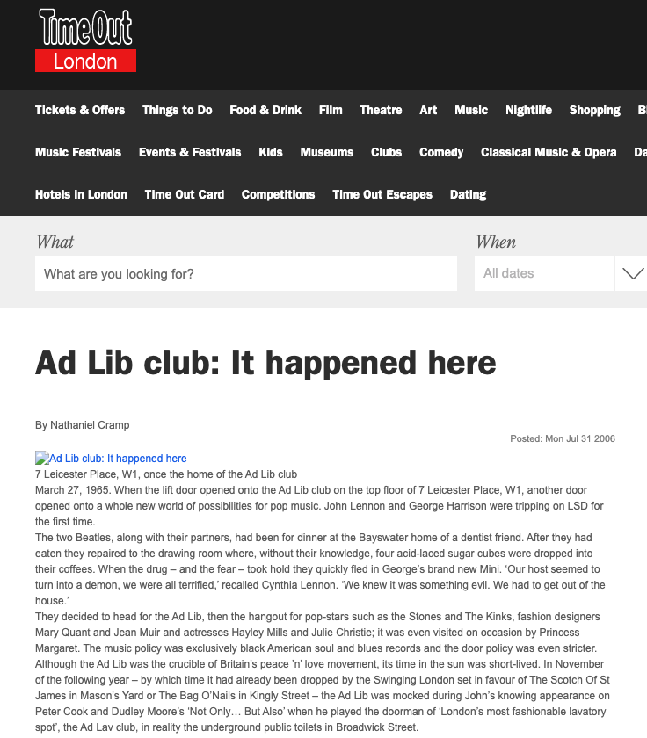

Slide 94
Passing off: Ad-Lib Club Limited
By 1964, the Ad-Lib Club was a widely known & popular night club in London, U.K., that had established a substantial goodwill attached to the name.
Forced to close in 1966 due to noise violations. After that it was looking for alternative premises to re-open.
Then, 1970 – on the same premises – it seemed as if the Ad-Lib Club is re-opening. Article stated: “The AD-LIB, first and most successful of London’s swinging discotheques of the 1960s will reopen this month”.
Ad-Lib, after seeing this article, asked the court for an injunction that would prevent the Defendant from passing off the Defendant’s business as the business of the Plaintiff.
The judge noted that in 1965, the Ad-Lib Club had substantial goodwill in its name. However, Ad-Lib closed in 1966.

Slide 95
Passing off: Ad-Lib Club Limited
It had been five years since Ad-Lib carried on the business of a club. Court still determined that Ad-Lib had goodwill in its name because:
Defendants must have chosen the name Ad-Lib Club by reason of the reputation acquired by Ad-Lib (the Plaintiff). No evidence filed showing any other reason for the selection of the name.
Based on various news articles, members of the public clearly seemed to see the new club as a continuation of the Plaintiff’s club.
Accordingly, Ad-Lib, the Plaintiff company, still has goodwill and was entitled to exploit it and protect it.

Slide 96
Passing off: Principles from Ad-Lib Club
Where someone stops carrying on a business, they keep, for a period of time, the goodwill attached to that business.
As long as that goodwill remains, the person should be able to enforce his rights in respect to any name attached to that goodwill.
When goodwill expires is a question of fact.

Slide 97
Overall principle
An enterprise can eventually lose its goodwill, after a period of time, if it shuts down. After a period of non-use, a name or product appearance will lose its “mojo” (not a technical term) and no longer be distinctive of a certain trade source.

Slide 98


Slide 99
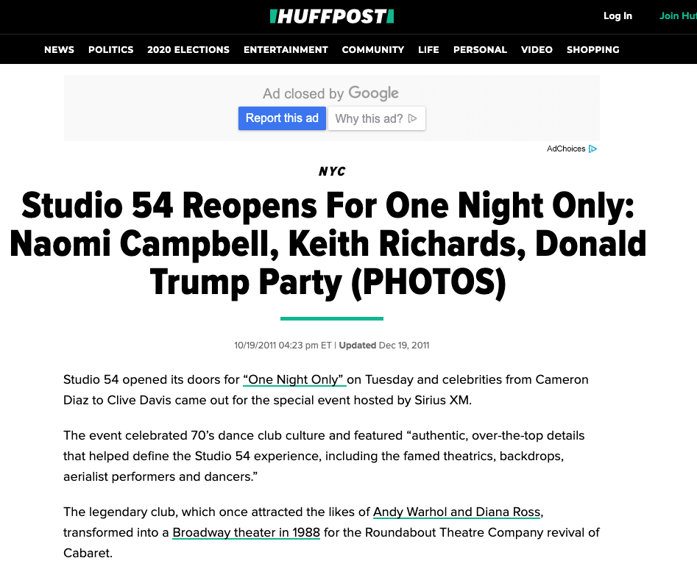

Slide 100
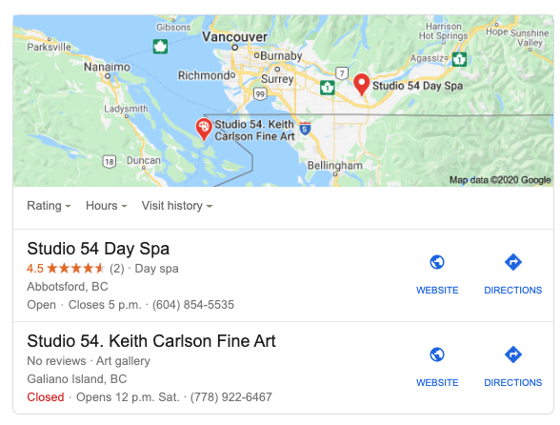

Slide 101
QUESTIONS?
THOUGHTS?
DISCUSSION?

Slide 102
Pause

Slide 103
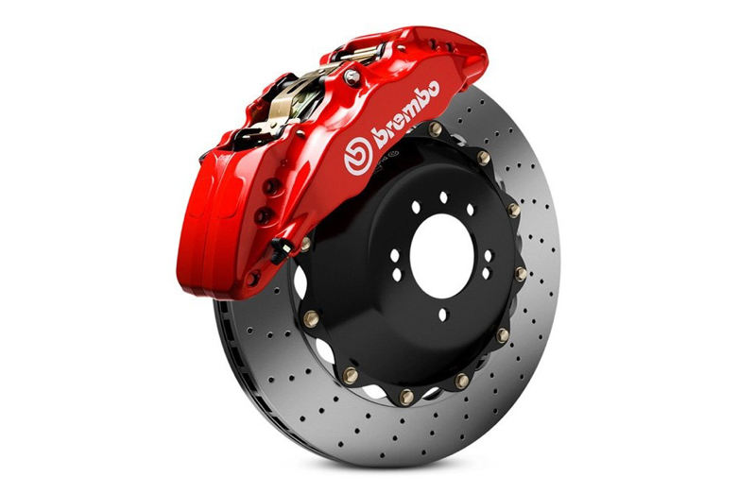

Slide 104



Passing off: Genericization

Slide 105

Passing off: Genericization
Back to: Institut national des appellations d’origine des vins…v. Andres Wines Ltd

Slide 106
Passing off: Genericization
Institut national des appellations d’origine des vins…v. Andres Wines Ltd
To wine experts Champagne has one meaning , sparking wine product originating from a particular part of the Champagne District of France, produced from grapes grown there by methods dictated by French law.
Defendant Andres claims the term champagne has become generic.
Evidence to support this argument?
Evidence that both nationally and internationally the term has for many years been used in connection with different commercial products to suggest high quality or excellence – thus diluting the distinctiveness of the term.

Slide 107
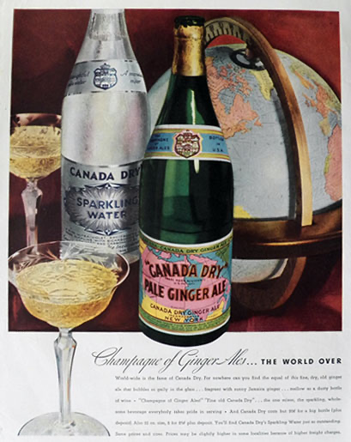
1934

Slide 108
Passing off: Genericization
Institut national des appellations d’origine des vins…v. Andres Wines Ltd
Champagne of ginger ales
Used to describe a colour
Foreign production of sparking wine under the label champagne – with a qualification that the product’s origin is not France.
Canadian Champagne, Spanish Champagne, US, Argentina, Brazil, India, Australia.
Term also misused by certain champagne houses.
Dictionary definitions show the diluted term.
Used the Google Search Engine to search for “the champagne of”….
This evidence supports the Defendant’s view – that the word champagne has assumed generic characteristics.

Slide 109
Passing off: Genericization
Institut national des appellations d’origine des vins…v. Andres Wines Ltd
Plaintiff’s countered this evidence by Survey evidence supporting the Plaintiff’s view that a meaningful percentage of the population associate champagne with France.
Court says that the word champagne has acquired generic attributes - used widely to describe a style or type of wine.Notes that also used to denote unique character, high quality and excellence.
Court holds that the word champagne has at most become “semi-generic”
Court not persuaded that the word Champagne has become diluted (pardon the pun) to the extent that it just refers to a class or genus of products. Still can refer to a particular merchant (group) & their product
It, in part, is still considered and accepted as referring to a particular type of sparking wine produced in France.
Conclusion is that CHAMPAGNE HAS NOT YET fallen into complete generic use.

Slide 110
Passing off: Genericization
Product names becoming generic:
  Q: Does the word refer merely to a class or genus of products?
  Examples of product names that have become generic?
  Institut National - Has “champagne” now become a generic term?
  Xerox was in danger

Slide 111
Passing off: Preventing Genericization
How can companies prevent their product name or company name from becoming a generic term?
Ad campaigns…
Lawsuits for passing off.
Lobbying for changes to laws.

Slide 112
Speaking of “Champagne”…
With respect to the Champagne industry the French Champagne industry has tried to protect the name champagne through lobbying efforts & legal actions since the early 1900’s
In 2003 they started to use consumer advertising to protect the name champagne from use by foreign wine producers or makers of non-wine products.
For example…

Slide 113
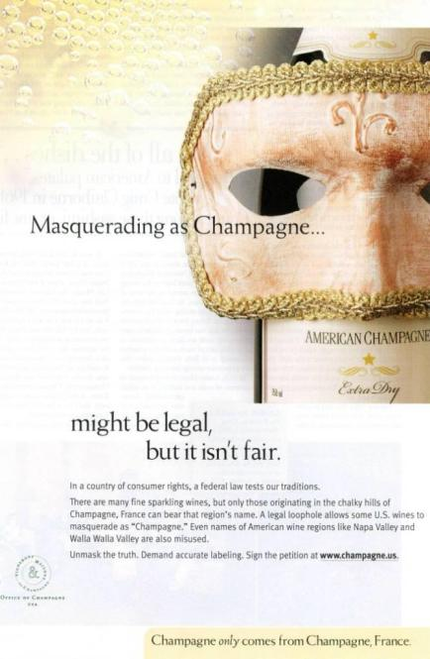

Slide 114

????????????????????????

Slide 115
Google is an internet search engine. Also a news aggregator, map provider, storehouse for images, library…
Is it a verb? (Googling, being Googled).
At least one lexicography site received a letter in response to the addition of the word “google” (as a verb) asking the site manager to delete the definition or “revise it to take account of the trademark status of Google”
Aside from sending letters from their legal department, Google places policies for third party use of its trademark on the web
http://www.google.com/permissions/trademark/rules.html
… use the Google Brand Search Engine to find “Rules for proper usage”
Has the word Google become generic?

Slide 116
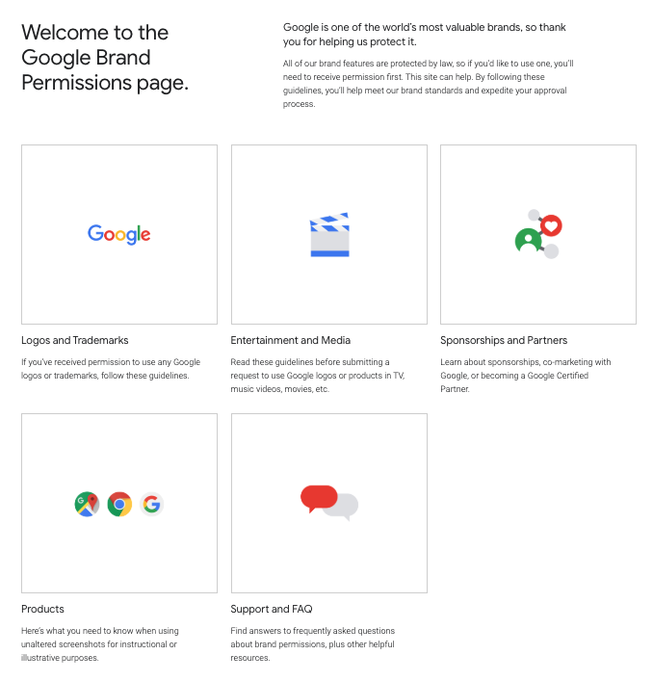

Slide 117
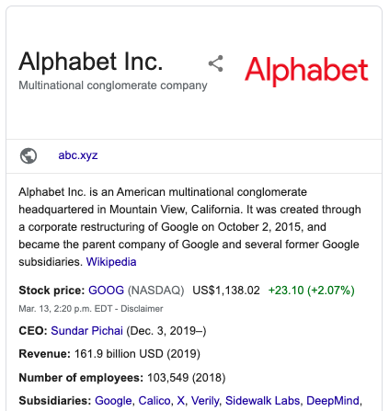
Corporate Strategy & Strategic Replacement?

Slide 118


Slide 119
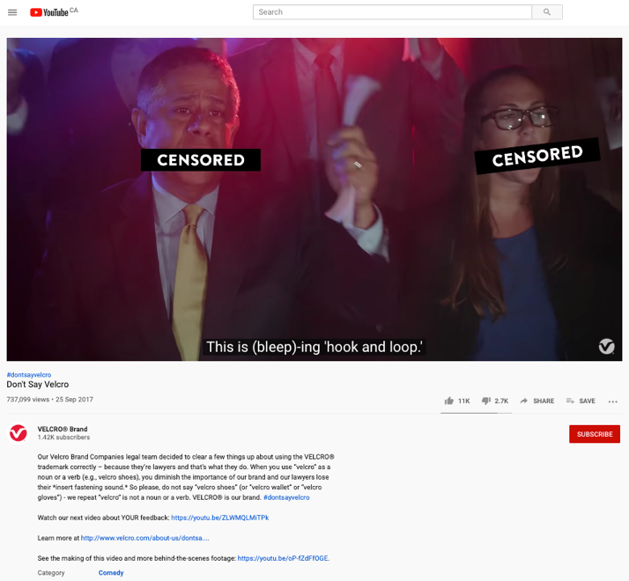
https://youtu.be/rRi8LptvFZY

Slide 120
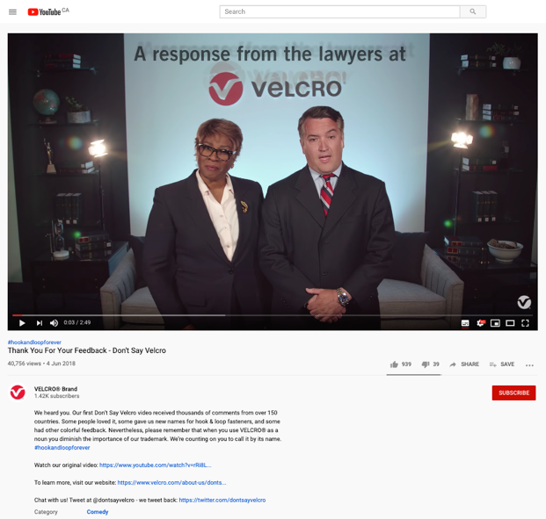
Follow-up
https://youtu.be/ZLWMQLMiTPk

Slide 121


Slide 122
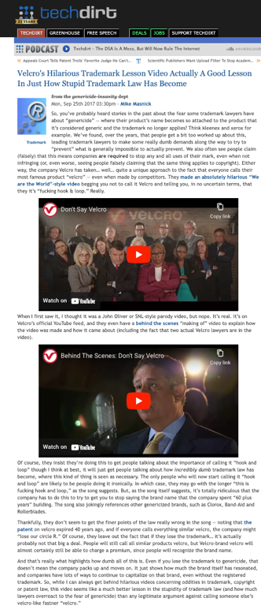

Slide 123
QUESTIONS?
THOUGHTS?
DISCUSSION?

Slide 124
Pause

Slide 125
Passing off Basics
Three (3) necessary components of a passing-off action:
  1. The existence of goodwill (done)
  2. Deception of the public due to a misrepresentation
  3. Actual or potential damage to the plaintiff

Slide 126
Passing off
Deception of the public due to a misrepresentation
Means misrepresentation
  Fundamental core feature of the tort of passing off
  Plaintiff must be able to establish that the defendant misrepresented his or her wares or services as those of the plaintiff in a manner that was likely to cause consumer confusion.
  Not necessary to establish actual confusion. Injunction to prevent anticipated confusion which would occur if a product were allowed to enter the market is possible.

Slide 127
Passing off
Back to: Institut national des appellations d’origine des vins…v. Andres Wines Ltd
Established that Plaintiff’s have goodwill in “champagne”
Thereafter in order to succeed Plaintiff must establish:
  That Defendant’s misrepresented their products as being Champagne (sparkling wines known as champagne and produced in France);
  That this misrepresentation is calculated or likely to deceive the public into thinking that the Canadian product is champagne;
  And that this conduct HAS or is LIKELY to injure the goodwill of the plaintiffs’ business (DAMAGE).
NOT ENOUGH for P to establish that the Defendants were BENEFITING from the use of the term champagne (which was established in the case). MERELY TAKING A BENEFIT DOES NOT CONSTITUTE TORT OF PASSING OFF.
Must prove misrepresentation leading to actual or potential confusion.
Court in Institut national held that there wasn’t a misrepresentation leading to confusion.
Canadian champagne is a distinct Canadian product not likely to be confused or even compared with French Champagne.

Slide 128
Passing off
Back to: Institut national des appellations d’origine des vins…v. Andres Wines Ltd
Canadian champagne producers wanting to establish there is no misrepresentation leading to confusion could show:
Marketing - They had marketed Canadian champagne in Ontario for many years;
Labelling - Word Canadian displayed as prominently as the word “Champagne” on Defendant’s products, in compliance with government directives, so as to clearly identify the products as Canadian;
Physical separation in Liquor Control Board of Ontario (LCBO) stores – for many years, the Canadian product has been physically separated from French champagnes in L.C.B.O. stores and listed separately by them..
ALSO evidence confirming that Canadian champagne has attained a reputation of its own in Ontario.
ALSO the Court found there was no confusion due to the nature of the wine consumer.

Slide 129
Passing off
Institut national des appellations d’origine des vins…v. Andres Wines Ltd
The Court said that the general public in Ontario is knowledgeable about wine products due to increased public exposure, educational exercises or publications on the subject, mass media ads that prevail on a daily basis [different than the situation in the UK in a case that dealt with Spanish Champagne - where it was found that customers would be confused, would think that the use of the term Spanish champagne is the same as French champagne].
The Court also found that the purchaser who is ignorant about wines and wishes to buy a bottle of champagne for a special occasion (aware of the general reputation of champagne) may choose a Canadian champagne under the mistaken belief that he is buying the champagne of high repute.
That said, consumers ignorant about wine would likely realize the difference between Canadian Champagne and Champagne from France either by the clear labelling of both, or the difference in listing and physical location at the L.C.B.O. stores, or, finally, by the vast price differential between the products.

Slide 130
Passing off: Recap
  Not enough for Plaintiff to establish Defendant was benefiting from using the term or name
  Need to prove misrepresentation leading to actual or potential confusion
  Misrepresentation may take a variety of forms
  Misrepresentation may be willful, negligent or careless (Kirkbi v. Ritvik)

Slide 131
Passing off: The Test Person 1
“The test person” is used in assessing confusion or the likelihood of confusion is crucial to the passing off analysis.
Can vary depending on the nature of the goods or services at issue. So in a case involving lemon juice in a squeeze bottle (RECKITT & COLMAN) the test person was the “shopper in a hurry”
Case suggests that if the product is an inexpensive mass market item, one usually part of a shopping trip for multiple items, where the consumer is likely to take it quickly from the shelf and toss it in their shopping cart, then similarities in product appearance are more likely to lead to confusion.
If the item in question is a luxury item, the consumer may well take more time to inspect the item, including the label, brand name, product literature. As a result, similarities in product appearance are less likely to lead to confusion.

Slide 132
Passing off: The Test Person 2
Why is the test person so important to the passing off analysis?
Impacts the confusion/misrepresentation requirement.
If you attribute knowledge, sophistication to the test person = less likely to be confused
If you say that the test person is in a hurry, not a lot of time = more likely to be confused.
Varying interpretations of the “test person” could either expand or narrow the tort of passing off. As a corollary, it either increases, or restricts competition.

Slide 133

What would a detailed case review reveal?

Slide 134
Passing off
British Columbia Automobile Assn. v. Office and Professional Employees' International Union, Local 378, 2001 BCSC 156 (B.C.S.C.)
During a labour dispute, Union creates various versions of websites similar to the BCAA’s website in appearance and uses the BCAA’s trademarks in its domain name and meta tags
Union used the domain names “bcaaonstrike” and “bcaabacktowork” - Websites www.bcaaonstrike.com and www.bcaabacktowork.com
Passing off?
Sigurdson J. finds context (labour dispute) significant to determination…

Slide 135
Passing off
British Columbia Automobile Assn. v. Office and Professional Employees' International Union, Local 378, 2001 BCSC 156 (B.C.S.C.)
First website looked very similar to the 1997 BCAA site
The phrase “Greetings BCAA is on strike” is on the website
Similarities with BCAA website design; colour, size of font, placement of logos
Had CAA and BCAA logos on site
Initial meta tags duplicated the 1997 content.
Was there a misrepresentation leading to confusion in this website?
Yes. With all the similarities, there was misrepresentation that the site was connected to the plaintiff’s site
Who is the test person for internet web sites?
Union argued that the test is a reasonably prudent user. Rejected [Note the broader concept of test person]
Was the “casual or hurried observer” [para. 212]

Slide 136
Passing off
British Columbia Automobile Assn. v. Office and Professional Employees' International Union, Local 378, 2001 BCSC 156 (B.C.S.C.)
Second website
Changes made.
Union removed CAA logo, changed BCAA
Moved Greetings message so that most of it couldn’t be seen on a standard screen
Passing off?
No. Reduced possibility of confusion

Slide 137
Passing off
British Columbia Automobile Assn. v. Office and Professional Employees' International Union, Local 378, 2001 BCSC 156 (B.C.S.C.)
Third site
Relates to the domain names bcaaonstrike.com and bcaabacktowork.com and the use of the meta tags
Held: NO passing off… No misrepresentation that the Union site is a site of the plaintiff, or a site that is endorsed by, affiliated with or connected to the plaintiff; Judge says there is no confusion or possibility of confusion in the minds of an internet web user that the site is associated with or the property of the BC Automobile Association.
Sigurdson J. held that in the context of a labour relations campaign, the fact that the Union is using similar meta tags and domain names (bcaabacktowork v. bcaa) is not as significant. Particularly because there is far less of a likelihood of confusion.
No evidence of actual confusion. Now, this is not a required element, but it’s a factor.
Ultimately , passing off w. first website; not 2nd or 3rd website.

Slide 138
Passing off
British Columbia Automobile Assn. v. Office and Professional Employees' International Union, Local 378, 2001 BCSC 156 (B.C.S.C.)
Three more points:
Note Sigurdson J.’s statement that a reasonable balance has to be struck between the legitimate protection of a party’s intellectual property and a citizen’s or a Union’s Charter right to freedom of expression.
Sigurdson J. notes that the prominence to be given to a disclaimer must, to some extent, depend on the likelihood of a false impression being conveyed to the public if there is no disclaimer. The greater the likelihood the more prominent must be the disclaimer. There will be some situations where no disclaimer will be adequate.
There was no evidence of actual confusion. Now, this is not a required element, but it’s a factor.
Ultimately , passing off with respect to the first website; not 2nd or 3rd website.

Slide 139
Questions to Contemplate?
If protestors can picket or leaflet outside a storefront, should they not be allowed to protest an online virtual storefront? Is there anything wrong with a “virtual picket line”? Are there particular norms that a “virtual picket line” should be obligated to adhere to?

Slide 140
Passing off
British Columbia Automobile Assn. v. Office and Professional Employees' International Union, Local 378, 2001 BCSC 156 (B.C.S.C.)
The Court, in BCAA, noted two broad categories of passing off:
  1) Where competitors are engaged in a common field of activity, and the Plaintiff has alleged that the Defendant has named, packaged or described its product or business in a manner likely to lead the public to believe the Defendant’s product or business is that of the Plaintiff
  2) Where the Defendant has promoted his product or business in such a way as to create the false impression that his product or business is in some way approved, authorized or endorsed by the Plaintiff or that there is some business connection between the Defendant and the Plaintiff. In this way a Defendant may hope to “cash in” on the goodwill of the Plaintiff
Accordingly, a large part of the issue comes to revolve around confusion as to source: Were customers confused into thinking that the OPEIU site was the BCAA site? Or were customers were confused into thinking that the OPEIU site was approved, authorized or endorsed by the Plaintiff – or that there is a business connection between the Defendant and the Plaintiff (which in a sense there was).

Slide 141
Passing off: Initial Interest Confusion 1
British Columbia Automobile Assn. v. Office and Professional Employees' International Union, Local 378, 2001 BCSC 156 (B.C.S.C.)
The Court in BCAA also brought up another type of confusion known “initial interest confusion” which is a somewhat controversial issue in passing off and TM law.
The “initial interest confusion” doctrine has received limited attention from Canadian courts, but a lot more attention in the U.S.
Initial interest confusion refers to the use of another's trade-mark in a manner calculated to capture initial consumer attention even though no actual sale is completed as a result of the confusion (Brookfield Communications Inc. v. West Coast Entertainment Corp., 174 F.3d 1036 (9th Cir. 1999).
This test of confusion carries with it a lower threshold than the traditional test of confusion in passing off (confusion as to source - your product is their product); confusion as to association, endorsement, approval.
Initial interest confusion simply considers whether the defendant's use of the plaintiff's mark evoked "initial interest” in a potential customer, even if it did not result in a sale.
A bit vague and amorphous. So vague that it potentially serves as a potent weapon for keeping legitimate competitors out of the market.

Slide 142
Passing off: Initial Interest Confusion 2
British Columbia Automobile Assn. v. Office and Professional Employees' International Union, Local 378, 2001 BCSC 156 (B.C.S.C.)
The “initial confusion” doctrine was expressly adopted in Brookfield Communications Inc v. West Coast Entertainment Corp (9th Cir. 1999) 174 F.3d 1036, 1061-66.
Case mentioned in BCAA v. OPEIU.
In Brookfield, two online retailers with tangentially related products went to battle over the defendant's use of plaintiff's trademark in defendant's internet website "metatags." (Metatags being computerized code words that play some role in attracting internet search engines to a website.)
Rather than applying a traditional analysis, the court applied the Initial Interest Confusion Doctrine, finding that the use of plaintiff's mark could result in the improper initial interest in defendant's site, and therefore trademark infringement. In so doing the Court used the following analogy…

Slide 143
“Using another's trademark in one's metatags is much like posting a sign with another's trademark in front of one's store. Suppose West Coast's competitor (let's call it "Blockbuster") puts up a billboard on a highway reading--"West Coast Video: 2 miles ahead at Exit 7"--where West Coast is really located at Exit 8 but Blockbuster is located at Exit 7. Customers looking for West Coast's store will pull off at Exit 7 and drive around looking for it. Unable to locate West Coast, but seeing the Blockbuster store right by the highway entrance, they may simply rent there. Even consumers who prefer West Coast may find it not worth the trouble to continue searching for West Coast since there is a Blockbuster right there. Customers are not confused in the narrow sense: they are fully aware that they are purchasing from Blockbuster and they have no reason to believe that Blockbuster is related to, or in any way sponsored by, West Coast. Nevertheless, the fact that there is only initial consumer confusion does not alter the fact that Blockbuster would be misappropriating West Coast's acquired goodwill.”

Slide 144
Passing off: Initial Interest Confusion 3
British Columbia Automobile Assn. v. Office and Professional Employees' International Union, Local 378, 2001 BCSC 156 (B.C.S.C.)
Any issues with the analogy in Brookfield Communications Inc v. West Coast Entertainment Corp ?
Big difference between driving around aimlessly looking for a video store, and simply hitting the ‘go-back’ button on your laptop. We are accustomed to false starts on the web and are unlikely to be dissuaded when they end up at the wrong site.
Departure from the core principal of trademark law – finds infringement where there is only a fleeting confusion which is dispelled before any purchase.
Can there really be a policy justification for finding infringement where the consumer is not confused at the time of purchase?

Slide 145
Passing off: Initial Interest Confusion 4
British Columbia Automobile Assn. v. Office and Professional Employees' International Union, Local 378, 2001 BCSC 156 (B.C.S.C.)
With respect to “Initial Interest Confusion” doctrine in Brookfield Communications Inc v. West Coast Entertainment Corp isn't more information, and competition between vendors, in the consumer's best interest? Until clear policy and evaluative standard are articulated, the Doctrine can only lead to problems. Doctrine mostly used in U.S.A*…but has been raised in Canada. Though mentioned in BCAA, it was not part of analysis.
*For example, the Initial Interest Confusion Doctrine has been used to curtail parodies, (See Dr. Seuss, supra.) criticism about the trademark owners, (OBH, Inc. v. Spotlight Magazine, Inc. (W.D.N. 4 2000) 86 F.Supp.2d 176; J.K. Harris & Co. v. Kassell (N.D. Cal. 2002) 2002 WL 1303124, rev'd (N.D. Cal.2003) 253 F.Supp.2d 1120)), directory information about used equipment dealers, (Caterpillar Inc. v. Telescan Techs, LLC ((C.D. Ill2002) 2000 U.S. Dist Lexis 3477; PACCAR Inc. v. Telescan Techs, LLC (6th Cir. 2003) 319 F.3d 246), and promotions by third party vendors of after-market servicing. See Promatek Indus. Ltd. v. Equitrac Corp. (7th Cir. 2002) 300 F.3d 808.

Slide 146
Passing off: Initial Interest Confusion 5
British Columbia Automobile Assn. v. Office and Professional Employees' International Union, Local 378, 2001 BCSC 156 (B.C.S.C.)
The “initial confusion” doctrine was expressly adopted in Brookfield Communications Inc v. West Coast Entertainment Corp (9th Cir. 1999) 174 F.3d 1036, 1061-66.
Case mentioned in BCAA v. OPEIU.
In Brookfield, two online retailers with tangentially related products went to battle over the defendant's use of plaintiff's trademark in defendant's internet website "metatags." (Metatags being computerized code words that play some role in attracting internet search engines to a website.)
Rather than applying a traditional analysis, the court applied the Initial Interest Confusion Doctrine, finding that the use of plaintiff's mark could result in the improper initial interest in defendant's site, and therefore trademark infringement. In so doing the Court used the following analogy…

Slide 147
Passing off: Initial Interest Confusion 6
Law Society of British Columbia v. Canada Domain Name Exchange Corp., [2002] B.C.J. No. 1909 (B.C.S.C.) 1
Defendant resolved the domain names lawsocietyofbc.ca & lsbc.ca to websites displaying adult content.
Court found Defendant had used the disputed domain names to attract the public to its websites for the purpose of generating income.
The Court held there was passing off.
Although there was no mention of initial interest confusion, the Court did find that the disputed domain names were being used to divert Internet traffic to the Defendant's websites, the contents of which would immediately dispel confusion among Internet users looking for the Plaintiff Law Society*.
Finding does appear compatible with the doctrine of initial interest confusion.
* Ya think?

Slide 148
Passing off: Initial Interest Confusion 7
Law Society of British Columbia v. Canada Domain Name Exchange Corp. 2
Court finds that in registering the domain name including the LSBC, Defendants made a false representation that they are associated or connected with the LSBC.
Rather than make a decision on the basis of initial interest confusion, the court in effect manages to fit this fact situation within the second type of passing off, being where a Defendant has promoted his product or business in such a way as to create the false impression that their product or business is in some way approved, authorized or endorsed by the Plaintiff or that there is some business connection between the Defendant and Plaintiff.
Is the Court’s characterization somewhat tenuous? False representation only made at point of registration; confusion dispelled by consumers, the “test people” – as soon as they find adult content on what they thought was the Law Society site
Reminder that initial interest confusion hasn’t been formally accepted in Canadian courts (alluded to in LSBC v. CDNEC; mentioned in BCAA). Watch for it.

Slide 149
Passing off: Initial Interest Confusion Recap
The Court in BCAA brought up another type of confusion known “initial interest confusion” which is a somewhat controversial issue in passing off and TM law.
The “initial interest confusion” doctrine has received limited attention from Canadian courts, but a lot more attention in the U.S.
Initial interest confusion refers to the use of another's trade-mark in a manner calculated to capture initial consumer attention even though no actual sale is completed as a result of the confusion (Brookfield Communications Inc. v. West Coast Entertainment Corp., 174 F.3d 1036 (9th Cir. 1999).
This test of confusion carries with it a lower threshold than the traditional test of confusion in passing off (confusion as to source - your product is their product); confusion as to association, endorsement, approval.
Initial interest confusion simply considers whether the defendant's use of the plaintiff's mark evoked “initial interest” in a potential customer, even if it did not result in a sale.
A bit vague and amorphous. So vague that it potentially serves as a potent weapon for keeping legitimate competitors out of the market.
Does this possible doctrine expand passing off too much?

Slide 150
Passing off: Initial interest confusion SUMMARY
Refers to the use of another's trade-mark in a manner calculated to capture initial consumer attention even though no actual sale is completed as a result of the confusion
Can serve as a potent weapon for keeping legitimate competitors out of the market
Limited attention in Canada; much more in US
Should it be allowed or discouraged in Canada?

Slide 151
QUESTIONS?
THOUGHTS?
DISCUSSION?

Slide 152
Pause

Slide 153

On with the show…

Slide 154
Passing off: Damage
Several types of possible damage in the context of a passing off action …
Loss of goodwill and reputation
Where a competitor passes off an inferior product as the plaintiff’s product. Dissatisfied customers who think they have purchased from the plaintiff may decide never to purchase from them again, and to tell their friends not to.

Slide 155
QUESTIONS?
THOUGHTS?
DISCUSSION?

Slide 156
Pause

Slide 158


Slide 160
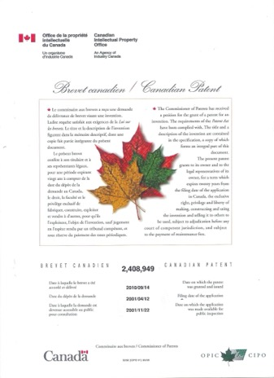
Coming Soon
Patents

Slide 161
SEE YOU IN TWO WEEKS!

Slide 162

Always include a cat picture

Slide 163
In learning you will teach
And in teaching you will learn
Phil Collins' Son of Man (1999)

