Slide 1

Trademarks Fin
Talk 10
LAW 422 001
Intellectual Property Law
Allard School of Law, UBC
Fall, 2023
Jon Festinger K.C.
UBC/Allard School of Law
TrU Faculty of Law
Of Counsel, chandler, fogden, lyman
https://iplaw.allard.ubc.ca/

Slide 2
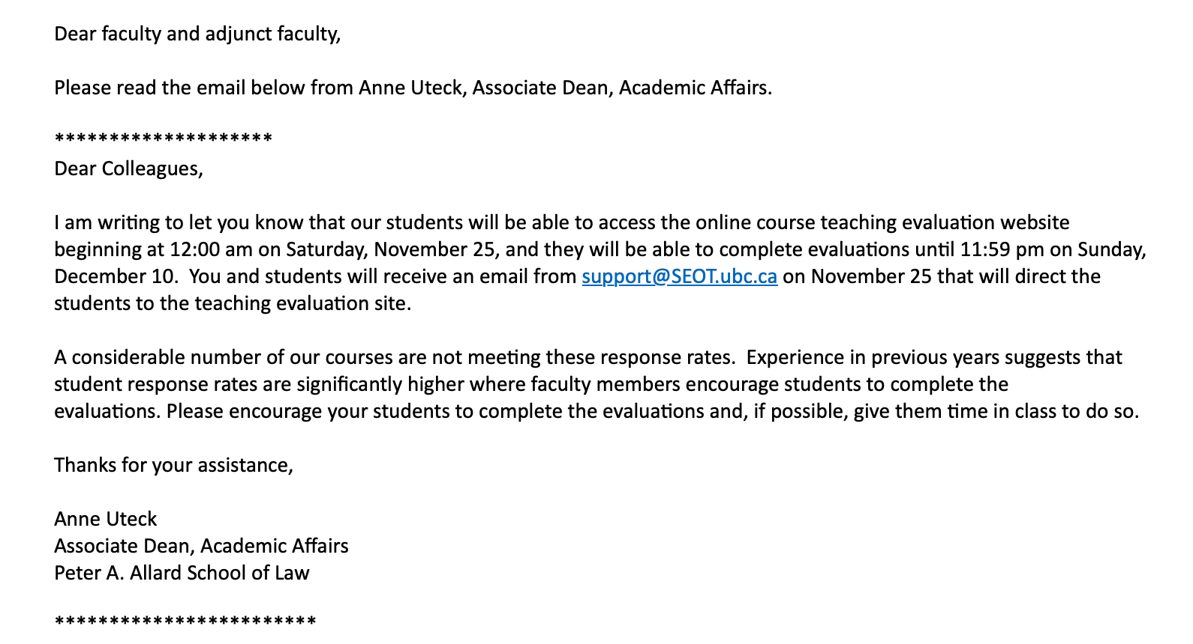
But First…Course Evaluations

Slide 3
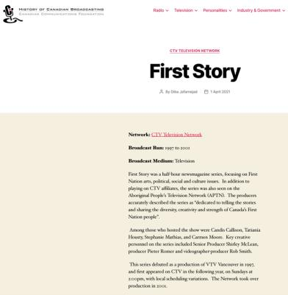
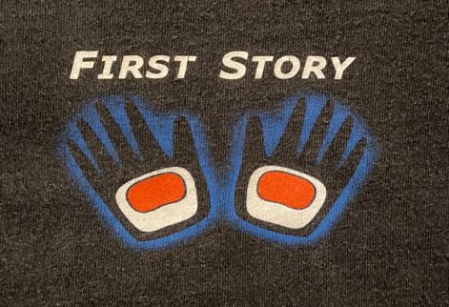
Acknowledgement that we are situated on the
traditional, ancestral, unceded territory of the Musquem. people.

Slide 4
Logistics

Slide 5
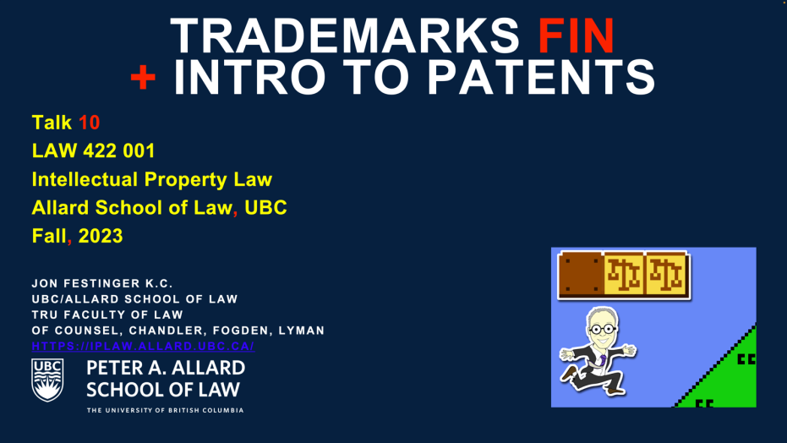
On Course Website (includes all of Patents)

Slide 6
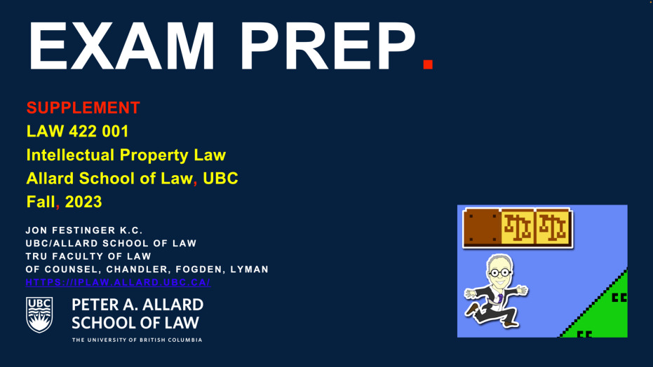
Also On Course Website

Slide 7
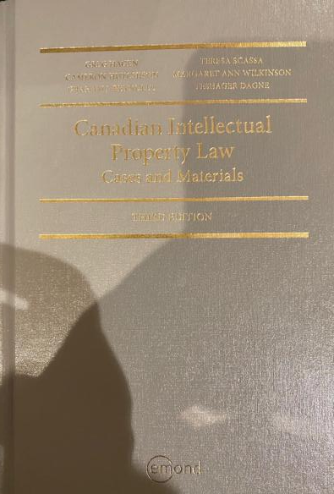
Text @ UBC Bookstore

Slide 8
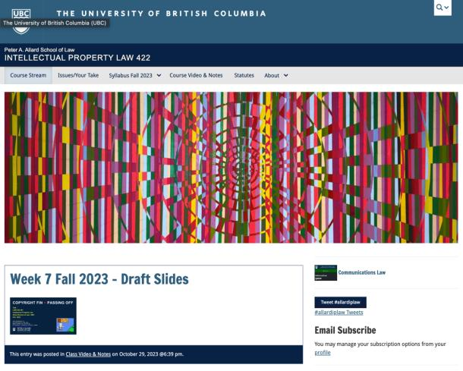
Course Website
https://iplaw.allard.ubc.ca/

Slide 9
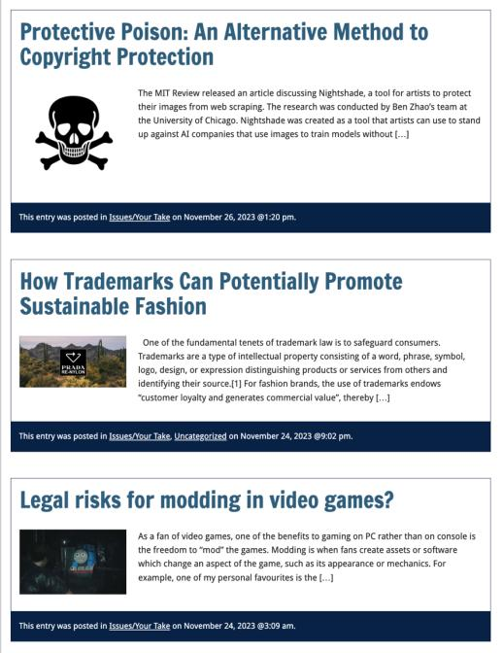

Slide 10
PLEASE
SIGN UP

Slide 11
For full privileges on the website
1. Please create an account at http://cms.ubc.ca/ using your CWL.
2. Once you create an account and sign in at http://cms.ubc.ca/ you can click your name in the top right. Halfway down the following page will be your WordPress email address.
3. Send me your WordPress email address at jon.festinger@ubc.ca or at jon_festinger@thecdm.ca
4. Then, I will invite you to participate with authoring privileges via your WordPress email address.

Slide 12
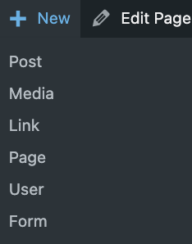

Slide 13
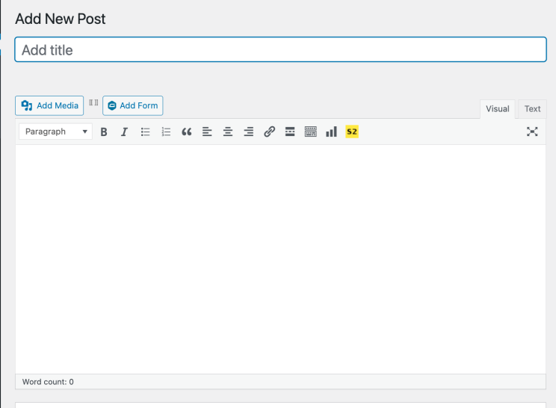

Adding Images

Slide 14



Slide 15
Adding Links

Slide 16
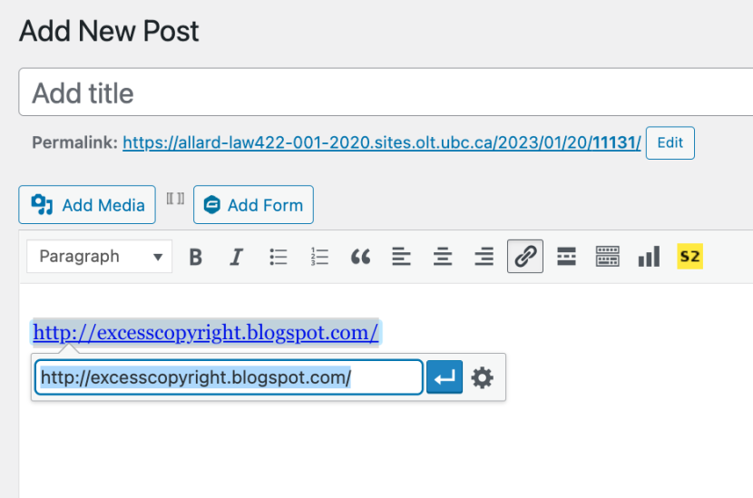


Slide 17
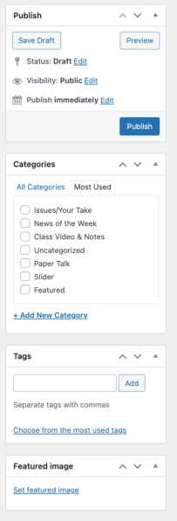
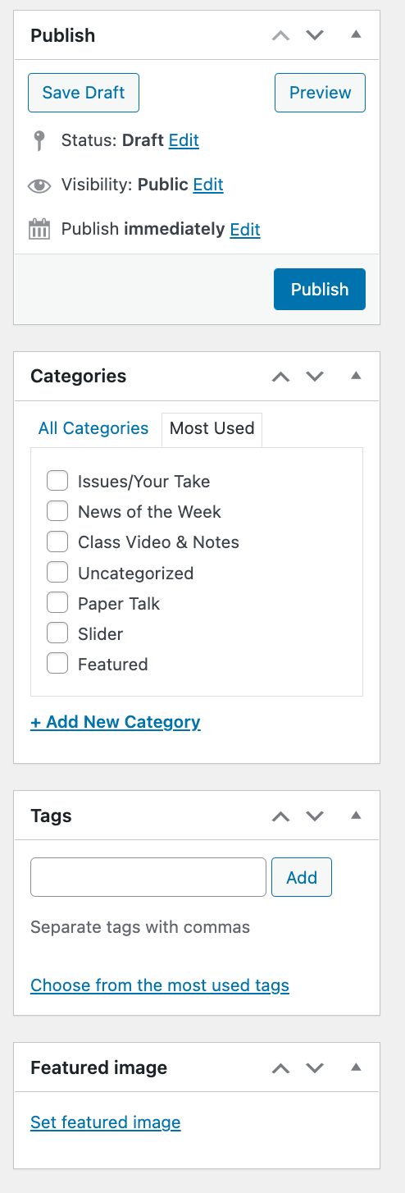

Adding a “Featured Image”

Slide 18


Slide 19
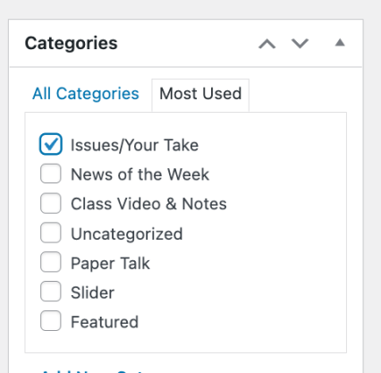

Setting Categories

Slide 20
Thank you for
your bios. & favorite I.P.’s
Much appreciated.

Slide 21
Let’s talk about…
The 30%
Paper/Presentation/Post = 20%
Participation = 10%

Slide 22
20% = a modest proposal…
750-1000 words (or equivalent) per person
written, video, podcast, in-class presentation (?), interpretive dance
Website or not
Groups or individually
LLM Students – one extra

Slide 23
DUE 11:59:59 PM
LAST DAY
OF THE TERM
(END OF EXAM PERIOD)

Slide 24
HOWEVER,…
ENCOURAGE POSTING
BEFORE END OF CLASSES
…YOUR CLASSMATES
WILL BENEFIT

Slide 25
Additional
Evaluation
(LLM students)

Slide 26
LLMCL Students Registered in the Class as such: Additional Task
750 – 1000 word post (or email)
???????????

Slide 27
Please use:
Jfestinger@telus.net
jon.festinger@ubc.ca

Slide 28
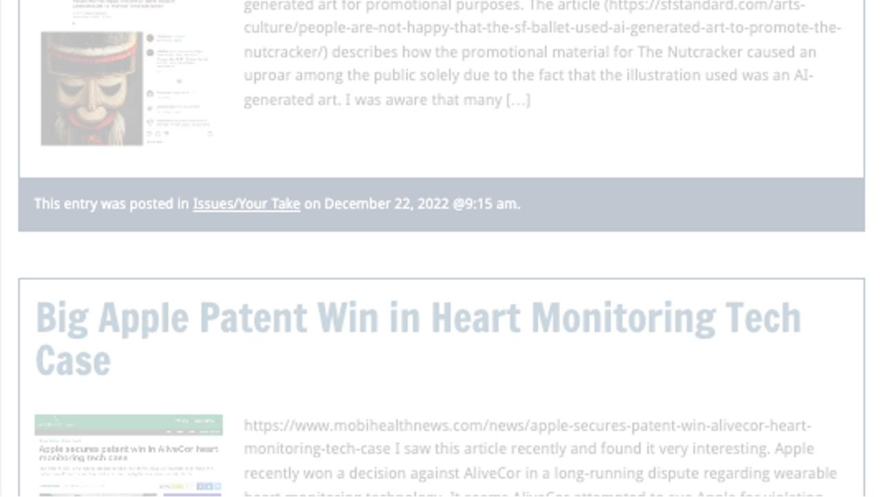
Past Presentations mostly all on the course website…

Slide 29
The 10%
Participation is broadly defined includes any or all:
class contributions however made
website contributions
email or other discussions with Instructor

Slide 30

Anything & everything can be done via email if you prefer

Slide 31
Final Exam
Tuesday, December 19, 2023
@ 9 AM PST
422.001/570C.001 INTELLECTUAL PROPERTY
Computers = Room ?
Hand-writers = Room ?

Slide 32
Zoom Q&A Sessions
(Study Groups Preferred If Possible)

Slide 33
QUESTIONS?
THOUGHTS?
DISCUSSION?

Slide 34

Pause

Slide 35

Random Notes

Slide 36


Slide 37
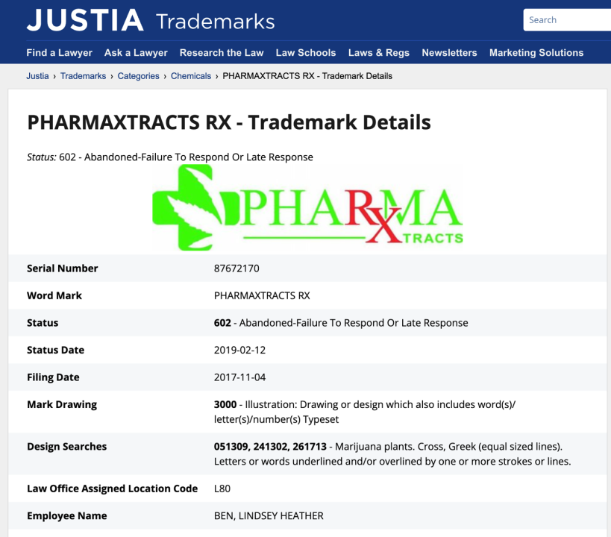

Slide 38
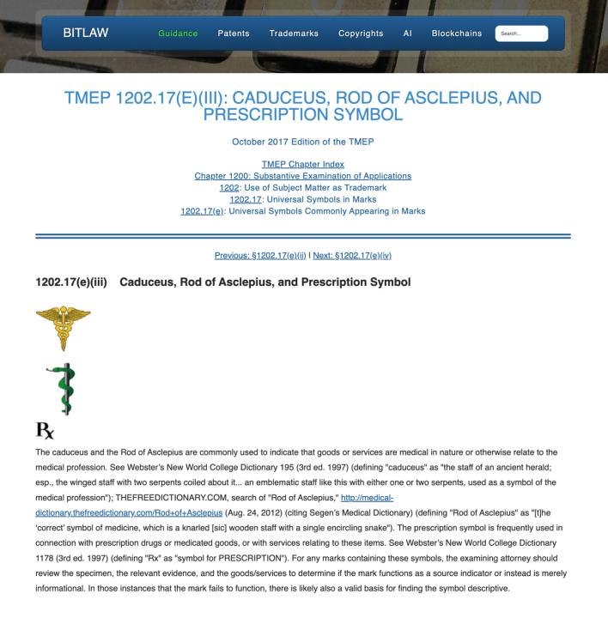

Slide 39
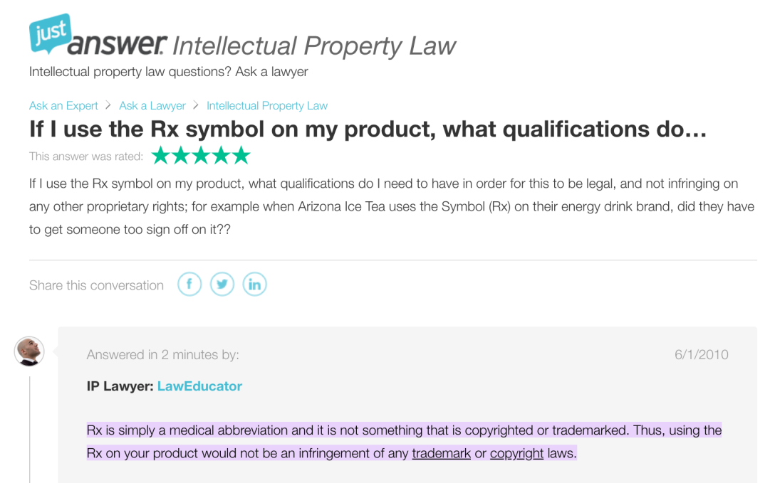

Slide 40
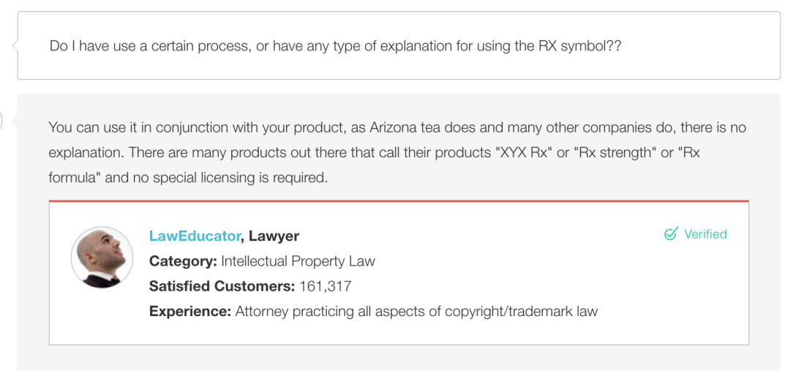

Slide 41
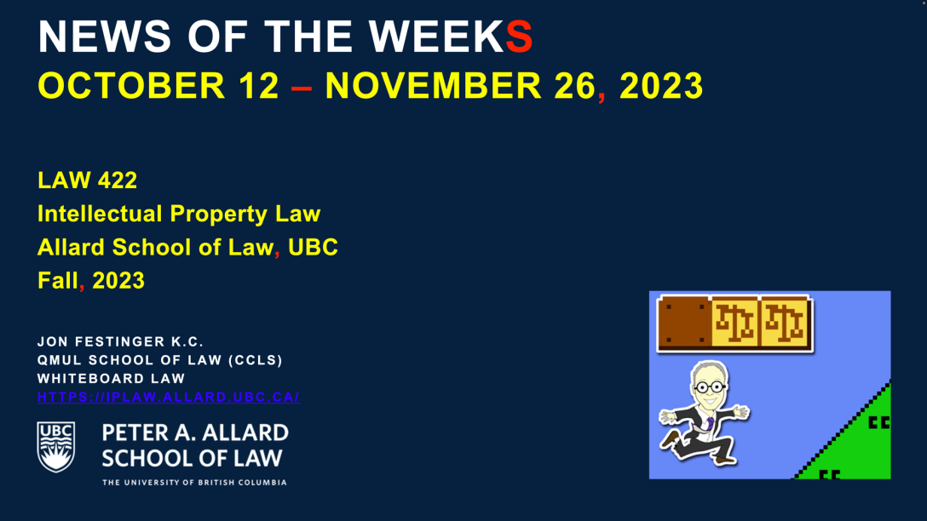

Slide 42
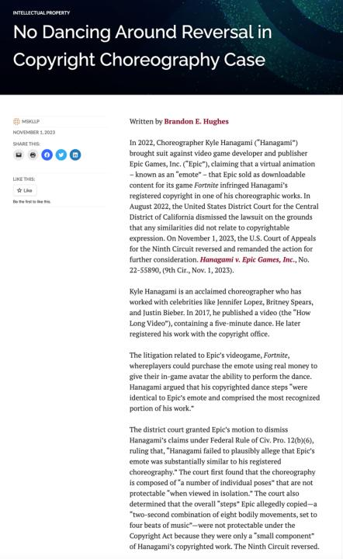

Slide 43
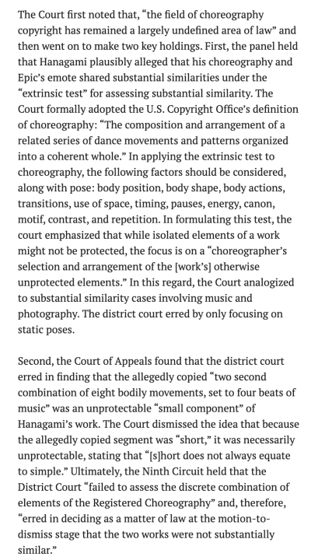

Slide 44
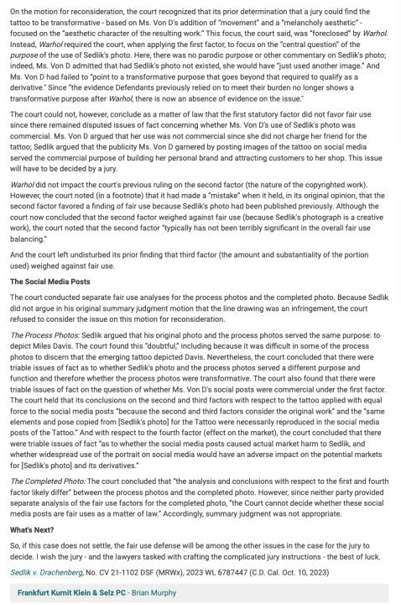

Slide 45
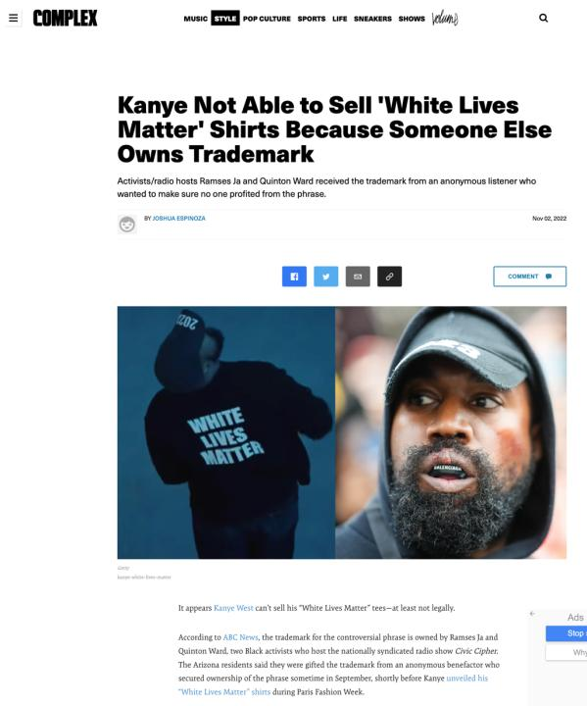

Slide 46
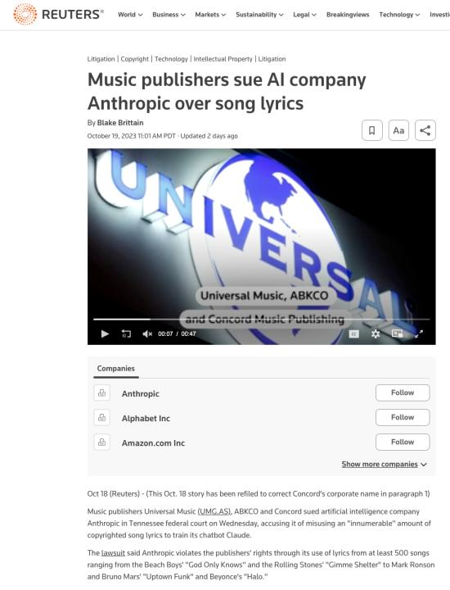

Slide 47
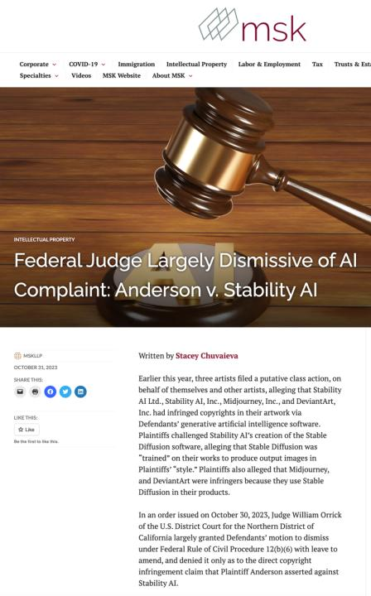

Slide 48
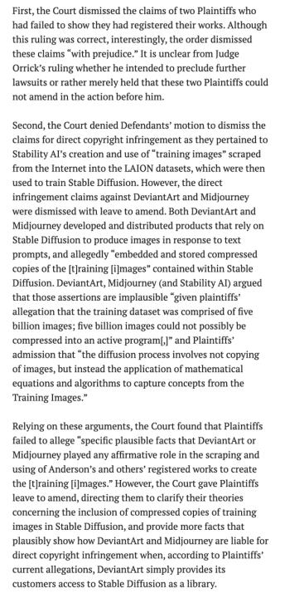

Slide 49
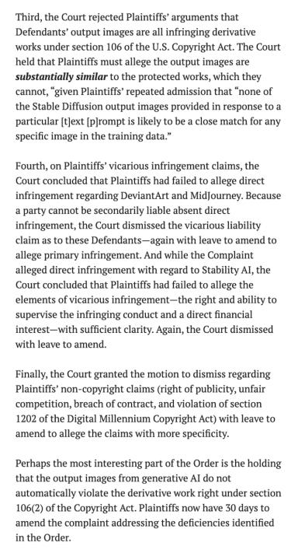

Slide 50
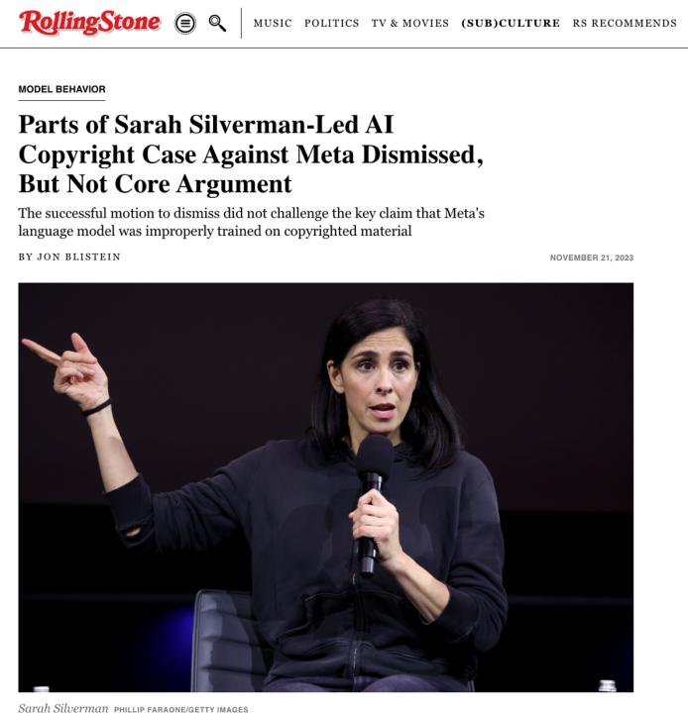

Slide 51
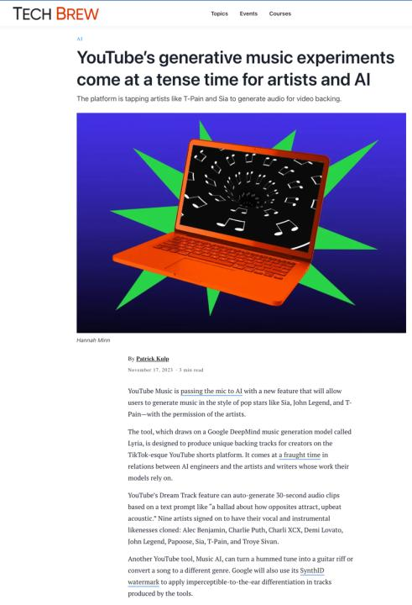

Slide 52
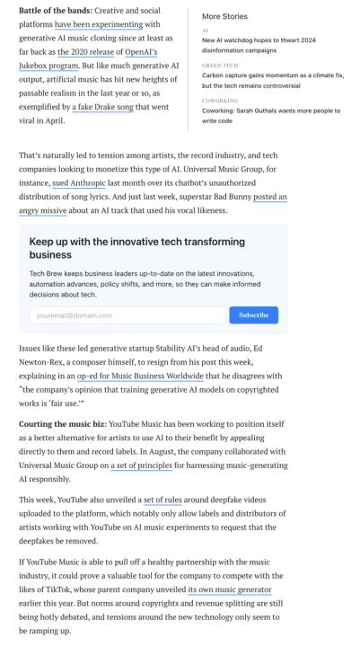

Slide 53
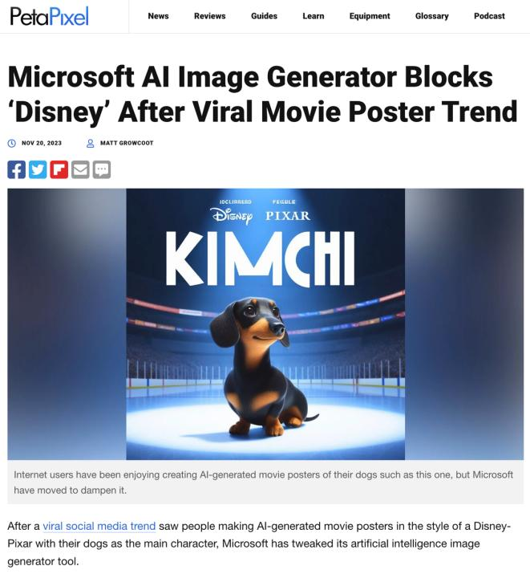

Slide 54
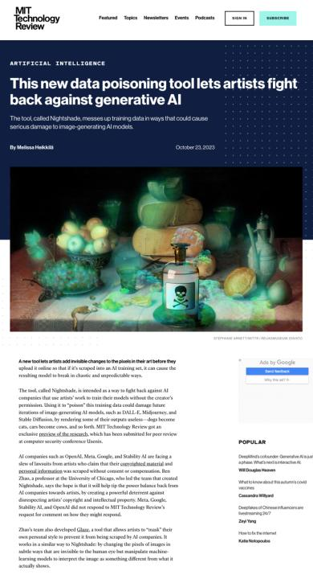

Slide 55
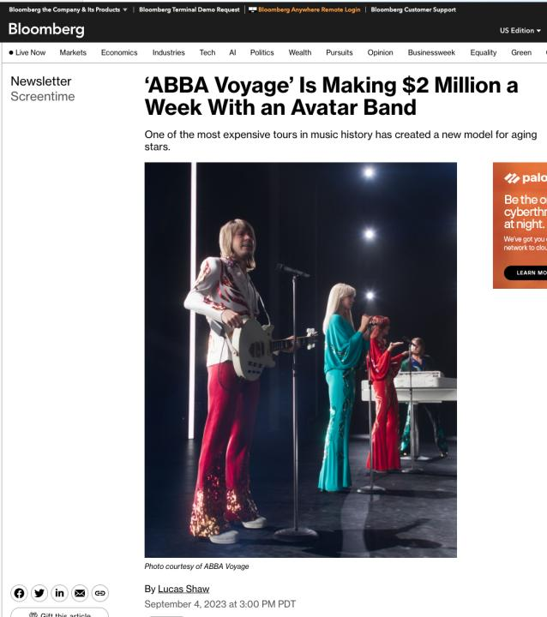

Slide 56


Slide 57
QUESTIONS?
THOUGHTS?
DISCUSSION?

Slide 58
Pause

Slide 59

Where we have been…

Slide 60

Trademarks

Slide 61
Trademarks
What is a Trademark ™?
  A mark used by a person for the purpose
  of distinguishing that person’s goods or
  services from those of others in the
  marketplace
Various types of marks
  Ordinary (word & design), certification,
  collective, official, distinguishing guise

Slide 62

Trademarks
Ordinary marks
  Distinguish the products or services of a specific firm or individual

Slide 63
Trademarks v. Passing Off*
Why would you want to register your TM?
Why not just rely on passing off?
TM = no proof of goodwill required. Only proof of use.
Registration of a mark provides national protection
Registered marks are presumed valid for Canada for all the wares and services for which they are registered.
s. 22 of the TMA protects against mark dilution.
In situations where a mark is deemed invalid, a passing off action might still succeed.
* You will see this slide again later

Slide 64
Trademarks
Certification marks
  Identify wares or services which meet defined standards.
  Can be used by anyone who complies with the standards defined by the owner of the certification mark; and who is licensed by the owner
  Owned by one person but licensed to others
  Defined in s. 2 of the TMA

Slide 65

Trademarks
Collective marks
  Signs that distinguish the geographical origin, material, mode of manufacture or other common characteristics of goods or services of enterprises using the collective mark
  Function: inform public about certain features of the product
  Owned by an entity; members of this entity are entitled to use the mark.

Slide 66

Trademarks
A purely functional design may not be the basis of a TM, registered or unregistered
  See Kirkbi v. Ritvik (SCC)

Slide 67
Trademarks
Ordinary marks
Amended definition (2014 - in effect 2019):
  TM: A sign or combination of signs that is used or proposed to be used by a person for the purpose of distinguishing or so as to distinguish their goods and services from those of others.
  Sign: Includes a word, a personal name, a design, a letter, a numeral, a colour, a figurative element, a three-dimensional shape, a hologram, a moving image, a mode of packaging goods, a scent, a taste, a texture, and the positioning of a sign.

Slide 68
Trademarks
S. 12(1): A TM is registrable if it is not:
  (a) Primarily merely a name or surname of an individual living or who has died within 30 years
  (b) Clearly descriptive or deceptively misdescriptive in English or French of the character/quality of wares/services or of the conditions of production/persons employed in their production/place of origin

Slide 69
Trademarks
S. 12(1): TM is registrable if it is not:
  (c) Name in any language of any of the wares or services in connection with which it is used
  (d) Confusing with a registered TM (confusing defined in s. 6(2); factors in s. 6(5))
  (e) Mark prohibited by s. 9 or 10…
  S. 12(2): not registrable if its features are dictated primarily by a utilitarian function
  S. 12(3): If not registrable due to (1)(a) or (b), is registrable if has … become distinctive at the date of filing an application for registration (see also s. 32)

Slide 70
Trademarks
Canada (Registrar of TMs) v. Coles Book Stores, [1974] SCR 438
  1) Is the mark a word?
    Standard Oil Co. v. Canada (Registrar of TM), [1968] 2 Ex C.R. 523.
  2) Is it primarily merely a name or surname of an individual who is living or who has died within the previous 30 years?

Slide 71
“In the case at bar, the evidence clearly establishes that “Coles” is a surname that is well-known to the general public of Canada. On the other hand, the dictionary meanings of the word “cole” and in its plural form “coles”, particularly as found in the Oxford English Dictionary, are largely obsolete. A customer in need of a cabbage does not ask for a “cole”. The only common use of the word that I can think of is in the word “coleslaw”. The inference I draw from the evidence concerning the dictionary definitions of the word “cole” is that it is a word of rare, if not obsolete, usage and would be little known to the general public of Canada. I do not agree with the conclusion of the learned judge of the Exchequer Court that the principal character of the word “Coles” is “equally that of a surname and of a dictionary word in the English language.” My only possible conclusion in this case is that a person in Canada of ordinary intelligence and of ordinary education in English or French would immediately respond to the trade mark “Coles” by thinking of it as a surname and would not be likely to know that “Coles” has a dictionary meaning.”

Slide 72
Trademarks
Test to Apply: Would a person in Canada
of ordinary intelligence and of ordinary
education in English or French be just as
likely, if not more likely, to respond to the
word by thinking of it as a brand or a
mark of a business than as a name/surname?

Slide 73
Trademarks
Unilever Canada Inc. v. Superior Quality Foods Inc. (2007), 62 CPR (4th) 75, [2007] TMOB No. 66
Facts: Superior Quality Foods, Inc. filed an application to register the TM BETTER THAN BOULLION for use in association w. soups and soup bases.
Issue: s. 12(1)(b) …Is the mark clearly descriptive or deceptively misdescriptive in the English or French language of the character or quality of the wares or services in association with which it is used or proposed to be used or of the conditions of or the persons employed in their production or of their place of origin.

Slide 74
Trademarks
Unilever Canada Inc. v. Superior Quality Foods Inc. (2007), 62 CPR (4th) 75, [2007] TMOB No. 66
Clearly descriptive = does the mark tell potential dealers/purchasers of the goods/services what the goods and services are, or describe them or describe a property which is commonly associated with them?

Slide 75
Trademarks
  Unilever Canada Inc. v. Superior Quality Foods Inc. (2007), 62 CPR (4th) 75, [2007] TMOB No. 66
  Deceptively misdescriptive = would dealers/purchasers of the goods be deceived by the misdescription into purchasing goods or ordering services which different in character or quality from those expected?

Slide 76
Trademarks
  Unilever Canada Inc. v. Superior Quality Foods Inc. (2007), 62 CPR (4th) 75, [2007] TMOB No. 66
S. 12(1)(b):
  Point of View?: That of the average purchaser of the wares
  Consider the mark in its entirety (not dissected into constituent elements)
  Consider thee mark as a matter of immediate impression

Slide 77
Trademarks
  Unilever Canada Inc. v. Superior Quality Foods Inc. (2007), 62 CPR (4th) 75, [2007] TMOB No. 66
Decision: “The Mark … clearly describe[s] as a matter of first impression that the Applicant’s soups and soup bases are ‘better than boullion’, a laudatory description that is contrary to s. 12(1)(b)”
Policy justification: This is an ordinary, grammatical phrase that others in the industry should be able to use to fairly describe their products. / different decision - “the vocabulary of the English language is common property: it belongs to all” (Eastman Photographic Materials Company Ltd. v. Comptroller-General of Patents, Designs and Trade Marks, [1898] A.C. 571 (H.L.), Lord Herschell at page 580 ”

Slide 78
Trademarks
General Foods Ltd. v. Carnation Co. (1978), 45 CPR (2d) 282 (TMOB)
Can GFL register the TM “Instant Breakfast” for use in association with wares described as “fortified powder food for mixing with milk”?
S. 12(1): TM is registrable if it is not (c) Name in any language of any of the wares or services in connection with which it is used
Also s.30(a) of the Trademarks Act in setting specifics for TM applications requires that applications must contain “a statement in ordinary commercial terms of the specific goods or services in association with which the mark has been or is proposed to be used.”
Are the words “fortified powder food for mixing with milk” ordinary commercial terms? Board held no. Statement in ordinary commercial terms for the product would be “instant breakfast”.
Accordingly, application to register the TM Instant Breakfast, which is also the name of the wares in English was found not registrable per s. 12(1)(c).

Slide 79

Trademarks - changes
Distinguishing guise provisions repealed in 2019
  The shape or design of the product or packaging that effectively distinguishes the product from others. In order for a distinguishing guise to be registered, it must be proven that it has become distinctive through usage.
  S. 13 Trademarks Act REPEALED
  Example: shape of Coca-Cola bottle

Slide 80
Instead of “distinguishing guise”
s. 2 …“sign includes a word, a personal name, a design, a letter, a numeral, a colour, a figurative element, a three-dimensional shape, a hologram, a moving image, a mode of packaging goods, a sound, a scent, a taste, a texture and the positioning of a sign;”

Slide 81
Trademarks
Distinguishing guise
New 12(2): A trademark is not registrable if, in relation to the goods or services in association with which it is used or proposed to be used, its features are dictated primarily by a utilitarian function
New 18.1: The registration of a trademark may be expunged by the Federal Court on the application of any interested person if the Court decides that the registration is likely to unreasonably limit the development of any art or industry
20(1.2): The registration of a trademark does not prevent a person from using any utilitarian feature embodied in the trademark

Slide 82
Trademarks
Glaxo Wellcome Inc. v. Novopharm Ltd (2000)
Glaxo sought registration the distinguishing guise for a six sided tablet, shaped as a shield.
Principles
  Not required to show that most adult Canadians recognize the applicant’s distinguishing guise
  Although the shape of a product can constitute a mark, the mark is usually weak
  The standard of proof in distinguishing guise cases under is the same as in other registration cases
  Relevant period of time for distinctiveness → date of application

Slide 83
Trademarks
S. 9(1)(n)(iii):
  Allows entities which are “public authorities”
  to request the Registrar of Trade-marks to
  give public notice of their adoption and use of
  particular names or symbols. These marks
  are referred to as “official marks”.
  Once notice is given, these official marks are
  also removed from the general realm of trade
  and commerce.

Slide 84
Trademarks
S. 9(1)(n)(iii) is controversial
S. 9(1) prohibits anyone else from adopting an official mark. This prohibition is absolute.
None of the usual formalities for the adoption of official marks
No opposition proceeding; no scrutiny by Registrar
Mark can be descriptive; not required to be distinctive of wares, services
No need to renew; no provisions to remove unused marks

Slide 85
Trademarks
Ontario Ass’n of Architects v. Ontario Assn of Architectural Technologists, [2003] 1 F.C. 331 (FCA)
Defining characteristics of public authority =
  Degree of government control [para. 57-64]
  Extent to which the body’s activities benefit the public [para. 65-73]

Slide 86
Trademarks
1. Significant degree of governmental control
More rigorous part of test
Consider body’s objects, duties and powers, including distribution of its assets
Need some ongoing government supervision of the activities of the body claiming to be a public authority; sufficient to allow the government to exercise a degree of ongoing influence in the body’s governance and decision-making.

Slide 87
Trademarks
2. Public benefit
Broadly interpreted by the courts – some aspect for public benefit? Considered to act for public benefit.
In this case the Architectural Technologists set & enforce standards of professional competence & ethical conduct of its members.
As a result, FCA held that the Technologists regulate part of the practice of the profession. The lower court judge concluded that these activities benefit the public, and the FCA agreed.

Slide 88
Trademarks
A TM owner who has a registered mark that resembles an official mark effectively has their rights frozen at the time of publication of the official mark
  See Royal Roads University v. R. (2003), 27 CPR (4th) 240 (F.C.)

Slide 89
QUESTIONS?
THOUGHTS?
DISCUSSION?

Slide 90
Pause

Slide 91

Now, continuing our regularly
scheduled programming…

Slide 92

On with the show…

Slide 93
Trademarks : Use
USE IT
OR
LOSE IT?

Slide 94
Trademarks
“Use”
First use … entitles you to register a TM but amended provisions now allow for filing without intended use.
Failure to use … basis for expungement of TM
Unauthorized use … could lead to infringement actions

Slide 95
Trademarks
4. (1) A trade-mark is deemed to be used in association with goods if, at the time of the transfer of the property in or possession of the goods, in the normal course of trade, it is marked on the goods themselves or on the packages in which they are distributed or it is in any other manner so associated with the goods that notice of the association is then given to the person to whom the property or possession is transferred.
(2) A trade-mark is deemed to be used in association with services if it is used or displayed in the performance or advertising of those services.

Slide 96
Trademarks
Syntex Inc. v. Apotex Inc., [1984] 2 FC 1012 (FCA)
Facts:
  Syntex was the registered owner of the TradeMark Naprosyn; has sold Naproxen under this name since 1974.
  Apotex took Apo-Naproxen as the brand name of its product; registered it as a TM in Canada.
  In 1982 Apotex distributed a one-page flyer to hospital and retail pharmacists in Canada designed to promote the sale of Apo-Naproxen. Naprosyn was referenced on this flyer… A note w. Naprosyn 250mg written on it is juxtaposed with two containers of Apo-Naproxen tablets.
  Also, a message …“Now pharmacists have a choice when filling a prescription for Naprosyn.”…

Slide 97
Trademarks
Syntex Inc. v. Apotex Inc., [1984] 2 FC 1012 (FCA)
Did the Defendants Apotex “use” the TM of the Plaintiffs Syntex (see ss. 2, 4 TMA)?
  4. (1) A trade-mark is deemed to be used in association with goods if, at the time of the transfer of the property in or possession of the goods, in the normal course of trade, it is marked on the goods themselves or on the packages in which they are distributed / or it is in any other manner so associated with the goods that notice of the association is then given to the person to whom the property or possession is transferred.

Slide 98
Trademarks
Syntex Inc. v. Apotex Inc., [1984] 2 FC 1012 (FCA)
  4. (1) A trade-mark is deemed to be used in association with goods if, at the time of the transfer of the property in or possession of the goods, in the normal course of trade, … it is in any other manner so associated with the goods that notice of the association is then given to the person to whom the property or possession is transferred.

Slide 99
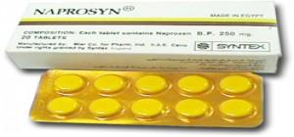
Trademarks
Syntex Inc. v. Apotex Inc., [1984] 2 FC 1012 (FCA)
Court said on this point… “It seems to me that the respondents (Syntex) face considerable difficulty in establishing at trial that the presence of the trade mark “Naprosyn” in the appellant’s flyer constituted a “use” that is contrary to subsection 22(1) of the Trade Marks Act”

Slide 100
Trademarks
Specialty Software Inc. v. Bewatec Kommunikationstechnik GMBH 2016 FC 223
Specialty Software Inc. registered the TM “MEDINET” in association w. computer software programs.
Mark was registered in relation to wares, not services.
…2013 – Bewatec attempted to have this mark expunged from the register.
To avoid expungement, Specialty had to show evidence of its use of the mark between November 22, 2010, and November 22, 2013.
Ultimately, Specialty provided evidence of use. But was this use in relation to wares?
Speciality used to sell its software on disks. Now, clients obtain access to the software over the Internet.

Slide 101
Trademarks
Specialty Software Inc. v. Bewatec Kommunikationstechnik GMBH 2016 FC 223
Clients obtain access to software over the Internet (they had previously received a disk containing the software).
Does this mean that Specialty is providing a service as opposed to selling a product?
MyLife.com Inc v Grbic,2014 TMOB 175 (CanLII) says that providing free access to a website was a service.

Slide 102
Trademarks
4 (1) A trade-mark is deemed to be used in association with goods if, at the time of the transfer of the property in or possession of the goods, in the normal course of trade, it is marked on the goods themselves or on the packages in which they are distributed or it is in any other manner so associated with the goods that notice of the association is then given to the person to whom the property or possession is transferred.
Is there a “good” here? If so, what is the good?
The good is the license to use the software.
The property is the right or the entitlement to enjoy the use of the license.
The transfer occurred through the granting of access in the form of login credentials.
The mark is visible throughout this process.
The disk, then, is just one means by which a transfer can occur. It can also occur through other ways (i.e., granting of access in the form of login credentials).

Slide 103
Trademarks
Has a TM been used within the meaning of s. 4(1) “in the normal course of trade” where goods are given away for free, as opposed to being sold?
See Distrimedic Inc. v. Dispill Inc., 2013 FC 1043 [302] … The expression "in the normal course of trade"…requires some payment or exchange, which excludes the use of a trade-mark in situations where the wares are given away for free or donated.

Slide 104
Trademarks
4(2) A trade-mark is deemed to be used in association with services if it is used or displayed in the performance or advertising of those services.

Slide 105
Trademarks
Gesco Industries Inc v. Sim & McBurney (2000) 9 CPR (4th) 480 (FCA)
The Registrar of Trademarks had expunged Gesco's registration of the trademark "Stainshield" for use in association with the services of stain resistant treatment for carpets and rugs.
The Registrar determined that Gesco failed to submit any evidence of use of the trademark.
Gesco appealed the Registrar's decision.
FCA held that when a trademark is used in association with services, the use does not have to occur in the normal course of trade.

Slide 106
Trademarks
Gesco Industries Inc v. Sim & McBurney (2000) 9 CPR (4th) 480 (FCA)
Rothstein J. defines services broadly.
He accepts the reasoning of Strayer J in this regard: [para 10]
No definition of services is given in the Trademarks Act because of the “plethora of services that the human mind is capable of conceiving”
Term should be liberally construed
Each case decided on its own facts, giving proper regard to judicial precedent.
Nothing to suggest that services with respect to which a TM may be established are limited to those which are not incidental or ancillary to the sale of goods.
So … services can include services incidental or ancillary to the sale of goods

Slide 107
Trademarks
Gesco Industries Inc v. Sim & McBurney (2000) 9 CPR (4th) 480 (FCA)
Was the Stainshield TM, in this case, used in association with the services disclosed in the registration of the TM (namely services of stain resistant treatment for application to carpets and rugs)?
Yes; Stainshield TM displayed in the advertising of the treatment of some of Gesco’s lines of carpets and rugs.
Services may be ancillary to the wares, but this doesn’t mean the TM is not used in association with the services. [para 11]
Are there good policy reasons for “use” to be more permissive for services than for goods?

Slide 108
QUESTIONS?
THOUGHTS?
DISCUSSION?

Slide 109
Pause

Slide 110
Trademarks v. Passing Off
Why would you want to register your TM?
Why not just rely on passing off?
TM = no proof of goodwill required. Only proof of use.
Registration of a mark provides national protection
Registered marks are presumed valid for Canada for all the wares and services for which they are registered.
s. 22 of the TMA protects against mark dilution.
In situations where a mark is deemed invalid, a passing off action might still succeed.

Slide 111
Trademarks: Transfer & Licensing
As a TM owner, you can transfer your TM.
Per s. 50 TMA you can also permit another person to use your mark without impairing the distinctiveness of the mark provided that:
    A licence exists
    Certain controls are in place over the quality of the wares What is sufficient control?
See also s. 48, TMA

Slide 112


Trademarks
Tommy Hilfiger Licensing Inc v. Produits de Qualité, 2005 FC 10

Slide 113
Trademarks
Tommy Hilfiger Licensing Inc v. Produits de Qualité, 2005 FC 10
Plaintiff, Tommy Hilfiger Licensing Inc. (THLI), owned the trademarks relating to the Tommy Hilfiger brand which manufactured and sold clothing.
Defendant, Quality Goods I.M.D. Inc. (controlled by Harry Rosen), created the "Explore Canada" logo and began displaying it on its souvenir products.
THLI sued Quality alleging infringement of the THLI trademarks.
Defendants argued that the Hilfiger trademarks were invalid.
Court held that the Hilfiger trademarks were valid and that the defendants' Explore Canada logo was likely to cause confusion.

Slide 114
Trademarks
Tommy Hilfiger Licensing Inc v. Produits de Qualité, 2005 FC 10
Court concluded that the Service Agreements signed by THLI allowed it to maintain sufficient control over the quality of the goods to avoid any potential confusion as to source
THLI’s service agreements required it to:
  Coordinate design and execution of licensed products.
  Review samples of licensed products.
  Plan and coordinate construction of licensees’ dedicated Tommy Hilfiger showrooms.
  Coordinate product launches.
  Plan and execute advertising and promotional plans and programs.

Slide 115
Trademark transferable
48 (1) A trademark, whether registered or unregistered, is transferable, and deemed always to have been transferable, either in connection with or separately from the goodwill of the business and in respect of either all or some of the goods or services in association with which it has been used.
Where two or more persons interested
(2) Nothing in subsection (1) prevents a trademark from being held not to be distinctive if as a result of a transfer thereof there subsisted rights in two or more persons to the use of confusing trademarks and the rights were exercised by those persons.

Slide 116
Trademarks
How to remove existing Trademarks from the register:
  S. 45: Expungement or amendment on the basis of non-use
  S. 57: Striking or amending a Trademark…

Slide 117
Trademarks
45. (1) The Registrar may at any time and, at the written request made after three years from the date of the registration of a trade-mark by any person who pays the prescribed fee shall, unless the Registrar sees good reason to the contrary, give notice to the registered owner of the trade-mark requiring the registered owner to furnish within three months an affidavit or a statutory declaration showing, with respect to each of the goods or services specified in the registration, whether the trade-mark was in use in Canada at any time during the three year period immediately preceding the date of the notice and, if not, the date when it was last so in use and the reason for the absence of such use since that date.

Slide 118
Trademarks
45. (3) Where, by reason of the evidence furnished to the Registrar or the failure to furnish any evidence, it appears to the Registrar that a trademark, either with respect to all of the goods or services specified in the registration or with respect to any of those goods or services, was not used in Canada at any time during the three year period immediately preceding the date of the notice and that the absence of use has not been due to special circumstances that excuse the absence of use, the registration of the trademark is liable to be expunged or amended accordingly.

Slide 119
Trademarks
57 (1) The Federal Court has exclusive original jurisdiction, on the application of the Registrar or of any person interested, to order that any entry in the register be struck out or amended on the ground that at the date of the application the entry as it appears on the register does not accurately express or define the existing rights of the person appearing to be the registered owner of the trademark.

Slide 120
QUESTIONS?
THOUGHTS?
DISCUSSION?

Slide 121
Pause

Slide 122
Trademarks
UNICAST SA v. South Asian Broadcasting Corporation Inc. - Conclusion
The fact that a trade-mark appears on a website that may be displayed on a computer screen in Canada is not sufficient to constitute use and advertising in Canada (for the purposes of s. 4(2) of the TMA).

Slide 123
Trademarks
UNICAST SA v. South Asian Broadcasting Corporation Inc. 2014 FC 295 (CanLII)
Applicant claims, citing to a case called HomeAway.com, Inc. v. Hrdlicka, 2012 FC 1467, that a trade-mark which appears on a computer screen website in Canada, regardless where the information may have originated from or be stored, constitutes for Trade-Marks Act purposes, use and advertising in Canada.
Court rejects this argument, taking this opportunity to clarify and put HomeAway into context…
  “[46]…Although it is true that subsection 4(2) TMA provides that a “trade-mark is deemed to be used in association with services if it is used or displayed in the performance […] of those services”, the Courts and tribunals, including the Trade-marks Opposition Board, have nonetheless added that such services must be effectively offered to Canadians or performed in Canada (see for example Express File Inc. v HRB Royalty Inc., 2005 FC 542(CanLII) at para 20, [2005] FCJ No 667).”
Not enough for the mark to merely appear on a computer screen…

Slide 124
Trademarks
UNICAST SA v. South Asian Broadcasting Corporation Inc.
[47] To go against this logical interpretation of the law would lead to some twisted and unfortunate consequences none of which could have been Parliament’s intent in drafting the Act. For example, should we follow the Applicant…, any foreign trade-mark holder could request and obtain the expungement of a bona fide Canadian trade-mark based on previous use through the Web even if this foreign trade-mark owner had basically nothing to do with Canada and no physical presence in the country. How could it be logical to interpret the applicable legal scheme as putting every single Canadian trade-mark owner at risk of having its trade-mark taken away by another trade-mark that has no nexus to Canada?.. It would be illogical and impossible to take this approach.

Slide 125
Trademarks
UNICAST SA v. South Asian Broadcasting Corporation Inc.
[48] What is more, the Respondent quite rightly submits that this situation would be unthinkable should the roles in these proceedings be reversed. Would a Canadian trade-mark owner have the right to request from a foreign trade-mark owner that they stop using their trade-mark if this foreign owner’s presence in Canada is limited to the Internet? … Again, this suggestion is preposterous. The notion of performing the services is essential.
[49] Therefore, the Applicant shall have to prove having used its trade-mark with respect to services actually provided to Canadians or performed in Canada.

Slide 126
Remember Ajit Weekly/Ajit Daily cases: contrast passing off actions versus trademark actions on the point of evidence of use (trademark) versus evidence of goodwill (passing off).

Slide 127
Trademarks
45. (3) Where, by reason of the evidence furnished to the Registrar or the failure to furnish any evidence, it appears to the Registrar that a trade-mark, either with respect to all of the goods or services specified in the registration or with respect to any of those goods or services, was not used in Canada at any time during the three year period immediately preceding the date of the notice and that the absence of use has not been due to special circumstances that excuse the absence of use, the registration of the trade-mark is liable to be expunged or amended accordingly.

Slide 128
QUESTIONS?
THOUGHTS?
DISCUSSION?

Slide 129
Pause

Slide 130
Trademarks
Scott Paper Limited v. Smart & Biggar, 2008 FCA 129 Conclusion
Fact that registered owner may have plans to resume use of mark is not sufficient to excuse non-use.

Slide 131
Trademarks
Scott Paper Limited v. Smart & Biggar 2008 FCA 129
No evidence of any use of the registered TM “VANITY” by Scott Paper
Because of this (we know that the period of non-use is defined as the period between the date of acquisition of the TM by the registered owner, and the date of notice - approximately 13 years) … long period of non-use…
Confronted, Scott Paper states that they genuinely intend to use the TM, and have developed plans in this regard
The Senior Hearing Officer concluded that a 13 year period of deliberate non-use could be excused by a registrant’s intention to use the mark in the near future.
This decision was appealed & reversed.

Slide 132
Trademarks
Scott Paper Limited v. Smart & Biggar, 2008 FCA 129
The general rule is that the absence of use is penalized by expungement
There is an exception to the general rule where the absence of use is due to special circumstances.
Special circumstances alleged by Scott Paper are the plans for resumption of use of the mark …
Pelletier JA clarifies that this is not sufficient to excuse non-use…“the 13 year absence of use was due to a deliberate decision not to use the mark”.
And … “a registrant’s intention to resume use of a mark which has been absent from the marketplace, even when steps have been taken to actualize those plans, cannot amount to special circumstances which excuse the non-use of the TM. The plans for future use do not explain the period of non-use and … cannot amount to special circumstances”

Slide 133
Trademarks
Scott Paper Limited v. Smart & Biggar, 2008 FCA 129
General principles re special circumstances that excuse non-use
1) Onus on registered owner to establish special circumstances excusing non-use of the TM
2) Consider two factors:
  Length of time of non-use
  What were the reasons for the non-use? Were these reasons beyond the registered owner’s control?
3) Circumstances of non-use must be special (ie do not exist in the majority of cases)
4) Special circumstances are an exception to the general rule that a TM which is not used should be expunged

Slide 134
Trademarks
Should trade-marks be “use it or lose it”?
Would you make any changes/modifications to the provision addressing expungement for non-use?
3. Is “use it or lose it” something that you think should also be incorporated into patent or copyright legislation?

Slide 135
Trademarks
S. 57 TMA → Can strike or amend a TM on the register on the basis that it “does not accurately express or define the existing rights of the [registered owner] of the mark.” (read w. s. 18)
If the TM was not registrable at the date of registration [18(1)(a)]
If the TM is not distinctive at the time proceedings bringing the validity of the registration into question are commenced [18(1)(b)]
If the TM has been abandoned [18(1)(c)]
If the applicant for registration was not the person entitled to secure the registration [18(1)(d)]
The application for registration was filed in bad faith

Slide 136
Trademarks
57 (1) The Federal Court has exclusive original jurisdiction, on the application of the Registrar or of any person interested, to order that any entry in the register be struck out or amended on the ground that at the date of the application the entry as it appears on the register does not accurately express or define the existing rights of the person appearing to be the registered owner of the trademark.

Slide 137
Trademarks
When registration invalid
18 (1) The registration of a trademark is invalid if
  (a) the trademark was not registrable at the date of registration;
  (b) the trademark is not distinctive at the time proceedings bringing the validity of the registration into question are commenced;
  (c) the trademark has been abandoned;
  (d) subject to section 17, the applicant for registration was not the person entitled to secure the registration; or
  (e) the application for registration was filed in bad faith.
Exception
(2) No registration of a trademark that had been so used in Canada by the registrant or his predecessor in title as to have become distinctive at the date of registration shall be held invalid merely on the ground that evidence of the distinctiveness was not submitted to the competent authority or tribunal before the grant of the registration.

Slide 138
Trademarks: Registration invalid if…
1) If the TM was not registrable at the date of registration [18(1)(a)]
  See ss. 9, 10, 12, 13
2) If the TM is not distinctive at the time proceedings bringing the validity of the registration into question are commenced [18(1)(b)]
  See for example the discussion on TMs becoming generic. Also ss. 48-50 TMA

Slide 139
12 (1) Subject to subsection (2), a trademark is registrable if it is not
(a) a word that is primarily merely the name or the surname of an individual who is living or has died within the preceding thirty years;
(b) whether depicted, written or sounded, either clearly descriptive or deceptively misdescriptive in the English or French language of the character or quality of the goods or services in association with which it is used or proposed to be used or of the conditions of or the persons employed in their production or of their place of origin;
(c) the name in any language of any of the goods or services in connection with which it is used or proposed to be used;
(d) confusing with a registered trademark;
(e) a sign or combination of signs whose adoption is prohibited by section 9 or 10;

Slide 140
Trademarks: Registration invalid if…
3) If the TM has been abandoned [18(1)(c)]
  Read in conjunction w. s. 45 of the TMA
4) If the applicant for registration was not the person entitled to secure the registration [18(1)]
  See ss. 16, 17 of the TMA
5) If the application for registration was filed in bad faith

Slide 141
QUESTIONS?
THOUGHTS?
DISCUSSION?

Slide 142
Pause

Slide 143
Trademarks
Promafil Canada Ltée v. Munsingwear Inc. (1992), 44 CPR (3d) 59, [1992] FCJ 611 (FCA).
Promafil (P/R) is a French company; Munsingwear (D/A) a US company.
Mark of the appellant Munsingwear is a picture of a penguin. Adopted by Munsingwear in the US in the 1950s for use on golf shirts.
Munsingwear is not in business in Canada. Stanfield’s (a Canadian company based in Truro, NS) obtained a licence from Munsingwear to make and sell golf shirts in Canada with the Pengiuin mark.
Accordingly the penguin was used, but never registered…
Why not?

Slide 144
Trademarks
Promafil Canada Ltée v. Munsingwear Inc. (1992), 44 CPR (3d) 59, [1992] FCJ 611 (FCA).
Promafil sold wool in Canada with a penguin design. Munsingwear was concerned about the possible registrability of its mark given the presence of the French design.
In 1977, Munsingwear decided to attempt to register the TM with respect to shirts and shorts – but not for wool
Promafil opposed the registration.
Despite this, Munsingwear registration was accepted by the Registrar, who held that the mark for wool was not confusing with the mark for clothing.
A few years later, Munsingwear found out that Promafil was attempting to sell clothing with a penguin design mark.

Slide 145
Trademarks
Promafil Canada Ltée v. Munsingwear Inc. (1992), 44 CPR (3d) 59, [1992] FCJ 611 (FCA).
Stanfield had also expanded its products sold (to include sweaters and socks).
Because they had expanded their clothing products and because they realized that the mark they were then using (corpulent penguin) differed from the mark they had registered (slim penguin), Stanfield filed an additional application to register.
Promafil then brought an action to oppose the registration of the new design, and to and expunge the old design.
  They said that the new penguin design shouldn’t be registered because it was confusing
  The old penguin design should be expunged as abandoned

Slide 146
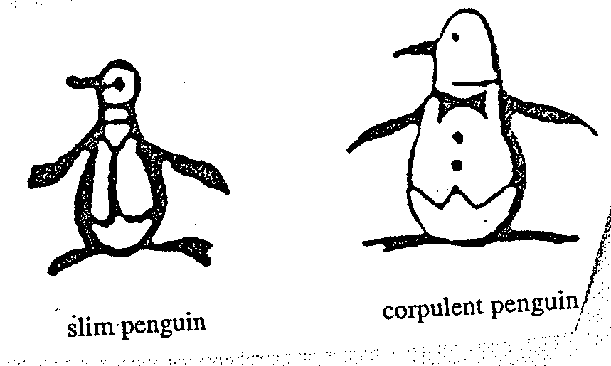
Trademarks
Promafil Canada Ltée v. Munsingwear Inc. (1992), 44 CPR (3d) 59, [1992] FCJ 611 (FCA).
Original Penguin
Revised Penguin

Slide 147
Trademarks
Promafil Canada Ltée v. Munsingwear Inc. (1992), 44 CPR (3d) 59, [1992] FCJ 611 (FCA).
Main issue was whether by registering one mark, and using another, is the first mark abandoned?
To show abandonment:
  Must show registered TM no longer in use in Canada
  Need to show intention to abandon mark.
Amendment:
  Can amend mark provided that the amendment does not materially alter the character of the mark. Can have variations on the same mark (both can be used). All law requires is that there is maintenance of recognizability to avoid confusion of unaware purchasers. (Promafil)

Slide 148
Trademarks
Promafil Canada Ltée v. Munsingwear Inc. (1992), 44 CPR (3d) 59, [1992] FCJ 611 (FCA).
At some point, a variation in a mark may be significant enough to constitute a new mark
One question to ask: Has the mark varied so much as to confuse the consumer as to the source of the ware?
Ongoing use of new mark could be abandonment of old mark.
Take technology into account (reason for improvement of mark).

Slide 149
Trademarks
Promafil Canada Ltée v. Munsingwear Inc.
FCA (MacGuigan JA) held:
Here differences are only petty and when used concurrently, one is still the variation of the other. A modified variant can co-exist with original…
The second design doesn’t have to replace the first design. There can be variations on the same design. The law can tolerate multiple variations of the same mark. Though, every variation is playing with fire…
If variation is too different then it would be a new mark or non-use of registered mark…
The key is to maintain recognisability and avoid confusion of unaware purchasers. If the same dominant features of the design are maintained, and the differences are petty – the unaware purchaser will not be misled.

Slide 150
QUESTIONS?
THOUGHTS?
DISCUSSION?

Slide 151
Pause

Slide 152
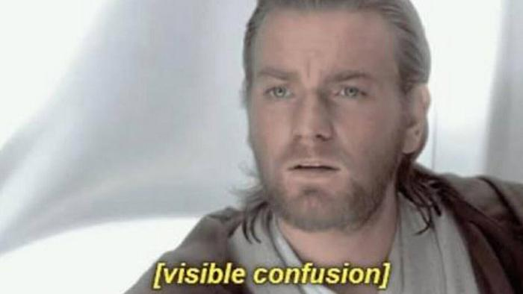
Trademarks: Doctrine of Confusion

Slide 153
Trademarks: Confusion
Doctrine of confusion – Critical Concept
Important in the context of registrability
(see ss. 12, 16)
Also important in infringement actions (see s. 20)
Core provision: s. 6 TMA (specifically
s. 6(2) and 6(5))

Slide 154
Trademarks : Confusion
TM is not registrable if it is confusing with a registered TM (12(1)(d)) or TMs or Trade-Names (“TN’s”) that had been previously used or made known (see s. 16)
Confusion is also an important part of infringement actions. An action in infringement can be successfully brought where there is unauthorized use of a mark that is confusing with a registered TM.

Slide 155
Trademarks : Confusion
6. (2) The use of a trade-mark causes confusion with another trade-mark if the use of both trade-marks in the same area would be likely to lead to the inference that the goods or services associated with those trade-marks are manufactured, sold, leased, hired or performed by the same person, whether or not the goods or services are of the same general class.

Slide 156
Trademarks : Confusion
What to be considered
6. (5) In determining whether trade-marks or trade-names are confusing, the court or the Registrar, as the case may be, shall have regard to all the surrounding circumstances including
  (a) the inherent distinctiveness of the trade-marks or trade-names and the extent to which they have become known;
  (b) the length of time the trade-marks or trade-names have been in use;
  (c) the nature of the goods, services or business;
  (d) the nature of the trade; and
  (e) the degree of resemblance between the trade-marks or trade-names in appearance or sound or in the ideas suggested by them.

Slide 157
QUESTIONS?
THOUGHTS?
DISCUSSION?

Slide 158
Pause

Slide 159
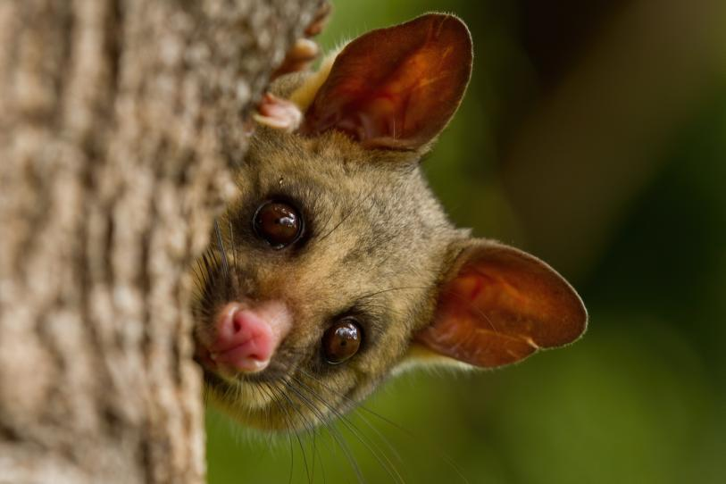
Brushtail Possum

Slide 160
Trademarks: Confusion
S & S Productions Inc. v. Possum Lodges (Messier), [2006] TMOB No. 144
Applicant – Messier ; Opponent – S & S Productions, Producers The Red Green Show on television
Messier filed an application to register the Trademark Possum Lodges based upon proposed use in association with “sale and rental of recreational lodging, namely, cabins, camps, lodges, campsites and cottages; time-sharing of recreational real estate; … restaurants”
Application was opposed by S & S Productions on basis of s. 38(2)(b) that the TM is not registrable because under s. 12(1)(d) it is confusing with their TM’s Possum Lodge and International Possum Brotherhood and design.

Slide 161
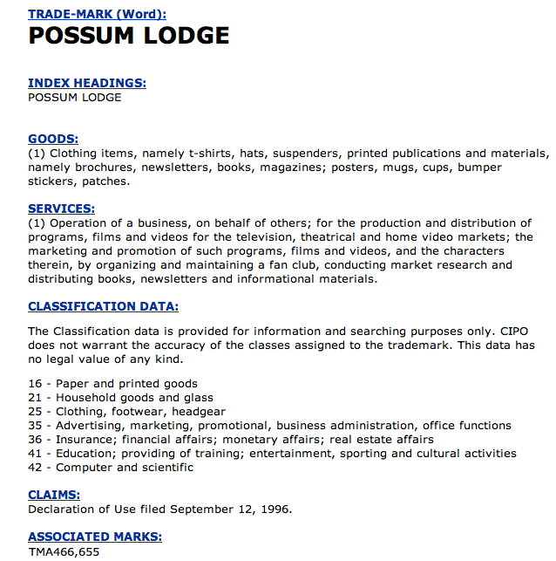
Trademarks: Confusion

Slide 162
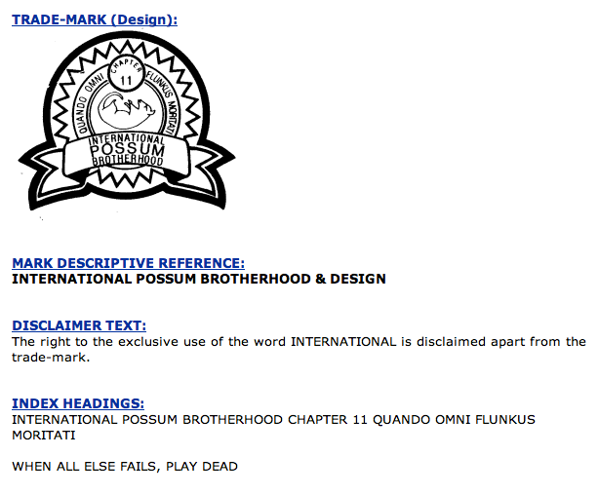
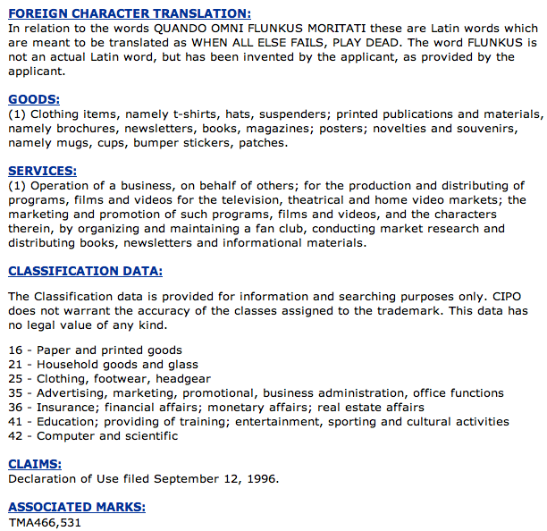
Trademarks: Confusion

Slide 163
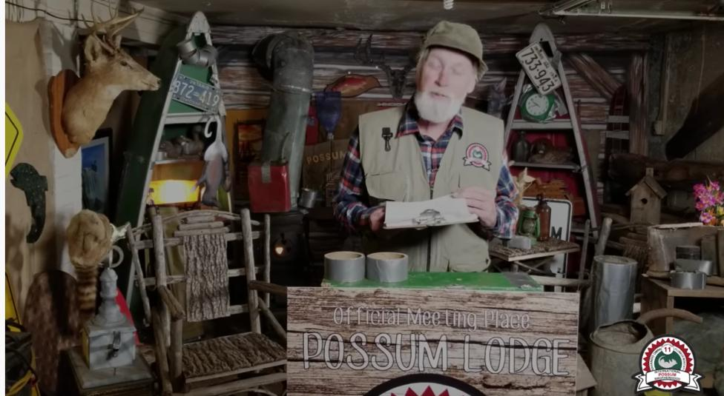
“The Red Green Show”

Slide 164
Trademarks: Application of s. 6
To assess confusion, go back to s. 6(5)…
Question that needs to be asked is (2)…would the use of both trade-marks in the same area…be likely to lead to the inference that the goods or services associated with those trade-marks are manufactured, sold, leased, hired or performed by the same person?
Application of s. 6(5) factors:
(a) the inherent distinctiveness of the trade-marks or trade-names and the extent to which they have become known
(b) The extent to which each trade-mark has become known
(b) the length of time the trade-marks or trade-names have been in use
(c) the nature of the goods, services or business; (d) nature of the trade…
(d) the nature of the trade
(e) the degree of resemblance between the trade-marks or trade-names in appearance or sound or in the ideas suggested by them

Slide 165
Trademarks: Application of s.6
To assess confusion, go back to s. 6(5)…
Question that needs to be asked is (2)…would the use of both trade-marks in the same area…be likely to lead to the inference that the goods or services associated with those trade-marks are manufactured, sold, leased, hired or performed by the same person?
Application of s. 6(5) factors:
  (a) The inherent distinctiveness of the trade-marks or trade-names and the extent to which they have become known

Slide 166
Trademarks: Application of s. 6
Marks which are inherently distinctive are unique marks – they intrinsically serve to identify a particular source of a product.
Examples are words or symbols invented or coined for the purpose of functioning as a TM (i.e., Exxon). Have no other significance than as a TM. They don’t suggest any characteristic of the goods or services they identify (Kodak cameras; Clorox bleach).
Marks have high inherent distinctiveness if they only communicate the message that they are identifying or signifying the source of the product.
Coined terms with design elements are generally seen as having high degrees of inherent distinctiveness.
Marks have lower inherent distinctiveness if they are descriptive or suggestive of a parties’ respective wares or services. (Marks made up of ordinary words, for instance, have lower inherent distinctiveness than marks made up of coined words and design elements).

Slide 167
Trademarks: Application of s. 6
In the Possum Lodges case both marks were said to be inherently distinctive with respect to their respective goods and services…(i.e., don’t really serve a descriptive function).
But Applicant Messier’s mark is less inherently distinctive because its second half describes its services i.e. lodging; lodges
  (b) The extent to which each trade-mark has become known
No evidence of use or promotion of Applicant’s mark while extensive use of Opponent’s Possum Lodge mark…which was much better known…
Possum Lodge figures prominently in “The Red Green Show”… (great description of Possum Lodge in para. 16 of decision…)

Slide 168
Trademarks: Application of s. 6
  (b) the length of time the trade-marks or trade-names have been in use
Applicant’s mark hadn’t yet been used/promoted while Opponent’s mark was used extensively in Canada since 1991
  (c) the nature of the goods, services or business; (d) nature of the trade
Is there a nexus or connection between the goods, services and business of the Applicant and the Opponent?
No overlap, but connection … Applicant’s business involves recreational accommodation; Opponent’s television show [para 21] “satirize[s] the stereotypical Canadian outdoorsman and sportsman”.

Slide 169
Trademarks: Application of s. 6
(e) the degree of resemblance between the trade-marks or trade-names in appearance or sound or in the ideas suggested by them
Essentially identical…
Conclusion
Applicant is required to show that there is not a reasonable likelihood of confusion between the marks
Could not do so: “[para 24] “the Applicant has not satisfied me that, on a balance of probabilities, a Canadian who has an imperfect recollection of the Opponent’s TM as associated with the Opponent’s show, would not, as a matter of first impression, assume that there was some connection between the Applicant’s POSSUM LODGES recreational lodging, real estate and restaurant services and the Opponent’s television show.”

Slide 170
Trademarks: Application of s. 6
The Applicant failed in their duty to select a name with care to avoid any confusion. Does the decision make sense?
Note the language … “assume there was some connection between the Applicant’s [goods and services]” and those of the Opponent.
Compare this with the language of s. 6(2) …
The use of a trade-mark causes confusion with another trade-mark if the use of both trade-marks in the same area would be likely to lead to the inference that the goods or services associated with those trade-marks are manufactured, sold, leased, hired or performed by the same person, whether or not the goods or services are of the same general class.
Fundamental tension
How much protection TM owners should receive, and how much protection owners of well-known or famous TMs should receive?

Slide 171
QUESTIONS?
THOUGHTS?
DISCUSSION?

Slide 172
Pause

Slide 173
On with the show…

Slide 174


Slide 175

Trademarks: Confusion
Mattel v. 3894207 Canada Inc., 2006 SCC 22
The Numbered Company wanted to register TMs in connection with its small chain of Montreal suburban Barbie’s restaurants.
Mattel opposed the application on the basis that use of the name would create confusion with respect to its Mark BARBIE.

Slide 176
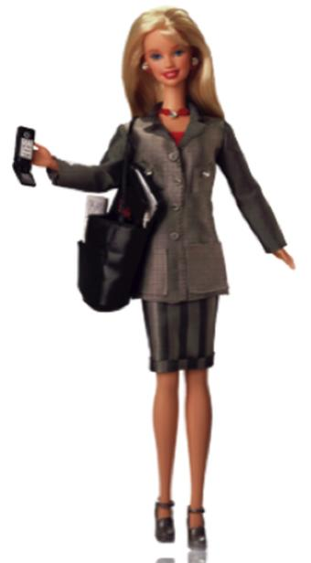
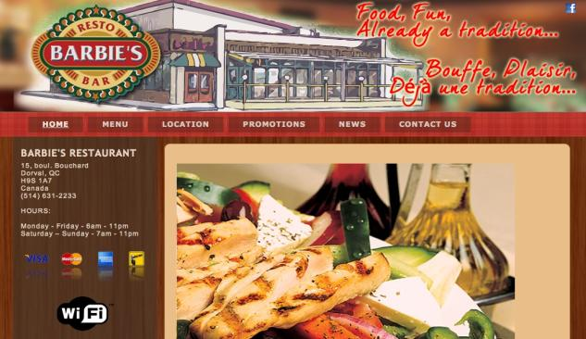


Slide 177
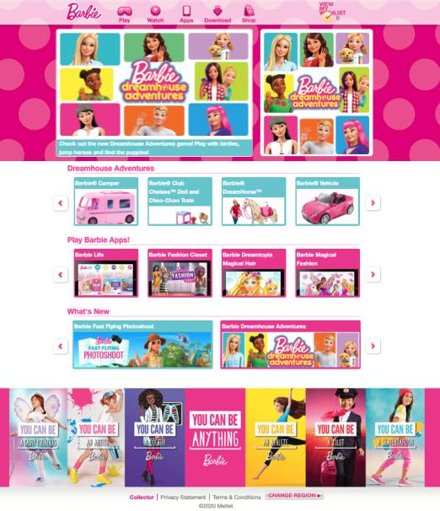
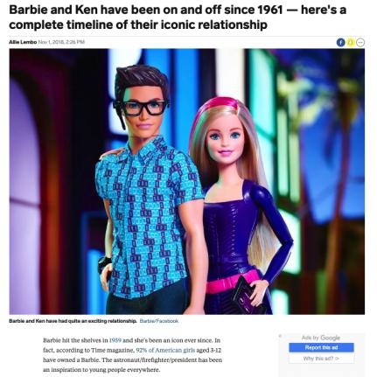

Slide 178
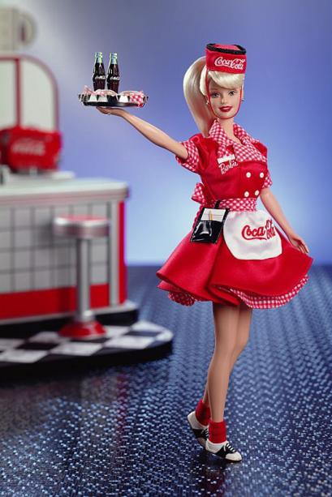

Slide 179
Trademarks: Confusion
Mattel v. 3894207 Canada Inc., 2006 SCC 22
Binnie J.:
  Some TMs are so well-known that use in connection with any wares or services would generate confusion.
  In those circumstances, no need to establish a connection between the goods and/or services for a finding of confusion to be made out (cf. Pink Panther case)
Who is the test person for the purpose of the confusion analysis?
How were the s. 6(5) factors applied?

Slide 180


Trademarks: Confusion
Mattel v. 3894207 Canada Inc., 2006 SCC 22

Slide 181
Trademarks : Confusion
Mattel v. 3894207 Canada Inc., 2006 SCC 22
Main issue is whether Mattel can use TM law to prevent people from using the name Barbie (a common name) in relation to services (like restaurants) very different from dolls and other wares aimed at 3-11 year old girls.
Based on the TMA, is the Defendant’s use of the mark Barbie confusing with the registered mark BARBIE?
Applicant has onus to show that there is not a reasonable likelihood of confusion between the two marks.
Confusion is caused if the use of both TMs leads the consumer to believe that the wares and services are supplied by the same person: s. 6(2) TMA.
Factors in determining whether TMs are confusing in s. 6(5) TMA.

Slide 182
Trademarks: Confusion
Mattel v. 3894207 Canada Inc., 2006 SCC 22
In applying the criteria set out in s. 6(5) of the TMA, TM Opposition Board found no real connection between the two marks. Barbie’s fame was limited to dolls and dolls’ accessories. Therefor, Mattel’s opposition was rejected & registration allowed.
Federal Court (Rouleau J) observed that we cannot automatically presume that there will be confusion just because the BARBIE mark is famous.
Test is reasonable likelihood of confusion, using the factors set out in s. 6(5).
The fame of a mark can’t simply obliterate the other factors. Need to look at all the factors in s. 6(5)
One of the key factors in s. 6(5) in this case is the striking difference between the wares. Appeal dismissed accordingly; Mattel loses.
Federal Court of Appeal agreed with Rouleau J & dismissed the appeal. Mattel loses again.

Slide 183
Trademarks : Confusion
Mattel v. 3894207 Canada Inc., 2006 SCC 22
In Supreme Court of Canada…Binnie J. did find that some trade-marks are so well known that use in connection with any wares or services would generate confusion. Other brands are product specific.
Example given of a brand that may not be product specific? Virgin – used in connection with such a wide variety of wares and services that it knows virtually no bounds.
Example given of a brand that may be product specific? Apple = well-known TMs associated separately with computers, record label, automobile glass.
In discussing the role to be played by fame in confusion cases, the SCC had to address another case; the Pink Panther case of the Ont. CA.

Slide 184


Slide 185
Trademarks: Confusion
In that case Pink Panther Beauty Corp. wanted to register the TM Pink Panther in association with beauty products. United Artists Corp., owner of the famous Pink Panther mark registered in association with the entertainment business objected, arguing that consumers would be confused.
Would consumers think that these goods came from the same source?
Ont. CA held in the Pink Panther case that it was unlikely consumers would be confused; PINK PANTHER beauty parlour patron would not be likely to think that the hairdressing services she received were provided by United Artists Studios.
The aspect of the Pink Panther decision the SCC chose to address was Linden JA’s statement for the majority that for confusion to occur, there must be some resemblance or linkage between the two products (i.e., Barbie doll and Barbie’s restaurant); and that only in exceptional circumstances can confusion be found when there is no connection between the products or services.

Slide 186
Trademarks : Confusion
Binnie J. of SCC in Mattel rejected Linden JA’s statement that for confusion to occur, there must be some resemblance or linkage between the two products (i.e., Barbie doll and Barbie’s restaurant); and that only in exceptional circumstances can confusion be found when there is no connection between the products or services.
Test articulated by SCC was that for famous and non-famous marks alike, whether there is confusion in the s. 6(2) sense, is determined by if the consumer thinks that the goods come from the same source. This question has must be analyzed in all the circumstances (as set out in s. 6(5) and beyond).
The nature of the wares is important:
  It is one of the criteria in 6(5)
  In cases involving famous marks it is likely to be an important factor (i.e., Barbie doll and Barbie’s restaurants), as fame can possibly carry the mark across product lines.
SCC emphasized in Mattel is that you do not have to establish a connection between the goods and/or services for a finding of confusion to be made out.

Slide 187
Trademarks: Confusion
Pink Panther and Mattel are examples of courts dealing with the contemporary reality of famous brands attempting to protect themselves against every incursion on their goodwill to preserve their investment in their brands.
FCA in Pink Panther restricts the ability of companies to protect famous marks; companies can only object to others using famous marks where there is a connection/resemblance between the goods, services.
SCC held FCA was wrong as net of protection drawn too narrowly.
SCC focused on the issue of confusion as to whether the consumer was confused into thinking that the goods came from the same source.
The nature of the goods is a factor in this analysis; an important factor in some cases. But it is not the sole issue.
In Mattel the SCC attempts to ensure that the protection given to marks (famous or not) relates to the purpose of TM law; protecting against confusion as to source.

Slide 188
Trademarks: Confusion – Test Person
Important question: From what perspective should consumer confusion be analyzed? Who is the test person for the purpose of the confusion analysis?
Addressed by SCC in Mattel. A few “test people” were rejected:
  The careful and diligent purchaser
  The “moron in a hurry”
SCC adopted the ordinary hurried purchaser and looked at the probability of the average person with average intellect acting with ordinary caution being deceived. Points to consider:
  Give the average consumer some credit – don’t assume that they’re totally devoid of intelligence, normal powers of recollection, or are totally unaware or uninformed.
  More care taken/attention given to big purchases (car as opposed to toy)

Slide 189
Trademarks: Confusion – Test Person
In buying ordinary run-of-the-mill consumer wares and services, the consumer is of average intelligence, generally running behind schedule, and has more money to spend than time to pay a lot of attention to detail.
In appropriate markets, this person is functionally bilingual.
To this person, TMs make shopping faster and easier.
When the new trade-mark catches their eye, they will have only a general and not very precise recollection of the earlier trade-mark (as it would be remembered by persons possessed of an average memory with its usual imperfections).
The standard is not people who do not notice anything. Rather it is persons who take no more than ordinary care to observe what is staring them in the face.
If the ordinary casual consumer somewhat in a hurry is likely to be deceived about the origin of the wares or services, then the statutory test is met.

Slide 190
Trademarks: Confusion - s. 6(5) factors
(a) Inherent distinctiveness of the TM and the extent to which they have become known
Is Barbie inherently distinctive?
Marks which are inherently distinctive are unique marks; they intrinsically serve to identify a unique source of a product. They have no other meaning or significance other than as a TM.
Barbie is not inherently distinctive. Barbie is an everyday expression not developed by Mattel; would normally receive less protection than an invented/unique/non-descriptive word.
Policy reason for receiving less protection? To prevent fencing in or appropriating words of a general nature in English or French.
That said Mattel’s mark had achieved strong secondary meaning (acquired distinctiveness) as associated with dolls, doll accessories

Slide 191
Trademarks: Confusion - s. 6(5) factors
(b) Length of time the TM has been in use
Important in considering whether the mark has really become distinctive. Here, Mattel’s mark publicized widely since 1960s; numbered company’s since 1992. Deeper roots for Mattel’s mark, over much wider area.
(c) Nature of the wares, services or businesses
Long way from the initial rule of 1866 that if a business carries on a trade in linen and not iron and stamps a lion on their linen; another business can stamp a lion on iron. In this example the nature of the wares is crucial
Today a relatively strong mark can leap vast product line differences in a single bound because confusion can still be found where there is no connection. That said, fact that there may be vast product line differences remains a significant obstacle.
In Mattel the nature of the wares are very different: Dolls and doll’s accessories v. restaurants
Court also dealt with argument that “the natural tendency towards corporate diversification” would lead the consumer to assume that the products/businesses would be connected. SCC rejected that argument because the law of TMs is based on use. No evidence that Barbie mark is distinctive of anything other than dolls and doll accessories.

Slide 192
Trademarks: Confusion - s. 6(5) factors
(d) Nature of the trade
Parties operated in different channels of trade: wares v. services; in this case the wares and services do not intermingle.
(e) Degree of resemblance between the TM in appearance, sound, ideas suggested by them
Both marks use name Barbie; sound the same; numbered company’s applied for mark wraps name in design. Mattel’s mark does not. Considerable resemblance.
(f) Other surrounding circumstances
Evidence of actual confusion would have been helpful. Not absolutely necessary, but the lack of any evidence of actual confusion is another “circumstance” to be considered.

Slide 193
Trademarks: Confusion
Mattel argued as well that the # co. was a free rider; they adopted TM to pirate the goodwill of Mattel.
To support this argument, Mattel pointed to a later TM application by the # co. (abandoned), that included a waitress in the design…
SCC said that there may be some justice in this argument, but that intent isn’t relevant to the issue of confusion. It comes back to the fact that the test is whether the consumer would be confused.
Mattel lost yet again. SCC upheld the decision of the Board that there was no likelihood of confusion in the marketplace.
-----------------------------------------------
Thoughts on this decision? Agree with the outcome? Should famous marks receive more protection than permitted by the SCC’s articulation of this test? Should the SCC reinstitute the determination in Pink Panther that, absent exceptional circumstances, there must be a resemblance or linkage between the two products?

Slide 194
QUESTIONS?
THOUGHTS?
DISCUSSION?

Slide 195
Pause

Slide 196
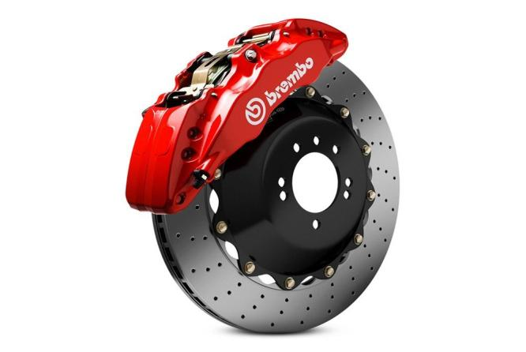

Slide 197
Trademarks: Confusion
Masterpiece Inc. v. Alavida Lifestyles Inc, 2011 SCC 27
Issue: Whether the trade-mark “Masterpiece Living”, proposed and subsequently registered by Alavida Lifestyles Inc. (“Alavida”), a company entering the retirement residence industry in Ontario, was [at the time it applied for registration – namely December 1, 2005] confusing with the unregistered trade-marks or trade-name previously used by Masterpiece Inc. in the retirement residence industry in Alberta (marks which included “Masterpiece the Art of Living”, “Masterpiece and the Art of Retirement Living”, and a stylized word “Masterpiece” alongside a butterfly logo).

Slide 198
Trademarks: Confusion
Masterpiece Inc. v. Alavida Lifestyles Inc., 2011 SCC 27: The facts
Decision clarifies several issues related to the confusion analysis.
Question dealt with in this case is [para2] whether the trade-mark “Masterpiece Living”, proposed and subsequently registered by Alavida Lifestyles Inc. (“Alavida”), a company entering the retirement residence industry in Ontario, was [at the time it applied for registration – namely December 1, 2005] confusing with the unregistered trade-marks or trade-name previously used by another company, Masterpiece Inc. in the retirement residence industry in Alberta (marks which included “Masterpiece the Art of Living”, “Masterpiece and the Art of Retirement Living”, and a stylized word “Masterpiece” alongside a butterfly logo).
Shortly after Alavida’s application, Masterpiece Inc. also started to use the TM “Masterpiece Living”.
January 2006 – Masterpiece Inc. applied to register Masterpiece as a TM; June 2006, it applied to register the TM Masterpiece Living. Both applications were denied on the basis that they were confusing with Alavida’s TM “Masterpiece Living”
Masterpiece Inc. then started this application to expunge Alavida’s registration of the term “Masterpiece Living”.

Slide 199
Trademarks: Confusion
Masterpiece Inc. v. Alavida Lifestyles Inc, 2011 SCC 27
1) Is geography relevant when performing a confusion analysis?
2) How to assess the resemblance between a proposed use TM and an existing unregistered TM?
3) Impact of the nature and cost of wares and services on the confusion analysis
4) Relevance of expert evidence

Slide 200
Trademarks: Confusion
1) Is geography relevant when performing a confusion analysis?
The location where a mark is used is not relevant when considering the likelihood of confusion between a mark that is registered (or for which an application for registration has been made) and a prior unregistered mark.

Slide 201
Trademarks : Confusion
  2) How to assess the resemblance between a proposed use TM and an existing unregistered TM?
  Separate analyses with respect to each of TMs, TNs (paras. 42-48)
  Factor with greatest impact on confusion analysis = degree of resemblance (paras. 49-50)
  Focus on full scope of possible uses of registered TM, not actual use (paras. 51-59)

Slide 202
Trademarks : Confusion
  2) How to assess the resemblance between a proposed use TM and an existing unregistered TM? (con’d)
  Unregistered marks? Consider how they have actually been used (para. 60)
  In assessing resemblance, consider whether a part of the mark is particularly striking or unique (paras. 60-65)

Slide 203
Trademarks: Confusion
3) When Considering the “Nature of the Trade” Under Section 6(5) of the Act, What Effect Does the Nature and Cost of the Wares or Services Have on the Confusion Analysis?
  The test is one of first impression (even if consumers shopping for expensive wares or services might be more alert, aware of TMs)
  Careful research which may later remedy confusion does not mean that no confusion ever existed or that it will not continue to exist in the minds of consumers who did not carry out that research. (para. 72)

Slide 204
Trademarks: Confusion
4) Relevance of expert evidence
Necessity & relevance of expert evidence should be questioned before such evidence is admitted (para. 99)
Judges should use their own common sense to determine whether the casual consumer would likely be confused in cases of wares or services being marketed to the general public (para. 92)
Surveys can be valuable (para. 93)

Slide 205
Trademarks: Confusion – Digging Deeper
A few aspects of this decision worth highlighting:
The possible relevance of the location where a mark is used when engaging in the confusion analysis
The considerations applicable in assessing the resemblance between a proposed use TM and an existing unregistered TM
The impact of the nature and cost of the wares or services on the confusion analysis (particularly the nature of the trade consideration)
Relevance of expert evidence in TM/TN confusion cases.

Slide 206
Trademarks: Confusion
Masterpiece Inc. v. Alavida Lifestyles Inc., 2011 SCC 27
First: The SCC dealt with the issue of whether “the location where a mark is used is relevant when considering the likelihood of confusion between an applied for or registered TM and a prior unregistered TM or TN”
Or – is geography relevant when performing a confusion analysis?
SCC held that “geographical separation in the use of otherwise confusingly similar TN and TM does not play a role” in the Confusion analysis. The location where a mark is used is not relevant when considering the likelihood of confusion between a mark that is registered (or for which an application for registration has been made) and a prior unregistered mark.
The SCC reached this conclusion largely through statutory interpretation – particularly – the way ss. 6(2-4) are framed “if the use of both ... in the same area would be likely to lead to the inference”

Slide 207
Trademarks: Confusion
Masterpiece Inc. v. Alavida Lifestyles Inc., 2011 SCC 27
See para 30 of the decision…It is immediately apparent from these words, “if the use of both . . . in the same area”, that the test for confusion is based upon the hypothetical assumption that both trade-names and trade-marks are used “in the same area”, irrespective of whether this is actually the case. As a result, geographical separation in the use of otherwise confusingly similar trade-names and trade-marks does not play a role in this hypothetical test. This must be the case, because, pursuant to s. 19 TMA, subject to certain exceptions, registration gives the owner the exclusive right to the use of the trade-mark throughout Canada.
Accordingly, in the fact situation of this case there can be confusion between a prior unregistered mark and a registered mark, even if they operate in two different provinces (Alberta/Ontario). As the Canadian TM regime is national in scope, the owner of a registered TM is entitled to the exclusive use of that mark in association with the wares or services to which it is connected throughout Canada.

Slide 208
Trademarks: Confusion
  Second: How to assess the resemblance between a proposed use TM and an existing unregistered TM?
Focussing on certain aspects of the court’s decision can clarify additional points:
Paras 42-48: If the question is whether a TM for which a person has applied is confusing with any TM or TN (i.e. Masterpiece Living with Masterpiece the Art of Living, Masterpiece the Art of Retirement Living, and stylized Masterpiece w. butterfly logo) then separate analyses need to be undertaken with respect to each of the TMs and TNs. This was not done here.

Slide 209
Trademarks: Confusion
Paras. 49-50: Rothstein J. states that the degree of resemblance is often likely to have the greatest effect on the confusion analysis; that the other factors become significant only once the marks are found to be identical or very similar; and that it has been suggested that consideration of resemblance is where most confusion analyses should start.
Paras 51-59: When considering whether a TM for which a person has applied is confusing with any TM or TN, the entire scope of the exclusive rights that would be granted to it under its registration needs to be considered, and not the limited uses to which it may have been put after the registration date. This wasn’t done here. Rather, the focus was on Alavida’s actual use, rather than the full scope of its possible uses (i.e. altering the advertising to give Masterpiece more prominence, Living less prominence; changing the font or style of lettering).

Slide 210
Trademarks: Confusion
Para 60: For unregistered marks, one need to consider how they had actually been used.
Paras. 60-65: In assessing resemblance (defined as the quality of being either like or similar), first consider whether there is an aspect of a trade-mark that is particularly striking or unique. In this case Rothstein J., Masterpiece is the word that distinguishes Alavida and Masterpiece Inc. from other sources of retirement residence services. This is the dominant word in the TMs and is identical between the two.

Slide 211
Trademarks: Confusion
Third: When Considering the “Nature of the Trade” Under Section 6(5) of the Act, what Effect Does the Nature and Cost of the Wares or Services Have on the Confusion Analysis?
When addressing this issue the SCC’s starting point was Binnie J’s statement in Mattel that when buying a car or a refrigerator, more care will naturally be taken than when buying a doll or a mid-priced meal.
The SCC’s main concern in Masterpiece, though, is that Courts may assume that this “care” may include research or inquiries or care that may be taken AFTER the test consumer encounters the TM.
This an issue because the more discerning we make our fictional test consumer; the more we grant them the ability to be perceptive; to do research after the fact; to make complex and time-consuming inquiries; the more difficult it is to ever establish confusion with respect to expensive or costly items.

Slide 212
Trademarks: Confusion
The SCC notes in para. 72 that careful research which may later remedy confusion does not mean that no confusion ever existed, or that it will not continue to exist in the minds of consumers who did not carry out that research.
Consequently, the SCC affirms in this case that the test is still one of first impression: What is the first impression of a consumer when they encounter a TM in the context of making a costly or important purchase? It is not relevant what the consumer does AFTER the consumer encounters the mark; it’s also not relevant that with expensive goods, consumers are not likely to make choices based on first impressions.
Certainly, as the SCC notes in para 70, where consumers are shopping for expensive wares or services, while still having an imperfect recollection of a prior trade-mark, they are likely to be somewhat more alert and aware of the trade-mark associated with the wares or services they are examining and its similarity or difference with that of the prior trade-mark. BUT still, we are just looking at the question of what is the first impression of a consumer when they encounter a TM.

Slide 213
Trademarks: Confusion
Fourth: Relevance of expert evidence
Rothstein J. did not find the expert evidence in this case helpful.
He stated that where parties propose to introduce expert evidence, a trial judge should question the necessity and relevance of the evidence before admitting it (99).
He noted that “In cases of wares or services being marketed to the general public, such as retirement residences, judges should…use their own common sense, excluding influences of their ‘own idiosyncratic knowledge or temperament’ to determine whether the casual consumer would be likely to be confused.” (92)

Slide 214
Trademarks: Confusion
Rothstein J. did note however that surveys can be valuable, that they “have the potential to provide empirical evidence which demonstrates consumer reactions in the marketplace — exactly the question that the trial judge is addressing in a confusion case” (93)
Per Rothstein J. the problem with the survey in this case was that because Masterpiece Inc. had not yet established a presence in the community in which it operated, there were no casual or average consumers with ‘imperfect recollection’ of Masterpiece Inc.’s marks to test.
Rothstein J. went so far as to say that it is highly unlikely that party may devise a valid survey in a case where a trade-mark user has not established a sufficient presence in the marketplace for consumers to have formed an imperfect recollection of its trade-mark (97)

Slide 215
Trademarks: Confusion
Masterpiece Inc. v. Alavida Lifestyles Inc., 2011 SCC 27: Outcome
Para. 104: “a casual consumer observing the Alavida trade-mark and having no more than an imperfect recollection of Masterpiece Inc.’s trade-mark would likely be confused into thinking that the source of the services associated with the Alavida trade-mark was one and the same as the source of the services associated with the Masterpiece Inc. trade-mark”
Rothstein J. held that “no other circumstances reduce[d] this likelihood of confusion to the point that confusion is not likely to occur” (consideration of some circumstances – i.e. nature of the services involved enhanced the likelihood of confusion).
Rothstein J. therefore concluded that Alavida was not the person entitled to secure the registration of its TM under s. 18(1) on the basis that it wasn’t entitled under 16(3) to register its mark (Masterpiece Inc’s use preceded Alavida’s proposed use); and ordered the Registrar to expunge this registration.

Slide 216
QUESTIONS?
THOUGHTS?
DISCUSSION?

Slide 217
Pause

Slide 218
Trademarks: Infringement
  Focus on Infringement
  What rights do you have as TM owners?
  How are those rights infringed?
  What remedies do you have as TM owners?
  What defenses are available?

Slide 219

Trademarks: Infringement

Slide 220
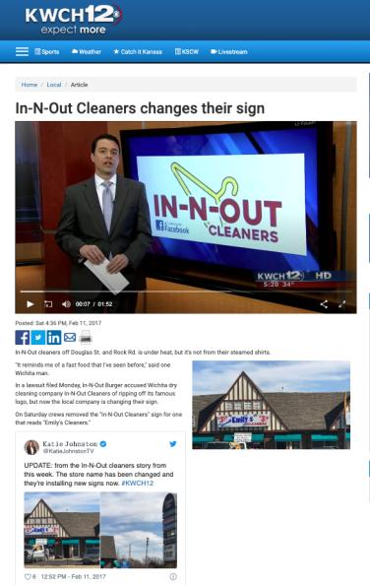
Wichita Kansas

Slide 221
QUESTIONS?
THOUGHTS?
DISCUSSION?

Slide 222
Pause

Slide 223
Trademarks: Infringement
Four main provisions in the TMA that address TM infringement
  S. 7: provides protection against passing off; applies to both registered and unregistered marks
  S. 19: governs use of precise TM registered for same wares and services
  S. 20: deals with confusing uses of TMs
  S. 22: governs uses that depreciate value of goodwill
Only S. 7 provides protection for UNREGISTERED MARKS – s. 7. This section applies to both registered and unregistered marks and provides protection against passing off. It can be understood as the codification of the two main types of passing off…
The other three provisions – ss. 19, 20, and 22 - ONLY apply to registered TMs.

Slide 224
Trademarks: Infringement
  S. 19: governs use of precise TM registered for
  same wares and services
  Subject to ss. 21, 32, 67
  S. 21:
    Honest, concurrent use of the mark
    Allows the court to carve out space for
    a party’s continuing use of a mark
    Compromise provision

Slide 225
Trademarks: Infringement
Rights conferred by registration
19 Subject to sections 21, 32 and 67, the
registration of a trademark in respect of any
goods or services, unless shown to be invalid,
gives to the owner of the trademark the exclusive
right to the use throughout Canada of the
trademark in respect of those goods or services.

Slide 226
Trademarks: Infringement
S. 19 gives the owner of a TM the exclusive right to use, throughout Canada, the TM in association with those wares and services for which it is registered.
S. 19 only applies where someone uses EXACTLY THE SAME TM; and uses it in association with one of the wares or services for which the original mark is registered.
For example, say that Coca Cola is registered only for soda drinks
If someone uses the TM Coca Cola with respect to couches, this would not be covered by s. 19.
As well, if someone uses the TM Cocca Colla (two cs, two ls) with respect to soda drinks, that would not be covered by s. 19.
Only if a second person used the TM Coca Cola (same TM) with respect to soda drinks (same wares and services) that S. 19 would be infringed.
In S. 19, it states that the rights conferred are subject to S. 21, 32, and 67...
Examine S. 21 which exception refers to the Honest, Concurrent use of the mark.

Slide 227
Trademarks: Infringement
For example: Company X has the common law trademark PRAIRIE for luggage. They have been in business in Manitoba and Sask. since 1980 but haven’t registered their mark
1990 Company Y comes along and would like to use the TM PRAIRIE. They do a registered search, find nothing similar, and register the same TM without knowing that X has been in business in Manitoba & Sask. with that trademark.
Company X not aware that company Y registered this mark until 1998, when it is sued for TM infringement by Company Y. But X was using the mark since 1980!
X’s response is to challenge the registration of the mark under s. 18. Specifically X cites the “entitled to register” section of s. 18 , saying that Company Y isn’t entitled to register the mark because Y’s mark was confusing with X’s mark, which X had used prior to the time Y applied to register.

Slide 228
Trademarks: Infringement
Argument will fail.
Defence, in s. 18, is no longer available because it has been more than 5 years since the mark was registered
17(2) says you have 5 years to object to the registration of a mark on the basis of your prior use of the mark.
s. 21 allows the court to carve out space for X’s continuing use of the mark. However the catch is that there has to be an “adequate specified distinction from the registered TM”, as the court may order.
So, the Court indeed allows X use the mark, but they have to distinguish it in some way to ensure the public is not confused as to source.
S. 21 has been described by commentators as the compromise provision. Through it, the court will find some way for both parties to use the TMs.

Slide 229
Trademarks: Infringement
When registration invalid
18 (1) The registration of a trademark is invalid if
  (a) the trademark was not registrable at the date of registration;
  (b) the trademark is not distinctive at the time proceedings bringing the validity of the registration into question are commenced;
  (c) the trademark has been abandoned;
  (d) subject to section 17, the applicant for registration was not the person entitled to secure the registration; or
  (e) the application for registration was filed in bad faith.

Slide 230
Trademarks: Infringement
When registration incontestable
17 (2) In proceedings commenced after the expiration of five years from the date of registration of a trademark or from July 1, 1954, whichever is the later, no registration shall be expunged or amended or held invalid on the ground of the previous use or making known referred to in subsection (1), unless it is established that the person who adopted the registered trademark in Canada did so with knowledge of that previous use or making known.

Slide 231
Trademarks: Infringement
Concurrent use of confusing marks
21 (1) If, in any proceedings respecting a registered trademark the registration of which is entitled to the protection of subsection 17(2), it is made to appear to the Federal Court that one of the parties to the proceedings, other than the registered owner of the trademark, had in good faith used a confusing trademark or trade name in Canada before the filing date of the application for that registration, and the Court considers that it is not contrary to the public interest that the continued use of the confusing trademark or trade name should be permitted in a defined territorial area concurrently with the use of the registered trademark, the Court may, subject to any terms that it considers just, order that the other party may continue to use the confusing trademark or trade name within that area with an adequate specified distinction from the registered trademark.

Slide 232
Trademarks: Infringement
  S. 20: deals with confusing uses of TMs.
  Covers two types of situations:
Where it is not the identical TM that has been used,
but one that is confusing with the registered TM;
(Cocca Colla for soft drinks)
2. Where it is the identical TM but one used with
respect to different wares or services. I.e., Coca
Cola for chairs - something Coca Cola [original
company] is not registered for)

Slide 233
Trademarks: Infringement
Final section dealing with TM infringement of registered marks is S. 22.
S. 22 governs use of a mark that has the effect of depreciating the value of the goodwill of that mark (no confusion is necessary).
Leading case is Veuve Cliquot but first case to deal with s. 22 is Clairol but first…
Clairol International Corp. v. Thomas Supply & Equipment Co., [1968] 2 Ex. C.R. 552

Slide 234
Trademarks: Infringement
Clairol International Corp. v. Thomas Supply & Equipment [1968] 2 Ex. C.R. 552
Facts: Revlon creates comparison charts…
To infringe s. 19: (see ss. 2, 4)
  1) The mark has to be “used” (see ss. 2, 4)
  2) Also “used” as a TM = must be used for the purposes of distinguishing wares and services → used as an indicator of source
  3) Applies only where someone uses the mark as registered; in association with goods or services for which it is registered

Slide 235
Trademarks: Infringement
Clairol International Corp. v. Thomas Supply & Equipment [1968] 2 Ex. C.R. 552
Clairol owns the TMs Miss Clairol and Hair Color Bath; both registered for use in association with hair tinting and coloring preparations.
Revlon, attempting to increase market share, devised two different ways by which users of products of competitors could successfully choose the same product shades.
On packages for Revlon Color Silk, Revlon put comparison charts indicating the equivalent Clairol products.
They also created brochures featuring the comparison charts.
Two of the plaintiff Clairol’s arguments were that the use of their trademarks in the color comparison charts infringed s. 19 and s. 22 of the Trademarks Act.

Slide 236
Trademarks: Infringement
Clairol International Corp. v. Thomas Supply & Equipment [1968] 2 Ex. C.R. 552
Deals with the question “what does the word “USE” mean in s. 19?”
Look first to s. 2 of the Act for a definition of “use” in relation to a TM. “Use” is defined in s. 2 as “any use that by Section 4 is deemed to be a use in association with wares or services”.
Look to s. 4 which is very specific about use
s. 4(1) deals with use in association with wares; s. 4(2) deals with use in association with services.
In this case, there are no services at issue, only wares, actual boxes of hair dye. Did Revlon use Clairol’s marks in association with their own wares within the meaning of s. 4(1)?
Per s. 4(1), a TM is used in association with wares if, the TM is marked on the product or package at time of transfer of possession or is in any other manner so associated with the wares that notice of the association is given to the person to whom the property is transferred.
In this situation Clariol’s TMs are marked on the boxes, so on the package at the time of the transfer of possession.

Slide 237
Trademarks: Infringement
Clairol International Corp. v. Thomas Supply & Equipment [1968] 2 Ex. C.R. 552
However, this is not the end of the issue.
S. 19 talks about when a TM is used: In order to ensure that this section is not interpreted in an overly broad manner, the court holds that we cannot look only at the word “use”, but also at the definition of TM.
In order to infringe s. 19, the mark must be used (s. 2, then s. 4 (1 or 2) depending on whether the Defendant uses the mark in association with their own wares or services.
The mark also must be used as a TM. This essentially means that the mark must be used in a way that would indicate that the company behind the TM is the SOURCE of the product.
As well, this section applies only where someone uses the mark as registered; in association with goods or services for which it is registered

Slide 238
Trademarks: Infringement
Clairol International Corp. v. Thomas Supply
& Equipment [1968] 2 Ex. C.R. 552
Is there “use” as a
“trademark” here with
respect to the packages?

Slide 239
Trademarks: Infringement
Clairol International Corp. v. Thomas Supply & Equipment [1968] 2 Ex. C.R. 552
No, there is not. Clear that Revlon is not trying to pretend that it is a Clairol product, just trying to show what the right Revlon product to purchase is if you usually buy Clairol
Accordingly, the test for s. 19 infringement not made out.
The brochures are also fine.

Slide 240
Trademarks : Infringement
Clairol International Corp. v. Thomas Supply & Equipment (1968)
S. 22:
  The defendant must have used the mark as set out in s. 2 and 4 of the Act.
  If there is “use”, then the test becomes whether the use is likely to depreciate the value of the goodwill attaching to the mark (i.e. by reducing the esteem in which the mark is held; or enticing customers away)

Slide 241
Trademarks: Infringement
Clairol International Corp. v. Thomas Supply & Equipment (1968)
This is the first time a s. 22 issue was before the court. [Exact s. 22 test will come from Veuve, but this is useful for historical purposes, and to see the stance taken by this Court on comparative advertising].
22. (1) No person shall use a trade-mark registered by another person in a manner that is likely to have the effect of depreciating the value of the goodwill attaching thereto.
How far is this section meant to extend?
Written broadly enough to capture negative comments made in conversation about a specific product.
The court acknowledges that this section is worded broadly but says that it’s unlikely that there is any attempt to suppress critical expression.
*One key is that the court reads in an implied limitation in this section…use in the course of trade.
But even with this implied limitation, this is still potentially a very broad right. It could cover comparison price charts or discussion by sales-clerks of competing products.
We see the court reiterate that purpose of s. 22 is not to stop legitimate comparisons.

Slide 242
Trademarks: Infringement
Clairol International Corp. v. Thomas Supply & Equipment (1968)
In evaluating use in s. 22 the court in Clairol held that we again need to go to s. 4 of the TMA
The TM must be “used” by the Defendant in association with their own wares and services.
Court already found the Clairol marks were “used” in accordance with wares on the package, but not on brochures.
So, the TM is used on the package, so the first part of the s. 22 analysis was met (as the analysis was structured in this case).
NB: Do not need to apply the second part of the “use” test; not a requirement under s. 22 for the mark to have been “used” as a TM.

Slide 243
Trademarks: Infringement
Clairol International Corp. v. Thomas Supply & Equipment (1968)
The second part of the s. 22 test is whether the TM used in matter likely to depreciate the goodwill in the mark?
This brings up the question of what is to be regarded as the goodwill attaching to a TM? The definition given by the court is: the goodwill attaching to the TM is that portion of goodwill that consists of the whole advantage that may have been built up by years of honest work/trade, or money promoting the mark.
To depreciate the value of this goodwill, then, is to reduce the advantage of the reputation/connection

Slide 244
Trademarks: Infringement
Clairol International Corp. v. Thomas Supply & Equipment (1968):
How might depreciating goodwill occur?
Court says that the value of goodwill can be depreciated in two ways:
  (1) Reduce the esteem in which the mark is held
  (2) By enticing customers away.
That said, it is legitimate for businesses to attract consumers from competitors BUT they must do so by honest means
s. 22 sets some limits on what those honest means are. You can put information on your wares for the purpose of telling customers about your own wares in order to get them to buy your goods in preference to those of the owner of a particular TM.

Slide 245
Trademarks: Infringement
What you can not do, however, is put your competitor’s TM on your goods to entice customers away.
That is what happened in this situation.
The competitor’s TMs were used on the package to suggest to customers that they could easily make the switch.
This was found by the court to be a violation of s. 22.
The use on the brochures is not a violation of s. 22; in putting the marks on the brochures, the Defendant isn’t using the mark in association with its wares.
As a result, Revlon can make brochures that give the comparison between the two products; they just can not put the Clairol marks or the chart on their product boxes.

Slide 246
Trademarks: Infringement
What is the impact of Clairol on comparative advertising?
Case suggests we CAN have comparative advertising with respect to products, but not services.
With respect to wares (products), you can mention opposing TMs in ads, or put them on charts and in displays. In doing so, you’re not “using” the TM according to the Trademarks Act; and s. 22 doesn’t kick in since the TM isn’t being “used”.
Result of CLAIROL seems to be that if your TM is registered in association with services, and if you produce an advertisement that uses your competitor’s marks = you are infringing s. 22 because of s. 4(2) which clarifies that use in association with services includes ads.
This is not the law today, though…

Slide 247
QUESTIONS?
THOUGHTS?
DISCUSSION?

Slide 248
Pause

Slide 249
Trademarks : Infringement – the law today
Future Shop v. A&B Sound, [1994] 8 W.W.R. 376
Facts: A&B Sound creates price comparison ads
The public has an interest in comparative advertising
Is the use of the competitor's trademark for a purpose which stresses the similarities or the differences with the trademarked competition ok?
  Similarities?: Not ok - S. 22 infringed.
  Differences?: Ok - S. 22 not infringed.

Slide 250
Trademarks: Infringement – the law today
Future Shop v. A&B Sound, [1994] 8 W.W.R. 376
A & B sound put up price comparison ads in which they effectively stated; here are our products and prices, here are Future Shop’s prices.
Future shop sued for TM infringement. It said that using their mark which was registered for services in comparative advertising is a violation of s. 22.
Based on Clairol it seemed like Future Shop’s argument was sound, and that the use of mark, registered for services, in comparative advertising, is a violation of s. 22.
HOWEVER:
Court held that granting an injunction in this case would deprive the defendant of the option of continuing to pursue its strategy of seeking to attract customers by highlighting its low prices in comparison with those of the plaintiff by fair and accurate ads.
Also, the public has an interest in comparative advertising to the extent that the comparative information offered in those ads helped consumers make better choices.

Slide 251
Trademarks: Infringement – the law today
It appeared after Clairol, that if you run a service and produce an ad which refers to competitor’s marks, s. 22 would be infringed because use in association with services includes ads.
Court in Future Shop v. A&B Sound holds that this is not the case, that the previous principle is too broad and is detrimental to commerce and to the public interest.
The question, depending on the evidence in any particular case, is whether the use of the competitor's trademark is for a purpose which stresses the similarities or the differences with the trademarked competition.
If the purpose is to stress the similarities, then you are appropriating the value of the goodwill associated with the TM, contrary to s. 22.
If the purpose is to stress the differences with the trademark, then the use is for the purpose of distancing the trademarked ware or service and s. 22 is not offended.
Court in Future Shop v. A&B Sound held that we should still allow comparison; and that we should protect freedom of expression.

Slide 252
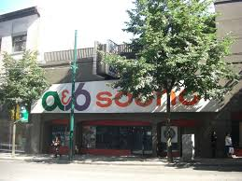


Slide 253


Slide 254
Trademarks: Infringement – the law today
SUMMARY
1. Emphasizing differences in services and products is fine according to s. 22.
2. It is when trying to appropriate the value of goodwill by emphasizing the similarities between products, the use would run afoul of s. 22.

Slide 255
QUESTIONS?
THOUGHTS?
DISCUSSION?

Slide 256
Pause

Slide 257
Trademarks: Infringement
Questions to Ponder
Is it important, in constructing a legal regime around trademarks, to preserve space for comparative advertising?
What limits, if any, should be placed on comparative advertising?
How do you feel about the balance struck by the courts in this regard?

Slide 258


Slide 259


Slide 260


Slide 261
QUESTIONS?
THOUGHTS?
DISCUSSION?

Slide 262
Pause

Slide 263

How is S. 22 TMA like this Guy?

Slide 264
Trademarks: Infringement
Veuve Clicquot Ponsardin v. Boutiques Cliquot (SCC, 2006)
Facts: Champagne house objects to use of similar
name by women’s wear store
The mere mental association of the two marks does
not necessarily give rise to a likelihood of depreciation
S. 22 = “super weapon” - Needs to be kept in check
Courts should separate anti-dilution claims into
discrete elements; require proof for each element

Slide 265
Trademarks: Infringement
Veuve Clicquot Ponsardin v. Boutiques Cliquot (SCC, 2006)
“Veuve Clicquot”:
  One of the world’s great champagne houses
  Numerous marks registered in Canada, and used in connection with products in Canada since at least 1899
  Part of the Louis Vuitton luxury goods group
“Cliquot”:
  Name of six women’s wear shops in Quebec & eastern Ontario
  TMs registered are Cliquot, Cliquot “Un Monde a Part”; also “Cliquot” is trade name
  Sell clothing that is “marketed as good value”; that “appeals to the career woman rather than grandes dames” [interesting play on words given the TM registration, by Veuve Clicquot, of La Grande Dame]

Slide 266
Trademarks: Infringement
Veuve Clicquot Ponsardin v. Boutiques Cliquot (SCC, 2006)
Word Cliquot does not appear on any of the clothing in the Cliquot boutiques. It appears only on exterior signs, bags, wrapping, business cards, and invoices.
Appellants’ and respondents’ marks have co-existed for about 10 years.
Veuve Clicquot claims BOTH that:
  Consumers will be confused that the women’s clothing and the champagne originate from the same source, thereby infringing the registered TMs of the appellant contrary to s. 20 of the TMA; AND
  That the use by the Respondents depreciates the value of the goodwill attached to the appellants’ marks, contrary to s. 22 of the Act.

Slide 267
Trademarks: Infringement
Veuve Clicquot Ponsardin v. Boutiques Cliquot (SCC, 2006)
Trial Judge found that there was little (if any) confusion as to source.
Trial Judge also found that the use, by the respondents, of the words Cliquot or Cliquot un monde a part, did not violate s. 22 of the Act.
Federal CA agreed, as did the SCC.
S. 22 analysis:
The s. 22 remedy was introduced as part of the 1953 amendments to the Trade-Marks Act. Justification was that TM would be less valuable to the owner if it were used by others in connection with a wide variety of other goods even in situations where there was no confusion.
Canada is not the only country to have such a remedy. It can also be found in the US, UK, Europe.

Slide 268
Trademarks: Infringement
Veuve Clicquot Ponsardin v. Boutiques Cliquot (SCC, 2006)
Crucial point in the Veuve Clicquot case is Binnie J.’s statement that the mere mental association of the two marks does not necessarily give rise to a likelihood of depreciation. There are other steps to the test…
There are also some other important remarks on this provision should be interpreted:
S. 22 is sometimes referred to as a “super weapon” which, in the interest of fair competition, needs to be kept in check
A super weapon because conceivably could apply in a wide range of situations to constrain individual behaviour and constrain competition. Recall that the main purpose of TM law is not to protect the mark itself. It’s to protect the mark as representative of source.

Slide 269

Trademarks: Infringement
Veuve Clicquot Ponsardin v. Boutiques Cliquot (SCC, 2006)
How does the SCC keep this “super weapon” in check?
SCC says - because of its status as a super weapon, any…
  Dilution should be proved by evidence
  Courts should separate any anti-dilution claim into its discrete elements and require proof for each of those elements.

Slide 270
Trademarks: Infringement
Veuve Clicquot Ponsardin v. Boutiques Cliquot (SCC, 2006)
1) Was the Plaintiff’s registered TM “used” in connection with the Defendant’s wares or services in a way that gives notice of the association?
2) Is the Plaintiff’s registered TM sufficiently well-known to have significant goodwill attached to it?
3) Is the Plaintiff’s mark used in a manner likely to have an effect on that goodwill?
4) Is the likely effect to depreciate the value of the goodwill?

Slide 271
Trademarks: Infringement
Veuve Clicquot Ponsardin v. Boutiques Cliquot (SCC, 2006)
THE TEST FOR S. 22…Test to use when evaluating s. 22 claims.
S. 22 has four elements
1) That a claimant's registered trade-mark was used by the defendant in connection with wares or services in a way that gives notice of the association; does not matter whether or not those wares and services are competitive with those of the claimant.
2) That the claimant's registered trade-mark is sufficiently well known to have significant goodwill attached to it. Canada’s dilution/depreciation provision doesn’t require the mark to be famous (difference between US, European laws)
3) The claimant’s mark used in a manner likely to have an effect on that goodwill (i.e. linkage)
4) Likely effect would be to depreciate the value of its goodwill

Slide 272
Trademarks: Infringement
Veuve Clicquot Ponsardin v. Boutiques Cliquot (SCC, 2006)
1) Was the Plaintiff’s registered TM “used” in connection with the Defendant’s wares or services in a way that gives notice of the association?
“Use” as defined in s. 4
Would the casual observer recognize the mark used by the Defendant as the mark of the P?

Slide 273
Trademarks: Infringement
Veuve Clicquot Ponsardin v. Boutiques Cliquot (SCC, 2006)
1) Use of the claimant’s registered mark
“Use” defined in s. 4
“Use”, if for wares, marked on the wares themselves or on packaging or in any other manner so associated with the wares that notice of the association is given
Important to note that the fact that Cliquot was spelled differently does not by itself mean that the TM was not used. What matters is would the casual observer recognize the mark used by the Respondent as the mark of the Appellant (IE Coke, Koke).
Trial Judge held that a consumer who saw the word cliquot used in the D’s stores WOULD NOT MAKE ANY ASSOCIATION with the Plaintiff’s mark. Accordingly, there is NO USE for services pursuant to s. 4.
Without a link between the respondents’ store and the Veuve Clicquot mark, the Veuve Clicquot mark cannot be depreciated.
S. 22 claim fails at the first step.
However, the Court thankfully (for us) goes through the rest of the analysis, partly because s. 22 just doesn’t get litigated very often.

Slide 274
Trademarks: Infringement
Veuve Clicquot Ponsardin v. Boutiques Cliquot (SCC, 2006)
2) Is the Plaintiff’s registered TM sufficiently well-known to have significant goodwill attached to it?
Goodwill = positive association that attracts customers towards its owner’s wares or services
How to determine how much goodwill exists in a mark [see para. 54]

Slide 275
Trademarks: Infringement
Veuve Clicquot Ponsardin v. Boutiques Cliquot (SCC, 2006)
2) Proof of goodwill
“Goodwill” isn’t defined in the Act, but generally means the positive association that attracts customers towards its owner’s wares or services rather than those of its competitors
For s. 22 to apply there needs to be the existence of goodwill capable of depreciation by a “non-confusing use”.
“[54] While “fame” is not a requirement of s. 22, a court required to determine the existence of goodwill capable of depreciation by a “non-confusing” use (as here) will want to take that approach into consideration, as well as more general factors such as the degree of recognition of the mark within the relevant universe of consumers, the volume of sales and the depth of market penetration of products associated with the claimant’s mark, the extent and duration of advertising and publicity accorded the claimant’s mark, the geographic reach of the claimant’s mark, its degree of inherent or acquired distinctiveness, whether products associated with the claimant’s mark are confined to a narrow or specialized channel of trade, or move in multiple channels, and the extent to which the mark is identified with a particular quality.”
In this case there is a substantial amount of goodwill that attaches to the Veuve Clicquot mark. This goodwill extends beyond wine and champagne.

Slide 276
Trademarks: Infringement
Veuve Clicquot Ponsardin v. Boutiques Cliquot (SCC, 2006)
3) Is the Plaintiff’s mark used in a manner likely to have an effect on that goodwill?
Plaintiff must prove a connection or linkage made by consumers between the Plaintiff’s goodwill and the defendant’s use

Slide 277
Trademarks: Infringement
Veuve Clicquot Ponsardin v. Boutiques Cliquot (SCC, 2006)
3) Likely connection or linkage made by consumers between claimant’s goodwill and defendants’ use?
Trial Judge found that the somewhat hurried consumer does not associate what is displayed in the Respondents' stores with the mark of Veuve Clicquot. As a result, there can be no impact on the goodwill attached to VEUVE CLICQUOT.
AND any linkage does have to be proved. That is why the section does not read: No person shall use a [famous] trade-mark registered by another person [because to do so] is likely to have the effect of depreciating the value of the goodwill attaching thereto.
The complainant must prove a connection or linkage made by consumers between the claimant’s goodwill and the defendants’ use.

Slide 278
Trademarks: Infringement
Veuve Clicquot Ponsardin v. Boutiques Cliquot (SCC, 2006)
4) Is the likely effect to depreciate the value of the goodwill?
Depreciate = lower the value of; to disparage, belittle, underrate
  Lower value:
    Loss of distinctiveness
    Dilution (blurring of brand image)
Disparage = tarnish; creation of negative associations

Slide 279
Trademarks: Infringement
Veuve Clicquot Ponsardin v. Boutiques Cliquot (SCC, 2006)
Likelihood of depreciation
Veuve Clicquot is a famous mark with significant goodwill is attached to it in the luxury goods trade
Word “depreciate” is used in its ordinary dictionary meaning of "lower the value of" as well as to "disparage, belittle, underrate"
  Value can be lowered in a variety of ways:
  Loss of distinctiveness: Value can be lowered in situations where the mark is used by different users (either by company itself licensing too widely. For example, the Pierre Cardin brand moved down market through overuse of licensing; or through others using).
  Dilution: Meaning a blurring of brand image. Dilution works its harm not by causing confusion in consumers’ minds regarding the source of a good or a service, but by creating an association in consumers’ minds between a mark and a different good or service. I.e. Tiffany ex ample → Mass. court, in dealing with a local restaurant calling itself Tiffany, talked about the risk of erosion of the public's identification of the mark uniquely with the plaintiff's jewellery and luxury business, diminishing its distinctiveness, uniqueness, effectiveness and prestigious connotations

Slide 280
Trademarks: Infringement
Veuve Clicquot Ponsardin v. Boutiques Cliquot (SCC, 2006)
Likelihood of depreciation (con’d)
  Disparagement or tarnishing of a TM is where the Defendant creates negative association for the mark.
    Thurlow J. considered this was the case in the Clairol case
    Examples given was Dallas Cowboy Cheerleaders Inc. v. Pussycat Cinema Ltd. as well as other cases involving sexually explicit or pornographic businesses in the US [para. 66]
  Depreciation not limited to BLURRING and TARNISHMENT in Canada. It is not enough to show that depreciation COULD occur – must prove that it’s LIKLELY to occur.
In this case the Court found that a casual consumer would not associate the name of the respondents’ stores with the house of Veuve Clicquot. Accordingly, the necessary elements for a s. 22 depreciation claim were not established.

Slide 281
Trademarks: Infringement
Conclusion on s. 19, 20, 22
In these cases, we see the Courts interpreting s. 19, 20, 22 in a narrow fashion, restricting the ambit of the sections to the context of commercial competition.
This leaves magazines, unions, and individuals generally free to criticize companies without the fear of trade-mark consequences. The courts are reluctant to use TM law to shut down the ability of people to protest.
In Clairol, when court talks about goodwill, depreciation is found on basis that customers will be diverted to the opposing party (appropriated) as opposed to simply driven away.
Absent a commercially competitive context it is much less likely that there will be depreciation in the value of goodwill. Other parties are not taking goodwill away for their own use.

Slide 282
QUESTIONS?
THOUGHTS?
DISCUSSION?

Slide 283
Pause

Slide 284

Trademarks: Remedies

Slide 285
Trademarks: Remedies
Remedies
See s. 53.2 (read together w. s. 2, “interested person”)
Including:
  Injunctions (interlocutory or permanent)
  Damages compensating for lost sales, damage to goodwill, loss of control of reputation
  Accounting of profits (alternative to damages)
  Destruction of offending materials
  Removal of mark from wares
  Concealment of mark on wares
  Punitive damages (in certain circumstances)

Slide 286
Trademarks: Remedies
The primary remedies provision in the TMA is s. 53.2. This provision needs to be read together with s. 2 – for the definition of an “interested person”.
Remedies available include:
  Injunctions (interlocutory or permanent)
  Damages
    To compensate for harm suffered:
      Lost sales
      Damage to goodwill
      Loss of control of reputation
  (or) Accounting of profits
  Order for the destruction or other disposition of offending materials
  Removal of offending mark from wares
  Permanent concealment of mark on wares
  Punitive damages in certain circumstances

Slide 287
Trademarks: Remedies
Defences to TM infringement
1) Challenge the validity of the other party’s TM
  See s. 18
2) A Defendant had used, in good faith, a confusing Trade Name in Canada prior to the filing of the Plaintiff’s application for registration of TM
  See s. 21
3) Mark should be cancelled where non-use
4) Defences set out in s. 20 (bona fide…)

Slide 288
Trademarks: Remedies
Defences to TM infringement
A defendant could challenge the validity of the other party’s TM: S. 18 is the provision to rely on if this defence is to be raised (TM registered).
  s. 18(1)(a): Invalid if the TM was not registrable at the date of registration (ss. 9, 10, 12, 13)
  s. 18(1)(b): Invalid if the TM is not distinctive at the time of the challenge (become generic – see Champagne case)
  s. 18(1)(c): Invalid if it has been abandoned (see the corpulent penguin case for the test for abandonment)
  s. 18(1)(d): Invalid if the applicant was not the person entitled to register the mark [refer back to s. 16, but note the limitation in s. 17]

Slide 289
Trademarks: Remedies
Defendant had used in good faith a confusing Trade Name in Canada before the date of the filing of the Plaintiff’s application for registration (s. 21)
The Plaintiff’s mark should be cancelled because of non-use (see S. 45)
Certain defences contained in s. 20 can be invoked where a TM owner alleges that the Defendant has infringed their TM by using a confusing mark.
  I.e.: (1.1) The registration of a trade-mark does not prevent a person from making, in a manner that is not likely to have the effect of depreciating the value of the goodwill attaching to the trade-mark,
    (a) any bona fide use of his or her personal name as a trade-name; or (b) any bona fide use, other than as a trade-mark, of the geographical name of his or her place of business or of any accurate description of the character or quality of his or her goods or services.

Slide 290

Trademarks: Remedies
Assume Trader Joe’s TM is registered in Canada – as of 2011.
Is Pirate Joe’s infringing Trader Joe’s registered TM? s. 19, 20, 22…

Slide 291
Trademarks: Remedies – Q&A
Do you think the provisions in the TMA provide
sufficient protection against infringement for TM
owners?
2. Do you think the provisions in the TMA overprotect
TM owners?
  In answering these questions please think of specific
  legislative reforms that in your view would make the
  degree of protection available to TM owners more
  appropriate.

Slide 292
QUESTIONS?
THOUGHTS?
DISCUSSION?

Slide 293
Pause

Slide 294
Trademarks
Review

Slide 295
Trademarks: Infringement
– the law today
SUMMARY
1. Emphasizing differences in services and products is fine according to s. 22.
2. It is when trying to appropriate the value of goodwill by emphasizing the similarities between products, the use would run afoul of s. 22.

Slide 296

Trademarks: Infringement
Veuve Clicquot Ponsardin v. Boutiques Cliquot (SCC, 2006)
How does the SCC keep this “super weapon” in check?
SCC says - because of its status as a super weapon, any…
  Dilution should be proved by evidence
  Courts should separate any anti-dilution claim into its discrete elements and require proof for each of those elements.

Slide 297
Trademarks: Remedies
Remedies
See s. 53.2 (read together w. s. 2, “interested person”)
Including:
  Injunctions (interlocutory or permanent)
  Damages compensating for lost sales, damage to goodwill, loss of control of reputation
  Accounting of profits (alternative to damages)
  Destruction of offending materials
  Removal of mark from wares
  Concealment of mark on wares
  Punitive damages (in certain circumstances)

Slide 298
Trademarks
Are the provisions of the TMA allowing for challenges to TM registration:
Weighted too heavily in favour of persons that have registered marks (or are applying to have a mark registered)?
Weighted too heavily in favour of persons wishing to oppose or invalidate a registration?
Adequately balanced between both parties (and the public interest more broadly)?

Slide 299

Trademarks Review

Slide 300

Trademarks Review

Slide 301
Trademarks Review
The Kitasoo Band Council approaches you and would like to register the mark SPIRIT BEAR as an official mark. Do you anticipate any issues with the registration of this mark?

Slide 302
Trademarks Review
The Kitasoo Band Council approaches you and would like to register the mark SPIRIT BEAR as an official mark. Do you anticipate any issues with the registration of this mark?

Slide 303

Trademarks Review

Slide 304
Trademarks Review
Is a TM registered in association with
goods and not services “used” when it
is reproduced, by a competitor, on a
brochure placed next to both the
product on which the TM is marked
and the competitor’s product?

Slide 305
Trademarks Review
Do you think the provisions in the TMA
provide adequate protection against
infringement for TM owners? If so, why? If
not, what changes would you make to the
TMA to increase protection against
infringement?

Slide 306
Trademarks Review
Does the TMA sufficiently balance the
property rights of TM owners with the
speech rights of non-TM-owning parties?

Slide 307

Trademarks Review

Slide 308

Trademarks Review

Slide 309

Trademarks Review

Slide 310
Trademarks Review
Does TM law in Canada adequately balance
between the rights of TM owners and the
rights of the public to make use of marks
capable of being protected under TM law?

Slide 311
QUESTIONS?
THOUGHTS?
DISCUSSION?

Slide 312
Pause

Slide 314
On with the show…

Slide 315

Patents

Slide 316

Guest Speaker

Slide 317

https://iplaw.allard.ubc.ca/2020/06/01/gowlings-roch-ripley-r-nelson-godfrey-on-patent-remedies-etc/

Slide 318
Patents
First…
Introduction to patents
Patentable subject matter
  Invention
    Composition of matter; manufacture; machine; art; process; improvement
Non-patentable subject matter
    Mere scientific principles or abstract theorem; professional arts; higher life forms; methods of medical or surgical treatment

Slide 319
Patents
Federal Government:
Authority over patents: s. 91(22), Constitution Act, 1867
Authority exercised in part through the enactment of the Patent Act, RSC, c. P-4
Definition of patent:
a limited term monopoly for an invention; the right, given to an inventor by the government, to exclude others from making, using or selling one’s invention from the day the patent is granted.
“…to advance research and development and to encourage broader economic activity” (Free World Trust, 2000 SCC)

Slide 320
Patents
”Patentee” can only get a patent for “inventions” (s. 2)
Also, patent only granted if your invention is novel, useful, and non-obvious (ss. 2, 28.3)
Term of protection: 20 years (ss. 44, 46)
Contrast with confidential information

Slide 321

The Patent Bargain
Patent system is a “quid pro quo”

Slide 322
Patents
At its core, the patent system is a bargain between the inventor and the public:
One party discloses an invention in exchange for a 20 year monopoly period in which to make, use, and sell the invention
See Teva Canada Ltd. v. Pfizer Canada, Inc.
  FACTS: Teva had challenged the validity of Pfizer’s patent for Viagra.

Slide 323
The Patent Bargain
Teva Canada Ltd. v. Pfizer Canada, Inc.
FACTS: Teva had challenged the validity of Pfizer’s patent for Viagra.
“[N]ot intended as an accolade or civic award for ingenuity. It is a method by which inventive solutions to practical problems are coaxed into the public domain by the promise of a limited monopoly for a limited time.”
Patent specification = heart of the disclosure requirement
Patent system is a “quid pro quo”

Slide 324
The Business Context: perceptions of value
In 2015, intangible assets accounted for 87% of the value of Standard & Poor’s 500 (tracking 500 companies with the largest market capitalization listed on the New York Stock Exchange (Ocean Tomo 2015)
Are patents overvalued generally?
Does start-up perception that patents are “necessary” result in overly general or irrelevant “false flag” patents that simply go unchallenged in the short-term.
E.g., = Cool product with patent, but patent is purely ancillary and has nothing to do with the key features that differentiate the product in the market
Likewise, query practical uses of “patent pending”.

Slide 325

Patents

Slide 326

Trolls
https://www.youtube.com/watch?v=sG9UMMq2dz4

Slide 327
Patents
Is a patent a good bargain?
Might we be better off with longer patent
protection?
Without any sort of patent protection?

Slide 328
Patents
Invention = … any new and useful art, process, machine, manufacture or composition of matter, or any new and useful improvement in any art, process, machine, manufacture or composition of matter (s. 2, Patent Act)
Contrast to Copyright where “mods” are discouraged rather than encouraged

Slide 329
Patents
Novelty and usefulness
(see s. 2, Patent Act)
Non-obviousness
(see s. 28.3, Patent Act)

Slide 330
Patents
Invention = … any new and useful art, process, machine, manufacture or composition of matter, or any new and useful improvement in any art, process, machine, manufacture or composition of matter (s. 2, Patent Act)
Contrast to Copyright where “mods” are discouraged rather than encouraged

Slide 331
Patents
Harvard College (SCC):
Majority
  Invention defined broadly, should be interpreted broadly; but is not unlimited
  Some subject matter is outside the scope of protection
Commissioner has no discretion to refuse a patent on the basis of public policy considerations independent of express provisions of the Act

Slide 332
My comments on majority decision in Harvard College
(have edited out regrettably inappropriate comments)
“…I have spent way too much arguing in my head with Mr. Justice Bastarache’s every word in Harvard Mouse.” – email to Prof. Graham Reynolds, 8.15.20.
My original (unexpurgated but decontextualized) marginal notes in the textbook version of the case:
  ”STRAINED WOULD BE AN UNDERSTATEMENT. INTELLECTUALLY HONEST?”
  Huh?
  Huh?
  Worst writing in the history of the Court (SCC)???
  It doesn’t?
  So what?
  So strained!!!
  ???
  Huh!
  Really?
  Huh – non sequitur
  LWTF? How? Wha..?
  B…Turns a preference for parliamentary clarity into a requirement for it – wrongly.
None of the above means I’m right, just that I had a similar reaction to some of you.

Slide 333
But…
Isn’t majority just limiting patents and saying that patents are too broad? I want to limit copyright similarly so benefits can accrue to everyone (for example – mods).
Isn’t the prohibition from patenting higher life forms equivalent to being anti-slavery?
I tend to be “species’ centric” in suggesting A.I.’s can’t create copyright material. If that’s ok what’s wrong with species-centric in this situation?

Slide 334
Patents
Composition of matter
The category ‘composition of matter’ refers to combinations of ingredients, whether combined as a chemical union or a physical mixture, and includes chemical compounds, compositions and substances (12.02.05, “MOPOP” – Manual of Patent Office Practice)

Slide 335
Patents
Composition of matter – Harvard College
Defined more narrowly than “all compositions of two or more substances and … all composite articles”
Does not include higher life form like the oncomouse
Statutory interpretation principles used to support this determination
Other factors that suggest that higher life forms are not compositions of matter
  Recourse to dictionary definitions
  “Combine” – but elements require no human intervention
  “Composition of matter” seems inadequate as a description of a higher life form

Slide 336
Patents
Manufacture
Majority (Harvard College)
  Manufacture = non-living mechanistic product or process
MOPOP (Manual of Patent Office Practice)
  The process of making (by hand, by machine, industrially, by mass production…) technical articles or material (in modern use on a large scale) by the application of physical labour or mechanical power; or the article or material made by such a process” (MOPOP 12.02.04).

Slide 337


Slide 338
Patents
Machine
  The mechanical embodiment of any function or mode of operation designed to accomplish a particular effect (MOPOP, s. 12.02.03)
  Example: Amazon.com, Inc. v. Canada (Attorney General), [2010] FC 1011, where certain patent claims disclosed ‘a machine … used to implement Amazon.com’s one-click ordering system”

Slide 339
Patents
Art
The application of knowledge to effect a desired result; must be defined in a way that gives practical effect to the knowledge.
Claimed as a method or a use
  Method – involves directing the person skilled in the art to take a step/series of steps to arrive at the desired result
  Use – defined in terms of the means to be applied; the “how” is left to the common general knowledge of the “person skilled in the art”

Slide 340
Art (as use)
  The application of certain means to achieve a specific result
  I.e.: the use of a known drug applied to treat a known disease

Slide 341
Patents
Art (as method)
Method
  An act or series of acts performed by some … object and producing in that object some change of either character or condition” (citing to Lawson – cited in Amazon.com, Inc.(MOPOP, 12.02.01)
  Test cited in Amazon:
    Not a disembodied idea; must have method of practical application
    A new and inventive method of applying skill and knowledge
    Has a commercially useful result

Slide 342
Patents
Art (as method)
  Claim 1 of Patent 2682261 – requesting prior art
  from the public in exchange for a reward
NB: fine arts are excluded from patentability
(inventions must apply to fields of technology)

Slide 343
Patents
Process
“A process can be considered to be a mode or method of operation by which a result or effect is produced by physical or chemical action, by the operation or application of some element or power of nature or one substance to another”
(MOPOP – Manual Of Patent Office Practice )
A process through which a known method is applied to known materials is patentable (Commissioner of Patents v. Ciba Ltd., 1959 SCC)

Slide 344
QUESTIONS?
THOUGHTS?
DISCUSSION?

Slide 345
Pause

Slide 347
Now, to our regularly
scheduled programming…

Slide 348
On with the show…

Slide 349
Patents
Process
“A process can be considered to be a mode or method of operation by which a result or effect is produced by physical or chemical action, by the operation or application of some element or power of nature or one substance to another”
(MOPOP – Manual Of Patent Office Practice )
A process through which a known method is applied to known materials is patentable (Commissioner of Patents v. Ciba Ltd., 1959 SCC)

Slide 350
Patents
Process
Claim 1 of Patent 2697087 – PROCESS OF
REMOVING CALCIUM AND OBTAINING SULFATE
SALTS FROM AN AQUEOUS SUGAR SOLUTION

Slide 351
Patents
Improvements
Most inventions are improvements of other
inventions
Not an improvement? A “pioneering” invention
A patent on the improvement does not give
the right to make, sell, or use the original
invention (s. 32, Patent Act)

Slide 352
Patents
Mere scientific principle or abstract theorem
Starting point: s. 27(8), Patent Act
This section interpreted as excluding, from patentability, natural phenomena and laws of nature (Arbour J., Schmeiser)
Are human gene patents patentable subject matter?

Slide 353
Patents
Mere scientific principle or abstract theorems
Historically – computer programs are not patentable because they are mathematical algorithms (unpatentable per s. 27(8)) (see Schlumberger Ltd. v. Canada (Patent Commissioner), 1982
But…see Motorola Inc., in which Motorola succeeded in patenting a mathematical algorithm by claiming it as part of a machine (the computer)

Slide 354
Patents
Patentability of business methods
Canada (Attorney General) v. Amazon.com, Inc., 2011 FCA 328
  FACTS: one-click online purchase method
  (1) No case law to support claim of tradition of excluding business methods from patentability
  (2) To avoid patenting a mere idea or discovery, the claimed invention must have some “physical existence” that “manifests a discernible effect or change”. This is not met merely by virtue of the fact that the claimed invention has a “practical application”.

Slide 355
Patents
Professional Arts v. Professional Skills
  Professional skills are considered not to
  be patentable on the basis that they
  reflect the personal knowledge and
  capacities that one would expect from
  any-one skilled in their field
  See Lawson

Slide 356
Patents
Higher life forms
Post Harvard College:
  Patent applications cannot include claims to higher life forms (i.e., seeds, plants, non-human animals) or to humans
  Can patent isolated genes and cells (cell lines, cell cultures)
  Fertilized eggs?
    CIPO practice notice – fertilized egg is considered to be a higher life form because it can develop into a higher life form

Slide 357
Patents
Higher life forms
But … Monsanto Canada Inc. v. Schmeiser (2004)
  Schmeiser infringed Monsanto’s patented modified canlola gene by growing and harvesting his canola plants containing the patented gene.

Slide 358
QUESTIONS?
THOUGHTS?
DISCUSSION?

Slide 359
Pause

Slide 360
Patent Requirements
Next…
Requirements of patentability:
  Novelty
  Non-obviousness
  Utility

Slide 361
Patents
Novelty and usefulness
(see s. 2, Patent Act)
Non-obviousness
(see s. 28.3, Patent Act)

Slide 362
Patents
Novelty
Also referred to as “anticipation” (prior action that prevents the action of another)
Has the invention been disclosed in some way prior to the date of the patent claim?
See s. 28.2, Patent Act
Underlying policy reason?

Slide 363
Patents
Novelty
Prior art: Material which may disclose the invention which you’re claiming
Can use this to establish that an invention existed before the patent claim
See s. 28.2 outline of what constitutes prior art for the purpose of assessing novelty

Slide 364
Patents
Novelty
Filing date v. claim date
  Filing date: date on which the Commissioner receives certain documents, information and fees (s. 28(1))
  Claim date: each claim has a claim date; establishes the date for determining the patentability of the invention defined by the claim

Slide 365
Patents
Novelty
The claim date is normally the filing date (s. 28.1)
…except where the person who has filed the application has previously filed an application for a patent which discloses the subject-matter defined in the claim
  For example: Amy invents a widget; files on January 1, 2019. Amy files again, on October 15, 2019, for the same widget. Earlier date can be an advantage to Amy if there is a competitive “rush to file’

Slide 366
Patents
Novelty
s. 28.1(1)(a)(i): Claim date could be the date of a previously filed application in Canada where the filing date of the most recent application is within 12 months from the date of the filing date of the previously filed application
How? Make a request for priority under s. 28.4(1) on the basis of a previously filed application

Slide 367
Patents
Novelty
s. 28.1(1)(a)(ii): Foreign filings section
  If a person has filed an application for the same invention in another treaty country, then under s. 28.1(1)(b) and (c), if the 2nd filing is within 12 months of the first filing, and if the applicant has made a request for priority on the basis of the previously regularly filed application, then the first date can be the claim date

Slide 368
Patents
Novelty
When does prior art amount to disclosure (rendering what is being applied for not new/novel)?
  S. 28.2(1)(d): where someone else has filed an application for a patent in Canada with a filing date after your claim date; where that other party has another date prior to the claim date of your application that they can rely upon under s. 28.1; where this date is within twelve months of their Canadian filing date; and where the other party has requested priority based on their earlier filing date.

Slide 369
Patents
Novelty
Example: (s. 28.2(1)(d))
  February 16, 2018: B files for a patent in Germany
  March 2, 2018: A files in US.
  June 23, 2018: A files in Canada and makes a request for priority based on the earlier filing date.
  August 5, 2018: B files in Canada and makes a request for priority based on the earlier filing date.
In this case, although B’s Canadian filing date is after A’s, her claim date is prior to A’s claim date. A’s patent will be void for lack of novelty.

Slide 370
Patents
When has anticipation occurred?
Lack of novelty is only found when your invention has been disclosed in a single publication/use
This publication must disclose the invention without “mosaicing” references
Mosaicing = collect a file of references and say that these references, taken together, disclose the subject matter
Commonly occurs through publication…

Slide 371
Patents
Other ways through which disclosure can occur
Display of the invention in a public place
Sale of the invention
Use of the invention
Conference presentation
Disclosure online
Filing of earlier patent application
NB: in Canada or elsewhere… (s. 28.2)

Slide 372
Patents
Novelty was refined in Apotex v. Sanofi-Synthelabo (SCC, 2008)
Two-part test: There is no novelty where there is (1) prior disclosure and (2) enablement
(1) Prior disclosure:
  The prior [publication/sale/use/patent] must disclose subject matter which, if performed, would necessarily result in infringement of that patent. At this stage, the skilled person is simply [analyzing] the prior [publication/sale/use/patent] for the purposes of understanding it. There is no room for trial and error or experimentation by the skilled person.

Slide 373
Patents
Novelty
(2) Enablement (see paras. 26-27, 37 in Apotex)
  Would the person skilled in the art have been able to perform the invention without undue burden?
    If inventive steps are required, the prior art will not be considered to be enabling
    Routine trials are acceptable
    The skilled person can use common general knowledge to supplement the information in the prior art or prior disclosed materials
    Obvious errors or omissions in prior art will not prevent enablement.

Slide 374
QUESTIONS?
THOUGHTS?
DISCUSSION?

Slide 375
Pause

Slide 376
Patents
Double patenting/evergreening
[63] … The inventor is only entitled to “a” patent for each invention: Patent Act , s. 36(1). If a subsequent patent issues with identical claims, there is an improper extension of the monopoly (Binnie J., Whirlpool Corp., SCC, 2000)
Look only at the claims (not the disclosure), as it is the claims that define the monopoly

Slide 377
Patents
Double patenting/evergreening
Same invention double patenting
  Identical or coterminous claims
Obviousness double patenting
  Prohibits the issuance of a second patent with claims that are not patentably distinct” from those of the earlier patent.

Slide 378
Patents: Doublepatenting/evergreening
Whirlpool Corp. v. Camco Inc. 2000 SCC 67 Binnie J.:
“[66] … In Commissioner of Patents v. Farbwerke Hoechst Aktiengesellschaft Vormals Meister Lucius & Bruning , [1964] S.C.R. 49, the issue was whether Farbwerke Hoechst could obtain a patent for a medicine that was a diluted version of a medicine for which it had already obtained a patent. The claims were neither identical nor conterminous. Judson J. nevertheless held the subsequent patent to be invalid, explaining at p. 53:
  A person is entitled to a patent for a new, useful and inventive medicinal substance but to dilute that new substance once its medical uses are established does not result in further invention. The diluted and undiluted substance are but two aspects of exactly the same invention. In this case, the addition of an inert carrier, which is a common expedient to increase bulk, and so facilitate measurement and administration, is nothing more than dilution and does not result in a further invention over and above that of the medicinal itself.”

Slide 379
Patents
Double patenting/evergreening
Rennie J.A.’s judgment in Mylan Pharmaceuticals distinguishes between invalidity on the basis of obviousness and “obviousness-type double patenting” (OTDP).
Key point: in an OTDP challenge, “only the earlier patent can be cited as rendering the impugned patent not patentably distinct; any other prior art is only relevant insofar as it contributes to the common general knowledge of the skilled person.”

Slide 380


A “Prior Art” story
Magnavox v. Mattel 1982 U.S. Dist. LEXIS 13773 (N.D. Ill.)

Slide 381
Chronology
1962: Spacewar! released on DEC PDP-1 mainframe @ MIT
...’507 from experiments done by Rusch, employee of Sanders Associates in 1967/68
1971: Sanders & Magnavox enter into exclusive license
1972: Magnavox Odyssey introduced (analog circuitry)
1975: Atari introduces Pong game console for home use (analog)
1976: General Instruments introduces TV game microprocessor (digital circuitry)
Magnavox sues Atari for patent violation & infringing concept of electronic ping pong (settled by Atari becoming Magnavox exclusive licensee)
1978: Magnavox Odyssey 2 has a microprocessor (digital)
1979: Mattel introduces Intellivision with General Instruments microprocessor (digital). Magnavox sues Mattel.

Slide 382

Court decided…
No distinction between analog and digital: “I regard analog and digital circuitry as two means which are interchangeable largely, which are equivalent, and which are, therefore, essentially the same means for achieving substantially the same results in substantially the same way.”
So far, so good…

Slide 383

But…OOPS!

Slide 384
Result: Creation of a meaningless
Computer Game/TV Console Divide
Mattel argued its console was not based on ’507 but on computer prior art, Space War!
Court noted PDP-1 was 6’ tall by 7’ wide, & cost approximately $120K. Court found for Magnavox: “…it is clear from the evidence that Mattel did not in fact follow the prior art but, instead, followed developments in the television game industry, an industry which was created because of the work done at Sanders in developing the first television games and an industry which expanded and developed and become economically viable largely because of television games which followed the teachings of the ’507 Patent.”

Slide 385
QUESTIONS?
THOUGHTS?
DISCUSSION?

Slide 386
Pause

Slide 387
Patents
Now…
Requirements of patentability:
  Novelty
  Non-obviousness
  Utility

Slide 388
Patents
Obviousness
Policy reason behind this requirement?
See s. 28.3

Slide 389
Patents
Obviousness
Policy reason behind this requirement?
See s. 28.3

Slide 390
Invention must not be obvious
28.3 The subject-matter defined by a claim in an application for a patent in Canada must be subject-matter that would not have been obvious on the claim date to a person skilled in the art or science to which it pertains, having regard to
(a) information disclosed before the one-year period immediately preceding the filing date or, if the claim date is before that period, before the claim date by the applicant, or by a person who obtained knowledge, directly or indirectly, from the applicant in such a manner that the information became available to the public in Canada or elsewhere; and
(b) information disclosed before the claim date by a person not mentioned in paragraph (a) in such a manner that the information became available to the public in Canada or elsewhere.

Slide 391
Patents
Obviousness
Who is the “Test Person”?
  Unimaginative skilled technician
Question to ask:
  Would the person skilled in the relevant art
  and science, based on their skill and knowledge but
  without a scintilla of imagination, have been led to
  this invention

Slide 392
Patents
Novelty and obviousness, distinguished
Novelty: Can’t “mosaic”
Obviousness: Could the unimaginative skilled person have taken all of the pieces and, using reasonable deduction, have arrived at this invention?

Slide 393
Patents
Apotex v. Sanofi-Synthelabo (2008, SCC)
Refinement of the test for obviousness to obvious to try
  Was the invention “obvious to try”?
  For a finding that an invention was “obvious to try”, there must be evidence to convince a judge on a balance of probabilities that it was more or less self-evident to try and obtain the invention (para. 66).

Slide 394
Patents
Obviousness inquiry (para. 67, Apotex):
(a) Identify the notional ‘person skilled in the art’
(b) Identify the relevant common general knowledge of that person
Identify the inventive concept of the claim in question or construe it
Identify what, if any, differences between the matter cited as forming part of the ‘state of the art’ and the inventive concept of the claim as construed
Viewed without any knowledge of the alleged invention as claimed, do those differences constitute steps which would have been obvious to the person skilled in the art or do they require any degree of invention?

Slide 395
Patents
Obvious to try factors:
  Is it more or less self-evident that what is being tried ought to work?
  What is the extent, nature and amount of effort required to carry out the invention?
  Is there a motive provided in the prior art to find the solution the patent addresses?
  Look at the history of the invention. Did inventor reach the invention quickly, easily, directly and relatively inexpensively?

Slide 397
QUESTIONS?
THOUGHTS?
DISCUSSION?

Slide 398
Pause

Slide 399
Patents
Next…
Requirements of patentability:
  Novelty
  Non-obviousness
  Utility

Slide 400
Patents
An invention must be useful to be patented. There is no definition of “utility” in the Patent Act.
Teva Canada Ltd v. Pfizer Canada Inc, 2012 SCC 60 at para 38, the Supreme Court of Canada stated: “all that is required to meet the utility requirement in s. 2 is that the invention described in the patent do what the patent says it will do, that is, that the promise of the invention be fulfilled.”

Slide 401
Patents
Utility
Laboratoires Servier, Adir, Oril Industries, Servier Canada Inc v Apotex Inc, 2008 FC 825, Snider J.: “[270] Beyond this general statement of the law, there are a number of other guiding posts:
• Where the specification does not promise a specific result, no particular level of utility is required - a “mere scintilla” of utility will suffice…However, as stated in Consolboard, above, where the specification sets out an explicit “promise,” utility must be measured against that promise;
• Utility does not depend upon marketability…; In other words, in assessing whether an invention has utility, the issue is not whether the invention is sufficiently useful as to be able to support commercialization, unless commercial utility is specifically promised;
• The relevant date has been held to be the filing of the Canadian patent application…; and
• Where a claim is to a class of compounds, lack of utility of one or more of the compounds will invalidate all of the compounds of that particular claim…”

Slide 402
Patents
Utility: Apotex Inc v. Wellcome Foundation Ltd, 2002 SCC 77, Binnie J:
“[3] In my view, for the reasons which follow, the inventive use of AZT was made by the five Glaxo/Wellcome scientists named in the patent on or before March 16, 1985, the priority date of the patent. It was sufficient that at that time the Glaxo/Wellcome scientists disclosed in the patent a rational basis for making a sound prediction that AZT would prove useful in the treatment and prophylaxis of AIDS, which it did. For the Commissioner of Patents to have allowed Glaxo/Wellcome a patent based on speculation would have been unfair to the public. For him to have required Glaxo/Wellcome to demonstrate AZT’s efficacy through the clinical tests required by the Minister of Health for approval of a new drug for medical prescription would have been unfair to Glaxo/Wellcome. The disclosure made in the patent was and is of real use and benefit to millions of HIV and AIDS sufferers around the world (irrespective of Glaxo/Wellcome’s pricing policy for AZT, which it must be acknowledged has generated serious controversy in some countries, particularly in the developing world). The fact remains that Glaxo/Wellcome, by making the disclosure, has fulfilled its side of the bargain with the public, and is by law entitled to legal protection for what it has disclosed.”

Slide 403
Patents
Utility: The “Public Interest” cuts both ways…
“…[36] It is not surprising that the appellants, being generic drug manufacturers, would like to obtain at least a percentage of the AZT market in Canada. To do so they must somehow have the patent declared invalid. Yet their challenge, understandably motivated by the hope of private profit, raises broader issues of public interest.”

Slide 404
Patents
Utility: The Doctrine of “Sound Prediction”
Apotex Inc v. Wellcome Foundation Ltd, 2002 SCC 77, Binnie J:
“[70] The doctrine of sound prediction has three components. Firstly, as here, there must be a factual basis for the prediction…Secondly, the inventor must have at the date of the patent application an articulable and “sound” line of reasoning from which the desired result can be inferred from the factual basis…Thirdly, there must be proper disclosure. Normally, it is sufficient if the specification provides a full, clear and exact description of the nature of the invention and the manner in which it can be practised….It is generally not necessary for an inventor to provide a theory of why the invention works…In this sort of case, however, the sound prediction is to some extent the quid pro quo the applicant offers in exchange for the patent monopoly. Precise disclosure requirements in this regard do not arise for decision in this case because both the underlying facts…and the line of reasoning…were in fact disclosed…”

Slide 405
Patents
Rita, an American engineer living in Brooklyn, New York, invents, on March 17, 2019, a new type of spring. She files for a patent in the United States on March 19, 2019. Rita files for a patent in Canada on September 19, 2019. Graham, a Canadian inventor living in Hope, BC, independently arrives at the same invention on August 2, 2018. Graham files a patent application in Canada on August 8, 2018. Is Graham entitled to the Canadian patent in the circumstances described above? Why or why not?

Slide 406

Patents
You have been asked by Industry Canada to reform the novelty and non-obviousness requirements as set out in the Patent Act. Which reforms would you recommend, and why?

Slide 407
QUESTIONS?
THOUGHTS?
DISCUSSION?

Slide 408
Pause

Slide 409
Patents
Next…
Requirements of patentability:
  Novelty
  Non-obviousness
  Utility

Slide 410
Patents
Utility: The Doctrine of “Sound Prediction”
Apotex Inc v. Wellcome Foundation Ltd, 2002 SCC 77, Binnie J:
“[70] The doctrine of sound prediction has three components. Firstly, as here, there must be a factual basis for the prediction…Secondly, the inventor must have at the date of the patent application an articulable and “sound” line of reasoning from which the desired result can be inferred from the factual basis…Thirdly, there must be proper disclosure. Normally, it is sufficient if the specification provides a full, clear and exact description of the nature of the invention and the manner in which it can be practised….It is generally not necessary for an inventor to provide a theory of why the invention works…In this sort of case, however, the sound prediction is to some extent the quid pro quo the applicant offers in exchange for the patent monopoly. Precise disclosure requirements in this regard do not arise for decision in this case because both the underlying facts…and the line of reasoning…were in fact disclosed…”

Slide 411
Patents
“…[66] The doctrine of “sound prediction” balances the public interest in early disclosure of new and useful inventions, even before their utility has been verified by tests (which in the case of pharmaceutical products may take years) and the public interest in avoiding cluttering the public domain with useless patents, and granting monopoly rights in exchange for misinformation.”

Slide 412
Dr. Janet (not Jane) Ridout
“…[13]…On December 5, 1984, Dr. Jane Rideout, the team member who had recommended testing AZT, sent a note to the Glaxo/Wellcome patent group stating: “Ethically the MD’s at BW [Glaxo/Wellcome] cannot suppress the activity of such a compound for very long”. By that, she meant that HIV/AIDS sufferers should not be deprived of potential relief through unnecessary delay, scientific timidity, or corporate dithering. Work on a patent application began soon afterwards.
[14] Dr. Rideout shared the view that further work was essential. She added, in her note to the Glaxo/Wellcome patent group, that a patent should only be pursued “if [AZT is] active against HIV” and “if all of this holds up [i.e., if activity is shown against HIV]” (emphasis added).”

Slide 413




Slide 414
QUESTIONS?
THOUGHTS?
DISCUSSION?

Slide 415
Pause

Slide 416
On with the show…

Slide 417
Patents
Remaining Outline
Miscellaneous patent law topics
  Patent rights, term and ownership
  Post-grant issues
  Infringement
  Defences to infringement and abuse of rights

Slide 418
Patents
Patent Term
  20 years from the filing date of the patent (s. 44), so long as maintenance fees continue to be paid (s. 46).
Assignment of the right to obtain a patent (see s. 49). Assignment should be in writing (s. 31(2))
Patent Act does not expressly deal with who owns patent between employer/employee (unlike Copyright Act)

Slide 419
Patents
Exclusive Rights of the patent owner (s. 42, Patent Act)
  Right to make the invention
  Right to construct the invention
  Right to use the invention
These rights “generally protect [the] business interests” of the patentee (para. 36, Monsanto v. Schmeiser )

Slide 420
Patents
Monsanto Canada, Inc. v. Schmeiser
Facts: Involves genetically altered canola seed
Did Schmeiser infringe Monsanto’s patent by “making” the gene or cell? (undecided)
Did Schmeiser “use” the gene and cell? (see para. 28)
  Q: Did the Defendant’s activity deprive the inventor in whole or in part, directly or indirectly, of the full enjoyment of the patent monopoly?
  Patent holder is entitled to protection even in the absence of commercial exploitation

Slide 421
Patents
Monsanto Canada, Inc. v. Schmeiser
"Use" applies both to patented products
and processes, and also to their output …
This expansive doctrine applies, however,
only if the patent plays an important part in
production (para. 41 – from Prof. Vaver)

Slide 422
Patents
Monsanto Canada, Inc. v. Schmeiser
Defendant infringes a patent when the Defendant manufactures, seeks to use, or uses a patented part contained within something that is not patented, provided the patented part is significant or important
Here: the patented genes compose the entire structure of the plant (analogy – Lego blocks)

Slide 423
Patents
Monsanto Canada, Inc. v. Schmeiser
Stand-by utility:
  A person has the invention and isn’t using it, but can in the future if they need to (ex fire extinguisher)
  Did the Defendant intend to exploit the invention of the need arose?
  A business that possesses a patented product for trade may be presumed to either have used it or to intend to use it.
  As a presumption, can be rebutted
See para. 58 for principles of use

Slide 424
Patents
Monsanto Canada, Inc. v. Schmeiser Para. 58 principles of use:
“1. “Use” or “exploiter”, in their ordinary dictionary meaning, denote utilization with a view to production or advantage.
2. The basic principle in determining whether the defendant has “used” a patented invention is whether the inventor has been deprived, in whole or in part, directly or indirectly, of the full enjoyment of the monopoly conferred by the patent.
3. If there is a commercial benefit to be derived from the invention, it belongs to the patent holder.
4. It is no bar to a finding of infringement that the patented object or process is a part of or composes a broader unpatented structure or process, provided the patented invention is significant or important to the defendant’s activities that involve the unpatented structure.
5. Possession of a patented object or an object incorporating a patented feature may constitute “use” of the object’s stand-by or insurance utility and thus constitute infringement.
6. Possession, at least in commercial circumstances, raises a rebuttable presumption of “use”.
7. While intention is generally irrelevant to determining whether there has been “use” and hence infringement, the absence of intention to employ or gain any advantage from the invention may be relevant to rebutting the presumption of use raised by possession.”

Slide 425
Patents
Monsanto Canada, Inc. v. Schmeiser found:
Saving and planting seed, then harvesting and selling the resultant plants, constitutes “utilization” of the patented material within the meaning of s. 42.
Mr. Schmeiser deprived Monsanto of the full enjoyment of its monopoly.

Slide 426
Patents
Patentability of life
Monsanto does not reverse Harvard College with respect to the patentability of life explained:
  Majority of the SCC noted that all members of the Court in the Harvard Mouse case said, in obiter, that a fertilized, genetically altered oncomouse egg would be patentable subject matter, regardless of its development into a mouse (at para. 3, per Binnie J. for the minority; at para. 162, per Bastarache J. for the majority).
  So, an egg was patentable even if it grows into a mouse.
  By analogy, a gene is patentable even if it grows into a plant

Slide 427
Patents
Patentability of life questions…
Should farmers have a right/privilege to save seed and replant?
If so, how should this right/privilege be protected at law?

Slide 428


Slide 429


Slide 430


Slide 431


Slide 432


Slide 433


Slide 434

https://youtu.be/BwgnXZ98AfI

Slide 435


Slide 436


Slide 437


Slide 438


Slide 439


Slide 440
QUESTIONS?
THOUGHTS?
DISCUSSION?

Slide 441
Pause

Slide 442
Patents: Post-grant Issues
A. Patent rights, once granted, can be lost (see s. 60(1))
Who is an “interested person” under s. 60(1):
  Actual or potential infringers
  Anyone dealing with the same/similar kind of thing as the Defendant and is in competition.
  Where a person is using or wants to use an invention in respect of which another person claims to have a patent
    Per Purcell Systems, Inc. v. Argus Technologies, 2008 FC 1210.
One-way patents can be invalidated = new prior art (s. 48.1(1))

Slide 443
Patents: Post-grant Issues
A. Patent rights, once granted, can be lost.
S. 48.1(1) provides that: “Any person may request a re-examination of any claim of a patent by filing with the Commissioner prior art, consisting of patents, applications for patents open to public inspection and printed publications, and by paying a prescribed fee.”

Slide 444
Patents: Post-grant Issues
B. Patent rights, once granted, can be modified…
See s. 48(1), which permits parts of a patent to be disclaimed
  S. 48(1)(a): Claim is overbroad when it is more than what was invented
  S. 48(1)(b): Claim is overbroad if it claims subject matter to which the patentee had no lawful right

Slide 445
Patents: Post-grant Issues
C. Patent rights, once granted, can be dedicated to the public
See Parke-Davis Division v. Canada (Minister of Health), 2002 FCA 454 @ para 84 “… Although there is no provision in the Patent Act which governs the termination of patent rights by dedication to public use, we are not persuaded that such a thing is impossible as a matter of law. Assuming it is possible, publication of a dedication notice in the Canadian Patent Office Record is certainly a method by which a dedication to public use can be accomplished.”
FCA also found that a valid dedication cannot be revoked.

Slide 446
QUESTIONS?
THOUGHTS?
DISCUSSION?

Slide 447
Pause

Slide 448
Patents: Patent infringement
Infringement = doing anything that the patentee has the exclusive right to do (s. 42)
Making, constructing, using the invention, selling it to be others to be used
*Actions must take place in Canada to be infringing
Limitation period = 6 years from the act of infringement (s. 55.01, Patent Act)

Slide 449
Patents: Patent infringement
Criminal liability
Making false representations in relation to the Patent Act (s. 76)
Falsely marking your goods as those of the patentee (s. 75)
Violating obligations with respect to patented medicines (s. 76.1)

Slide 450
Patents: Defences to patent infringement
Your invention doesn’t fall within the patent’s claims
The patent is not valid (see ss. 59, 60; n.b.: s. 43(2))
Licence
Limitation period (see s. 55.01)
Exception relating to regulatory approval (s. 55.2(1))
Experimental use exceptions (s. 55.2(6), s. 55.3)

Slide 451
Patents: Defences to patent infringement
Term of the patent had expired
Existing uses defence (s. 56 (as amended in 2018)
Act committed outside of Canada
Repair of the patented article
  MacLennan v. Produits Gilbert Inc., 2008 FCA 35
Patent exhaustion
Abuse of rights/compulsory licence (s. 65)
Exceptions relating to Access to Medicines Regime
Patents used in vessels, aircraft, etc.

Slide 452
Patents: Defences to patent infringement redux
1) Claims construction
Argue that invention does not fall within the patent’s claims; thus is not infringing
2) Argue that the patent is not valid
s. 59: The defendant, in any action for infringement of a patent may plead as matter of defence any fact or default which by this Act or by law renders the patent void, and the court shall take cognizance of that pleading and of the relevant facts and decide accordingly. [I.e. not patentable subject matter; not novel, useful, non-obvious; misrepresentations in application; insufficient disclosure]
But … One potential stumbling block for this defence is the fact that the patent benefits from a presumption of validity (s. 43(2) of the Patent Act).
A finding of invalidity (for anticipation, obviousness or lack of utility or because the patent covers unpatentable subject-matter) is a reversal of the Patent Office determination that the patent should be granted. In raising this defence, you would usually have to adduce new evidence that the patent examiner did not consider or show that the Commissioner applied the wrong test or erroneous data. This defence is expressly mentioned in s. 59.
An alternative is for a defendant to make a counterclaim under s 60(1) (quoted above) and s 60(2) for impeachment and a declaration of invalidity.

Slide 453
Patents: Defences to patent infringement redux
3) Licence
A third defence is that you had a licence to use the invention. If you had a license to use the invention, then you had permission from the owner, and as a result – use of the invention would not be infringing
4) Limitation period expired
55.01 No remedy may be awarded for an act of infringement committed more than six years before the commencement of the action for infringement.
Accordingly, the patentee has 6 years from the act of infringement to bring a suit … As a defence, you could argue that the limitation period has expired.

Slide 454
Patents: Defences to patent infringement redux
5) Exception relating to regulatory approval
55.2(1) It is not an infringement of a patent for any person to make, construct, use or sell the patented invention solely for uses reasonably related to the development and submission of information required under any law of Canada, a province or a country other than Canada that regulates the manufacture, construction, use or sale of any product. [i.e. Food and Drugs Act]
This provision is relied on most frequently in the pharmaceutical industry – i.e. where a generic pharmaceutical company makes a pharmaceutical preparation prior to the expiry of the brand name patent. This is one sector in which there is a very long regulatory approval process to bring a product to market.
Generic drug manufacturers widely rely upon s. 55.2(1) as they prepare to bring generic products to market as soon as patents on brand name drugs have expired.
Under this provision, a generic drug manufacturer, for example, could develop a generic version of a medicine and take whatever steps were necessary to meet the regulatory requirements pertaining to the sale of the drug before the expiry of the relevant patent.
This section, which is known as the “early working” exception, was challenged as a violation of Canada’s obligations under TRIPS. But it was held to be valid as long as it’s not limited to one sector, as long as it’s technologically neutral
Another provision which was challenged at the same time was s. 55.2(2) which was known as the “stockpiling exception”. It provides for the manufacturing and stockpiling of pharmaceutical products without the consent of the patent holder for a period of six months prior to the expiration of the patent term. This provision was found invalid as it related specifically to the pharmaceutical sector.

Slide 455
Patents: Defences to patent infringement redux
6) Experimental use exceptions
55.2(6) For greater certainty, subsection (1) does not affect any exception to the exclusive property or privilege granted by a patent that exists at law in respect of acts done privately and on a non-commercial scale or for a non-commercial purpose or in respect of any use, manufacture, construction or sale of the patented invention solely for the purpose of experiments that relate to the subject-matter of the patent.
This is a narrowly worded provision which reflects a common law exemption, dating back to the 19th century, which permitted patents to be used not only for experiments but for private amusement or for making models
Key is non-commercial purposes; has been interpreted not to extend to research performed in university labs (not considered to be motivated by non-commercial purposes)
s. 55.3(1) provides that: “[a]n act committed for the purpose of experimentation relating to the subject-matter of a patent is not an infringement of the patent.”
The Governor in Council is also empowered under this section to:
(2) … make regulations respecting
(a) factors that the court may consider, must consider or is not permitted to consider in determining whether an act is, or is not, committed for the purpose [OF EXPERIMENTATION]; and
(b) circumstances in which an act is, or is not, committed for the purpose [OF EXPERIMENTATION].

Slide 456
Patents: Defences to patent infringement redux
7) Term of the patent had expired
8) Existing Uses defence
This defence, contained in s. 56, deals with situations where a person has acquired the subject matter defined in the claim before the claim date. This defence is now much more detailed than it was previously.
  56 (1) Subject to subsection (2), if — before the claim date of a claim in a patent — a person, in good faith, committed an act that would otherwise constitute an infringement of the patent in respect of that claim, or made serious and effective preparations to commit such an act, it is not an infringement of the patent or any certificate of supplementary protection that sets out the patent, in respect of that claim, if the person commits the same act on or after that claim date.
Questions that could arise…
What constitutes good faith?
Was the act the same act?
See also s. 56(2) – (11)

Slide 457
Patents: Defences to patent infringement redux
9) Act committed outside of Canada
If the alleged infringing act occurred outside Canada, then it will also not be infringement under Canada’s Patent Act.
10) Repair of the patented article
If you are a purchaser of a patented article, you may repair the components without infringing the patent.
As stated by Fox in Canadian Patent Law and Practice, this right is based on the fact that the patent holder is presumed to permit this type of activity (mentioned in MacLennan v. Produits Gilbert Inc., 2008 FCA 35).
There is a limitation…that extensive repairs or changes that amount to reconstructing the article substantially, however, infringe the patentee’s right to make or construct the invention.

Slide 458
Patents: Defences to patent infringement redux
11) Patent exhaustion
Under this doctrine, the patentee is taken to impliedly renounce their exclusive right of using and selling the patented article once it has been sold.
So, once the article is sold – it can be used by the purchasing party or sold on to another party without this being an infringing act.

Slide 459
Patents: Defences to patent infringement redux
12) Abuse of rights / compulsory licence
Patent Act gives the Commissioner of Patents authority to grant a licence to another person’s patent rights when there has been an abuse of patent rights in s. 65.
65(1) states that the Attorney General of Canada or any interested person may apply – at any time after 3 years from the grant of the patent – to the Commissioner alleging that there has been abuse of the patentee’s exclusive rights.
65(2) sets out the critera for patent abuse:
(c) if the demand for the patented article in Canada is not being met to an adequate extent and on reasonable terms;
(d) if, by reason of the refusal of the patentee to grant a licence or licences on reasonable terms, the trade or industry of Canada or the trade of any person or class of persons trading in Canada, or the establishment of any new trade or industry in Canada, is prejudiced, and it is in the public interest that a licence or licences should be granted;
(e) if any trade or industry in Canada, or any person or class of persons engaged therein, is unfairly prejudiced by the conditions attached by the patentee, whether before or after the passing of this Act, to the purchase, hire, licence or use of the patented article or to the using or working of the patented process; or
(f) if it is shown that the existence of the patent, being a patent for an invention relating to a process involving the use of materials not protected by the patent or for an invention relating to a substance produced by such a process, has been utilized by the patentee so as unfairly to prejudice in Canada the manufacture, use or sale of any materials.
s. 66 authorizes the Patent Commissioner to take certain steps in cases of abuse. These include – the grant of a licence.

Slide 460
Patents: Defences to patent infringement redux
13) Exceptions re access to pharmaceuticals for developing countries
The Patent Act contains exceptions that relate to Canada’s Access to Medicines Regime. These are set out in ss 21.01 to 21.2, under the heading the Use of Patents for International Humanitarian Purposes to Address Public Health Problems.
14) Patents used in vessels, aircraft, etc.
s. 23 of the Patent Act, states that…No patent shall extend to prevent the use of any invention in any ship, vessel, aircraft or land vehicle of any country entering Canada temporarily or accidentally, if the invention is employed exclusively for the needs of the ship, vessel, aircraft or land vehicle, and not so used for the manufacture of any goods to be sold within or exported from Canada.

Slide 461
Patents: Jurisdiction
Infringement actions can be brought in Federal Court or the relevant provincial court (s. 54)
Federal Court has exclusive jurisdiction to impeach a patent, annul a patent, and have an entry in the patent registry varied (s. 20 (also see s. 60))

Slide 462
QUESTIONS?
THOUGHTS?
DISCUSSION?

Slide 463
Pause

Slide 464
Finis

Slide 465
THANK YOU!

Slide 466


Slide 467
SEE YOU NEXT WEEK?

Slide 468
THANK YOU!

Slide 469
Don’t be a stranger

Slide 470
Good Luck
With All Your
Exams & Papers

Slide 471

Always include a cat picture
“I am a COPY-cat”

Slide 472
In learning you will teach
And in teaching you will learn
Phil Collins' Son of Man (1999)

Slide 474

Coming Soon
Patents

Slide 475
SEE YOU IN TWO WEEKS!

Slide 476
Always include a cat picture

Slide 477
In learning you will teach
And in teaching you will learn
Phil Collins' Son of Man (1999)

Slide 480


