Slide 1

Copyright Fin + Passing Off
Talk 7
LAW 422 001
Intellectual Property Law
Allard School of Law, UBC
Fall, 2023
Jon Festinger K.C.
Allard Law of Law, UBC
QMUL School of Law (CCLS)
Of Counsel, chandler, fogden, lyman
https://iplaw.allard.ubc.ca/

Slide 2
Logistics

Slide 3
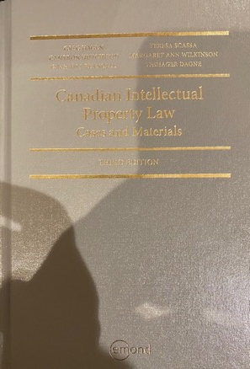
Text @ UBC Bookstore

Slide 4
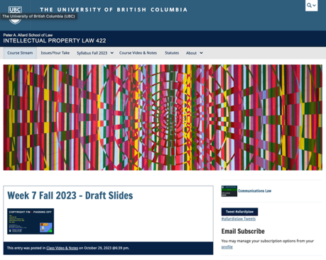
Course Website
https://iplaw.allard.ubc.ca/

Slide 5
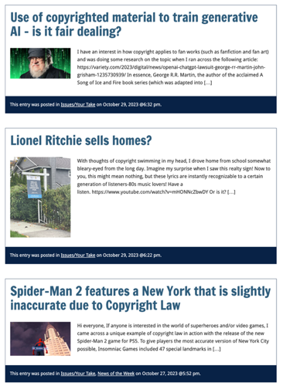

Slide 6
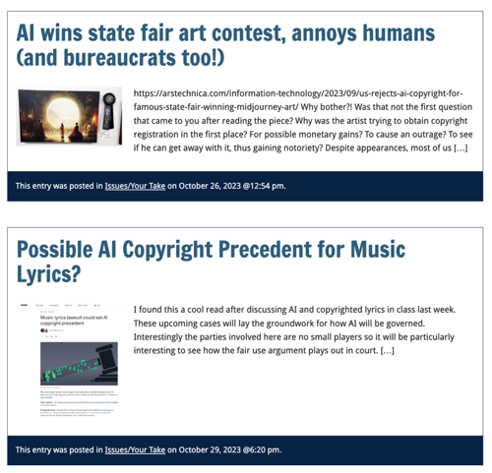

Slide 7
PLEASE
SIGN UP

Slide 8
For full privileges on the website
1. Please create an account at http://cms.ubc.ca/ using your CWL.
2. Once you create an account and sign in at http://cms.ubc.ca/ you can click your name in the top right. Halfway down the following page will be your WordPress email address.
3. Send me your WordPress email address at jon.festinger@ubc.ca or at jon_festinger@thecdm.ca
4. Then, I will invite you to participate with authoring privileges via your WordPress email address.

Slide 9



Slide 10



Adding Images

Slide 11




Slide 12

Adding Links

Slide 13
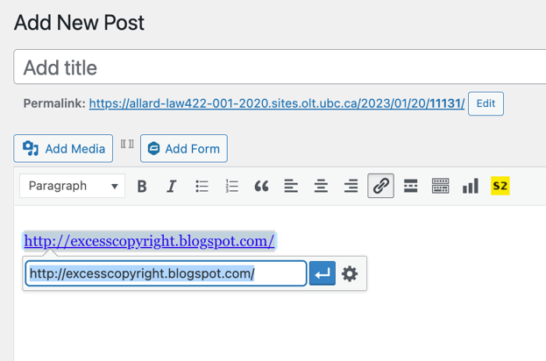
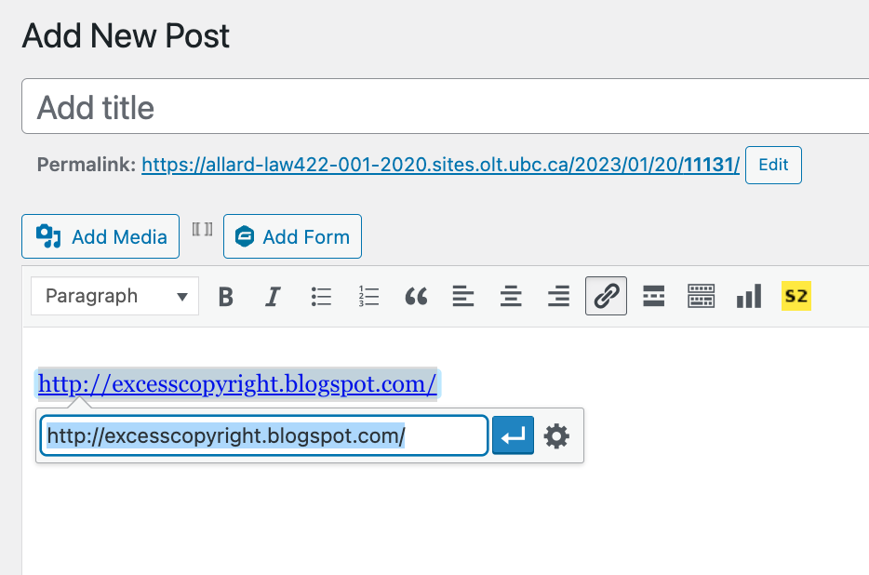


Slide 14



Adding a “Featured Image”

Slide 15



Slide 16
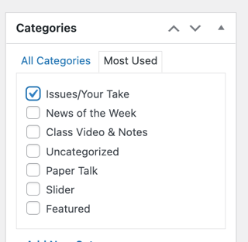

Setting Categories

Slide 17
Thank you for
your bios. & favorite I.P.’s
Much appreciated.

Slide 18
Let’s talk about…
The 30%
Paper/Presentation/Post = 20%
Participation = 10%

Slide 19
20% = a modest proposal…
750-1000 words (or equivalent) per person
written, video, podcast, in-class presentation (?), interpretive dance
Website or not
Groups or individually
LLM Students – one extra

Slide 20
DUE 11:59:59 PM
LAST DAY
OF THE TERM
(END OF EXAM PERIOD)

Slide 21
HOWEVER,…
ENCOURAGE POSTING
BEFORE END OF CLASSES
…YOUR CLASSMATES
WILL BENEFIT

Slide 22
Additional
Evaluation
(LLM students)

Slide 23
LLMCL Students Registered in the Class as such: Additional Task
750 – 1000 word post (or email)
???????????

Slide 24
Please use:
Jfestinger@telus.net
jon.festinger@ubc.ca

Slide 25
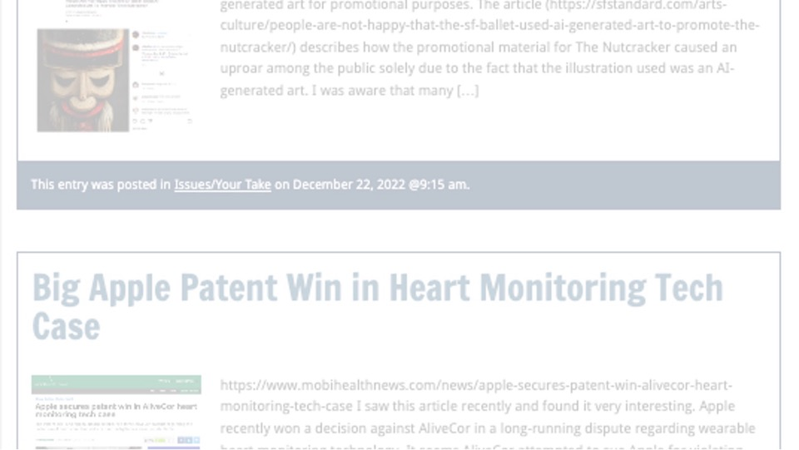
Past Presentations mostly all on the course website…

Slide 26
The 10%
Participation is broadly defined includes any or all:
class contributions however made
website contributions
email or other discussions with Instructor

Slide 27

Anything & everything can be done via email if you prefer

Slide 28
QUESTIONS?
THOUGHTS?
DISCUSSION?

Slide 29
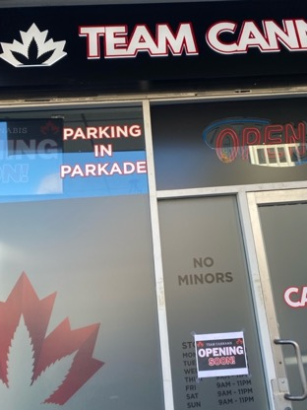
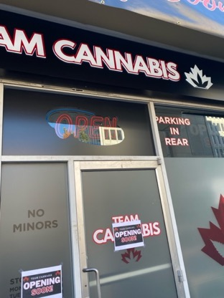


Slide 30

Pause

Slide 32

Where we have been…

Slide 33
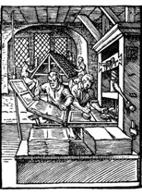
“Copyright Law Review to Date”

Slide 34
Overview of copyright
Definition of copyright:
  Set of exclusive rights in works of expression; performers’ performances; sound recordings; and communication signals.
The Clash, Chateau Neuf, Oslo, Norway
21 May 1980 Helge Øverås

Slide 35
Purpose of copyright in Canada?
Théberge:
  “[12] Generally speaking, Canadian copyright law has traditionally been more concerned with economic than moral rights.… The economic rights are based on a conception of artistic and literary works essentially as articles of commerce.” (Binnie J.)
But Cinar Corp. v. Robinson?
  [114] … the infringement of copyright in this case interfered with Robinson’s personal rights to inviolability and to dignity, recognized by ss. 1 and 4 of the [Quebec] Charter. (McLachlin CJ)

Slide 36
Overview of copyright
Purpose of copyright as articulated by the SCC
  Former approach: “author-centric”
  Shift in Théberge
    “balance between promoting the public interest in the encouragement and dissemination of works of the arts and intellect and obtaining a just reward for the creator“ (para. 30)
  Refined in Cinar Corporation v. Robinson, 2013 SCC 73
    Copyright Act “seeks to ensure that an author will reap the benefits of his efforts, in order to incentivize the creation of new works” (para. 23)

Slide 37
What is copyrightable
Originality in Canada
Pre-2004
  “Sweat of the brow”:
    Work receives copyright protection if it originates from an author and is more than a mere copy.
  “Creativity”
    A work must be the product of creativity in order to be original

Slide 38
What is copyrightable
Facts and ideas
  Not entitled to copyright protection
  Kenrick & Co. v. Lawrence & Co. (1890)
    How is idea separated from expression in this decision?

Slide 39
What is copyrightable: Artistic Works
5. (1) Subject to this Act, copyright shall subsist in Canada, for the term hereinafter mentioned, in every original literary, dramatic, musical and artistic work if…

Slide 40
S. 2 Definitions
literary work includes tables, computer programs, and compilations of literary works; (oeuvre littéraire)
dramatic work includes
(a) any piece for recitation, choreographic work or mime, the scenic arrangement or acting form of which is fixed in writing or otherwise,
(b) any cinematographic work, and
(c) any compilation of dramatic works; (oeuvre dramatique)
musical work means any work of music or musical composition, with or without words, and includes any compilation thereof; (oeuvre musicale)
artistic work includes paintings, drawings, maps, charts, plans, photographs, engravings, sculptures, works of artistic craftsmanship, architectural works, and compilations of artistic works; (oeuvre artistique)

Slide 41
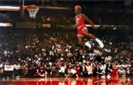
What is copyrightable
FWS Joint Sports Claimants v. Canada 1991 FCA (CB)
No copyright in a sporting event per se though television production of a sporting event is copyrightable
Unpredictable and incompatible with the notion of a choreographic piece of art?

Slide 42
Copyrighting Data?
Geophysical Service Incorporated v. Encana Corporation, 2016 ABQB 230
It appears from the case that is not the raw data that is copyrightable as those would simply be facts, but how the data is presented.
  “[76] I find the seismic sections, i.e. the squiggly or zebra lines, fit within the definition of an artistic work, similar to a map, plan or chart, or a compilation of an artistic work, since the product is the result of selection or arrangement of the data, or sound recordings, from the geology of the subsurface.”
Do you agree? Alta. C.A. confirmed & SCC denied leave.

Slide 43
Rights of the copyright owner
Produce … any translation (3(1)(a))
Convert dramatic work into non-dramatic work (3(1)(b)
Convert non-dramatic work into dramatic work (3(1)(c))
To make a sound recording, etc. of a literary, etc. work (3(1)(d))
Reproduce, etc. a literary, etc. work as a cinematographic work (3(1)(e))
Communicate a work to the public by telecommunication (3(1)(f))
Present an artistic work at a public exhibition…. (3(1)(g))
Rent out a computer program, etc. (3(1)(h))
Rent out a sound recording of a musical work … (3(1)(i))
Sell or transfer ownership of tangible object … (3(1)(j)
Authorize any of above acts (3(1))

Slide 44
Rights of the copyright owner
Who owns the rights? (ss. 13, 14)
ss. 13(4), 13(7): assignments, exclusive licences need to be in writing; non-exclusive licences don’t need to be in writing (Robertson v. Thomson)
Benefit of copyright registration: If an assignment or licence not registered, and the assignor or licensor subsequently assigns or licences the copyright interest – for valuable consideration – to a different assignee or licensee who didn’t have ACTUAL NOTICE of the prior assignment – the prior assignment/licence can be declared void (57(3)). So, if you’re an assignee, licensee – it is to your benefit to register the assignment of copyright or the licence granting you an interest (57(1)).

Slide 45
Rights of the copyright owner
Reproduction of “broadcast incidental copies”
CBC v. SODRAC 2003 Inc. [2015] 3 SCR 615
Should every instance of copying be considered to infringe the “reproduction” right?
Rothstein J. (majority):
  SCC’s understanding of the purpose of copyright has evolved; principle of technological neutrality now recognized to be a core copyright principle …
  But these principles don’t override express statutory terms.
  Broadcast-incidental copying activities engage the reproduction right
Abella J.’s dissent suggested Rothstein J. inappropriately “employs a literal approach to the interpretation of s. 3(1)(d), reading the words of the provision without the benefit of the purpose and context of the Act to ascertain its true meaning.”

Slide 46
Rights of the copyright owner
What constitutes taking a “substantial part” of a work?
  Applies to all rights, not just reproduction
  Cinar Corp. v. Robinson (2013, SCC)
    Matter of fact and degree; flexible notion
    Standard of review
    Decided by quality rather than quantity
    Q: “do the copied features constitute a substantial part of the plaintiff’s work?

Slide 47
Rights of the copyright owner
Right to perform a work in public
Canadian Admiral Corp. v. Rediffusion Inc., [1954] Ex. C.R. 382
  Exception given where audience is not part of author’s public
  Main case is Jennings v. Stephens [1936] 1 All E.R. 228 & 413 where 600 workers listened to broadcast music in a factory. Held that everything depends on the character of the audience – Is the audience part of the copyright owner’s public? If the audience considered in relation to the owner of the copyright can properly be described as the owner's "public" or part of his "public," then anyone who performs the work before that audience without the consent of the author would be infringing his copyright.

Slide 48
Harms Inc. and Chappel & Co v. Martan’s Club (1927): Performance at the Embassy Club at which club members, potential members and some guests were present. Held to be a performance in public.
Performing Right Society Ltd. v. Hawthorn’s Hotel Ltd (1933): An orchestral trio played in the lounge of Hawthorn’s Hotel. In the lounge were several guests of the hotel, among others. This was a performance by the hotel orchestra in public – it was open to any members of the public who cared to be guests of the hotel – either by eating or dining there.
Performing Right Society Ltd v. Gillette Industries (1943): Defendants installed loudspeakers in their factory and broadcast music in various departments to about 600 workers. All strangers were excluded from the factory. Was in public.

Slide 49
Rights of the copyright owner
Right to perform a work in public
Canadian Cable Television Association v. Canada (Copyright Board), [1993] 2 F.C. 138
  Reference to “early conflicting decision” (Rediffusion)
  Letourneau J.: “I would have thought on a mere common sense basis that when the Prime Minister of Canada addresses the nation, either from his home or his private office, and reaches the citizens in their homes by means of radio and television, he appears in public and performs in public. I would have been content to leave it at that had it not been for early conflicting decisions on this issue.”

Slide 50
Rights of the copyright owner
Right to communicate a work to the public by telecommunication (s. 3(1)(f))
TV
Radio
Online
“3 (1) For the purposes of this Act, copyright, in relation to a work, means the sole right to produce or reproduce the work or any substantial part thereof in any material form whatever, to perform the work or any substantial part thereof in public or, if the work is unpublished, to publish the work or any substantial part thereof, and includes the sole right
(f) in the case of any literary, dramatic, musical or artistic work, to communicate the work to the public by telecommunication,…”

Slide 51
Rights of the copyright owner
Right to communicate a work to the
public by telecommunication (s. 3(1)(f))
CCH Canadian v. LSUC (2004)
  Faxed transmissions of a single copy
  of a work to a single individual is not a
  communication to the public
  Emanated from a single point;
  & intended to be received at a single point

Slide 52
Q1:When does a communication to the public occur on the Internet?
Some content online content is accessible through “push” technologies (radio streams), other content is accessible through “pull” technologies.
Content is stored & cached on servers, and is only communicated to individuals when they access or “pull” it – when they access a stream that isn’t running constantly, download a file, etc.
So … when does a communication to the public occur?
The SCC decided that a telecommunication occurs on the internet at the point where the content is transmitted from the host server to the end user (each time that the content is transmitted).

Slide 53
Q2: Who communicates in a copyright sense on the Internet?
The person who communicates the work is the person who is the content provider – who uploads the work, creates the stream, posts the work
Do ISP’s (Internet Service Providers), as intermediaries, participate in the transmission of copyrighted works? Do they also communicate the work to the public? (Practical Ramifications → Deep Pockets $$$$$$$)
In answering SCC turned to s. 2.4(1)(b) – which states that participants in a telecommunication who only provide the “means of telecommunication necessary” (carriers) are deemed NOT to be communicators (follows Communications law doctrine of SEPARATION OF CONTENT FROM CARRIAGE).
Court noted that statute does not say intermediaries are engaged in communication BUT have a kind of immunity. RATHER it provides that intermediaries are deemed, for Copyright Act purposes, not to be communicating the work to the public at all. They are invisible.

Slide 54
Q3: When does a communication on the Internet occur in Canada?
Majority held Canada could exercise copyright jurisdiction in respect both of transmissions originating in Canada and transmissions originating abroad but received in Canada. This conclusion was said to be consistent with our general law as well as with national and international copyright practice. [Also consistent with many internet jurisdiction cases, many about defamation, of the time…until today]
But…this doesn’t mean “automatic copyright liability” on foreign content providers who communicate copyright works to Canadian end users. For copyright liability to be imposed on foreign content providers, there needs to be - in the context of a message or communication - a real and substantial connection.
Factors to be considered are situs of content provider, host server, intermediaries, end user

Slide 55
Rights of the copyright owner
Right to communicate a work to the public by telecommunication (s. 3(1)(f))
CWTA v. SOCAN (2008)
  Is the transmission of a musical ringtone to a cellphone a ‘communication to the public by telecommunication’?

Slide 56
Yes, it is. Court defines communication as – the passing of information from one person to another:
“A musical ringtone is information in the form of a digital audio file that is capable of being communicated. … The wireless transmission of a musical ringtone to a cellphone is a communication, whether the owner of the cellphone accesses it immediately in order to hear the music, or at some later time. … Communication completed once info is received.”
Next question: Is the communication by telecommunication of a ringtone from a wireless carrier’s website to a customer’s cell phone a communication to the public?
Court says yes.
FCA: If a wireless carrier were to transmit a particular ring-tone simultaneously to all customers who have requested it, that transmission would be a communication to the public. It would be illogical to reach a different result simply because the transmissions are done one by one, and thus at different times.]

Slide 57
Rights of the copyright owner
Right to communicate a work to the public by telecommunication (s. 3(1)(f))
ESA v. SOCAN (2012)
  Does the Copyright Act require a second royalty to be paid when games are downloaded as opposed to sold in stores?
  Conclusion: Internet delivery of copies of video games containing musical works does not constitute a communication to the public.

Slide 58
Entertainment Software Association v. Society of Composers, Authors and Music Publishers of Canada (Pentalogy case)
  Issue is whether the Copyright Act requires a second royalty to be paid when games are downloaded as opposed to sold in store? A royalty is already paid to account for the reproduction of the musical work. However if a download of a video game is found to constitute a communication to the public by telecommunication IN ADDITION to a reproduction, then a second right would be engaged.
  Conclusion: SCC held that “the Internet delivery of copies of video games containing musical works” does not constitute a communication to the public – so doesn’t infringe s. 3(1)(f).

Slide 59
Rights of the copyright owner
Right to communicate a work to the public by
telecommunication (s. 3(1)(f))
Rogers Communications Inc. v. SOCAN 2012 SCC 35
  Does individual streaming, triggered by the
  individual actions of individual users,
  constitute “communication to the public” or a
  “private communication” ?

Slide 60
YES, IT IS
‘COMMUNICATION TO THE PUBLIC’
(despite what was said in CCH v. LSUC that transmission of a single copy to a single person isn’t a communication to the public - also think about it → CCH photocopy and fax facts are reasonably distinguishable)

Slide 61
Rights of the copyright owner
Right to communicate a work to the public by telecommunication (s. 3(1)(f))
S. 2.4(1.1) (amended)
  For the purposes of this Act, communication of a work or other subject-matter to the public by telecommunication includes making it available to the public by telecommunication in a way that allows a member of the public to have access to it from a place and at a time individually chosen by that member of the public.

Slide 62
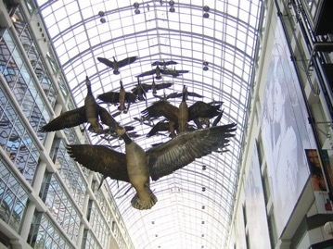
MORAL RIGHTS
Sections 14.1 and 14.2 of the Copyright Act
Snow v. Eaton Centre

Slide 63
Sections 14.1 and 14.2 of the Copyright Act
  the right to the integrity of the work; &
  the right, where reasonable in the circumstances, to be associated with the work as its author by name or under a pseudonym and the right to remain anonymous.
Section 34.2 of the Copyright Act - remedies for infringement of moral rights include injunctions, damages, and delivery up.
Moral rights can be waived, but not transferred.
Cases:
Snow v. Eaton Centre Ltd., (1982) 70 C.P.R. (2d) 105 (Ont. H.C.J.)
Ritchie v. Sawmill Creek Golf & Country Club Ltd., (2004) 189 O.A.C. 282
Wiseau Studio, LLC et al. v. Harper et al. 2020 ONSC 2504

Slide 64
Independent Creation Doctrine - Canada

Slide 65
63 Many of the detailed similarities, in my view, can be traced to the common store of folklore about primitive species with human characteristics upon which Lucas was as free to draw as were Preston and Hurry. Yet drawing upon a common store of information does not in itself answer to the claim of infringement. It is the expression of ideas, not the ideas themselves, that is the subject of copyright. It is entirely possible that two or more authors, composers, dramatists or other artists may draw upon a common store of information for ideas and each may have copyright in his or her expression of those ideas. But if while drawing upon the common information base, one should copy the expression in literary or dramatic form of another author copyright may be infringed.

Slide 66
Users’ Rights

Slide 67
Today: Two Defences to copyright infringement
Defence of public interest
Fair dealing

Slide 68
User rights: Public Interest Defence
Defence of public interest
R. v. Lorimer & Co. Ltd., [1984] 1 FC 1065
Defence of public interest argued – In the public interest that this information be disseminated as broadly as possible.
Court indicated that it has no doubt that a defence of public interest – as set out in the UK cases on which the Lorimer’s counsel relied – is available in proper circumstances against an assertion of Crown copyright.
But the facts don’t support the public interest defence here
  Great disclosure in report
  Free copies given out, put in libraries across the country
  No concern about the public not being informed
N.B. Act doesn’t mention “public interest”

Slide 69
User rights: Public Interest Defence
Defence of public interest
Lion Laboratories v Evans [1985] QB 526
Lion Laboratories manufactured and marketed the Lion Intoximeter which was used by the police for measuring blood alcohol levels of motorists.
Two ex-employees approached the Press with four documents taken from Lion.
Such reproduction was held to be justified, despite the nature of material, being confidential and protected by copyright.
Court agreed that the defence of public interest applied to the investigations regarding the accuracy of the equipment to avoid incorrect readings when used by the police on motorist.

Slide 70


Fair Dealing v. Fair Use

Slide 71
Users’ rights: Fair Dealing
29. Fair dealing for the purpose of research, private study, education, parody or satire does not infringe copyright.

Slide 72
Fair Dealing: Criticism or Review
29.1 Fair dealing for the purpose of criticism or review does not infringe copyright if the following are mentioned:
(a) the source; and
  (b) if given in the source, the name of the (i) author, in the case of a work

Slide 73
Fair Dealing: News Reporting
29.2 Fair dealing for the purpose of news reporting does not infringe copyright if the following are mentioned:
(a) the source; and
  (b) if given in the source, the name of the (i) author, in the case of a work

Slide 74
Eight fair dealing categories (exhaustive list)
Research
Private Study
Education
Parody
Satire
Criticism
Review
News reporting

Slide 75
Users’ rights: Fair Dealing
Eight fair dealing categories (exhaustive list)
No definition of “fair” in the Copyright Act, or of the fair dealing categories
For many years, fair dealing did not play a prominent role in copyright
During this time, fair dealing was interpreted restrictively
Why might this have been the case?

Slide 76
Users’ rights
Fair dealing in CCH:
An integral part of the Copyright Act - not just a defence
The fair dealing “exception”, like other exceptions in the Copyright Act, is a users’ right. In order to maintain the proper balance between the rights of a copyright owner and users’ interests, it must not be interpreted restrictively.
Always available. If other exceptions might also be available, argue fair dealing first, then turn to other exceptions and defences.
Two step process:
  1) Defence establishes the dealing was for one of the listed purposes.
  2) Defence establishes the dealing was fair.
Fair dealing category of research to be given a large and liberal interpretation in order to ensure users’ rights are not unduly constrained
Research is not limited to non-commercial or private contexts. Lawyers carrying on the business of law for profit are conducting research within the meaning of s. 29 of the Copyright Act.

Slide 77
User rights: “Fair” in Fair Dealing
CCH Canadian et al v. LSUC (2004)
Whether something is fair is a question of fact and depends on the facts of each case.
Factors that can be considered to help assess whether a dealing is fair:
  Purpose of the dealing
  Character of the dealing
  Amount of the dealing
  Were there alternatives to the dealing?
  Nature of the work
  Effect of the dealing on the work

Slide 78

The fairness stew

Slide 79
1. Purpose of the Dealing
Fair if for one of the allowable purposes under the Copyright Act
  S. 29 = research, private study, education, parody or satire
  S.29.1 = criticism or review
  S. 29.2 = news reporting
Some dealings may be more, or less, fair, than others - i.e., research for commercial purposes may not be as fair as research for charitable purposes

Slide 80
2. Character of the Dealing
How was the work dealt with? Multiple copies distributed, will tend towards being unfair, especially if more copies than necessary or otherwise gratuitous.
Single copy used for single legit purpose – easier to conclude it is fair.
Copies destroyed after use may also favour a finding of fairness.
Do consider customs, practices & norms in a particular industry or trade → However CBC v. SODRAC (SCC 2015) doesn’t – why not? CATEGORIES EXHAUSTIVE

Slide 81
3. Amount of the Dealing
You can deal fairly with a whole work (i.e., photographs)
Amount taken may be more, or less, fair depending on the purpose - i.e., research, may be essential to copy an entire academic article

Slide 82
4. Alternatives to the Dealing
Was there a non-copyrighted equivalent of the work that could have been used instead of the copyrighted work?
Was the dealing reasonably necessary to achieve the ultimate purpose?
Meaning not gratuitous.
I.e., Would a criticism have been equally effective if it did not actually reproduce the copyrighted work it was criticizing? If yes, that weighs against a finding of fairness.

Slide 83
5. Nature of the Work
If a work is unpublished, dealing might be fairer because its reproduction could lead to a wider public dissemination for the work
Confidential work? May be unfair in the circumstances.

Slide 84
6. Effect of the dealing on the work
Is the reproduced work likely to compete with the market of the original work?
Not the only factor - not the most important factor - but can sometimes seem like the most important factor in the cases

Slide 85
Users’ rights
SOCAN v. Bell (2012) – continued
Users’ rights:
  Essential part of furthering public interest objectives of the Copyright Act
  One of the tools employed to achieve the proper balance between protection and access
  Fairness analysis: Where much of the heavy lifting is one in fair dealing
Fair dealing applied → iTunes previews

Slide 86
Users’ rights
Alberta (Education) v. Canadian Copyright Licensing Agency (Access Copyright) (2012)
Another “pentalogy” case
Main issue: Copies of works made at teachers’ initiatives with instructions to students that they read the material … fair dealing?
Category 4 of the proposed tariff dealt with copies of works made at the teachers’ initiative with instructions to students that they read the material. Teachers would photocopy short excerpts from textbooks and distribute those copies to students as a complement to the main textbook the students used.

Slide 87
Abella J.
“ The test for fair dealing was articulated in CCH as involving two steps. The first is to determine whether the dealing is for the allowable purpose of “research or private study” under s. 29 , “criticism or review” under s. 29.1 , or “news reporting” under s. 29.2 of the Act. The second step of CCH assesses whether the dealing is “fair”. The onus is on the person invoking “fair dealing” to satisfy all aspects of the test. To assist in determining whether the dealing is “fair”, this Court set out a number of fairness factors: the purpose, character, and amount of the dealing; the existence of any alternatives to the dealing; the nature of the work; and the effect of the dealing on the work.”

Slide 88
[27] With respect, the word “private” in “private study” should not be understood as requiring users to view copyrighted works in splendid isolation. Studying and learning are essentially personal endeavours, whether they are engaged in with others or in solitude. By focusing on the geography of classroom instruction rather than on the concept of studying, the Board again artificially separated the teachers’ instruction from the students’ studying.
[32] In my view, buying books for each student is not a realistic alternative to teachers copying short excerpts to supplement student textbooks. First, the schools have already purchased originals that are kept in the class or library, from which the teachers make copies. The teacher merely facilitates wider access to this limited number of texts by making copies available to all students who need them. In addition, purchasing a greater number of original textbooks to distribute to students is unreasonable in light of the Board’s finding that teachers only photocopy short excerpts to complement existing textbooks. Under the Board’s approach, schools would be required to buy sufficient copies for every student of every text, magazine and newspaper in Access Copyright’s repertoire that is relied on by a teacher. This is a demonstrably unrealistic outcome. Copying short excerpts, as a result, is reasonably necessary to achieve the ultimate purpose of the students’ research and private study.

Slide 89
Users’ rights: Another “at odds” case?
The Canadian Copyright Licensing Agency
v. York University, 2017 FC 669
Were York University’s Fair Dealing Guidelines fair?
Phelan J. concludes not
Is Phelan J.’s ruling consistent with the
SCC’s fair dealing jurisprudence?

Slide 90
Not Phelan It J.
[28] A further and final factor of the fairness of the Guidelines is that York has made no real effort to review, audit, or enforce its own Guidelines. As became evident, educational efforts on setting their copyright rules are insufficient because there was no effective compliance mechanism. Even professors operating outside of the Guidelines are not held accountable. The complete abrogation of any meaningful effort to ensure compliance with the Guidelines – as if the Guidelines put copyright compliance on autopilot – underscores the unfairness of York’s Guidelines.

Slide 91
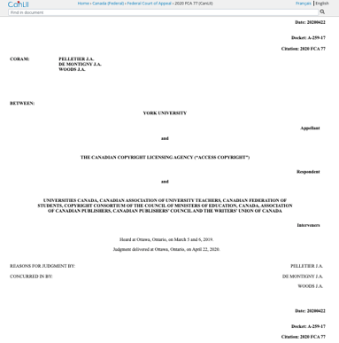
…Ignored (sort of) by…FCA
https://www.canlii.org/en/ca/fca/doc/2020/2020fca77/2020fca77.html

Slide 92
S.C.C. Decision

Slide 93
Abella J. “[20] The question on Access Copyright’s appeal is whether s. 68.2(1) of the Copyright Act empowers Access Copyright to enforce royalty payments set out in a Copyright Board approved tariff against a user who chooses not to be bound by a licence on the approved terms. More specifically, the issue is whether Access Copyright can extract from York the royalties set out in the interim tariff despite the fact that York chose not to be bound by a licence.
[28] The issue in this case is one of statutory interpretation, which, as this Court has repeatedly said, is an exercise in discerning legislative intent by looking at the grammatical and ordinary meaning of the text in the context of the statute’s scheme and objectives.
[39] As matter of legislative coherence, it would be incongruous if royalties fixed in the context of licence negotiations between a collective society and a specific user were voluntary, but those set in a general tariff were mandatory.

Slide 94
[71] …Instead of operating as a part of a scheme designed to control collective societies’ potentially unfair market power, Access Copyright’s interpretation would turn tariffs into a plainly anti‑competitive tool, boosting collective societies’ power to the detriment of users.
[83] …there is no live dispute between the parties. This is not an action for infringement, since Access Copyright has no standing to bring such an action. And the copyright owners who do have standing to bring an infringement action in respect of York’s copying activities are not parties to these proceedings and, as a result, have not had the opportunity to advance arguments or adduce evidence about how York’s Guidelines interact with and affect their copyrighted works...All of this makes consideration of the Guidelines in this case inappropriate.

Slide 95
[87] While I therefore agree that the requested Declaration should not be granted, this should not be construed as endorsing the reasoning of the Federal Court and Federal Court of Appeal on the fair dealing issue. There are some significant jurisprudential problems with those aspects of their judgments that warrant comment.
[88] In commenting on those errors, it is important to emphasize that our reasons do not decide the issue of fair dealing…While correcting the errors committed by the Federal Court and Court of Appeal favours the position argued before this Court by York, these reasons address only some of the factors that make up the fair dealing analysis, an analysis that requires consideration of facts and factors not addressed here.
[89] The main problem with their analysis was that they approached the fairness analysis exclusively from the institutional perspective. This error tainted their analysis of several fairness factors. By anchoring the analysis in the institutional nature of the copying and York’s purported commercial purpose, the nature of fair dealing as a user’s right was overlooked and the fairness assessment was over before it began.

Slide 96
[91] Accordingly, to understand and apply fair dealing doctrine requires first understanding the copyright balance. Copyright law has public interest goals. The relationship between members of the public and copyrighted works is not merely the “consequence of the author-work relationship”…
[92] Instead, increasing public access to and dissemination of artistic and intellectual works, which enrich society and often provide users with the tools and inspiration to generate works of their own, is a primary goal of copyright. “Excessive control by holders of copyrights and other forms of intellectual property may unduly limit the ability of the public domain to incorporate and embellish creative innovation in the long-term interests of society as a whole” (Théberge v. Galerie d’Art du Petit Champlain inc., 2002 SCC 34 (CanLII), [2002] 2 S.C.R. 336, at para. 32, per Binnie J.).

Slide 97
[102] In other words, contrary to the Federal Court of Appeal’s view, in the educational context it is not only the institutional perspective that matters. When teaching staff at a university make copies for their students’ education, they are not “hid[ing] behind the shield of the user’s allowable purpose in order to engage in a separate purpose that tends to make the dealing unfair”.
[103] It was therefore an error for the Court of Appeal, in addressing the purpose of the dealing, to hold that it is only the “institution’s perspective that matters” and that York’s financial purpose was a “clear indication of unfairness”…Funds “saved” by proper exercise of the fair dealing right go to the University’s core objective of education, not to some ulterior commercial purpose... The purpose of copying conducted by university teachers for student use is for the student’s education…

Slide 98
Users’ rights
United Airlines, Inc. v. Cooperstock, 2017 FC 616
First case to define the fair dealing category of parody:
  Two basic elements to parody: the evocation of an existing work while exhibiting noticeable differences and the expression of mockery or humour
  Not required to identify source of work being parodied
  Parody does not require that the expression of mockery or humour to be directed at the exact thing being parodied

Slide 99
Users’ rights: Parody found
United Airlines, Inc. v. Cooperstock, 2017 FC 616
Phelan J. relied on Deckmyn v. Vandersteen, a decision of the European Court of Justice, in defining parody for the purposes of the Canadian Copyright Act:
  [119] … Parody should be understood as having two basic elements: the evocation of an existing work while exhibiting noticeable differences and the expression of mockery or humour. I would also note that the fair dealing exception for the purpose of parody in s 29 of the Copyright Act does not require a user to identify the source of the work being parodied. In addition, in my view, parody does not require that the expression of mockery or humour to be directed at the exact thing being parodied. It is possible, for example, for a parody to evoke a work such as a logo while expressing mockery of the source company, or to evoke a well-known song while expressing mockery of another entity entirely.
  [120] In my view, UNTIED.com falls within the definition of parody described above: it evokes existing works (the United Website, the United Logo, and the Globe Design) while showing some differences (such as content and disclaimers), and it expresses mockery (and criticism) of the Plaintiff. Therefore, the first stage of the CCH test has been met in this case.

Slide 100
Users’ rights: Parody found BUT
United Airlines, Inc. v. Cooperstock, 2017 FC 616
Phelan J…
(3) Conclusion on Copyright Infringement
[141] Parody is not simply a defence to copyright infringement – it is also an aspect of free speech. However, like all free speech, it is not unrestricted. The Defendant’s website meets the first step of the CCH test, as it is for the allowable purpose of parody, but it does not meet the second step of the test. The questionable purpose of the dealing, amount of the dealing, and effect of the dealing all weigh in favour of the conclusion that this dealing is not fair.

Slide 101
Users’ rights
Common carrier exception (s. 2.4(1)(b)) similar but not the same as…
Applicable in the context of communication to the public by telecommunication
“Communication to the public by telecommunication
2.4 (1) For the purposes of communication to the public by telecommunication,
b) a person whose only act in respect of the communication of a work or other subject-matter to the public consists of providing the means of telecommunication necessary for another person to so communicate the work or other subject-matter does not communicate that work or other subject-matter to the public;…”

Slide 102
Policy behind s. 2.4(1)(b))
In part intermediaries are deemed not to be communicators to avoid unnecessary layering and possible effective duplication of copyright liability that would result from intermediary sales layers (“wholesalers”) also being liable for infringements.
Public policy decision to discourage lawsuits against intermediaries, encouraging them to expand and improve operations without the threat of infringement. Not doing so could chill growth in the communications sector where Canada (with some justification) has seen itself as a world leader.

Slide 103
Enforcement & Remedies
Which courts?
Conflicting application for copyright registration? Must go to Federal Court (per S. 20, Federal Courts Act)
Dispute turns on common law principles like contract? Looking for criminal remedies? Must go to the provincial courts.
Federal Court has concurrent jurisdiction where a remedy is sought respecting copyright (per s. 41.24, Copyright Act)

Slide 104
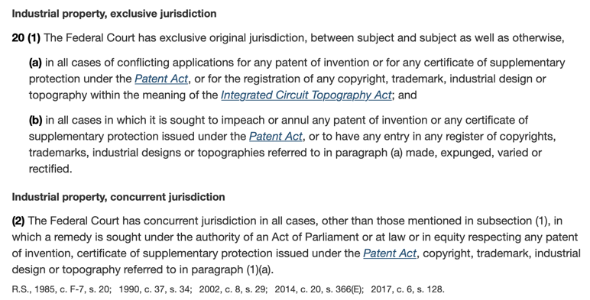

Slide 105
In other words,…
Generally, you can choose to enforce your copyright either in the Federal Court or the provincial courts (like the BC Supreme Court) per both in the Federal Courts Act, and s. 41.24 of the Copyright Act, provided you are not trying to resolve a conflicting application for registration of copyright, and so long as the dispute doesn’t turn on common law principles (but?)…

Slide 106
Enforcement & Remedies
Primary infringement section in Copyright Act:
27. (1) It is an infringement of copyright for any person to do, without the consent of the owner of the copyright, anything that by this Act only the owner of the copyright has the right to do.

Slide 107
Enforcement & Remedies
Secondary infringement section in Copyright Act:
27. (2) It is an infringement of copyright for any person to
  (a) sell or rent out, (b) distribute to such an extent as to affect prejudicially the owner of the copyright, (c) by way of trade distribute, expose or offer for sale or rental, or exhibit in public,…or (e) import into Canada for the purpose of doing anything referred to in paragraphs (a) to (c),
a copy of a work, sound recording or fixation of a performer’s performance or of a communication signal that the person knows or should have known infringes copyright or would infringe copyright if it had been made in Canada by the person who made it.

Slide 108
Enforcement & Remedies
Other ways through which copyright
owners can enforce/protect/guard against
copyright infringement:
Contracts
Technological protection measures
Rights management information
Notification letters

Slide 109
Enforcement & Remedies
Should users be able to bargain away through contract their fair dealing rights, or should these always be available?
Or asked another way - Should the law allow us to bargain away our “fair dealing/users rights” via mostly digital contracts (End User License Agreements etc.) that hardly ever, if ever, is actually read?
Note that in many ways it’s easier to sue pursuant to a contract than using the Copyright Act
OR SHOULD OUR “FAIR DEALING/USERS RIGHTS” ALWAYS BE AVAILABLE TO US? COULD THAT ONE DAY BECOME THE ADDITIONAL MEANING OF ‘USER RIGHTS’ OVER AND ABOVE FAIR DEALING?

Slide 110
TPM’s: Technological Protection Measures
S. 41 of the Copyright Act defines technological protection measure as:
“any effective technology, device or component that, in the ordinary course of its operation,
(a) controls access to a work, to a performer’s performance fixed in a sound recording or to a sound recording and whose use is authorized by the copyright owner;” [AKA an ACCESS control TPM]
“or (b) restricts the doing — with respect to a work, to a performer’s performance fixed in a sound recording or to a sound recording — of any act referred to in section 3, 15 or 18 and any act for which remuneration is payable under section 19.” [AKA a COPY control TPM]

Slide 111
TPM’s: Technological Protection Measures – S. 41.1(1)(c)
41.1 (1) No person shall…
(c) manufacture, import, distribute, offer for sale or rental or provide — including by selling or renting — any technology, device or component if
(i) the technology, device or component is designed or produced primarily for the purposes of circumventing a technological protection measure,
(ii) the uses or purposes of the technology, device or component are not commercially significant other than when it is used for the purposes of circumventing a technological protection measure, or
(iii) the person markets the technology, device or component as being for the purposes of circumventing a technological protection measure or acts in concert with another person in order to market the technology, device or component as being for those purposes.

Slide 112
TPM’s: Technological Protection Measures - Exceptions
Eight exceptions to the anti-circumvention measures are set out in the Copyright Act, relating to:
  Law enforcement and national security
  Interoperability of computer programs
  Encryption research
  Protection of privacy
  Computer or network security
  Accommodation of persons with perceptual disabilities
  Broadcasting undertakings
  Radio apparatus
Should anything be added to the list?
What if you circumvent a TPM in order to do something that is covered by fair dealing?
What if you circumvent a TPM in order to do something that is covered by technological neutrality?

Slide 113
Nintendo of America Inc. v. King (2017)
41.12(3)…
(3) Paragraph 41.1(1)(c) does not apply to a person who manufactures, imports or provides a technology, device or component for the purposes of circumventing a technological protection measure if the person does so for the purpose of making the computer program and any other computer program interoperable and
  (a) uses that technology, device or component only for that purpose; or
  (b) provides that technology, device or component to another person only for that purpose.

Slide 114
Nintendo of America Inc. v. King (2017)
Court (or should we say Nintendo’s counsel) held that the interoperability exception did not apply. Reasoning (in part):
Primary purpose of King’s devices was to enable users to play pirated copies of Nintendo Games
Although Respondent’s devices could be used for non-infringing activities (i.e. homebrew - third party software designed for use on Nintendo consoles but not necessarily owned or licensed by Nintendo) – the court noted that “the scale of such activities is dwarfed by the market for illicit and infringing activities”
There wasn’t any need for TPM circumvention to achieve interoperability since there are legitimate ways for developers to develop software without circumventing Nintendo’s TPMs
No evidence presented by King that their users tried making Nintendo’s consoles interoperable with homebrew software.

Slide 115
Enforcement & Remedies
Rights management information
  41.22 (1) No person shall knowingly remove
  or alter any rights management information
  in electronic form without the consent of the
  owner of the copyright in the work … if the
  person knows or should have known that the
  removal or alteration will facilitate or conceal
  any infringement of the owner’s copyright or
  adversely affect the owner’s right to remuneration
  under section 19.

Slide 116
Enforcement & Remedies: RMI
Rights management information is defined in 41.22 (4):
(4) In this section, rights management information means information that
  (a) is attached to or embodied in a copy of a work, a performer’s performance fixed in a sound recording or a sound recording, or appears in connection with its communication to the public by telecommunication; and
  (b) identifies or permits the identification of the work or its author, the performance or its performer, the sound recording or its maker or the holder of any rights in the work, the performance or the sound recording, or concerns the terms or conditions of the work’s, performance’s or sound recording’s use
RMI infringement entitles the plaintiff to the same range of remedies available for copyright infringement, including damages, injunctions etc.

Slide 117
Enforcement & Remedies
Notification letters
Notice and notice system: ss. 41.25-41.27,
Copyright Act
  Recent reforms: addition of provision outlining
  prohibited content
  See: http://www.ic.gc.ca/eic/site/oca-bc.nsf/eng
  /ca02920.html for primer on notice and notice

Slide 118
Enforcement & Remedies
Notification letters
  Another way copyright owners can deal with copyright infringement is by sending cease and desist letters to individuals that they have identified as having engaged in the unauthorized use of copyrighted expression.
  In 2012, Parliament formally instituted a notice and notice system. This system took effect in early 2015 (although it had been used for years previously).
  These statutory provisions are set out in ss. 41.25-41.27 of the Copyright Act.

Slide 119
Notice & Notice Made Simple
The copyright owner’s representative identifies alleged unauthorized use or sharing of one of their works;
That representative sends a notice detailing this unauthorized activity to the associated ISP; and
The ISP must forward that notice to the user, in cases where a specific user account can be identified.

Slide 120
REFORMS: Addition of a provision regarding prohibited content in the Copyright Act
s. 41.25(3)
Prohibited content
(3) A notice of claimed infringement shall not contain
(a) an offer to settle the claimed infringement;
(b) a request or demand, made in relation to the claimed infringement, for payment or for personal information;
(c) a reference, including by way of hyperlink, to such an offer, request or demand; and
(d) any other information that may be prescribed by regulation.

Slide 121
Criminal enforcement
See ss. 42, 43 of the Copyright Act for criminal sanctions
For instance, s. 42(1):
42 (1) Every person commits an offence who knowingly
  (a) makes for sale or rental an infringing copy of a work or other subject-matter in which copyright subsists;
  (b) sells or rents out, or by way of trade exposes or offers for sale or rental, an infringing copy of a work or other subject-matter in which copyright subsists;
  (c) distributes infringing copies of a work or other subject-matter in which copyright subsists, either for the purpose of trade or to such an extent as to affect prejudicially the owner of the copyright;...

Slide 122
Criminal enforcement (con’d)
See ss. 42, 43 of the Copyright Act for criminal sanctions
For instance, s. 42(1):
42 (1) Every person commits an offence who knowingly
  …(d) by way of trade exhibits in public an infringing copy of a work or other subject-matter in which copyright subsists;
  (e) possesses, for sale, rental, distribution for the purpose of trade or exhibition in public by way of trade, an infringing copy of a work or other subject-matter in which copyright subsists;
  (f) imports, for sale or rental, into Canada any infringing copy of a work or other subject-matter in which copyright subsists; or
  (g) exports or attempts to export, for sale or rental, an infringing copy of a work or other subject-matter in which copyright subsists.
Summary conviction: $25,000 fine; 6 months imprisonment; or both
Indictment: $1,000,000 fine; 5 years imprisonment or both

Slide 123
Enforcement & Remedies
Primary remedies provision, Copyright Act
34. (1) Where copyright has been infringed, the owner of the copyright is, subject to this Act, entitled to all remedies by way of injunction, damages, accounts, delivery up and otherwise that are or may be conferred by law for the infringement of a right.
NB. These same remedies are available for infringements of moral rights. (34(2))

Slide 124
Enforcement & Remedies
Primary remedies provision, Copyright Act
S. 35(1) Copyright Act clarifies that where a person has infringed copyright, they are liable to pay both:
Damages suffered by the copyright owner due to the infringement &
Any profits made from the infringement not previously accounted for when calculating damages
Copyright owners also have the choice of, rather than recovering damages and profits, of recovering statutory damages.

Slide 125
Enforcement & Remedies
Statutory damages S. 38.1 Copyright Act
Note critical distinction between statutory damages for infringements for commercial purposes, and statutory damages for infringements for non-commercial purposes
  Commercial: $500-$20,000 per work infringed (s. 38.1(1)(a))
  Non-commercial: $100-$5,000 for all works infringed (s. 38.1(1)(b))

Slide 126
Statutory damages s. 38.1 (1) Copyright Act
Statutory damages
38.1 (1) Subject to this section, a copyright owner may elect, at any time before final judgment is rendered, to recover, instead of damages and profits referred to in subsection 35(1), an award of statutory damages for which any one infringer is liable individually, or for which any two or more infringers are liable jointly and severally,
  (a) in a sum of not less than $500 and not more than $20,000 that the court considers just, with respect to all infringements involved in the proceedings for each work or other subject-matter, if the infringements are for commercial purposes; and
  (b) in a sum of not less than $100 and not more than $5,000 that the court considers just, with respect to all infringements involved in the proceedings for all works or other subject-matter, if the infringements are for non-commercial purposes.

Slide 127
QUESTIONS?
THOUGHTS?
DISCUSSION?

Slide 128
Pause

Slide 129
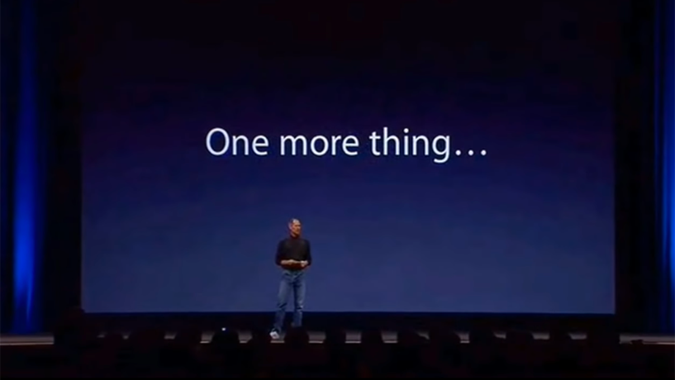

Slide 130


Slide 131
Users’ rights
Common carrier exception (s. 2.4(1)(b))
Bell Canada v. 1326030 Ontario Inc. (iTVBox.net)
2016 FC 612 affirmed 2017 FCA 55
Interlocutory Injunction application
“[8] The Plaintiffs specifically identified three types of pre-installed applications which they submit could be used to access copyrighted content:
A. KODI: with the proper add-on(s), the open-source media player KODI could be used to access online streaming websites;
B. Showbox: the media player software Showbox could be used to access online streaming websites and permanently download content such as television programming or motion pictures; and
C. Private IPTV Services: these are private Internet servers which re-transmit television broadcasts over the Internet, usually for a monthly fee.”

Slide 132
Motion for interlocutory injunction relief.
Defendants were individuals and businesses selling set-top boxes
on which they have previously installed and configured a set of
“plug & play” applications.
Plaintiffs argued was that these pre-installed applications could
be used to access copyrighted content.
Only one Defendant filed a record and appeared at the injunction
hearing.
Court satisfied that the Plaintiffs established a strong prima facie
case of copyright infringement and that an injunction would
prevent irreparable harm without unduely inconveniencing
the Defendants.

Slide 133


Slide 134


Slide 135


Slide 136
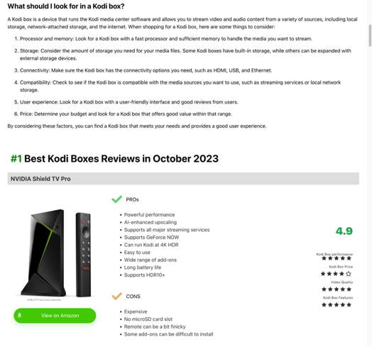

Slide 137
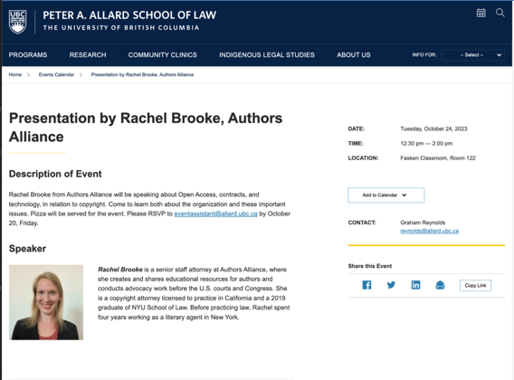
Any Questions?

Slide 138
Moral Rights in works used by generative A.I.?
Moral rights
14.1 (1) The author of a work has, subject to section 28.2, the right to
the integrity of the work…
Nature of right of integrity
28.2 (1) The…right to the integrity of a work…is infringed only if the work or the performance is, to the prejudice of its author’s or performer’s honour or reputation,
  (a) distorted, mutilated or otherwise modified…

Slide 139
When work not distorted, etc.
(3) For the purposes of this section,
  (a) a change in the location of a work, the physical means by which a work is exposed or the physical structure containing a work, or
  (b) steps taken in good faith to restore or preserve the work
shall not, by that act alone, constitute a distortion, mutilation or other modification of the work.

Slide 140
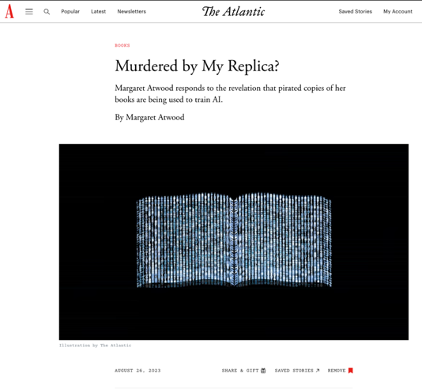

Slide 141
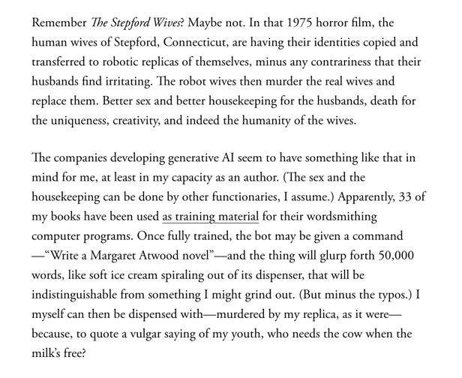

Slide 142
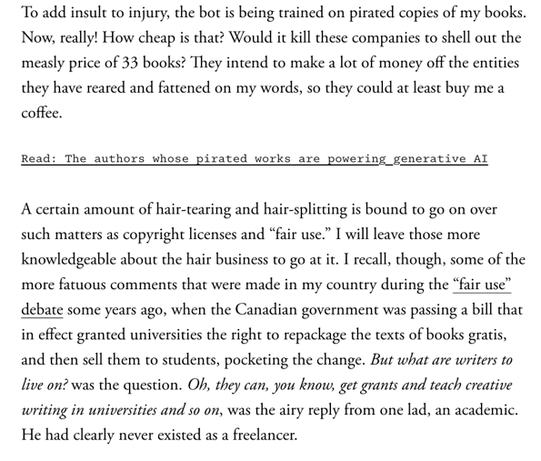

Slide 143
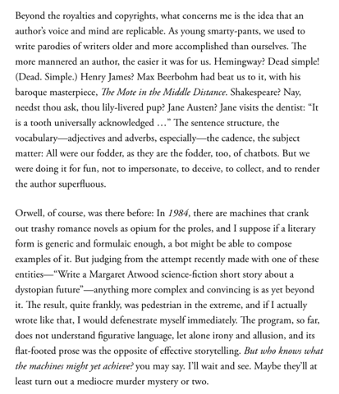

Slide 144
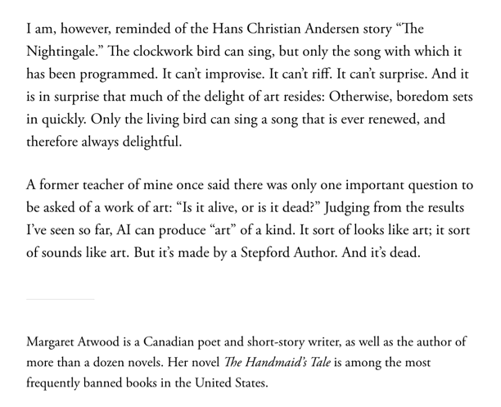

Slide 145

Now, continuing our regularly
scheduled programming…

Slide 146
Copyright Trolling/Lying in Wait
Section 35 never mentions good faith/bad faith but does mention “calculating the damages the court deems just”.
  35 (1) Where a person infringes copyright, the person is liable to pay such damages to the owner of the copyright as the owner has suffered due to the infringement and, in addition to those damages, such part of the profits that the infringer has made from the infringement and that were not taken into account in calculating the damages as the court considers just.
Section 38.1(5) dealing with statutory damages provides more leeway including among its factors (a) the good faith or bad faith of the defendant; (b) the conduct of the parties before and during the proceedings;

Slide 147
Enforcement & Remedies
Punitive and exemplary damages
Boudreau v. Lin
Standard for punitive/exemplary damages said to be flagrant behavior and callous disregard for the Plaintiff’s rights
Cinar Corporation v. Robinson
S. 49 of the Quebec Charter – “punitive damages may be awarded if there is an unlawful and intentional interference with any of the rights and freedoms that the Charter recognizes”.

Slide 148
Enforcement & Remedies
Punitive and exemplary damages
Cinar Corporation v. Robinson (continued)
In Cinar: Rights to property, inviolability, dignity were at stake
Right to dignity (s. 4). In this case “Cinar, Weinberg, Charest and Izard consistently and contemptuously denied having access to Robinson’s work, and disparaged Robinson’s claims that they had copied his work”
Cinar, Weinberg, Charest and Izard found liable for punitive damages.
Had been intentional interference with protected rights under Charter
Amount of punitive/exemplary damages was $500,000, apportioned amongst the parties.

Slide 149
Enforcement & Remedies
Limitation period for civil remedies: s. 43.1(1)
  Three years:
    From the time the act occurred (or)
    After the time when the Plaintiff knew or could reasonably have been expected to know of the act
  Does the limitation period apply to injunctive relief? → not decided in Warman v. Fournier

Slide 150
Warman v. Fournier
Warman authored a speech which was reproduced on the Defendant’s website.
A few points about limitation periods from this case:
Warman knew about the infringement since Sept 2007. Case was heard in 2012. Claim was outside limitation period. Time barred from bringing the claim.
Argued that the limitation period doesn’t apply to injunctive relief. Court didn’t reach a decision on this issue but did note recent cases in which injunctions were sought, limitation periods were applied and the remedy was denied. Court said that at the very least, the limitation period should inform the exercise of the Court’s discretion to grant an injunction for copyright infringement.
In this case the court declined to exercise discretion to grant an injunction.

Slide 151
Enforcement & Remedies
Are the suite of remedies available to copyright owners under the Copyright Act sufficient?
Should copyright owners be able to restrict the Internet access of those who have either infringed their copyrights online or who they allege have done so?

Slide 152
QUESTIONS?
THOUGHTS?
DISCUSSION?

Slide 153
Pause

Slide 154
Copyright
Review

Slide 155
Copyright Review
Who owns the copyright in a painting
created by an inmate as part of a
prison employment program?
Discuss.

Slide 156

Copyright Review
Roy Lichtenstein, Whaam! (1963)

Slide 157

Copyright Review
Photo credit to AP

Slide 158
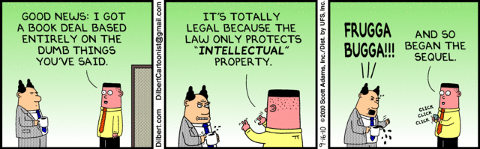
Copyright Review

Slide 159
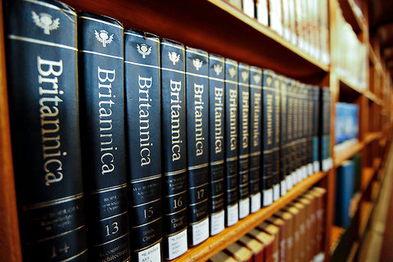
Copyright Review
Photo credit Ángel Franco/New York Times

Slide 160
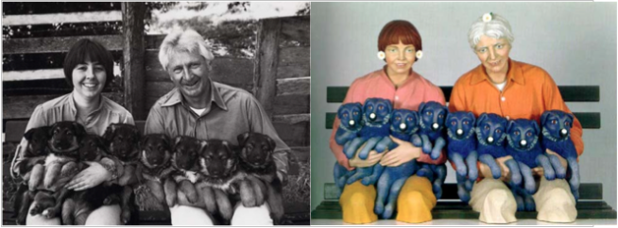
Copyright Review
L: Art Rogers, Puppies (1985) / R: Jeff Koons, String of Puppies (1988)

Slide 161
Copyright Review
In taking a picture of your partner at the Vancouver Art Gallery, you accidentally include, in the background of the picture, a work of art still under copyright. Is this infringement of copyright?

Slide 162
Copyright Review
Does Canadian copyright law adequately balance the rights of authors, the rights of copyright owners, and the rights of users? Discuss.

Slide 163
Copyright Review
The fair dealing defence should always be available. Do you agree or disagree with this statement? On what basis?

Slide 164
Copyright Review
Should copyright owners be able to restrict the Internet access of those who have either infringed their copyrights online or who they allege have done so?

Slide 165


Copyright Review

Slide 166
Copyright Review
Can there be a secondary infringement pursuant to s. 27. (2) if there was no primary infringement pursuant to s. 27. (1)???

Slide 167
QUESTIONS?
THOUGHTS?
DISCUSSION?

Slide 168
Pause

Slide 170
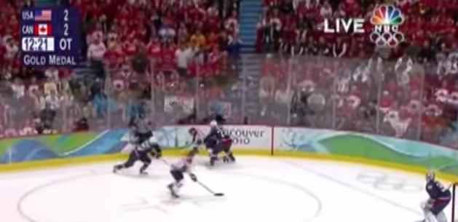
“Passing Off”
The Golden Goal – Jerome Iginla
passing off to Sidney Crosby

Slide 171
From Copyright to Passing Off/Trademarks
©
™*
From Protecting Creativity to Protecting Use
*not official but useful

Slide 172
Passing off
Three (3) necessary components of
a passing-off action:
  1. The existence of goodwill +
  2. Deception of the public due to a
  misrepresentation +
  3. Actual or potential damage to the
  plaintiff

Slide 173
Paul André Crépeau (1926-2011)
“…the law of the marketplace…”

Slide 174
Passing off in contrast to Trademarks: Think…
LOCATION, LOCATION, LOCATION
LOCAL, LOCAL, LOCAL
WHERE ARE THE GOODS KNOWN +/or SOLD

Slide 175
Passing off in contrast to Trademarks: Think…
Temporal dimension
How much time should the protection last beyond closing/unavailability if it can be recovered?
Fun brand cases
Genericization

Slide 176
Conceptual Frameworks
Think “the marketplace”
Think BRANDS
Associate BRANDS with REPUTATION (“goodwill”)
“USE” is the key concept in both passing off & trademarks
“Use It or Lose It” = historical, underlying concept (not quite as literal anymore in Canada per recent Trademark reform)
Not as overtly about “intellectual effort” as copyright
No “Public Domain” per se

Slide 177
Passing off
Tort action available in certain circumstances of unfair competition
Common Law (where no statute)
Both a common law tort and a statutory cause of action under the Canadian Trade-marks Act
No one may pass off their goods as those of another
General remedy for two categories of deception in the commercial context:
  Company B represents products as being those of Company A to take advantage of Company A’s goodwill and reputation e.g. Coke v. Cola Joe
  Goods of Trader A supplied to party who has ordered goods of Trader B. Purchasing party led to believe they have received goods of Trader B.

Slide 178
Category 1

Slide 179

Category 2

Slide 180
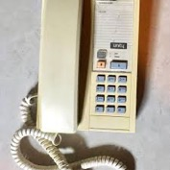
Orkin Exterminating v. Pestco (1985 Ont. CA)
People called what they thought was the ORKIN phone number, but then were actually connected with Pestco, and led or allowed to believe that ORKIN has taken care of their pest problem.

Slide 181
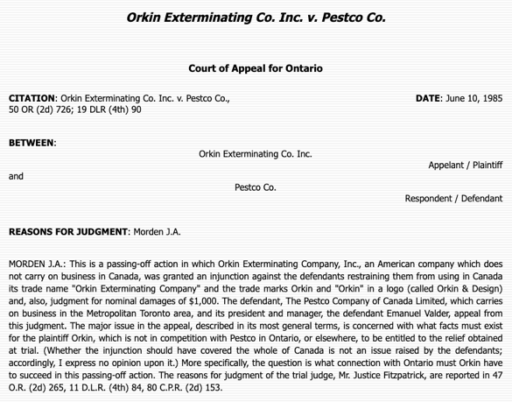

Slide 182
Passing off
Three (3) necessary components of
a passing-off action:
  1. The existence of goodwill +
  2. Deception of the public due to a
  misrepresentation +
  3. Actual or potential damage to the
  plaintiff

Slide 183
Passing off: Goodwill
Goodwill
The benefit and advantage of the good name, reputation, and connection of a business
Where the trade-mark or get-up is associated in the mind of the purchasing public with the plaintiff's goods, or with one trade source.
Get-up: The whole visible external appearance of goods

Slide 184
Passing off
Note is that passing off is generally seen as an action available between commercial competitors.
The Supreme Court of Canada, however, in Ciba‑Geigy Canada Ltd. v. Apotex Inc., [1992] 3 S.C.R. 12 emphasized that there is a consumer protection dimension to the tort. Gonthier J. notes that however one looks at the passing-off action, its purpose is clearly to protect all persons affected by the product.
“All persons” being the competitor and the people who buy the product
“People” who buy the product includes the first person who buys the product [who may be a wholesaler], all other intermediate purchasers, and the ultimate consumer.

Slide 185
Ciba‑Geigy Canada Ltd. v. Apotex Inc.
“The plaintiff Ciba‑Geigy Canada Ltd. ("Ciba‑Geigy") is a pharmaceutical laboratory which since 1977 has manufactured and sold metoprolol tartrate ("metoprolol") in Canada under a licence from AB Hässle of Sweden. Metoprolol is included in the list contained in Schedule F of the Food and Drug Regulations of drugs which can only be sold on prescription. Since 1977 this beta-blocker product, the trade name of which is “Lopresor”, has been prescribed by doctors in Ontario and Canada for low or moderate hypertension; since 1981 it has been prescribed in Ontario for patients suffering from angina…
The respondents, Apotex Inc. (“Apotex”) and Novopharm Limited (“Novopharm”), obtained licences under the Patent Act, R.S.C., 1985, c. P-4 (formerly R.S.C. 1970, c. P-4), to manufacture and sell metoprolol in Canada.”

Slide 186
Ciba‑Geigy Canada Ltd. v. Apotex Inc.
Core Issue: Whether, in a passing‑off action dealing with the get‑up of a prescription drug, the public affected by the risk of confusion includes not only health care professionals but also the patients who consume the drugs?
If so: Appellants Ciba-Geigy Canada Ltd. who brought the original passing off action would succeed in appeal.
Finding: The patient who uses the product is also included in “the public affected by risk of confusion”.

Slide 187
Ciba‑Geigy Canada Ltd. v. Apotex Inc.
“(b) Protection of Customers
In the Anglo‑Saxon legal systems, "the person chiefly concerned is the competitor affected by the unfair act”…He is frequently in fact the first party affected by the practice or aware of it.
However, "[i]t should never be overlooked that . . . unfair competition cases are affected with a public interest. A dealer's good will is protected, not merely for his profit, but in order that the purchasing public may not be enticed into buying A's product when it wants B's product" (General Baking Co. v. Gorman, 3 F.2d 891 (1st Cir. 1925), at p. 893). Accordingly, "the power of the court in such cases is exercised, not only to do individual justice, but to safeguard the interests of the public" (Scandinavia Belting Co. v. Asbestos & Rubber Works of America, Inc., 257 F. 937 (2d Cir. 1919), at p. 941). The ordinary customer, the consumer, is at the heart of the matter here. According to the civilian lawyer Chenevard, supra, at p. 20, in a case of unfair competition it is "the buyer who is the first to be injured".

Slide 189
Passing off: Where does goodwill come from?
Goodwill has said to come from the fact that the trade-mark or get-up is associated in the mind of the purchasing public with the plaintiff’s goods, or with one trade source, whether or not the public can identify that source.
A GET-UP can be defined as: The whole visible external appearance of goods/ specifically … in the form in which they are likely to be seen by the public before purchase.
If the goods are sold in packages, then the get-up is the way the package looks – the appearance of the package taken as a whole.
If the goods are not sold in packaging – the get-up is the way the good looks - the visible external appearance of the goods themselves.

Slide 190
Passing off: Where does goodwill come from?
How would you go about establishing the existence of goodwill? What sorts of information would you want to have?
Evidence of length of time in business
Strength of market for product/service
Strength of association between name/mark/product and company as source.

Slide 191
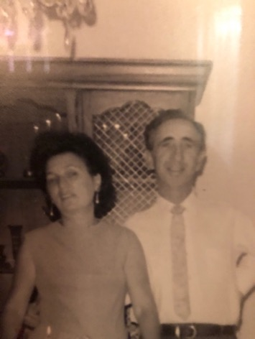
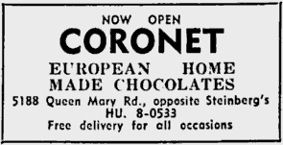

Slide 192
Passing off: Where does goodwill come from?
How would you go about establishing the existence of goodwill? What sorts of information would you want to have?
Evidence of length of time in business
Strength of market for product/service
Strength of association between name/mark/product and company as source.

Slide 193
The existence of goodwill 1
The existence of goodwill, though sometimes easy to establish, is a crucial element of the tort of passing off.
Protection against passing off ONLY where goodwill or reputation has been established.
A co. whose goods or services are well known in NS, but not in BC, will not be protected at Common Law from another company offering similarly named or branded products or services in BC. This is because confusion or misrepresentation is the essence of the tort of passing off.

Slide 194
The existence of goodwill 2
In other words where the Plaintiff’s product or service is unknown in a certain region, it will be hard for the Plaintiff to argue that customers were misled into thinking they were purchasing the P’s products when they were purchasing those of the defendant.
Goodwill is oddly “regional”, though one can string together regions to become national or even international.
Protection against passing off is available only where there is goodwill or reputation – IE only where the alleged offence occurs within a territory where there is goodwill.

Slide 195
Passing off: Shared Goodwill
Institut national des appelations d’origine des vins…v. Andres Wines Ltd (1987), 60 OR (2d) 316 aff’d Ont. CA (1990) 74 OR (2d) 203, leave to appeal to SCC refused.
Ont. Superior Court considered whether anyone was entitled to bring an action in passing off when the alleged misrepresentation related, not to the goods or services of ONE particular trader, but to a kind or quality of goods produced by a group of traders using the appellation “Champagne” which is also a district in France.
Plaintiff (I.N.A.O.) was a trade organization effectively representing winemakers in that district as they are the French public institute in charge of the defence of geographical indications.

Slide 196
Passing off: Shared Goodwill
Institut national des appellations d’origine des vins…v. Andres Wines Ltd (continued)
Note previous definition of goodwill as the benefit and advantage of the good name, reputation, and connection of a business. Seems overtly to meet the criteria?
Specific legal question is: Can goodwill exist not just with respect to one business, but with respect to a kind of goods produced by a group of traders?
Geographical indications are place names (in some countries also words associated with a place) used to identify the origin and quality, reputation or other characteristics of products
Geographical indications other than Champagne?

Slide 197


Slide 198
Tequila (town in Mexico)
Roquefort (commune in southern France)
Scotch whiskey
Parma ham
Montreal Bagel v. NY Bagel?
Chicago Deep Dish Pizza?
????

Slide 199
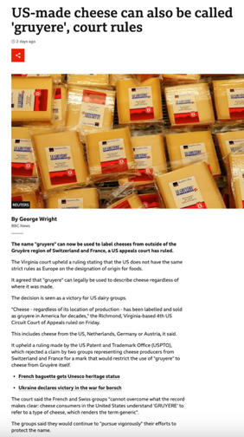

Slide 200
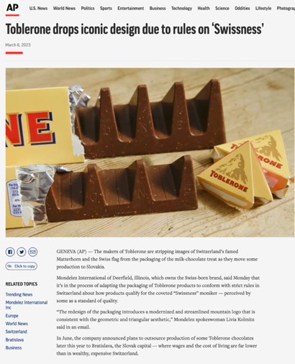

Slide 201
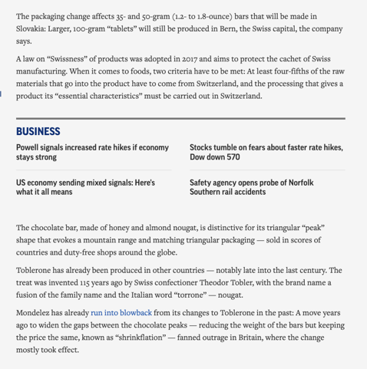

Slide 202
Passing off: Shared Goodwill
Institut national des appelations d’origine des vins…v. Andres Wines Ltd (continued)
Plaintiff seeking injunction to prevent Canadian wineries from selling their wine under a name which incorporates the word “champagne” (Canadian Champagne). The sparkling wine called “Champagne” is a product of the Champagne district of France.
Paras 8 – 12 go into detail on the history of Champagne; interesting stuff.
The laws of France provide for and protect all producers of sparking wine whose grapes, area of growth, method of production, marketing and standards meet the stringent regulations in France:
  Grapes - limited to Chardonnay, Pinot Noir and Meunier
  Area of growth - white chalky terrain with certain prevailing temperatures
  Method of production - various acceptable planting and harvesting techniques; double fermentation process in bottles or in cuve close

Slide 203
Passing off: Shared Goodwill
Institut national des appellations d’origine des vins…v. Andres Wines Ltd (continued)
These laws permit producers who meet the stringent regulations to advertise and market their sparkling wines as “champagne”. If these stringent regulations are not met, producers have to call their drink sparkling wine.
Over centuries, considerable and economically significant goodwill has been created in the name Champagne; both in France and internationally.
Each producer, including the plaintiff champagne houses, has a shared vested interest in the national and international goodwill and reputation of the name champagne.
Not yet existing future qualifying producers also share in the benefits derived from the goodwill attached to the named product. So this is not a closed category; other producers who will meet the requirements will also be able to share in the goodwill.

Slide 204
Passing off: Shared Goodwill
Institut national des appellations d’origine des vins…v. Andres Wines Ltd (continued)
Main question: Should the concept of “shared goodwill” should be accepted in Canada?
The court recognized that to accept “shared goodwill” would be to expand the tort of passing off.
Parenthetically note as we explore the extent to which the tort of passing off has expanded over time – and whether or not this is a good thing for Canadian businesses and society?

Slide 205
Passing off: Shared Goodwill
Institut national des appellations d’origine des vins…v. Andres Wines Ltd (continued)
As mentioned, the court recognized that to accept “shared goodwill” would be to expand the tort of passing off.
The classic form of the tort of passing off involves Business A leading the public to believe that his goods were in fact those of Business B.
Not the claim here. Plaintiffs not alleging Defendants passing off their goods as the product of any one of the 16 champagne houses in France.
So not business A is leading the public to believe that goods were those of business B
Rather, the basis of I.N.A.O.’s claim is Defendants are passing off their wine as “champagne”, where according to I.N.A.O’s own definition, it is not champagne.

Slide 206
Passing off: Shared Goodwill
Institut national des appellations d’origine des vins…v. Andres Wines Ltd (continued)
The claim here is still based on damage to goodwill. It’s not however based on the damage to goodwill of one business.
Rather, the claim is based on the alleged damage to the goodwill which each qualifying producer shares jointly with the other qualifying producers.
In this case, the court decided to extend the nature of the passing off action, holding that the fact that the plaintiffs are asserting a shared right to use the name champagne does not disentitle them to protect the name Champagne by a passing off action.

Slide 207
Passing off: Shared Goodwill
Institut national des appellations d’origine des vins…v. Andres Wines Ltd (continued)
Clear from case is Court’s unwillingness to limit the principles of passing off to only those situations where there is a direct or indirect connection between the goods of the plaintiffs and the defendants and where ownership of the goodwill in a mark resides in one plaintiff only.
The concept of shared goodwill was indirectly approved of by the SCC in Consumers Distributing Co v. Seiko Time Canada Ltd. (1984).

Slide 208
Passing off: Shared Goodwill Summary
Institut National:
Plaintiff entitled to bring an action in passing off when the alleged misrepresentation relates, not to the goods or services of a particular trader, but to a kind or quality of goods produced by a group of traders.

Slide 209
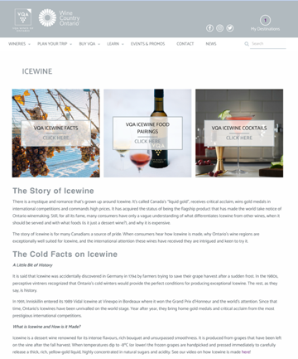
What about ice-wine?

Slide 210
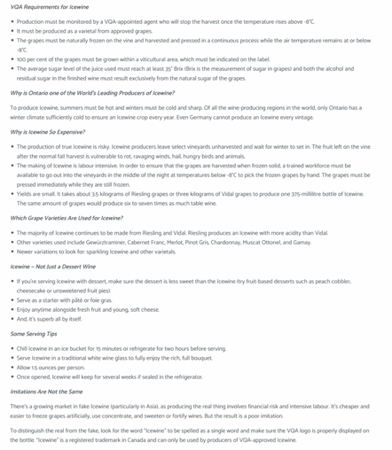

Slide 211
QUESTIONS?
THOUGHTS?
DISCUSSION?

Slide 212
Pause

Slide 213
Passing off: Foreign goodwill
Law protects through passing off action a company's property in its business or goodwill.
Goodwill is the benefit and advantage of the good name, reputation, and connection of a business.
Back to Orkin Exterminating Co. Inc. v. Petsco Co. of Canada Ltd (1985), 50 OR (2d) 726 [not required reading but on p344 CB]
Question dealt with is whether a company that doesn’t do business in Canada has goodwill in Canada for the purposes of a passing off action?

Slide 214
Passing off: Foreign goodwill
Orkin Exterminating Co. Inc. v. Petsco Co. of Canada Ltd (1985), 50 OR (2d) 726 (continued)
Court found that a company whose goods or services are well known in the U.S., but not in Canada, will not be protected at common law from another company offering similarly named or branded products or services in Canada.
Reason is because confusion or misrepresentation is the essence of the tort.
Where Plaintiff’s product or service is unknown in a certain region, it is hard to argue that customers were misled into thinking they were purchasing the Plaintiff’s products.
That said however, goodwill can exist outside the area where a company carries on a business.

Slide 215
Passing off: Foreign goodwill
So how might foreign reputation be built up?
Canadians travelling in the United States were exposed to Orkin's extensive advertising and use of its trademarks ;
Canadians in Canada were exposed to Orkin's advertising and articles appearing in American publications circulated here & Orkin’s ads appearing on TV and radio broadcast from American stations but received in Canada;
Thousands of Canadians had used Orkin services on a regular basis in connection with property owned or rented by them in the United States;
Orkin provides services to companies, in the U.S., which have operations in Canada
Orkin's international reputation in the pest control field resulted in the Canadian government seeking its advice as a consultant respecting the control of pests for the Exposition in Montreal in the mid-1970’s
Moreover the fact that Pestco, in 1967, chose to use the name Orkin in Ontario is evidence from which it may be inferred that the name Orkin had commercial value at that time in Ontario. This, according to the Court, is an important indication of goodwill in a “foreign” territory.

Slide 216
Passing off: Foreign goodwill
Sadhu Singh Hamdard Trust v. Navsun Holdings Ltd. (2016)
Case explores the related questions of:
  1. Whether an entity that does minimal business in Canada but that has a website accessible to (and accessed by) Canadians can establish sufficient goodwill for a successful action in passing off in a Canadian court? &
  2. How can such a company demonstrate its reputation?

Slide 217
Passing off: Foreign goodwill
Sadhu Singh Hamdard Trust v. Navsun Holdings Ltd. (2016) (continued)
[4] Hamdard Trust is the owner and publisher of an Indian Punjabi-language daily newspaper called the “Ajit Daily”. This paper has been published in India since 1955 and is well-known among the Punjabi population in India. An online version has been available since 2002. Only a small number of subscriptions have been sold in Canada, but several of the affiants whose affidavits were before the Federal Court on the summary trial motion lived in Canada and deposed or confirmed in cross-examination that they were aware of the Ajit Daily and its reputation as an important Punjabi paper in India.

Slide 218
Passing off: Foreign goodwill
Sadhu Singh Hamdard Trust v. Navsun Holdings Ltd. (2016) (continued)
[5] The Bains Defendants own and publish a Canadian Punjabi-language newspaper called the “Ajit Weekly”, a free newspaper that has been published in Canada since 1993 and that is distributed at the front of supermarkets and other stores. An online version has been available since 1998. The Ajit Weekly has carried advertisements that Hamdard Trust believes are offensive to some of the Ajit Daily readership.
[6] There has been considerable litigation between Hamdard Trust and the Bains Defendants over the use of the Ajit name and the stylized depiction of the name on the masthead of the Ajit Weekly, which Hamdard Trust alleges constitutes an unauthorized copying of the Ajit Daily trade-mark.
In this case …
[19] Hamdard Trust alleges that in misappropriating the Ajit Daily logo the Bains Defendants were engaged in passing off.

Slide 219
Passing off: Foreign goodwill
Sadhu Singh Hamdard Trust v. Navsun Holdings Ltd. (2016) (continued)
Federal Court dismissed Hamdard Trust’s claim for passing off, finding that it had failed to establish any of the elements for a claim of passing off.
Federal Court of Appeal set aside that decision, finding that the lower court made several palpable and overriding errors in evaluating the evidence on each element of the test.

Slide 220
Passing off: Foreign goodwill
Sadhu Singh Hamdard Trust v. Navsun Holdings Ltd. (2016) (continued)
Number of Ajit Daily subscribers in Canada? 7 in 2010.
FCA determined that the Federal Court erred in law by analyzing the existence of goodwill solely from the perspective of those who were shown to have read the Ajit Daily in Canada.
Instead, the FCA indicated the question is simply: Does the Plaintiff’s TM have a reputation in the jurisdiction, even if the TM is not used by the Plaintiff in the jurisdiction?

Slide 221
Passing off: Foreign goodwill
Sadhu Singh Hamdard Trust v. Navsun Holdings Ltd. (2016) (continued)
There was evidence that the Plaintiff’s TM had a reputation in the jurisdiction:
  1. The Ajit Daily enjoyed a reputation in the eyes of several affiants in Canada as a well-known Punjabi-language newspaper published in India
  2.A number of Canadians accessed the Ajit Daily’s online version by visiting its website.
  3. There were seven subscribers to the paper.
Court noted that if a wider reputation had been established, it would have been enough to establish the goodwill to meet the first step in the test for passing off.

Slide 222
Q.: Should an entity doing minimal business in Canada but having an accessible website that is accessed by Canadians be able to establish sufficient goodwill to make out a successful action in passing off in a Canadian court? If so, how might such a company demonstrate its reputation?

Slide 223
Passing off: Entities doing minimal business in Canada
Sadhu Singh Hamdard Trust v. Navsun Holdings Ltd. (2016)
Does Plaintiff’s TM have a reputation in the jurisdiction, even if that TM is not used in the jurisdiction?
Larger question: Should an entity that does minimal business in Canada but that has a website accessible to (and accessed by) Canadians be able to establish sufficient goodwill to make out a successful action in passing off in a Canadian court?

Slide 224
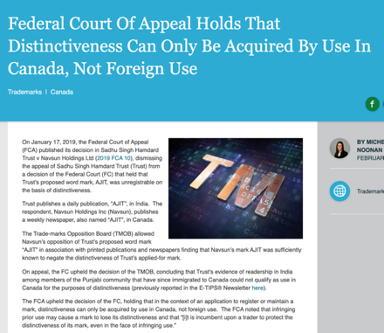
But Trademarks?

Slide 225
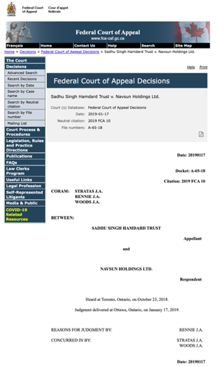

Slide 226
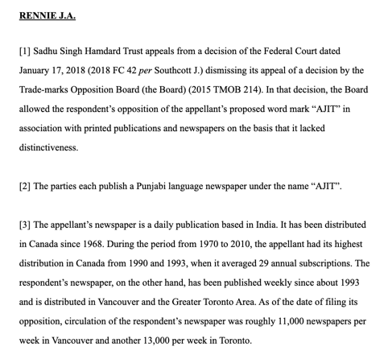

Slide 227
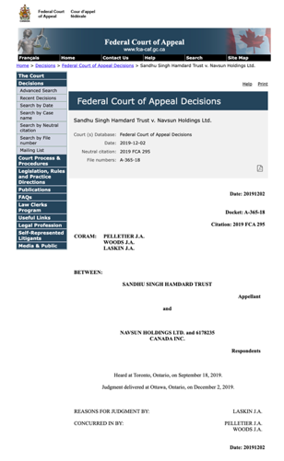

Slide 228
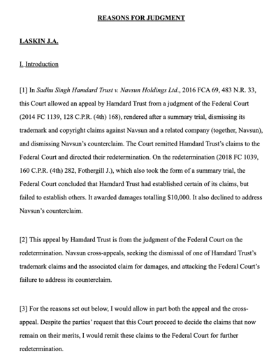

Slide 229
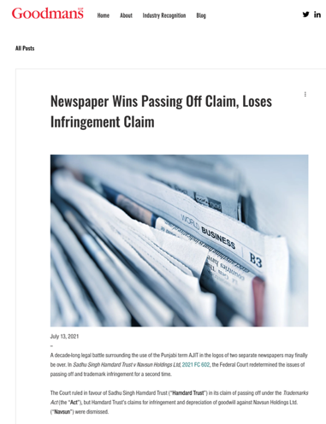

Slide 230


Slide 231
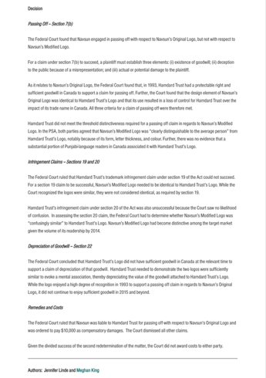

Slide 232
QUESTIONS?
THOUGHTS?
DISCUSSION?

Slide 233
Pause

Slide 234
To what extent can goodwill be acquired in a purely descriptive product name?
Risky to use purely descriptive terms for a mark.
Risk is of not acquiring goodwill or reputation in the product simply because the name describes the good itself.
Goodwill – or secondary meaning – can be acquired through a product’s name, or through a product’s appearance…
A product that has a particularly distinctive appearance might come to be associated by consumers with one trade source. Then a competitor who copies the product appearance might be liable for passing off.
Challenge in these cases is that the Plaintiff must show that the appearance of the product has acquired a secondary meaning – that it comes from one trade source.

Slide 235
Passing off: Ray Plastics
Product was a combination snowbrush, ice scraper and squeegee called “Snow Trooper”: Black nylon scraper is 27" in overall length, has 3 rows of bristles, 5/8" hardwood painted black, and a traditional yellow brush
uncommon appearance…
very successful seller at Canadian Tire, K Mart, Zellers and Pro Hardware in 1982 and 1983.
Constructed by Raywares, a division of Ray Plastics Limited.
One of Raywares’ main competitors was Brushcraft, a division of Dustbane.
At the initiative of Canadian Tire, Brushcraft produced a similar product to the Snow Trooper for the years 1984 and following.
This product was described as "virtually identical", and "a virtual clone" to the Snow Trooper.

Slide 236
Passing off: Ray Plastics
Ray Plastics sued Dustbane for passing off.
Issue: Did goodwill exist?
Ray needed to prove that potential buyers believe that the goods being sold – here Brushcraft’s snowbrush, are either those of Ray or come from the same source as the “originals”
Court notes that in discussing passing off in cases of “appearance” or get-up, …what you have to establish is that consumers, by virtue of the appearance of the product – regard it as coming from one trade source; OR that the product appearance has developed a secondary meaning – that it comes from one trade source.
Important: The consumer doesn’t have to know which company produces the original product. Just need to establish that … consumers believe that the Snowbrush made by Dustbane comes from the same source as the Snow Trooper.
It’s easier to establish this reputation or secondary meaning with a distinctive product.

Slide 237
Passing off: Ray Plastics
Court notes that where the appearance is in some way novel or striking or unusual, it is easier to conclude that there has come to be an association of that appearance with a single trade source
The Snow Trooper get-up is very distinctive.
Other factors that the court found significant in this case:
1) Ray Plastics had done extensive advertising over two years with respect to the Snow Trooper.
2) Sales figures
3) There was evidence of intentional, direct copying. The court found that evidence of intentional, direct copying establishes a prima facie case of secondary meaning.
SO the goodwill/secondary meaning found to exist in the product appearance of the snow trooper.

Slide 238
Passing off: Ray Plastics
A product that is particularly distinctive in its appearance may come to be associated by consumers with a particular trade source
If the product appearance is an inherent feature of the product, it can’t be relied on as a TM

Slide 239
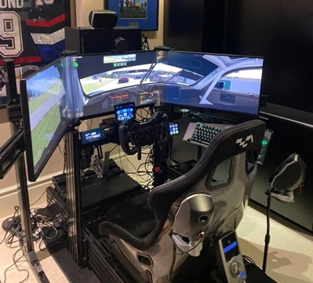

A Brief Sim-Racing Passing Off (?) Interlude

Slide 240
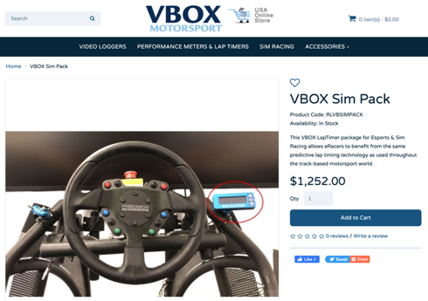
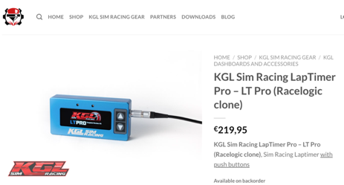
CONFUSION?
OR NOT?

Slide 241
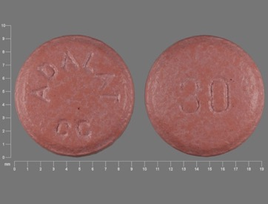
Passing off: Novopharm v. Bayer Inc. (2000)

Slide 242


Slide 243
QUESTIONS?
THOUGHTS?
DISCUSSION?

Slide 244
Pause

Slide 245


Slide 246


Trademarks

Slide 247
SEE YOU NEXT WEEK!

Slide 248

Always include a cat picture

Slide 249
In learning you will teach
And in teaching you will learn
Phil Collins' Son of Man (1999)

