Slide 1

Users Rights 2
Talk 5
LAW 422 001
Intellectual Property Law
Allard School of Law, UBC
Fall, 2023
Jon Festinger K.C.
QMUL School of Law (CCLS)
Whiteboard Law
https://iplaw.allard.ubc.ca/

Slide 2
Logistics

Slide 3
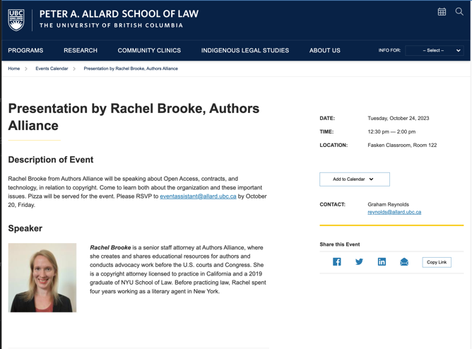

Slide 4
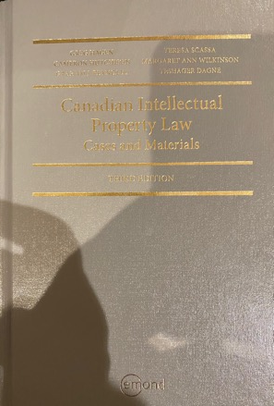
Text @ UBC Bookstore

Slide 5
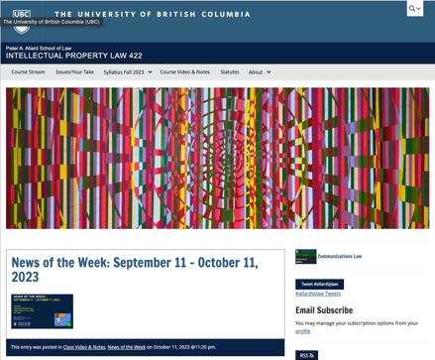
Course Website
https://iplaw.allard.ubc.ca/

Slide 6
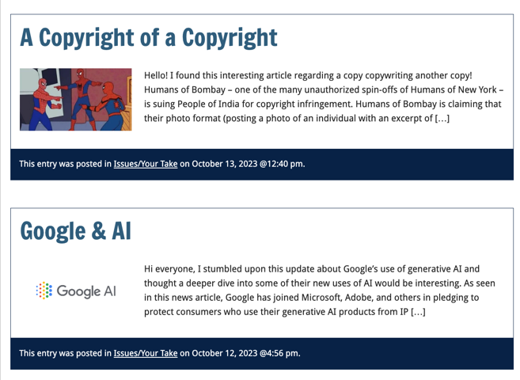

Slide 7
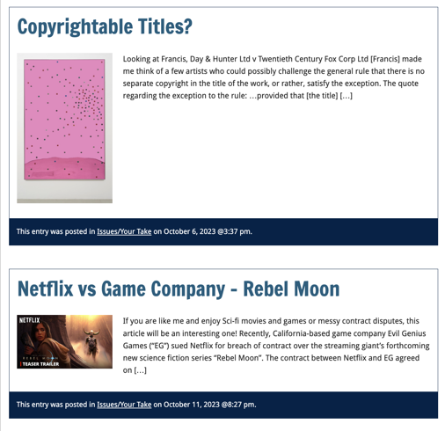

Slide 8
PLEASE
SIGN UP

Slide 9
For full privileges on the website
1. Please create an account at http://cms.ubc.ca/ using your CWL.
2. Once you create an account and sign in at http://cms.ubc.ca/ you can click your name in the top right. Halfway down the following page will be your WordPress email address.
3. Send me your WordPress email address at jon.festinger@ubc.ca or at jon_festinger@thecdm.ca
4. Then, I will invite you to participate with authoring privileges via your WordPress email address.

Slide 10



Slide 11
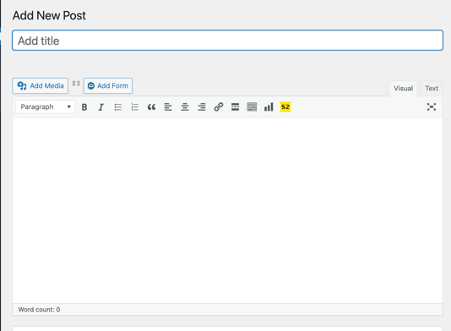
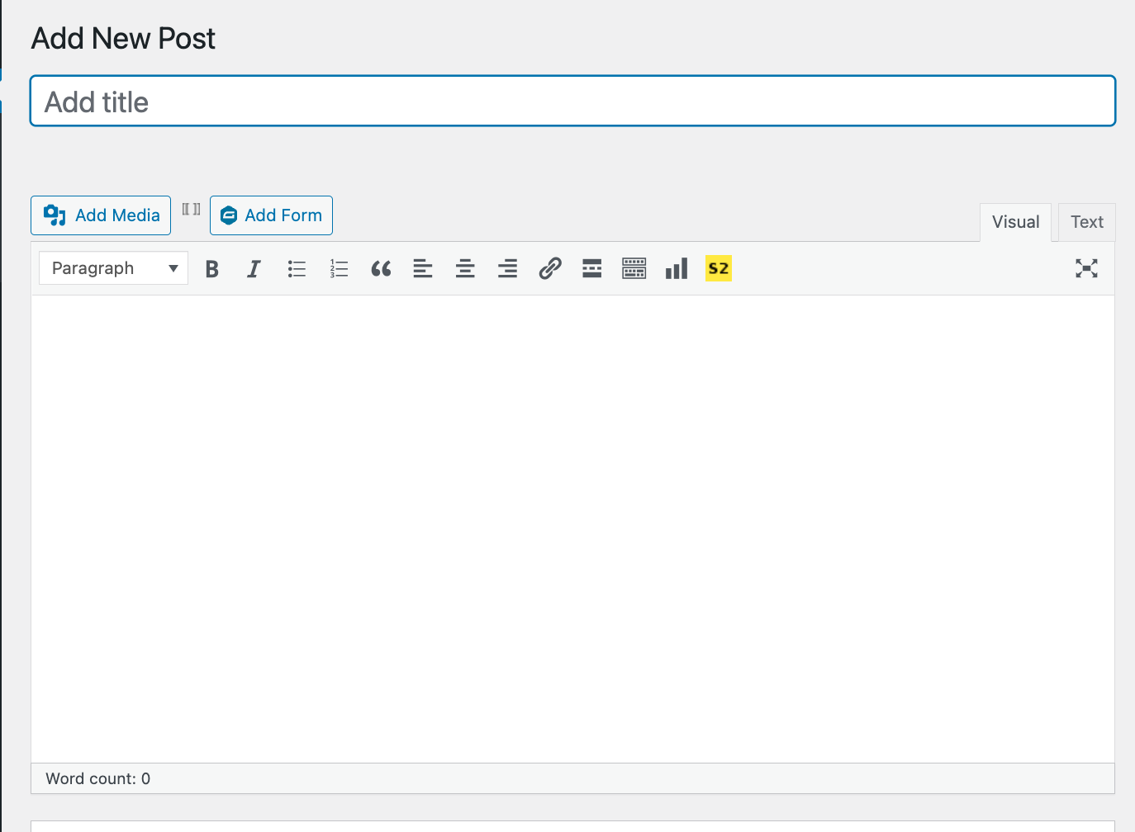

Adding Images

Slide 12




Slide 13

Adding Links

Slide 14
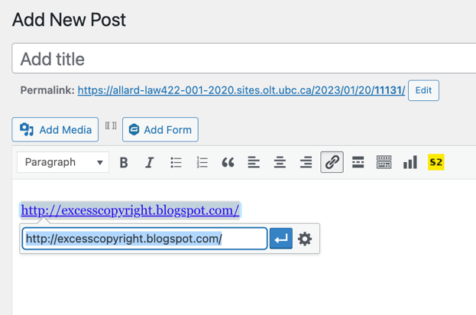
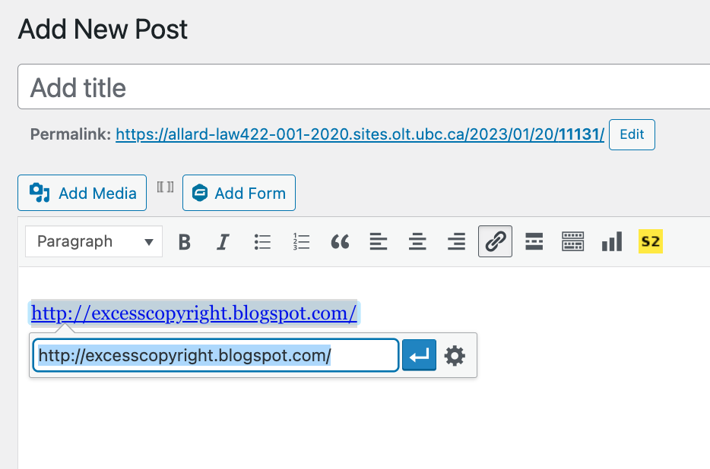


Slide 15



Adding a “Featured Image”

Slide 16



Slide 17
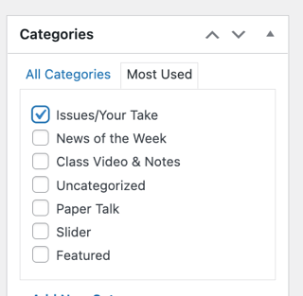

Setting Categories

Slide 18
Thank you for
your bios. & favorite I.P.’s
Much appreciated.

Slide 19
Let’s talk about…
The 30%
Paper/Presentation/Post = 20%
Participation = 10%

Slide 20
20% = a modest proposal…
750-1000 words (or equivalent) per person
written, video, podcast, in-class presentation (?), interpretive dance
Website or not
Groups or individually
LLM Students – one extra

Slide 21
DUE 11:59:59 PM
LAST DAY
OF THE TERM
(END OF EXAM PERIOD)

Slide 22
HOWEVER,…
ENCOURAGE POSTING
BEFORE END OF CLASSES
…YOUR CLASSMATES
WILL BENEFIT

Slide 23
Additional
Evaluation
(LLM students)

Slide 24
LLMCL Students Registered in the Class as such: Additional Task
750 – 1000 word post (or email)
???????????

Slide 25
Please use:
Jfestinger@telus.net
jon.festinger@ubc.ca

Slide 26
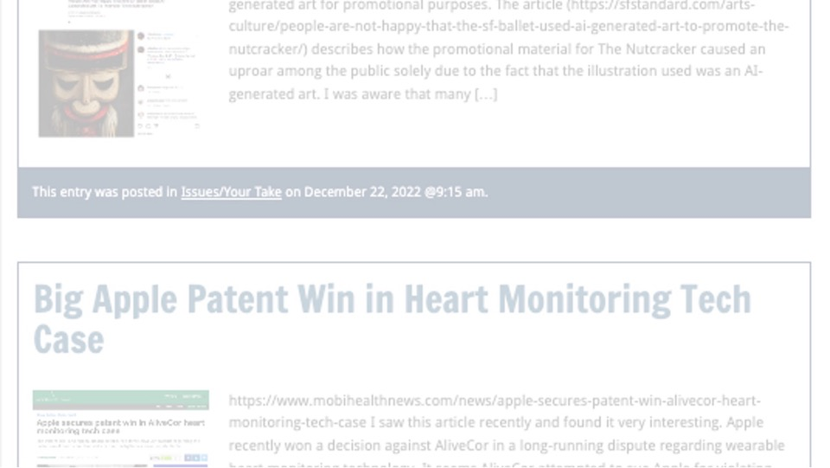
Past Presentations mostly all on the course website…

Slide 27
The 10%
Participation is broadly defined includes any or all:
class contributions however made
website contributions
email or other discussions with Instructor

Slide 28

Anything & everything can be done via email if you prefer

Slide 29
QUESTIONS?
THOUGHTS?
DISCUSSION?

Slide 30

Pause

Slide 32

Where we have been…

Slide 33
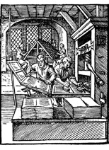
“Copyright Law Review to Date”

Slide 34
Overview of copyright
Definition of copyright:
  Set of exclusive rights in works of expression; performers’ performances; sound recordings; and communication signals.
The Clash, Chateau Neuf, Oslo, Norway
21 May 1980 Helge Øverås

Slide 35
Purpose of copyright in Canada?
Théberge:
  “[12] Generally speaking, Canadian copyright law has traditionally been more concerned with economic than moral rights.… The economic rights are based on a conception of artistic and literary works essentially as articles of commerce.” (Binnie J.)
But Cinar Corp. v. Robinson?
  [114] … the infringement of copyright in this case interfered with Robinson’s personal rights to inviolability and to dignity, recognized by ss. 1 and 4 of the [Quebec] Charter. (McLachlin CJ)

Slide 36
Overview of copyright
Purpose of copyright as articulated by the SCC
  Former approach: “author-centric”
  Shift in Théberge
    “balance between promoting the public interest in the encouragement and dissemination of works of the arts and intellect and obtaining a just reward for the creator“ (para. 30)
  Refined in Cinar Corporation v. Robinson, 2013 SCC 73
    Copyright Act “seeks to ensure that an author will reap the benefits of his efforts, in order to incentivize the creation of new works” (para. 23)

Slide 37
What is copyrightable
Originality in Canada
Pre-2004
  “Sweat of the brow”:
    Work receives copyright protection if it originates from an author and is more than a mere copy.
  “Creativity”
    A work must be the product of creativity in order to be original

Slide 38
What is copyrightable
Facts and ideas
  Not entitled to copyright protection
  Kenrick & Co. v. Lawrence & Co. (1890)
    How is idea separated from expression in this decision?

Slide 39
What is copyrightable: Artistic Works
5. (1) Subject to this Act, copyright shall subsist in Canada, for the term hereinafter mentioned, in every original literary, dramatic, musical and artistic work if…

Slide 40
S. 2 Definitions
literary work includes tables, computer programs, and compilations of literary works; (oeuvre littéraire)
dramatic work includes
(a) any piece for recitation, choreographic work or mime, the scenic arrangement or acting form of which is fixed in writing or otherwise,
(b) any cinematographic work, and
(c) any compilation of dramatic works; (oeuvre dramatique)
musical work means any work of music or musical composition, with or without words, and includes any compilation thereof; (oeuvre musicale)
artistic work includes paintings, drawings, maps, charts, plans, photographs, engravings, sculptures, works of artistic craftsmanship, architectural works, and compilations of artistic works; (oeuvre artistique)

Slide 41
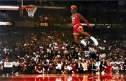
What is copyrightable
FWS Joint Sports Claimants v. Canada 1991 FCA (CB)
No copyright in a sporting event per se though television production of a sporting event is copyrightable
Unpredictable and incompatible with the notion of a choreographic piece of art?

Slide 42
Copyrighting Data?
Geophysical Service Incorporated v. Encana Corporation, 2016 ABQB 230
It appears from the case that is not the raw data that is copyrightable as those would simply be facts, but how the data is presented.
  “[76] I find the seismic sections, i.e. the squiggly or zebra lines, fit within the definition of an artistic work, similar to a map, plan or chart, or a compilation of an artistic work, since the product is the result of selection or arrangement of the data, or sound recordings, from the geology of the subsurface.”
Do you agree? Alta. C.A. confirmed & SCC denied leave.

Slide 43
Rights of the copyright owner
Produce … any translation (3(1)(a))
Convert dramatic work into non-dramatic work (3(1)(b)
Convert non-dramatic work into dramatic work (3(1)(c))
To make a sound recording, etc. of a literary, etc. work (3(1)(d))
Reproduce, etc. a literary, etc. work as a cinematographic work (3(1)(e))
Communicate a work to the public by telecommunication (3(1)(f))
Present an artistic work at a public exhibition…. (3(1)(g))
Rent out a computer program, etc. (3(1)(h))
Rent out a sound recording of a musical work … (3(1)(i))
Sell or transfer ownership of tangible object … (3(1)(j)
Authorize any of above acts (3(1))

Slide 44
Rights of the copyright owner
Who owns the rights? (ss. 13, 14)
ss. 13(4), 13(7): assignments, exclusive licences need to be in writing; non-exclusive licences don’t need to be in writing (Robertson v. Thomson)
Benefit of copyright registration: If an assignment or licence not registered, and the assignor or licensor subsequently assigns or licences the copyright interest – for valuable consideration – to a different assignee or licensee who didn’t have ACTUAL NOTICE of the prior assignment – the prior assignment/licence can be declared void (57(3)). So, if you’re an assignee, licensee – it is to your benefit to register the assignment of copyright or the licence granting you an interest (57(1)).

Slide 45
Rights of the copyright owner
Reproduction of “broadcast incidental copies”
CBC v. SODRAC 2003 Inc. [2015] 3 SCR 615
Should every instance of copying be considered to infringe the “reproduction” right?
Rothstein J. (majority):
  SCC’s understanding of the purpose of copyright has evolved; principle of technological neutrality now recognized to be a core copyright principle …
  But these principles don’t override express statutory terms.
  Broadcast-incidental copying activities engage the reproduction right
Abella J.’s dissent suggested Rothstein J. inappropriately “employs a literal approach to the interpretation of s. 3(1)(d), reading the words of the provision without the benefit of the purpose and context of the Act to ascertain its true meaning.”

Slide 46
Rights of the copyright owner
What constitutes taking a “substantial part” of a work?
  Applies to all rights, not just reproduction
  Cinar Corp. v. Robinson (2013, SCC)
    Matter of fact and degree; flexible notion
    Standard of review
    Decided by quality rather than quantity
    Q: “do the copied features constitute a substantial part of the plaintiff’s work?

Slide 47
Rights of the copyright owner
Right to perform a work in public
Canadian Admiral Corp. v. Rediffusion Inc., [1954] Ex. C.R. 382
  Exception given where audience is not part of author’s public
  Main case is Jennings v. Stephens [1936] 1 All E.R. 228 & 413 where 600 workers listened to broadcast music in a factory. Held that everything depends on the character of the audience – Is the audience part of the copyright owner’s public? If the audience considered in relation to the owner of the copyright can properly be described as the owner's "public" or part of his "public," then anyone who performs the work before that audience without the consent of the author would be infringing his copyright.

Slide 48
Harms Inc. and Chappel & Co v. Martan’s Club (1927): Performance at the Embassy Club at which club members, potential members and some guests were present. Held to be a performance in public.
Performing Right Society Ltd. v. Hawthorn’s Hotel Ltd (1933): An orchestral trio played in the lounge of Hawthorn’s Hotel. In the lounge were several guests of the hotel, among others. This was a performance by the hotel orchestra in public – it was open to any members of the public who cared to be guests of the hotel – either by eating or dining there.
Performing Right Society Ltd v. Gillette Industries (1943): Defendants installed loudspeakers in their factory and broadcast music in various departments to about 600 workers. All strangers were excluded from the factory. Was in public.

Slide 49
Rights of the copyright owner
Right to perform a work in public
Canadian Cable Television Association v. Canada (Copyright Board), [1993] 2 F.C. 138
  Reference to “early conflicting decision” (Rediffusion)
  Letourneau J.: “I would have thought on a mere common sense basis that when the Prime Minister of Canada addresses the nation, either from his home or his private office, and reaches the citizens in their homes by means of radio and television, he appears in public and performs in public. I would have been content to leave it at that had it not been for early conflicting decisions on this issue.”

Slide 50
Rights of the copyright owner
Right to communicate a work to the public by telecommunication (s. 3(1)(f))
TV
Radio
Online
“3 (1) For the purposes of this Act, copyright, in relation to a work, means the sole right to produce or reproduce the work or any substantial part thereof in any material form whatever, to perform the work or any substantial part thereof in public or, if the work is unpublished, to publish the work or any substantial part thereof, and includes the sole right
(f) in the case of any literary, dramatic, musical or artistic work, to communicate the work to the public by telecommunication,…”

Slide 51
Rights of the copyright owner
Right to communicate a work to the
public by telecommunication (s. 3(1)(f))
CCH Canadian v. LSUC (2004)
  Faxed transmissions of a single copy
  of a work to a single individual is not a
  communication to the public
  Emanated from a single point;
  & intended to be received at a single point

Slide 52
Q1:When does a communication to the public occur on the Internet?
Some content online content is accessible through “push” technologies (radio streams), other content is accessible through “pull” technologies.
Content is stored & cached on servers, and is only communicated to individuals when they access or “pull” it – when they access a stream that isn’t running constantly, download a file, etc.
So … when does a communication to the public occur?
The SCC decided that a telecommunication occurs on the internet at the point where the content is transmitted from the host server to the end user (each time that the content is transmitted).

Slide 53
Q2: Who communicates in a copyright sense on the Internet?
The person who communicates the work is the person who is the content provider – who uploads the work, creates the stream, posts the work
Do ISP’s (Internet Service Providers), as intermediaries, participate in the transmission of copyrighted works? Do they also communicate the work to the public? (Practical Ramifications → Deep Pockets $$$$$$$)
In answering SCC turned to s. 2.4(1)(b) – which states that participants in a telecommunication who only provide the “means of telecommunication necessary” (carriers) are deemed NOT to be communicators (follows Communications law doctrine of SEPARATION OF CONTENT FROM CARRIAGE).
Court noted that statute does not say intermediaries are engaged in communication BUT have a kind of immunity. RATHER it provides that intermediaries are deemed, for Copyright Act purposes, not to be communicating the work to the public at all. They are invisible.

Slide 54
Q3: When does a communication on the Internet occur in Canada?
Majority held Canada could exercise copyright jurisdiction in respect both of transmissions originating in Canada and transmissions originating abroad but received in Canada. This conclusion was said to be consistent with our general law as well as with national and international copyright practice. [Also consistent with many internet jurisdiction cases, many about defamation, of the time…until today]
But…this doesn’t mean “automatic copyright liability” on foreign content providers who communicate copyright works to Canadian end users. For copyright liability to be imposed on foreign content providers, there needs to be - in the context of a message or communication - a real and substantial connection.
Factors to be considered are situs of content provider, host server, intermediaries, end user

Slide 55
Rights of the copyright owner
Right to communicate a work to the public by telecommunication (s. 3(1)(f))
CWTA v. SOCAN (2008)
  Is the transmission of a musical ringtone to a cellphone a ‘communication to the public by telecommunication’?

Slide 56
Yes, it is. Court defines communication as – the passing of information from one person to another:
“A musical ringtone is information in the form of a digital audio file that is capable of being communicated. … The wireless transmission of a musical ringtone to a cellphone is a communication, whether the owner of the cellphone accesses it immediately in order to hear the music, or at some later time. … Communication completed once info is received.”
Next question: Is the communication by telecommunication of a ringtone from a wireless carrier’s website to a customer’s cell phone a communication to the public?
Court says yes.
FCA: If a wireless carrier were to transmit a particular ring-tone simultaneously to all customers who have requested it, that transmission would be a communication to the public. It would be illogical to reach a different result simply because the transmissions are done one by one, and thus at different times.]

Slide 57
Rights of the copyright owner
Right to communicate a work to the public by telecommunication (s. 3(1)(f))
ESA v. SOCAN (2012)
  Does the Copyright Act require a second royalty to be paid when games are downloaded as opposed to sold in stores?
  Conclusion: Internet delivery of copies of video games containing musical works does not constitute a communication to the public.

Slide 58
Entertainment Software Association v. Society of Composers, Authors and Music Publishers of Canada (Pentalogy case)
  Issue is whether the Copyright Act requires a second royalty to be paid when games are downloaded as opposed to sold in store? A royalty is already paid to account for the reproduction of the musical work. However if a download of a video game is found to constitute a communication to the public by telecommunication IN ADDITION to a reproduction, then a second right would be engaged.
  Conclusion: SCC held that “the Internet delivery of copies of video games containing musical works” does not constitute a communication to the public – so doesn’t infringe s. 3(1)(f).

Slide 59
Rights of the copyright owner
Right to communicate a work to the public by
telecommunication (s. 3(1)(f))
Rogers Communications Inc. v. SOCAN 2012 SCC 35
  Does individual streaming, triggered by the
  individual actions of individual users,
  constitute “communication to the public” or a
  “private communication” ?

Slide 60
YES, IT IS
‘COMMUNICATION TO THE PUBLIC’
(despite what was said in CCH v. LSUC that transmission of a single copy to a single person isn’t a communication to the public - also think about it → CCH photocopy and fax facts are reasonably distinguishable)

Slide 61
Rights of the copyright owner
Right to communicate a work to the public by telecommunication (s. 3(1)(f))
S. 2.4(1.1) (amended)
  For the purposes of this Act, communication of a work or other subject-matter to the public by telecommunication includes making it available to the public by telecommunication in a way that allows a member of the public to have access to it from a place and at a time individually chosen by that member of the public.

Slide 62
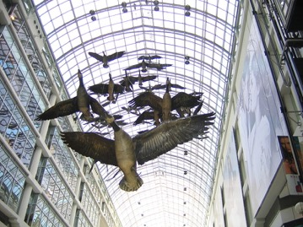
MORAL RIGHTS
Sections 14.1 and 14.2 of the Copyright Act
Snow v. Eaton Centre

Slide 63
Sections 14.1 and 14.2 of the Copyright Act
  the right to the integrity of the work; &
  the right, where reasonable in the circumstances, to be associated with the work as its author by name or under a pseudonym and the right to remain anonymous.
Section 34.2 of the Copyright Act - remedies for infringement of moral rights include injunctions, damages, and delivery up.
Moral rights can be waived, but not transferred.
Cases:
Snow v. Eaton Centre Ltd., (1982) 70 C.P.R. (2d) 105 (Ont. H.C.J.)
Ritchie v. Sawmill Creek Golf & Country Club Ltd., (2004) 189 O.A.C. 282
Wiseau Studio, LLC et al. v. Harper et al. 2020 ONSC 2504

Slide 64
Independent Creation Doctrine - Canada

Slide 65
63 Many of the detailed similarities, in my view, can be traced to the common store of folklore about primitive species with human characteristics upon which Lucas was as free to draw as were Preston and Hurry. Yet drawing upon a common store of information does not in itself answer to the claim of infringement. It is the expression of ideas, not the ideas themselves, that is the subject of copyright. It is entirely possible that two or more authors, composers, dramatists or other artists may draw upon a common store of information for ideas and each may have copyright in his or her expression of those ideas. But if while drawing upon the common information base, one should copy the expression in literary or dramatic form of another author copyright may be infringed.

Slide 66
Users’ Rights

Slide 67
Today: Two Defences to copyright infringement
Defence of public interest
Fair dealing

Slide 68
User rights: Public Interest Defence
Defence of public interest
R. v. Lorimer & Co. Ltd., [1984] 1 FC 1065
Defence of public interest argued – In the public interest that this information be disseminated as broadly as possible.
Court indicated that it has no doubt that a defence of public interest – as set out in the UK cases on which the Lorimer’s counsel relied – is available in proper circumstances against an assertion of Crown copyright.
But the facts don’t support the public interest defence here
  Great disclosure in report
  Free copies given out, put in libraries across the country
  No concern about the public not being informed
N.B. Act doesn’t mention “public interest”

Slide 69
User rights: Public Interest Defence
Defence of public interest
Lion Laboratories v Evans [1985] QB 526
Lion Laboratories manufactured and marketed the Lion Intoximeter which was used by the police for measuring blood alcohol levels of motorists.
Two ex-employees approached the Press with four documents taken from Lion.
Such reproduction was held to be justified, despite the nature of material, being confidential and protected by copyright.
Court agreed that the defence of public interest applied to the investigations regarding the accuracy of the equipment to avoid incorrect readings when used by the police on motorist.

Slide 70


Fair Dealing v. Fair Use

Slide 71
Users’ rights: Fair Dealing
29. Fair dealing for the purpose of research, private study, education, parody or satire does not infringe copyright.

Slide 72
Fair Dealing: Criticism or Review
29.1 Fair dealing for the purpose of criticism or review does not infringe copyright if the following are mentioned:
(a) the source; and
  (b) if given in the source, the name of the (i) author, in the case of a work

Slide 73
Fair Dealing: News Reporting
29.2 Fair dealing for the purpose of news reporting does not infringe copyright if the following are mentioned:
(a) the source; and
  (b) if given in the source, the name of the (i) author, in the case of a work

Slide 74
QUESTIONS?
THOUGHTS?
DISCUSSION?

Slide 75
Pause

Slide 76

Random Notes

Slide 77
Copyright Issues: Academic Sector
Coming Next Week
Apart From:
Law Society case
Access Copyright case
York University case
(which we are dealing with today)

Slide 78
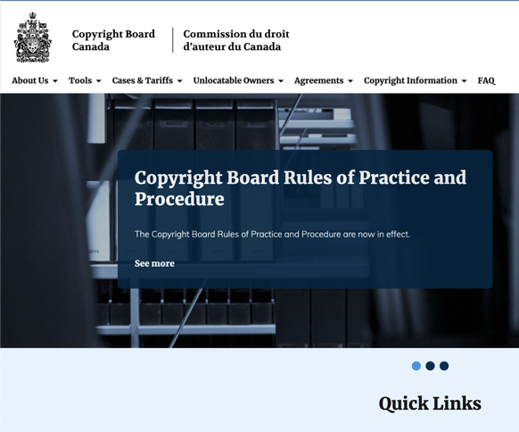

Slide 79
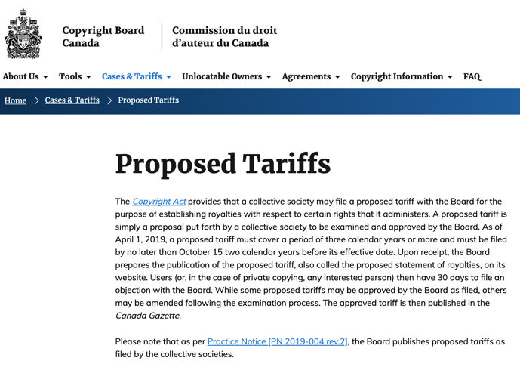

Slide 80
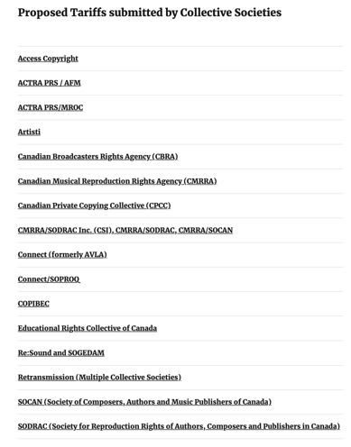

Slide 81
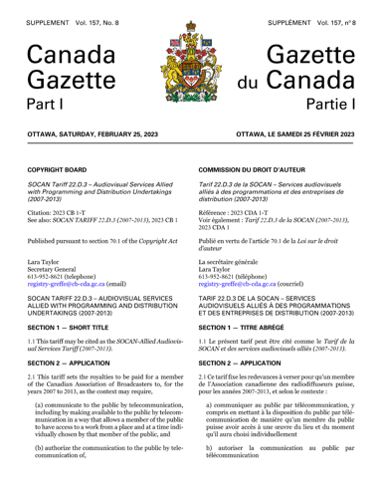

Slide 82
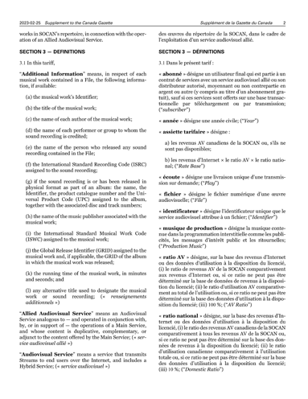

Slide 83
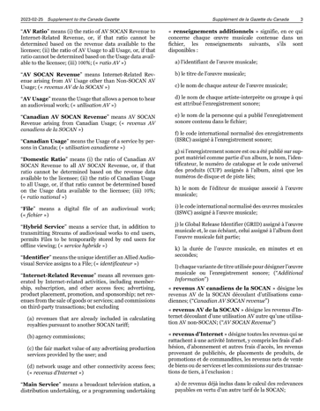

Slide 84
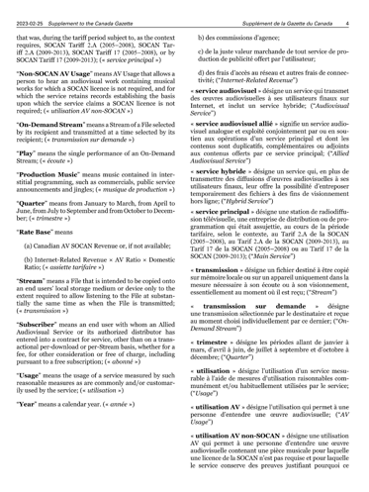

Slide 85
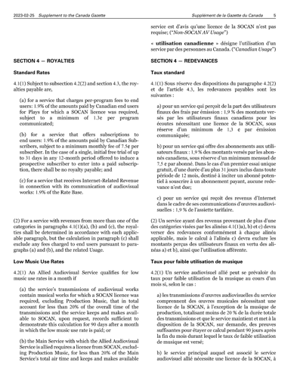

Slide 86
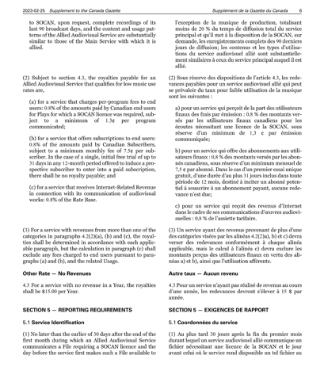

Slide 87
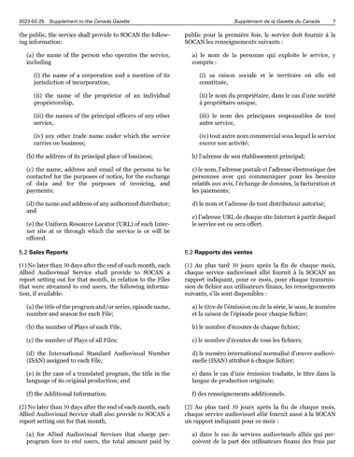

Slide 88
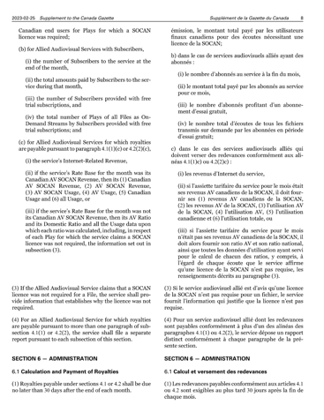

Slide 89
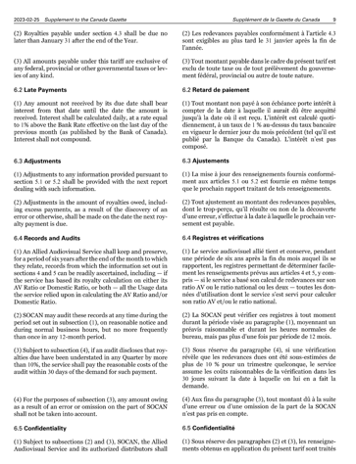

Slide 90
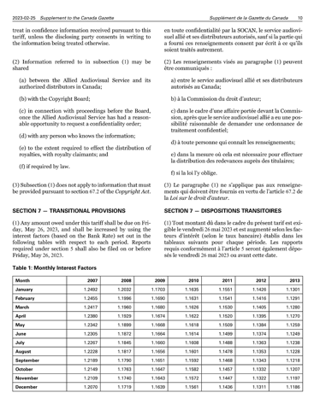

Slide 91
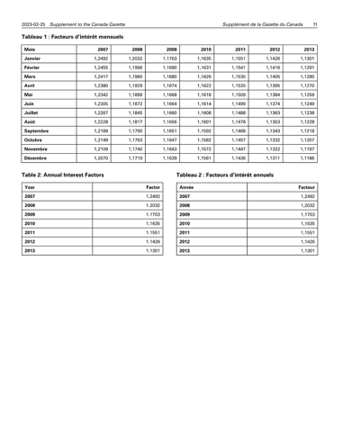

Slide 92
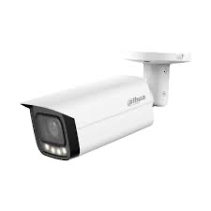
Copyright in CCTV Footage?

Slide 93
Standard of Originality
In CCH Canadian Ltd. v. Law Society of Upper Canada, 2004 SCC 13 McLachlin C.J. speaking to the standard of originality required for copyright stated:
  ”I conclude that the correct position falls between these extremes. For a work to be “original” within the meaning of the Copyright Act , it must be more than a mere copy of another work. At the same time, it need not be creative, in the sense of being novel or unique. What is required to attract copyright protection in the expression of an idea is an exercise of skill and judgment… This exercise of skill and judgment will necessarily involve intellectual effort.”

Slide 94


Slide 95
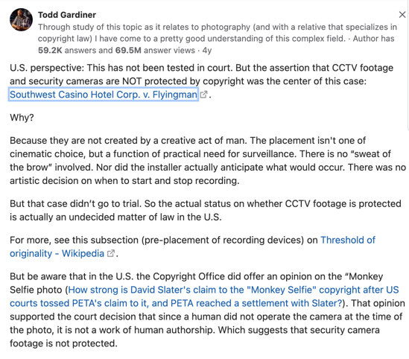

Slide 96
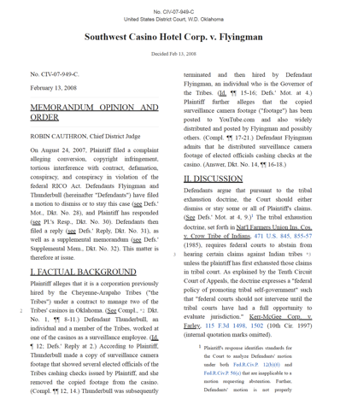

Slide 97
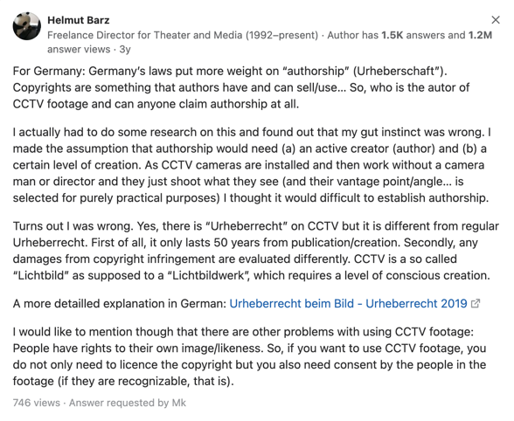

Slide 98


Slide 99
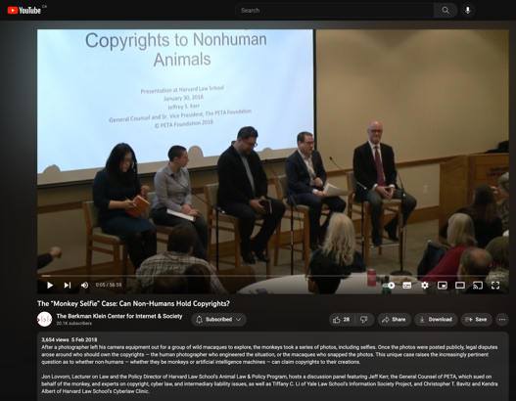
https://youtu.be/Zlvgil4zNQk

Slide 100
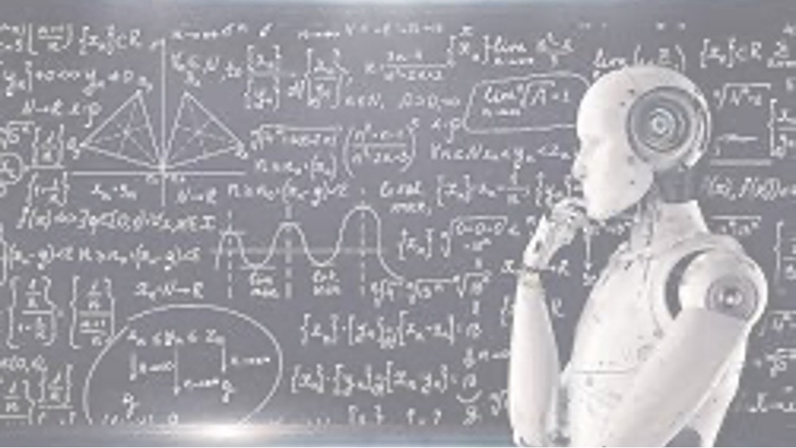
A.I.I.P.
Follow-up

Slide 101
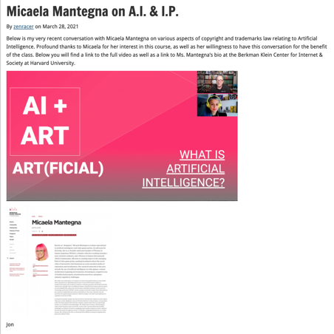

Slide 102
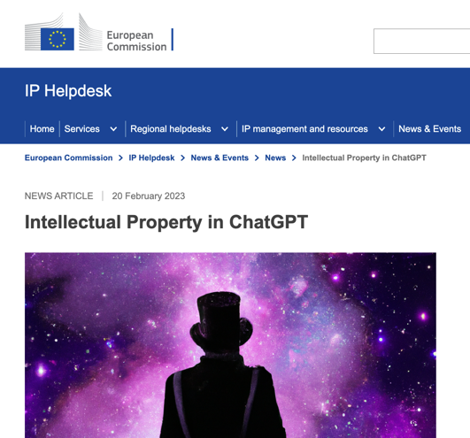

Slide 103
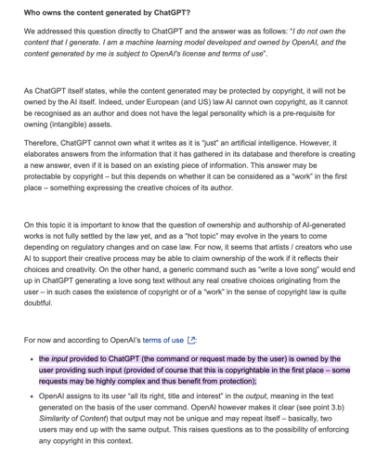

Slide 104

Novel (?) uses of copyright

Slide 105
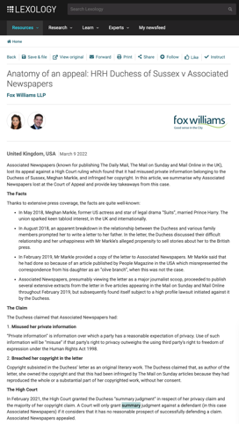

Slide 106
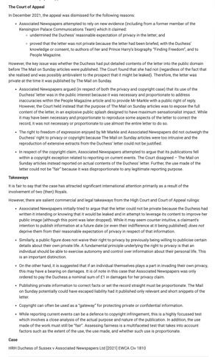

Slide 107
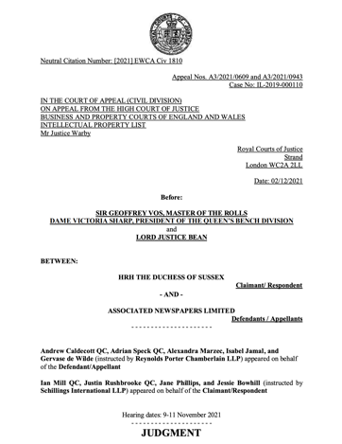

Slide 108
“1. The central question in these appeals is whether the judge (Mr – now Lord - Justice Warby) was right to make orders for summary judgment in favour of the claimant, Meghan, Duchess of Sussex (the Duchess or the claimant) against the publishers of the Mail on Sunday newspaper and the MailOnline, Associated Newspapers Limited (Associated Newspapers or the defendant). Summary judgment was granted in respect of the Duchess’s claims for misuse of private information and infringement of copyright. The claims relate to the publication in a number of Mail articles (the Articles) of about half the contents of a 5-page handwritten letter (the Letter) which the Duchess had sent on 27 August 2018 to her father, Mr Thomas Markle (Mr Markle)…

Slide 109
3. In his judgment of 11 February 2021, the judge also held that the Duchess was entitled to summary judgment on the issues of subsistence and infringement of copyright in the Letter, but that the issue remained of whether a Mr Jason Knauf (Mr Knauf), a former member of the Kensington Palace Communications Team, was a co-author. After the judgment, it became clear that Mr Knauf had not co-authored the Letter and claimed no copyright in it, and the judge gave final summary judgment on the copyright claim in a further judgment of 12 May 2021…
9. As to copyright, Associated Newspapers’ two main grounds of appeal are that (i) the judge failed properly to evaluate the interference with article 10, saying that this was not one of the rare cases in which freedom of expression would outweigh copyright in the absence of a fair dealing defence, and (ii) the judge failed properly to evaluate the fair dealing defence, bearing in mind the limited scope of the copyright in the Letter and the wide scope of the concept of reporting current events.

Slide 110
Daddy, [1] It is with a heavy heart that I write this, not understanding why you have chosen to take this path, turning a blind eye to the pain you’re causing. The last time we spoke was 7 days before our wedding when Harry and I called you. This was followed by a turbulent and confusing week where we called you multiple times a day to try to understand what was happening. [2] From my phone alone, I called you over 20 times and you ignored my calls, opting instead to solely speak to tabloids - leaving me in the days before our wedding worried, confused, shocked, and absolutely blindsided. [3] Post wedding you then made a choice to begin an onslaught of media interviews, which are still ongoing. Your actions have broken mv heart into a million pieces - not simply because you have manufactured such unnecessary and unwarranted pain, but by making the choice to not tell the truth as you are puppeteered in this. Something I will never understand. [4] You’ve told the press that you called me to say you weren’t coming to the wedding - that didn’t happen because you never called. You’ve said I’ve never helped you financially and you’ve never asked me for help which is also untrue; you sent me an email last October that said, “if I’ve depended too much on you for financial help then I’m sorry but please if you could help me more, not as a bargaining chip for mv loyalty. You already have that whether you realize it or not.” [5] And while I still refuse to read any press, it was shared with me what you said about … [Here, the claimant complained that her father had been unjust in what he wrote about a relative, and the claimant’s behaviour towards that relative. She provided a detailed rebuttal]. [6] I have only ever loved, protected, and defended you, offering whatever financial support I could, worrying about your health be it your … [Here, the claimant referred to a number of health problems encountered by her father] …, and always asking how I could help. [7] So the week of the wedding to hear about you having a heart attack through a tabloid was horrifying. I called and texted you and desperately tried to find out about the medical treatment you would need and where you would be. I begged you to accept help - we sent someone to your home, tried to have them drive you to the hospital, to get the best care and protection for you, and instead of speaking to me to accept this or any help, you stopped answering your phone and chose to only speak to tabloids. I will never understand why especially with you knowing I have always looked out for your health. … [Here, the claimant wrote about the nature and content of conversations with her father over the past 10 years] [8] … in the last two years your obsession with tabloid media only exacerbated my worry for you, which is why I pleaded with you to stop reading the tabloids. On a daily basis you fixated and clicked on the lies they were writing about me, especially those manufactured by your other daughter, who I barely know. … [9] [The claimant wrote about her upbringing, her half-sister and their relationship] … Though you feel you did your best to stop her while you watched me silently suffer at the hand of her vicious lies, I crumbled inside. … [… The claimant described her feelings about her father’s health …] … [10] I … urged you day after day to stop reading the tabloids. But you couldn’t ­ and your fascination grew into paranoia (and then rage) of how you were being portrayed. You know how much anguish tabloid press has caused – lies simply for click bait. So to suffer through this media circus created by you is all the more devastating. You continue to be manipulated by the press, who are likely promising you the world to keep churning out these fictitious stories, yet still ridiculing you. The lies you have been paid to share about me, about our help for you, … [Reference was made to support the claimant says her father received] … - is staggering and confusing. [… Reference was made to the contents of correspondence sent by Mr Markle …] [11] We all rallied around to support and protect you from day one and this you know. So to hear about the attacks you’ve made at Harry in press, who was nothing but patient, kind, and understanding with you is perhaps the most painful of all. I will truly never understand it. [12] For some reason you choose to continue fabricating these stories, manufacturing this fictitious narrative, and entrenching yourself deeper into this web you’ve spun. The only thing that helps me sleep at night is the faith and knowing that a lie can’t live forever. [13] My hope is that you can take a moment to reflect on this. To remember our conversation seven days before the wedding when we asked you if the claims of you working with the paparazzi and press were true and told you if we tried to protect you from the story running (something we've never attempted to do for anyone - ourselves included) that we wouldn't be able to use that strength to protect our own children one day. Even knowing that, you said it wasn’t true. [14] I believed you, trusted you, and told you I loved vou. The next morning the CCTV footage came out. You haven’t reached out to me since the week of our wedding, and while you claim you have no way of contacting me, my number has remained the same. This you know. No texts, no missed calls, no outreach from you – just more global interviews you’re being paid to do to say harmful and hurtful things that are untrue. [15] If you love me, as you tell the press you do, please stop. Please allow us to live our lives in peace. Please stop lying, please stop creating so much pain, please stop exploiting mv relationship with mv husband, and please stop taking the bait from the press. I realize you are so far down this rabbit hole that you feel (or may feel) there is no way out, but if you take a moment to pause I think you’ll see that being able to live with a clear conscience is more valuable than any payment in the world. I ask for nothing other than peace, and I wish the same for you. Meg

Slide 111
The copyright claim
59. At [130]-[152] the judge dealt with the essential legal principles, the issues, originality and infringement, before turning to the fair dealing for the purpose of reporting current events and the public interest defences at [153]-[158], which are the subject of this appeal.
60. On fair dealing, the judge said that his previous analysis led “ineluctably to the conclusion that this defence could not succeed”. The defendant’s case identified 5 current events, broadly summarised, as: (i) the claimant’s relationship with her father, (ii) the People Article disclosing the existence of the Letter, (iii) Mr Markle’s reaction to the People Article, (iv) Mr Markle’s dispute with the version put into the public domain, and (v) his dispute with the version of the claimant’s conduct towards him. (ii)-(v) arguably qualified as public events. The only requirement of the defence which was satisfied was the acknowledgment of the author. Summary judgment dismissing fair dealing defences had been given in Hyde Park Residence Ltd v. Yelland [2001] Ch 143 (Hyde Park), Ashdown v. Telegraph Group Ltd [2001] EWCA Civ 1142 (Ashdown), and HRH Prince of Wales v. Associated Newspapers Ltd [2008] Ch 57. Guidance was to be found in Ashdown at [70] (approving an extract from Laddie, Prescott and Vitoria, The Modern Law of Copyright and Designs):
  … by far the most important factor is whether the alleged fair dealing is in fact commercially competing with the proprietor’s exploitation of the copyright work, a substitute for the probable purchase of authorised copies, and the like. If it is, the fair dealing defence will almost certainly fail. If it is not and there is a moderate taking and there are no special adverse factors, the defence is likely to succeed, especially if the defendant’s additional purpose is to right a wrong, to ventilate an honest grievance, to engage in political controversy, and so on. The second most important factor is whether the work has already been published or otherwise exposed to the public. If it has not, and especially if the material has been obtained by a breach of confidence or other mean or underhand dealing, the courts will be reluctant to say this is fair. However this is by no means conclusive, for sometimes it is necessary for the purposes of legitimate public controversy to make use of ‘leaked’ information. The third most important factor is the amount and importance of the work that has been taken. For, although it is permissible to take a substantial part of the work (if not, there could be no question of infringement in the first place), in some circumstances the taking of an excessive amount, or the taking of even a small amount if on a regular basis, would negative fair dealing.

Slide 112
61. The judge said that the Letter was not intended for commercial exploitation, but the defendant knew it was unpublished. Communicating the Letter to the defendant here may have been unlawful. The copying of large parts of the original literary content of Judgment the Letter infringed the claimant’s privacy rights and was irrelevant and disproportionate to any legitimate reporting purpose. The reproduction was essentially for the purpose of reporting the contents of the Letter, which was not a current event. The use made was not fair.
62. On public interest and article 10, section 171(3) of the Copyright Designs and Patents Act 1988 (CDPA) preserved the common law defence. The court refuses to allow its process to be used for purposes that are contrary to the public interest (see Hyde Park at [43]). The protection of freedom of speech under article 10 was one aspect of the public interest: “[f]reedom of expression would prevail, in the public interest, in “those rare cases where this right trumps” those conferred by the CDPA: Ashdown [58]”. The judge said that such cases will be few because: (i) copyright was itself a right protected by article 1 of the First Protocol to the ECHR, (ii) the protection of copyright was a legitimate aim capable of justifying an interference with freedom of expression, and the court had to strike a fair balance, (iii) it would be very rare for the public interest to justify the copying of the form of a work to which copyright attaches: Ashdown [59], and (iv) the fair dealing defence will normally itself properly reflect the public interest in freedom of expression: Ashdown [66].
63. The judge thought that this was not one of the rare cases referred to in Ashdown. There was “no basis on which the court could conclude that, although the copying of the work was not fair dealing for news reporting purposes, the public interest [required] the copyright to be overridden” for the reasons given under the heading of fair dealing.

Slide 113
Dealing with the issues
96. The public interest/article 10 copyright issue: Did the judge fail properly to evaluate the interference with article 10? 96. I am taking the article 10 defence first, because Mr Adrian Speck QC, who argued this part of the case for Associated Newspapers, put it first. Mr Speck criticised the judge for relying on Ashdown without mentioning the key differences between that case and this: there the justification for quoting from Mr Ashdown’s memorandum was to establish authenticity and to prove that the journalist actually had it in his possession, whereas there was no such issue here. Moreover, the Letter was not obtained improperly as it had been in Ashdown, so that the defendant did not need to show this to be a rare case as the judge had thought at [157]. The judge lumped freedom of speech together with fair dealing, and used his arguments on privacy to reject both, without even considering Mr Markle’s own right to free speech. The judge had also failed to evaluate the extent or weight of the copyright, in the sense of the intellectual creativity in the Letter. Had he done so, he would have realised that the Letter had a low level of copyright protection to put in the balance against the article 10 rights. It was wrong also to assume that using large parts of the Letter was more objectionable than using less, since using more allows fairer evaluation.
97. It is true that the judge dealt with the article 10 defence shortly at [157]-[158], having rejected the fair dealing defence broadly for the reasons that he rejected the defences to the privacy claim. It is true also that the balancing exercise between a copyright, which is a property right, on the one hand and freedom of speech on the other hand is not identical to the balancing exercise that the judge had undertaken between article 8 and article 10 rights. It is also true that the Letter contained some pre-existing facts which were not themselves protected by copyright.

Slide 114
98. In my judgment, however, the judge understood that “the nature and degree of the originality involved in a work can affect the availability of defences such as fair dealing, public interest, and … freedom of expression” [139]. Secondly, nothing advanced by Mr Speck suggested that there was any triable issue that would look different after a trial. The balancing exercise that had to be undertaken was between the claimant’s copyright in the Letter on the one hand and the article 10 rights of Mr Markle and Associated Newspapers. Whilst it is true that the judge did not expressly mention Mr Markle’s article 10 rights, that was the context to the exercise he was undertaking. Thirdly, I think that Mr Speck’s criticisms of the judge’s references to Ashdown were overstated. Indeed, at [39], Lord Phillips CJ said in Ashdown that: “in most circumstances, the principle of freedom of expression will be sufficiently protected if there is a right to publish information and ideas set out in another’s literary work, without copying the very words which that person has employed to convey the information or express the ideas. In such circumstances it will normally be necessary in a democratic society that the author of the work should have his property in his own creation protected”. At [58], Lord Phillips said “[w]e prefer the conclusion of Mance LJ [in Hyde Park at [82]] that the circumstances in which public interest may override copyright are not capable of precise categorisation or definition. Now that the Human Rights Act 1998 is in force, there is the clearest public interest in giving effect to the right of freedom of expression in those rare cases where this right trumps the rights conferred by the [CDPA]”. These dicta were relevant to what the judge had to decide, even bearing in mind the different factual context in Ashdown. Fourthly, I cannot see that the defendant has seriously impugned the balancing exercise that the judge carried out in what was a careful and detailed decision. I do not think it is a valid criticism to suggest that he did not set out all the arguments again under this heading, when he correctly explained the exercise he had to undertake and reached a clear conclusion. In the result, I also agree with the conclusion he reached.

Slide 115
7. The fair dealing copyright issue: Did the judge wrongly rely on his privacy analysis to reject the fair dealing defence?
  99. Associated Newspapers adopted similar arguments on the fair dealing defence to those advanced under article 10. As I said at [61] above, the judge’s main reason for rejecting the fair dealing defence was that the reproduction of the Letter was essentially for the purpose of reporting its contents, which were not a current event, and that the use made of the Letter was not fair.
  100. In Pro Sieben Media v. Carlton UK Television [1999] 1 WLR 605 (Pro Sieben), Robert Walker LJ explained at page 614 that: “Criticism or review” and “reporting current events” are expressions of wide and indefinite scope. Any attempt to plot their precise boundaries [was] doomed to failure. They [were] expressions which should be interpreted liberally…”. The judge identified 4 topics at [153] that he considered current events (the People Article’s description of the Letter, Mr Markle’s reaction to the People Article and his dispute with it and with the claimant’s view of her conduct towards him), and accepted that some other events might also arguably qualify. But the judge did not comment on the defendant’s pleading that the Letter and the claimant’s Judgment views had entered the public domain by wide reporting. It was, the defendant argued, impossible to evaluate the fairness of the publication summarily. Moreover, the judge failed to understand how liberally the concept of fair dealing was to be interpreted and elided the question of fairness with the question of what was, in the context, reporting current events. According to Mr Speck, the judge simply took too narrow a view of the public interest in the current events surrounding the estrangement of the claimant and Mr Markle. And the Articles did report some of the events that the judge had himself accepted were current events.

Slide 116
101. My reasons for rejecting this ground of appeal are similar to those expressed above in relation to the public interest defence. The judge did understand the nature and degree of the originality involved in the Letter, and that it could affect the fair dealing defence.
102. Secondly, once again, Mr Speck did not point to a triable issue in relation to fair dealing, save to say that the evaluation of fairness should be done after a trial. I cannot see why. The judge could evaluate the copyright in the letter and balance it with what the People Article had made into current events, so as to take a view about what those current events were and the fairness of allowing publication of what was reproduced in the Articles. The judge accepted the existence of the Letter and its description of its contents had been put into the public domain by the People Article. The extract he cited at [154] from Laddie, Prescott and Vitoria made clear that that the defence would often succeed if the defendant’s purpose was to right a wrong or to ventilate an honest grievance. The liberal reporting of current events adumbrated by Pro Sieben might, for completeness, have been mentioned by the judge, but does not really impact his reasoning at [155] and [156] to the effect that the defendant knew it was dealing with an unpublished work, it copied a large and important proportion of the work’s original literary content, most of which infringed the claimant’s privacy rights and was disproportionate to any legitimate reporting purpose. The fairness of the reproduction was, therefore, very limited. Most importantly, perhaps, the use made of the Letter was unfair, because it was not about reporting current events, but reporting the actual contents of the Letter to make the splash of publication already referred to.
103. Thirdly, I cannot see that the defendant has been able here, any more than under article 10, seriously to impugn the balancing exercise that the judge carried out between the copyright protection on the one hand and the fairness of publication on the other hand in the context of his determinations as to what were current events. In essence all that could be, and was, properly undertaken by reference to the People Article, the Letter and the Articles. I repeat that the judge’s decision, looked at as a whole, was careful and detailed.”

Slide 117
Conclusions
104. For the reasons I have given, I would admit the new evidence filed by both parties, and dismiss Associated Newspapers’ appeal on all the grounds for which permission was given.
105. I should not leave this case without reiterating the narrowness of the issues we have had to decide. The appeal was against the judge’s decision that it could be seen mainly on the basis of the central documents in the case (viz the People Article, the Letter, and the Articles themselves) that the claimant’s reasonable expectation of privacy and copyright in the Letter had been infringed. After careful consideration of his judgment, I agree with the views the judge expressed on these very confined, mostly factual, questions.
106. Essentially, whilst it might have been proportionate to disclose and publish a very small part of the Letter to rebut inaccuracies in the People Article, it was not necessary to deploy half the contents of the Letter as Associated Newspapers did. As the Articles themselves demonstrate, and as the judge found, the primary purpose of the Articles was not to publish Mr Markle’s responses to the inaccurate allegations against him in the People Article. The true purpose of the publication was, as the first 4 lines of the Articles said: to reveal for the first time [to the world] the “[t]he full content of a sensational letter written by [the Duchess] to her estranged father shortly after her wedding”. The contents of the Letter were private when it was written and when it was published, even if the claimant, it now appears, realised that her father might leak its contents to the media.

Slide 118
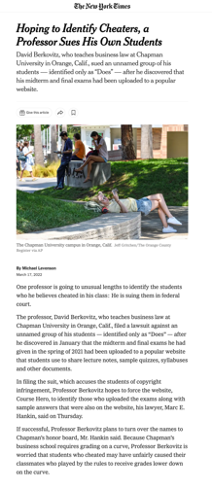

Slide 119
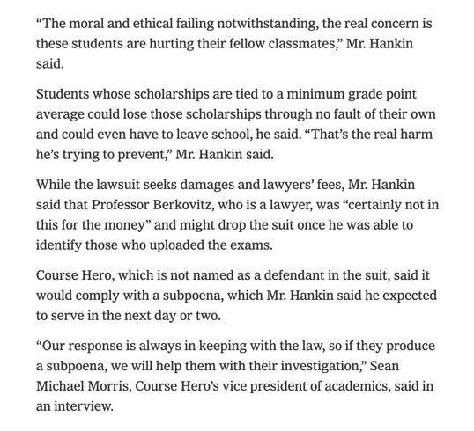

Slide 120
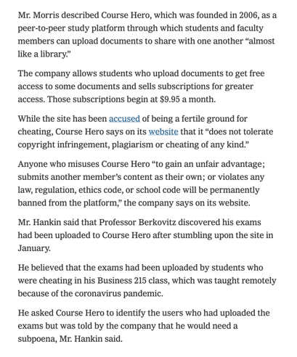

Slide 121
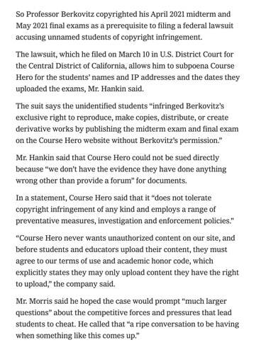

Slide 122
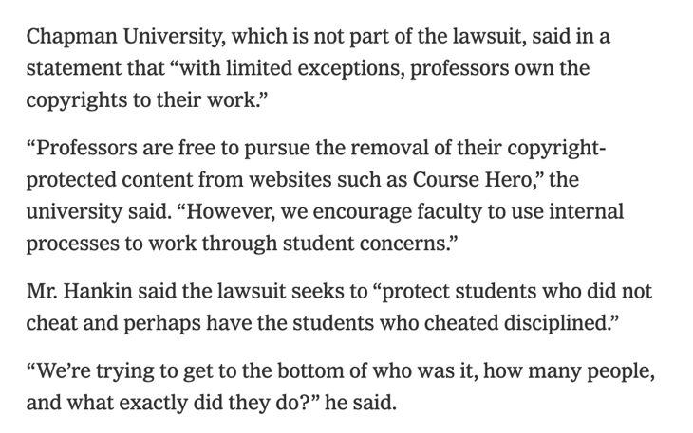

Slide 123
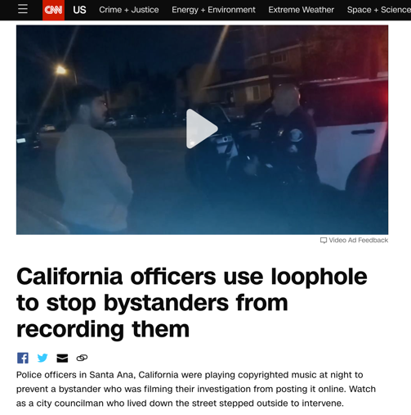

Slide 124
QUESTIONS?
THOUGHTS?
DISCUSSION?

Slide 125
Pause

Slide 126

Now, continuing our regularly
scheduled programming…

Slide 127
Users’ rights: Fair Dealing
Eight fair dealing categories (exhaustive list)
No definition of “fair” in the Copyright Act, or of the fair dealing categories
For many years, fair dealing did not play a prominent role in copyright
During this time, fair dealing was interpreted restrictively
Why might this have been the case?

Slide 128
Eight fair dealing categories (exhaustive list)
Research
Private Study
Education
Parody
Satire
Criticism
Review
News reporting

Slide 129
What changed?
CCH v. LSUC (SCC) endorsed “users’ rights”
Flows from Théberge , where copyright was found not to be only about about rewarding and protecting authors; but focussed on the balancing between the public interest in encouraging and disseminating creative and intellectual works and securing a just reward for the author.
Move from defence to copyright action to a more positive articulated User Right.
Means User Right’s can be a sword? How would that work/what would that look like?

Slide 130
Things that have also changed
Internet backbone

Slide 131

+ digital

Slide 132
+ collaboration

Slide 133
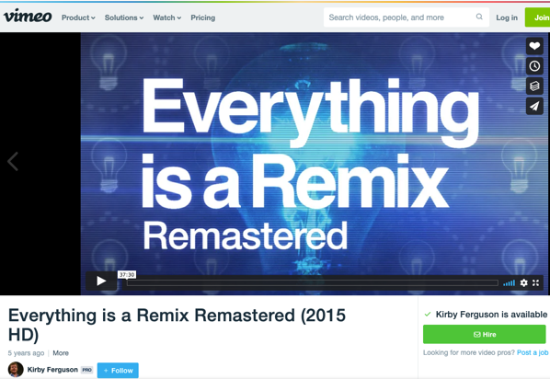
https://vimeo.com/139094998
[Optional]

Slide 134
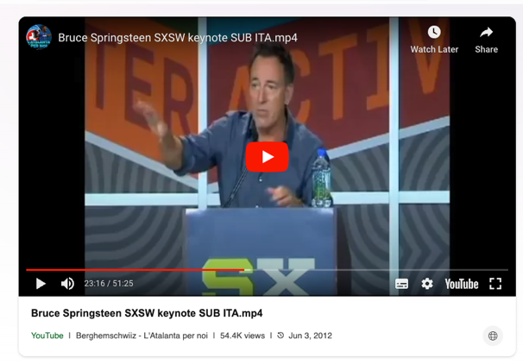
https://www.bing.com/videos/riverview/relatedvideo?&q=bruce+springsteen+sxsw+keynote+speech&&mid=18E121326672065CCBC618E121326672065CCBC6&&FORM=VRDGAR

Slide 135
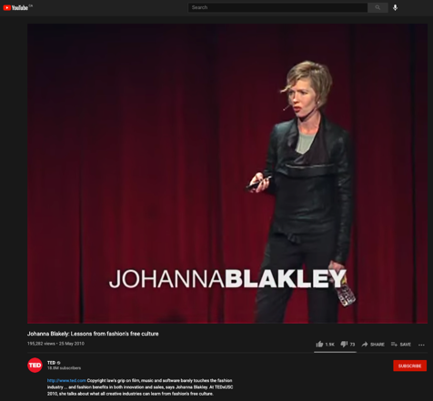
https://youtu.be/zL2FOrx41N0

Slide 136
Back to CCH on USERS’ RIGHTS
CCH Canadian et al v. LSUC (2004)
LSUC operates the Great Library. Within it is a
custom photocopy service for lawyers who
can’t make it to the Library. There is also a
photocopy machine that the public can use.
CCH Canadian (legal publisher) and others
brought action against the LSUC for copyright
infringement.

Slide 137
Users’ rights
Fair dealing in CCH:
An integral part of the Copyright Act - not just a defence
The fair dealing “exception”, like other exceptions in the Copyright Act, is a users’ right. In order to maintain the proper balance between the rights of a copyright owner and users’ interests, it must not be interpreted restrictively.
Always available. If other exceptions might also be available, argue fair dealing first, then turn to other exceptions and defences.
Two step process:
  1) Defence establishes the dealing was for one of the listed purposes.
  2) Defence establishes the dealing was fair.
Fair dealing category of research to be given a large and liberal interpretation in order to ensure users’ rights are not unduly constrained
Research is not limited to non-commercial or private contexts. Lawyers carrying on the business of law for profit are conducting research within the meaning of s. 29 of the Copyright Act.

Slide 138
Summary of CCH on USERS’ RIGHTS
CCH Canadian et al v. LSUC (SCC 2004)
  Fair dealing is an integral part of the Copyright Act
  Fair dealing is a users’ right; must not be interpreted restrictively
  Two step process: purpose; fairneanalysis
  Categories must be given a large and liberal interpretation (i.e., research

Slide 139
User rights: “Fair” in Fair Dealing
CCH Canadian et al v. LSUC (2004)
Whether something is fair is a question of fact and depends on the facts of each case.
Factors that can be considered to help assess whether a dealing is fair:
  Purpose of the dealing
  Character of the dealing
  Amount of the dealing
  Were there alternatives to the dealing?
  Nature of the work
  Effect of the dealing on the work

Slide 140

The fairness stew

Slide 141
1. Purpose of the Dealing
Fair if for one of the allowable purposes under the Copyright Act
  S. 29 = research, private study, education, parody or satire
  S.29.1 = criticism or review
  S. 29.2 = news reporting
Some dealings may be more, or less, fair, than others - i.e., research for commercial purposes may not be as fair as research for charitable purposes

Slide 142
2. Character of the Dealing
How was the work dealt with? Multiple copies distributed, will tend towards being unfair, especially if more copies than necessary or otherwise gratuitous.
Single copy used for single legit purpose – easier to conclude it is fair.
Copies destroyed after use may also favour a finding of fairness.
Do consider customs, practices & norms in a particular industry or trade → However CBC v. SODRAC (SCC 2015) doesn’t – why not? CATEGORIES EXHAUSTIVE

Slide 143
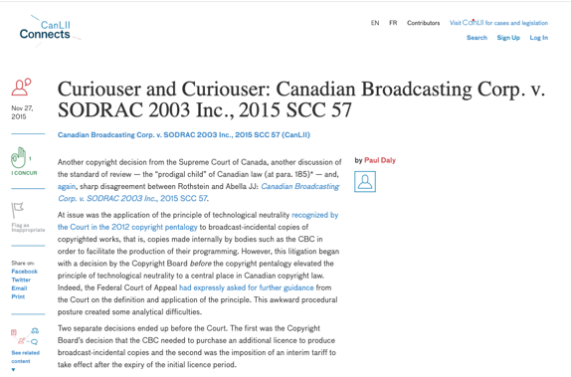
Footnote: Criticisms of Majority in CBC v. SODRAC not related to fair dealing

Slide 144


Slide 145


Slide 146


Slide 147


Slide 148


Slide 149
3. Amount of the Dealing
You can deal fairly with a whole work (i.e., photographs)
Amount taken may be more, or less, fair depending on the purpose - i.e., research, may be essential to copy an entire academic article

Slide 150
4. Alternatives to the Dealing
Was there a non-copyrighted equivalent of the work that could have been used instead of the copyrighted work?
Was the dealing reasonably necessary to achieve the ultimate purpose?
Meaning not gratuitous.
I.e., Would a criticism have been equally effective if it did not actually reproduce the copyrighted work it was criticizing? If yes, that weighs against a finding of fairness.

Slide 151
5. Nature of the Work
If a work is unpublished, dealing might be fairer because its reproduction could lead to a wider public dissemination for the work
Confidential work? May be unfair in the circumstances.

Slide 152
6. Effect of the dealing on the work
Is the reproduced work likely to compete with the market of the original work?
Not the only factor - not the most important factor - but can sometimes seem like the most important factor in the cases

Slide 153
Users’ rights
CCH Canadian et al v. LSUC (2004) Fair dealing applied: LSUC’s custom photocopying service
The law society can rely on its general practice to establish fair dealing; doesn’t have to provide evidence that every patron used the material provided for in a fair dealing manner
Purpose of the dealing:
  Custom photocopying service clearly for purposes of research, review, private study
  Retrieval, reproduction and photocopying of legal works are necessary and essential elements of the research process

Slide 154
Users’ rights
CCH Canadian et al v. LSUC (2004) Fair dealing applied: LSUC’s custom photocopying service
Dealings were fair
  Purpose of the dealing:
    Reasonable safeguards in Access Policy to ensure that materials are being used for research and private study
  Character of the dealing:
    Single copies of works provided; no evidence multiple copies provided to multiple members of public
  Amount of the dealing:
    Access Policy limits the amount to be copied

Slide 155
Users’ rights
CCH Canadian et al v. LSUC (2004) Fair dealing applied: LSUC’s custom photocopying service
Dealings were fair
  Alternatives of the dealing:
    No apparent alternatives
    Can’t reasonably expect constituency to research on-site at the Great Library
    Insufficient resources to satisfy demand if everyone were permitted to borrow materials
    Availability of licence irrelevant to deciding whether a dealing has been “fair”
  Nature of the work:
    In the public interest that access to judicial decisions and other legal resources not be unjustifiably restrained
  Effect of the dealing on the work:
    No evidence shown that the market for the publishers’ works had decreased as a result of copies being made under the custom photocopying service.

Slide 156

Carpet Cosplay
Dragon Con Marriott hotel carpet Copyright design

Slide 157


Slide 158


Slide 159

Reflection Exercise
In your view would carpet cosplay be considered fair dealing in Canada? Why? Or Why not?

Slide 160


Slide 161
Users’ rights
SOCAN v. Bell (2012) - years later – What Is A “User’s Right”
Do iTunes previews constitute “fair dealing”?
If answer is no, those providing previews would be have to pay tariffs for each preview played as communication to the public by telecommunication
Note statements in paragraphs 8-10 regarding nature of copyright in Canada& significance of Théberge case
  Théberge: move away from author-centric approach to copyright
  Need to sensitively balance protection and access

Slide 162
Users’ rights
SOCAN v. Bell (2012) – continued
Users’ rights:
  Essential part of furthering public interest objectives of the Copyright Act
  One of the tools employed to achieve the proper balance between protection and access
  Fairness analysis: Where much of the heavy lifting is one in fair dealing
Fair dealing applied → iTunes previews

Slide 163
Users’ rights
SOCAN v. Bell (2012) – continued
Fair dealing applied → iTunes previews
1. Purpose of the dealing
Whose purpose? Predominant perspective here → ultimate users of the previews/purpose → help them research and identify musical works. Rejected alternative was service providers who sell downloads with a commercial motive.
There were reasonable safeguards to ensure dealing restricted to research purposes [lower quality, short clips]
2. Character of the dealing
Streamed, not downloaded; no permanent copy from preview; once heard, file automatically deleted from the user’s computer.

Slide 164
Users’ rights
SOCAN v. Bell (2012) – continued
Fair dealing applied → iTunes previews
3. Amount of preview
Amount assessed based on individual use, not the amount of the dealing in the aggregate.
Why not aggregate? Because of ease and magnitude of online dissemination, could lead to disproportionate findings of unfairness when compared with non-digital works
Small-ish proportion of whole song

Slide 165
Users’ rights
SOCAN v. Bell (2012) – continued
Fair dealing applied → iTunes previews
4. Alternatives to the dealing
No real alternatives to inform consumer what work sounds like; alternatives suggested are expensive, technologically complicated, and market inhibiting [Arguments rejected - could have used advertising, textual descriptions, album artwork, user-generated reviews, return policies]
5. Nature of the work
Reframed - “is the work one which should be widely disseminated” / significance?
Previews will assist in work being widely disseminated.

Slide 166
Users’ rights
SOCAN v. Bell (2012) – continued
6. Effect of the dealing on the work
Because of short duration, degraded quality previews do not compete with downloads of the works themselves.
Also increase sale and dissemination of copyrighted musical works (leading to more income from creators)
So…fair

Slide 167
Next case: Imagine a classroom selfie

Slide 168
Users’ rights
Alberta (Education) v. Canadian Copyright Licensing Agency (Access Copyright) (2012)
Another “pentalogy” case
Main issue: Copies of works made at teachers’ initiatives with instructions to students that they read the material … fair dealing?
Category 4 of the proposed tariff dealt with copies of works made at the teachers’ initiative with instructions to students that they read the material. Teachers would photocopy short excerpts from textbooks and distribute those copies to students as a complement to the main textbook the students used.

Slide 169
Users’ rights
Alberta (Education) v. Canadian Copyright Licensing Agency (Access Copyright) (2012)
Copyright Board’s decision?
  1) Had purpose of research or private study
  2) But not fair dealing
FCA’s decision?
  Conclusion that Category 4 copies were not fair dealing was reasonable

Slide 170
Users’ rights
Alberta (Education) v. Canadian Copyright Licensing Agency (Access Copyright) (2012)
SCC’s judgment – Copyright Board’s decision was unreasonable – Category 4 dealings were fair dealings
1) Purpose of the dealing
Research or private study
“Private” – What does this mean? SCC – doesn’t require users to view works in “splendid isolation” – studying and learning are personal endeavours, whether engaged in with others or in solitude

Slide 171
Users’ rights
Alberta (Education) v. Canadian Copyright Licensing Agency (Access Copyright) (2012)
SCC’s judgment – Category 4 dealings were fair dealings
2) Fair? (SCC looks specifically at certain factors)
Purpose of the dealing
  What perspective used to determine whether dealing is a fair dealing = → THE USER
  Exception – where the copier hides behind the shield of the user’s allowable purpose to engage in a separate purpose that tends to make the dealing unfair – here, separate purpose also relevant (“course pack cases”)
  Teachers – there to facilitate research and private study of the students using the materials

Slide 172
Users’ rights
Alberta (Education) v. Canadian Copyright Licensing Agency (Access Copyright) (2012)
SCC’s judgment – Category 4 dealings were fair dealings
2) Fair? - continued
Amount of the dealing
  SCC – focus on the proportion between the excerpted copy and the entire work (not the overall quantity of what is disseminated)
Alternatives to the dealing
  SCC criticized as unrealistic the Board’s suggestion that an alternative to photocopying textbooks would be to buy original texts for each student.
  Copying short excerpts is reasonably necessary to achieve the ultimate purpose of the students’ research and private study

Slide 173
Users’ rights
Alberta (Education) v. Canadian Copyright Licensing Agency (Access Copyright) (2012)
SCC’s judgment – Category 4 dealings were fair dealings
2) Fair? - continued
Effect of the dealing on the work
  No evidence offered to link decline in textbook sales to photocopying done by teachers
  SCC – hard to see how copying competes with the market for textbooks, given the finding that the copying was limited to short excerpts of complementary texts

Slide 174
Abella J.
“ The test for fair dealing was articulated in CCH as involving two steps. The first is to determine whether the dealing is for the allowable purpose of “research or private study” under s. 29 , “criticism or review” under s. 29.1 , or “news reporting” under s. 29.2 of the Act. The second step of CCH assesses whether the dealing is “fair”. The onus is on the person invoking “fair dealing” to satisfy all aspects of the test. To assist in determining whether the dealing is “fair”, this Court set out a number of fairness factors: the purpose, character, and amount of the dealing; the existence of any alternatives to the dealing; the nature of the work; and the effect of the dealing on the work.”

Slide 175
Abella J. understands pedagogy
[15] In my view, the key problem is in the way the Board approached the “purpose of the dealing” factor. The Board concluded that since the Category 4 copies were not made as a result of a student request, they were no longer for the purpose of research or private study at the second stage.
[23] In the case before us, however, there is no such separate purpose on the part of the teacher. Teachers have no ulterior motive when providing copies to students. Nor can teachers be characterized as having the completely separate purpose of “instruction”; they are there to facilitate the students’ research and private study. It seems to me to be axiomatic that most students lack the expertise to find or request the materials required for their own research and private study, and rely on the guidance of their teachers. They study what they are told to study, and the teacher’s purpose in providing copies is to enable the students to have the material they need for the purpose of studying. The teacher/copier therefore shares a symbiotic purpose with the student/user who is engaging in research or private study. Instruction and research/private study are, in the school context, tautological.

Slide 176
[27] With respect, the word “private” in “private study” should not be understood as requiring users to view copyrighted works in splendid isolation. Studying and learning are essentially personal endeavours, whether they are engaged in with others or in solitude. By focusing on the geography of classroom instruction rather than on the concept of studying, the Board again artificially separated the teachers’ instruction from the students’ studying.
[32] In my view, buying books for each student is not a realistic alternative to teachers copying short excerpts to supplement student textbooks. First, the schools have already purchased originals that are kept in the class or library, from which the teachers make copies. The teacher merely facilitates wider access to this limited number of texts by making copies available to all students who need them. In addition, purchasing a greater number of original textbooks to distribute to students is unreasonable in light of the Board’s finding that teachers only photocopy short excerpts to complement existing textbooks. Under the Board’s approach, schools would be required to buy sufficient copies for every student of every text, magazine and newspaper in Access Copyright’s repertoire that is relied on by a teacher. This is a demonstrably unrealistic outcome. Copying short excerpts, as a result, is reasonably necessary to achieve the ultimate purpose of the students’ research and private study.

Slide 177
QUESTIONS?
THOUGHTS?
DISCUSSION?

Slide 178
Pause

Slide 179
Coming Soon
“Remedies”

Slide 180
SEE YOU NEXT WEEK!

Slide 181

Always include a cat picture

Slide 182
In learning you will teach
And in teaching you will learn
Phil Collins' Son of Man (1999)

