Slide 1
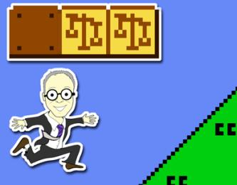
Rights of Copyright Owners 2
& Users Rights
Talk 4
LAW 422 001
Intellectual Property Law
Allard School of Law, UBC
Fall, 2023
Jon Festinger K.C.
QMUL School of Law (CCLS)
Whiteboard Law
https://iplaw.allard.ubc.ca/

Slide 2
Logistics

Slide 3
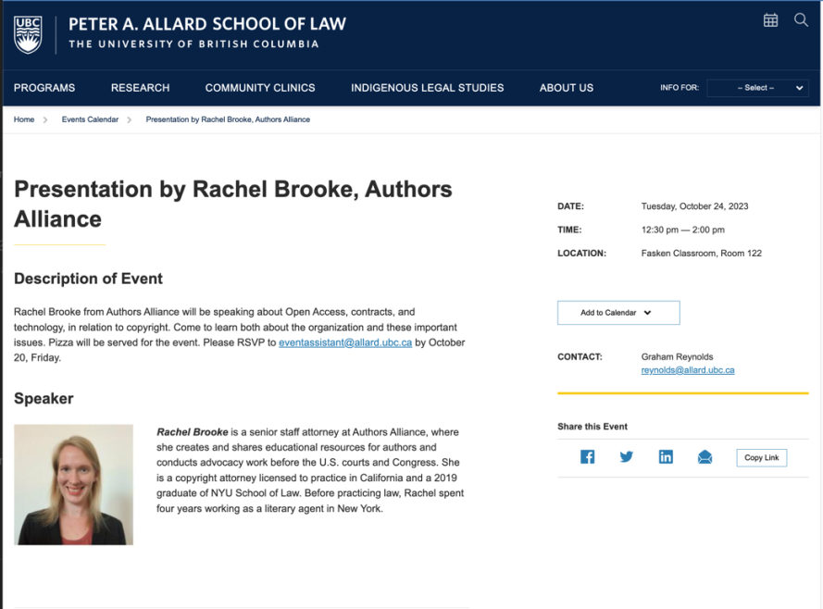

Slide 4
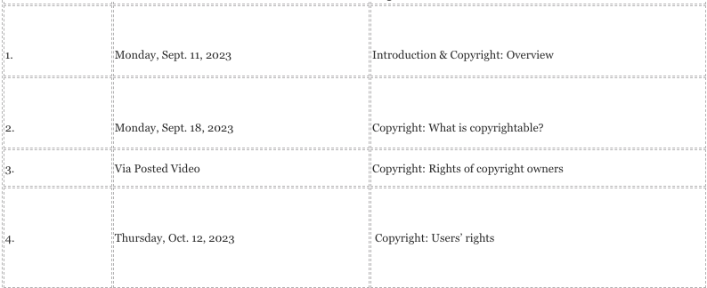
Uh-Oh!!!

Slide 5
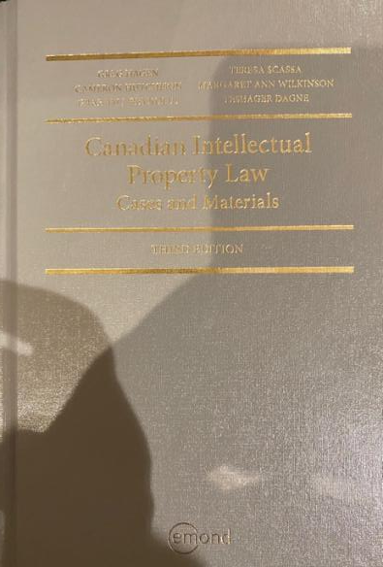
Text @ UBC Bookstore

Slide 6
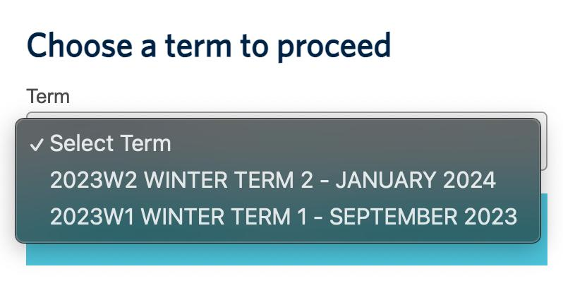

Slide 7
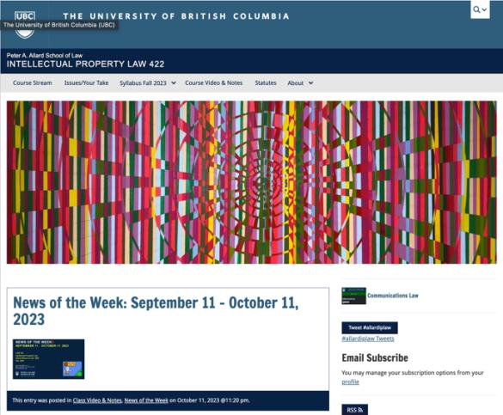
Course Website
https://iplaw.allard.ubc.ca/

Slide 8
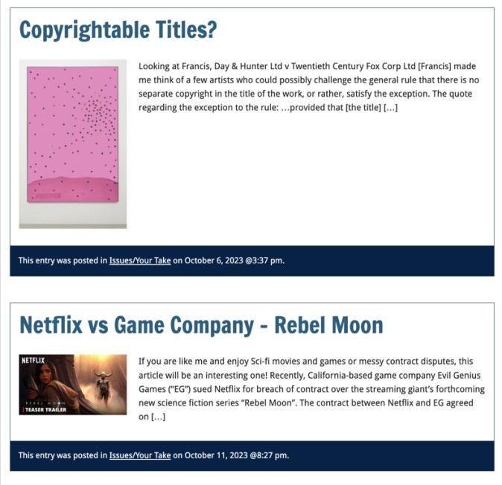

Slide 9
PLEASE
SIGN UP

Slide 10
For full privileges on the website
1. Please create an account at http://cms.ubc.ca/ using your CWL.
2. Once you create an account and sign in at http://cms.ubc.ca/ you can click your name in the top right. Halfway down the following page will be your WordPress email address.
3. Send me your WordPress email address at jon.festinger@ubc.ca or at jon_festinger@thecdm.ca
4. Then, I will invite you to participate with authoring privileges via your WordPress email address.

Slide 11


Slide 12



Adding Images

Slide 13




Slide 14

Adding Links

Slide 15



Slide 16



Adding a “Featured Image”

Slide 17



Slide 18
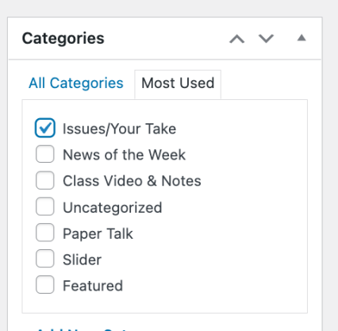

Setting Categories

Slide 19
Thank you for
your bios. & favorite I.P.’s
Much appreciated.

Slide 20
Past Presentations mostly all on the course website…

Slide 21
The 10%
Participation is broadly defined includes any or all:
class contributions however made
website contributions
email or other discussions with Instructor

Slide 22

Anything & everything can be done via email if you prefer

Slide 23
QUESTIONS?
THOUGHTS?
DISCUSSION?

Slide 24

Pause

Slide 25


Slide 26
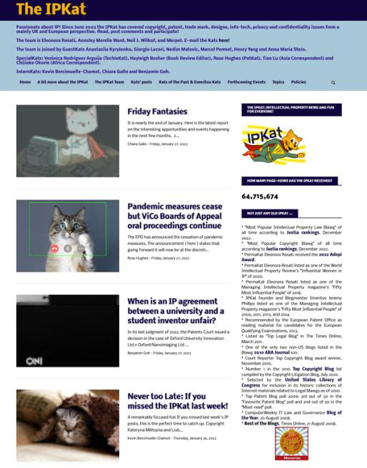

Slide 27
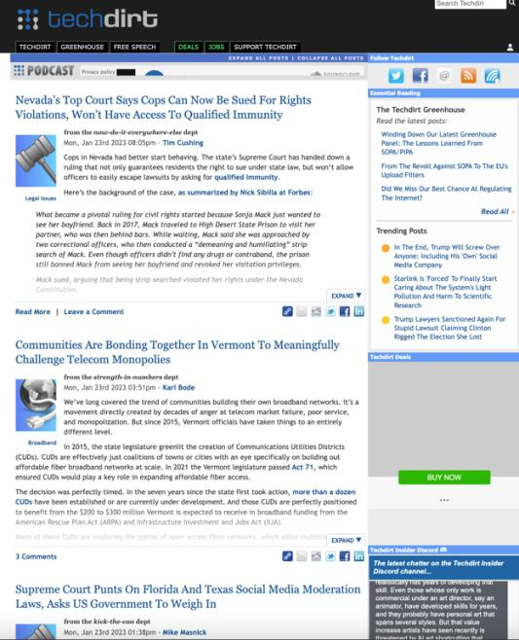

Slide 28
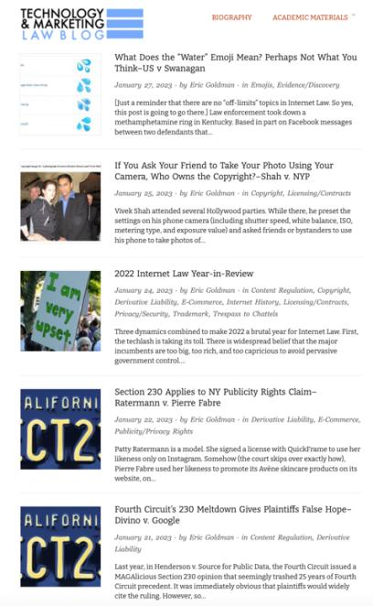

Slide 29
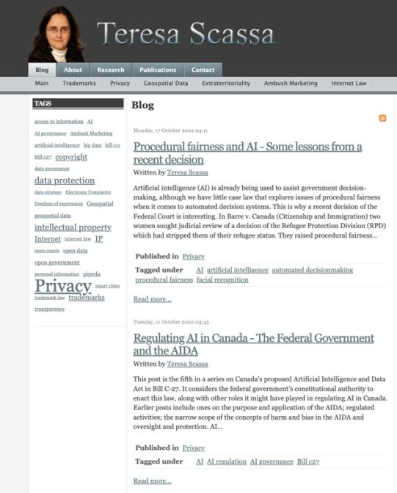

Slide 30
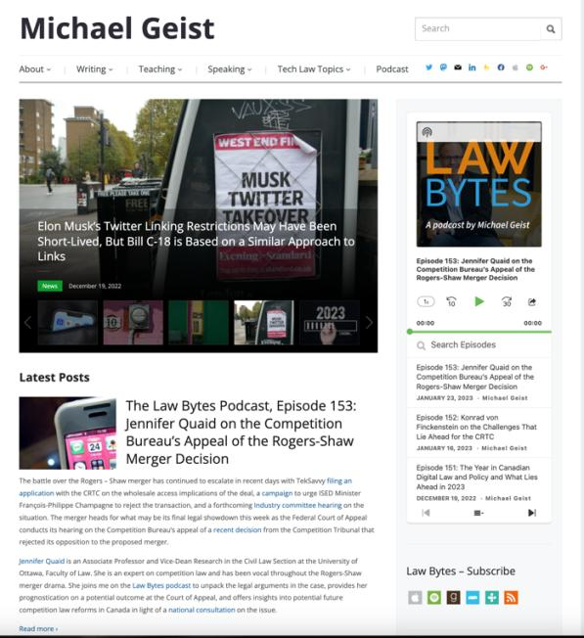

Slide 31
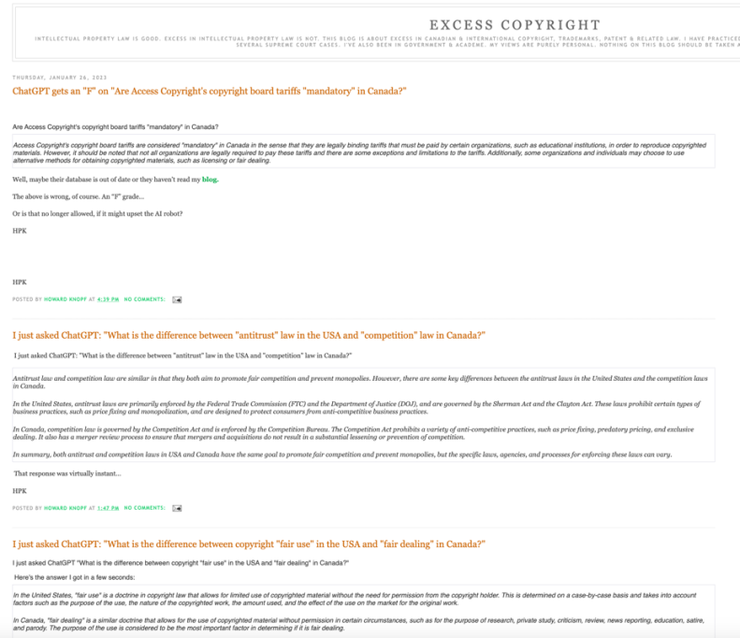

Slide 32
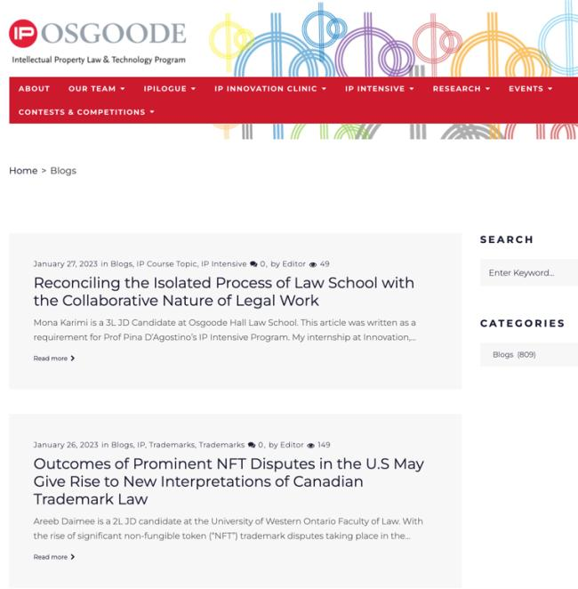

Slide 33
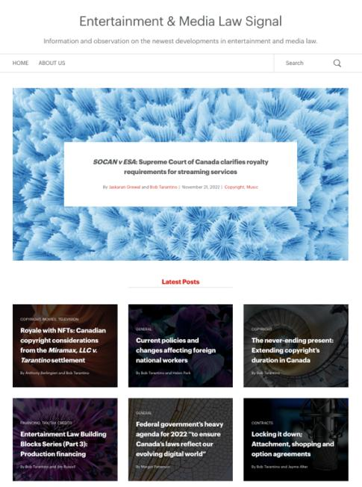

Slide 34
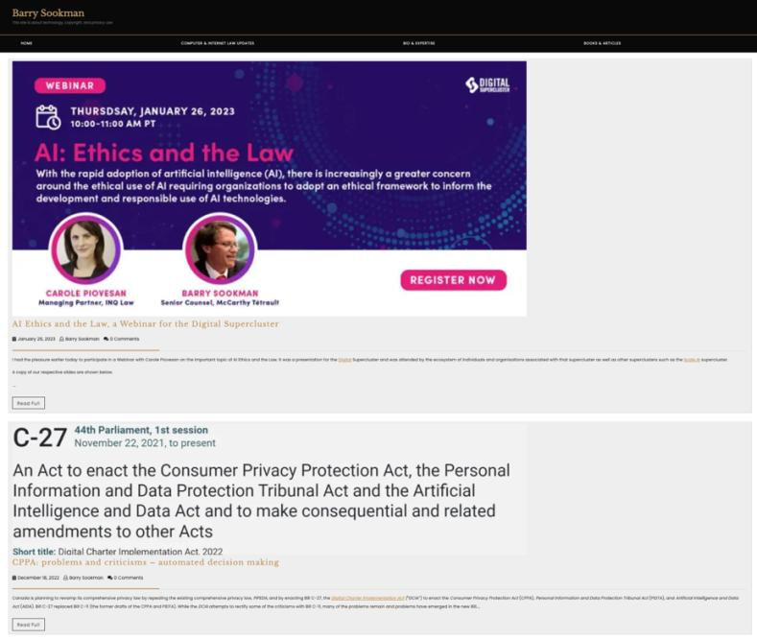

Slide 35


Slide 36
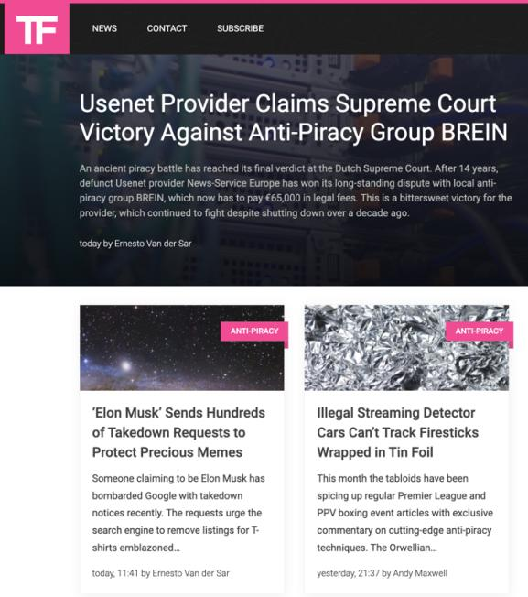

Slide 37
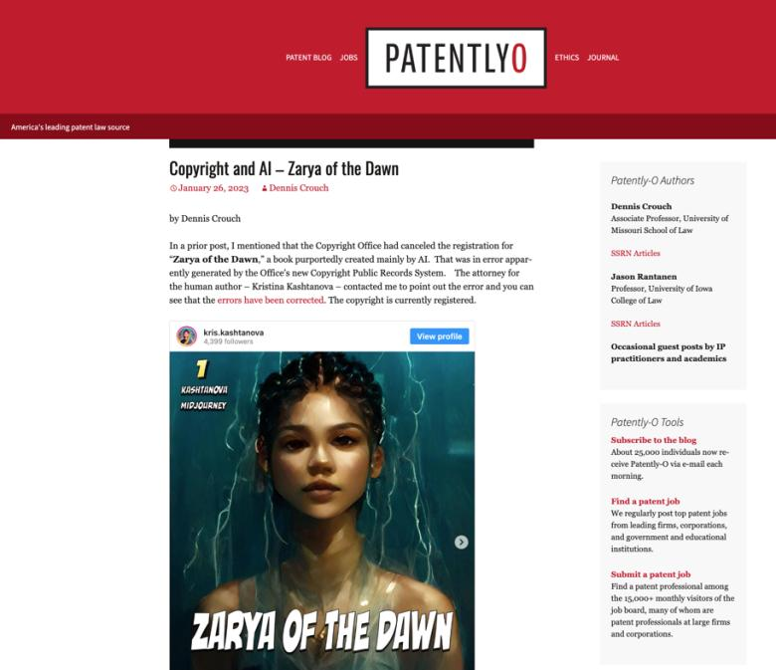

Slide 38
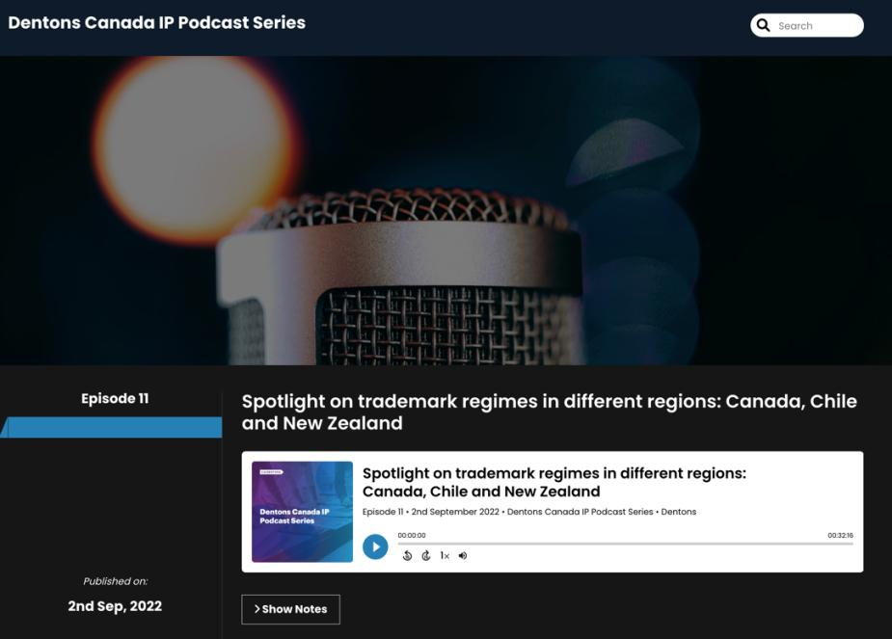

Slide 39
QUESTIONS?
THOUGHTS?
DISCUSSION?

Slide 40
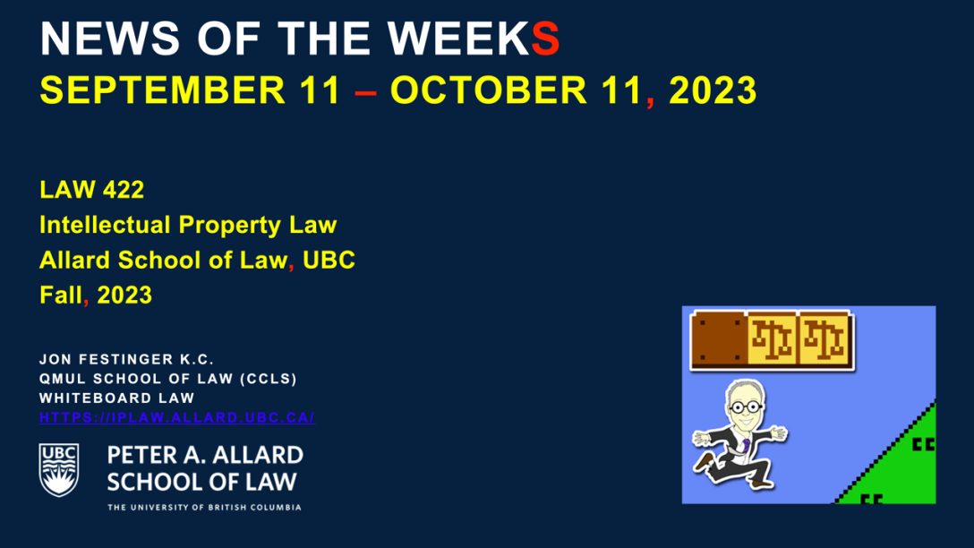

Slide 41
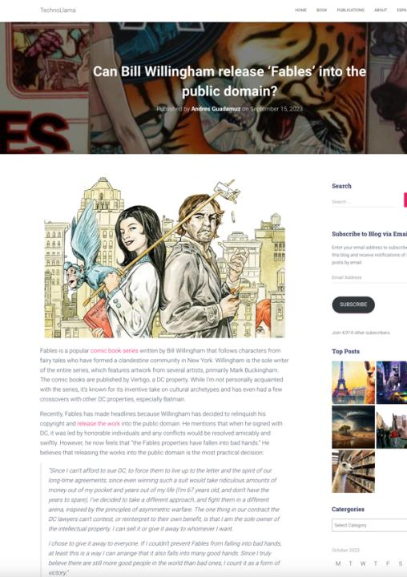

Slide 42
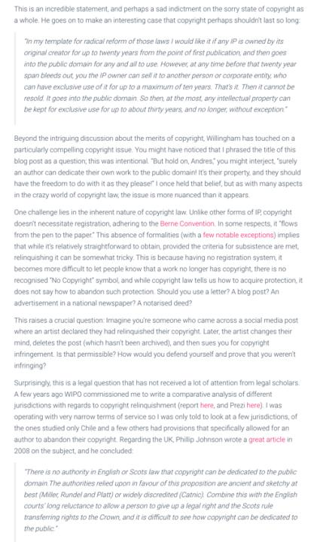

Slide 43
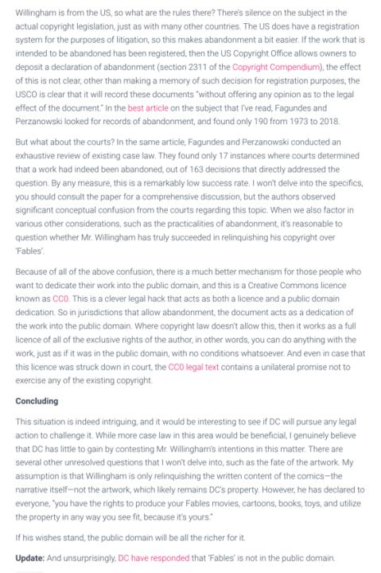

Slide 44
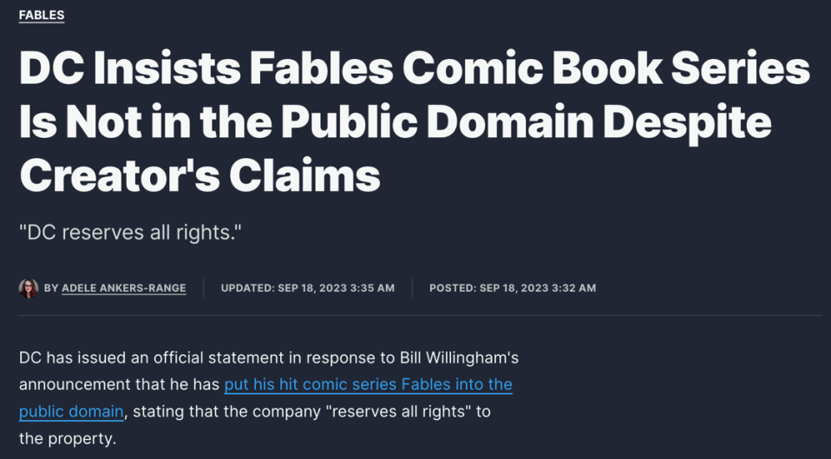
DC Response

Slide 45
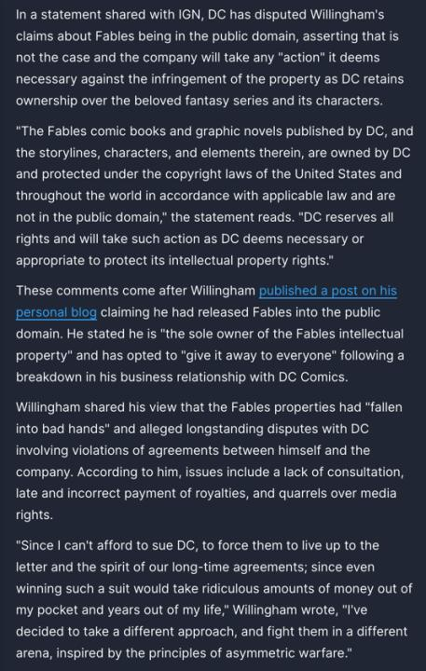

Slide 46
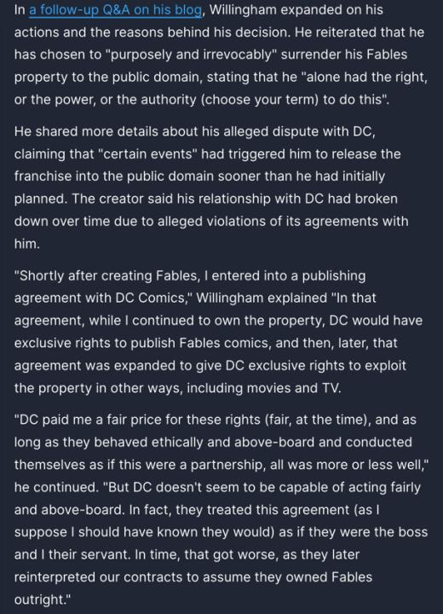

Slide 47
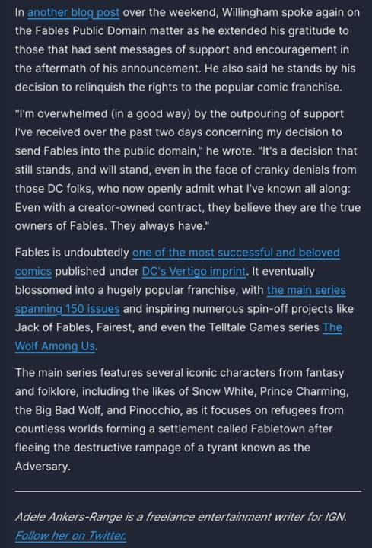

Slide 48


Slide 49
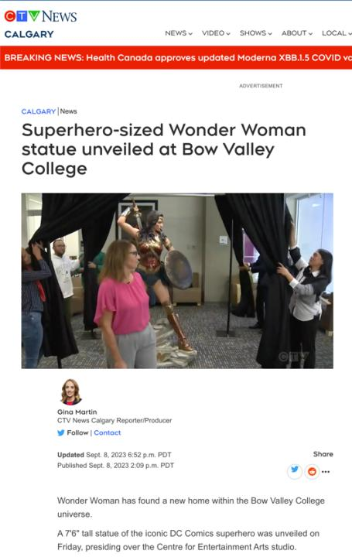

Slide 50
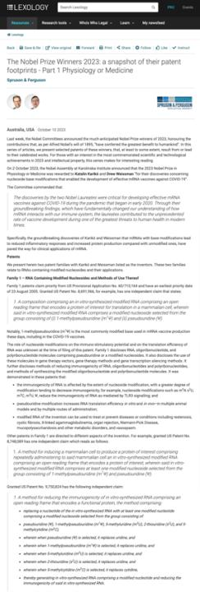

Slide 51
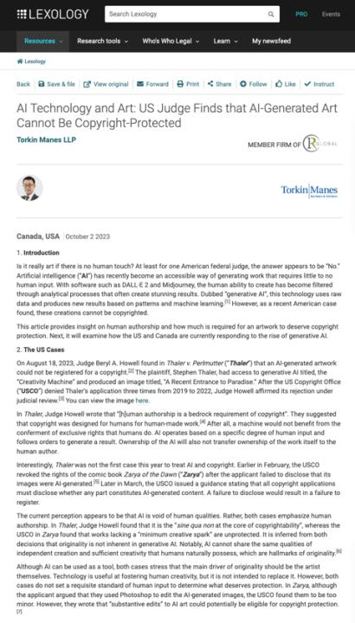

Slide 52
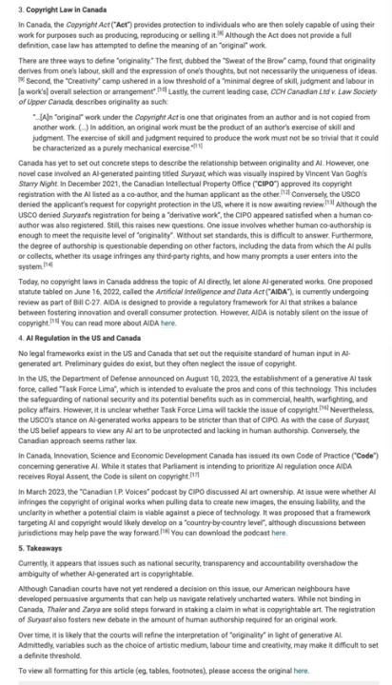

Slide 53
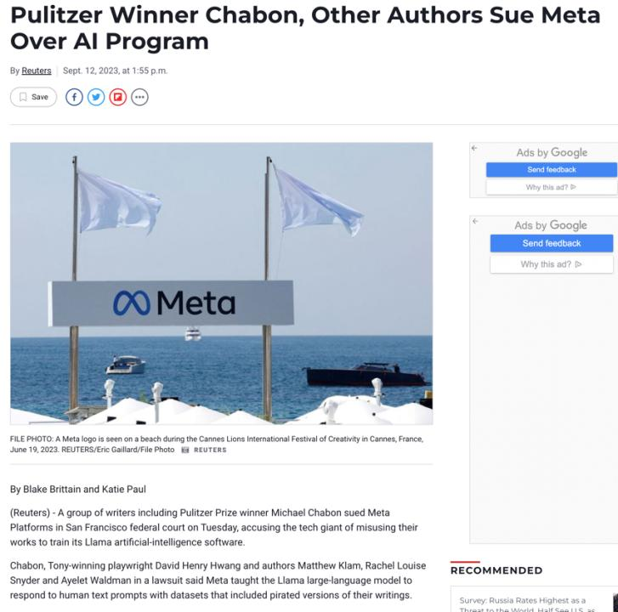

Slide 54
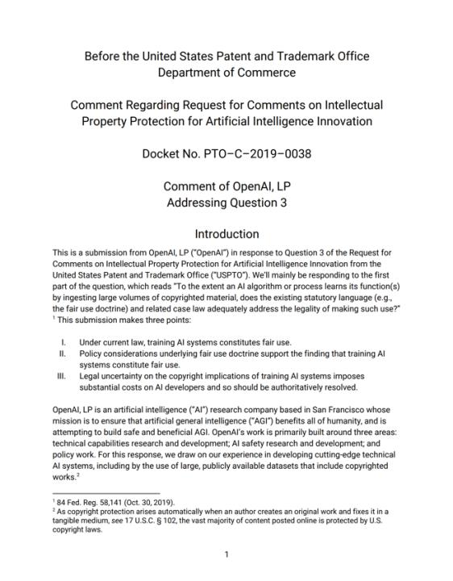

Slide 55
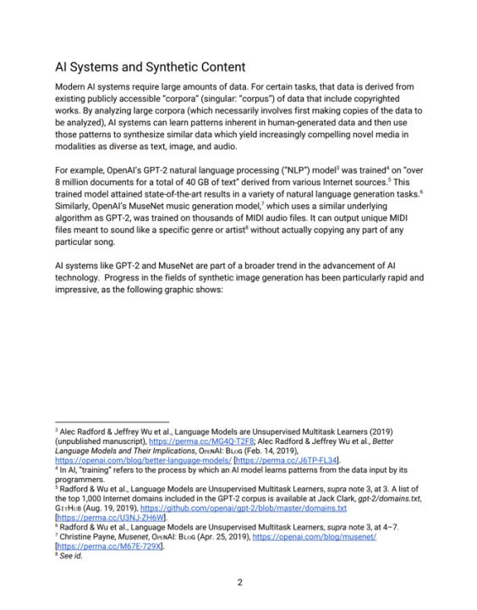

Slide 56
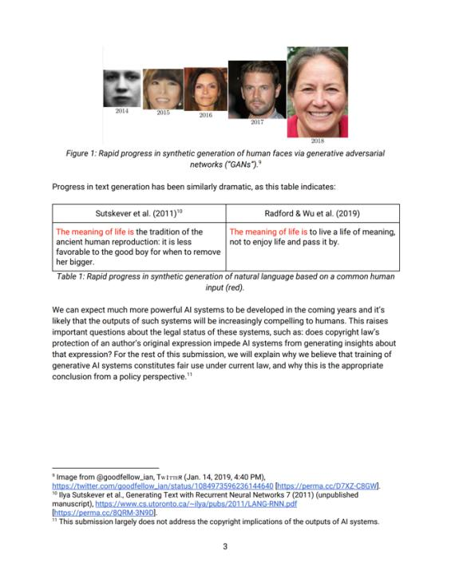

Slide 57
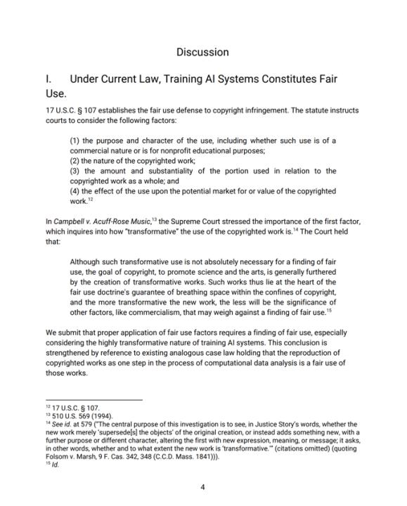

Slide 58
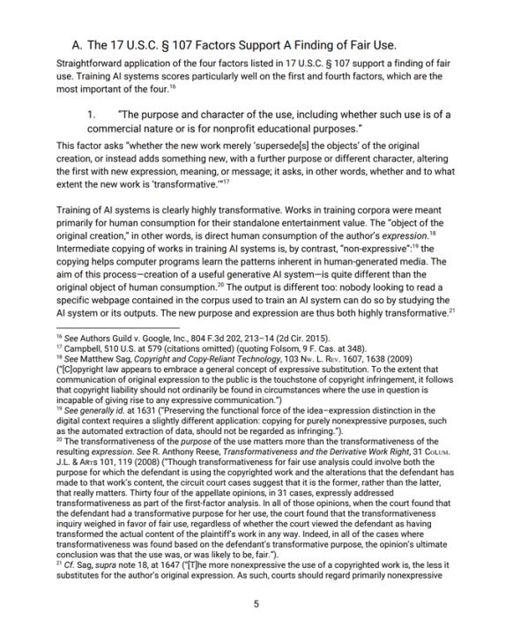

Slide 59
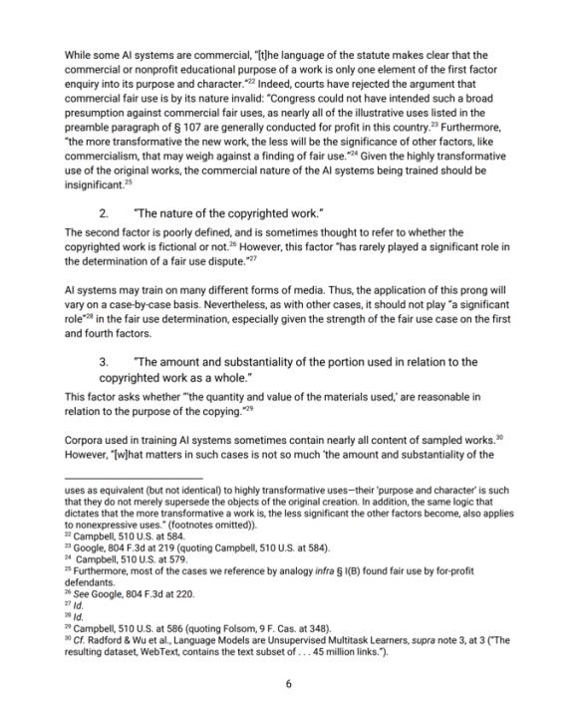

Slide 60
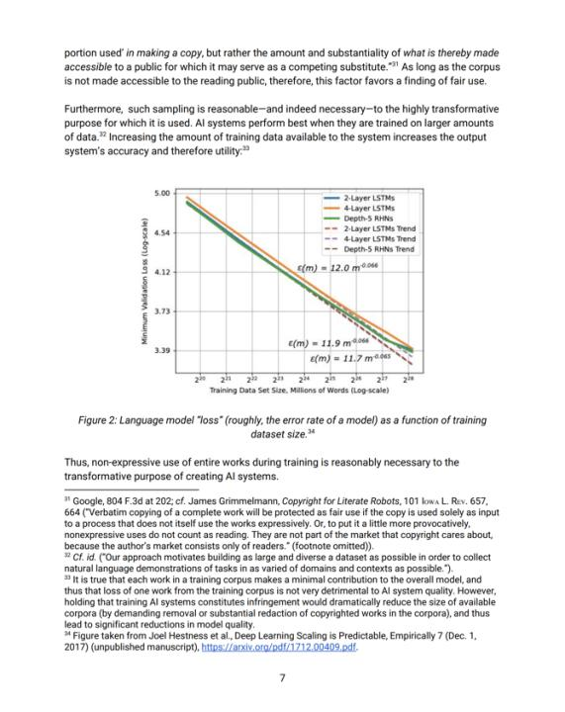

Slide 61
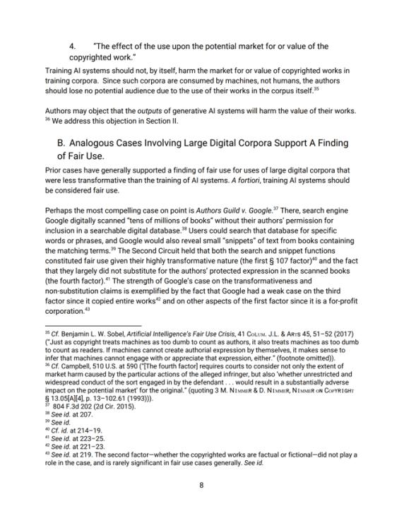

Slide 62
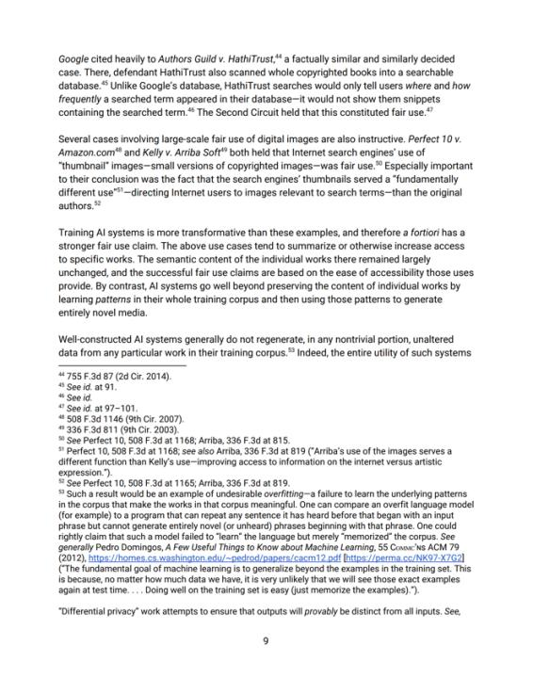

Slide 63
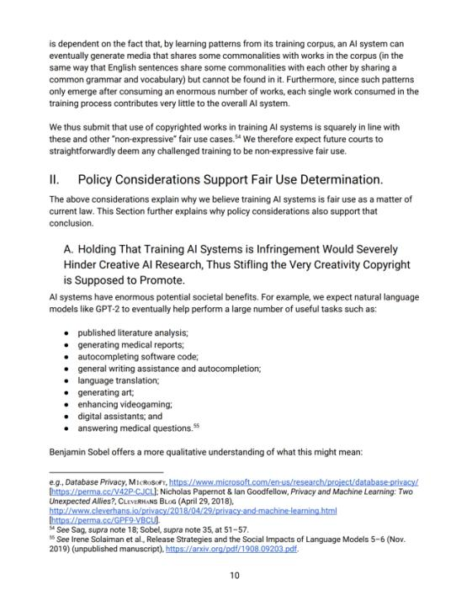

Slide 64
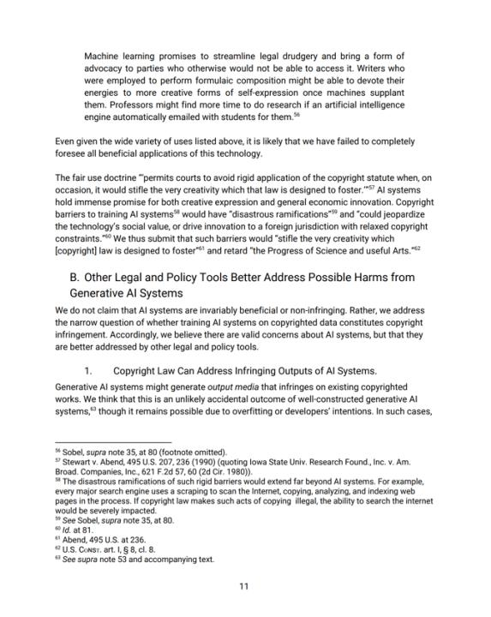

Slide 65
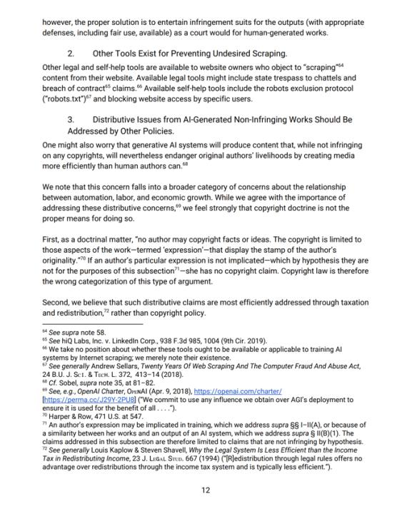

Slide 66
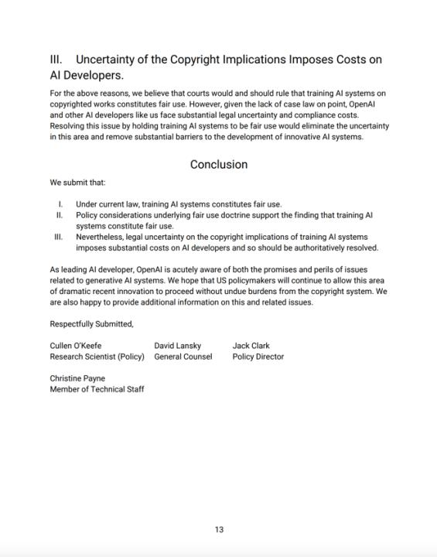

Slide 67
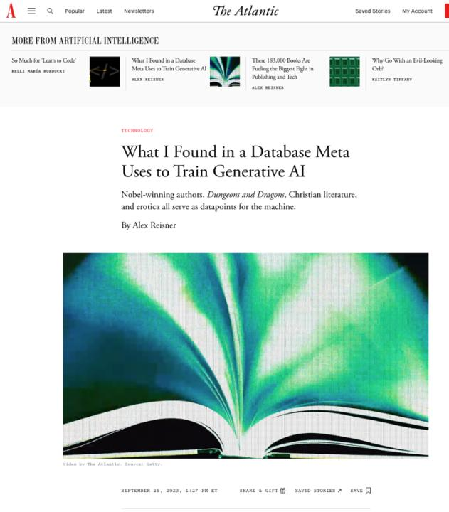

Slide 68
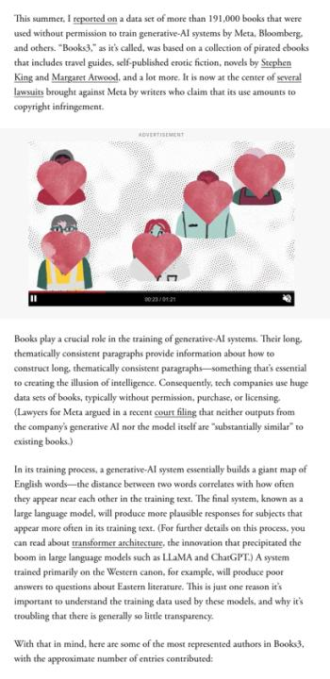

Slide 69
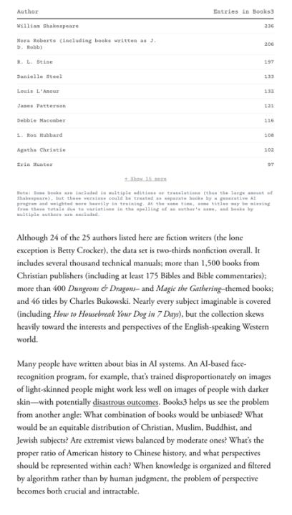

Slide 70
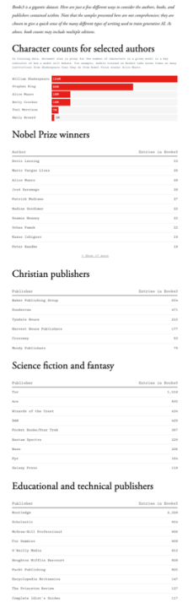

Slide 71


Slide 72


Slide 73


Slide 74


Slide 75


Slide 76


Slide 77



Slide 78


Slide 79


Slide 80
QUESTIONS?
THOUGHTS?
DISCUSSION?

Slide 81

Follow-Up: Facts Are Not Copyrightable
Fact Adjacent Issues…

Slide 82


Slide 83


Slide 84


Slide 85


Slide 86


Slide 87
QUESTIONS?
THOUGHTS?
DISCUSSION?

Slide 88
Follow-Up:
History of
A.I.I.P.

Slide 89
Broadly, three sperate questions
Can an A.I. independently own I.P. it has created? This is effectively a “Robot’s Rights” issue and is for practical purposes remote from this course.
Does a work built or created by an A.I./Robot qualify for copyright or patent protection? This very much a live issue being debated in various jurisdictions.
What are the practical risks of A.I./Robot creation (which due to computational power can generate almost unlimited permutations very efficiently) on I.P. Law, if any?

Slide 90
So far?...
“What’s clear in AI is that
The ‘A’ is the computer
and the ‘I’ is a human”

Slide 91


Slide 92
A.I. & Copyright
In CCH Canadian Ltd. v. Law Society of Upper Canada, 2004 SCC 13 McLachlin C.J. speaking to the standard of originality required for copyright stated:
  ”I conclude that the correct position falls between these extremes. For a work to be “original” within the meaning of the Copyright Act , it must be more than a mere copy of another work. At the same time, it need not be creative, in the sense of being novel or unique. What is required to attract copyright protection in the expression of an idea is an exercise of skill and judgment… This exercise of skill and judgment will necessarily involve intellectual effort.”
Query: Is any A.I. capable of judgment or intellectual effort or just their metaphorical cousin prediction?

Slide 93


Slide 94

Question was: “Can Tencent have a copyright
in works generated by it’s A.I.?”

Slide 95


Slide 96


Slide 97


Slide 98
“The universe (which others call the Library) is composed of an indefinite and perhaps infinite number of hexagonal galleries, with vast air shafts between, surrounded by very low railings. From any of the hexagons one can see, interminably, the upper and lower floors. The distribution of the galleries is invariable.”

Slide 99


Slide 100


Slide 101


Slide 102

https://youtu.be/YGdMTLgU4hE

Slide 103
Monopoly in I.P. (especially in patents, particularly in drug patents) is a “thing”.
What of monopoly in I.P. through A.I. (Artificial Intelligence)?

Slide 104


Slide 105


Slide 106


Slide 107

Core of the Issue

Slide 108


Slide 109


Slide 110


Slide 111


Slide 112


Slide 113
Solution?...
Doctrine of Independent Creation
To show infringement of copyright two elements must be present:
there must be sufficient objective similarity between the infringing work and the copyright work (or a substantial part of it).
the copyright work must be the source from which the infringing work was derived. Independent creation is a defence so long as there was no access to the copyright work or copying.

Slide 114
QUESTIONS?
THOUGHTS?
DISCUSSION?

Slide 115


Slide 116

Where we have been…

Slide 117

“Copyright Law Review to Date”

Slide 118

Overview of copyright
Definition of copyright:
  Set of exclusive rights in works of expression; performers’ performances; sound recordings; and communication signals.
The Clash, Chateau Neuf, Oslo, Norway
21 May 1980 Helge Øverås

Slide 119
Purpose of copyright in Canada?
Théberge:
  “[12] Generally speaking, Canadian copyright law has traditionally been more concerned with economic than moral rights.… The economic rights are based on a conception of artistic and literary works essentially as articles of commerce.” (Binnie J.)
But Cinar Corp. v. Robinson?
  [114] … the infringement of copyright in this case interfered with Robinson’s personal rights to inviolability and to dignity, recognized by ss. 1 and 4 of the [Quebec] Charter. (McLachlin CJ)

Slide 120
Overview of copyright
Purpose of copyright as articulated by the SCC
  Former approach: “author-centric”
  Shift in Théberge
    “balance between promoting the public interest in the encouragement and dissemination of works of the arts and intellect and obtaining a just reward for the creator“ (para. 30)
  Refined in Cinar Corporation v. Robinson, 2013 SCC 73
    Copyright Act “seeks to ensure that an author will reap the benefits of his efforts, in order to incentivize the creation of new works” (para. 23)

Slide 121
What is copyrightable
Originality in Canada
Pre-2004
  “Sweat of the brow”:
    Work receives copyright protection if it originates from an author and is more than a mere copy.
  “Creativity”
    A work must be the product of creativity in order to be original

Slide 122
What is copyrightable
Facts and ideas
  Not entitled to copyright protection
  Kenrick & Co. v. Lawrence & Co. (1890)
    How is idea separated from expression in this decision?

Slide 123
What is copyrightable: Artistic Works
5. (1) Subject to this Act, copyright shall subsist in Canada, for the term hereinafter mentioned, in every original literary, dramatic, musical and artistic work if…

Slide 124
S. 2 Definitions
literary work includes tables, computer programs, and compilations of literary works; (oeuvre littéraire)
dramatic work includes
(a) any piece for recitation, choreographic work or mime, the scenic arrangement or acting form of which is fixed in writing or otherwise,
(b) any cinematographic work, and
(c) any compilation of dramatic works; (oeuvre dramatique)
musical work means any work of music or musical composition, with or without words, and includes any compilation thereof; (oeuvre musicale)
artistic work includes paintings, drawings, maps, charts, plans, photographs, engravings, sculptures, works of artistic craftsmanship, architectural works, and compilations of artistic works; (oeuvre artistique)

Slide 125

What is copyrightable
FWS Joint Sports Claimants v. Canada 1991 FCA (CB)
No copyright in a sporting event per se though television production of a sporting event is copyrightable
Unpredictable and incompatible with the notion of a choreographic piece of art?

Slide 126
Copyrighting Data?
Geophysical Service Incorporated v. Encana Corporation, 2016 ABQB 230
It appears from the case that is not the raw data that is copyrightable as those would simply be facts, but how the data is presented.
  “[76] I find the seismic sections, i.e. the squiggly or zebra lines, fit within the definition of an artistic work, similar to a map, plan or chart, or a compilation of an artistic work, since the product is the result of selection or arrangement of the data, or sound recordings, from the geology of the subsurface.”
Do you agree? Alta. C.A. confirmed & SCC denied leave.

Slide 127


Copyrightable?

Slide 128

Dance & choreography is very challenging area in practical terms

Slide 129

What is copyrightable
Is a fireworks display a dramatic work?

Slide 130


Slide 132


Slide 133

Begging the question…
Is John Cage’s 4’33” a musical work?

Slide 134
Rights of the copyright owner
Three fundamental rights:
Produce or reproduce
the work (3(1))
Perform the work
(including broadcasting rights) (3(1))
The right to publish (3(1))

Slide 135
Rights of the copyright owner
Produce … any translation (3(1)(a))
Convert dramatic work into non-dramatic work (3(1)(b)
Convert non-dramatic work into dramatic work (3(1)(c))
To make a sound recording, etc. of a literary, etc. work (3(1)(d))
Reproduce, etc. a literary, etc. work as a cinematographic work (3(1)(e))
Communicate a work to the public by telecommunication (3(1)(f))
Present an artistic work at a public exhibition…. (3(1)(g))
Rent out a computer program, etc. (3(1)(h))
Rent out a sound recording of a musical work … (3(1)(i))
Sell or transfer ownership of tangible object … (3(1)(j)
Authorize any of above acts (3(1))

Slide 136
Rights of the copyright owner
For how long should these
rights last?
What should be the term of
copyright?

Slide 137
Options:
1. The Statute of Anne 1710 (UK) gave a limited term of protection to works of 28 years.
2. The Copyright Act 1842 (UK), for which a number of prominent authors lobbied, increased the term of protection to 42 years from publication, or seven years beyond the death of the author, whichever was the longer.
3. Berne Convention – life of the author plus 50 years.
4. USA approach: life of the author plus 70 years. Canada has until Jan. 2023 to adopt under CUSMA.
5. Renewable every 20 years (infinitely).
6. Renewable every 20 years (to a maximum).
7. Perpetual.

Slide 138
Rights of the copyright owner
Term of copyright in Canada (ss. 6-12)
Anonymous or pseudonymous works
  70 years from end of the year in which the work was published; or 75 years from the end of the year in which it was made (whichever ends earlier) (s. 6.1)
Crown
  70 years from end of the calendar year in which the work is first published (s. 12)

Slide 139
Amusements Wiltron Inc. v. Mainville (1991) RJQ 1930, 40 CPR 3d 521 (Que SC)
Courts apply similar criteria for distinguishing employees from independent contractors in the copyright context as they do for other areas of law (e.g., tax law)
In the copyright context, courts normally consider four factors to determine whether someone is an employee or an independent contractor:
  (1) ownership of the tools,
  (2) control or direction (relationship of subordination),
  (3) whether the author assumes all or part of the business risk (loss of profit), and
  (4) the degree of integration of the author into the business of the employer

Slide 140
Rights of the copyright owner
Who owns the rights? (ss. 13, 14)
ss. 13(4), 13(7): assignments, exclusive licences need to be in writing; non-exclusive licences don’t need to be in writing (Robertson v. Thomson)
Benefit of copyright registration: If an assignment or licence not registered, and the assignor or licensor subsequently assigns or licences the copyright interest – for valuable consideration – to a different assignee or licensee who didn’t have ACTUAL NOTICE of the prior assignment – the prior assignment/licence can be declared void (57(3)). So, if you’re an assignee, licensee – it is to your benefit to register the assignment of copyright or the licence granting you an interest (57(1)).

Slide 141
Rights of the copyright owner
Who owns the rights? (ss. 13, 14)
s. 14: reversionary interest - where an author has been the first owner of copyright in a work, even though they’ve transferred that interest during their lifetime, the copyright interest will revert to the author’s estate 25 years after the death of the author.

Slide 142
Copyright in works
3 (1) For the purposes of this Act, copyright, in relation to a work, means the sole right to produce or reproduce the work or any substantial part thereof in any material form whatever, to perform the work or any substantial part thereof in public or, if the work is unpublished, to publish the work or any substantial part thereof, and includes the sole right (to)…

Slide 143
Rights of the copyright owner
Reproduction of “broadcast incidental copies”
CBC v. SODRAC 2003 Inc. [2015] 3 SCR 615
Should every instance of copying be considered to infringe the “reproduction” right?
Rothstein J. (majority):
  SCC’s understanding of the purpose of copyright has evolved; principle of technological neutrality now recognized to be a core copyright principle …
  But these principles don’t override express statutory terms.
  Broadcast-incidental copying activities engage the reproduction right
Abella J.’s dissent suggested Rothstein J. inappropriately “employs a literal approach to the interpretation of s. 3(1)(d), reading the words of the provision without the benefit of the purpose and context of the Act to ascertain its true meaning.”

Slide 144
Copyright in works
3 (1) For the purposes of this Act, copyright, in relation to a work, means the sole right to produce or reproduce the work or any substantial part thereof in any material form whatever, to perform the work or any substantial part thereof in public or, if the work is unpublished, to publish the work or any substantial part thereof, and includes the sole right…

Slide 145
Rights of the copyright owner
What constitutes taking a “substantial part” of a work?
  Applies to all rights, not just reproduction
  Cinar Corp. v. Robinson (2013, SCC)
    Matter of fact and degree; flexible notion
    Standard of review
    Decided by quality rather than quantity
    Q: “do the copied features constitute a substantial part of the plaintiff’s work?

Slide 146
“The issue of substantiality is one of mixed fact and law. Consequently, an appellate court should generally defer to the trial judge’s findings on substantiality, unless those findings are based on an error of law or palpable and overriding errors of fact”
“the cumulative effect of the features copied from the work must be considered, to determine whether those features amount to a substantial part of [the Plaintiff’s] skill and judgment expressed in [their] work as a whole.”
“A substantial part of a work is not limited to the words on the page or the brushstrokes on the canvas. The Act protects authors against both literal and non-literal copying, so long as the copied material forms a substantial part of the infringed work. “
“The need to strike an appropriate balance between giving protection to the skill and judgment exercised by authors in the expression of their ideas, on the one hand, and leaving ideas and elements from the public domain free for all to draw upon, on the other, forms the background against which the arguments of the parties must be considered.”

Slide 147
Pause

Slide 148

Now, continuing our regularly
scheduled programming…

Slide 149

Rights of the copyright owner
Right to perform a work in public
Where to draw the line between public and private?

Slide 150
S.3 Copyright Act
3 (1) For the purposes of this Act, copyright, in relation to a work, means the sole right to produce or reproduce the work or any substantial part thereof in any material form whatever, to perform the work or any substantial part thereof in public or, if the work is unpublished, to publish the work or any substantial part thereof, and includes the sole right
  (a) to produce, reproduce, perform or publish any translation of the work,…

Slide 151
Rights of the copyright owner
Right to perform a work in public
Canadian Admiral Corp. v. Rediffusion Inc., [1954] Ex. C.R. 382
  Did the Defendant Redifusion perform the work in public when it rediffused the football telecast to its subscribers in their homes, and their showrooms/sales offices?
  If the audience considered in relation to the owners of the copyright can properly be described as the owner’s ‘public’ or part of their ‘public’, then anyone who performs the work before that audience without the consent of the author would be infringing their copyright (Jennings v. Stephens)

Slide 152
Rights of the copyright owner
Right to perform a work in public
Canadian Admiral Corp. v. Rediffusion Inc., [1954] Ex. C.R. 382
  Exception given where audience is not part of author’s public
  Main case is Jennings v. Stephens [1936] 1 All E.R. 228 & 413 where 600 workers listened to broadcast music in a factory. Held that everything depends on the character of the audience – Is the audience part of the copyright owner’s public? If the audience considered in relation to the owner of the copyright can properly be described as the owner's "public" or part of his "public," then anyone who performs the work before that audience without the consent of the author would be infringing his copyright.

Slide 153
Net Result
A performance in public means a performance to an audience which is not domestic or quasi domestic in character. The answer depends “solely upon the character of the audience” and factors such as whether visitors are present, whether an entrance fee is charged, or the number of people in the audience are not pre-determined.

Slide 154
Rights of the copyright owner
Right to perform a work in public
Canadian Admiral Corp. v. Rediffusion Inc., [1954] Ex. C.R. 382: Exception given where audience is not part of author’s public
  Other cases cited: Duck v. Bates (1884)
    Play performed to nurses, attendants, doctors, students, some of their families at Guy’s Hospital. It was held to be a domestic or quasi-domestic performance – not a performance in public.
    Could argue that Duck defines Performance In Public in a more narrowly than does Jennings

Slide 155
Rights of the copyright owner
Right to perform a work in public
Canadian Admiral Corp. v. Rediffusion Inc., [1954] Ex. C.R. 382
  Even 1M private performances does not constitute performance in public
  Rediffusion (cable) to private homes not in public.
Berri Street showroom however was open to the public. Nothing of a domestic or quasi-domestic nature. As a result, it can be viewed as a performance in public.

Slide 156
Harms Inc. and Chappel & Co v. Martan’s Club (1927): Performance at the Embassy Club at which club members, potential members and some guests were present. Held to be a performance in public.
Performing Right Society Ltd. v. Hawthorn’s Hotel Ltd (1933): An orchestral trio played in the lounge of Hawthorn’s Hotel. In the lounge were several guests of the hotel, among others. This was a performance by the hotel orchestra in public – it was open to any members of the public who cared to be guests of the hotel – either by eating or dining there.
Performing Right Society Ltd v. Gillette Industries (1943): Defendants installed loudspeakers in their factory and broadcast music in various departments to about 600 workers. All strangers were excluded from the factory. Was in public.

Slide 157

Rights of the copyright owner
Right to perform a work in public
Canadian Cable Television Association v. Canada (Copyright Board), [1993] 2 F.C. 138
  Held that a radio or television broadcast does amount to a performance of the work in public
  In public = openly, without concealment, and to the knowledge of all
  But consistent w. s. 2.3 of the Copyright Act?

Slide 158
Rights of the copyright owner
Right to perform a work in public
Canadian Cable Television Association v. Canada (Copyright Board), [1993] 2 F.C. 138
  Reference to “early conflicting decision” (Rediffusion)
  Letourneau J.: “I would have thought on a mere common sense basis that when the Prime Minister of Canada addresses the nation, either from his home or his private office, and reaches the citizens in their homes by means of radio and television, he appears in public and performs in public. I would have been content to leave it at that had it not been for early conflicting decisions on this issue.”

Slide 159
Rights of the copyright owner
Right to communicate a work to the public by telecommunication (s. 3(1)(f))
TV
Radio
Online
“3 (1) For the purposes of this Act, copyright, in relation to a work, means the sole right to produce or reproduce the work or any substantial part thereof in any material form whatever, to perform the work or any substantial part thereof in public or, if the work is unpublished, to publish the work or any substantial part thereof, and includes the sole right
(f) in the case of any literary, dramatic, musical or artistic work, to communicate the work to the public by telecommunication,…”

Slide 160
Rights of the copyright owner
Right to communicate a work to the
public by telecommunication (s. 3(1)(f))
CCH Canadian v. LSUC (2004)
  Faxed transmissions of a single copy
  of a work to a single individual is not a
  communication to the public
  Emanated from a single point;
  & intended to be received at a single point

Slide 161
Rights of the copyright owner
Right to communicate a work to the public by telecommunication (s. 3(1)(f))
SOCAN v. CAIP (Tariff 22) 2004 SCC 45
Music industry brought an action seeking to compel Internet providers to pay a royalty to cover unauthorized copying by their subscribers.
  Q. 1:When does a communication to the public occur on the Internet?
  Q. 2: Who communicates in a copyright sense on the Internet?
  Q. 3: When does a communication on the Internet occur in Canada?

Slide 162
Rights of the copyright owner
Right to communicate a work to the public by telecommunication (s. 3(1)(f))
SOCAN v. CAIP (Tariff 22) 2004 SCC 45
  S. 2 Copyright Act definition of “telecommunication” …“means any transmission of signs, signals, writing, images or sounds or intelligence of any nature by wire, radio, visual, optical or other electromagnetic system;”

Slide 163
Q1:When does a communication to the public occur on the Internet?
Some content online content is accessible through “push” technologies (radio streams), other content is accessible through “pull” technologies.
Content is stored & cached on servers, and is only communicated to individuals when they access or “pull” it – when they access a stream that isn’t running constantly, download a file, etc.
So … when does a communication to the public occur?
The SCC decided that a telecommunication occurs on the internet at the point where the content is transmitted from the host server to the end user (each time that the content is transmitted).

Slide 164
Q2: Who communicates in a copyright sense on the Internet?
The person who communicates the work is the person who is the content provider – who uploads the work, creates the stream, posts the work
Do ISP’s (Internet Service Providers), as intermediaries, participate in the transmission of copyrighted works? Do they also communicate the work to the public? (Practical Ramifications → Deep Pockets $$$$$$$)
In answering SCC turned to s. 2.4(1)(b) – which states that participants in a telecommunication who only provide the “means of telecommunication necessary” (carriers) are deemed NOT to be communicators (follows Communications law doctrine of SEPARATION OF CONTENT FROM CARRIAGE).
Court noted that statute does not say intermediaries are engaged in communication BUT have a kind of immunity. RATHER it provides that intermediaries are deemed, for Copyright Act purposes, not to be communicating the work to the public at all. They are invisible.

Slide 165
Q3: When does a communication on the Internet occur in Canada?
Majority held Canada could exercise copyright jurisdiction in respect both of transmissions originating in Canada and transmissions originating abroad but received in Canada. This conclusion was said to be consistent with our general law as well as with national and international copyright practice. [Also consistent with many internet jurisdiction cases, many about defamation, of the time…until today]
But…this doesn’t mean “automatic copyright liability” on foreign content providers who communicate copyright works to Canadian end users. For copyright liability to be imposed on foreign content providers, there needs to be - in the context of a message or communication - a real and substantial connection.
Factors to be considered are situs of content provider, host server, intermediaries, end user

Slide 166
Rights of the copyright owner
Right to communicate a work to the public by telecommunication (s. 3(1)(f))
CWTA v. SOCAN (2008)
  Is the transmission of a musical ringtone to a cellphone a ‘communication to the public by telecommunication’?

Slide 167
Yes, it is. Court defines communication as – the passing of information from one person to another:
“A musical ringtone is information in the form of a digital audio file that is capable of being communicated. … The wireless transmission of a musical ringtone to a cellphone is a communication, whether the owner of the cellphone accesses it immediately in order to hear the music, or at some later time. … Communication completed once info is received.”
Next question: Is the communication by telecommunication of a ringtone from a wireless carrier’s website to a customer’s cell phone a communication to the public?
Court says yes.
FCA: If a wireless carrier were to transmit a particular ring-tone simultaneously to all customers who have requested it, that transmission would be a communication to the public. It would be illogical to reach a different result simply because the transmissions are done one by one, and thus at different times.]

Slide 168
Rights of the copyright owner
Right to communicate a work to the public by telecommunication (s. 3(1)(f))
ESA v. SOCAN (2012)
  Does the Copyright Act require a second royalty to be paid when games are downloaded as opposed to sold in stores?
  Conclusion: Internet delivery of copies of video games containing musical works does not constitute a communication to the public.

Slide 169
Entertainment Software Association v. Society of Composers, Authors and Music Publishers of Canada (Pentalogy case)
  Facts…
  Video games can be acquired several different ways. Buy the cartridge/disc in store. Have the game delivered mail/Amazon. Play online. Download a copy of the game (from STEAM etc.).
  Video games are composed of several different copyright works, including musical works.
  Reproduction royalties are paid for the use of music in video games. These royalties are negotiated before the game is distributed.
  Digital downloads (including subscriptions, digital full games, digital add-on content, mobile apps, social network gaming) started exceeding physical format sales in 2014.

Slide 170
Entertainment Software Association v. Society of Composers, Authors and Music Publishers of Canada (Pentalogy case)
  Issue is whether the Copyright Act requires a second royalty to be paid when games are downloaded as opposed to sold in store? A royalty is already paid to account for the reproduction of the musical work. However if a download of a video game is found to constitute a communication to the public by telecommunication IN ADDITION to a reproduction, then a second right would be engaged.
  Conclusion: SCC held that “the Internet delivery of copies of video games containing musical works” does not constitute a communication to the public – so doesn’t infringe s. 3(1)(f).

Slide 171
QUESTIONS?
THOUGHTS?
DISCUSSION?

Slide 172
Pause

Slide 173
Rights of the copyright owner
Right to communicate a work to the public by telecommunication (s. 3(1)(f))
ESA v. SOCAN (2012)
  Reasoning/arguments employed by majority to reach their conclusion
    Principle of technological neutrality
    Need for consistency with purpose of copyright (Théberge)
    Preserve traditional balance in digital environment (Craig)
    Alternative proposal inefficient
    Legislative history & debates
    Case law
    Historic distinction between rights of performance and those of reproduction

Slide 174
1) Concluding that a download of a video game should attract both a reproduction royalty and a communication tariff would “violate the principle of technological neutrality, which requires that the Copyright Act apply equally between traditional and more technologically advanced forms of the same media”
2) Concluding that a download of a video game should attract both a reproduction royalty and a communication tariff would be inconsistent with the purpose of copyright in Théberge – need to balance; also need to recognize that creators’ rights are limited.
3) The traditional balance between authors and users should be preserved in the digital environment (Carys Craig) / non-digital environment – get one royalty (reproduction); Should not get an additional royalty in the digital environment.
4) An alternative proposal – by Rothstein J. in dissent – to adjust the two fees between collective agencies – would be inefficient.

Slide 175
5) Legislative history shows that the right to communicate is historically connected to the right to perform a work – not to the right to download – or “reproduce permanent copies of the work”. Legislative debates support this interpretation
6) Case law supports this interpretation
  Which case did they point to 1968 decision … Composers, Authors and Publishers Association of Canada Ltd v. CTV Television Network Ltd
  Which case(s) was distinguished? SOCAN v. CAIP, CWTA v. SOCAN.
7) Copyright Board’s interpretation ignores the historic distinction between rights of performance; and rights of reproduction
  Performances are impermanent – don’t leave user with durable copy; Reproductions do leave users with durable copies.
SO – single activity of downloading – cannot and does not infringe two rights.

Slide 176
Rights of the copyright owner
Right to communicate a work to the public by
telecommunication (s. 3(1)(f))
Rogers Communications Inc. v. SOCAN 2012 SCC 35
  Does individual streaming, triggered by the
  individual actions of individual users,
  constitute “communication to the public” or a
  “private communication” ?

Slide 177
YES, IT IS
‘COMMUNICATION TO THE PUBLIC’
(despite what was said in CCH v. LSUC that transmission of a single copy to a single person isn’t a communication to the public - also think about it → CCH photocopy and fax facts are reasonably distinguishable)

Slide 178
Any other conclusion could lead to weird results: Would mean that sending 1 email to 100 people (on the “To:” line amounts to ‘communication to the public’; while sending separate emails to 100 people saying the same thing would not be communication to the public.

Slide 179
Rights of the copyright owner
Right to communicate a work to the public by telecommunication (s. 3(1)(f))
Rogers Communications Inc. v. SOCAN (2012)
Reasoning/arguments employed to reach conclusion
  CCH distinguished; ruling limited to facts
  Other conclusion would lead to arbitrary, inconsistent results.
  Language of s. 3(1)(f)
  Legislative history
  Balance in copyright
  Developments at international level

Slide 180
Rights of the copyright owner
Right to communicate a work to the public by telecommunication (s. 3(1)(f))
S. 2.4(1.1) (amended)
  For the purposes of this Act, communication of a work or other subject-matter to the public by telecommunication includes making it available to the public by telecommunication in a way that allows a member of the public to have access to it from a place and at a time individually chosen by that member of the public.

Slide 181

Cutting edge of issues argued over a year ago…
Does “on demand” streaming attract a copyright fee if never transmitted?

Slide 182

In this context…

Slide 183


Slide 184


Slide 185

Rights of the copyright owner
What modifications, if any, would
you make to the bundle of rights
available to copyright owners?

Slide 186
QUESTIONS?
THOUGHTS?
DISCUSSION?

Slide 187
Pause

Slide 188


Slide 189

1. MORAL RIGHTS
Sections 14.1 and 14.2 of the Copyright Act
Snow v. Eaton Centre

Slide 190
Sections 14.1 and 14.2 of the Copyright Act
  the right to the integrity of the work; &
  the right, where reasonable in the circumstances, to be associated with the work as its author by name or under a pseudonym and the right to remain anonymous.
Section 34.2 of the Copyright Act - remedies for infringement of moral rights include injunctions, damages, and delivery up.
Moral rights can be waived, but not transferred.
Cases:
Snow v. Eaton Centre Ltd., (1982) 70 C.P.R. (2d) 105 (Ont. H.C.J.)
Ritchie v. Sawmill Creek Golf & Country Club Ltd., (2004) 189 O.A.C. 282
Wiseau Studio, LLC et al. v. Harper et al. 2020 ONSC 2504

Slide 191
2. Orphan Works
Circumstances in which licence may be issued by Board
77 (1) Where, on application to the Board by a person who wishes to obtain a licence to use
  (a) a published work, (b) a fixation of a performer’s performance, (c) a published sound recording, or (d) a fixation of a communication signal
in which copyright subsists, the Board is satisfied that the applicant has made reasonable efforts to locate the owner of the copyright and that the owner cannot be located, the Board may issue to the applicant a licence to do an act mentioned in section 3, 15, 18 or 21, as the case may be.
(2) A licence issued…is non-exclusive and is subject to such terms and conditions as the Board may establish.
(3) The owner of a copyright may, not later than five years after the expiration of a licence issued pursuant to subsection (1) in respect of the copyright, collect the royalties fixed in the licence or, in default of their payment, commence an action to recover them in a court of competent jurisdiction….

Slide 192

https://videogamelaw.allard.ubc.ca/2014/11/14/viff-panel-disscussion/

Slide 193

3. Independent Creation Doctrine - Canada

Slide 194


Slide 195



Slide 196


Slide 197


Slide 198


Slide 199


Slide 200


Slide 201


Slide 202
63 Many of the detailed similarities, in my view, can be traced to the common store of folklore about primitive species with human characteristics upon which Lucas was as free to draw as were Preston and Hurry. Yet drawing upon a common store of information does not in itself answer to the claim of infringement. It is the expression of ideas, not the ideas themselves, that is the subject of copyright. It is entirely possible that two or more authors, composers, dramatists or other artists may draw upon a common store of information for ideas and each may have copyright in his or her expression of those ideas. But if while drawing upon the common information base, one should copy the expression in literary or dramatic form of another author copyright may be infringed.

Slide 203
4. Benefits of copyright registration
Registering copyright with the Canadian Intellectual Property Office (CIPO) entitles copyright holder to a registration certificate as official proof of ownership.
Creates a rebuttable presumption that copyright exists in the copyrighted work, and that the copyright registrant is the owner of the work.
This rebuttable presumption can be useful in litigation.

Slide 204
QUESTIONS?
THOUGHTS?
DISCUSSION?

Slide 205
Pause

Slide 207

Now…
“Rights of Non-Copyright Owners: Fair Dealing etc.”

Slide 208


What should non-copyright owners be allowed do with respect to copyrighted works?
Should you have the “right” to engage in a creative way with copyrighted works? What does this mean?

Slide 209
Users’ Rights

Slide 210
Users’ rights
Sequence of events in a copyright lawsuit
1) Unauthorized act occurs. Has an infringement prima facie occurred?
  27. (1) It is an infringement of copyright for any person to do, without the consent of the owner of the copyright, anything that by this Act only the owner of the copyright has the right to do.
2) Burden shifts to the Defense to establish a defense to copyright infringement.

Slide 211
Court needs to determine: Was something done that only the copyright owner has the right to do?
Reproduced a work in whole or in substantial part
Performed a work in public
Communicated a work to the public by telecommunication

Slide 212
Today: Two Defences to copyright infringement
Defence of public interest
Fair dealing

Slide 213
User rights: Public Interest Defence
Defence of public interest
R. v. Lorimer & Co. Ltd., [1984] 1 FC 1065
1. Crown published a report in 1981 entitled “The State of Competition in the Canadian Petroleum Industry.” 1748 pages. 7 volumes. $70 per set ($10 per volume).
2. Lorimer felt a condensed version “would enjoy good public distribution”. Lorimer sought permission to publish a condensed version of the report & was refused.
3.Nothing covert. Lorimer, ‘in his capacity as president of the Defendant company, wrote to the Minister of Supply and Services’ indicating that the Defendant company is ‘preparing … a version of the report for publication’, and that it was prepared to ‘pay to the Receiver General a royalty of eight per cent of the retail price on all copies sold’.
4. Lorimer’s abridged version was 626 pages and offered for $14.95.
5. Sold well. Crown sued for copyright infringement.

Slide 214
User rights: Public Interest Defence
Defence of public interest
R. v. Lorimer & Co. Ltd., [1984] 1 FC 1065
Defence of public interest argued – In the public interest that this information be disseminated as broadly as possible.
Court indicated that it has no doubt that a defence of public interest – as set out in the UK cases on which the Lorimer’s counsel relied – is available in proper circumstances against an assertion of Crown copyright.
But the facts don’t support the public interest defence here
  Great disclosure in report
  Free copies given out, put in libraries across the country
  No concern about the public not being informed
N.B. Act doesn’t mention “public interest”

Slide 215
User rights: Public Interest Defence
Defence of public interest
Lion Laboratories v Evans [1985] QB 526
Lion Laboratories manufactured and marketed the Lion Intoximeter which was used by the police for measuring blood alcohol levels of motorists.
Two ex-employees approached the Press with four documents taken from Lion.
Such reproduction was held to be justified, despite the nature of material, being confidential and protected by copyright.
Court agreed that the defence of public interest applied to the investigations regarding the accuracy of the equipment to avoid incorrect readings when used by the police on motorist.

Slide 216
Wrongdoing does not disqualify the public interest defence.
“I can see no sensible reason why this defence should be limited to cases in which there has been wrongdoing on the part of the plaintiffs.... No doubt it is in such circumstances that the defence will usually arise, but it is not difficult to think of instances where, although there has been no wrongdoing on the part of the plaintiff, it may be vital in the public interest to publish a part of his confidential information”

Slide 217
User rights: Fair Dealing
Fair dealing
Under fair dealing, individuals have the right to use a substantial part of another’s copyright-protected expression without that person’s permission, provided that the individual acts in furtherance of certain purposes, that the individual acts in a fair manner, and that - in some cases - certain attribution requirements are satisfied.
Broadest defence to copyright infringement set out in the Copyright Act.
If fair dealing is made out, an individual will not be found to have infringed copyright.
This defence exists in various forms in several jurisdictions – focus here is on the Canadian articulation of this defence.
We’ll start by looking at the language of the Copyright Act – and then we’ll look at how courts have interpreted these provisions.

Slide 218


Fair Dealing v. Fair Use

Slide 219

https://papers.ssrn.com/sol3/papers.cfm?abstract_id=3228052

Slide 220
Users’ rights: Fair Dealing
29. Fair dealing for the purpose of research, private study, education, parody or satire does not infringe copyright.

Slide 221
Fair Dealing: Criticism or Review
29.1 Fair dealing for the purpose of criticism or review does not infringe copyright if the following are mentioned:
(a) the source; and
  (b) if given in the source, the name of the (i) author, in the case of a work

Slide 222
Fair Dealing: News Reporting
29.2 Fair dealing for the purpose of news reporting does not infringe copyright if the following are mentioned:
(a) the source; and
  (b) if given in the source, the name of the (i) author, in the case of a work

Slide 223
Users’ rights: Fair Dealing
Eight fair dealing categories (exhaustive list)
No definition of “fair” in the Copyright Act, or of the fair dealing categories
For many years, fair dealing did not play a prominent role in copyright
During this time, fair dealing was interpreted restrictively
Why might this have been the case?

Slide 224


Slide 225



Slide 226


Slide 227
Eight fair dealing categories (exhaustive list)
Research
Private Study
Education
Parody
Satire
Criticism
Review
News reporting

Slide 228
Got to here

Slide 229
QUESTIONS?
THOUGHTS?
DISCUSSION?

Slide 230
Pause

Slide 231


Slide 232
Coming Soon
“MORE Rights of Non-Copyright Owners: Fair Dealing etc.”

Slide 233
SEE YOU NEXT WEEK!

Slide 234

Always include a cat picture

Slide 235
In learning you will teach
And in teaching you will learn
Phil Collins' Son of Man (1999)

