Slide 1
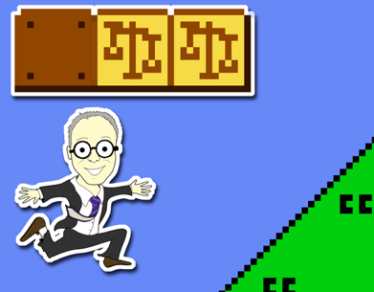
Intellectual Property Law: Introduction
Talk 1
LAW 422 001
Intellectual Property Law
Allard School of Law, UBC
Fall, 2023
Jon Festinger K.C.
QMUL School of Law (CCLS)
Whiteboard Law
https://iplaw.allard.ubc.ca/

Slide 2
Today’s Plan
1. What & Who
2. Introduction of subjects
3. Syllabus & Logistics
4. Exercise
5. Copyright Overview

Slide 3
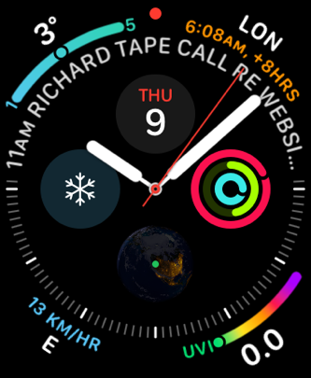
Yes, we will probably spend
the whole three hours…

Slide 4
Copyright
Trademark
Patents

Slide 5
Each with different (sometimes very different) public interest aspects

Slide 6
Intellectual Property Law is about:
What kinds of creations of the mind can one have rights in?
Who can have those rights?
What kinds of rights are there; and how are those rights enforced?

Slide 7
INTELLECTUAL (ok?) PROPERTY (really?)

Slide 8
Ch-Ch-Changes

Slide 9
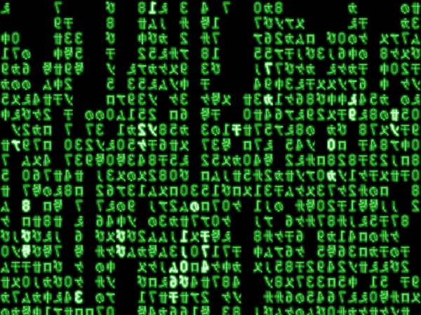
When everything is digitally fixated…

Slide 10
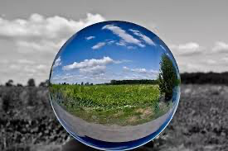
The Metaverse: Life through the digital lens

Slide 11
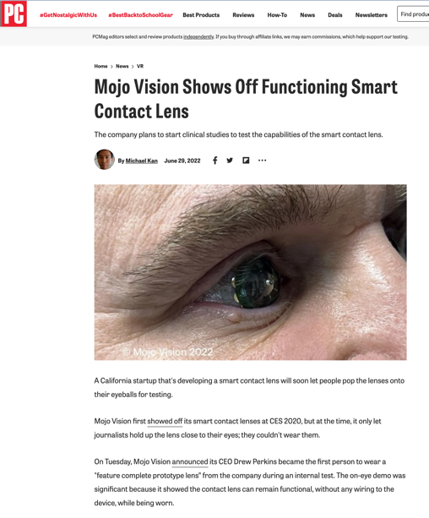
Essentially the exam question every year

Slide 12
Defenses to copyright infringement?
Temporary Reproductions for Technological Processes
30.71 It is not an infringement of copyright to make a reproduction of a work or other subject-matter if
(a) the reproduction forms an essential part of a technological process;
(b) the reproduction’s only purpose is to facilitate a use that is not an infringement of copyright; and
(c) the reproduction exists only for the duration of the technological process.

Slide 13
Without s.30.71 (Before 2012)
Fair Dealing (requires a category – education?)
Majority decision in Théberge v. Les Galleries d’Art du Petit Champlain Inc. [2002] 2 SCR 336
Technological neutrality doctrine of SCC
Canadian Admiral Corp. v. Rediffusion Inc. [1954] Ex. CR 382
Incidental Use/De Minimis? - S.30.7 Copyright Act
Retransmission, Network Services etc. (Copyright Act)
Contra
CBC v. SODRAC [2015] 3 S.C.R. 615

Slide 14
Thought Experiment: Trademarks
What is the essence of a brand?
What is the essence of a brand the metaverse?

Slide 15
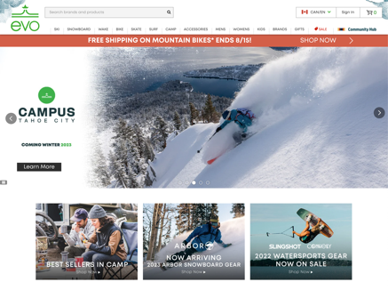
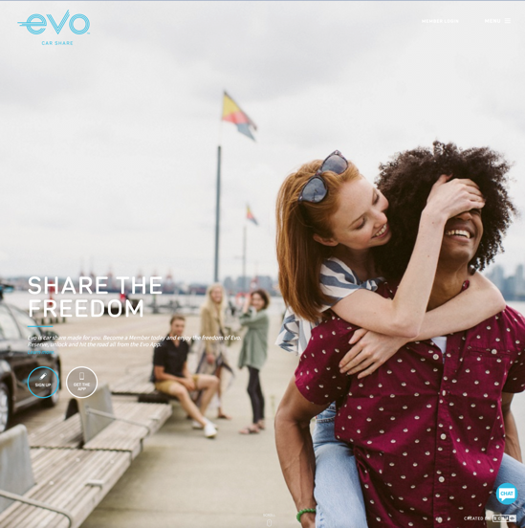
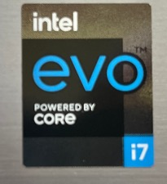

Slide 16
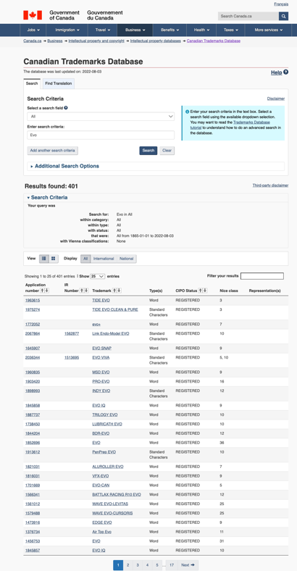

Slide 17
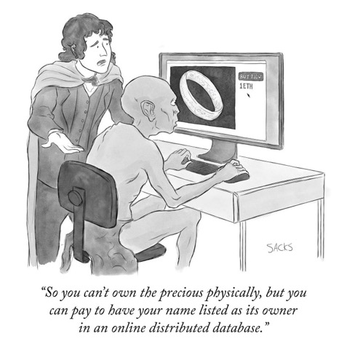
N.F.T.’s
Copyright or Trademark Issue?

Slide 18
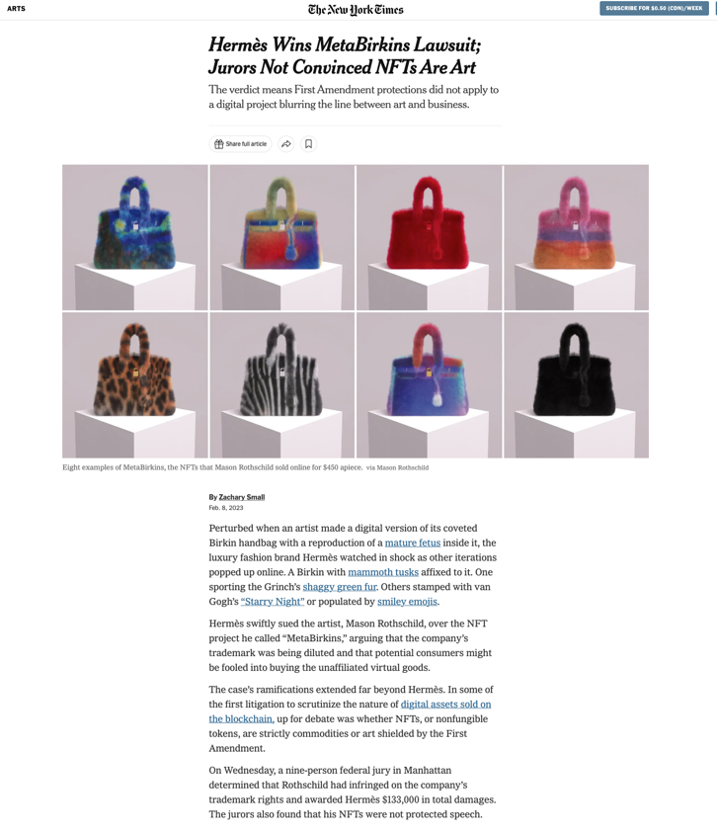

Slide 19
A.I.
Creation of the mind?

Slide 20
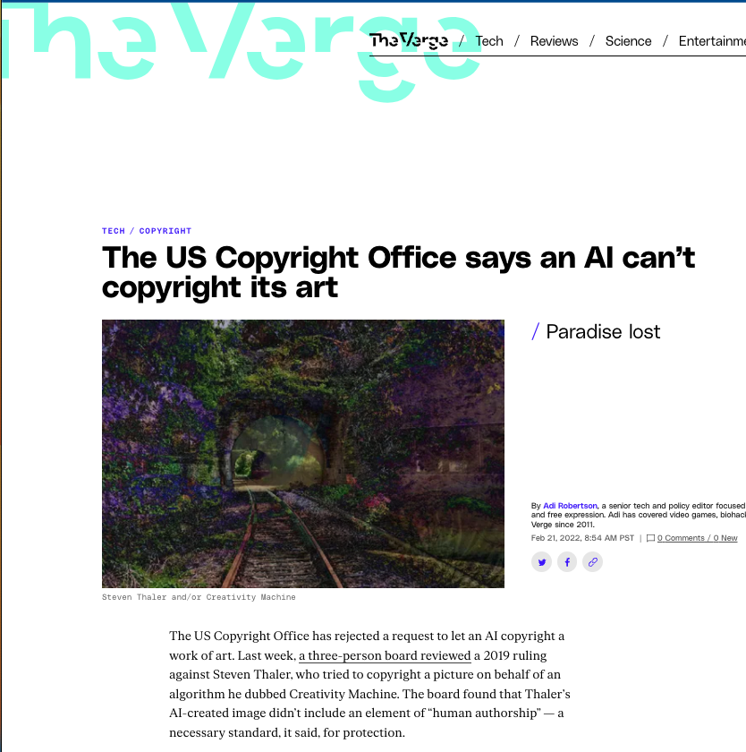

Slide 21
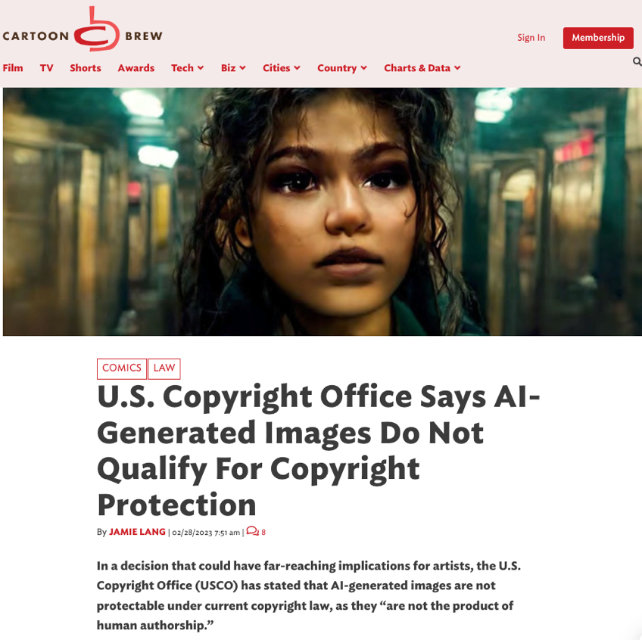

Slide 22
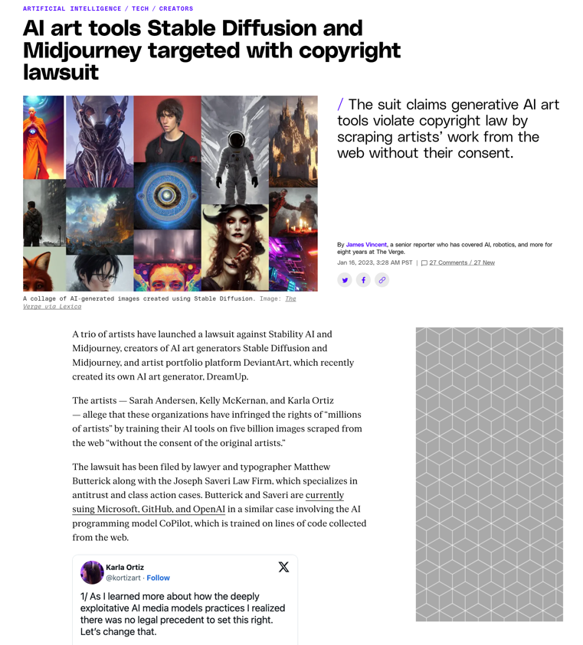

Slide 23
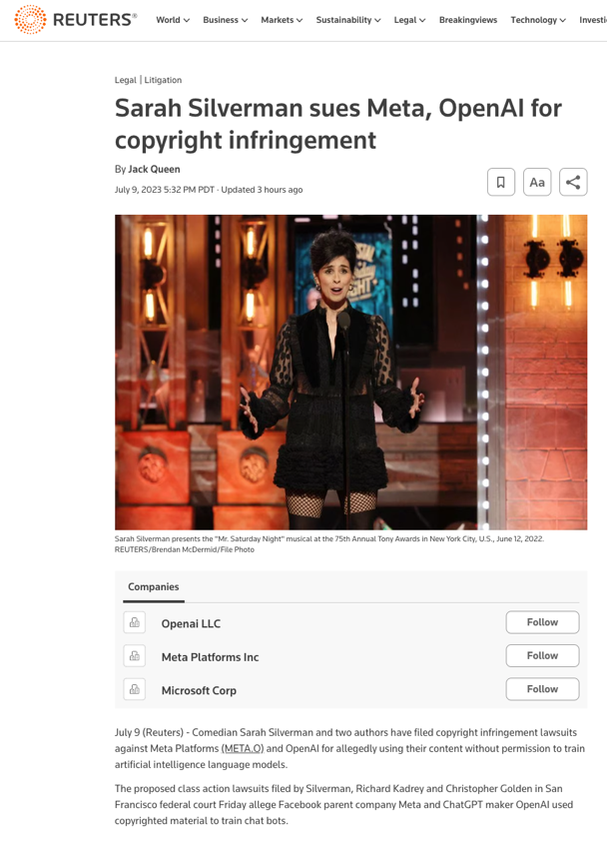

Slide 24
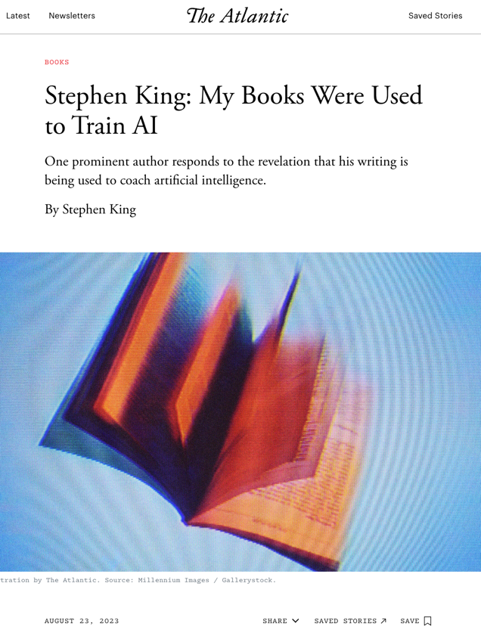

Slide 25
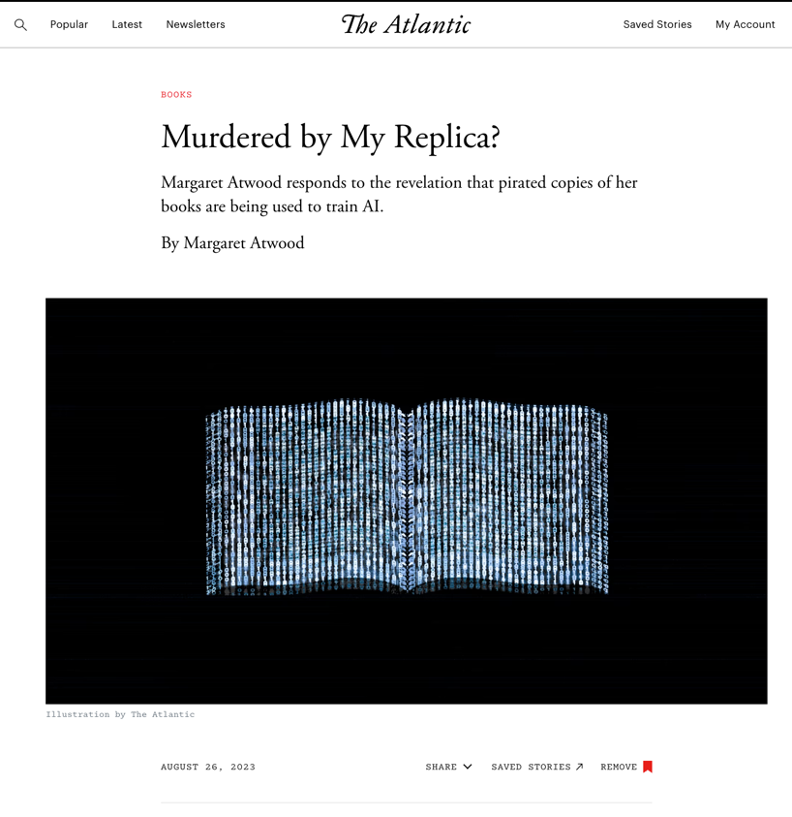

Slide 26
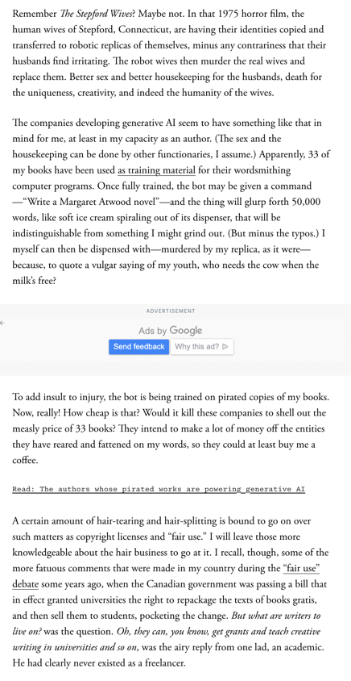

Slide 27
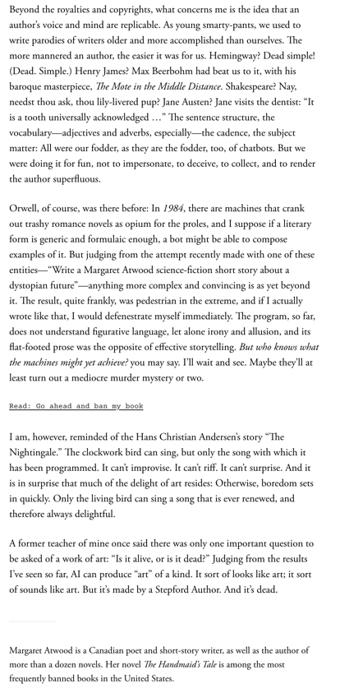

Slide 28
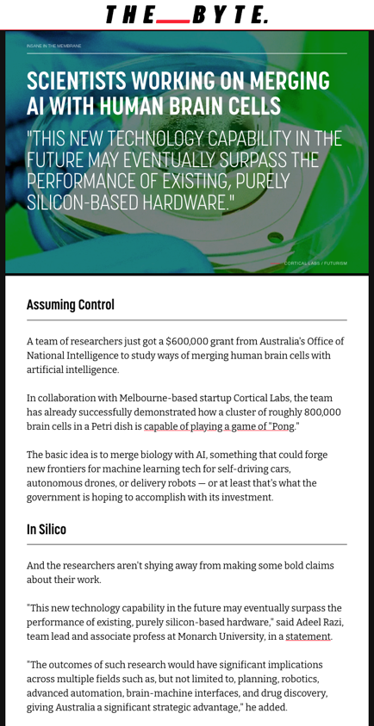

Slide 29
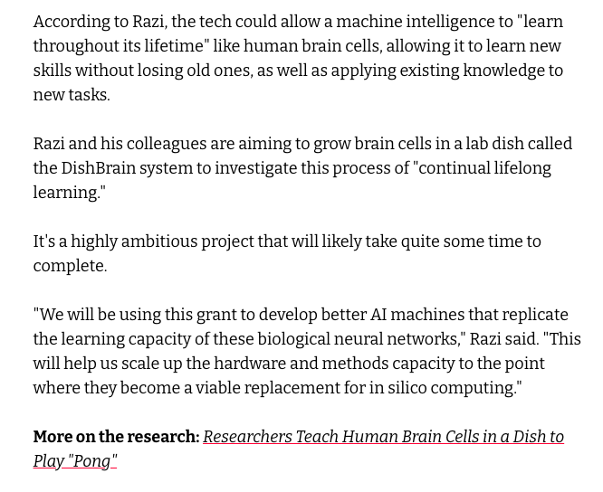

Slide 30
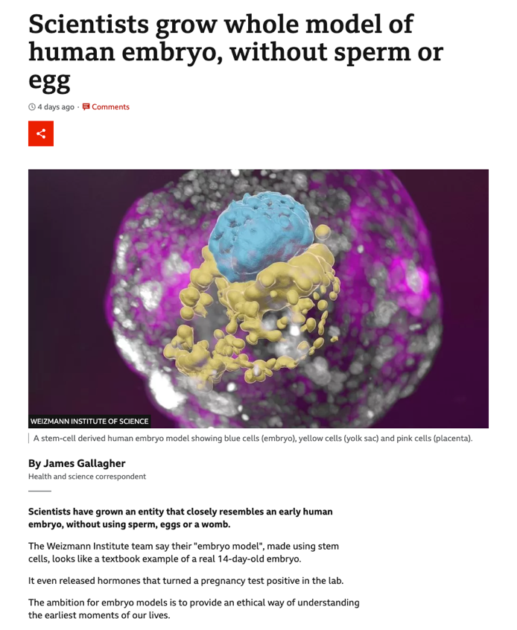

Slide 31
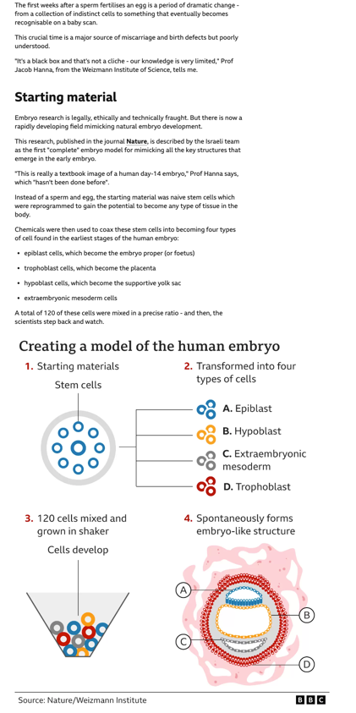

Slide 32
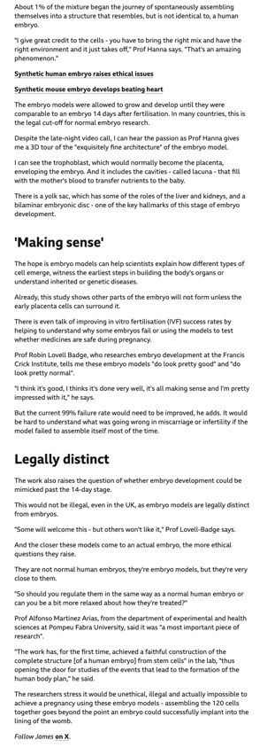

Slide 33
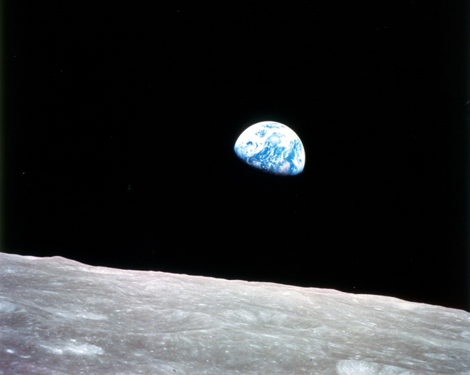
Canadian Law: International Context

Slide 34
I.P. - Once a niche area, not anymore…

Slide 35
Logistics

Slide 36
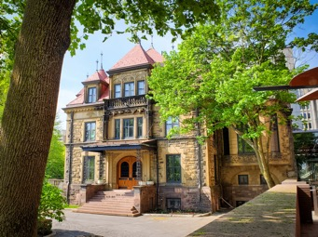
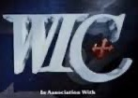
Me (IP history?)

Slide 37
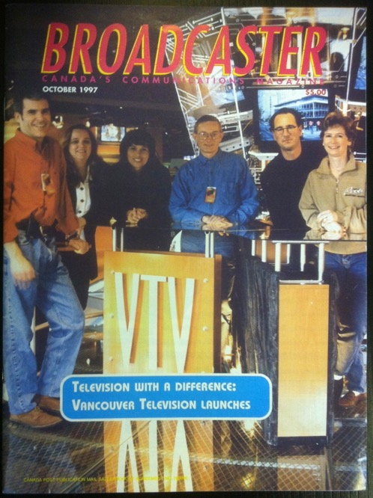

Slide 40
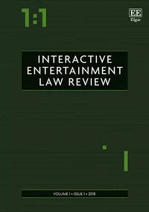

Slide 41
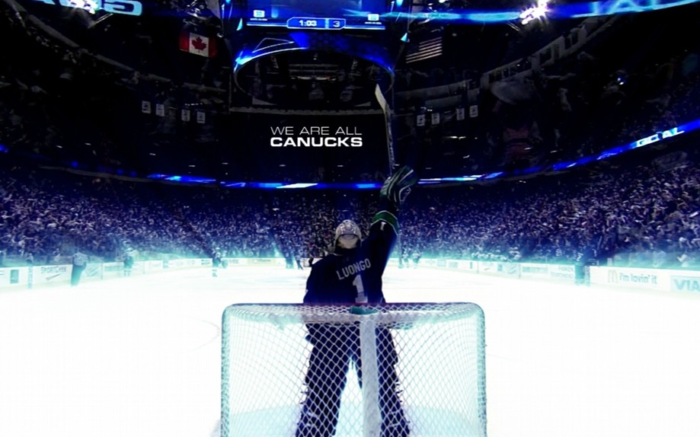

Slide 42
Favorite Intellectual Property
(current or all-time)?

Slide 45
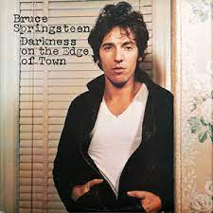

Slide 47
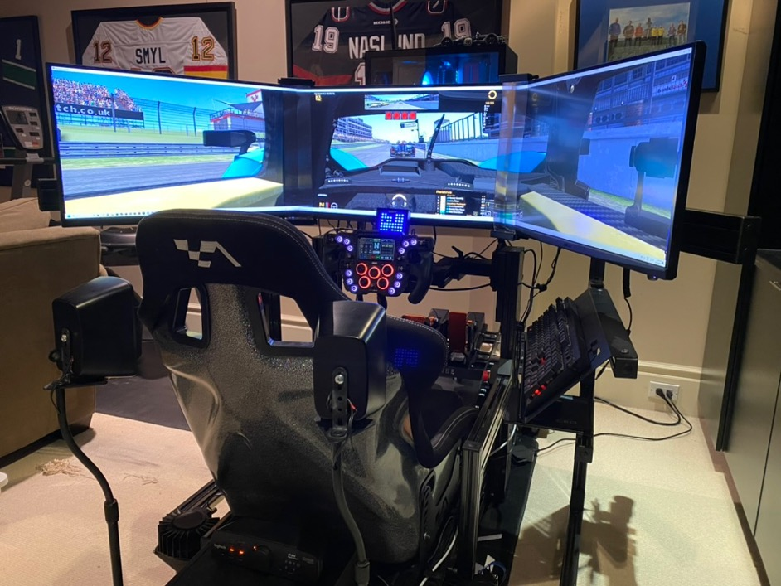

Slide 54
Now
You

Slide 55
Entirely optional but please…
…email me a short bio of yourself referencing:
Anything at all you want to say about yourself
Your academic interests
What you might like to get out of this course (I.E., interest in a type of patent, or a copyright issue etc.)
Favorite Intellectual Property (ies) - current or all-time

Slide 56
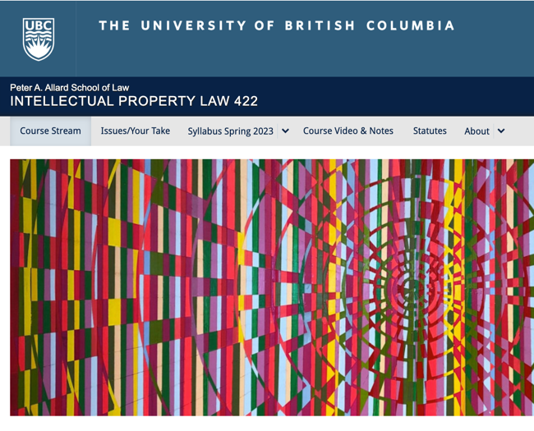
Course Website
https://iplaw.allard.ubc.ca/

Slide 57
Syllabus

Slide 58
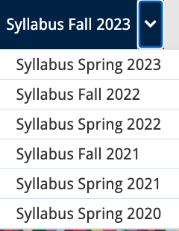

Slide 59
Lecture Capture

Slide 60
PLEASE
SIGN UP

Slide 61
For full privileges on the website
1. Please create an account at http://cms.ubc.ca/ using your CWL.
2. Once you create an account and sign in at http://cms.ubc.ca/ you can click your name in the top right. Halfway down the following page will be your WordPress email address.
3. Send me your WordPress email address at jon.festinger@ubc.ca or at jon_festinger@thecdm.ca
4. Then, I will invite you to participate with authoring privileges via your WordPress email address.

Slide 62
Why post?
Engaging and engaging others is the key.
Because you don’t love speaking up in class.
Because you just saw or realized something, and you’ll never remember it unless you post it now.

Slide 63
Tips:
Don’t feel your posts have to be perfect. Engaging and engaging others is the key.

Slide 64
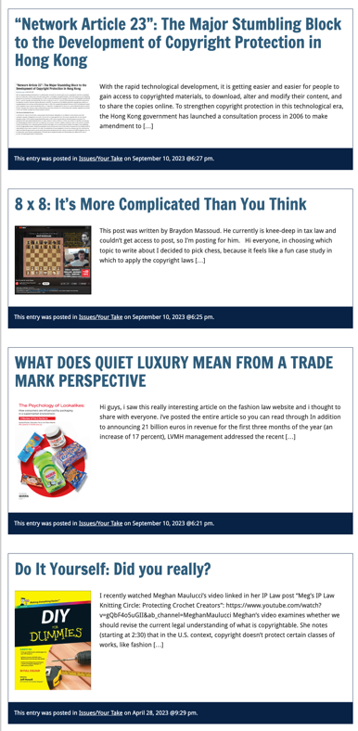

Slide 65
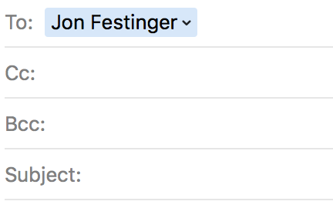
Anything & everything can be done via email if you prefer

Slide 66
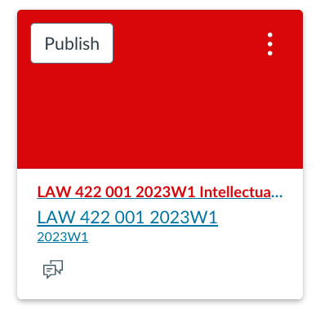
UBC Canvas?

Slide 67
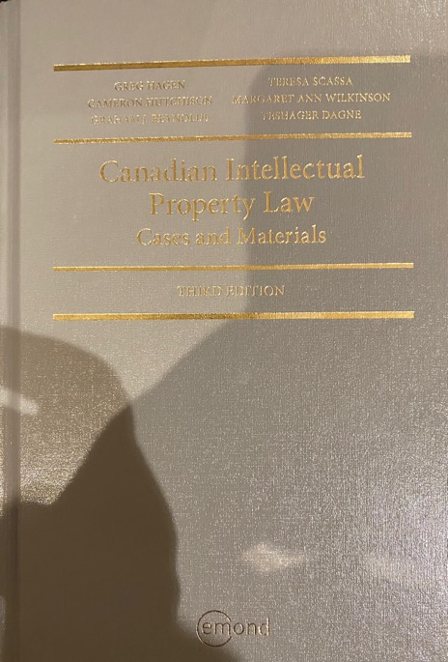
Text

Slide 68
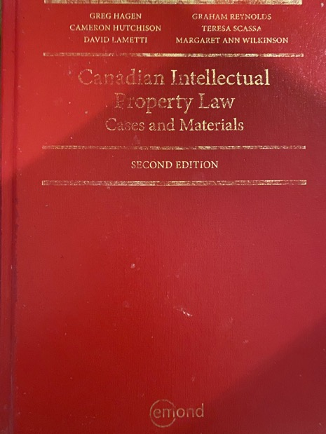
Former Text

Slide 69
Features of this Course
70% Exam not 100%
IP Law “In Context”
Website

Slide 70
Let’s talk about…
The 30%

Slide 71
A modest proposal…
750-1000 words (or equivalent) per person
written, video, podcast, in-class presentation (?), interpretive dance
Website or not
Groups or individually
LLM Students – one extra post

Slide 72
Past Presentations mostly all on the course website…

Slide 73
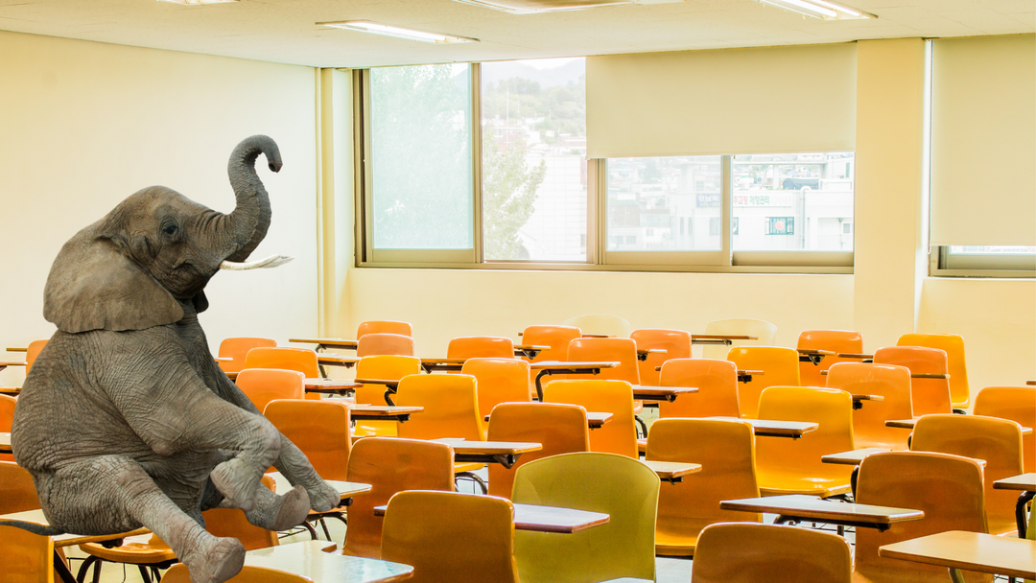

Slide 74
Generative A.I.
Policy?

Slide 75
News of
the Week

Slide 77
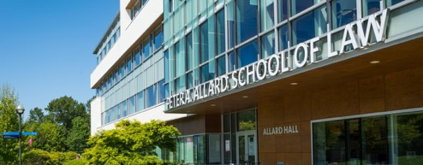
Office “Hours”: Ideally Mondays just before or after class but am flexible…
Email: jon.festinger@ubc.ca; jfestinger@telus.net
Office: 449
Phone:
c. 604-837-6426
(please text)

Slide 78
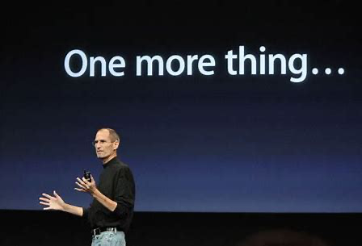

Slide 79
Reflecting on earlier slide…
Intellectual Property Law is about:
What kinds of creations of the mind can one have rights in?
Who can have those rights?
What kinds of rights are there; and how are those rights enforced?
Any IP issues/conundrums
you are curious about?…

Slide 81
Pause

Slide 82
QUESTIONS?
THOUGHTS?
DISCUSSION?

Slide 83
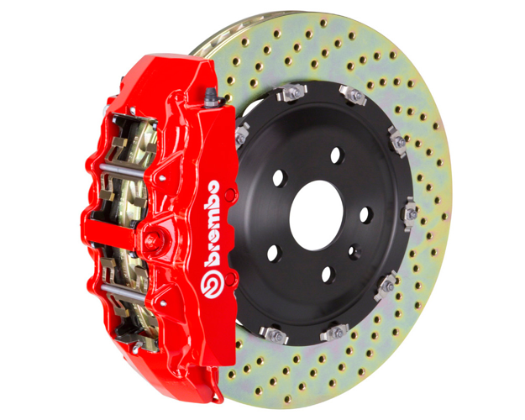

Slide 84
SEE YOU NEXT WEEK!

Slide 85
Always include a cat picture

Slide 86
In learning you will teach
And in teaching you will learn
Phil Collins' Son of Man (1999)

