Slide 1


Passing Off 2
Talk 8
LAW 422 002
Intellectual Property Law
Allard School of Law, UBC
Spring, 2022
Jon Festinger Q.C.
Centre for Digital Media
QMUL School of Law (CCLS)
Whiteboard Law
http://commlaw.allard.ubc
@jonfestinger
jon_festinger@thecdm.ca

Slide 2
Stuff

Slide 3
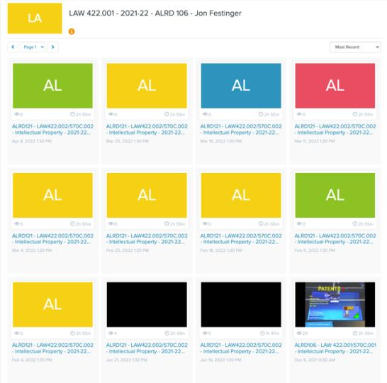
Livestream Link?
https://mediasite.audiovisual.ubc.ca/Mediasite/Channel/law422-001-2021-22

Slide 4
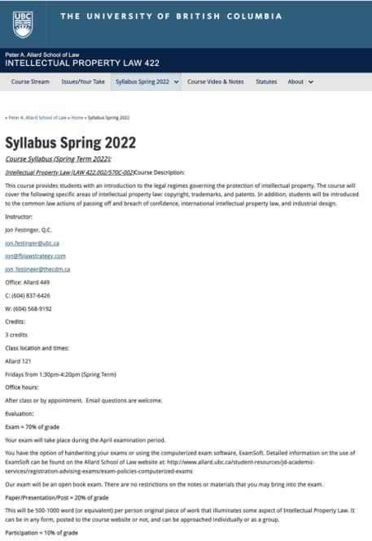
Any Questions?…

Slide 5
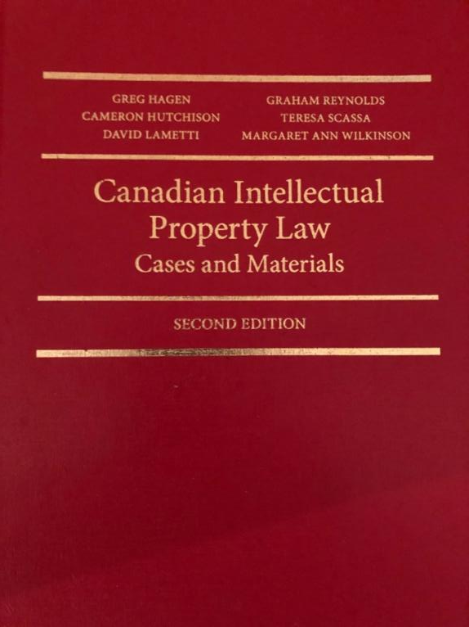

Slide 6

Office “Hours”: Ideally Mondays before or after class but am flexible…
Email: jon.festinger@ubc.ca
Office: Allard 449
Phone:
  o. 604-568-9192
  c. 604-837-6426

Slide 7
LLMCL Students Registered in the Class as such: Additional Task
750 – 1000 word post (or email)
???????????

Slide 8
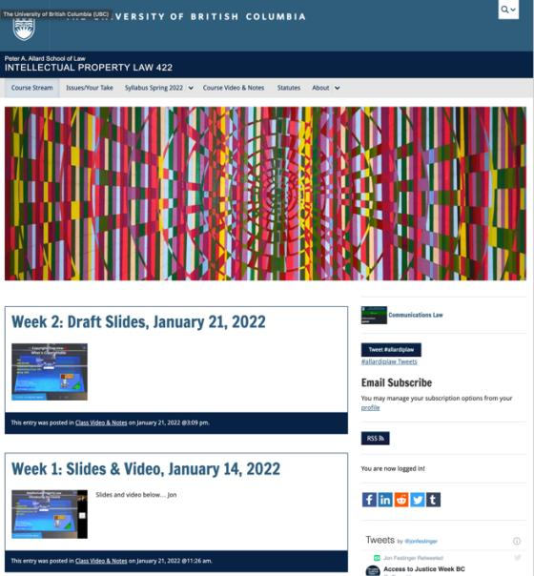
Course Website
https://iplaw.allard.ubc.ca/

Slide 9
PLEASE
SIGN UP

Slide 10
For full privileges on the website
1. Please create an account at http://cms.ubc.ca/ using your CWL.
2. Once you create an account and sign in at http://cms.ubc.ca/ you can click your name in the top right. Halfway down the following page will be your WordPress email address.
3. Send me your WordPress email address at jon.festinger@ubc.ca or at jon_festinger@thecdm.ca
4. Then, I will invite you to participate with authoring privileges via your WordPress email address.

Slide 11

Why post?
Engaging and engaging others is the key.
Because you don’t love speaking up in class.
Because you just saw or realized something, and you’ll never remember it unless you post it now.
# AllardIPLaw

Slide 12
Tips:
Don’t feel your posts have to be perfect. Engaging and engaging others is the key.

Slide 13

Anything & everything can be done via email if you prefer

Slide 14
Evaluation
70% = Exam
Paper/Presentation/Post = 20%
Participation = 10%

Slide 15
Let’s talk about…
The 30%

Slide 16
A modest proposal…
500-1000 words (or equivalent) per person
written, video, podcast, in-class presentation (?), interpretive dance
Website or not
If posted to website, note to me pls.
Groups or individually

Slide 17
QUESTIONS?
THOUGHTS?
DISCUSSION?

Slide 18

Pause

Slide 19
News of
the Week

Slide 20
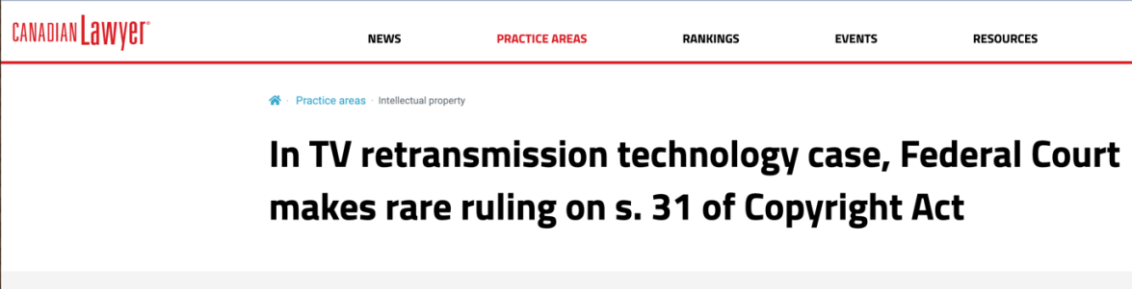

Slide 21
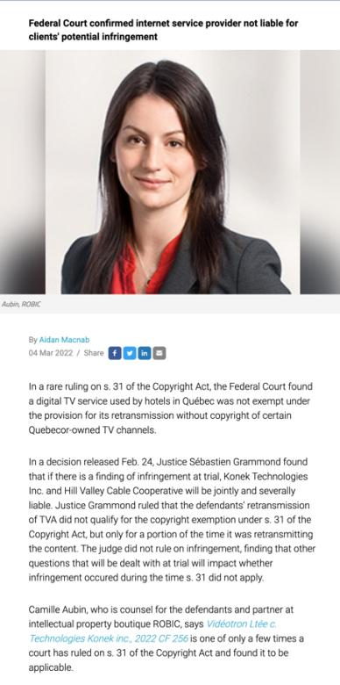

Slide 22
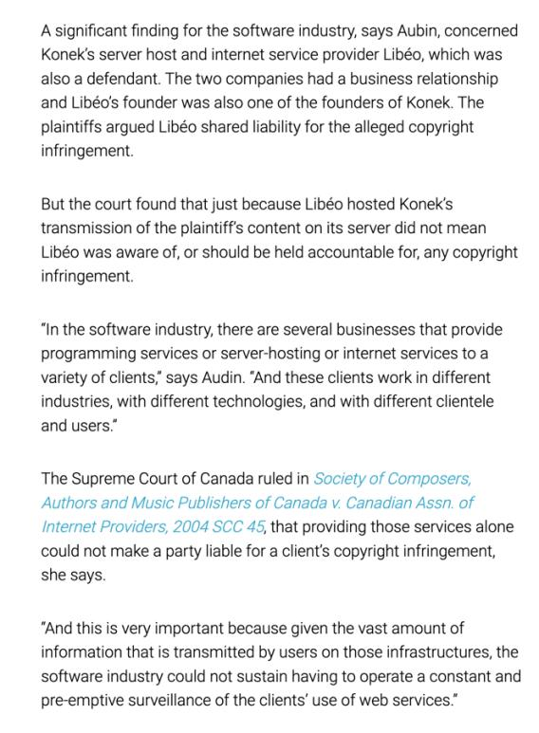

Slide 23
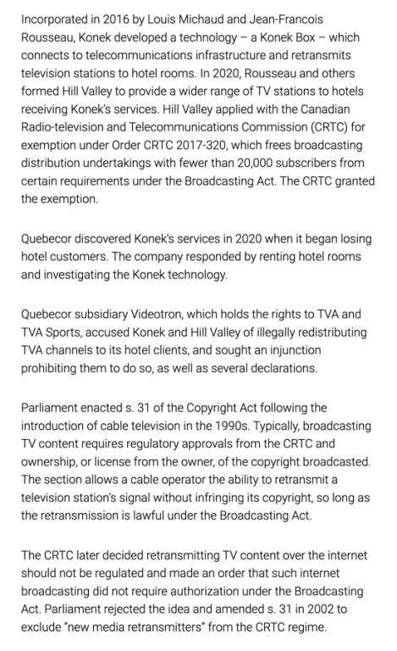

Slide 24
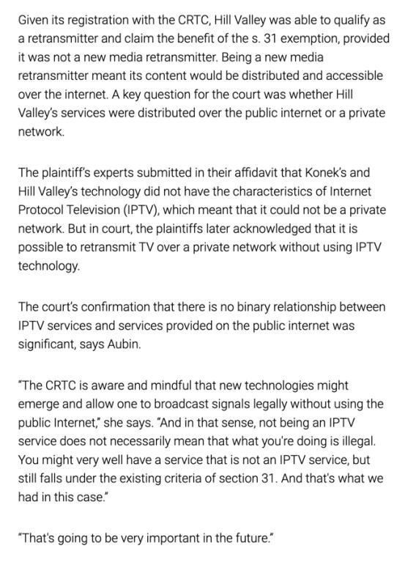

Slide 25
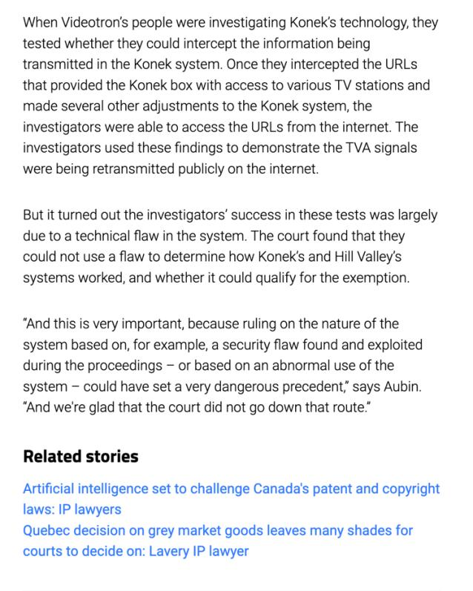

Slide 26
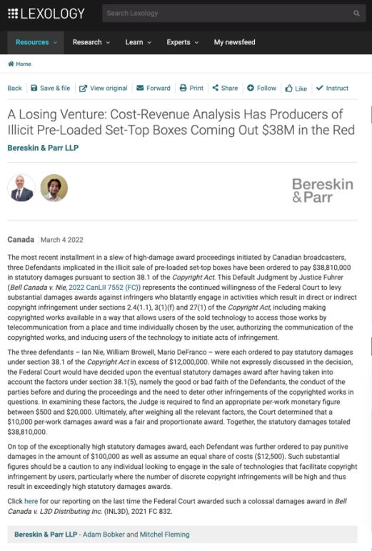

Slide 27
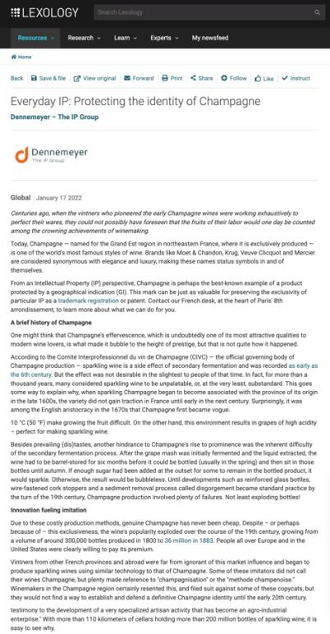

Slide 28
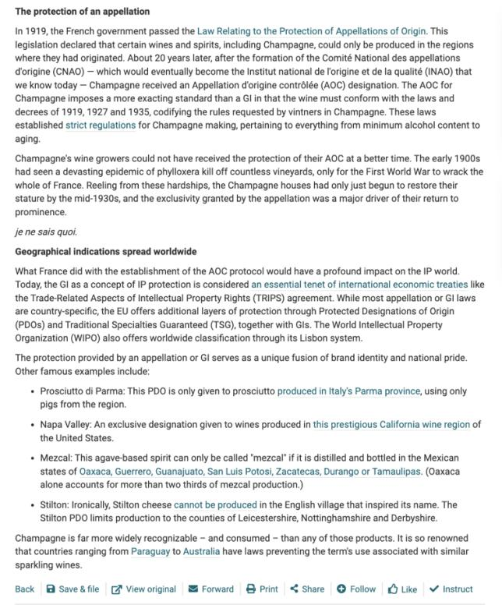

Slide 29
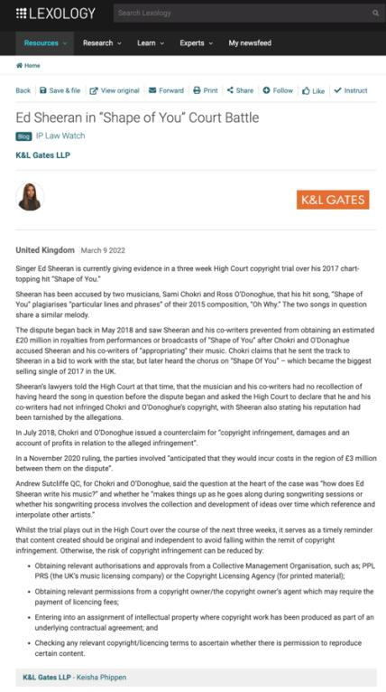

Slide 30
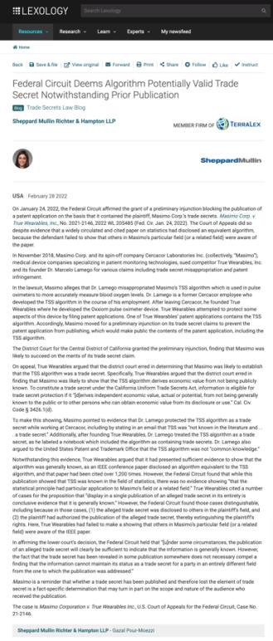

Slide 31
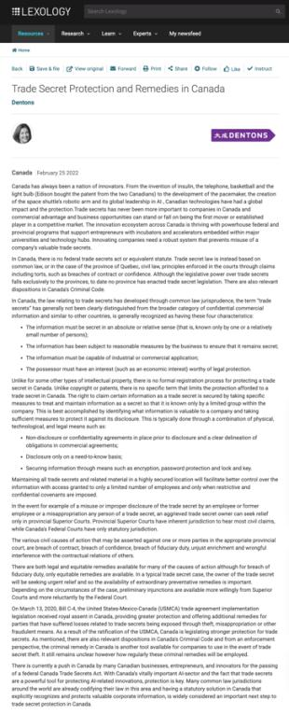

Slide 32
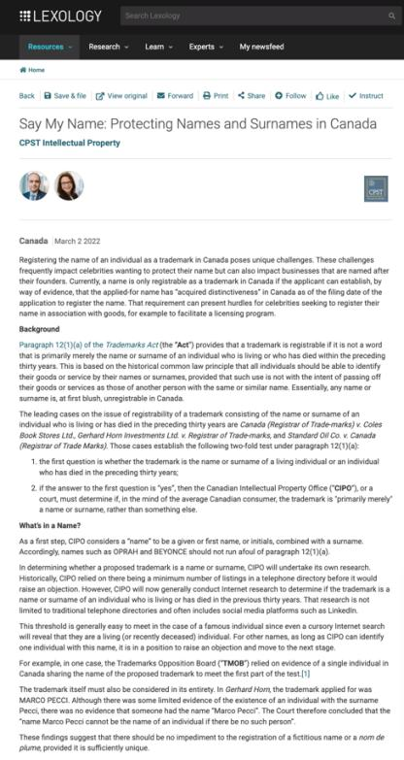

Slide 33
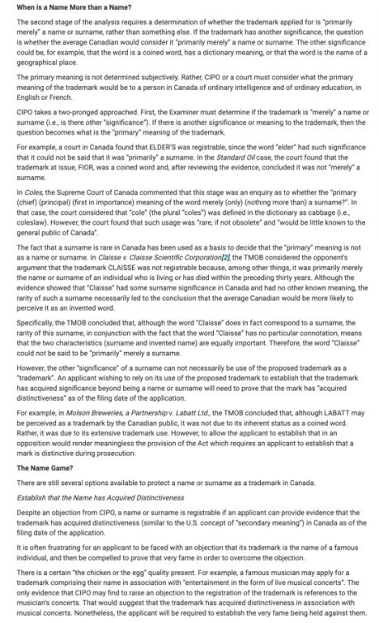

Slide 34
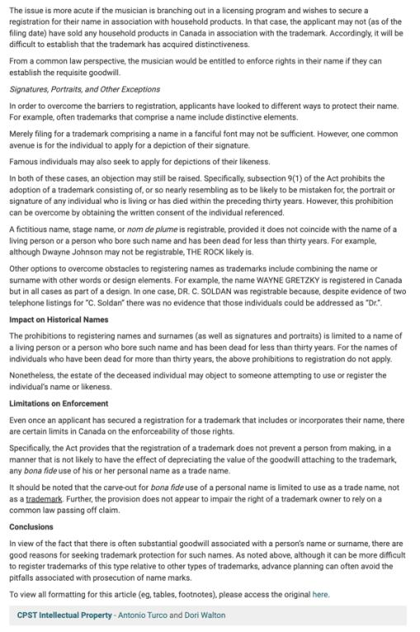

Slide 35
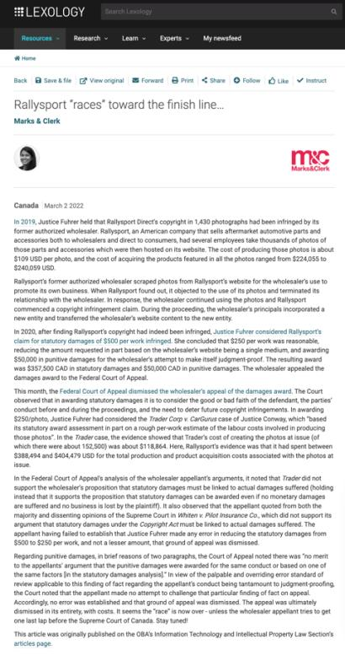

Slide 36
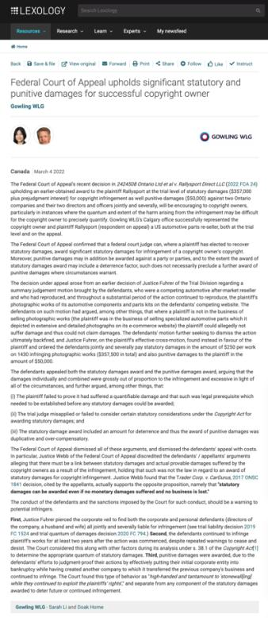

Slide 37
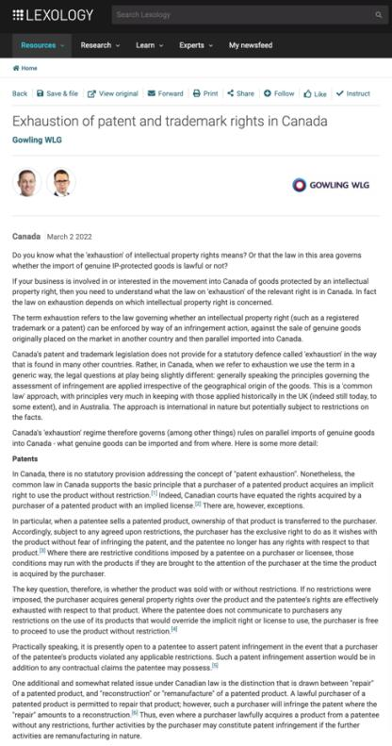

Slide 38
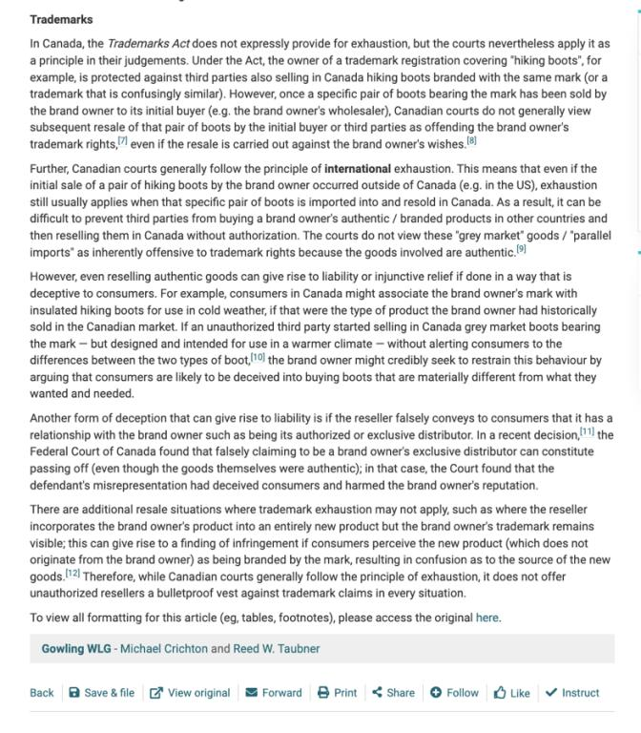

Slide 39
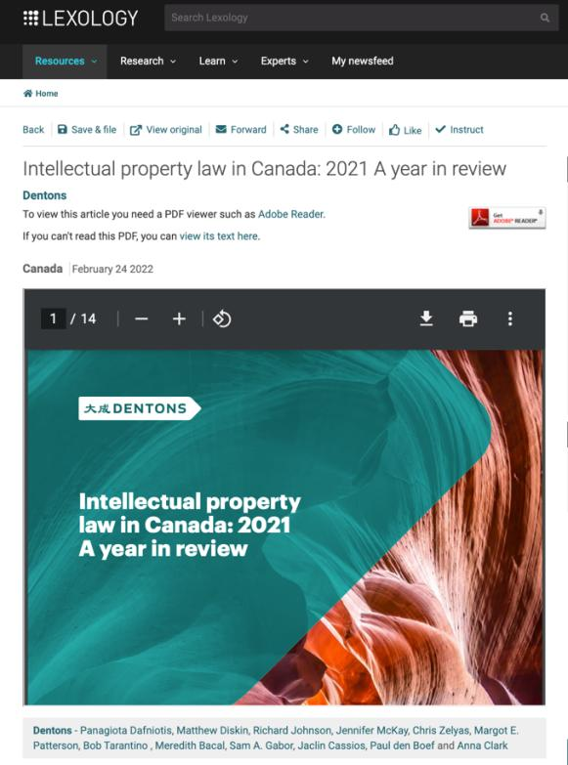

Slide 40
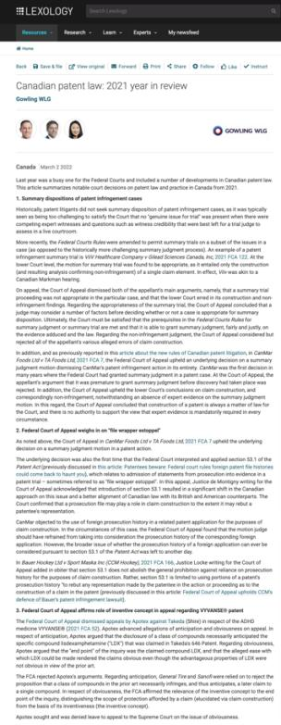

Slide 41
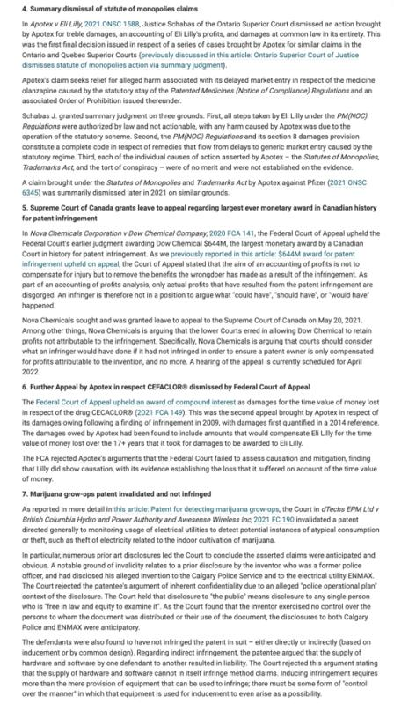

Slide 42
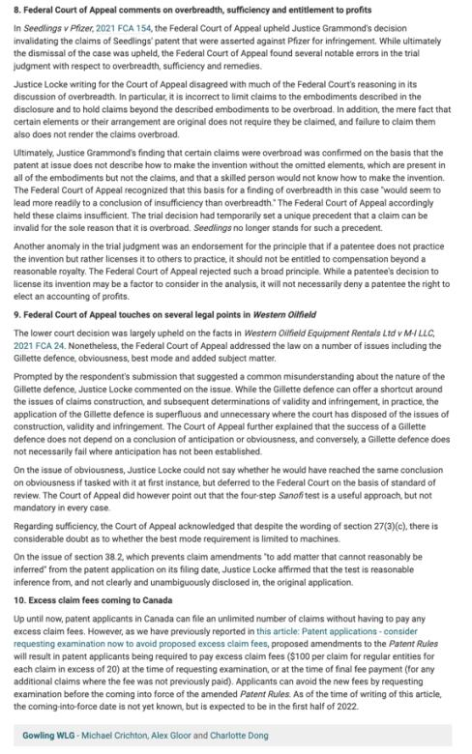

Slide 43
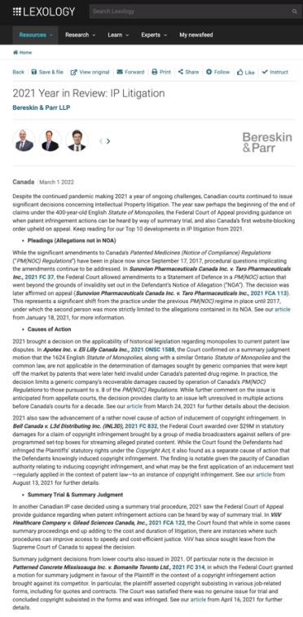

Slide 44
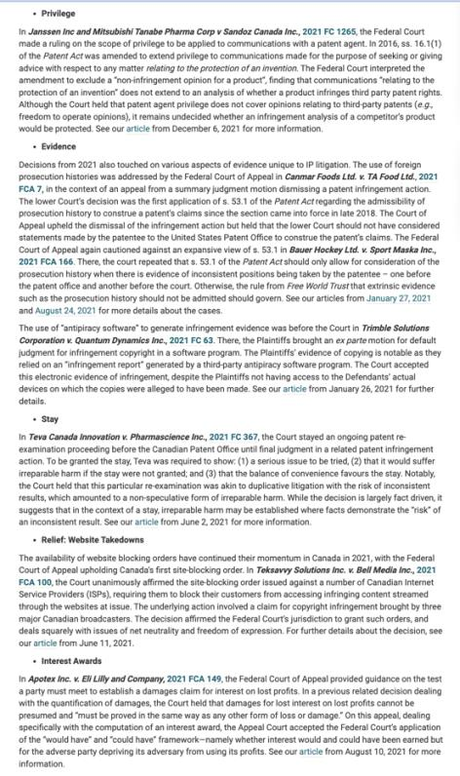

Slide 45
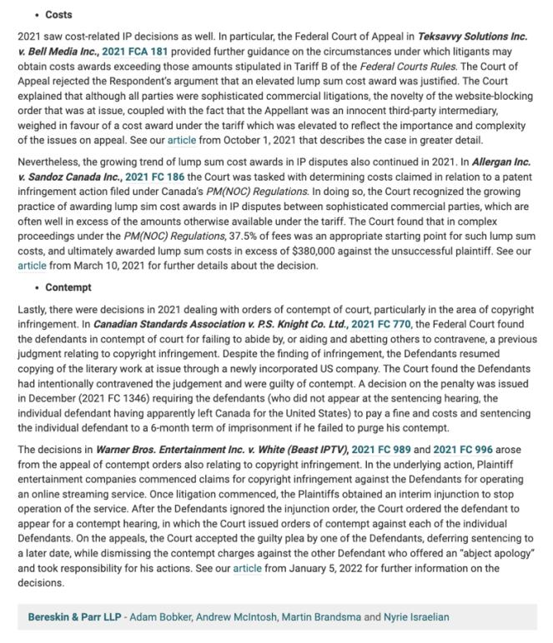

Slide 46
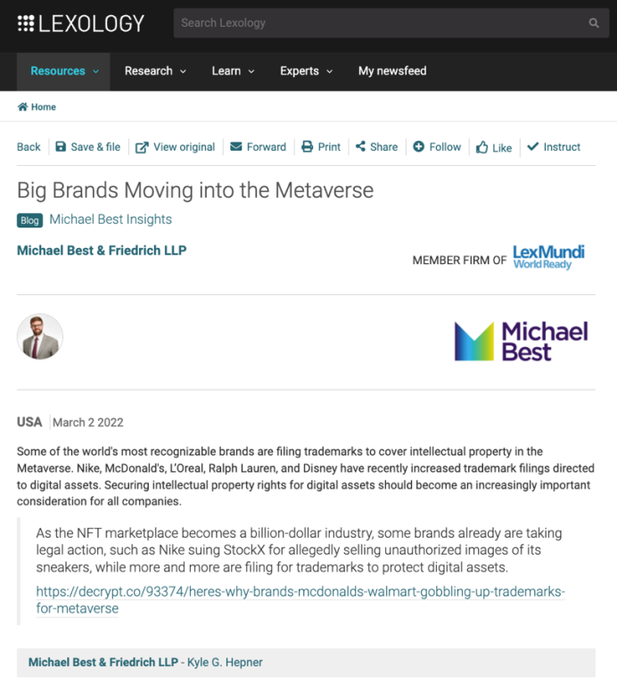

Slide 47
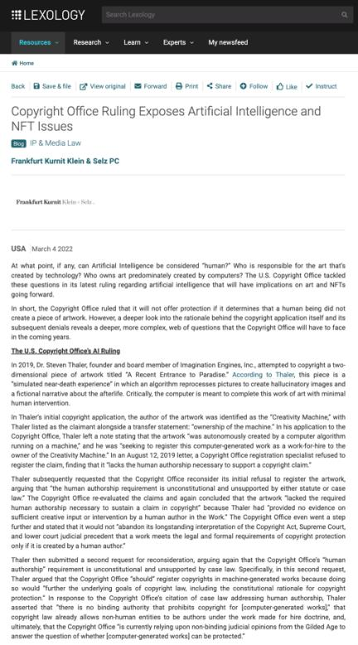

Slide 48
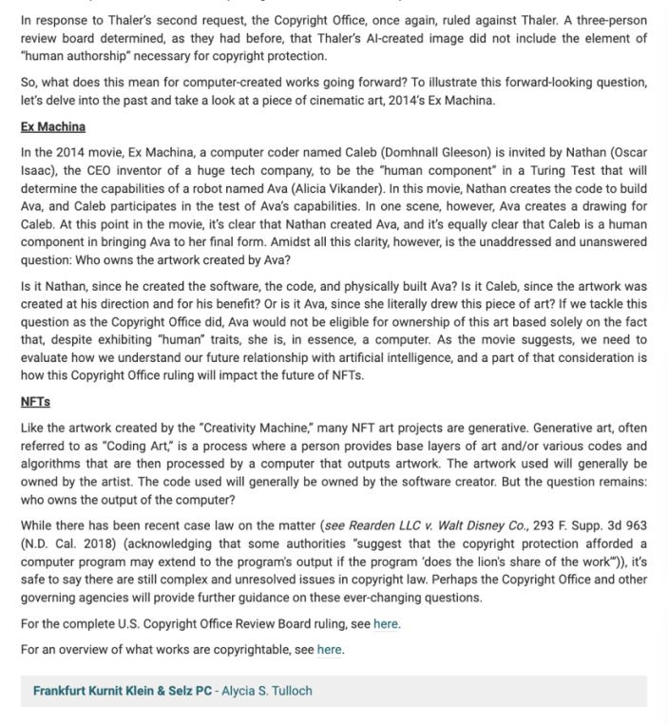

Slide 49
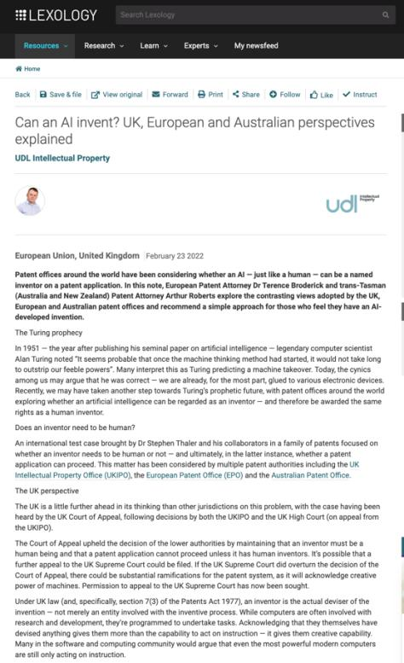

Slide 50
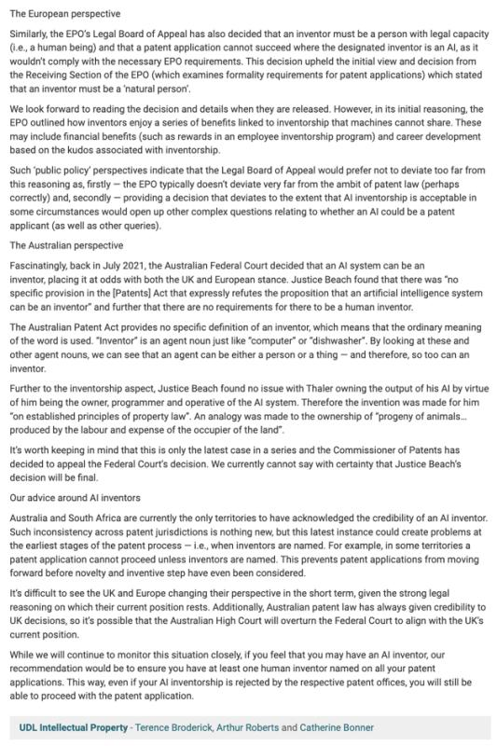

Slide 51
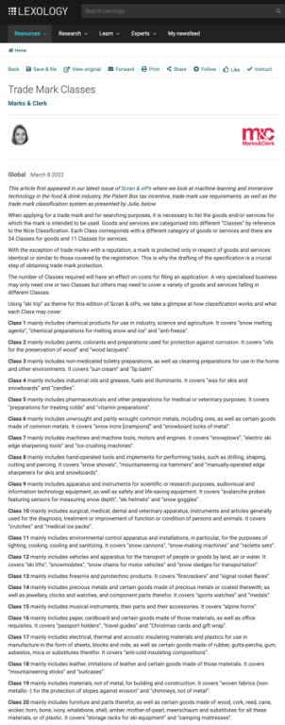

Slide 52
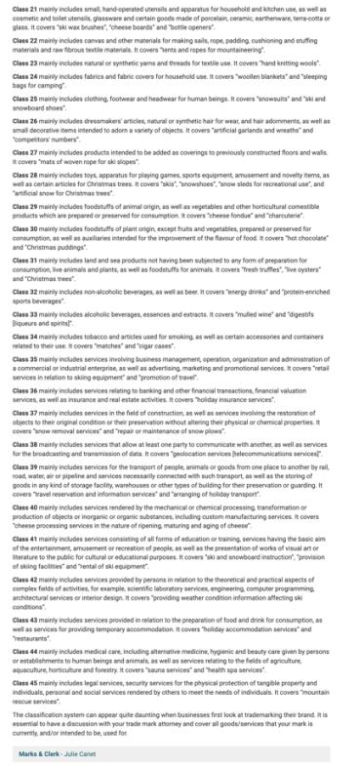

Slide 53
News of
the Week
Other

Slide 54
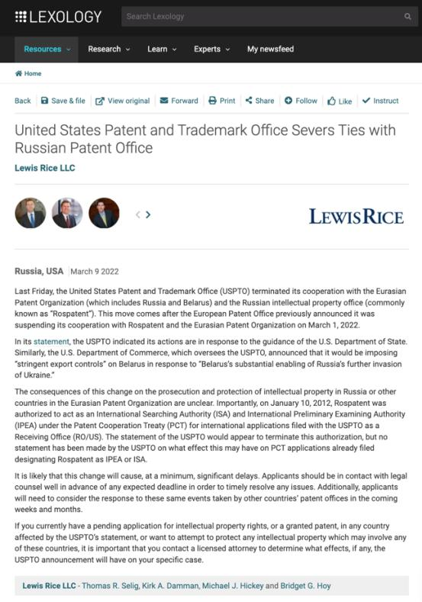

Slide 55
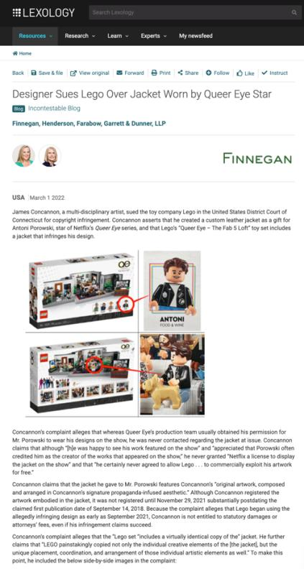

Slide 56
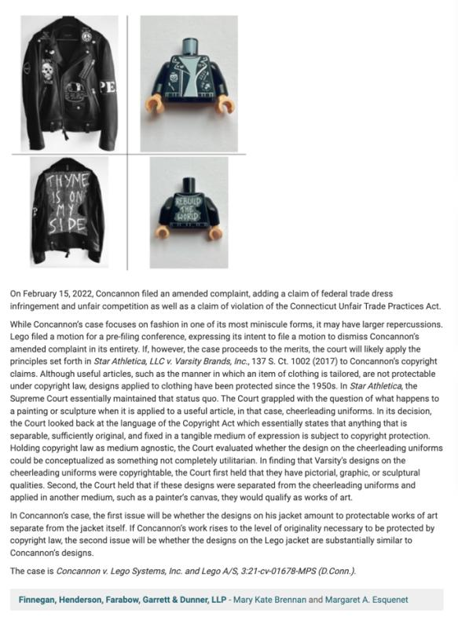

Slide 57
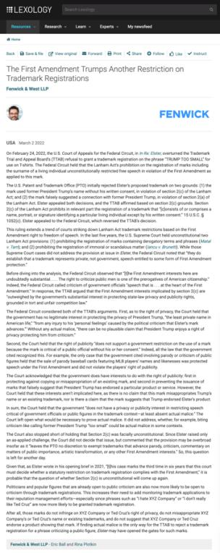

Slide 58
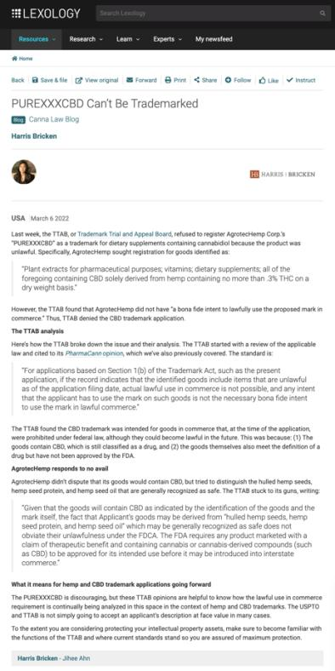

Slide 59
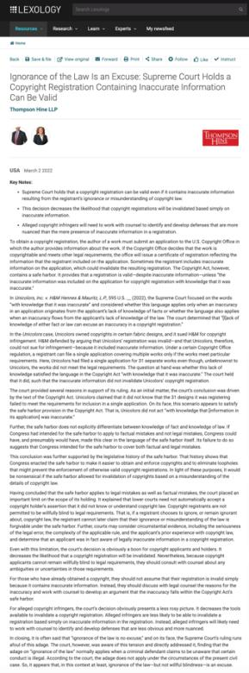

Slide 60
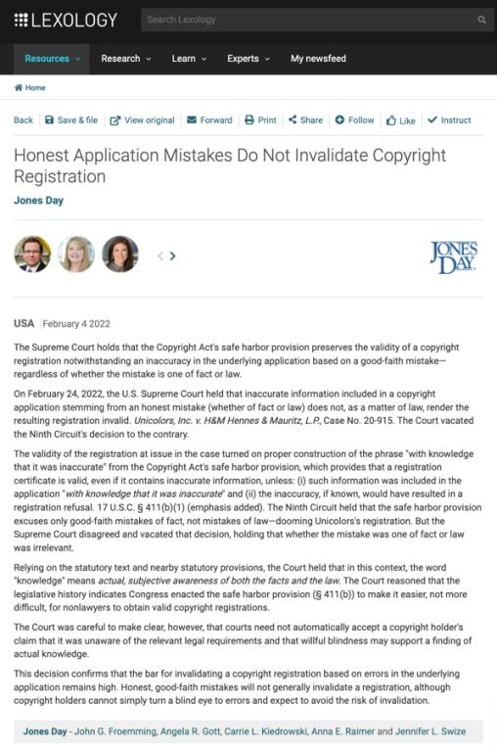

Slide 61
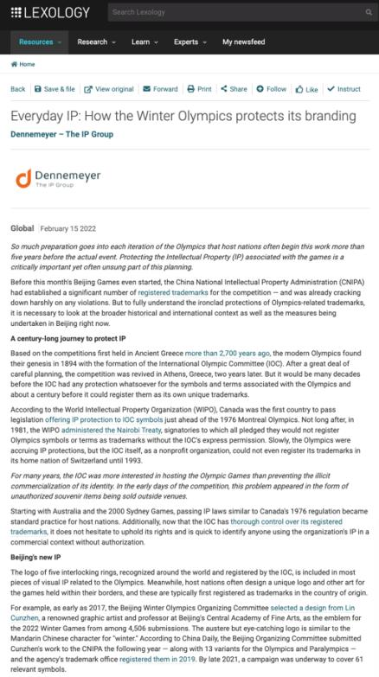

Slide 62
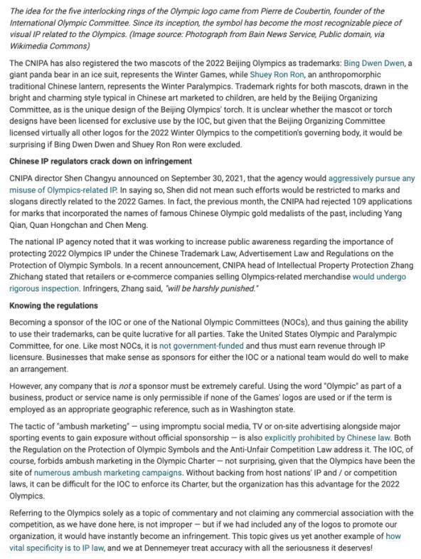

Slide 63
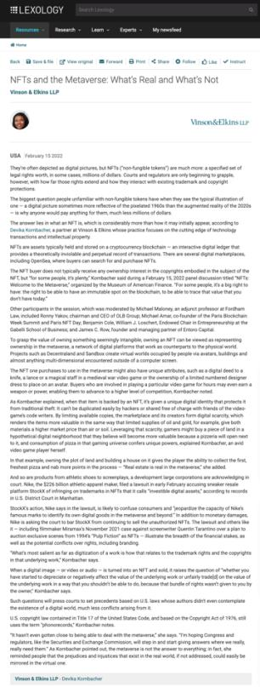

Slide 64
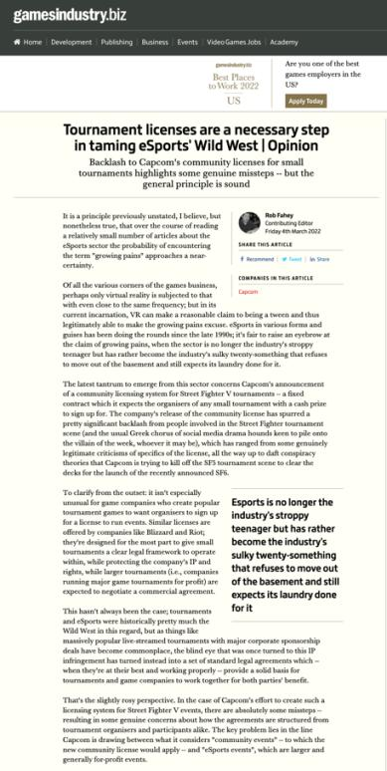

Slide 65
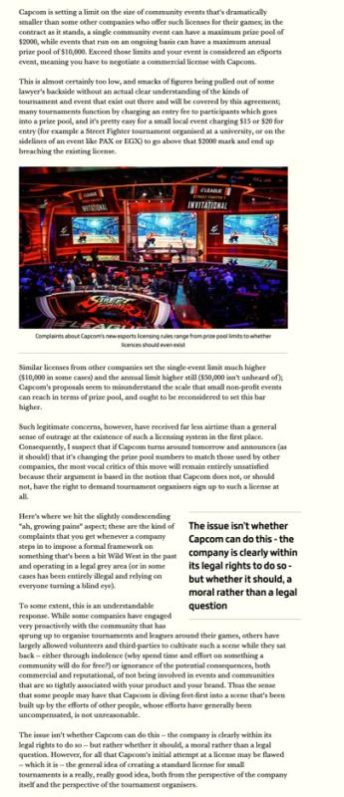

Slide 66
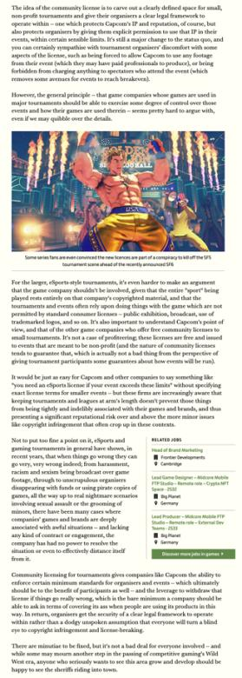

Slide 67


Slide 68


Slide 70


Slide 71


Slide 72
QUESTIONS?
THOUGHTS?
DISCUSSION?

Slide 73
Pause

Slide 74
Added to
Last Week’s Slides

Slide 75

Interlude: What about animal copyright?

Slide 76


Slide 77


Slide 78


Slide 79


Slide 80

https://youtu.be/Zlvgil4zNQk

Slide 81


Slide 82

End of animal interlude

Slide 83
QUESTIONS?
THOUGHTS?
DISCUSSION?

Slide 84
Pause

Slide 85

“Passing Off”
The Golden Goal – Jerome Iginla
passing off to Sidney Crosby

Slide 86

Re-capping

Slide 87
Passing off
Three (3) necessary components of a passing-off action:
  1. The existence of goodwill +
  2. Deception of the public due to a misrepresentation +
  3. Actual or potential damage to the plaintiff

Slide 88
Passing off
Tort action available in certain circumstances of unfair competition
Common Law (where no statute)
Both a common law tort and a statutory cause of action under the Canadian Trade-marks Act
No one may pass off their goods as those of another
General remedy for two categories of deception in the commercial context:
  Company B represents products as being those of Company A to take advantage of Company A’s goodwill and reputation e.g. Coke v. Cola Joe
  Goods of Trader A supplied to party who has ordered goods of Trader B. Purchasing party led to believe they have received goods of Trader B.

Slide 89
Passing off: Where does goodwill come from?
How would you go about establishing the existence of goodwill? What sorts of information would you want to have?
Evidence of length of time in business
Strength of market for product/service
Strength of association between name/mark/product and company as source.

Slide 90

Passing off: Shared Goodwill

Slide 91
Passing off: Shared Goodwill Summary
Institut National:
Plaintiff entitled to bring an action in passing off when the alleged misrepresentation relates, not to the goods or services of a particular trader, but to a kind or quality of goods produced by a group of traders.

Slide 92

What about ice-wine?

Slide 93


Slide 94
QUESTIONS?
THOUGHTS?
DISCUSSION?

Slide 95
Pause

Slide 96

Now Back to Our Regularly Scheduled Programming…

Slide 97
Passing off: Foreign goodwill
Law protects through passing off action a company's property in its business or goodwill.
Goodwill is the benefit and advantage of the good name, reputation, and connection of a business.
Back to Orkin Exterminating Co. Inc. v. Petsco Co. of Canada Ltd (1985), 50 OR (2d) 726 [not required reading but on p344 CB]
Question dealt with is whether a company that doesn’t do business in Canada has goodwill in Canada for the purposes of a passing off action?

Slide 98
Passing off: Foreign goodwill
Orkin Exterminating Co. Inc. v. Petsco Co. of Canada Ltd (1985), 50 OR (2d) 726 (continued)
Court found that a company whose goods or services are well known in the U.S., but not in Canada, will not be protected at common law from another company offering similarly named or branded products or services in Canada.
Reason is because confusion or misrepresentation is the essence of the tort.
Where Plaintiff’s product or service is unknown in a certain region, it is hard to argue that customers were misled into thinking they were purchasing the Plaintiff’s products.
That said however, goodwill can exist outside the area where a company carries on a business.

Slide 99
Passing off: Foreign goodwill
So how might foreign reputation be built up?
Canadians travelling in the United States were exposed to Orkin's extensive advertising and use of its trademarks ;
Canadians in Canada were exposed to Orkin's advertising and articles appearing in American publications circulated here & Orkin’s ads appearing on TV and radio broadcast from American stations but received in Canada;
Thousands of Canadians had used Orkin services on a regular basis in connection with property owned or rented by them in the United States;
Orkin provides services to companies, in the U.S., which have operations in Canada
Orkin's international reputation in the pest control field resulted in the Canadian government seeking its advice as a consultant respecting the control of pests for the Exposition in Montreal in the mid-1970’s
Moreover the fact that Pestco, in 1967, chose to use the name Orkin in Ontario is evidence from which it may be inferred that the name Orkin had commercial value at that time in Ontario. This, according to the Court, is an important indication of goodwill in a “foreign” territory.

Slide 100
Passing off: Foreign goodwill
Sadhu Singh Hamdard Trust v. Navsun Holdings Ltd. (2016)
Case explores the related questions of:
  1. Whether an entity that does minimal business in Canada but that has a website accessible to (and accessed by) Canadians can establish sufficient goodwill for a successful action in passing off in a Canadian court? &
  2. How can such a company demonstrate its reputation?

Slide 101
Passing off: Foreign goodwill
Sadhu Singh Hamdard Trust v. Navsun Holdings Ltd. (2016) (continued)
[4] Hamdard Trust is the owner and publisher of an Indian Punjabi-language daily newspaper called the “Ajit Daily”. This paper has been published in India since 1955 and is well-known among the Punjabi population in India. An online version has been available since 2002. Only a small number of subscriptions have been sold in Canada, but several of the affiants whose affidavits were before the Federal Court on the summary trial motion lived in Canada and deposed or confirmed in cross-examination that they were aware of the Ajit Daily and its reputation as an important Punjabi paper in India.

Slide 102
Passing off: Foreign goodwill
Sadhu Singh Hamdard Trust v. Navsun Holdings Ltd. (2016) (continued)
[5] The Bains Defendants own and publish a Canadian Punjabi-language newspaper called the “Ajit Weekly”, a free newspaper that has been published in Canada since 1993 and that is distributed at the front of supermarkets and other stores. An online version has been available since 1998. The Ajit Weekly has carried advertisements that Hamdard Trust believes are offensive to some of the Ajit Daily readership.
[6] There has been considerable litigation between Hamdard Trust and the Bains Defendants over the use of the Ajit name and the stylized depiction of the name on the masthead of the Ajit Weekly, which Hamdard Trust alleges constitutes an unauthorized copying of the Ajit Daily trade-mark.
In this case …
[19] Hamdard Trust alleges that in misappropriating the Ajit Daily logo the Bains Defendants were engaged in passing off.

Slide 103
Passing off: Foreign goodwill
Sadhu Singh Hamdard Trust v. Navsun Holdings Ltd. (2016) (continued)
Federal Court dismissed Hamdard Trust’s claim for passing off, finding that it had failed to establish any of the elements for a claim of passing off.
Federal Court of Appeal set aside that decision, finding that the lower court made several palpable and overriding errors in evaluating the evidence on each element of the test.

Slide 104
Passing off: Foreign goodwill
Sadhu Singh Hamdard Trust v. Navsun Holdings Ltd. (2016) (continued)
Number of Ajit Daily subscribers in Canada? 7 in 2010.
FCA determined that the Federal Court erred in law by analyzing the existence of goodwill solely from the perspective of those who were shown to have read the Ajit Daily in Canada.
Instead, the FCA indicated the question is simply: Does the Plaintiff’s TM have a reputation in the jurisdiction, even if the TM is not used by the Plaintiff in the jurisdiction?

Slide 105
Passing off: Foreign goodwill
Sadhu Singh Hamdard Trust v. Navsun Holdings Ltd. (2016) (continued)
There was evidence that the Plaintiff’s TM had a reputation in the jurisdiction:
  1. The Ajit Daily enjoyed a reputation in the eyes of several affiants in Canada as a well-known Punjabi-language newspaper published in India
  2.A number of Canadians accessed the Ajit Daily’s online version by visiting its website.
  3. There were seven subscribers to the paper.
Court noted that if a wider reputation had been established, it would have been enough to establish the goodwill to meet the first step in the test for passing off.

Slide 106
Q.: Should an entity doing minimal business in Canada but having an accessible website that is accessed by Canadians be able to establish sufficient goodwill to make out a successful action in passing off in a Canadian court? If so, how might such a company demonstrate its reputation?

Slide 107
Passing off: Entities doing minimal business in Canada
Sadhu Singh Hamdard Trust v. Navsun Holdings Ltd. (2016)
Does Plaintiff’s TM have a reputation in the jurisdiction, even if that TM is not used in the jurisdiction?
Larger question: Should an entity that does minimal business in Canada but that has a website accessible to (and accessed by) Canadians be able to establish sufficient goodwill to make out a successful action in passing off in a Canadian court?

Slide 108

But Trademarks?

Slide 109


Slide 110


Slide 111


Slide 112


Slide 113


Slide 114


Slide 115


Slide 116
QUESTIONS?
THOUGHTS?
DISCUSSION?

Slide 117
Pause

Slide 118
To what extent can goodwill be acquired in a purely descriptive product name?
Risky to use purely descriptive terms for a mark.
Risk is of not acquiring goodwill or reputation in the product simply because the name describes the good itself.
Goodwill – or secondary meaning – can be acquired through a product’s name, or through a product’s appearance…
A product that has a particularly distinctive appearance might come to be associated by consumers with one trade source. Then a competitor who copies the product appearance might be liable for passing off.
Challenge in these cases is that the Plaintiff must show that the appearance of the product has acquired a secondary meaning – that it comes from one trade source.

Slide 119
Passing off: Ray Plastics
Product was a combination snowbrush, ice scraper and squeegee called “Snow Trooper”: Black nylon scraper is 27" in overall length, has 3 rows of bristles, 5/8" hardwood painted black, and a traditional yellow brush
uncommon appearance…
very successful seller at Canadian Tire, K Mart, Zellers and Pro Hardware in 1982 and 1983.
Constructed by Raywares, a division of Ray Plastics Limited.
One of Raywares’ main competitors was Brushcraft, a division of Dustbane.
At the initiative of Canadian Tire, Brushcraft produced a similar product to the Snow Trooper for the years 1984 and following.
This product was described as "virtually identical", and "a virtual clone" to the Snow Trooper.

Slide 120
Passing off: Ray Plastics
Ray Plastics sued Dustbane for passing off.
Issue: Did goodwill exist?
Ray needed to prove that potential buyers believe that the goods being sold – here Brushcraft’s snowbrush, are either those of Ray or come from the same source as the “originals”
Court notes that in discussing passing off in cases of “appearance” or get-up, …what you have to establish is that consumers, by virtue of the appearance of the product – regard it as coming from one trade source; OR that the product appearance has developed a secondary meaning – that it comes from one trade source.
Important: The consumer doesn’t have to know which company produces the original product. Just need to establish that … consumers believe that the Snowbrush made by Dustbane comes from the same source as the Snow Trooper.
It’s easier to establish this reputation or secondary meaning with a distinctive product.

Slide 121
Passing off: Ray Plastics
Court notes that where the appearance is in some way novel or striking or unusual, it is easier to conclude that there has come to be an association of that appearance with a single trade source
The Snow Trooper get-up is very distinctive.
Other factors that the court found significant in this case:
1) Ray Plastics had done extensive advertising over two years with respect to the Snow Trooper.
2) Sales figures
3) There was evidence of intentional, direct copying. The court found that evidence of intentional, direct copying establishes a prima facie case of secondary meaning.
SO the goodwill/secondary meaning found to exist in the product appearance of the snow trooper.

Slide 122
Passing off: Ray Plastics
A product that is particularly distinctive in its appearance may come to be associated by consumers with a particular trade source
If the product appearance is an inherent feature of the product, it can’t be relied on as a TM

Slide 123

Passing off: Novopharm v. Bayer Inc. (2000)

Slide 124
Passing off: Novopharm v. Bayer Inc. (2000)
Question is whether a manufacturer of a pharmaceutical in pill, capsule or tablet form can claim goodwill or reputation in the shape, size or colour of the tablet?
Many prescription drugs are not sold in packages, they are dispensed by pharmacists in plain plastic vials.
“If patients identified the plaintiff's product by its appearance, the marketing by the defendant of tablets that were confusingly similar in appearance would prevent patients from exercising consumer choice by specifying which product they wished to have prescribed.” (para 90) / could also have negative health impacts.

Slide 125
Passing off: Novopharm v. Bayer Inc. Court 1
Issue was whether consumers, by virtue of the appearance of the pill, regard it as coming from one trade source?
Points made by the court in answering this question:
Pink round small tablets are commonplace in the pharmaceutical market. (40 medications available in Canada for treatment of high blood pressure and angina that were pink in colour – Macdonald (Pharmacist)). Accordingly, Bayer has a heavy burden to discharge to prove that they have a secondary meaning (that ordinary consumers associate them with a single trade source).
The fact that in 1992 Adalat was the only extended-release nifedipine product on the market does not necessarily mean that consumers have identified its appearance with a single source.

Slide 126
Passing off: Novopharm v. Bayer Inc. Court 2
Issue was whether consumers, by virtue of the appearance of the pill, regard it as coming from one trade source?
Points made by the court in answering this question:
Consumers often identify the appearance of a pharmaceutical product with its therapeutic purposes, instead of with a single manufacturer. I.e. “Colour/shape = pill I take for condition X; as opposed to colour/shape = same manufacturer.”
Evidence did not prove that physicians or pharmacists to any significant degree identified Adalat by colour or shape (they relied primarily on labels).
Bayer was unable to establish that patients associate pink round angina pills with the brand name Adalat.

Slide 127
Passing off: Novopharm v. Bayer Inc. (2000)
Key points (simplified):
Pink round small tablets are commonplace in the marketplace
Only product in the market? Not by itself conclusive of goodwill/distinctiveness
Appearance of a pharma product often associated with therapeutic purposes instead of single manufacturer
Physicians/pharmacists rely primarily on labels

Slide 128
Passing off: Novopharm v. Bayer Inc. (2000)
Court also highlighted two competing public policy considerations:
Reducing the price of medication by not limiting competition through the grant of a monopoly in the product’s appearance
Maximizing consumers’ freedom of choice to prefer a brand:
  Some patients may experience adverse side effects from one product but not from another, even though they are interchangeable.
  Not all manufacturers exercise the same level of quality control. In this case, a consumer may want to ensure that they receive the brand name product.
Way the tension between these competing public policy considerations is resolved in passing off is through the requirement that in order to bring a successful passing off action, evidence must be presented before the court that clearly establishes on a balance of probabilities that a significant number of consumers associate the appearance of the product with a single trade source. Did not happen in Novopharm v. Bayer.

Slide 129
Summary
In passing off cases dealing with product appearance or product packaging Plaintiff must establish that the certain product feature or packaging is distinctive of a particular trade or commercial source.
If not established, then secondary meaning has not been established either, and there is no goodwill or reputation that the defendant can exploit.
Key from casebook: “IF the product appearance is an inherent feature of the product – i.e. ex given – shape and configuration of a Lego block – then it can’t be relied on as a TM.”
Why? See Kirkbi AG v. Ritvik Holdings, 2005 SCC.

Slide 130
Passing off: Kirkbi AG v. Ritvik Holdings, 2005 SCC
If the product appearance is an inherent feature of the product, it can’t be relied on as a TM.
Because that would give a monopoly over the manufacture of the product.

Slide 131
QUESTIONS?
THOUGHTS?
DISCUSSION?

Slide 132
Pause

Slide 133


U.S. Copyright analogy 1:
Golden Tee v. PGA Tour Golf
Defendant PGA Tour Golf WINS

Slide 134

U.S. Trademark analogy:
ESS Entertainment & Rock Star
The Play Pen & The Pig Pen
Defendant Rock Star (Pig Pen) WINS

Slide 135


Slide 136
QUESTIONS?
THOUGHTS?
DISCUSSION?

Slide 137
Pause

Slide 138
Losing Reputation or Goodwill: HOW?
3 ways top lose goodwill or reputation:
Acquiescence over time to competitors using identical or similar get-up so that it’s no longer distinctive of the Plaintiff as a trade source
When a plaintiff goes out of business and is no longer using a particular name…fades away…
When the mark becomes generic…

Slide 139


Slide 140
Passing off: Ad-Lib Club Limited
By 1964, the Ad-Lib Club was a widely known & popular night club in London, U.K., that had established a substantial goodwill attached to the name.
Forced to close in 1966 due to noise violations. After that it was looking for alternative premises to re-open.
Then, 1970 – on the same premises – it seemed as if the Ad-Lib Club is re-opening. Article stated: “The AD-LIB, first and most successful of London’s swinging discotheques of the 1960s will reopen this month”.
Ad-Lib, after seeing this article, asked the court for an injunction that would prevent the Defendant from passing off the Defendant’s business as the business of the Plaintiff.
The judge noted that in 1965, the Ad-Lib Club had substantial goodwill in its name. However, Ad-Lib closed in 1966.

Slide 141
Passing off: Ad-Lib Club Limited
It had been five years since Ad-Lib carried on the business of a club. Court still determined that Ad-Lib had goodwill in its name because:
Defendants must have chosen the name Ad-Lib Club by reason of the reputation acquired by Ad-Lib (the Plaintiff). No evidence filed showing any other reason for the selection of the name.
Based on various news articles, members of the public clearly seemed to see the new club as a continuation of the Plaintiff’s club.
Accordingly, Ad-Lib, the Plaintiff company, still has goodwill and was entitled to exploit it and protect it.

Slide 142
Passing off: Principles from Ad-Lib Club
Where someone stops carrying on a business, they keep, for a period of time, the goodwill attached to that business.
As long as that goodwill remains, the person should be able to enforce his rights in respect to any name attached to that goodwill.
When goodwill expires is a question of fact.

Slide 143
Overall principle
An enterprise can eventually lose its goodwill, after a period of time, if it shuts down. After a period of non-use, a name or product appearance will lose its “mojo” (not a technical term) and no longer be distinctive of a certain trade source.

Slide 144


Slide 145


Slide 146


Slide 147
QUESTIONS?
THOUGHTS?
DISCUSSION?

Slide 148
Pause

Slide 149



Passing off: Genericization

Slide 150

Passing off: Genericization
Back to: Institut national des appellations d’origine des vins…v. Andres Wines Ltd

Slide 151
Passing off: Genericization
Institut national des appellations d’origine des vins…v. Andres Wines Ltd
To wine experts Champagne has one meaning , sparking wine product originating from a particular part of the Champagne District of France, produced from grapes grown there by methods dictated by French law.
Defendant Andres claims the term champagne has become generic.
Evidence to support this argument?
Evidence that both nationally and internationally the term has for many years been used in connection with different commercial products to suggest high quality or excellence – thus diluting the distinctiveness of the term.

Slide 152

1934

Slide 153
Passing off: Genericization
Institut national des appellations d’origine des vins…v. Andres Wines Ltd
Champagne of ginger ales
Used to describe a colour
Foreign production of sparking wine under the label champagne – with a qualification that the product’s origin is not France.
Canadian Champagne, Spanish Champagne, US, Argentina, Brazil, India, Australia.
Term also misused by certain champagne houses.
Dictionary definitions show the diluted term.
Used the Google Search Engine to search for “the champagne of”….
This evidence supports the Defendant’s view – that the word champagne has assumed generic characteristics.

Slide 154
Passing off: Genericization
Institut national des appellations d’origine des vins…v. Andres Wines Ltd
Plaintiff’s countered this evidence by Survey evidence supporting the Plaintiff’s view that a meaningful percentage of the population associate champagne with France.
Court says that the word champagne has acquired generic attributes - used widely to describe a style or type of wine.Notes that also used to denote unique character, high quality and excellence.
Court holds that the word champagne has at most become “semi-generic”
Court not persuaded that the word Champagne has become diluted (pardon the pun) to the extent that it just refers to a class or genus of products. Still can refer to a particular merchant (group) & their product
It, in part, is still considered and accepted as referring to a particular type of sparking wine produced in France.
Conclusion is that CHAMPAGNE HAS NOT YET fallen into complete generic use.

Slide 155
Passing off: Genericization
Product names becoming generic:
  Q: Does the word refer merely to a class or genus of products?
  Examples of product names that have become generic?
  Institut National - Has “champagne” now become a generic term?
  Xerox was in danger

Slide 156
Passing off: Preventing Genericization
How can companies prevent their product name or company name from becoming a generic term?
Ad campaigns…
Lawsuits for passing off.
Lobbying for changes to laws.

Slide 157
Speaking of “Champagne”…
With respect to the Champagne industry the French Champagne industry has tried to protect the name champagne through lobbying efforts & legal actions since the early 1900’s
In 2003 they started to use consumer advertising to protect the name champagne from use by foreign wine producers or makers of non-wine products.
For example…

Slide 158


Slide 159

????????????????????????

Slide 160
Google is an internet search engine. Also a news aggregator, map provider, storehouse for images, library…
Is it a verb? (Googling, being Googled).
At least one lexicography site received a letter in response to the addition of the word “google” (as a verb) asking the site manager to delete the definition or “revise it to take account of the trademark status of Google”
Aside from sending letters from their legal department, Google places policies for third party use of its trademark on the web
http://www.google.com/permissions/trademark/rules.html
… use the Google Brand Search Engine to find “Rules for proper usage”
Has the word Google become generic?

Slide 161


Slide 162

Corporate Strategy & Strategic Replacement?

Slide 163


Slide 164

https://youtu.be/rRi8LptvFZY

Slide 165

Follow-up
https://youtu.be/ZLWMQLMiTPk

Slide 166
QUESTIONS?
THOUGHTS?
DISCUSSION?

Slide 167
Pause

Slide 168
Passing off Basics
Three (3) necessary components of a passing-off action:
  1. The existence of goodwill (done)
  2. Deception of the public due to a misrepresentation
  3. Actual or potential damage to the plaintiff

Slide 169
Passing off
Deception of the public due to a misrepresentation
Means misrepresentation
  Fundamental core feature of the tort of passing off
  Plaintiff must be able to establish that the defendant misrepresented his or her wares or services as those of the plaintiff in a manner that was likely to cause consumer confusion.
  Not necessary to establish actual confusion. Injunction to prevent anticipated confusion which would occur if a product were allowed to enter the market is possible.

Slide 170
Passing off
Back to: Institut national des appellations d’origine des vins…v. Andres Wines Ltd
Established that Plaintiff’s have goodwill in “champagne”
Thereafter in order to succeed Plaintiff must establish:
  That Defendant’s misrepresented their products as being Champagne (sparkling wines known as champagne and produced in France);
  That this misrepresentation is calculated or likely to deceive the public into thinking that the Canadian product is champagne;
  And that this conduct HAS or is LIKELY to injure the goodwill of the plaintiffs’ business (DAMAGE).
NOT ENOUGH for P to establish that the Defendants were BENEFITING from the use of the term champagne (which was established in the case). MERELY TAKING A BENEFIT DOES NOT CONSTITUTE TORT OF PASSING OFF.
Must prove misrepresentation leading to actual or potential confusion.
Court in Institut national held that there wasn’t a misrepresentation leading to confusion.
Canadian champagne is a distinct Canadian product not likely to be confused or even compared with French Champagne.

Slide 171
Passing off
Back to: Institut national des appellations d’origine des vins…v. Andres Wines Ltd
Canadian champagne producers wanting to establish there is no misrepresentation leading to confusion could show:
Marketing - They had marketed Canadian champagne in Ontario for many years;
Labelling - Word Canadian displayed as prominently as the word “Champagne” on Defendant’s products, in compliance with government directives, so as to clearly identify the products as Canadian;
Physical separation in Liquor Control Board of Ontario (LCBO) stores – for many years, the Canadian product has been physically separated from French champagnes in L.C.B.O. stores and listed separately by them..
ALSO evidence confirming that Canadian champagne has attained a reputation of its own in Ontario.
ALSO the Court found there was no confusion due to the nature of the wine consumer.

Slide 172
Passing off
Institut national des appellations d’origine des vins…v. Andres Wines Ltd
The Court said that the general public in Ontario is knowledgeable about wine products due to increased public exposure, educational exercises or publications on the subject, mass media ads that prevail on a daily basis [different than the situation in the UK in a case that dealt with Spanish Champagne - where it was found that customers would be confused, would think that the use of the term Spanish champagne is the same as French champagne].
The Court also found that the purchaser who is ignorant about wines and wishes to buy a bottle of champagne for a special occasion (aware of the general reputation of champagne) may choose a Canadian champagne under the mistaken belief that he is buying the champagne of high repute.
That said, consumers ignorant about wine would likely realize the difference between Canadian Champagne and Champagne from France either by the clear labelling of both, or the difference in listing and physical location at the L.C.B.O. stores, or, finally, by the vast price differential between the products.

Slide 173
Passing off: Recap
  Not enough for Plaintiff to establish Defendant was benefiting from using the term or name
  Need to prove misrepresentation leading to actual or potential confusion
  Misrepresentation may take a variety of forms
  Misrepresentation may be willful, negligent or careless (Kirkbi v. Ritvik)

Slide 174
Passing off: The Test Person 1
“The test person” is used in assessing confusion or the likelihood of confusion is crucial to the passing off analysis.
Can vary depending on the nature of the goods or services at issue. So in a case involving lemon juice in a squeeze bottle (RECKITT & COLMAN) the test person was the “shopper in a hurry”
Case suggests that if the product is an inexpensive mass market item, one usually part of a shopping trip for multiple items, where the consumer is likely to take it quickly from the shelf and toss it in their shopping cart, then similarities in product appearance are more likely to lead to confusion.
If the item in question is a luxury item, the consumer may well take more time to inspect the item, including the label, brand name, product literature. As a result, similarities in product appearance are less likely to lead to confusion.

Slide 175
Passing off: The Test Person 2
Why is the test person so important to the passing off analysis?
Impacts the confusion/misrepresentation requirement.
If you attribute knowledge, sophistication to the test person = less likely to be confused
If you say that the test person is in a hurry, not a lot of time = more likely to be confused.
Varying interpretations of the “test person” could either expand or narrow the tort of passing off. As a corollary, it either increases, or restricts competition.

Slide 176

What would a detailed case review reveal?

Slide 177
Passing off
British Columbia Automobile Assn. v. Office and Professional Employees' International Union, Local 378, 2001 BCSC 156 (B.C.S.C.)
During a labour dispute, Union creates various versions of websites similar to the BCAA’s website in appearance and uses the BCAA’s trademarks in its domain name and meta tags
Union used the domain names “bcaaonstrike” and “bcaabacktowork” - Websites www.bcaaonstrike.com and www.bcaabacktowork.com
Passing off?
Sigurdson J. finds context (labour dispute) significant to determination…

Slide 178
Passing off
British Columbia Automobile Assn. v. Office and Professional Employees' International Union, Local 378, 2001 BCSC 156 (B.C.S.C.)
First website looked very similar to the 1997 BCAA site
The phrase “Greetings BCAA is on strike” is on the website
Similarities with BCAA website design; colour, size of font, placement of logos
Had CAA and BCAA logos on site
Initial meta tags duplicated the 1997 content.
Was there a misrepresentation leading to confusion in this website?
Yes. With all the similarities, there was misrepresentation that the site was connected to the plaintiff’s site
Who is the test person for internet web sites?
Union argued that the test is a reasonably prudent user. Rejected [Note the broader concept of test person]
Was the “casual or hurried observer” [para. 212]

Slide 179
Passing off
British Columbia Automobile Assn. v. Office and Professional Employees' International Union, Local 378, 2001 BCSC 156 (B.C.S.C.)
Second website
Changes made.
Union removed CAA logo, changed BCAA
Moved Greetings message so that most of it couldn’t be seen on a standard screen
Passing off?
No. Reduced possibility of confusion

Slide 180
Passing off
British Columbia Automobile Assn. v. Office and Professional Employees' International Union, Local 378, 2001 BCSC 156 (B.C.S.C.)
Third site
Relates to the domain names bcaaonstrike.com and bcaabacktowork.com and the use of the meta tags
Held: NO passing off… No misrepresentation that the Union site is a site of the plaintiff, or a site that is endorsed by, affiliated with or connected to the plaintiff; Judge says there is no confusion or possibility of confusion in the minds of an internet web user that the site is associated with or the property of the BC Automobile Association.
Sigurdson J. held that in the context of a labour relations campaign, the fact that the Union is using similar meta tags and domain names (bcaabacktowork v. bcaa) is not as significant. Particularly because there is far less of a likelihood of confusion.
No evidence of actual confusion. Now, this is not a required element, but it’s a factor.
Ultimately , passing off w. first website; not 2nd or 3rd website.

Slide 181
Passing off
British Columbia Automobile Assn. v. Office and Professional Employees' International Union, Local 378, 2001 BCSC 156 (B.C.S.C.)
Three more points:
Note Sigurdson J.’s statement that a reasonable balance has to be struck between the legitimate protection of a party’s intellectual property and a citizen’s or a Union’s Charter right to freedom of expression.
Sigurdson J. notes that the prominence to be given to a disclaimer must, to some extent, depend on the likelihood of a false impression being conveyed to the public if there is no disclaimer. The greater the likelihood the more prominent must be the disclaimer. There will be some situations where no disclaimer will be adequate.
There was no evidence of actual confusion. Now, this is not a required element, but it’s a factor.
Ultimately , passing off with respect to the first website; not 2nd or 3rd website.

Slide 182
Questions to Contemplate?
If protestors can picket or leaflet outside a storefront, should they not be allowed to protest an online virtual storefront? Is there anything wrong with a “virtual picket line”? Are there particular norms that a “virtual picket line” should be obligated to adhere to?

Slide 183
Passing off
British Columbia Automobile Assn. v. Office and Professional Employees' International Union, Local 378, 2001 BCSC 156 (B.C.S.C.)
The Court, in BCAA, noted two broad categories of passing off:
  1) Where competitors are engaged in a common field of activity, and the Plaintiff has alleged that the Defendant has named, packaged or described its product or business in a manner likely to lead the public to believe the Defendant’s product or business is that of the Plaintiff
  2) Where the Defendant has promoted his product or business in such a way as to create the false impression that his product or business is in some way approved, authorized or endorsed by the Plaintiff or that there is some business connection between the Defendant and the Plaintiff. In this way a Defendant may hope to “cash in” on the goodwill of the Plaintiff
Accordingly, a large part of the issue comes to revolve around confusion as to source: Were customers confused into thinking that the OPEIU site was the BCAA site? Or were customers were confused into thinking that the OPEIU site was approved, authorized or endorsed by the Plaintiff – or that there is a business connection between the Defendant and the Plaintiff (which in a sense there was).

Slide 184
Passing off: Initial Interest Confusion 1
British Columbia Automobile Assn. v. Office and Professional Employees' International Union, Local 378, 2001 BCSC 156 (B.C.S.C.)
The Court in BCAA also brought up another type of confusion known “initial interest confusion” which is a somewhat controversial issue in passing off and TM law.
The “initial interest confusion” doctrine has received limited attention from Canadian courts, but a lot more attention in the U.S.
Initial interest confusion refers to the use of another's trade-mark in a manner calculated to capture initial consumer attention even though no actual sale is completed as a result of the confusion (Brookfield Communications Inc. v. West Coast Entertainment Corp., 174 F.3d 1036 (9th Cir. 1999).
This test of confusion carries with it a lower threshold than the traditional test of confusion in passing off (confusion as to source - your product is their product); confusion as to association, endorsement, approval.
Initial interest confusion simply considers whether the defendant's use of the plaintiff's mark evoked "initial interest” in a potential customer, even if it did not result in a sale.
A bit vague and amorphous. So vague that it potentially serves as a potent weapon for keeping legitimate competitors out of the market.

Slide 185
Passing off: Initial Interest Confusion 2
British Columbia Automobile Assn. v. Office and Professional Employees' International Union, Local 378, 2001 BCSC 156 (B.C.S.C.)
The “initial confusion” doctrine was expressly adopted in Brookfield Communications Inc v. West Coast Entertainment Corp (9th Cir. 1999) 174 F.3d 1036, 1061-66.
Case mentioned in BCAA v. OPEIU.
In Brookfield, two online retailers with tangentially related products went to battle over the defendant's use of plaintiff's trademark in defendant's internet website "metatags." (Metatags being computerized code words that play some role in attracting internet search engines to a website.)
Rather than applying a traditional analysis, the court applied the Initial Interest Confusion Doctrine, finding that the use of plaintiff's mark could result in the improper initial interest in defendant's site, and therefore trademark infringement. In so doing the Court used the following analogy…

Slide 186
“Using another's trademark in one's metatags is much like posting a sign with another's trademark in front of one's store. Suppose West Coast's competitor (let's call it "Blockbuster") puts up a billboard on a highway reading--"West Coast Video: 2 miles ahead at Exit 7"--where West Coast is really located at Exit 8 but Blockbuster is located at Exit 7. Customers looking for West Coast's store will pull off at Exit 7 and drive around looking for it. Unable to locate West Coast, but seeing the Blockbuster store right by the highway entrance, they may simply rent there. Even consumers who prefer West Coast may find it not worth the trouble to continue searching for West Coast since there is a Blockbuster right there. Customers are not confused in the narrow sense: they are fully aware that they are purchasing from Blockbuster and they have no reason to believe that Blockbuster is related to, or in any way sponsored by, West Coast. Nevertheless, the fact that there is only initial consumer confusion does not alter the fact that Blockbuster would be misappropriating West Coast's acquired goodwill.”

Slide 187
Passing off: Initial Interest Confusion 3
British Columbia Automobile Assn. v. Office and Professional Employees' International Union, Local 378, 2001 BCSC 156 (B.C.S.C.)
Any issues with the analogy in Brookfield Communications Inc v. West Coast Entertainment Corp ?
Big difference between driving around aimlessly looking for a video store, and simply hitting the ‘go-back’ button on your laptop. We are accustomed to false starts on the web and are unlikely to be dissuaded when they end up at the wrong site.
Departure from the core principal of trademark law – finds infringement where there is only a fleeting confusion which is dispelled before any purchase.
Can there really be a policy justification for finding infringement where the consumer is not confused at the time of purchase?

Slide 188
Passing off: Initial Interest Confusion 4
British Columbia Automobile Assn. v. Office and Professional Employees' International Union, Local 378, 2001 BCSC 156 (B.C.S.C.)
With respect to “Initial Interest Confusion” doctrine in Brookfield Communications Inc v. West Coast Entertainment Corp isn't more information, and competition between vendors, in the consumer's best interest? Until clear policy and evaluative standard are articulated, the Doctrine can only lead to problems. Doctrine mostly used in U.S.A*…but has been raised in Canada. Though mentioned in BCAA, it was not part of analysis.
*For example, the Initial Interest Confusion Doctrine has been used to curtail parodies, (See Dr. Seuss, supra.) criticism about the trademark owners, (OBH, Inc. v. Spotlight Magazine, Inc. (W.D.N. 4 2000) 86 F.Supp.2d 176; J.K. Harris & Co. v. Kassell (N.D. Cal. 2002) 2002 WL 1303124, rev'd (N.D. Cal.2003) 253 F.Supp.2d 1120)), directory information about used equipment dealers, (Caterpillar Inc. v. Telescan Techs, LLC ((C.D. Ill2002) 2000 U.S. Dist Lexis 3477; PACCAR Inc. v. Telescan Techs, LLC (6th Cir. 2003) 319 F.3d 246), and promotions by third party vendors of after-market servicing. See Promatek Indus. Ltd. v. Equitrac Corp. (7th Cir. 2002) 300 F.3d 808.

Slide 189
Passing off: Initial Interest Confusion 5
British Columbia Automobile Assn. v. Office and Professional Employees' International Union, Local 378, 2001 BCSC 156 (B.C.S.C.)
The “initial confusion” doctrine was expressly adopted in Brookfield Communications Inc v. West Coast Entertainment Corp (9th Cir. 1999) 174 F.3d 1036, 1061-66.
Case mentioned in BCAA v. OPEIU.
In Brookfield, two online retailers with tangentially related products went to battle over the defendant's use of plaintiff's trademark in defendant's internet website "metatags." (Metatags being computerized code words that play some role in attracting internet search engines to a website.)
Rather than applying a traditional analysis, the court applied the Initial Interest Confusion Doctrine, finding that the use of plaintiff's mark could result in the improper initial interest in defendant's site, and therefore trademark infringement. In so doing the Court used the following analogy…

Slide 190
Passing off: Initial Interest Confusion 6
Law Society of British Columbia v. Canada Domain Name Exchange Corp., [2002] B.C.J. No. 1909 (B.C.S.C.) 1
Defendant resolved the domain names lawsocietyofbc.ca & lsbc.ca to websites displaying adult content.
Court found Defendant had used the disputed domain names to attract the public to its websites for the purpose of generating income.
The Court held there was passing off.
Although there was no mention of initial interest confusion, the Court did find that the disputed domain names were being used to divert Internet traffic to the Defendant's websites, the contents of which would immediately dispel confusion among Internet users looking for the Plaintiff Law Society*.
Finding does appear compatible with the doctrine of initial interest confusion.
* Ya think?

Slide 191
Passing off: Initial Interest Confusion 7
Law Society of British Columbia v. Canada Domain Name Exchange Corp. 2
Court finds that in registering the domain name including the LSBC, Defendants made a false representation that they are associated or connected with the LSBC.
Rather than make a decision on the basis of initial interest confusion, the court in effect manages to fit this fact situation within the second type of passing off, being where a Defendant has promoted his product or business in such a way as to create the false impression that their product or business is in some way approved, authorized or endorsed by the Plaintiff or that there is some business connection between the Defendant and Plaintiff.
Is the Court’s characterization somewhat tenuous? False representation only made at point of registration; confusion dispelled by consumers, the “test people” – as soon as they find adult content on what they thought was the Law Society site
Reminder that initial interest confusion hasn’t been formally accepted in Canadian courts (alluded to in LSBC v. CDNEC; mentioned in BCAA). Watch for it.

Slide 192
Passing off: Initial interest confusion SUMMARY
Refers to the use of another's trade-mark in a manner calculated to capture initial consumer attention even though no actual sale is completed as a result of the confusion
Can serve as a potent weapon for keeping legitimate competitors out of the market
Limited attention in Canada; much more in US
Should it be allowed or discouraged in Canada?

Slide 193
QUESTIONS?
THOUGHTS?
DISCUSSION?

Slide 194
Pause

Slide 195
Coming Soon
™

Slide 196


A MATTER OF PERSPECTIVE

Slide 197

Conclusion

Slide 198
UNTIL NEXT
TIME!

Slide 199

Always include a cat picture

Slide 200
In learning you will teach
And in teaching you will learn
Phil Collins' Son of Man (1999)

Slide 201
Our Academic Partners

