Slide 1


Intellectual Property Law:
Introducing the Course
Talk 1
LAW 422 001
Intellectual Property Law
Allard School of Law, UBC
Fall, 2022
Jon Festinger Q.C.
Centre for Digital Media
QMUL School of Law (CCLS)
Whiteboard Law
http://commlaw.allard.ubc
@jonfestinger
jon_festinger@thecdm.ca

Slide 2
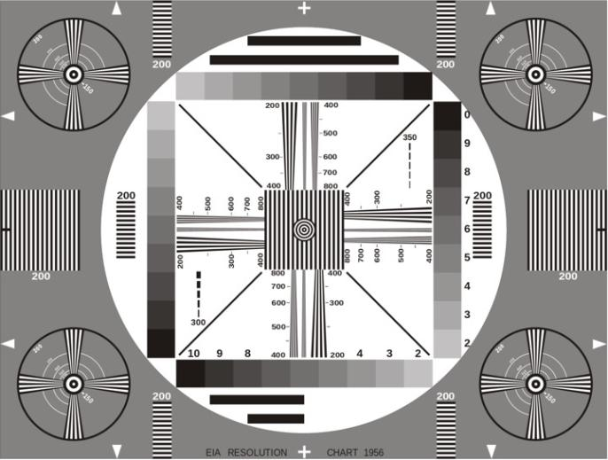
Permission to Record?

Slide 3
Today’s Plan
1. What & Who
2. Introduction of subjects
3. Syllabus & Logistics
4. Exercise

Slide 4
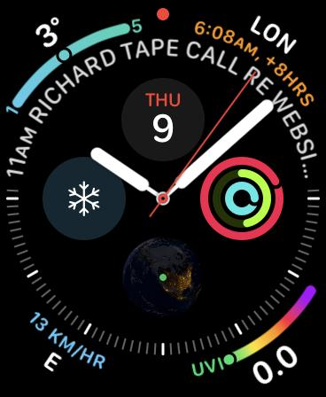
No, we will not spend the whole three hours…
Maybe an hour and a half...

Slide 5
Copyright
Trademark
Patents

Slide 6
Each with different (sometimes very different) public interest aspects

Slide 7
Intellectual Property Law is about:
What kinds of creations of the mind can one have rights in?
Who can have those rights?
What kinds of rights are there; and how are those rights enforced?

Slide 8
Ch-Ch-Changes

Slide 9
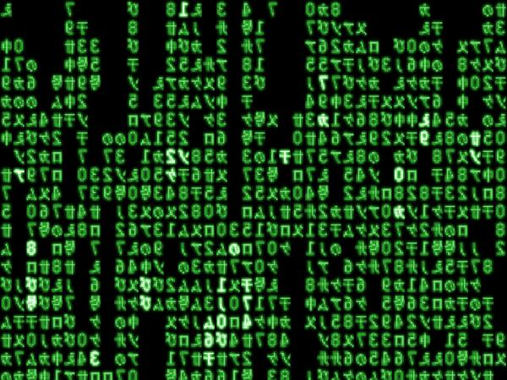
When everything is digitally fixated…

Slide 10
A.I.
Creation of the mind?

Slide 11
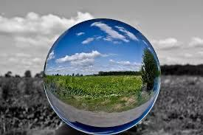
The Metaverse:
Life through the digital lens

Slide 12
Defenses to copyright infringement?
Temporary Reproductions for Technological Processes
30.71 It is not an infringement of copyright to make a reproduction of a work or other subject-matter if
(a) the reproduction forms an essential part of a technological process;
(b) the reproduction’s only purpose is to facilitate a use that is not an infringement of copyright; and
(c) the reproduction exists only for the duration of the technological process.

Slide 13
Without s.30.71 (Before 2012)
Fair Dealing (requires a category – education?)
Majority decision in Théberge v. Les Galleries d’Art du Petit Champlain Inc. [2002] 2 SCR 336
Technological neutrality doctrine of SCC
Canadian Admiral Corp. v. Rediffusion Inc. [1954] Ex. CR 382
Incidental Use/De Minimis? - S.30.7 Copyright Act
Retransmission, Network Services etc. (Copyright Act)
Contra
CBC v. SODRAC [2015] 3 S.C.R. 615

Slide 14

Thought Experiment: Trademarks
What is the essence of a brand?
What is the essence of a brand the metaverse?

Slide 15
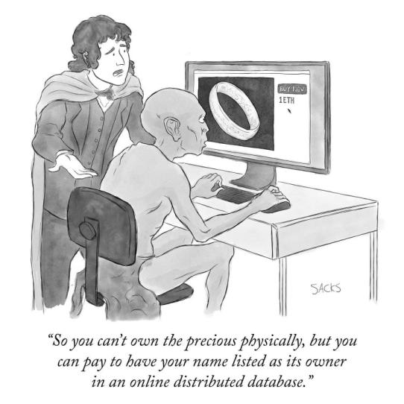
N.F.T.’s

Slide 16
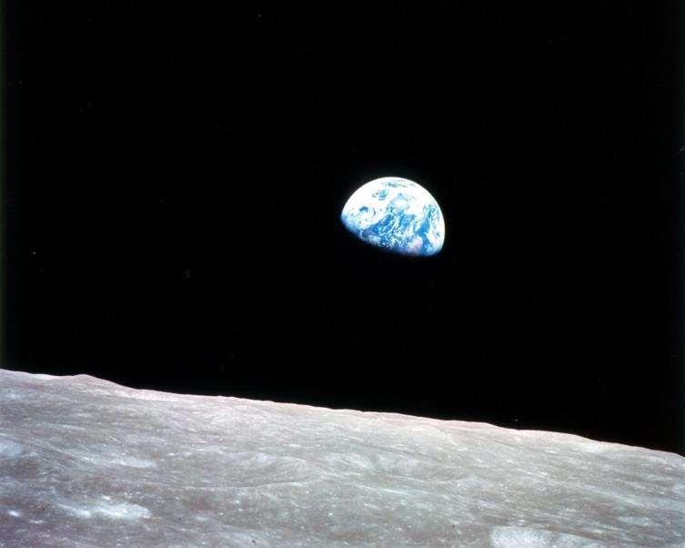
Canadian Law: International Context

Slide 17
I.P. - Once a niche area, not anymore…

Slide 18
Logistics

Slide 19
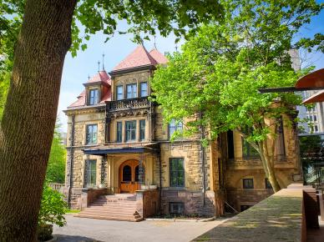



Me (IP history?)

Slide 20
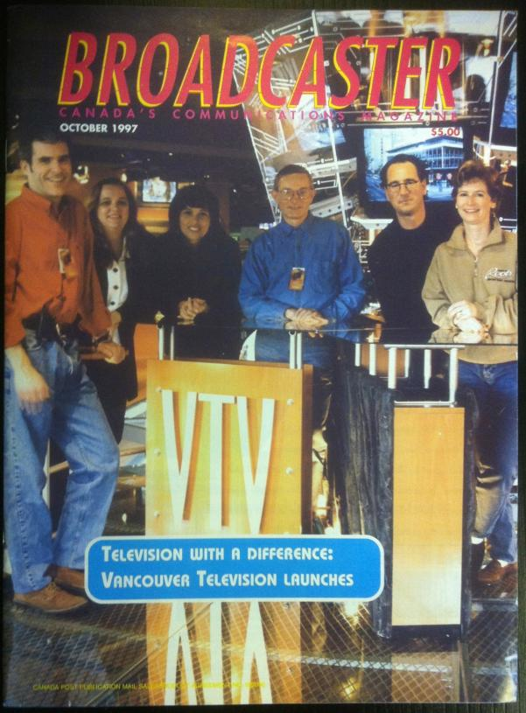

Slide 21


Slide 22
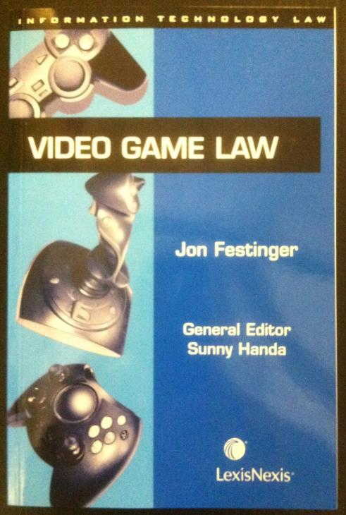

Slide 23
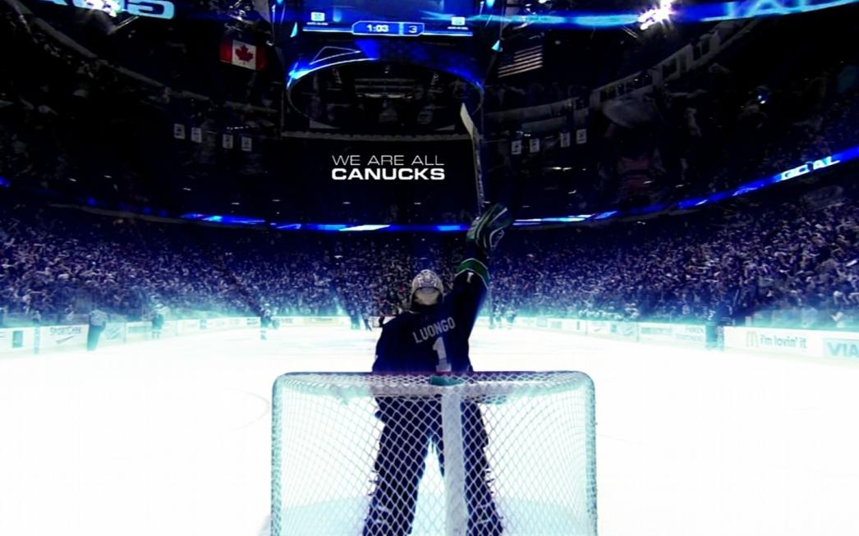

Slide 24
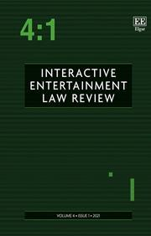

Slide 25
Favorite Intellectual Property
(current or all-time)?

Slide 26


Slide 27


Slide 28
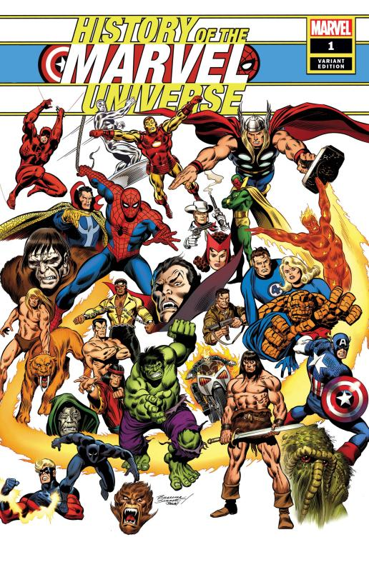

Slide 29
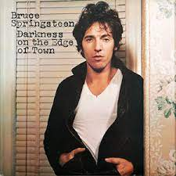

Slide 30


Slide 31
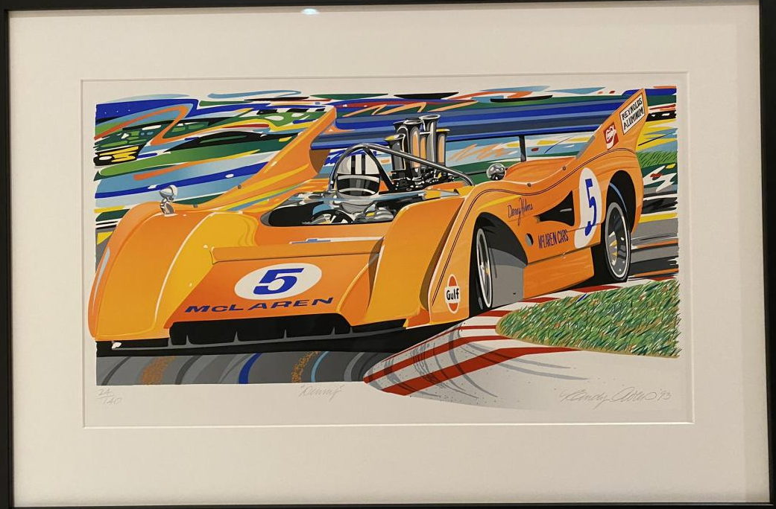

Slide 32
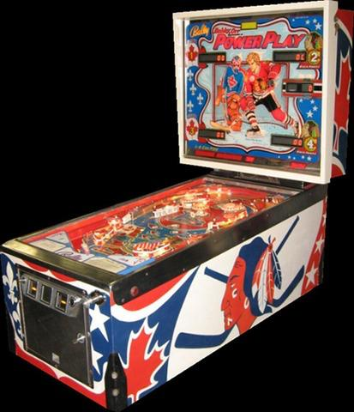

Slide 33


Slide 34
Now
You

Slide 35
Entirely optional but please…
…email me a short bio of yourself referencing:
Anything at all you want to say about yourself
Your academic interests
What you might like to get out of this course (I.E., interest in a type of patent, or a copyright issue etc.)
Favorite Intellectual Property (ies) - current or all-time

Slide 36
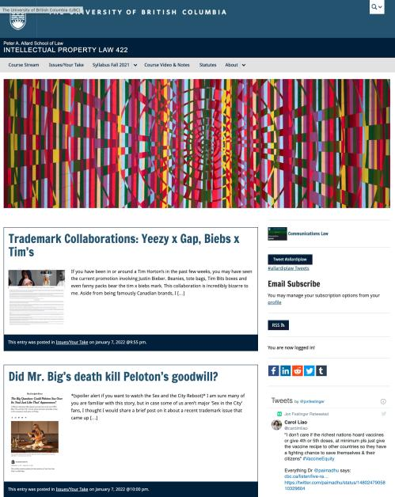
Course Website
https://iplaw.allard.ubc.ca/

Slide 37
PLEASE
SIGN UP

Slide 38
For full privileges on the website
1. Please create an account at http://cms.ubc.ca/ using your CWL.
2. Once you create an account and sign in at http://cms.ubc.ca/ you can click your name in the top right. Halfway down the following page will be your WordPress email address.
3. Send me your WordPress email address at jon.festinger@ubc.ca or at jon_festinger@thecdm.ca
4. Then, I will invite you to participate with authoring privileges via your WordPress email address.

Slide 39

Why post?
Engaging and engaging others is the key.
Because you don’t love speaking up in class.
Because you just saw or realized something, and you’ll never remember it unless you post it now.
# AllardIPLaw

Slide 40
Tips:
Don’t feel your posts have to be perfect. Engaging and engaging others is the key.

Slide 41

Anything & everything can be done via email if you prefer

Slide 42
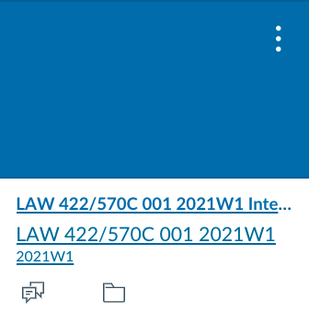
UBC Canvas?

Slide 43
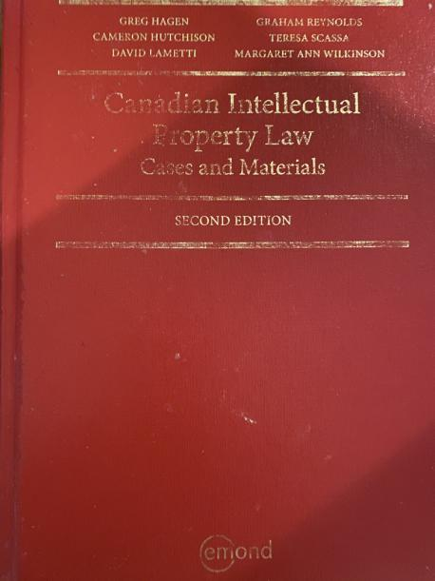
Text

Slide 44
Features of this Course
70% Exam not 100%
IP Law “In Context”
Website usage
Technology?

Slide 45
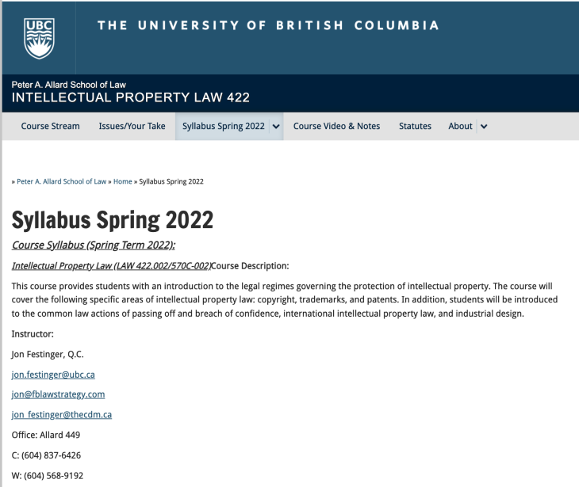
Syllabus: The Same But…

Slide 46
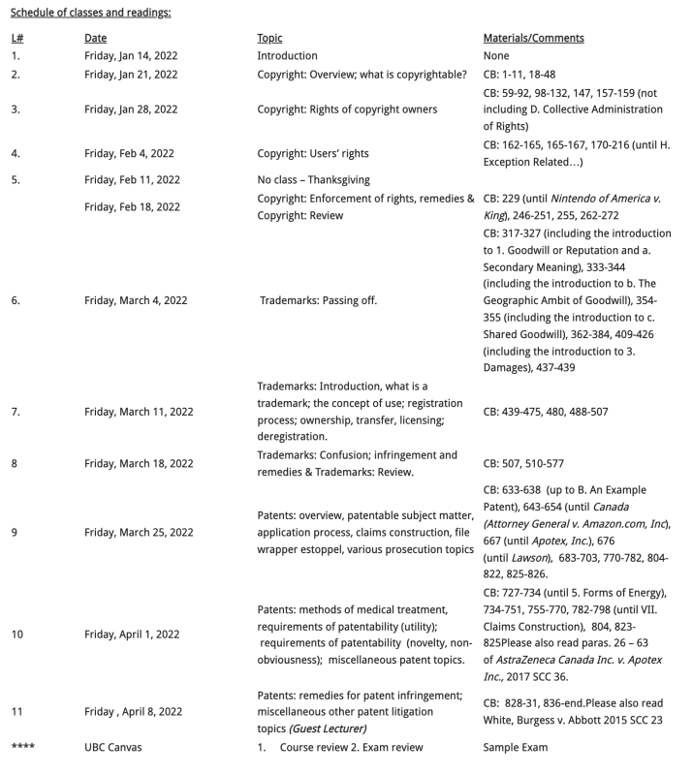

Slide 47
News of
the Week

Slide 48

Office “Hours”: Ideally Fridays before or after class but am flexible…
Email: jon.festinger@ubc.ca
Office: 449
Phone:
o. 604-568-9192
c. 604-837-6426

Slide 49

Pause

Slide 50
QUESTIONS?
THOUGHTS?
DISCUSSION?

Slide 51
Evaluation
(LLMCL students?)

Slide 52
Let’s talk about…
The 30%

Slide 53
A modest proposal…
500-1000 words (or equivalent) per person
written, video, podcast, in-class presentation (?), interpretive dance
Website or not
Groups or individually

Slide 54
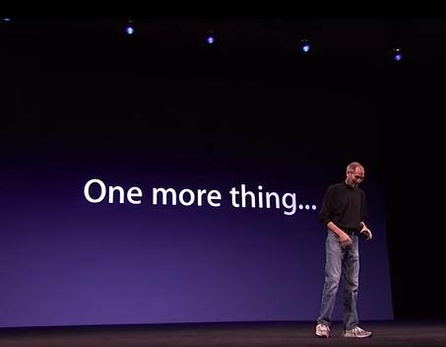


Slide 55
Reflecting on earlier slide…
Intellectual Property Law is about:
What kinds of creations of the mind can one have rights in?
Who can have those rights?
What kinds of rights are there; and how are those rights enforced?
Any IP issues/conundrums
you are curious about?…

Slide 56
INTELLECTUAL (ok?)
PROPERTY (really?)

Slide 57
For next week…

Slide 58


Slide 59
QUESTIONS?
THOUGHTS?
DISCUSSION?

Slide 60
Pause

Slide 61
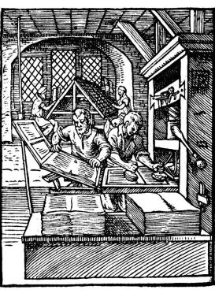
Coming Soon
“Copyright Law”

Slide 62
SEE YOU NEXT WEEK!

Slide 63

Always include a cat picture

Slide 64
In learning you will teach
And in teaching you will learn
Phil Collins' Son of Man (1999)

Slide 65
Our Academic Partners

