Slide 1
LOT Network: Protection Against Patent Trolls

Slide 2
What is it?
Non-profit organization founded specifically to combat patent assertion entities (also known as patent trolls)
Founding members: Canon, Google, Red Hat
Member companies come from a diversity of industries
Notable new member this year: Bytedance, creator of TikTok
Notes:
https://lotnet.com/

Slide 3
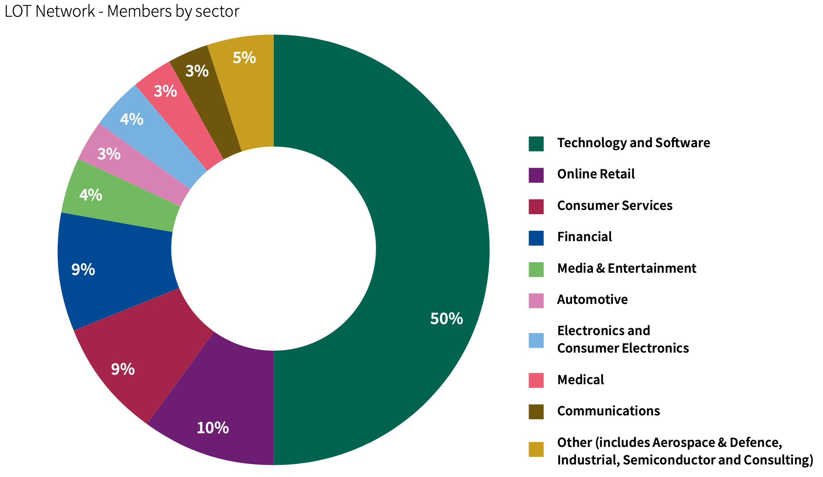
What is it?
Non-profit organization founded specifically to combat patent assertion entities (also known as patent trolls)
Founding members: Canon, Google, Red Hat
Member companies come from a diversity of industries
Notable new member this year: Bytedance, creator of TikTok
Notes:
LOT Network Report 2020: Why the largest portfolio in the world reduces risk from Patent Assertion Entities (28 October 2020)

Slide 4
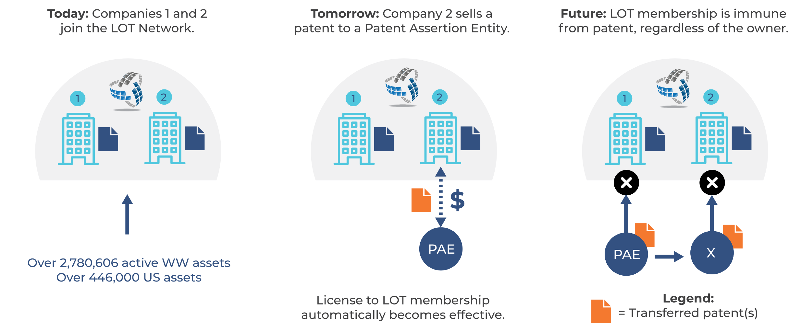
How are Members Protected?
Defining characteristic of a “PAE”, per the LOT Agreement
“collectively derived from Patent Assertion more than half of their total consolidated gross revenue measured over the full 12 months preceding a particular date”
Note: Members retain all other traditional uses of patents, meaning that members can still sue each other – Waymo v Uber (2017), IBM v Airbnb (2020)
Notes:
LOT Network Report 2020: Why the largest portfolio in the world reduces risk from Patent Assertion Entities (28 October 2020)

Slide 5
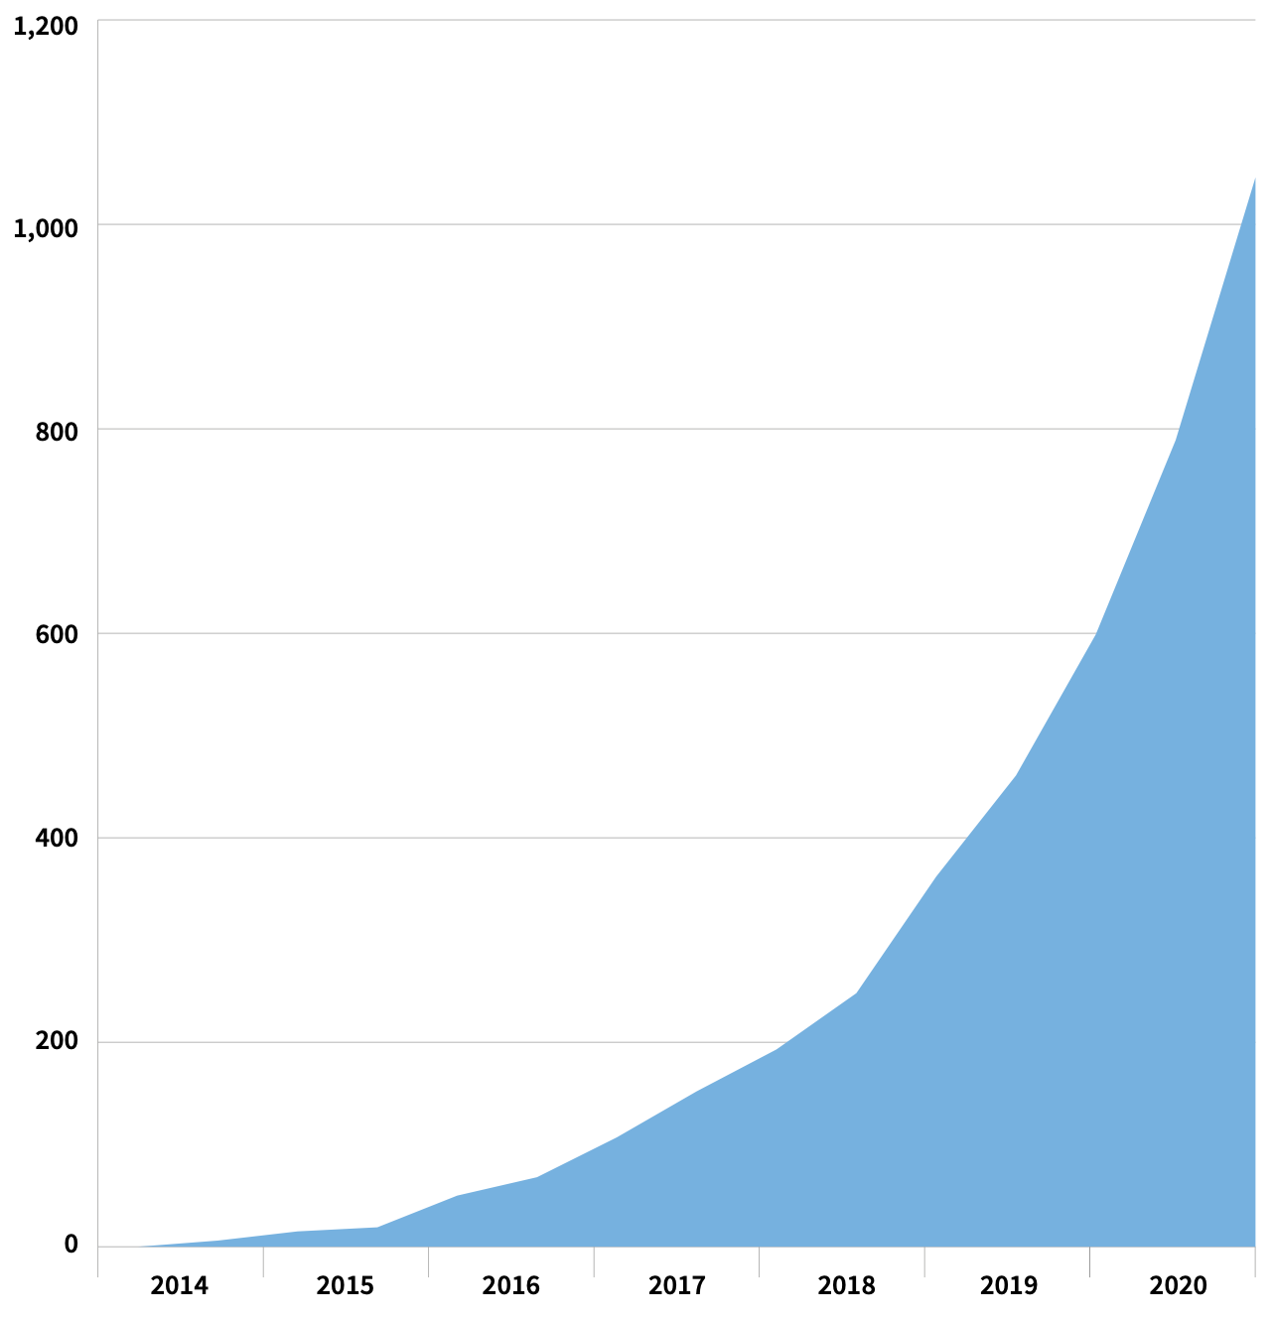
Fast Growth
New Member Companies by year:
2014: 15
2015: 35
2016: 57
2017: 87
2018: 169
2019: 236
2020: 598
2021: 651 and counting
75 in November
13 in December
Now: 1,848 companies, over 3.3 million patent assets in the network
Notes:
https://lotnet.com/members/

Slide 6
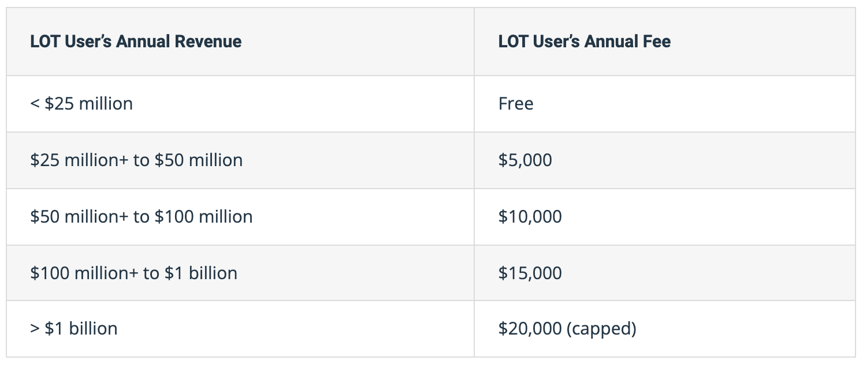
Key Reasons for Its Exponential Growth
Pricing structure incentivizes smaller startup companies to join
Incentive to join increases as more companies join (more so if those companies have large patent portfolios)
Four out of the top five largest patent holders based on active patent families are LOT members (as of January 2021)
Canon (joined 2014 – 36,161 active patent families)
Microsoft (joined 2018 – 30,042)
IBM (joined 2020 – 38,541)
Robert Bosch GmbH (joined 2021 – 28,235)
Notes:
https://lotnet.com/lot-network-pricing/
https://www.ificlaims.com/rankings-global-assets-2020.htm

Slide 7
Shortcomings
A staff member of a patent advisory and transaction firm in Texas stated in 2017 that arrangements such as the LOT Network are “patent dilution schemes” that are ”all about destroying the value of the portfolios of its members”.
My personal views are that the LOT Agreement is crafted in a way that limits depreciation of value of patent portfolios to a minimum.
Another IP expert stated that while the LOT Network does provide protection against patent assertion entities, it does not account for poor patent quality, or member companies who are competitors suing one another solely for the purpose of stalling progress.
Notes:
http://ipwire.com/stories/trouble-lot-network/
https://www.cnbc.com/2018/02/08/a-tesla-self-driving-blind-spot-that-few-are-focusing-on.html

Slide 8
Prospects
The LOT Network now has “13 of the largest holder of AI patents, 11 of the world’s largest holders of blockchain patents, and 7 of the world’s largest automotive original equipment manufacturers (OEMs) among its membership”.
It is likely that membership will continue to grow at a fast pace as the snowball effect of joining the LOT Network becomes more evident.
Notes:
https://lotnet.com/lot-network-achieves-significant-membership-milestone-1000-members-and-counting/

