Slide 1

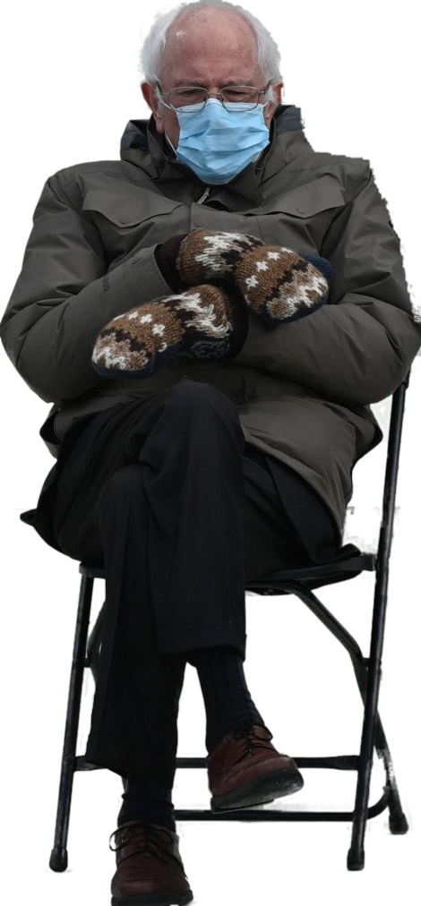

Trademarks 3
Talk 9
LAW 422 001
Intellectual Property Law
Allard School of Law, UBC
Fall, 2021
Jon Festinger Q.C.
Centre for Digital Media
QMUL School of Law (CCLS)
Whiteboard Law
http://commlaw.allard.ubc
@jonfestinger
jon_festinger@thecdm.ca

Slide 2
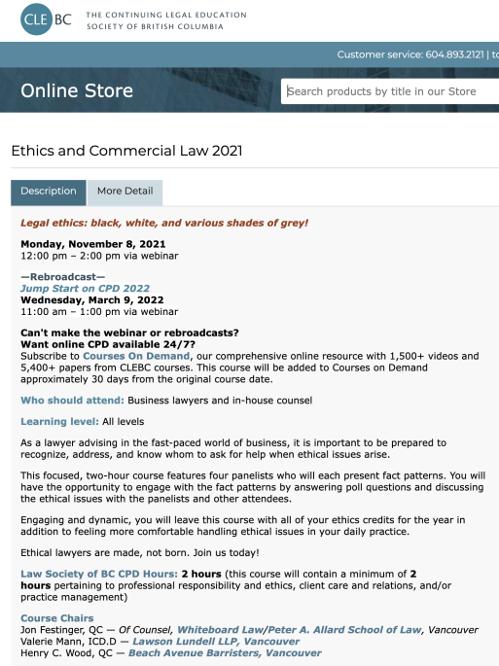
Thanks!

Slide 3
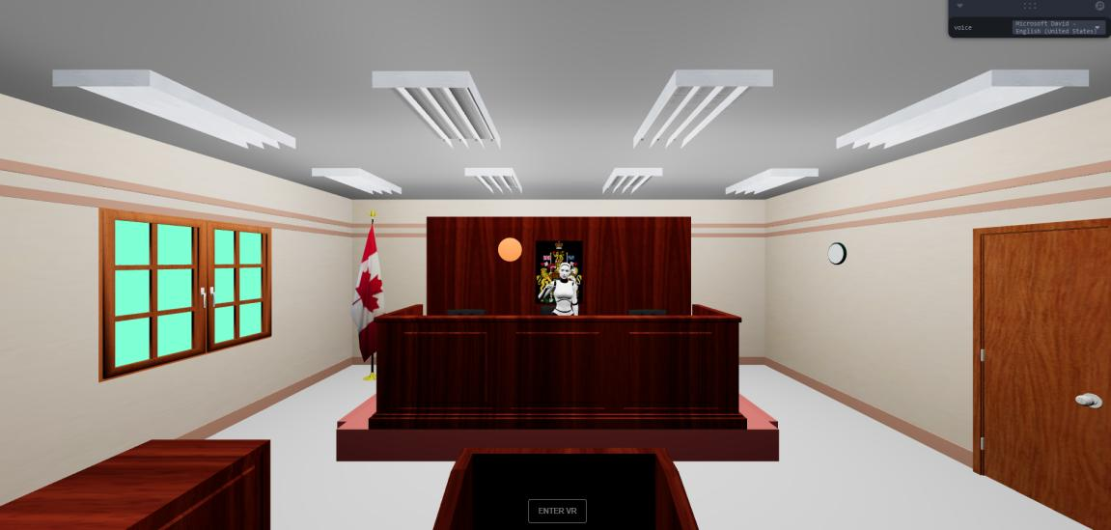
UBC Emerging Media Law Moot A.I. Project

Slide 4


Slide 5
Course Evaluations
NOVEMBER 25
TO
DECEMBER 8

Slide 6
Stuff

Slide 7
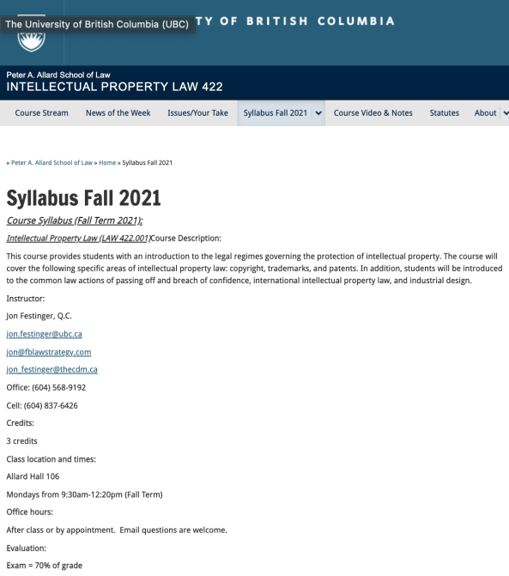
Any Questions?…

Slide 8
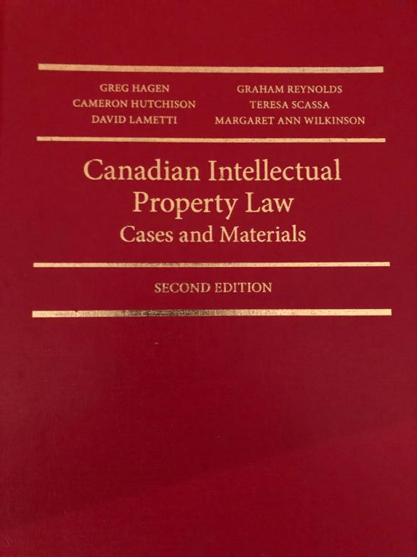

Slide 9

Office “Hours”: Ideally Mondays before or after class but am flexible…
Email me : jon.festinger@ubc.ca
Skype: jon.festinger
Phone:
o. 604-568-9192
c. 604-837-6426

Slide 10
Thank you for
your (optional) bios.
Much appreciated.

Slide 11
Evaluation
(LLMCL students extra)

Slide 12
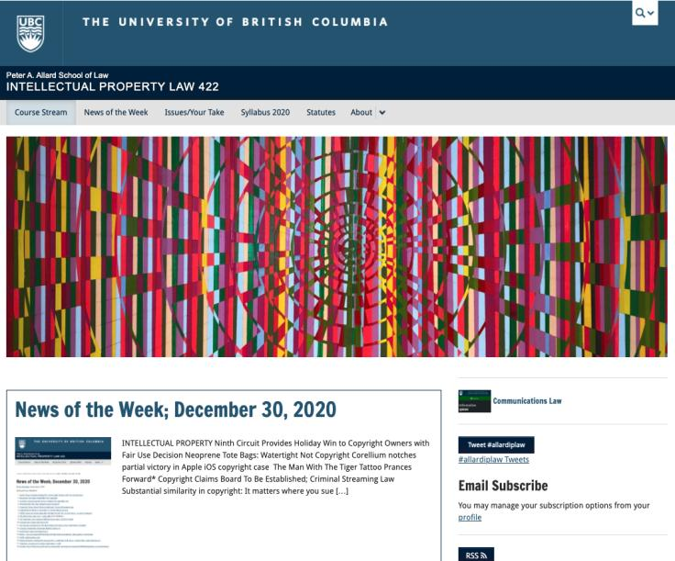
Course Website
https://iplaw.allard.ubc.ca/

Slide 13
For full privileges on the website
1. Please create an account at http://cms.ubc.ca/ using your CWL.
2. Once you create an account and sign in at http://cms.ubc.ca/ you can click your name in the top right. Halfway down the following page will be your WordPress email address.
3. Send me your WordPress email address at jon.festinger@ubc.ca or at jon_festinger@thecdm.ca
4. Then, I will invite you to participate with authoring privileges via your WordPress email address.

Slide 14
Evaluation
70% = Exam
Paper/Presentation/Post = 20%
Participation = 10%

Slide 15
Let’s talk about…
The 30%

Slide 16
A modest proposal…
500-1000 words (or equivalent) per person
written, video, podcast, in-class presentation (?), interpretive dance
Website or not
If posted to website, note to me pls.
Groups or individually

Slide 17
QUESTIONS?
THOUGHTS?
DISCUSSION?

Slide 18

Pause

Slide 19
News of
the Week

Slide 20
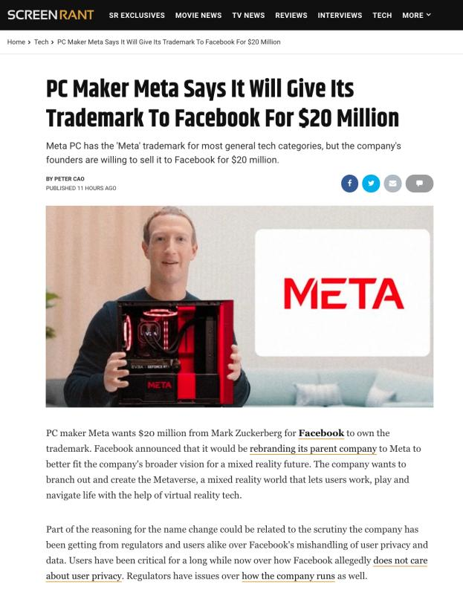

Slide 21
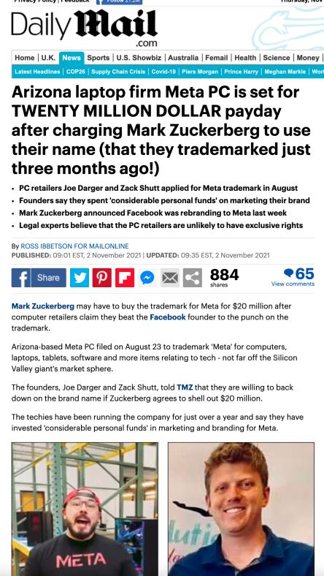

Slide 22
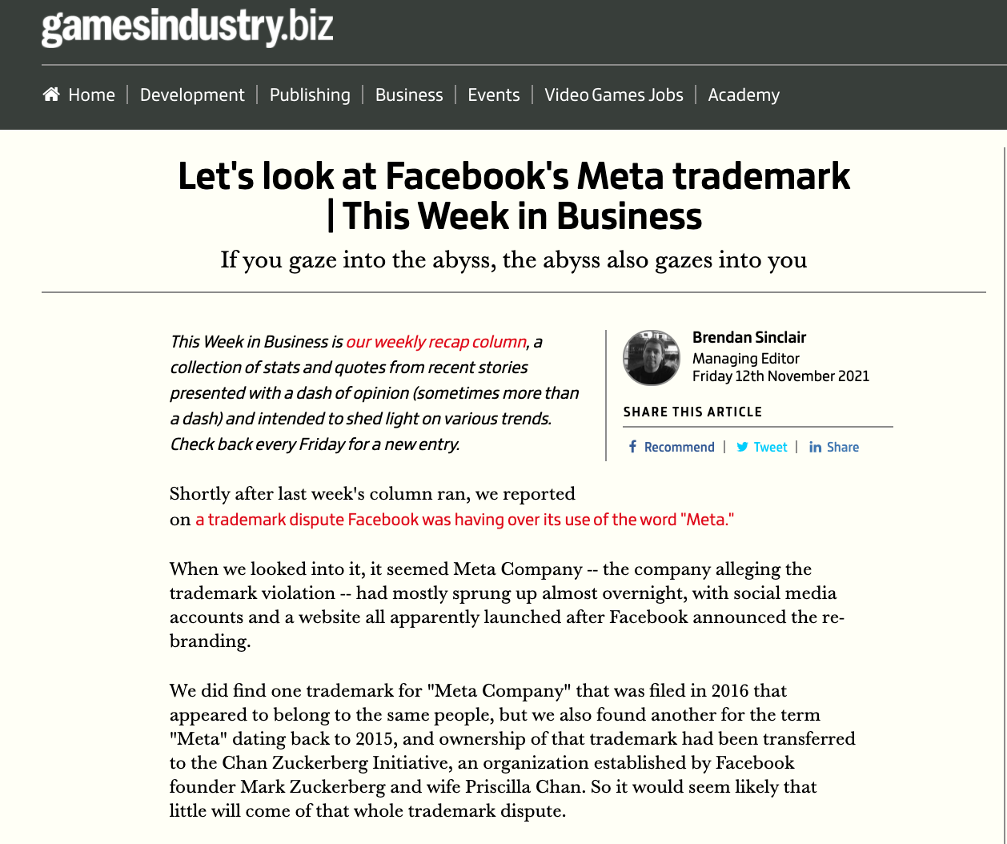

Slide 23
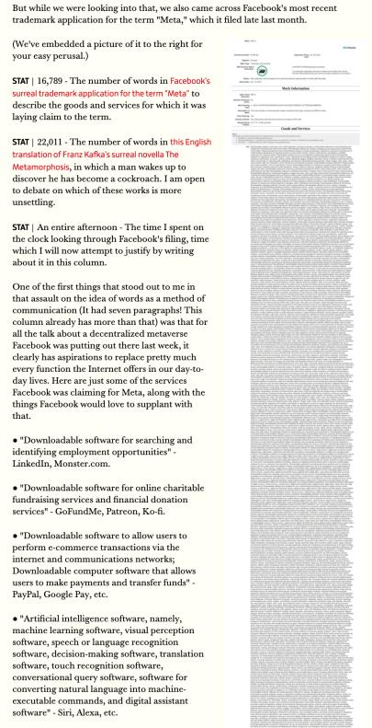

Slide 24
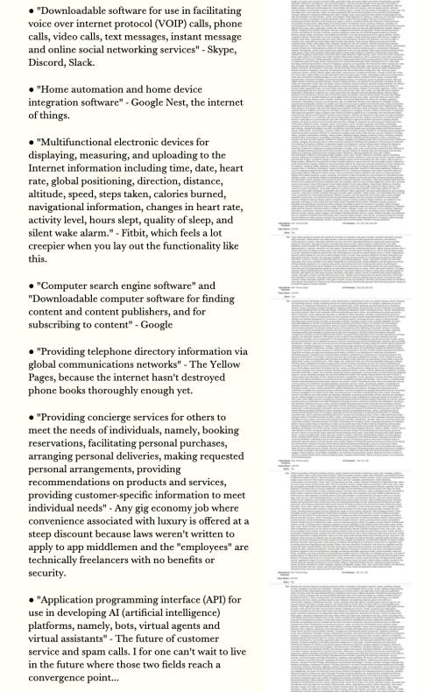

Slide 25
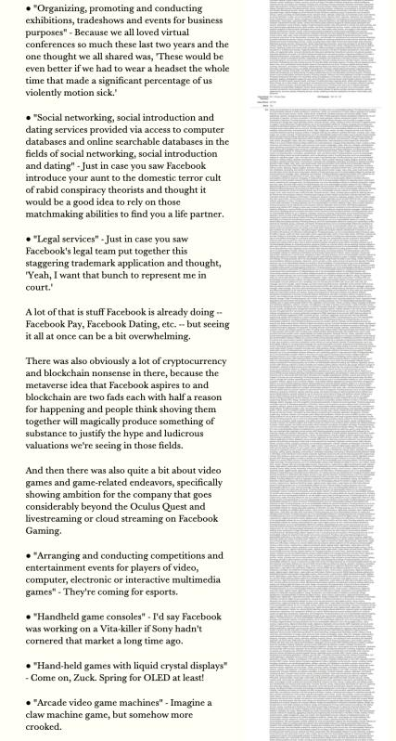

Slide 26
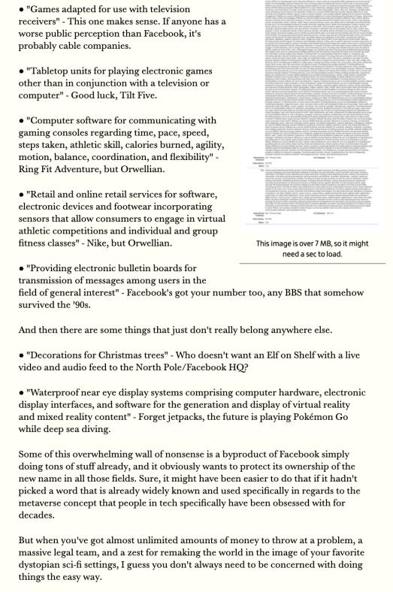

Slide 27
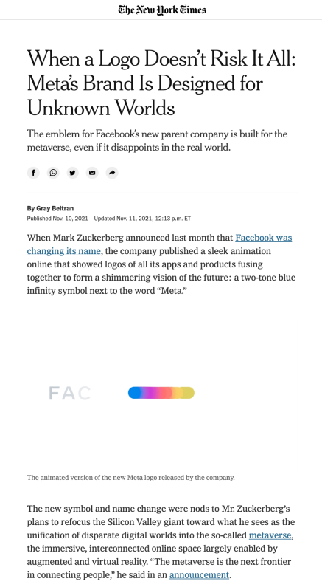

Slide 28
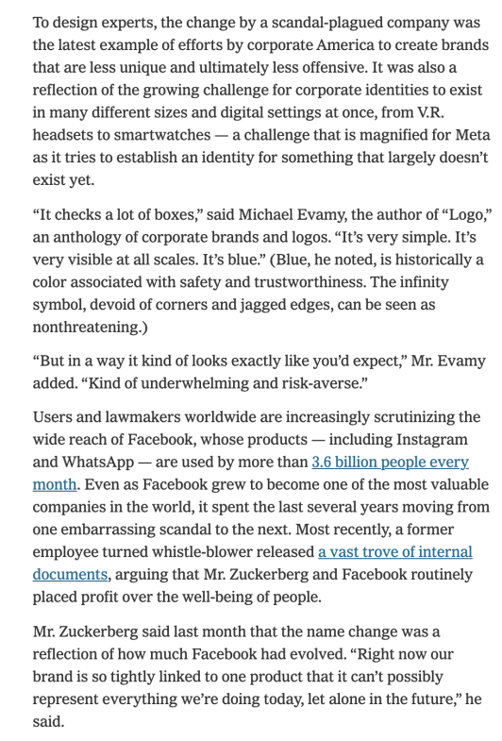

Slide 29
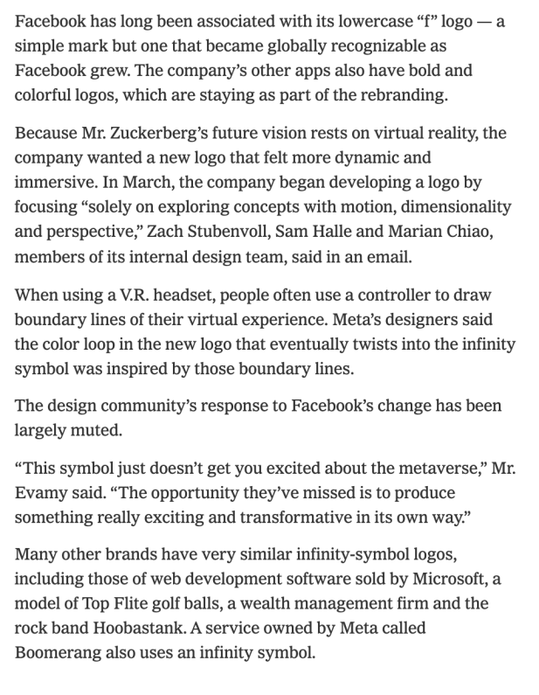

Slide 30


Slide 31
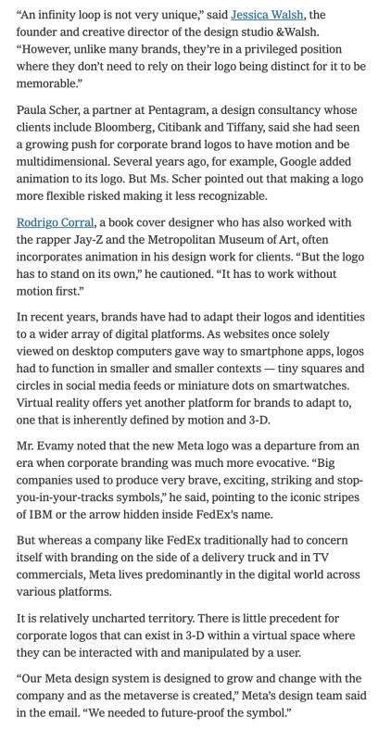

Slide 32
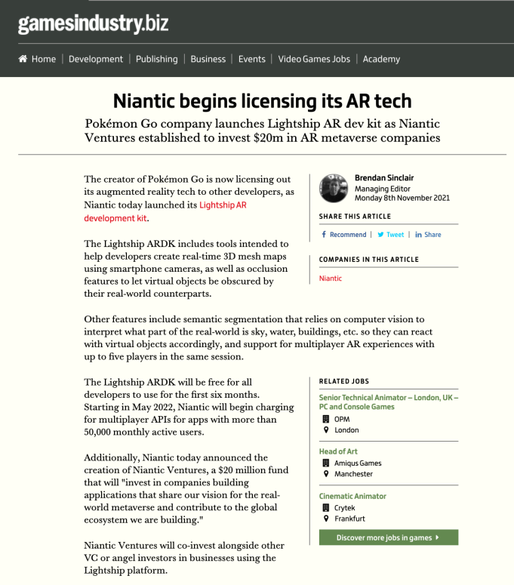

Slide 33
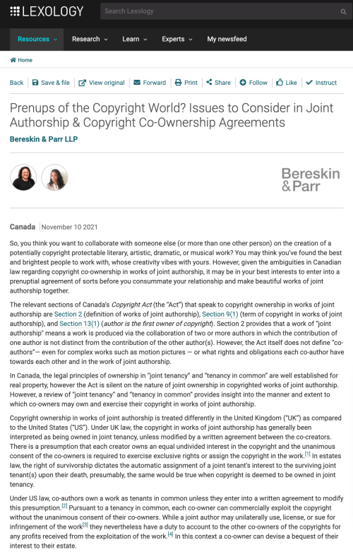

Slide 34
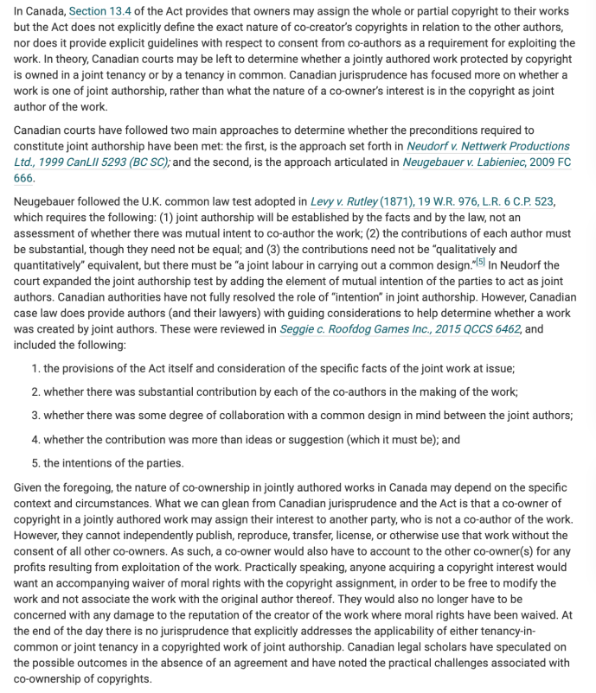

Slide 35
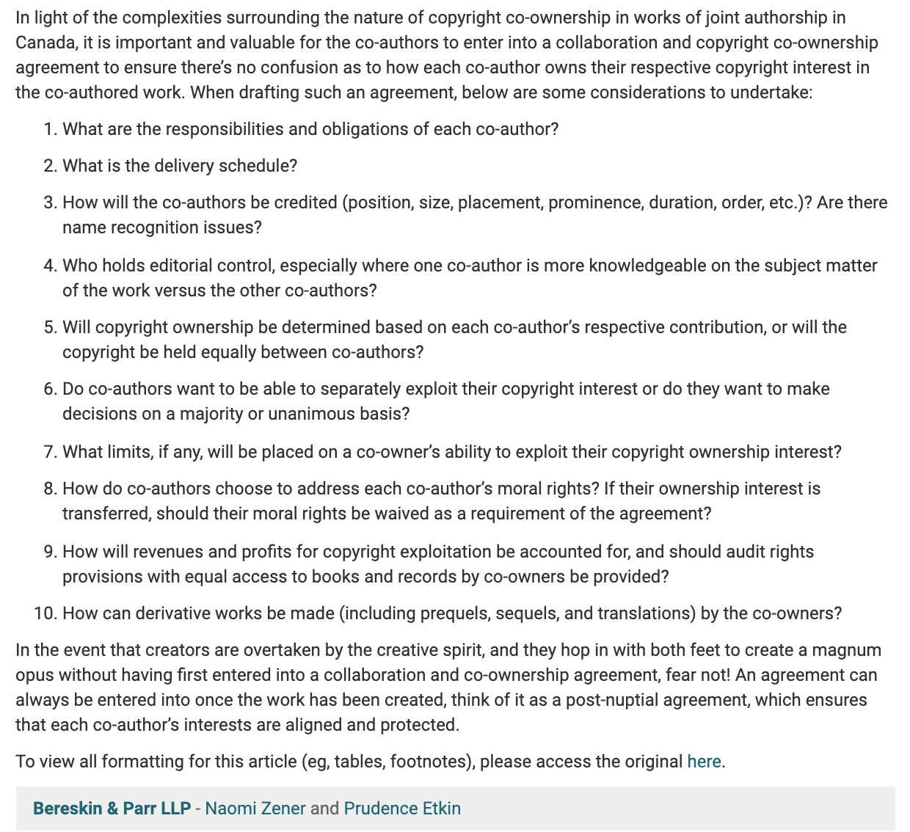

Slide 36
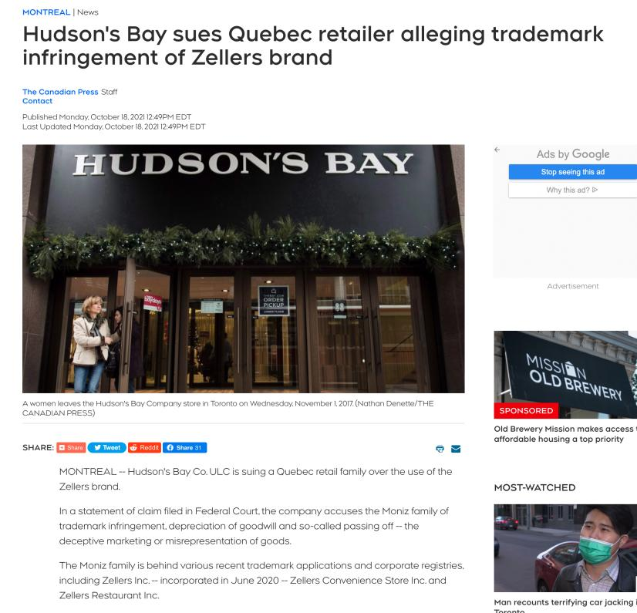

Slide 37
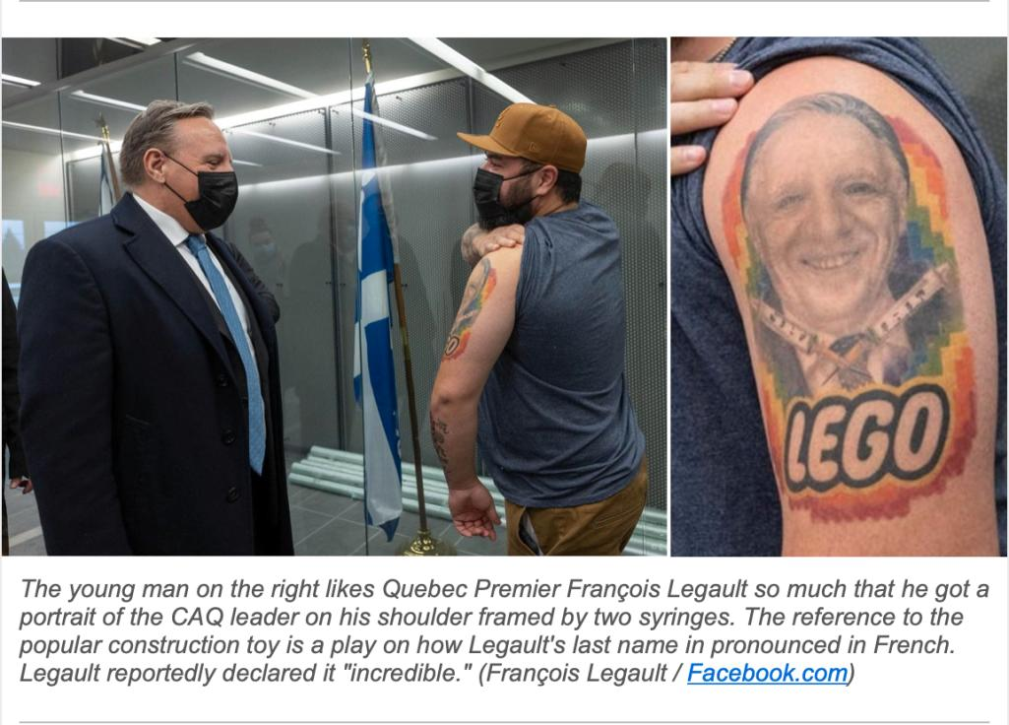

Slide 38
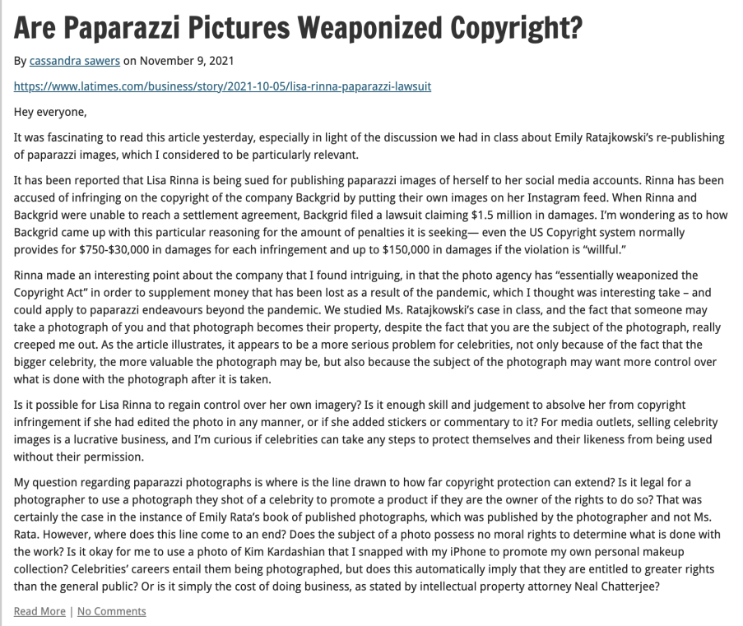

Slide 39
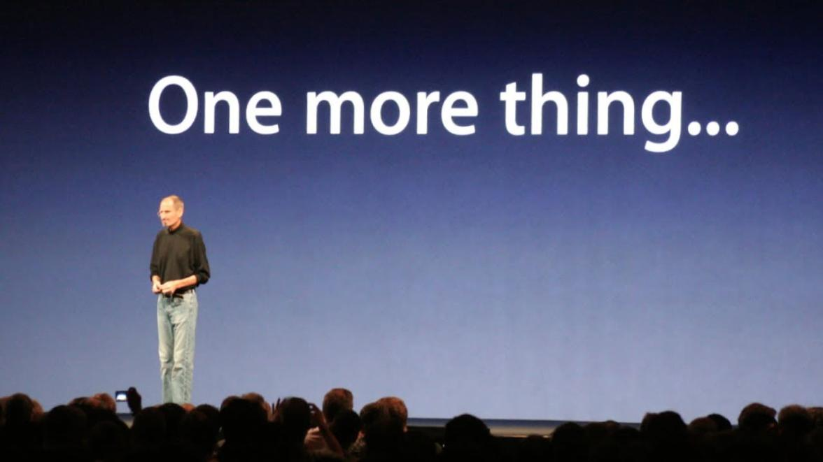


Slide 40
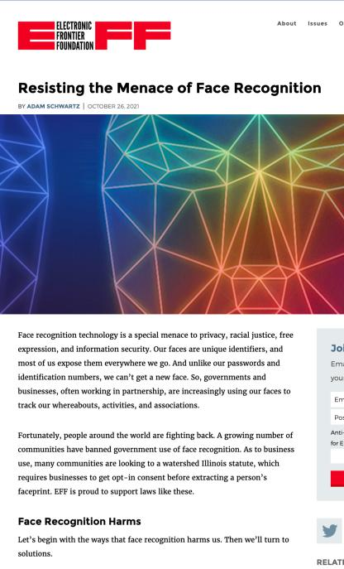
1. From 2 weeks ago…

Slide 41
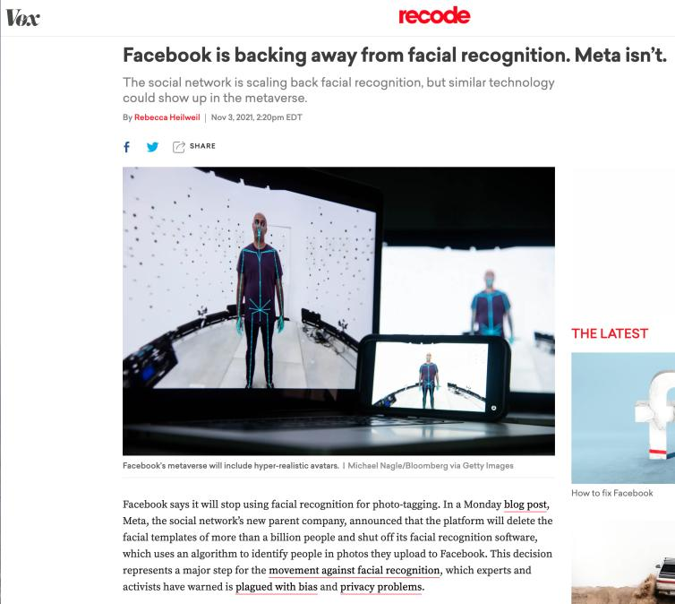
This week…

Slide 42
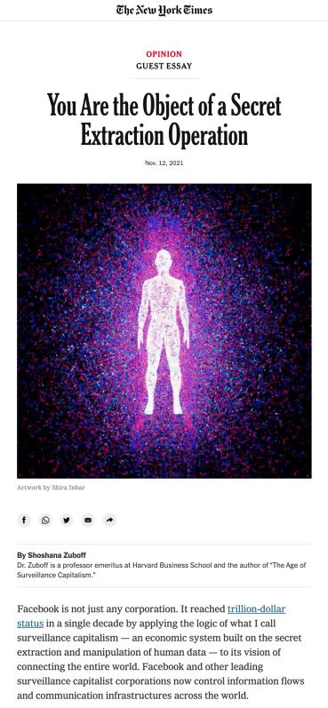

Slide 43
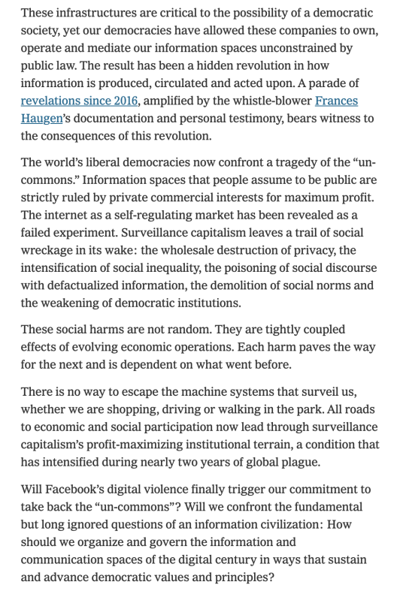

Slide 44
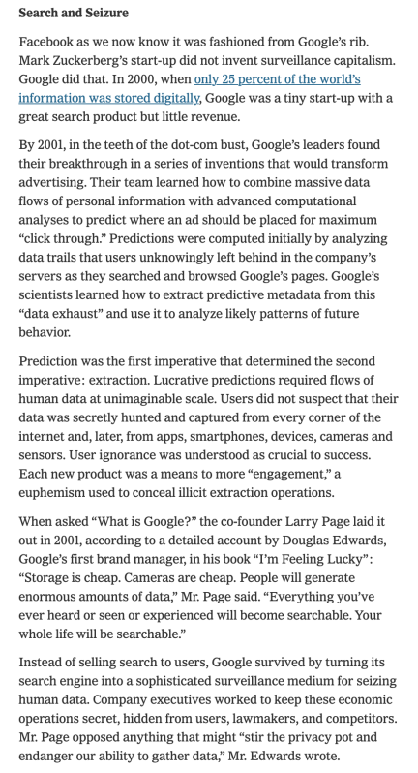

Slide 45
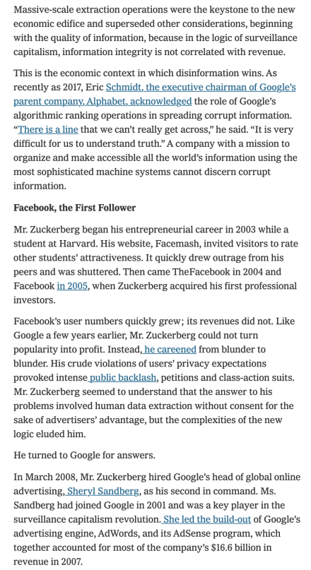

Slide 46
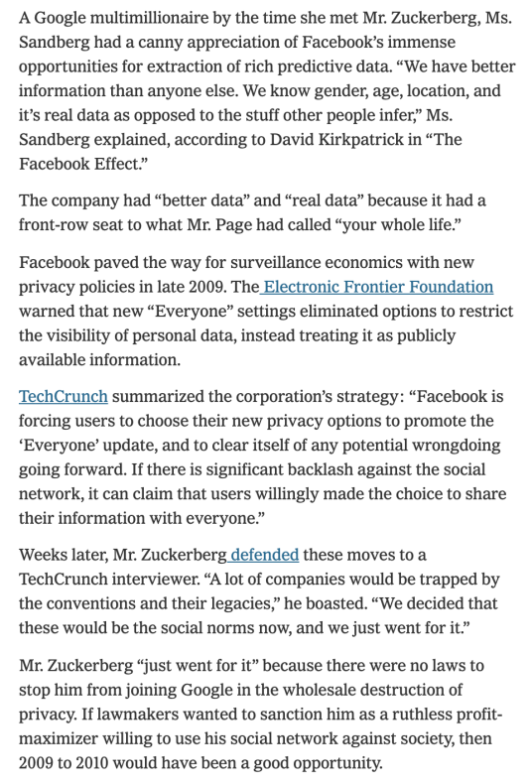

Slide 47
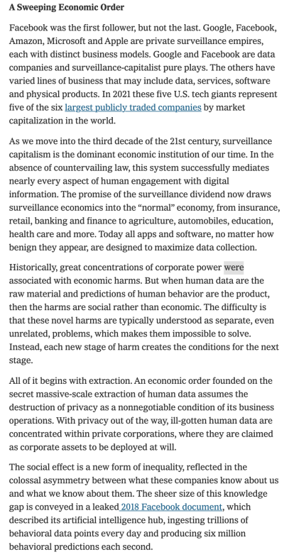

Slide 48
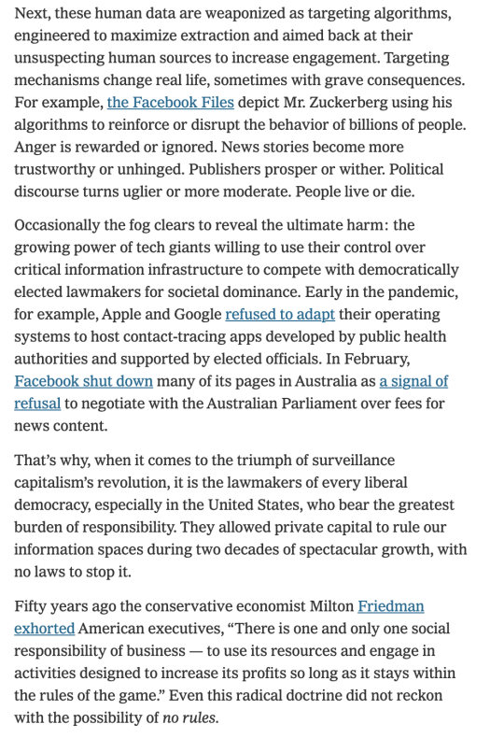

Slide 49
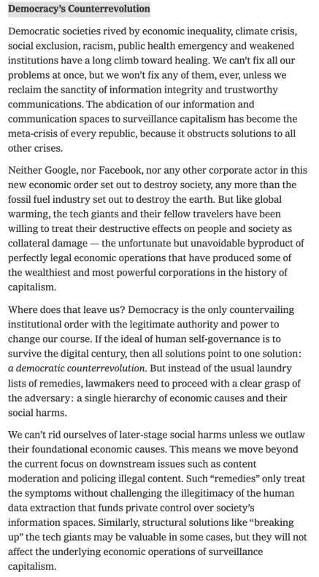

Slide 50
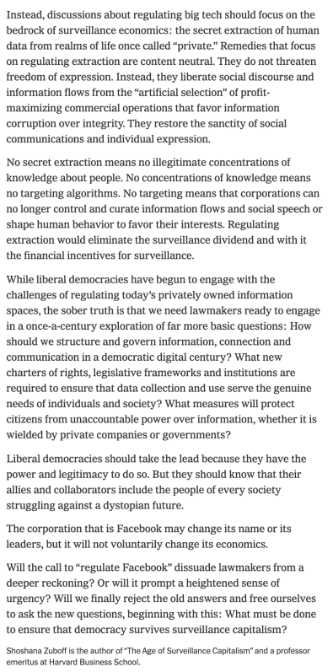

Slide 51
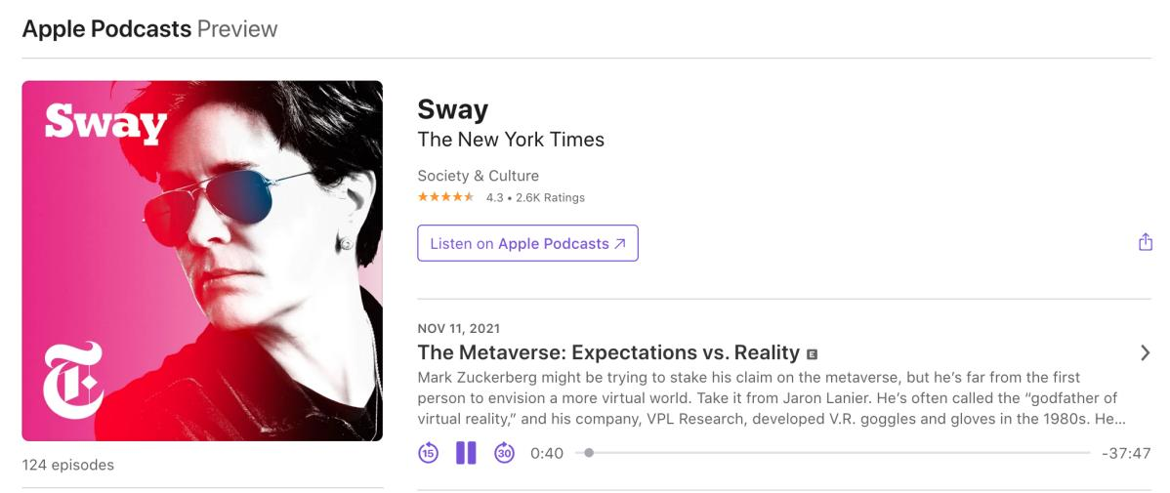
https://www.nytimes.com/2021/11/11/opinion/sway-kara-swisher-jaron-lanier.html
https://www.nytimes.com/2021/11/11/opinion/sway-kara-swisher-jaron-lanier.html?showTranscript=1

Slide 52
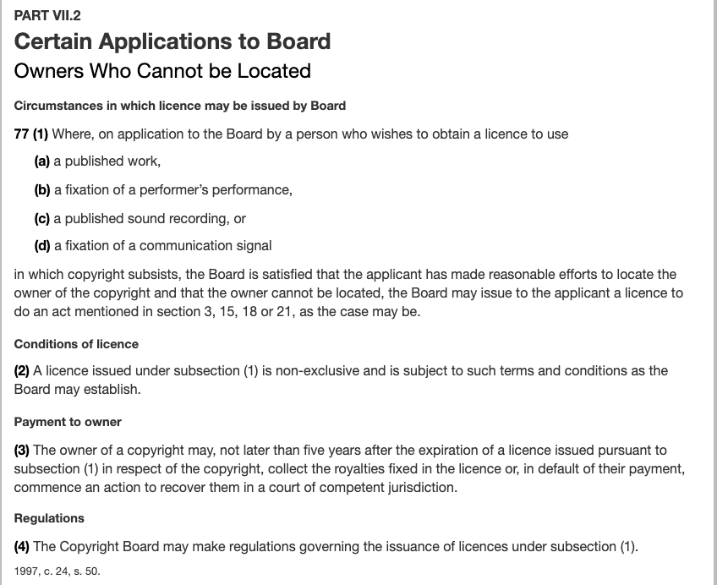
2. Orhan Works Update…

Slide 53
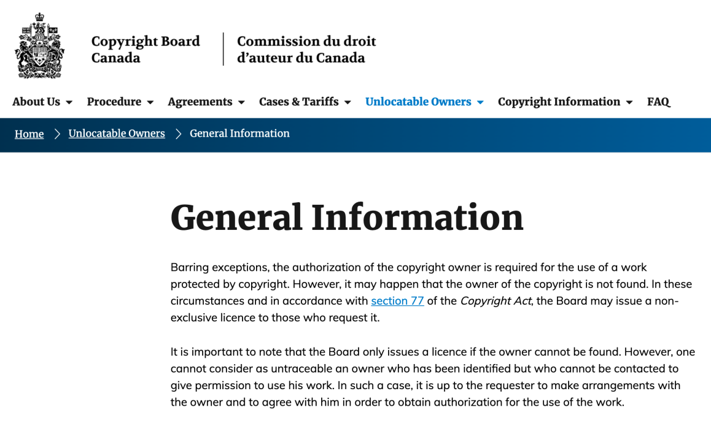

Slide 54
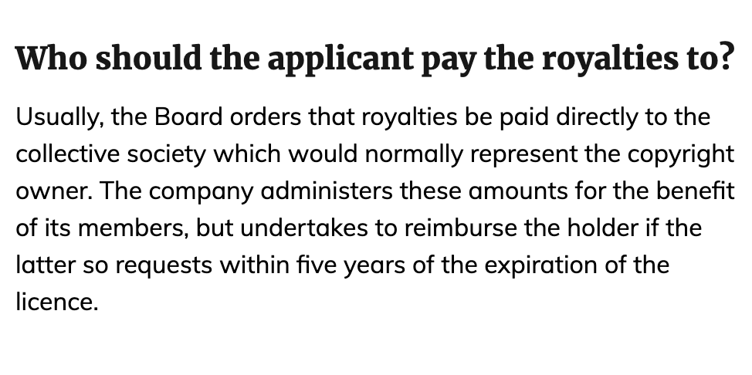

Slide 55
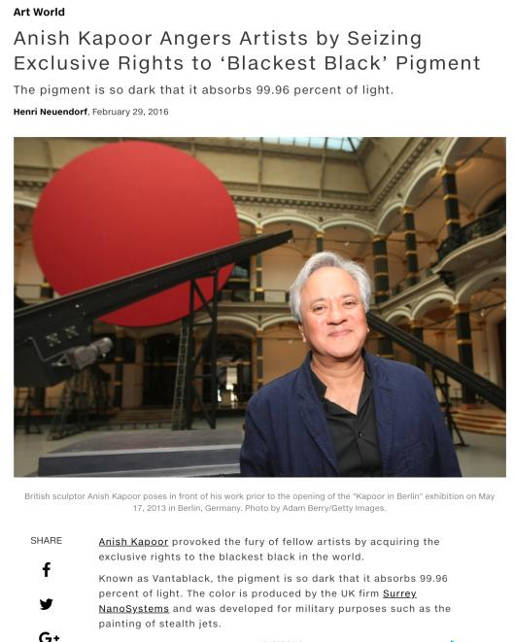
3. The Blackest Black

Slide 56
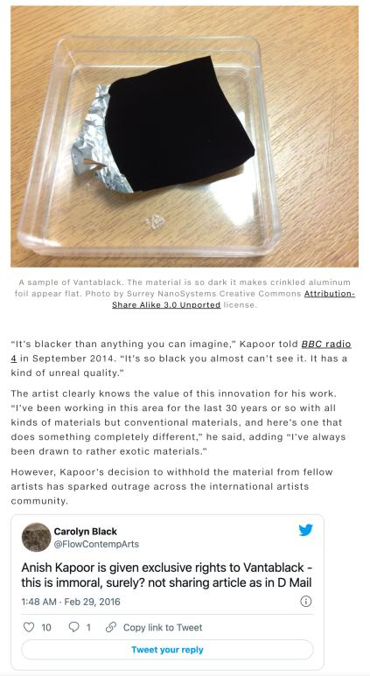

Slide 57
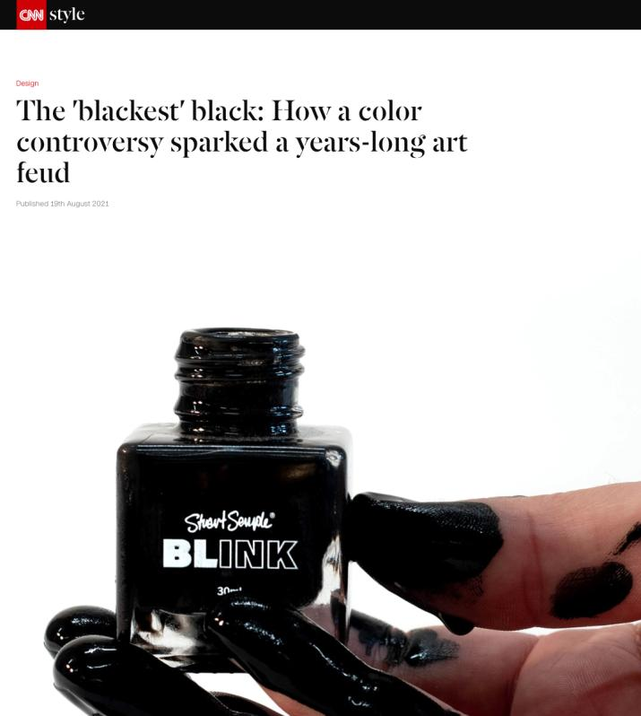

Slide 58
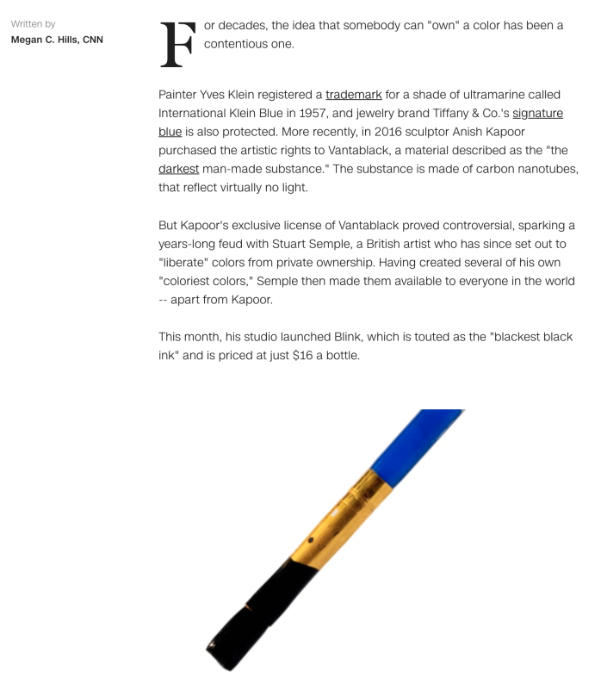

Slide 59
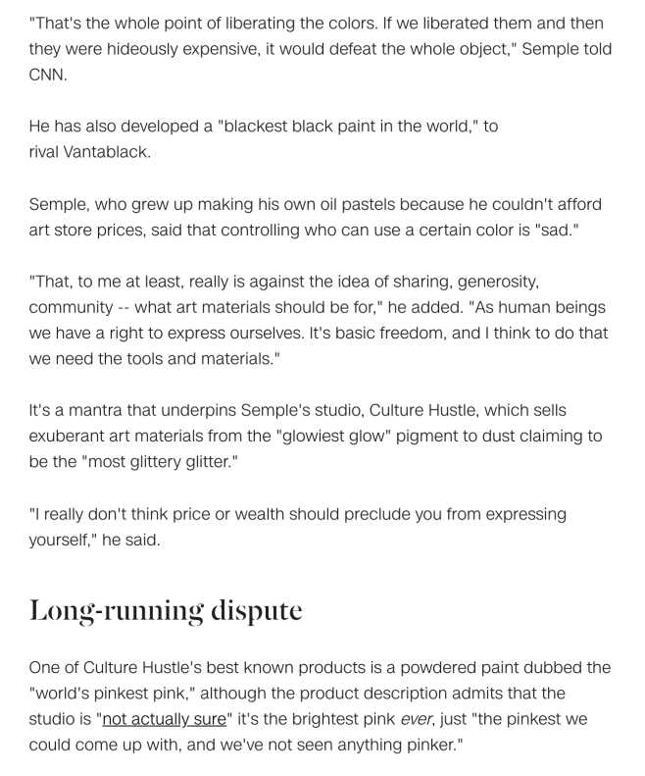

Slide 60
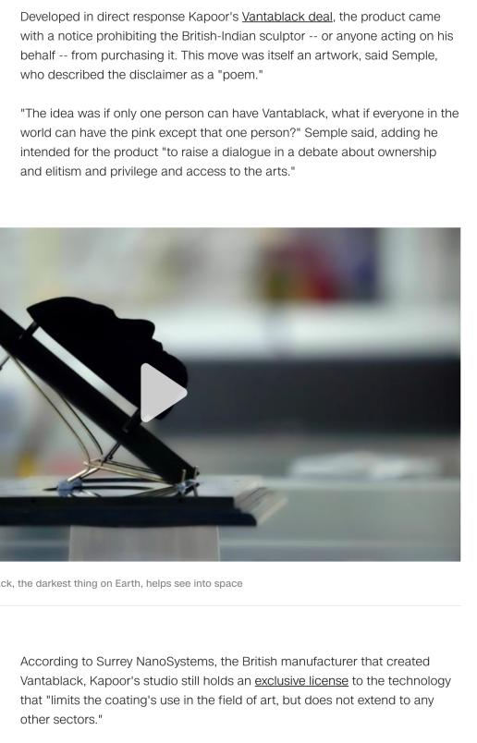

Slide 61
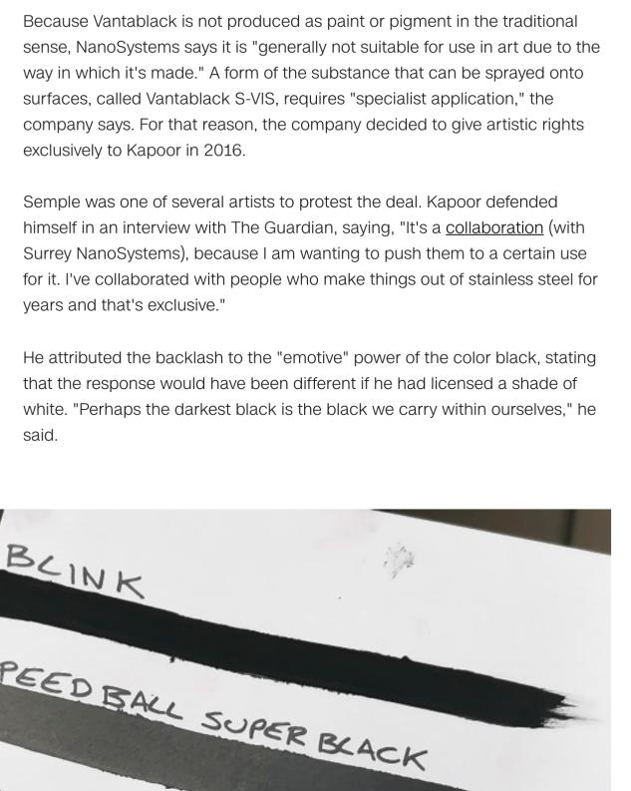

Slide 62
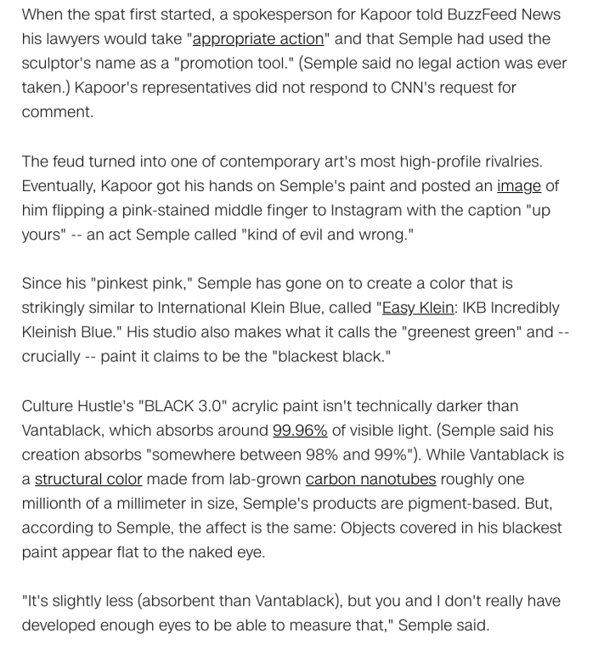

Slide 63
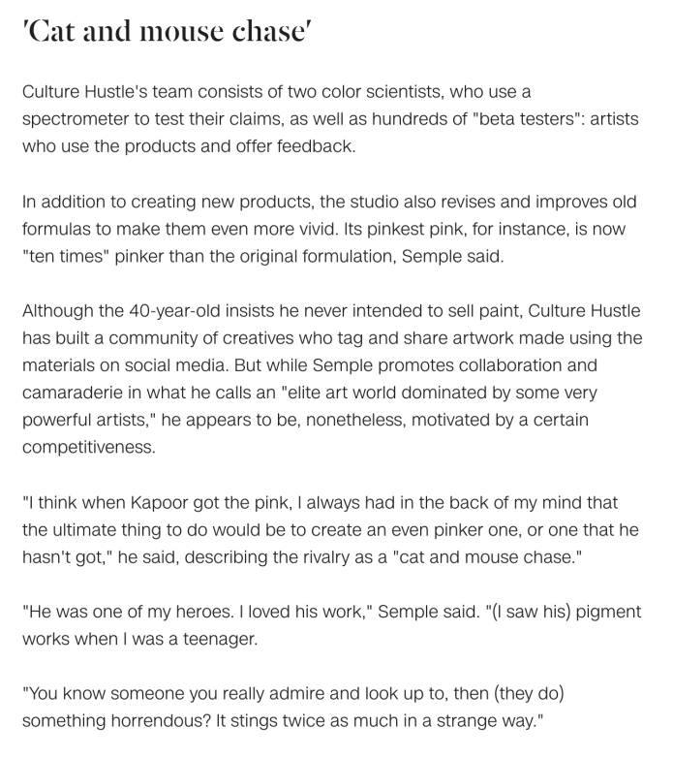

Slide 64

4. NFT Update…

Slide 65
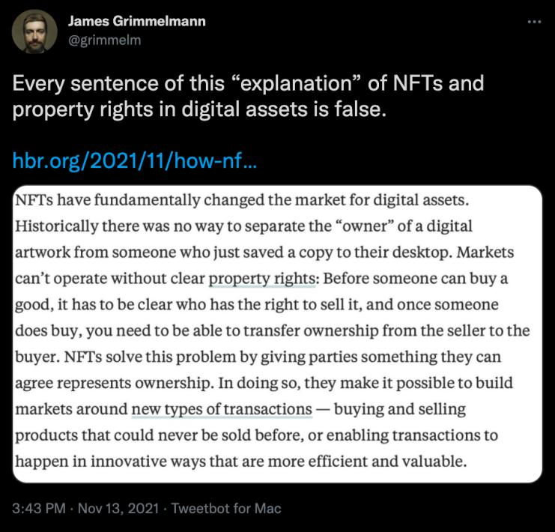
https://twitter.com/grimmelm/status/1459668266515931140

Slide 66


Slide 67


Slide 68


Slide 69


Slide 70
Yours?

Slide 71
QUESTIONS?
THOUGHTS?
DISCUSSION?

Slide 72
Pause

Slide 73
For Next Class: Keep a list of interesting brands to see how they would hold up under Canadian trademark law.

Slide 74


Slide 75


Slide 76


Slide 77


Slide 78


Slide 79


Slide 80


Slide 81




Slide 82
THOUGHTS?
DISCUSSION?

Slide 83
Pause

Slide 84

Re-capping

Slide 85
Trademarks
What is a Trademark ™?
  A mark used by a person for the purpose of distinguishing that person’s goods or services from those of others in the marketplace
Various types of marks
  Ordinary (word & design), certification, collective, official, distinguishing guise

Slide 86
Trademarks
Ordinary marks
  S. 2: definition of trade-mark (in part): (a) a mark that is used by a person for the purpose of distinguishing or so as to distinguish goods or services manufactured, sold, leased, hired or performed by him from those manufactured, sold, leased, hired or performed by others.

Slide 87


Slide 88
Trademarks
Ordinary marks
Amended definition (2014 - in effect 2019):
  TM: A sign or combination of signs that is used or proposed to be used by a person for the purpose of distinguishing or so as to distinguish their goods and services from those of others.
  Sign: Includes a word, a personal name, a design, a letter, a numeral, a colour, a figurative element, a three-dimensional shape, a hologram, a moving image, a mode of packaging goods, a scent, a taste, a texture, and the positioning of a sign.

Slide 89
Trademarks
S. 12(1): A TM is registrable if it is not:
  (a) Primarily merely a name or surname of an individual living or who has died within 30 years
  (b) Clearly descriptive or deceptively misdescriptive in English or French of the character/quality of wares/services or of the conditions of production/persons employed in their production/place of origin

Slide 90
Trademarks
Test to Apply: Would a person in Canada of ordinary intelligence and of ordinary education in English or French be just as likely, if not more likely, to respond to the word by thinking of it as a brand or a mark of a business than as a name/surname?

Slide 91
Trademarks
Unilever Canada Inc. v. Superior Quality Foods Inc. (2007), 62 CPR (4th) 75, [2007] TMOB No. 66
Clearly descriptive = does the mark tell potential dealers/purchasers of the goods/services what the goods and services are, or describe them or describe a property which is commonly associated with them?

Slide 92
Trademarks
  Unilever Canada Inc. v. Superior Quality Foods Inc. (2007), 62 CPR (4th) 75, [2007] TMOB No. 66
  Deceptively misdescriptive = would dealers/purchasers of the goods be deceived by the misdescription into purchasing goods or ordering services which different in character or quality from those expected?

Slide 93
Trademarks
  Unilever Canada Inc. v. Superior Quality Foods Inc. (2007), 62 CPR (4th) 75, [2007] TMOB No. 66
S. 12(1)(b):
  Point of View?: That of the average purchaser of the wares
  Consider the mark in its entirety (not dissected into constituent elements)
  Consider thee mark as a matter of immediate impression

Slide 94

Trademarks: Distinguishing guise no more

Slide 95
Instead of “distinguishing guise”
s. 2 …“sign includes a word, a personal name, a design, a letter, a numeral, a colour, a figurative element, a three-dimensional shape, a hologram, a moving image, a mode of packaging goods, a sound, a scent, a taste, a texture and the positioning of a sign;”

Slide 96
Trademarks
Distinguishing guise
Now that distinguishing guises have ceased to exist as a separate category of TM, similar limitations to those set out in the previous s. 13(1) will be carried over elsewhere, and will apply to all marks

Slide 97
Trademarks : Special Marks
S. 9 Trademarks Act
Two categories of prohibited marks
  Absolute prohibitions
  Official marks (9(1)(n)(iii))
What policy reasons could justify including a type of symbol/mark on the list of absolute prohibitions?

Slide 98
Trademarks
Statutory requirements for public authorities
  Mark must have been adopted and used
  Adoption and use has to be by a public authority in Canada
  Adoption and use must be as an official mark for wares and services

Slide 99
Trademarks
Ontario Ass’n of Architects v. Ontario Assn of Architectural Technologists, [2003] 1 F.C. 331 (FCA)
Defining characteristics of public authority =
  Degree of government control [para. 57-64]
  Extent to which the body’s activities benefit the public [para. 65-73]

Slide 100
Trademarks
A TM owner who has a registered mark that resembles an official mark effectively has their rights frozen at the time of publication of the official mark
  See Royal Roads University v. R. (2003), 27 CPR (4th) 240 (F.C.)

Slide 101
QUESTIONS?
THOUGHTS?
DISCUSSION?

Slide 102
Pause

Slide 103
Continuing From
Last Week

Slide 104
Trademarks : Use
USE IT
OR
LOSE IT?

Slide 105
Trademarks
“Use”
First use … entitles you to register a TM but amended provisions now allow for filing without intended use.
Failure to use … basis for expungement of TM
Unauthorized use … could lead to infringement actions

Slide 106
Trademarks
4. (1) A trade-mark is deemed to be used in association with goods if, at the time of the transfer of the property in or possession of the goods, in the normal course of trade, it is marked on the goods themselves or on the packages in which they are distributed or it is in any other manner so associated with the goods that notice of the association is then given to the person to whom the property or possession is transferred.
(2) A trade-mark is deemed to be used in association with services if it is used or displayed in the performance or advertising of those services.

Slide 107
Trademarks
Syntex Inc. v. Apotex Inc., [1984] 2 FC 1012 (FCA)
Facts:
  Syntex was the registered owner of the TradeMark Naprosyn; has sold Naproxen under this name since 1974.
  Apotex took Apo-Naproxen as the brand name of its product; registered it as a TM in Canada.
  In 1982 Apotex distributed a one-page flyer to hospital and retail pharmacists in Canada designed to promote the sale of Apo-Naproxen. Naprosyn was referenced on this flyer… A note w. Naprosyn 250mg written on it is juxtaposed with two containers of Apo-Naproxen tablets.
  Also a message …“Now pharmacists have a choice when filling a prescription for Naprosyn.”…

Slide 108
Trademarks
Syntex Inc. v. Apotex Inc., [1984] 2 FC 1012 (FCA)
Did the Defendants Apotex “use” the TM of the Plaintiffs Syntex (see ss. 2, 4 TMA)?
  4. (1) A trade-mark is deemed to be used in association with goods if, at the time of the transfer of the property in or possession of the goods, in the normal course of trade, it is marked on the goods themselves or on the packages in which they are distributed / or it is in any other manner so associated with the goods that notice of the association is then given to the person to whom the property or possession is transferred.

Slide 109
Trademarks
Syntex Inc. v. Apotex Inc., [1984] 2 FC 1012 (FCA)
  4. (1) A trade-mark is deemed to be used in association with goods if, at the time of the transfer of the property in or possession of the goods, in the normal course of trade, … it is in any other manner so associated with the goods that notice of the association is then given to the person to whom the property or possession is transferred.

Slide 110
Trademarks
Syntex Inc. v. Apotex Inc., [1984] 2 FC 1012 (FCA)
  4. (1) A trade-mark is deemed to be used in association with goods if, at the time of the transfer of the property in or possession of the goods, in the normal course of trade, … it is in any other manner so associated with the goods that notice of the association is then given to the person to whom the property or possession is transferred.

Slide 111

Trademarks
Syntex Inc. v. Apotex Inc., [1984] 2 FC 1012 (FCA)
Court said on this point… “It seems to me that the respondents (Syntex) face considerable difficulty in establishing at trial that the presence of the trade mark “Naprosyn” in the appellant’s flyer constituted a “use” that is contrary to subsection 22(1) of the Trade Marks Act”

Slide 112

What happens to trademark registrations when evolving technology has changed the manner or medium by which the identified goods and services are offered for sale to consumers?

Slide 113
Trademarks
Specialty Software Inc. v. Bewatec Kommunikationstechnik GMBH 2016 FC 223
Clients obtain access to software over the Internet (they had previously received a disk containing the software).
Does this mean that Specialty is providing a service as opposed to selling a product?
MyLife.com Inc v Grbic,2014 TMOB 175 (CanLII) says that providing free access to a website was a service.

Slide 114
Trademarks
Specialty Software Inc. v. Bewatec Kommunikationstechnik GMBH 2016 FC 223
Specialty Software Inc. registered the TM “MEDINET” in association w. computer software programs.
Mark was registered in relation to wares, not services.
…2013 – Bewatec attempted to have this mark expunged from the register.
To avoid expungement, Specialty had to show evidence of its use of the mark between November 22, 2010 and November 22, 2013.
Ultimately, Specialty provided evidence of use. But was this use in relation to wares?
Speciality used to sell its software on disks. Now, clients obtain access to the software over the Internet.

Slide 115
Trademarks
Specialty Software Inc. v. Bewatec Kommunikationstechnik GMBH 2016 FC 223
Party initiating the cancellation proceedings, argued that evidence of use was not sufficient to shield the registration from expungement due to non-use, because Specialty was no longer distributing goods, but rather offering services.
Federal Court disagreed, noting that although Specialty used to sell its software on disks, which are obviously tangible and easily identified as wares, it was in reality selling a license to use the software the entire time.
Selling a license is an intangible good.
Accordingly, the Federal Court declined to expunge the 1992 trademark registration on the grounds of non-use.

Slide 116
Trademarks
4 (1) A trade-mark is deemed to be used in association with goods if, at the time of the transfer of the property in or possession of the goods, in the normal course of trade, it is marked on the goods themselves or on the packages in which they are distributed or it is in any other manner so associated with the goods that notice of the association is then given to the person to whom the property or possession is transferred.
Is there a “good” here? If so, what is the good?
The good is the license to use the software.
The property is the right or the entitlement to enjoy the use of the license.
The transfer occurred through the granting of access in the form of login credentials.
The mark is visible throughout this process.
The disk, then, is just one means by which a transfer can occur. It can also occur through other ways (i.e., granting of access in the form of login credentials).

Slide 117
Trademarks
Has a TM been used within the meaning of s. 4(1) “in the normal course of trade” where goods are given away for free, as opposed to being sold?
See Distrimedic Inc. v. Dispill Inc., 2013 FC 1043 [302] … The expression "in the normal course of trade"…requires some payment or exchange, which excludes the use of a trade-mark in situations where the wares are given away for free or donated.

Slide 118
Trademarks
4(2) A trade-mark is deemed to be used in association with services if it is used or displayed in the performance or advertising of those services.

Slide 119
Trademarks
Gesco Industries Inc v. Sim & McBurney (2000) 9 CPR (4th) 480 (FCA)
The Registrar of Trademarks had expunged Gesco's registration of the trademark "Stainshield" for use in association with the services of stain resistant treatment for carpets and rugs.
The Registrar determined that Gesco failed to submit any evidence of use of the trademark.
Gesco appealed the Registrar's decision.
FCA held that when a trademark is used in association with services, the use does not have to occur in the normal course of trade.

Slide 120
Trademarks
Gesco Industries Inc v. Sim & McBurney (2000) 9 CPR (4th) 480 (FCA)
Rothstein J. defines services broadly.
He accepts the reasoning of Strayer J in this regard: [para 10]
No definition of services is given in the Trademarks Act because of the “plethora of services that the human mind is capable of conceiving”
Term should be liberally construed
Each case decided on its own facts, giving proper regard to judicial precedent.
Nothing to suggest that services with respect to which a TM may be established are limited to those which are not incidental or ancillary to the sale of goods.
So … services can include services incidental or ancillary to the sale of goods

Slide 121
Trademarks
Gesco Industries Inc v. Sim & McBurney (2000) 9 CPR (4th) 480 (FCA)
Was the Stainshield TM, in this case, used in association with the services disclosed in the registration of the TM (namely services of stain resistant treatment for application to carpets and rugs)?
Yes; Stainshield TM displayed in the advertising of the treatment of some of Gesco’s lines of carpets and rugs.
Services may be ancillary to the wares, but this doesn’t mean the TM is not used in association with the services. [para 11]
Are there good policy reasons for “use” to be more permissive for services than for goods?

Slide 122
QUESTIONS?
THOUGHTS?
DISCUSSION?

Slide 123
Pause

Slide 124
Trademarks v. Passing Off
Why would you want to register your TM?
Why not just rely on passing off?
TM = no proof of goodwill required. Only proof of use.
Registration of a mark provides national protection
Registered marks are presumed valid for Canada for all the wares and services for which they are registered.
s. 22 of the TMA protects against mark dilution
In situations where a mark is deemed invalid, a passing off action might still succeed

Slide 125
Trademarks: Transfer & Licensing
As a TM owner, you can transfer your TM.
Per s. 50 TMA you can also permit another person to use your mark without impairing the distinctiveness of the mark provided that:
    A licence exists
    Certain controls are in place over the quality of the wares What is sufficient control?
See also s. 48, TMA

Slide 126


Trademarks
Tommy Hilfiger Licensing Inc v. Produits de Qualité, 2005 FC 10

Slide 127
Trademarks
Tommy Hilfiger Licensing Inc v. Produits de Qualité, 2005 FC 10
Plaintiff, Tommy Hilfiger Licensing Inc. (THLI), owned the trademarks relating to the Tommy Hilfiger brand which manufactured and sold clothing.
Defendant, Quality Goods I.M.D. Inc. (controlled by Harry Rosen), created the "Explore Canada" logo and began displaying it on its souvenir products.
THLI sued Quality alleging infringement of the THLI trademarks.
Defendants argued that the Hilfiger trademarks were invalid.
Court held that the Hilfiger trademarks were valid and that the defendants' Explore Canada logo was likely to cause confusion.

Slide 128
Trademarks
Tommy Hilfiger Licensing Inc v. Produits de Qualité, 2005 FC 10
Court concluded that the Service Agreements signed by THLI allowed it to maintain sufficient control over the quality of the goods to avoid any potential confusion as to source
THLI’s service agreements required it to:
  Coordinate design and execution of licensed products.
  Review samples of licensed products.
  Plan and coordinate construction of licensees’ dedicated Tommy Hilfiger showrooms.
  Coordinate product launches.
  Plan and execute advertising and promotional plans and programs.

Slide 129
Trademark transferable
48 (1) A trademark, whether registered or unregistered, is transferable, and deemed always to have been transferable, either in connection with or separately from the goodwill of the business and in respect of either all or some of the goods or services in association with which it has been used.
Where two or more persons interested
(2) Nothing in subsection (1) prevents a trademark from being held not to be distinctive if as a result of a transfer thereof there subsisted rights in two or more persons to the use of confusing trademarks and the rights were exercised by those persons.

Slide 130
QUESTIONS?
THOUGHTS?
DISCUSSION?

Slide 131
Pause

Slide 132
Trademarks
How to remove existing Trademarks from the register:
  S. 45: Expungement or amendment on the basis of non-use
  S. 57: Striking or amending a Trademark…

Slide 133
Trademarks
45. (1) The Registrar may at any time and, at the written request made after three years from the date of the registration of a trade-mark by any person who pays the prescribed fee shall, unless the Registrar sees good reason to the contrary, give notice to the registered owner of the trade-mark requiring the registered owner to furnish within three months an affidavit or a statutory declaration showing, with respect to each of the goods or services specified in the registration, whether the trade-mark was in use in Canada at any time during the three year period immediately preceding the date of the notice and, if not, the date when it was last so in use and the reason for the absence of such use since that date.

Slide 134
Trademarks
45. (3) Where, by reason of the evidence furnished to the Registrar or the failure to furnish any evidence, it appears to the Registrar that a trademark, either with respect to all of the goods or services specified in the registration or with respect to any of those goods or services, was not used in Canada at any time during the three year period immediately preceding the date of the notice and that the absence of use has not been due to special circumstances that excuse the absence of use, the registration of the trademark is liable to be expunged or amended accordingly.

Slide 135
Trademarks
57 (1) The Federal Court has exclusive original jurisdiction, on the application of the Registrar or of any person interested, to order that any entry in the register be struck out or amended on the ground that at the date of the application the entry as it appears on the register does not accurately express or define the existing rights of the person appearing to be the registered owner of the trademark.

Slide 136
Trademarks
UNICAST SA v. South Asian Broadcasting Corporation Inc. 2014 FC 295 (CanLII)
Applicant claims, citing to a case called HomeAway.com, Inc. v. Hrdlicka, 2012 FC 1467, that a trade-mark which appears on a computer screen website in Canada, regardless where the information may have originated from or be stored, constitutes for Trade-Marks Act purposes, use and advertising in Canada.
Court rejects this argument, taking this opportunity to clarify and put HomeAway into context…
  “[46]…Although it is true that subsection 4(2) TMA provides that a “trade-mark is deemed to be used in association with services if it is used or displayed in the performance […] of those services”, the Courts and tribunals, including the Trade-marks Opposition Board, have nonetheless added that such services must be effectively offered to Canadians or performed in Canada (see for example Express File Inc. v HRB Royalty Inc., 2005 FC 542(CanLII) at para 20, [2005] FCJ No 667).”
Not enough for the mark to merely appear on a computer screen…

Slide 137
Trademarks
UNICAST SA v. South Asian Broadcasting Corporation Inc.
[47] To go against this logical interpretation of the law would lead to some twisted and unfortunate consequences none of which could have been Parliament’s intent in drafting the Act. For example, should we follow the Applicant…, any foreign trade-mark holder could request and obtain the expungement of a bona fide Canadian trade-mark based on previous use through the Web even if this foreign trade-mark owner had basically nothing to do with Canada and no physical presence in the country. How could it be logical to interpret the applicable legal scheme as putting every single Canadian trade-mark owner at risk of having its trade-mark taken away by another trade-mark that has no nexus to Canada?.. It would be illogical and impossible to take this approach.

Slide 138
Trademarks
UNICAST SA v. South Asian Broadcasting Corporation Inc.
[48] What is more, the Respondent quite rightly submits that this situation would be unthinkable should the roles in these proceedings be reversed. Would a Canadian trade-mark owner have the right to request from a foreign trade-mark owner that they stop using their trade-mark if this foreign owner’s presence in Canada is limited to the Internet? … Again, this suggestion is preposterous. The notion of performing the services is essential.
[49] Therefore, the Applicant shall have to prove having used its trade-mark with respect to services actually provided to Canadians or performed in Canada.

Slide 139
Trademarks
UNICAST SA v. South Asian Broadcasting Corporation Inc. - Conclusion
The fact that a trade-mark appears on a website that may be displayed on a computer screen in Canada is not sufficient to constitute use and advertising in Canada (for the purposes of s. 4(2) of the TMA).

Slide 140
QUESTIONS?
THOUGHTS?
DISCUSSION?

Slide 141
Pause

Slide 142
Trademarks
45. (3) Where, by reason of the evidence furnished to the Registrar or the failure to furnish any evidence, it appears to the Registrar that a trade-mark, either with respect to all of the goods or services specified in the registration or with respect to any of those goods or services, was not used in Canada at any time during the three year period immediately preceding the date of the notice and that the absence of use has not been due to special circumstances that excuse the absence of use, the registration of the trade-mark is liable to be expunged or amended accordingly.

Slide 143
Trademarks
Scott Paper Limited v. Smart & Biggar 2008 FCA 129
No evidence of any use of the registered TM “VANITY” by Scott Paper
Because of this (we know that the period of non-use is defined as the period between the date of acquisition of the TM by the registered owner, and the date of notice - approximately 13 years) … long period of non-use…
Confronted, Scott Paper states that they genuinely intend to use the TM, and have developed plans in this regard
The Senior Hearing Officer concluded that a 13 year period of deliberate non-use could be excused by a registrant’s intention to use the mark in the near future.
This decision was appealed & reversed.

Slide 144
Trademarks
Scott Paper Limited v. Smart & Biggar, 2008 FCA 129
The general rule is that the absence of use is penalized by expungement
There is an exception to the general rule where the absence of use is due to special circumstances.
Special circumstances alleged by Scott Paper are the plans for resumption of use of the mark …
Pelletier JA clarifies that this is not sufficient to excuse non-use…“the 13 year absence of use was due to a deliberate decision not to use the mark”.
And … “a registrant’s intention to resume use of a mark which has been absent from the marketplace, even when steps have been taken to actualize those plans, cannot amount to special circumstances which excuse the non-use of the TM. The plans for future use do not explain the period of non-use and … cannot amount to special circumstances”

Slide 145
Trademarks
Scott Paper Limited v. Smart & Biggar, 2008 FCA 129
General principles re special circumstances that excuse non-use
1) Onus on registered owner to establish special circumstances excusing non-use of the TM
2) Consider two factors:
  Length of time of non-use
  What were the reasons for the non-use? Were these reasons beyond the registered owner’s control?
3) Circumstances of non-use must be special (ie do not exist in the majority of cases)
4) Special circumstances are an exception to the general rule that a TM which is not used should be expunged

Slide 146

Trademarks
Scott Paper Limited v. Smart & Biggar, 2008 FCA 129 Conclusion
Fact that registered owner may have plans to resume use of mark is not sufficient to excuse non-use.

Slide 147
Trademarks
Should trade-marks be “use it or lose it”?
Would you make any changes/modifications to the provision addressing expungement for non-use?
Is “use it or lose it” something that you think should also be incorporated into patent or copyright legislation?

Slide 148
Trademarks
S. 57 TMA → Can strike or amend a TM on the register on the basis that it “does not accurately express or define the existing rights of the [registered owner] of the mark.” (read w. s. 18)
If the TM was not registrable at the date of registration [18(1)(a)]
If the TM is not distinctive at the time proceedings bringing the validity of the registration into question are commenced [18(1)(b)]
If the TM has been abandoned [18(1)(c)]
If the applicant for registration was not the person entitled to secure the registration [18(1)(d)]
The application for registration was filed in bad faith

Slide 149
Trademarks
57 (1) The Federal Court has exclusive original jurisdiction, on the application of the Registrar or of any person interested, to order that any entry in the register be struck out or amended on the ground that at the date of the application the entry as it appears on the register does not accurately express or define the existing rights of the person appearing to be the registered owner of the trademark.

Slide 150
Trademarks
When registration invalid
18 (1) The registration of a trademark is invalid if
  (a) the trademark was not registrable at the date of registration;
  (b) the trademark is not distinctive at the time proceedings bringing the validity of the registration into question are commenced;
  (c) the trademark has been abandoned;
  (d) subject to section 17, the applicant for registration was not the person entitled to secure the registration; or
  (e) the application for registration was filed in bad faith.
Exception
(2) No registration of a trademark that had been so used in Canada by the registrant or his predecessor in title as to have become distinctive at the date of registration shall be held invalid merely on the ground that evidence of the distinctiveness was not submitted to the competent authority or tribunal before the grant of the registration.

Slide 151
Trademarks: Registration invalid if…
1) If the TM was not registrable at the date of registration [18(1)(a)]
  See ss. 9, 10, 12, 13
2) If the TM is not distinctive at the time proceedings bringing the validity of the registration into question are commenced [18(1)(b)]
  See for example the discussion on TMs becoming generic. Also ss. 48-50 TMA

Slide 152
12 (1) Subject to subsection (2), a trademark is registrable if it is not
(a) a word that is primarily merely the name or the surname of an individual who is living or has died within the preceding thirty years;
(b) whether depicted, written or sounded, either clearly descriptive or deceptively misdescriptive in the English or French language of the character or quality of the goods or services in association with which it is used or proposed to be used or of the conditions of or the persons employed in their production or of their place of origin;
(c) the name in any language of any of the goods or services in connection with which it is used or proposed to be used;
(d) confusing with a registered trademark;
(e) a sign or combination of signs whose adoption is prohibited by section 9 or 10;

Slide 153
Trademarks: Registration invalid if…
3) If the TM has been abandoned [18(1)(c)]
  Read in conjunction w. s. 45 of the TMA
4) If the applicant for registration was not the person entitled to secure the registration [18(1)]
  See ss. 16, 17 of the TMA
5) If the application for registration was filed in bad faith

Slide 154
Trademarks
Promafil Canada Ltée v. Munsingwear Inc. (1992), 44 CPR (3d) 59, [1992] FCJ 611 (FCA).
Promafil (P/R) is a French company; Munsingwear (D/A) a US company.
Mark of the appellant Munsingwear is a picture of a penguin. Adopted by Munsingwear in the US in the 1950s for use on golf shirts.
Munsingwear is not in business in Canada. Stanfield’s (a Canadian company based in Truro, NS) obtained a licence from Munsingwear to make and sell golf shirts in Canada with the Pengiuin mark.
Accordingly the penguin was used, but never registered…
Why not?

Slide 155
Trademarks
Promafil Canada Ltée v. Munsingwear Inc. (1992), 44 CPR (3d) 59, [1992] FCJ 611 (FCA).
Promafil sold wool in Canada with a penguin design. Munsingwear was concerned about the possible registrability of its mark given the presence of the French design.
In 1977, Munsingwear decided to attempt to register the TM with respect to shirts and shorts – but not for wool
Promafil opposed the registration.
Despite this, Munsingwear registration was accepted by the Registrar, who held that the mark for wool was not confusing with the mark for clothing.
A few years later, Munsingwear found out that Promafil was attempting to sell clothing with a penguin design mark.

Slide 156
Trademarks
Promafil Canada Ltée v. Munsingwear Inc. (1992), 44 CPR (3d) 59, [1992] FCJ 611 (FCA).
Stanfield had also expanded its products sold (to include sweaters and socks).
Because they had expanded their clothing products and because they realized that the mark they were then using (corpulent penguin) differed from the mark they had registered (slim penguin), Stanfield filed an additional application to register.
Promafil then brought an action to oppose the registration of the new design, and to and expunge the old design.
  They said that the new penguin design shouldn’t be registered because it was confusing
  The old penguin design should be expunged as abandoned

Slide 157

Trademarks
Promafil Canada Ltée v. Munsingwear Inc. (1992), 44 CPR (3d) 59, [1992] FCJ 611 (FCA).
Original Penguin
Revised Penguin

Slide 158
Trademarks
Promafil Canada Ltée v. Munsingwear Inc. (1992), 44 CPR (3d) 59, [1992] FCJ 611 (FCA).
Main issue was whether by registering one mark, and using another, is the first mark abandoned?
To show abandonment:
  Must show registered TM no longer in use in Canada
  Need to show intention to abandon mark.
Amendment:
  Can amend mark provided that the amendment does not materially alter the character of the mark. Can have variations on the same mark (both can be used). All law requires is that there is maintenance of recognizability to avoid confusion of unaware purchasers. (Promafil)

Slide 159
Trademarks
Promafil Canada Ltée v. Munsingwear Inc. (1992), 44 CPR (3d) 59, [1992] FCJ 611 (FCA).
At some point, a variation in a mark may be significant enough to constitute a new mark
One question to ask: Has the mark varied so much as to confuse the consumer as to the source of the ware?
Ongoing use of new mark could be abandonment of old mark.
Take technology into account (reason for improvement of mark).

Slide 160
Trademarks
Promafil Canada Ltée v. Munsingwear Inc.
FCA (MacGuigan JA) held:
Here differences are only petty and when used concurrently, one is still the variation of the other. A modified variant can co-exist with original…
The second design doesn’t have to replace the first design. There can be variations on the same design. The law can tolerate multiple variations of the same mark. Though, every variation is playing with fire…
If variation is too different then it would be a new mark or non-use of registered mark…
The key is to maintain recognisability and avoid confusion of unaware purchasers. If the same dominant features of the design are maintained, and the differences are petty – the unaware purchaser will not be misled.

Slide 161
Trademarks
Are the provisions of the TMA allowing for challenges to TM registration:
Weighted too heavily in favour of persons that have registered marks (or are applying to have a mark registered)?
Weighted too heavily in favour of persons wishing to oppose or invalidate a registration?
Adequately balanced between both parties (and the public interest more broadly)?

Slide 162


Original (1970)

Slide 163


Slide 164
QUESTIONS?
THOUGHTS?
DISCUSSION?

Slide 165
Pause

Slide 166

Coming Soon
Patents

Slide 167


A MATTER OF PERSPECTIVE

Slide 168

Conclusion

Slide 169
UNTIL NEXT
TIME!

Slide 170

Always include a cat picture

Slide 171
In learning you will teach
And in teaching you will learn
Phil Collins' Son of Man (1999)

Slide 172
Our Academic Partners

