Slide 1

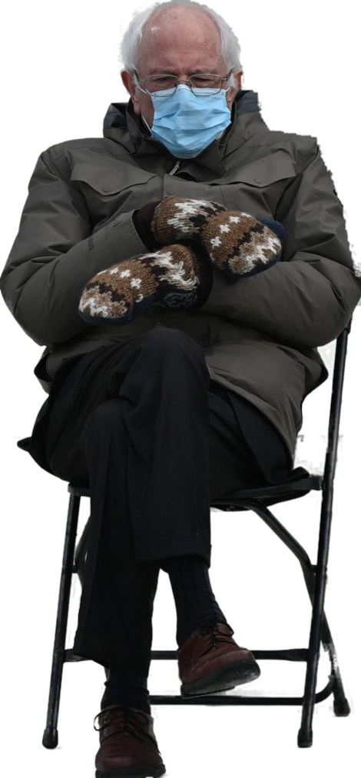

Trademarks 2
Talk 8
LAW 422 001
Intellectual Property Law
Allard School of Law, UBC
Fall, 2021
Jon Festinger Q.C.
Centre for Digital Media
QMUL School of Law (CCLS)
Whiteboard Law
http://commlaw.allard.ubc
@jonfestinger
jon_festinger@thecdm.ca

Slide 2
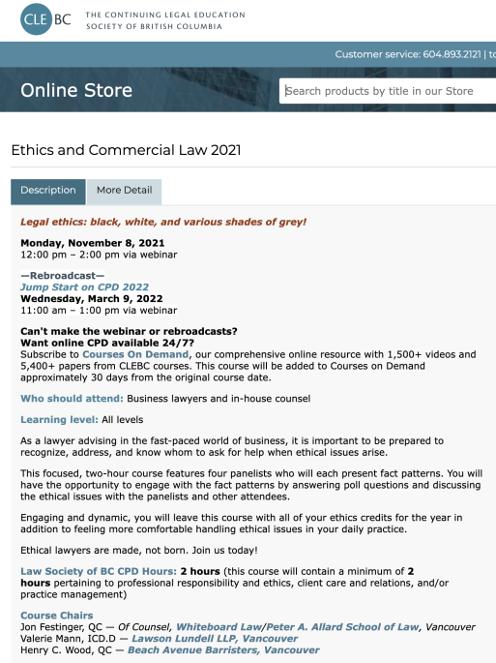
Apologies

Slide 3
UBC Emerging Media Law Moot A.I. Project
Please send me an email if you have mooted at Allard and would be willing to be interviewed as we determine the feature set

Slide 4
Stuff

Slide 5
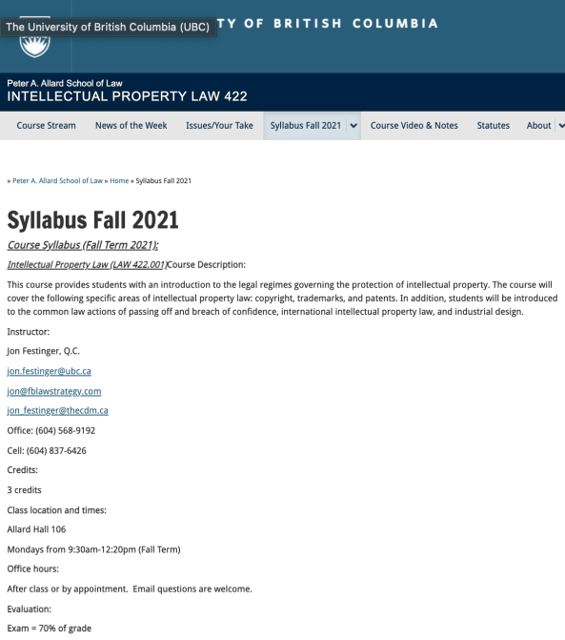
Any Questions?…

Slide 6
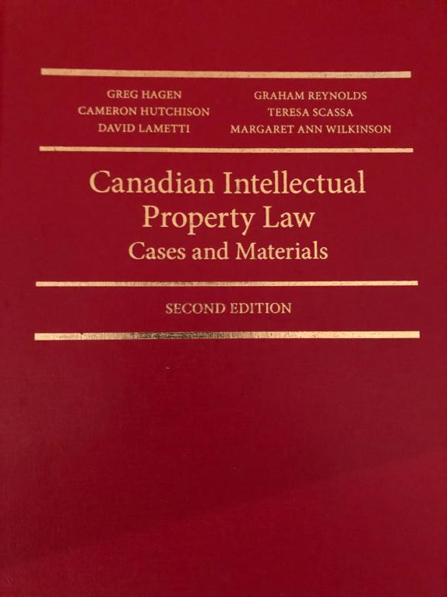

Slide 7

Office “Hours”: Ideally Mondays before or after class but am flexible…
Email me : jon.festinger@ubc.ca
Skype: jon.festinger
Phone:
o. 604-568-9192
c. 604-837-6426

Slide 8
Thank you for
your (optional) bios.
Much appreciated.

Slide 9
Evaluation
(LLMCL students extra)

Slide 10
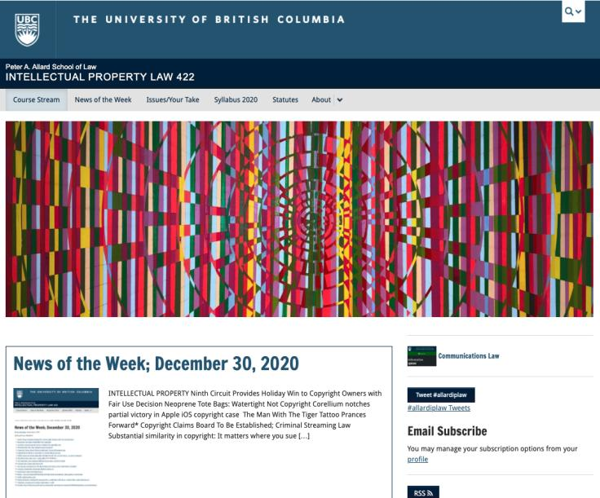
Course Website
https://iplaw.allard.ubc.ca/

Slide 11
For full privileges on the website
1. Please create an account at http://cms.ubc.ca/ using your CWL.
2. Once you create an account and sign in at http://cms.ubc.ca/ you can click your name in the top right. Halfway down the following page will be your WordPress email address.
3. Send me your WordPress email address at jon.festinger@ubc.ca or at jon_festinger@thecdm.ca
4. Then, I will invite you to participate with authoring privileges via your WordPress email address.

Slide 12
Evaluation
70% = Exam
Paper/Presentation/Post = 20%
Participation = 10%

Slide 13
Let’s talk about…
The 30%

Slide 14
A modest proposal…
500-1000 words (or equivalent) per person
written, video, podcast, in-class presentation (?), interpretive dance
Website or not
If posted to website, note to me pls.
Groups or individually

Slide 15
QUESTIONS?
THOUGHTS?
DISCUSSION?

Slide 16

Pause

Slide 17
News of
the Week

Slide 18
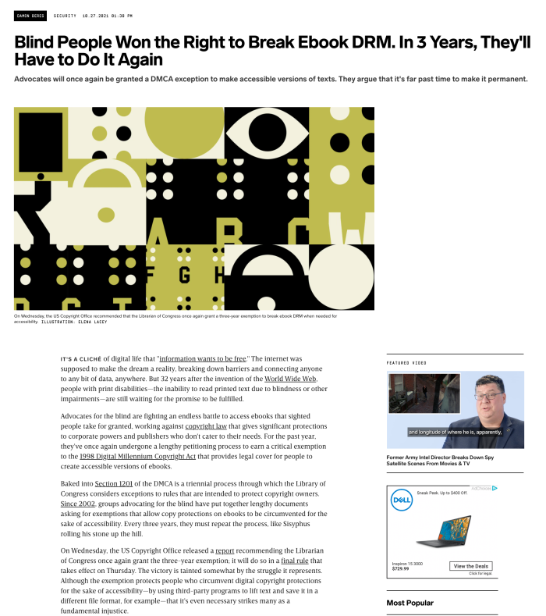

Slide 19
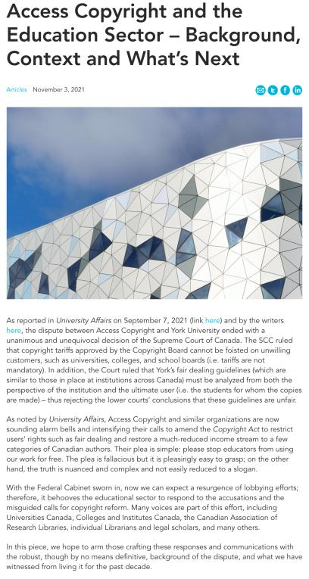

Slide 20
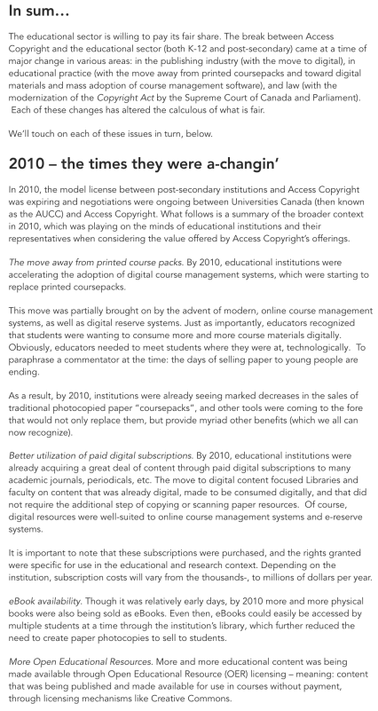

Slide 21
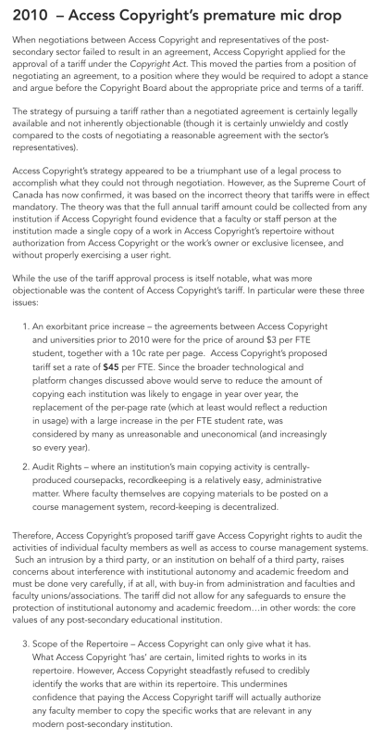

Slide 22
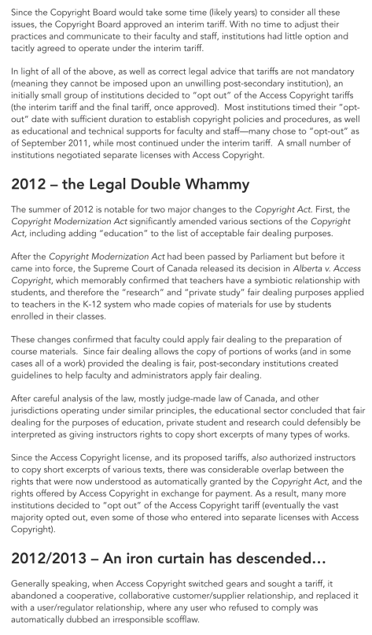

Slide 23
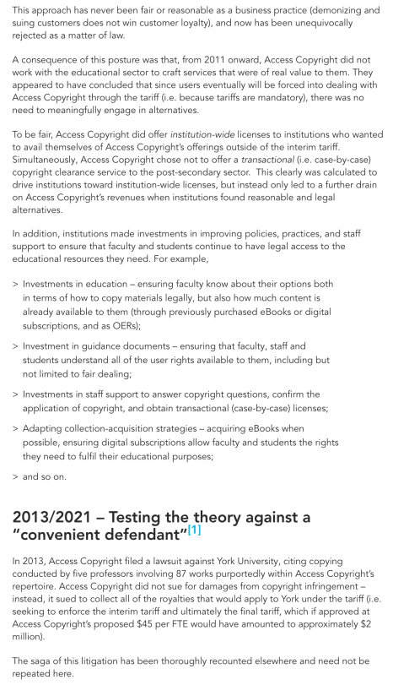

Slide 24
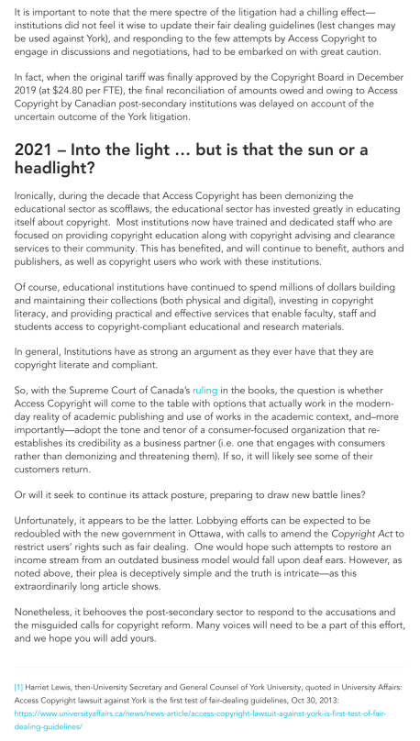

Slide 25
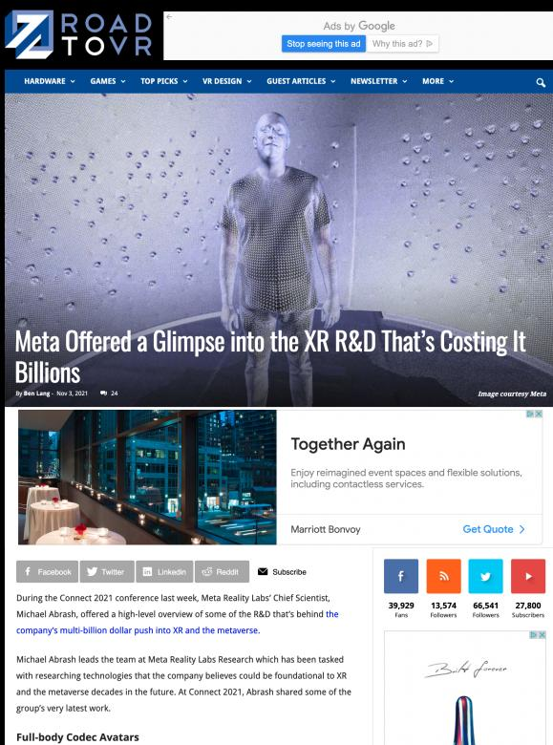

Slide 26
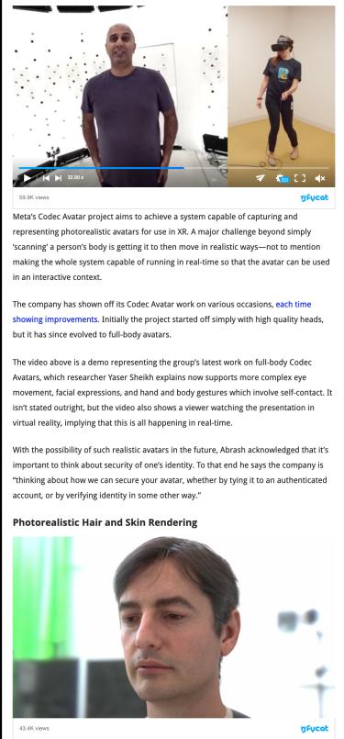

Slide 27
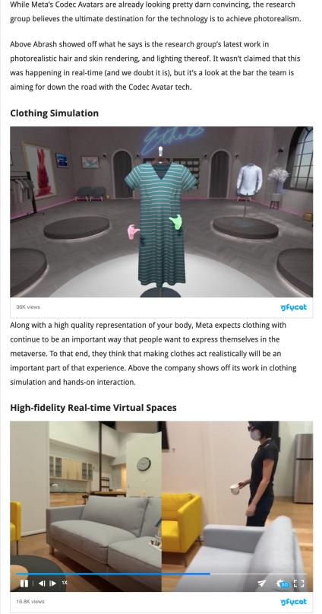

Slide 28
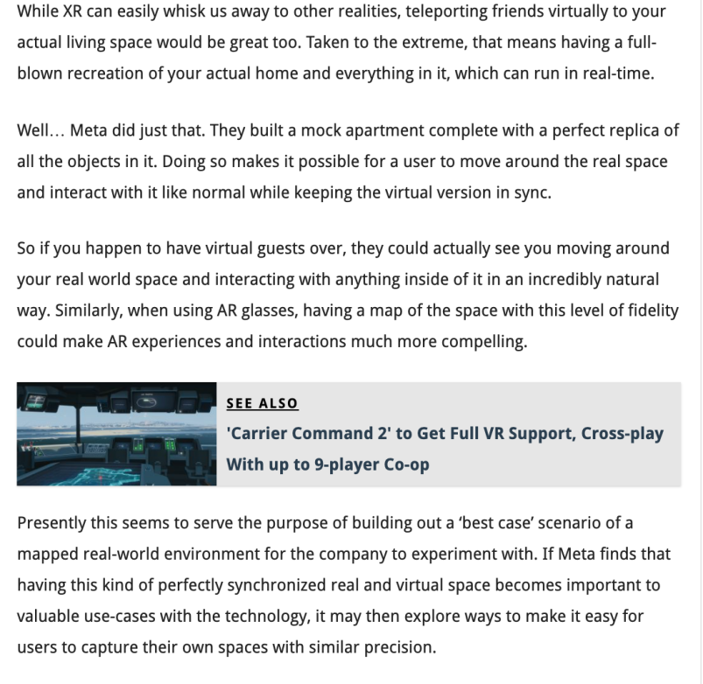

Slide 29
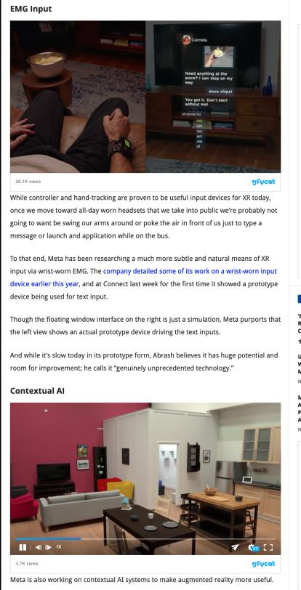

Slide 30
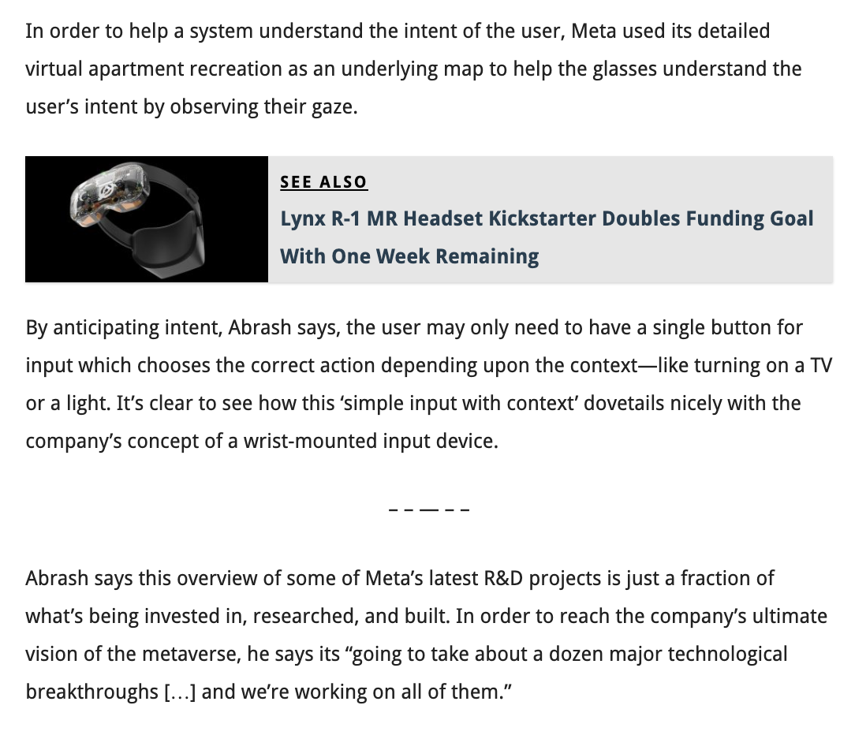

Slide 31
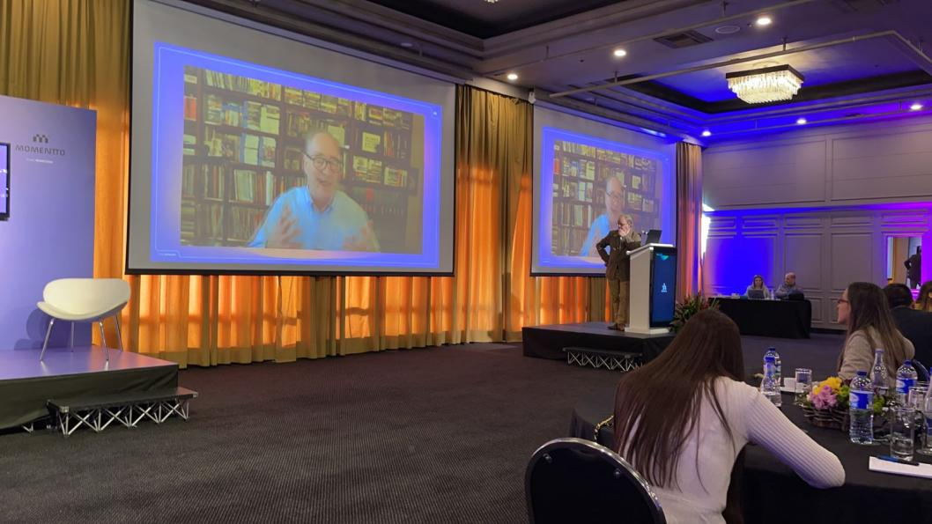
Meta Example?: Last Friday Keynote on Compliance in the Digital World in Columbia

Slide 32
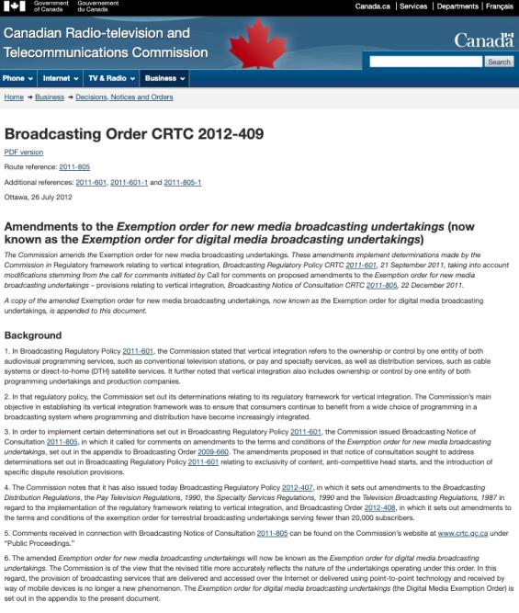
CRTC claims to have jurisdiction over internet content but exempts it from regulation

Slide 33
Yours?

Slide 34
QUESTIONS?
THOUGHTS?
DISCUSSION?

Slide 35
Pause

Slide 36
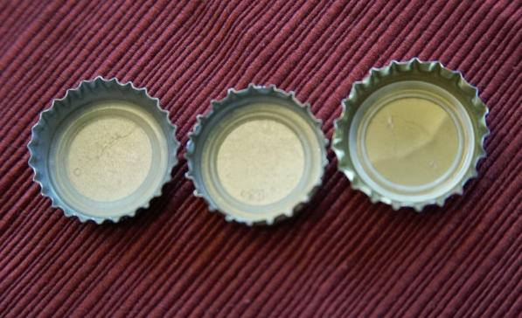
Re-capping

Slide 37
Trademarks
What is a Trademark ™?
  A mark used by a person for the purpose of distinguishing that person’s goods or services from those of others in the marketplace
Various types of marks
  Ordinary (word & design), certification, collective, official, distinguishing guise

Slide 38
Trademarks
Ordinary marks
  S. 2: definition of trade-mark (in part): (a) a mark that is used by a person for the purpose of distinguishing or so as to distinguish goods or services manufactured, sold, leased, hired or performed by him from those manufactured, sold, leased, hired or performed by others.

Slide 39
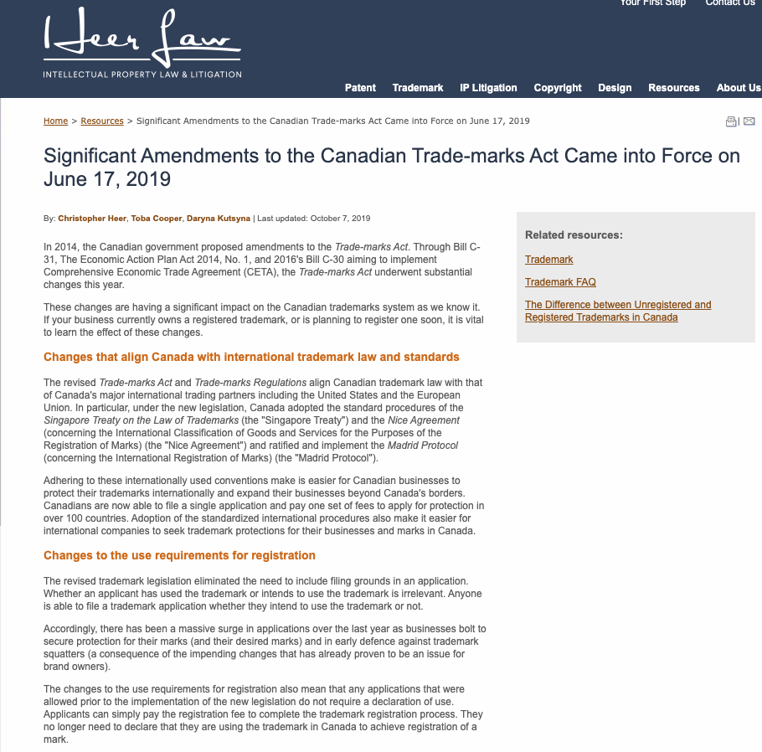

Slide 40
Trademarks
Ordinary marks
Amended definition (2014 - in effect 2019):
  TM: A sign or combination of signs that is used or proposed to be used by a person for the purpose of distinguishing or so as to distinguish their goods and services from those of others.
  Sign: Includes a word, a personal name, a design, a letter, a numeral, a colour, a figurative element, a three-dimensional shape, a hologram, a moving image, a mode of packaging goods, a scent, a taste, a texture, and the positioning of a sign.

Slide 41
Trademarks
S. 12(1): A TM is registrable if it is not:
  (a) Primarily merely a name or surname of an individual living or who has died within 30 years
  (b) Clearly descriptive or deceptively misdescriptive in English or French of the character/quality of wares/services or of the conditions of production/persons employed in their production/place of origin

Slide 42
QUESTIONS?
THOUGHTS?
DISCUSSION?

Slide 43
Pause

Slide 44
Continuing From
Last Week

Slide 45
Trademarks
S. 12(1): TM is registrable if it is not:
  (c) Name in any language of any of the wares or services in connection with which it is used
  (d) Confusing with a registered TM (confusing defined in s. 6(2); factors in s. 6(5))
  (e) Mark prohibited by s. 9 or 10…
  S. 12(2): not registrable if its features are dictated primarily by a utilitarian function
  S. 12(3): If not registrable due to (1)(a) or (b), is registrable if has … become distinctive at the date of filing an application for registration (see also s. 32)

Slide 46
Trademarks
Canada (Registrar of TMs) v. Coles Book Stores, [1974] SCR 438
  1) Is the mark a word?
    Standard Oil Co. v. Canada (Registrar of TM), [1968] 2 Ex C.R. 523.
  2) Is it primarily merely a name or surname of an individual who is living or who has died within the previous 30 years?

Slide 47
“In the case at bar, the evidence clearly establishes that “Coles” is a surname that is well-known to the general public of Canada. On the other hand, the dictionary meanings of the word “cole” and in its plural form “coles”, particularly as found in the Oxford English Dictionary, are largely obsolete. A customer in need of a cabbage does not ask for a “cole”. The only common use of the word that I can think of is in the word “coleslaw”. The inference I draw from the evidence concerning the dictionary definitions of the word “cole” is that it is a word of rare, if not obsolete, usage and would be little known to the general public of Canada. I do not agree with the conclusion of the learned judge of the Exchequer Court that the principal character of the word “Coles” is “equally that of a surname and of a dictionary word in the English language.” My only possible conclusion in this case is that a person in Canada of ordinary intelligence and of ordinary education in English or French would immediately respond to the trade mark “Coles” by thinking of it as a surname and would not be likely to know that “Coles” has a dictionary meaning.”

Slide 48
Trademarks
Test to Apply: Would a person in Canada of ordinary intelligence and of ordinary education in English or French be just as likely, if not more likely, to respond to the word by thinking of it as a brand or a mark of a business than as a name/surname?

Slide 49
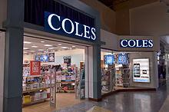

Slide 50
Trademarks
Unilever Canada Inc. v. Superior Quality Foods Inc. (2007), 62 CPR (4th) 75, [2007] TMOB No. 66
Facts: Superior Quality Foods, Inc. filed an application to register the TM BETTER THAN BOULLION for use in association w. soups and soup bases.
Issue: s. 12(1)(b) …Is the mark clearly descriptive or deceptively misdescriptive in the English or French language of the character or quality of the wares or services in association with which it is used or proposed to be used or of the conditions of or the persons employed in their production or of their place of origin.

Slide 51
Trademarks
Unilever Canada Inc. v. Superior Quality Foods Inc. (2007), 62 CPR (4th) 75, [2007] TMOB No. 66
Clearly descriptive = does the mark tell potential dealers/purchasers of the goods/services what the goods and services are, or describe them or describe a property which is commonly associated with them?

Slide 52
Trademarks
  Unilever Canada Inc. v. Superior Quality Foods Inc. (2007), 62 CPR (4th) 75, [2007] TMOB No. 66
  Deceptively misdescriptive = would dealers/purchasers of the goods be deceived by the misdescription into purchasing goods or ordering services which different in character or quality from those expected?

Slide 53
Trademarks
  Unilever Canada Inc. v. Superior Quality Foods Inc. (2007), 62 CPR (4th) 75, [2007] TMOB No. 66
S. 12(1)(b):
  Point of View?: That of the average purchaser of the wares
  Consider the mark in its entirety (not dissected into constituent elements)
  Consider thee mark as a matter of immediate impression

Slide 54
Trademarks
  Unilever Canada Inc. v. Superior Quality Foods Inc. (2007), 62 CPR (4th) 75, [2007] TMOB No. 66
S. 12(1)(b):
  Clearly = easy to understand, self-evidence, plain
  Character = feature, trait, characteristic of wares
  Quality = degree of excellence; laudatory description (i.e., expressing praise)

Slide 55
Trademarks
  Unilever Canada Inc. v. Superior Quality Foods Inc. (2007), 62 CPR (4th) 75, [2007] TMOB No. 66
Decision: “The Mark … clearly describe[s] as a matter of first impression that the Applicant’s soups and soup bases are ‘better than boullion’, a laudatory description that is contrary to s. 12(1)(b)”
Policy justification: This is an ordinary, grammatical phrase that others in the industry should be able to use to fairly describe their products. / different decision - “the vocabulary of the English language is common property: it belongs to all” (Eastman Photographic Materials Company Ltd. v. Comptroller-General of Patents, Designs and Trade Marks, [1898] A.C. 571 (H.L.), Lord Herschell at page 580 ”

Slide 56

What about?...Descriptive or Misdescriptive

Slide 57
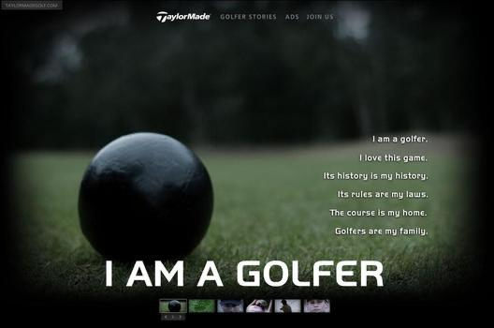
From...

Slide 58


Slide 59


Slide 60
Trademarks
General Foods Ltd. v. Carnation Co. (1978), 45 CPR (2d) 282 (TMOB)
Can GFL register the TM “Instant Breakfast” for use in association with wares described as “fortified powder food for mixing with milk”?
S. 12(1): TM is registrable if it is not (c) Name in any language of any of the wares or services in connection with which it is used
Also s.30(a) of the Trademarks Act in setting specifics for TM applications requires that applications must contain “a statement in ordinary commercial terms of the specific goods or services in association with which the mark has been or is proposed to be used.”
Are the words “fortified powder food for mixing with milk” ordinary commercial terms? Board held no. Statement in ordinary commercial terms for the product would be “instant breakfast”.
Accordingly, application to register the TM Instant Breakfast, which is also the name of the wares in English was found not registrable per s. 12(1)(c).

Slide 61
Trademarks
What is the significance in the distinction between s. 12(1)(b) and 12(1)(c)? Why might this distinction have been formalized in the TMA?
12 (1) Subject to subsection (2), a trademark is registrable if it is not..
  (b) …either clearly descriptive or deceptively misdescriptive in the English or French language of the character or quality of the goods or services in association with which it is used…;
  (c) the name in any language of any of the goods or services in connection with which it is used or proposed to be used;

Slide 62
QUESTIONS?
THOUGHTS?
DISCUSSION?

Slide 63
Pause

Slide 64
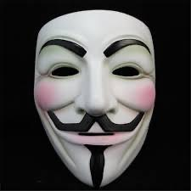
Trademarks: Distinguishing guise no more

Slide 65

Trademarks - changes
Distinguishing guise provisions repealed in 2019
  The shape or design of the product or packaging that effectively distinguishes the product from others. In order for a distinguishing guise to be registered, it must be proven that it has become distinctive through usage.
  S. 13 Trademarks Act REPEALED
  Example: shape of Coca-Cola bottle

Slide 66
Instead of “distinguishing guise”
s. 2 …“sign includes a word, a personal name, a design, a letter, a numeral, a colour, a figurative element, a three-dimensional shape, a hologram, a moving image, a mode of packaging goods, a sound, a scent, a taste, a texture and the positioning of a sign;”

Slide 67
Trademarks
Distinguishing guise
Now that distinguishing guises have ceased to exist as a separate category of TM, similar limitations to those set out in the previous s. 13(1) will be carried over elsewhere, and will apply to all marks

Slide 68
Trademarks
Distinguishing guise
New 12(2): A trademark is not registrable if, in relation to the goods or services in association with which it is used or proposed to be used, its features are dictated primarily by a utilitarian function
New 18.1: The registration of a trademark may be expunged by the Federal Court on the application of any interested person if the Court decides that the registration is likely to unreasonably limit the development of any art or industry
20(1.2): The registration of a trademark does not prevent a person from using any utilitarian feature embodied in the trademark

Slide 69
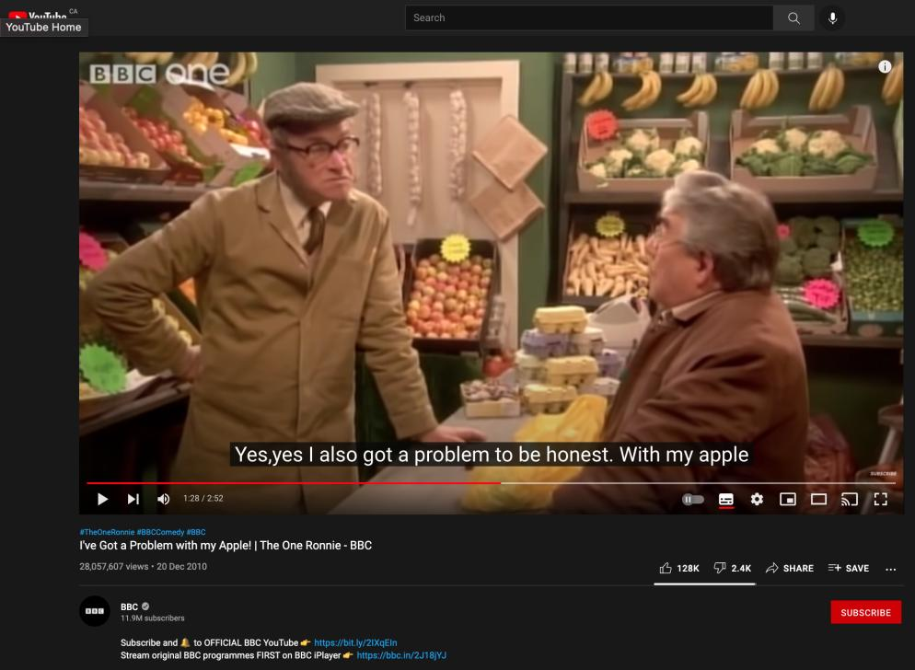
https://youtu.be/kAG39jKi0lI

Slide 70
Trademarks
Glaxo Wellcome Inc. v. Novopharm Ltd (2000)
Glaxo sought registration the distinguishing guise for a six sided tablet, shaped as a shield.
Principles
  Not required to show that most adult Canadians recognize the applicant’s distinguishing guise
  Although the shape of a product can constitute a mark, the mark is usually weak
  The standard of proof in distinguishing guise cases under is the same as in other registration cases
  Relevant period of time for distinctiveness → date of application

Slide 71
Trademarks : Special Marks
S. 9 Trademarks Act
Two categories of prohibited marks
  Absolute prohibitions
  Official marks (9(1)(n)(iii))
What policy reasons could justify including a type of symbol/mark on the list of absolute prohibitions?

Slide 72
Trademarks
S. 9(1)(n)(iii):
  Allows entities which are “public authorities” to request the Registrar of Trade-marks to give public notice of their adoption and use of particular names or symbols. These marks are referred to as “official marks”.
  Once notice is given, these official marks are also removed from the general realm of trade and commerce.

Slide 73
Trademarks
S. 9(1)(n)(iii) is controversial
S. 9(1) prohibits anyone else from adopting an official mark. This prohibition is absolute.
None of the usual formalities for the adoption of official marks
No opposition proceeding; no scrutiny by Registrar
Mark can be descriptive; not required to be distinctive of wares, services
No need to renew; no provisions to remove unused marks

Slide 74
Trademarks
Statutory requirements for public authorities
  Mark must have been adopted and used
  Adoption and use has to be by a public authority in Canada
  Adoption and use must be as an official mark for wares and services

Slide 75
Trademarks
Ontario Ass’n of Architects v. Ontario Assn of Architectural Technologists, [2003] 1 F.C. 331 (FCA)
Public notice was given that the Association of Architectural Technologists of Ontario, a self-regulatory professional body and Ontario non-for-profit corporation without share capital, adopted and used as official marks for services – the words ARCHITECTURAL TECHNICIAN, ARCHITECTE-TECHNICIEN, ARCHITECTURAL TECHNOLOGIST, ARCHITECTE-TECHNOLOGUE. As a result, members of the appellant, the Ontario Association of Architects ("OAA"), can be prevented from using these words in connection with their professional services - unless they had started to use them before April 28, 1999, the date when the Registrar gave public notice in the Trade-marks Journal of their adoption and use by the AATO as official marks.

Slide 76
Trademarks
Ontario Ass’n of Architects v. Ontario Assn of Architectural Technologists, [2003] 1 F.C. 331 (FCA)
Defining characteristics of public authority =
  Degree of government control [para. 57-64]
  Extent to which the body’s activities benefit the public [para. 65-73]

Slide 77
QUESTIONS?
THOUGHTS?
DISCUSSION?

Slide 78
Pause

Slide 79
Trademarks
1. Significant degree of governmental control
More rigorous part of test
Consider body’s objects, duties and powers, including distribution of its assets
Need some ongoing government supervision of the activities of the body claiming to be a public authority; sufficient to allow the government to exercise a degree of ongoing influence in the body’s governance and decision-making.

Slide 80
Trademarks
2. Public benefit
Broadly interpreted by the courts – some aspect for public benefit? Considered to act for public benefit.
In this case the Architectural Technologists set & enforce standards of professional competence & ethical conduct of its members.
As a result, FCA held that the Technologists regulate part of the practice of the profession. The lower court judge concluded that these activities benefit the public, and the FCA agreed.

Slide 81
Trademarks
A TM owner who has a registered mark that resembles an official mark effectively has their rights frozen at the time of publication of the official mark
  See Royal Roads University v. R. (2003), 27 CPR (4th) 240 (F.C.)

Slide 82
Trademarks: Applying the provision
MARK/NUMBER
Land of Anne 907857
The Anne Collection 907535
Red-Haired Anne 909009
Rainbow Valley 909010
Gilbert Blythe 909011
Akage No Anne 909012
Avonlea 909013
Matthew Cuthbert 909014
Anne of Green Gables The Musical 909015
Anne with an "E" 909016
Marilla Cuthbert 909017
Josie Pye 909018
Road to Avonlea 909019
Kindred Spirits 909020
Rilla of Inglesides 909021
Anne of Avonlea 909022
Anne Shirley 909023
Diana Barry 909024

Slide 83
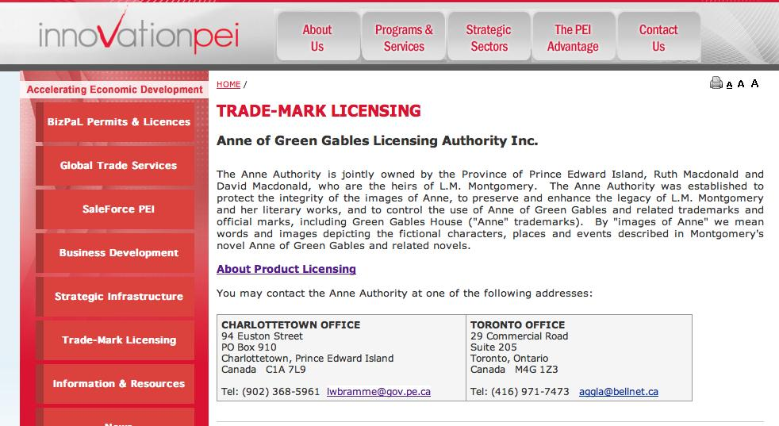
Trademarks

Slide 84
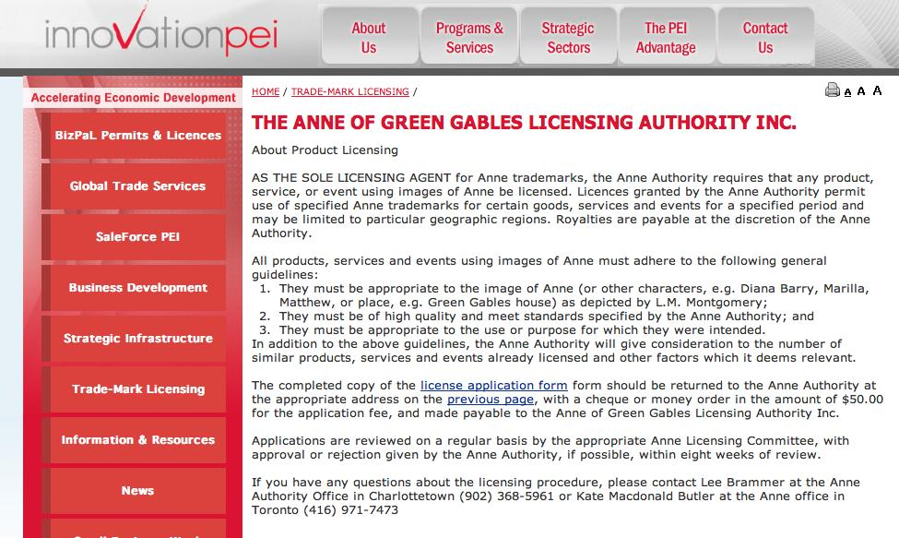
Trademarks

Slide 85
Trademarks
“170 The PEI government has significant influence and control with respect to the Anne Authority. The PEI government has members on the Anne Authority committee. The PEI branch of that committee controls all licensing in Prince Edward Island. One of the prime objectives, from the government perspective, was to protect the local craft industry in the Province, freeing it from costly licenses but maintaining a uniform-quality Anne image. The Province is partnered with the Heirs, who share a philanthropical and financial objective with respect to protecting and promoting a licensed Anne image. Applying the combined test of control, influence and purpose to promote the public good, I conclude that the Anne Authority is a public authority. If it was necessary to determine the issue, I would in all of the circumstances conclude that the Anne Authority is a public authority. Therefore, the Assignment Agreement that conveyed rights from the PEI government to the Anne Authority would be valid.”
(Anne of Green Gables Licensing Authority Inc. v. Avonlea Traditions Inc. (2000), 4 C.P.R. (4th) 289

Slide 86
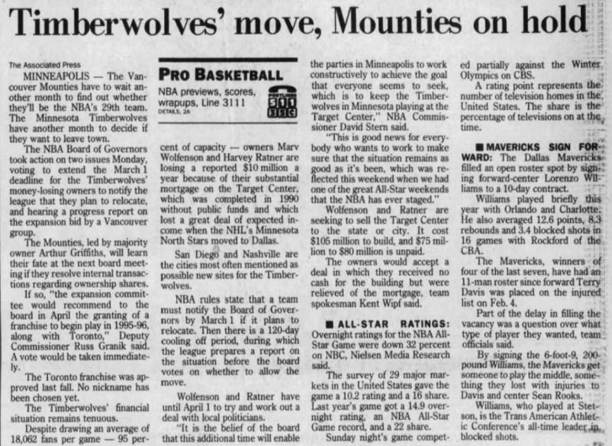
S. 9(1)(o): “Royal Canadian Mounted Police” or “R.C.M.P.”

Slide 87
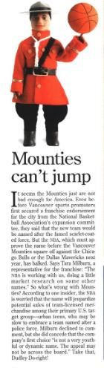
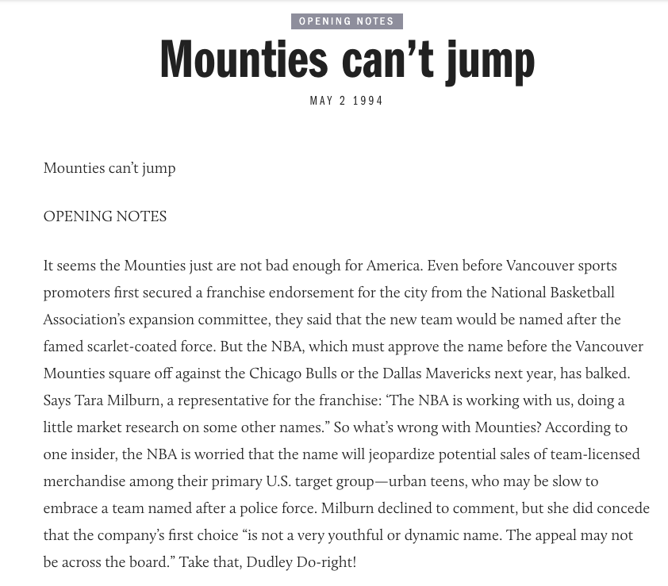

Slide 88
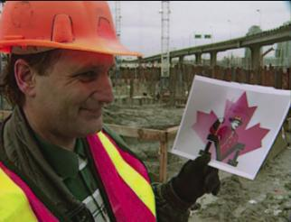

Slide 89
QUESTIONS?
THOUGHTS?
DISCUSSION?

Slide 90
Pause

Slide 91
Trademarks : Use
USE IT
OR
LOSE IT?

Slide 92
Trademarks
“Use”
First use … entitles you to register a TM but amended provisions now allow for filing without intended use.
Failure to use … basis for expungement of TM
Unauthorized use … could lead to infringement actions

Slide 93
Trademarks
4. (1) A trade-mark is deemed to be used in association with goods if, at the time of the transfer of the property in or possession of the goods, in the normal course of trade, it is marked on the goods themselves or on the packages in which they are distributed or it is in any other manner so associated with the goods that notice of the association is then given to the person to whom the property or possession is transferred.
(2) A trade-mark is deemed to be used in association with services if it is used or displayed in the performance or advertising of those services.

Slide 94
For Next Class: Keep a list of interesting brands to see how they would hold up under Canadian trademark law.

Slide 95
QUESTIONS?
THOUGHTS?
DISCUSSION?

Slide 96
Pause

Slide 97
Coming Soon
™3

Slide 98

Trademarks: Doctrine of Confusion

Slide 99

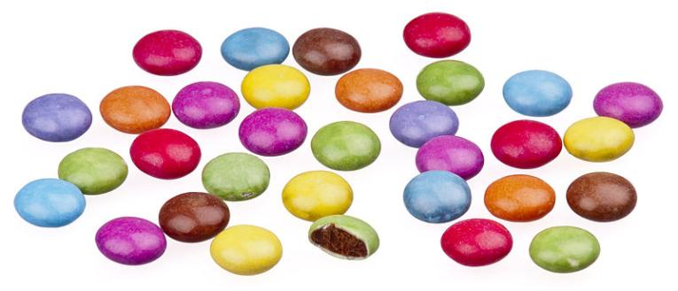
A MATTER OF PERSPECTIVE

Slide 100

Conclusion

Slide 101
UNTIL NEXT
TIME!

Slide 102

Always include a cat picture

Slide 103
In learning you will teach
And in teaching you will learn
Phil Collins' Son of Man (1999)

Slide 104
Our Academic Partners

