Slide 1



Passing Off 2
+ Trademarks 1
Talk 7
LAW 422 001
Intellectual Property Law
Allard School of Law, UBC
Fall, 2021
Jon Festinger Q.C.
Centre for Digital Media
QMUL School of Law (CCLS)
Whiteboard Law
http://commlaw.allard.ubc
@jonfestinger
jon_festinger@thecdm.ca

Slide 2
Stuff

Slide 3
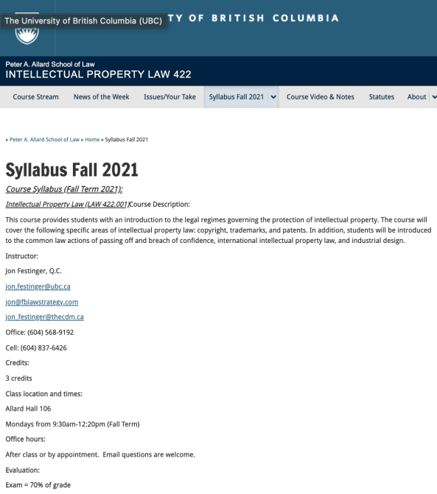
Any Questions?…

Slide 4
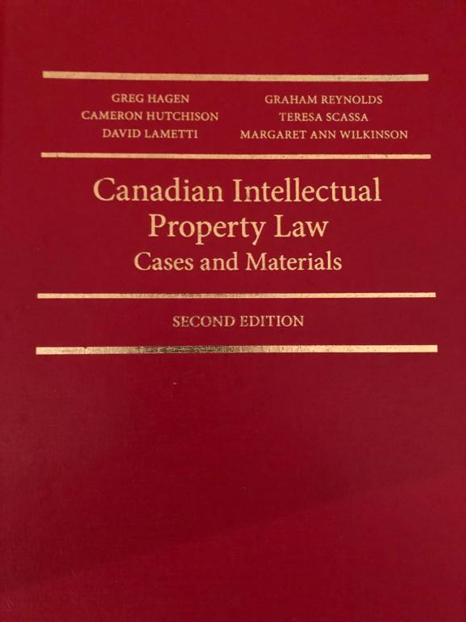

Slide 5

Office “Hours”: Ideally Mondays before or after class but am flexible…
Email me : jon.festinger@ubc.ca
Skype: jon.festinger
Phone:
o. 604-568-9192
c. 604-837-6426

Slide 6
Thank you for
your (optional) bios.
Much appreciated.

Slide 7
Evaluation
(LLMCL students extra)

Slide 8
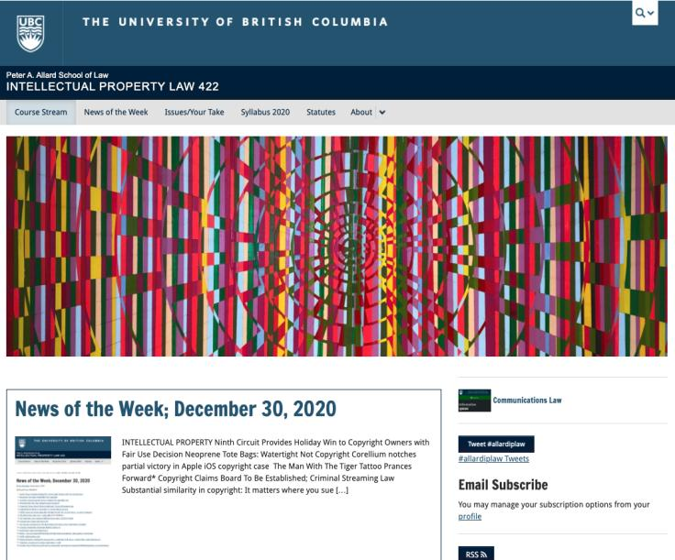
Course Website
https://iplaw.allard.ubc.ca/

Slide 9
For full privileges on the website
1. Please create an account at http://cms.ubc.ca/ using your CWL.
2. Once you create an account and sign in at http://cms.ubc.ca/ you can click your name in the top right. Halfway down the following page will be your WordPress email address.
3. Send me your WordPress email address at jon.festinger@ubc.ca or at jon_festinger@thecdm.ca
4. Then, I will invite you to participate with authoring privileges via your WordPress email address.

Slide 10
Evaluation
70% = Exam
Paper/Presentation/Post = 20%
Participation = 10%

Slide 11
Let’s talk about…
The 30%

Slide 12
A modest proposal…
500-1000 words (or equivalent) per person
written, video, podcast, in-class presentation (?), interpretive dance
Website or not
If posted to website, note to me pls.
Groups or individually

Slide 13
QUESTIONS?
THOUGHTS?
DISCUSSION?

Slide 14

Pause

Slide 15
News of
the Week

Slide 16
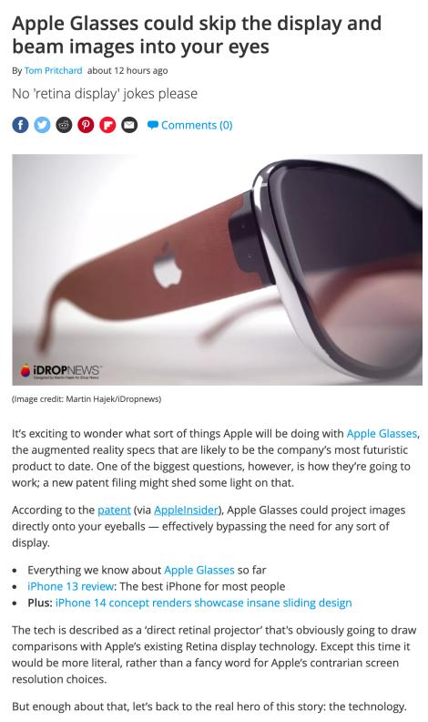

Slide 17
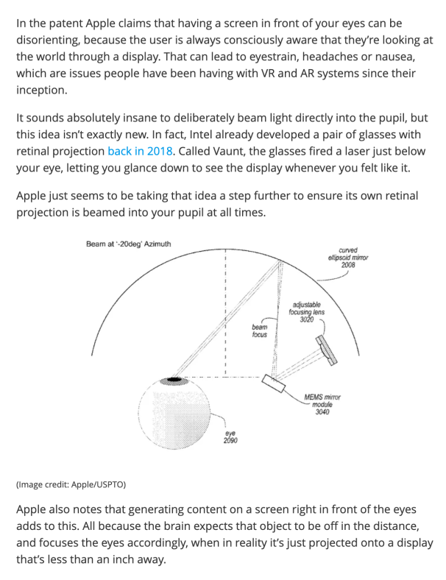

Slide 18
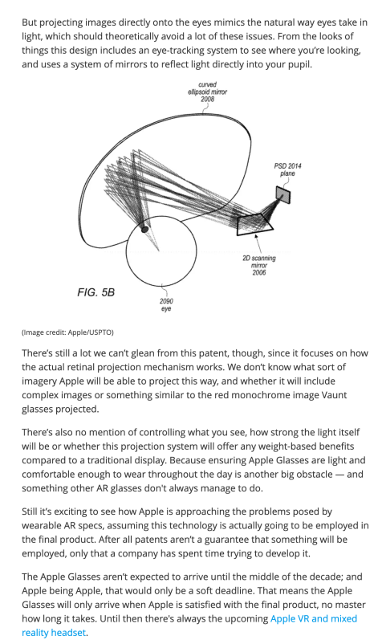

Slide 19
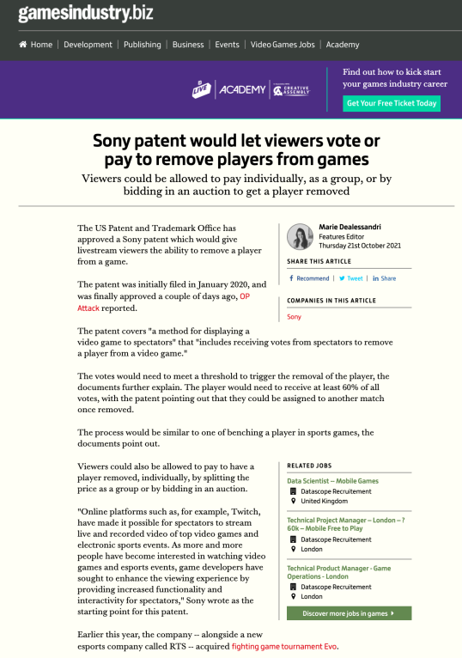

Slide 20


Slide 21


Slide 22
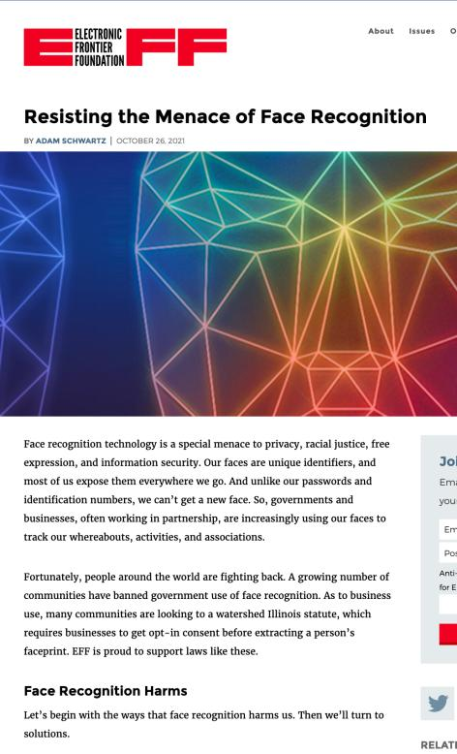

Slide 23
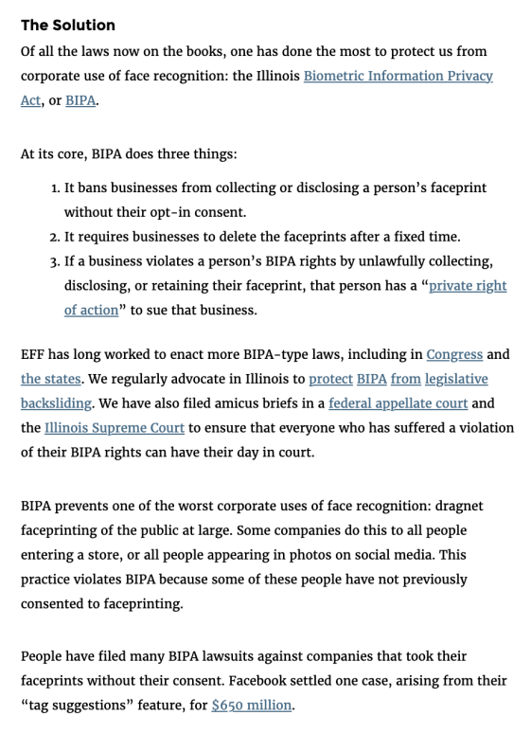

Slide 24
Is there a more IP-ish solution?

Slide 25
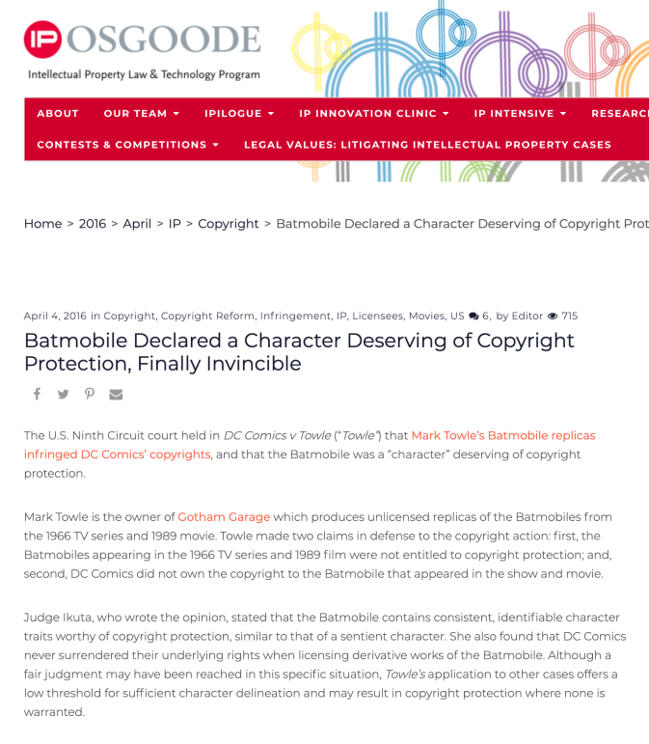

Slide 26
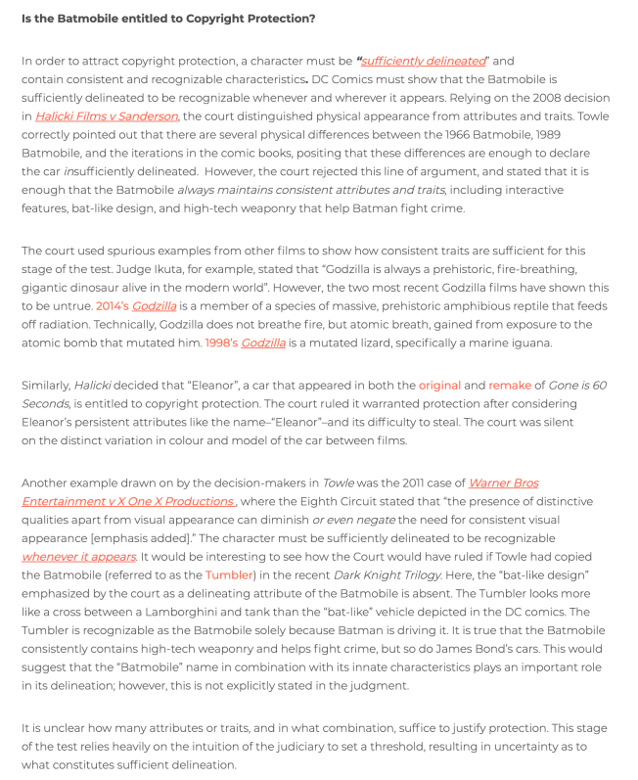

Slide 27
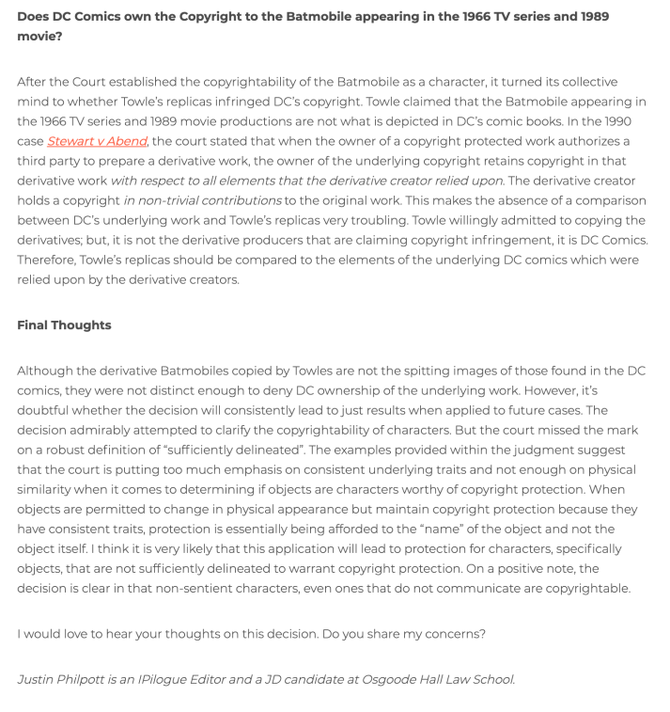

Slide 28
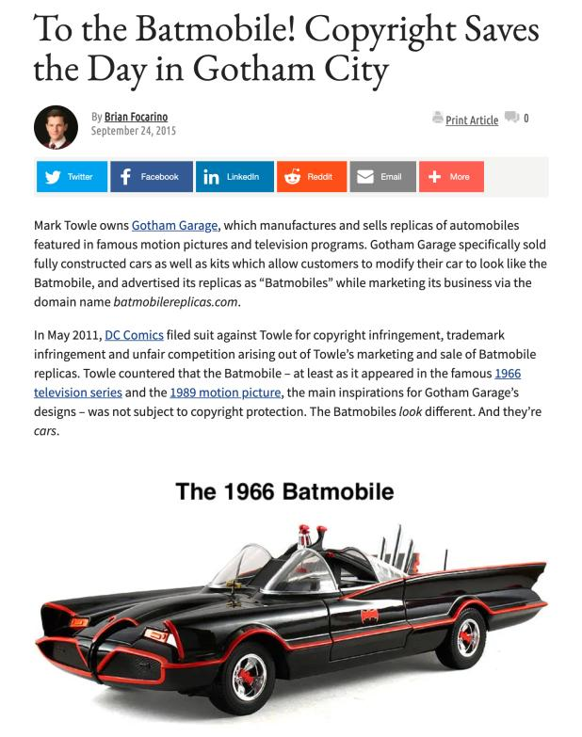

Slide 29
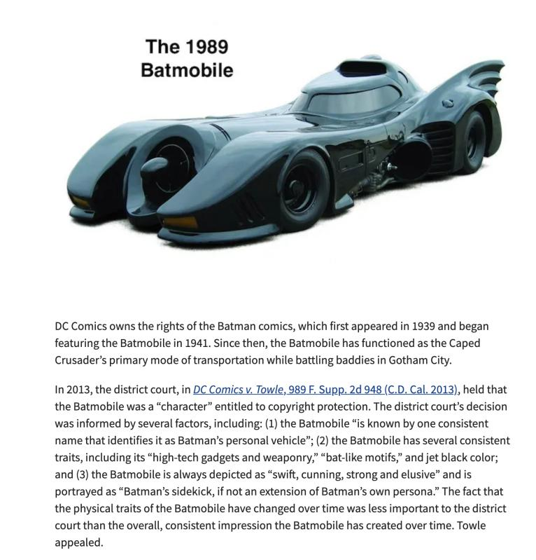

Slide 30
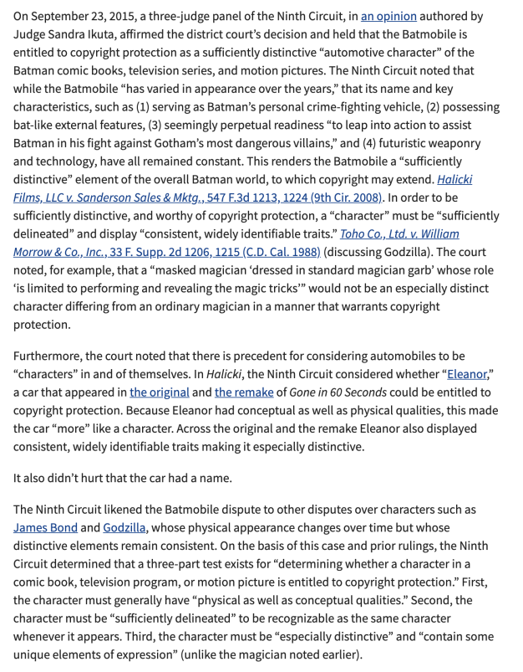

Slide 31
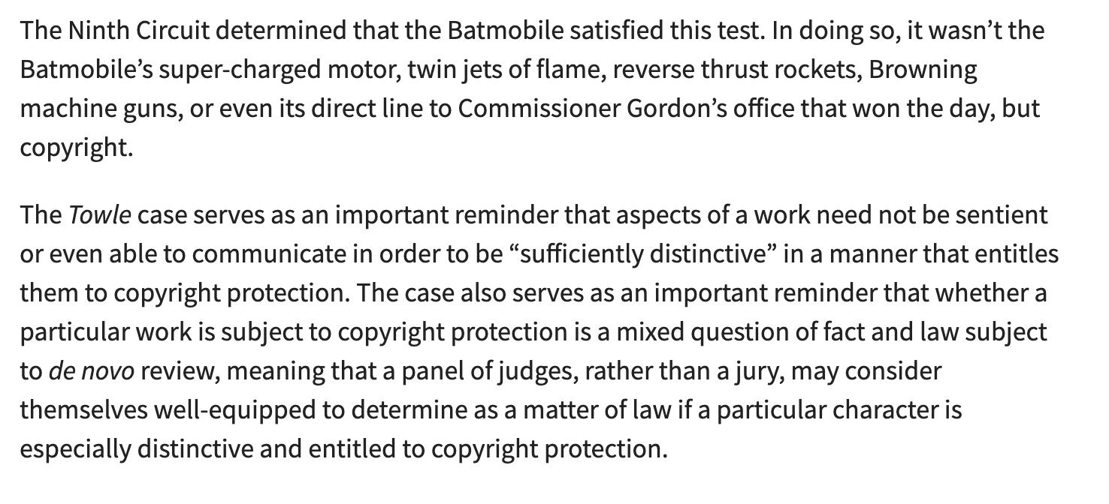

Slide 32
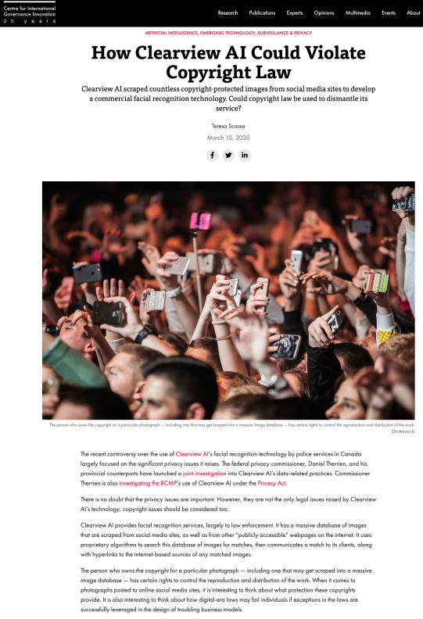

Slide 33
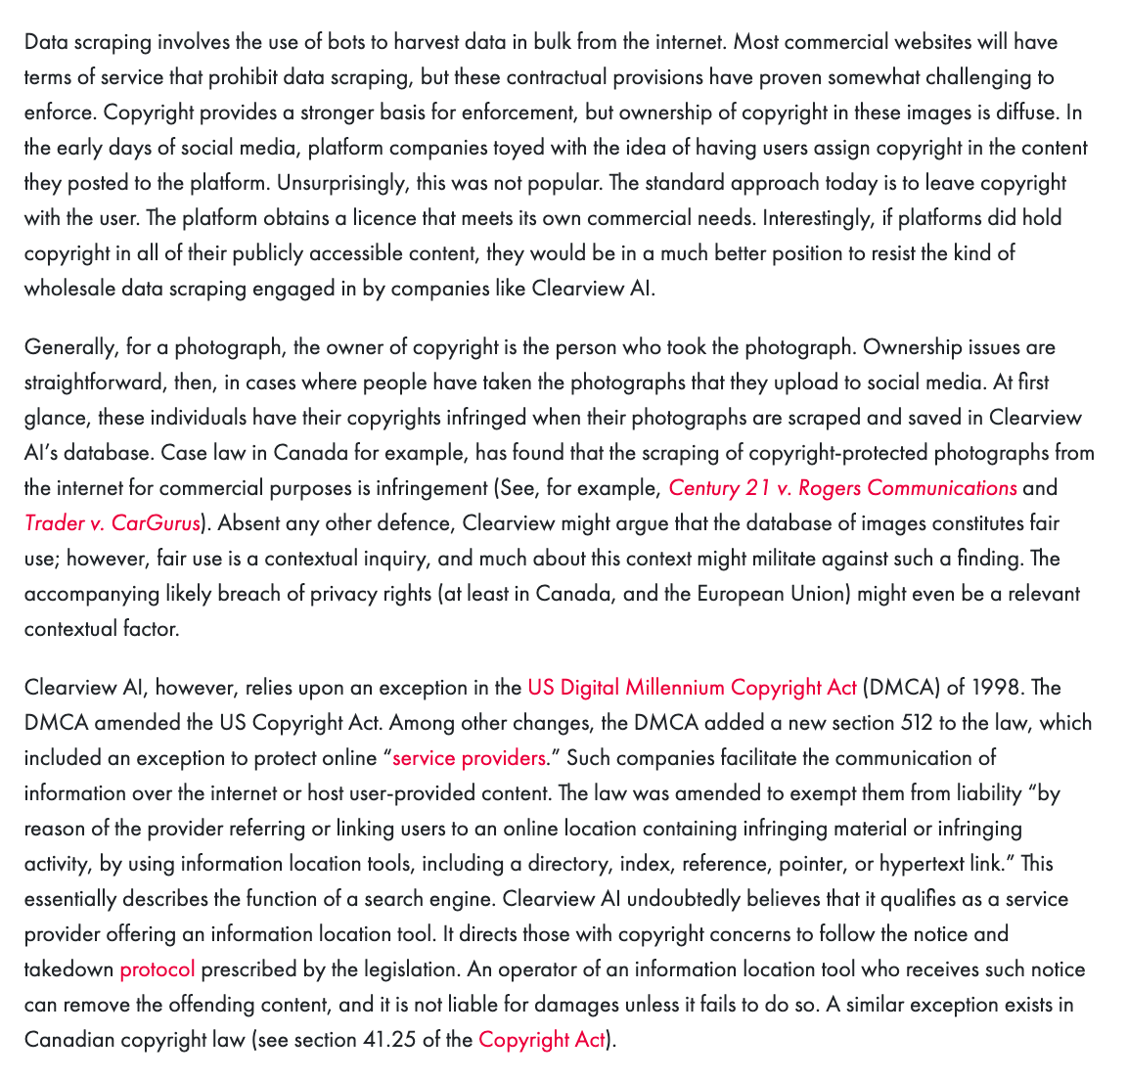

Slide 34
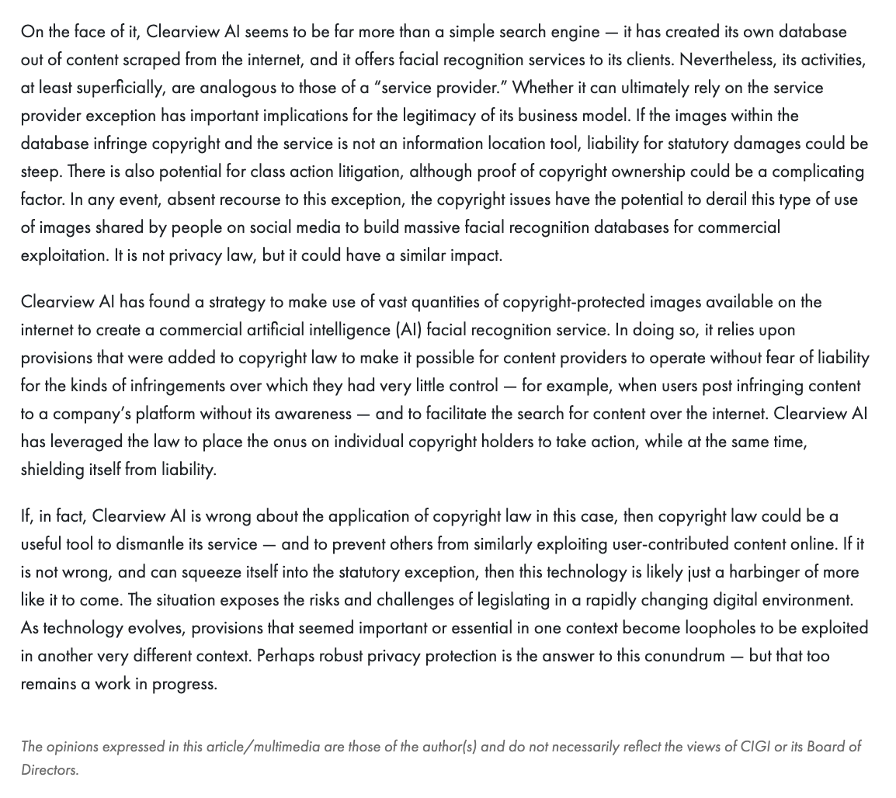

Slide 35
Yours?

Slide 36
QUESTIONS?
THOUGHTS?
DISCUSSION?

Slide 37
Pause

Slide 38
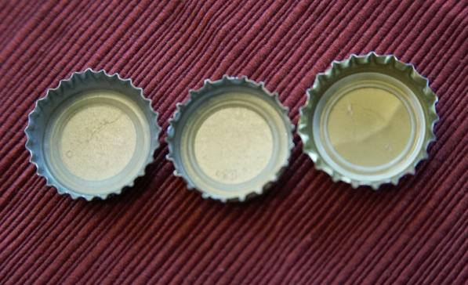
Re-capping

Slide 39
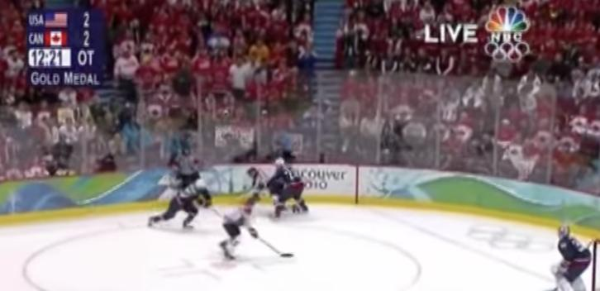
“Passing Off”
The Golden Goal – Jerome Iginla
passing off to Sidney Crosby

Slide 40
From Copyright to Passing Off/Trademarks
©
™*
From Protecting Creativity to Protecting Use
*not official but useful

Slide 41
Passing off
Three (3) necessary components of a passing-off action:
  1. The existence of goodwill +
  2. Deception of the public due to a misrepresentation +
  3. Actual or potential damage to the plaintiff

Slide 42
Passing off: Shared Goodwill Summary
Institut National:
Plaintiff entitled to bring an action in passing off when the alleged misrepresentation relates, not to the goods or services of a particular trader, but to a kind or quality of goods produced by a group of traders.

Slide 43
Passing off: Foreign goodwill
Sadhu Singh Hamdard Trust v. Navsun Holdings Ltd. (2016)
Case explores the related questions of:
  1. Whether an entity that does minimal business in Canada but that has a website accessible to (and accessed by) Canadians can establish sufficient goodwill for a successful action in passing off in a Canadian court? &
  2. How can such a company demonstrate its reputation?

Slide 44
Passing off: Foreign goodwill
Sadhu Singh Hamdard Trust v. Navsun Holdings Ltd. (2016) (continued)
Federal Court dismissed Hamdard Trust’s claim for passing off, finding that it had failed to establish any of the elements for a claim of passing off.
Federal Court of Appeal set aside that decision, finding that the lower court made several palpable and overriding errors in evaluating the evidence on each element of the test.

Slide 45
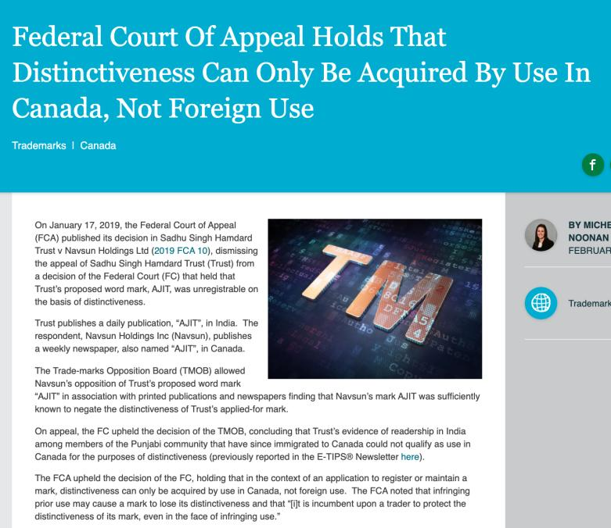
But Trademarks?

Slide 46
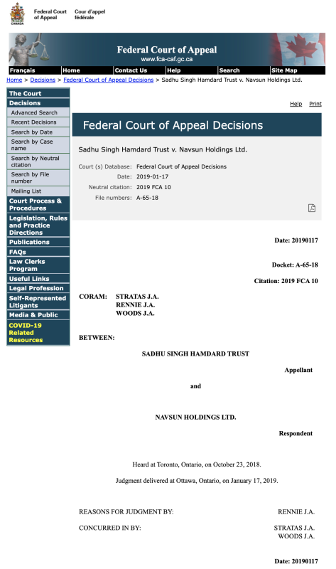

Slide 47
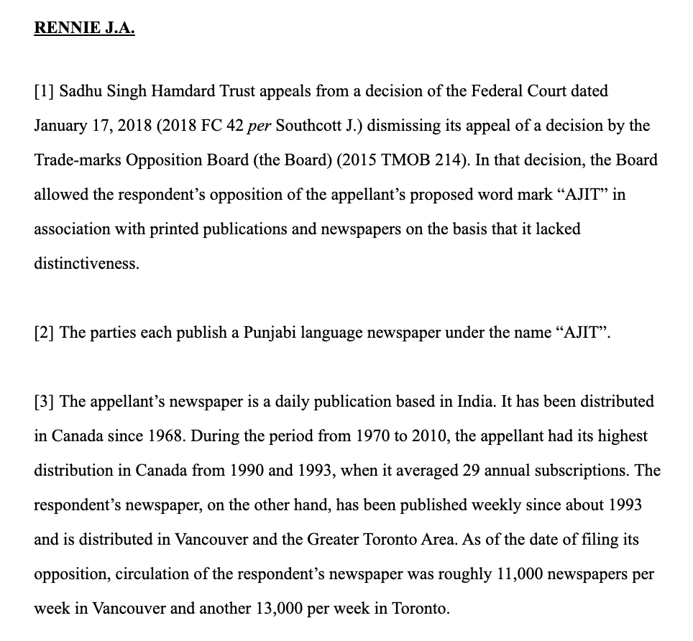

Slide 48
QUESTIONS?
THOUGHTS?
DISCUSSION?

Slide 49
Pause

Slide 50
Continuing From
Last Week

Slide 51
To what extent can goodwill be acquired in a purely descriptive product name?
Risky to use purely descriptive terms for a mark.
Risk is of not acquiring goodwill or reputation in the product simply because the name describes the good itself.
Goodwill – or secondary meaning – can be acquired through a product’s name, or through a product’s appearance…
A product that has a particularly distinctive appearance might come to be associated by consumers with one trade source. Then a competitor who copies the product appearance might be liable for passing off.
Challenge in these cases is that the Plaintiff must show that the appearance of the product has acquired a secondary meaning – that it comes from one trade source.

Slide 52
Passing off: Ray Plastics
Product was a combination snowbrush, ice scraper and squeegee called “Snow Trooper”: Black nylon scraper is 27" in overall length, has 3 rows of bristles, 5/8" hardwood painted black, and a traditional yellow brush
uncommon appearance…
very successful seller at Canadian Tire, K Mart, Zellers and Pro Hardware in 1982 and 1983.
Constructed by Raywares, a division of Ray Plastics Limited.
One of Raywares’ main competitors was Brushcraft, a division of Dustbane.
At the initiative of Canadian Tire, Brushcraft produced a similar product to the Snow Trooper for the years 1984 and following.
This product was described as "virtually identical", and "a virtual clone" to the Snow Trooper.

Slide 53
Passing off: Ray Plastics
Ray Plastics sued Dustbane for passing off.
Issue: Did goodwill exist?
Ray needed to prove that potential buyers believe that the goods being sold – here Brushcraft’s snowbrush, are either those of Ray or come from the same source as the “originals”
Court notes that in discussing passing off in cases of “appearance” or get-up, …what you have to establish is that consumers, by virtue of the appearance of the product – regard it as coming from one trade source; OR that the product appearance has developed a secondary meaning – that it comes from one trade source.
Important: The consumer doesn’t have to know which company produces the original product. Just need to establish that … consumers believe that the Snowbrush made by Dustbane comes from the same source as the Snow Trooper.
It’s easier to establish this reputation or secondary meaning with a distinctive product.

Slide 54
Passing off: Ray Plastics
Court notes that where the appearance is in some way novel or striking or unusual, it is easier to conclude that there has come to be an association of that appearance with a single trade source
The Snow Trooper get-up is very distinctive.
Other factors that the court found significant in this case:
1) Ray Plastics had done extensive advertising over two years with respect to the Snow Trooper.
2) Sales figures
3) There was evidence of intentional, direct copying. The court found that evidence of intentional, direct copying establishes a prima facie case of secondary meaning.
SO the goodwill/secondary meaning found to exist in the product appearance of the snow trooper.

Slide 55
Passing off: Ray Plastics
A product that is particularly distinctive in its appearance may come to be associated by consumers with a particular trade source
If the product appearance is an inherent feature of the product, it can’t be relied on as a TM

Slide 56
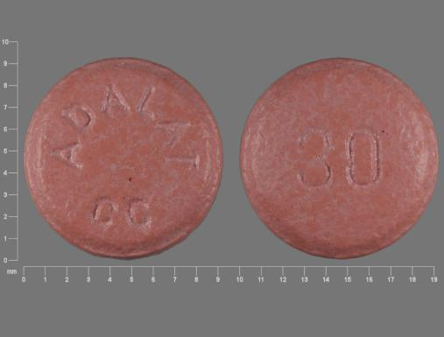
Passing off: Novopharm v. Bayer Inc. (2000)

Slide 57
Passing off: Novopharm v. Bayer Inc. (2000)
Question is whether a manufacturer of a pharmaceutical in pill, capsule or tablet form can claim goodwill or reputation in the shape, size or colour of the tablet?
Many prescription drugs are not sold in packages, they are dispensed by pharmacists in plain plastic vials.
“If patients identified the plaintiff's product by its appearance, the marketing by the defendant of tablets that were confusingly similar in appearance would prevent patients from exercising consumer choice by specifying which product they wished to have prescribed.” (para 90) / could also have negative health impacts.

Slide 58
Passing off: Novopharm v. Bayer Inc. Court 1
Issue was whether consumers, by virtue of the appearance of the pill, regard it as coming from one trade source?
Points made by the court in answering this question:
Pink round small tablets are commonplace in the pharmaceutical market. (40 medications available in Canada for treatment of high blood pressure and angina that were pink in colour – Macdonald (Pharmacist)). Accordingly, Bayer has a heavy burden to discharge to prove that they have a secondary meaning (that ordinary consumers associate them with a single trade source).
The fact that in 1992 Adalat was the only extended-release nifedipine product on the market does not necessarily mean that consumers have identified its appearance with a single source.

Slide 59
Passing off: Novopharm v. Bayer Inc. Court 2
Issue was whether consumers, by virtue of the appearance of the pill, regard it as coming from one trade source?
Points made by the court in answering this question:
Consumers often identify the appearance of a pharmaceutical product with its therapeutic purposes, instead of with a single manufacturer. I.e. “Colour/shape = pill I take for condition X; as opposed to colour/shape = same manufacturer.”
Evidence did not prove that physicians or pharmacists to any significant degree identified Adalat by colour or shape (they relied primarily on labels).
Bayer was unable to establish that patients associate pink round angina pills with the brand name Adalat.

Slide 60
Passing off: Novopharm v. Bayer Inc. (2000)
Key points (simplified):
Pink round small tablets are commonplace in the marketplace
Only product in the market? Not by itself conclusive of goodwill/distinctiveness
Appearance of a pharma product often associated with therapeutic purposes instead of single manufacturer
Physicians/pharmacists rely primarily on labels

Slide 61
Passing off: Novopharm v. Bayer Inc. (2000)
Court also highlighted two competing public policy considerations:
Reducing the price of medication by not limiting competition through the grant of a monopoly in the product’s appearance
Maximizing consumers’ freedom of choice to prefer a brand:
  Some patients may experience adverse side effects from one product but not from another, even though they are interchangeable.
  Not all manufacturers exercise the same level of quality control. In this case, a consumer may want to ensure that they receive the brand name product.
Way the tension between these competing public policy considerations is resolved in passing off is through the requirement that in order to bring a successful passing off action, evidence must be presented before the court that clearly establishes on a balance of probabilities that a significant number of consumers associate the appearance of the product with a single trade source. Did not happen in Novopharm v. Bayer.

Slide 62
Summary
In passing off cases dealing with product appearance or product packaging Plaintiff must establish that the certain product feature or packaging is distinctive of a particular trade or commercial source.
If not established, then secondary meaning has not been established either, and there is no goodwill or reputation that the defendant can exploit.
Key from casebook: “IF the product appearance is an inherent feature of the product – i.e. ex given – shape and configuration of a Lego block – then it can’t be relied on as a TM.”
Why? See Kirkbi AG v. Ritvik Holdings, 2005 SCC.

Slide 63
Passing off: Kirkbi AG v. Ritvik Holdings, 2005 SCC
If the product appearance is an inherent feature of the product, it can’t be relied on as a TM.
Because that would give a monopoly over the manufacture of the product.

Slide 64
QUESTIONS?
THOUGHTS?
DISCUSSION?

Slide 65
Pause

Slide 66
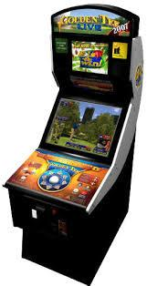
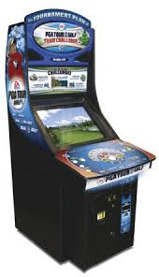
U.S. Copyright analogy:
Golden Tee v. PGA Tour Golf
Defendant PGA Tour Golf WINS

Slide 67

U.S. Trademark analogy:
ESS Entertainment & Rock Star
The Play Pen & The Pig Pen
Defendant Rock Star (Pig Pen) WINS

Slide 68
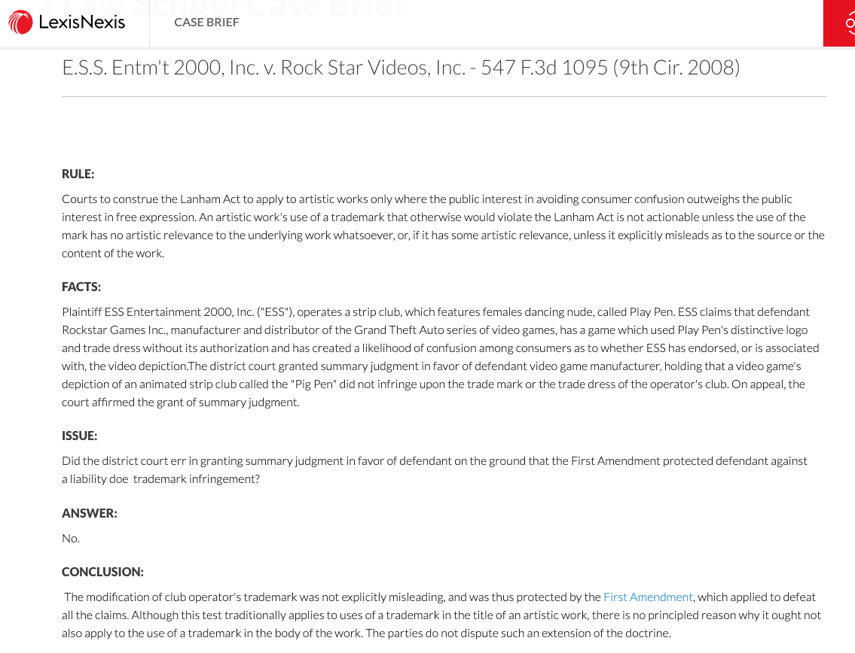

Slide 69
QUESTIONS?
THOUGHTS?
DISCUSSION?

Slide 70
Pause

Slide 71
Losing Reputation or Goodwill: HOW?
3 ways top lose goodwill or reputation:
Acquiescence over time to competitors using identical or similar get-up so that it’s no longer distinctive of the Plaintiff as a trade source
When a plaintiff goes out of business and is no longer using a particular name…fades away…
When the mark becomes generic…

Slide 72
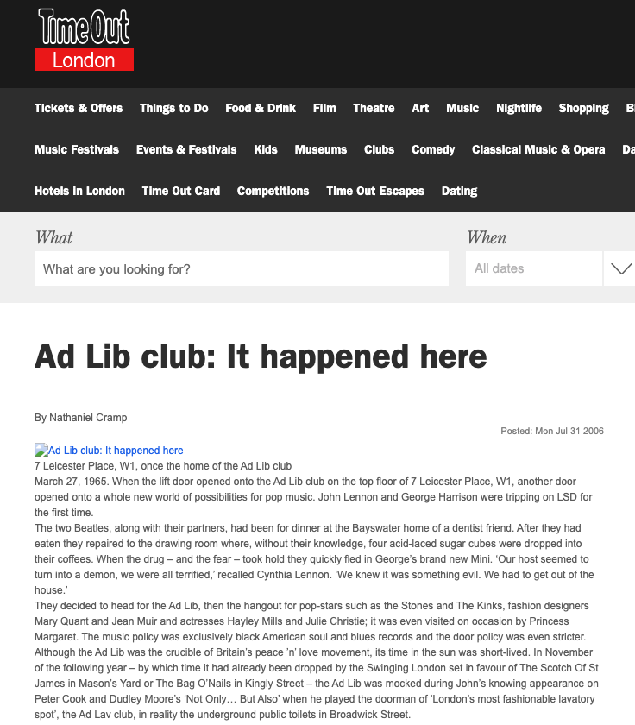

Slide 73
Passing off: Ad-Lib Club Limited
By 1964, the Ad-Lib Club was a widely known & popular night club in London, U.K., that had established a substantial goodwill attached to the name.
Forced to close in 1966 due to noise violations. After that it was looking for alternative premises to re-open.
Then, 1970 – on the same premises – it seemed as if the Ad-Lib Club is re-opening. Article stated: “The AD-LIB, first and most successful of London’s swinging discotheques of the 1960s will reopen this month”.
Ad-Lib, after seeing this article, asked the court for an injunction that would prevent the Defendant from passing off the Defendant’s business as the business of the Plaintiff.
The judge noted that in 1965, the Ad-Lib Club had substantial goodwill in its name. However, Ad-Lib closed in 1966.

Slide 74
Passing off: Ad-Lib Club Limited
It had been five years since Ad-Lib carried on the business of a club. Court still determined that Ad-Lib had goodwill in its name because:
Defendants must have chosen the name Ad-Lib Club by reason of the reputation acquired by Ad-Lib (the Plaintiff). No evidence filed showing any other reason for the selection of the name.
Based on various news articles, members of the public clearly seemed to see the new club as a continuation of the Plaintiff’s club.
Accordingly, Ad-Lib, the Plaintiff company, still has goodwill and was entitled to exploit it and protect it.

Slide 75
Passing off: Principles from Ad-Lib Club
Where someone stops carrying on a business, they keep, for a period of time, the goodwill attached to that business.
As long as that goodwill remains, the person should be able to enforce his rights in respect to any name attached to that goodwill.
When goodwill expires is a question of fact.

Slide 76
Overall principle
An enterprise can eventually lose its goodwill, after a period of time, if it shuts down. After a period of non-use, a name or product appearance will lose its “mojo” (not a technical term) and no longer be distinctive of a certain trade source.

Slide 77
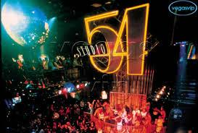

Slide 78
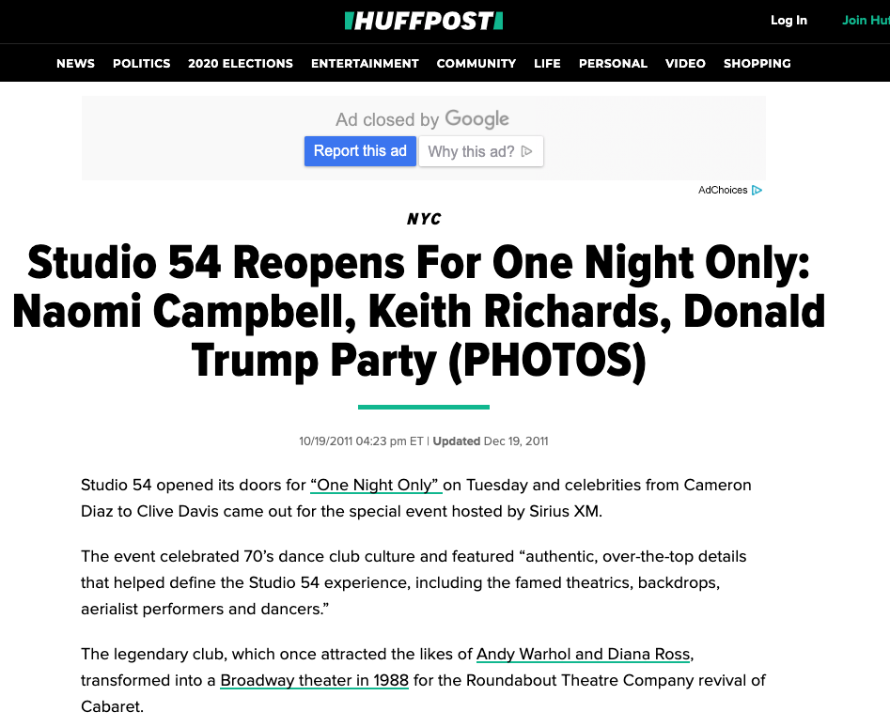

Slide 79
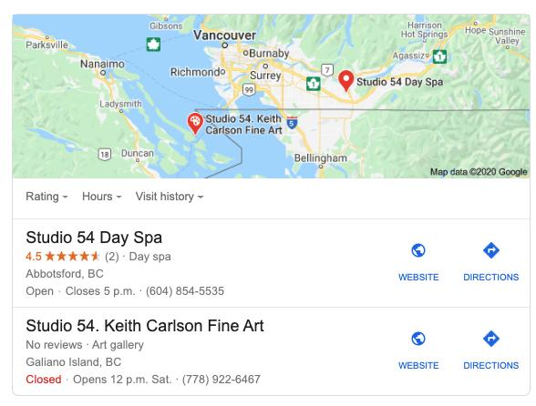

Slide 80
QUESTIONS?
THOUGHTS?
DISCUSSION?

Slide 81
Pause

Slide 82



Passing off: Genericization

Slide 83
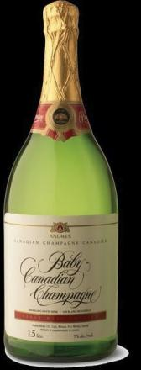
Passing off: Genericization
Back to: Institut national des appellations d’origine des vins…v. Andres Wines Ltd

Slide 84
Passing off: Genericization
Institut national des appellations d’origine des vins…v. Andres Wines Ltd
To wine experts Champagne has one meaning , sparking wine product originating from a particular part of the Champagne District of France, produced from grapes grown there by methods dictated by French law.
Defendant Andres claims the term champagne has become generic.
Evidence to support this argument?
Evidence that both nationally and internationally the term has for many years been used in connection with different commercial products to suggest high quality or excellence – thus diluting the distinctiveness of the term.

Slide 85
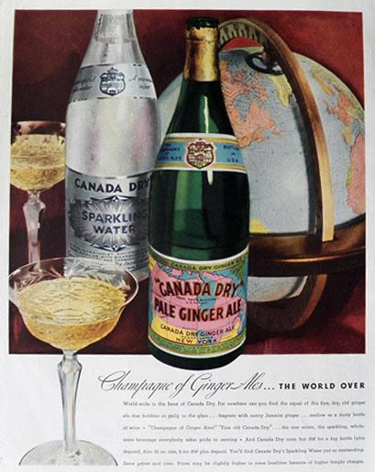
1934

Slide 86
Passing off: Genericization
Institut national des appellations d’origine des vins…v. Andres Wines Ltd
Champagne of ginger ales
Used to describe a colour
Foreign production of sparking wine under the label champagne – with a qualification that the product’s origin is not France.
Canadian Champagne, Spanish Champagne, US, Argentina, Brazil, India, Australia.
Term also misused by certain champagne houses.
Dictionary definitions show the diluted term.
Used the Google Search Engine to search for “the champagne of”….
This evidence supports the Defendant’s view – that the word champagne has assumed generic characteristics.

Slide 87
Passing off: Genericization
Institut national des appellations d’origine des vins…v. Andres Wines Ltd
Plaintiff’s countered this evidence by Survey evidence supporting the Plaintiff’s view that a meaningful percentage of the population associate champagne with France.
Court says that the word champagne has acquired generic attributes - used widely to describe a style or type of wine.Notes that also used to denote unique character, high quality and excellence.
Court holds that the word champagne has at most become “semi-generic”
Court not persuaded that the word Champagne has become diluted (pardon the pun) to the extent that it just refers to a class or genus of products. Still can refer to a particular merchant (group) & their product
It, in part, is still considered and accepted as referring to a particular type of sparking wine produced in France.
Conclusion is that CHAMPAGNE HAS NOT YET fallen into complete generic use.

Slide 88
Passing off: Genericization
Product names becoming generic:
  Q: Does the word refer merely to a class or genus of products?
  Examples of product names that have become generic?
  Institut National - Has “champagne” now become a generic term?
  Xerox was in danger

Slide 89
Passing off: preventing genericization
How can companies prevent their product name or company name from becoming a generic term?
Ad campaigns…
Lawsuits for passing off.
Lobbying for changes to laws.

Slide 90
Speaking of “Champagne”…
With respect to the Champagne industry the French Champagne industry has tried to protect the name champagne through lobbying efforts & legal actions since the early 1900’s
In 2003 they started to use consumer advertising to protect the name champagne from use by foreign wine producers or makers of non-wine products.
For example…

Slide 91
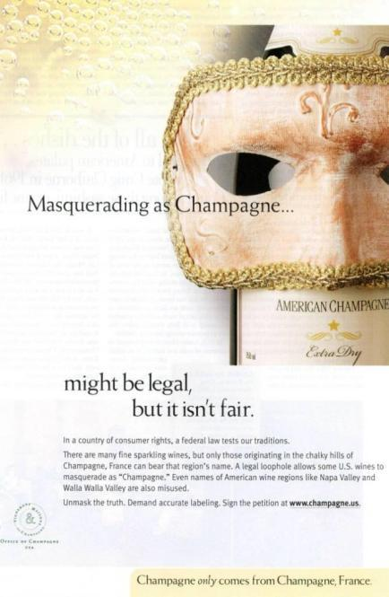

Slide 92

????????????????????????

Slide 93
Google is an internet search engine. Also a news aggregator, map provider, storehouse for images, library…
Is it a verb? (Googling, being Googled).
At least one lexicography site received a letter in response to the addition of the word “google” (as a verb) asking the site manager to delete the definition or “revise it to take account of the trademark status of Google”
Aside from sending letters from their legal department, Google places policies for third party use of its trademark on the web
http://www.google.com/permissions/trademark/rules.html
… use the Google Brand Search Engine to find “Rules for proper usage”
Has the word Google become generic?

Slide 94


Slide 95
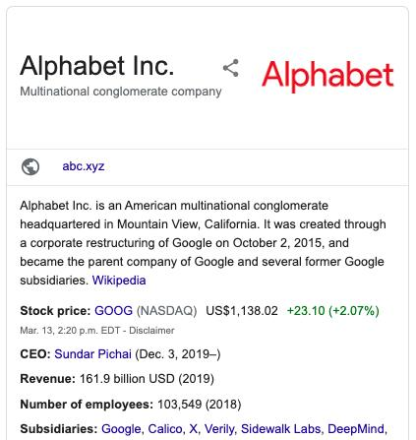
Corporate Strategy & Strategic Replacement?

Slide 96
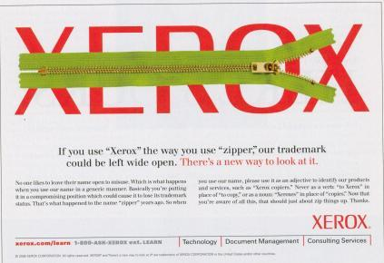

Slide 97
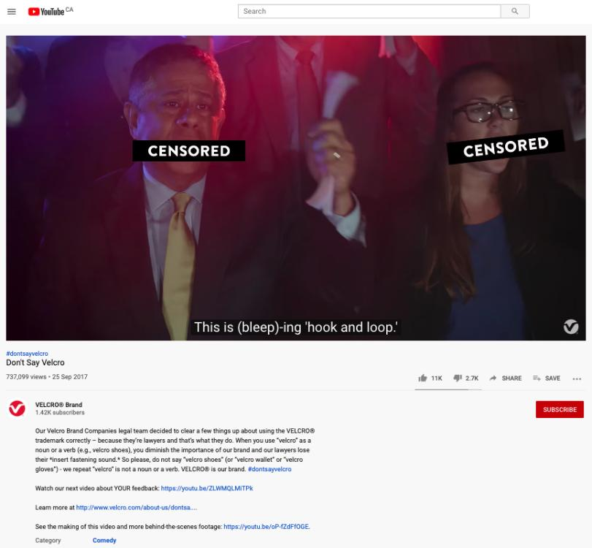
https://youtu.be/rRi8LptvFZY

Slide 98
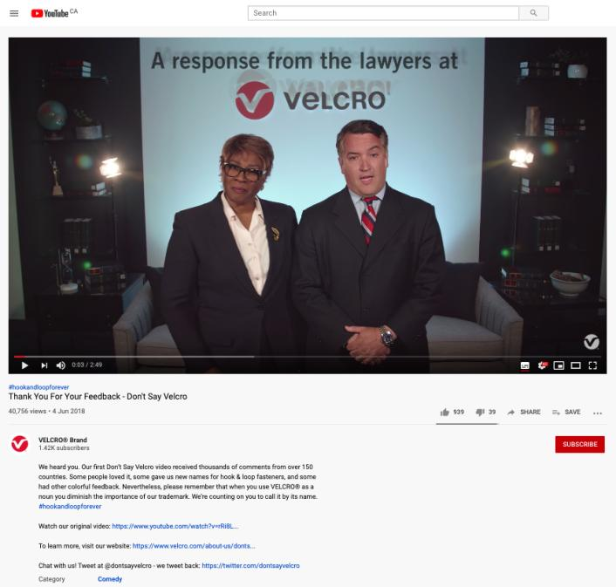
Follow-up
https://youtu.be/ZLWMQLMiTPk

Slide 99
QUESTIONS?
THOUGHTS?
DISCUSSION?

Slide 100
Pause

Slide 101
Passing off Basics
Three (3) necessary components of a passing-off action:
  1. The existence of goodwill (done)
  2. Deception of the public due to a misrepresentation
  3. Actual or potential damage to the plaintiff

Slide 102
Passing off
Deception of the public due to a misrepresentation
Means misrepresentation
  Fundamental core feature of the tort of passing off
  Plaintiff must be able to establish that the defendant misrepresented his or her wares or services as those of the plaintiff in a manner that was likely to cause consumer confusion.
  Not necessary to establish actual confusion. Injunction to prevent anticipated confusion which would occur if a product were allowed to enter the market is possible.

Slide 103
Passing off
Back to: Institut national des appellations d’origine des vins…v. Andres Wines Ltd
Established that Plaintiff’s have goodwill in “champagne”
Thereafter in order to succeed Plaintiff must establish:
  That Defendant’s misrepresented their products as being Champagne (sparkling wines known as champagne and produced in France);
  That this misrepresentation is calculated or likely to deceive the public into thinking that the Canadian product is champagne;
  And that this conduct HAS or is LIKELY to injure the goodwill of the plaintiffs’ business (DAMAGE).
NOT ENOUGH for Plaintiff to establish that the Defendant was BENEFITING from the use of the term champagne (which was established in the case). MERELY TAKING A BENEFIT DOES NOT CONSTITUTE TORT OF PASSING OFF.
Must prove misrepresentation leading to actual or potential confusion.
Court in Institut national held that there wasn’t a misrepresentation leading to confusion.
Canadian champagne is a distinct Canadian product not likely to be confused or even compared with French Champagne.

Slide 104
Passing off
Back to: Institut national des appellations d’origine des vins…v. Andres Wines Ltd
Canadian champagne producers wanting to establish there is no misrepresentation leading to confusion could show:
Marketing - They had marketed Canadian champagne in Ontario for many years;
Labelling - Word Canadian displayed as prominently as the word “Champagne” on Defendant’s products, in compliance with government directives, so as to clearly identify the products as Canadian;
Physical separation in Liquor Control Board of Ontario (LCBO) stores – for many years, the Canadian product has been physically separated from French champagnes in L.C.B.O. stores and listed separately by them..
ALSO evidence confirming that Canadian champagne has attained a reputation of its own in Ontario.
ALSO the Court found there was no confusion due to the nature of the wine consumer.

Slide 105
Passing off
Institut national des appellations d’origine des vins…v. Andres Wines Ltd
The Court said that the general public in Ontario is knowledgeable about wine products due to increased public exposure, educational exercises or publications on the subject, mass media ads that prevail on a daily basis [different than the situation in the UK in a case that dealt with Spanish Champagne - where it was found that customers would be confused, would think that the use of the term Spanish champagne is the same as French champagne].
The Court also found that the purchaser who is ignorant about wines and wishes to buy a bottle of champagne for a special occasion (aware of the general reputation of champagne) may choose a Canadian champagne under the mistaken belief that he is buying the champagne of high repute.
That said, consumers ignorant about wine would likely realize the difference between Canadian Champagne and Champagne from France either by the clear labelling of both, or the difference in listing and physical location at the L.C.B.O. stores, or, finally, by the vast price differential between the products.

Slide 106
Passing off: Recap
  Not enough for Plaintiff to establish Defendant was benefiting from using the term or name
  Need to prove misrepresentation leading to actual or potential confusion
  Misrepresentation may take a variety of forms
  Misrepresentation may be willful, negligent or careless (Kirkbi v. Ritvik)

Slide 107
Passing off: The Test Person 1
“The test person” is used in assessing confusion or the likelihood of confusion is crucial to the passing off analysis.
Can vary depending on the nature of the goods or services at issue. So in a case involving lemon juice in a squeeze bottle (RECKITT & COLMAN) the test person was the “shopper in a hurry”
Case suggests that if the product is an inexpensive mass market item, one usually part of a shopping trip for multiple items, where the consumer is likely to take it quickly from the shelf and toss it in their shopping cart, then similarities in product appearance are more likely to lead to confusion.
If the item in question is a luxury item, the consumer may well take more time to inspect the item, including the label, brand name, product literature. As a result, similarities in product appearance are less likely to lead to confusion.

Slide 108
Passing off: The Test Person 2
Why is the test person so important to the passing off analysis?
Impacts the confusion/misrepresentation requirement.
If you attribute knowledge, sophistication to the test person = less likely to be confused
If you say that the test person is in a hurry, not a lot of time = more likely to be confused.
Varying interpretations of the “test person” could either expand or narrow the tort of passing off. As a corollary, it either increases, or restricts competition.

Slide 109

What would a detailed case review reveal?

Slide 110
Passing off
British Columbia Automobile Assn. v. Office and Professional Employees' International Union, Local 378, 2001 BCSC 156 (B.C.S.C.)
During a labour dispute, Union creates various versions of websites similar to the BCAA’s website in appearance and uses the BCAA’s trademarks in its domain name and meta tags
Union used the domain names “bcaaonstrike” and “bcaabacktowork” - Websites www.bcaaonstrike.com and www.bcaabacktowork.com
Passing off?
Sigurdson J. finds context (labour dispute) significant to determination…

Slide 111
Passing off
British Columbia Automobile Assn. v. Office and Professional Employees' International Union, Local 378, 2001 BCSC 156 (B.C.S.C.)
First website looked very similar to the 1997 BCAA site
The phrase “Greetings BCAA is on strike” is on the website
Similarities with BCAA website design; colour, size of font, placement of logos
Had CAA and BCAA logos on site
Initial meta tags duplicated the 1997 content.
Was there a misrepresentation leading to confusion in this website?
Yes. With all the similarities, there was misrepresentation that the site was connected to the plaintiff’s site
Who is the test person for internet web sites?
Union argued that the test is a reasonably prudent user. Rejected [Note the broader concept of test person]
Was the “casual or hurried observer” [para. 212]

Slide 112
Passing off
British Columbia Automobile Assn. v. Office and Professional Employees' International Union, Local 378, 2001 BCSC 156 (B.C.S.C.)
Second website
Changes made.
Union removed CAA logo, changed BCAA
Moved Greetings message so that most of it couldn’t be seen on a standard screen
Passing off?
No. Reduced possibility of confusion

Slide 113
Passing off
British Columbia Automobile Assn. v. Office and Professional Employees' International Union, Local 378, 2001 BCSC 156 (B.C.S.C.)
Third site
Relates to the domain names bcaaonstrike.com and bcaabacktowork.com and the use of the meta tags
Held: NO passing off… No misrepresentation that the Union site is a site of the plaintiff, or a site that is endorsed by, affiliated with or connected to the plaintiff; Judge says there is no confusion or possibility of confusion in the minds of an internet web user that the site is associated with or the property of the BC Automobile Association.
Sigurdson J. held that in the context of a labour relations campaign, the fact that the Union is using similar meta tags and domain names (bcaabacktowork v. bcaa) is not as significant. Particularly because there is far less of a likelihood of confusion.
No evidence of actual confusion. Now, this is not a required element, but it’s a factor.
Ultimately , passing off w. first website; not 2nd or 3rd website.

Slide 114
Passing off
British Columbia Automobile Assn. v. Office and Professional Employees' International Union, Local 378, 2001 BCSC 156 (B.C.S.C.)
Three more points:
Note Sigurdson J.’s statement that a reasonable balance has to be struck between the legitimate protection of a party’s intellectual property and a citizen’s or a Union’s Charter right to freedom of expression.
Sigurdson J. notes that the prominence to be given to a disclaimer must, to some extent, depend on the likelihood of a false impression being conveyed to the public if there is no disclaimer. The greater the likelihood the more prominent must be the disclaimer. There will be some situations where no disclaimer will be adequate.
There was no evidence of actual confusion. Now, this is not a required element, but it’s a factor.
Ultimately , passing off with respect to the first website; not 2nd or 3rd website.

Slide 115
Questions to Contemplate?
If protestors can picket or leaflet outside a storefront, should they not be allowed to protest an online virtual storefront? Is there anything wrong with a “virtual picket line”? Are there particular norms that a “virtual picket line” should be obligated to adhere to?

Slide 116
Passing off
British Columbia Automobile Assn. v. Office and Professional Employees' International Union, Local 378, 2001 BCSC 156 (B.C.S.C.)
The Court, in BCAA, noted two broad categories of passing off:
  1) Where competitors are engaged in a common field of activity, and the Plaintiff has alleged that the Defendant has named, packaged or described its product or business in a manner likely to lead the public to believe the Defendant’s product or business is that of the Plaintiff
  2) Where the Defendant has promoted his product or business in such a way as to create the false impression that his product or business is in some way approved, authorized or endorsed by the Plaintiff or that there is some business connection between the Defendant and the Plaintiff. In this way a Defendant may hope to “cash in” on the goodwill of the Plaintiff
Accordingly, a large part of the issue comes to revolve around confusion as to source: Were customers confused into thinking that the OPEIU site was the BCAA site? Or were customers were confused into thinking that the OPEIU site was approved, authorized or endorsed by the Plaintiff – or that there is a business connection between the Defendant and the Plaintiff (which in a sense there was).

Slide 117
Passing off: Initial Interest Confusion 1
British Columbia Automobile Assn. v. Office and Professional Employees' International Union, Local 378, 2001 BCSC 156 (B.C.S.C.)
The Court in BCAA also brought up another type of confusion known “initial interest confusion” which is a somewhat controversial issue in passing off and TM law.
The “initial interest confusion” doctrine has received limited attention from Canadian courts, but a lot more attention in the U.S.
Initial interest confusion refers to the use of another's trade-mark in a manner calculated to capture initial consumer attention even though no actual sale is completed as a result of the confusion (Brookfield Communications Inc. v. West Coast Entertainment Corp., 174 F.3d 1036 (9th Cir. 1999).
This test of confusion carries with it a lower threshold than the traditional test of confusion in passing off (confusion as to source - your product is their product); confusion as to association, endorsement, approval.
Initial interest confusion simply considers whether the defendant's use of the plaintiff's mark evoked "initial interest” in a potential customer, even if it did not result in a sale.
A bit vague and amorphous. So vague that it potentially serves as a potent weapon for keeping legitimate competitors out of the market.

Slide 118
Passing off: Initial Interest Confusion 2
British Columbia Automobile Assn. v. Office and Professional Employees' International Union, Local 378, 2001 BCSC 156 (B.C.S.C.)
The “initial confusion” doctrine was expressly adopted in Brookfield Communications Inc v. West Coast Entertainment Corp (9th Cir. 1999) 174 F.3d 1036, 1061-66.
Case mentioned in BCAA v. OPEIU.
In Brookfield, two online retailers with tangentially related products went to battle over the defendant's use of plaintiff's trademark in defendant's internet website "metatags." (Metatags being computerized code words that play some role in attracting internet search engines to a website.)
Rather than applying a traditional analysis, the court applied the Initial Interest Confusion Doctrine, finding that the use of plaintiff's mark could result in the improper initial interest in defendant's site, and therefore trademark infringement. In so doing the Court used the following analogy…

Slide 119
“Using another's trademark in one's metatags is much like posting a sign with another's trademark in front of one's store. Suppose West Coast's competitor (let's call it "Blockbuster") puts up a billboard on a highway reading--"West Coast Video: 2 miles ahead at Exit 7"--where West Coast is really located at Exit 8 but Blockbuster is located at Exit 7. Customers looking for West Coast's store will pull off at Exit 7 and drive around looking for it. Unable to locate West Coast, but seeing the Blockbuster store right by the highway entrance, they may simply rent there. Even consumers who prefer West Coast may find it not worth the trouble to continue searching for West Coast since there is a Blockbuster right there. Customers are not confused in the narrow sense: they are fully aware that they are purchasing from Blockbuster and they have no reason to believe that Blockbuster is related to, or in any way sponsored by, West Coast. Nevertheless, the fact that there is only initial consumer confusion does not alter the fact that Blockbuster would be misappropriating West Coast's acquired goodwill.”

Slide 120
Passing off: Initial Interest Confusion 3
British Columbia Automobile Assn. v. Office and Professional Employees' International Union, Local 378, 2001 BCSC 156 (B.C.S.C.)
Any issues with the analogy in Brookfield Communications Inc v. West Coast Entertainment Corp ?
Big difference between driving around aimlessly looking for a video store, and simply hitting the ‘go-back’ button on your laptop. We are accustomed to false starts on the web and are unlikely to be dissuaded when they end up at the wrong site.
Departure from the core principal of trademark law – finds infringement where there is only a fleeting confusion which is dispelled before any purchase.
Can there really be a policy justification for finding infringement where the consumer is not confused at the time of purchase?

Slide 121
Passing off: Initial Interest Confusion 4
British Columbia Automobile Assn. v. Office and Professional Employees' International Union, Local 378, 2001 BCSC 156 (B.C.S.C.)
With respect to “Initial Interest Confusion” doctrine in Brookfield Communications Inc v. West Coast Entertainment Corp isn't more information, and competition between vendors, in the consumer's best interest? Until clear policy and evaluative standard are articulated, the Doctrine can only lead to problems. Doctrine mostly used in U.S.A*…but has been raised in Canada. Though mentioned in BCAA, it was not part of analysis.
*For example, the Initial Interest Confusion Doctrine has been used to curtail parodies, (See Dr. Seuss, supra.) criticism about the trademark owners, (OBH, Inc. v. Spotlight Magazine, Inc. (W.D.N. 4 2000) 86 F.Supp.2d 176; J.K. Harris & Co. v. Kassell (N.D. Cal. 2002) 2002 WL 1303124, rev'd (N.D. Cal.2003) 253 F.Supp.2d 1120)), directory information about used equipment dealers, (Caterpillar Inc. v. Telescan Techs, LLC ((C.D. Ill2002) 2000 U.S. Dist Lexis 3477; PACCAR Inc. v. Telescan Techs, LLC (6th Cir. 2003) 319 F.3d 246), and promotions by third party vendors of after-market servicing. See Promatek Indus. Ltd. v. Equitrac Corp. (7th Cir. 2002) 300 F.3d 808.

Slide 122
Passing off: Initial Interest Confusion 5
British Columbia Automobile Assn. v. Office and Professional Employees' International Union, Local 378, 2001 BCSC 156 (B.C.S.C.)
The “initial confusion” doctrine was expressly adopted in Brookfield Communications Inc v. West Coast Entertainment Corp (9th Cir. 1999) 174 F.3d 1036, 1061-66.
Case mentioned in BCAA v. OPEIU.
In Brookfield, two online retailers with tangentially related products went to battle over the defendant's use of plaintiff's trademark in defendant's internet website "metatags." (Metatags being computerized code words that play some role in attracting internet search engines to a website.)
Rather than applying a traditional analysis, the court applied the Initial Interest Confusion Doctrine, finding that the use of plaintiff's mark could result in the improper initial interest in defendant's site, and therefore trademark infringement. In so doing the Court used the following analogy…

Slide 123
Passing off: Initial Interest Confusion 6
Law Society of British Columbia v. Canada Domain Name Exchange Corp., [2002] B.C.J. No. 1909 (B.C.S.C.) 1
Defendant resolved the domain names lawsocietyofbc.ca & lsbc.ca to websites displaying adult content.
Court found Defendant had used the disputed domain names to attract the public to its websites for the purpose of generating income.
The Court held there was passing off.
Although there was no mention of initial interest confusion, the Court did find that the disputed domain names were being used to divert Internet traffic to the Defendant's websites, the contents of which would immediately dispel confusion among Internet users looking for the Plaintiff Law Society*.
Finding does appear compatible with the doctrine of initial interest confusion.
* Ya think?

Slide 124
Passing off: Initial Interest Confusion 7
Law Society of British Columbia v. Canada Domain Name Exchange Corp. 2
Court finds that in registering the domain name including the LSBC, Defendants made a false representation that they are associated or connected with the LSBC.
Rather than make a decision on the basis of initial interest confusion, the court in effect manages to fit this fact situation within the second type of passing off, being where a Defendant has promoted his product or business in such a way as to create the false impression that their product or business is in some way approved, authorized or endorsed by the Plaintiff or that there is some business connection between the Defendant and Plaintiff.
Is the Court’s characterization somewhat tenuous? False representation only made at point of registration; confusion dispelled by consumers, the “test people” – as soon as they find adult content on what they thought was the Law Society site
Reminder that initial interest confusion hasn’t been formally accepted in Canadian courts (alluded to in LSBC v. CDNEC; mentioned in BCAA). Watch for it.

Slide 125
Passing off: Initial interest confusion SUMMARY
Refers to the use of another's trade-mark in a manner calculated to capture initial consumer attention even though no actual sale is completed as a result of the confusion
Can serve as a potent weapon for keeping legitimate competitors out of the market
Limited attention in Canada; much more in US
Should it be allowed or discouraged in Canada?

Slide 126
Passing off Basics Redux
Three (3) necessary components of a passing-off action:
  1. The existence of goodwill (done)
  2. Deception of the public due to a misrepresentation (done)
  3. Actual or potential damage to the plaintiff

Slide 127
Passing off: Damage
Several types of possible damage in the context of a passing off action …
Loss of goodwill and reputation
Where a competitor passes off an inferior product as the plaintiff’s product. Dissatisfied customers who think they have purchased from the plaintiff may decide never to purchase from them again, and to tell their friends not to.

Slide 128
Passing off: Damage
Cases that fit?
Spalding v. Gamage where Gamage took a product of the Plaintiff’s that had been discontinued (a soccer ball discarded by Spalding as waste material and excluded from public sale) and marketed it an “improved” Spalding product.
Institut National
Ray Plastics
A competing product which is identical or confusingly similar to the Plaintiff’s product cuts into sales.
Two primary types of damages that are pled in passing off cases:
1. Loss of goodwill
2. Loss of trade
[Pages 433 and 434 address defenses and remedies to passing off]

Slide 129
Passing off: Damage Summary
  Final element that a Plaintiff must establish in a passing off action
  In the case of an application for an injunction, the Plaintiff need only show a likelihood of damage
  Types of recognized damage:
    Loss of goodwill and reputation
    Cases → Spalding v. Gamage (1915, UK)
    Loss of trade

Slide 130
Passing off: Defences
Plaintiff has failed to make out one of the elements of the tort
Use of one’s own name in business [within limits]
  Surname, not given name or nickname
  Using name honestly, without intent to trade on goodwill or reputation of another business
  Might have to use it in a way that is not confusing with an already existing business under that name
Defendant holds a TM registration for the mark it is using
  Molson Canada v. Oland Breweries Ltd. (2002), 19 CPR (4th) 201 (ONCA) → “a complete answer” to a claim in passing off
Plaintiff has acquiesced in use of mark

Slide 131
Passing off: Remedies
Damages
  For actual harm suffered
  For harm to reputation or goodwill (courts must fix “proper and reasonable amount”)
Permanent injunctions
Order for disgorgement of profits (as alternative to damages)
Delivery up or destruction of wares or materials with the offending mark
Punitive damages (to punish egregious conduct)

Slide 132
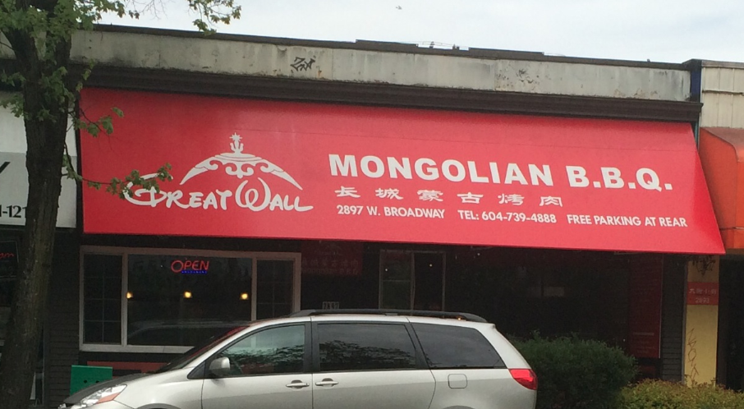
Passing off

Slide 133
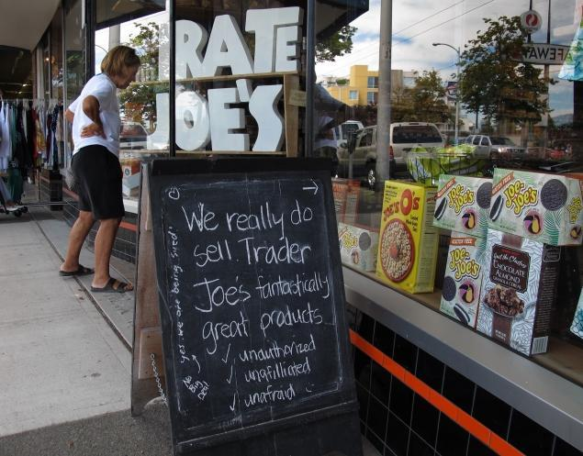
Passing off

Slide 134
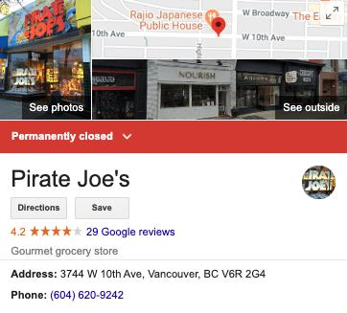

Slide 135
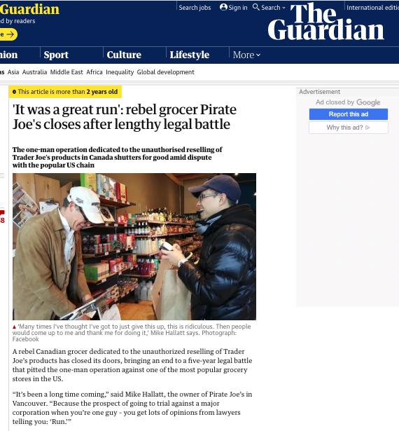

Slide 136
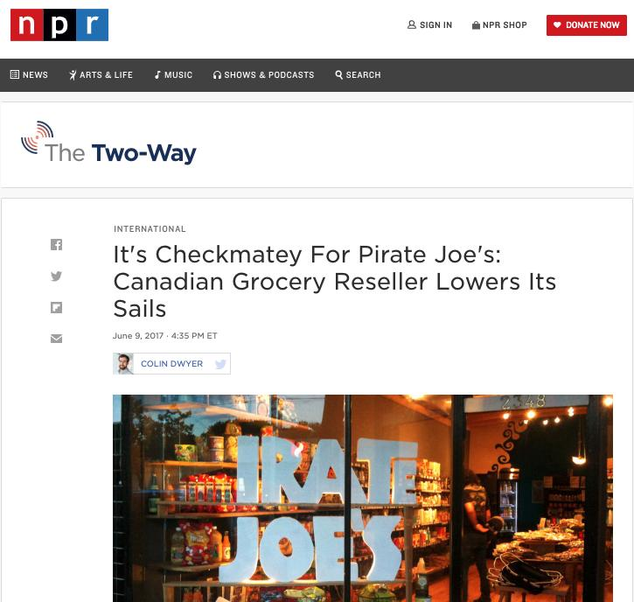

Slide 137
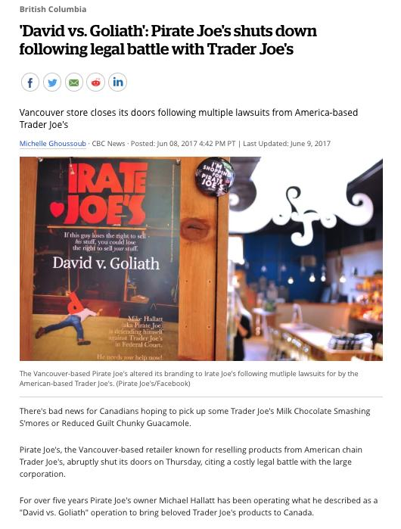

Slide 138
How far should the tort of passing off be permitted to expand?

Slide 139
QUESTIONS?
THOUGHTS?
DISCUSSION?

Slide 140
Pause

Slide 141

Now Trademarks

Slide 142
Trademarks
What is a Trademark ™?
  A mark used by a person for the purpose of distinguishing that person’s goods or services from those of others in the marketplace
Various types of marks
  Ordinary (word & design), certification, collective, official, distinguishing guise

Slide 143

Trademarks
Ordinary marks
  Distinguish the products or services of a specific firm or individual

Slide 144
Trademarks
Certification marks
  Identify wares or services which meet defined standards.
  Can be used by anyone who complies with the standards defined by the owner of the certification mark; and who is licensed by the owner
  Owned by one person but licensed to others
  Defined in s. 2 of the TMA

Slide 145

Trademarks
Certification marks

Slide 146


Can you think of other certification marks?

Slide 147

Trademarks
Collective marks
  Signs that distinguish the geographical origin, material, mode of manufacture or other common characteristics of goods or services of enterprises using the collective mark
  Function: inform public about certain features of the product
  Owned by an entity; members of this entity are entitled to use the mark.

Slide 148

Trademarks
A purely functional design may not be the basis of a TM, registered or unregistered
  See Kirkbi v. Ritvik (SCC)

Slide 149
Trademarks
Ordinary marks
  S. 2: definition of trade-mark (in part): (a) a mark that is used by a person for the purpose of distinguishing or so as to distinguish goods or services manufactured, sold, leased, hired or performed by him from those manufactured, sold, leased, hired or performed by others.

Slide 150
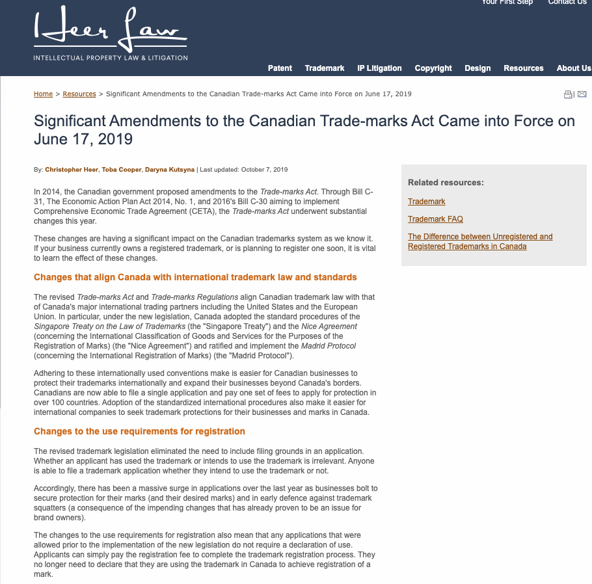

Slide 151
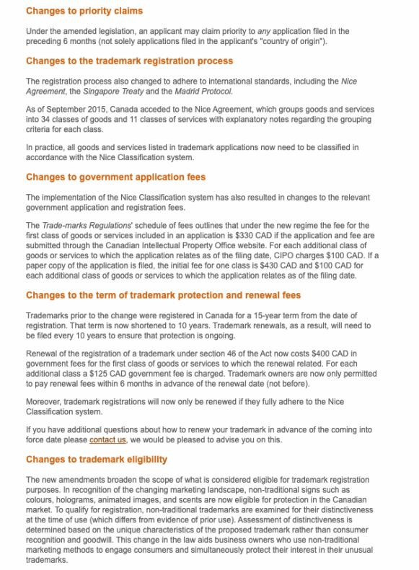

Slide 152
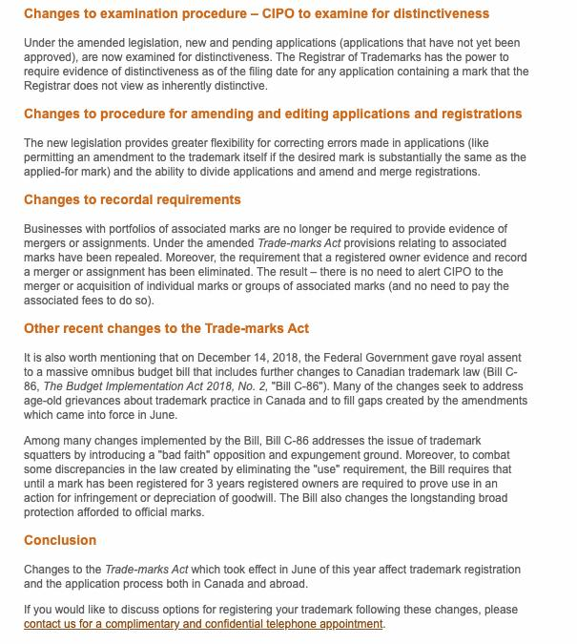

Slide 153
Trademarks
Ordinary marks
Amended definition (2014 - in effect 2019):
  TM: A sign or combination of signs that is used or proposed to be used by a person for the purpose of distinguishing or so as to distinguish their goods and services from those of others.
  Sign: Includes a word, a personal name, a design, a letter, a numeral, a colour, a figurative element, a three-dimensional shape, a hologram, a moving image, a mode of packaging goods, a scent, a taste, a texture, and the positioning of a sign.

Slide 154
Trademarks
S. 12(1): A TM is registrable if it is not:
  (a) Primarily merely a name or surname of an individual living or who has died within 30 years
  (b) Clearly descriptive or deceptively misdescriptive in English or French of the character/quality of wares/services or of the conditions of production/persons employed in their production/place of origin

Slide 155


Slide 156


Slide 157


Slide 158
Trademarks
S. 12(1): TM is registrable if it is not:
  (c) Name in any language of any of the wares or services in connection with which it is used
  (d) Confusing with a registered TM (confusing defined in s. 6(2); factors in s. 6(5))
  (e) Mark prohibited by s. 9 or 10…
  S. 12(2): not registrable if its features are dictated primarily by a utilitarian function
  S. 12(3): If not registrable due to (1)(a) or (b), is registrable if has … become distinctive at the date of filing an application for registration (see also s. 32)

Slide 159
Trademarks
Canada (Registrar of TMs) v. Coles Book Stores, [1974] SCR 438
  1) Is the mark a word?
    Standard Oil Co. v. Canada (Registrar of TM), [1968] 2 Ex C.R. 523.
  2) Is it primarily merely a name or surname of an individual who is living or who has died within the previous 30 years?

Slide 160
“In the case at bar, the evidence clearly establishes that “Coles” is a surname that is well-known to the general public of Canada. On the other hand, the dictionary meanings of the word “cole” and in its plural form “coles”, particularly as found in the Oxford English Dictionary, are largely obsolete. A customer in need of a cabbage does not ask for a “cole”. The only common use of the word that I can think of is in the word “coleslaw”. The inference I draw from the evidence concerning the dictionary definitions of the word “cole” is that it is a word of rare, if not obsolete, usage and would be little known to the general public of Canada. I do not agree with the conclusion of the learned judge of the Exchequer Court that the principal character of the word “Coles” is “equally that of a surname and of a dictionary word in the English language.” My only possible conclusion in this case is that a person in Canada of ordinary intelligence and of ordinary education in English or French would immediately respond to the trade mark “Coles” by thinking of it as a surname and would not be likely to know that “Coles” has a dictionary meaning.”

Slide 161
Trademarks
Test to Apply: Would a person in Canada of ordinary intelligence and of ordinary education in English or French be just as likely, if not more likely, to respond to the word by thinking of it as a brand or a mark of a business than as a name/surname?

Slide 162
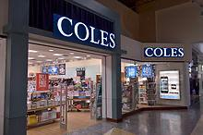

Slide 163
Trademarks
Unilever Canada Inc. v. Superior Quality Foods Inc. (2007), 62 CPR (4th) 75, [2007] TMOB No. 66
Facts: Superior Quality Foods, Inc. filed an application to register the TM BETTER THAN BOULLION for use in association w. soups and soup bases.
Issue: s. 12(1)(b) …Is the mark clearly descriptive or deceptively misdescriptive in the English or French language of the character or quality of the wares or services in association with which it is used or proposed to be used or of the conditions of or the persons employed in their production or of their place of origin.

Slide 164
Trademarks
Unilever Canada Inc. v. Superior Quality Foods Inc. (2007), 62 CPR (4th) 75, [2007] TMOB No. 66
Clearly descriptive = does the mark tell potential dealers/purchasers of the goods/services what the goods and services are, or describe them or describe a property which is commonly associated with them?

Slide 165
Trademarks
  Unilever Canada Inc. v. Superior Quality Foods Inc. (2007), 62 CPR (4th) 75, [2007] TMOB No. 66
  Deceptively misdescriptive = would dealers/purchasers of the goods be deceived by the misdescription into purchasing goods or ordering services which different in character or quality from those expected?

Slide 166
Trademarks
  Unilever Canada Inc. v. Superior Quality Foods Inc. (2007), 62 CPR (4th) 75, [2007] TMOB No. 66
S. 12(1)(b):
  Point of View?: That of the average purchaser of the wares
  Consider the mark in its entirety (not dissected into constituent elements)
  Consider thee mark as a matter of immediate impression

Slide 167
Trademarks
  Unilever Canada Inc. v. Superior Quality Foods Inc. (2007), 62 CPR (4th) 75, [2007] TMOB No. 66
S. 12(1)(b):
  Clearly = easy to understand, self-evidence, plain
  Character = feature, trait, characteristic of wares
  Quality = degree of excellence; laudatory description (i.e., expressing praise)

Slide 168
Trademarks
  Unilever Canada Inc. v. Superior Quality Foods Inc. (2007), 62 CPR (4th) 75, [2007] TMOB No. 66
Decision: “The Mark … clearly describe[s] as a matter of first impression that the Applicant’s soups and soup bases are ‘better than boullion’, a laudatory description that is contrary to s. 12(1)(b)”
Policy justification: This is an ordinary, grammatical phrase that others in the industry should be able to use to fairly describe their products. / different decision - “the vocabulary of the English language is common property: it belongs to all” (Eastman Photographic Materials Company Ltd. v. Comptroller-General of Patents, Designs and Trade Marks, [1898] A.C. 571 (H.L.), Lord Herschell at page 580 ”

Slide 169
Trademarks
General Foods Ltd. v. Carnation Co. (1978), 45 CPR (2d) 282 (TMOB)
Can GFL register the TM “Instant Breakfast” for use in association with wares described as “fortified powder food for mixing with milk”?
S. 12(1): TM is registrable if it is not (c) Name in any language of any of the wares or services in connection with which it is used
Also s.30(a) of the Trademarks Act in setting specifics for TM applications requires that applications must contain “a statement in ordinary commercial terms of the specific goods or services in association with which the mark has been or is proposed to be used.”
Are the words “fortified powder food for mixing with milk” ordinary commercial terms? Board held no. Statement in ordinary commercial terms for the product would be “instant breakfast”.
Accordingly, application to register the TM Instant Breakfast, which is also the name of the wares in English was found not registrable per s. 12(1)(c).

Slide 170
Trademarks
What is the significance in the distinction between s. 12(1)(b) and 12(1)(c)? Why might this distinction have been formalized in the TMA?
12 (1) Subject to subsection (2), a trademark is registrable if it is not..
  (b) …either clearly descriptive or deceptively misdescriptive in the English or French language of the character or quality of the goods or services in association with which it is used…;
  (c) the name in any language of any of the goods or services in connection with which it is used or proposed to be used;

Slide 171
QUESTIONS?
THOUGHTS?
DISCUSSION?

Slide 172
Pause

Slide 173
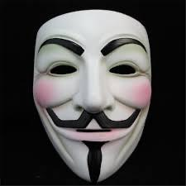
Trademarks: Distinguishing guise no more

Slide 174

Trademarks - changes
Distinguishing guise provisions repealed in 2019
  The shape or design of the product or packaging that effectively distinguishes the product from others. In order for a distinguishing guise to be registered, it must be proven that it has become distinctive through usage.
  S. 13 Trademarks Act REPEALED
  Example: shape of Coca-Cola bottle

Slide 175
Instead of “distinguishing guise”
s. 2 …“sign includes a word, a personal name, a design, a letter, a numeral, a colour, a figurative element, a three-dimensional shape, a hologram, a moving image, a mode of packaging goods, a sound, a scent, a taste, a texture and the positioning of a sign;”

Slide 176
Trademarks
Distinguishing guise
Now that distinguishing guises have ceased to exist as a separate category of TM, similar limitations to those set out in the previous s. 13(1) will be carried over elsewhere, and will apply to all marks

Slide 177
Trademarks
Distinguishing guise
New 12(2): A trademark is not registrable if, in relation to the goods or services in association with which it is used or proposed to be used, its features are dictated primarily by a utilitarian function
New 18.1: The registration of a trademark may be expunged by the Federal Court on the application of any interested person if the Court decides that the registration is likely to unreasonably limit the development of any art or industry
20(1.2): The registration of a trademark does not prevent a person from using any utilitarian feature embodied in the trademark

Slide 178
Trademarks
Glaxo Wellcome Inc. v. Novopharm Ltd (2000)
Glaxo sought registration the distinguishing guise for a six sided tablet, shaped as a shield.
Principles
  Not required to show that most adult Canadians recognize the applicant’s distinguishing guise
  Although the shape of a product can constitute a mark, the mark is usually weak
  The standard of proof in distinguishing guise cases under is the same as in other registration cases
  Relevant period of time for distinctiveness → date of application

Slide 179
Trademarks : Special Marks
S. 9 Trademarks Act
Two categories of prohibited marks
  Absolute prohibitions
  Official marks (9(1)(n)(iii))
What policy reasons could justify including a type of symbol/mark on the list of absolute prohibitions?

Slide 180
Trademarks
S. 9(1)(n)(iii):
  Allows entities which are “public authorities” to request the Registrar of Trade-marks to give public notice of their adoption and use of particular names or symbols. These marks are referred to as “official marks”.
  Once notice is given, these official marks are also removed from the general realm of trade and commerce.

Slide 181
Trademarks
S. 9(1)(n)(iii) is controversial
S. 9(1) prohibits anyone else from adopting an official mark. This prohibition is absolute.
None of the usual formalities for the adoption of official marks
No opposition proceeding; no scrutiny by Registrar
Mark can be descriptive; not required to be distinctive of wares, services
No need to renew; no provisions to remove unused marks

Slide 182
Trademarks
Statutory requirements for public authorities
  Mark must have been adopted and used
  Adoption and use has to be by a public authority in Canada
  Adoption and use must be as an official mark for wares and services

Slide 183
Trademarks
Ontario Ass’n of Architects v. Ontario Assn of Architectural Technologists, [2003] 1 F.C. 331 (FCA)
Public notice was given that the Association of Architectural Technologists of Ontario, a self-regulatory professional body and Ontario non-for-profit corporation without share capital, adopted and used as official marks for services – the words ARCHITECTURAL TECHNICIAN, ARCHITECTE-TECHNICIEN, ARCHITECTURAL TECHNOLOGIST, ARCHITECTE-TECHNOLOGUE. As a result, members of the appellant, the Ontario Association of Architects ("OAA"), can be prevented from using these words in connection with their professional services - unless they had started to use them before April 28, 1999, the date when the Registrar gave public notice in the Trade-marks Journal of their adoption and use by the AATO as official marks.

Slide 184
Trademarks
Ontario Ass’n of Architects v. Ontario Assn of Architectural Technologists, [2003] 1 F.C. 331 (FCA)
Defining characteristics of public authority =
  Degree of government control [para. 57-64]
  Extent to which the body’s activities benefit the public [para. 65-73]

Slide 185
QUESTIONS?
THOUGHTS?
DISCUSSION?

Slide 186
Pause

Slide 187
Trademarks
1. Significant degree of governmental control
More rigorous part of test
Consider body’s objects, duties and powers, including distribution of its assets
Need some ongoing government supervision of the activities of the body claiming to be a public authority; sufficient to allow the government to exercise a degree of ongoing influence in the body’s governance and decision-making.

Slide 188
Trademarks
2. Public benefit
Broadly interpreted by the courts – some aspect for public benefit? Considered to act for public benefit.
In this case the Architectural Technologists set & enforce standards of professional competence & ethical conduct of its members.
As a result, FCA held that the Technologists regulate part of the practice of the profession. The lower court judge concluded that these activities benefit the public, and the FCA agreed.

Slide 189
Trademarks
A TM owner who has a registered mark that resembles an official mark effectively has their rights frozen at the time of publication of the official mark
  See Royal Roads University v. R. (2003), 27 CPR (4th) 240 (F.C.)

Slide 190
Trademarks: Applying the provision
MARK/NUMBER
Land of Anne 907857
The Anne Collection 907535
Red-Haired Anne 909009
Rainbow Valley 909010
Gilbert Blythe 909011
Akage No Anne 909012
Avonlea 909013
Matthew Cuthbert 909014
Anne of Green Gables The Musical 909015
Anne with an "E" 909016
Marilla Cuthbert 909017
Josie Pye 909018
Road to Avonlea 909019
Kindred Spirits 909020
Rilla of Inglesides 909021
Anne of Avonlea 909022
Anne Shirley 909023
Diana Barry 909024

Slide 191

Trademarks

Slide 192

Trademarks

Slide 193
Trademarks
“170 The PEI government has significant influence and control with respect to the Anne Authority. The PEI government has members on the Anne Authority committee. The PEI branch of that committee controls all licensing in Prince Edward Island. One of the prime objectives, from the government perspective, was to protect the local craft industry in the Province, freeing it from costly licenses but maintaining a uniform-quality Anne image. The Province is partnered with the Heirs, who share a philanthropical and financial objective with respect to protecting and promoting a licensed Anne image. Applying the combined test of control, influence and purpose to promote the public good, I conclude that the Anne Authority is a public authority. If it was necessary to determine the issue, I would in all of the circumstances conclude that the Anne Authority is a public authority. Therefore, the Assignment Agreement that conveyed rights from the PEI government to the Anne Authority would be valid.”
(Anne of Green Gables Licensing Authority Inc. v. Avonlea Traditions Inc. (2000), 4 C.P.R. (4th) 289

Slide 194

S. 9(1)(o): “Royal Canadian Mounted Police” or “R.C.M.P.”

Slide 195



Slide 196


Slide 197
Trademarks : Use
USE IT
OR
LOSE IT?

Slide 198
Trademarks
“Use”
First use … entitles you to register a TM but amended provisions now allow for filing without intended use.
Failure to use … basis for expungement of TM
Unauthorized use … could lead to infringement actions

Slide 199
Trademarks
4. (1) A trade-mark is deemed to be used in association with goods if, at the time of the transfer of the property in or possession of the goods, in the normal course of trade, it is marked on the goods themselves or on the packages in which they are distributed or it is in any other manner so associated with the goods that notice of the association is then given to the person to whom the property or possession is transferred.
(2) A trade-mark is deemed to be used in association with services if it is used or displayed in the performance or advertising of those services.

Slide 200
Trademarks
Syntex Inc. v. Apotex Inc., [1984] 2 FC 1012 (FCA)
Facts:
  Syntex was the registered owner of the TradeMark Naprosyn; has sold Naproxen under this name since 1974.
  Apotex took Apo-Naproxen as the brand name of its product; registered it as a TM in Canada.
  In 1982 Apotex distributed a one-page flyer to hospital and retail pharmacists in Canada designed to promote the sale of Apo-Naproxen. Naprosyn was referenced on this flyer… A note w. Naprosyn 250mg written on it is juxtaposed with two containers of Apo-Naproxen tablets.
  Also a message …“Now pharmacists have a choice when filling a prescription for Naprosyn.”…

Slide 201
Trademarks
Syntex Inc. v. Apotex Inc., [1984] 2 FC 1012 (FCA)
Did the Defendants Apotex “use” the TM of the Plaintiffs Syntex (see ss. 2, 4 TMA)?
  4. (1) A trade-mark is deemed to be used in association with goods if, at the time of the transfer of the property in or possession of the goods, in the normal course of trade, it is marked on the goods themselves or on the packages in which they are distributed / or it is in any other manner so associated with the goods that notice of the association is then given to the person to whom the property or possession is transferred.

Slide 202
Trademarks
Syntex Inc. v. Apotex Inc., [1984] 2 FC 1012 (FCA)
  4. (1) A trade-mark is deemed to be used in association with goods if, at the time of the transfer of the property in or possession of the goods, in the normal course of trade, … it is in any other manner so associated with the goods that notice of the association is then given to the person to whom the property or possession is transferred.

Slide 203
Trademarks
Syntex Inc. v. Apotex Inc., [1984] 2 FC 1012 (FCA)
  4. (1) A trade-mark is deemed to be used in association with goods if, at the time of the transfer of the property in or possession of the goods, in the normal course of trade, … it is in any other manner so associated with the goods that notice of the association is then given to the person to whom the property or possession is transferred.

Slide 204

Trademarks
Syntex Inc. v. Apotex Inc., [1984] 2 FC 1012 (FCA)
Court said on this point… “It seems to me that the respondents (Syntex) face considerable difficulty in establishing at trial that the presence of the trade mark “Naprosyn” in the appellant’s flyer constituted a “use” that is contrary to subsection 22(1) of the Trade Marks Act”

Slide 205
Trademarks
Specialty Software Inc. v. Bewatec Kommunikationstechnik GMBH 2016 FC 223
Specialty Software Inc. registered the TM “MEDINET” in association w. computer software programs.
Mark was registered in relation to wares, not services.
…2013 – Bewatec attempted to have this mark expunged from the register.
To avoid expungement, Specialty had to show evidence of its use of the mark between November 22, 2010 and November 22, 2013.
Ultimately, Specialty provided evidence of use. But was this use in relation to wares?
Speciality used to sell its software on disks. Now, clients obtain access to the software over the Internet.

Slide 206
Trademarks
Specialty Software Inc. v. Bewatec Kommunikationstechnik GMBH 2016 FC 223
Clients obtain access to software over the Internet (they had previously received a disk containing the software).
Does this mean that Specialty is providing a service as opposed to selling a product?
MyLife.com Inc v Grbic,2014 TMOB 175 (CanLII) says that providing free access to a website was a service.

Slide 207
Trademarks
4 (1) A trade-mark is deemed to be used in association with goods if, at the time of the transfer of the property in or possession of the goods, in the normal course of trade, it is marked on the goods themselves or on the packages in which they are distributed or it is in any other manner so associated with the goods that notice of the association is then given to the person to whom the property or possession is transferred.
Is there a “good” here? If so, what is the good?
The good is the license to use the software.
The property is the right or the entitlement to enjoy the use of the license.
The transfer occurred through the granting of access in the form of login credentials.
The mark is visible throughout this process.
The disk, then, is just one means by which a transfer can occur. It can also occur through other ways (i.e., granting of access in the form of login credentials).

Slide 208
Trademarks
Has a TM been used within the meaning of s. 4(1) “in the normal course of trade” where goods are given away for free, as opposed to being sold?
See Distrimedic Inc. v. Dispill Inc., 2013 FC 1043 [302] … The expression "in the normal course of trade"…requires some payment or exchange, which excludes the use of a trade-mark in situations where the wares are given away for free or donated.

Slide 209
Trademarks
4(2) A trade-mark is deemed to be used in association with services if it is used or displayed in the performance or advertising of those services.

Slide 210
Trademarks
Gesco Industries Inc v. Sim & McBurney (2000) 9 CPR (4th) 480 (FCA)
The Registrar of Trademarks had expunged Gesco's registration of the trademark "Stainshield" for use in association with the services of stain resistant treatment for carpets and rugs.
The Registrar determined that Gesco failed to submit any evidence of use of the trademark.
Gesco appealed the Registrar's decision.
FCA held that when a trademark is used in association with services, the use does not have to occur in the normal course of trade.

Slide 211
Trademarks
Gesco Industries Inc v. Sim & McBurney (2000) 9 CPR (4th) 480 (FCA)
Rothstein J. defines services broadly.
He accepts the reasoning of Strayer J in this regard: [para 10]
No definition of services is given in the Trademarks Act because of the “plethora of services that the human mind is capable of conceiving”
Term should be liberally construed
Each case decided on its own facts, giving proper regard to judicial precedent.
Nothing to suggest that services with respect to which a TM may be established are limited to those which are not incidental or ancillary to the sale of goods.
So … services can include services incidental or ancillary to the sale of goods

Slide 212
Trademarks
Gesco Industries Inc v. Sim & McBurney (2000) 9 CPR (4th) 480 (FCA)
Was the Stainshield TM, in this case, used in association with the services disclosed in the registration of the TM (namely services of stain resistant treatment for application to carpets and rugs)?
Yes; Stainshield TM displayed in the advertising of the treatment of some of Gesco’s lines of carpets and rugs.
Services may be ancillary to the wares, but this doesn’t mean the TM is not used in association with the services. [para 11]
Are there good policy reasons for “use” to be more permissive for services than for goods?

Slide 213
Trademarks v. Passing Off
Why would you want to register your TM?
Why not just rely on passing off?
TM = no proof of goodwill required. Only proof of use.
Registration of a mark provides national protection
Registered marks are presumed valid for Canada for all the wares and services for which they are registered.
s. 22 of the TMA protects against mark dilution
In situations where a mark is deemed invalid, a passing off action might still succeed

Slide 214
Trademarks: Transfer & Licensing
As a TM owner, you can transfer your TM.
Per s. 50 TMA you can also permit another person to use your mark without impairing the distinctiveness of the mark provided that:
    A licence exists
    Certain controls are in place over the quality of the wares What is sufficient control?
See also s. 48, TMA

Slide 215


Trademarks
Tommy Hilfiger Licensing Inc v. Produits de Qualité, 2005 FC 10

Slide 216
Trademarks
Tommy Hilfiger Licensing Inc v. Produits de Qualité, 2005 FC 10
Plaintiff, Tommy Hilfiger Licensing Inc. (THLI), owned the trademarks relating to the Tommy Hilfiger brand which manufactured and sold clothing.
Defendant, Quality Goods I.M.D. Inc. (controlled by Harry Rosen), created the "Explore Canada" logo and began displaying it on its souvenir products.
THLI sued Quality alleging infringement of the THLI trademarks.
Defendants argued that the Hilfiger trademarks were invalid.
Court held that the Hilfiger trademarks were valid and that the defendants' Explore Canada logo was likely to cause confusion.

Slide 217
Trademarks
Tommy Hilfiger Licensing Inc v. Produits de Qualité, 2005 FC 10
Court concluded that the Service Agreements signed by THLI allowed it to maintain sufficient control over the quality of the goods to avoid any potential confusion as to source
THLI’s service agreements required it to:
  Coordinate design and execution of licensed products.
  Review samples of licensed products.
  Plan and coordinate construction of licensees’ dedicated Tommy Hilfiger showrooms.
  Coordinate product launches.
  Plan and execute advertising and promotional plans and programs.

Slide 218
Trademark transferable
48 (1) A trademark, whether registered or unregistered, is transferable, and deemed always to have been transferable, either in connection with or separately from the goodwill of the business and in respect of either all or some of the goods or services in association with which it has been used.
Where two or more persons interested
(2) Nothing in subsection (1) prevents a trademark from being held not to be distinctive if as a result of a transfer thereof there subsisted rights in two or more persons to the use of confusing trademarks and the rights were exercised by those persons.

Slide 219
Trademarks
How to remove existing Trademarks from the register:
  S. 45: Expungement or amendment on the basis of non-use
  S. 57: Striking or amending a Trademark…

Slide 220
Trademarks
45. (1) The Registrar may at any time and, at the written request made after three years from the date of the registration of a trade-mark by any person who pays the prescribed fee shall, unless the Registrar sees good reason to the contrary, give notice to the registered owner of the trade-mark requiring the registered owner to furnish within three months an affidavit or a statutory declaration showing, with respect to each of the goods or services specified in the registration, whether the trade-mark was in use in Canada at any time during the three year period immediately preceding the date of the notice and, if not, the date when it was last so in use and the reason for the absence of such use since that date.

Slide 221
Trademarks
45. (3) Where, by reason of the evidence furnished to the Registrar or the failure to furnish any evidence, it appears to the Registrar that a trademark, either with respect to all of the goods or services specified in the registration or with respect to any of those goods or services, was not used in Canada at any time during the three year period immediately preceding the date of the notice and that the absence of use has not been due to special circumstances that excuse the absence of use, the registration of the trademark is liable to be expunged or amended accordingly.

Slide 222
Trademarks
57 (1) The Federal Court has exclusive original jurisdiction, on the application of the Registrar or of any person interested, to order that any entry in the register be struck out or amended on the ground that at the date of the application the entry as it appears on the register does not accurately express or define the existing rights of the person appearing to be the registered owner of the trademark.

Slide 223
Trademarks
UNICAST SA v. South Asian Broadcasting Corporation Inc. 2014 FC 295 (CanLII)
Applicant claims, citing to a case called HomeAway.com, Inc. v. Hrdlicka, 2012 FC 1467, that a trade-mark which appears on a computer screen website in Canada, regardless where the information may have originated from or be stored, constitutes for Trade-Marks Act purposes, use and advertising in Canada.
Court rejects this argument, taking this opportunity to clarify and put HomeAway into context…
  “[46]…Although it is true that subsection 4(2) TMA provides that a “trade-mark is deemed to be used in association with services if it is used or displayed in the performance […] of those services”, the Courts and tribunals, including the Trade-marks Opposition Board, have nonetheless added that such services must be effectively offered to Canadians or performed in Canada (see for example Express File Inc. v HRB Royalty Inc., 2005 FC 542(CanLII) at para 20, [2005] FCJ No 667).”
Not enough for the mark to merely appear on a computer screen…

Slide 224
Trademarks
UNICAST SA v. South Asian Broadcasting Corporation Inc.
[47] To go against this logical interpretation of the law would lead to some twisted and unfortunate consequences none of which could have been Parliament’s intent in drafting the Act. For example, should we follow the Applicant…, any foreign trade-mark holder could request and obtain the expungement of a bona fide Canadian trade-mark based on previous use through the Web even if this foreign trade-mark owner had basically nothing to do with Canada and no physical presence in the country. How could it be logical to interpret the applicable legal scheme as putting every single Canadian trade-mark owner at risk of having its trade-mark taken away by another trade-mark that has no nexus to Canada?.. It would be illogical and impossible to take this approach.

Slide 225
Trademarks
UNICAST SA v. South Asian Broadcasting Corporation Inc.
[48] What is more, the Respondent quite rightly submits that this situation would be unthinkable should the roles in these proceedings be reversed. Would a Canadian trade-mark owner have the right to request from a foreign trade-mark owner that they stop using their trade-mark if this foreign owner’s presence in Canada is limited to the Internet? … Again, this suggestion is preposterous. The notion of performing the services is essential.
[49] Therefore, the Applicant shall have to prove having used its trade-mark with respect to services actually provided to Canadians or performed in Canada.

Slide 226
Trademarks
UNICAST SA v. South Asian Broadcasting Corporation Inc. - Conclusion
The fact that a trade-mark appears on a website that may be displayed on a computer screen in Canada is not sufficient to constitute use and advertising in Canada (for the purposes of s. 4(2) of the TMA).

Slide 227
Trademarks
45. (3) Where, by reason of the evidence furnished to the Registrar or the failure to furnish any evidence, it appears to the Registrar that a trade-mark, either with respect to all of the goods or services specified in the registration or with respect to any of those goods or services, was not used in Canada at any time during the three year period immediately preceding the date of the notice and that the absence of use has not been due to special circumstances that excuse the absence of use, the registration of the trade-mark is liable to be expunged or amended accordingly.

Slide 228
Trademarks
Scott Paper Limited v. Smart & Biggar 2008 FCA 129
No evidence of any use of the registered TM “VANITY” by Scott Paper
Because of this (we know that the period of non-use is defined as the period between the date of acquisition of the TM by the registered owner, and the date of notice - approximately 13 years) … long period of non-use…
Confronted, Scott Paper states that they genuinely intend to use the TM, and have developed plans in this regard
The Senior Hearing Officer concluded that a 13 year period of deliberate non-use could be excused by a registrant’s intention to use the mark in the near future.
This decision was appealed & reversed.

Slide 229
Trademarks
Scott Paper Limited v. Smart & Biggar, 2008 FCA 129
The general rule is that the absence of use is penalized by expungement
There is an exception to the general rule where the absence of use is due to special circumstances.
Special circumstances alleged by Scott Paper are the plans for resumption of use of the mark …
Pelletier JA clarifies that this is not sufficient to excuse non-use…“the 13 year absence of use was due to a deliberate decision not to use the mark”.
And … “a registrant’s intention to resume use of a mark which has been absent from the marketplace, even when steps have been taken to actualize those plans, cannot amount to special circumstances which excuse the non-use of the TM. The plans for future use do not explain the period of non-use and … cannot amount to special circumstances”

Slide 230
Trademarks
Scott Paper Limited v. Smart & Biggar, 2008 FCA 129
General principles re special circumstances that excuse non-use
1) Onus on registered owner to establish special circumstances excusing non-use of the TM
2) Consider two factors:
  Length of time of non-use
  What were the reasons for the non-use? Were these reasons beyond the registered owner’s control?
3) Circumstances of non-use must be special (ie do not exist in the majority of cases)
4) Special circumstances are an exception to the general rule that a TM which is not used should be expunged

Slide 231

Trademarks
Scott Paper Limited v. Smart & Biggar, 2008 FCA 129 Conclusion
Fact that registered owner may have plans to resume use of mark is not sufficient to excuse non-use.

Slide 232
Trademarks
Should trade-marks be “use it or lose it”?
Would you make any changes/modifications to the provision addressing expungement for non-use?
Is “use it or lose it” something that you think should also be incorporated into patent or copyright legislation?

Slide 233

Trademarks
S. 57 TMA → Can strike or amend a TM on the register on the basis that it “does not accurately express or define the existing rights of the [registered owner] of the mark.” (read w. s. 18)
If the TM was not registrable at the date of registration [18(1)(a)]
If the TM is not distinctive at the time proceedings bringing the validity of the registration into question are commenced [18(1)(b)]
If the TM has been abandoned [18(1)(c)]
If the applicant for registration was not the person entitled to secure the registration [18(1)(d)]
The application for registration was filed in bad faith

Slide 234
Trademarks
57 (1) The Federal Court has exclusive original jurisdiction, on the application of the Registrar or of any person interested, to order that any entry in the register be struck out or amended on the ground that at the date of the application the entry as it appears on the register does not accurately express or define the existing rights of the person appearing to be the registered owner of the trademark.

Slide 235
Trademarks
When registration invalid
18 (1) The registration of a trademark is invalid if
  (a) the trademark was not registrable at the date of registration;
  (b) the trademark is not distinctive at the time proceedings bringing the validity of the registration into question are commenced;
  (c) the trademark has been abandoned;
  (d) subject to section 17, the applicant for registration was not the person entitled to secure the registration; or
  (e) the application for registration was filed in bad faith.
Exception
(2) No registration of a trademark that had been so used in Canada by the registrant or his predecessor in title as to have become distinctive at the date of registration shall be held invalid merely on the ground that evidence of the distinctiveness was not submitted to the competent authority or tribunal before the grant of the registration.

Slide 236
Trademarks: Registration invalid if…
1) If the TM was not registrable at the date of registration [18(1)(a)]
  See ss. 9, 10, 12, 13
2) If the TM is not distinctive at the time proceedings bringing the validity of the registration into question are commenced [18(1)(b)]
  See for example the discussion on TMs becoming generic. Also ss. 48-50 TMA

Slide 237
12 (1) Subject to subsection (2), a trademark is registrable if it is not
(a) a word that is primarily merely the name or the surname of an individual who is living or has died within the preceding thirty years;
(b) whether depicted, written or sounded, either clearly descriptive or deceptively misdescriptive in the English or French language of the character or quality of the goods or services in association with which it is used or proposed to be used or of the conditions of or the persons employed in their production or of their place of origin;
(c) the name in any language of any of the goods or services in connection with which it is used or proposed to be used;
(d) confusing with a registered trademark;
(e) a sign or combination of signs whose adoption is prohibited by section 9 or 10;

Slide 238
Trademarks: Registration invalid if…
3) If the TM has been abandoned [18(1)(c)]
  Read in conjunction w. s. 45 of the TMA
4) If the applicant for registration was not the person entitled to secure the registration [18(1)]
  See ss. 16, 17 of the TMA
5) If the application for registration was filed in bad faith

Slide 239
Trademarks
Promafil Canada Ltée v. Munsingwear Inc. (1992), 44 CPR (3d) 59, [1992] FCJ 611 (FCA).
Promafil (P/R) is a French company; Munsingwear (D/A) a US company.
Mark of the appellant Munsingwear is a picture of a penguin. Adopted by Munsingwear in the US in the 1950s for use on golf shirts.
Munsingwear is not in business in Canada. Stanfield’s (a Canadian company based in Truro, NS) obtained a licence from Munsingwear to make and sell golf shirts in Canada with the Pengiuin mark.
Accordingly the penguin was used, but never registered…
Why not?

Slide 240
Trademarks
Promafil Canada Ltée v. Munsingwear Inc. (1992), 44 CPR (3d) 59, [1992] FCJ 611 (FCA).
Promafil sold wool in Canada with a penguin design. Munsingwear was concerned about the possible registrability of its mark given the presence of the French design.
In 1977, Munsingwear decided to attempt to register the TM with respect to shirts and shorts – but not for wool
Promafil opposed the registration.
Despite this, Munsingwear registration was accepted by the Registrar, who held that the mark for wool was not confusing with the mark for clothing.
A few years later, Munsingwear found out that Promafil was attempting to sell clothing with a penguin design mark.

Slide 241
Trademarks
Promafil Canada Ltée v. Munsingwear Inc. (1992), 44 CPR (3d) 59, [1992] FCJ 611 (FCA).
Stanfield had also expanded its products sold (to include sweaters and socks).
Because they had expanded their clothing products and because they realized that the mark they were then using (corpulent penguin) differed from the mark they had registered (slim penguin), Stanfield filed an additional application to register.
Promafil then brought an action to oppose the registration of the new design, and to and expunge the old design.
  They said that the new penguin design shouldn’t be registered because it was confusing
  The old penguin design should be expunged as abandoned

Slide 242

Trademarks
Promafil Canada Ltée v. Munsingwear Inc. (1992), 44 CPR (3d) 59, [1992] FCJ 611 (FCA).

Slide 243
Trademarks
Promafil Canada Ltée v. Munsingwear Inc. (1992), 44 CPR (3d) 59, [1992] FCJ 611 (FCA).
Main issue was whether by registering one mark, and using another, is the first mark abandoned?
To show abandonment:
  Must show registered TM no longer in use in Canada
  Need to show intention to abandon mark.
Amendment:
  Can amend mark provided that the amendment does not materially alter the character of the mark. Can have variations on the same mark (both can be used). All law requires is that there is maintenance of recognizability to avoid confusion of unaware purchasers. (Promafil)

Slide 244
Trademarks
Promafil Canada Ltée v. Munsingwear Inc. (1992), 44 CPR (3d) 59, [1992] FCJ 611 (FCA).
At some point, a variation in a mark may be significant enough to constitute a new mark
One question to ask: Has the mark varied so much as to confuse the consumer as to the source of the ware?
Ongoing use of new mark could be abandonment of old mark.
Take technology into account (reason for improvement of mark).

Slide 245
Trademarks
Promafil Canada Ltée v. Munsingwear Inc.
FCA (MacGuigan JA) held:
Here differences are only petty and when used concurrently, one is still the variation of the other. A modified variant can co-exist with original…
The second design doesn’t have to replace the first design. There can be variations on the same design. The law can tolerate multiple variations of the same mark. Though, every variation is playing with fire…
If variation is too different then it would be a new mark or non-use of registered mark…
The key is to maintain recognisability and avoid confusion of unaware purchasers. If the same dominant features of the design are maintained, and the differences are petty – the unaware purchaser will not be misled.

Slide 246
Trademarks
Are the provisions of the TMA allowing for challenges to TM registration:
Weighted too heavily in favour of persons that have registered marks (or are applying to have a mark registered)?
Weighted too heavily in favour of persons wishing to oppose or invalidate a registration?
Adequately balanced between both parties (and the public interest more broadly)?

Slide 247
Coming Soon
™2

Slide 248

Trademarks: Doctrine of Confusion

Slide 249


A MATTER OF PERSPECTIVE

Slide 250

Conclusion

Slide 251
UNTIL NEXT
TIME!

Slide 252

Always include a cat picture

Slide 253
In learning you will teach
And in teaching you will learn
Phil Collins' Son of Man (1999)

Slide 254
Our Academic Partners

