Slide 1

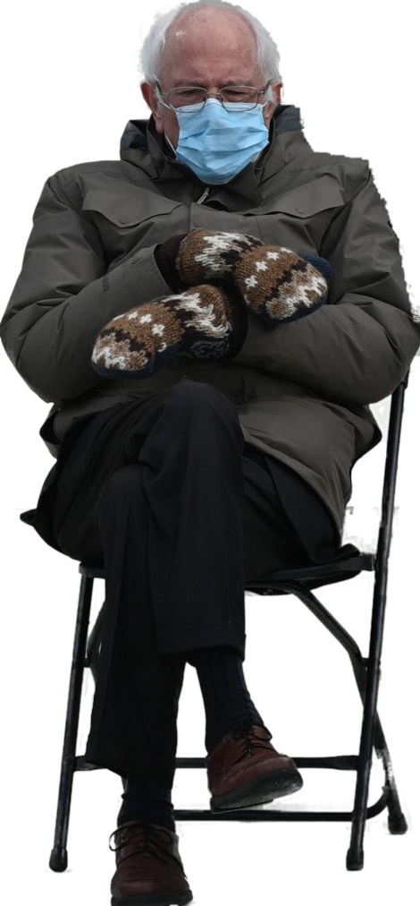

Trademarks 4
Talk 10
LAW 422 001
Intellectual Property Law
Allard School of Law, UBC
Fall, 2021
Jon Festinger Q.C.
Centre for Digital Media
QMUL School of Law (CCLS)
Whiteboard Law
http://commlaw.allard.ubc
@jonfestinger
jon_festinger@thecdm.ca

Slide 2
Stuff

Slide 3
Course Evaluations
NOVEMBER 25
TO
DECEMBER 8

Slide 4
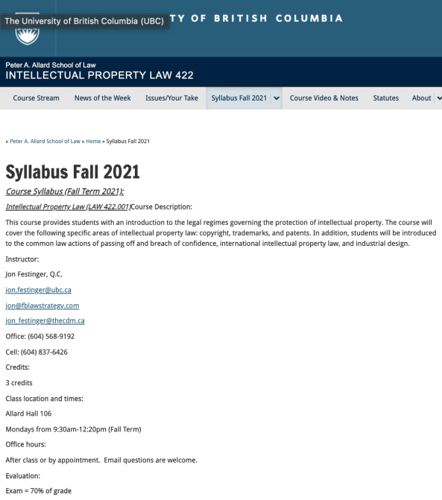
Any Questions?…

Slide 5
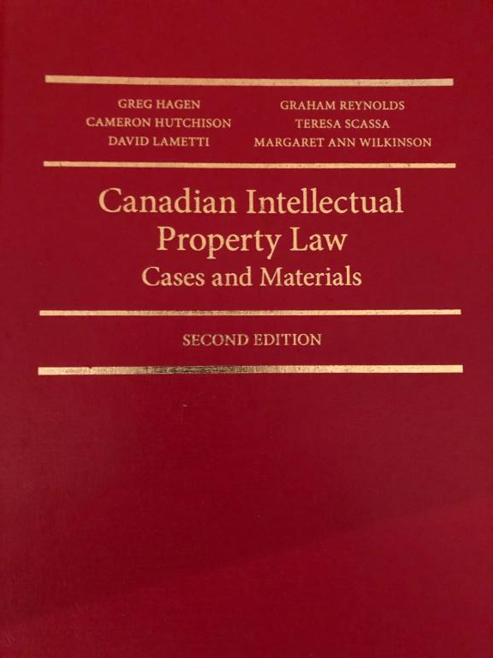

Slide 6

Office “Hours”: Ideally Mondays before or after class but am flexible…
Email me : jon.festinger@ubc.ca
Skype: jon.festinger
Phone:
o. 604-568-9192
c. 604-837-6426

Slide 7
Thank you for
your (optional) bios.
Much appreciated.

Slide 8
Evaluation
(LLMCL students extra)

Slide 9
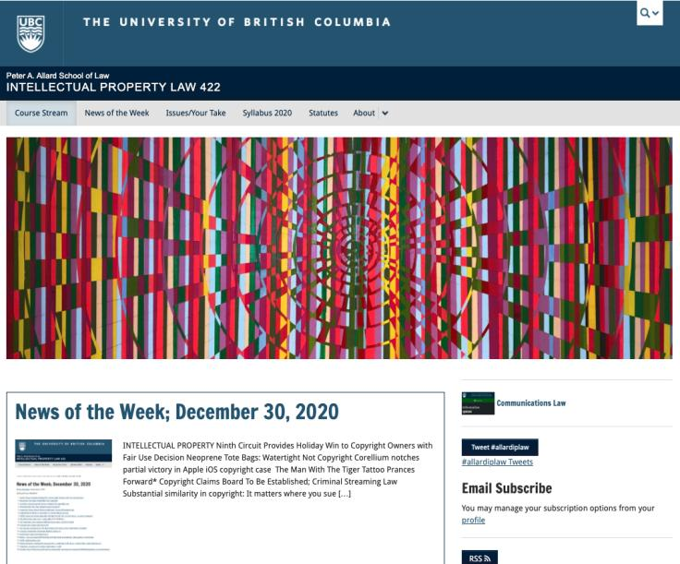
Course Website
https://iplaw.allard.ubc.ca/

Slide 10
For full privileges on the website
1. Please create an account at http://cms.ubc.ca/ using your CWL.
2. Once you create an account and sign in at http://cms.ubc.ca/ you can click your name in the top right. Halfway down the following page will be your WordPress email address.
3. Send me your WordPress email address at jon.festinger@ubc.ca or at jon_festinger@thecdm.ca
4. Then, I will invite you to participate with authoring privileges via your WordPress email address.

Slide 11
Evaluation
70% = Exam
Paper/Presentation/Post = 20%
Participation = 10%

Slide 12
Let’s talk about…
The 30%

Slide 13
A modest proposal…
500-1000 words (or equivalent) per person
written, video, podcast, in-class presentation (?), interpretive dance
Website or not
If posted to website, note to me pls.
Groups or individually

Slide 14
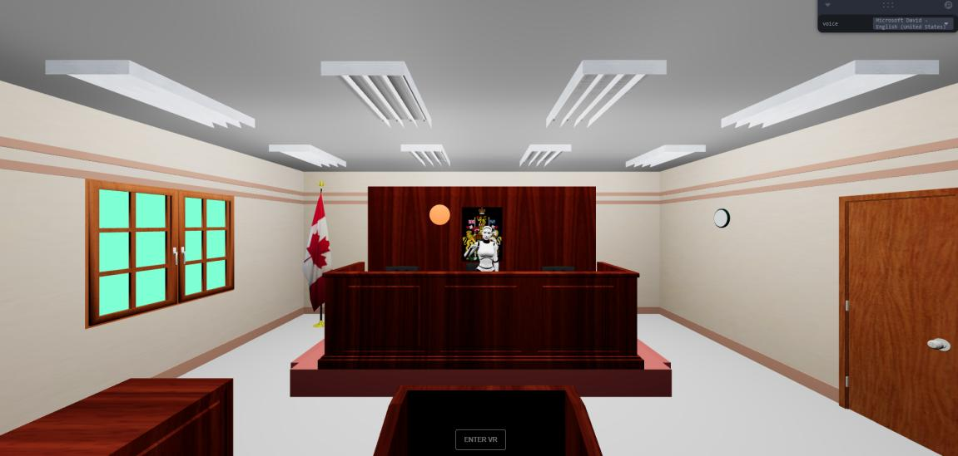
UBC Emerging Media Law Moot A.I. Project

Slide 15


Slide 16
QUESTIONS?
THOUGHTS?
DISCUSSION?

Slide 17

Pause

Slide 18
News of
the Week

Slide 19
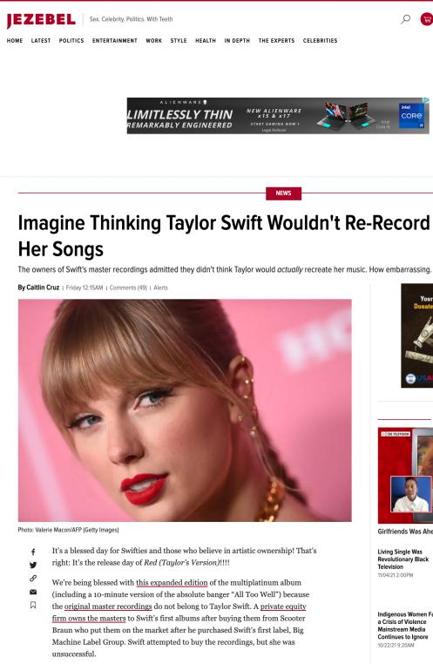

Slide 20
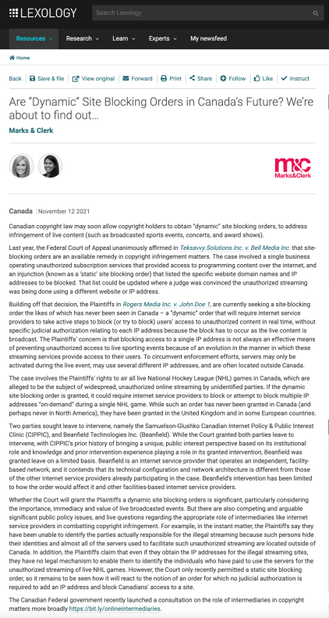

Slide 21
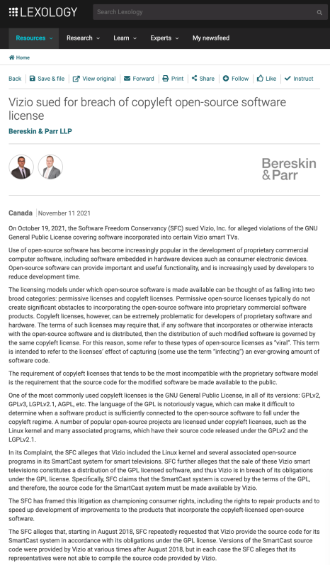

Slide 22
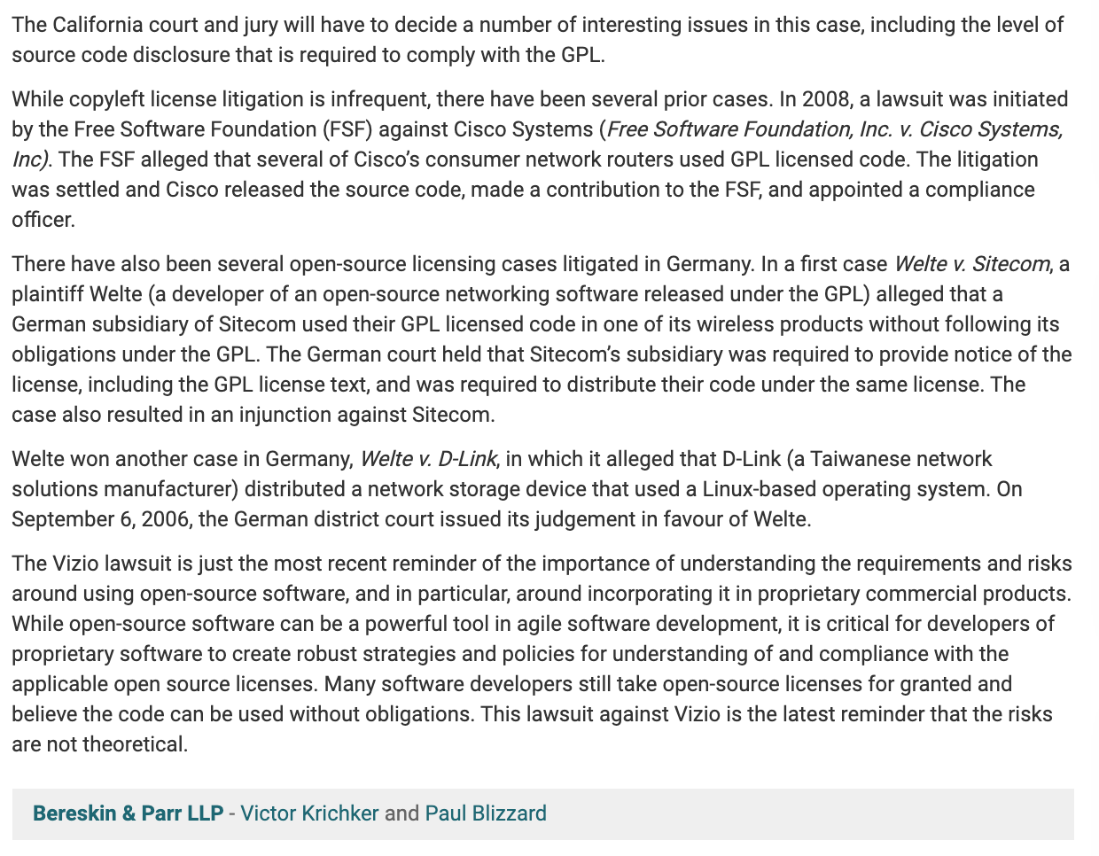

Slide 23
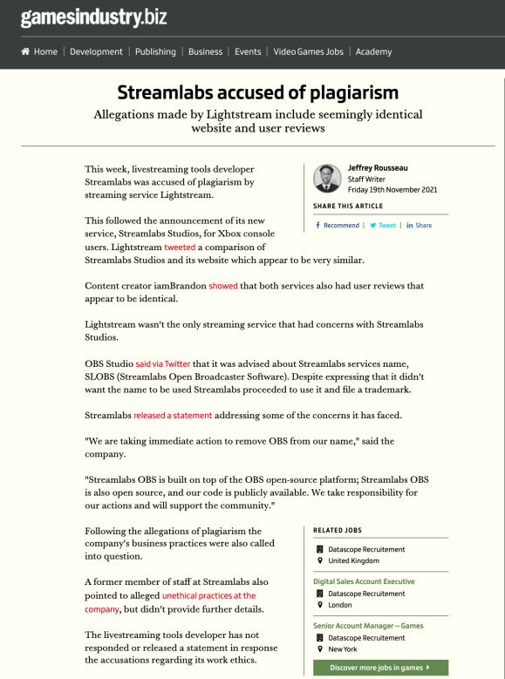

Slide 24
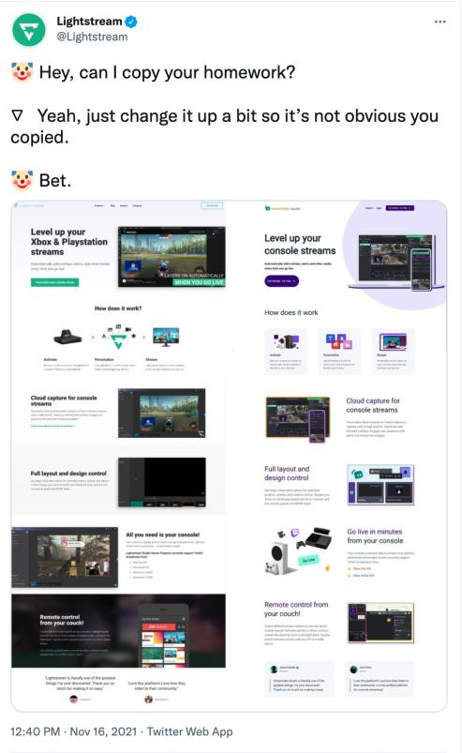

Slide 25
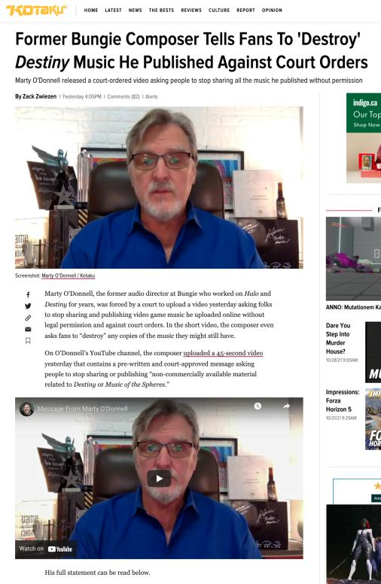

Slide 26
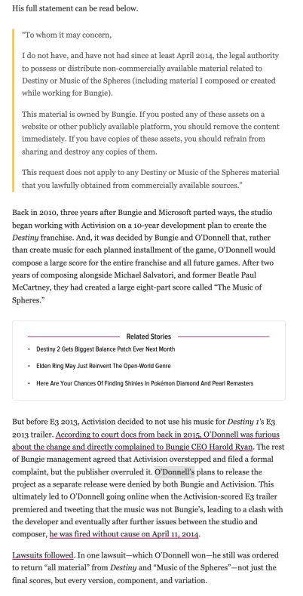

Slide 27
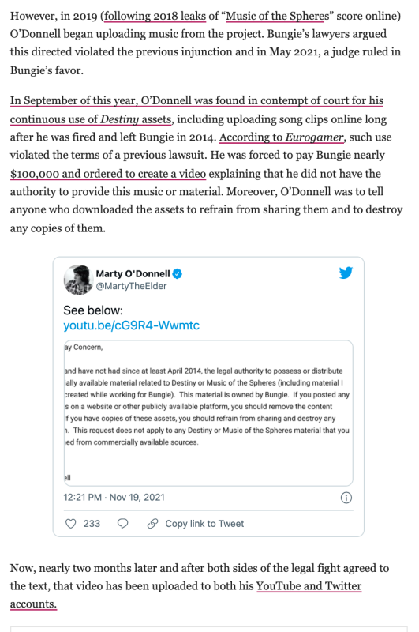

Slide 28
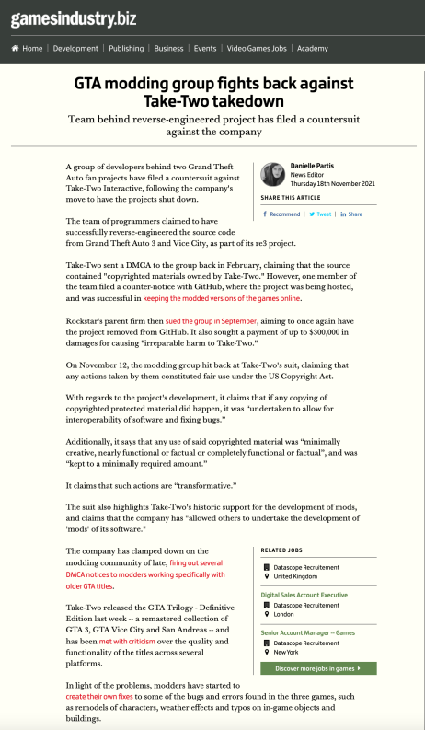

Slide 29

In Facebook/Meta News

Slide 30
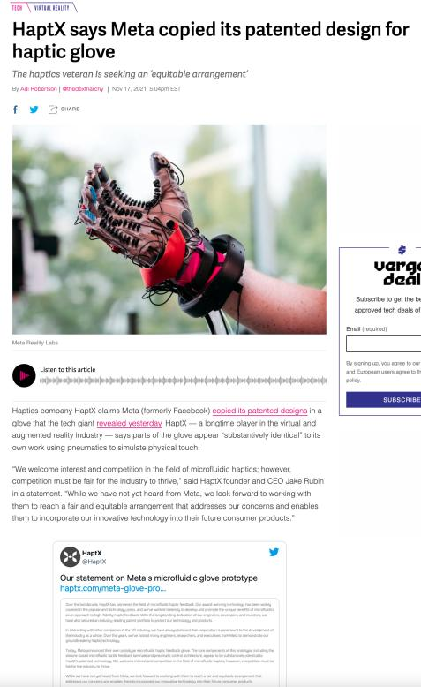
Thanks Veronica

Slide 31
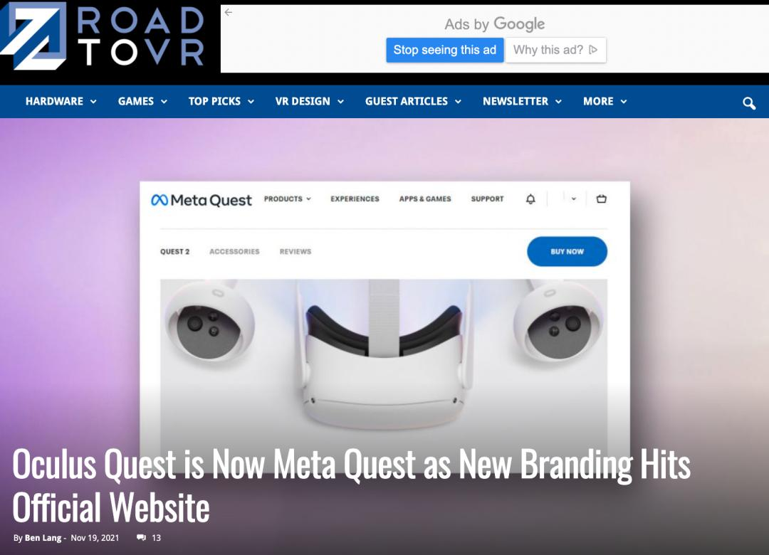

Slide 32
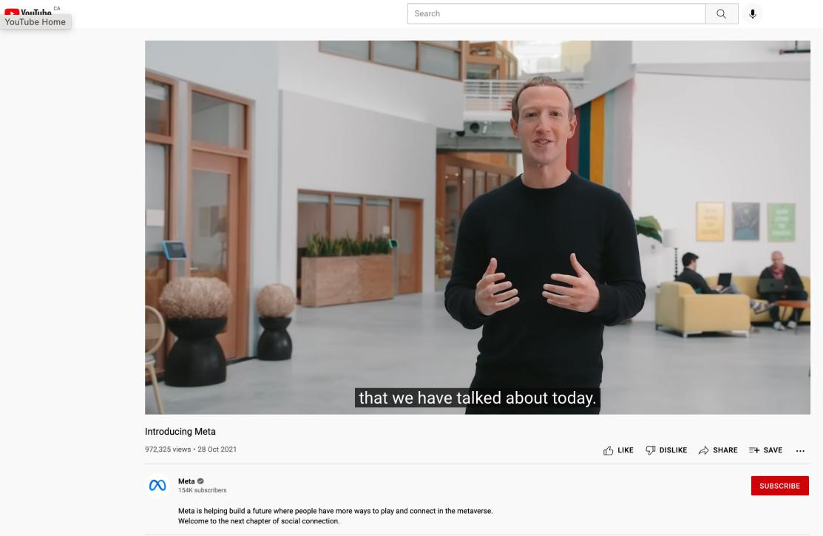

Slide 33
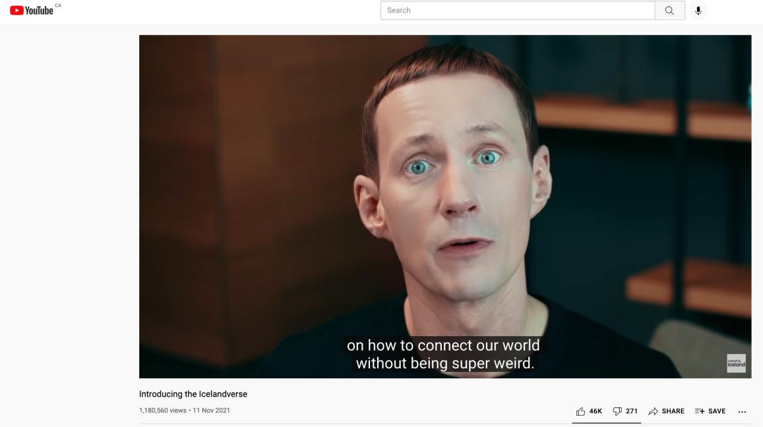

Slide 34
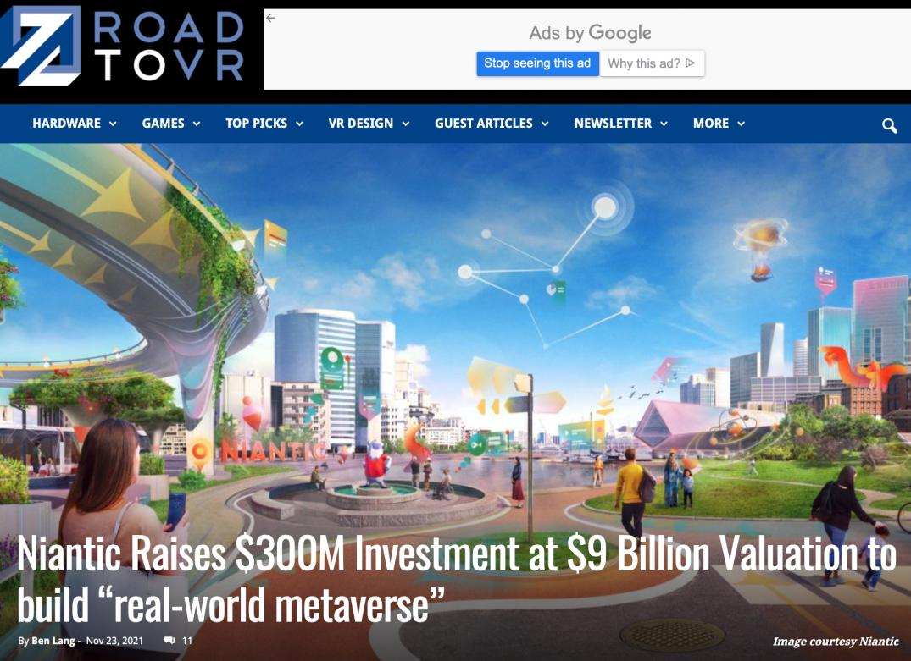

Slide 35
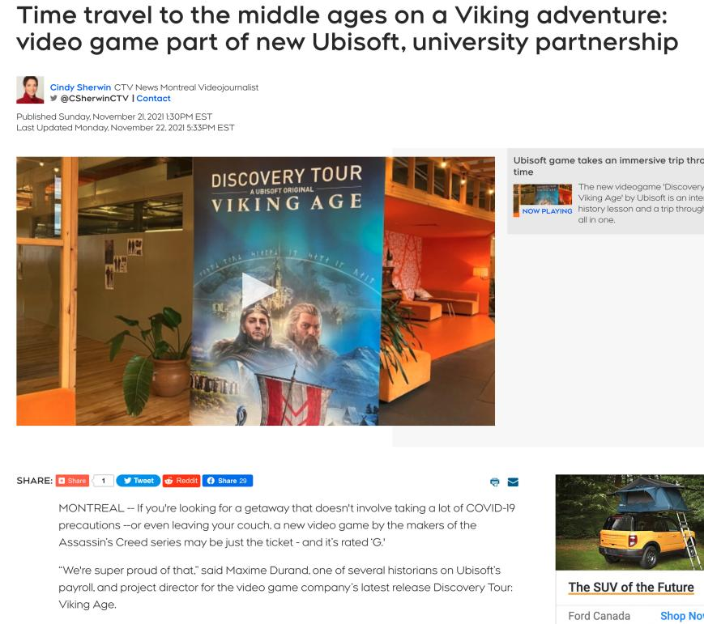

Slide 36
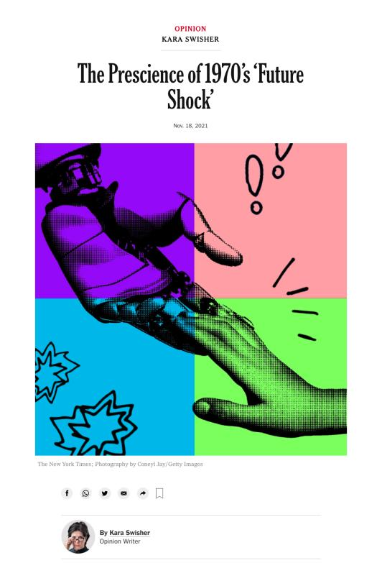

Slide 37
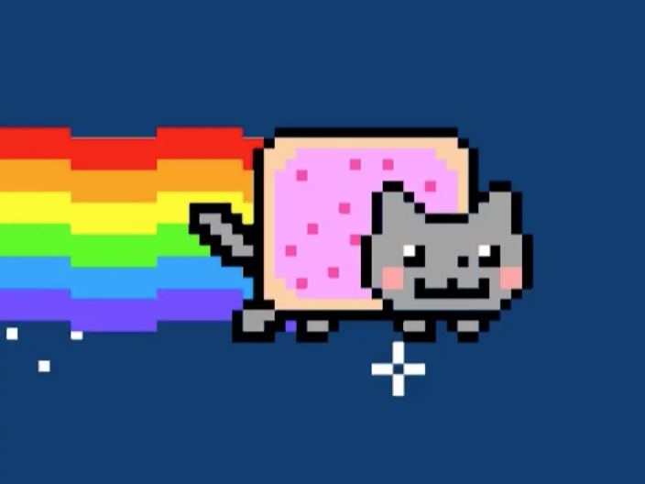
NFT Update…

Slide 38
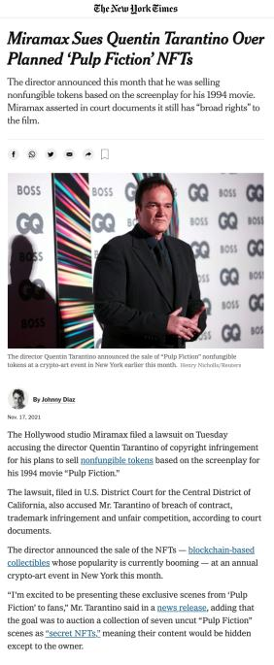
On Website
Thanks Trevor

Slide 39
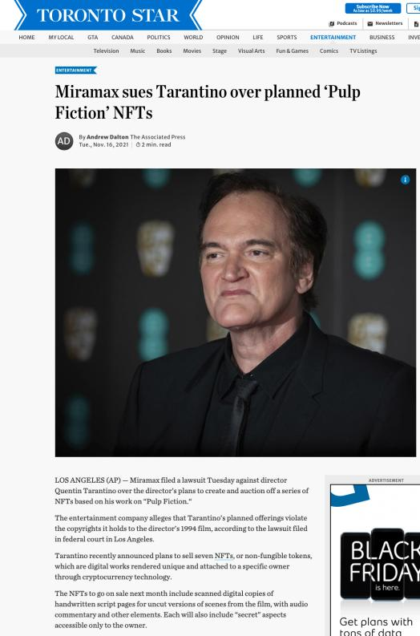

Slide 40
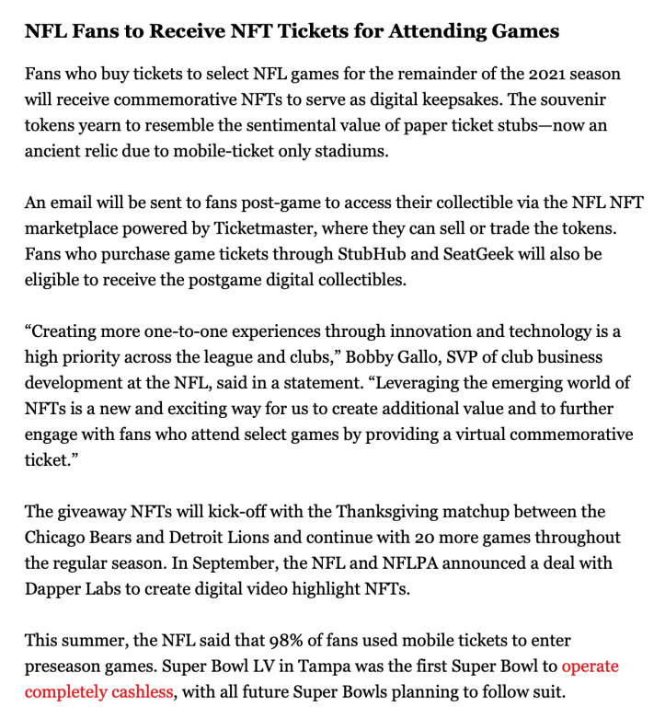

Slide 41


Slide 42
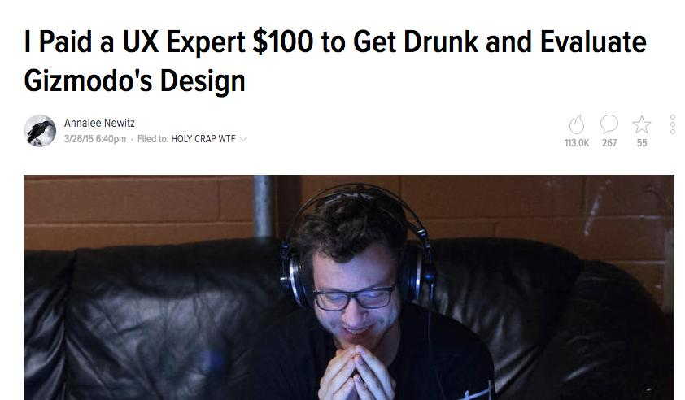
Follow-Up

Slide 43
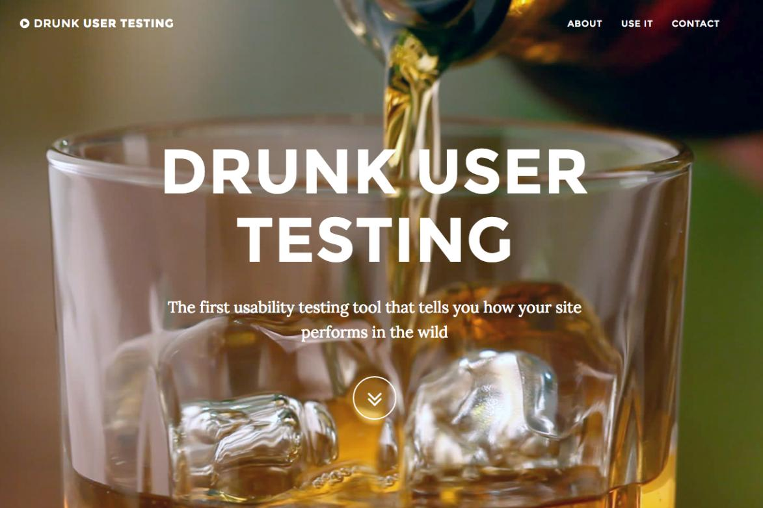

Slide 44
Yours?

Slide 45
QUESTIONS?
THOUGHTS?
DISCUSSION?

Slide 46
Pause

Slide 47
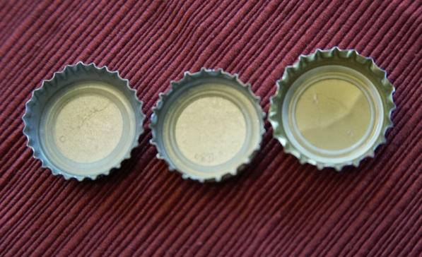
Re-capping

Slide 48
Trademarks
What is a Trademark ™?
  A mark used by a person for the purpose of distinguishing that person’s goods or services from those of others in the marketplace
Various types of marks
  Ordinary (word & design), certification, collective, official, distinguishing guise

Slide 49
Trademarks
Ordinary marks
  S. 2: definition of trade-mark (in part): (a) a mark that is used by a person for the purpose of distinguishing or so as to distinguish goods or services manufactured, sold, leased, hired or performed by him from those manufactured, sold, leased, hired or performed by others.

Slide 50
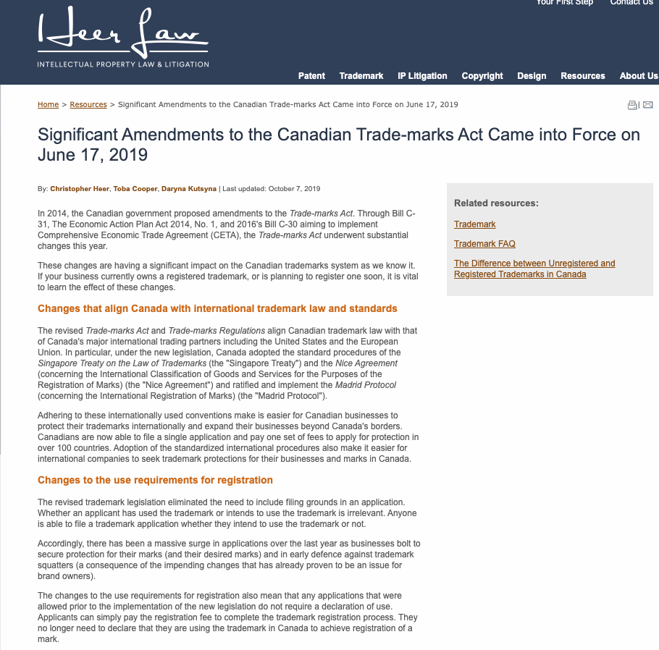

Slide 51
Trademarks
Ordinary marks
Amended definition (2014 - in effect 2019):
  TM: A sign or combination of signs that is used or proposed to be used by a person for the purpose of distinguishing or so as to distinguish their goods and services from those of others.
  Sign: Includes a word, a personal name, a design, a letter, a numeral, a colour, a figurative element, a three-dimensional shape, a hologram, a moving image, a mode of packaging goods, a scent, a taste, a texture, and the positioning of a sign.

Slide 52
Trademarks
S. 12(1): A TM is registrable if it is not:
  (a) Primarily merely a name or surname of an individual living or who has died within 30 years
  (b) Clearly descriptive or deceptively misdescriptive in English or French of the character/quality of wares/services or of the conditions of production/persons employed in their production/place of origin

Slide 53
Trademarks
Test to Apply: Would a person in Canada of ordinary intelligence and of ordinary education in English or French be just as likely, if not more likely, to respond to the word by thinking of it as a brand or a mark of a business than as a name/surname?

Slide 54
Trademarks
Unilever Canada Inc. v. Superior Quality Foods Inc. (2007), 62 CPR (4th) 75, [2007] TMOB No. 66
Clearly descriptive = does the mark tell potential dealers/purchasers of the goods/services what the goods and services are, or describe them or describe a property which is commonly associated with them?

Slide 55
Trademarks
  Unilever Canada Inc. v. Superior Quality Foods Inc. (2007), 62 CPR (4th) 75, [2007] TMOB No. 66
  Deceptively misdescriptive = would dealers/purchasers of the goods be deceived by the misdescription into purchasing goods or ordering services which different in character or quality from those expected?

Slide 56
Trademarks
  Unilever Canada Inc. v. Superior Quality Foods Inc. (2007), 62 CPR (4th) 75, [2007] TMOB No. 66
S. 12(1)(b):
  Point of View?: That of the average purchaser of the wares
  Consider the mark in its entirety (not dissected into constituent elements)
  Consider thee mark as a matter of immediate impression

Slide 57
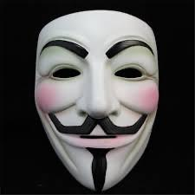
Trademarks: Distinguishing guise no more

Slide 58
Instead of “distinguishing guise”
s. 2 …“sign includes a word, a personal name, a design, a letter, a numeral, a colour, a figurative element, a three-dimensional shape, a hologram, a moving image, a mode of packaging goods, a sound, a scent, a taste, a texture and the positioning of a sign;”

Slide 59
Trademarks
Distinguishing guise
Now that distinguishing guises have ceased to exist as a separate category of TM, similar limitations to those set out in the previous s. 13(1) will be carried over elsewhere, and will apply to all marks

Slide 60
Trademarks : Special Marks
S. 9 Trademarks Act
Two categories of prohibited marks
  Absolute prohibitions
  Official marks (9(1)(n)(iii))
What policy reasons could justify including a type of symbol/mark on the list of absolute prohibitions?

Slide 61
Trademarks
Statutory requirements for public authorities
  Mark must have been adopted and used
  Adoption and use has to be by a public authority in Canada
  Adoption and use must be as an official mark for wares and services

Slide 62
Trademarks
Ontario Ass’n of Architects v. Ontario Assn of Architectural Technologists, [2003] 1 F.C. 331 (FCA)
Defining characteristics of public authority =
  Degree of government control [para. 57-64]
  Extent to which the body’s activities benefit the public [para. 65-73]

Slide 63
Trademarks
A TM owner who has a registered mark that resembles an official mark effectively has their rights frozen at the time of publication of the official mark
  See Royal Roads University v. R. (2003), 27 CPR (4th) 240 (F.C.)

Slide 64
Trademarks : Use
USE IT
OR
LOSE IT?

Slide 65
Trademarks
“Use”
First use … entitles you to register a TM but amended provisions now allow for filing without intended use.
Failure to use … basis for expungement of TM
Unauthorized use … could lead to infringement actions

Slide 66
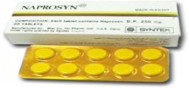
Trademarks
Syntex Inc. v. Apotex Inc., [1984] 2 FC 1012 (FCA)
Court said on this point… “It seems to me that the respondents (Syntex) face considerable difficulty in establishing at trial that the presence of the trade mark “Naprosyn” in the appellant’s flyer constituted a “use” that is contrary to subsection 22(1) of the Trade Marks Act”

Slide 67
Trademarks v. Passing Off
Why would you want to register your TM?
Why not just rely on passing off?
TM = no proof of goodwill required. Only proof of use.
Registration of a mark provides national protection
Registered marks are presumed valid for Canada for all the wares and services for which they are registered.
s. 22 of the TMA protects against mark dilution
In situations where a mark is deemed invalid, a passing off action might still succeed

Slide 68


Trademarks
Tommy Hilfiger Licensing Inc v. Produits de Qualité, 2005 FC 10

Slide 69
Trademarks
How to remove existing Trademarks from the register:
  S. 45: Expungement or amendment on the basis of non-use
  S. 57: Striking or amending a Trademark…

Slide 70
Trademarks
UNICAST SA v. South Asian Broadcasting Corporation Inc. - Conclusion
The fact that a trade-mark appears on a website that may be displayed on a computer screen in Canada is not sufficient to constitute use and advertising in Canada (for the purposes of s. 4(2) of the TMA).

Slide 71
Trademarks
Scott Paper Limited v. Smart & Biggar, 2008 FCA 129 Conclusion
Fact that registered owner may have plans to resume use of mark is not sufficient to excuse non-use.

Slide 72
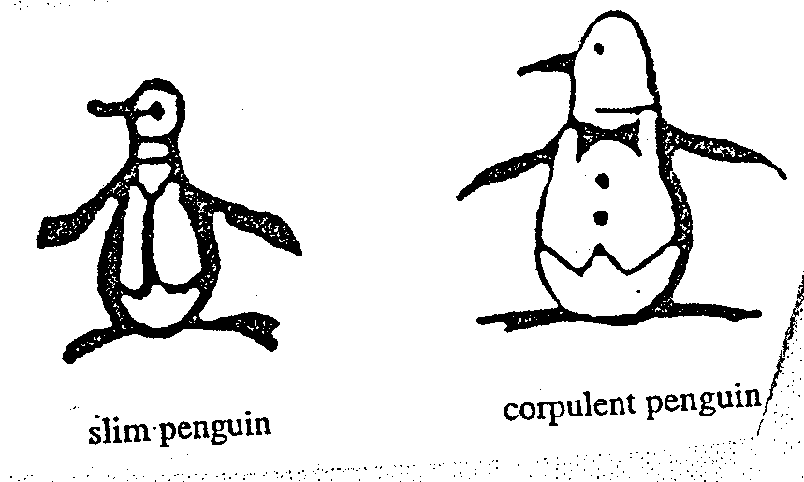
Trademarks
Promafil Canada Ltée v. Munsingwear Inc. (1992), 44 CPR (3d) 59, [1992] FCJ 611 (FCA).
Original Penguin
Revised Penguin

Slide 73
Trademarks : Confusion
Doctrine of confusion – Critical Concept
Important in the context of registrability (see ss. 12, 16)
Also important in infringement actions (see s. 20)
Core provision: s. 6 TMA (specifically s. 6(2) and 6(5))

Slide 74
Trademarks : Confusion
TM is not registrable if it is confusing with a registered TM (12(1)(d)) or TMs or Trade-Names (“TN’s”) that had been previously used or made known (see s. 16)
Confusion is also an important part of infringement actions. An action in infringement can be successfully brought where there is unauthorized use of a mark that is confusing with a registered TM.

Slide 75
Trademarks : Confusion
6. (2) The use of a trade-mark causes confusion with another trade-mark if the use of both trade-marks in the same area would be likely to lead to the inference that the goods or services associated with those trade-marks are manufactured, sold, leased, hired or performed by the same person, whether or not the goods or services are of the same general class.

Slide 76
Trademarks : Confusion
What to be considered
6. (5) In determining whether trade-marks or trade-names are confusing, the court or the Registrar, as the case may be, shall have regard to all the surrounding circumstances including
  (a) the inherent distinctiveness of the trade-marks or trade-names and the extent to which they have become known;
  (b) the length of time the trade-marks or trade-names have been in use;
  (c) the nature of the goods, services or business;
  (d) the nature of the trade; and
  (e) the degree of resemblance between the trade-marks or trade-names in appearance or sound or in the ideas suggested by them.

Slide 77
Trademarks: Infringement
– the law today
SUMMARY
1. Emphasizing differences in services and products is fine according to s. 22.
2. It is when trying to appropriate the value of goodwill by emphasizing the similarities between products, the use would run afoul of s. 22.

Slide 78
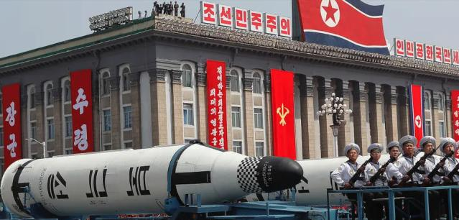
Trademarks: Infringement
Veuve Clicquot Ponsardin v. Boutiques Cliquot (SCC, 2006)
How does the SCC keep this “super weapon” in check?
SCC says - because of its status as a super weapon, any…
  Dilution should be proved by evidence
  Courts should separate any anti-dilution claim into its discrete elements and require proof for each of those elements.

Slide 79
Trademarks: Remedies
Remedies
See s. 53.2 (read together w. s. 2, “interested person”)
Including:
  Injunctions (interlocutory or permanent)
  Damages compensating for lost sales, damage to goodwill, loss of control of reputation
  Accounting of profits (alternative to damages)
  Destruction of offending materials
  Removal of mark from wares
  Concealment of mark on wares
  Punitive damages (in certain circumstances)

Slide 80
QUESTIONS?
THOUGHTS?
DISCUSSION?

Slide 81
Pause

Slide 82
Continuing From
Last Week

Slide 83
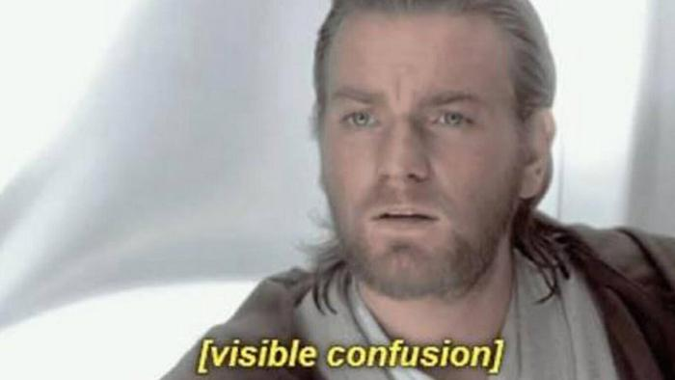
Trademarks: Doctrine of Confusion

Slide 84
Trademarks : Confusion
Doctrine of confusion – Critical Concept
Important in the context of registrability (see ss. 12, 16)
Also important in infringement actions (see s. 20)
Core provision: s. 6 TMA (specifically s. 6(2) and 6(5))

Slide 85
Trademarks : Confusion
TM is not registrable if it is confusing with a registered TM (12(1)(d)) or TMs or Trade-Names (“TN’s”) that had been previously used or made known (see s. 16)
Confusion is also an important part of infringement actions. An action in infringement can be successfully brought where there is unauthorized use of a mark that is confusing with a registered TM.

Slide 86
Trademarks : Confusion
6. (2) The use of a trade-mark causes confusion with another trade-mark if the use of both trade-marks in the same area would be likely to lead to the inference that the goods or services associated with those trade-marks are manufactured, sold, leased, hired or performed by the same person, whether or not the goods or services are of the same general class.

Slide 87
Trademarks : Confusion
What to be considered
6. (5) In determining whether trade-marks or trade-names are confusing, the court or the Registrar, as the case may be, shall have regard to all the surrounding circumstances including
  (a) the inherent distinctiveness of the trade-marks or trade-names and the extent to which they have become known;
  (b) the length of time the trade-marks or trade-names have been in use;
  (c) the nature of the goods, services or business;
  (d) the nature of the trade; and
  (e) the degree of resemblance between the trade-marks or trade-names in appearance or sound or in the ideas suggested by them.

Slide 88
Trademarks : Infringement
Four main provisions in the TMA that address TM infringement
  S. 7: provides protection against passing off; applies to both registered and unregistered marks
  S. 19: governs use of precise TM registered for same wares and services
  S. 20: deals with confusing uses of TMs
  S. 22: governs uses that depreciate value of goodwill
Only S. 7 provides protection for UNREGISTERED MARKS – s. 7. This section applies to both registered and unregistered marks and provides protection against passing off. It can be understood as the codification of the two main types of passing off…
The other three provisions – ss. 19, 20, and 22 - ONLY apply to registered TMs.

Slide 89
Trademarks: Infringement
Veuve Clicquot Ponsardin v. Boutiques Cliquot (SCC, 2006)
Facts: Champagne house objects to use of similar name by women’s wear store
The mere mental association of the two marks does not necessarily give rise to a likelihood of depreciation
S. 22 = “super weapon” - Needs to be kept in check
Courts should separate anti-dilution claims into discrete elements; require proof for each element

Slide 90
QUESTIONS?
THOUGHTS?
DISCUSSION?

Slide 91
Pause

Slide 92
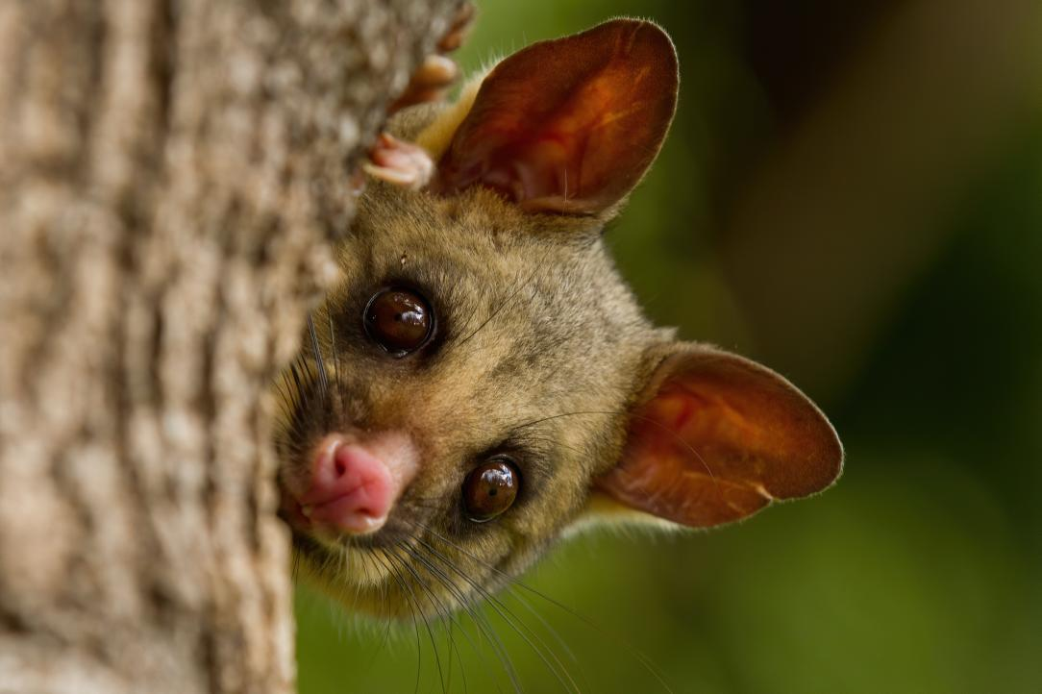
Brushtail Possum

Slide 93
Trademarks: Confusion
S & S Productions Inc. v. Possum Lodges (Messier), [2006] TMOB No. 144
Applicant – Messier ; Opponent – S & S Productions, Producers The Red Green Show on television
Messier filed an application to register the Trademark Possum Lodges based upon proposed use in association with “sale and rental of recreational lodging, namely, cabins, camps, lodges, campsites and cottages; time-sharing of recreational real estate; … restaurants”
Application was opposed by S & S Productions on basis of s. 38(2)(b) that the TM is not registrable because under s. 12(1)(d) it is confusing with their TM’s Possum Lodge and International Possum Brotherhood and design.

Slide 94
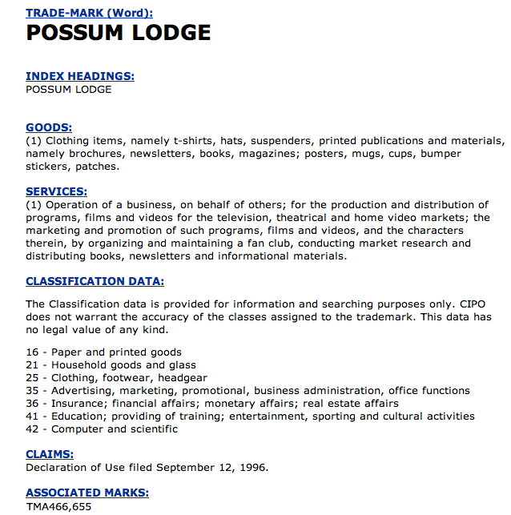
Trademarks: Confusion

Slide 95
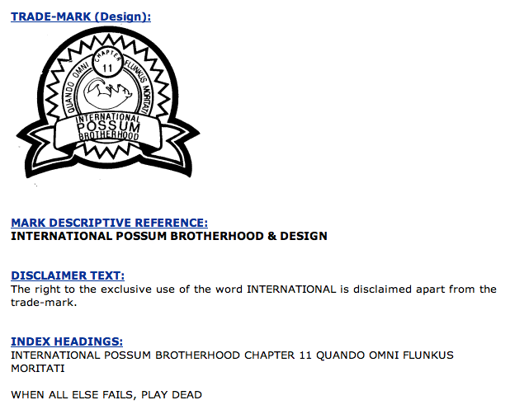
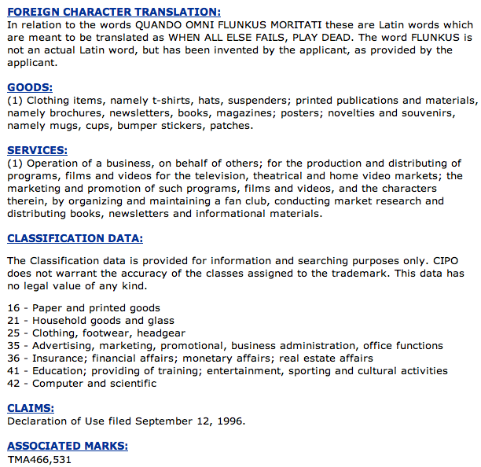
Trademarks : Confusion

Slide 96
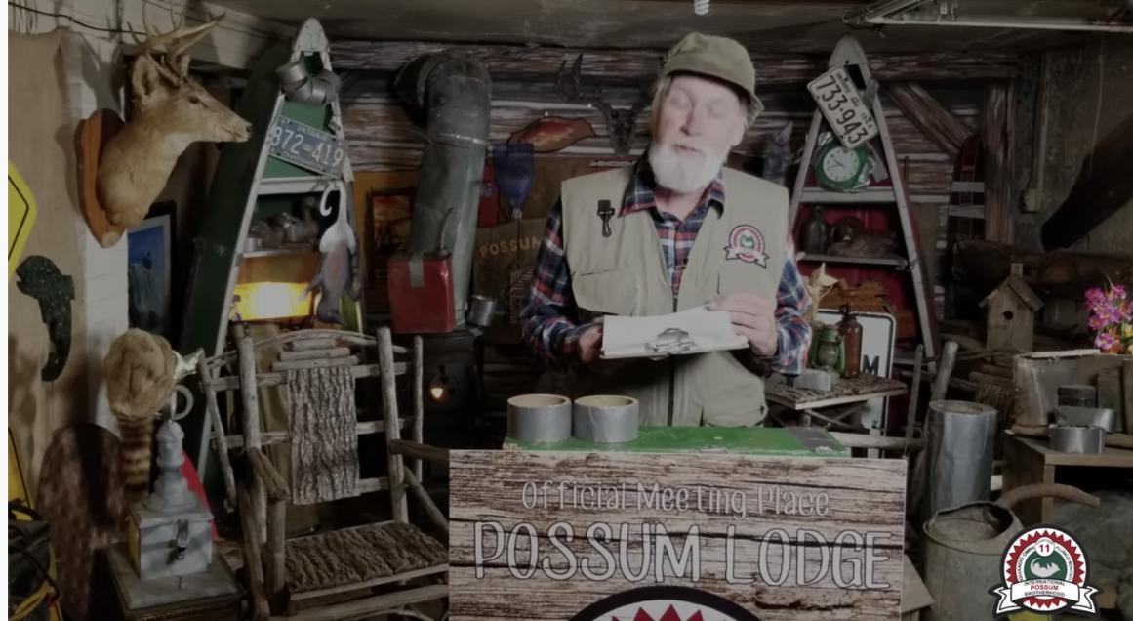
“The Red Green Show”

Slide 97
Trademarks: Application of s. 6
To assess confusion, go back to s. 6(5)…
Question that needs to be asked is (2)…would the use of both trade-marks in the same area…be likely to lead to the inference that the goods or services associated with those trade-marks are manufactured, sold, leased, hired or performed by the same person?
Application of s. 6(5) factors:
(a) the inherent distinctiveness of the trade-marks or trade-names and the extent to which they have become known
(b) The extent to which each trade-mark has become known
(b) the length of time the trade-marks or trade-names have been in use
(c) the nature of the goods, services or business; (d) nature of the trade…
(d) the nature of the trade
(e) the degree of resemblance between the trade-marks or trade-names in appearance or sound or in the ideas suggested by them

Slide 98
Trademarks: Application of s. 6
To assess confusion, go back to s. 6(5)…
Question that needs to be asked is (2)…would the use of both trade-marks in the same area…be likely to lead to the inference that the goods or services associated with those trade-marks are manufactured, sold, leased, hired or performed by the same person?
Application of s. 6(5) factors:
  (a) The inherent distinctiveness of the trade-marks or trade-names and the extent to which they have become known

Slide 99
Trademarks: Application of s. 6
Marks which are inherently distinctive are unique marks – they intrinsically serve to identify a particular source of a product.
Examples are words or symbols invented or coined for the purpose of functioning as a TM (i.e., Exxon). Have no other significance than as a TM. They don’t suggest any characteristic of the goods or services they identify (Kodak cameras; Clorox bleach).
Marks have high inherent distinctiveness if they only communicate the message that they are identifying or signifying the source of the product.
Coined terms with design elements are generally seen as having high degrees of inherent distinctiveness.
Marks have lower inherent distinctiveness if they are descriptive or suggestive of a parties’ respective wares or services. (Marks made up of ordinary words, for instance, have lower inherent distinctiveness than marks made up of coined words and design elements).

Slide 100
Trademarks: Application of s. 6
In the Possum Lodges case both marks were said to be inherently distinctive with respect to their respective goods and services…(i.e., don’t really serve a descriptive function).
But Applicant Messier’s mark is less inherently distinctive because its second half describes its services i.e. lodging; lodges
  (b) The extent to which each trade-mark has become known
No evidence of use or promotion of Applicant’s mark while extensive use of Opponent’s Possum Lodge mark…which was much better known…
Possum Lodge figures prominently in “The Red Green Show”… (great description of Possum Lodge in para. 16 of decision…)

Slide 101
Trademarks: Application of s. 6
  (b) the length of time the trade-marks or trade-names have been in use
Applicant’s mark hadn’t yet been used/promoted while Opponent’s mark was used extensively in Canada since 1991
  (c) the nature of the goods, services or business; (d) nature of the trade
Is there a nexus or connection between the goods, services and business of the Applicant and the Opponent?
No overlap, but connection … Applicant’s business involves recreational accommodation; Opponent’s television show [para 21] “satirize[s] the stereotypical Canadian outdoorsman and sportsman”.

Slide 102
Trademarks: Application of s. 6
(e) the degree of resemblance between the trade-marks or trade-names in appearance or sound or in the ideas suggested by them
Essentially identical…
Conclusion
Applicant is required to show that there is not a reasonable likelihood of confusion between the marks
Could not do so: “[para 24] “the Applicant has not satisfied me that, on a balance of probabilities, a Canadian who has an imperfect recollection of the Opponent’s TM as associated with the Opponent’s show, would not, as a matter of first impression, assume that there was some connection between the Applicant’s POSSUM LODGES recreational lodging, real estate and restaurant services and the Opponent’s television show.”

Slide 103
Trademarks: Application of s. 6
The Applicant failed in their duty to select a name with care to avoid any confusion. Does the decision make sense?
Note the language … “assume there was some connection between the Applicant’s [goods and services]” and those of the Opponent.
Compare this with the language of s. 6(2) …
The use of a trade-mark causes confusion with another trade-mark if the use of both trade-marks in the same area would be likely to lead to the inference that the goods or services associated with those trade-marks are manufactured, sold, leased, hired or performed by the same person, whether or not the goods or services are of the same general class.
Fundamental tension
How much protection TM owners should receive, and how much protection owners of well-known or famous TMs should receive?

Slide 104
QUESTIONS?
THOUGHTS?
DISCUSSION?

Slide 105
Pause

Slide 106

Trademarks: Confusion
Mattel v. 3894207 Canada Inc., 2006 SCC 22
The Numbered Company wanted to register TMs in connection with its small chain of Montreal suburban Barbie’s restaurants.
Mattel opposed the application on the basis that use of the name would create confusion with respect to its Mark BARBIE.

Slide 107
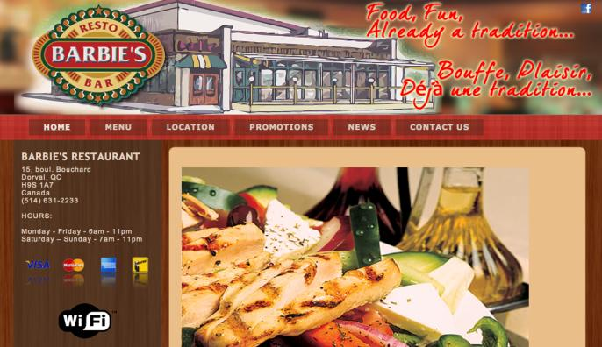
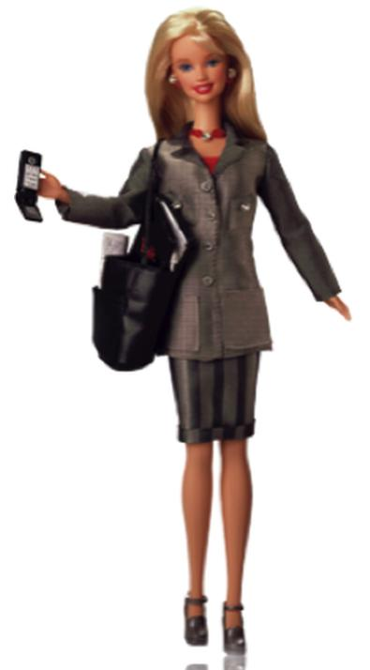


Slide 108
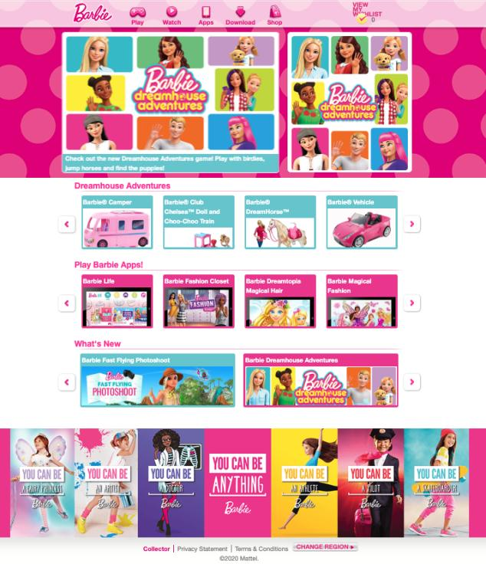
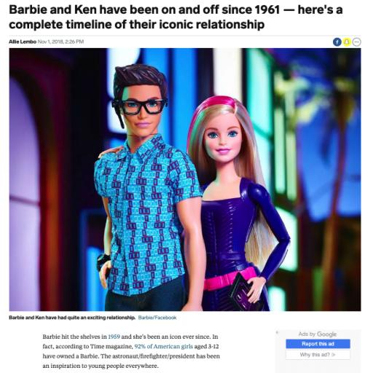

Slide 109
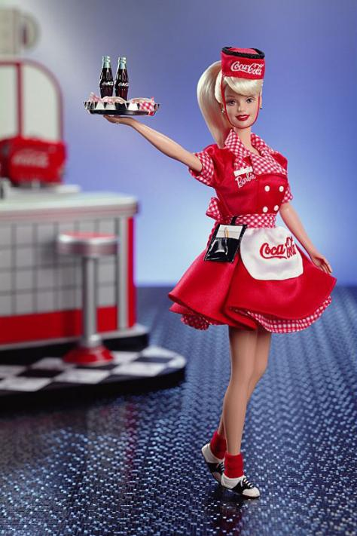

Slide 110
Trademarks: Confusion
Mattel v. 3894207 Canada Inc., 2006 SCC 22
Binnie J.:
  Some TMs are so well-known that use in connection with any wares or services would generate confusion.
  In those circumstances, no need to establish a connection between the goods and/or services for a finding of confusion to be made out (cf. Pink Panther case)
Who is the test person for the purpose of the confusion analysis?
How were the s. 6(5) factors applied?

Slide 111


Trademarks: Confusion
Mattel v. 3894207 Canada Inc., 2006 SCC 22

Slide 112
Trademarks : Confusion
Mattel v. 3894207 Canada Inc., 2006 SCC 22
Main issue is whether Mattel can use TM law to prevent people from using the name Barbie (a common name) in relation to services (like restaurants) very different from dolls and other wares aimed at 3-11 year old girls.
Based on the TMA, is the Defendant’s use of the mark Barbie confusing with the registered mark BARBIE?
Applicant has onus to show that there is not a reasonable likelihood of confusion between the two marks.
Confusion is caused if the use of both TMs leads the consumer to believe that the wares and services are supplied by the same person: s. 6(2) TMA.
Factors in determining whether TMs are confusing in s. 6(5) TMA.

Slide 113
Trademarks: Confusion
Mattel v. 3894207 Canada Inc., 2006 SCC 22
In applying the criteria set out in s. 6(5) of the TMA, TM Opposition Board found no real connection between the two marks. Barbie’s fame was limited to dolls and dolls’ accessories. Therefor, Mattel’s opposition was rejected & registration allowed.
Federal Court (Rouleau J) observed that we cannot automatically presume that there will be confusion just because the BARBIE mark is famous.
Test is reasonable likelihood of confusion, using the factors set out in s. 6(5).
The fame of a mark can’t simply obliterate the other factors. Need to look at all the factors in s. 6(5)
One of the key factors in s. 6(5) in this case is the striking difference between the wares. Appeal dismissed accordingly; Mattel loses.
Federal Court of Appeal agreed with Rouleau J & dismissed the appeal. Mattel loses again.

Slide 114
Trademarks : Confusion
Mattel v. 3894207 Canada Inc., 2006 SCC 22
In Supreme Court of Canada…Binnie J. did find that some trade-marks are so well known that use in connection with any wares or services would generate confusion. Other brands are product specific.
Example given of a brand that may not be product specific? Virgin – used in connection with such a wide variety of wares and services that it knows virtually no bounds.
Example given of a brand that may be product specific? Apple = well-known TMs associated separately with computers, record label, automobile glass.
In discussing the role to be played by fame in confusion cases, the SCC had to address another case; the Pink Panther case of the Ont. CA.

Slide 115


Slide 116
Trademarks: Confusion
In that case Pink Panther Beauty Corp. wanted to register the TM Pink Panther in association with beauty products. United Artists Corp., owner of the famous Pink Panther mark registered in association with the entertainment business objected, arguing that consumers would be confused.
Would consumers think that these goods came from the same source?
Ont. CA held in the Pink Panther case that it was unlikely consumers would be confused; PINK PANTHER beauty parlour patron would not be likely to think that the hairdressing services she received were provided by United Artists Studios.
The aspect of the Pink Panther decision the SCC chose to address was Linden JA’s statement for the majority that for confusion to occur, there must be some resemblance or linkage between the two products (i.e., Barbie doll and Barbie’s restaurant); and that only in exceptional circumstances can confusion be found when there is no connection between the products or services.

Slide 117
Trademarks : Confusion
Binnie J. of SCC in Mattel rejected Linden JA’s statement that for confusion to occur, there must be some resemblance or linkage between the two products (i.e., Barbie doll and Barbie’s restaurant); and that only in exceptional circumstances can confusion be found when there is no connection between the products or services.
Test articulated by SCC was that for famous and non-famous marks alike, whether there is confusion in the s. 6(2) sense, is determined by if the consumer thinks that the goods come from the same source. This question has must be analyzed in all the circumstances (as set out in s. 6(5) and beyond).
The nature of the wares is important:
  It is one of the criteria in 6(5)
  In cases involving famous marks it is likely to be an important factor (i.e., Barbie doll and Barbie’s restaurants), as fame can possibly carry the mark across product lines.
SCC emphasized in Mattel is that you do not have to establish a connection between the goods and/or services for a finding of confusion to be made out.

Slide 118
Trademarks: Confusion
Pink Panther and Mattel are examples of courts dealing with the contemporary reality of famous brands attempting to protect themselves against every incursion on their goodwill to preserve their investment in their brands.
FCA in Pink Panther restricts the ability of companies to protect famous marks; companies can only object to others using famous marks where there is a connection/resemblance between the goods, services.
SCC held FCA was wrong as net of protection drawn too narrowly.
SCC focused on the issue of confusion as to whether the consumer was confused into thinking that the goods came from the same source.
The nature of the goods is a factor in this analysis; an important factor in some cases. But it is not the sole issue.
In Mattel the SCC attempts to ensure that the protection given to marks (famous or not) relates to the purpose of TM law; protecting against confusion as to source.

Slide 119
Trademarks: Confusion – Test Person
Important question: From what perspective should consumer confusion be analyzed? Who is the test person for the purpose of the confusion analysis?
Addressed by SCC in Mattel. A few “test people” were rejected:
  The careful and diligent purchaser
  The “moron in a hurry”
SCC adopted the ordinary hurried purchaser and looked at the probability of the average person with average intellect acting with ordinary caution being deceived. Points to consider:
  Give the average consumer some credit – don’t assume that they’re totally devoid of intelligence, normal powers of recollection, or are totally unaware or uninformed.
  More care taken/attention given to big purchases (car as opposed to toy)

Slide 120
Trademarks: Confusion – Test Person
In buying ordinary run-of-the-mill consumer wares and services, the consumer is of average intelligence, generally running behind schedule, and has more money to spend than time to pay a lot of attention to detail.
In appropriate markets, this person is functionally bilingual.
To this person, TMs make shopping faster and easier.
When the new trade-mark catches their eye, they will have only a general and not very precise recollection of the earlier trade-mark (as it would be remembered by persons possessed of an average memory with its usual imperfections).
The standard is not people who do not notice anything. Rather it is persons who take no more than ordinary care to observe what is staring them in the face.
If the ordinary casual consumer somewhat in a hurry is likely to be deceived about the origin of the wares or services, then the statutory test is met.

Slide 121
Trademarks: Confusion - s. 6(5) factors
(a) Inherent distinctiveness of the TM and the extent to which they have become known
Is Barbie inherently distinctive?
Marks which are inherently distinctive are unique marks; they intrinsically serve to identify a unique source of a product. They have no other meaning or significance other than as a TM.
Barbie is not inherently distinctive. Barbie is an everyday expression not developed by Mattel; would normally receive less protection than an invented/unique/non-descriptive word.
Policy reason for receiving less protection? To prevent fencing in or appropriating words of a general nature in English or French.
That said Mattel’s mark had achieved strong secondary meaning (acquired distinctiveness) as associated with dolls, doll accessories

Slide 122
Trademarks: Confusion - s. 6(5) factors
(b) Length of time the TM has been in use
Important in considering whether the mark has really become distinctive. Here, Mattel’s mark publicized widely since 1960s; numbered company’s since 1992. Deeper roots for Mattel’s mark, over much wider area.
(c) Nature of the wares, services or businesses
Long way from the initial rule of 1866 that if a business carries on a trade in linen and not iron and stamps a lion on their linen; another business can stamp a lion on iron. In this example the nature of the wares is crucial
Today a relatively strong mark can leap vast product line differences in a single bound because confusion can still be found where there is no connection. That said, fact that there may be vast product line differences remains a significant obstacle.
In Mattel the nature of the wares are very different: Dolls and doll’s accessories v. restaurants
Court also dealt with argument that “the natural tendency towards corporate diversification” would lead the consumer to assume that the products/businesses would be connected. SCC rejected that argument because the law of TMs is based on use. No evidence that Barbie mark is distinctive of anything other than dolls and doll accessories.

Slide 123
Trademarks: Confusion - s. 6(5) factors
(d) Nature of the trade
Parties operated in different channels of trade: wares v. services; in this case the wares and services do not intermingle.
(e) Degree of resemblance between the TM in appearance, sound, ideas suggested by them
Both marks use name Barbie; sound the same; numbered company’s applied for mark wraps name in design. Mattel’s mark does not. Considerable resemblance.
(f) Other surrounding circumstances
Evidence of actual confusion would have been helpful. Not absolutely necessary, but the lack of any evidence of actual confusion is another “circumstance” to be considered.

Slide 124
Trademarks: Confusion
Mattel argued as well that the # co. was a free rider; they adopted TM to pirate the goodwill of Mattel.
To support this argument, Mattel pointed to a later TM application by the # co. (abandoned), that included a waitress in the design…
SCC said that there may be some justice in this argument, but that intent isn’t relevant to the issue of confusion. It comes back to the fact that the test is whether the consumer would be confused.
Mattel lost yet again. SCC upheld the decision of the Board that there was no likelihood of confusion in the marketplace.
-----------------------------------------------
Thoughts on this decision? Agree with the outcome? Should famous marks receive more protection than permitted by the SCC’s articulation of this test? Should the SCC reinstitute the determination in Pink Panther that, absent exceptional circumstances, there must be a resemblance or linkage between the two products?

Slide 125
QUESTIONS?
THOUGHTS?
DISCUSSION?

Slide 126
Pause

Slide 127
Trademarks: Confusion
Masterpiece Inc. v. Alavida Lifestyles Inc, 2011 SCC 27
Issue: Whether the trade-mark “Masterpiece Living”, proposed and subsequently registered by Alavida Lifestyles Inc. (“Alavida”), a company entering the retirement residence industry in Ontario, was [at the time it applied for registration – namely December 1, 2005] confusing with the unregistered trade-marks or trade-name previously used Masterpiece Inc. in the retirement residence industry in Alberta (marks which included “Masterpiece the Art of Living”, “Masterpiece and the Art of Retirement Living”, and a stylized word “Masterpiece” alongside a butterfly logo).

Slide 128
Trademarks: Confusion
Masterpiece Inc. v. Alavida Lifestyles Inc, 2011 SCC 27
1) Is geography relevant when performing a confusion analysis?
2) How to assess the resemblance between a proposed use TM and an existing unregistered TM?
3) Impact of the nature and cost of wares and services on the confusion analysis
4) Relevance of expert evidence

Slide 129
Trademarks : Confusion
1) Is geography relevant when performing a confusion analysis?
The location where a mark is used is not relevant when considering the likelihood of confusion between a mark that is registered (or for which an application for registration has been made) and a prior unregistered mark.

Slide 130
Trademarks : Confusion
  2) How to assess the resemblance between a proposed use TM and an existing unregistered TM?
  Separate analyses with respect to each of TMs, TNs (paras. 42-48)
  Factor with greatest impact on confusion analysis = degree of resemblance (paras. 49-50)
  Focus on full scope of possible uses of registered TM, not actual use (paras. 51-59)

Slide 131
Trademarks : Confusion
  2) How to assess the resemblance between a proposed use TM and an existing unregistered TM?
  Unregistered marks? Consider how they have actually been used (para. 60)
  In assessing resemblance, consider whether a part of the mark is particularly striking or unique (paras. 60-65)

Slide 132
Trademarks: Confusion
3) When Considering the “Nature of the Trade” Under Section 6(5) of the Act, What Effect Does the Nature and Cost of the Wares or Services Have on the Confusion Analysis?
  The test is one of first impression (even if consumers shopping for expensive wares or services might be more alert, aware of TMs)
  Careful research which may later remedy confusion does not mean that no confusion ever existed or that it will not continue to exist in the minds of consumers who did not carry out that research. (para. 72)

Slide 133
Trademarks: Confusion
4) Relevance of expert evidence
Necessity & relevance of expert evidence should be questioned before such evidence is admitted (para. 99)
Judges should use their own common sense to determine whether the casual consumer would likely be confused in cases of wares or services being marketed to the general public (para. 92)
Surveys can be valuable (para. 93)

Slide 134
Trademarks: Confusion
Masterpiece Inc. v. Alavida Lifestyles Inc., 2011 SCC 27
Decision clarifies several issues related to the confusion analysis.
Question dealt with in this case is [para2] whether the trade-mark “Masterpiece Living”, proposed and subsequently registered by Alavida Lifestyles Inc. (“Alavida”), a company entering the retirement residence industry in Ontario, was [at the time it applied for registration – namely December 1, 2005] confusing with the unregistered trade-marks or trade-name previously used by another company, Masterpiece Inc. in the retirement residence industry in Alberta (marks which included “Masterpiece the Art of Living”, “Masterpiece and the Art of Retirement Living”, and a stylized word “Masterpiece” alongside a butterfly logo).
Shortly after Alavida’s application, Masterpiece Inc. also started to use the TM “Masterpiece Living”.
January 2006 – Masterpiece Inc. applied to register Masterpiece as a TM; June 2006, it applied to register the TM Masterpiece Living. Both applications were denied on the basis that they were confusing with Alavida’s TM “Masterpiece Living”
Masterpiece Inc. then started this application to expunge Alavida’s registration of the term “Masterpiece Living”.

Slide 135
Trademarks: Confusion
A few aspects of this decision worth highlighting:
The possible relevance of the location where a mark is used when engaging in the confusion analysis
The considerations applicable in assessing the resemblance between a proposed use TM and an existing unregistered TM
The impact of the nature and cost of the wares or services on the confusion analysis (particularly the nature of the trade consideration)
Relevance of expert evidence in TM/TN confusion cases.

Slide 136
Trademarks: Confusion
Masterpiece Inc. v. Alavida Lifestyles Inc., 2011 SCC 27
First: The SCC dealt with the issue of whether “the location where a mark is used is relevant when considering the likelihood of confusion between an applied for or registered TM and a prior unregistered TM or TN”
Or – is geography relevant when performing a confusion analysis?
SCC held that “geographical separation in the use of otherwise confusingly similar TN and TM does not play a role” in the Confusion analysis. The location where a mark is used is not relevant when considering the likelihood of confusion between a mark that is registered (or for which an application for registration has been made) and a prior unregistered mark.
The SCC reached this conclusion largely through statutory interpretation – particularly – the way ss. 6(2-4) are framed “if the use of both ... in the same area would be likely to lead to the inference”

Slide 137
Trademarks: Confusion
Masterpiece Inc. v. Alavida Lifestyles Inc., 2011 SCC 27
See para 30 of the decision…It is immediately apparent from these words, “if the use of both . . . in the same area”, that the test for confusion is based upon the hypothetical assumption that both trade-names and trade-marks are used “in the same area”, irrespective of whether this is actually the case. As a result, geographical separation in the use of otherwise confusingly similar trade-names and trade-marks does not play a role in this hypothetical test. This must be the case, because, pursuant to s. 19 TMA, subject to certain exceptions, registration gives the owner the exclusive right to the use of the trade-mark throughout Canada.
Accordingly, in the fact situation of this case there can be confusion between a prior unregistered mark and a registered mark, even if they operate in two different provinces (Alberta/Ontario). As the Canadian TM regime is national in scope, the owner of a registered TM is entitled to the exclusive use of that mark in association with the wares or services to which it is connected throughout Canada.

Slide 138
Trademarks: Confusion
  Second: How to assess the resemblance between a proposed use TM and an existing unregistered TM?
Focussing on certain aspects of the court’s decision can clarify additional points:
Paras 42-48: If the question is whether a TM for which a person has applied is confusing with any TM or TN (i.e. Masterpiece Living with Masterpiece the Art of Living, Masterpiece the Art of Retirement Living, and stylized Masterpiece w. butterfly logo) then separate analyses need to be undertaken with respect to each of the TMs and TNs. This was not done here.

Slide 139
Trademarks: Confusion
Paras. 49-50: Rothstein J. states that the degree of resemblance is often likely to have the greatest effect on the confusion analysis; that the other factors become significant only once the marks are found to be identical or very similar; and that it has been suggested that consideration of resemblance is where most confusion analyses should start.
Paras 51-59: When considering whether a TM for which a person has applied is confusing with any TM or TN, the entire scope of the exclusive rights that would be granted to it under its registration needs to be considered, and not the limited uses to which it may have been put after the registration date. This wasn’t done here. Rather, the focus was on Alavida’s actual use, rather than the full scope of its possible uses (i.e. altering the advertising to give Masterpiece more prominence, Living less prominence; changing the font or style of lettering).

Slide 140
Trademarks: Confusion
Para 60: For unregistered marks, one need to consider how they had actually been used.
Paras. 60-65: In assessing resemblance (defined as the quality of being either like or similar), first consider whether there is an aspect of a trade-mark that is particularly striking or unique. In this case Rothstein J., Masterpiece is the word that distinguishes Alavida and Masterpiece Inc. from other sources of retirement residence services. This is the dominant word in the TMs and is identical between the two.

Slide 141
Trademarks: Confusion
Third: When Considering the “Nature of the Trade” Under Section 6(5) of the Act, what Effect Does the Nature and Cost of the Wares or Services Have on the Confusion Analysis?
When addressing this issue the SCC’s starting point was Binnie J’s statement in Mattel that when buying a car or a refrigerator, more care will naturally be taken than when buying a doll or a mid-priced meal.
The SCC’s main concern in Masterpiece, though, is that Courts may assume that this “care” may include research or inquiries or care that may be taken AFTER the test consumer encounters the TM.
This an issue because the more discerning we make our fictional test consumer; the more we grant them the ability to be perceptive; to do research after the fact; to make complex and time-consuming inquiries; the more difficult it is to ever establish confusion with respect to expensive or costly items.

Slide 142
Trademarks: Confusion
The SCC notes in para. 72 that careful research which may later remedy confusion does not mean that no confusion ever existed, or that it will not continue to exist in the minds of consumers who did not carry out that research.
Consequently, the SCC affirms in this case that the test is still one of first impression: What is the first impression of a consumer when they encounter a TM in the context of making a costly or important purchase? It is not relevant what the consumer does AFTER the consumer encounters the mark; it’s also not relevant that with expensive goods, consumers are not likely to make choices based on first impressions.
Certainly, as the SCC notes in para 70, where consumers are shopping for expensive wares or services, while still having an imperfect recollection of a prior trade-mark, they are likely to be somewhat more alert and aware of the trade-mark associated with the wares or services they are examining and its similarity or difference with that of the prior trade-mark. BUT still, we are just looking at the question of what is the first impression of a consumer when they encounter a TM.

Slide 143
Trademarks: Confusion
Fourth: Relevance of expert evidence
Rothstein J. did not find the expert evidence in this case helpful.
He stated that where parties propose to introduce expert evidence, a trial judge should question the necessity and relevance of the evidence before admitting it (99).
He noted that “In cases of wares or services being marketed to the general public, such as retirement residences, judges should…use their own common sense, excluding influences of their ‘own idiosyncratic knowledge or temperament’ to determine whether the casual consumer would be likely to be confused.” (92)

Slide 144
Trademarks: Confusion
Rothstein J. did note however that surveys can be valuable, that they “have the potential to provide empirical evidence which demonstrates consumer reactions in the marketplace — exactly the question that the trial judge is addressing in a confusion case” (93)
Per Rothstein J. the problem with the survey in this case was that because Masterpiece Inc. had not yet established a presence in the community in which it operated, there were no casual or average consumers with ‘imperfect recollection’ of Masterpiece Inc.’s marks to test.
Rothstein J. went so far as to say that it is highly unlikely that party may devise a valid survey in a case where a trade-mark user has not established a sufficient presence in the marketplace for consumers to have formed an imperfect recollection of its trade-mark (97)

Slide 145
Trademarks: Confusion
Masterpiece Inc. v. Alavida Lifestyles Inc., 2011 SCC 27: Outcome
Para. 104: “a casual consumer observing the Alavida trade-mark and having no more than an imperfect recollection of Masterpiece Inc.’s trade-mark would likely be confused into thinking that the source of the services associated with the Alavida trade-mark was one and the same as the source of the services associated with the Masterpiece Inc. trade-mark”
Rothstein J. held that “no other circumstances reduce[d] this likelihood of confusion to the point that confusion is not likely to occur” (consideration of some circumstances – i.e. nature of the services involved enhanced the likelihood of confusion).
Rothstein J. therefore concluded that Alavida was not the person entitled to secure the registration of its TM under s. 18(1) on the basis that it wasn’t entitled under 16(3) to register its mark (Masterpiece Inc’s use preceded Alavida’s proposed use); and ordered the Registrar to expunge this registration.

Slide 146
QUESTIONS?
THOUGHTS?
DISCUSSION?

Slide 147
Pause

Slide 148
Trademarks: Infringement
  Focus on Infringement
    What rights do you have as TM owners?
    How are those rights infringed?
    What remedies do you have as TM owners?
    What defenses are available?

Slide 149

Trademarks: Infringement

Slide 150
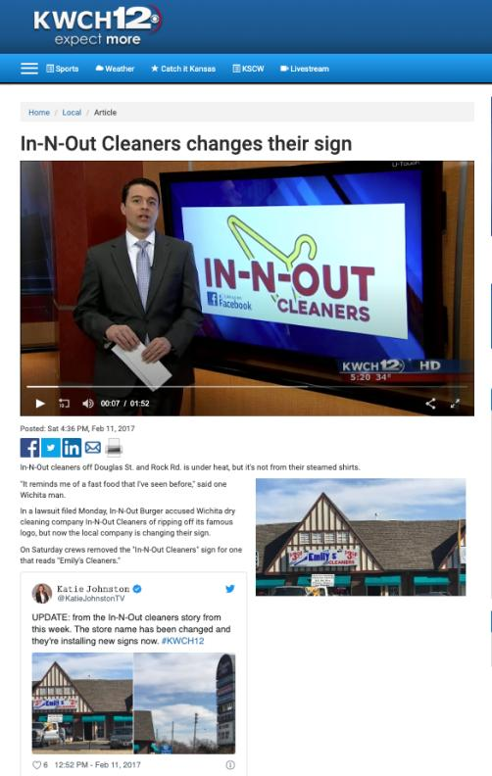
Wichita Kansas

Slide 151
Trademarks : Infringement
Four main provisions in the TMA that address TM infringement
  S. 7: provides protection against passing off; applies to both registered and unregistered marks
  S. 19: governs use of precise TM registered for same wares and services
  S. 20: deals with confusing uses of TMs
  S. 22: governs uses that depreciate value of goodwill
Only S. 7 provides protection for UNREGISTERED MARKS – s. 7. This section applies to both registered and unregistered marks and provides protection against passing off. It can be understood as the codification of the two main types of passing off…
The other three provisions – ss. 19, 20, and 22 - ONLY apply to registered TMs.

Slide 152
Trademarks: Infringement
  S. 19: governs use of precise TM registered for same wares and services
  Subject to ss. 21, 32, 67
  S. 21:
    Honest, concurrent use of the mark
    Allows the court to carve out space for a party’s continuing use of a mark
    Compromise provision

Slide 153
Trademarks: Infringement
Rights conferred by registration
19 Subject to sections 21, 32 and 67, the registration of a trademark in respect of any goods or services, unless shown to be invalid, gives to the owner of the trademark the exclusive right to the use throughout Canada of the trademark in respect of those goods or services.

Slide 154
Trademarks: Infringement
S. 19 gives the owner of a TM the exclusive right to use, throughout Canada, the TM in association with those wares and services for which it is registered.
S. 19 only applies where someone uses EXACTLY THE SAME TM; and uses it in association with one of the wares or services for which the original mark is registered.
For example say that Coca Cola is registered only for soda drinks
If someone uses the TM Coca Cola with respect to couches, this would not be covered by s. 19.
As well, if someone uses the TM Cocca Colla (two cs, two ls) with respect to soda drinks, that would not be covered by s. 19.
Only if a second person used the TM Coca Cola (same TM) with respect to soda drinks (same wares and services) that S. 19 would be infringed.
In S. 19, it states that the rights conferred are subject to S. 21, 32, and 67...
Examine S. 21 which exception refers to the Honest, Concurrent use of the mark.

Slide 155
Trademarks: Infringement
For example: Company X has the common law trademark PRAIRIE for luggage. They have been in business in Manitoba and Sask. since 1980 but haven’t registered their mark
1990 Company Y comes along and would like to use the TM PRAIRIE. They do a registered search, find nothing similar, and register the same TM without knowing that X has been in business in Manitoba & Sask. with that trademark.
Company X not aware that company Y registered this mark until 1998, when it is sued for TM infringement by Company Y. But X was using the mark since 1980!
X’s response is to challenge the registration of the mark under s. 18. Specifically X cites the “entitled to register” section of s. 18 , saying that Company Y isn’t entitled to register the mark because Y’s mark was confusing with X’s mark, which X had used prior to the time Y applied to register.

Slide 156
Trademarks: Infringement
Argument will fail.
Defence, in s. 18, is no longer available because it has been more than 5 years since the mark was registered
17(2) says you have 5 years to object to the registration of a mark on the basis of your prior use of the mark.
s. 21 allows the court to carve out space for X’s continuing use of the mark. However the catch is that there has to be an “adequate specified distinction from the registered TM”, as the court may order.
So, the Court indeed allows X use the mark, but they have to distinguish it in some way to ensure the public is not confused as to source.
S. 21 has been described by commentators as the compromise provision. Through it, the court will find some way for both parties to use the TMs.

Slide 157
Trademarks: Infringement
When registration invalid
18 (1) The registration of a trademark is invalid if
  (a) the trademark was not registrable at the date of registration;
  (b) the trademark is not distinctive at the time proceedings bringing the validity of the registration into question are commenced;
  (c) the trademark has been abandoned;
  (d) subject to section 17, the applicant for registration was not the person entitled to secure the registration; or
  (e) the application for registration was filed in bad faith.

Slide 158
Trademarks: Infringement
When registration incontestable
17 (2) In proceedings commenced after the expiration of five years from the date of registration of a trademark or from July 1, 1954, whichever is the later, no registration shall be expunged or amended or held invalid on the ground of the previous use or making known referred to in subsection (1), unless it is established that the person who adopted the registered trademark in Canada did so with knowledge of that previous use or making known.

Slide 159
Trademarks: Infringement
Concurrent use of confusing marks
21 (1) If, in any proceedings respecting a registered trademark the registration of which is entitled to the protection of subsection 17(2), it is made to appear to the Federal Court that one of the parties to the proceedings, other than the registered owner of the trademark, had in good faith used a confusing trademark or trade name in Canada before the filing date of the application for that registration, and the Court considers that it is not contrary to the public interest that the continued use of the confusing trademark or trade name should be permitted in a defined territorial area concurrently with the use of the registered trademark, the Court may, subject to any terms that it considers just, order that the other party may continue to use the confusing trademark or trade name within that area with an adequate specified distinction from the registered trademark.

Slide 160
Trademarks : Infringement
  S. 20: deals with confusing uses of TMs.
  Covers two types of situations:
Where it is not the identical TM that has been used, but one that is confusing with the registered TM; (Cocca Colla for soft drinks)
Where it is the identical TM but one used with respect to different wares or services. I.e., Coca Cola for chairs - something Coca Cola [original company] is not registered for)

Slide 161
Trademarks: Infringement
Final section dealing with TM infringement of registered marks is S. 22.
S. 22 governs use of a mark that has the effect of depreciating the value of the goodwill of that mark (no confusion is necessary).
Leading case is Veuve Cliquot but first case to deal with s. 22 is Clairol but first…
Clairol International Corp. v. Thomas Supply & Equipment Co., [1968] 2 Ex. C.R. 552

Slide 162
Trademarks: Infringement
Clairol International Corp. v. Thomas Supply & Equipment [1968] 2 Ex. C.R. 552
Facts: Revlon creates comparison charts…
To infringe s. 19: (see ss. 2, 4)
  1) The mark has to be “used” (see ss. 2, 4)
  2) Also “used” as a TM = must be used for the purposes of distinguishing wares and services → used as an indicator of source
  3) Applies only where someone uses the mark as registered; in association with goods or services for which it is registered

Slide 163
Trademarks: Infringement
Clairol International Corp. v. Thomas Supply & Equipment [1968] 2 Ex. C.R. 552
Clairol owns the TMs Miss Clairol and Hair Color Bath; both registered for use in association with hair tinting and coloring preparations.
Revlon, attempting to increase market share, devised two different ways by which users of products of competitors could successfully choose the same product shades.
On packages for Revlon Color Silk, Revlon put comparison charts indicating the equivalent Clairol products.
They also created brochures featuring the comparison charts.
Two of the plaintiff Clairol’s arguments were that the use of their trademarks in the color comparison charts infringed s. 19 and s. 22 of the Trademarks Act.

Slide 164
Trademarks: Infringement
Clairol International Corp. v. Thomas Supply & Equipment [1968] 2 Ex. C.R. 552
Deals with the question “what does the word “USE” mean in s. 19?”
Look first to s. 2 of the Act for a definition of “use” in relation to a TM. “Use” is defined in s. 2 as “any use that by Section 4 is deemed to be a use in association with wares or services”.
Look to s. 4 which is very specific about use
s. 4(1) deals with use in association with wares; s. 4(2) deals with use in association with services.
In this case, there are no services at issue, only wares, actual boxes of hair dye. Did Revlon use Clairol’s marks in association with their own wares within the meaning of s. 4(1)?
Per s. 4(1), a TM is used in association with wares if, the TM is marked on the product or package at time of transfer of possession or is in any other manner so associated with the wares that notice of the association is given to the person to whom the property is transferred.
In this situation Clariol’s TMs are marked on the boxes, so on the package at the time of the transfer of possession.

Slide 165
Trademarks: Infringement
Clairol International Corp. v. Thomas Supply & Equipment [1968] 2 Ex. C.R. 552
However, this is not the end of the issue.
S. 19 talks about when a TM is used: In order to ensure that this section is not interpreted in an overly broad manner, the court holds that we cannot look only at the word “use”, but also at the definition of TM.
In order to infringe s. 19, the mark must be used (s. 2, then s. 4 (1 or 2) depending on whether the Defendant uses the mark in association with their own wares or services.
The mark also must be used as a TM. This essentially means that the mark must be used in a way that would indicate that the company behind the TM is the SOURCE of the product.
As well, this section applies only where someone uses the mark as registered; in association with goods or services for which it is registered

Slide 166
Trademarks: Infringement
Clairol International Corp. v. Thomas Supply & Equipment [1968] 2 Ex. C.R. 552
Is there “use” as a “trademark” here with respect to the packages?
No, there is not. Clear that Revlon is not trying to pretend that it is a Clairol product, just trying to show what the right Revlon product to purchase is if you usually buy Clairol
Accordingly, the test for s. 19 infringement not made out.
The brochures are also fine.

Slide 167
Trademarks : Infringement
Clairol International Corp. v. Thomas Supply & Equipment (1968)
S. 22:
  The defendant must have used the mark as set out in s. 2 and 4 of the Act.
  If there is “use”, then the test becomes whether the use is likely to depreciate the value of the goodwill attaching to the mark (i.e. by reducing the esteem in which the mark is held; or enticing customers away)

Slide 168
Trademarks: Infringement
Clairol International Corp. v. Thomas Supply & Equipment (1968)
This is the first time a s. 22 issue was before the court. [exact s. 22 test will come from Veuve, but this is useful for historical purposes, and to see the stance taken by this Court on comparative advertising].
22. (1) No person shall use a trade-mark registered by another person in a manner that is likely to have the effect of depreciating the value of the goodwill attaching thereto.
How far is this section meant to extend?
Written broadly enough to capture negative comments made in conversation about a specific product.
The court acknowledges that this section is worded broadly, but says that it’s unlikely that there is any attempt to suppress critical expression.
*One key is that the court reads in an implied limitation in this section…use in the course of trade.
But even with this implied limitation, this is still potentially a very broad right. It could cover comparison price charts or discussion by sales-clerks of competing products.
We see the court reiterate that purpose of s. 22 is not to stop legitimate comparisons.

Slide 169
Trademarks: Infringement
Clairol International Corp. v. Thomas Supply & Equipment (1968)
In evaluating use in s. 22 the court in Clairol held that we again need to go to s. 4 of the TMA
The TM must be “used” by the Defendant in association with their own wares and services.
Court already found the Clairol marks were “used” in accordance with wares on the package, but not on brochures.
So the TM is used on the package, so the first part of the s. 22 analysis was met (as the analysis was structured in this case).
NB: Do not need to apply the second part of the “use” test; not a requirement under s. 22 for the mark to have been “used” as a TM.

Slide 170
Trademarks: Infringement
Clairol International Corp. v. Thomas Supply & Equipment (1968)
The second part of the s. 22 test is whether the TM used in matter likely to depreciate the goodwill in the mark?
This brings up the question of what is to be regarded as the goodwill attaching to a TM? The definition given by the court is: the goodwill attaching to the TM is that portion of goodwill that consists of the whole advantage that may have been built up by years of honest work/trade, or money promoting the mark.
To depreciate the value of this goodwill, then, is to reduce the advantage of the reputation/connection

Slide 171
Trademarks: Infringement
Clairol International Corp. v. Thomas Supply & Equipment (1968):
How might depreciating goodwill occur?
Court says that the value of goodwill can be depreciated in two ways:
  (1) Reduce the esteem in which the mark is held
  (2) By enticing customers away.
That said, it is legitimate for businesses to attract consumers from competitors BUT they must do so by honest means
s. 22 sets some limits on what those honest means are. You can put information on your wares for the purpose of telling customers about your own wares in order to get them to buy your goods in preference to those of the owner of a particular TM.

Slide 172
Trademarks: Infringement
You can put information on your wares for the purpose of telling customers about your own wares in order to get them to buy your goods in preference to those of the owner of a particular TM.
What you can not do, however, is put your competitor’s TM on your goods to entice customers away.
That is what happened in this situation.
The competitor’s TMs were used on the package to suggest to customers that they could easily make the switch.
This was found by the court to be a violation of s. 22.
The use on the brochures is not a violation of s. 22; in putting the marks on the brochures, the Defendant isn’t using the mark in association with its wares.
As a result, Revlon can make brochures that give the comparison between the two products; they just can not put the Clairol marks or the chart on their product boxes.

Slide 173
Trademarks: Infringement
What is the impact of Clairol on comparative advertising?
Case suggests we CAN have comparative advertising with respect to products, but not services.
With respect to wares (products), you can mention opposing TMs in ads, or put them on charts and in displays. In doing so, you’re not “using” the TM according to the Trademarks Act; and s. 22 doesn’t kick in since the TM isn’t being “used”.
Result of CLAIROL seems to be that if your TM is registered in association with services, and if you produce an advertisement that uses your competitor’s marks = you are infringing s. 22 because of s. 4(2) which clarifies that use in association with services includes ads.
This is not the law today, though…

Slide 174
Trademarks : Infringement – the law today
Future Shop v. A&B Sound, [1994] 8 W.W.R. 376
Facts: A&B Sound creates price comparison ads
The public has an interest in comparative advertising
Is the use of the competitor's trademark for a purpose which stresses the similarities or the differences with the trademarked competition ok?
  Similarities?: Not ok - S. 22 infringed.
  Differences?: Ok - S. 22 not infringed.

Slide 175
Trademarks: Infringement – the law today
Future Shop v. A&B Sound, [1994] 8 W.W.R. 376
A & B sound put up price comparison ads in which they effectively stated; here are our products and prices, here are Future Shop’s prices.
Future shop sued for TM infringement. It said that using their mark which was registered for services in comparative advertising is a violation of s. 22.
Based on Clairol it seemed like Future Shop’s argument was sound, and that the use of mark, registered for services, in comparative advertising, is a violation of s. 22.
HOWEVER:
Court held that granting an injunction in this case would deprive the defendant of the option of continuing to pursue its strategy of seeking to attract customers by highlighting its low prices in comparison with those of the plaintiff by fair and accurate ads.
Also, the public has an interest in comparative advertising to the extent that the comparative information offered in those ads helped consumers make better choices.

Slide 176
Trademarks: Infringement – the law today
It appeared after Clairol, that if you run a service and produce an ad which refers to competitor’s marks, s. 22 would be infringed because use in association with services includes ads.
Court in Future Shop v. A&B Sound holds that this is not the case, that the previous principle is too broad and is detrimental to commerce and to the public interest.
The question, depending on the evidence in any particular case, is whether the use of the competitor's trademark is for a purpose which stresses the similarities or the differences with the trademarked competition.
If the purpose is to stress the similarities, then you are appropriating the value of the goodwill associated with the TM, contrary to s. 22.
If the purpose is to stress the differences with the trademark, then the use is for the purpose of distancing the trademarked ware or service and s. 22 is not offended.
Court in Future Shop v. A&B Sound held that we should still allow comparison; and that we should protect freedom of expression.

Slide 177
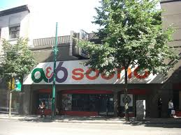
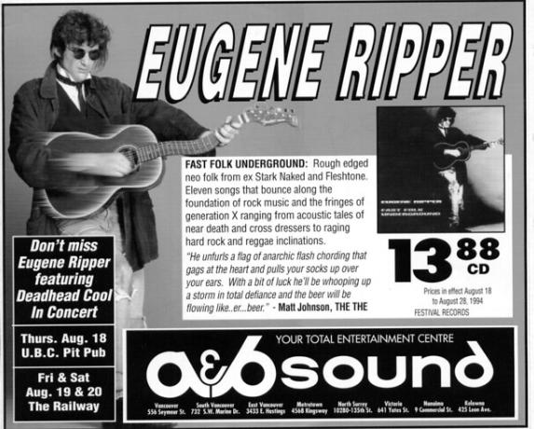

Slide 178
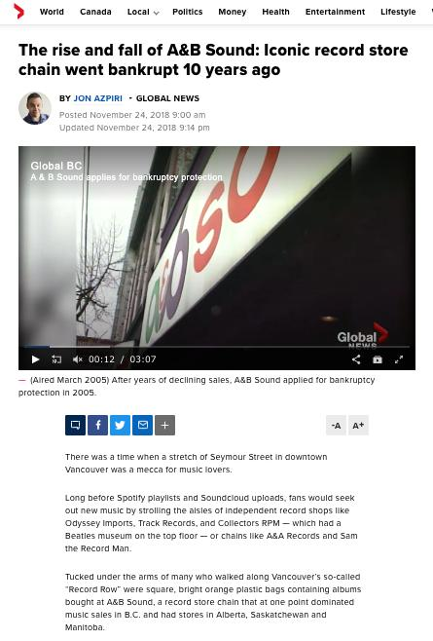

Slide 179
Trademarks: Infringement
– the law today
SUMMARY
1. Emphasizing differences in services and products is fine according to s. 22.
2. It is when trying to appropriate the value of goodwill by emphasizing the similarities between products, the use would run afoul of s. 22.

Slide 180
Trademarks: Infringement
Questions to Ponder
Is it important, in constructing a legal regime around trademarks, to preserve space for comparative advertising?
What limits, if any, should be placed on comparative advertising?
How do you feel about the balance struck by the courts in this regard?

Slide 181
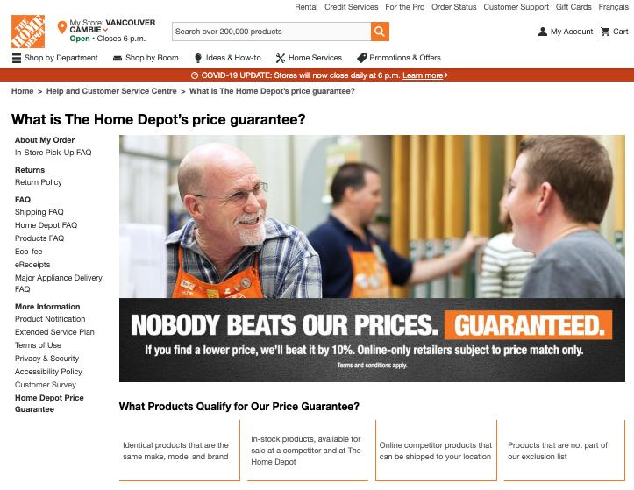

Slide 182


Slide 183


Slide 184

How is S. 22 TMA like this Guy?

Slide 185
Trademarks: Infringement
Veuve Clicquot Ponsardin v. Boutiques Cliquot (SCC, 2006)
Facts: Champagne house objects to use of similar name by women’s wear store
The mere mental association of the two marks does not necessarily give rise to a likelihood of depreciation
S. 22 = “super weapon” - Needs to be kept in check
Courts should separate anti-dilution claims into discrete elements; require proof for each element

Slide 186
Trademarks: Infringement
Veuve Clicquot Ponsardin v. Boutiques Cliquot (SCC, 2006)
“Veuve Clicquot”:
  One of the world’s great champagne houses
  Numerous marks registered in Canada, and used in connection with products in Canada since at least 1899
  Part of the Louis Vuitton luxury goods group
“Cliquot”:
  Name of six women’s wear shops in Quebec & eastern Ontario
  TMs registered are Cliquot, Cliquot “Un Monde a Part”; also “Cliquot” is trade name
  Sell clothing that is “marketed as good value”; that “appeals to the career woman rather than grandes dames” [interesting play on words given the TM registration, by Veuve Clicquot, of La Grande Dame]

Slide 187
Trademarks: Infringement
Veuve Clicquot Ponsardin v. Boutiques Cliquot (SCC, 2006)
Word Cliquot does not appear on any of the clothing in the Cliquot boutiques. It appears only on exterior signs, bags, wrapping, business cards, and invoices.
Appellants’ and respondents’ marks have co-existed for about 10 years.
Veuve Clicquot claims BOTH that:
  Consumers will be confused that the women’s clothing and the champagne originate from the same source, thereby infringing the registered TMs of the appellant contrary to s. 20 of the TMA; AND
  That the use by the Respondents depreciates the value of the goodwill attached to the appellants’ marks, contrary to s. 22 of the Act.

Slide 188
Trademarks: Infringement
Veuve Clicquot Ponsardin v. Boutiques Cliquot (SCC, 2006)
Trial Judge found that there was little (if any) confusion as to source.
Trial Judge also found that the use, by the respondents, of the words Cliquot or Cliquot un monde a part, did not violate s. 22 of the Act.
Federal CA agreed, as did the SCC.
S. 22 analysis:
The s. 22 remedy was introduced as part of the 1953 amendments to the Trade-Marks Act. Justification was that TM would be less valuable to the owner if it were used by others in connection with a wide variety of other goods even in situations where there was no confusion.
Canada is not the only country to have such a remedy. It can also be found in the US, UK, Europe.

Slide 189
Trademarks: Infringement
Veuve Clicquot Ponsardin v. Boutiques Cliquot (SCC, 2006)
Crucial point in the Veuve Clicquot case is Binnie J.’s statement that the mere mental association of the two marks does not necessarily give rise to a likelihood of depreciation. There are other steps to the test…
There are also some other important remarks on this provision should be interpreted:
S. 22 is sometimes referred to as a “super weapon” which, in the interest of fair competition, needs to be kept in check
A super weapon because conceivably could apply in a wide range of situations to constrain individual behaviour and constrain competition. Recall that the main purpose of TM law is not to protect the mark itself. It’s to protect the mark as representative of source.

Slide 190
Trademarks: Infringement
Veuve Clicquot Ponsardin v. Boutiques Cliquot (SCC, 2006)
How does the SCC keep this “super weapon” in check?
SCC says - because of its status as a super weapon, any…
  Dilution should be proved by evidence
  Courts should separate any anti-dilution claim into its discrete elements and require proof for each of those elements.

Slide 191
Trademarks: Infringement
Veuve Clicquot Ponsardin v. Boutiques Cliquot (SCC, 2006)
1) Was the Plaintiff’s registered TM “used” in connection with the Defendant’s wares or services in a way that gives notice of the association?
2) Is the Plaintiff’s registered TM sufficiently well-known to have significant goodwill attached to it?
3) Is the Plaintiff’s mark used in a manner likely to have an effect on that goodwill?
4) Is the likely effect to depreciate the value of the goodwill?

Slide 192
Trademarks: Infringement
Veuve Clicquot Ponsardin v. Boutiques Cliquot (SCC, 2006)
THE TEST FOR S. 22…Test to use when evaluating s. 22 claims.
S. 22 has four elements
1) That a claimant's registered trade-mark was used by the defendant in connection with wares or services in a way that gives notice of the association; does not matter whether or not those wares and services are competitive with those of the claimant.
2) That the claimant's registered trade-mark is sufficiently well known to have significant goodwill attached to it. Canada’s dilution/depreciation provision doesn’t require the mark to be famous (difference between US, European laws)
3) The claimant’s mark used in a manner likely to have an effect on that goodwill (i.e. linkage)
4) Likely effect would be to depreciate the value of its goodwill

Slide 193
Trademarks: Infringement
Veuve Clicquot Ponsardin v. Boutiques Cliquot (SCC, 2006)
1) Was the Plaintiff’s registered TM “used” in connection with the Defendant’s wares or services in a way that gives notice of the association?
“Use” as defined in s. 4
Would the casual observer recognize the mark used by the Defendant as the mark of the P?

Slide 194
Trademarks: Infringement
Veuve Clicquot Ponsardin v. Boutiques Cliquot (SCC, 2006)
1) Use of the claimant’s registered mark
“Use” defined in s. 4
“Use”, if for wares, marked on the wares themselves or on packaging or in any other manner so associated with the wares that notice of the association is given
Important to note that the fact that Cliquot was spelled differently does not by itself mean that the TM was not used. What matters is would the casual observer recognize the mark used by the Respondent as the mark of the Appellant (IE Coke, Koke).
Trial Judge held that a consumer who saw the word cliquot used in the D’s stores WOULD NOT MAKE ANY ASSOCIATION with the Plaintiff’s mark. Accordingly, there is NO USE for services pursuant to s. 4.
Without a link between the respondents’ store and the Veuve Clicquot mark, the Veuve Clicquot mark cannot be depreciated.
S. 22 claim fails at the first step.
However, the Court thankfully (for us) goes through the rest of the analysis, partly because s. 22 just doesn’t get litigated very often.

Slide 195
Trademarks: Infringement
Veuve Clicquot Ponsardin v. Boutiques Cliquot (SCC, 2006)
2) Is the Plaintiff’s registered TM sufficiently well-known to have significant goodwill attached to it?
Goodwill = positive association that attracts customers towards its owner’s wares or services
How to determine how much goodwill exists in a mark [see para. 54]

Slide 196
Trademarks: Infringement
Veuve Clicquot Ponsardin v. Boutiques Cliquot (SCC, 2006)
2) Proof of goodwill
“Goodwill” isn’t defined in the Act, but generally means the positive association that attracts customers towards its owner’s wares or services rather than those of its competitors
For s. 22 to apply there needs to be the existence of goodwill capable of depreciation by a “non-confusing use”.
“[54] While “fame” is not a requirement of s. 22, a court required to determine the existence of goodwill capable of depreciation by a “non-confusing” use (as here) will want to take that approach into consideration, as well as more general factors such as the degree of recognition of the mark within the relevant universe of consumers, the volume of sales and the depth of market penetration of products associated with the claimant’s mark, the extent and duration of advertising and publicity accorded the claimant’s mark, the geographic reach of the claimant’s mark, its degree of inherent or acquired distinctiveness, whether products associated with the claimant’s mark are confined to a narrow or specialized channel of trade, or move in multiple channels, and the extent to which the mark is identified with a particular quality.”
In this case there is a substantial amount of goodwill that attaches to the Veuve Clicquot mark. This goodwill extends beyond wine and champagne.

Slide 197
Trademarks: Infringement
Veuve Clicquot Ponsardin v. Boutiques Cliquot (SCC, 2006)
3) Is the Plaintiff’s mark used in a manner likely to have an effect on that goodwill?
Plaintiff must prove a connection or linkage made by consumers between the Plaintiff’s goodwill and the defendant’s use

Slide 198
Trademarks: Infringement
Veuve Clicquot Ponsardin v. Boutiques Cliquot (SCC, 2006)
3) Likely connection or linkage made by consumers between claimant’s goodwill and defendants’ use?
Trial Judge found that the somewhat hurried consumer does not associate what is displayed in the Respondents' stores with the mark of Veuve Clicquot. As a result, there can be no impact on the goodwill attached to VEUVE CLICQUOT.
AND any linkage does have to be proved. That is why the section does not read: No person shall use a [famous] trade-mark registered by another person [because to do so] is likely to have the effect of depreciating the value of the goodwill attaching thereto.
The complainant must prove a connection or linkage made by consumers between the claimant’s goodwill and the defendants’ use.

Slide 199
Trademarks: Infringement
Veuve Clicquot Ponsardin v. Boutiques Cliquot (SCC, 2006)
4) Is the likely effect to depreciate the value of the goodwill?
Depreciate = lower the value of; to disparage, belittle, underrate
  Lower value:
    Loss of distinctiveness
    Dilution (blurring of brand image)
Disparage = tarnish; creation of negative associations

Slide 200
Trademarks: Infringement
Veuve Clicquot Ponsardin v. Boutiques Cliquot (SCC, 2006)
Likelihood of depreciation
Veuve Clicquot is a famous mark with significant goodwill is attached to it in the luxury goods trade
Word “depreciate” is used in its ordinary dictionary meaning of "lower the value of" as well as to "disparage, belittle, underrate"
  Value can be lowered in a variety of ways:
  Loss of distinctiveness: Value can be lowered in situations where the mark is used by different users (either by company itself licensing too widely. For example, the Pierre Cardin brand moved down market through overuse of licensing; or through others using).
  Dilution: Meaning a blurring of brand image. Dilution works its harm not by causing confusion in consumers’ minds regarding the source of a good or a service, but by creating an association in consumers’ minds between a mark and a different good or service. I.e. Tiffany ex ample → Mass. court, in dealing with a local restaurant calling itself Tiffany, talked about the risk of erosion of the public's identification of the mark uniquely with the plaintiff's jewellery and luxury business, diminishing its distinctiveness, uniqueness, effectiveness and prestigious connotations

Slide 201
Trademarks: Infringement
Veuve Clicquot Ponsardin v. Boutiques Cliquot (SCC, 2006)
Likelihood of depreciation (con’d)
  Disparagement or tarnishing of a TM is where the Defendant creates negative association for the mark.
    Thurlow J. considered this was the case in the Clairol case
    Examples given was Dallas Cowboy Cheerleaders Inc. v. Pussycat Cinema Ltd. as well as other cases involving sexually explicit or pornographic businesses in the US [para. 66]
  Depreciation not limited to BLURRING and TARNISHMENT in Canada. It is not enough to show that depreciation COULD occur – must prove that it’s LIKLELY to occur.
In this case the Court found that a casual consumer would not associate the name of the respondents’ stores with the house of Veuve Clicquot. Accordingly, the necessary elements for a s. 22 depreciation claim were not established.

Slide 202
Trademarks: Infringement
Conclusion on s. 19, 20, 22
In these cases, we see the Courts interpreting s. 19, 20, 22 in a narrow fashion, restricting the ambit of the sections to the context of commercial competition.
This leaves magazines, unions, and individuals generally free to criticize companies without the fear of trade-mark consequences. The courts are reluctant to use TM law to shut down the ability of people to protest.
In Clairol, when court talks about goodwill, depreciation is found on basis that customers will be diverted to the opposing party (appropriated) as opposed to simply driven away.
Absent a commercially competitive context it is much less likely that there will be depreciation in the value of goodwill. Other parties are not taking goodwill away for their own use.

Slide 203

Trademarks: Remedies

Slide 204
Trademarks: Remedies
Remedies
See s. 53.2 (read together w. s. 2, “interested person”)
Including:
  Injunctions (interlocutory or permanent)
  Damages compensating for lost sales, damage to goodwill, loss of control of reputation
  Accounting of profits (alternative to damages)
  Destruction of offending materials
  Removal of mark from wares
  Concealment of mark on wares
  Punitive damages (in certain circumstances)

Slide 205
Trademarks: Remedies
The primary remedies provision in the TMA is s. 53.2. This provision needs to be read together with s. 2 – for the definition of an “interested person”.
Remedies available include:
  Injunctions (interlocutory or permanent)
  Damages
    To compensate for harm suffered:
      Lost sales
      Damage to goodwill
      Loss of control of reputation
  (or) Accounting of profits
  Order for the destruction or other disposition of offending materials
  Removal of offending mark from wares
  Permanent concealment of mark on wares
  Punitive damages in certain circumstances

Slide 206
Trademarks: Remedies
Defences to TM infringement
1) Challenge the validity of the other party’s TM
  See s. 18
2) A Defendant had used, in good faith, a confusing Trade Name in Canada prior to the filing of the Plaintiff’s application for registration of TM
  See s. 21
3) Mark should be cancelled where non-use
4) Defences set out in s. 20 (bona fide…)

Slide 207
Trademarks: Remedies
Defences to TM infringement
A defendant could challenge the validity of the other party’s TM: S. 18 is the provision to rely on if this defence is to be raised (TM registered).
  s. 18(1)(a): Invalid if the TM was not registrable at the date of registration (ss. 9, 10, 12, 13)
  s. 18(1)(b): Invalid if the TM is not distinctive at the time of the challenge (become generic – see Champagne case)
  s. 18(1)(c): Invalid if it has been abandoned (see the corpulent penguin case for the test for abandonment)
  s. 18(1)(d): Invalid if the applicant was not the person entitled to register the mark [refer back to s. 16, but note the limitation in s. 17]

Slide 208
Trademarks: Remedies
Defendant had used in good faith a confusing Trade Name in Canada before the date of the filing of the Plaintiff’s application for registration (s. 21)
The Plaintiff’s mark should be cancelled because of non-use (see S. 45)
Certain defences contained in s. 20 can be invoked where a TM owner alleges that the Defendant has infringed their TM by using a confusing mark.
  I.e.: (1.1) The registration of a trade-mark does not prevent a person from making, in a manner that is not likely to have the effect of depreciating the value of the goodwill attaching to the trade-mark,
    (a) any bona fide use of his or her personal name as a trade-name; or (b) any bona fide use, other than as a trade-mark, of the geographical name of his or her place of business or of any accurate description of the character or quality of his or her goods or services.

Slide 209

Trademarks: Remedies
Assume Trader Joe’s TM is registered in Canada – as of 2011.
Is Pirate Joe’s infringing Trader Joe’s registered TM? s. 19, 20, 22…

Slide 210
Trademarks: Remedies – Q&A
1. Do you think the provisions in the TMA provide sufficient protection against infringement for TM owners?
2. Do you think the provisions in the TMA overprotect TM owners?
In answering these questions please think of specific legislative reforms that in your view would make the degree of protection available to TM owners more appropriate.

Slide 211
Trademarks
Review

Slide 212

Trademarks Review

Slide 213

Trademarks Review

Slide 214
Trademarks Review
The Kitasoo Band Council approaches you and would like to register the mark SPIRIT BEAR as an official mark. Do you anticipate any issues with the registration of this mark?

Slide 215

Trademarks Review

Slide 216
Trademarks Review
Is a TM registered in association with goods and not services “used” when it is reproduced, by a competitor, on a brochure placed next to both the product on which the TM is marked and the competitor’s product?

Slide 217
Trademarks Review
Kropp (Re), 2012 TMOB 232
Facts: Hudson’s Bay Co. requests that the Registrar of TMs issue a notice under s. 45 to Fairy Bay Guest House Inc. regarding the trade-mark FAIRY BAY.

Slide 218
Trademarks Review
Do you think the provisions in the TMA provide adequate protection against infringement for TM owners? If so, why? If not, what changes would you make to the TMA to increase protection against infringement?

Slide 219
Trademarks Review
Does the TMA sufficiently balance the property rights of TM owners with the speech rights of non-TM-owning parties?

Slide 220


Trademarks Review

Slide 221

Trademarks Review

Slide 222

Trademarks Review

Slide 223

Trademarks Review

Slide 224
Trademarks Review
Does TM law in Canada adequately balance between the rights of TM owners and the rights of the public to make use of marks capable of being protected under TM law?

Slide 225
Pause

Slide 226

Coming Soon
Patents 2

Slide 227


A MATTER OF PERSPECTIVE

Slide 228

Conclusion

Slide 229
UNTIL NEXT
TIME!

Slide 230

Always include a cat picture

Slide 231
In learning you will teach
And in teaching you will learn
Phil Collins' Son of Man (1999)

Slide 232
Our Academic Partners

