Slide 1


Copyright Overview &
What is Copyrightable?
Week 2
LAW 424 002
Intellectual Property Law
Allard School of Law, UBC
Spring, 2021
Jon Festinger Q.C.
Centre for Digital Media
QMUL School of Law (CCLS)
Whiteboard Law
http://commlaw.allard.ubc
@jonfestinger
jon_festinger@thecdm.ca

Slide 2
Stuff

Slide 3
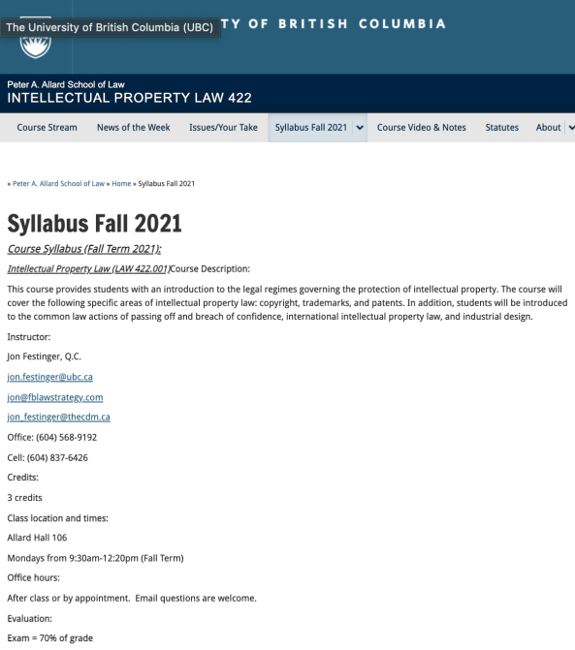
Any Questions?…

Slide 4
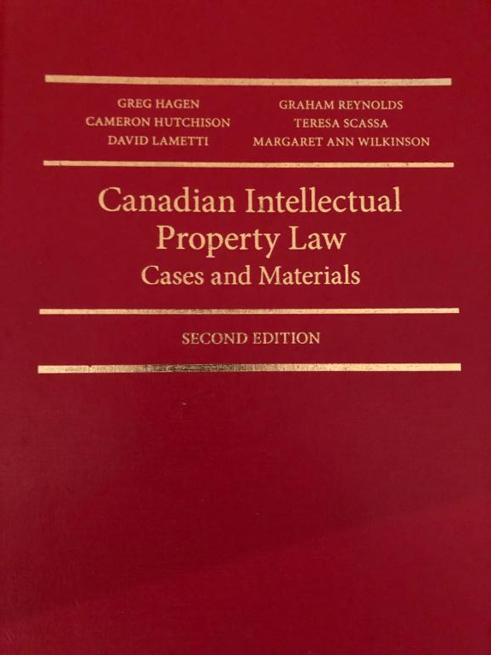

Slide 5

Office “Hours”: Ideally Mondays before or after class but am flexible…
Email me : jon.festinger@ubc.ca
Skype: jon.festinger
Phone:
o. 604-568-9192
c. 604-837-6426

Slide 6
Evaluation
(LLMCL students?)

Slide 7
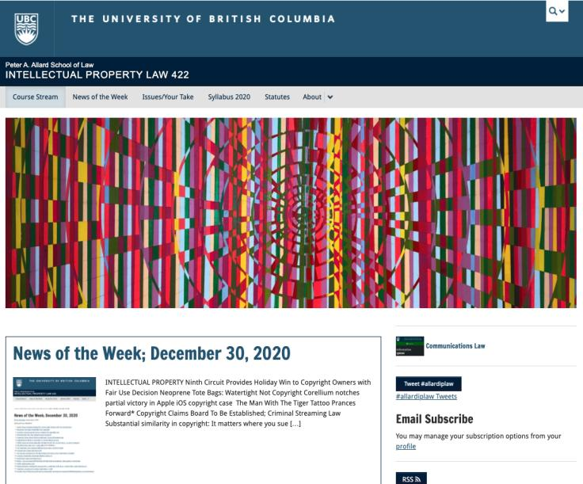
Course Website
https://iplaw.allard.ubc.ca/

Slide 8
PLEASE
SIGN UP

Slide 9
For full privileges on the website
1. Please create an account at http://cms.ubc.ca/ using your CWL.
2. Once you create an account and sign in at http://cms.ubc.ca/ you can click your name in the top right. Halfway down the following page will be your WordPress email address.
3. Send me your WordPress email address at jon.festinger@ubc.ca or at jon_festinger@thecdm.ca
4. Then, I will invite you to participate with authoring privileges via your WordPress email address.

Slide 10

Why post?
Engaging and engaging others is the key.
Because you don’t love speaking up in class.
Because you just saw or realized something, and you’ll never remember it unless you post it now.
# AllardIPLaw

Slide 11
Tips:
Don’t feel your posts have to be perfect. Engaging and engaging others is the key.

Slide 12

Anything & everything can be done via email if you prefer

Slide 13
Thank you for
your bios.
Much appreciated.

Slide 14
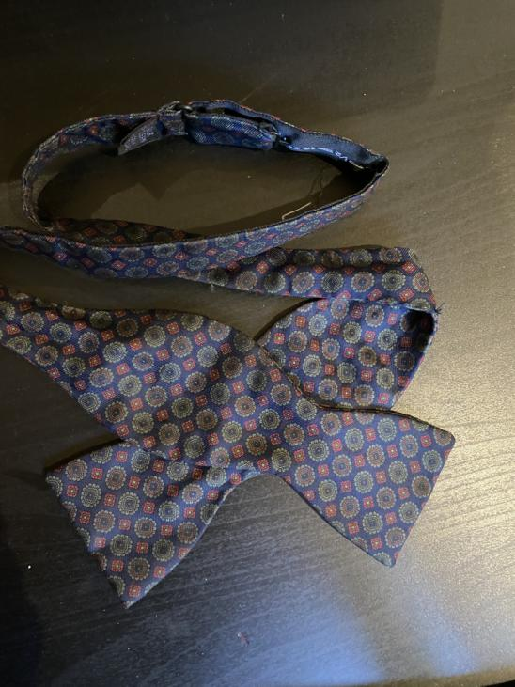

Slide 15
News of
the Weeks

Slide 16
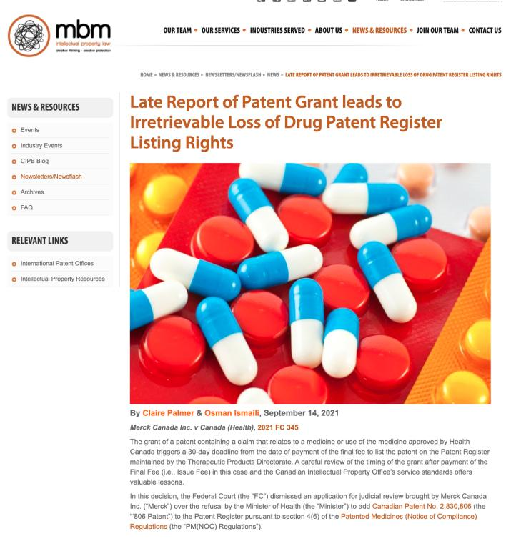

Slide 17
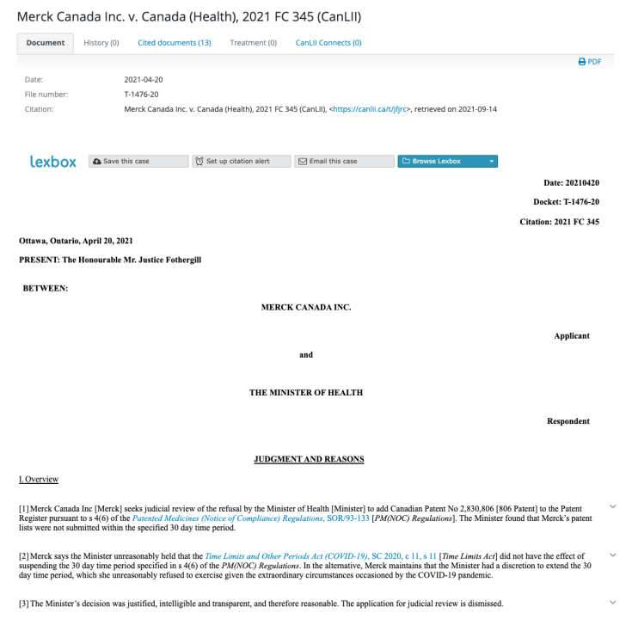

Slide 18
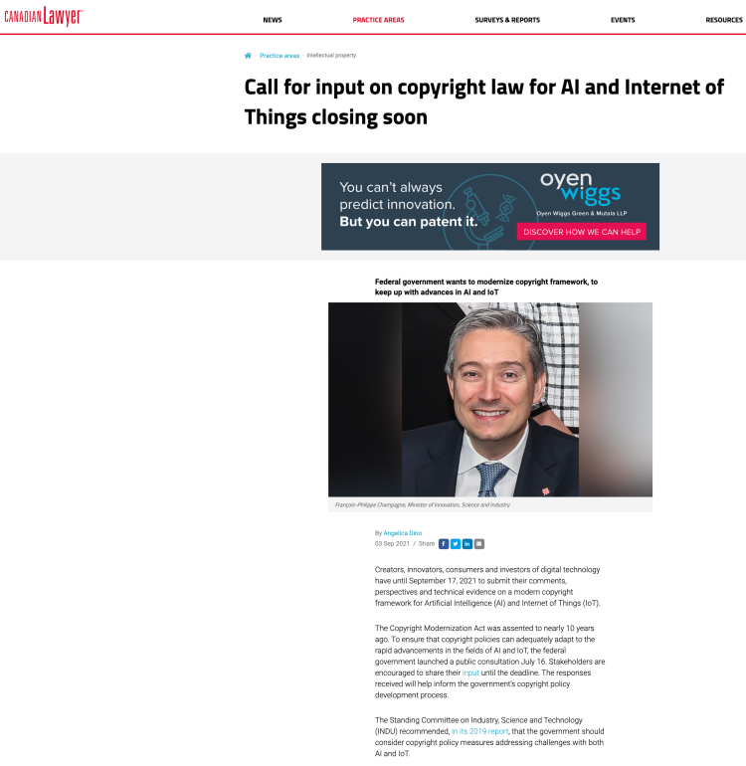

Slide 19
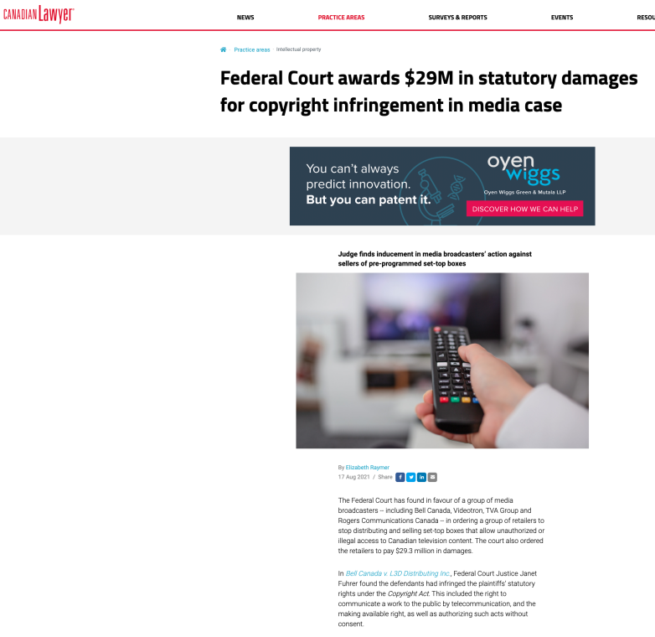

Slide 20
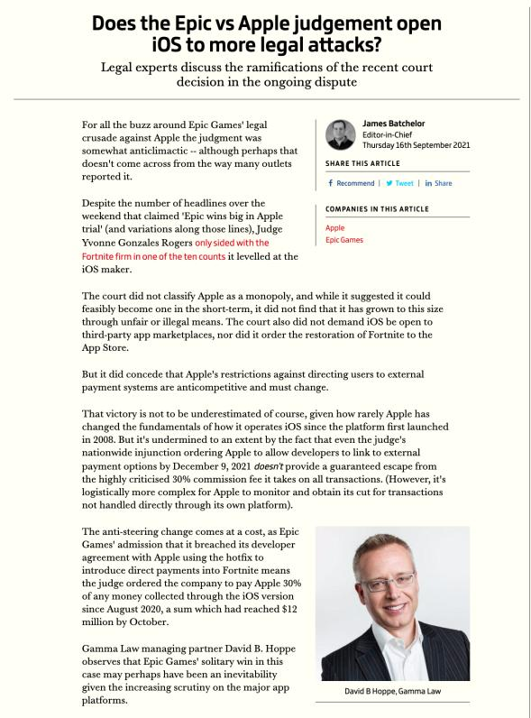

Slide 21
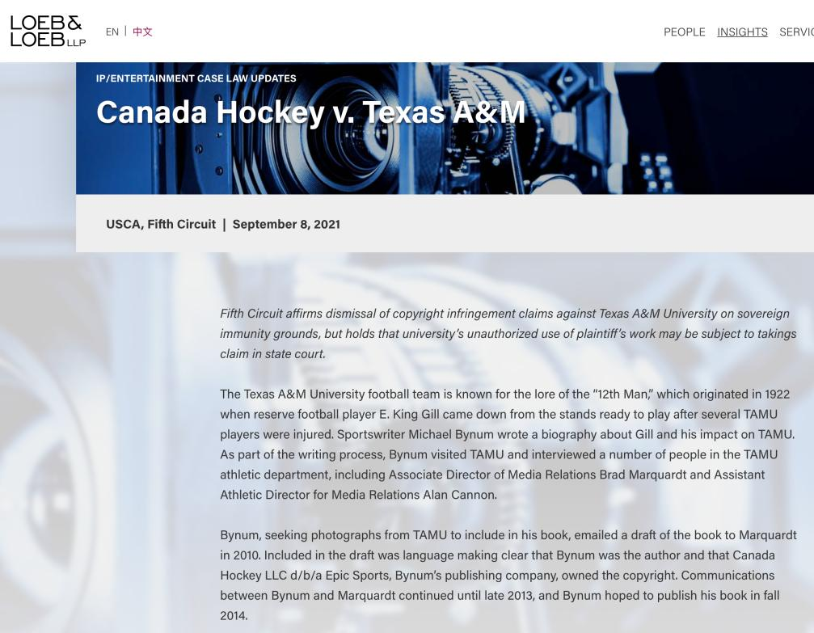

Slide 22
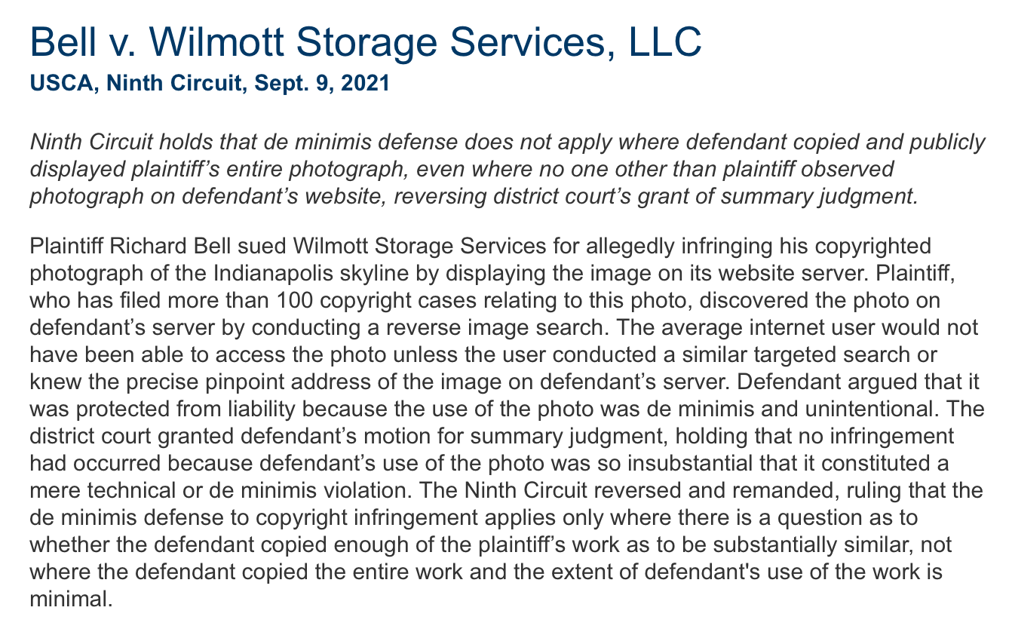

Slide 23
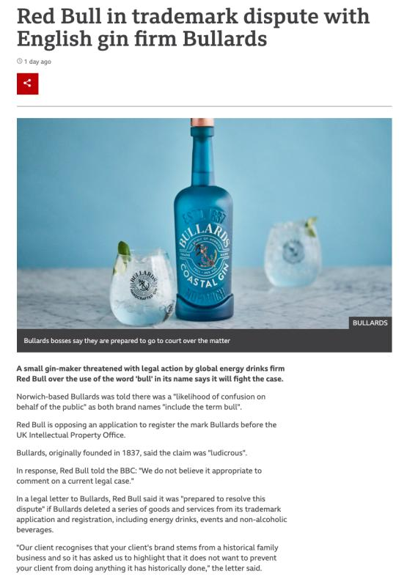

Slide 24

Pause

Slide 25
QUESTIONS?
THOUGHTS?
DISCUSSION?

Slide 26
Have you thought about? …

Slide 27


Slide 28
Pause

Slide 29
QUESTIONS?
THOUGHTS?
DISCUSSION?

Slide 30

Now, to our regularly
scheduled programming…

Slide 31
Outline of Class
1) Overview of copyright:
  A. Definition of copyright
  B. Purpose of copyright
  C. Origins of copyright
  D. Which level of government has legislative authority over copyright?

Slide 32
Outline
2) What is copyrightable?
  Subsistence of copyright in works
    Registration as a requirement for copyright protection?
    Fixation
    Originality
    Are facts and ideas protected?

Slide 33
Outline
  3) What does it mean to say that something is literary, artistic, dramatic, or musical?
  What should qualify as copyrightable “works”?

Slide 34
Outline
  “Works” in today’s class,
  “Rights” in future classes

Slide 35
Pause

Slide 36
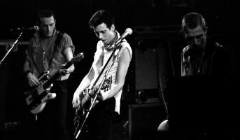
Overview of copyright
Definition of copyright:
  Set of exclusive rights in works of expression; performers’ performances; sound recordings; and communication signals.
The Clash, Chateau Neuf, Oslo, Norway
21 May 1980 Helge Øverås

Slide 37
Overview of copyright
Purpose of copyright:
  On what basis can copyright be justified?
    You have been asked by the leader of a newly independent country to advise her on whether her state should establish a copyright regime.
    On what basis might you justify the creation of such a system?

Slide 38
Overview of copyright
Justifications
Economic incentive for creation (then why does copyright continue after death)?
Societal “progress in the arts & sciences”
Natural rights to one’s own labour & personality (→ personality = privacy or IP)
Reinforces free expression?

Slide 39
Overview of copyright
Purpose of copyright
  Significant consequences flow from the adoption of one purpose of copyright or another, due to the prevailing approach to statutory interpretation in Canada (Driedger’s “modern approach”), under which provisions are interpreted purposively.

Slide 40
Please Self Identify
AUTHOR
or
CONNECTOR

Slide 41
Who is an AUTHOR?
“The creative is the place where no one else has ever been. You have to leave the city of your comfort and go into the wilderness of your intuition. What you’ll discover will be wonderful. What you’ll discover is yourself.”

Slide 42
Who is a CONNECTOR?
“Creativity is just connecting things. When you ask creative people how they did something, they feel a little guilty because they didn't really do it, they just saw something. It seemed obvious to them after a while. That's because they were able to connect experiences they've had and synthesize new things.”

Slide 43
Please Self Identify
AUTHOR
or
CONNECTOR

Slide 44

“Connecting”(remixing)
*“If you wish to make an apple pie from scratch, you must first invent the universe.” – Carl Sagan
* “Creativity is just connecting things. When you ask creative people how
they did something, they feel a little guilty because they didn't really do it, they
just saw something. It seemed obvious to them after a while. That's because
they were able to connect experiences they've had and synthesize new things.”
Steve Jobs in a Wired Magazine interview (Feb. 1996)
http://www.wired.com/wired/archive/4.02/jobs_pr.html
* “Creativity is contagious. Pass it on.” – Albert Einstein
* “All Creative Work is Derivative” – Nina Paley
http://blog.ninapaley.com/2010/02/09/all-creative-work-is-derivative/
* “The great driver of scientific and technological innovation [in the last 600 years has been] the increase in our ability to reach out and exchange ideas with other people, and to borrow other people’s hunches and combine them with our hunches and turn them into something new.” – Steven Johnson “Where Good Ideas Come From: The Natural History of Innovation”

Slide 45

The Romantic Author (The “Unique Gift”)
* “The creative is the place where no one else has ever been. You have to leave the city of your comfort and go into the wilderness of your intuition. What you’ll discover will be wonderful. What you’ll discover is yourself.”
* Personal creation mythology deeply rooted in our psyches’: “And G-d said: ‘Let us make man in our image, after our likeness;”(Genesis, Chap. 1 Verse 26)
* View of creativity as uniquely personal (or not) impacts beliefs about copyright & IP (e.g. film & music business – T.V. more flexible?) – consequences of “specialness”

Slide 46
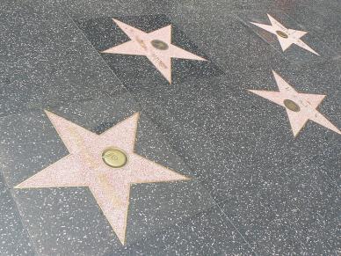
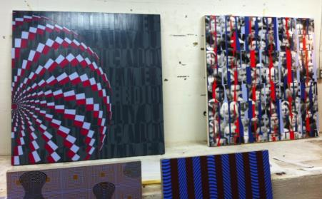
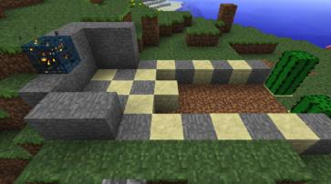
The Result?
* Role and consequences of IP law aligning along according to personal belief: Do Copyright literalists’ adopt “self” generated model of creativity? Do “Connection-ists” adopt open source model?
* the “Hollywood Model” v. the “Remix Model”

Slide 47
Know Your
Bias!

Slide 48
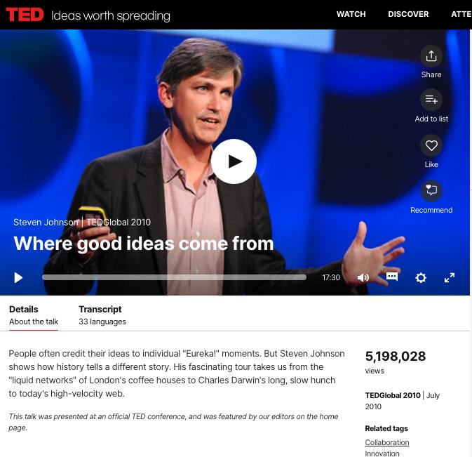
https://www.ted.com/talks/steven_johnson_where_good_ideas_come_from
Entirely optional

Slide 49
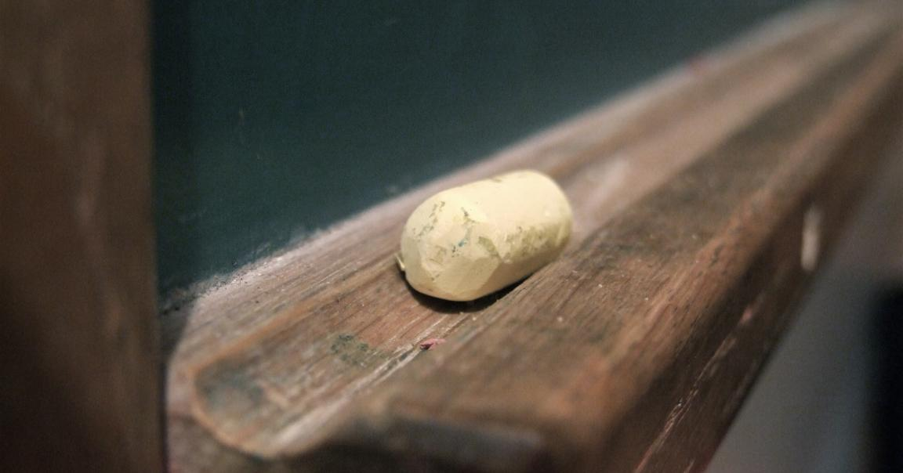
Education as remixing

Slide 50
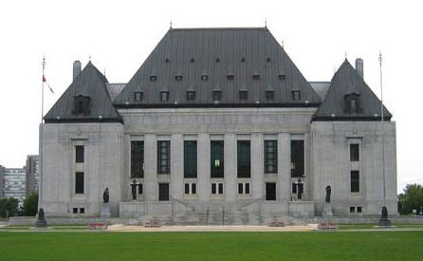
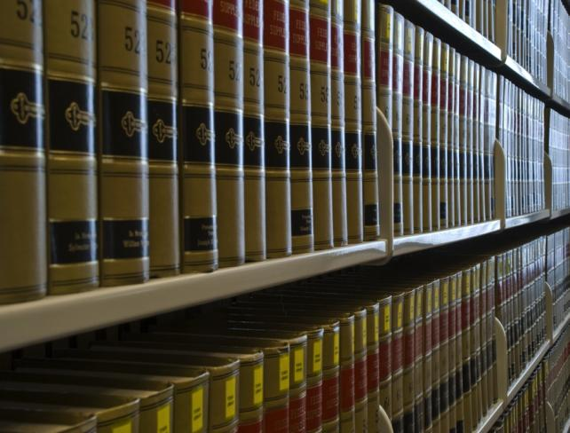
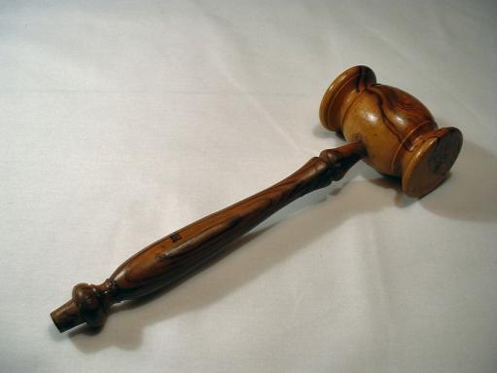
The Common Law as Remix

Slide 51
Pause

Slide 52
Origins of copyright
  Stationers Company…
  Statute of Anne (1709/10)
  Impact of French “droits d’auteur” system?
  Is Canadian copyright an amalgam of the UK and French approaches?

Slide 53
Overview of copyright (one perspective)
Origins of copyright:
  Stationers Company…
  Limited competition amongst themselves
  Received special privileges to “regulate and to censor works on the government’s behalf”.
  Negative reaction to this iron grip
  Statute of Anne (1709/10)

Slide 54
Overview of copyright
(another perspective)
STATUTE OF ANNE (1710)
AS FREE SPEECH

Slide 55
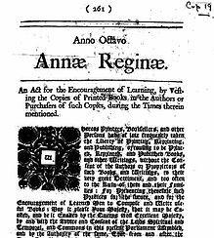
The Statute of Anne (1710) can be interpreted as the apotheosis in a trajectory of authorial freedom from censorship.

Slide 56
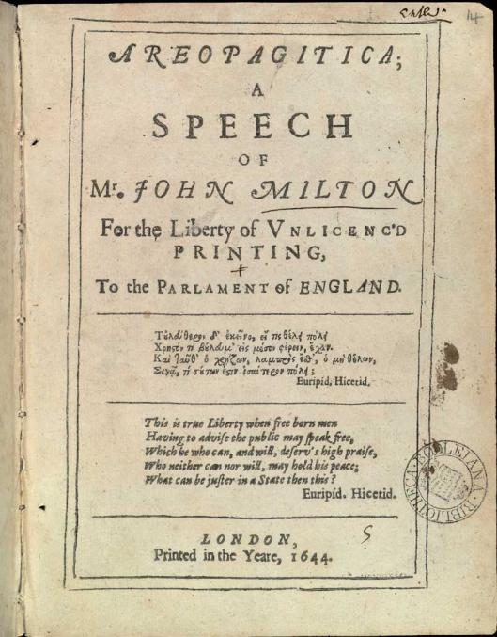

Slide 57
“For Books are not absolutely dead things, but doe contain a potencie of life in them to be as active as that soule was whose progeny they are; nay they do preserve as in a violl the purest efficacie and extraction of that living intellect that bred them…
And though all the windes of doctrin were let loose to play upon the earth, so Truth be in the field, we do injuriously, by licencing and prohibiting to misdoubt her strength. Let her and Falshood grapple; who ever knew Truth put to the wors, in a free and open encounter
Lords and Commons of England, consider what Nation it is whereof ye are, and whereof ye are the governours: a Nation not slow and dull, but of a quick, ingenious, and piercing spirit, acute to invent, suttle and sinewy to discours, not beneath the reach of any point the highest that human capacity can soar to.”

Slide 58
TRAJECTORY OF CREATIVE FREEDOMS
{KING..} Star Chamber (UK) abolished July 1641; {TO PARLIAMENT..} → Replacement of Royal censorship with Parliamentary censorship.
{TO REGULATOR..} “Licensing Order of 1643”: Parliament required authors to have a government license before a work could be published. Enforced by Stationers’ Company, a printers guild with the exclusive power to print literary works, and the responsibility to censor them, in return for monopoly on the printing trade.
{TO EXCLUSIVE GUILD..} “Licensing of the Press Act 1662” - "An Act for preventing the frequent Abuses in printing seditious treasonable and unlicensed Bookes and Pamphlets and for regulating of Printing and Printing Presses.”
{TO PUBLISHERS/AUTHORS..} “The Statute of Anne” 1710 moved control to publishers/authors…

Slide 59

Meanwhile in France
System was based on “les droits d’auteur” to protect the integrity of the authors work and personality, as well to reward the author for their labour
Antecedent of “droits moraux” (moral rights) as recognized by Canada.

Slide 60
Pause

Slide 61
Purpose of copyright in Canada?
Théberge:
  “[12] Generally speaking, Canadian copyright law has traditionally been more concerned with economic than moral rights.… The economic rights are based on a conception of artistic and literary works essentially as articles of commerce.” (Binnie J.)
But Cinar Corp. v. Robinson?
  [114] … the infringement of copyright in this case interfered with Robinson’s personal rights to inviolability and to dignity, recognized by ss. 1 and 4 of the [Quebec] Charter. (McLachlin CJ)

Slide 62
Overview of copyright
Purpose of copyright as articulated by the SCC
  Former approach: “author-centric”
  Shift in Théberge
    “balance between promoting the public interest in the encouragement and dissemination of works of the arts and intellect and obtaining a just reward for the creator“ (para. 30)
  Refined in Cinar Corporation v. Robinson, 2013 SCC 73
    Copyright Act “seeks to ensure that an author will reap the benefits of his efforts, in order to incentivize the creation of new works” (para. 23)

Slide 63
Overview of copyright
Théberge v. Galerie d’Art du Petit Champlain Inc. (2002)
  Whether transferring the work from paper to canvas violated the Copyright Act by creating an unauthorized reproduction? 4/7 SCC found there was no copy made, only ink had been transferred. Moral rights claim could have been made to prevent but not for economic compensation
Cinar Corporation v. Robinson, 2013
  In 1982, Robinson drew sketches of the characters for a proposed children's television series to be called The Adventures of Robinson Curiosity. Presented to Cinar and others unsuccessfully. In 1994 the first episode of Robinson Sucroe was broadcast in Quebec.

Slide 64
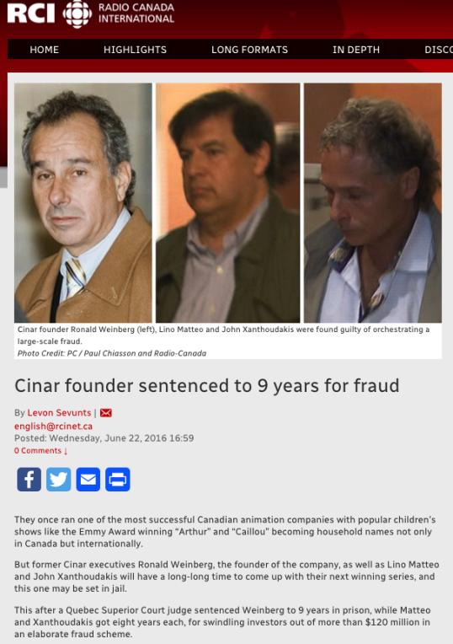

Slide 65
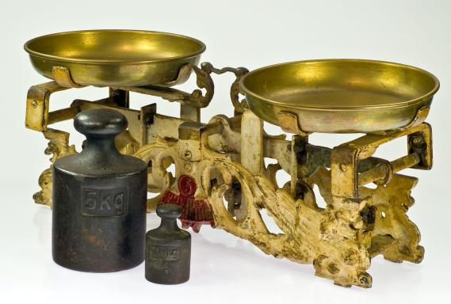
Théberge promotes “balance” between the public interest in connecting & just reward for the author

Slide 66
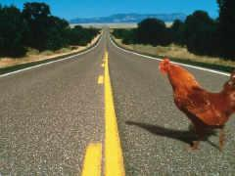
Why did the Canadian chicken cross the road?

Slide 67
Pause

Slide 68
Overview of copyright
Legislative authority over copyright in Canada
  Federal Government (s. 91(23) Constitution Act, 1867)
  First Copyright Act (1921, Came Into Force 1924) largely a copy of the UK Copyright Act of 1911
  Modernization of Canadian copyright law: a work constantly in progress
  Bill C-11: Copyright Modernization Act (CIF 2012)
  Relatively recent copyright extension for sound recordings

Slide 69
Copyright is Federal
91. It shall be lawful for the Queen, by and with the Advice and Consent of the Senate and House of Commons, to make Laws for the Peace, Order, and good Government of Canada, in relation to all Matters not coming within the Classes of Subjects by this Act assigned exclusively to the Legislatures of the Provinces; and for greater Certainty, but not so as to restrict the Generality of the foregoing Terms of this Section, it is hereby declared that (notwithstanding anything in this Act) the exclusive Legislative Authority of the Parliament of Canada extends to all Matters coming within the Classes of Subjects next hereinafter enumerated; that is to say,…
22. Patents of Invention and Discovery.
23. Copyrights

Slide 70
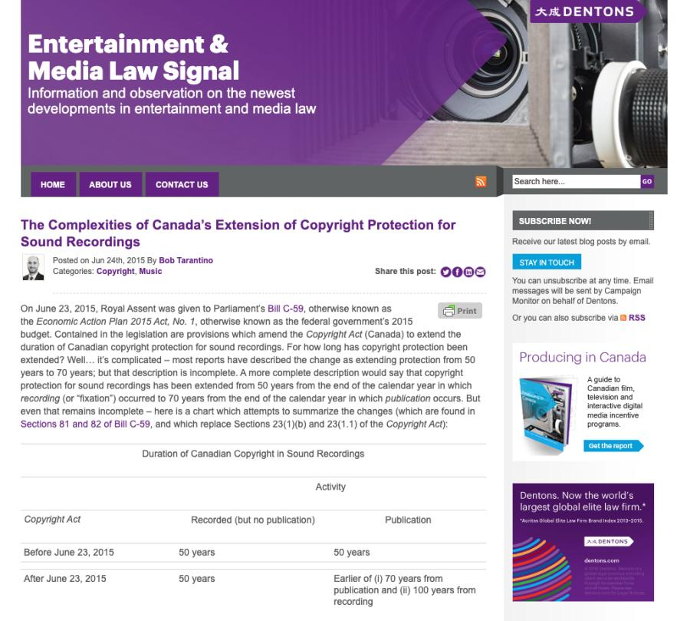

Slide 71
Overview of copyright
Legislative authority over copyright in Canada
  No common law copyright in Canada
  Théberge:
    [5] Copyright in [Canada] is a creature of statute and the rights and remedies it provides are exhaustive.
    Also see s. 89, Copyright Act: “No person is entitled to copyright otherwise than under and in accordance with this Act…”
  Relevant statute: Copyright Act, RSC 1985, c. C-42 as amended.

Slide 72
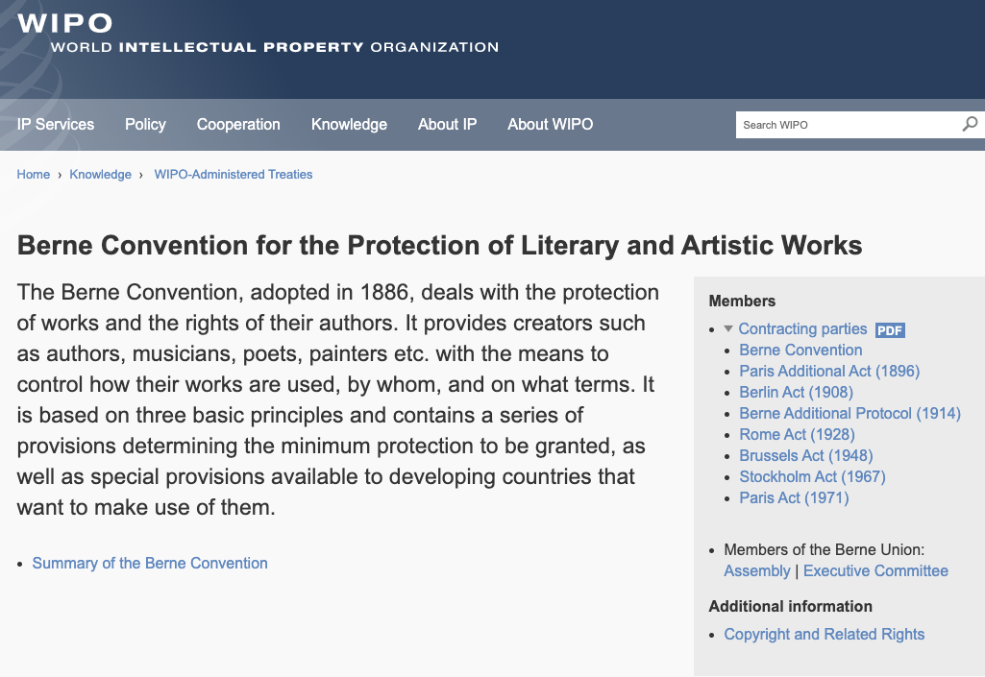
Role of International Treaties:

Slide 73
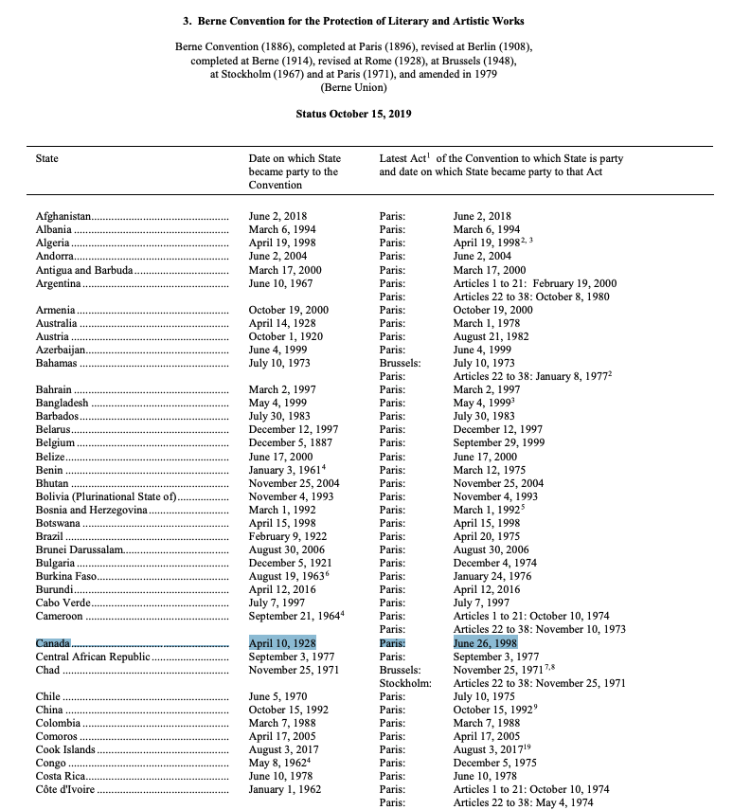
168 parties to Berne; 161 members of WTO

Slide 74
Pause

Slide 75
What is copyrightable?
©

Slide 76
What is copyrightable
Subsistence of copyright
5. (1) Subject to this Act, copyright shall subsist in Canada, for the term hereinafter mentioned, in every original literary, dramatic, musical and artistic work if any one of the following conditions is met:
  (a) in the case of any work, whether published or unpublished, including a cinematographic work, the author was, at the date of the making of the work, a citizen or subject of, or a person ordinarily resident in, a treaty country;

Slide 77
What is copyrightable
Registration
  Not a condition for the subsistence of copyright
  Should it be?
  Possible to register your copyright (benefits to be discussed later in the term)

Slide 78
What is copyrightable
Fixation
A requirement for the subsistence of copyright imposed by judicial interpretation
  “The work, to be capable of copyright protection, must be fixed in a tangible form” (Canadian Admiral Corp. v. Rediffusion Inc., [1954] Ex. CR 382, 20 CPR 75
Is the fixation requirement beneficial?
Does add some certainty + more works in public domain

Slide 79
Result of Fixation Requirement
Improvisational, performance art, kinetic pieces, open world massively multiplayer video game scenarios, are more at risk of not having copyright protection. See for example Komesaroff v. Mickle, [1988] R.P.C. 204 at 210 (Vict. S.C.), refusing protection to a moving sand sculpture.
Content in RAM computer memory?
Indigenous oral story-telling

Slide 80
What is copyrightable (Fixation)
Gould Estate et al v. Stoddart Publishing Co. Ltd et al (1996)
  Can copyright subsist in spoken words?
    No – not every utterance made by individuals is a “valuable property right”
  A person’s oral statements are not literary creations and do not attract copyright protection

Slide 81
What is copyrightable (Fixation)
Accordingly, oral statements, speeches (as such), interviews, or conversations are not literary creations (without fixation) and are not protected by copyright
Your notes are much more likely to be protected than my semi-improvised ramblings. Slides protected. Video “lecture capture” is protected (whose copyright?). See Walter v Lane [1900] AC 539

Slide 82
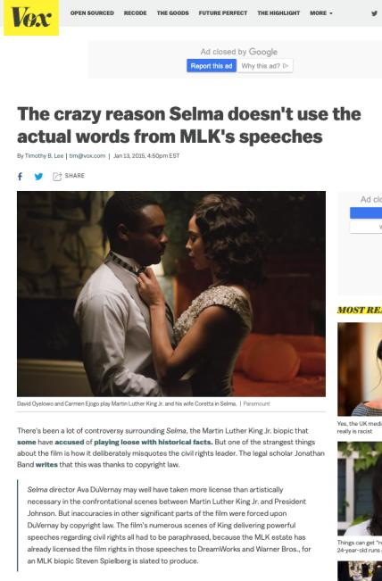
???????????????????????????

Slide 83
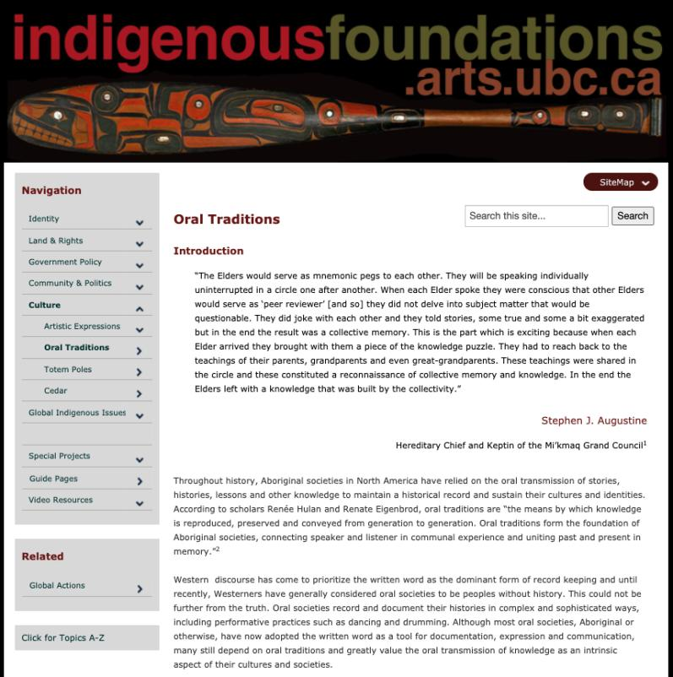

Slide 84
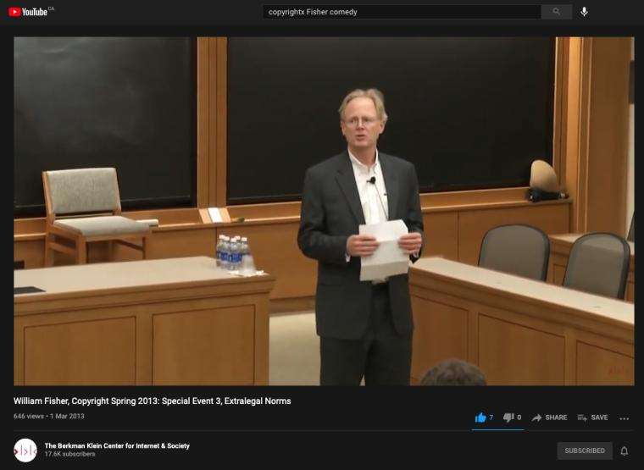
Re: Comedy & Copyright
https://youtu.be/8U7bUo1vChs
Entirely optional

Slide 85
Pause

Slide 86
What is copyrightable: Originality
5. (1) Subject to this Act, copyright shall subsist in Canada, for the term hereinafter mentioned, in every original literary, dramatic, musical and artistic work if…

Slide 87
What is copyrightable
Originality
  If copyright subsists “in every original… work”…
  How should originality be defined?

Slide 88
What is copyrightable
Originality in Canada
Pre-2004
  “Sweat of the brow”:
    Work receives copyright protection if it originates from an author and is more than a mere copy.
  “Creativity”
    A work must be the product of creativity in order to be original

Slide 89
SCC takes the “middle way”

Slide 90
What is copyrightable
Originality
CCH Canadian Ltd. v. Law Society of Upper Canada, 2004 SCC 13
  For a work to be original, you need an exercise of skill and judgment that is more than a purely mechanical exercise
  Skill = use of one’s knowledge, developed aptitude or practiced ability in producing the work
  Judgment = use of one’s capacity for discernment or ability to form an opinion or evaluation by comparing different possible options in producing the work

Slide 91
McLachlin C.J.
[16] ”I conclude that the correct position falls between these extremes. For a work to be “original” within the meaning of the Copyright Act , it must be more than a mere copy of another work. At the same time, it need not be creative, in the sense of being novel or unique. What is required to attract copyright protection in the expression of an idea is an exercise of skill and judgment. By skill, I mean the use of one’s knowledge, developed aptitude or practised ability in producing the work. By judgment, I mean the use of one’s capacity for discernment or ability to form an opinion or evaluation by comparing different possible options in producing the work. This exercise of skill and judgment will necessarily involve intellectual effort. The exercise of skill and judgment required to produce the work must not be so trivial that it could be characterized as a purely mechanical exercise. For example, any skill and judgment that might be involved in simply changing the font of a work to produce “another” work would be too trivial to merit copyright protection as an “original” work.”

Slide 92
What is copyrightable
Originality
  McLachlin CJ arrived at her conclusion after considering:
    Plain meaning of original
    History of copyright
    Recent jurisprudence
    Purpose of the Copyright Act
    Workable, yet fair standard

Slide 93
Meaning that…
Headnotes, case summaries, topical indexes & compilations of reported judicial decisions originating from their authors and are not simply copies. There is more than trivial skill & judgment in their creation (as every law student knows)
However, reported judicial decisions, by themselves, are not original works in which the publishers could claim copyright, even where typos and minor errors are fixed.

Slide 94
What is copyrightable
What about A.I. mediated creativity ?

Slide 95
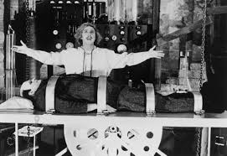
Must copyright be human?

Slide 96
Can an A.I. pass the “McLachlin Test”?
Can an A.I. exercise “skill and judgment”?
Perhaps yes, if test is “ability to form an evaluation by comparing different possible options”…
But does this skill and judgment “necessarily involve intellectual effort”?
And more weirdly is what an A.I. does “so trivial that it could be characterized as a purely mechanical exercise”?

Slide 97
Pause

Slide 98
Facts & Ideas are not copyrightable
IDEA/EPRESSION
DICHOTOMY

Slide 99
What is copyrightable
Facts and ideas
  Not entitled to copyright protection
  Kenrick & Co. v. Lawrence & Co. (1890)
    How is idea separated from expression in this decision?

Slide 100
What is copyrightable
Plaintiff printers drew a representation of hand holding a pencil completing a cross in a box as a method to instruct voters who couldn’t read on how to exercise their democratic franchise.
Plaintiffs duly registered their drawing under the copyright laws of the time.
Defendants created a similar but not identical drawing for the same purpose and were sued by the plaintiffs for infringement.
The plaintiffs action failed.

Slide 101
“It seems to me, therefore, that although every drawing of whatever kind may be entitled to registration, the degree and kind of protection given must vary greatly with the character of the drawing, and that with such a drawing as we are dealing with the copyright must be confined to that which is special to the individual drawing over and above the idea...there are scarcely more ways that one of drawing a pencil or the hand that holds it. If the particular arrangement of square, cross, hand, or pencil be relied upon it is nothing more than a claim of copyright for the subject, which in my opinion cannot possibly be supported.”

Slide 102
IDEA/EPRESSION
DICHOTOMY
Donoghue v. Allied Newspapers Limited (1938) Ch 106
Copyright owner is…"the person who has clothed the idea in form, whether by means of a picture, a play or a book"

Slide 103
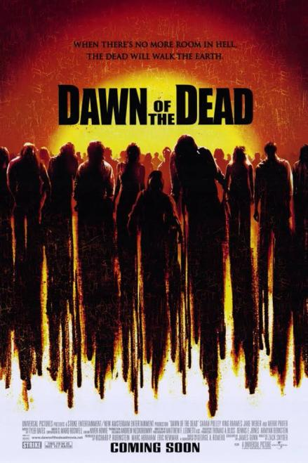
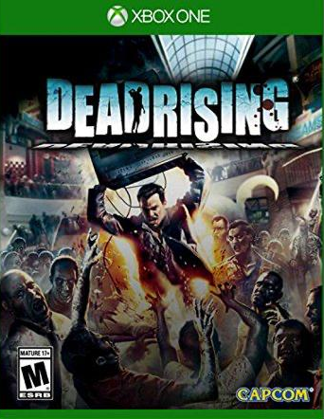
Footnote: Scenes a faire doctrine

Slide 104
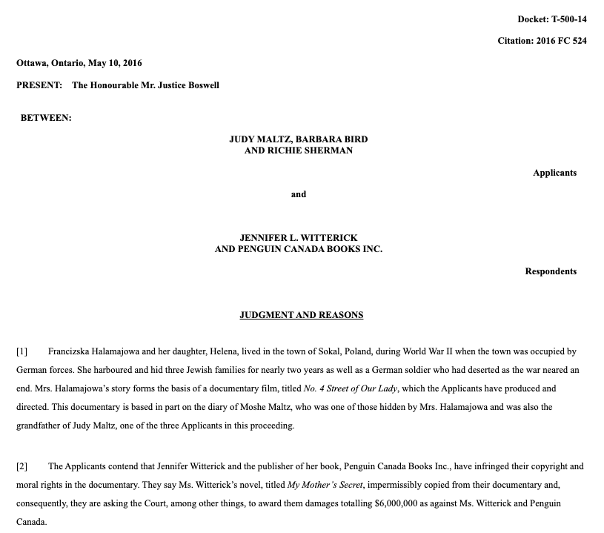
Footnote: No Copyright in Facts

Slide 105
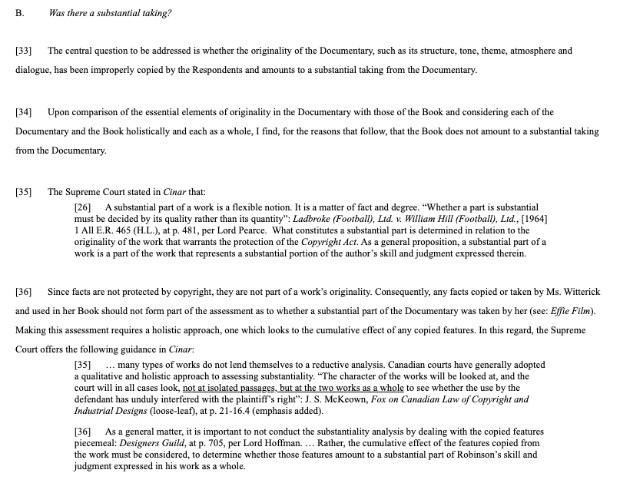

Slide 106
“[47] Although the Documentary and the Book each recount some of the same facts of Francizska Halamajowa’s story, there is no substantial taking or use by the Respondents of anything owned by the Applicants because the use of common historical facts is not copyright infringement. The Respondents have not appropriated or taken a substantial portion of the Documentary’s originality. It is difficult to identify a single element taken that is not either something generic or merely a fact.”

Slide 107
Pause

Slide 108
Continuing: What is copyrightable
  What does it mean to say that something is literary, artistic, dramatic, or musical → S.3(1)(e)?
  What should qualify as copyrightable “works”?

Slide 109
What is copyrightable: Artistic Works
5. (1) Subject to this Act, copyright shall subsist in Canada, for the term hereinafter mentioned, in every original literary, dramatic, musical and artistic work if…

Slide 110
S. 2 Definitions
literary work includes tables, computer programs, and compilations of literary works; (oeuvre littéraire)
dramatic work includes
(a) any piece for recitation, choreographic work or mime, the scenic arrangement or acting form of which is fixed in writing or otherwise,
(b) any cinematographic work, and
(c) any compilation of dramatic works; (oeuvre dramatique)
musical work means any work of music or musical composition, with or without words, and includes any compilation thereof; (oeuvre musicale)
artistic work includes paintings, drawings, maps, charts, plans, photographs, engravings, sculptures, works of artistic craftsmanship, architectural works, and compilations of artistic works; (oeuvre artistique)

Slide 111

What is copyrightable
How might “literary work” be defined?

Slide 112
What is copyrightable
  University of London Press, Ltd. v. University Tutorial Press, Ltd. [1916] 2 Ch. 601
  Literary merit and quality are not factors when assessing if something is a literary work

Slide 113
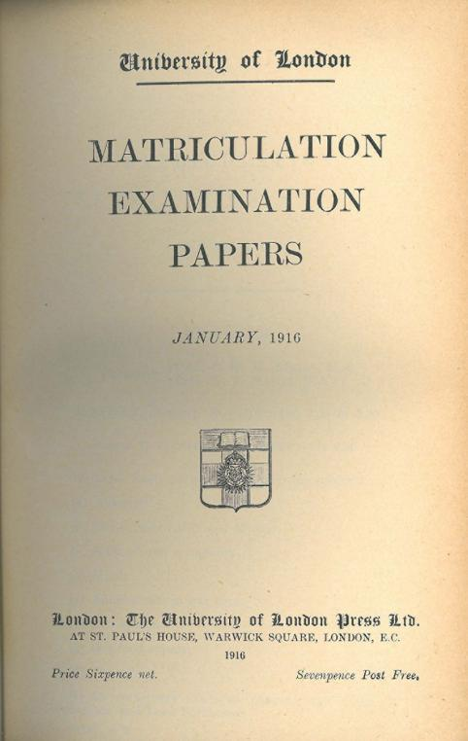
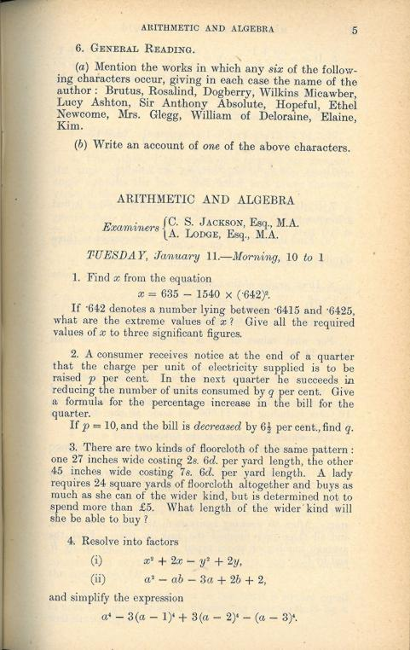

Slide 114
Peterson J. “Assuming that they are ``literary work'’, the question then is whether they are original…Copyright Acts are not concerned with the originality of ideas, but with the expression of thought, and, in the case of ``literary work'’, with the expression of thought in print or writing…In the present case it was not suggested that any of the papers were copied… If an author, for purposes of copyright, must not draw on the stock of knowledge which is common to himself and others who are students of the same branch of learning, only those historians who discovered fresh historical facts could acquire copyright for their works…The objections with which I have dealt do not appear to me to have any substance, and, after all, there remains the rough practical test that what is worth copying is prima facie worth protecting. In my judgment, then, the papers set by Professor Lodge and Mr. Jackson are "original literary work" and proper subject for copyright under the Act of 1911.”

Slide 115

What is copyrightable
  Exxon Corp v. Exxon Insurance Consultants International Ltd., [1981] 3 All E.R. 241 (Ch.D)
  Some expression is not eligible for copyright protection because it is too minimal to satisfy the requirements of an “original literary work” under s. 2.
What about Twitter messages

Slide 116
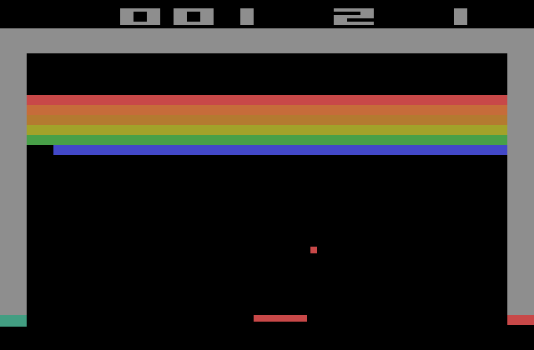
BREAKOUT
Issue: The “creativity standard” in copyright.

Slide 117
Atari v. Oman - 1989/1992 USCA DC Cir.
“BREAKOUT's audiovisual display features a wall formed by red, amber, green, and blue layers of rectangles representing bricks. A player maneuvers a control knob that causes a rectangular-shaped representation of a paddle to hit a square-shaped representation of a ball against the brick wall. When the ball hits a brick, that brick disappears from its row, the player scores points, and a brick on a higher row becomes exposed. A "breakout" occurs when the ball penetrates through all rows of bricks and moves into the space between the wall and the top of the screen; the ball then ricochets in a zig-zag pattern off the sides of the screen and the top layer of the wall, removing bricks upon contact and adding more points to the player's score. Various tones sound as the ball touches different objects or places on the screen. The size of the paddle diminishes and the motion of the ball accelerates as the game is played.”
District court judge asked counsel for the Register, "If Picasso had painted a round object on a canvas, would you say because it depicts a familiar subject--namely, something that's round--it can't be copyrighted?”
Atari Games Corp. v. Oman, 979 F. 2d 242 - 1992 - ‎Court of Appeals, Dist. of Columbia Circuit
Atari Games Corp. v. Oman, 888 F. 2d 878 - 1989 - ‎Court of Appeals, Dist. of Columbia Circuit
Atari Games Corp. v. Oman, 693 F. Supp. 1204 - 1988 - ‎Dist. Court, Dist. of Columbia

Slide 118
Pause

Slide 119
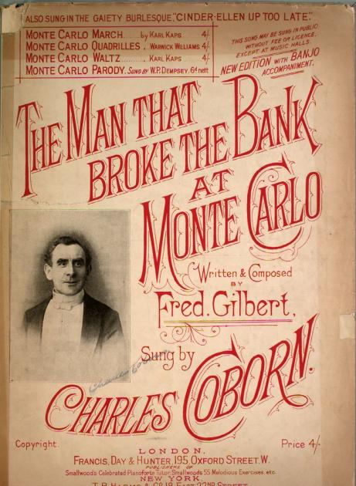
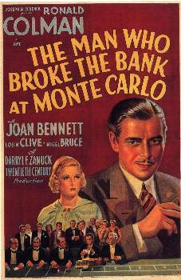
What is copyrightable

Slide 120
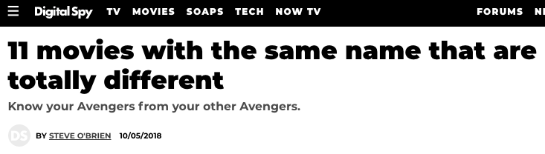
What is copyrightable
Francis Day and Hunter v. 20th Century Fox Corp, Ltd.
  Generally, there is no separate copyright in the title of a work

Slide 121
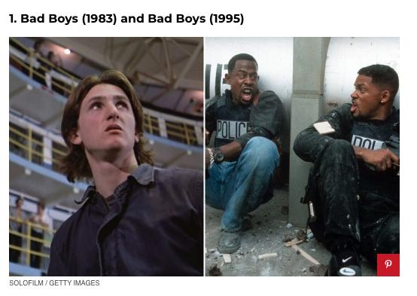

Slide 122
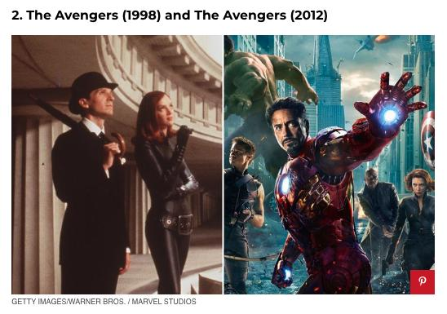

Slide 123
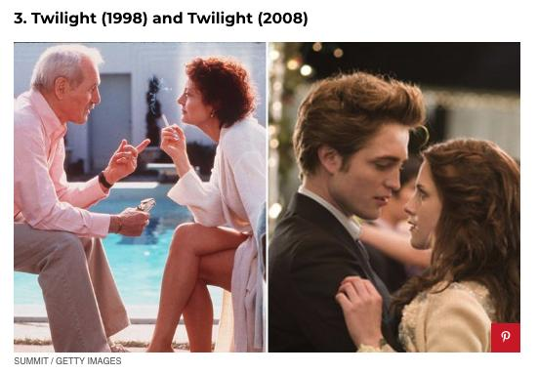

Slide 124
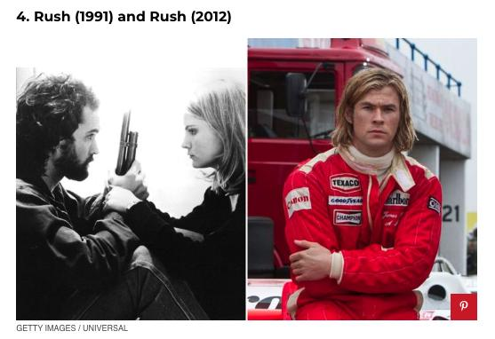

Slide 125
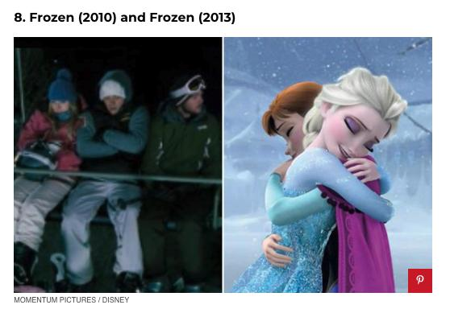

Slide 126
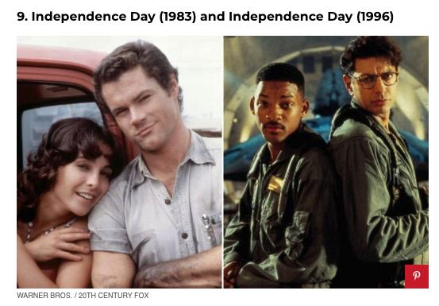

Slide 127
What is copyrightable
Francis Day and Hunter v. 20th Century Fox Corp, Ltd.
  NOTE: definition of a “work” in the Copyright Act - includes “the title thereof when such title is original and distinctive”

Slide 128

Note also Trademark alternative

Slide 129
Pause

Slide 130
What is copyrightable: Dramatic Work
5. (1) Subject to this Act, copyright shall subsist in Canada, for the term hereinafter mentioned, in every original literary, dramatic, musical and artistic work if…

Slide 131
What is copyrightable
Dramatic work
  Must have a story, a thread of consecutively based events either narrated or presented by dialogue or action or both (Hutton v. CBC (1989))
  Or (based on s. 2):
    Choreography, mime and recitation piece with scenic arrangement or acting form fixed in writing or otherwise
    Cinematographic work
    Compilation of dramatic works

Slide 132
1994 (5 years after Hutton v. CBC)
Copyright Act was amended to provide:
  "dramatic work" includes
    (a) any piece for recitation, choreographic work or mime, the scenic arrangement or acting form of which is fixed in writing or otherwise,
    (b) any cinematographic work, and
    (c) any compilation of dramatic works;
[Cinematographic work – defined as “includ[ing] any work expressed by any process analogous to cinematography (motion-picture photography – tv, video, film, etc.), whether or not accompanied by a soundtrack” ]
[Choreographic work –defined as “includ[ing] any work of choreography, whether or not it has any story line;]

Slide 133
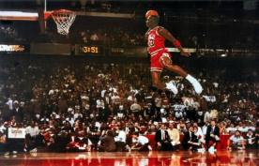
What is copyrightable
FWS Joint Sports Claimants v. Canada 1991 FCA (CB)
No copyright in a sporting event though television production of a sporting event is
Unpredictable and incompatible with the notion of a choreographic piece of art?

Slide 134

What is copyrightable
National Basketball Association v. Motorola, Inc., 105 F 3d. 841 (2nd Cir. 1997)
  You can’t have copyright in specific athletic feats
  Not in scores either

Slide 135

Found no Copyright in…

Slide 136
WINTER, Circuit Judge: “What "authorship" there is in a sports event, moreover, must be open to copying by competitors if fans are to be attracted. If the inventor of the T-formation in football had been able to copyright it, the sport might have come to an end instead of prospering. Even where athletic preparation most resembles authorship--figure skating, gymnastics, and, some would uncharitably say, professional wrestling--a performer who conceives and executes a particularly graceful and difficult--or, in the case of wrestling, seemingly painful--acrobatic feat cannot copyright it without impairing the underlying competition in the future. A claim of being the only athlete to perform a feat doesn't mean much if no one else is allowed to try.”

Slide 137
What is copyrightable
Artistic works
  How should artistic be defined?
  Should artistic merit, the artist’s intention to create “art”, and the aesthetic value of the work be relevant to whether something meets the classification of artistic works?

Slide 138
What is copyrightable
Artistic works
  “artistic work” defined in s. 2 as including:
    paintings, drawings, maps, charts, plans, photographs, engravings, sculptures, works of artistic craftsmanship, architectural works, and compilations of artistic works.

Slide 139

What is copyrightable
Medium is the message,
not aesthetic value?

Slide 140

The Dream, Pablo Picasso, 1932

Slide 141
What is copyrightable
Artistic works
DRG Inc. v. Datfile Ltd. [1988] 2 F.C. 243
  Two series of colour coded labels were registered under the Copyright Act. It was unsuccessfully argued that the registrations were not properly the subject of copyright.
  Court found that an artistic work is a work that finds expression in a visual medium.
  Artistic merit, artist’s intention to create “art” and the actual aesthetic value of the work are not pertinent to the question of whether a work meets the classification of “artistic work”

Slide 142
Reed J.: [15] “Even if works of craftsmanship and architecture must be measured against some test of “artistic”-ness (as set out in the Hensher, Merlet or Hay cases) I do not accept that the category of artistic works in general must meet such a test. I do not accept that the word “artistic” in reference to “artistic works” is being used in the same sense as the word “artistic” in reference to “works of artistic craftsmanship”, that is, if in the latter case “artistic”-ness requires a determination along the lines of that attempted in Hensher, Merlet or Hay. In my view the phrase “artistic work” is used merely as a generic description of the type of works which follow. It is used as a general description of works which find expression in a visual medium as opposed to works of literary, musical or dramatic expression.”

Slide 143
What is copyrightable
Are raw and processed seismic data original artistic and literary works?
  See Geophysical Service Incorporated v. Encana Corporation, 2016 ABQB 230
    Eidsvik J. stated that “the raw seismic field data and written reports are a literary work or a compilation of a literary work” (para. 75) and that “the seismic sections…fit within the definition of an artistic work” (para 76).

Slide 144
What is copyrightable
Musical works
  Any work of music or musical composition, with or without words (s. 2 CA)
  Prior to 1993, a musical work had to be “printed, reduced to writing or otherwise graphically produced or reproduced” in order to be protected.

Slide 145

SSRN

Slide 146


Slide 147

What is copyrightable
Is a fireworks display a dramatic work?

Slide 148
What is copyrightable
Is John Cage’s 4’33” a musical work?
  https://youtu.be/JTEFKFiXSx4

Slide 149


Slide 150
What is copyrightable?
Should additional categories of works be added to the Copyright Act? If so, what categories of works would you add, and why?
Should the concept of categories of works be discarded entirely? Why or why not?
Should “intentionality” (that you intend your work to be copyright) be added to the copyright act?

Slide 151
QUESTIONS?
THOUGHTS?
DISCUSSION?

Slide 152
Pause

Slide 153

Coming Soon
“Rights of Copyright Owners”
What rights should be part of the bundle of rights of copyright owners?

Slide 154
SEE YOU NEXT WEEK!

Slide 155

Always include a cat picture

Slide 156
In learning you will teach
And in teaching you will learn
Phil Collins' Son of Man (1999)

Slide 157
Our Academic Partners

