Slide 1


Intellectual Property Law:
Introducing the Course
Week 1
LAW 422 001
Intellectual Property Law
Allard School of Law, UBC
Fall, 2021
Jon Festinger Q.C.
Centre for Digital Media
QMUL School of Law (CCLS)
Whiteboard Law
http://commlaw.allard.ubc
@jonfestinger
jon_festinger@thecdm.ca

Slide 2
Today’s Plan
1. Introductions (instructor and class)
2. Syllabus
3. Introduction of course material
4. Exercise

Slide 3
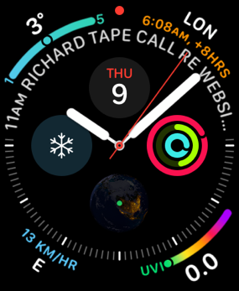
No, we will not spend the whole three hours…
Maybe an hour and a half...

Slide 4
Copyright
Trademark
Patents

Slide 5
Each with different (sometimes very different) public interest aspects

Slide 6
Intellectual Property Law is about:
What kinds of creations of the mind can one have rights in?
Who can have those rights?
What kinds of rights are there; and how are those rights enforced?

Slide 7
A.I.

Slide 8

When everything is digitally saved…

Slide 9
Once a niche area, not anymore…

Slide 10
Logistics

Slide 11
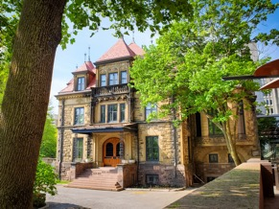



Me (IP history?)

Slide 12


Slide 13
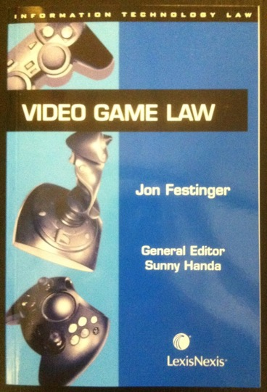

Slide 14


Slide 15


Slide 16
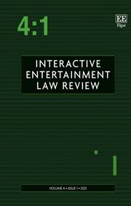

Slide 17
Favorite Intellectual Property
(current or all-time)?

Slide 18


Slide 20


Slide 21


Slide 22
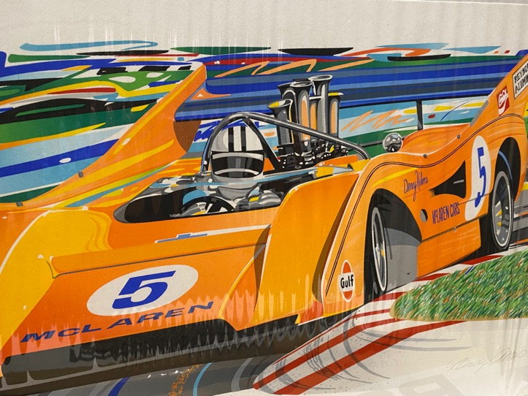

Slide 24


Slide 25
Now
You

Slide 26
Entirely optional but please…
…email me a short bio of yourself referencing:
Anything at all you want to say about yourself
Your academic interests
What you might like to get out of this course (I.E., interest in a type of patent, or a copyright issue etc.)
Favorite Intellectual Property (ies) - current or all-time

Slide 27
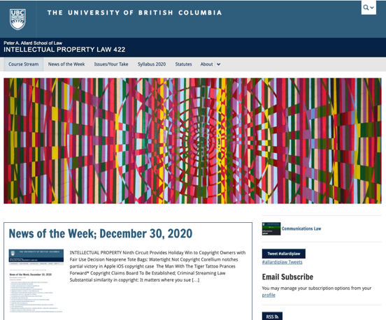
Course Website
https://iplaw.allard.ubc.ca/

Slide 28
PLEASE
SIGN UP

Slide 29
For full privileges on the website
1. Please create an account at http://cms.ubc.ca/ using your CWL.
2. Once you create an account and sign in at http://cms.ubc.ca/ you can click your name in the top right. Halfway down the following page will be your WordPress email address.
3. Send me your WordPress email address at jon.festinger@ubc.ca or at jon_festinger@thecdm.ca
4. Then, I will invite you to participate with authoring privileges via your WordPress email address.

Slide 30

Why post?
Engaging and engaging others is the key.
Because you don’t love speaking up in class.
Because you just saw or realized something, and you’ll never remember it unless you post it now.
# AllardIPLaw

Slide 31
Tips:
Don’t feel your posts have to be perfect. Engaging and engaging others is the key.

Slide 32

Anything & everything can be done via email if you prefer

Slide 33
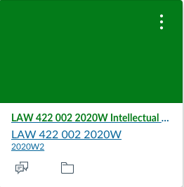
UBC Canvas??????????

Slide 34
News of
the Week

Slide 35
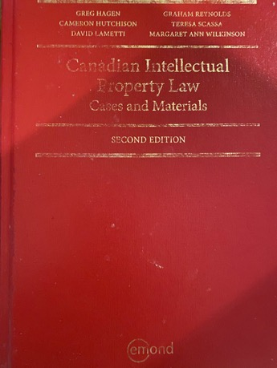
Text

Slide 36
Features of this Course
70% Exam not 100%
IP Law “In Context”
Website usage
Technology?

Slide 37
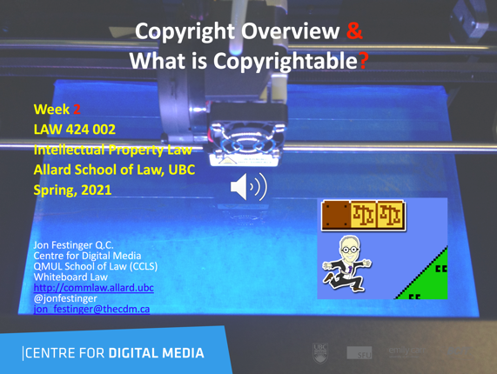

(not so) SECRET SOURCE

Slide 38
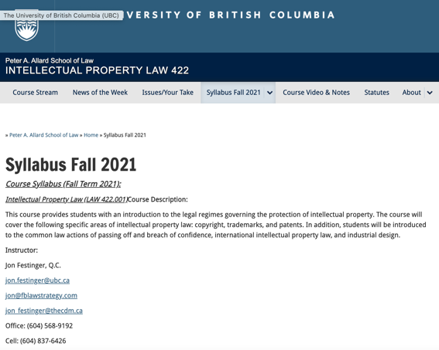
Syllabus: The Same But…

Slide 39
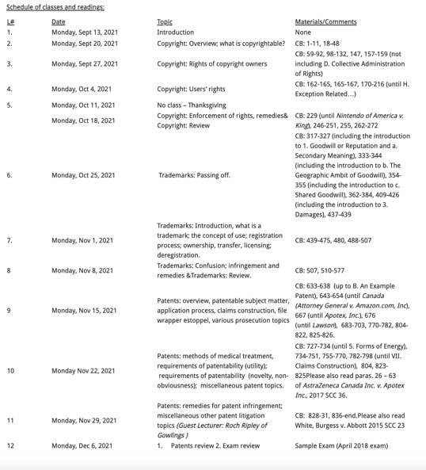

Slide 40

Office “Hours”: Ideally Fridays before or after class but am flexible…
Email me : jon.festinger@ubc.ca
Skype: jon.festinger
Phone:
o. 604-568-9192
c. 604-837-6426

Slide 41

Pause

Slide 42
QUESTIONS?
THOUGHTS?
DISCUSSION?

Slide 43
Evaluation
(LLMCL students?)

Slide 44
Let’s talk about…
The 30%

Slide 45
A modest proposal…
500-1000 words (or equivalent) per person
written, video, podcast, in-class presentation (?), interpretive dance
Website or not
Groups or individually

Slide 46
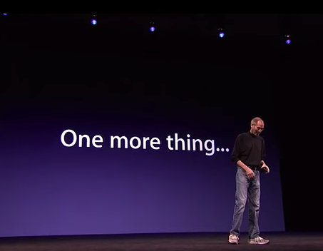


Slide 47
Reflecting on earlier slide…
Intellectual Property Law is about:
What kinds of creations of the mind can one have rights in?
Who can have those rights?
What kinds of rights are there; and how are those rights enforced?
Any IP issues/conundrums
you are curious about?…

Slide 48
INTELLECTUAL PROPERTY?

Slide 49
For next week…

Slide 50


Slide 51
QUESTIONS?
THOUGHTS?
DISCUSSION?

Slide 52
Pause

Slide 53
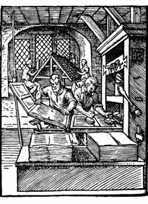
Coming Soon
“Copyright Law”

Slide 54
SEE YOU NEXT WEEK!

Slide 55

Always include a cat picture

Slide 56
In learning you will teach
And in teaching you will learn
Phil Collins' Son of Man (1999)

Slide 57
Our Academic Partners

