Slide 1
Fluid trademarks
Law 422 - Intellectual Property
Ashley Wang

Slide 2
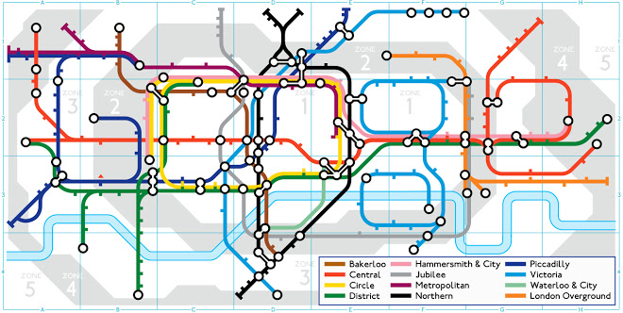
Pi day
150 Anniversary of the London Tube
Sculptor Alexander Calder’s birthday
Trademarks that CHANGE over time

Slide 3
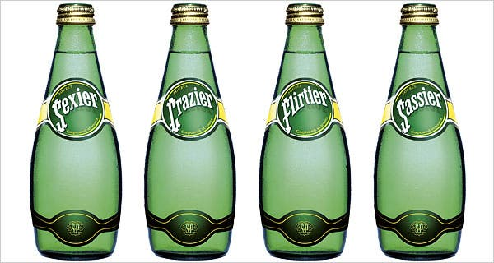
Trademarks that CHANGE over time

Slide 4
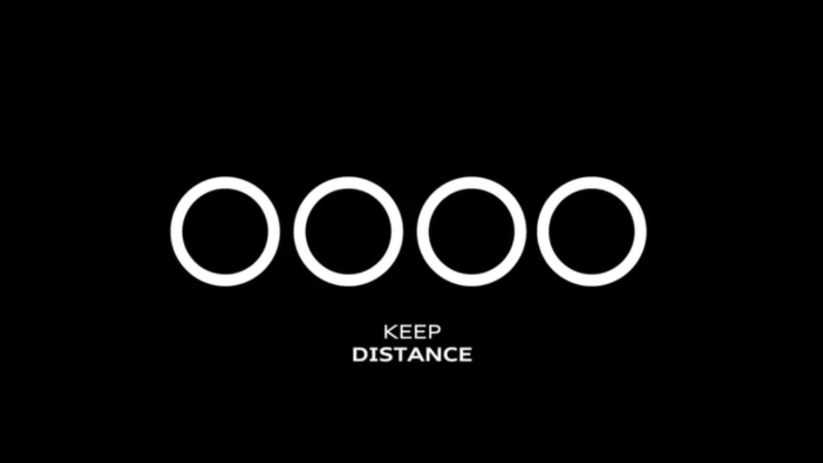
Trademarks that CHANGE over time

Slide 5
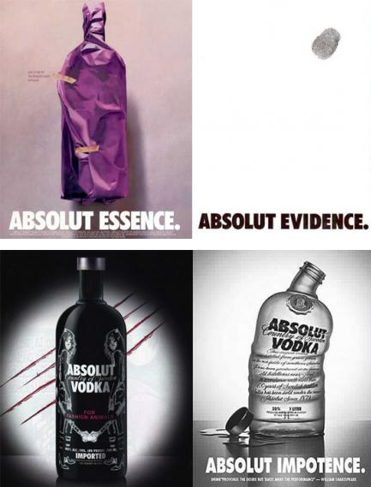
The Law
No method for trademark registration
Register the fluid mark as a whole
Register the fluid marks individually

Slide 6
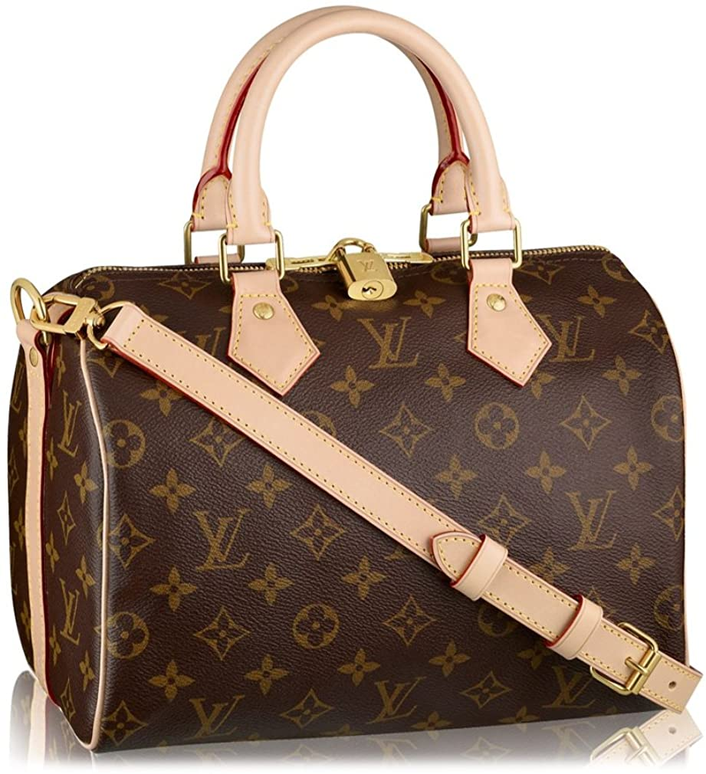
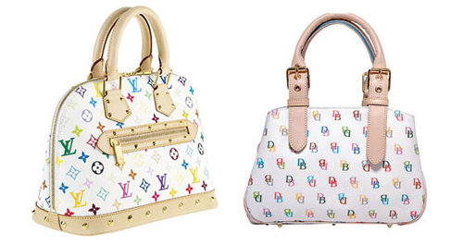
The Law
US Precedent: Louis Vuitton Malletier vs. Dooney Bourke
Held:
There are discernable differences in the two marks
Dooney Bourke won!

Slide 7
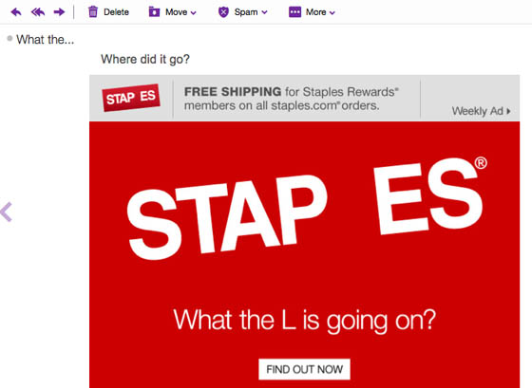
What do I think
Canadian Trademark Act: broadened definition of trademark
“Sign” includes a word, a personal name, a design, a letter, a numeral, a colour, a figurative element, a three-dimensional shape, a hologram, a moving image, a mode of packaging goods, a sound, a scent, a taste, a texture and the positioning of a sign
Trademarks Act R.S.C., 1985, c. T-13

Slide 8
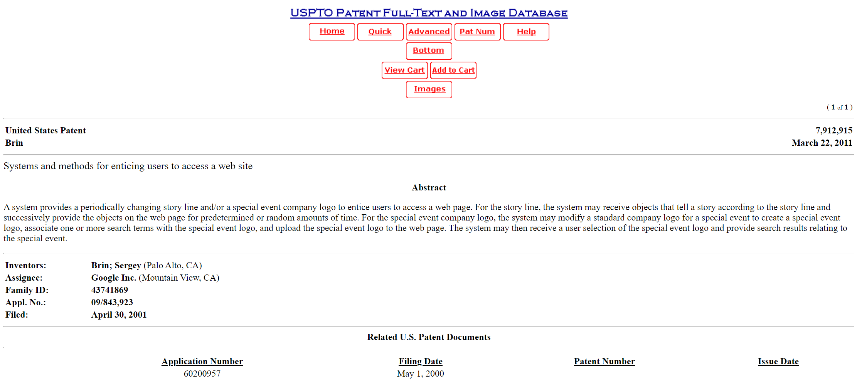
What do I think
Avenues for protection:
Protection of unregistered trademarks
Copyright
Patent
U.S. Patent No. 7,912,915 “System and Method for Enticing Users to a Web Site”
a.k.a. Google Doodle

Slide 9
Thank you!

Slide 10
Sources
http://patft.uspto.gov/netacgi/nph-Parser?Sect1=PTO1&Sect2=HITOFF&d=PALL&p=1&u=%2Fnetahtml%2FPTO%2Fsrchnum.htm&r=1&f=G&l=50&s1=7,912,915.PN.&OS=PN/7,912,915&RS=PN/7,912,915
https://www.lw.com/thoughtLeadership/fluid-trademarks-all-fun-or-some-risk
https://www.mondaq.com/canada/trademark/753034/canada-moves-ahead-with-fluid-marks
https://caselaw.findlaw.com/us-2nd-circuit/1187671.html

