Slide 1
Copyright law (Taylor’s version)
By Emma Reaume – Prof. Festinger – Law 422 – April 27, 2021

Slide 2
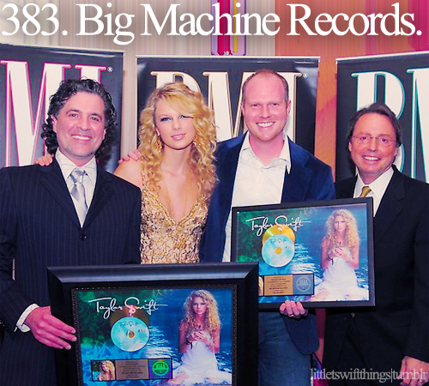
Background Info
Taylor Swift signed away her economic rights in her music to Big Machine Records when she first entered the industry
Big Machine Records owned the ”masters” (original recordings) of her songs from her first 6 albums
In 2018, when her contract with Big Machine ended, she tried to buy back her masters, but they couldn’t agree on a deal
Big Machine sold to Scooter Braun, who Taylor accused of bullying her over the years
Scooter sold Taylor’s masters to Shamrock Holdings for $300 mil.
Taylor did not want Scooter to profit off her work, so she announced that she would be re-recording all of those albums and re-releasing them
She also expressed concern about him having the power over her work as he had “tried to dismantle” her career over the years (Tumblr)
Image: 107.5 Kool FM <https://1075koolfm.com/taylor-swift-may-soon-be-a-free-agent/>

Slide 3
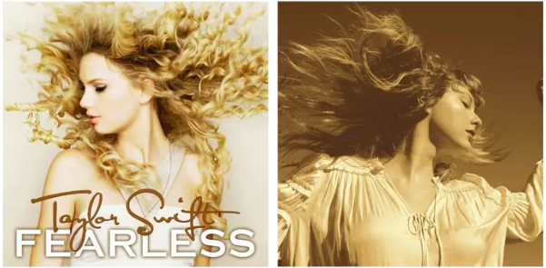
Fearless (Taylor’s Version)
2008 album Fearless was the first album Taylor re-recorded
She managed to re-record the songs so well that they are almost indistinguishable from the originals
Taylor’s version includes all 19 songs from the original platinum album plus 6 unreleased songs “from the vault”
Very successful, album hit #1 on Rolling Stone chart for the week it was released
Fearless (2008)
Fearless (Taylor’s Version) (2021)

Slide 4
Key issue: Moral rights
Part of the issue is Taylor wanting to profit off her own work, but the main issues seem to be that she doesn’t want Scooter Braun to profit off it + concern for what he may do with her music

Slide 5
IP Law - Moral Rights
Right to the integrity of the work
This right gives the author the ability to object to a use of their work that they find offensive (like in Snow v Eaton Centre)
This is a creative right derived from the investment the author put into making the work
Separate from economic rights (doesn’t give her the ability to profit off the songs or license out their use)

Slide 6
Moral Rights in the US
Derived from the Berne Convention
Moral rights have only been codified for visual artists in the US (through the Visual Artists Rights Act) – doesn’t include musicians
In the US, moral rights for other artists are mainly dealt with by contract, TM, and privacy laws (Jonathan)
Moral rights give the author the ability to object to a use of their work that they find offensive (like in Snow v Eaton Centre)
In the US, claims like this have been unsuccessful because moral rights are so much narrower for musicians (e.g., Franconero v. Universal Music Corp. [2003])
Result is that musicians in the US are less protected than in Canada because of inequality in contractual bargaining power

Slide 7
Moral Rights in Canada
Every artist in Canada automatically has moral rights in their work (Copyright Act ss. 14.1, 14.2, 17.1,17.2)
Canadian artists are still able to waive moral rights through contracts
Taylor was the primary writer of all her songs, so she would hold the moral right to the integrity of the songs in Canada
She could object to a specific use of her songs by Scooter/Shamrock, but probably couldn’t object to them owning/using the songs in general.
(Shelby Griffin on Pinterest https://www.pinterest.ca/pin/9992430396244924/)

Slide 8
Key issue: Ownership
Scooter/Shamrock own the master recordings of the albums, not the songs themselves.

Slide 9
Copyright in Taylor Swift’s Case
Without a contract clause preventing it, artists are generally free to re-record songs they wrote at any time (McMahon)
Don’t know the details of her contract with Big Machine Records but it’s common for music contracts to include a clause disallowing the artist from rerecording the songs for 5 years from the commercial release date, or 2 years after the expiration of the agreement, whichever is later (Spanos)
Taylor’s re-recording doesn’t prevent the holder of the masters to continue profiting off those songs or take away their right to use/license the old masters

Slide 10
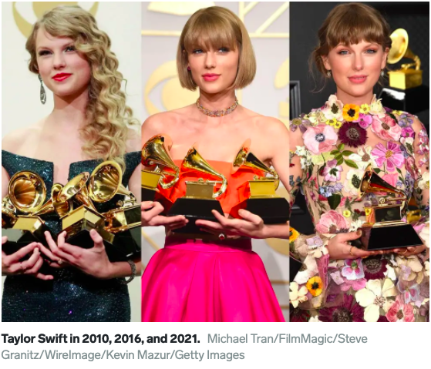
Beyond Copyright Law
If copyright law had prevented Taylor from re-recording the songs, it would be unfortunate, but she would be fine
Although the re-recording is allowed by copyright law in the US, other factors were also necessary to make the album a success:
Loyal fanbase
Taylor’s talent/ability to reproduce the songs to sound almost exactly the same
Resources – if Taylor was not already commercially successful, she probably wouldn’t have had the resources to re-record the whole song
(Callie Ahlgrim for Insider https://www.insider.com/taylor-swift-grammys-history-aoty-three-times-2021-3)

Slide 11
Lasting Questions
Will the venture be successful?
Will listeners completely stop listening to the original version of Fearless?
Will movies/TV shows that want to license the songs do so from Taylor or Shamrock (holder of the masters)?
Will the success that the album has found in the weeks since its release continue?
Will fans be as receptive to re-releases of other albums?
How will the music industry change?
Image: People.com <https://people.com/celebrity/star-tracks-thursday-july-11-2019/>

Slide 12
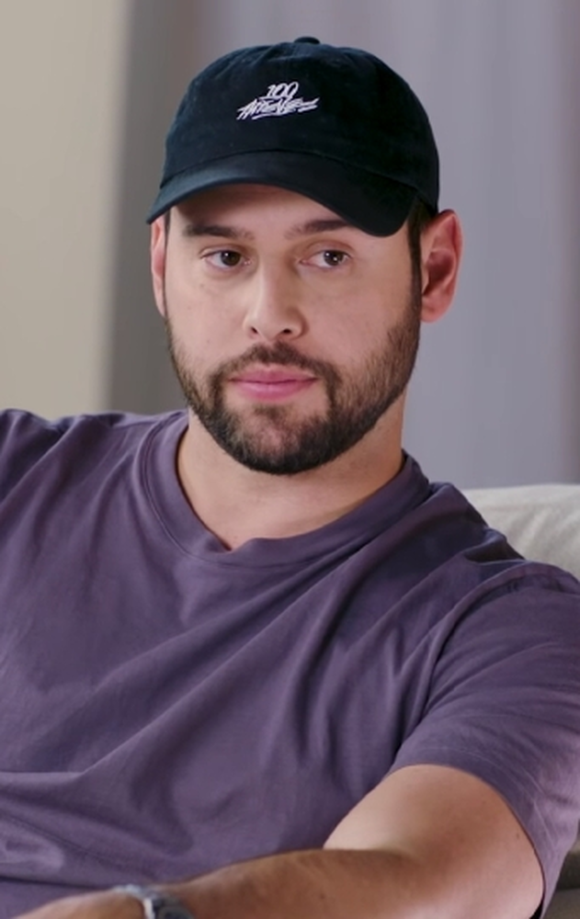
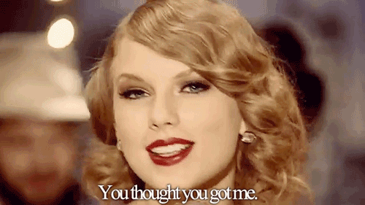
Final Thoughts
This situation illustrates the importance of copyright law’s goal of protecting creators
Also explains why creators should hold special rights in the works they create – time, effort, and talent to make the work shouldn’t become worthless by contracts entered when the parties have a big power imbalance
I’m excited for Taylor to rerecord “Mean” – I think we all know who she will be thinking of when she sings;
“I bet you got pushed around Somebody made you cold But the cycle ends right now”
Top: Scooter Braun (Wikipedia <https://en.wikipedia.org/wiki/Scooter_Braun>), Bottom: GIF of Swift singing “Mean” (AngelicDoll on imgur <https://imgur.com/gallery/dvKBS>)

Slide 13
References
LEGISLATION
Copyright Act, RSC 1985, c C-42.
JURISPRUDENCE
Franconero v. Universal Music Corp., 2003 U.S. Dist. LEXIS 22800 (S.D.N.Y. December 18, 2003).
Snow v The Eaton Centre Ltd et al, [1982] OJ No 3645.
SECONDARY MARTIERALS: ARTICLES
Brittany Spanos, ”Can Taylor Swift Re-Record Her Old Albums? Should she?” (22 August 2019), online: Rolling Stone <https://www.rollingstone.com/pro/news/can-taylor-swift-re-record-her-old-albums-should-she-875296/>.
Doug McMahon, “Copyright Issues (Taylor’s Version): Who owns intellectual property in music?” (20 April 2021), online: McCann FitzGerald <https://www.mccannfitzgerald.com/knowledge/intellectual-property/copyright-issues-taylors-version-who-owns-intellectual-property-in-music>.
Jonathan, “Moral Rights for Musicians: A primer” (10 May 2016), online (blog): Future of Music Coalition <http://futureofmusic.org/blog/2016/05/10/moral-rights-musicians-primer>.
“Top 200 Albums: The week’s biggest albums April 9th – April 15th 2021” (last modified 26 April 2021), online: Rolling Stone <https://www.rollingstone.com/charts/albums/2021-04-09/>.
Zack O’Malley Greenberg, “The World’s Highest-Paid Women in Music 2019: Taylor Swift doubles up no. 2 Beyonce” (26 August 2019), online: Forbes <https://www.forbes.com/sites/zackomalleygreenburg/2019/08/26/the-worlds-highest-paid-women-in-music-2019-taylor-swift-doubles-up-no-2-beyonc/?sh=1b5b29d21aff> .

