Slide 1
Not All is Fair & Lovely in Trademarks: How Changing Societal Climate May Force Companies to Reconsider their Choices
By Raunaq Saini

Slide 2
Colourism in India
Pictured: My sister and I at
the Taj Mahal

Slide 3
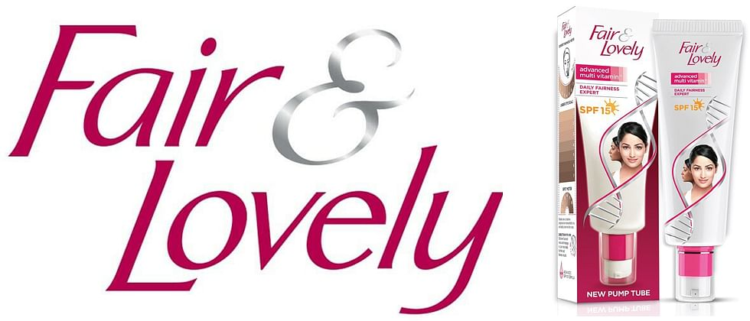
What is Fair & Lovely?

Slide 5
Black Lives Matter Movement

Slide 6
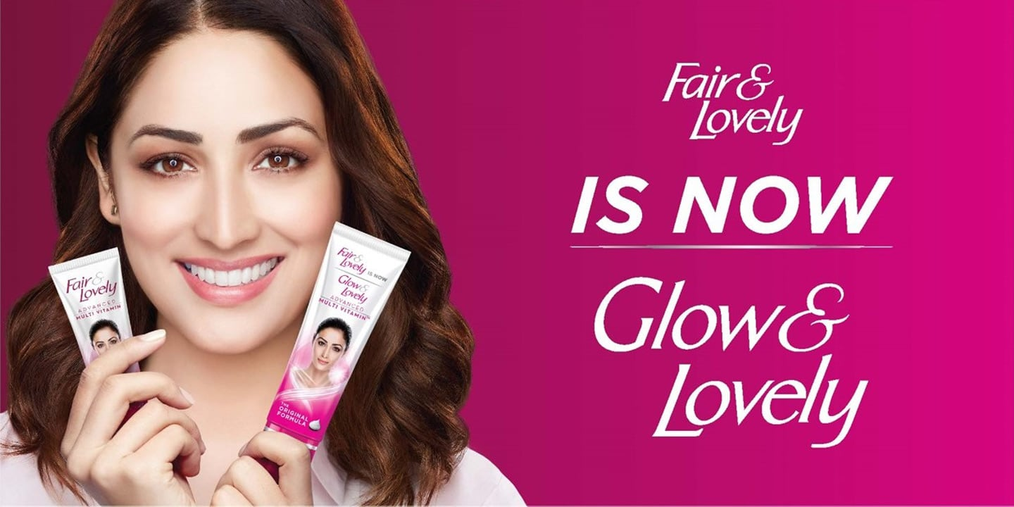

Slide 7
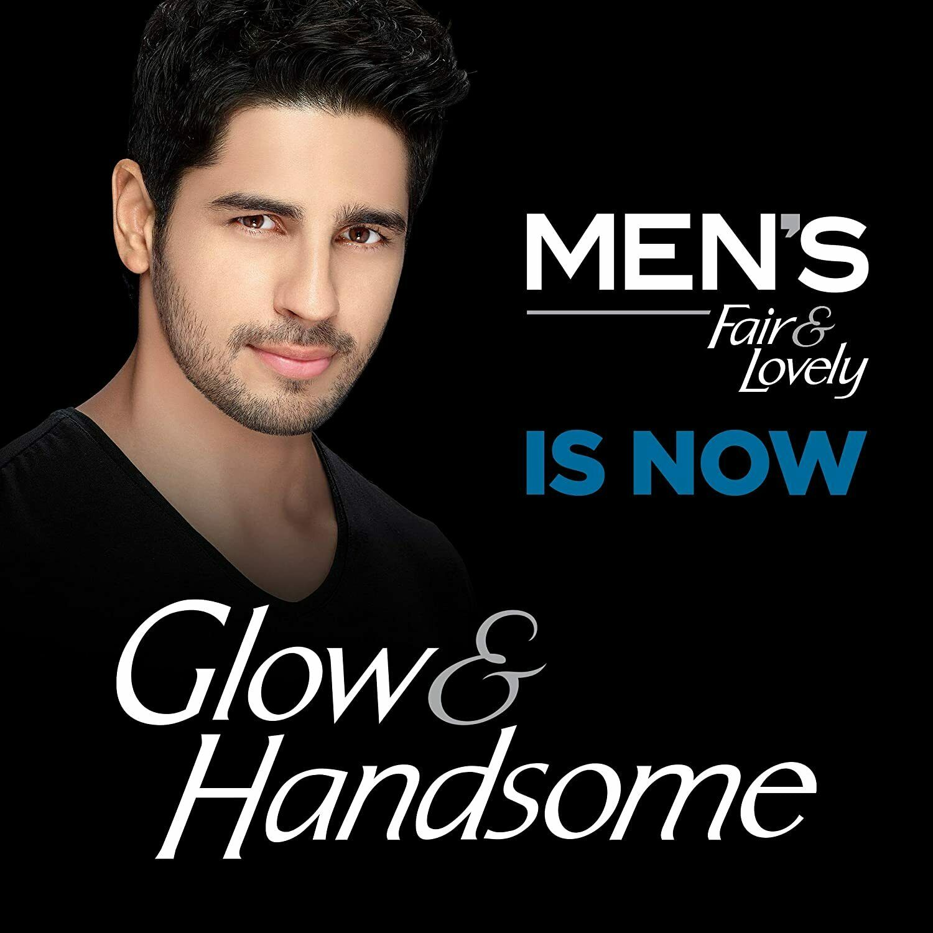

Slide 8
Trademark Dispute

Slide 9
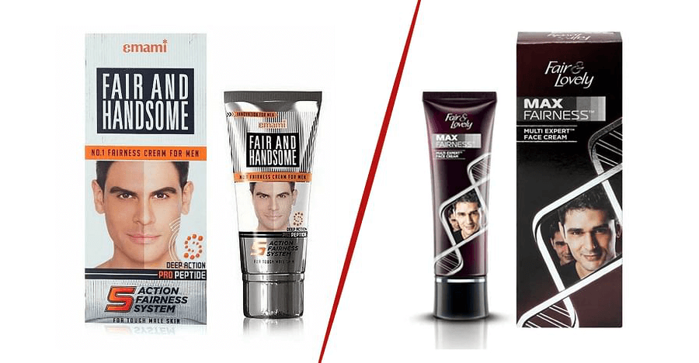

Slide 10
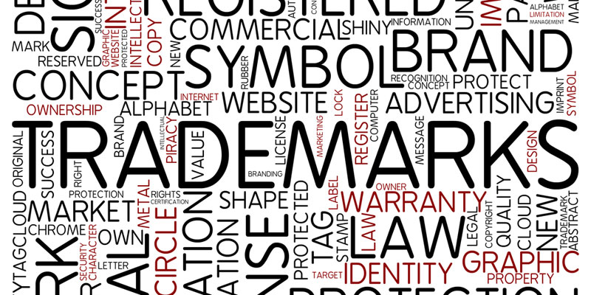
Why is this Important?

Slide 11
Thank you!

Slide 12
Sources
https://www.bbc.com/news/world-asia-india-53182169
https://www.indiatvnews.com/business/news-emami-high-court-glow-and-handsome-643120#:~:text=In%202006%20it%20launched%20%60Fair,to%20do%20so%2C%20it%20claimed
https://www.mondaq.com/india/trademark/981216/all-is-fair-in-trademark-wars-the-glow-handsome-saga-continues
https://www.mondaq.com/india/trademark/984766/is-everything-fair-and-lovely-in-business-hindustan-unilever-vs-emami
https://www.nbcnews.com/news/asian-america/skin-lightening-cream-fair-lovely-change-name-after-backlash-n1232124
https://www.obhanandassociates.com/blog/all-is-fair-in-trademark-wars/?utm_source=Mondaq&utm_medium=syndication&utm_campaign=LinkedIn-integration

