Slide 1

Make-up Artistry and Copyright Protection
LAW422 - Intellectual Property Law
Olivia Veldkamp

Slide 2
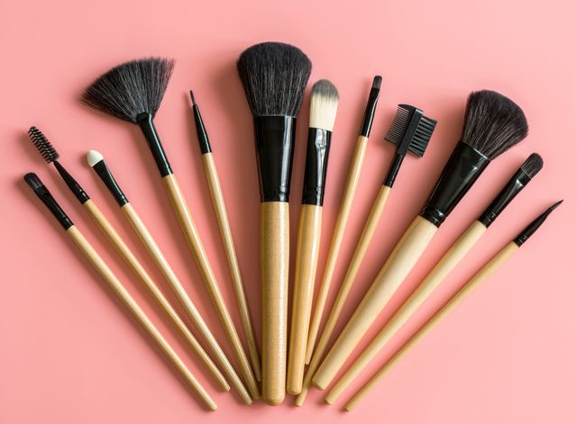
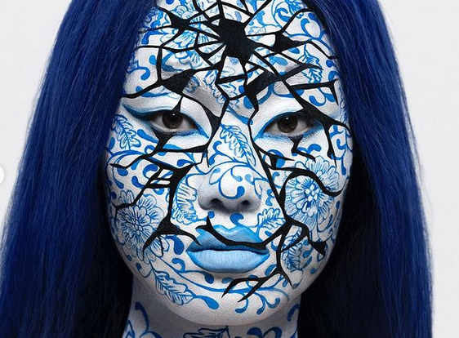
Introduction

Slide 3
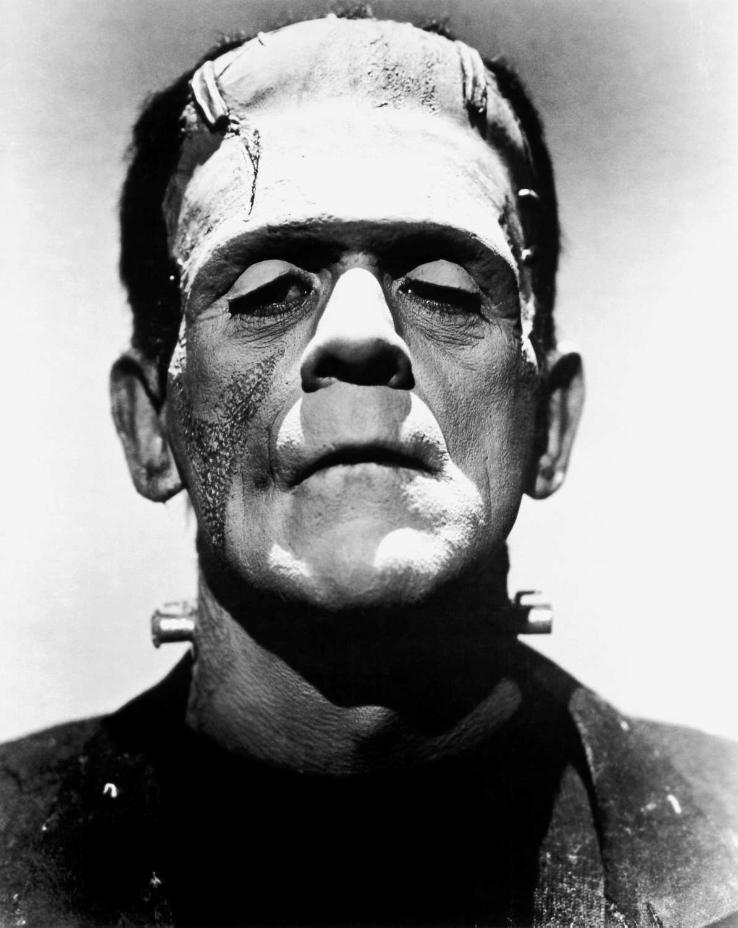
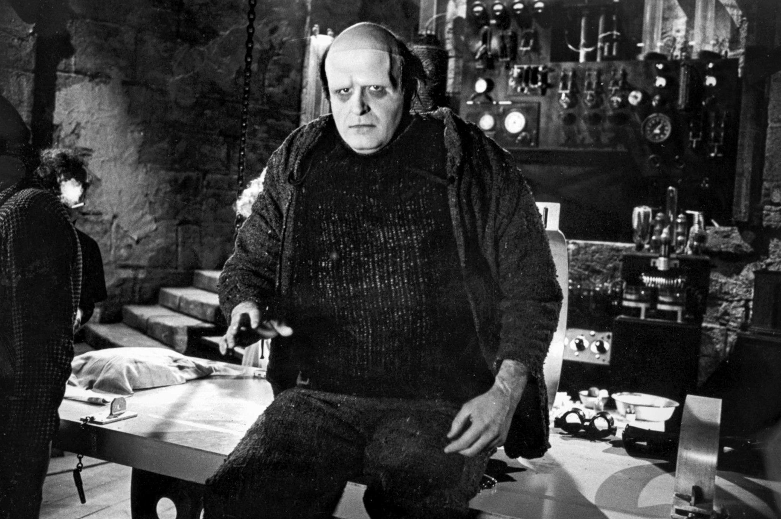
Frankenstein’s Monster

Slide 4
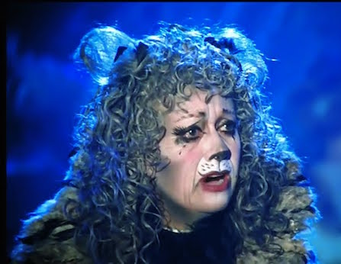
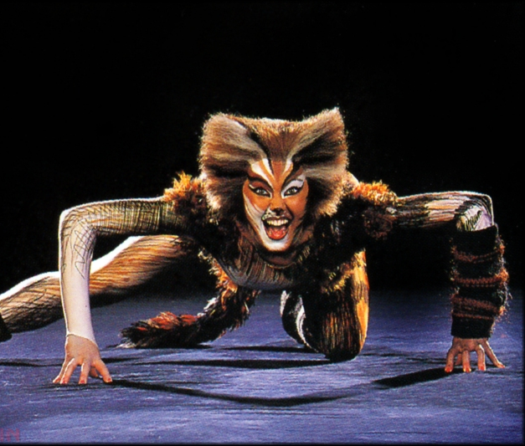
Cats!

Slide 5

Developments in Argentina?

Slide 6

What about Canada?

Slide 7
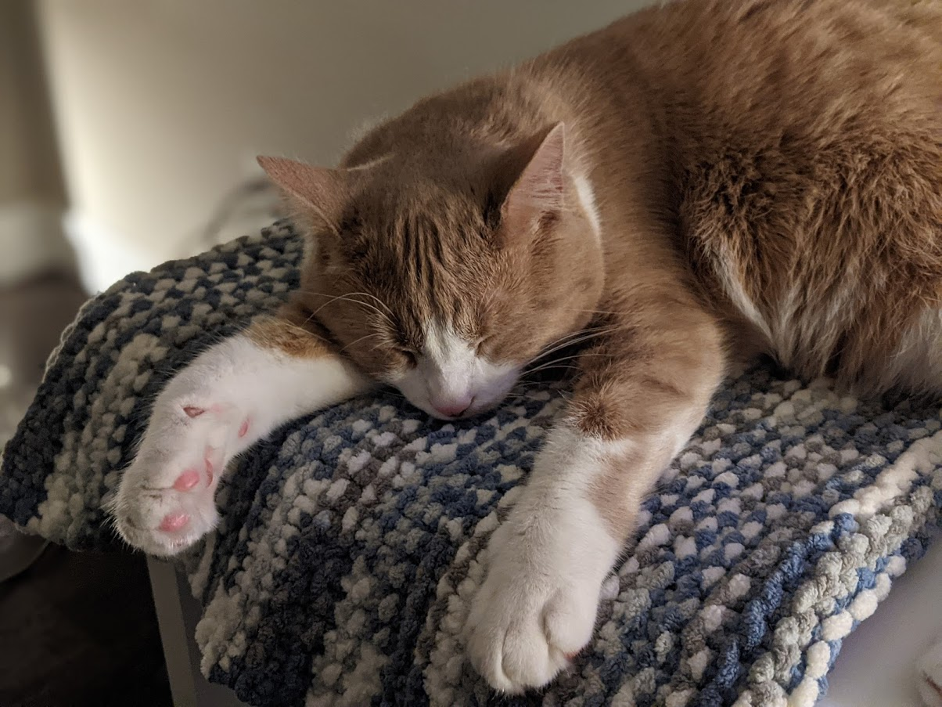
Thank you!
And as Professor Festinger says… always include a cat picture!

