Slide 1

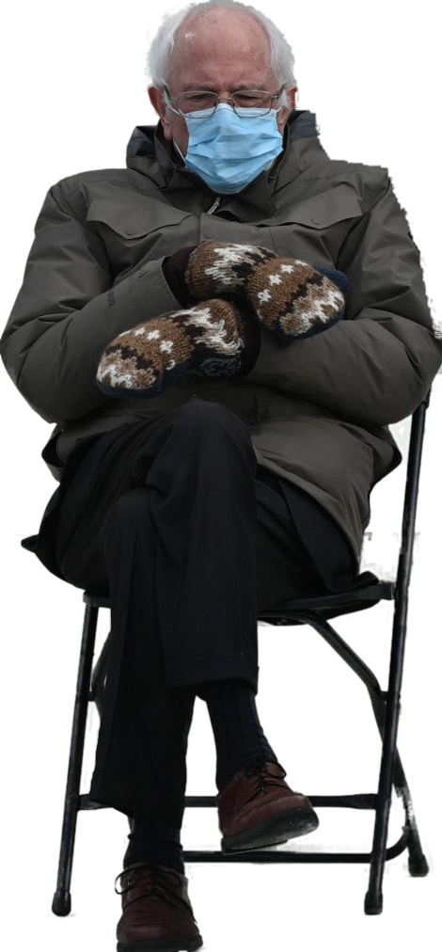

TRADEMARKS REVIEW
+ PATENTS INTRO
Talk 9 Introduction
LAW 422
Intellectual Property Law
Allard School of Law, UBC
Spring, 2021
Jon Festinger Q.C.
Centre for Digital Media
QMUL School of Law (CCLS)
Whiteboard Law
http://commlaw.allard.ubc
@jonfestinger
jon_festinger@thecdm.ca

Slide 2
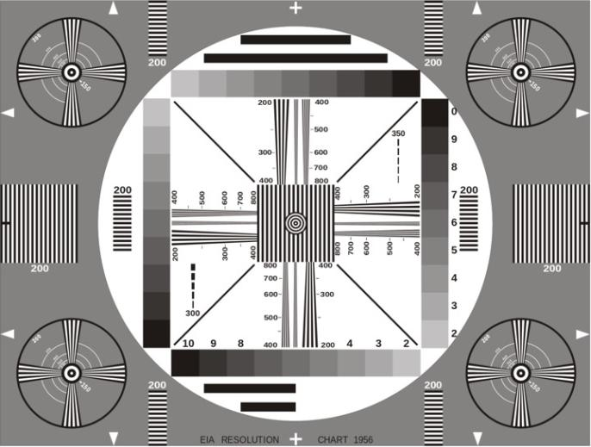
Permission to Record?

Slide 3
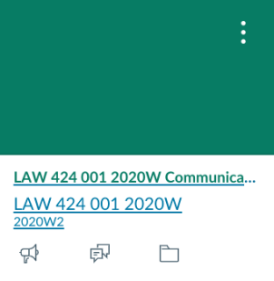
The draft slides
UBC Canvas

Slide 4
Logistics

Slide 5
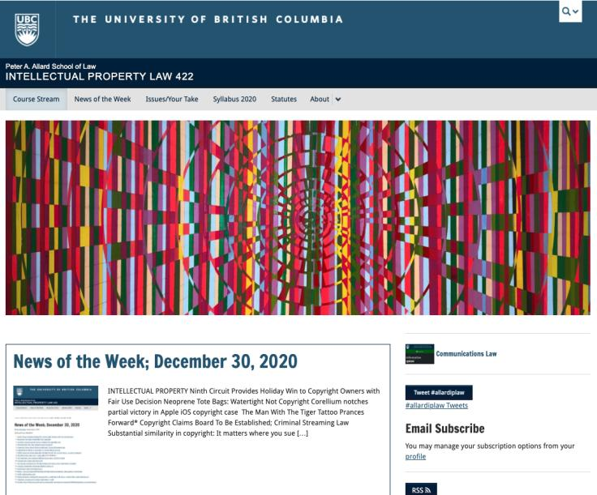
Course Website
https://iplaw.allard.ubc.ca/

Slide 6
For full privileges on the website
1. Please create an account at http://cms.ubc.ca/ using your CWL.
2. Once you create an account and sign in at http://cms.ubc.ca/ you can click your name in the top right. Halfway down the following page will be your WordPress email address.
3. Send me your WordPress email address at jon.festinger@ubc.ca or at jon_festinger@thecdm.ca
4. Then, I will invite you to participate with authoring privileges via your WordPress email address.

Slide 7
Methodology Prioritized
Slides relate directly to textbook & Syllabus
Added material or “context” in Slides not in textbook (not optional)
Added “context” from News of the Week (optional – but does often supply fact situations useful in exploring consequences in Canadian law or that could serve as the basis of an exam question)

Slide 8
Presentations (20%)
How’s it going?
Don’t let it be a last minute panic.
If you have posted a presentation, please drop me an email saying that.

Slide 9
Presentations (from Syllabus)
“Paper/Presentation/Post = 20% of grade
This will be 500-1000 word (or equivalent) per person original piece of work that illuminates some aspect of Intellectual Property Law. It can be in any form, posted to the course website or not, and can be approached individually or as a group.”

Slide 10
Presentations
1-5 (ideally) per group
Sign-up by emailing me
Any topic - not constrained by what we are talking about that week
Consult re the topic you want to take on?
Post one thing you want us to read or watch?
5-7 minutes (notionally) per student = 500-1000 words

Slide 11

Office “Hours”: Ideally Fridays before or after class but am flexible…
Email me : jon.festinger@ubc.ca
Skype: jon.festinger
Phone:
o. 604-568-9192
c. 604-837-6426

Slide 12

Thanks for the emails with questions.
Still thinking about a pre-exam compilation.

Slide 13
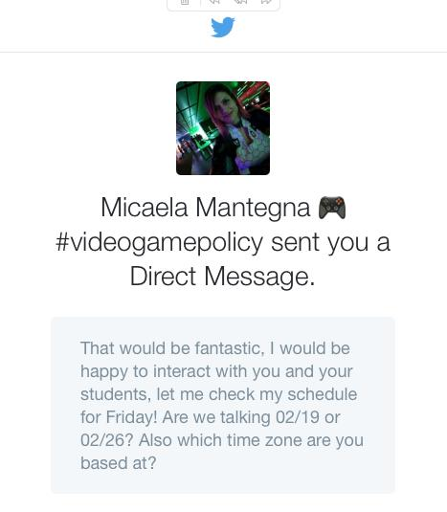
Still On the Agenda?
No Friday April 2 class

Slide 14
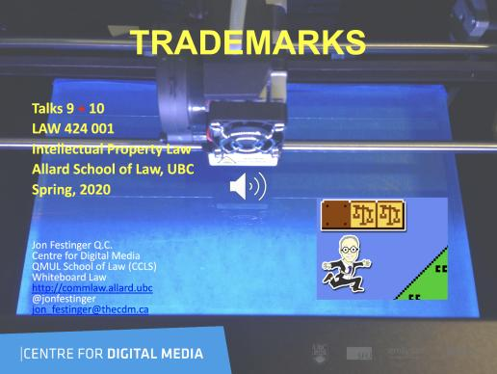
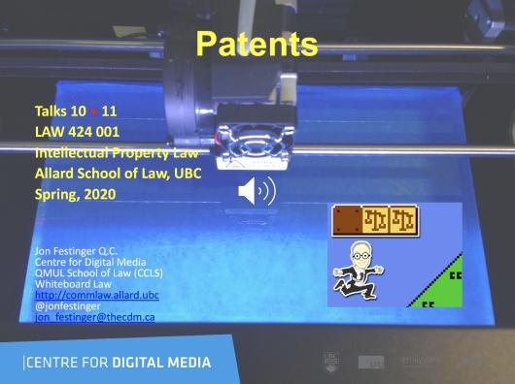
Last years audio-slides on (?) UBC Canvas

Slide 15
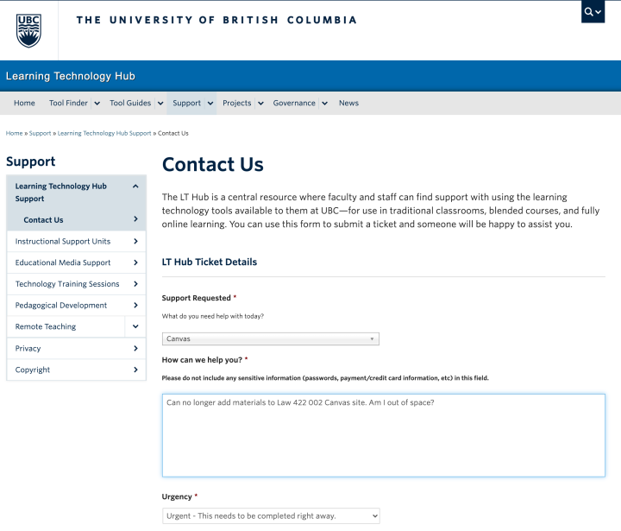
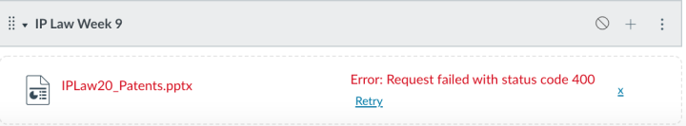

Slide 16
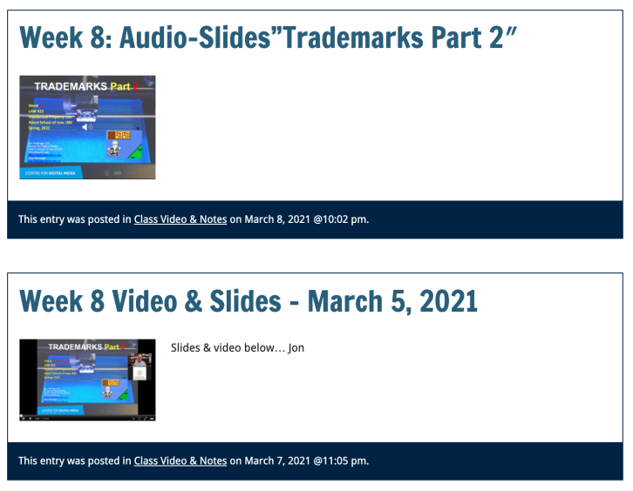
Week 8 Video & Slides on Course Website*
* No ‘single point of failure’

Slide 17
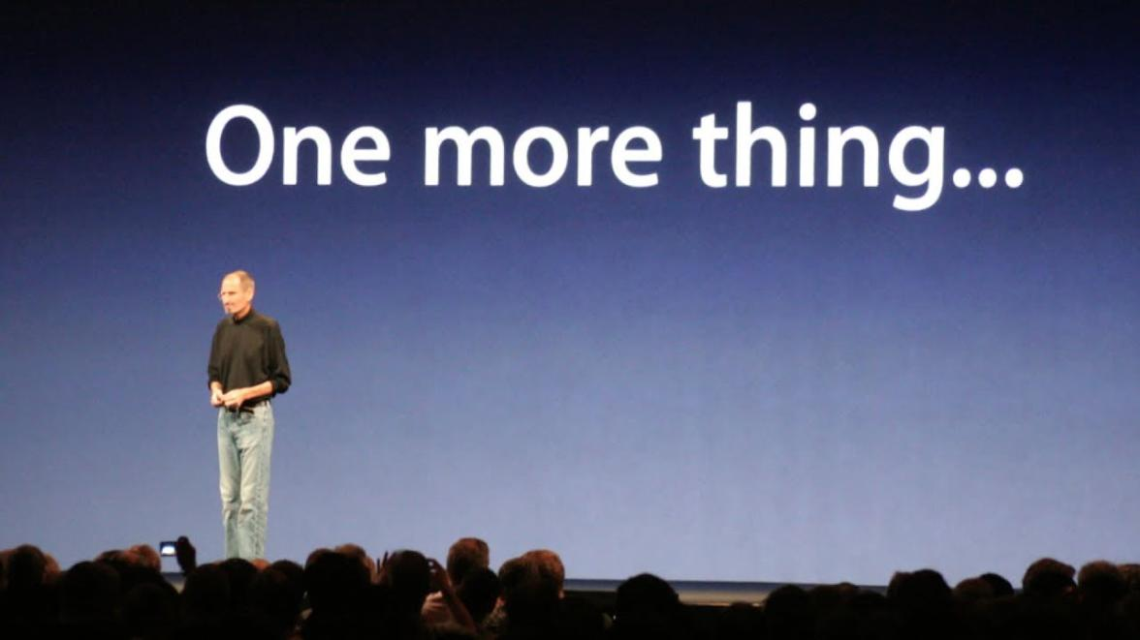

Slide 18
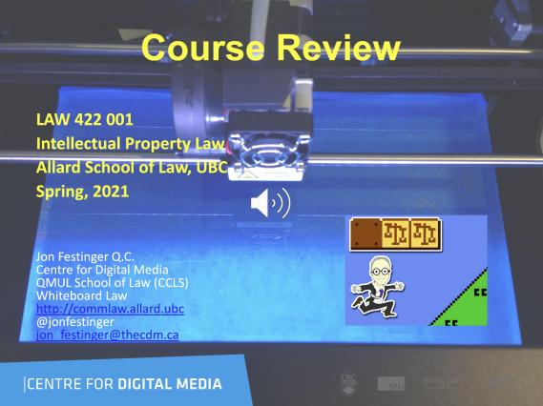
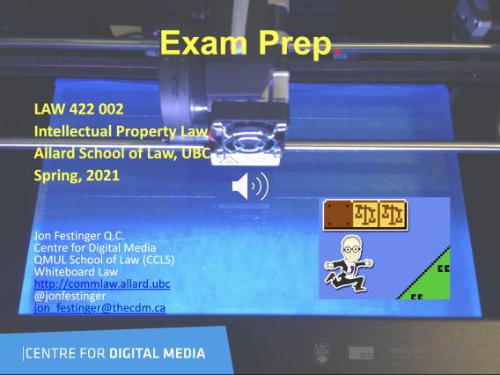
Coming Soon

Slide 19
News of
the Week
(Trump & IP Edition)

Slide 20
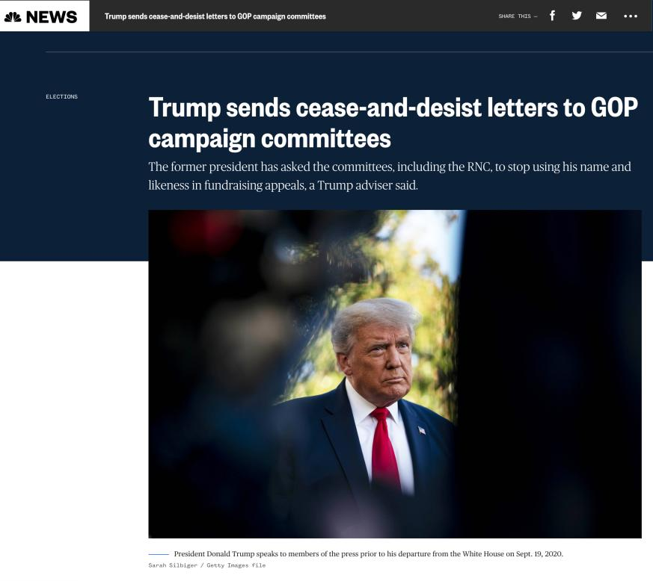

Slide 21
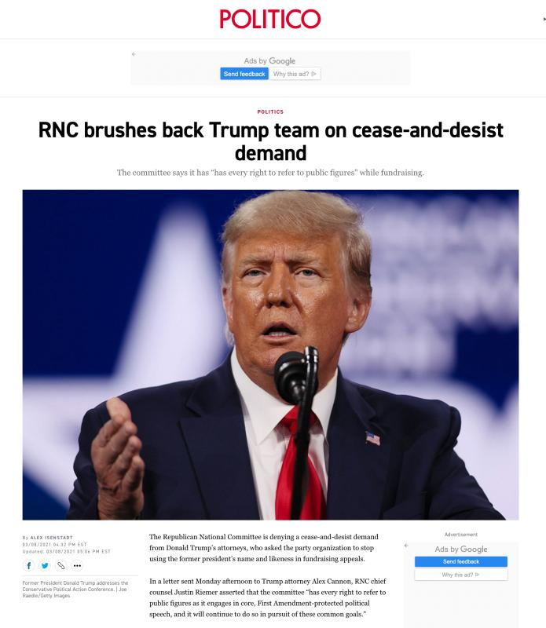

Slide 22
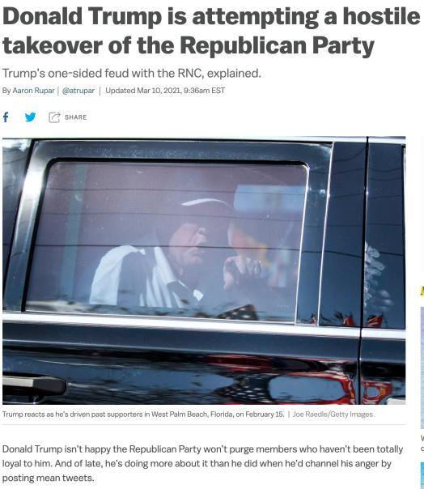
Motives?

Slide 23
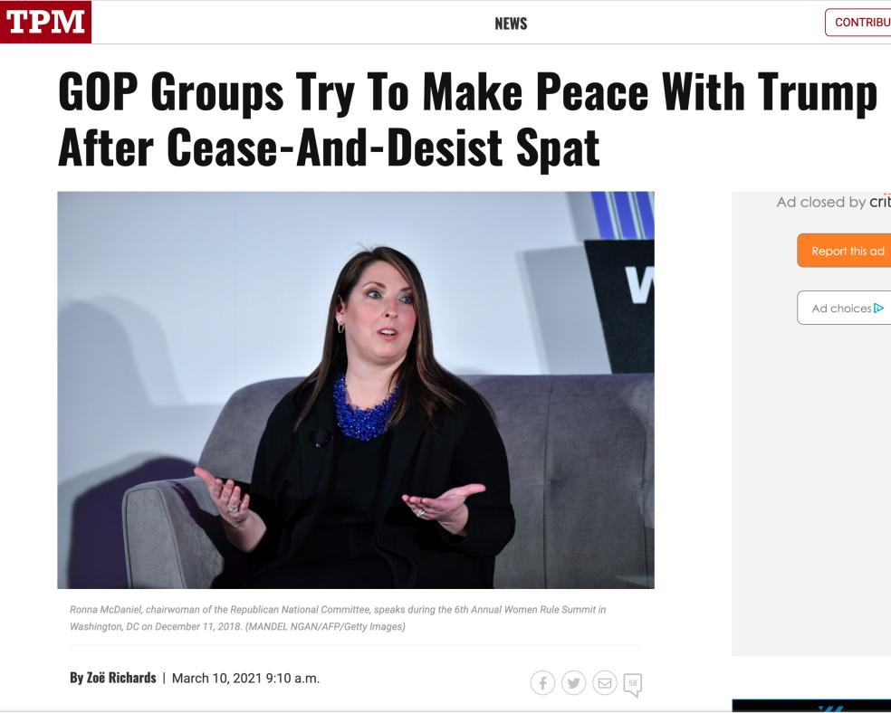

Slide 24
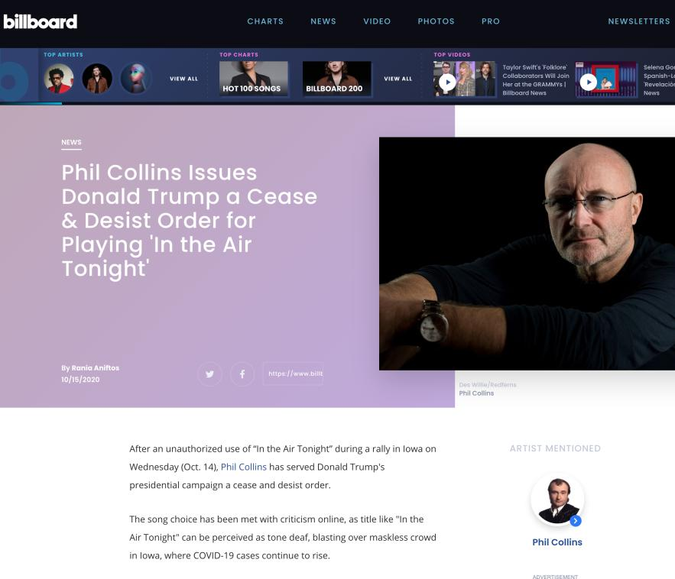

Slide 25
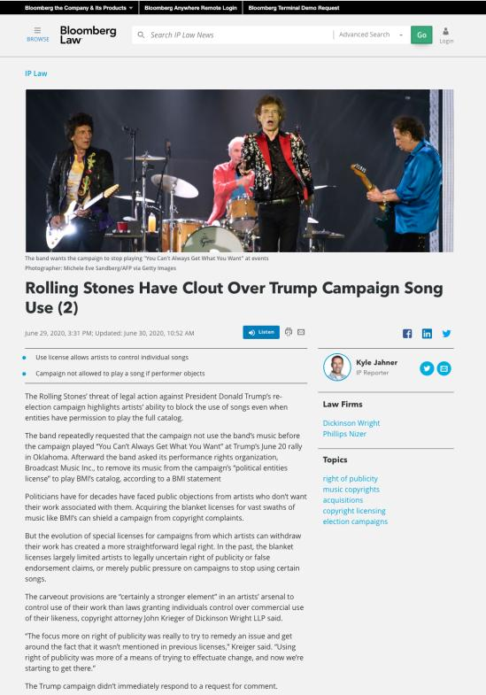

Slide 26
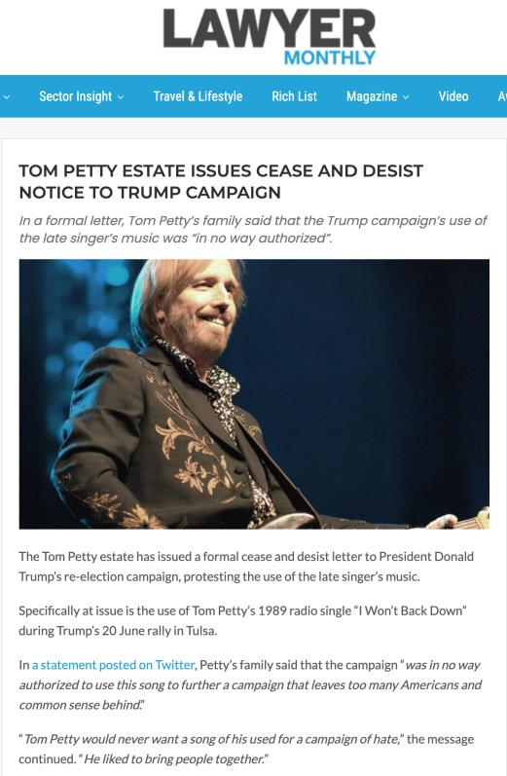

Slide 27
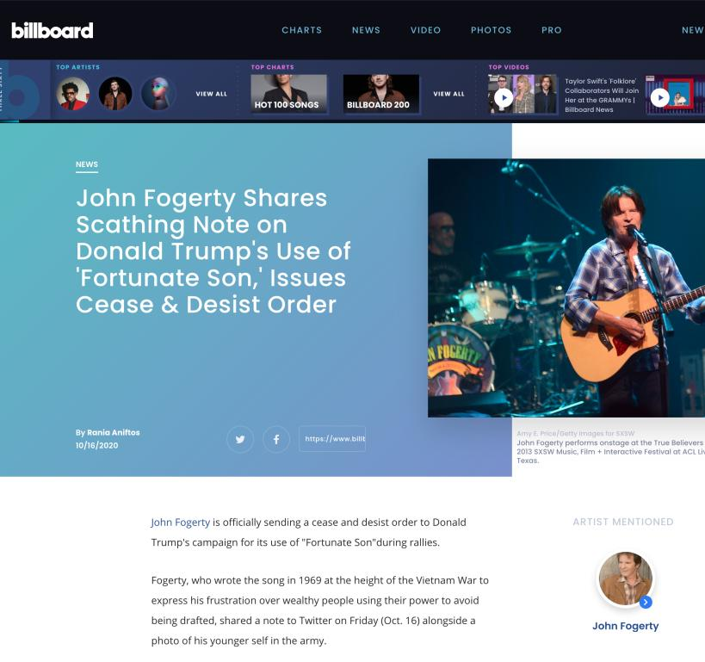

Slide 28
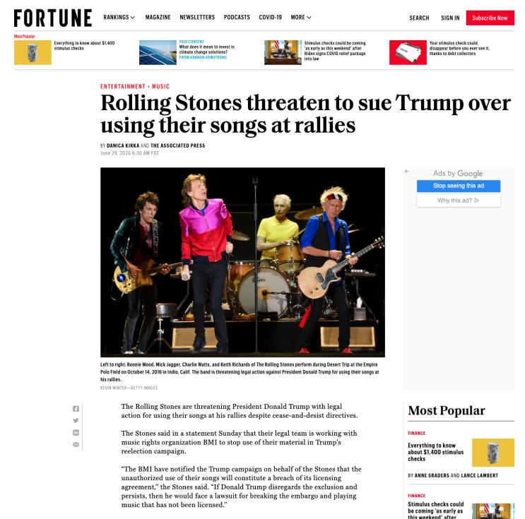

Slide 29
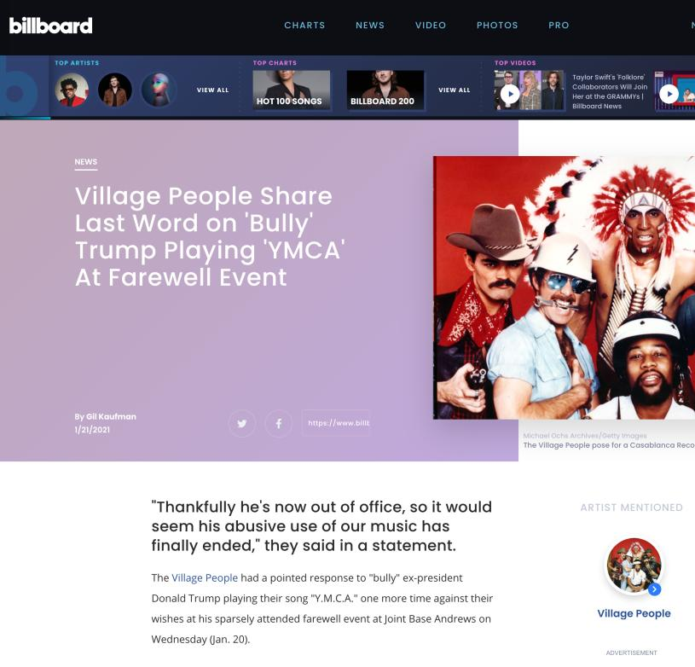

Slide 30
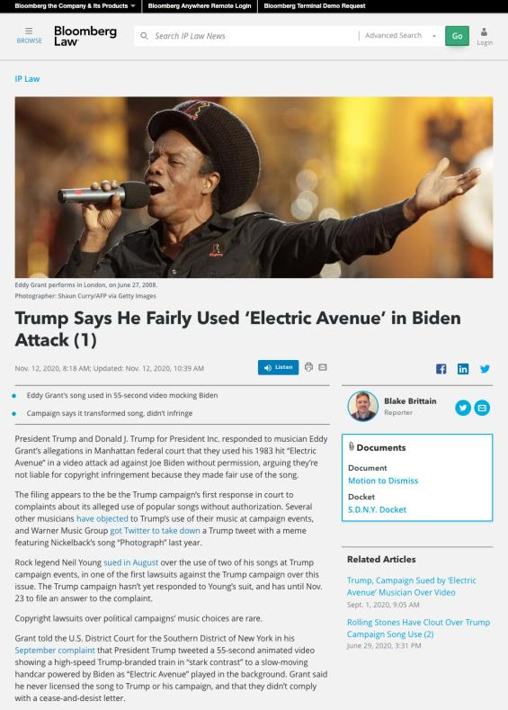

Slide 31
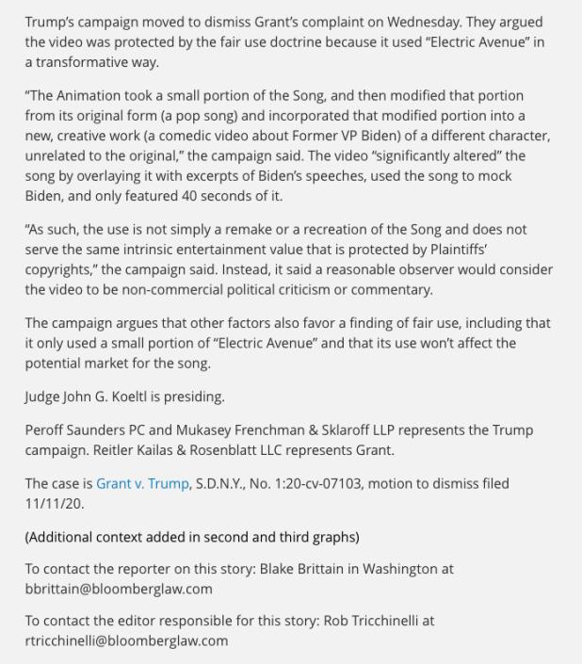

Slide 32
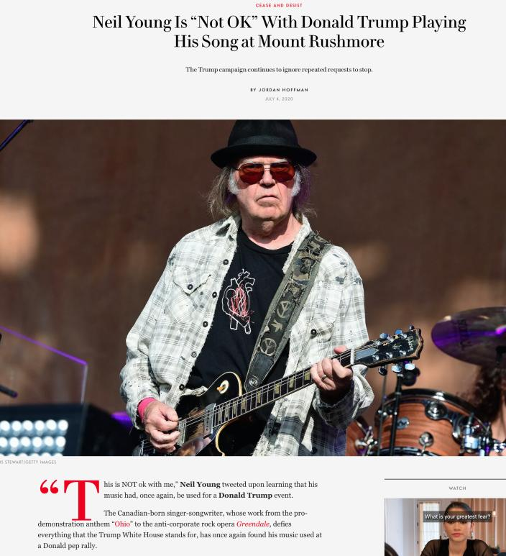

Slide 33
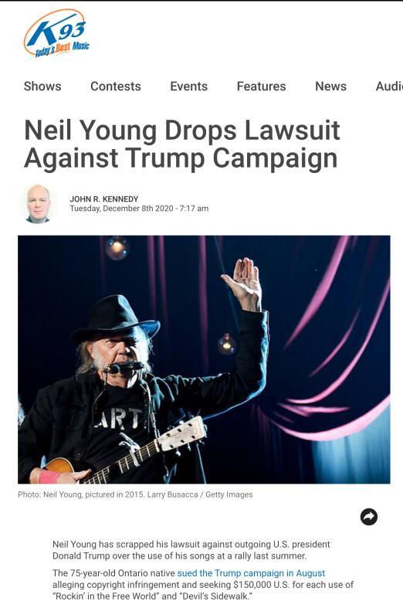

Slide 34
News of
The Week
Last Year

Slide 35
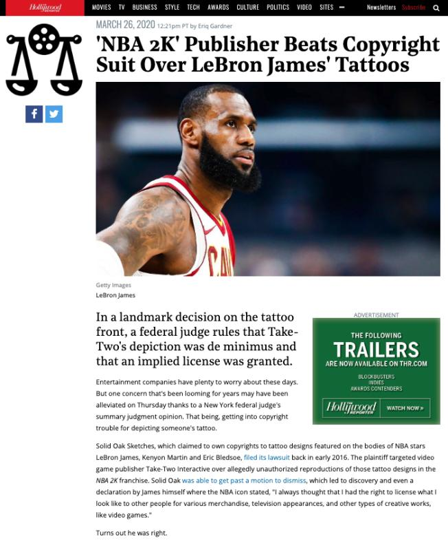

Slide 36
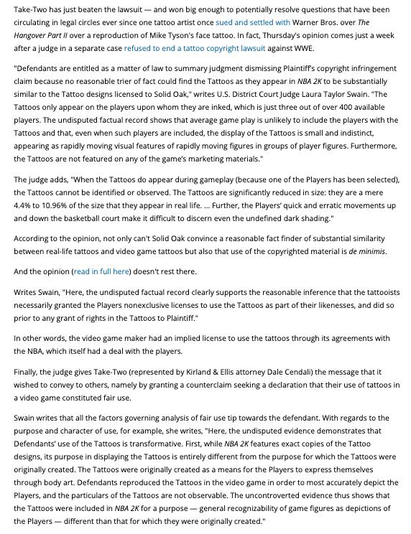

Slide 37
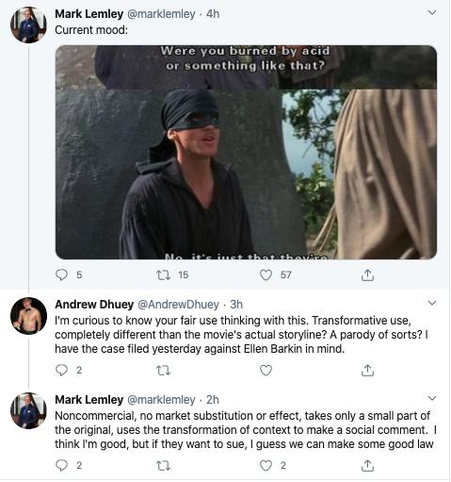

Slide 38
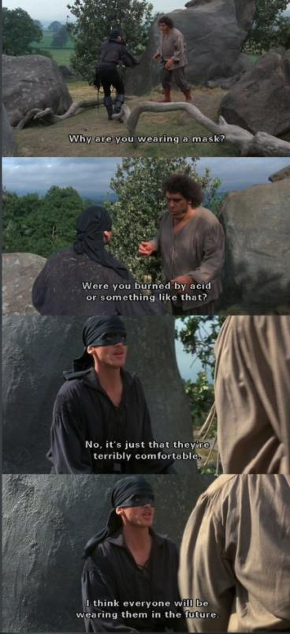

Slide 39
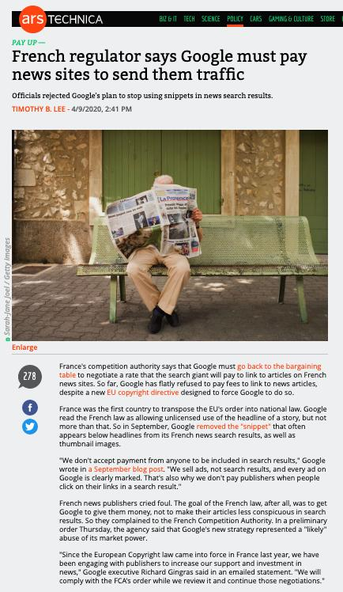

Slide 40
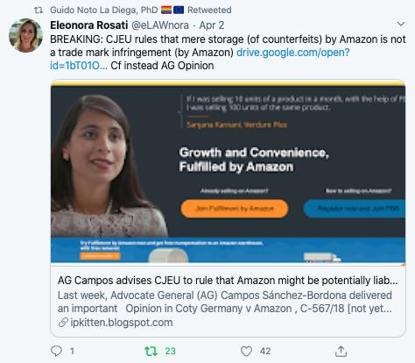

Slide 41
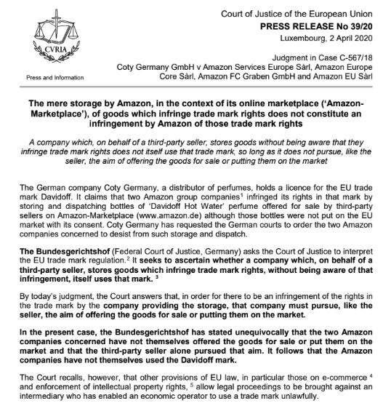

Slide 42
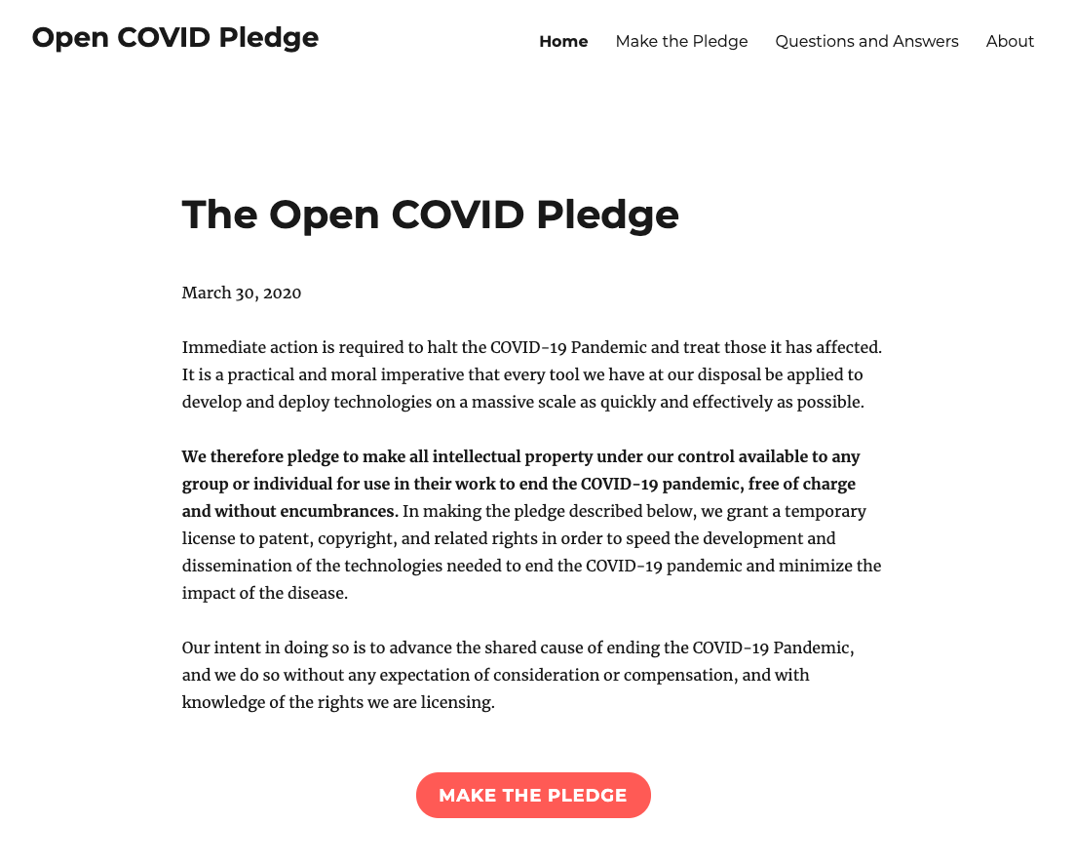

Slide 43
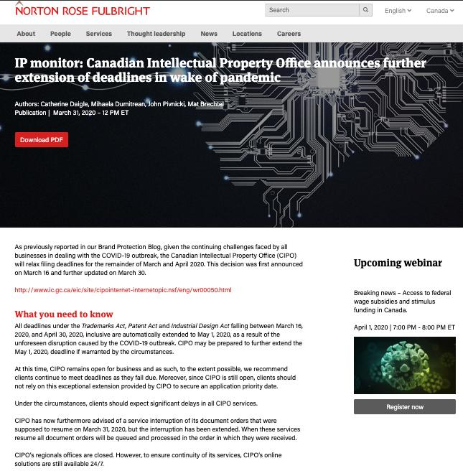

Slide 44
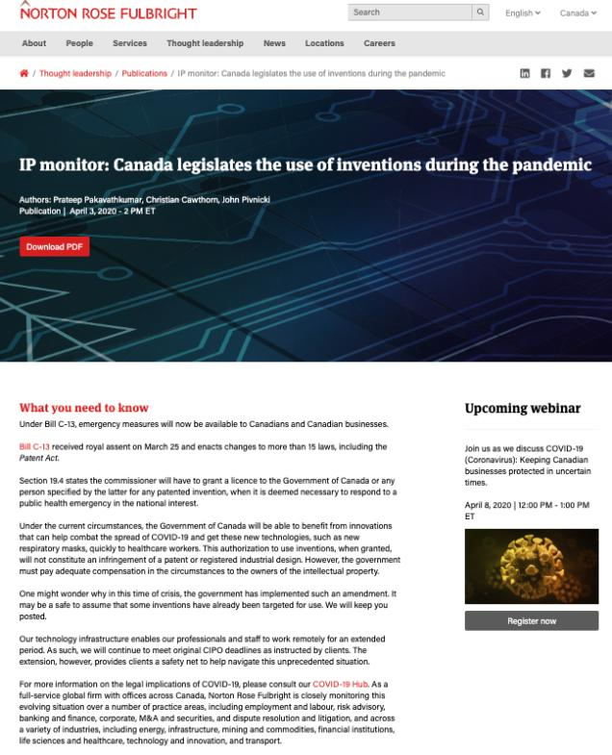

Slide 45
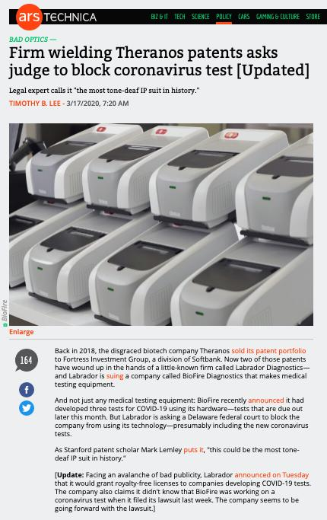

Slide 46
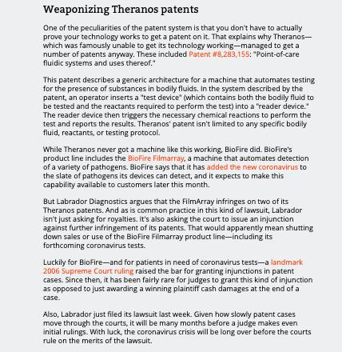

Slide 47
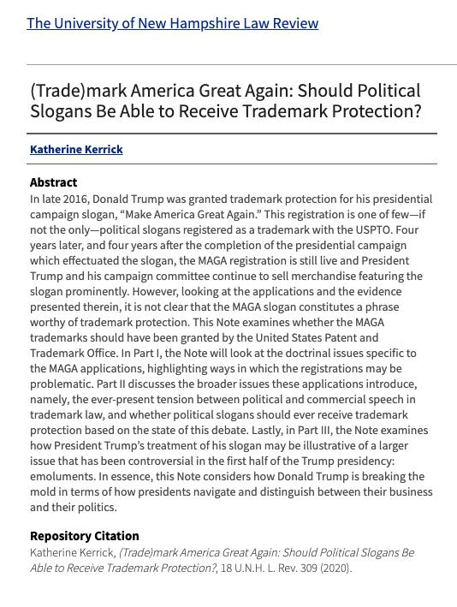

Slide 48
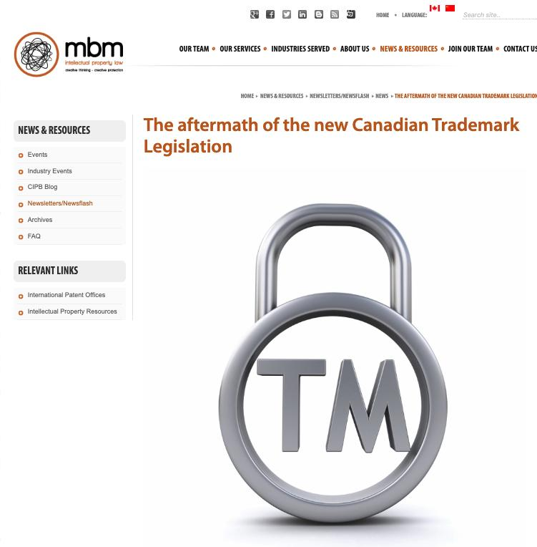

Slide 49
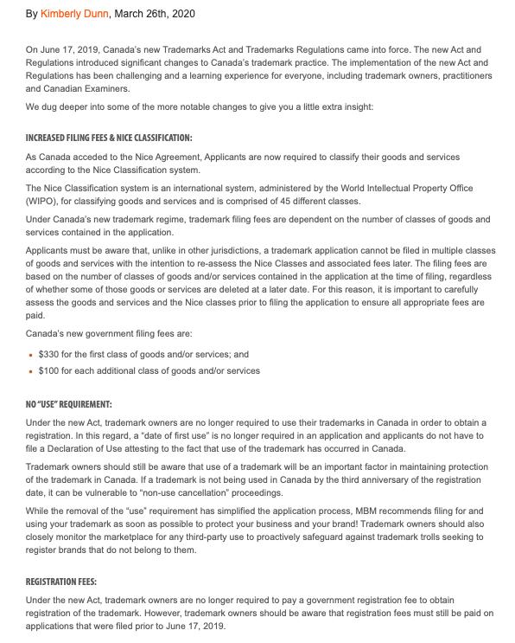

Slide 50
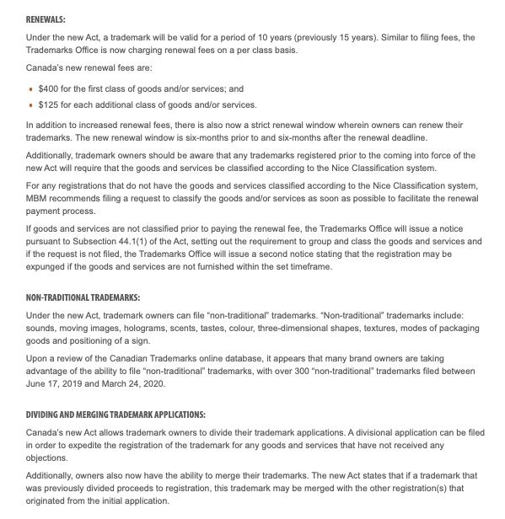

Slide 51
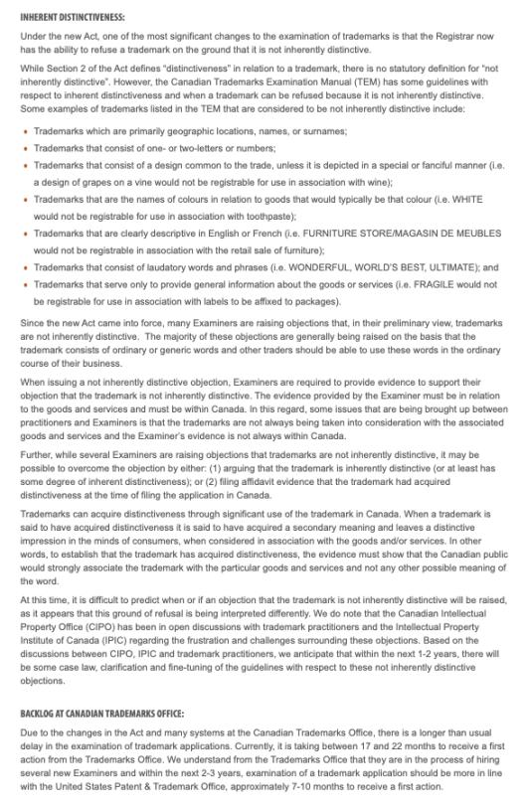

Slide 52

Pause

Slide 53
QUESTIONS?
THOUGHTS?
DISCUSSION?

Slide 54
Your News of the Week

Slide 55
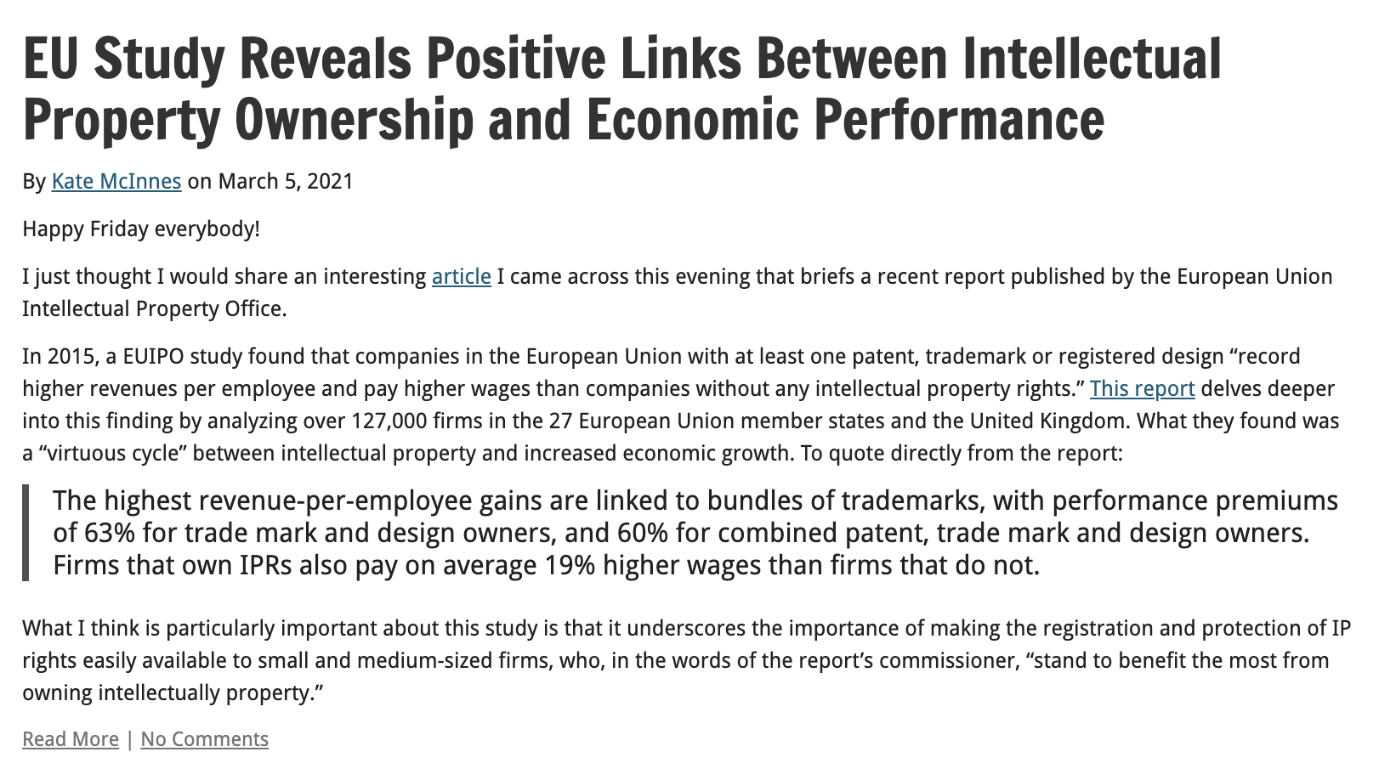

Slide 56
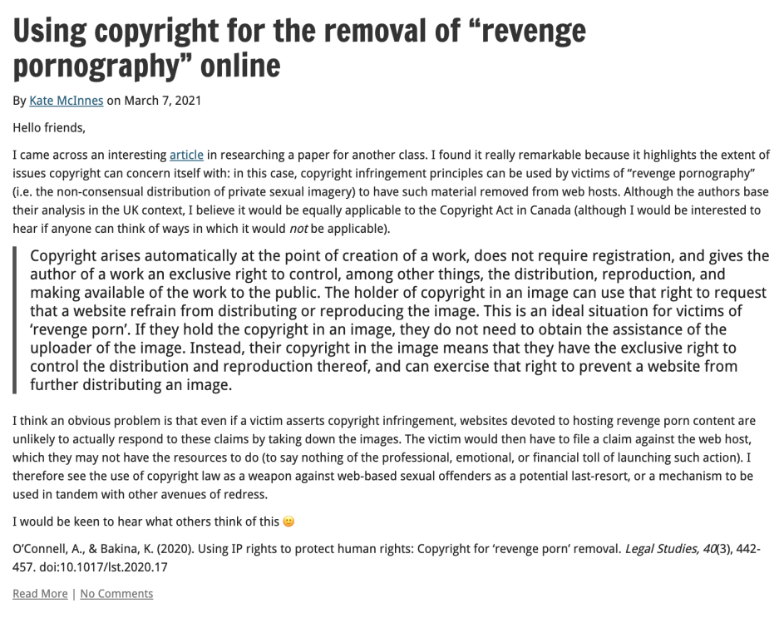

Slide 57
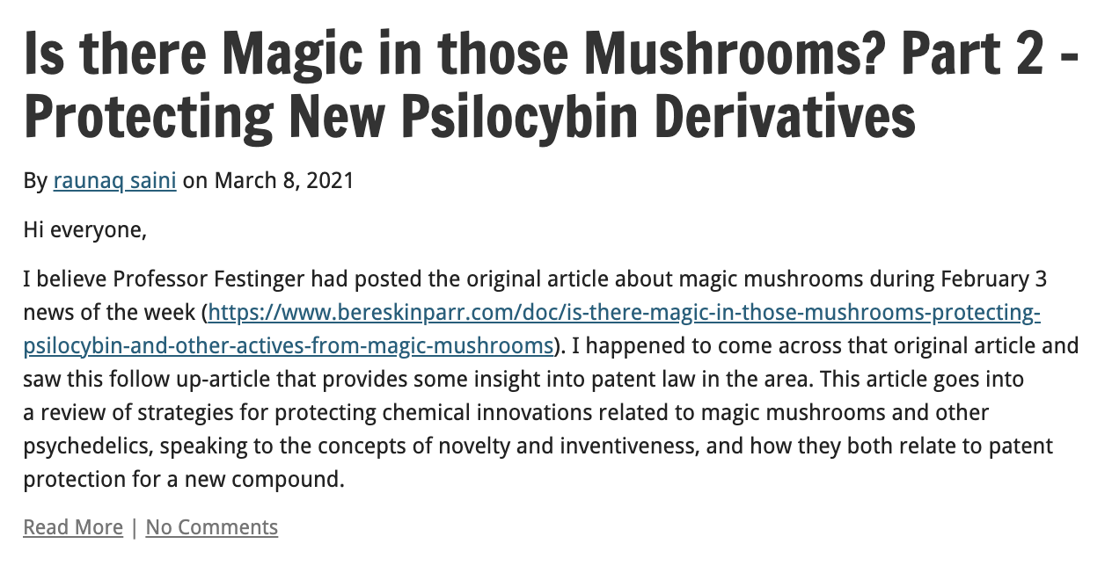

Slide 58
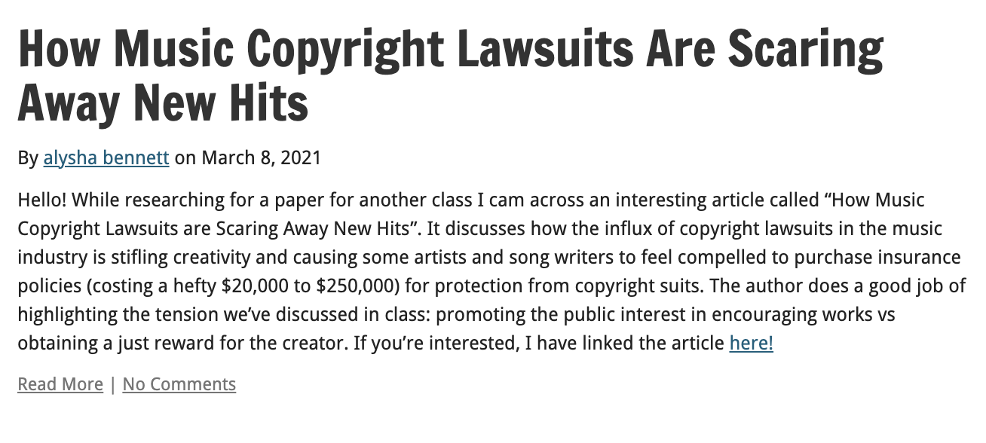

Slide 59
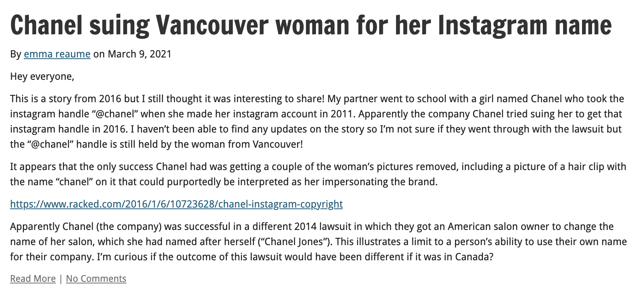

Slide 60
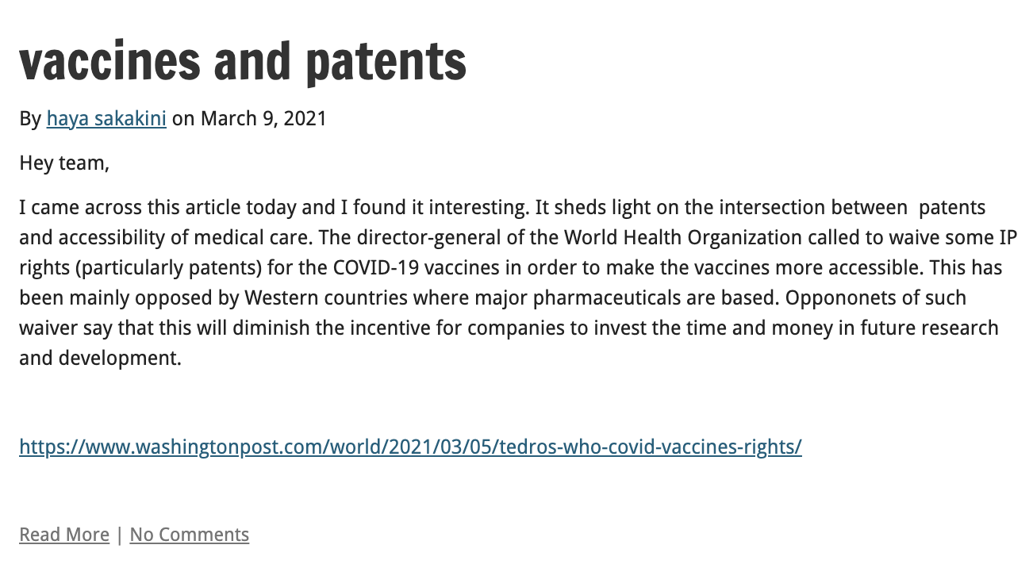

Slide 61
Your Presentations

Slide 62


Slide 63


Slide 64



Slide 65



Slide 66
Pause

Slide 67
QUESTIONS?
THOUGHTS?
DISCUSSION?

Slide 68
Trademarks
Review

Slide 69

Trademarks Review

Slide 70

Trademarks Review

Slide 71
Trademarks Review
The Kitasoo Band Council approaches you and would like to register the mark SPIRIT BEAR as an official mark. Do you anticipate any issues with the registration of this mark?

Slide 72

Trademarks Review

Slide 73
Trademarks Review
Is a TM registered in association with goods and not services “used” when it is reproduced, by a competitor, on a brochure placed next to both the product on which the TM is marked and the competitor’s product?

Slide 74
Trademarks Review
Kropp (Re), 2012 TMOB 232
Facts: Hudson’s Bay Co. requests that the Registrar of TMs issue a notice under s. 45 to Fairy Bay Guest House Inc. regarding the trade-mark FAIRY BAY.

Slide 75
Trademarks Review
Do you think the provisions in the TMA provide adequate protection against infringement for TM owners? If so, why? If not, what changes would you make to the TMA to increase protection against infringement?

Slide 76
Trademarks Review
Does the TMA sufficiently balance the property rights of TM owners with the speech rights of non-TM-owning parties?

Slide 77


Trademarks Review

Slide 78

Trademarks Review

Slide 79

Trademarks Review

Slide 80

Trademarks Review

Slide 81
Trademarks Review
Does TM law in Canada adequately balance between the rights of TM owners and the rights of the public to make use of marks capable of being protected under TM law?

Slide 82
Pause

Slide 83

Now, back to our regularly scheduled programming…

Slide 84

Patents

Slide 85
Patents
First…
Introduction to patents
Patentable subject matter
  Invention
    Composition of matter; manufacture; machine; art; process; improvement
Non-patentable subject matter
  Mere scientific principles or abstract theorem; professional arts; higher life forms; methods of medical or surgical treatment

Slide 86
Patents
Federal Government:
Authority over patents: s. 91(22), Constitution Act, 1867
Authority exercised in part through the enactment of the Patent Act, RSC, c. P-4
Definition of patent:
a limited term monopoly for an invention; the right, given to an inventor by the government, to exclude others from making, using or selling one’s invention from the day the patent is granted.
“.. “to advance research and development and to encourage broader economic activity” (Free World Trust, 2000 SCC)

Slide 87
Patents
”Patentee” can only get a patent for “inventions” (s. 2)
Also, patent only granted if your invention is novel, useful, and non-obvious (ss. 2, 28.3)
Term of protection: 20 years (ss. 44, 46)
Contrast with confidential information

Slide 88
Patents
At its core, the patent system is a bargain between the inventor and the public:
One party discloses an invention in exchange for a 20 year monopoly period in which to make, use, and sell the invention
See Teva Canada Ltd. v. Pfizer Canada, Inc.
  FACTS: Teva had challenged the validity of Pfizer’s patent for Viagra.

Slide 89
Patents
Teva Canada Ltd. v. Pfizer Canada, Inc.
Patent system is a “quid pro quo”
“[N]ot intended as an accolade or civic award for ingenuity. It is a method by which inventive solutions to practical problems are coaxed into the public domain by the promise of a limited monopoly for a limited time.”
Patent specification = heart of the disclosure requirement

Slide 90
Patents
Is a patent a good bargain?
Might we be better off with longer patent protection?
Without any sort of patent protection?

Slide 91

Guest Speakers in Audio-Slides

Slide 92


Slide 93

Coming Soon
Patents Part 2

Slide 94


A MATTER OF PERSPECTIVE

Slide 95

Conclusion

Slide 96
UNTIL NEXT
TIME!

Slide 97

Always include a cat picture

Slide 98
In learning you will teach
And in teaching you will learn
Phil Collins' Son of Man (1999)

