Slide 1

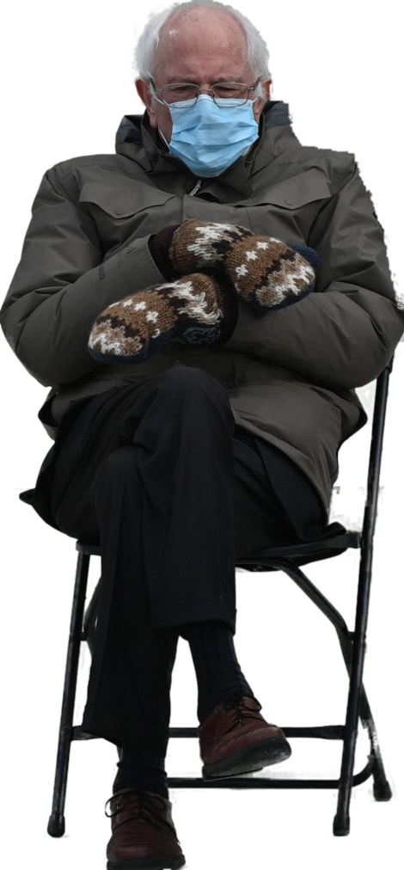

PATENTS 2
Talk 11 Introduction
LAW 422
Intellectual Property Law
Allard School of Law, UBC
Spring, 2021
Jon Festinger Q.C.
Centre for Digital Media
QMUL School of Law (CCLS)
Whiteboard Law
http://commlaw.allard.ubc
@jonfestinger
jon_festinger@thecdm.ca

Slide 2
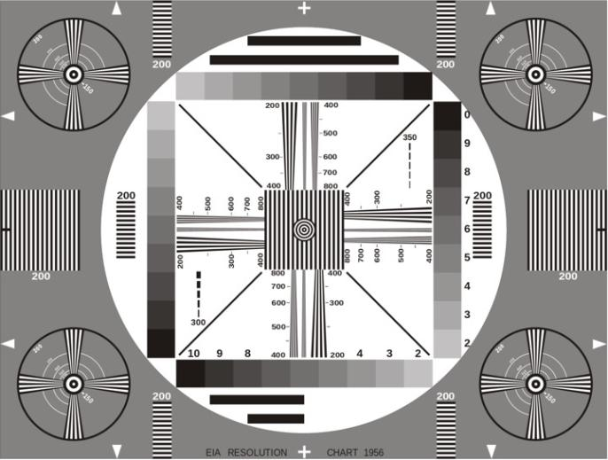
Permission to Record?

Slide 3
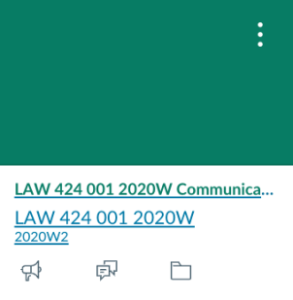
The draft slides
UBC Canvas

Slide 4
Logistics

Slide 5

This is our last class of the semester…
Next Friday is Good Friday
Allard classes end Thursday April 8
Exam is Friday April 16

Slide 6
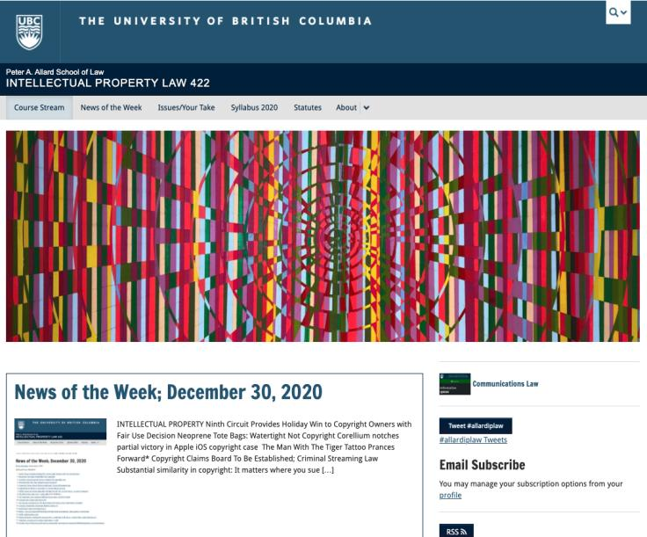
Course Website
https://iplaw.allard.ubc.ca/

Slide 7
For full privileges on the website
1. Please create an account at http://cms.ubc.ca/ using your CWL.
2. Once you create an account and sign in at http://cms.ubc.ca/ you can click your name in the top right. Halfway down the following page will be your WordPress email address.
3. Send me your WordPress email address at jon.festinger@ubc.ca or at jon_festinger@thecdm.ca
4. Then, I will invite you to participate with authoring privileges via your WordPress email address.

Slide 8
Methodology Prioritized
Slides relate directly to textbook & Syllabus
Added material or “context” in Slides not in textbook (not optional)
Added “context” from News of the Week (optional – but does often supply fact situations useful in exploring consequences in Canadian law or that could serve as the basis of an exam question)

Slide 9
Presentations (20%)
How’s it going?
Don’t let it be a last minute panic.
If you have posted a presentation, please drop me an email saying that.

Slide 10
Presentations (from Syllabus)
“Paper/Presentation/Post = 20% of grade
This will be 500-1000 word (or equivalent) per person original piece of work that illuminates some aspect of Intellectual Property Law. It can be in any form, posted to the course website or not, and can be approached individually or as a group.”

Slide 11
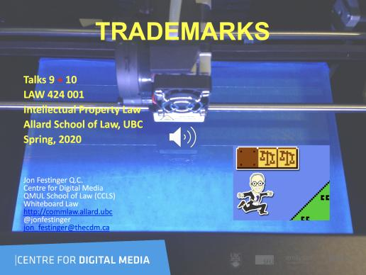
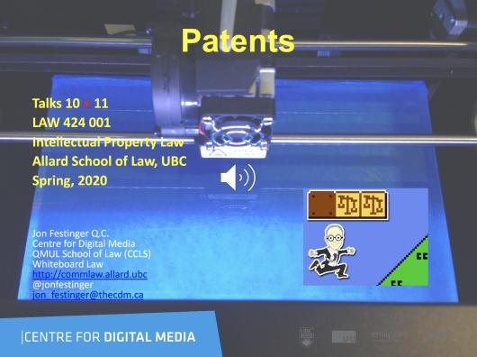
Last years audio-slides on UBC Canvas

Slide 12
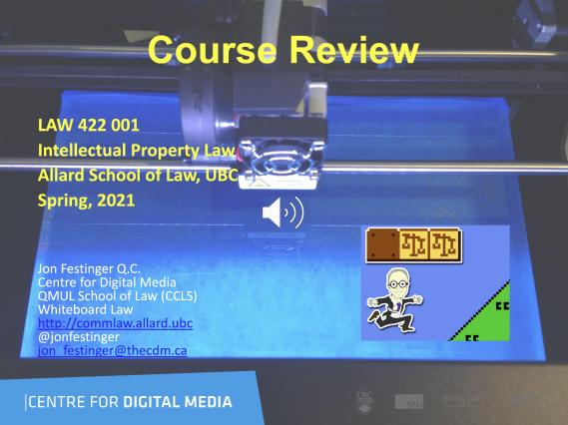
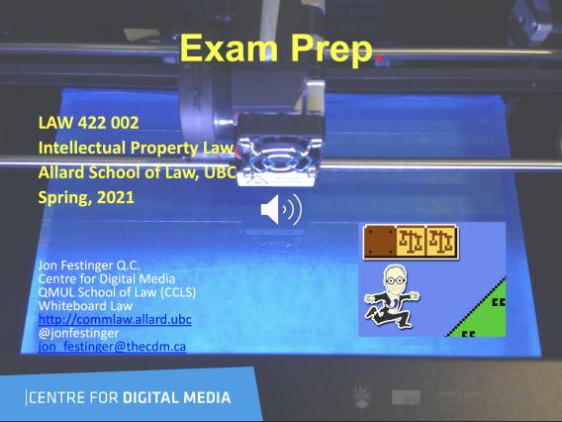
Coming Soon

Slide 13
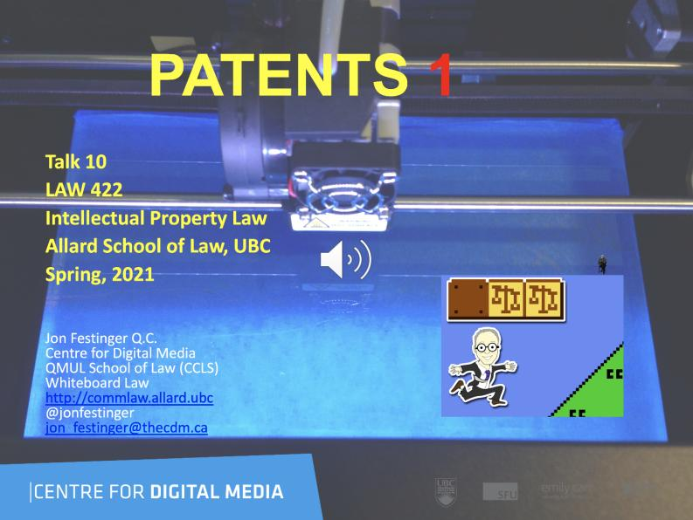
Week 10 Audio-Slides?

Slide 14
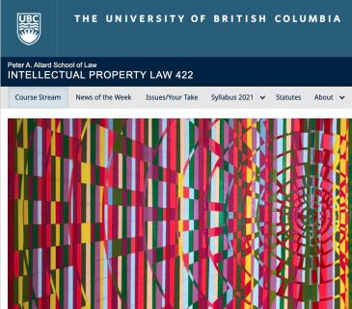
What should be last day for course website (or other) contributions for participation?
Last day of classes
Exam date
Last day of exams
Doesn’t matter we are all living in a video game anyways.

Slide 15

Office “Hours”: Ideally Fridays before or after class but am flexible…
Email me : jon.festinger@ubc.ca
Skype: jon.festinger
Phone:
o. 604-568-9192
c. 604-837-6426

Slide 16

Thanks for the emails with questions.
Planning pre-exam compilation.
Group Zoom question seesions?

Slide 17

Guest Speakers

Slide 18
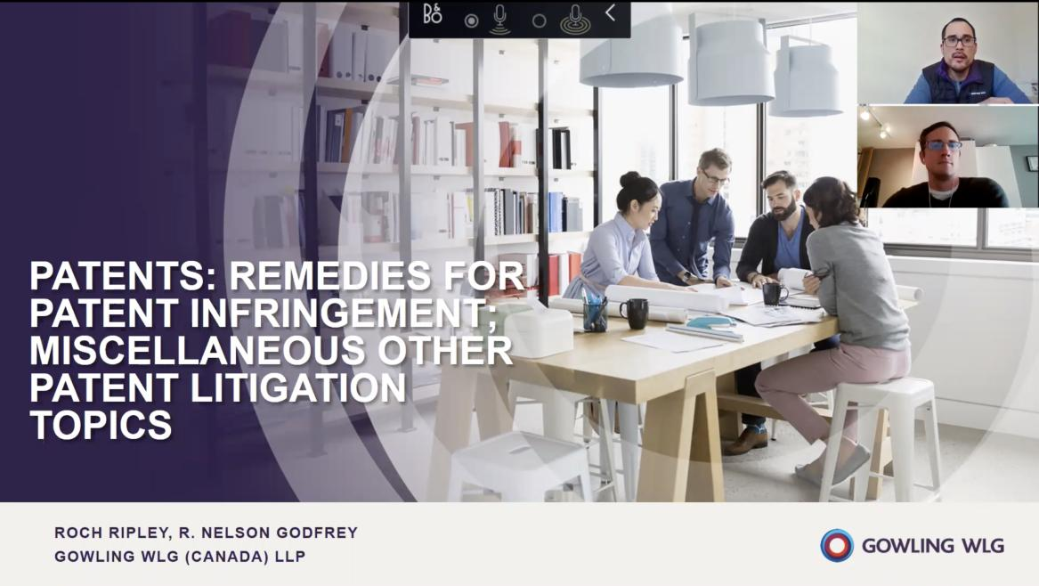

Slide 19

Micaela Mantegna on A.I. & I.P.

Slide 20
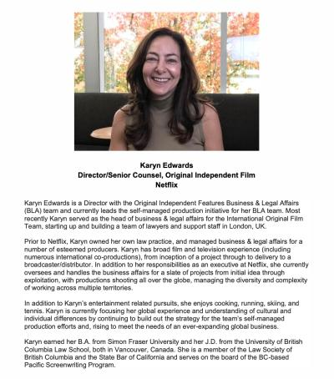

Coming soon?: Karyn Edwards of Netflix

Slide 21
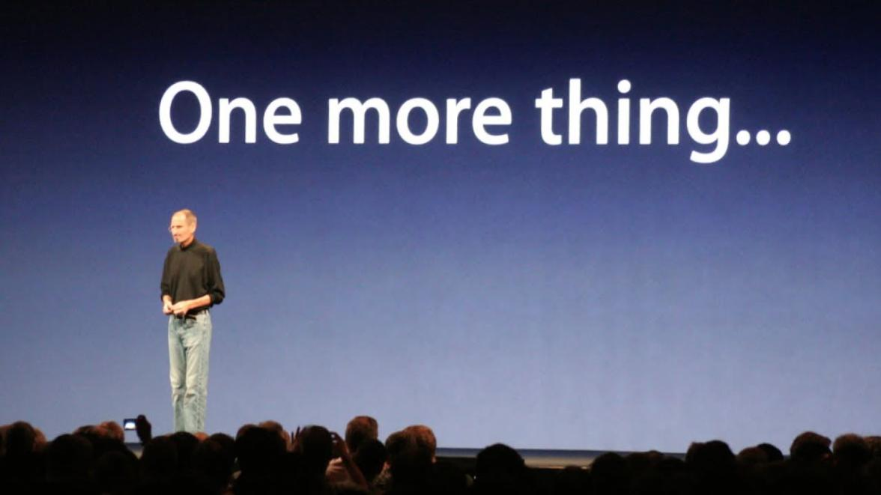

Slide 22
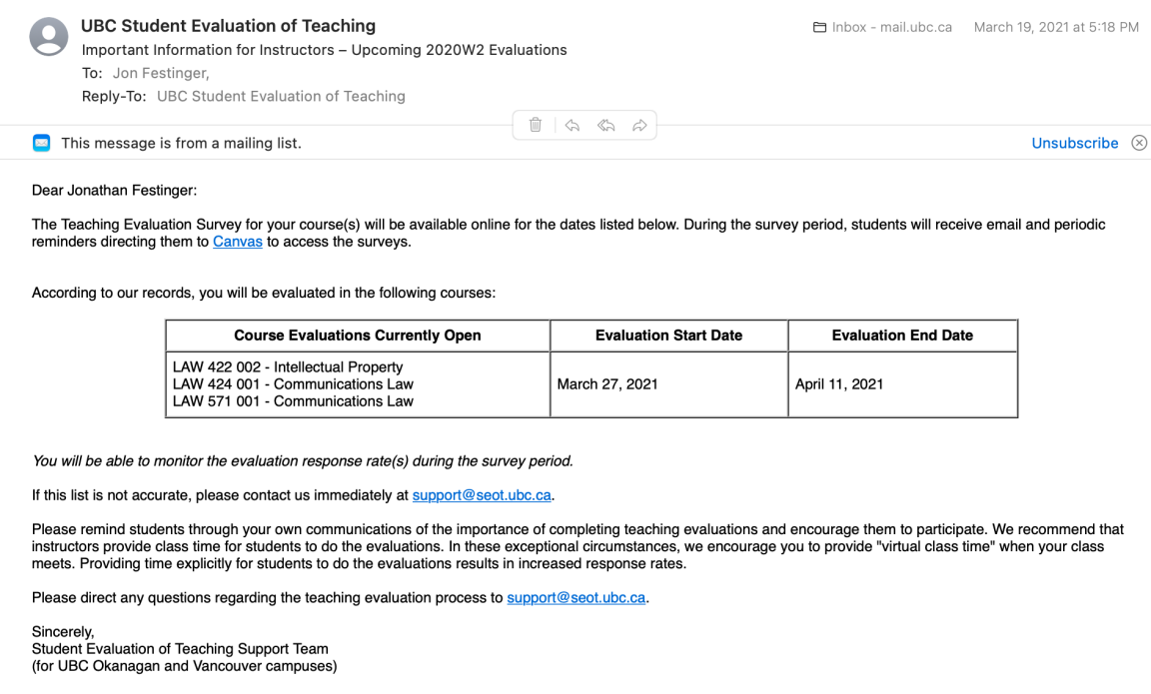

Slide 23
News of
the Week
(NFT* Edition)
*NonFungible Tokens

Slide 24
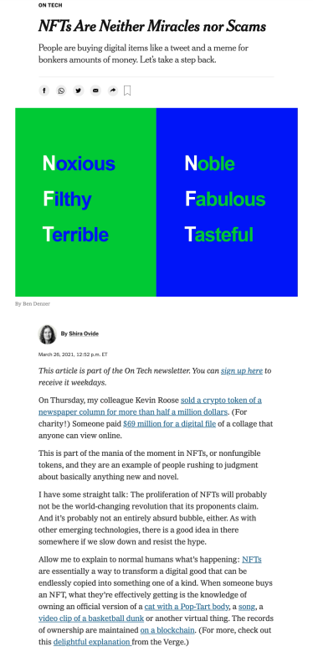

Slide 25
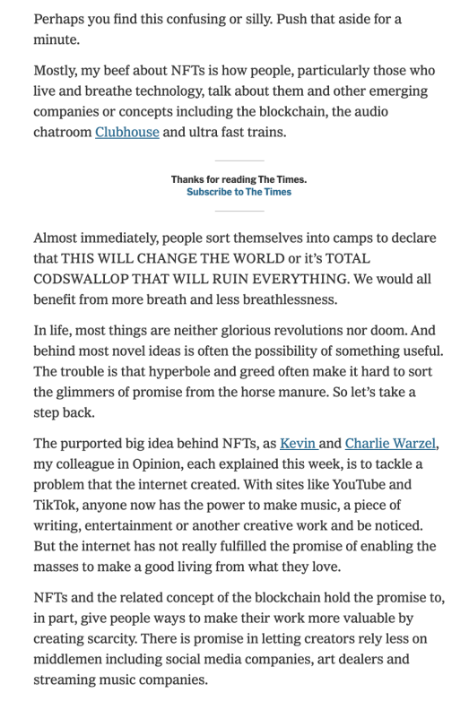

Slide 26
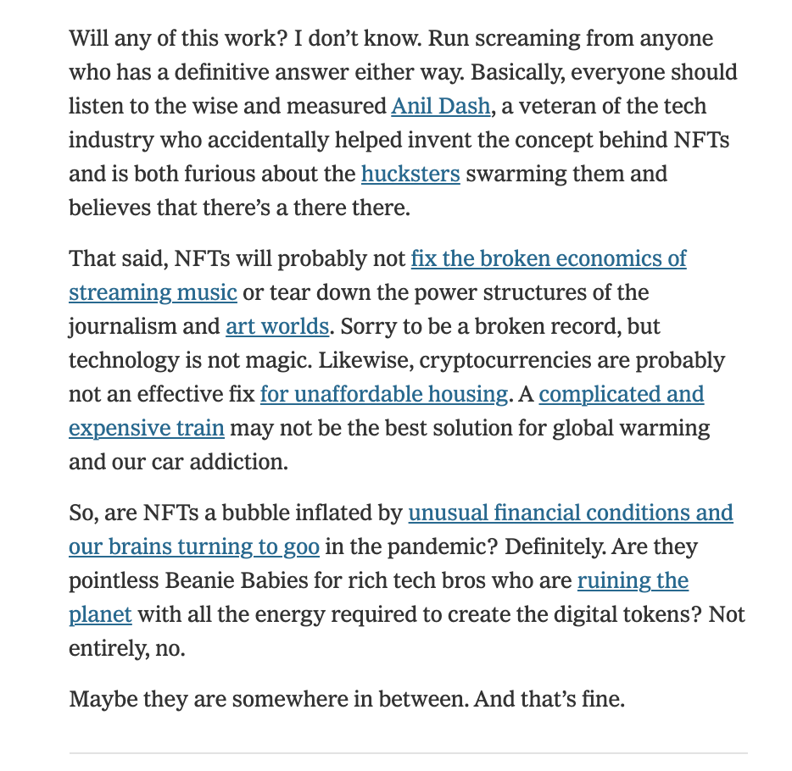

Slide 27
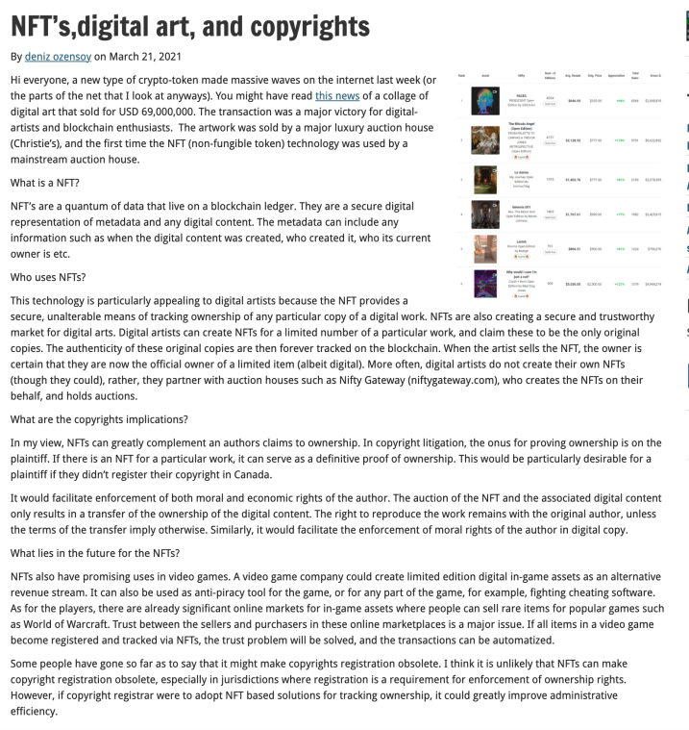

Slide 28
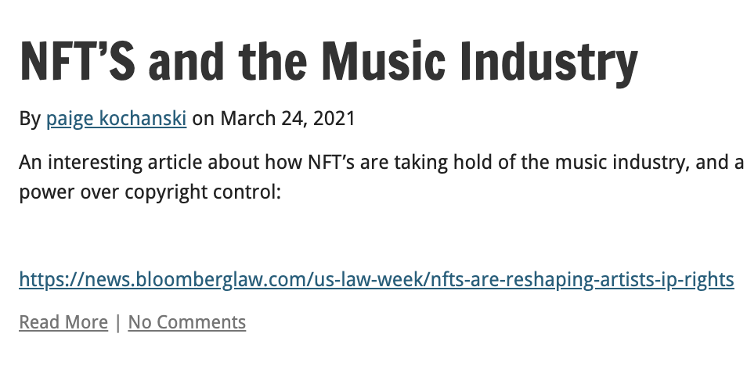

Slide 29
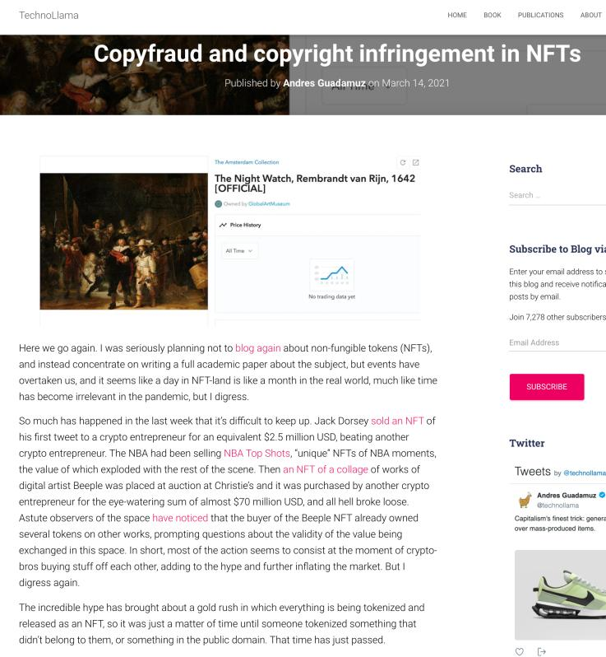

Slide 30
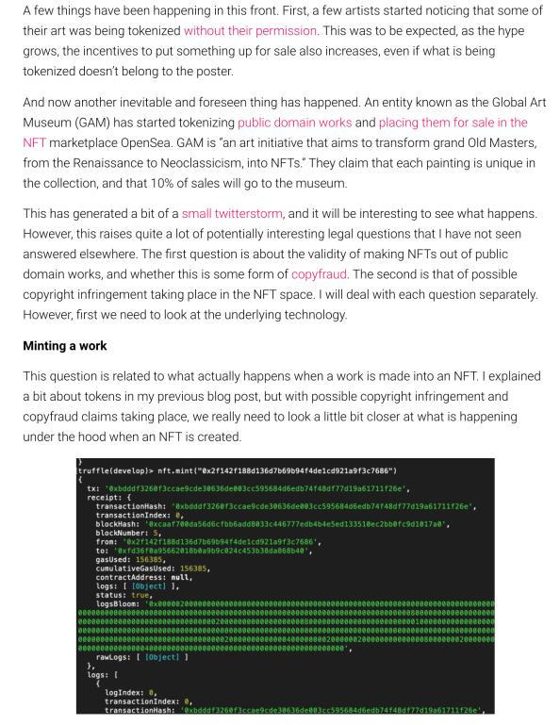

Slide 31
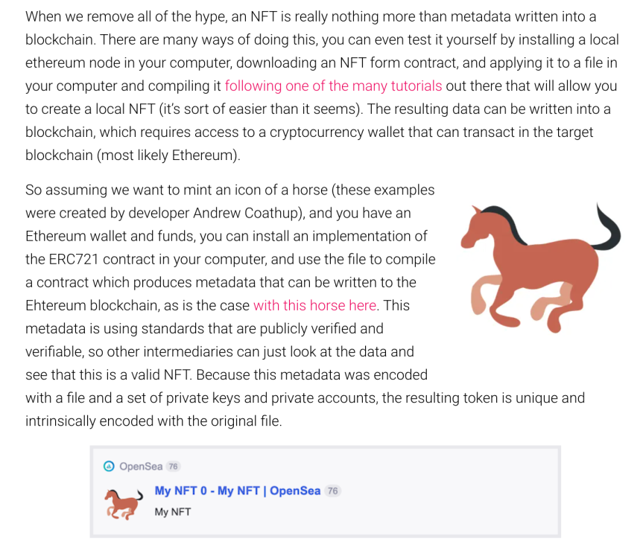

Slide 32
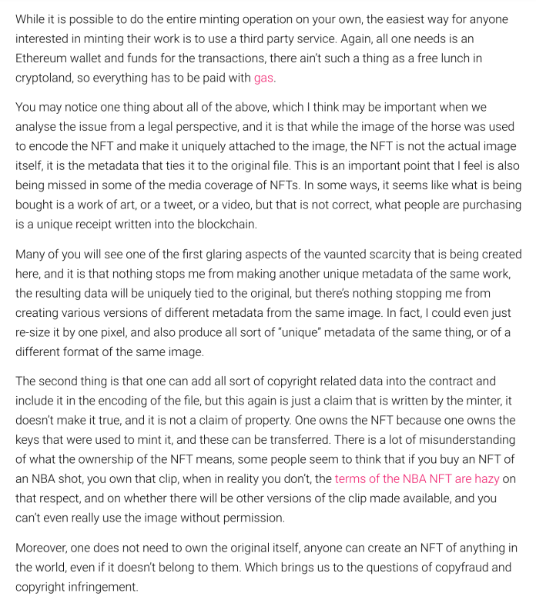

Slide 33
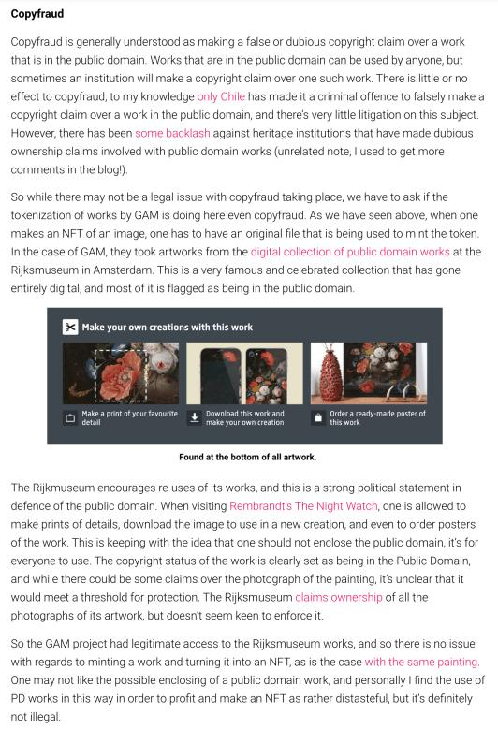

Slide 34
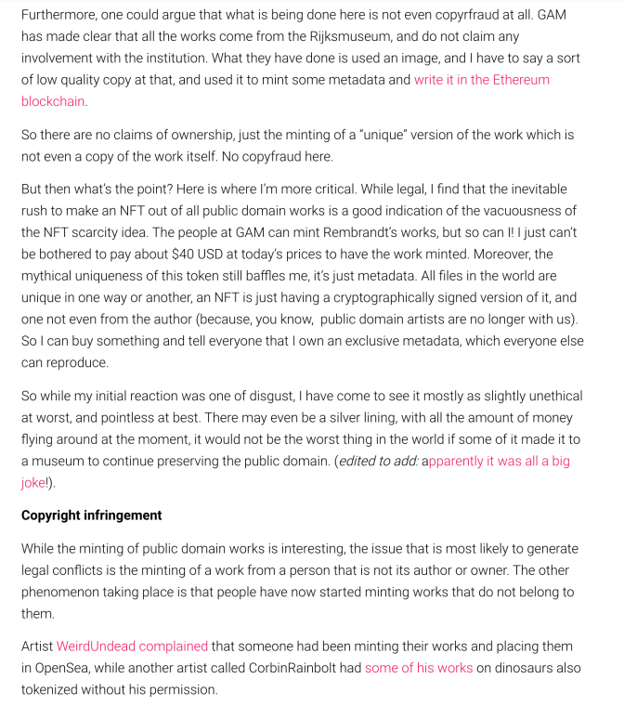

Slide 35
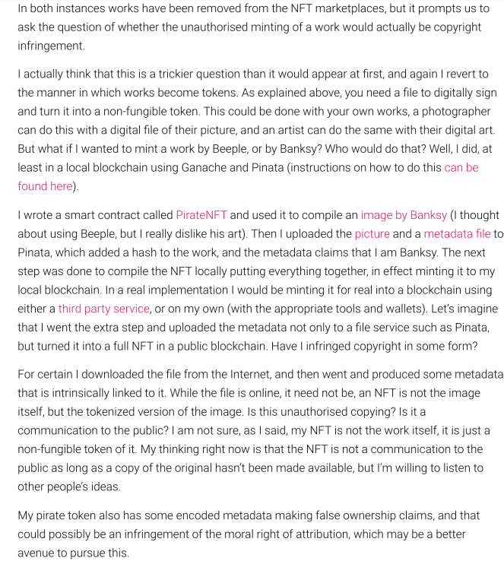

Slide 36
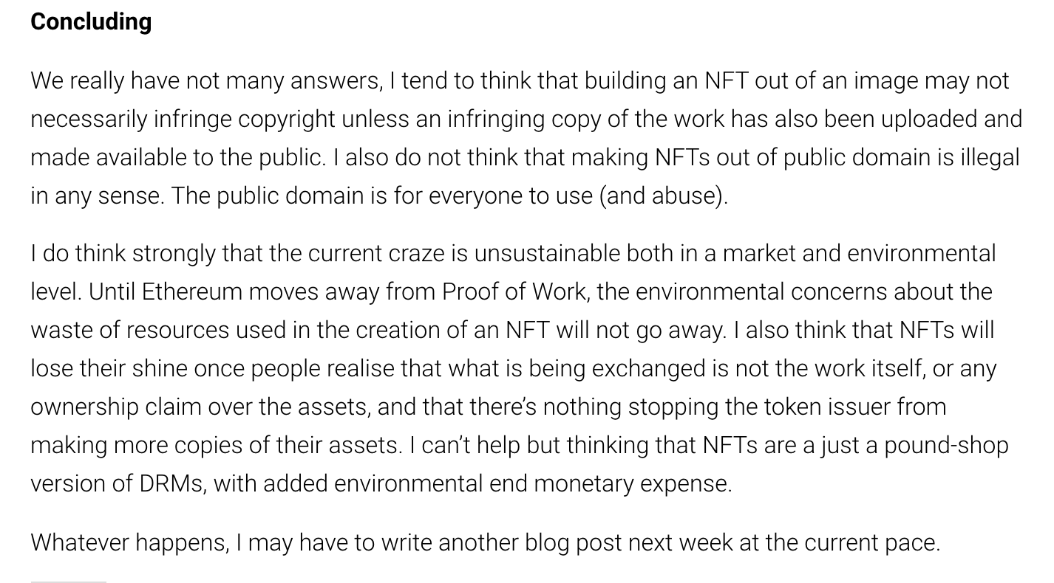

Slide 37

Pause

Slide 38
QUESTIONS?
THOUGHTS?
DISCUSSION?

Slide 39
Your News of the Week

Slide 40
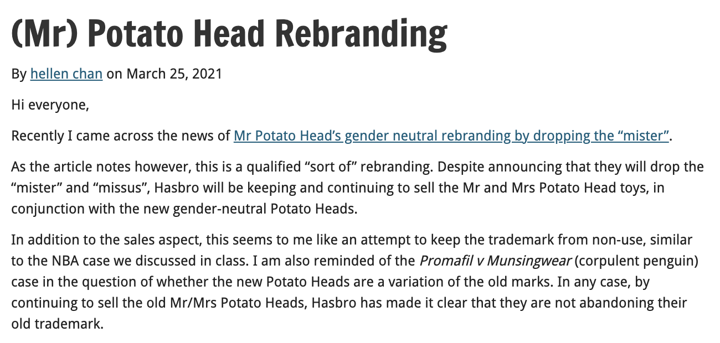

Slide 41
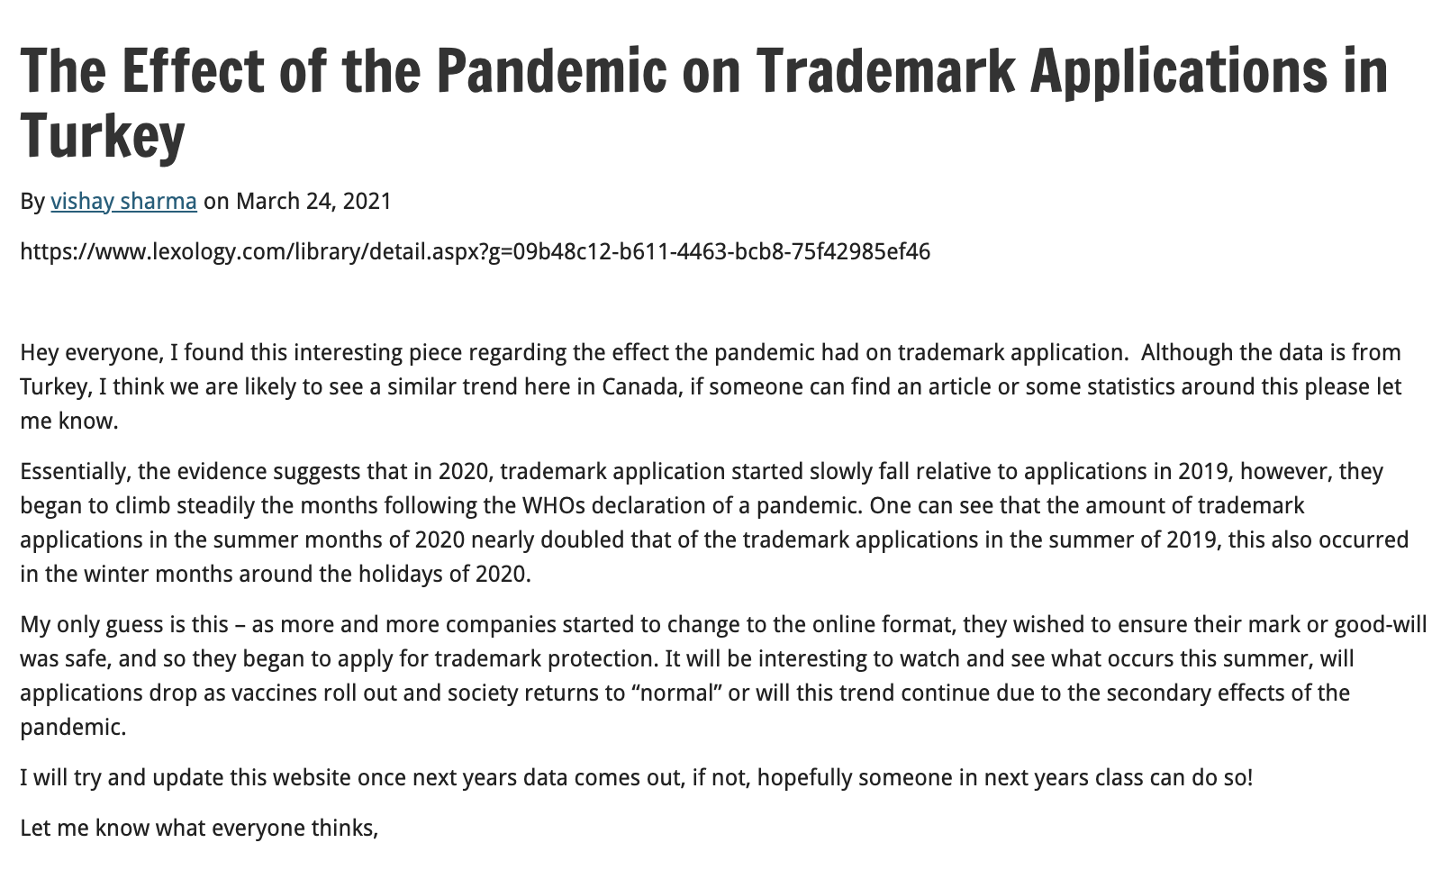

Slide 42
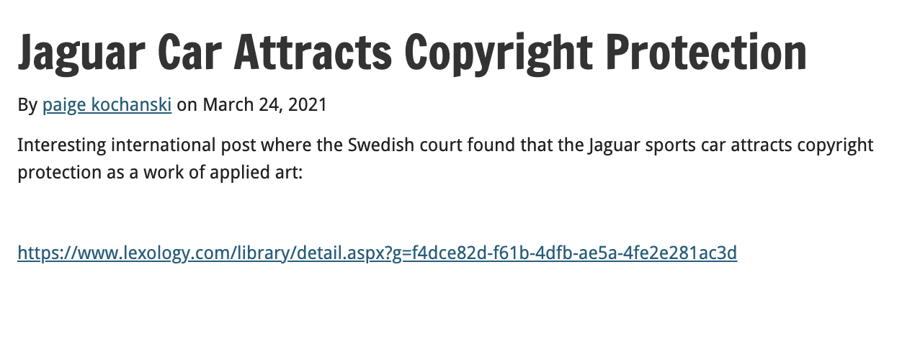

Slide 43
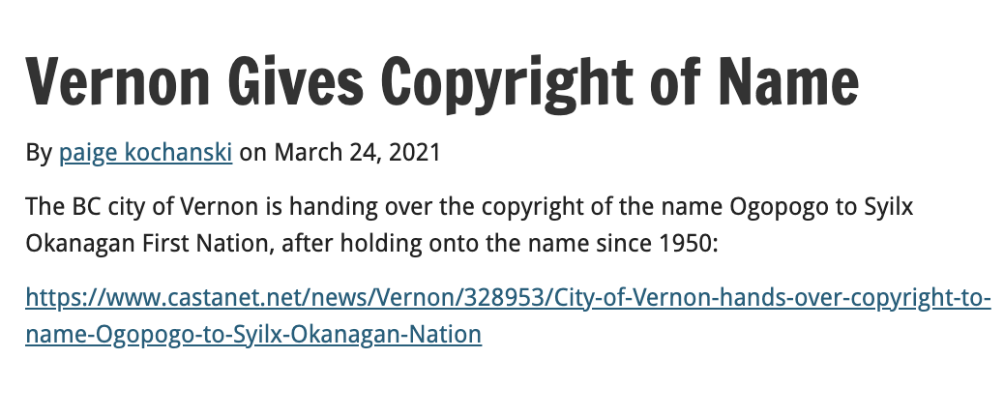

Slide 44
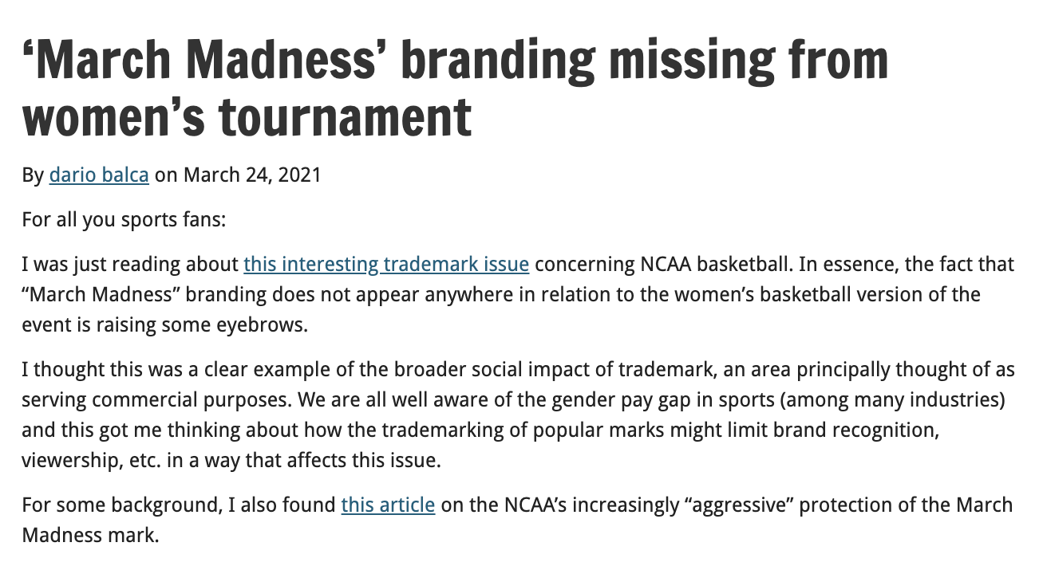

Slide 45
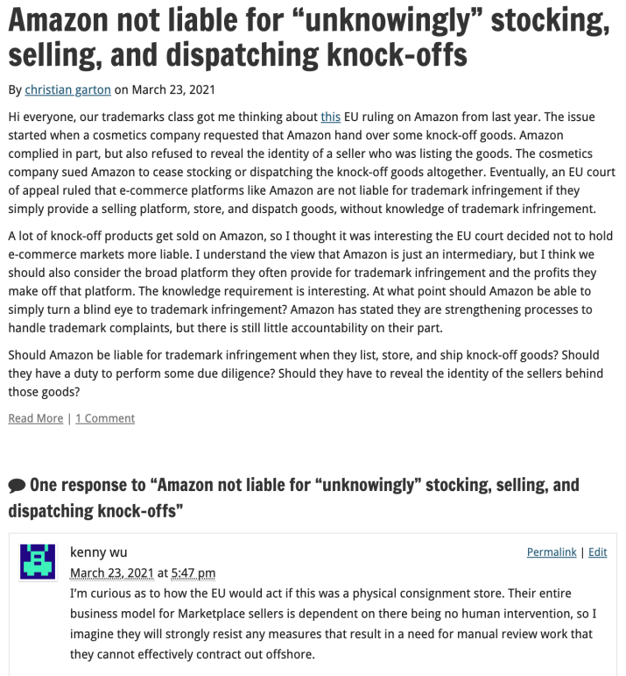

Slide 46
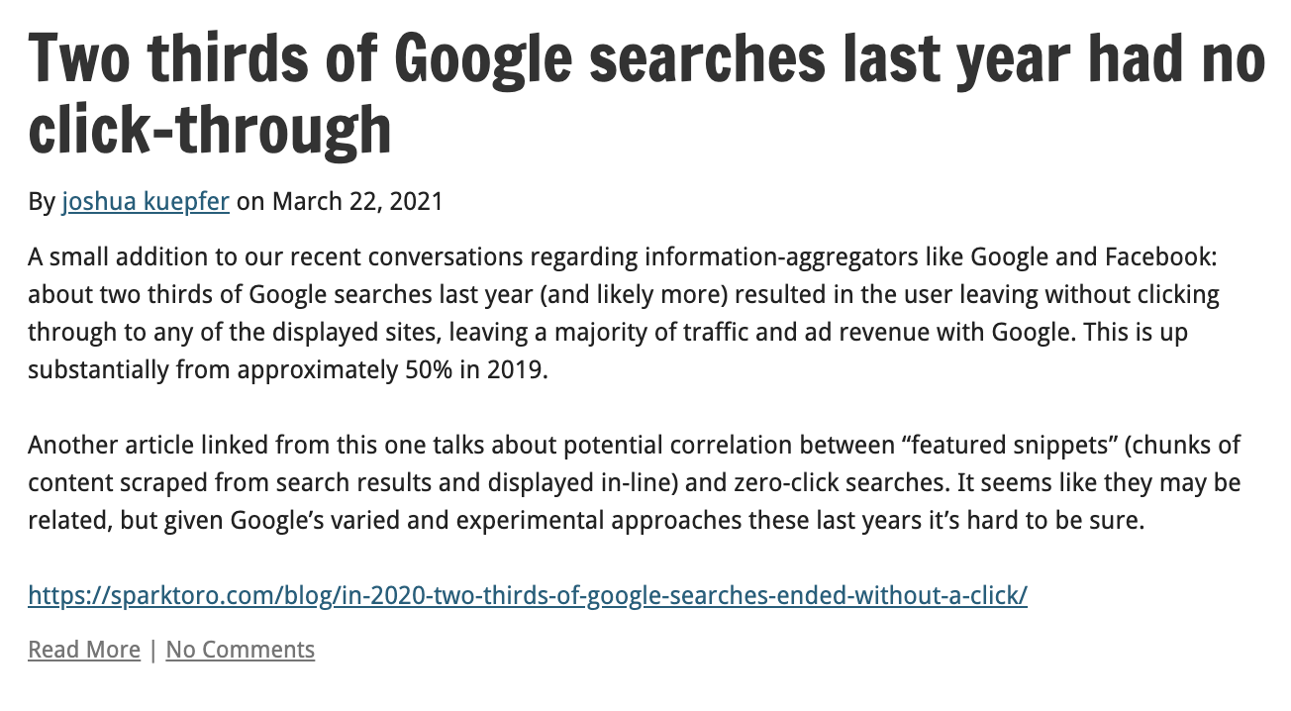

Slide 47
Your Presentations

Slide 48
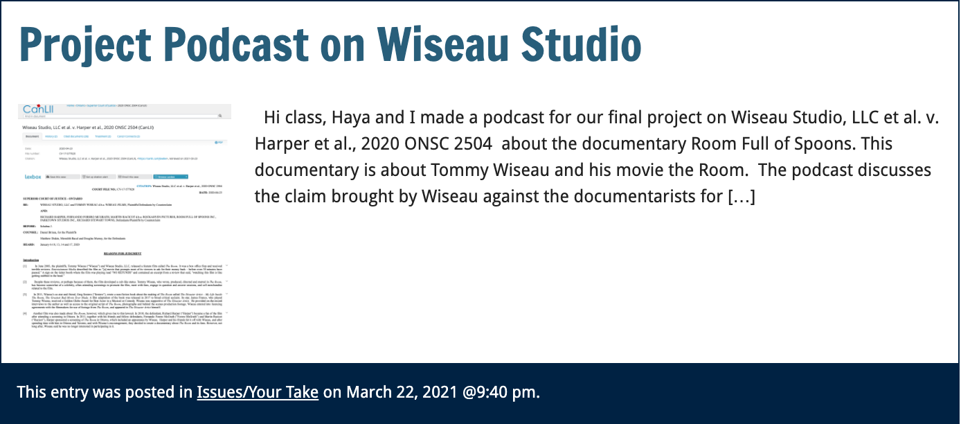

Slide 49


Slide 50
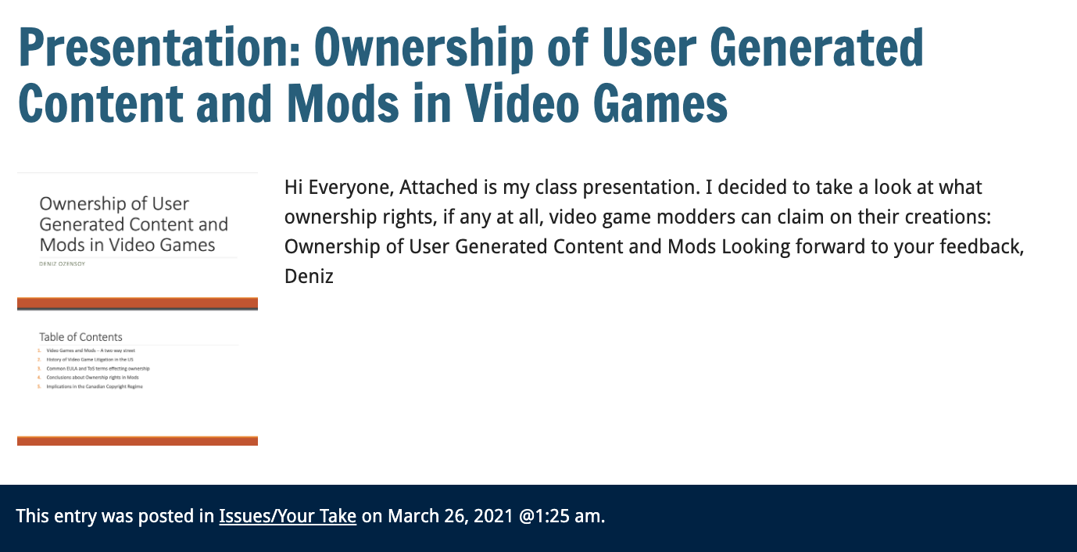

Slide 51
Presentation
today

Slide 52
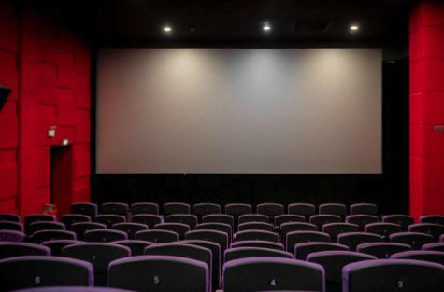

Slide 53
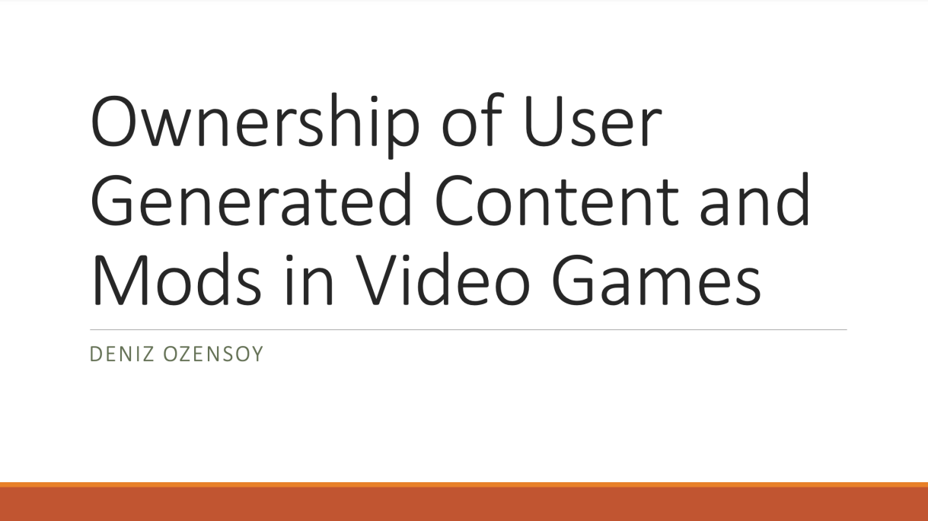

Slide 54
Pause

Slide 55
QUESTIONS?
THOUGHTS?
DISCUSSION?

Slide 56

Now, back to our regularly scheduled programming…

Slide 57
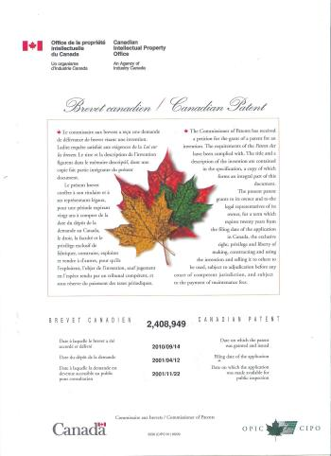
Patents

Slide 58
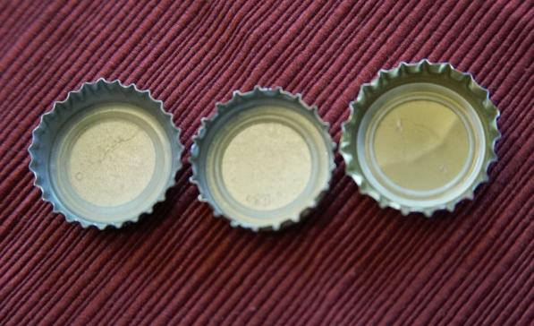
Re-capping

Slide 59
Patents
”Patentee” can only get a patent for “inventions” (s. 2)
Also, patent only granted if your invention is novel, useful, and non-obvious (ss. 2, 28.3)
Term of protection: 20 years (ss. 44, 46)
Contrast with confidential information

Slide 60
Patents
At its core, the patent system is a bargain between the inventor and the public:
One party discloses an invention in exchange for a 20-year monopoly period in which to make, use, and sell the invention
See Teva Canada Ltd. v. Pfizer Canada, Inc.
  FACTS: Teva had challenged the validity of Pfizer’s patent for Viagra.

Slide 61
Patents
Teva Canada Ltd. v. Pfizer Canada, Inc.
Patent system is a “quid pro quo”
“[N]ot intended as an accolade or civic award for ingenuity. It is a method by which inventive solutions to practical problems are coaxed into the public domain by the promise of a limited monopoly for a limited time.”
Patent specification = heart of the disclosure requirement

Slide 62
The Business Context
In 2015, intangible assets accounted for 87% of the value of Standard & Poor’s 500 (tracking 500 companies with the largest market capitalization listed on the New York Stock Exchange) [Ocean Tomo 2015]
Are patents overvalued generally?
Does start-up perception that patents are “necessary” result in overly general or irrelevant “false flag” patents that simply go unchallenged in the short-term.
E.g., = Cool product with patent, but patent is purely ancillary and has nothing to do with the key features that differentiate the product in the market
Likewise, query practical uses of “patent pending”.

Slide 63
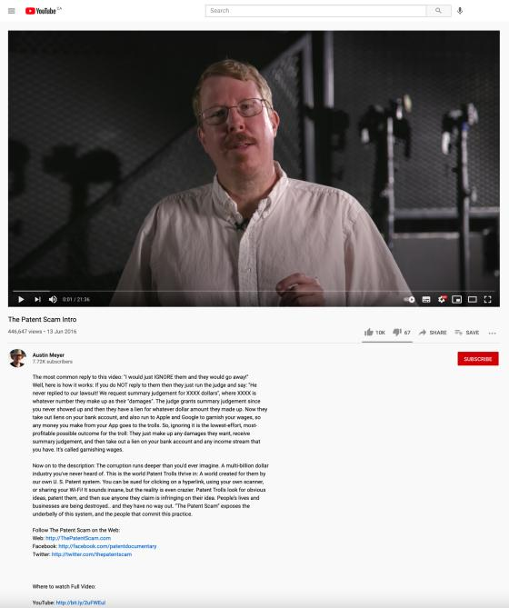
Trolls
https://www.youtube.com/watch?v=sG9UMMq2dz4

Slide 64
Patents
Harvard College (SCC):
Majority
  Invention defined broadly, should be interpreted broadly; but is not unlimited
  Some subject matter is outside the scope of protection
Commissioner has no discretion to refuse a patent on the basis of public policy considerations independent of express provisions of the Act

Slide 65
Patents
Composition of matter
The category ‘composition of matter’ refers to combinations of ingredients, whether combined as a chemical union or a physical mixture, and includes chemical compounds, compositions and substances (12.02.05, “MOPOP” – Manual of Patent Office Practice)

Slide 66
Patents
Composition of matter – Harvard College
Defined more narrowly than “all compositions of two or more substances and … all composite articles”
Does not include higher life form like the oncomouse
Statutory interpretation principles used to support this determination
Other factors that suggest that higher life forms are not compositions of matter (???)
  Recourse to dictionary definitions
  “Combine” – but elements require no human intervention
  “Composition of matter” seems inadequate as a description of a higher life form (???)

Slide 67
Patents
Manufacture
Majority (Harvard College)
  Manufacture = non-living mechanistic product or process
MOPOP (Manual of Patent Office Practice)
  The process of making (by hand, by machine, industrially, by mass production…) technical articles or material (in modern use on a large scale) by the application of physical labour or mechanical power; or the article or material made by such a process” (MOPOP 12.02.04).

Slide 68
My comments on majority decision in Harvard College
(have edited out regrettably inappropriate comments)
“…I have spent way too much arguing in my head with Mr. Justice Bastarache’s every word in Harvard Mouse.” – email to Prof. Graham Reynolds, 8.15.20.
My original (unexpurgated but decontextualized) marginal notes in the textbook version of the case:
  ”STRAINED WOULD BE AN UNDERSTATEMENT. INTELLECTUALLY HONEST?”
  Huh?
  Huh?
  Worst writing in the history of the Court (SCC)???
  It doesn’t?
  So what?
  So strained!!!
  ???
  Huh!
  Really?
  Huh – non sequitur
  LWTF? How? Wha..?
  B…Turns a preference for parliamentary clarity into a requirement for it – wrongly.
None of the above means I’m right, just that I had a similar reaction to some of you.

Slide 69
Patents
Machine
The mechanical embodiment of any function or mode of operation designed to accomplish a particular effect (MOPOP, s. 12.02.03)
Ex: Amazon.com, Inc. v. Canada (Attorney General), [2010] FC 1011, where certain patent claims disclosed ‘a machine … used to implement Amazon.com’s one-click ordering system”

Slide 70
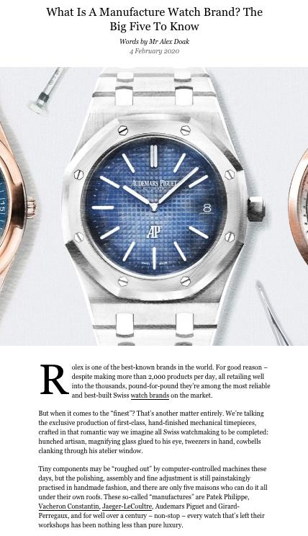

Slide 71
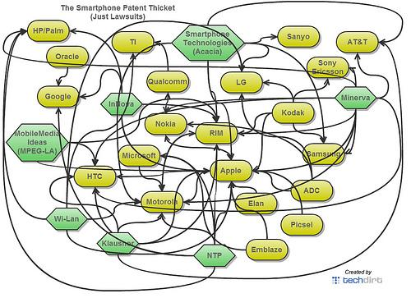
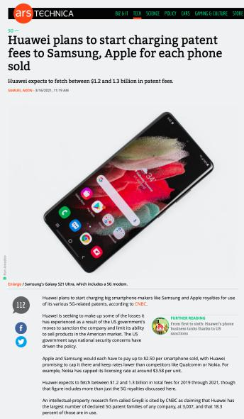
Patents

Slide 72
Patents
Art (as use)
The application of certain means to achieve a specific result
I.e.: the use of a known drug applied to treat a known disease

Slide 73
Patents
Art (as method)
Method
  “An act or series of acts performed by some … object and producing in that object some change of either character or condition” (citing to Lawson – cited in Amazon.com, Inc.(MOPOP, 12.02.01)
  Test cited in Amazon:
    Not a disembodied idea; must have method of practical application
    A new and inventive method of applying skill and knowledge
    Having a commercially useful result

Slide 74
Patents
Process
“A process can be considered to be a mode or method of operation by which a result or effect is produced by physical or chemical action, by the operation or application of some element or power of nature or one substance to another” (MOPOP)
A process through which a known method is applied to known materials is patentable (Commissioner of Patents v. Ciba Ltd., 1959 SCC)

Slide 75
Patents
Improvements
Most inventions are improvements of other inventions
Not an improvement? A “pioneering” invention
A patent on the improvement does not give you the right to make, sell, or use the original invention (s. 32, Patent Act)

Slide 76
Patents
Mere scientific principle or abstract theorem
Starting point: s. 27(8), Patent Act
This section interpreted as excluding, from patentability, natural phenomena and laws of nature (Arbour J., Schmeiser)
Are human gene patents patentable subject matter?

Slide 77
Patents
Mere scientific principle or abstract theorems
Historically – computer programs are not patentable because they are mathematical algorithms (unpatentable per s. 27(8)) (see Schlumberger Ltd. v. Canada (Patent Commissioner), 1982
But…see Motorola Inc., in which Motorola succeeded in patenting a mathematical algorithm by claiming it as part of a machine (the computer)

Slide 78
Patents
Patentability of business methods
Canada (Attorney General) v. Amazon.com, Inc., 2011 FCA 328
  FACTS: one-click online purchase method
  (1) No case law to support claim of tradition of excluding business methods from patentability
  (2) To avoid patenting a mere idea or discovery, the claimed invention must have some “physical existence” that “manifests a discernible effect or change”. This is not met merely through the claimed invention having a “practical application”.

Slide 79
Patents
Professional Arts v. Professional Skills
  Professional skills are considered not to be patentable on the basis that they reflect the personal knowledge and capacities that one would expect from any-one skilled in their field
  See Lawson

Slide 80
Patents
Higher life forms
Post Harvard College:
  Patent applications cannot include claims to higher life forms (i.e., seeds, plants, non-human animals) or to humans
  Can patent isolated genes and cells (cell lines, cell cultures)
  Fertilized eggs?
    CIPO practice notice – fertilized egg is considered to be a higher life form because it can develop into a higher life form

Slide 81
Patents
Higher life forms
But … Monsanto Canada Inc. v. Schmeiser (2004)
  Schmeiser infringed Monsanto’s patented modified canlola gene by growing and harvesting his canola plants containing their patented gene.

Slide 82
Patents
Methods of Medical or Surgical Treatments
Tennessee Eastman Co. et al. v. Commissioner of Patents [1974] S.C.R. 111
  Authority for the proposition that medical or therapeutic methods are not patentable in Canada.
  Tennessee Eastman sought a patent for a surgical method for bonding a wound through the application of glues. The glues themselves were not new. The “discovery” was that the glues could be used in place of stitches to close wounds.

Slide 83
Pause

Slide 84
QUESTIONS?
THOUGHTS?
DISCUSSION?

Slide 85
Patent Requirements
Next…
Requirements of patentability:
  Novelty
  Non-obviousness
  Utility

Slide 86
Patents
Novelty and usefulness (see s. 2, Patent Act)
Non-obviousness (see s. 28.3, Patent Act)

Slide 87
Patents
Novelty
Also referred to as “anticipation” (prior action that prevents the action of another)
Has the invention been disclosed in some way prior to the date of the patent claim?
See s. 28.2, Patent Act
Underlying policy reason?

Slide 88
Patents
Novelty
Prior art: Material which may disclose the invention which you’re claiming
Can use this to establish that an invention existed before the patent claim
See s. 28.2 outline of what constitutes prior art for the purpose of assessing novelty

Slide 89
Patents
Novelty
s. 28.1(1)(a)(ii): Foreign filings section
  If a person has filed an application for the same invention in another treaty country, then under s. 28.1(1)(b) and (c), if the 2nd filing is within 12 months of the first filing, and if the applicant has made a request for priority on the basis of the previously regularly filed application, then the first date can be the claim date

Slide 90
Patents
When has anticipation occurred?
Lack of novelty is only found when your invention has been disclosed in a single publication/use
This publication must disclose the invention without “mosaicing” references
Mosaicing = collect a file of references and say that these references, taken together, disclose the subject matter
Commonly occurs through publication…

Slide 91
Patents
Other ways through which disclosure can occur
Display of the invention in a public place
Sale of the invention
Use of the invention
Conference presentation
Disclosure online
Filing of earlier patent application
NB: in Canada or elsewhere… (s. 28.2)

Slide 92
Patents
Novelty was recently refined in Apotex v. Sanofi-Synthelabo (SCC, 2008)
Two part test: There is no novelty where there is (1) prior disclosure and (2) enablement
(1) Prior disclosure:
  The prior [publication/sale/use/patent] must disclose subject matter which, if performed, would necessarily result in infringement of that patent. At this stage, the skilled person is simply [analyzing] the prior [publication/sale/use/patent] for the purposes of understanding it. There is no room for trial and error or experimentation by the skilled person.

Slide 93
Patents
Novelty
(2) Enablement (see paras. 26-27, 37 in Apotex)
  Would the person skilled in the art have been able to perform the invention without undue burden?
    If inventive steps are required, the prior art will not be considered to be enabling
    Routine trials are acceptable
    The skilled person can use common general knowledge to supplement the information in the prior art or prior disclosed materials
    Obvious errors or omissions in prior art will not prevent enablement.

Slide 94
Pause

Slide 95
QUESTIONS?
THOUGHTS?
DISCUSSION?

Slide 96
Patents
Double patenting/evergreening
[63] … The inventor is only entitled to “a” patent for each invention: Patent Act , s. 36(1). If a subsequent patent issues with identical claims, there is an improper extension of the monopoly (Binnie J., Whirlpool Corp., SCC, 2000)
Look only at the claims (not the disclosure), as it is the claims that define the monopoly

Slide 97
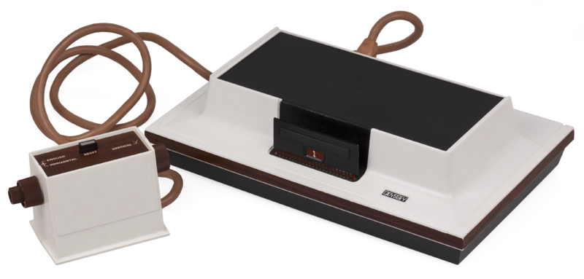
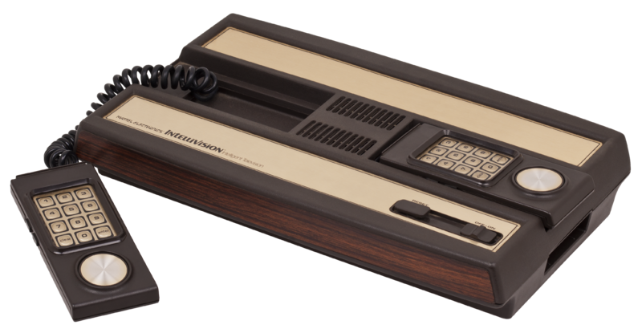
A “Prior Art” story
Magnavox v. Mattel 1982 U.S. Dist. LEXIS 13773 (N.D. Ill.)

Slide 98
Chronology
1962: Spacewar! released on DEC PDP-1 mainframe @ MIT
...’507 from experiments done by Rusch, employee of Sanders Associates in 1967/68
1971: Sanders & Magnavox enter into exclusive license
1972: Magnavox Odyssey introduced (analog circuitry)
1975: Atari introduces Pong game console for home use (analog)
1976: General Instruments introduces TV game microprocessor (digital circuitry)
Magnavox sues Atari for patent violation & infringing concept of electronic ping pong (settled by Atari becoming Magnavox exclusive licensee)
1978: Magnavox Odyssey 2 has a microprocessor (digital)
1979: Mattel introduces Intellivision with General Instruments microprocessor (digital). Magnavox sues Mattel.

Slide 99
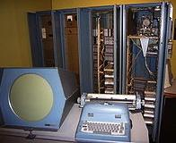
Court decided…
No distinction between analog and digital: “I regard analog and digital circuitry as two means which are interchangeable largely, which are equivalent, and which are, therefore, essentially the same means for achieving substantially the same results in substantially the same way.”
So far, so good…

Slide 100

But…OOPS!

Slide 101
Result: Creation of a meaningless
Computer Game/TV Console Divide
Mattel argued its console was not based on ’507 but on computer prior art, Space War!
Court noted PDP-1 was 6’ tall by 7’ wide, & cost approximately $120K. Court found for Magnavox: “…it is clear from the evidence that Mattel did not in fact follow the prior art but, instead, followed developments in the television game industry, an industry which was created because of the work done at Sanders in developing the first television games and an industry which expanded and developed and become economically viable largely because of television games which followed the teachings of the ’507 Patent.”

Slide 102
Pause

Slide 103
QUESTIONS?
THOUGHTS?
DISCUSSION?

Slide 104
Patents
Now…
Requirements of patentability:
  Novelty
  Non-obviousness
  Utility

Slide 105
Patents
Obviousness
Who is the “Test Person”?
Unimaginative skilled technician
Question to ask:
Would the person skilled in the relevant art and science, based on their skill and knowledge but without a scintilla of imagination, have been led to this invention?

Slide 106
Patents
Novelty and obviousness, distinguished
Novelty: Can’t “mosaic”
Obviousness: Could the unimaginative skilled person have taken all of the pieces and, using reasonable deduction, have arrived at this invention?

Slide 107
Patents
Obviousness inquiry (para. 67, Apotex):
(a) Identify the notional ‘person skilled in the art’
(b) Identify the relevant common general knowledge of that person
Identify the inventive concept of the claim in question or construe it
Identify what, if any, differences between the matter cited as forming part of the ‘state of the art’ and the inventive concept of the claim as construed
Viewed without any knowledge of the alleged invention as claimed, do those differences constitute steps which would have been obvious to the person skilled in the art or do they require any degree of invention?

Slide 108
Patents
Next…
Requirements of patentability:
  Novelty
  Non-obviousness
  Utility

Slide 109
Patents
Utility
An invention must be useful to be patented. There is no definition of “utility” in the Patent Act.
Teva Canada Ltd v. Pfizer Canada Inc, 2012 SCC 60 at para 38, the Supreme Court of Canada stated “all that is required to meet the utility requirement in s. 2 is that the invention described in the patent do what the patent says it will do, that is, that the promise of the invention be fulfilled.”

Slide 110
Patents
Utility
Laboratoires Servier, Adir, Oril Industries, Servier Canada Inc v Apotex Inc, 2008 FC 825, Snider J.: “[270] Beyond this general statement of the law, there are a number of other guiding posts:
• Where the specification does not promise a specific result, no particular level of utility is required - a “mere scintilla” of utility will suffice…However, as stated in Consolboard, above, where the specification sets out an explicit “promise,” utility must be measured against that promise;
• Utility does not depend upon marketability…; In other words, in assessing whether an invention has utility, the issue is not whether the invention is sufficiently useful as to be able to support commercialization, unless commercial utility is specifically promised;
• The relevant date has been held to be the filing of the Canadian patent application…; and
• Where a claim is to a class of compounds, lack of utility of one or more of the compounds will invalidate all of the compounds of that particular claim…”

Slide 111
Patents
Utility: Apotex Inc v. Wellcome Foundation Ltd, 2002 SCC 77, Binnie J:
“[3] In my view, for the reasons which follow, the inventive use of AZT was made by the five Glaxo/Wellcome scientists named in the patent on or before March 16, 1985, the priority date of the patent. It was sufficient that at that time the Glaxo/Wellcome scientists disclosed in the patent a rational basis for making a sound prediction that AZT would prove useful in the treatment and prophylaxis of AIDS, which it did. For the Commissioner of Patents to have allowed Glaxo/Wellcome a patent based on speculation would have been unfair to the public. For him to have required Glaxo/Wellcome to demonstrate AZT’s efficacy through the clinical tests required by the Minister of Health for approval of a new drug for medical prescription would have been unfair to Glaxo/Wellcome. The disclosure made in the patent was and is of real use and benefit to millions of HIV and AIDS sufferers around the world (irrespective of Glaxo/Wellcome’s pricing policy for AZT, which it must be acknowledged has generated serious controversy in some countries, particularly in the developing world). The fact remains that Glaxo/Wellcome, by making the disclosure, has fulfilled its side of the bargain with the public, and is by law entitled to legal protection for what it has disclosed.”

Slide 112
Patents
Utility: The “Public Interest” cuts both ways…
“…[36] It is not surprising that the appellants, being generic drug manufacturers, would like to obtain at least a percentage of the AZT market in Canada. To do so they must somehow have the patent declared invalid. Yet their challenge, understandably motivated by the hope of private profit, raises broader issues of public interest.”

Slide 113
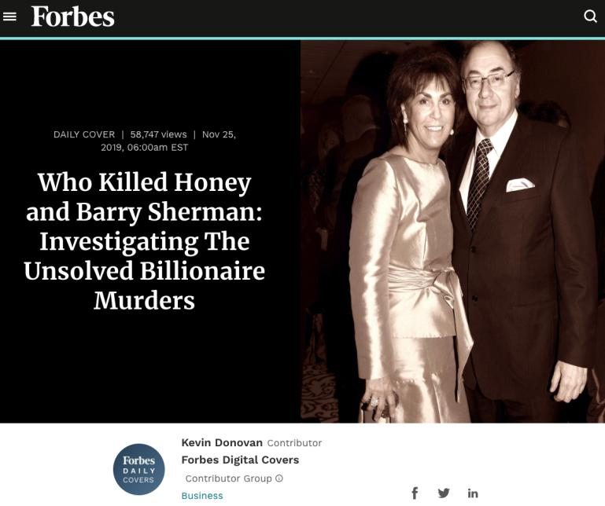
Re: Apotex

Slide 114
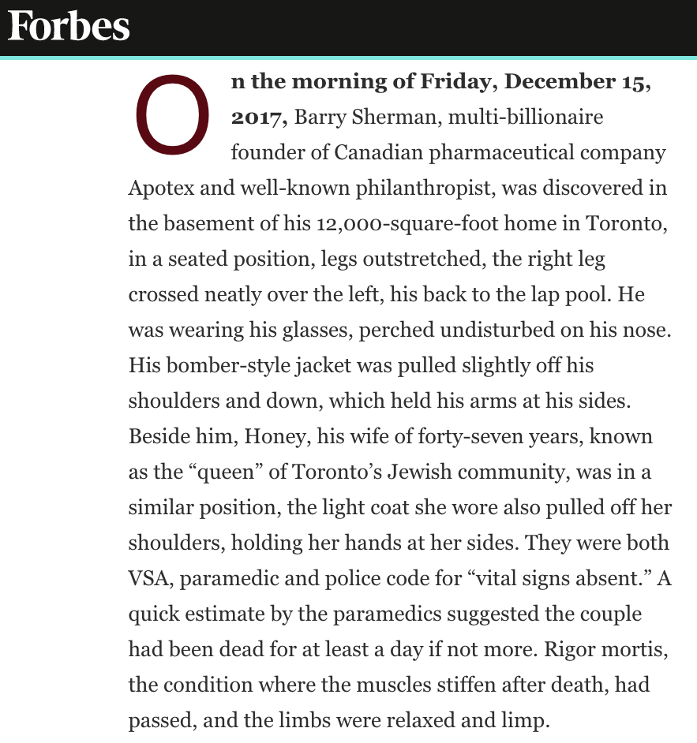

Slide 115
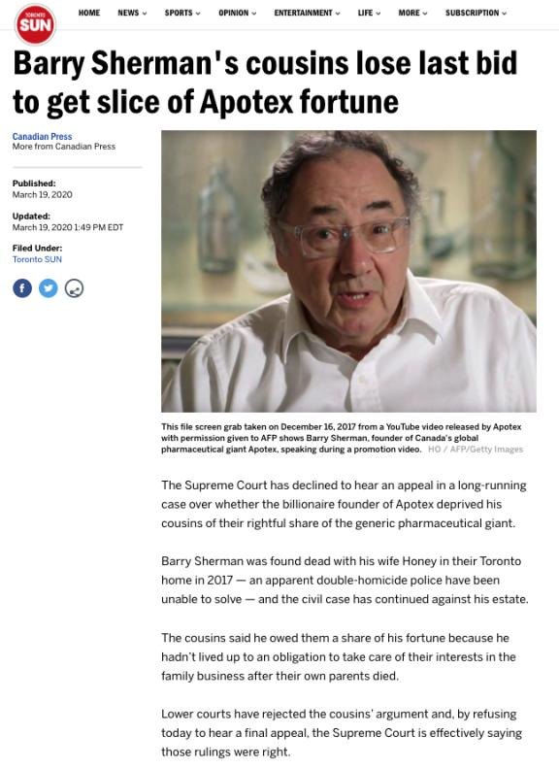

Slide 116
Patents
Utility: The Doctrine of “Sound Prediction”
Apotex Inc v. Wellcome Foundation Ltd, 2002 SCC 77, Binnie J:
“[70] The doctrine of sound prediction has three components. Firstly, as here, there must be a factual basis for the prediction…Secondly, the inventor must have at the date of the patent application an articulable and “sound” line of reasoning from which the desired result can be inferred from the factual basis…Thirdly, there must be proper disclosure. Normally, it is sufficient if the specification provides a full, clear and exact description of the nature of the invention and the manner in which it can be practised….It is generally not necessary for an inventor to provide a theory of why the invention works…In this sort of case, however, the sound prediction is to some extent the quid pro quo the applicant offers in exchange for the patent monopoly. Precise disclosure requirements in this regard do not arise for decision in this case because both the underlying facts…and the line of reasoning…were in fact disclosed…”

Slide 117
Patents
“…[66] The doctrine of “sound prediction” balances the public interest in early disclosure of new and useful inventions, even before their utility has been verified by tests (which in the case of pharmaceutical products may take years) and the public interest in avoiding cluttering the public domain with useless patents, and granting monopoly rights in exchange for misinformation.”

Slide 118
Dr. Janet (not Jane) Ridout
“…[13]…On December 5, 1984, Dr. Jane Rideout, the team member who had recommended testing AZT, sent a note to the Glaxo/Wellcome patent group stating: “Ethically the MD’s at BW [Glaxo/Wellcome] cannot suppress the activity of such a compound for very long”. By that, she meant that HIV/AIDS sufferers should not be deprived of potential relief through unnecessary delay, scientific timidity, or corporate dithering. Work on a patent application began soon afterwards.
[14] Dr. Rideout shared the view that further work was essential. She added, in her note to the Glaxo/Wellcome patent group, that a patent should only be pursued “if [AZT is] active against HIV” and “if all of this holds up [i.e., if activity is shown against HIV]” (emphasis added).”

Slide 119




Slide 120
Continuing with our show…

Slide 121
Patents
Remaining Outline
Miscellaneous patent law topics
Patent rights, term and ownership
Post-grant issues
Infringement
Defences to infringement and abuse of rights

Slide 122
Patents
Patent Term
  20 years from the filing date of the patent (s. 44), so long as maintenance fees continue to be paid (s. 46).
Assignment of the right to obtain a patent (see s. 49). Assignment must be in writing & signed (s. 50)
Patent Act does not expressly deal with who owns patent between employer/employee (unlike Copyright Act)

Slide 123
Patents
Exclusive Rights of the patent owner (s. 42, Patent Act)
  Right to make the invention
  Right to construct the invention
  Right to use the invention
These rights “generally protect [the] business interests” of the patentee (para. 36, Monsanto v. Schmeiser )

Slide 124
Patents
Monsanto Canada, Inc. v. Schmeiser
Facts: Involves genetically altered canola seed
Did Schmeiser infringe Monsanto’s patent by “making” the gene or cell? (undecided)
Did Schmeiser “use” the gene and cell? (see para. 28)
  Q: Did the Defendant’s activity deprive the inventor in whole or in part, directly or indirectly, of the full enjoyment of the patent monopoly?
  Patent holder is entitled to protection even in the absence of commercial exploitation

Slide 125
Patents
Monsanto Canada, Inc. v. Schmeiser
"Use" applies both to patented products and processes, and also to their output … This expansive doctrine applies, however, only if the patent plays an important part in production (para. 41 – from Prof. Vaver)

Slide 126
Patents
Monsanto Canada, Inc. v. Schmeiser
Defendant infringes a patent when the Defendant manufactures, seeks to use, or uses a patented part contained within something that is not patented, provided the patented part is significant or important
Here: the patented genes compose the entire structure of the plant (analogy – Lego blocks)

Slide 127
Patents
Monsanto Canada, Inc. v. Schmeiser
Stand-by utility:
  A person has the invention and isn’t using it, but can in the future if they need to (ex fire extinguisher)
  Did the Defendant intend to exploit the invention of the need arose?
  A business that possesses a patented product for trade may be presumed to either have used it or to intend to use it.
  As a presumption, can be rebutted
See para. 58 for principles of use

Slide 128
Patents
Monsanto Canada, Inc. v. Schmeiser found:
Saving and planting seed, then harvesting and selling the resultant plants, constitutes “utilization” of the patented material within the meaning of s. 42.
Mr. Schmeiser deprived Monsanto of the full enjoyment of its monopoly

Slide 129
Patents
Patentability of life
Monsanto does not reverse Harvard College with respect to the patentability of life
Higher life forms are still unpatentable
…but inventions embedded in higher life forms may be patentable
…and those patents are infringed when the higher life form is “used”

Slide 130
Patents
Patentability of life
Monsanto does not reverse Harvard College with respect to the patentability of life explained:
  Majority of the SCC noted that all members of the Court in the Harvard Mouse case said, in obiter, that a fertilized, genetically altered oncomouse egg would be patentable subject matter, regardless of its development into a mouse (at para. 3, per Binnie J. for the minority; at para. 162, per Bastarache J. for the majority).
  So, an egg was patentable even if it grows into a mouse.
  By analogy, a gene is patentable even if it grows into a plant

Slide 131
Patents
Patentability of life questions…
Should farmers have a right/privilege to save seed and replant?
If so, how should this right/privilege be protected at law?

Slide 132


Slide 133


Slide 134


Slide 135


Slide 136


Slide 137


Slide 138

https://youtu.be/BwgnXZ98AfI

Slide 139


Slide 140
Patents: Post-grant Issues
A. Patent rights, once granted, can be lost (see s. 60(1))
Who is an “interested person” under s. 60(1):
  Actual or potential infringers
  Anyone dealing with the same/similar kind of thing as the Defendant and is in competition.
  Where a person is using or wants to use an invention in respect of which another person claims to have a patent
    Per Purcell Systems, Inc. v. Argus Technologies, 2008 FC 1210.
One way patents can be invalidated = new prior art (s. 48.1(1))

Slide 141
Patents: Post-grant Issues
A. Patent rights, once granted, can be lost.
S. 48.1(1) provides that: “Any person may request a re-examination of any claim of a patent by filing with the Commissioner prior art, consisting of patents, applications for patents open to public inspection and printed publications, and by paying a prescribed fee.”

Slide 142
Patents: Post-grant Issues
B. Patent rights, once granted, can be modified…
See s. 48(1), which permits parts of a patent to be disclaimed
  S. 48(1)(a): Claim is overbroad when it is more than what was invented
  S. 48(1)(b): Claim is overbroad if it claims subject matter to which the patentee had no lawful right

Slide 143
Patents: Post-grant Issues
C. Patent rights, once granted, can be dedicated to the public
See Parke-Davis Division v. Canada (Minister of Health), 2002 FCA 454 @ para 84 “… Although there is no provision in the Patent Act which governs the termination of patent rights by dedication to public use, we are not persuaded that such a thing is impossible as a matter of law. Assuming it is possible, publication of a dedication notice in the Canadian Patent Office Record is certainly a method by which a dedication to public use can be accomplished.”
FCA also found that a valid dedication cannot be revoked.

Slide 144
Patents: Patent infringement
Infringement = doing anything that the patentee has the exclusive right to do (s. 42)
Making, constructing, using the invention, selling it to be others to be used
*Actions must take place in Canada to be infringing
Limitation period = 6 years from the act of infringement (s. 55.01, Patent Act)

Slide 145
Patents: Patent infringement
Criminal liability
Making false representations in relation to the Patent Act (s. 76)
Falsely marking your goods as those of the patentee (s. 75)
Violating obligations with respect to patented medicines (s. 76.1)

Slide 146
Patents: Defences to patent infringement
Your invention doesn’t fall within the patent’s claims
The patent is not valid (see ss. 59, 60; n.b.: s. 43(2))
Licence
Limitation period (see s. 55.01)
Exception relating to regulatory approval (s. 55.2(1))
Experimental use exceptions (s. 55.2(6), s. 55.3)

Slide 147
Patents: Defences to patent infringement
Term of the patent had expired
Existing uses defence (s. 56 (as amended in 2018)
Act committed outside of Canada
Repair of the patented article
  MacLennan v. Produits Gilbert Inc., 2008 FCA 35
Patent exhaustion
Abuse of rights/compulsory licence (s. 65)
Exceptions relating to Access to Medicines Regime
Patents used in vessels, aircraft, etc.

Slide 148
Patents: Defences to patent infringement redux
1) Claims construction
Argue that invention does not fall within the patent’s claims; thus is not infringing
2) Argue that the patent is not valid
s. 59: The defendant, in any action for infringement of a patent may plead as matter of defence any fact or default which by this Act or by law renders the patent void, and the court shall take cognizance of that pleading and of the relevant facts and decide accordingly. [I.e. not patentable subject matter; not novel, useful, non-obvious; misrepresentations in application; insufficient disclosure]
But … One potential stumbling block for this defence is the fact that the patent benefits from a presumption of validity (s. 43(2) of the Patent Act).
A finding of invalidity (for anticipation, obviousness or lack of utility or because the patent covers unpatentable subject-matter) is a reversal of the Patent Office determination that the patent should be granted. In raising this defence, you would usually have to adduce new evidence that the patent examiner did not consider or show that the Commissioner applied the wrong test or erroneous data. This defence is expressly mentioned in s. 59.
An alternative is for a defendant to make a counterclaim under s 60(1) (quoted above) and s 60(2) for impeachment and a declaration of invalidity.

Slide 149
Patents: Defences to patent infringement redux
3) Licence
A third defence is that you had a licence to use the invention. If you had a license to use the invention, then you had permission from the owner, and as a result – use of the invention would not be infringing
4) Limitation period expired
55.01 No remedy may be awarded for an act of infringement committed more than six years before the commencement of the action for infringement.
Accordingly, the patentee has 6 years from the act of infringement to bring a suit … As a defence, you could argue that the limitation period has expired.

Slide 150
Patents: Defences to patent infringement redux
5) Exception relating to regulatory approval
55.2(1) It is not an infringement of a patent for any person to make, construct, use or sell the patented invention solely for uses reasonably related to the development and submission of information required under any law of Canada, a province or a country other than Canada that regulates the manufacture, construction, use or sale of any product. [i.e. Food and Drugs Act]
This provision is relied on most frequently in the pharmaceutical industry – i.e. where a generic pharmaceutical company makes a pharmaceutical preparation prior to the expiry of the brand name patent. This is one sector in which there is a very long regulatory approval process to bring a product to market.
Generic drug manufacturers widely rely upon s. 55.2(1) as they prepare to bring generic products to market as soon as patents on brand name drugs have expired.
Under this provision, a generic drug manufacturer, for example, could develop a generic version of a medicine and take whatever steps were necessary to meet the regulatory requirements pertaining to the sale of the drug before the expiry of the relevant patent.
This section, which is known as the “early working” exception, was challenged as a violation of Canada’s obligations under TRIPS. But it was held to be valid as long as it’s not limited to one sector, as long as it’s technologically neutral
Another provision which was challenged at the same time was s. 55.2(2) which was known as the “stockpiling exception”. It provides for the manufacturing and stockpiling of pharmaceutical products without the consent of the patent holder for a period of six months prior to the expiration of the patent term. This provision was found invalid as it related specifically to the pharmaceutical sector.

Slide 151
Patents: Defences to patent infringement redux
6) Experimental use exceptions
55.2(6) For greater certainty, subsection (1) does not affect any exception to the exclusive property or privilege granted by a patent that exists at law in respect of acts done privately and on a non-commercial scale or for a non-commercial purpose or in respect of any use, manufacture, construction or sale of the patented invention solely for the purpose of experiments that relate to the subject-matter of the patent.
This is a narrowly worded provision which reflects a common law exemption, dating back to the 19th century, which permitted patents to be used not only for experiments but for private amusement or for making models
Key is non-commercial purposes; has been interpreted not to extend to research performed in university labs (not considered to be motivated by non-commercial purposes)
s. 55.3(1) provides that: “[a]n act committed for the purpose of experimentation relating to the subject-matter of a patent is not an infringement of the patent.”
The Governor in Council is also empowered under this section to:
(2) … make regulations respecting
(a) factors that the court may consider, must consider or is not permitted to consider in determining whether an act is, or is not, committed for the purpose [OF EXPERIMENTATION]; and
(b) circumstances in which an act is, or is not, committed for the purpose [OF EXPERIMENTATION].

Slide 152
Patents: Defences to patent infringement redux
7) Term of the patent had expired
8) Existing Uses defence
This defence, contained in s. 56, deals with situations where a person has acquired the subject matter defined in the claim before the claim date. This defence is now much more detailed than it was previously.
  56 (1) Subject to subsection (2), if — before the claim date of a claim in a patent — a person, in good faith, committed an act that would otherwise constitute an infringement of the patent in respect of that claim, or made serious and effective preparations to commit such an act, it is not an infringement of the patent or any certificate of supplementary protection that sets out the patent, in respect of that claim, if the person commits the same act on or after that claim date.
Questions that could arise…
What constitutes good faith?
Was the act the same act?
See also s. 56(2) – (11)

Slide 153
Patents: Defences to patent infringement redux
9) Act committed outside of Canada
If the alleged infringing act occurred outside Canada, then it will also not be infringement under Canada’s Patent Act.
10) Repair of the patented article
If you are a purchaser of a patented article, you may repair the components without infringing the patent.
As stated by Fox in Canadian Patent Law and Practice, this right is based on the fact that the patent holder is presumed to permit this type of activity (mentioned in MacLennan v. Produits Gilbert Inc., 2008 FCA 35).
There is a limitation…that extensive repairs or changes that amount to reconstructing the article substantially, however, infringe the patentee’s right to make or construct the invention.

Slide 154
Patents: Defences to patent infringement redux
11) Patent exhaustion
Under this doctrine, the patentee is taken to impliedly renounce their exclusive right of using and selling the patented article once it has been sold.
So, once the article is sold – it can be used by the purchasing party or sold on to another party without this being an infringing act.

Slide 155
Patents: Defences to patent infringement redux
12) Abuse of rights / compulsory licence
Patent Act gives the Commissioner of Patents authority to grant a licence to another person’s patent rights when there has been an abuse of patent rights in s. 65.
65(1) states that the Attorney General of Canada or any interested person may apply – at any time after 3 years from the grant of the patent – to the Commissioner alleging that there has been abuse of the patentee’s exclusive rights.
65(2) sets out the critera for patent abuse:
(c) if the demand for the patented article in Canada is not being met to an adequate extent and on reasonable terms;
(d) if, by reason of the refusal of the patentee to grant a licence or licences on reasonable terms, the trade or industry of Canada or the trade of any person or class of persons trading in Canada, or the establishment of any new trade or industry in Canada, is prejudiced, and it is in the public interest that a licence or licences should be granted;
(e) if any trade or industry in Canada, or any person or class of persons engaged therein, is unfairly prejudiced by the conditions attached by the patentee, whether before or after the passing of this Act, to the purchase, hire, licence or use of the patented article or to the using or working of the patented process; or
(f) if it is shown that the existence of the patent, being a patent for an invention relating to a process involving the use of materials not protected by the patent or for an invention relating to a substance produced by such a process, has been utilized by the patentee so as unfairly to prejudice in Canada the manufacture, use or sale of any materials.
s. 66 authorizes the Patent Commissioner to take certain steps in cases of abuse. These include – the grant of a licence.

Slide 156
Patents: Defences to patent infringement redux
13) Exceptions re access to pharmaceuticals for developing countries
The Patent Act contains exceptions that relate to Canada’s Access to Medicines Regime. These are set out in ss 21.01 to 21.2, under the heading the Use of Patents for International Humanitarian Purposes to Address Public Health Problems.
14) Patents used in vessels, aircraft, etc.
s. 23 of the Patent Act, states that…No patent shall extend to prevent the use of any invention in any ship, vessel, aircraft or land vehicle of any country entering Canada temporarily or accidentally, if the invention is employed exclusively for the needs of the ship, vessel, aircraft or land vehicle, and not so used for the manufacture of any goods to be sold within or exported from Canada.

Slide 157
Patents: Jurisdiction
Infringement actions can be brought in Federal Court or the relevant provincial court (s. 54)
Federal Court has exclusive jurisdiction to impeach a patent, annul a patent, and have an entry in the patent registry varied (s. 20 (also see s. 60))

Slide 158
Coming Soon

Slide 159


A MATTER OF PERSPECTIVE

Slide 160
Finis

Slide 161


Slide 162
Don’t be a stranger

Slide 163

Always include a cat picture

Slide 164
In learning you will teach
And in teaching you will learn
Phil Collins' Son of Man (1999)

