Slide 1

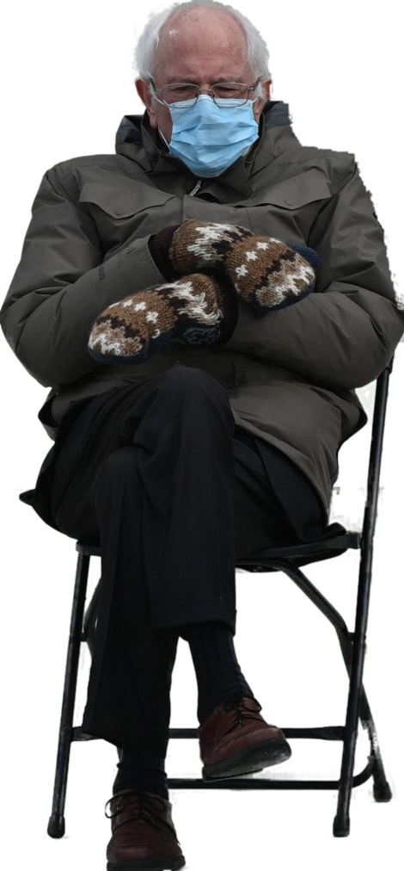

PATENTS 1
Talk 10 Introduction
LAW 422
Intellectual Property Law
Allard School of Law, UBC
Spring, 2021
Jon Festinger Q.C.
Centre for Digital Media
QMUL School of Law (CCLS)
Whiteboard Law
http://commlaw.allard.ubc
@jonfestinger
jon_festinger@thecdm.ca

Slide 2
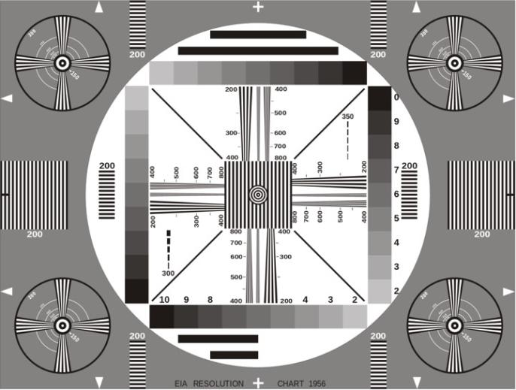
Permission to Record?

Slide 3
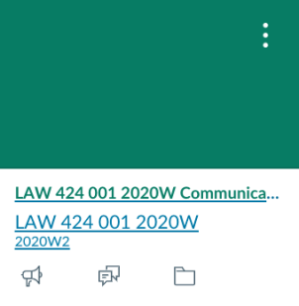
The draft slides
UBC Canvas

Slide 4
Logistics

Slide 5
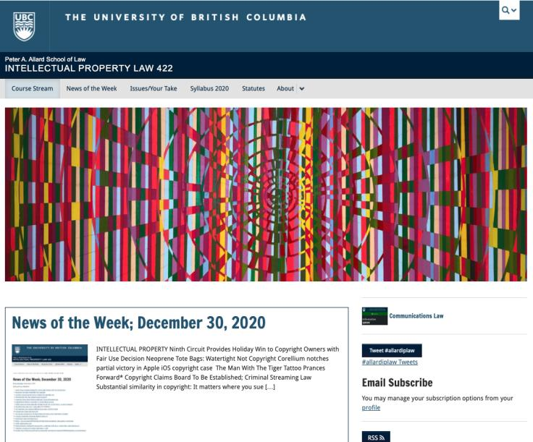
Course Website
https://iplaw.allard.ubc.ca/

Slide 6
For full privileges on the website
1. Please create an account at http://cms.ubc.ca/ using your CWL.
2. Once you create an account and sign in at http://cms.ubc.ca/ you can click your name in the top right. Halfway down the following page will be your WordPress email address.
3. Send me your WordPress email address at jon.festinger@ubc.ca or at jon_festinger@thecdm.ca
4. Then, I will invite you to participate with authoring privileges via your WordPress email address.

Slide 7
Methodology Prioritized
Slides relate directly to textbook & Syllabus
Added material or “context” in Slides not in textbook (not optional)
Added “context” from News of the Week (optional – but does often supply fact situations useful in exploring consequences in Canadian law or that could serve as the basis of an exam question)

Slide 8
Presentations (20%)
How’s it going?
Don’t let it be a last minute panic.
If you have posted a presentation, please drop me an email saying that.

Slide 9
Presentations (from Syllabus)
“Paper/Presentation/Post = 20% of grade
This will be 500-1000 word (or equivalent) per person original piece of work that illuminates some aspect of Intellectual Property Law. It can be in any form, posted to the course website or not, and can be approached individually or as a group.”

Slide 10
Presentations
1-5 (ideally) per group
Sign-up by emailing me
Any topic - not constrained by what we are talking about that week
Consult re the topic you want to take on?
Post one thing you want us to read or watch?
5-7 minutes (notionally) per student = 500-1000 words

Slide 11

Office “Hours”: Ideally Fridays before or after class but am flexible…
Email me : jon.festinger@ubc.ca
Skype: jon.festinger
Phone:
o. 604-568-9192
c. 604-837-6426

Slide 12

Thanks for the emails with questions.
Still thinking about a pre-exam compilation.

Slide 13
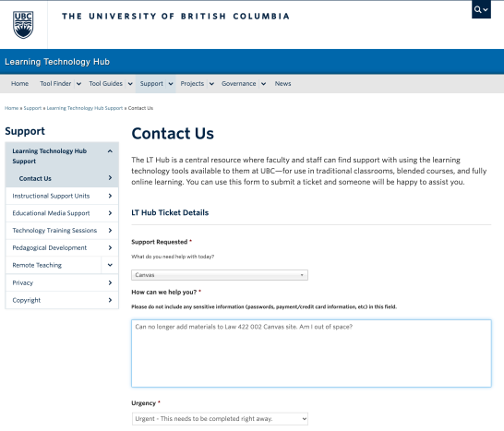

I broke the internet? [not exactly]

Slide 14
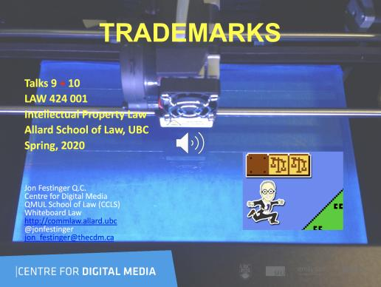
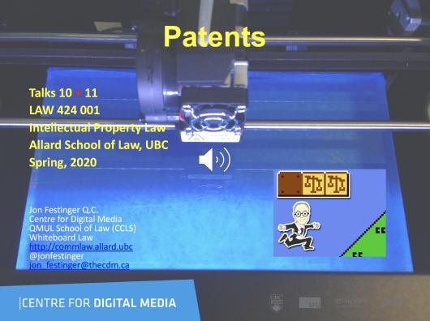
Last years audio-slides on UBC Canvas

Slide 15
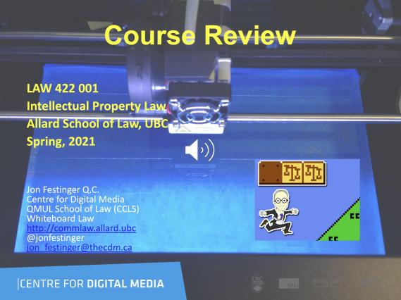
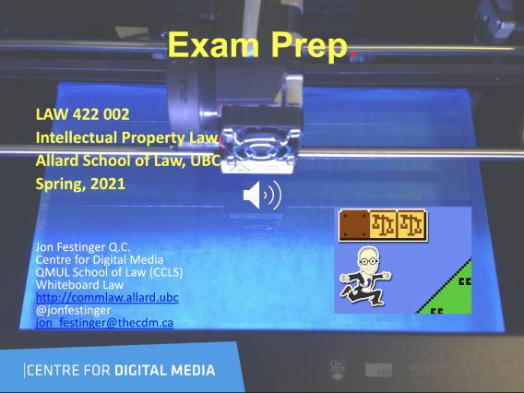
Coming Soon

Slide 16
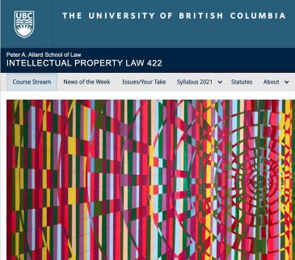
What should be last day for course website contributions for participation?
Last day of classes
Exam date
Last day of exams
Doesn’t matter we are all living in a video game anyways.

Slide 17
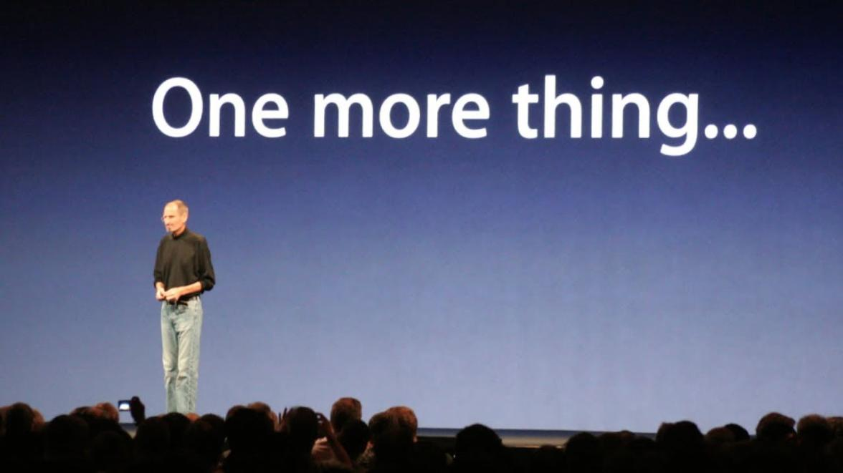

Slide 18

Guest Speakers

Slide 19
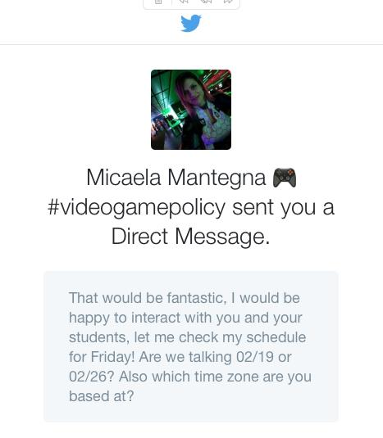
Recording a Video Interview re A.I. & I.P.
No Friday April 2 class

Slide 20
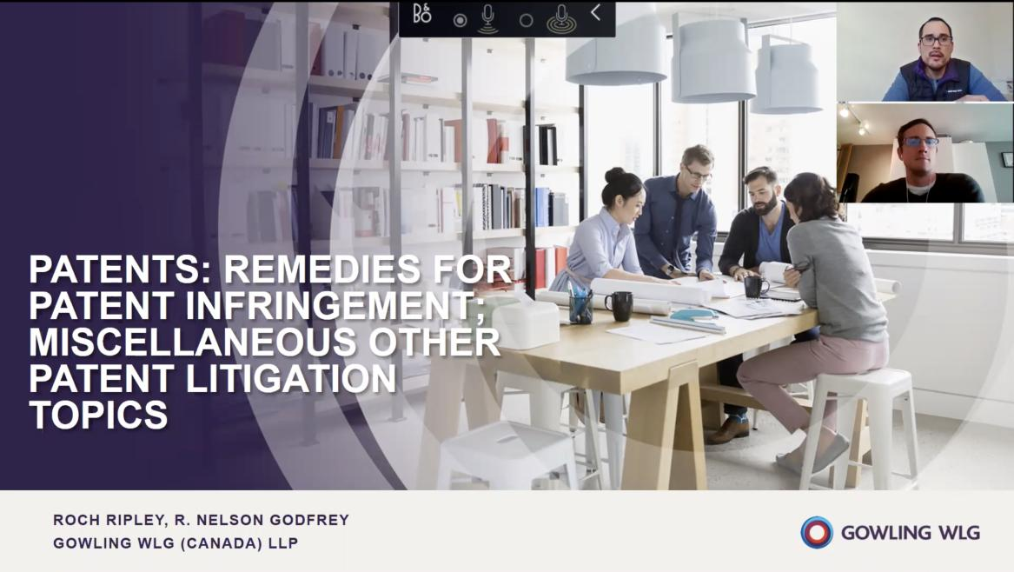

Slide 21
News of
the Week

Slide 22
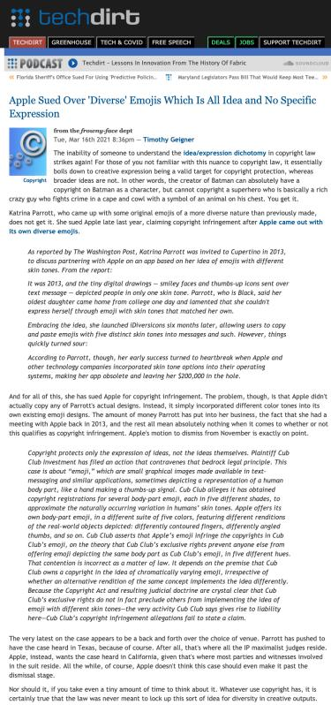

Slide 23
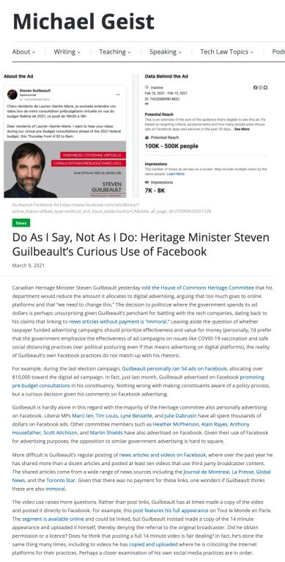

Slide 24
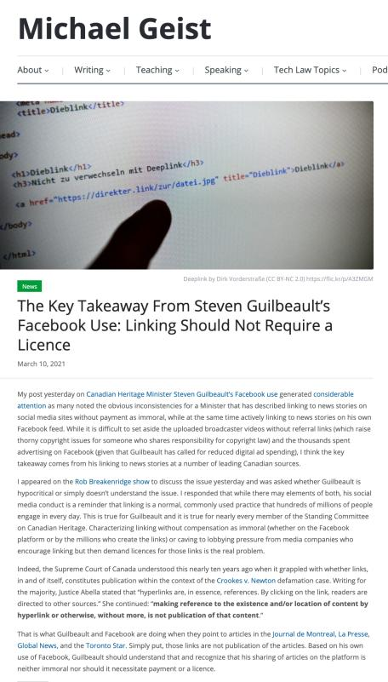

Slide 25
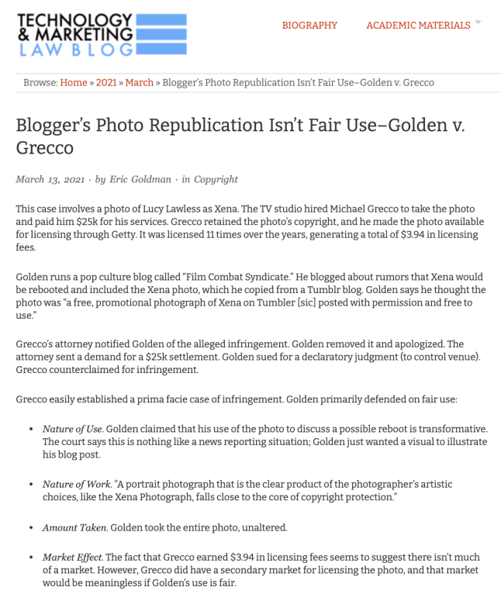

Slide 26
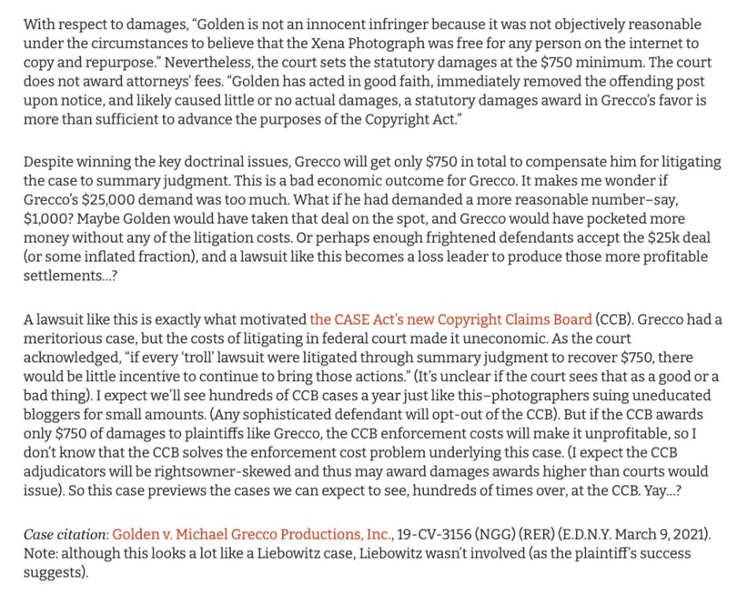

Slide 27
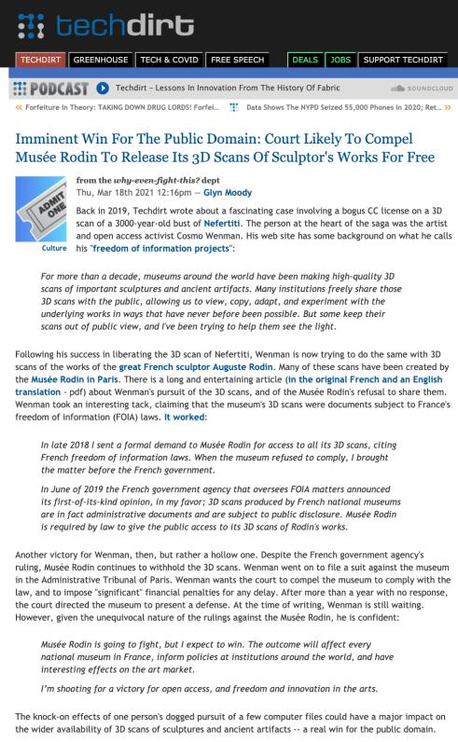

Slide 28
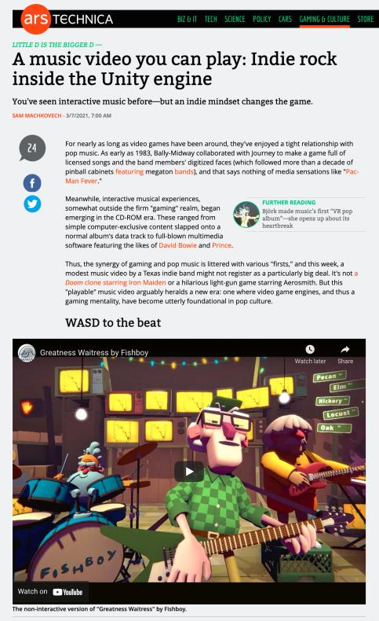

Slide 29
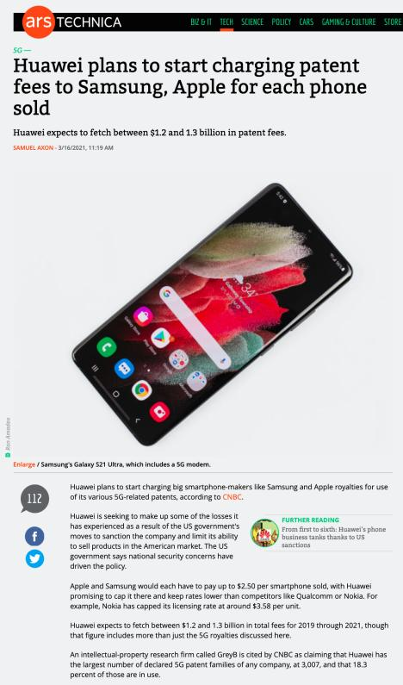

Slide 30

Pause

Slide 31
QUESTIONS?
THOUGHTS?
DISCUSSION?

Slide 32
Your News of the Week

Slide 33
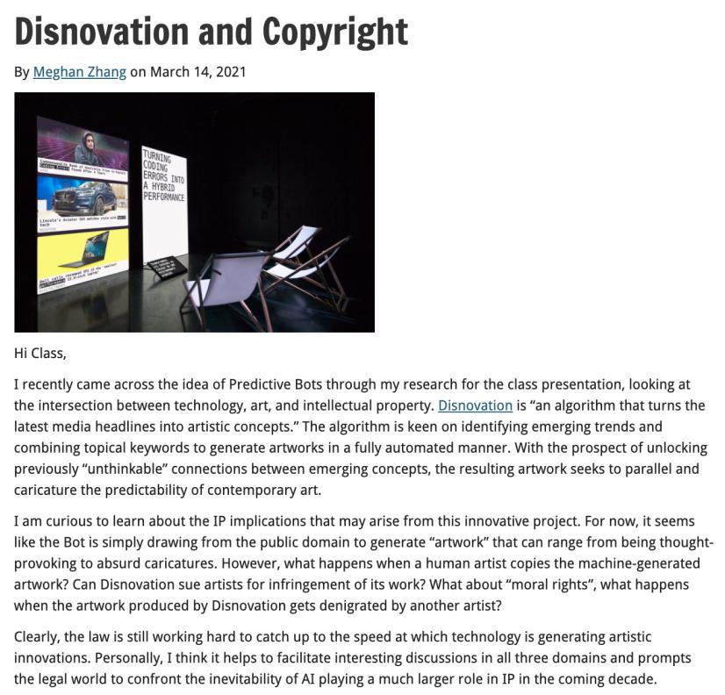

Slide 34


Slide 35
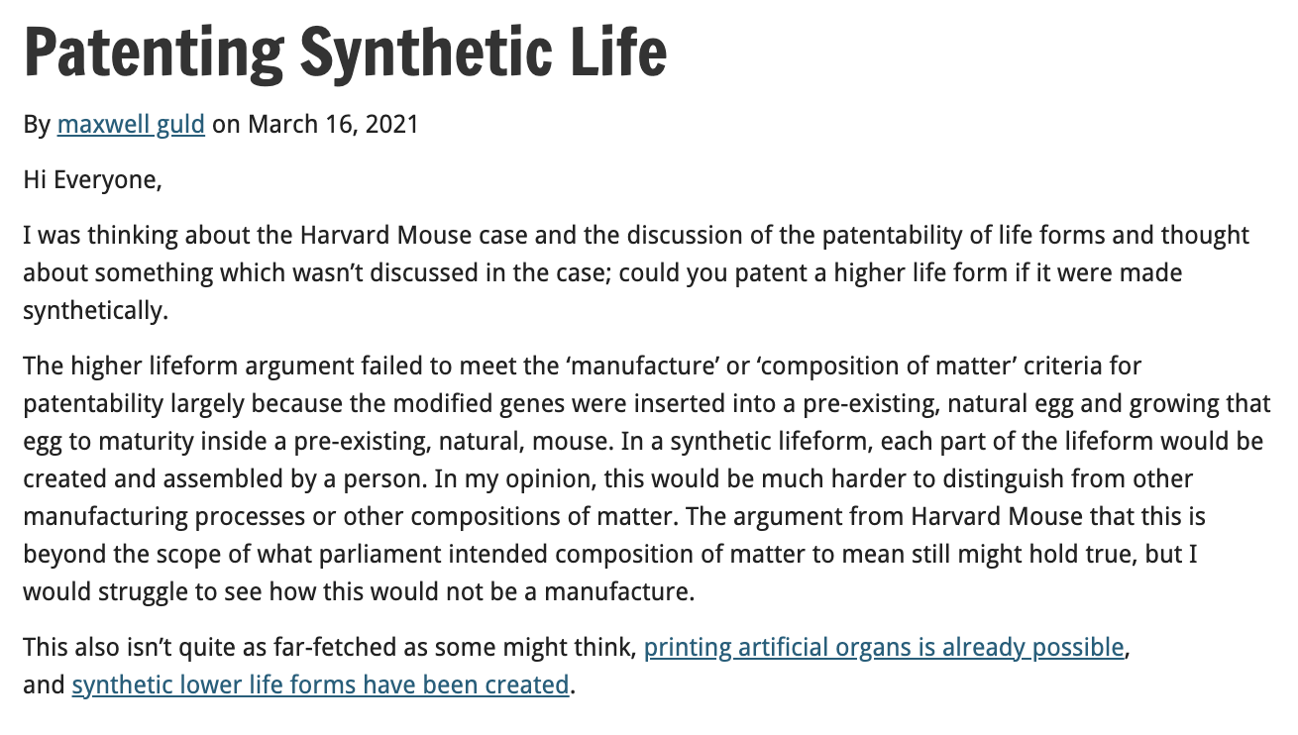

Slide 36
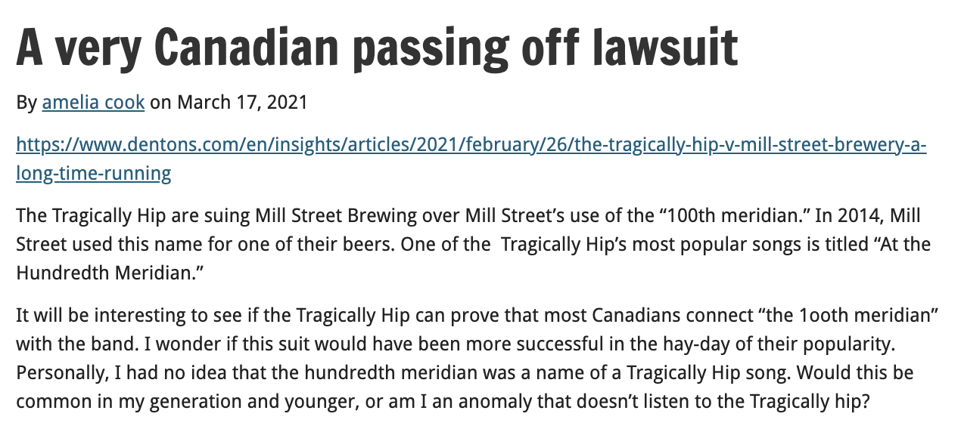

Slide 37
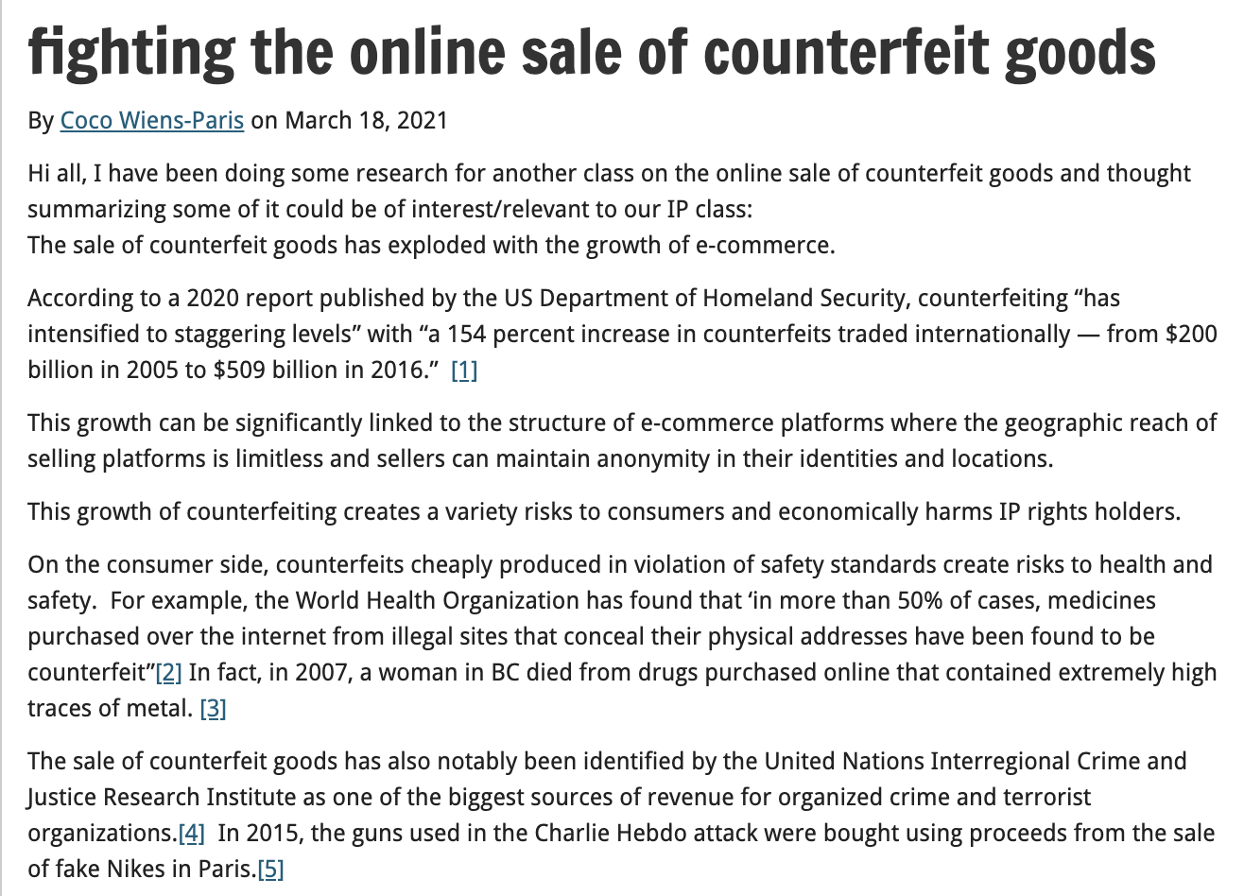

Slide 38
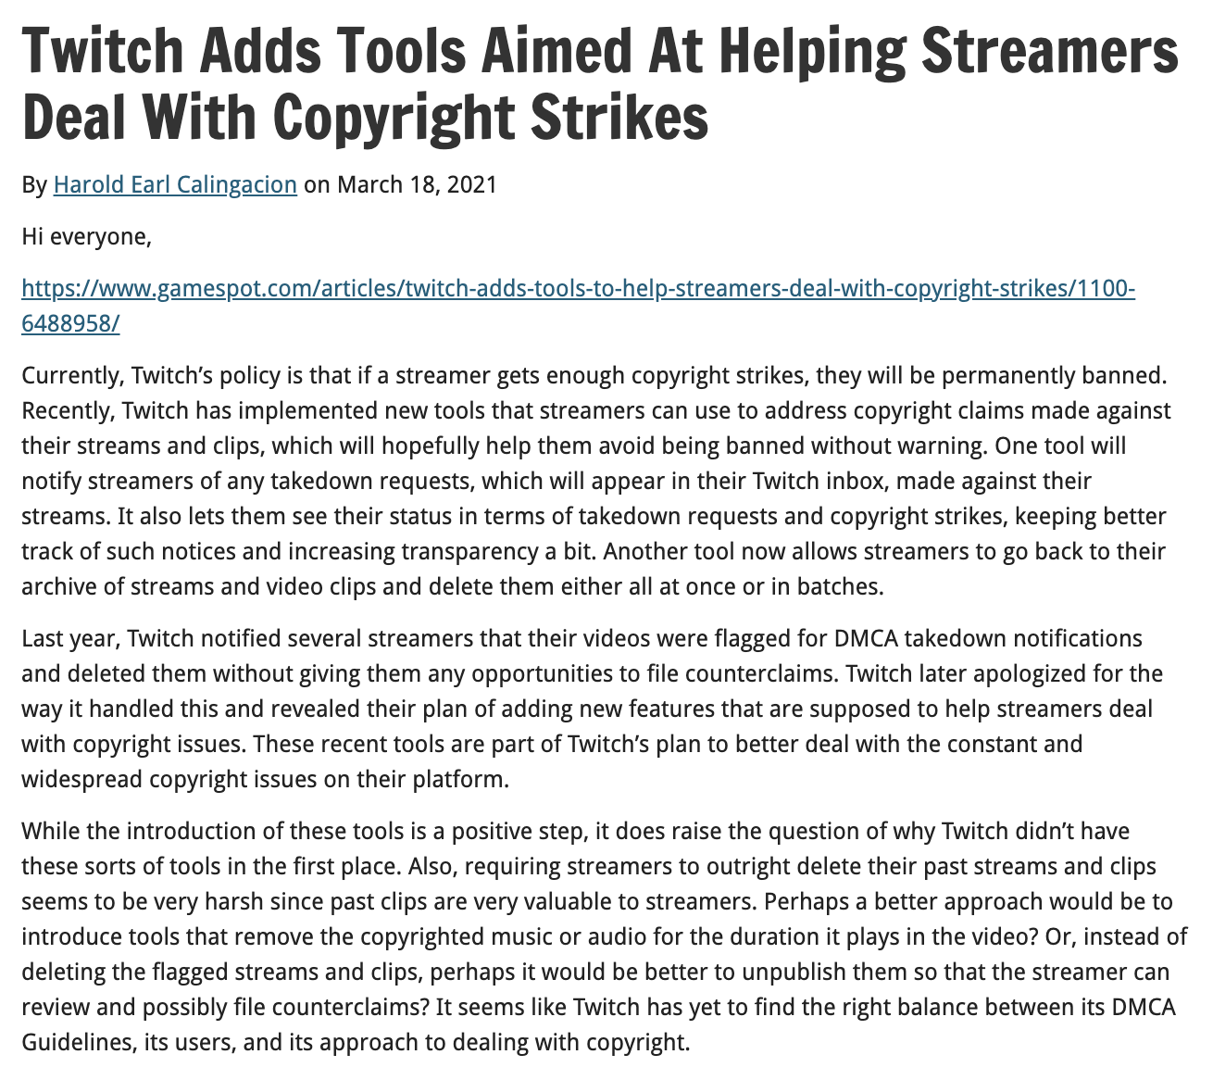

Slide 39
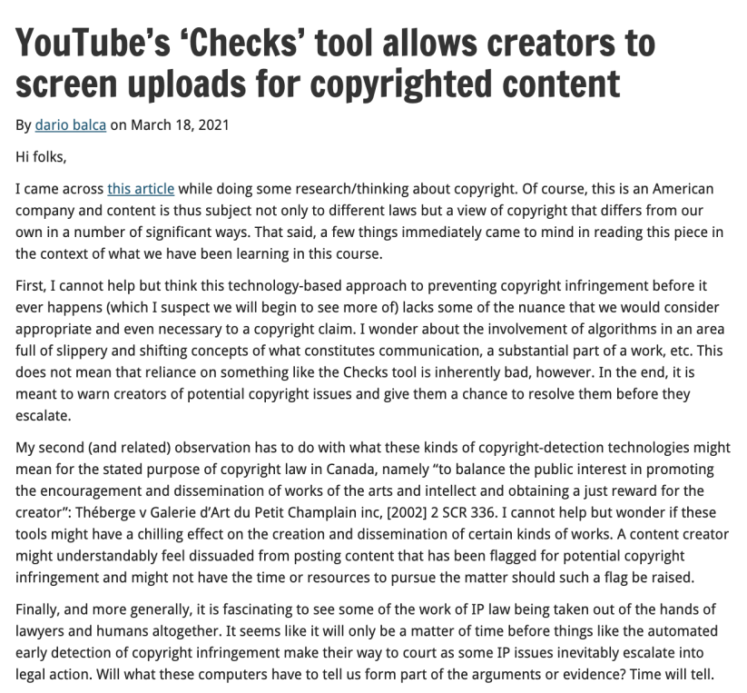

Slide 40
Your Presentations

Slide 41
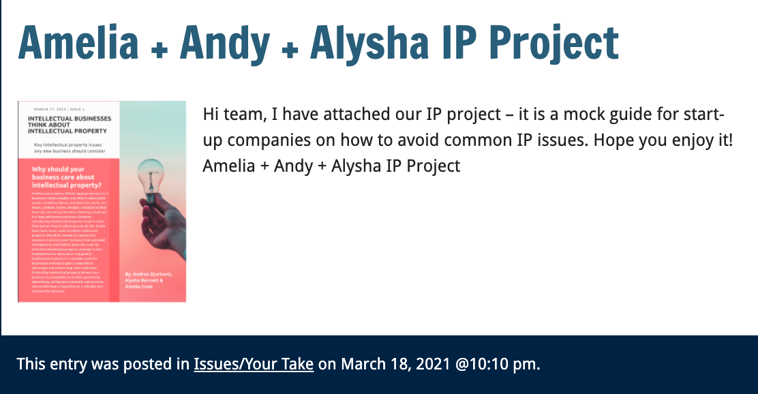

Slide 42
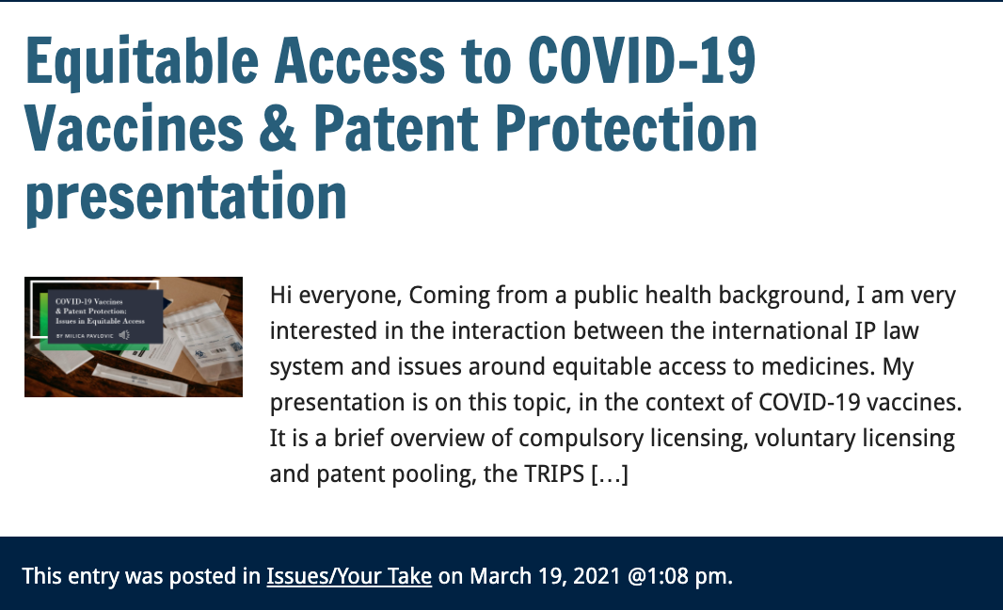

Slide 43
Presentations
today

Slide 44
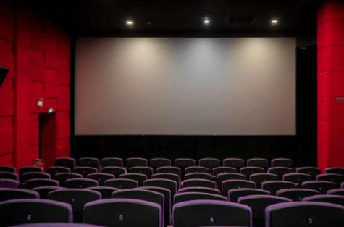
Chinenye Eze
Jenny Gu & Max Guld

Slide 45
Pause

Slide 46
QUESTIONS?
THOUGHTS?
DISCUSSION?

Slide 47

Now, back to our regularly scheduled programming…

Slide 48
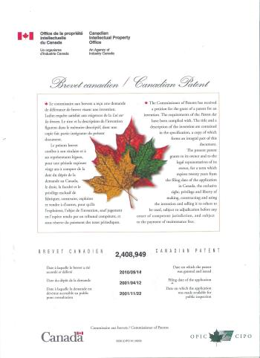
Patents

Slide 49
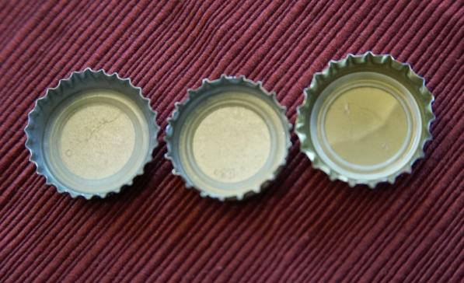
Re-capping

Slide 50
Patents
First…
Introduction to patents
Patentable subject matter
  Invention
    Composition of matter; manufacture; machine; art; process; improvement
Non-patentable subject matter
    Mere scientific principles or abstract theorem; professional arts; higher life forms; methods of medical or surgical treatment

Slide 51
Patents
Federal Government:
Authority over patents: s. 91(22), Constitution Act, 1867
Authority exercised in part through the enactment of the Patent Act, RSC, c. P-4
Definition of patent:
a limited term monopoly for an invention; the right, given to an inventor by the government, to exclude others from making, using or selling one’s invention from the day the patent is granted.
“…to advance research and development and to encourage broader economic activity” (Free World Trust, 2000 SCC)

Slide 52
Patents
”Patentee” can only get a patent for “inventions” (s. 2)
Also, patent only granted if your invention is novel, useful, and non-obvious (ss. 2, 28.3)
Term of protection: 20 years (ss. 44, 46)
Contrast with confidential information

Slide 53
Patents
At its core, the patent system is a bargain between the inventor and the public:
One party discloses an invention in exchange for a 20 year monopoly period in which to make, use, and sell the invention
See Teva Canada Ltd. v. Pfizer Canada, Inc.
  FACTS: Teva had challenged the validity of Pfizer’s patent for Viagra.

Slide 54
Patents
Teva Canada Ltd. v. Pfizer Canada, Inc.
Patent system is a “quid pro quo”
“[N]ot intended as an accolade or civic award for ingenuity. It is a method by which inventive solutions to practical problems are coaxed into the public domain by the promise of a limited monopoly for a limited time.”
Patent specification = heart of the disclosure requirement

Slide 55
Continuing with our show…

Slide 56
The Business Context: perceptions of value
In 2015, intangible assets accounted for 87% of the value of Standard & Poor’s 500 (tracking 500 companies with the largest market capitalization listed on the New York Stock Exchange (Ocean Tomo 2015)
Are patents overvalued generally?
Does start-up perception that patents are “necessary” result in overly general or irrelevant “false flag” patents that simply go unchallenged in the short-term.
E.g., = Cool product with patent, but patent is purely ancillary and has nothing to do with the key features that differentiate the product in the market
Likewise, query practical uses of “patent pending”.

Slide 57
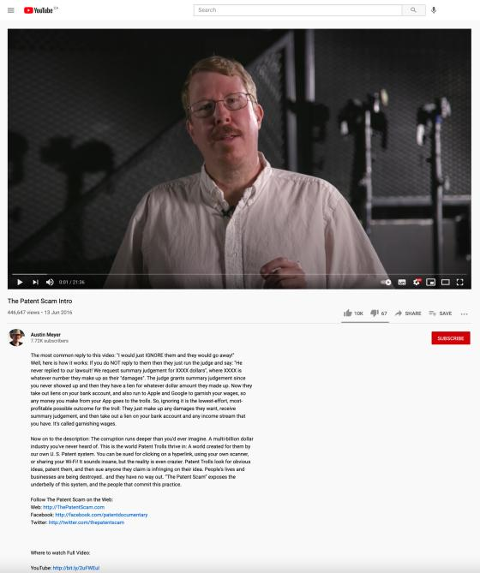
Trolls
https://www.youtube.com/watch?v=sG9UMMq2dz4

Slide 58
Patents
Invention = … any new and useful art, process, machine, manufacture or composition of matter, or any new and useful improvement in any art, process, machine, manufacture or composition of matter (s. 2, Patent Act)
Contrast to Copyright where “mods” are discouraged rather than encouraged

Slide 59
Patents
Harvard College (SCC):
Majority
  Invention defined broadly, should be interpreted broadly; but is not unlimited
  Some subject matter is outside the scope of protection
Commissioner has no discretion to refuse a patent on the basis of public policy considerations independent of express provisions of the Act

Slide 60
My comments on majority decision in Harvard College
(have edited out regrettably inappropriate comments)
“…I have spent way too much arguing in my head with Mr. Justice Bastarache’s every word in Harvard Mouse.” – email to Prof. Graham Reynolds, 8.15.20.
My original (unexpurgated but decontextualized) marginal notes in the textbook version of the case:
  ”STRAINED WOULD BE AN UNDERSTATEMENT. INTELLECTUALLY HONEST?”
  Huh?
  Huh?
  Worst writing in the history of the Court (SCC)???
  It doesn’t?
  So what?
  So strained!!!
  ???
  Huh!
  Really?
  Huh – non sequitur
  LWTF? How? Wha..?
  B…Turns a preference for parliamentary clarity into a requirement for it – wrongly.
None of the above means I’m right, just that I had a similar reaction to some of you.

Slide 61
Patents
Composition of matter
The category ‘composition of matter’ refers to combinations of ingredients, whether combined as a chemical union or a physical mixture, and includes chemical compounds, compositions and substances (12.02.05, “MOPOP” – Manual of Patent Office Practice)

Slide 62
Patents
Composition of matter – Harvard College
Defined more narrowly than “all compositions of two or more substances and … all composite articles”
Does not include higher life form like the oncomouse
Statutory interpretation principles used to support this determination
Other factors that suggest that higher life forms are not compositions of matter
  Recourse to dictionary definitions
  “Combine” – but elements require no human intervention
  “Composition of matter” seems inadequate as a description of a higher life form

Slide 63
Patents
Manufacture
Majority (Harvard College)
  Manufacture = non-living mechanistic product or process
MOPOP (Manual of Patent Office Practice)
  The process of making (by hand, by machine, industrially, by mass production…) technical articles or material (in modern use on a large scale) by the application of physical labour or mechanical power; or the article or material made by such a process” (MOPOP 12.02.04).

Slide 64
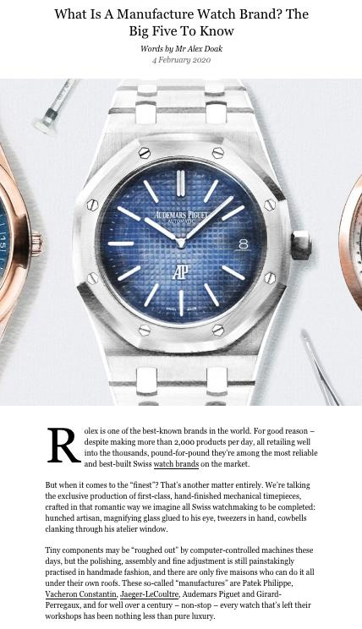

Slide 65
Patents
Machine
The mechanical embodiment of any function or mode of operation designed to accomplish a particular effect (MOPOP, s. 12.02.03)
Ex: Amazon.com, Inc. v. Canada (Attorney General), [2010] FC 1011, where certain patent claims disclosed ‘a machine … used to implement Amazon.com’s one-click ordering system”

Slide 66
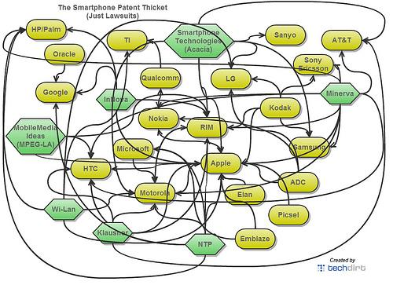
Patents

Slide 67
Patents
Art
The application of knowledge to effect a desired result; must be defined in a way that gives practical effect to the knowledge.
Claimed as a method or a use
  Method – involves directing the person skilled in the art (POSITA) to take a step/series of steps to arrive at the desired result
  Use – defined in terms of the means to be applied; the “how” is left to the common general knowledge of the “person skilled in the art”

Slide 68
Patents
Art (as use)
The application of certain means to achieve a specific result
I.e.: the use of a known drug applied to treat a known disease

Slide 69
Patents
Art (as method)
Method
  An act or series of acts performed by some … object and producing in that object some change of either character or condition” (citing to Lawson – cited in Amazon.com, Inc.(MOPOP, 12.02.01)
  Test cited in Amazon:
    Not a disembodied idea; must have method of practical application
    A new and inventive method of applying skill and knowledge
    Has a commercially useful result

Slide 70
Patents
Art (as method)
  Claim 1 of Patent 2682261 – requesting prior art from the public in exchange for a reward
NB: fine arts are excluded from patentability (inventions must apply to fields of technology)

Slide 71
Patents
Process
“A process can be considered to be a mode or method of operation by which a result or effect is produced by physical or chemical action, by the operation or application of some element or power of nature or one substance to another” (MOPOP)
A process through which a known method is applied to known materials is patentable (Commissioner of Patents v. Ciba Ltd., 1959 SCC)

Slide 72
Patents
Process
Claim 1 of Patent 2697087 – PROCESS OF REMOVING CALCIUM AND OBTAINING SULFATE SALTS FROM AN AQUEOUS SUGAR SOLUTION

Slide 73
Patents
Improvements
Most inventions are improvements of other inventions
Not an improvement? A “pioneering” invention
A patent on the improvement does not give you the right to make, sell, or use the original invention (s. 32, Patent Act)

Slide 74
Patents
Mere scientific principle or abstract theorem
Starting point: s. 27(8), Patent Act
This section interpreted as excluding, from patentability, natural phenomena and laws of nature (Arbour J., Schmeiser)
Are human gene patents patentable subject matter?

Slide 75
Patents
Mere scientific principle or abstract theorems
Historically – computer programs are not patentable because they are mathematical algorithms (unpatentable per s. 27(8)) (see Schlumberger Ltd. v. Canada (Patent Commissioner), 1982
But…see Motorola Inc., in which Motorola succeeded in patenting a mathematical algorithm by claiming it as part of a machine (the computer)

Slide 76
Patents
Patentability of business methods
Canada (Attorney General) v. Amazon.com, Inc., 2011 FCA 328
  FACTS: one-click online purchase method
  (1) No case law to support claim of tradition of excluding business methods from patentability
  (2) To avoid patenting a mere idea or discovery, the claimed invention must have some “physical existence” that “manifests a discernible effect or change”. This is not met merely by virtue of the fact that the claimed invention has a “practical application”.

Slide 77
Patents
Professional Arts v. Professional Skills
  Professional skills are considered not to be patentable on the basis that they reflect the personal knowledge and capacities that one would expect from any-one skilled in their field
  See Lawson

Slide 78
Patents
Higher life forms
Post Harvard College:
  Patent applications cannot include claims to higher life forms (i.e., seeds, plants, non-human animals) or to humans
  Can patent isolated genes and cells (cell lines, cell cultures)
  Fertilized eggs?
    CIPO practice notice – fertilized egg is considered to be a higher life form because it can develop into a higher life form

Slide 79
Patents
Higher life forms
But … Monsanto Canada Inc. v. Schmeiser (2004)
  Schmeiser infringed Monsanto’s patented modified canlola gene by growing and harvesting his canola plants containing the patented gene.

Slide 80
Pause

Slide 81
QUESTIONS?
THOUGHTS?
DISCUSSION?

Slide 82
Patent Requirements
Next…
Requirements of patentability:
  Novelty
  Non-obviousness
  Utility

Slide 83
Patents
Novelty and usefulness (see s. 2, Patent Act)
Non-obviousness (see s. 28.3, Patent Act)

Slide 84
Patents
Novelty
Also referred to as “anticipation” (prior action that prevents the action of another)
Has the invention been disclosed in some way prior to the date of the patent claim?
See s. 28.2, Patent Act
Underlying policy reason?

Slide 85
Patents
Novelty
Prior art: Material which may disclose the invention which you’re claiming
Can use this to establish that an invention existed before the patent claim
See s. 28.2 outline of what constitutes prior art for the purpose of assessing novelty

Slide 86
Patents
Novelty
Filing date v. claim date
  Filing date: date on which the Commissioner receives certain documents, information and fees (s. 28(1))
  Claim date: each claim has a claim date; establishes the date for determining the patentability of the invention defined by the claim

Slide 87
Patents
Novelty
The claim date is normally the filing date (s. 28.1)
…except where the person who has filed the application has previously filed an application for a patent which discloses the subject-matter defined in the claim
  For example: Amy invents a widget; files on January 1, 2019. Amy files again, on October 15, 2019, for the same widget. Earlier date can be an advantage to Amy if there is a competitive “rush to file’

Slide 88
Patents
Novelty
s. 28.1(1)(a)(i): Claim date could be the date of a previously filed application in Canada where the filing date of the most recent application is within 12 months from the date of the filing date of the previously filed application
How? Make a request for priority under s. 28.4(1) on the basis of a previously filed application

Slide 89
Patents
Novelty
s. 28.1(1)(a)(ii): Foreign filings section
  If a person has filed an application for the same invention in another treaty country, then under s. 28.1(1)(b) and (c), if the 2nd filing is within 12 months of the first filing, and if the applicant has made a request for priority on the basis of the previously regularly filed application, then the first date can be the claim date

Slide 90
Patents
Novelty
When does prior art amount to disclosure (rendering what is being applied for not new/novel)?
  S. 28.2(1)(d): where someone else has filed an application for a patent in Canada with a filing date after your claim date; where that other party has another date prior to the claim date of your application that they can rely upon under s. 28.1; where this date is within twelve months of their Canadian filing date; and where the other party has requested priority based on their earlier filing date.

Slide 91
Patents
Novelty
Example: (s. 28.2(1)(d))
  February 16, 2018: B files for a patent in Germany
  March 2, 2018: A files in US.
  June 23, 2018: A files in Canada and makes a request for priority based on the earlier filing date.
  August 5, 2018: B files in Canada and makes a request for priority based on the earlier filing date.
In this case, although B’s Canadian filing date is after A’s, her claim date is prior to A’s claim date. A’s patent will be void for lack of novelty.

Slide 92
Patents
When has anticipation occurred?
Lack of novelty is only found when your invention has been disclosed in a single publication/use
This publication must disclose the invention without “mosaicing” references
Mosaicing = collect a file of references and say that these references, taken together, disclose the subject matter
Commonly occurs through publication…

Slide 93
Patents
Other ways through which disclosure can occur
Display of the invention in a public place
Sale of the invention
Use of the invention
Conference presentation
Disclosure online
Filing of earlier patent application
NB: in Canada or elsewhere… (s. 28.2)

Slide 94
Patents
Novelty was recently refined in Apotex v. Sanofi-Synthelabo (SCC, 2008)
Two part test: There is no novelty where there is (1) prior disclosure and (2) enablement
(1) Prior disclosure:
  The prior [publication/sale/use/patent] must disclose subject matter which, if performed, would necessarily result in infringement of that patent. At this stage, the skilled person is simply [analyzing] the prior [publication/sale/use/patent] for the purposes of understanding it. There is no room for trial and error or experimentation by the skilled person.

Slide 95
Patents
Novelty
(2) Enablement (see paras. 26-27, 37 in Apotex)
  Would the person skilled in the art have been able to perform the invention without undue burden?
    If inventive steps are required, the prior art will not be considered to be enabling
    Routine trials are acceptable
    The skilled person can use common general knowledge to supplement the information in the prior art or prior disclosed materials
    Obvious errors or omissions in prior art will not prevent enablement.

Slide 96
Pause

Slide 97
QUESTIONS?
THOUGHTS?
DISCUSSION?

Slide 98
Patents
Double patenting/evergreening
[63] … The inventor is only entitled to “a” patent for each invention: Patent Act , s. 36(1). If a subsequent patent issues with identical claims, there is an improper extension of the monopoly (Binnie J., Whirlpool Corp., SCC, 2000)
Look only at the claims (not the disclosure), as it is the claims that define the monopoly

Slide 99
Patents
Double patenting/evergreening
Same invention double patenting
  Identical or coterminous claims
Obviousness double patenting
  Prohibits the issuance of a second patent with claims that are not “patentably distinct” from those of the earlier patent.

Slide 100
Patents: Doublepatenting/evergreening
Whirlpool Corp. v. Camco Inc. 2000 SCC 67 Binnie J.:
“[66] … In Commissioner of Patents v. Farbwerke Hoechst Aktiengesellschaft Vormals Meister Lucius & Bruning , [1964] S.C.R. 49, the issue was whether Farbwerke Hoechst could obtain a patent for a medicine that was a diluted version of a medicine for which it had already obtained a patent. The claims were neither identical nor conterminous. Judson J. nevertheless held the subsequent patent to be invalid, explaining at p. 53:
  A person is entitled to a patent for a new, useful and inventive medicinal substance but to dilute that new substance once its medical uses are established does not result in further invention. The diluted and undiluted substance are but two aspects of exactly the same invention. In this case, the addition of an inert carrier, which is a common expedient to increase bulk, and so facilitate measurement and administration, is nothing more than dilution and does not result in a further invention over and above that of the medicinal itself.”

Slide 101
Patents
Double patenting/evergreening
Rennie J.A.’s judgment in Mylan Pharmaceuticals distinguishes between invalidity on the basis of obviousness and “obviousness-type double patenting” (OTDP).
Key point: in an OTDP challenge, “only the earlier patent can be cited as rendering the impugned patent not patentably distinct; any other prior art is only relevant insofar as it contributes to the common general knowledge of the skilled person.”

Slide 102
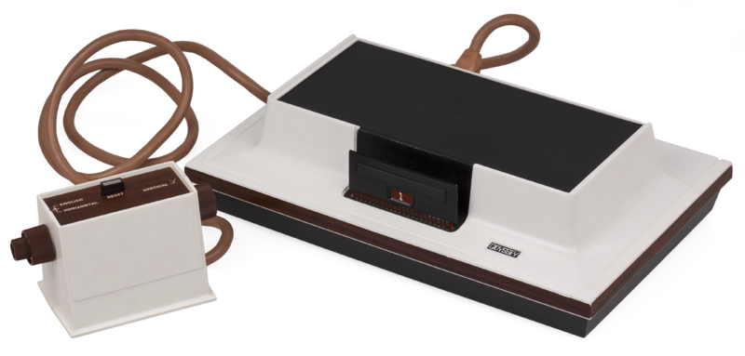
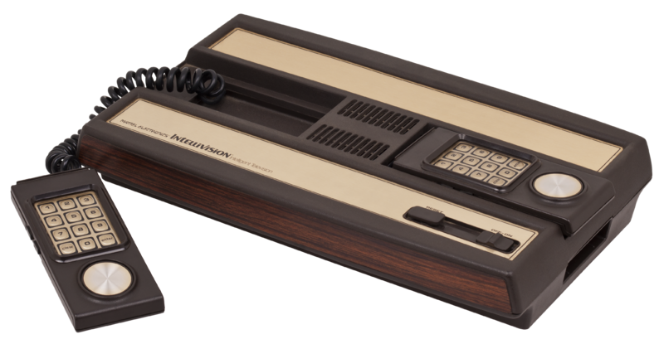
A “Prior Art” story
Magnavox v. Mattel 1982 U.S. Dist. LEXIS 13773 (N.D. Ill.)

Slide 103
Chronology
1962: Spacewar! released on DEC PDP-1 mainframe @ MIT
...’507 from experiments done by Rusch, employee of Sanders Associates in 1967/68
1971: Sanders & Magnavox enter into exclusive license
1972: Magnavox Odyssey introduced (analog circuitry)
1975: Atari introduces Pong game console for home use (analog)
1976: General Instruments introduces TV game microprocessor (digital circuitry)
Magnavox sues Atari for patent violation & infringing concept of electronic ping pong (settled by Atari becoming Magnavox exclusive licensee)
1978: Magnavox Odyssey 2 has a microprocessor (digital)
1979: Mattel introduces Intellivision with General Instruments microprocessor (digital). Magnavox sues Mattel.

Slide 104
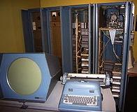
Court decided…
No distinction between analog and digital: “I regard analog and digital circuitry as two means which are interchangeable largely, which are equivalent, and which are, therefore, essentially the same means for achieving substantially the same results in substantially the same way.”
So far, so good…

Slide 105

But…OOPS!

Slide 106
Result: Creation of a meaningless
Computer Game/TV Console Divide
Mattel argued its console was not based on ’507 but on computer prior art, Space War!
Court noted PDP-1 was 6’ tall by 7’ wide, & cost approximately $120K. Court found for Magnavox: “…it is clear from the evidence that Mattel did not in fact follow the prior art but, instead, followed developments in the television game industry, an industry which was created because of the work done at Sanders in developing the first television games and an industry which expanded and developed and become economically viable largely because of television games which followed the teachings of the ’507 Patent.”

Slide 107
Pause

Slide 108
QUESTIONS?
THOUGHTS?
DISCUSSION?

Slide 109
Patents
Now…
Requirements of patentability:
  Novelty
  Non-obviousness
  Utility

Slide 110
Patents
Obviousness
Policy reason behind this requirement?
See s. 28.3

Slide 111
Patents
Obviousness
Who is the “Test Person”?
Unimaginative skilled technician
Question to ask:
Would the person skilled in the relevant art and science, based on their skill and knowledge but without a scintilla of imagination, have been led to this invention?

Slide 112
Patents
Novelty and obviousness, distinguished
Novelty: Can’t “mosaic”
Obviousness: Could the unimaginative skilled person have taken all of the pieces and, using reasonable deduction, have arrived at this invention?

Slide 113
Patents
Apotex v. Sanofi-Synthelabo (2008, SCC)
Refinement of the test for obviousness to obvious to try
  Was the invention “obvious to try”?
  For a finding that an invention was “obvious to try”, there must be evidence to convince a judge on a balance of probabilities that it was more or less self-evident to try and obtain the invention (para. 66).

Slide 114
Patents
Obviousness inquiry (para. 67, Apotex):
(a) Identify the notional ‘person skilled in the art’
(b) Identify the relevant common general knowledge of that person
Identify the inventive concept of the claim in question or construe it
Identify what, if any, differences between the matter cited as forming part of the ‘state of the art’ and the inventive concept of the claim as construed
Viewed without any knowledge of the alleged invention as claimed, do those differences constitute steps which would have been obvious to the person skilled in the art or do they require any degree of invention?

Slide 115
Patents
Obvious to try factors:
  Is it more or less self-evident that what is being tried ought to work?
  What is the extent, nature and amount of effort required to carry out the invention?
  Is there a motive provided in the prior art to find the solution the patent addresses?
  Look at the history of the invention. Did inventor reach the invention quickly, easily, directly and relatively inexpensively?

Slide 116
Patents
Next…
Requirements of patentability:
  Novelty
  Non-obviousness
  Utility

Slide 117
Patents
Utility
An invention must be useful to be patented. There is no definition of “utility” in the Patent Act.
Teva Canada Ltd v. Pfizer Canada Inc, 2012 SCC 60 at para 38, the Supreme Court of Canada stated “all that is required to meet the utility requirement in s. 2 is that the invention described in the patent do what the patent says it will do, that is, that the promise of the invention be fulfilled.”

Slide 118
Patents
Utility
Laboratoires Servier, Adir, Oril Industries, Servier Canada Inc v Apotex Inc, 2008 FC 825, Snider J.: “[270] Beyond this general statement of the law, there are a number of other guiding posts:
• Where the specification does not promise a specific result, no particular level of utility is required - a “mere scintilla” of utility will suffice…However, as stated in Consolboard, above, where the specification sets out an explicit “promise,” utility must be measured against that promise;
• Utility does not depend upon marketability…; In other words, in assessing whether an invention has utility, the issue is not whether the invention is sufficiently useful as to be able to support commercialization, unless commercial utility is specifically promised;
• The relevant date has been held to be the filing of the Canadian patent application…; and
• Where a claim is to a class of compounds, lack of utility of one or more of the compounds will invalidate all of the compounds of that particular claim…”

Slide 119
Patents
Utility: Apotex Inc v. Wellcome Foundation Ltd, 2002 SCC 77, Binnie J:
“[3] In my view, for the reasons which follow, the inventive use of AZT was made by the five Glaxo/Wellcome scientists named in the patent on or before March 16, 1985, the priority date of the patent. It was sufficient that at that time the Glaxo/Wellcome scientists disclosed in the patent a rational basis for making a sound prediction that AZT would prove useful in the treatment and prophylaxis of AIDS, which it did. For the Commissioner of Patents to have allowed Glaxo/Wellcome a patent based on speculation would have been unfair to the public. For him to have required Glaxo/Wellcome to demonstrate AZT’s efficacy through the clinical tests required by the Minister of Health for approval of a new drug for medical prescription would have been unfair to Glaxo/Wellcome. The disclosure made in the patent was and is of real use and benefit to millions of HIV and AIDS sufferers around the world (irrespective of Glaxo/Wellcome’s pricing policy for AZT, which it must be acknowledged has generated serious controversy in some countries, particularly in the developing world). The fact remains that Glaxo/Wellcome, by making the disclosure, has fulfilled its side of the bargain with the public, and is by law entitled to legal protection for what it has disclosed.”

Slide 120
Patents
Utility: The “Public Interest” cuts both ways…
“…[36] It is not surprising that the appellants, being generic drug manufacturers, would like to obtain at least a percentage of the AZT market in Canada. To do so they must somehow have the patent declared invalid. Yet their challenge, understandably motivated by the hope of private profit, raises broader issues of public interest.”

Slide 121
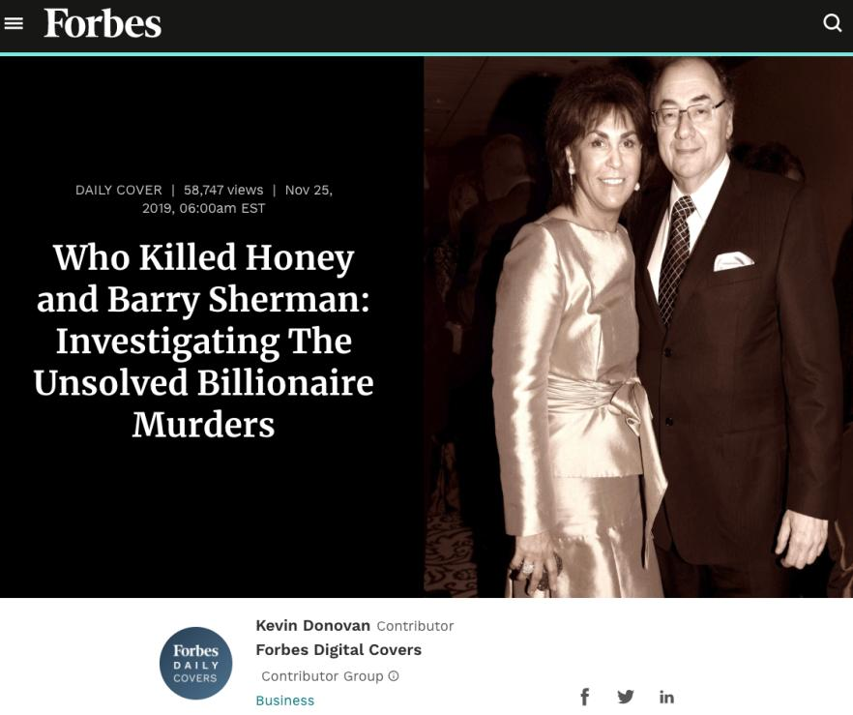

Slide 122
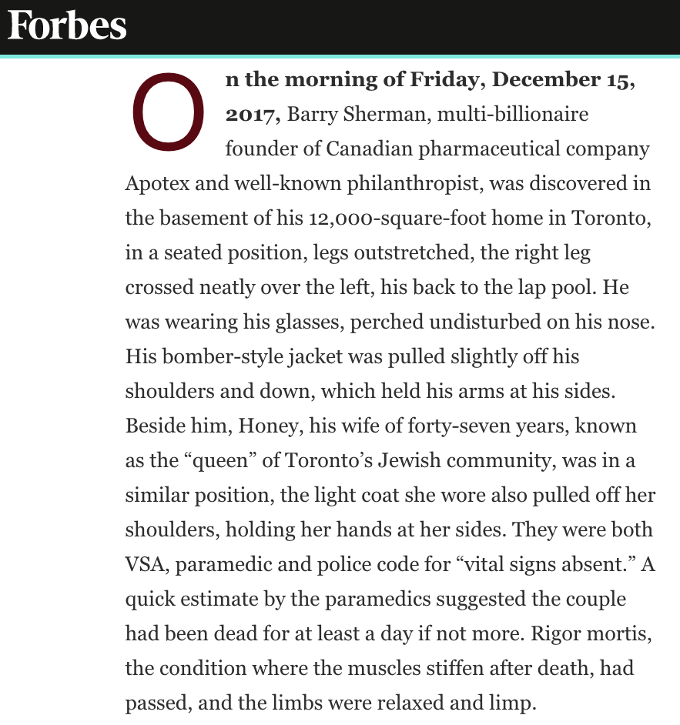

Slide 123
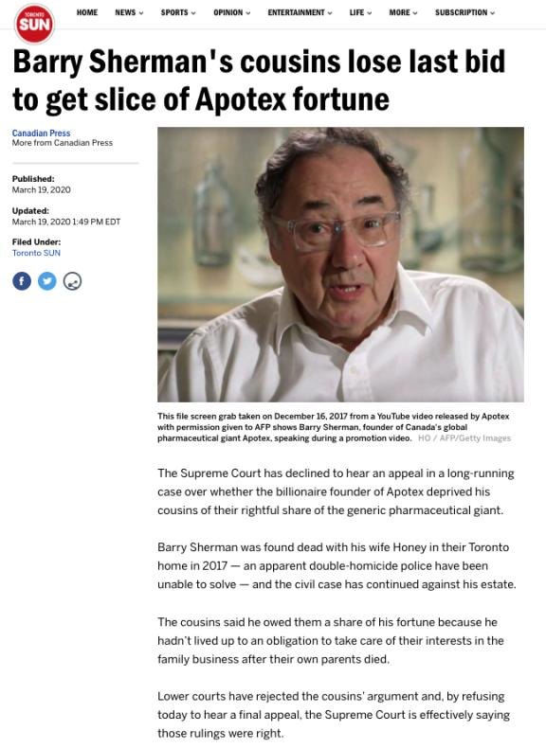

Slide 124
Patents
Utility: The Doctrine of “Sound Prediction”
Apotex Inc v. Wellcome Foundation Ltd, 2002 SCC 77, Binnie J:
“[70] The doctrine of sound prediction has three components. Firstly, as here, there must be a factual basis for the prediction…Secondly, the inventor must have at the date of the patent application an articulable and “sound” line of reasoning from which the desired result can be inferred from the factual basis…Thirdly, there must be proper disclosure. Normally, it is sufficient if the specification provides a full, clear and exact description of the nature of the invention and the manner in which it can be practised….It is generally not necessary for an inventor to provide a theory of why the invention works…In this sort of case, however, the sound prediction is to some extent the quid pro quo the applicant offers in exchange for the patent monopoly. Precise disclosure requirements in this regard do not arise for decision in this case because both the underlying facts…and the line of reasoning…were in fact disclosed…”

Slide 125
Patents
Rita, an American engineer living in Brooklyn, New York, invents, on March 17, 2019, a new type of spring. She files for a patent in the United States on March 19, 2019. Rita files for a patent in Canada on September 19, 2019. Graham, a Canadian inventor living in Hope, BC, independently arrives at the same invention on August 2, 2018. Graham files a patent application in Canada on August 8, 2018. Is Graham entitled to the Canadian patent in the circumstances described above? Why or why not?

Slide 126

Patents
You have been asked by Industry Canada to reform the novelty and non-obviousness requirements as set out in the Patent Act. Which reforms would you recommend, and why?

Slide 127

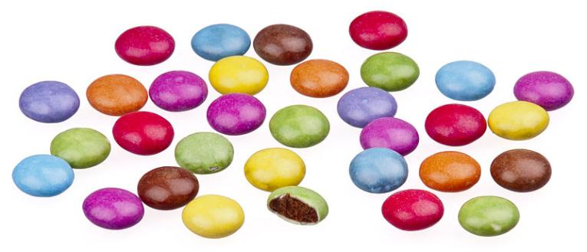
A MATTER OF PERSPECTIVE

Slide 128

Conclusion

Slide 129
UNTIL NEXT
TIME!

Slide 130

Always include a cat picture

Slide 131
In learning you will teach
And in teaching you will learn
Phil Collins' Son of Man (1999)

