Slide 1

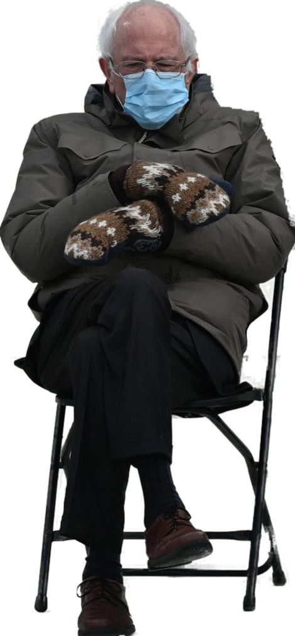

TRADEMARKS Part 2
Talk 8 Introduction
LAW 422
Intellectual Property Law
Allard School of Law, UBC
Spring, 2021
Jon Festinger Q.C.
Centre for Digital Media
QMUL School of Law (CCLS)
Whiteboard Law
http://commlaw.allard.ubc
@jonfestinger
jon_festinger@thecdm.ca

Slide 2
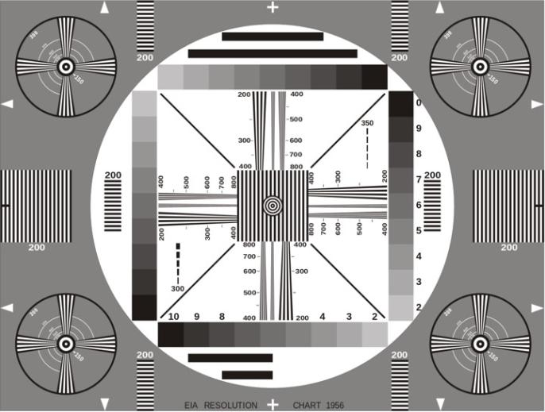
Permission to Record?

Slide 3
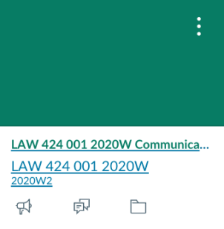
The draft slides
UBC Canvas

Slide 4
Logistics

Slide 5
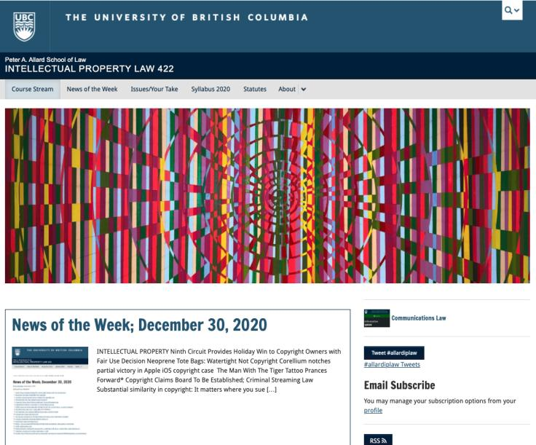
Course Website
https://iplaw.allard.ubc.ca/

Slide 6
For full privileges on the website
1. Please create an account at http://cms.ubc.ca/ using your CWL.
2. Once you create an account and sign in at http://cms.ubc.ca/ you can click your name in the top right. Halfway down the following page will be your WordPress email address.
3. Send me your WordPress email address at jon.festinger@ubc.ca or at jon_festinger@thecdm.ca
4. Then, I will invite you to participate with authoring privileges via your WordPress email address.

Slide 7
Methodology Prioritized
Slides relate directly to textbook & Syllabus
Added material or “context” in Slides not in textbook (not optional)
Added “context” from News of the Week (optional – but does often supply fact situations useful in exploring consequences in Canadian law or that could serve as the basis of an exam question)

Slide 8
Presentations (20%)
How’s it going?
Don’t let it be a last minute panic.
If you have posted a presentation, please drop me an email saying that.

Slide 9
Presentations (from Syllabus)
“Paper/Presentation/Post = 20% of grade
This will be 500-1000 word (or equivalent) per person original piece of work that illuminates some aspect of Intellectual Property Law. It can be in any form, posted to the course website or not, and can be approached individually or as a group.”

Slide 10
Presentations
1-5 (ideally) per group
Sign-up by emailing me
Any topic - not constrained by what we are talking about that week
Consult re the topic you want to take on?
Post one thing you want us to read or watch?
5-7 minutes (notionally) per student = 500-1000 words

Slide 11

Office “Hours”: Ideally Fridays before or after class but am flexible…
Email me : jon.festinger@ubc.ca
Skype: jon.festinger
Phone:
o. 604-568-9192
c. 604-837-6426

Slide 12

Thanks for the emails with questions.
Still thinking about a pre-exam compilation.

Slide 13
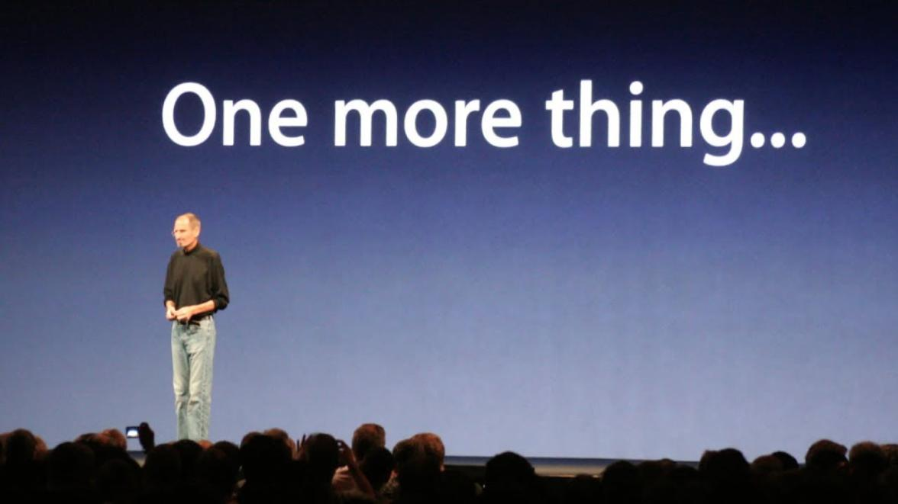

Slide 14
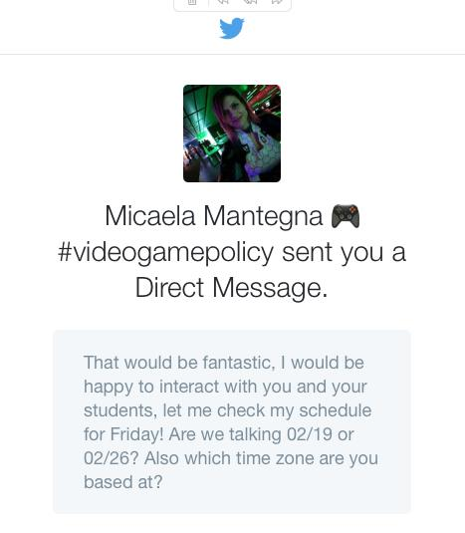
Still On the Agenda

Slide 15
News of
the Week

Slide 16
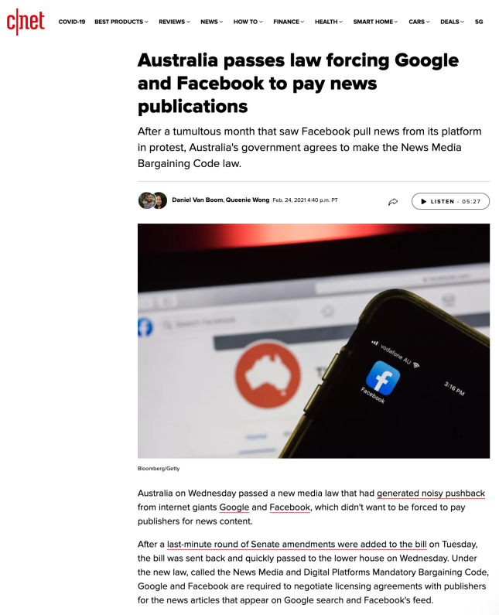

Slide 17
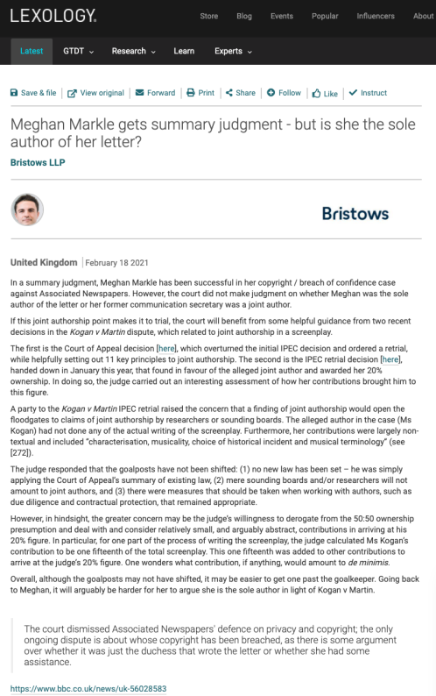

Slide 18
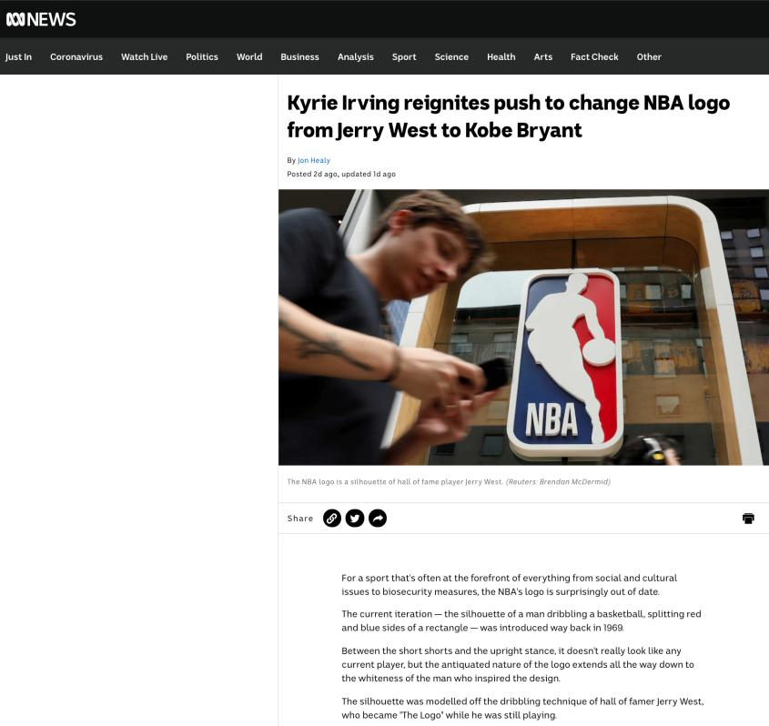

Slide 19
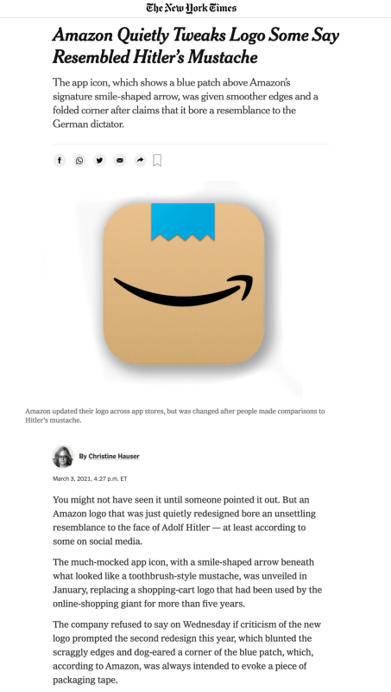

Slide 20

Pause

Slide 21
QUESTIONS?
THOUGHTS?
DISCUSSION?

Slide 22
Your News of the Week

Slide 23
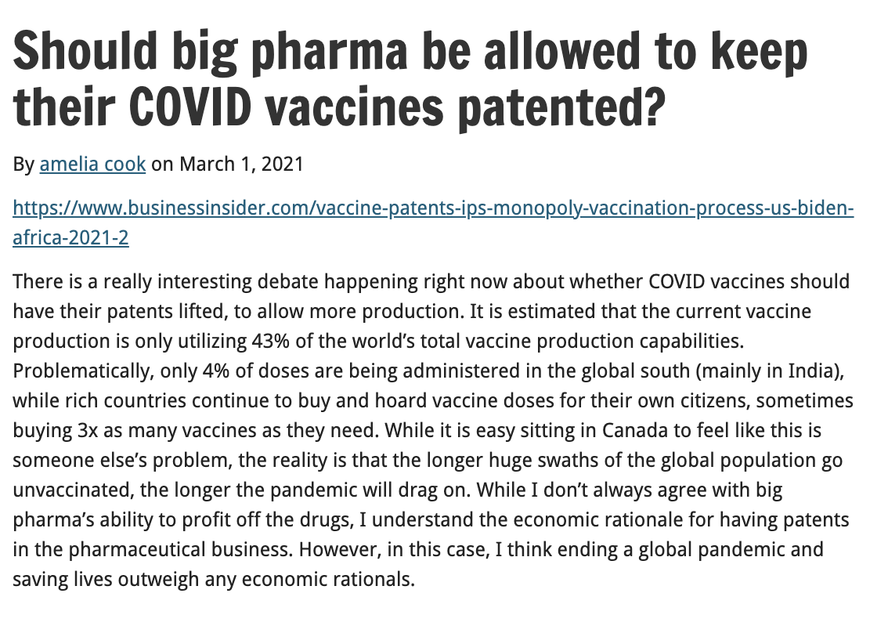

Slide 24
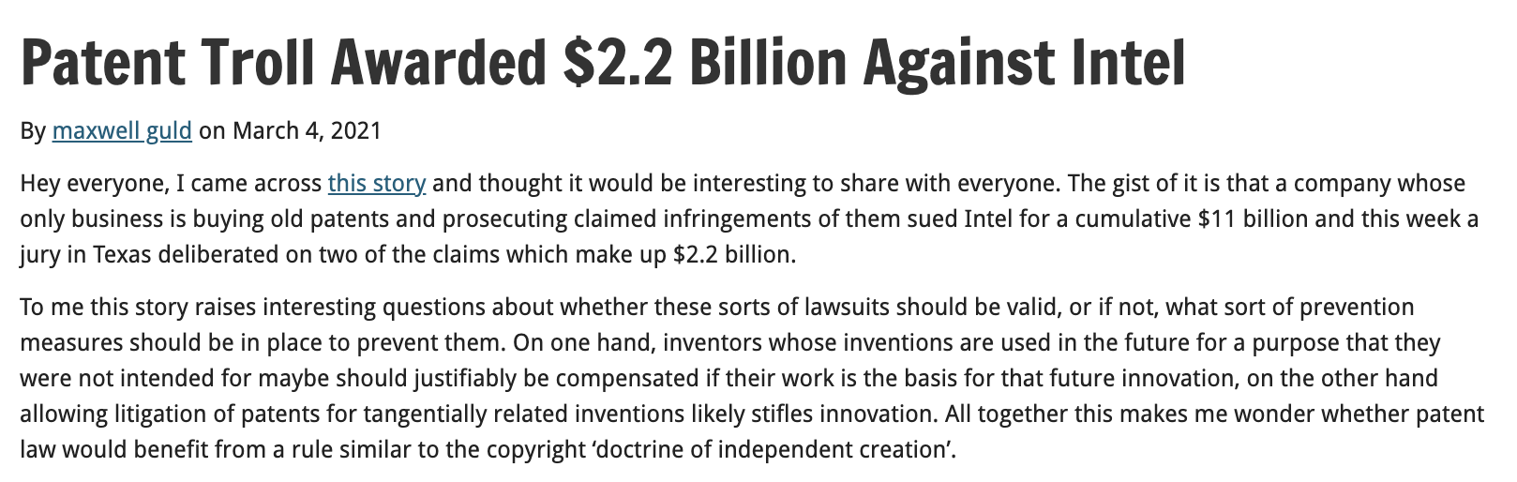

Slide 25
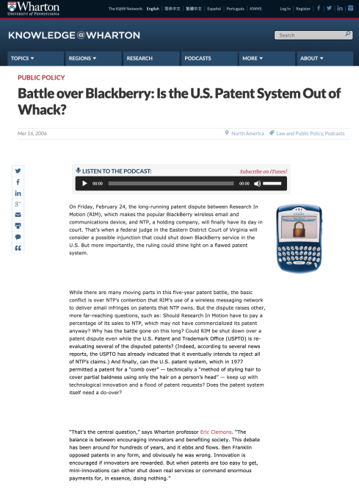
Remember Blackberry was trolled (IMHO)

Slide 26
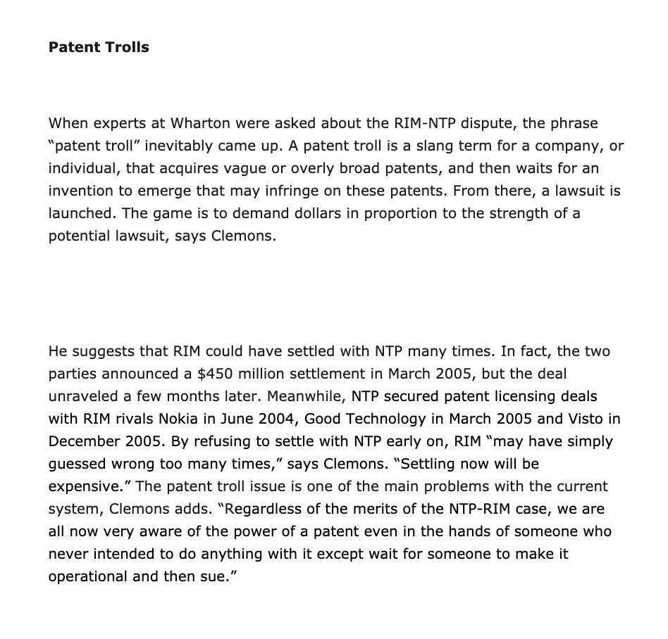

Slide 27
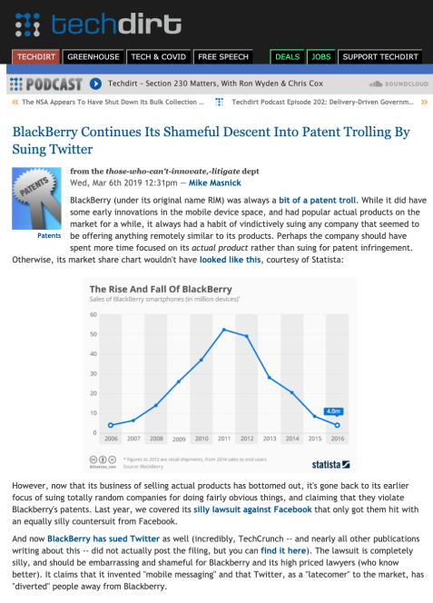
Then Blackberry became a troll (IMHO)

Slide 28
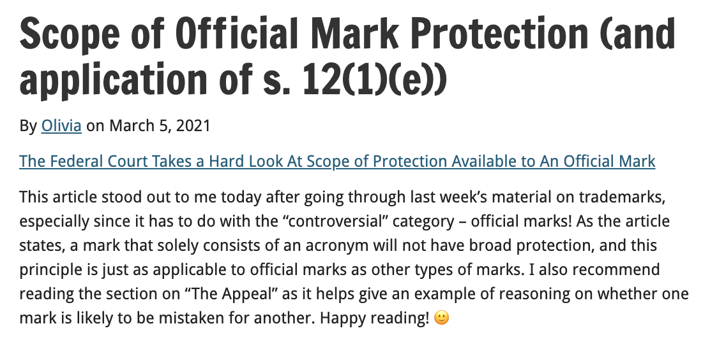

Slide 29
Pause

Slide 30
QUESTIONS?
THOUGHTS?
DISCUSSION?

Slide 31

Now, back to our regularly scheduled programming…

Slide 32

Today: Trademarks Part 2

Slide 33
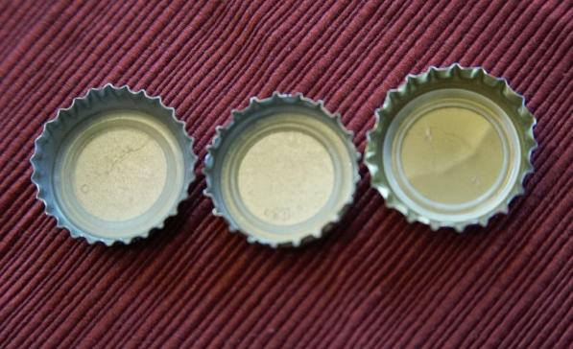
Re-capping Part 1

Slide 34
Trademarks
What is a Trademark ™?
  A mark used by a person for the purpose of distinguishing that person’s goods or services from those of others in the marketplace
Various types of marks
  Ordinary (word & design), certification, collective, official, distinguishing guise

Slide 35

Trademarks
Ordinary marks
  Distinguish the products or services of a specific firm or individual

Slide 36

Trademarks
Certification marks

Slide 37

Trademarks
A purely functional design may not be the basis of a TM, registered or unregistered
  See Kirkbi v. Ritvik (SCC)

Slide 38
Trademarks
A purely functional design may not be the basis of a TM, registered or unregistered. See Kirkbi v. Ritvik (SCC)
  Kirkbi held the patents for LEGO. When the patents expired in Canada, Ritvik started selling bricks interchangeable with LEGO.
  Kirkbi tried to assert a trade‑mark in the “LEGO indicia”: the upper surface of the block with eight studs in a regular geometric pattern.
  Registrar of Trade‑marks refused registration. Kirkbi then claimed the LEGO indicia as an unregistered mark and sought a declaration that it had been infringed by Ritvik pursuant to s. 7 (b) of the Trade-marks Act and the common law doctrine of passing off.
  Trial judge found that purely functional features, such as the LEGO indicia, could not become the basis of a trade‑mark, whether registered and unregistered. Upheld by Fed. C.A. & SCC

Slide 39
Trademarks
Ordinary marks
  S. 2: definition of trade-mark (in part): (a) a mark that is used by a person for the purpose of distinguishing or so as to distinguish goods or services manufactured, sold, leased, hired or performed by him from those manufactured, sold, leased, hired or performed by others.

Slide 40
Trademarks
Ordinary marks
Amended definition (2014 - in effect 2019):
  TM: A sign or combination of signs that is used or proposed to be used by a person for the purpose of distinguishing or so as to distinguish their goods and services from those of others.
  Sign: Includes a word, a personal name, a design, a letter, a numeral, a colour, a figurative element, a three-dimensional shape, a hologram, a moving image, a mode of packaging goods, a scent, a taste, a texture, and the positioning of a sign.

Slide 41
Trademarks
S. 12(1): A TM is registrable if it is not:
  (a) Primarily merely a name or surname of an individual living or who has died within 30 years
  (b) Clearly descriptive or deceptively misdescriptive in English or French of the character/quality of wares/services or of the conditions of production/persons employed in their production/place of origin

Slide 42
Trademarks
S. 12(1): TM is registrable if it is not:
  (c) Name in any language of any of the wares or services in connection with which it is used
  (d) Confusing with a registered TM (confusing defined in s. 6(2); factors in s. 6(5))
  (e) Mark prohibited by s. 9 or 10…
  S. 12(2): not registrable if its features are dictated primarily by a utilitarian function
  S. 12(3): If not registrable due to (1)(a) or (b), is registrable if has … become distinctive at the date of filing an application for registration (see also s. 32)

Slide 43
Trademarks
  Unilever Canada Inc. v. Superior Quality Foods Inc. (2007), 62 CPR (4th) 75, [2007] TMOB No. 66
  Deceptively misdescriptive = would dealers/purchasers of the goods be deceived by the misdescription into purchasing goods or ordering services which different in character or quality from those expected?

Slide 44
Trademarks
  Unilever Canada Inc. v. Superior Quality Foods Inc. (2007), 62 CPR (4th) 75, [2007] TMOB No. 66
Decision: “The Mark … clearly describe[s] as a matter of first impression that the Applicant’s soups and soup bases are ‘better than boullion’, a laudatory description that is contrary to s. 12(1)(b)”
Policy justification: This is an ordinary, grammatical phrase that others in the industry should be able to use to fairly describe their products. / different decision - “the vocabulary of the English language is common property: it belongs to all” (Eastman Photographic Materials Company Ltd. v. Comptroller-General of Patents, Designs and Trade Marks, [1898] A.C. 571 (H.L.), Lord Herschell at page 580 ”

Slide 45
Trademarks
General Foods Ltd. v. Carnation Co. (1978), 45 CPR (2d) 282 (TMOB)
Can GFL register the TM “Instant Breakfast” for use in association with wares described as “fortified powder food for mixing with milk”?
S. 12(1): TM is registrable if it is not (c) Name in any language of any of the wares or services in connection with which it is used
Also s.30(a) of the Trademarks Act in setting specifics for TM applications requires that applications must contain “a statement in ordinary commercial terms of the specific goods or services in association with which the mark has been or is proposed to be used.”
Are the words “fortified powder food for mixing with milk” ordinary commercial terms? Board held no. Statement in ordinary commercial terms for the product would be “instant breakfast”.
Accordingly, application to register the TM Instant Breakfast, which is also the name of the wares in English was found not registrable per s. 12(1)(c).

Slide 46
Trademarks
What is the significance in the distinction between s. 12(1)(b) and 12(1)(c)? Why might this distinction have been formalized in the TMA?
12 (1) Subject to subsection (2), a trademark is registrable if it is not..
  (b) …either clearly descriptive or deceptively misdescriptive in the English or French language of the character or quality of the goods or services in association with which it is used…;
  (c) the name in any language of any of the goods or services in connection with which it is used or proposed to be used;

Slide 47
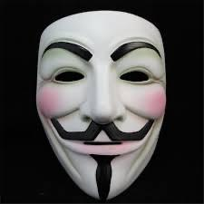
Trademarks: Distinguishing guise no more

Slide 48
Instead of “distinguishing guise”
s. 2 …“sign includes a word, a personal name, a design, a letter, a numeral, a colour, a figurative element, a three-dimensional shape, a hologram, a moving image, a mode of packaging goods, a sound, a scent, a taste, a texture and the positioning of a sign;”

Slide 49
Trademarks
Distinguishing guise
New 12(2): A trademark is not registrable if, in relation to the goods or services in association with which it is used or proposed to be used, its features are dictated primarily by a utilitarian function
New 18.1: The registration of a trademark may be expunged by the Federal Court on the application of any interested person if the Court decides that the registration is likely to unreasonably limit the development of any art or industry
20(1.2): The registration of a trademark does not prevent a person from using any utilitarian feature embodied in the trademark

Slide 50
Trademarks: Official Marks
S. 9(1)(n)(iii):
  Allows entities which are “public authorities” to request the Registrar of Trade-marks to give public notice of their adoption and use of particular names or symbols. These marks are referred to as “official marks”.
  Once notice is given, these official marks are also removed from the general realm of trade and commerce. S. 9(1) prohibits anyone else from adopting an official mark. This prohibition is absolute.
  S. 9(1)(n)(iii) process is thus controversial.

Slide 51
Trademarks
Ontario Ass’n of Architects v. Ontario Assn of Architectural Technologists, [2003] 1 F.C. 331 (FCA)
Defining characteristics of public authority =
  Degree of government control [para. 57-64]
  Extent to which the body’s activities benefit the public [para. 65-73]

Slide 52
Trademarks
“170 The PEI government has significant influence and control with respect to the Anne Authority. The PEI government has members on the Anne Authority committee. The PEI branch of that committee controls all licensing in Prince Edward Island. One of the prime objectives, from the government perspective, was to protect the local craft industry in the Province, freeing it from costly licenses but maintaining a uniform-quality Anne image. The Province is partnered with the Heirs, who share a philanthropical and financial objective with respect to protecting and promoting a licensed Anne image. Applying the combined test of control, influence and purpose to promote the public good, I conclude that the Anne Authority is a public authority. If it was necessary to determine the issue, I would in all of the circumstances conclude that the Anne Authority is a public authority. Therefore, the Assignment Agreement that conveyed rights from the PEI government to the Anne Authority would be valid.”
(Anne of Green Gables Licensing Authority Inc. v. Avonlea Traditions Inc. (2000), 4 C.P.R. (4th) 289

Slide 53
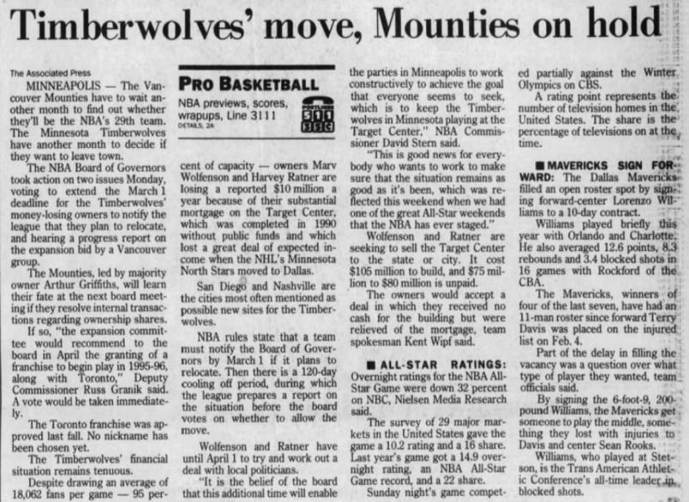
S. 9(1)(o): “Royal Canadian Mounted Police” or “R.C.M.P.”

Slide 54
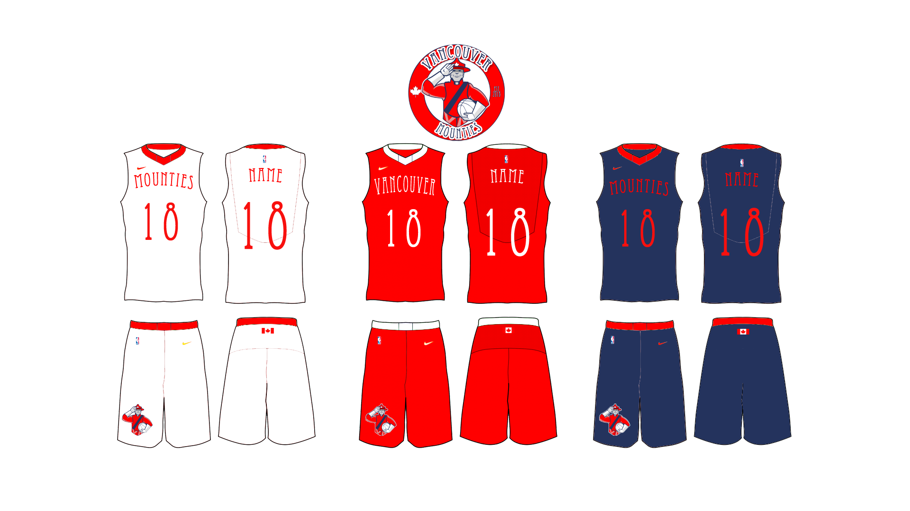

Slide 55
Trademarks
“Use”
First use … entitles you to register a TM but amended provisions now allow for filing without intended use.
Failure to use … basis for expungement of TM
Unauthorized use … could lead to infringement actions

Slide 56
Trademarks
Syntex Inc. v. Apotex Inc., [1984] 2 FC 1012 (FCA)
  4. (1) A trade-mark is deemed to be used in association with goods if, at the time of the transfer of the property in or possession of the goods, in the normal course of trade, … it is in any other manner so associated with the goods that notice of the association is then given to the person to whom the property or possession is transferred.

Slide 57
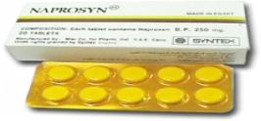
Trademarks
Syntex Inc. v. Apotex Inc., [1984] 2 FC 1012 (FCA)
Court said on this point… “It seems to me that the respondents (Syntex) face considerable difficulty in establishing at trial that the presence of the trade mark “Naprosyn” in the appellant’s flyer constituted a “use” that is contrary to subsection 22(1) of the Trade Marks Act”

Slide 58
Trademarks
4(2) A trade-mark is deemed to be used in association with services if it is used or displayed in the performance or advertising of those services.

Slide 59
Trademarks
Gesco Industries Inc v. Sim & McBurney (2000) 9 CPR (4th) 480 (FCA)
Was the Stainshield TM, in this case, used in association with the services disclosed in the registration of the TM (namely services of stain resistant treatment for application to carpets and rugs)?
Yes; Stainshield TM displayed in the advertising of the treatment of some of Gesco’s lines of carpets and rugs.
Services may be ancillary to the wares, but this doesn’t mean the TM is not used in association with the services. [para 11]
Are there good policy reasons for “use” to be more permissive for services than for goods?

Slide 60


Trademarks
Tommy Hilfiger Licensing Inc v. Produits de Qualité, 2005 FC 10

Slide 61
Trademarks
UNICAST SA v. South Asian Broadcasting Corporation Inc. 2014 FC 295 (CanLII)
Applicant claims, citing to a case called HomeAway.com, Inc. v. Hrdlicka, 2012 FC 1467, that a trade-mark which appears on a computer screen website in Canada, regardless where the information may have originated from or be stored, constitutes for Trade-Marks Act purposes, use and advertising in Canada.
Court rejects this argument, taking this opportunity to clarify and put HomeAway into context…
  “[46]…Although it is true that subsection 4(2) TMA provides that a “trade-mark is deemed to be used in association with services if it is used or displayed in the performance […] of those services”, the Courts and tribunals, including the Trade-marks Opposition Board, have nonetheless added that such services must be effectively offered to Canadians or performed in Canada (see for example Express File Inc. v HRB Royalty Inc., 2005 FC 542(CanLII) at para 20, [2005] FCJ No 667).”
Not enough for the mark to merely appear on a computer screen…

Slide 62
Trademarks
UNICAST SA v. South Asian Broadcasting Corporation Inc. - Conclusion
The fact that a trade-mark appears on a website that may be displayed on a computer screen in Canada is not sufficient to constitute use and advertising in Canada (for the purposes of s. 4(2) of the TMA).

Slide 63

Trademarks
Scott Paper Limited v. Smart & Biggar, 2008 FCA 129 Conclusion
Fact that registered owner may have plans to resume use of mark is not sufficient to excuse non-use.

Slide 64
Trademarks
S. 57 TMA → Can strike or amend a TM on the register on the basis that it “does not accurately express or define the existing rights of the [registered owner] of the mark.” (read w. s. 18)
If the TM was not registrable at the date of registration [18(1)(a)]
If the TM is not distinctive at the time proceedings bringing the validity of the registration into question are commenced [18(1)(b)]
If the TM has been abandoned [18(1)(c)]
If the applicant for registration was not the person entitled to secure the registration [18(1)(d)]
The application for registration was filed in bad faith

Slide 65
Trademarks
When registration invalid
18 (1) The registration of a trademark is invalid if
  (a) the trademark was not registrable at the date of registration;
  (b) the trademark is not distinctive at the time proceedings bringing the validity of the registration into question are commenced;
  (c) the trademark has been abandoned;
  (d) subject to section 17, the applicant for registration was not the person entitled to secure the registration; or
  (e) the application for registration was filed in bad faith.
Exception
(2) No registration of a trademark that had been so used in Canada by the registrant or his predecessor in title as to have become distinctive at the date of registration shall be held invalid merely on the ground that evidence of the distinctiveness was not submitted to the competent authority or tribunal before the grant of the registration.

Slide 66
Trademarks
Promafil Canada Ltée v. Munsingwear Inc. (1992), 44 CPR (3d) 59, [1992] FCJ 611 (FCA).
Promafil (P/R) is a French company; Munsingwear (D/A) a US company.
Mark of the appellant Munsingwear is a picture of a penguin. Adopted by Munsingwear in the US in the 1950s for use on golf shirts.
Munsingwear is not in business in Canada. Stanfield’s (a Canadian company based in Truro, NS) obtained a licence from Munsingwear to make and sell golf shirts in Canada with the Pengiuin mark.
Accordingly the penguin was used, but never registered…
Why not?

Slide 67
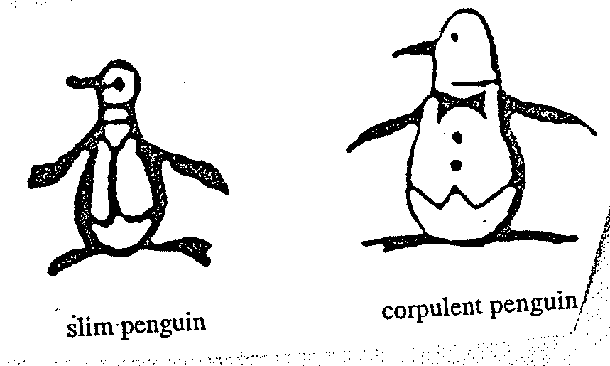
Trademarks
Promafil Canada Ltée v. Munsingwear Inc. (1992), 44 CPR (3d) 59, [1992] FCJ 611 (FCA).

Slide 68
Trademarks
Promafil Canada Ltée v. Munsingwear Inc. (1992), 44 CPR (3d) 59, [1992] FCJ 611 (FCA).
Main issue was whether by registering one mark, and using another, is the first mark abandoned?
To show abandonment:
  Must show registered TM no longer in use in Canada
  Need to show intention to abandon mark.
Amendment:
  Can amend mark provided that the amendment does not materially alter the character of the mark. Can have variations on the same mark (both can be used). All law requires is that there is maintenance of recognizability to avoid confusion of unaware purchasers. (Promafil)

Slide 69
Trademarks
Promafil Canada Ltée v. Munsingwear Inc.
FCA (MacGuigan JA) held:
Here differences are only petty and when used concurrently, one is still the variation of the other. A modified variant can co-exist with original…
The second design doesn’t have to replace the first design. There can be variations on the same design. The law can tolerate multiple variations of the same mark. Though, every variation is playing with fire…
If variation is too different then it would be a new mark or non-use of registered mark…
The key is to maintain recognisability and avoid confusion of unaware purchasers. If the same dominant features of the design are maintained, and the differences are petty – the unaware purchaser will not be misled.

Slide 70
Pause

Slide 71
QUESTIONS?
THOUGHTS?
DISCUSSION?

Slide 72
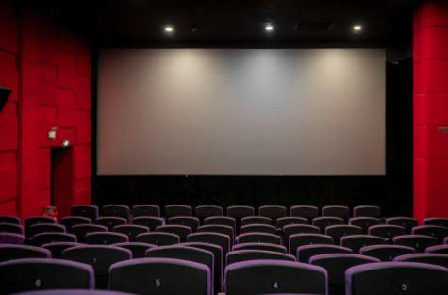
Continuing with our show…

Slide 73
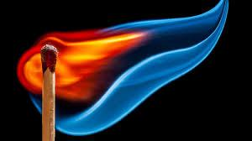
Re-ignition

Slide 74
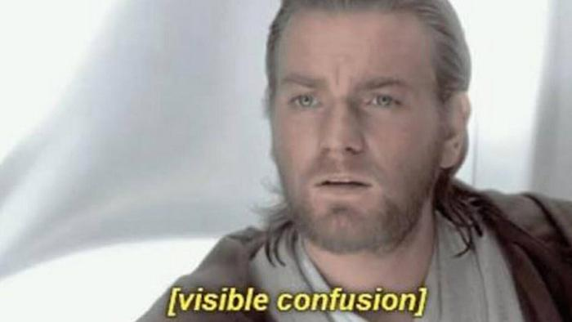
Trademarks: Doctrine of Confusion

Slide 75
Trademarks : Confusion
Doctrine of confusion – Critical Concept
Important in the context of registrability (see ss. 12, 16)
Also important in infringement actions (see s. 20)
Core provision: s. 6 TMA (specifically s. 6(2) and 6(5))

Slide 76
Trademarks : Confusion
TM is not registrable if it is confusing with a registered TM (12(1)(d)) or TMs or Trade-Names (“TN’s”) that had been previously used or made known (see s. 16)
Confusion is also an important part of infringement actions. An action in infringement can be successfully brought where there is unauthorized use of a mark that is confusing with a registered TM.

Slide 77
Trademarks : Confusion
6. (2) The use of a trade-mark causes confusion with another trade-mark if the use of both trade-marks in the same area would be likely to lead to the inference that the goods or services associated with those trade-marks are manufactured, sold, leased, hired or performed by the same person, whether or not the goods or services are of the same general class.

Slide 78
Trademarks : Confusion
What to be considered
6. (5) In determining whether trade-marks or trade-names are confusing, the court or the Registrar, as the case may be, shall have regard to all the surrounding circumstances including
  (a) the inherent distinctiveness of the trade-marks or trade-names and the extent to which they have become known;
  (b) the length of time the trade-marks or trade-names have been in use;
  (c) the nature of the goods, services or business;
  (d) the nature of the trade; and
  (e) the degree of resemblance between the trade-marks or trade-names in appearance or sound or in the ideas suggested by them.

Slide 79
Pause

Slide 80
QUESTIONS?
THOUGHTS?
DISCUSSION?

Slide 81
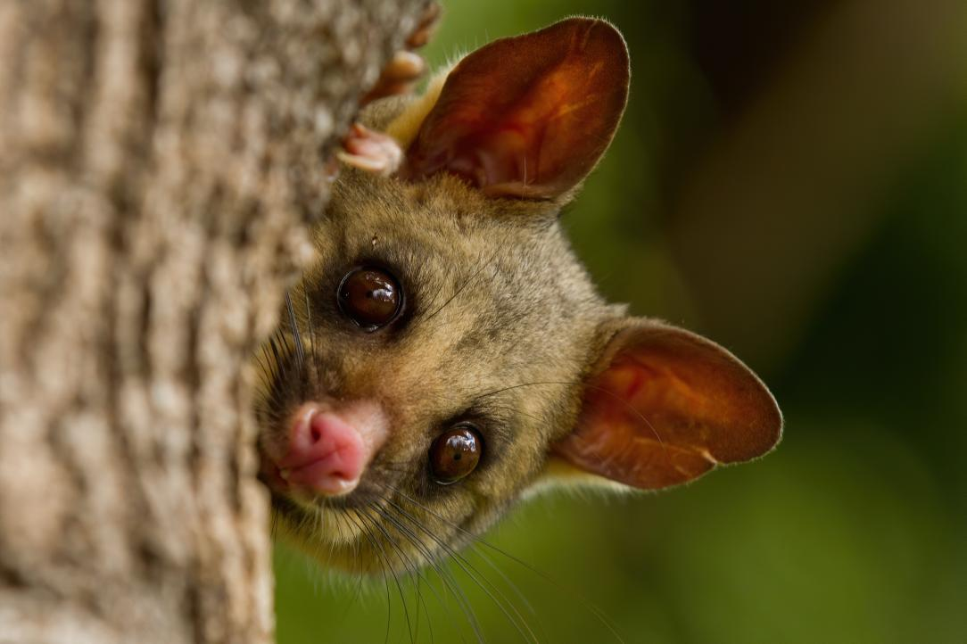
Brushtail Possum

Slide 82
Trademarks: Confusion
S & S Productions Inc. v. Possum Lodges (Messier), [2006] TMOB No. 144
Applicant – Messier ; Opponent – S & S Productions, Producers The Red Green Show on television
Messier filed an application to register the Trademark Possum Lodges based upon proposed use in association with “sale and rental of recreational lodging, namely, cabins, camps, lodges, campsites and cottages; time-sharing of recreational real estate; … restaurants”
Application was opposed by S & S Productions on basis of s. 38(2)(b) that the TM is not registrable because under s. 12(1)(d) it is confusing with their TM’s Possum Lodge and International Possum Brotherhood and design.

Slide 83
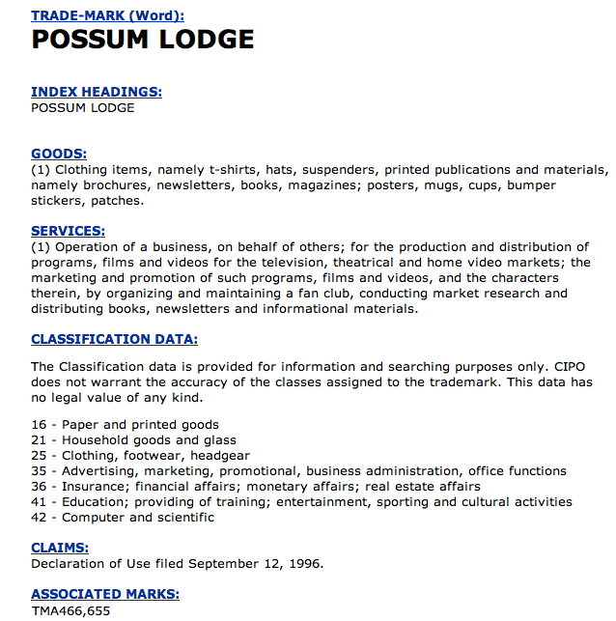
Trademarks: Confusion

Slide 84
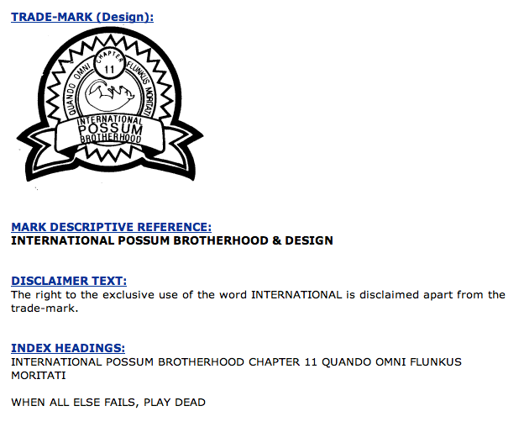
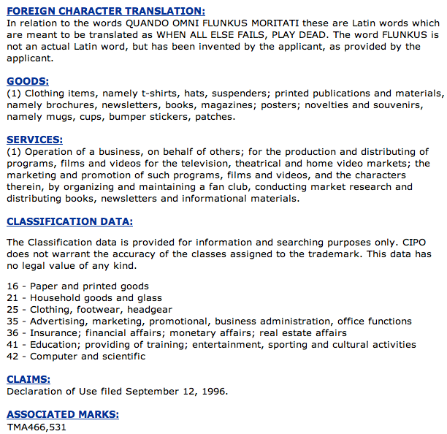
Trademarks : Confusion

Slide 85
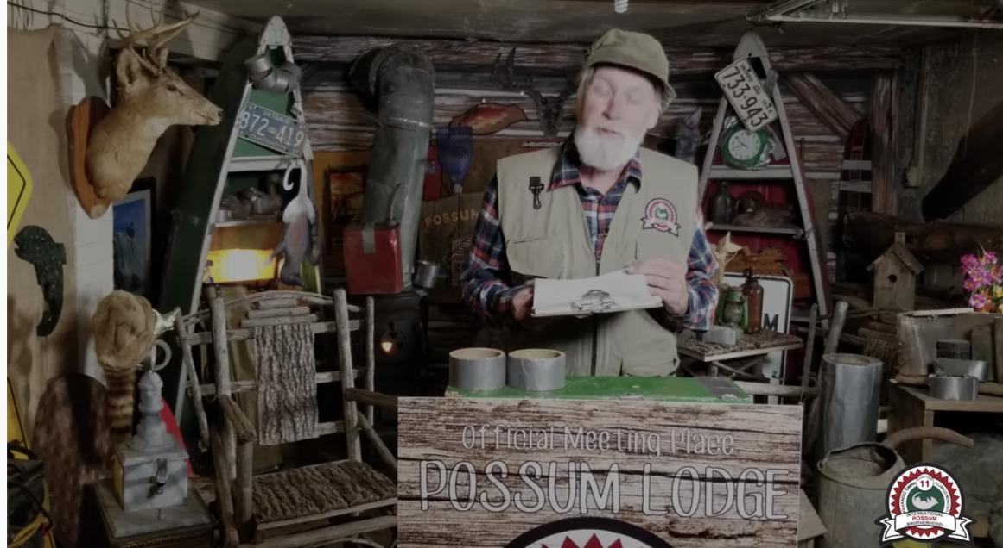
“The Red Green Show”

Slide 86
Trademarks: Application of s. 6
To assess confusion, go back to s. 6(5)…
Question that needs to be asked is (2)…would the use of both trade-marks in the same area…be likely to lead to the inference that the goods or services associated with those trade-marks are manufactured, sold, leased, hired or performed by the same person?
Application of s. 6(5) factors:
(a) the inherent distinctiveness of the trade-marks or trade-names and the extent to which they have become known
(b) The extent to which each trade-mark has become known
(b) the length of time the trade-marks or trade-names have been in use
(c) the nature of the goods, services or business; (d) nature of the trade…
(d) the nature of the trade
(e) the degree of resemblance between the trade-marks or trade-names in appearance or sound or in the ideas suggested by them

Slide 87
Trademarks: Application of s. 6
The Applicant failed in their duty to select a name with care to avoid any confusion. Does the decision make sense?
Note the language … “assume there was some connection between the Applicant’s [goods and services]” and those of the Opponent.
Compare this with the language of s. 6(2) …
The use of a trade-mark causes confusion with another trade-mark if the use of both trade-marks in the same area would be likely to lead to the inference that the goods or services associated with those trade-marks are manufactured, sold, leased, hired or performed by the same person, whether or not the goods or services are of the same general class.
Fundamental tension
How much protection TM owners should receive, and how much protection owners of well-known or famous TMs should receive?

Slide 88

Trademarks: Confusion
Mattel v. 3894207 Canada Inc., 2006 SCC 22
The Numbered Company wanted to register TMs in connection with its small chain of Montreal suburban Barbie’s restaurants.
Mattel opposed the application on the basis that use of the name would create confusion with respect to its Mark BARBIE.
Mattel lost in SCC

Slide 89
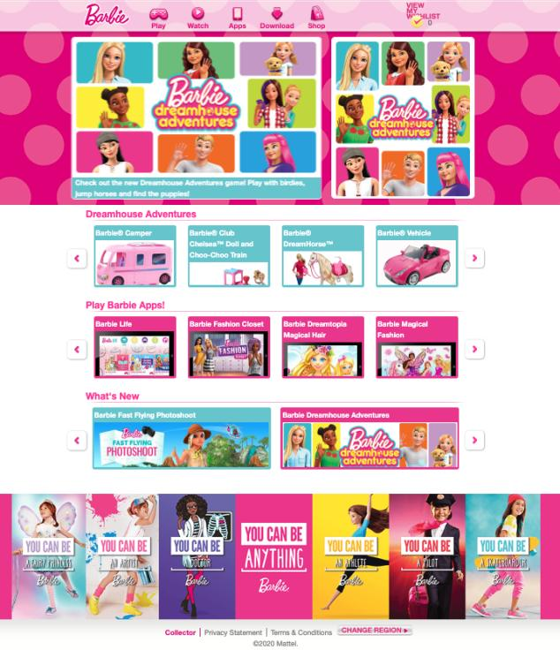
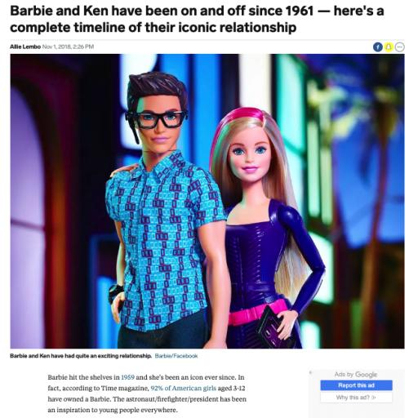

Slide 90
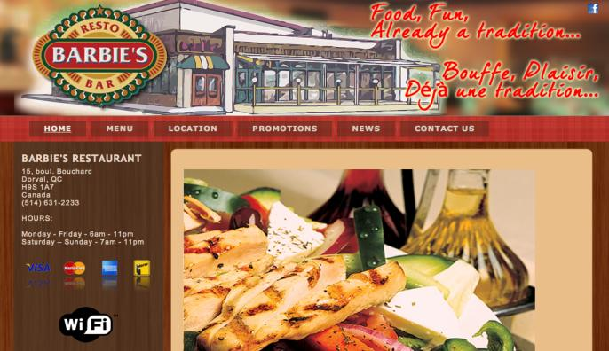
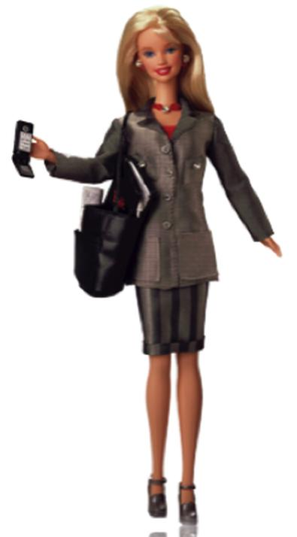


Slide 91


Trademarks: Confusion
Mattel v. 3894207 Canada Inc., 2006 SCC 22

Slide 92
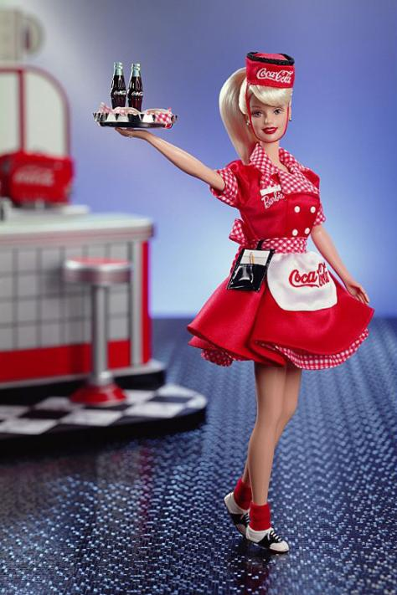

Slide 93
Trademarks: Confusion
Mattel v. 3894207 Canada Inc., 2006 SCC 22
Binnie J.:
  Some TMs are so well-known that use in connection with any wares or services would generate confusion.
  In those circumstances, no need to establish a connection between the goods and/or services for a finding of confusion to be made out (cf. Pink Panther case)
Who is the test person for the purpose of the confusion analysis?
How were the s. 6(5) factors applied?

Slide 94
Trademarks : Confusion
Mattel v. 3894207 Canada Inc., 2006 SCC 22
In Supreme Court of Canada…Binnie J. did find that some trade-marks are so well known that use in connection with any wares or services would generate confusion. Other brands are product specific.
Example given of a brand that may not be product specific? Virgin – used in connection with such a wide variety of wares and services that it knows virtually no bounds.
Example given of a brand that may be product specific? Apple = well-known TMs associated separately with computers, record label, automobile glass.
In discussing the role to be played by fame in confusion cases, the SCC had to address another case; the Pink Panther case of the Ont. CA.

Slide 95


Slide 96
Trademarks: Confusion
In that case Pink Panther Beauty Corp. wanted to register the TM Pink Panther in association with beauty products. United Artists Corp., owner of the famous Pink Panther mark registered in association with the entertainment business objected, arguing that consumers would be confused.
Would consumers think that these goods came from the same source?
Ont. CA held in the Pink Panther case that it was unlikely consumers would be confused; PINK PANTHER beauty parlour patron would not be likely to think that the hairdressing services she received were provided by United Artists Studios.

Slide 97
Trademarks : Confusion
Binnie J. of SCC in Mattel rejected Linden JA’s statement that for confusion to occur, there must be some resemblance or linkage between the two products (i.e., Barbie doll and Barbie’s restaurant); and that only in exceptional circumstances can confusion be found when there is no connection between the products or services.
Test articulated by SCC was that for famous and non-famous marks alike, whether there is confusion in the s. 6(2) sense, is determined by if the consumer thinks that the goods come from the same source. This question has must be analyzed in all the circumstances (as set out in s. 6(5) and beyond).
The nature of the wares is important:
  It is one of the criteria in 6(5)
  In cases involving famous marks it is likely to be an important factor (i.e., Barbie doll and Barbie’s restaurants), as fame can possibly carry the mark across product lines.
SCC emphasized in Mattel is that you do not have to establish a connection between the goods and/or services for a finding of confusion to be made out.

Slide 98
Trademarks: Confusion – Test Person
Important question: From what perspective should consumer confusion be analyzed? Who is the test person for the purpose of the confusion analysis?
Addressed by SCC in Mattel. A few “test people” were rejected:
  The careful and diligent purchaser
  The “moron in a hurry”
SCC adopted the ordinary hurried purchaser and looked at the probability of the average person with average intellect acting with ordinary caution being deceived. Points to consider:
  Give the average consumer some credit – don’t assume that they’re totally devoid of intelligence, normal powers of recollection, or are totally unaware or uninformed.
  More care taken/attention given to big purchases (car as opposed to toy)

Slide 99
Trademarks: Confusion – Test Person
In buying ordinary run-of-the-mill consumer wares and services, the consumer is of average intelligence, generally running behind schedule, and has more money to spend than time to pay a lot of attention to detail.
In appropriate markets, this person is functionally bilingual.
To this person, TMs make shopping faster and easier.
When the new trade-mark catches their eye, they will have only a general and not very precise recollection of the earlier trade-mark (as it would be remembered by persons possessed of an average memory with its usual imperfections).
The standard is not people who do not notice anything. Rather it is persons who take no more than ordinary care to observe what is staring them in the face.
If the ordinary casual consumer somewhat in a hurry is likely to be deceived about the origin of the wares or services, then the statutory test is met.

Slide 100
Trademarks: Confusion
Masterpiece Inc. v. Alavida Lifestyles Inc, 2011 SCC 27
Issue: Whether the trade-mark “Masterpiece Living”, proposed and subsequently registered by Alavida Lifestyles Inc. (“Alavida”), a company entering the retirement residence industry in Ontario, was [at the time it applied for registration – namely December 1, 2005] confusing with the unregistered trade-marks or trade-name previously used Masterpiece Inc. in the retirement residence industry in Alberta (marks which included “Masterpiece the Art of Living”, “Masterpiece and the Art of Retirement Living”, and a stylized word “Masterpiece” alongside a butterfly logo).

Slide 101
Trademarks: Confusion
Masterpiece Inc. v. Alavida Lifestyles Inc, 2011 SCC 27
1) Is geography relevant when performing a confusion analysis?
2) How to assess the resemblance between a proposed use TM and an existing unregistered TM?
3) Impact of the nature and cost of wares and services on the confusion analysis
4) Relevance of expert evidence

Slide 102
Trademarks: Confusion
A few aspects of this decision worth highlighting:
The possible relevance of the location where a mark is used when engaging in the confusion analysis
The considerations applicable in assessing the resemblance between a proposed use TM and an existing unregistered TM
The impact of the nature and cost of the wares or services on the confusion analysis (particularly the nature of the trade consideration)
Relevance of expert evidence in TM/TN confusion cases.

Slide 103
Trademarks: Confusion
Masterpiece Inc. v. Alavida Lifestyles Inc., 2011 SCC 27
The SCC dealt with the issue of whether “the location where a mark is used is relevant when considering the likelihood of confusion between an applied for or registered TM and a prior unregistered TM or TN”
Or – is geography relevant when performing a confusion analysis?
SCC held that “geographical separation in the use of otherwise confusingly similar TN and TM does not play a role” in the Confusion analysis. The location where a mark is used is not relevant when considering the likelihood of confusion between a mark that is registered (or for which an application for registration has been made) and a prior unregistered mark.
The SCC reached this conclusion largely through statutory interpretation – particularly – the way ss. 6(2-4) are framed “if the use of both ... in the same area would be likely to lead to the inference”

Slide 104
Trademarks: Confusion
Relevance of expert evidence
Rothstein J. did not find the expert evidence in this case helpful.
He stated that where parties propose to introduce expert evidence, a trial judge should question the necessity and relevance of the evidence before admitting it (99).
He noted that “In cases of wares or services being marketed to the general public, such as retirement residences, judges should…use their own common sense, excluding influences of their ‘own idiosyncratic knowledge or temperament’ to determine whether the casual consumer would be likely to be confused.” (92)

Slide 105
Trademarks: Confusion
Rothstein J. did note however that surveys can be valuable, that they “have the potential to provide empirical evidence which demonstrates consumer reactions in the marketplace — exactly the question that the trial judge is addressing in a confusion case” (93)
Per Rothstein J. the problem with the survey in this case was that because Masterpiece Inc. had not yet established a presence in the community in which it operated, there were no casual or average consumers with ‘imperfect recollection’ of Masterpiece Inc.’s marks to test.
Rothstein J. went so far as to say that it is highly unlikely that party may devise a valid survey in a case where a trade-mark user has not established a sufficient presence in the marketplace for consumers to have formed an imperfect recollection of its trade-mark (97)

Slide 106
Pause

Slide 107
QUESTIONS?
THOUGHTS?
DISCUSSION?

Slide 108
Trademarks: Infringement
  Focus on Infringement
    What rights do you have as TM owners?
    How are those rights infringed?
    What remedies do you have as TM owners?
    What defenses are available?

Slide 109

Trademarks: Infringement

Slide 110
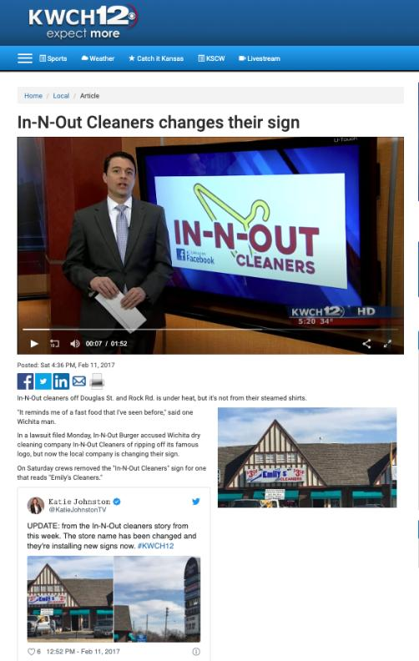
Wichita Kansas

Slide 111
Trademarks : Infringement
Four main provisions in the TMA that address TM infringement
  S. 7: provides protection against passing off; applies to both registered and unregistered marks
  S. 19: governs use of precise TM registered for same wares and services
  S. 20: deals with confusing uses of TMs
  S. 22: governs uses that depreciate value of goodwill
Only S. 7 provides protection for UNREGISTERED MARKS – s. 7. This section applies to both registered and unregistered marks and provides protection against passing off. It can be understood as the codification of the two main types of passing off…
The other three provisions – ss. 19, 20, and 22 - ONLY apply to registered TMs.

Slide 112
Trademarks: Infringement
  S. 19: governs use of precise TM registered for same wares and services
  Subject to ss. 21, 32, 67
  S. 21:
    Honest, concurrent use of the mark
    Allows the court to carve out space for a party’s continuing use of a mark
    Compromise provision

Slide 113
Trademarks: Infringement
Rights conferred by registration
19 Subject to sections 21, 32 and 67, the registration of a trademark in respect of any goods or services, unless shown to be invalid, gives to the owner of the trademark the exclusive right to the use throughout Canada of the trademark in respect of those goods or services.

Slide 114
Trademarks: Infringement
S. 19 gives the owner of a TM the exclusive right to use, throughout Canada, the TM in association with those wares and services for which it is registered.
S. 19 only applies where someone uses EXACTLY THE SAME TM; and uses it in association with one of the wares or services for which the original mark is registered.
For example say that Coca Cola is registered only for soda drinks
If someone uses the TM Coca Cola with respect to couches, this would not be covered by s. 19.
As well, if someone uses the TM Cocca Colla (two cs, two ls) with respect to soda drinks, that would not be covered by s. 19.
Only if a second person used the TM Coca Cola (same TM) with respect to soda drinks (same wares and services) that S. 19 would be infringed.
In S. 19, it states that the rights conferred are subject to S. 21, 32, and 67...
Examine S. 21 which exception refers to the Honest, Concurrent use of the mark.

Slide 115
Trademarks: Infringement
For example: Company X has the common law trademark PRAIRIE for luggage. They have been in business in Manitoba and Sask. since 1980 but haven’t registered their mark
1990 Company Y comes along and would like to use the TM PRAIRIE. They do a registered search, find nothing similar, and register the same TM without knowing that X has been in business in Manitoba & Sask. with that trademark.
Company X not aware that company Y registered this mark until 1998, when it is sued for TM infringement by Company Y. But X was using the mark since 1980!
X’s response is to challenge the registration of the mark under s. 18. Specifically X cites the “entitled to register” section of s. 18 , saying that Company Y isn’t entitled to register the mark because Y’s mark was confusing with X’s mark, which X had used prior to the time Y applied to register.

Slide 116
Trademarks: Infringement
Argument will fail.
Defence, in s. 18, is no longer available because it has been more than 5 years since the mark was registered
17(2) says you have 5 years to object to the registration of a mark on the basis of your prior use of the mark.
s. 21 allows the court to carve out space for X’s continuing use of the mark. However the catch is that there has to be an “adequate specified distinction from the registered TM”, as the court may order.
So, the Court indeed allows X use the mark, but they have to distinguish it in some way to ensure the public is not confused as to source.
S. 21 has been described by commentators as the compromise provision. Through it, the court will find some way for both parties to use the TMs.

Slide 117
Trademarks: Infringement
When registration invalid
18 (1) The registration of a trademark is invalid if
  (a) the trademark was not registrable at the date of registration;
  (b) the trademark is not distinctive at the time proceedings bringing the validity of the registration into question are commenced;
  (c) the trademark has been abandoned;
  (d) subject to section 17, the applicant for registration was not the person entitled to secure the registration; or
  (e) the application for registration was filed in bad faith.

Slide 118
Trademarks: Infringement
When registration incontestable
17 (2) In proceedings commenced after the expiration of five years from the date of registration of a trademark or from July 1, 1954, whichever is the later, no registration shall be expunged or amended or held invalid on the ground of the previous use or making known referred to in subsection (1), unless it is established that the person who adopted the registered trademark in Canada did so with knowledge of that previous use or making known.

Slide 119
Trademarks: Infringement
Concurrent use of confusing marks
21 (1) If, in any proceedings respecting a registered trademark the registration of which is entitled to the protection of subsection 17(2), it is made to appear to the Federal Court that one of the parties to the proceedings, other than the registered owner of the trademark, had in good faith used a confusing trademark or trade name in Canada before the filing date of the application for that registration, and the Court considers that it is not contrary to the public interest that the continued use of the confusing trademark or trade name should be permitted in a defined territorial area concurrently with the use of the registered trademark, the Court may, subject to any terms that it considers just, order that the other party may continue to use the confusing trademark or trade name within that area with an adequate specified distinction from the registered trademark.

Slide 120
Trademarks : Infringement
  S. 20: deals with confusing uses of TMs.
  Covers two types of situations:
Where it is not the identical TM that has been used, but one that is confusing with the registered TM; (Cocca Colla for soft drinks)
Where it is the identical TM but one used with respect to different wares or services. I.e., Coca Cola for chairs - something Coca Cola [original company] is not registered for)

Slide 121
Trademarks: Infringement
Final section dealing with TM infringement of registered marks is S. 22.
S. 22 governs use of a mark that has the effect of depreciating the value of the goodwill of that mark (no confusion is necessary).
Leading case is Veuve Cliquot but first case to deal with s. 22 is Clairol but first…
Clairol International Corp. v. Thomas Supply & Equipment Co., [1968] 2 Ex. C.R. 552

Slide 122
Trademarks: Infringement
Clairol International Corp. v. Thomas Supply & Equipment [1968] 2 Ex. C.R. 552
Facts: Revlon creates comparison charts…
To infringe s. 19: (see ss. 2, 4)
  1) The mark has to be “used” (see ss. 2, 4)
  2) Also “used” as a TM = must be used for the purposes of distinguishing wares and services → used as an indicator of source
  3) Applies only where someone uses the mark as registered; in association with goods or services for which it is registered

Slide 123
Trademarks : Infringement
Clairol International Corp. v. Thomas Supply & Equipment (1968)
S. 22:
  The defendant must have used the mark as set out in s. 2 and 4 of the Act.
  If there is “use”, then the test becomes whether the use is likely to depreciate the value of the goodwill attaching to the mark (i.e. by reducing the esteem in which the mark is held; or enticing customers away)

Slide 124
Trademarks: Infringement
Clairol International Corp. v. Thomas Supply & Equipment (1968)
This is the first time a s. 22 issue was before the court. [exact s. 22 test will come from Veuve, but this is useful for historical purposes, and to see the stance taken by this Court on comparative advertising].
22. (1) No person shall use a trade-mark registered by another person in a manner that is likely to have the effect of depreciating the value of the goodwill attaching thereto.
How far is this section meant to extend?
Written broadly enough to capture negative comments made in conversation about a specific product.
The court acknowledges that this section is worded broadly, but says that it’s unlikely that there is any attempt to suppress critical expression.
*One key is that the court reads in an implied limitation in this section…use in the course of trade.
But even with this implied limitation, this is still potentially a very broad right. It could cover comparison price charts or discussion by sales-clerks of competing products.
We see the court reiterate that purpose of s. 22 is not to stop legitimate comparisons.

Slide 125
Trademarks: Infringement
What is the impact of Clairol on comparative advertising?
Case suggests we CAN have comparative advertising with respect to products, but not services.
With respect to wares (products), you can mention opposing TMs in ads, or put them on charts and in displays. In doing so, you’re not “using” the TM according to the Trademarks Act; and s. 22 doesn’t kick in since the TM isn’t being “used”.
Result of CLAIROL seems to be that if your TM is registered in association with services, and if you produce an advertisement that uses your competitor’s marks = you are infringing s. 22 because of s. 4(2) which clarifies that use in association with services includes ads.
This is not the law today, though…

Slide 126
Trademarks : Infringement – the law today
Future Shop v. A&B Sound, [1994] 8 W.W.R. 376
Facts: A&B Sound creates price comparison ads
The public has an interest in comparative advertising
Is the use of the competitor's trademark for a purpose which stresses the similarities or the differences with the trademarked competition ok?
  Similarities?: Not ok - S. 22 infringed.
  Differences?: Ok - S. 22 not infringed.

Slide 127
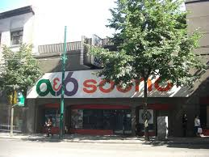
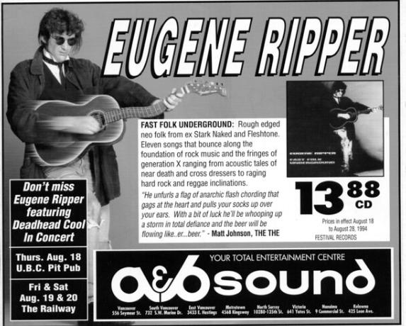

Slide 128
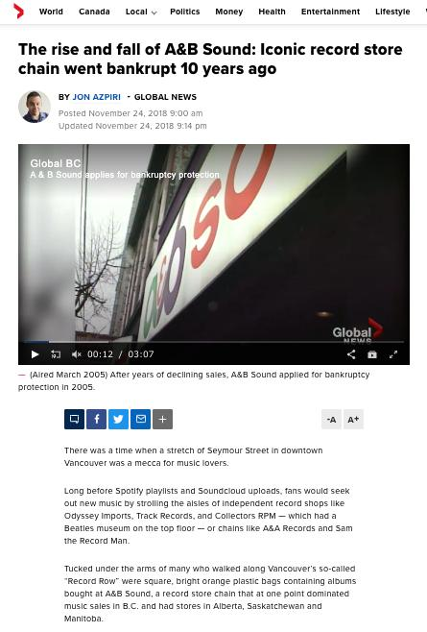

Slide 129
Trademarks: Infringement
– the law today
SUMMARY
1. Emphasizing differences in services and products is fine according to s. 22.
2. It is when trying to appropriate the value of goodwill by emphasizing the similarities between products, the use would run afoul of s. 22.

Slide 130
Trademarks: Infringement
Questions to Ponder
Is it important, in constructing a legal regime around trademarks, to preserve space for comparative advertising?
What limits, if any, should be placed on comparative advertising?
How do you feel about the balance struck by the courts in this regard?

Slide 131
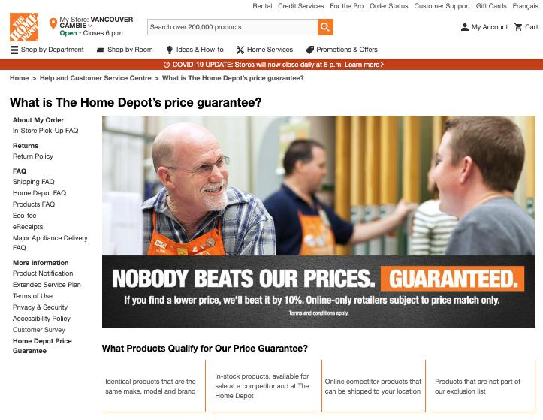

Slide 132
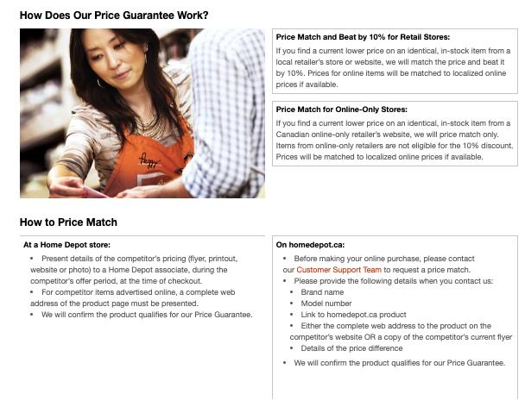

Slide 133
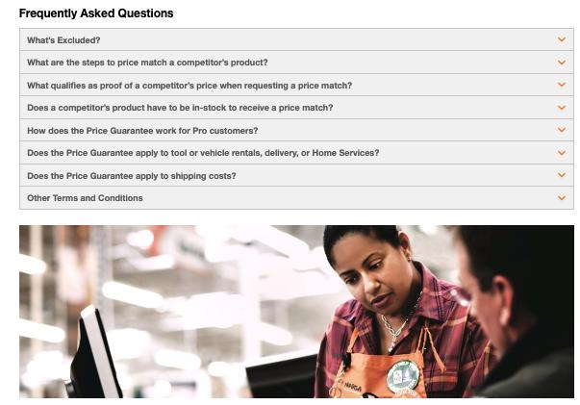

Slide 134
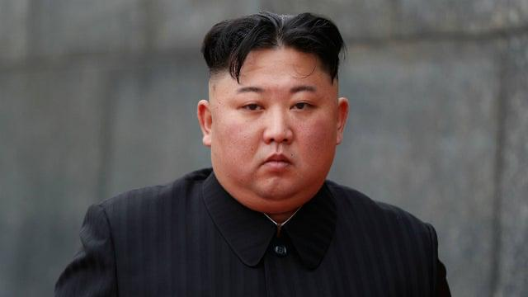
How is S. 22 TMA like this Guy?

Slide 135
Trademarks: Infringement
Veuve Clicquot Ponsardin v. Boutiques Cliquot (SCC, 2006)
Facts: Champagne house objects to use of similar name by women’s wear store
The mere mental association of the two marks does not necessarily give rise to a likelihood of depreciation
S. 22 = “super weapon” - Needs to be kept in check
Courts should separate anti-dilution claims into discrete elements; require proof for each element

Slide 136
Trademarks: Infringement
Veuve Clicquot Ponsardin v. Boutiques Cliquot (SCC, 2006)
“Veuve Clicquot”:
  One of the world’s great champagne houses
  Numerous marks registered in Canada, and used in connection with products in Canada since at least 1899
  Part of the Louis Vuitton luxury goods group
“Cliquot”:
  Name of six women’s wear shops in Quebec & eastern Ontario
  TMs registered are Cliquot, Cliquot “Un Monde a Part”; also “Cliquot” is trade name
  Sell clothing that is “marketed as good value”; that “appeals to the career woman rather than grandes dames” [interesting play on words given the TM registration, by Veuve Clicquot, of La Grande Dame]

Slide 137
Trademarks: Infringement
Veuve Clicquot Ponsardin v. Boutiques Cliquot (SCC, 2006)
Trial Judge found that there was little (if any) confusion as to source.
Trial Judge also found that the use, by the respondents, of the words Cliquot or Cliquot un monde a part, did not violate s. 22 of the Act.
Federal CA agreed, as did the SCC.
S. 22 analysis:
The s. 22 remedy was introduced as part of the 1953 amendments to the Trade-Marks Act. Justification was that TM would be less valuable to the owner if it were used by others in connection with a wide variety of other goods even in situations where there was no confusion.
Canada is not the only country to have such a remedy. It can also be found in the US, UK, Europe.

Slide 138
Trademarks: Infringement
Veuve Clicquot Ponsardin v. Boutiques Cliquot (SCC, 2006)
Crucial point in the Veuve Clicquot case is Binnie J.’s statement that the mere mental association of the two marks does not necessarily give rise to a likelihood of depreciation. There are other steps to the test…
There are also some other important remarks on this provision should be interpreted:
S. 22 is sometimes referred to as a “super weapon” which, in the interest of fair competition, needs to be kept in check
A super weapon because conceivably could apply in a wide range of situations to constrain individual behaviour and constrain competition. Recall that the main purpose of TM law is not to protect the mark itself. It’s to protect the mark as representative of source.

Slide 139
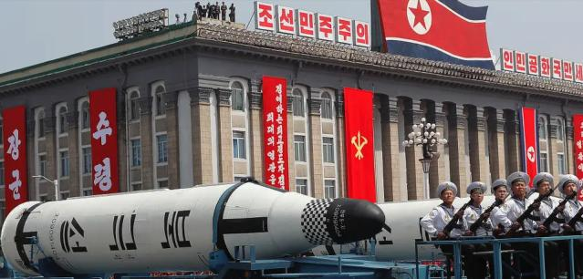
Trademarks: Infringement
Veuve Clicquot Ponsardin v. Boutiques Cliquot (SCC, 2006)
How does the SCC keep this “super weapon” in check?
SCC says - because of its status as a super weapon, any…
  Dilution should be proved by evidence
  Courts should separate any anti-dilution claim into its discrete elements and require proof for each of those elements.

Slide 140
Trademarks: Infringement
Conclusion on s. 19, 20, 22
In these cases, we see the Courts interpreting s. 19, 20, 22 in a narrow fashion, restricting the ambit of the sections to the context of commercial competition.
This leaves magazines, unions, and individuals generally free to criticize companies without the fear of trade-mark consequences. The courts are reluctant to use TM law to shut down the ability of people to protest.
In Clairol, when court talks about goodwill, depreciation is found on basis that customers will be diverted to the opposing party (appropriated) as opposed to simply driven away.
Absent a commercially competitive context it is much less likely that there will be depreciation in the value of goodwill. Other parties are not taking goodwill away for their own use.

Slide 141
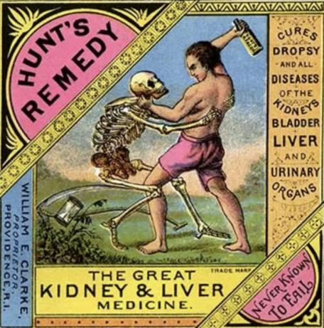
Trademarks: Remedies

Slide 142
Trademarks: Remedies
Remedies
See s. 53.2 (read together w. s. 2, “interested person”)
Including:
  Injunctions (interlocutory or permanent)
  Damages compensating for lost sales, damage to goodwill, loss of control of reputation
  Accounting of profits (alternative to damages)
  Destruction of offending materials
  Removal of mark from wares
  Concealment of mark on wares
  Punitive damages (in certain circumstances)

Slide 143
Trademarks: Remedies
The primary remedies provision in the TMA is s. 53.2. This provision needs to be read together with s. 2 – for the definition of an “interested person”.
Remedies available include:
  Injunctions (interlocutory or permanent)
  Damages
    To compensate for harm suffered:
      Lost sales
      Damage to goodwill
      Loss of control of reputation
  (or) Accounting of profits
  Order for the destruction or other disposition of offending materials
  Removal of offending mark from wares
  Permanent concealment of mark on wares
  Punitive damages in certain circumstances

Slide 144
Trademarks: Remedies
Defences to TM infringement
1) Challenge the validity of the other party’s TM
  See s. 18
2) A Defendant had used, in good faith, a confusing Trade Name in Canada prior to the filing of the Plaintiff’s application for registration of TM
  See s. 21
3) Mark should be cancelled where non-use
4) Defences set out in s. 20 (bona fide…)

Slide 145
Trademarks: Remedies
Defences to TM infringement
A defendant could challenge the validity of the other party’s TM: S. 18 is the provision to rely on if this defence is to be raised (TM registered).
  s. 18(1)(a): Invalid if the TM was not registrable at the date of registration (ss. 9, 10, 12, 13)
  s. 18(1)(b): Invalid if the TM is not distinctive at the time of the challenge (become generic – see Champagne case)
  s. 18(1)(c): Invalid if it has been abandoned (see the corpulent penguin case for the test for abandonment)
  s. 18(1)(d): Invalid if the applicant was not the person entitled to register the mark [refer back to s. 16, but note the limitation in s. 17]

Slide 146
Trademarks: Remedies
Defendant had used in good faith a confusing Trade Name in Canada before the date of the filing of the Plaintiff’s application for registration (s. 21)
The Plaintiff’s mark should be cancelled because of non-use (see S. 45)
Certain defences contained in s. 20 can be invoked where a TM owner alleges that the Defendant has infringed their TM by using a confusing mark.
  I.e.: (1.1) The registration of a trade-mark does not prevent a person from making, in a manner that is not likely to have the effect of depreciating the value of the goodwill attaching to the trade-mark,
    (a) any bona fide use of his or her personal name as a trade-name; or (b) any bona fide use, other than as a trade-mark, of the geographical name of his or her place of business or of any accurate description of the character or quality of his or her goods or services.

Slide 147
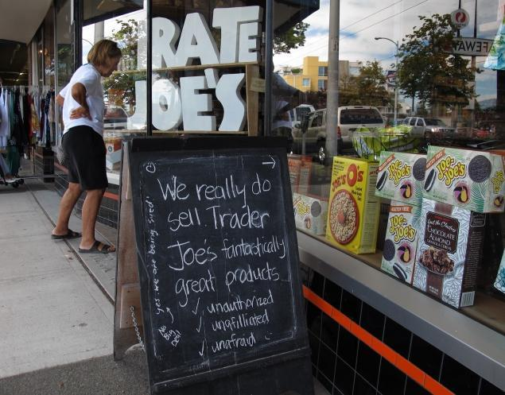
Trademarks: Remedies
Assume Trader Joe’s TM is registered in Canada – as of 2011.
Is Pirate Joe’s infringing Trader Joe’s registered TM? s. 19, 20, 22…

Slide 148
Trademarks: Remedies – Q&A
1. Do you think the provisions in the TMA provide sufficient protection against infringement for TM owners?
2. Do you think the provisions in the TMA overprotect TM owners?
In answering these questions please think of specific legislative reforms that in your view would make the degree of protection available to TM owners more appropriate.

Slide 149
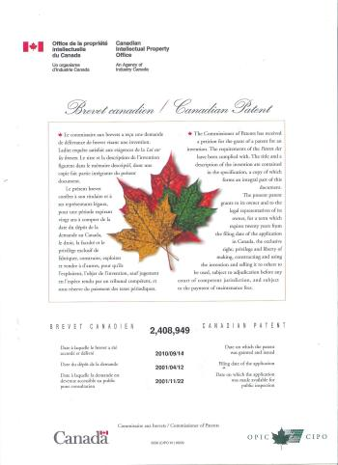
Coming Soon
Patents

Slide 150

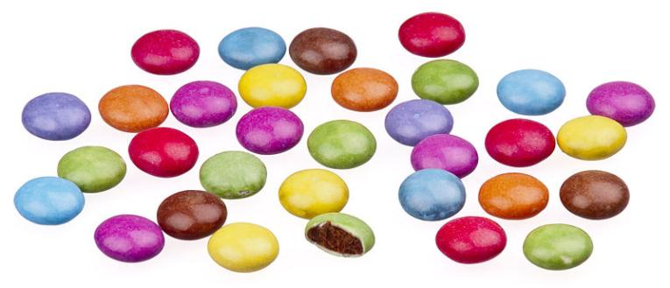
A MATTER OF PERSPECTIVE

Slide 151

Conclusion

Slide 152
UNTIL NEXT
TIME!

Slide 153

Always include a cat picture

Slide 154
In learning you will teach
And in teaching you will learn
Phil Collins' Son of Man (1999)

Slide 155
Our Academic Partners

Slide 156
Pause

Slide 157
QUESTIONS?
THOUGHTS?
DISCUSSION?

Slide 158
Pause

Slide 159
QUESTIONS?
THOUGHTS?
DISCUSSION?

Slide 160
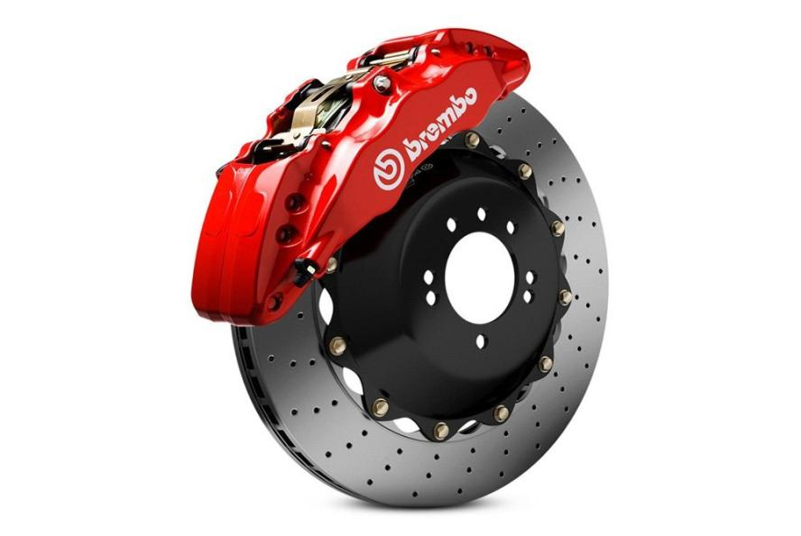
Take a Break

Slide 161
A MATTER OF PERSPECTIVE

Slide 162
Conclusion

Slide 163
UNTIL NEXT
TIME!

Slide 164
Always include a cat picture

Slide 165
In learning you will teach
And in teaching you will learn
Phil Collins' Son of Man (1999)

Slide 166
Our Academic Partners

