Slide 1
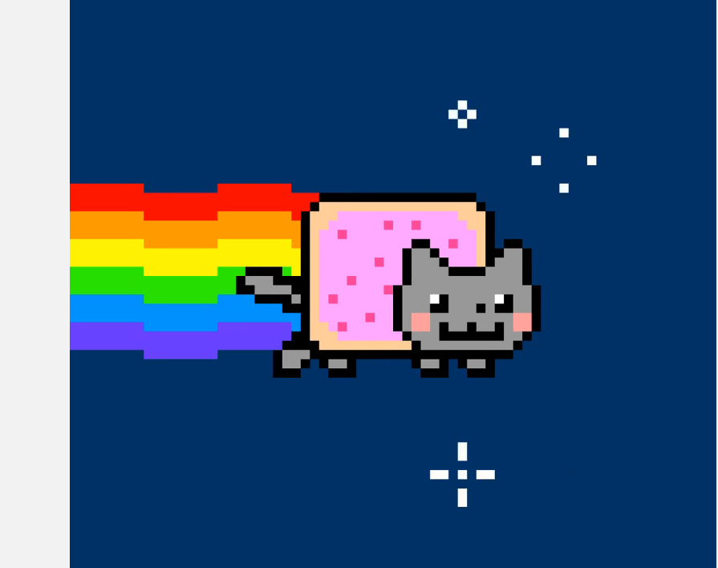
Digital Media, Non-Fungible Tokens (NFTs), and Digital Art
PART 1
Dario Balca
Meghan Zhang

Slide 2
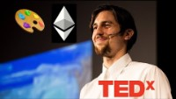

Blockchain
“Virtual Ledger”
Decentralized
Peer-to-Peer ecosystem
Allows a purely digital asset to have value and to be unique
Gordon Berger TEDx
What is the future of Art on Blockchain
(Crypto Art and NFTs)

Slide 3

What are NFTs?
Non-Fungible Tokens (NFT)s became an overnight sensation in the world of cryptocurrency after a unique digital copy of the Nyan Cat meme sold for 300ETH *
New and digital canvas for artistic expression
*ETH: open-source, blockchain-based, decentralized form of cryptocurrency

Slide 4


Fungible Tokens
Fungible tokens are substitutable
Examples: Bitcoins, Dollar bills
Non-fungibles are unique digital assets
Collectible art, videos, audios, etc.

Slide 5
NFTs and Cryptocurrency
Similar to cryptocurrency, NFTs use blockchain technology to:
Record ownership
Validate authenticity
Financial rewards for the artist
Verification of authenticity
“Pride of Ownership”

Slide 6
Recall Property Law…
House | NFT
Deed (Record of Ownership) Stored at Land Title Office Real | Electronic Record of Ownership Recorded on the Blockchain Incorporeal, Intangible
NFTs do not necessarily confer ownership to the underlying digital work

Slide 7
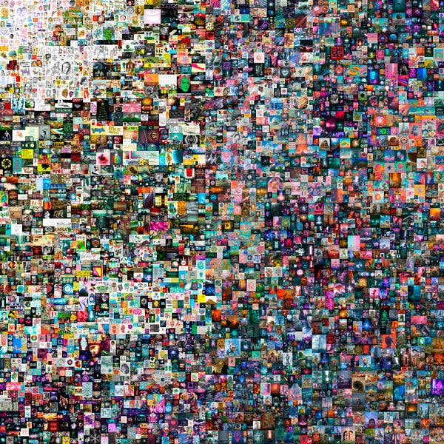
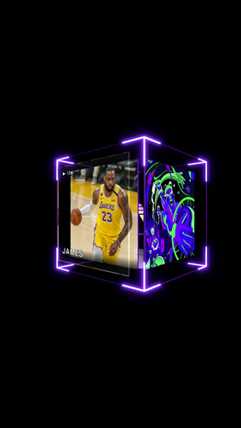
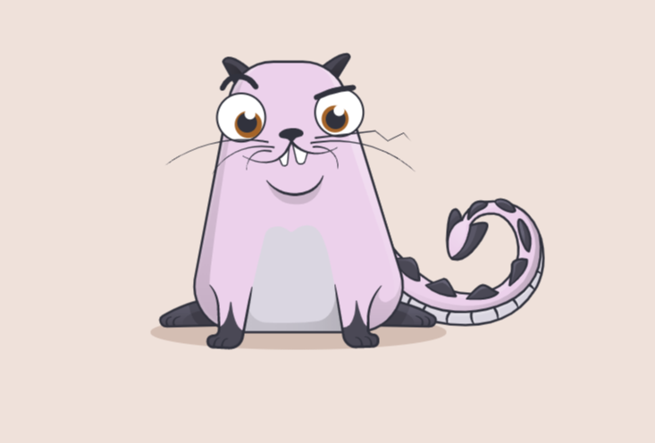
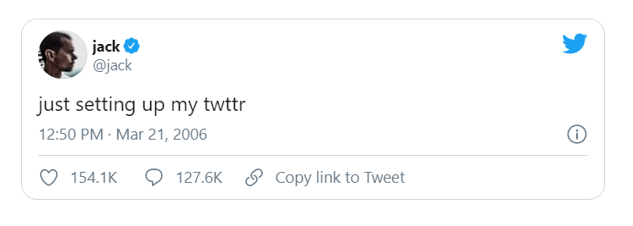
$210,000
Over $390,000
$2.9 Million

Slide 8
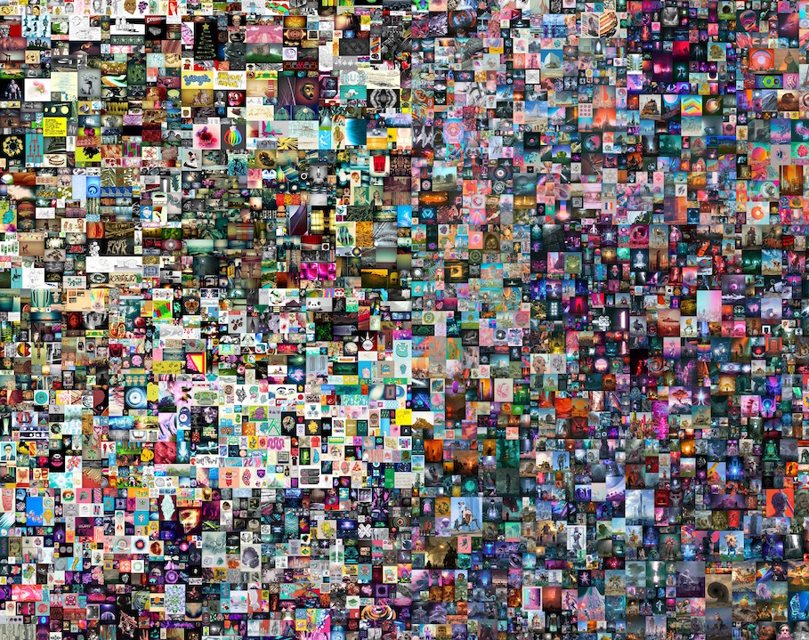
NFT Artwork by Beeple sold for $69 Million
“Everydays - The First 5000 Days”
Value?
Unique digital token encrypted with Beeple’s signature
Verifies its authenticity using blockchain technology

Slide 9

New Art Economy
Radical new streams of revenue for artists
Potential compensation for future sales
Digital editions for limited series of art works
Application to digital music, photography, podcasts, videos, articles, blogs

Slide 10
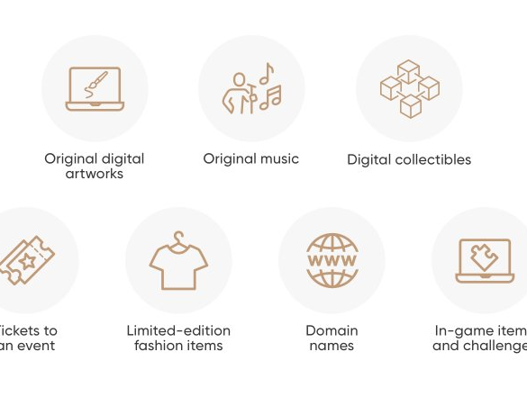
How does it Concern Intellectual Property?
Copyright Ownership: Collector versus Creator
Concerns on Infringement
Fair Use / Fair Dealing

Slide 11
Copyright
Copyright refers to a set of exclusive, time-limited rights in works of expression; performers’ performances; sound recordings; and communication signals (s.3.1 Copyright Act)
Three fundamental rights held by copyright owners:
Production / Reproduction
Performance / Broadcasting
Publication

Slide 12

Are NFTs Copyrightable?
Originality
“The expression of an idea through an exercise of skill and judgement, which necessarily involves intellectual input and “must not be so trivial that it could be characterized as a purely mechanical exercise.” (CCH)
Work
No higher standard of originality is required of an artistic work than that of a literary work (DRG).

Slide 13
Originality…
Difference between a NFT that’s made by the creator and one that’s simply converted into an NFT?
Too trivial?
Who can convert artworks into NFT’s?

Slide 14
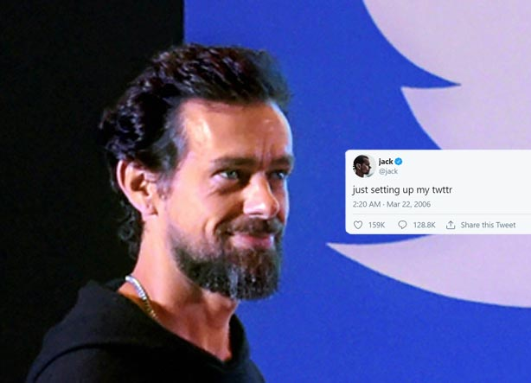
Jack Dorsey
(founder of Twitter)
Created a NFT from his first twitter post
His twitter posts are public
If I create an NFT from his first twitter post, the blockchain would have my name as the creator of the NFT
Can Jack Dorsey sue me for copyright infringement?

Slide 15
Copyright held by Creators
Creators preserve copyright to original underlying work giving rise to the NFT
Copyright protection can be conferred when the work is “fixed in a tangible form” (Canadian Admiral).
Still a good idea to register the copyright (s.53 CA)

Slide 16
Copyright held by Collectors
Transfer of entire copyright
License to make certain uses of the NFT

Slide 17

Section 13(4) Copyright Act
Assignments can be made:
  Wholly or partially
  Generally, or subject to limitations relating to territory, medium, sector of market, or other limitations related to the scope of assignment
  For the whole term of copyright or for any other part thereof
Principle of Technological Neutrality

Slide 18
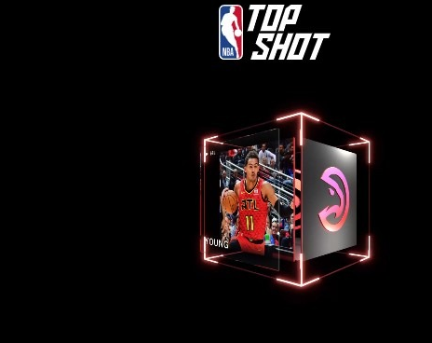
Terms of Use
NBA Top Shop License:
Grants the owner of “moments” a non-exclusive license to “use, copy, and display” the moment solely for personal and non-commercial purposes

Slide 19
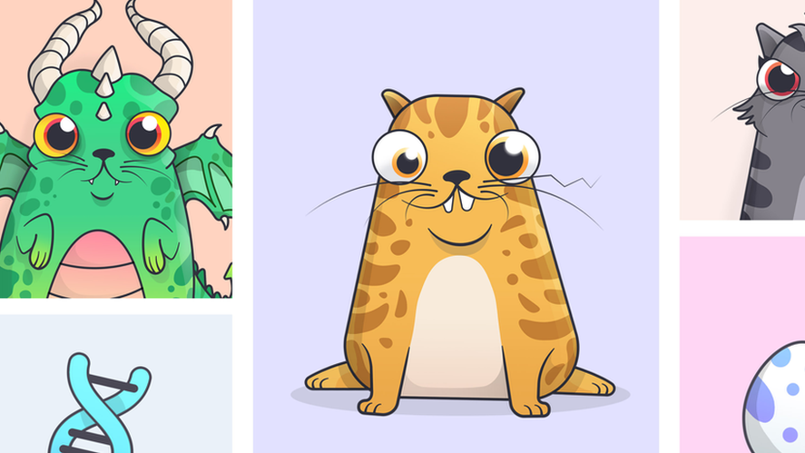
Terms of Use
CryptoKitties License:
NFT owners can generate commercial earnings from their NFT’s for up to $100,000 in gross revenue per year

Slide 20
Copyright held by Collectors
Right to utilize the copyrighted work depicted by the NFT for personal consumption (generally)
Right to exclude others from claiming ownership of the NFT
Similar to music files, collectors should not expect to generate commercial revenue from the NFT (unless otherwise specified in their contract with the creator)

Slide 21
Sources
https://ipandmedialaw.fkks.com/post/102gt4b/a-primer-on-nfts-and-intellectual-property
https://www.coindesk.com/nfts-a-legal-guide-for-creators-and-collectors
https://www.mondaq.com/unitedstates/copyright/1046680/a-primer-on-nfts-and-intellectual-property?type=related
https://www.coindesk.com/nfts-legal-questions
https://cnet3.cbsistatic.com/img/wI9uK7nx9t904gHIpUPP9XAPFWg=/940x0/2021/03/16/0d74d5fa-a419-4d0a-8961-a132735fccad/capture1.png
https://www.mondaq.com/unitedstates/copyright/1046680/a-primer-on-nfts-and-intellectual-property?type=related
https://www.legalcheek.com/lc-journal-posts/what-the-non-fungible-token-craze-means-for-ip-law/
https://www.mondaq.com/unitedstates/copyright/1046680/a-primer-on-nfts-and-intellectual-property?type=related

Slide 22
Sources
https://www.technollama.co.uk/can-copyright-teach-us-anything-about-nfts
https://www.npr.org/2021/03/05/974089381/whats-an-nft-and-why-are-people-paying-millions-to-buy-them
https://www.coindesk.com/what-are-nfts
https://www.theverge.com/22310188/nft-explainer-what-is-blockchain-crypto-art-faq
https://www.theverge.com/2021/3/15/22328203/nft-cryptoart-ethereum-blockchain-climate-change
https://www.nme.com/news/music/fans-criticise-gorillaz-selling-nft-impact-climate-change-revealed-2909226
https://www.newyorker.com/tech/annals-of-technology/how-beeple-crashed-the-art-world
https://www.rollingstone.com/pro/news/kings-of-leon-when-you-see-yourself-album-nft-crypto-1135192/
https://www.theverge.com/2021/3/1/22308075/grimes-nft-6-million-sales-nifty-gateway-warnymph
https://joanielemercier.com/the-problem-of-cryptoart/
https://cryptobriefing.com/rare-homer-simpson-pepe-nft-sells-320000/
https://medium.com/dapperlabs/nft-license-2-0-why-a-nft-can-do-what-mickey-mouse-never-could-27673d5f29aa
https://www.coindesk.com/market-wrap-bitcoin-steady-near-54k-rsi-indicator-warns-of-limited-uptrend

