Slide 1



FAIR DEALING REVIEW & (BRIEF)
INTRO TO COPYRIGHT REMEDIES
Talk 5 Introduction
LAW 424 001
Intellectual Property Law
Allard School of Law, UBC
Spring, 2021
Jon Festinger Q.C.
Centre for Digital Media
QMUL School of Law (CCLS)
Whiteboard Law
http://commlaw.allard.ubc
@jonfestinger
jon_festinger@thecdm.ca

Slide 2
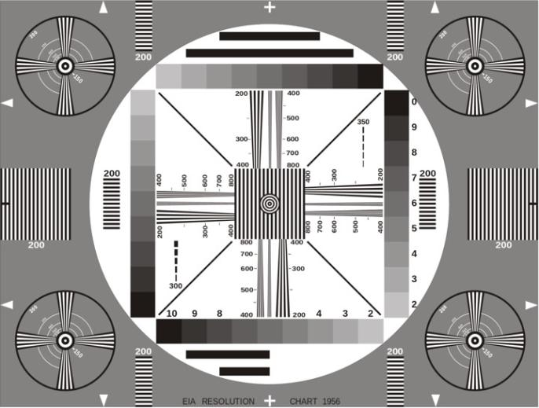
Permission to Record?

Slide 3

The draft slides

Slide 4
Logistics

Slide 5
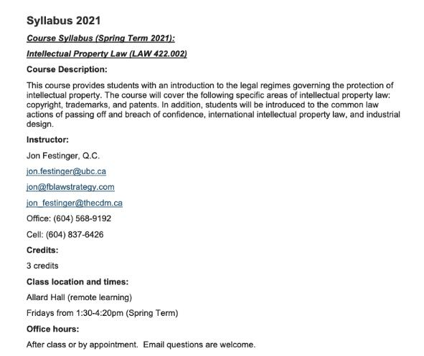
Any Questions?…

Slide 6
Methodology
Slides relate directly to textbook & Syllabus
Added material or “context” in Slides not in textbook (not optional)
Added “context” from News of the Week (optional – but does often supply fact situations useful in exploring consequences in Canadian law or that could serve as the basis of an exam question)

Slide 7
Presentations (from Syllabus)
“Paper/Presentation/Post = 20% of grade
This will be 500-1000 word (or equivalent) per person original piece of work that illuminates some aspect of Intellectual Property Law. It can be in any form, posted to the course website or not, and can be approached individually or as a group.”

Slide 8
Presentations
1-5 (ideally) per group
Sign-up by emailing me
Any topic - not constrained by what we are talking about that week
Consult re the topic you want to take on?
Post one thing you want us to read or watch?
5-7 minutes (notionally) per student = 500-1000 words

Slide 9

Office “Hours”: Ideally Fridays before or after class but am flexible…
Email me : jon.festinger@ubc.ca
Skype: jon.festinger
Phone:
o. 604-568-9192
c. 604-837-6426

Slide 10
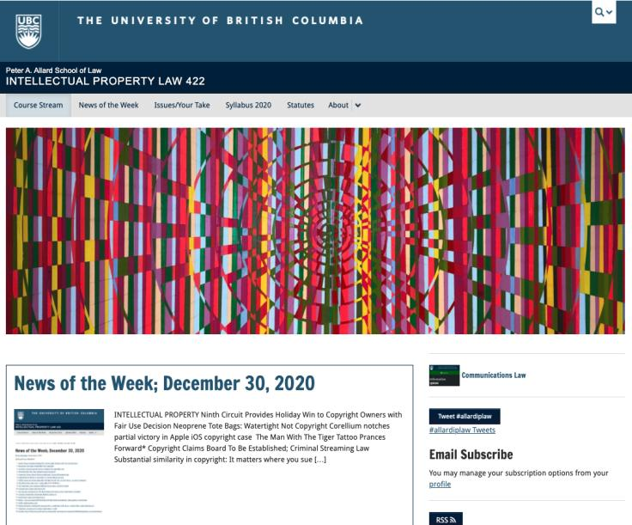
Course Website
https://iplaw.allard.ubc.ca/

Slide 11
For full privileges on the website
1. Please create an account at http://cms.ubc.ca/ using your CWL.
2. Once you create an account and sign in at http://cms.ubc.ca/ you can click your name in the top right. Halfway down the following page will be your WordPress email address.
3. Send me your WordPress email address at jon.festinger@ubc.ca or at jon_festinger@thecdm.ca
4. Then, I will invite you to participate with authoring privileges via your WordPress email address.

Slide 12
Thank you for
your bios.
Determined to reply.

Slide 13
News of
Week

Slide 14
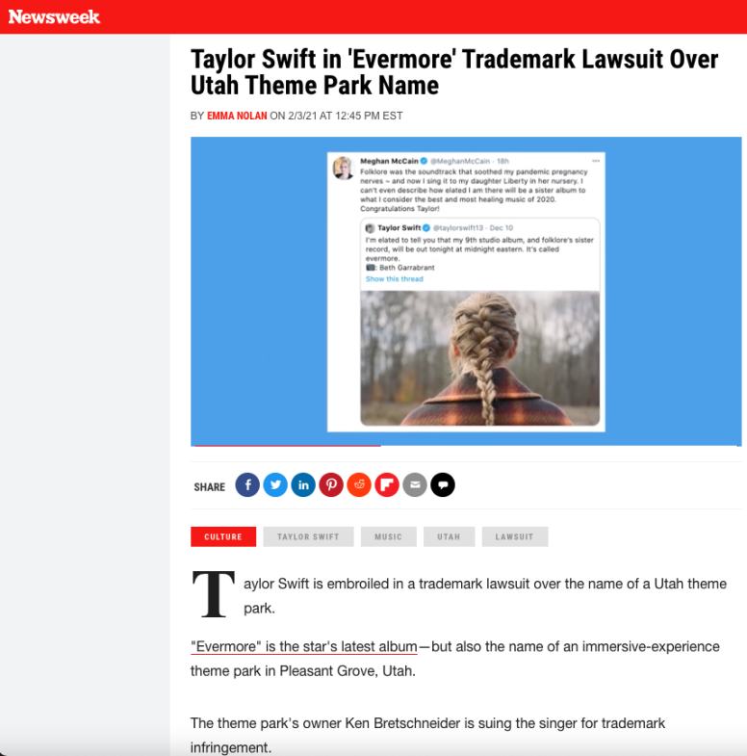

Slide 15
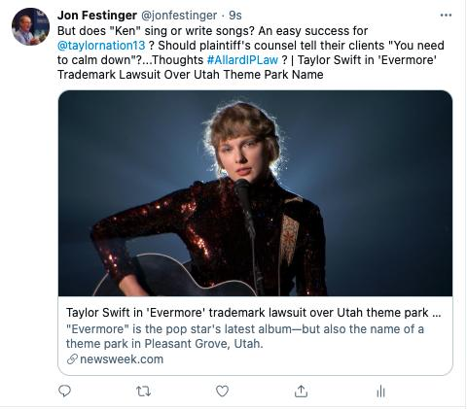

Slide 16
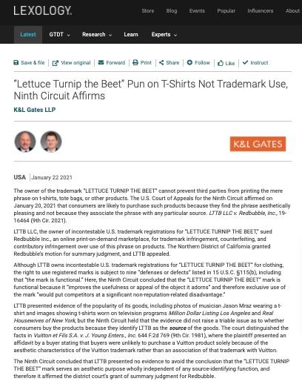

Slide 17
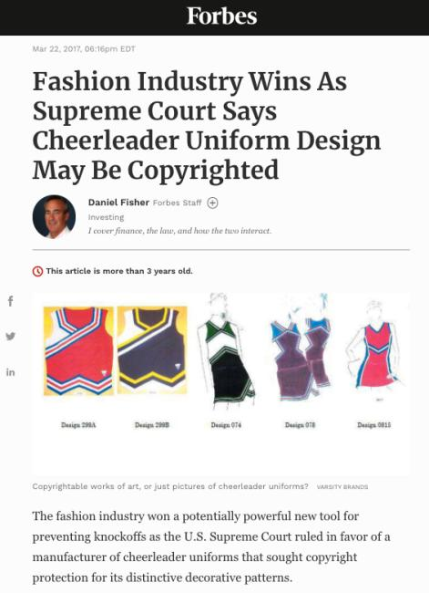
SCOTUS decision as discussed

Slide 18
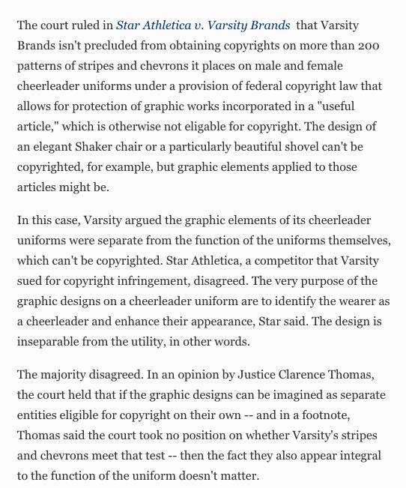

Slide 19
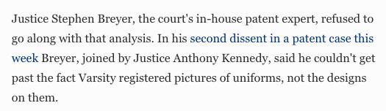
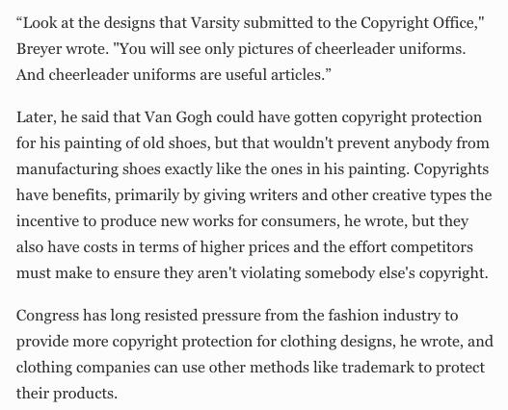

Slide 20
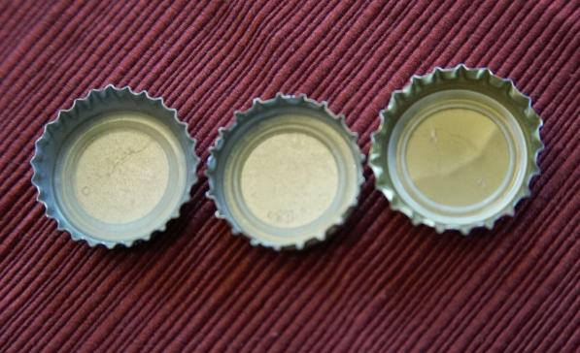
Re-capping

Slide 21
Copyright = set of exclusive rights in works of expression; performers’ performances; sound recordings; and communication signals.

Slide 22
Theberge:
Balance between promoting the public interest in the encouragement and dissemination of works of the arts and intellect and obtaining a just reward for the creator
Refined by Cinar Corp. v. Robinson:
Copyright act rewards creators in order to incentivize the creation of new works

Slide 23
Rights of the copyright owner
Three fundamental rights:
Produce or reproduce the work (3(1))
Perform the work (including broadcasting rights) (3(1))
The right to publish (3(1))

Slide 24

Rights of the copyright owner
Produce … any translation (3(1)(a))
Convert dramatic work into non-dramatic work (3(1)(b)
Convert non-dramatic work into dramatic work (3(1)(c))
To make a sound recording, etc. of a literary, etc. work (3(1)(d))
Reproduce, etc. a literary, etc. work as a cinematographic work (3(1)(e))
Communicate a work to the public by telecommunication (3(1)(f))
Present an artistic work at a public exhibition…. (3(1)(g))
Rent out a computer program, etc. (3(1)(h))
Rent out a sound recording of a musical work … (3(1)(i))
Sell or transfer ownership of tangible object … (3(1)(j)
Authorize any of above acts (3(1))

Slide 25
Users’ Rights

Slide 26
Today: Two Defences to copyright infringement
Defence of public interest
Fair dealing

Slide 27


Fair Dealing v. Fair Use

Slide 28
Users’ rights: Fair Dealing
29. Fair dealing for the purpose of research, private study, education, parody or satire does not infringe copyright.

Slide 29
Users’ rights: Fair Dealing
Eight fair dealing categories (exhaustive list)
No definition of “fair” in the Copyright Act, or of the fair dealing categories
For many years, fair dealing did not play a prominent role in copyright
During this time, fair dealing was interpreted restrictively
Why might this have been the case?

Slide 30
Transitioning to Users’ Rights
CCH v. LSUC (SCC) endorsed “users’ rights”
Flows from Théberge , where copyright was found not to be only about about rewarding and protecting authors; but focussed on the balancing between the public interest in encouraging and disseminating creative and intellectual works and securing a just reward for the author.
Move from defence to copyright action to a more positive articulated User Right.
Means User Right’s can be a sword? How would that work/what would that look like?

Slide 31
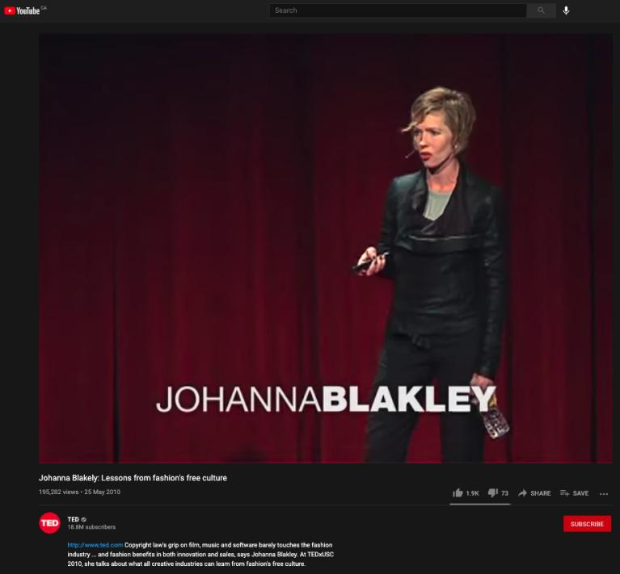
https://youtu.be/zL2FOrx41N0

Slide 32
Summary of CCH on USERS’ RIGHTS
CCH Canadian et al v. LSUC (SCC 2004)
  Fair dealing is an integral part of the Copyright Act
  Fair dealing is a users’ right; must not be interpreted restrictively; always available
  Two step process: purpose; fairness analysis
  Categories must be given a large and liberal interpretation (i.e., research)

Slide 33
User rights: “Fair” in Fair Dealing
CCH Canadian et al v. LSUC (2004)
Whether something is fair is a question of fact and depends on the facts of each case.
Factors that can be considered to help assess whether a dealing is fair:
  Purpose of the dealing
  Character of the dealing
  Amount of the dealing
  Were there alternatives to the dealing?
  Nature of the work
  Effect of the dealing on the work

Slide 34

The fairness stew

Slide 35
1. Purpose of the Dealing
Fair if for one of the allowable purposes under the Copyright Act
  S. 29 = research, private study, education, parody or satire
  S.29.1 = criticism or review
  S. 29.2 = news reporting
Some dealings may be more, or less, fair, than others - i.e., research for commercial purposes may not be as fair as research for charitable purposes

Slide 36
2. Character of the Dealing
How was the work dealt with? Multiple copies distributed, will tend towards being unfair, especially if more copies than necessary or otherwise gratuitous.
Single copy used for single legit purpose – easier to conclude it is fair.
Copies destroyed after use may also favour a finding of fairness.
Do consider customs, practices & norms in a particular industry or trade → However CBC v. SODRAC (SCC 2015) doesn’t – why not? CATEGORIES EXHAUSTIVE

Slide 37
3. Amount of the Dealing
You can deal fairly with a whole work (i.e. photographs)
Amount taken may be more, or less, fair depending on the purpose - i.e. research, may be essential to copy an entire academic article

Slide 38
4. Alternatives to the Dealing
  Was there a non-copyrighted equivalent of the work that could have been used instead of the copyrighted work?
  Was the dealing reasonably necessary to achieve the ultimate purpose?
  Meaning not gratuitous.
  I.e., Would a criticism have been equally effective if it did not actually reproduce the copyrighted work it was criticizing? If yes, that weighs against a finding of fairness.

Slide 39
5. Nature of the Work
If a work is unpublished, dealing might actually be more fair because its reproduction could lead to a wider public dissemination for the work
Confidential work? May be unfair in the circumstances.

Slide 40
6. Effect of the dealing on the work
  Is the reproduced work likely to compete with the market of the original work?
  Not the only factor - not the most important factor - but can sometimes seem like the most important factor in the cases

Slide 41

Carpet Cosplay
Dragon Con Marriott hotel carpet
Copyright design

Slide 42
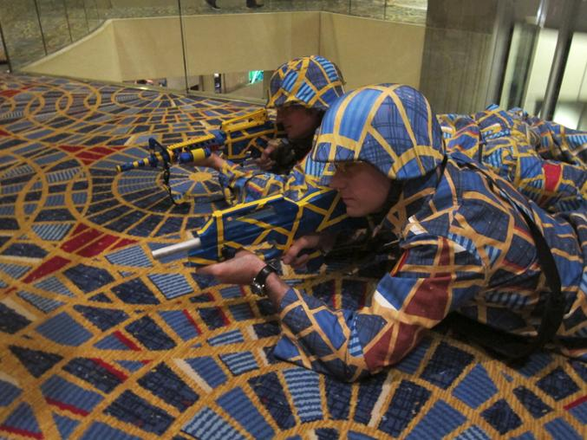

Slide 43

Reflection Exercise
In your view would carpet cosplay be considered fair dealing in Canada? Why? Or Why not?

Slide 44
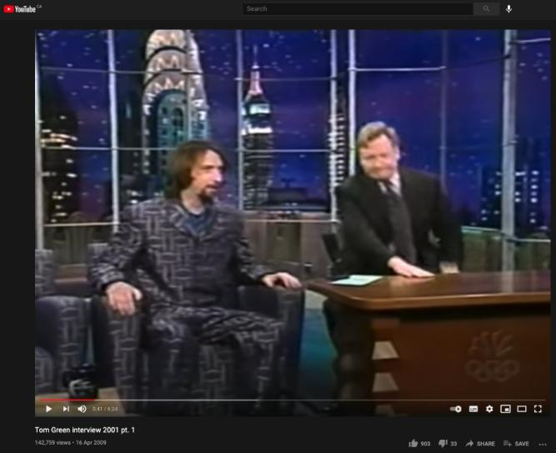
Bonus Chair Fabric Edition
Same idea but harder to argue?
https://youtu.be/tvIjwxrD_fE

Slide 45
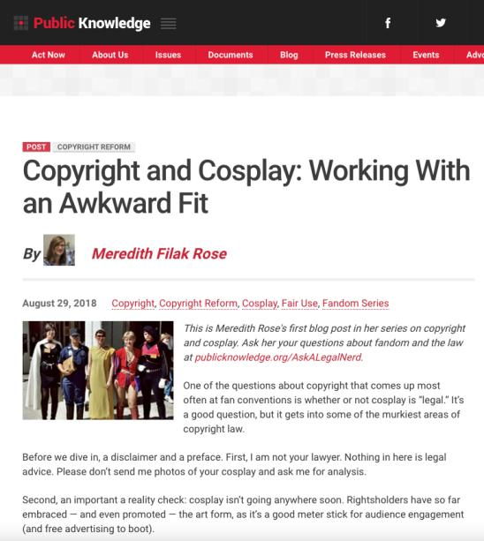
U.S. Cosplay
https://www.publicknowledge.org/blog/copyright-and-cosplay-working-with-an-awkward-fit/

Slide 46
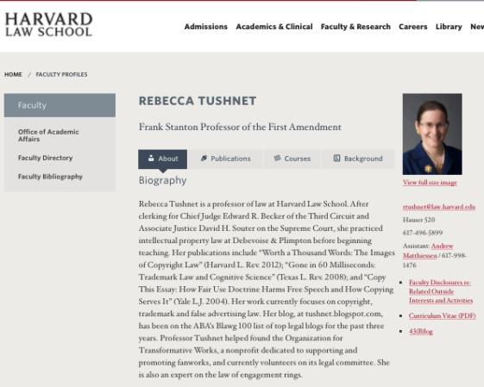
“Copyright law, fan practices,
and the rights of the author”
https://tushnet.files.wordpress.com/2013/06/fandombook.pdf

Slide 47
Users’ rights
SOCAN v. Bell (2012) - years later – What Is A “User’s Right”
Do iTunes previews constitute “fair dealing”?
If answer is no, those providing previews would be have to pay tariffs for each preview played as communication to the public by telecommunication
Note statements in paragraphs 8-10 regarding nature of copyright in Canada& significance of Théberge case
  Théberge: move away from author-centric approach to copyright
  Need to sensitively balance protection and access

Slide 48
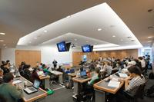
Next case: Imagine a classroom selfie

Slide 49
Users’ rights
Alberta (Education) v. Canadian Copyright Licensing Agency (Access Copyright) (2012)
Another “pentalogy” case
Main issue: Copies of works made at teachers’ initiatives with instructions to students that they read the material … fair dealing?
Category 4 of the proposed tariff dealt with copies of works made at the teachers’ initiative with instructions to students that they read the material. Teachers would photocopy short excerpts from textbooks and distribute those copies to students as a complement to the main textbook the students used.

Slide 50
Abella J.
“ The test for fair dealing was articulated in CCH as involving two steps. The first is to determine whether the dealing is for the allowable purpose of “research or private study” under s. 29 , “criticism or review” under s. 29.1 , or “news reporting” under s. 29.2 of the Act. The second step of CCH assesses whether the dealing is “fair”. The onus is on the person invoking “fair dealing” to satisfy all aspects of the test. To assist in determining whether the dealing is “fair”, this Court set out a number of fairness factors: the purpose, character, and amount of the dealing; the existence of any alternatives to the dealing; the nature of the work; and the effect of the dealing on the work.”

Slide 51
PARODY

Slide 52
Users’ rights
United Airlines, Inc. v. Cooperstock, 2017 FC 616
First case to define the fair dealing category of parody:
  Two basic elements to parody: the evocation of an existing work while exhibiting noticeable differences and the expression of mockery or humour
  Not required to identify source of work being parodied
  Parody does not require that the expression of mockery or humour to be directed at the exact thing being parodied

Slide 53
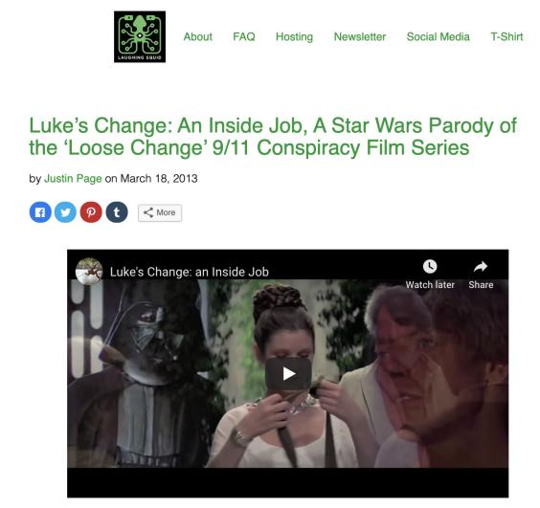
RE: Parody does not require that the expression of mockery or humour to be directed at the exact thing being parodied - CONSIDER…

Slide 54
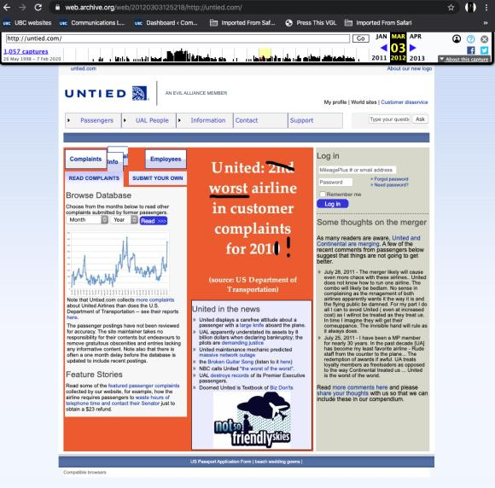
Site considered to be a parody, but not to be fair (fair dealing not made out)

Slide 55
Pause: Think about that….
Parody must be fair?
Conflating the fair in “fair use” with the category?
Does “Fair Education” make sense or “Fair Research”?
Thought Categories must be given a large and liberal interpretation per CCH v. LSUC
Look to “fair” in fair comment defamation defense → can’t be with malice, but otherwise fair
Should the motive matter to parody?????
Research with malice compared to the same research done the same way but without malice?????

Slide 56
Users’ rights: another “at odds” case
The Canadian Copyright Licensing Agency v. York University, 2017 FC 669
Were York University’s Fair Dealing Guidelines fair?
Phelan J. concludes not
Is Phelan J.’s ruling consistent with the SCC’s fair dealing jurisprudence?

Slide 57
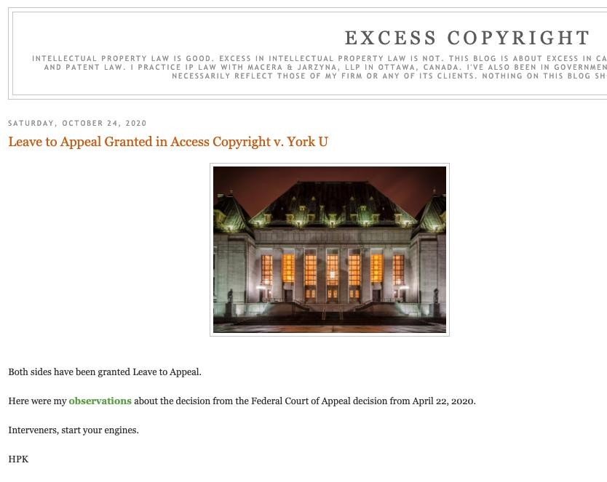

Slide 58
Users’ rights
Common carrier exception (s. 2.4(1)(b))
Applicable in the context of communication to the public by telecommunication
“Communication to the public by telecommunication
2.4 (1) For the purposes of communication to the public by telecommunication,
b) a person whose only act in respect of the communication of a work or other subject-matter to the public consists of providing the means of telecommunication necessary for another person to so communicate the work or other subject-matter does not communicate that work or other subject-matter to the public;…”

Slide 59
Users’ rights
Common carrier exception (s. 2.4(1)(b))
Applicable in the context of communication to the public by telecommunication
Main case interpreting this provision: SOCAN v. CAIP (2004 SCC – “Tariff 22”) re ISP LIABILITY
  1) Intermediaries are deemed by parliament NOT TO BE COMMUNICATING to the PUBLIC. This is not an “immunity” or “loophole”. IT IS AN EXEMPTION NOT AN EXCEPTION.

Slide 60
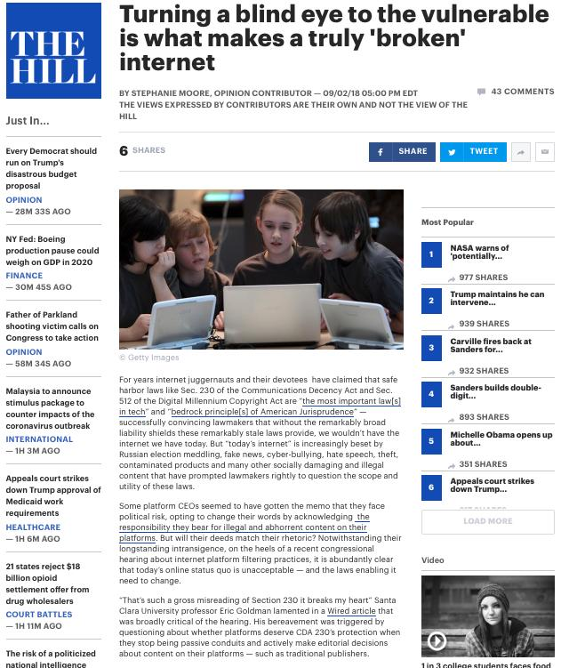

Slide 61
User rights
Common carrier exception (s. 2.4(1)(b))
Bell Canada v. 1326030 Ontario Inc. (iTVBox.net)
  Should the defendants in this case benefit from the common carrier exception?
…pre-loaded “plug and play” set-top boxes.
“[5] … electronic devices that can be connected to any standard television set in order to provide additional functionalities to that television, on which they have previously installed and configured a set of applications.”

Slide 62
Should common carrier exception (s. 2.4(1)(b)) apply?
“[22] …This is not a case where the Defendants merely serve as the conduit, as was argued by Mr. Wesley. Rather, they deliberately encourage consumers and potential clients to circumvent authorized ways of accessing content – say, by a cable subscription or by streaming content from the Plaintiffs’ websites – both in the manner in which they promote their business, and by offering tutorials in how to add and use applications which rely on illegally obtained content. The statutory defence provided in paragraph 2.4(1)(b) of the Copyright Act does not apply to the Defendants who go above and beyond selling a simple “means of telecommunication”. They also engage in acts related to the content of the infringed communications (Society of Composers, Authors and Music Publishers of Canada v Canadian Assn of Internet Providers, 2004 SCC 45 at para 92). Consumers can consequently stream or download the Plaintiffs’ programs and store them on their device without authorization from the Plaintiffs. This constitutes prima facie copyright infringement pursuant to section 27 of the Copyright Act.”

Slide 63
N.B.: S. 31.1 Copyright Act (added to the Copyright Act, 2012) – complimentary to & broader than S. 2.4(1)(b)
  31.1 (1) A person who, in providing services related to the operation of the Internet or another digital network, provides any means for the telecommunication or the reproduction of a work or other subject-matter through the Internet or that other network does not, solely by reason of providing those means, infringe copyright in that work or other subject-matter.
  (2) Subject to subsection (3), a person referred to in subsection (1) who caches the work or other subject-matter, or does any similar act in relation to it, to make the telecommunication more efficient does not, by virtue of that act alone, infringe copyright in the work or other subject-matter.
Meaning that ISPs are protected from copyright infringement as a result of caching or other “incidental” acts that provide more efficient Internet services.

Slide 64
N.B.: S. 32 (1) & S. 32 (2) Copyright Act
31 (1) In this section,
new media retransmitter means a person whose retransmission is lawful under the Broadcasting Act only by reason of the Exemption Order for New Media Broadcasting Undertakings issued by the Canadian Radio-television and Telecommunications Commission as Appendix A to Public Notice CRTC 1999-197, as amended from time to time;
Retransmitter means a person who performs a function comparable to that of a cable retransmission system, but does not include a new media retransmitter; signal means a signal that carries a literary, dramatic, musical or artistic work and is transmitted for free reception by the public by a terrestrial radio or terrestrial television station.

Slide 65
31 (2) It is not an infringement of copyright for a retransmitter to communicate to the public by telecommunication any literary, dramatic, musical or artistic work if
  (a) the communication is a retransmission of a local or distant signal;
  (b) the retransmission is lawful under the Broadcasting Act;
  (c) the signal is retransmitted simultaneously and without alteration, except as otherwise required or permitted by or under the laws of Canada;
  (d) in the case of the retransmission of a distant signal, the retransmitter has paid any royalties, and complied with any terms and conditions, fixed under this Act; and
  (e) the retransmitter complies with the applicable conditions, if any, referred to in paragraph (3)(b).

Slide 66



Not included in s. 31(1) & s. 31(2) protections

Slide 67





Included in s. 31(1) & s. 31(2) protections

Slide 68
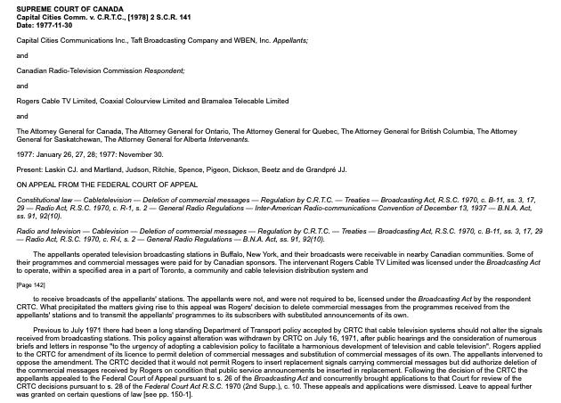
“Borrowing” U.S. TV signals & Simultaneous Substitution of Canadian Commercials

Slide 69
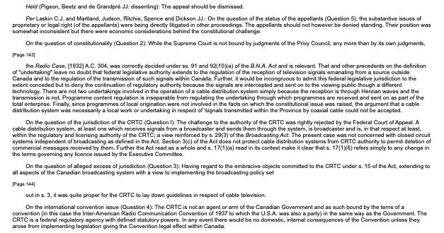

Slide 70
Laskin C.J.
“I am therefore in no doubt that federal legisla­tive authority extends to the regulation of the reception of television signals emanating from a source outside of Canada and to the regulation of the transmission of such signals within Canada. Those signals carry the programmes which are ultimately viewed on home television sets; and it would be incongruous, indeed, to admit federal legislative jurisdiction to the extent conceded but to deny the continuation of regulatory authority because the signals are intercepted and sent on to ultimate viewers through a different technology. Programme content regulation is inseparable from regulating the undertaking through which programmes are received and sent on as part of the total enterprise.”
Peker v. Masters Collection, 96 F.Supp.2d 216 (2000)

Slide 71
SCOTUS & Media Technology:
One Wedding & Two Funerals

Slide 72
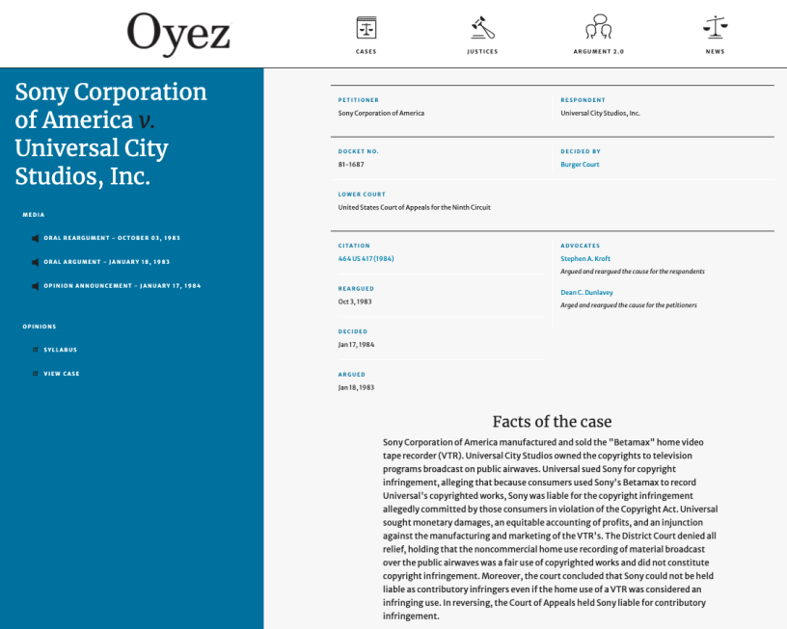
A time-shifted celebration…
https://www.oyez.org/cases/1982/81-1687

Slide 73
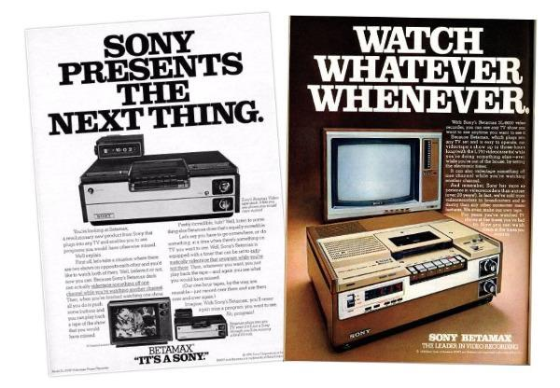

Slide 74
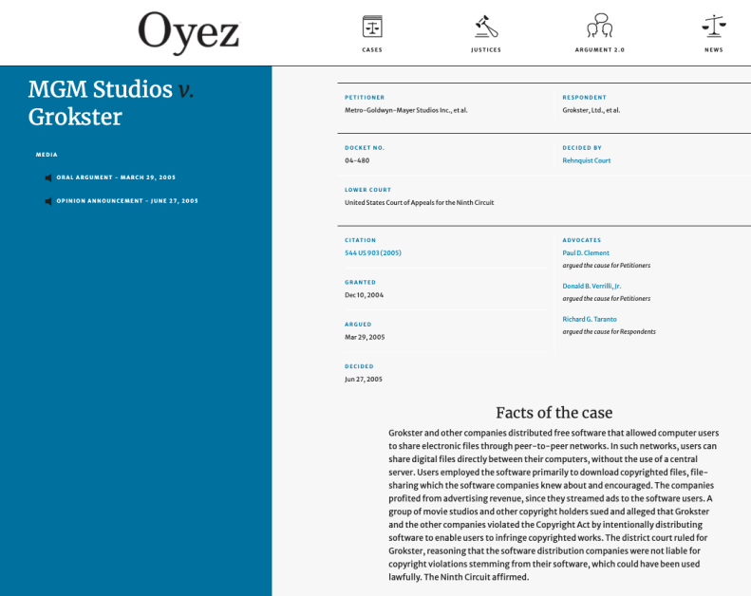
Killing peer-to-peer
https://www.oyez.org/cases/2004/04-480

Slide 75
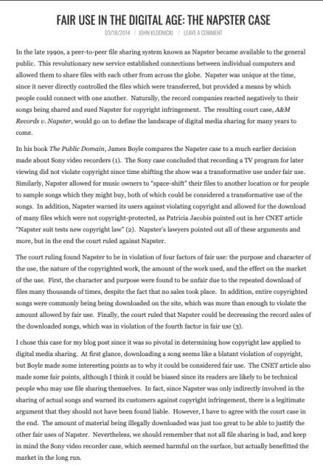
Preceded by Napster (not in SCOTUS)

Slide 76
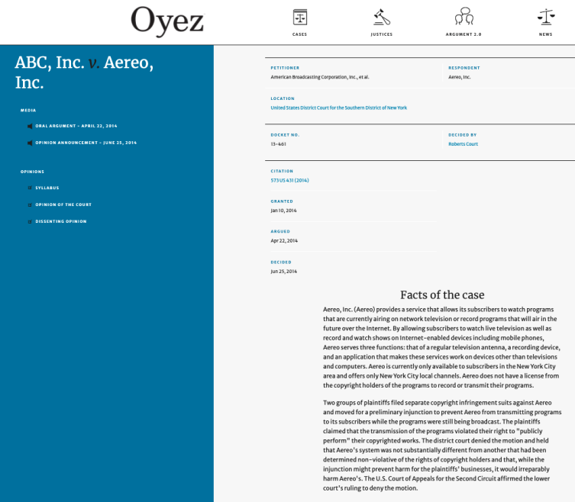
Another one bites the dust…
https://www.oyez.org/cases/2013/13-461

Slide 77
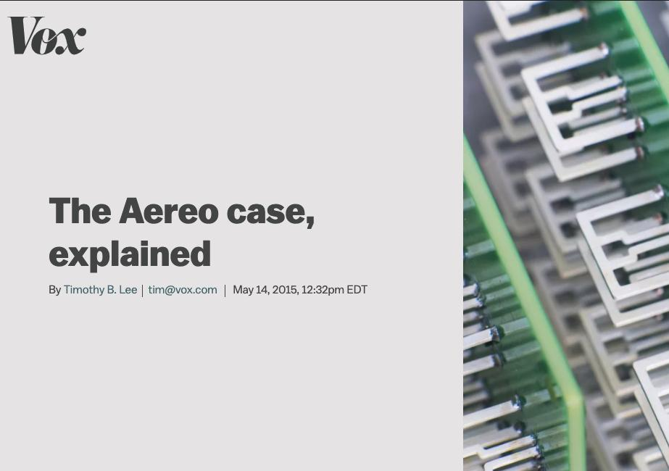

Slide 78
Canada’s “blank audio recording media” levy
Part VIII of the Copyright Act allows consumers to copy recorded music for their own personal use. The private copying levy was created to compensate music rights holders for private copies made of their music. 40 countries have some mechanism along these lines.
The levy is paid by importers and manufacturers of such media sold within Canada (and typically passed on to the retailer and then on to the purchaser).
Canada's current private copying levies are as follows: $0.29 per unit for CD-R, CD-RW, CD-R Audio, CD-RW Audio disks
Pursuant to a decision of the Copyright Board of Canada these royalties have been allocated since 2010 as follows: Music authors and publishers - 58.2%; Performers - 23.8%; Record companies - 18%

Slide 79
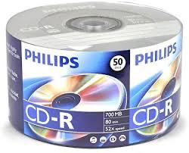
Canada’s “blank audio recording media” levy
Canadian Private Copying Collective v. Canadian Storage Media Alliance 2004 FCA 424 (Federal Court of Appeal) is authority for the proposition that "the Copyright Board has no legal authority to certify a tariff on digital audio recorders or on the memory permanently embedded in digital audio recorders.”

Slide 80
Users’ rights
1) Are there any defences not currently in the Copyright Act that you would like to see explicitly set out in the Act? Which ones and why?
2) Are there any defences currently in the Act that you feel are unnecessary or inappropriate, and that you would want to see removed? Which ones and why?

Slide 81

Now…
“Remedies +”

Slide 82
Now…A few more things
1. Non-commercial User-generated Content & Reproduction for Private purposes
2. Intersections of copyright and contract
3. TPMs
What are they?
Provisions dealing with TPMs
Exceptions to the TPM infringement provisions
Enforcement of TPMs
4. Rights management information
5. Notification letters
6. Remedies and procedures.
7. Moral rights

Slide 83
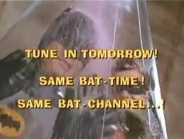
Cliffhanger to Audio-Slides

Slide 84
Copyright Review
+++++

Slide 85
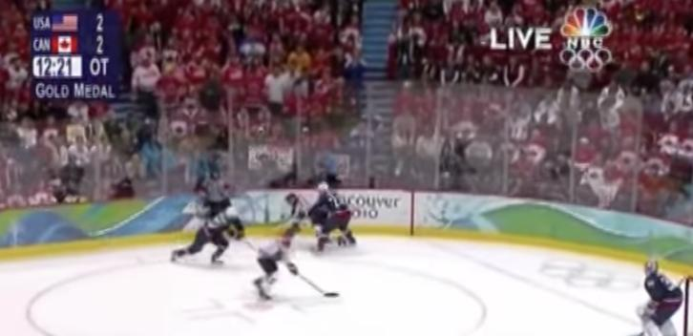
Coming Soon
“Passing Off”
The Golden Goal – Jerome Iginla
passing off to Sidney Crosby

Slide 86
SEE YOU SOON!

Slide 87

Always include a cat picture

Slide 88
In learning you will teach
And in teaching you will learn
Phil Collins' Son of Man (1999)

Slide 89
Our Academic Partners

