Slide 1

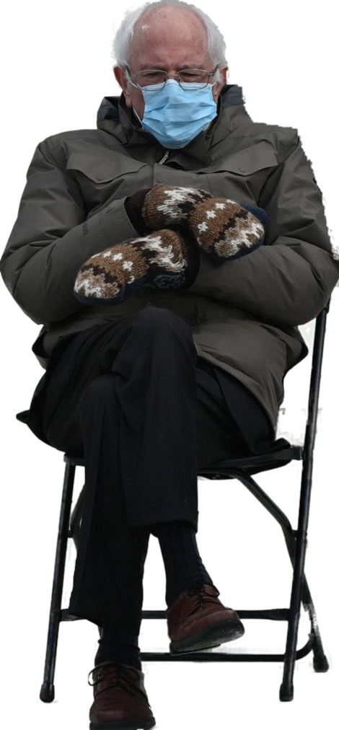

PASSING OFF
Talk 6 Introduction
LAW 424 001
Intellectual Property Law
Allard School of Law, UBC
Spring, 2021
Jon Festinger Q.C.
Centre for Digital Media
QMUL School of Law (CCLS)
Whiteboard Law
http://commlaw.allard.ubc
@jonfestinger
jon_festinger@thecdm.ca

Slide 2
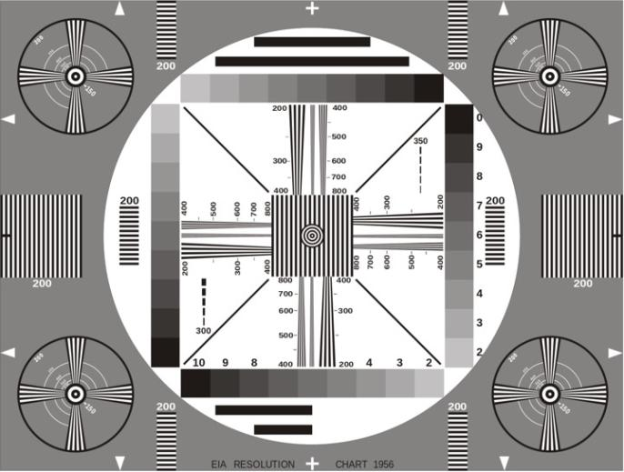
Permission to Record?

Slide 3
The draft slides

Slide 4
Logistics

Slide 5
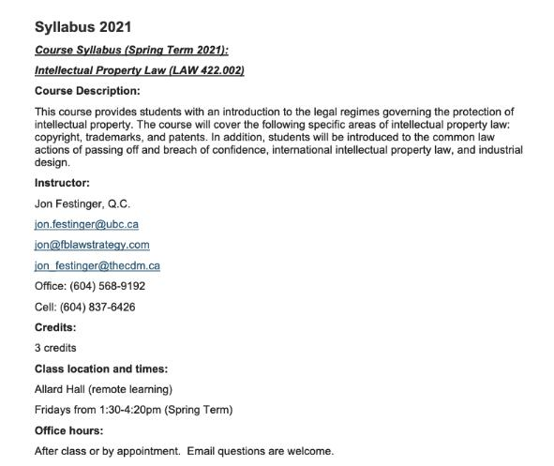
Will review for alignment during mid-term break: Any Questions/Comments?…

Slide 6
Methodology Prioritized
Slides relate directly to textbook & Syllabus
Added material or “context” in Slides not in textbook (not optional)
Added “context” from News of the Week (optional – but does often supply fact situations useful in exploring consequences in Canadian law or that could serve as the basis of an exam question)

Slide 7
Presentations (from Syllabus)
“Paper/Presentation/Post = 20% of grade
This will be 500-1000 word (or equivalent) per person original piece of work that illuminates some aspect of Intellectual Property Law. It can be in any form, posted to the course website or not, and can be approached individually or as a group.”

Slide 8
Presentations
1-5 (ideally) per group
Sign-up by emailing me
Any topic - not constrained by what we are talking about that week
Consult re the topic you want to take on?
Post one thing you want us to read or watch?
5-7 minutes (notionally) per student = 500-1000 words

Slide 9
Presentations (20%)
How’s it going?
Don’t let it be a last minute panic.
If you have posted a presentation, please drop me an email saying that.

Slide 10

Office “Hours”: Ideally Fridays before or after class but am flexible…
Email me : jon.festinger@ubc.ca
Skype: jon.festinger
Phone:
o. 604-568-9192
c. 604-837-6426

Slide 11

Thanks for the emails with questions.
Thinking about a pre-exam compilation.

Slide 12
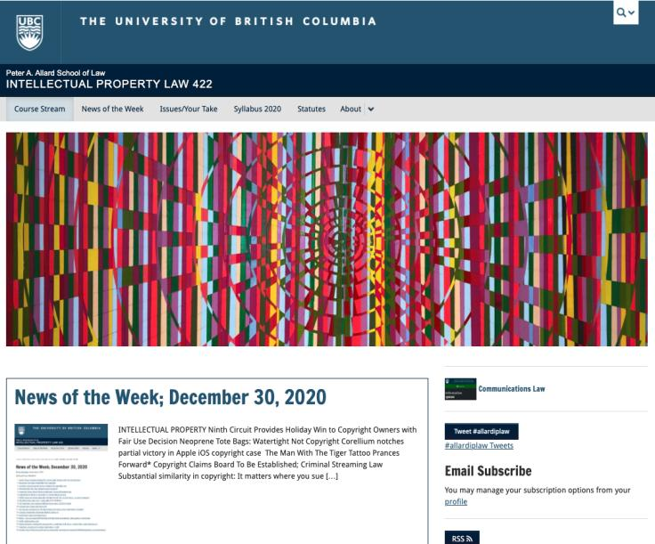
Course Website
https://iplaw.allard.ubc.ca/

Slide 13
For full privileges on the website
1. Please create an account at http://cms.ubc.ca/ using your CWL.
2. Once you create an account and sign in at http://cms.ubc.ca/ you can click your name in the top right. Halfway down the following page will be your WordPress email address.
3. Send me your WordPress email address at jon.festinger@ubc.ca or at jon_festinger@thecdm.ca
4. Then, I will invite you to participate with authoring privileges via your WordPress email address.

Slide 14
Thank you for
your bios.
Will reply to all
during spring-break.

Slide 15
Correction

Slide 16
Users’ rights
Common carrier exception (s. 2.4(1)(b))
Applicable in the context of communication to the public by telecommunication
Main case interpreting this provision: SOCAN v. CAIP (2004 SCC – “Tariff 22”) re ISP LIABILITY
  1) Intermediaries are deemed by parliament NOT TO BE COMMUNICATING to the PUBLIC. This is not an “immunity” or “loophole”. IT IS AN EXEMPTION NOT AN EXCEPTION.

Slide 17
N.B.: S. 31.1 Copyright Act (added to the Copyright Act, 2012) – complimentary to & broader than S. 2.4(1)(b)
  31.1 (1) A person who, in providing services related to the operation of the Internet or another digital network, provides any means for the telecommunication or the reproduction of a work or other subject-matter through the Internet or that other network does not, solely by reason of providing those means, infringe copyright in that work or other subject-matter.
  (2) Subject to subsection (3), a person referred to in subsection (1) who caches the work or other subject-matter, or does any similar act in relation to it, to make the telecommunication more efficient does not, by virtue of that act alone, infringe copyright in the work or other subject-matter.
Meaning that ISPs are protected from copyright infringement as a result of caching or other “incidental” acts that provide more efficient Internet services.

Slide 18
N.B.: S. 32 (1) & S. 32 (2) Copyright Act
31 (1) In this section,
new media retransmitter means a person whose retransmission is lawful under the Broadcasting Act only by reason of the Exemption Order for New Media Broadcasting Undertakings issued by the Canadian Radio-television and Telecommunications Commission as Appendix A to Public Notice CRTC 1999-197, as amended from time to time;
Retransmitter means a person who performs a function comparable to that of a cable retransmission system, but does not include a new media retransmitter; signal means a signal that carries a literary, dramatic, musical or artistic work and is transmitted for free reception by the public by a terrestrial radio or terrestrial television station.

Slide 19
31 (2) It is not an infringement of copyright for a retransmitter to communicate to the public by telecommunication any literary, dramatic, musical or artistic work if
  (a) the communication is a retransmission of a local or distant signal;
  (b) the retransmission is lawful under the Broadcasting Act;
  (c) the signal is retransmitted simultaneously and without alteration, except as otherwise required or permitted by or under the laws of Canada;
  (d) in the case of the retransmission of a distant signal, the retransmitter has paid any royalties, and complied with any terms and conditions, fixed under this Act; and
  (e) the retransmitter complies with the applicable conditions, if any, referred to in paragraph (3)(b).

Slide 20



Not included in s. 31(1) & s. 31(2) protections

Slide 21





Included in s. 31(1) & s. 31(2) protections

Slide 22
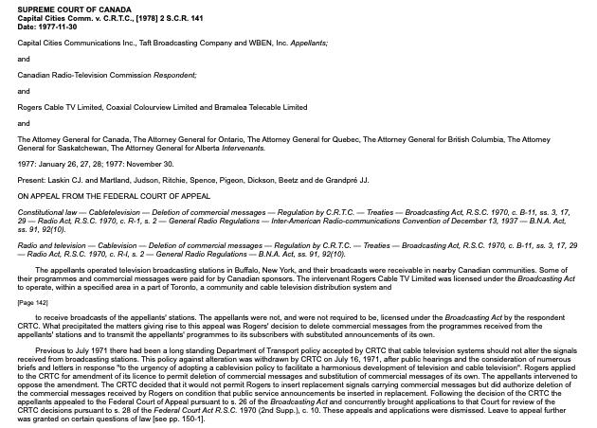
“Borrowing” U.S. TV signals & Simultaneous Substitution of Canadian Commercials

Slide 23
U.S.A. has stronger protections if you are an internet “platform”?
In USA S.512 DMCA + S.230 Communications Decency Act
47 U.S. Code § 230 - Protection for private blocking and screening of offensive material
(c)Protection for “Good Samaritan” blocking and screening of offensive material
  (1)Treatment of publisher or speaker
  No provider…of an interactive computer service shall be treated as the publisher or speaker of any information provided by another information content provider.

Slide 24
News of
the Week

Slide 25
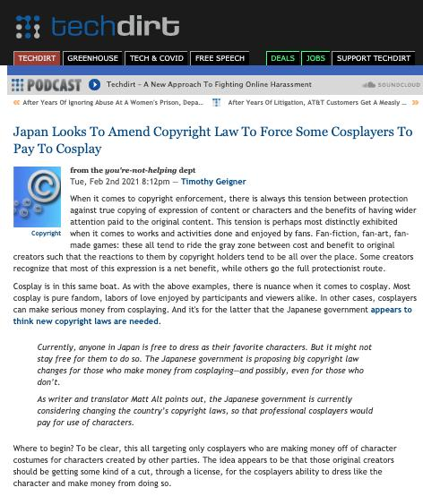

Slide 26
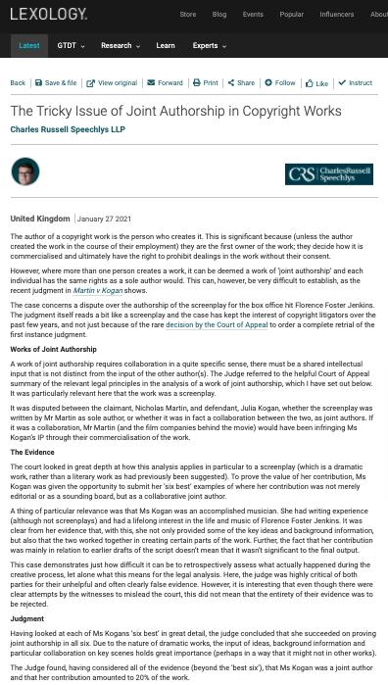

Slide 27
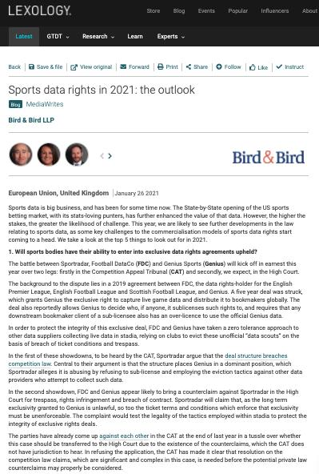

Slide 28
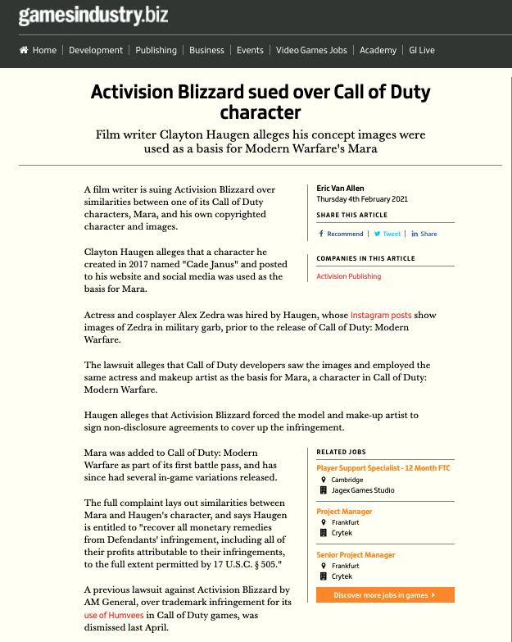

Slide 29
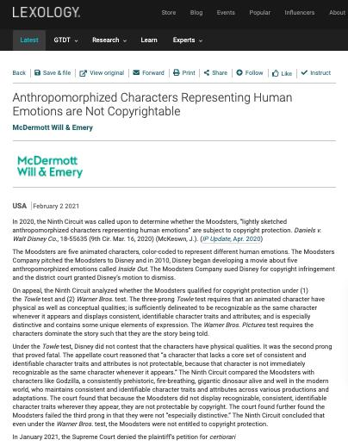

Slide 30
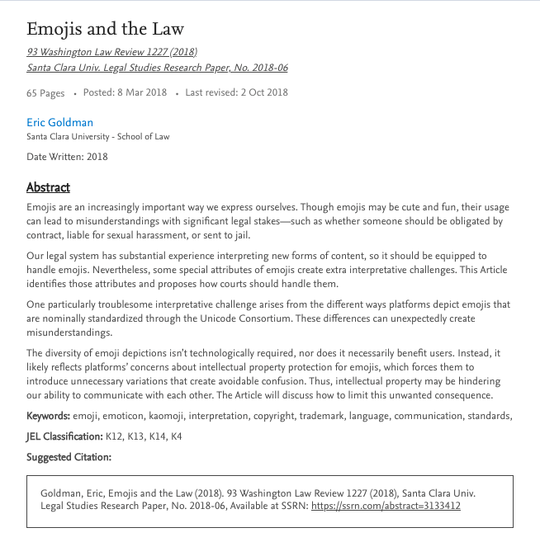
Emojis and the Law (previously)
https://papers.ssrn.com/sol3/papers.cfm?abstract_id=3133412

Slide 31
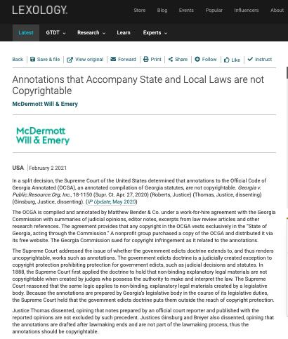

Slide 32
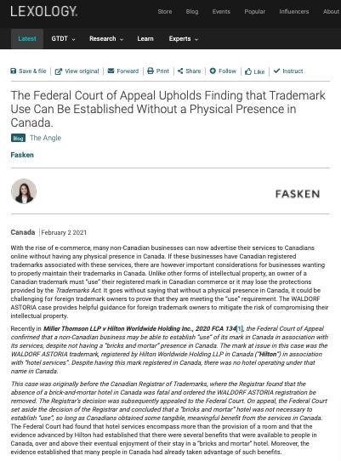

Slide 33
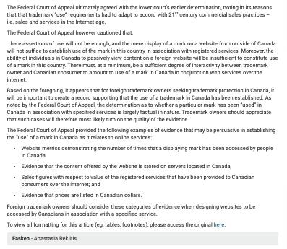

Slide 34
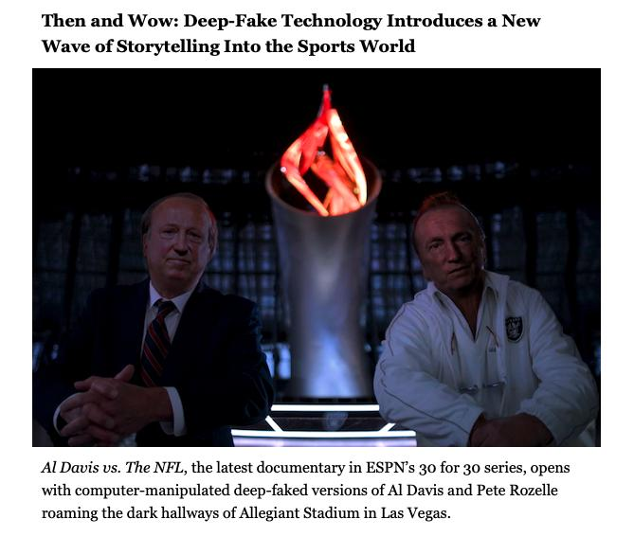

Slide 35
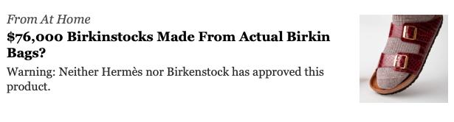
Exam question? (not really)

Slide 36
Your News of the Week

Slide 37
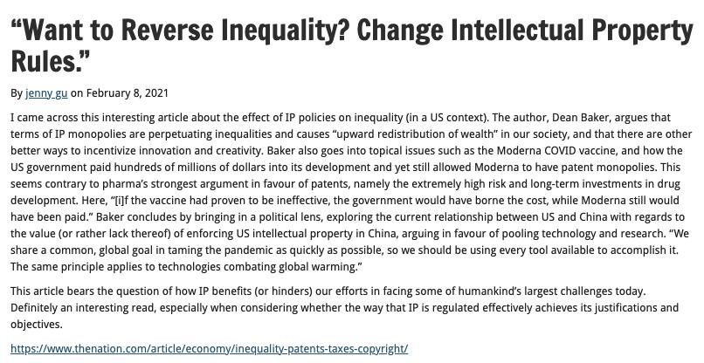

Slide 38
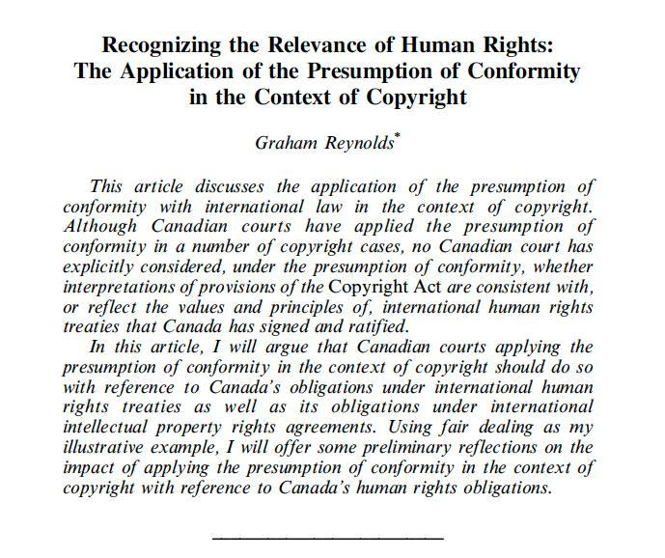

Slide 39
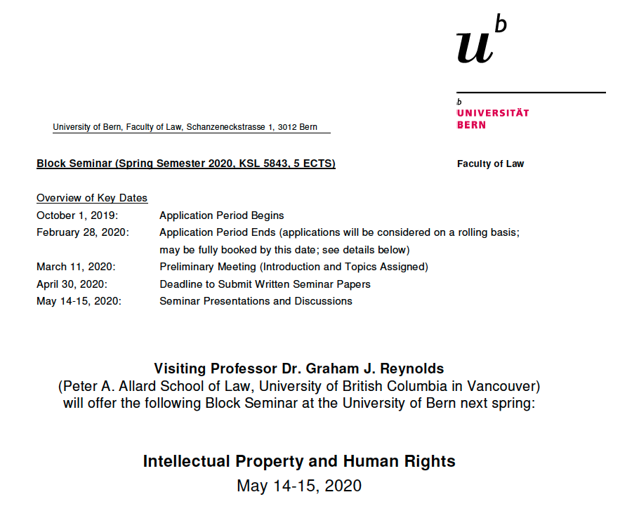

Slide 40
Conceptualizing the relationship between intellectual property and human rights
Intellectual property and freedom of expression
Intellectual property and the rights of indigenous peoples
Intellectual property and the right to the preservation of cultural heritage
Intellectual property and the right to a clean environment (and related rights)
Intellectual property and the right to health
Intellectual property and the rights of persons with disabilities
Intellectual property and the right to education
Intellectual property and equality (?)

Slide 41
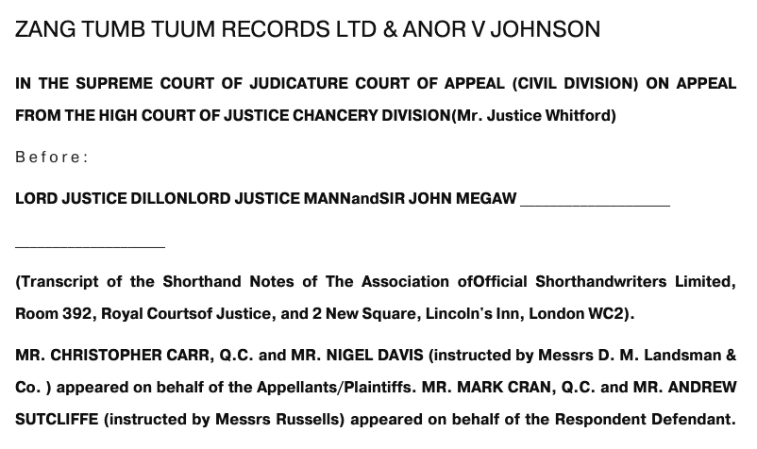

Slide 42


Slide 43
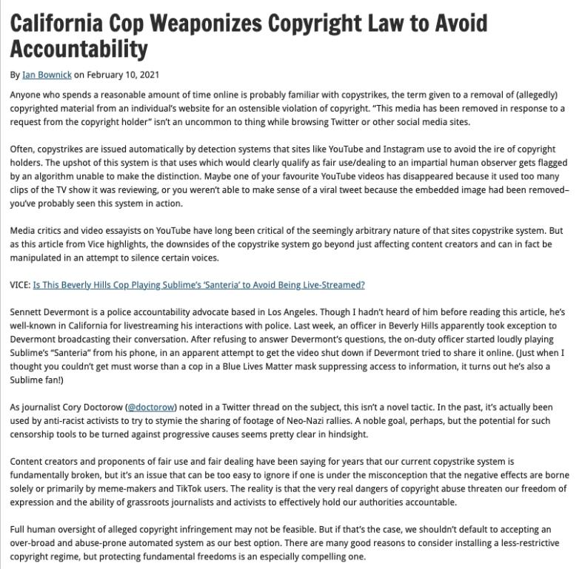

Slide 44
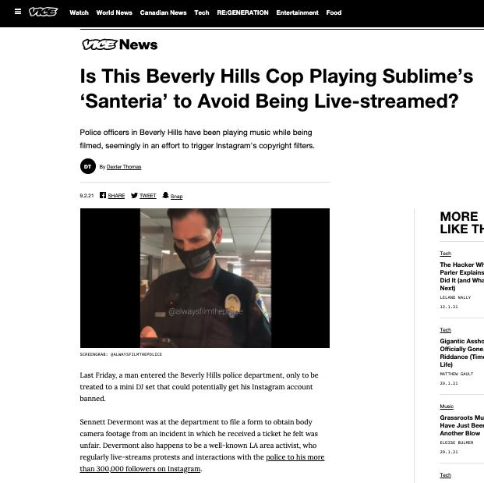

Slide 45
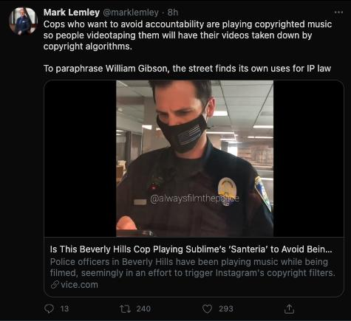

Slide 46
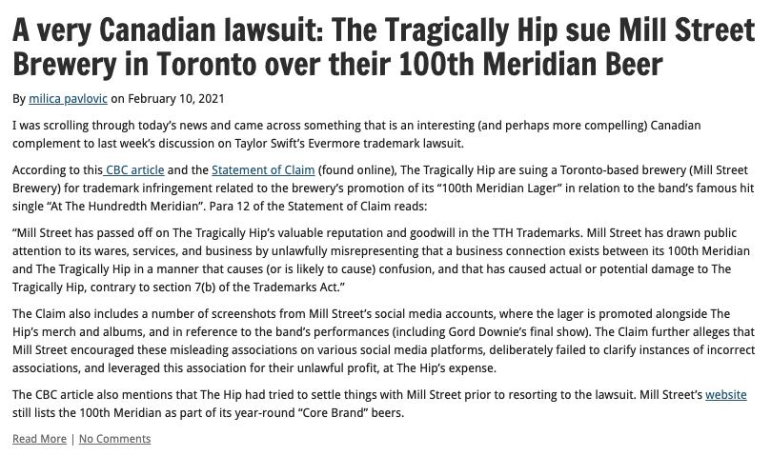

Slide 47


Slide 48

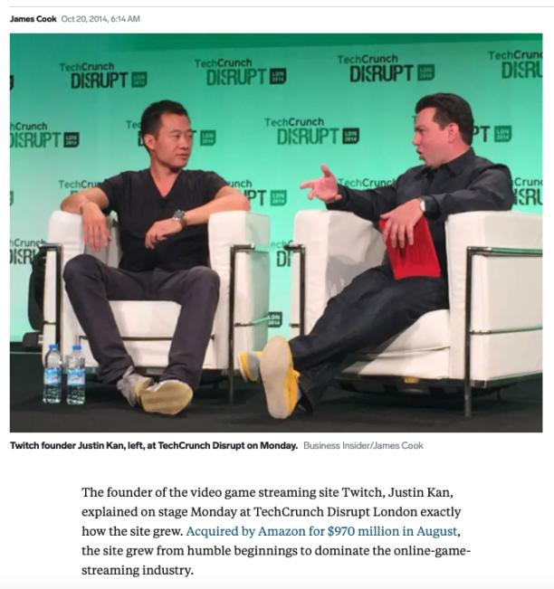

Slide 49
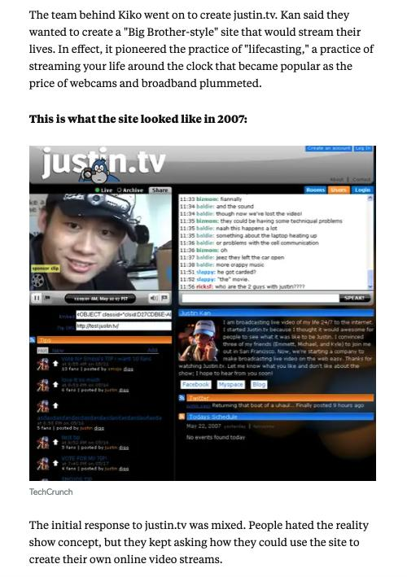

Slide 50
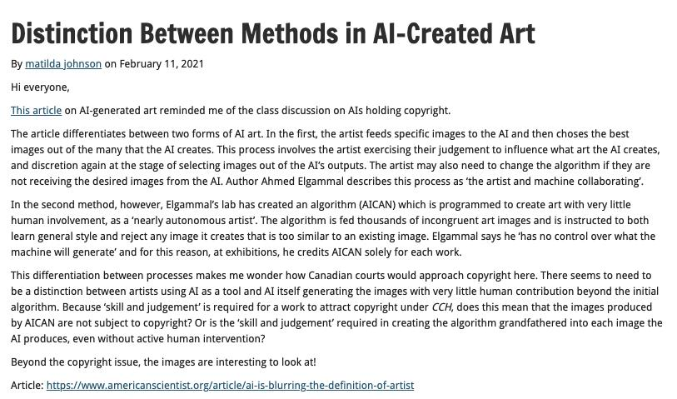

Slide 51
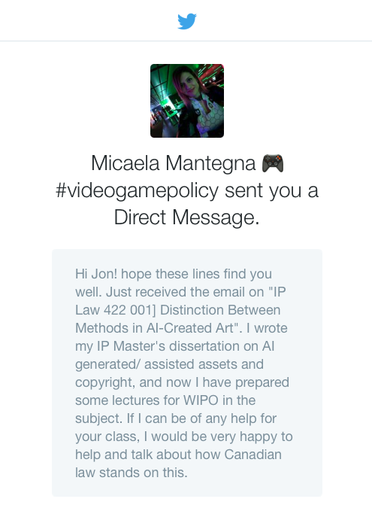

Slide 52
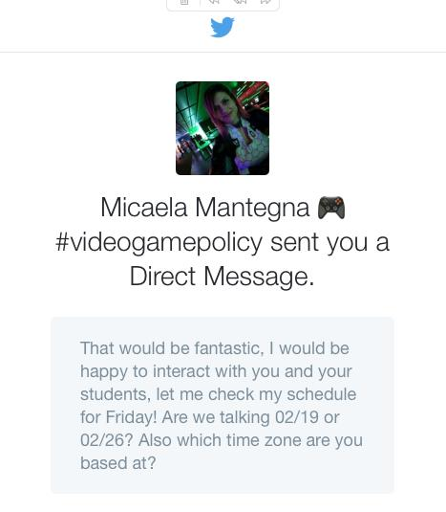

Slide 53
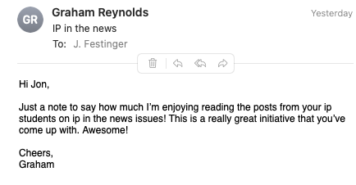

Slide 54
News of
the Week
Last Year
This Time

Slide 55
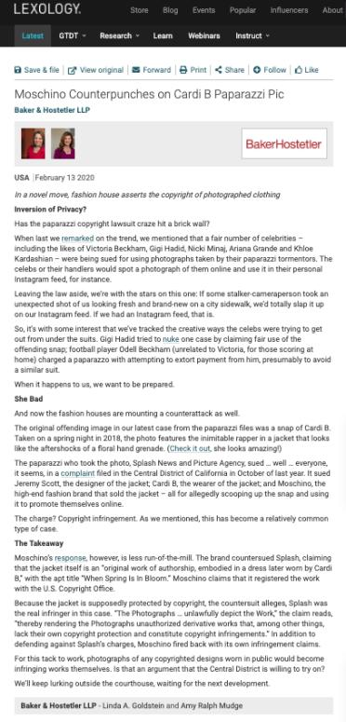

Slide 56
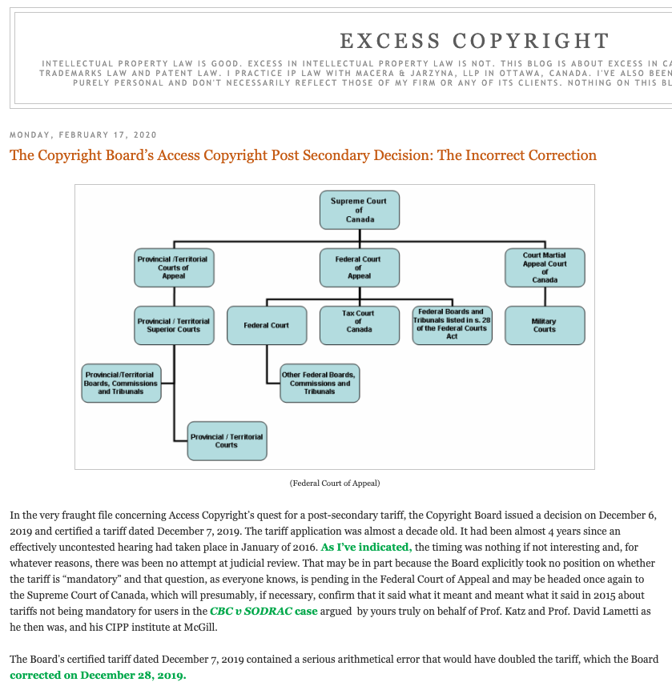

Slide 57
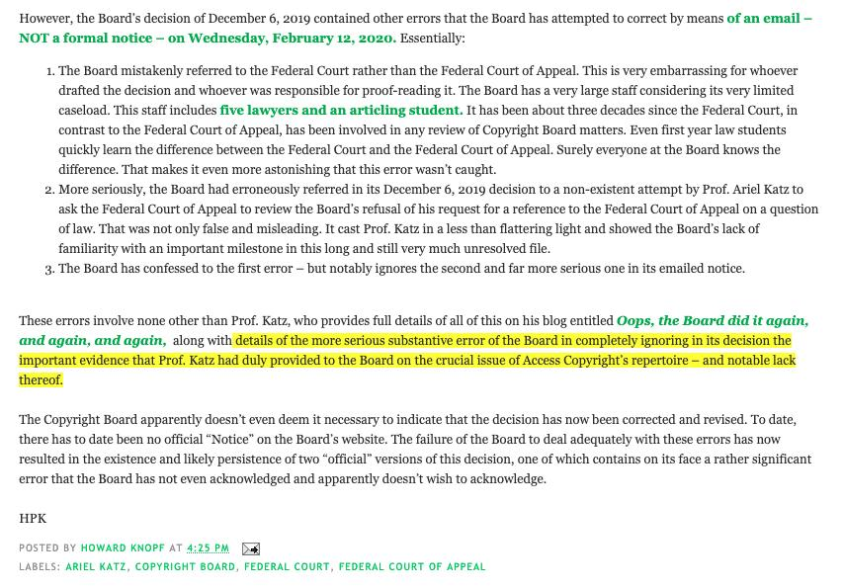

Slide 58
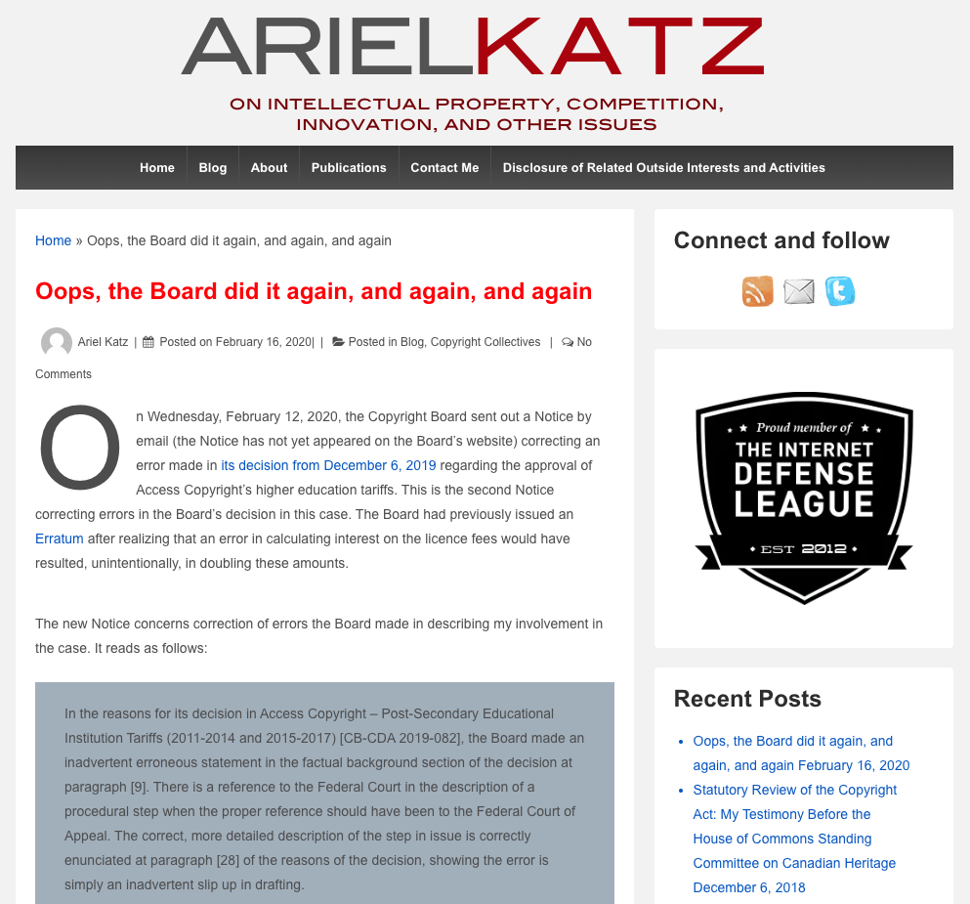

Slide 59
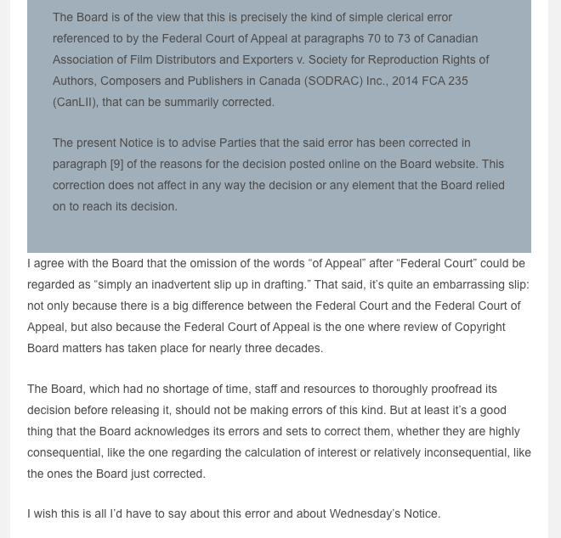

Slide 60
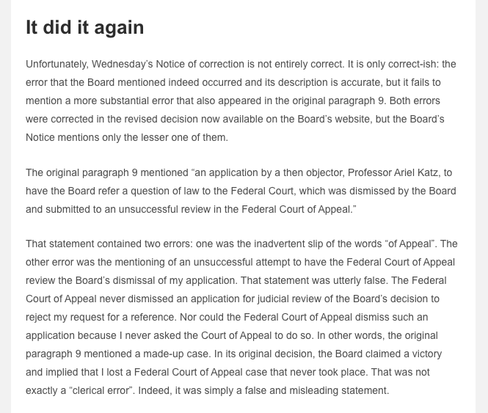

Slide 61
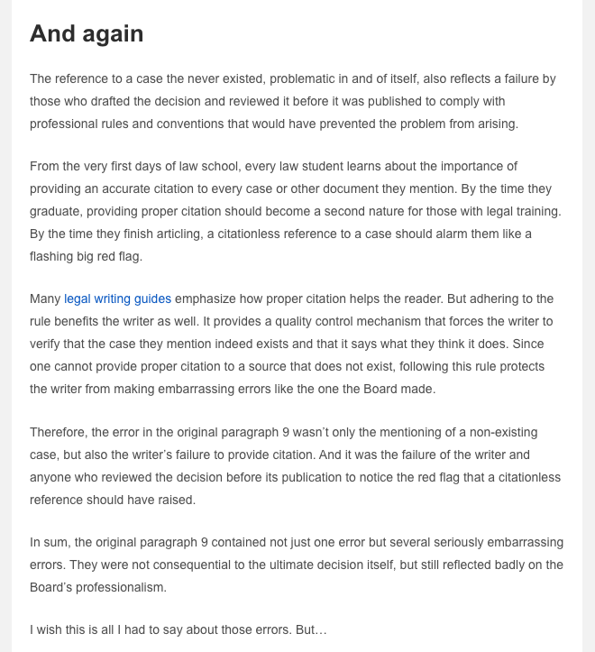

Slide 62
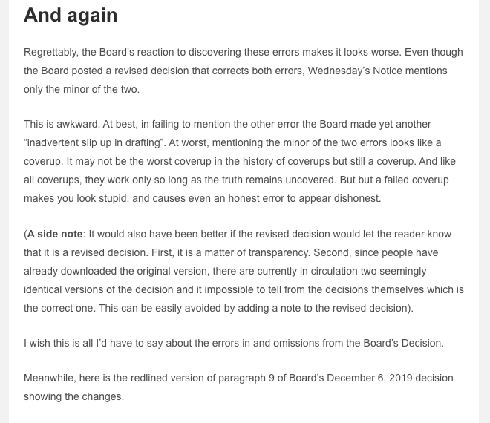

Slide 63
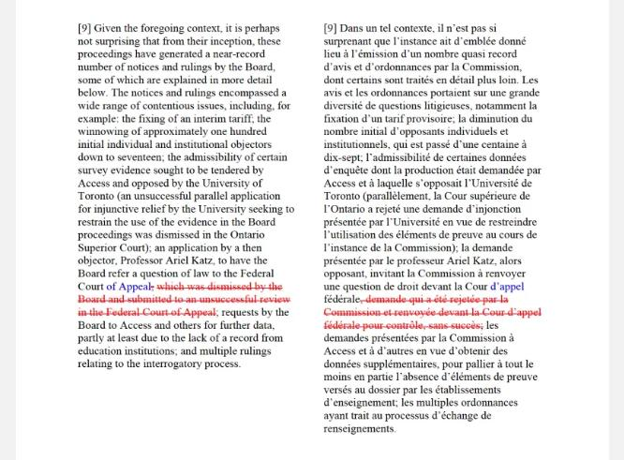

Slide 64
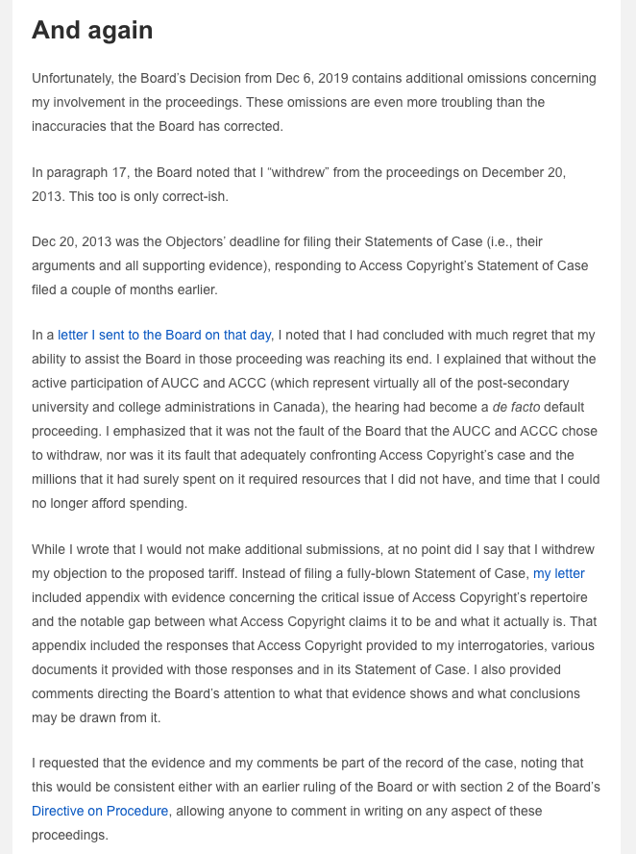

Slide 65
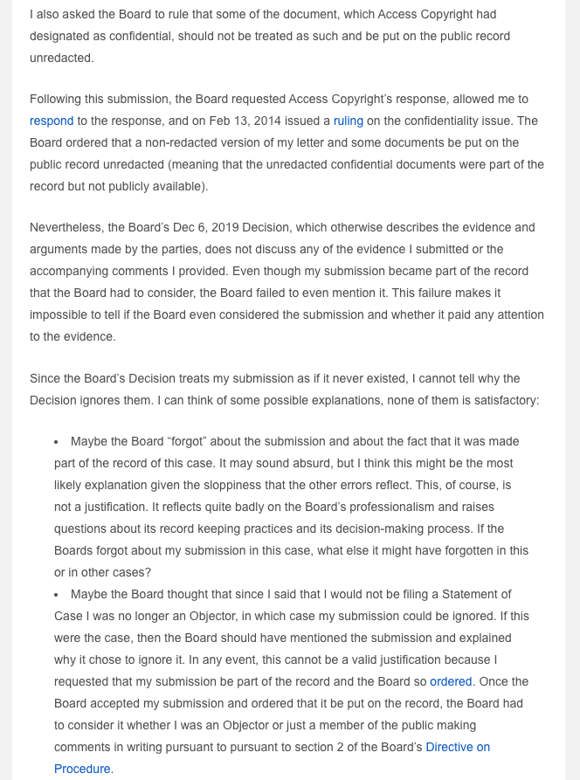

Slide 66
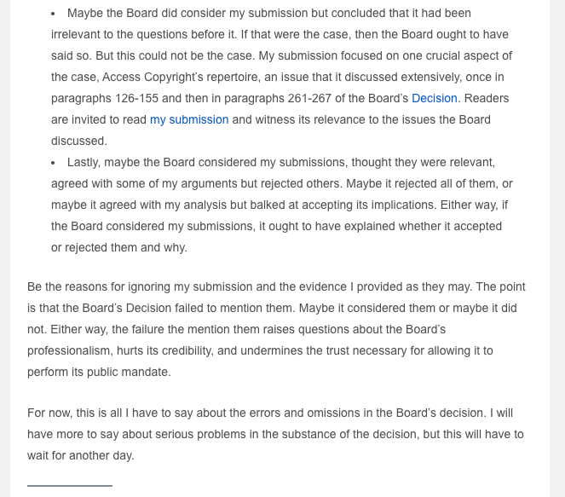

Slide 67
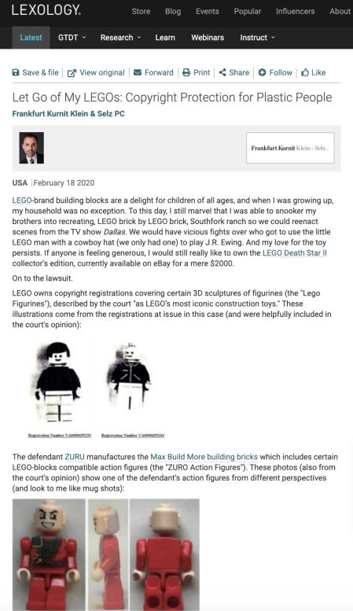

Slide 68
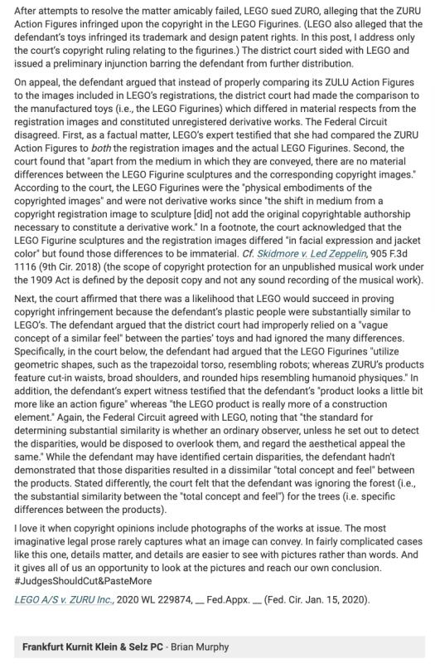

Slide 69
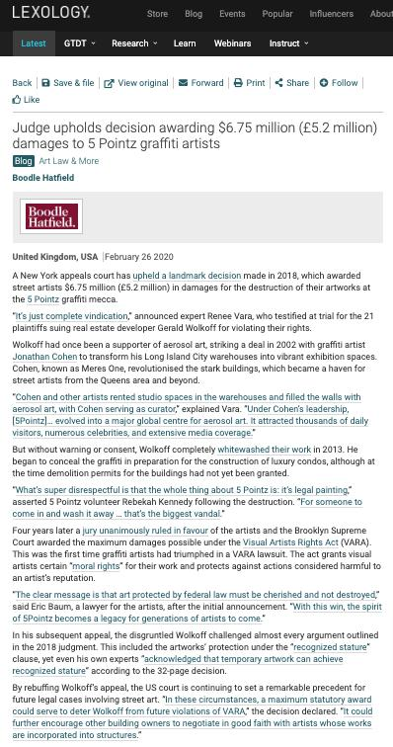

Slide 70
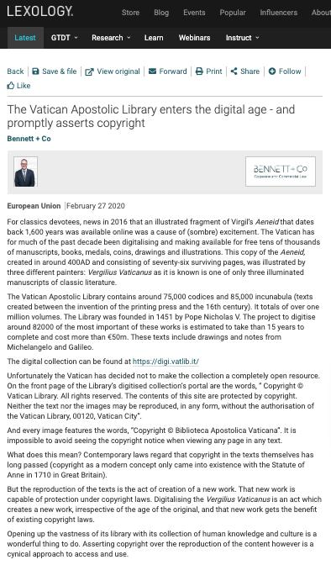

Slide 71
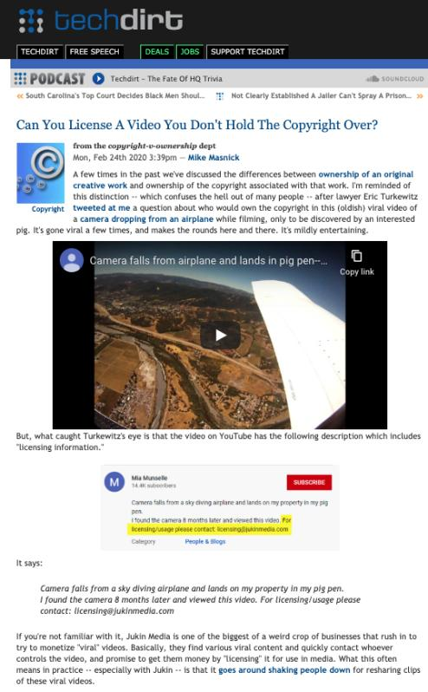

Slide 72
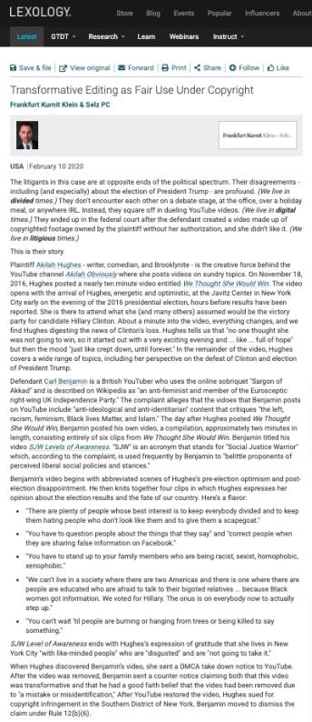

Slide 73
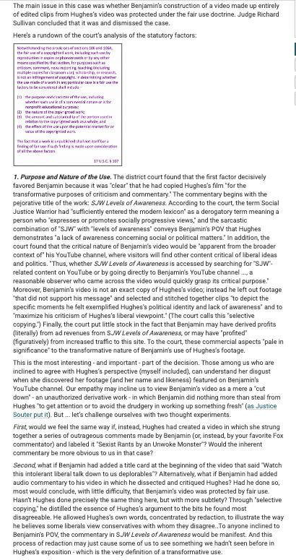

Slide 74
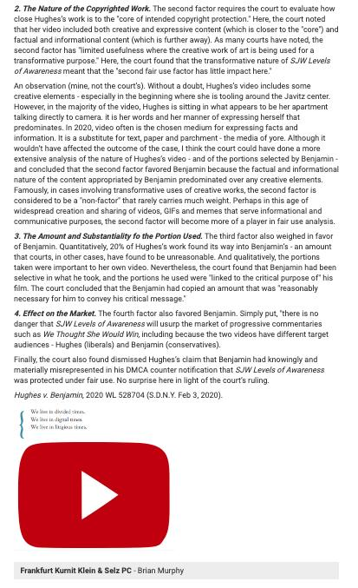

Slide 75

Pause

Slide 76
QUESTIONS?
THOUGHTS?
DISCUSSION?

Slide 77
Copyright
Review

Slide 78
Copyright Review
Who owns the copyright in a painting created by an inmate as part of a prison employment program? Discuss.

Slide 79

Copyright Review
Roy Lichtenstein, Whaam! (1963)

Slide 80

Copyright Review
Photo credit to AP

Slide 81

Copyright Review

Slide 82

Copyright Review
Photo credit Ángel Franco/New York Times

Slide 83

Copyright Review
L: Art Rogers, Puppies (1985) / R: Jeff Koons, String of Puppies (1988)

Slide 84
Copyright Review
In taking a picture of your partner at the Vancouver Art Gallery, you accidentally include, in the background of the picture, a work of art still under copyright. Is this infringement of copyright?

Slide 85
Copyright Review
Does Canadian copyright law adequately balance the rights of authors, the rights of copyright owners, and the rights of users? Discuss.

Slide 86
Copyright Review
The fair dealing defence should always be available. Do you agree or disagree with this statement? On what basis?

Slide 87
Copyright Review
Should copyright owners be able to restrict the Internet access of those who have either infringed their copyrights online or who they allege have done so?

Slide 88
Pause

Slide 89
QUESTIONS?
THOUGHTS?
DISCUSSION?

Slide 90


Slide 91

Independent Creation Doctrine - Canada

Slide 92


Slide 93


Slide 94


Slide 95
63 Many of the detailed similarities, in my view, can be traced to the common store of folklore about primitive species with human characteristics upon which Lucas was as free to draw as were Preston and Hurry. Yet drawing upon a common store of information does not in itself answer to the claim of infringement. It is the expression of ideas, not the ideas themselves, that is the subject of copyright. It is entirely possible that two or more authors, composers, dramatists or other artists may draw upon a common store of information for ideas and each may have copyright in his or her expression of those ideas. But if while drawing upon the common information base, one should copy the expression in literary or dramatic form of another author copyright may be infringed.

Slide 96
Pause

Slide 97
QUESTIONS?
THOUGHTS?
DISCUSSION?

Slide 98

Intellectual “Property”

Slide 99


Slide 100


Slide 101

Disney & Copyright term

Slide 102


Slide 103


Slide 104

Threshold of Joint Authorship in Copyright

Slide 105


Slide 106


Slide 107

http://lmlaw.ca/wp-content/uploads/2013/12/joint_authors.pdf

Slide 108
Pause

Slide 109
QUESTIONS?
THOUGHTS?
DISCUSSION?

Slide 110

“Passing Off”
The Golden Goal – Jerome Iginla
passing off to Sidney Crosby

Slide 111
From Copyright to Passing Off/Trademarks
©
™*
From Protecting Creativity to Protecting Use
*not official but useful

Slide 112

Paul André Crépeau (1926-2011)
“…the law of the marketplace…”

Slide 113
Passing off in contrast to Trademarks: Think…
LOCATION, LOCATION, LOCATION
LOCAL, LOCAL, LOCAL
WHERE ARE THE GOODS KNOWN +/or SOLD

Slide 114
Passing off in contrast to Trademarks: Think…
Temporal dimension
How much time should the protection last beyond closing/unavailability if it can be recovered?
Fun brand cases
Genericization

Slide 115
Conceptual Frameworks
Think “the marketplace”
Think BRANDS
Associate BRANDS with REPUTATION (“goodwill”)
“USE” is the key concept in both passing off & trademarks
“Use It or Lose It” = historical, underlying concept (not quite as literal anymore in Canada per recent Trademark reform)
Not as overtly about “intellectual effort” as copyright
No “Public Domain” per se

Slide 116
Passing off
Tort action available in certain circumstances of unfair competition
Common Law (where no statute)
Both a common law tort and a statutory cause of action under the Canadian Trade-marks Act
No one may pass off their goods as those of another
General remedy for two categories of deception in the commercial context:
  Company B represents products as being those of Company A to take advantage of Company A’s goodwill and reputation e.g. Coke v. Cola Joe
  Goods of Trader A supplied to party who has ordered goods of Trader B. Purchasing party led to believe they have received goods of Trader B.

Slide 117

Category 1

Slide 118


Category 2

Slide 119
Passing off
Three (3) necessary components of a passing-off action:
  1. The existence of goodwill +
  2. Deception of the public due to a misrepresentation +
  3. Actual or potential damage to the plaintiff

Slide 120
Passing off: Goodwill
Goodwill
The benefit and advantage of the good name, reputation, and connection of a business
Where the trade-mark or get-up is associated in the mind of the purchasing public with the plaintiff's goods, or with one trade source.
Get-up: The whole visible external appearance of goods

Slide 121


Slide 122

1934

Slide 123


Slide 124


Slide 125
Overall principle
An enterprise can eventually lose its goodwill, after a period of time, if it shuts down. After a period of non-use, a name or product appearance will lose it’s “mojo” (not a technical term) and no longer be distinctive of a certain trade source.

Slide 126


Slide 127


Slide 128


Slide 129



Passing off: Genericization

Slide 130


Slide 131

https://youtu.be/rRi8LptvFZY

Slide 132

Follow-up
https://youtu.be/ZLWMQLMiTPk

Slide 133

The “Test Person”
What would a detailed case review reveal?

Slide 134
Coming Soon
™

Slide 135
Pause

Slide 136
QUESTIONS?
THOUGHTS?
DISCUSSION?

Slide 137


A MATTER OF PERSPECTIVE

Slide 138

Conclusion

Slide 139
UNTIL NEXT
TIME!

Slide 140

Always include a cat picture

Slide 141
In learning you will teach
And in teaching you will learn
Phil Collins' Son of Man (1999)

Slide 142
Our Academic Partners

