Slide 1

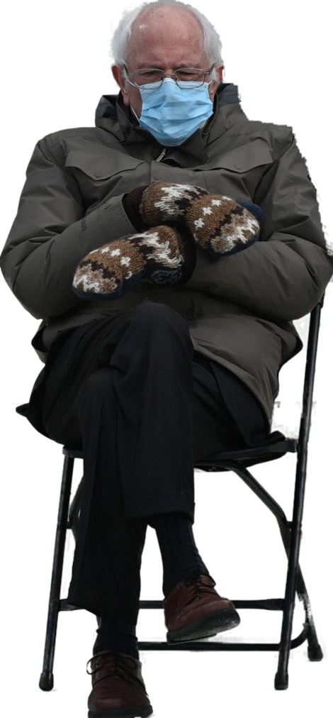

Users’ Rights
Talk 4 Introduction
LAW 424 002
Intellectual Property Law
Allard School of Law, UBC
Spring, 2021
Jon Festinger Q.C.
Centre for Digital Media
QMUL School of Law (CCLS)
Whiteboard Law
http://commlaw.allard.ubc
@jonfestinger
jon_festinger@thecdm.ca

Slide 2
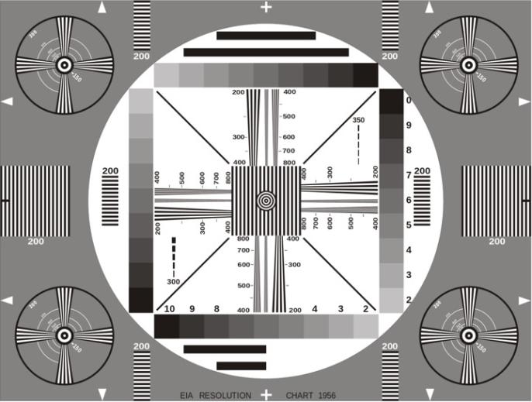
Permission to Record?

Slide 3

These draft slides

Slide 4
Logistics

Slide 5
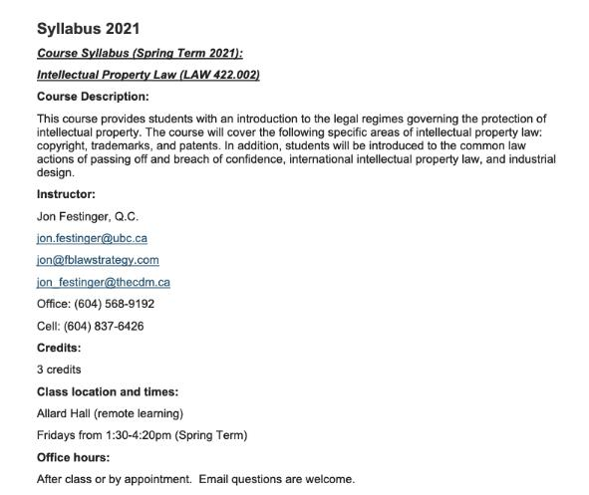
Any Questions?…

Slide 6
Methodology
Slides relate directly to textbook & Syllabus
Added material or “context” in Slides not in textbook (not optional)
Added “context” from News of the Week (optional – but does often supply fact situations useful in exploring consequences in Canadian law or that could serve as the basis of an exam question)

Slide 7
Presentations (from Syllabus)
“Paper/Presentation/Post = 20% of grade
This will be 500-1000 word (or equivalent) per person original piece of work that illuminates some aspect of Intellectual Property Law. It can be in any form, posted to the course website or not, and can be approached individually or as a group.”

Slide 8
Presentations
1-5 (ideally) per group
Sign-up by emailing me
Any topic – not constrained by what we are talking about that week
Consult re the topic you want to take on?
Post one thing you want us to read or watch?
5-7 minutes (notionally) per student = 500-1000 words

Slide 9

Office “Hours”: Ideally Fridays before or after class but am flexible…
Email me : jon.festinger@ubc.ca
Skype: jon.festinger
Phone:
o. 604-568-9192
c. 604-837-6426

Slide 10
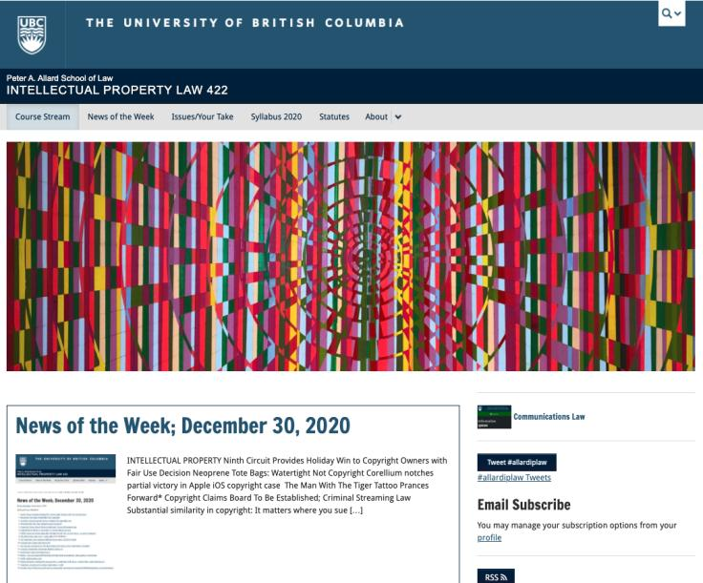
Course Website
https://iplaw.allard.ubc.ca/

Slide 11
For full privileges on the website
1. Please create an account at http://cms.ubc.ca/ using your CWL.
2. Once you create an account and sign in at http://cms.ubc.ca/ you can click your name in the top right. Halfway down the following page will be your WordPress email address.
3. Send me your WordPress email address at jon.festinger@ubc.ca or at jon_festinger@thecdm.ca
4. Then, I will invite you to participate with authoring privileges via your WordPress email address.

Slide 12
Thank you for
your bios.
Determined to reply.

Slide 13
News of
Week

Slide 14
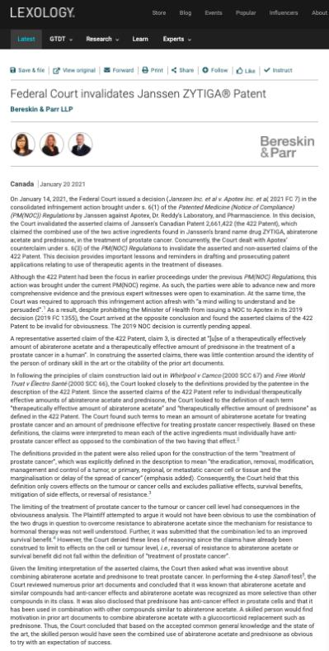

Slide 15
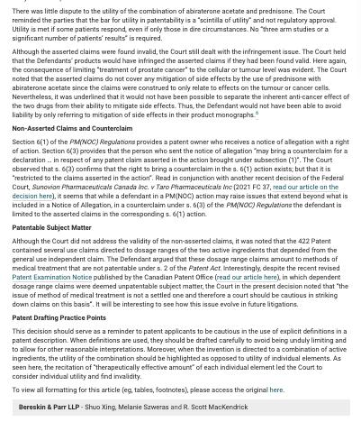

Slide 16
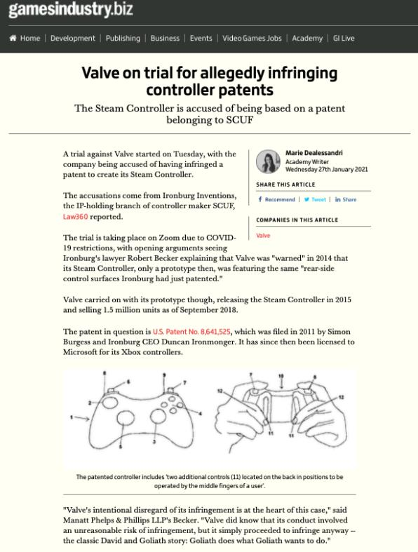

Slide 17
News of
Week
last year

Slide 18
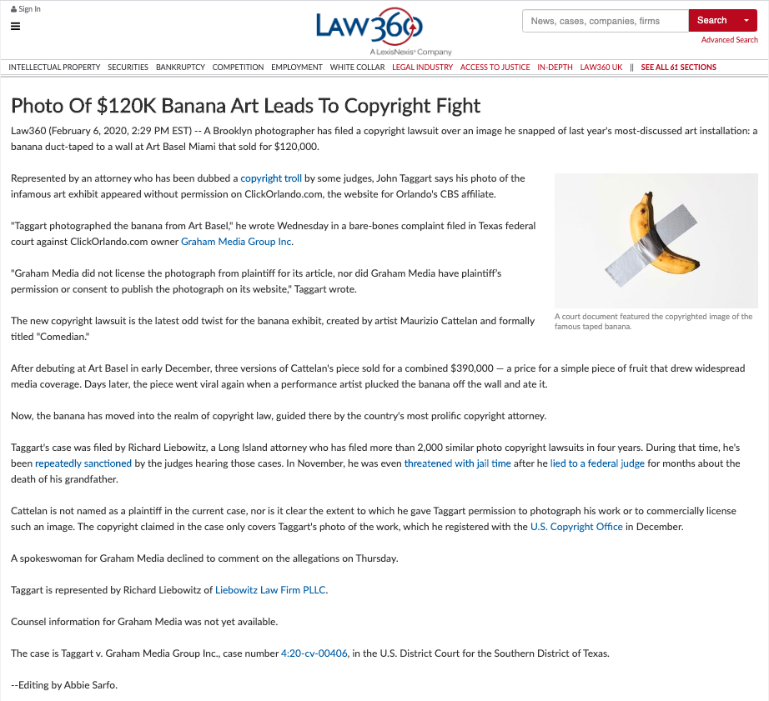

Slide 19
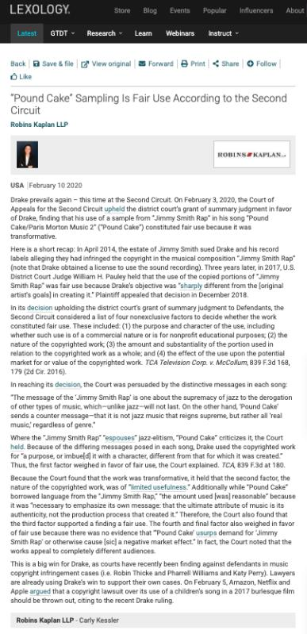

Slide 20
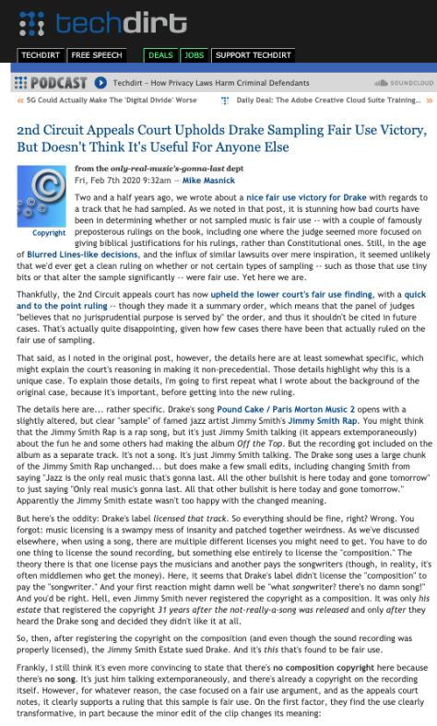

Slide 21
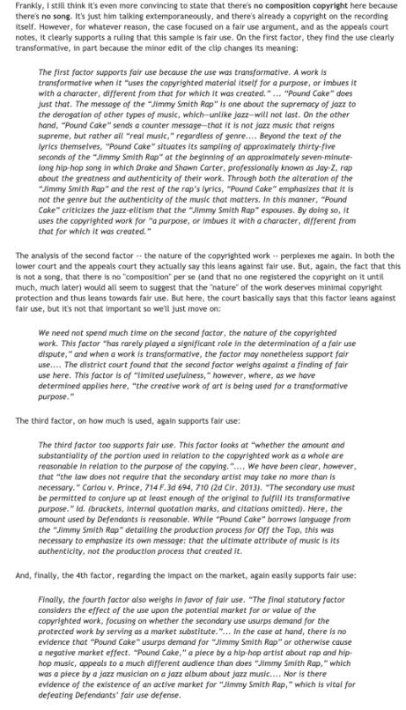

Slide 22
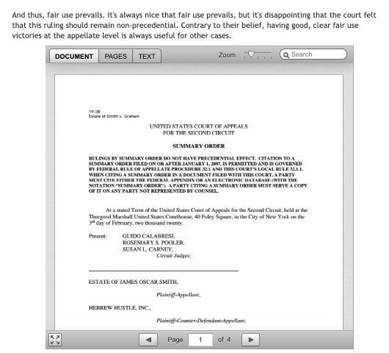

Slide 23
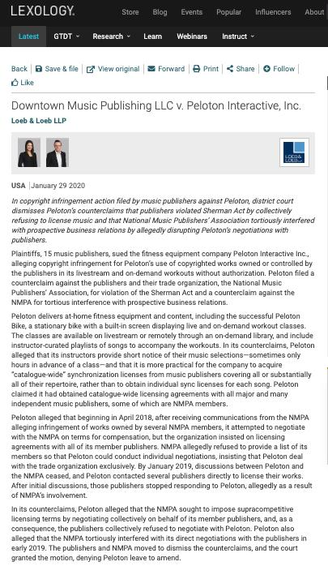

Slide 24
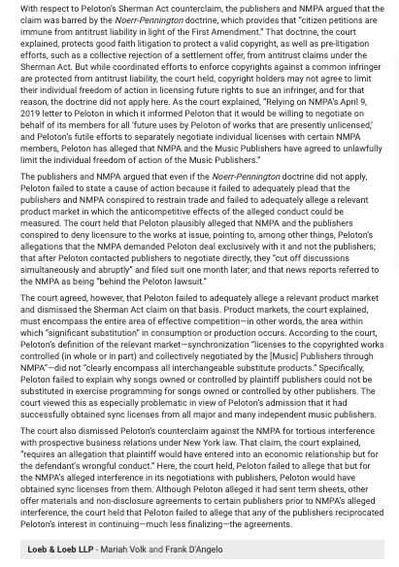

Slide 25
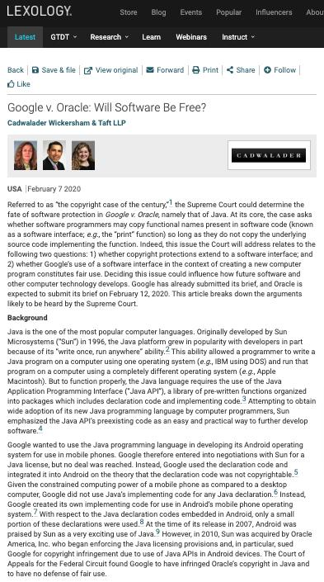

Slide 26
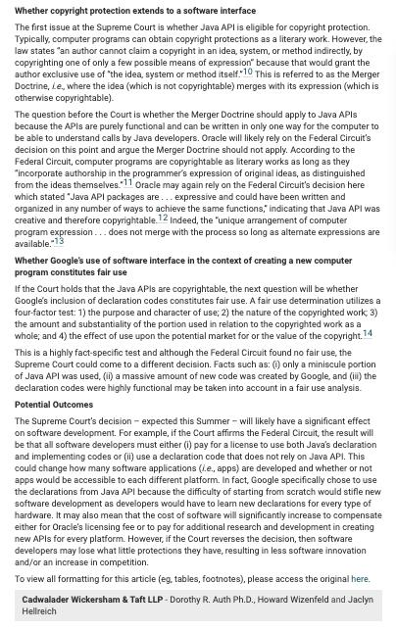

Slide 27
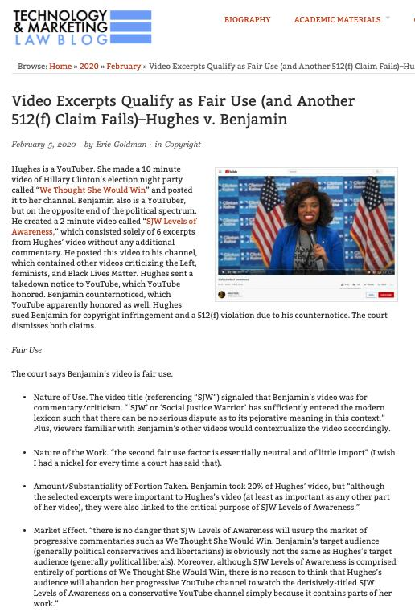

Slide 28
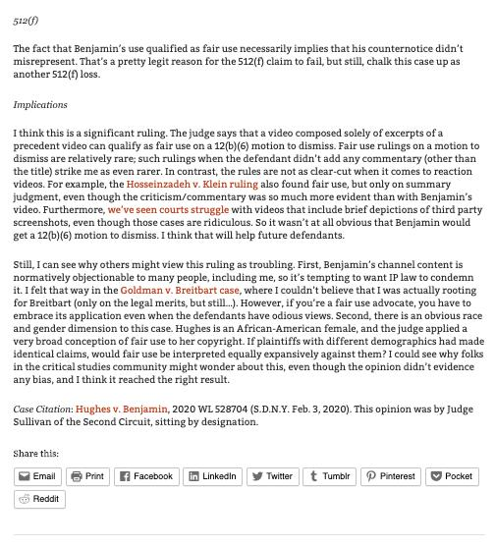

Slide 29
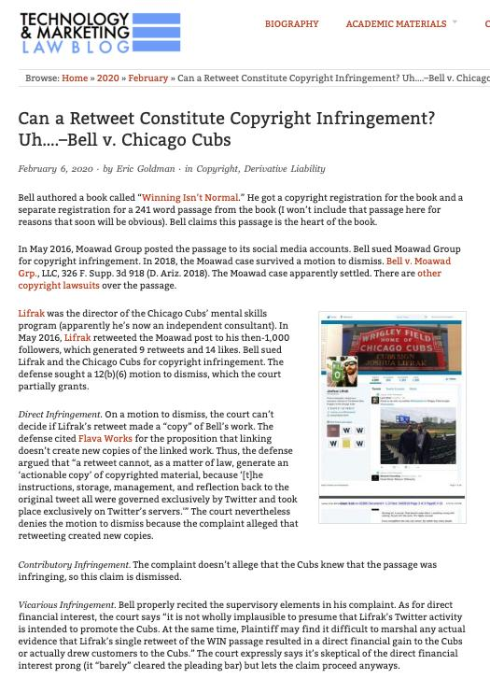

Slide 30
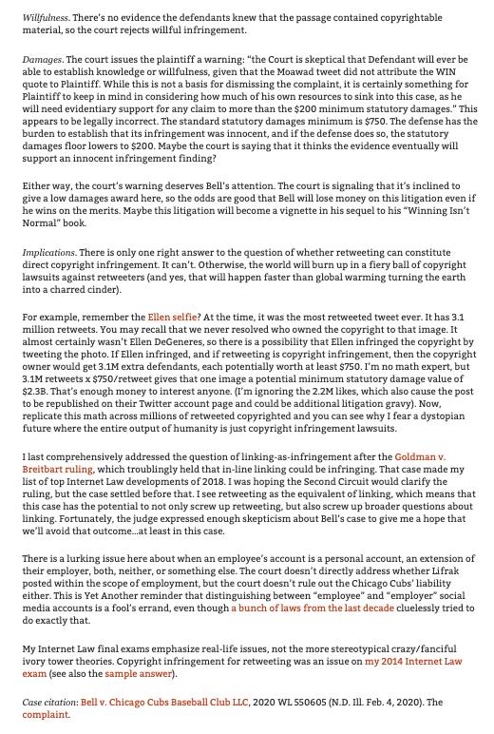

Slide 31
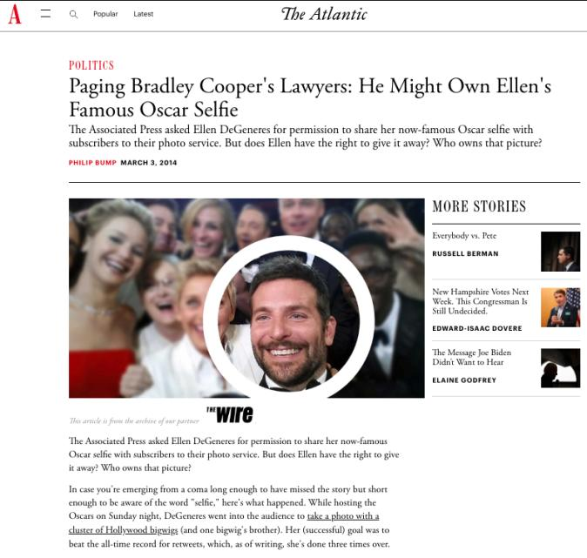
Academy Awards Special

Slide 32
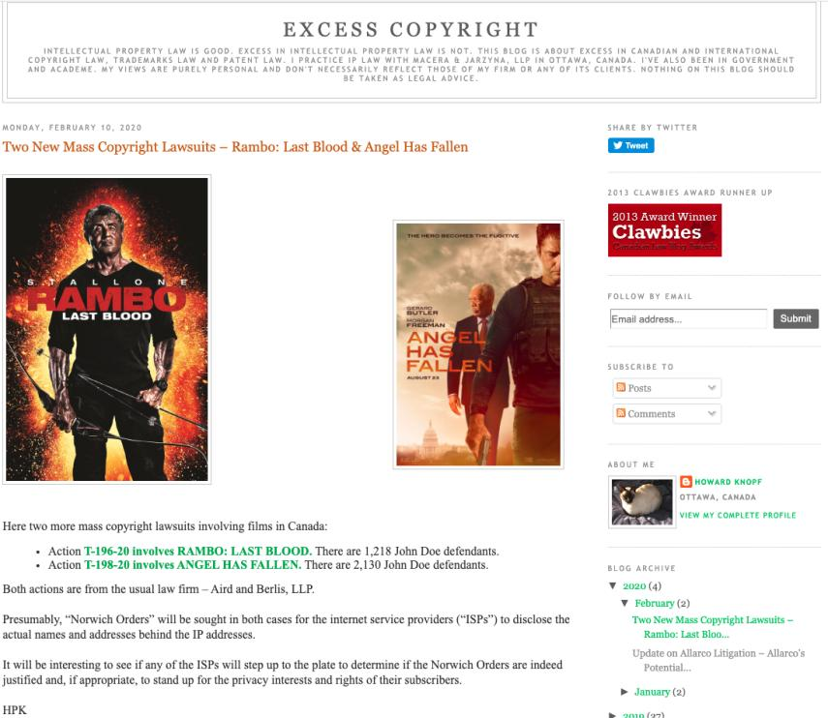

Slide 33
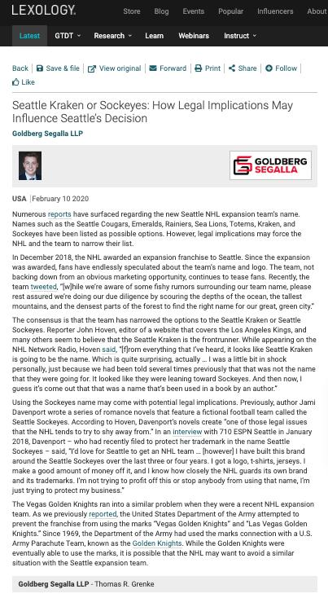

Slide 34
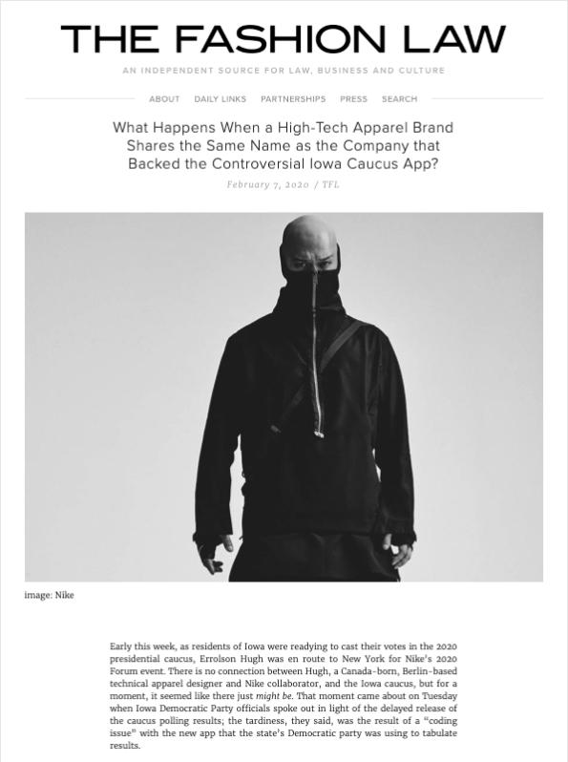

Slide 35

Pause

Slide 36
QUESTIONS?
THOUGHTS?
DISCUSSION?

Slide 37
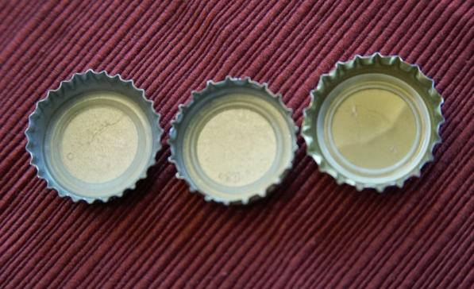
Re-capping

Slide 38
Copyright = set of exclusive rights in works of expression; performers’ performances; sound recordings; and communication signals.

Slide 39
Theberge:
Balance between promoting the public interest in the encouragement and dissemination of works of the arts and intellect and obtaining a just reward for the creator
Refined by Cinar Corp. v. Robinson:
Copyright act rewards creators in order to incentivize the creation of new works

Slide 40
Rights of the copyright owner
Three fundamental rights:
Produce or reproduce the work (3(1))
Perform the work (including broadcasting rights) (3(1))
The right to publish (3(1))

Slide 41
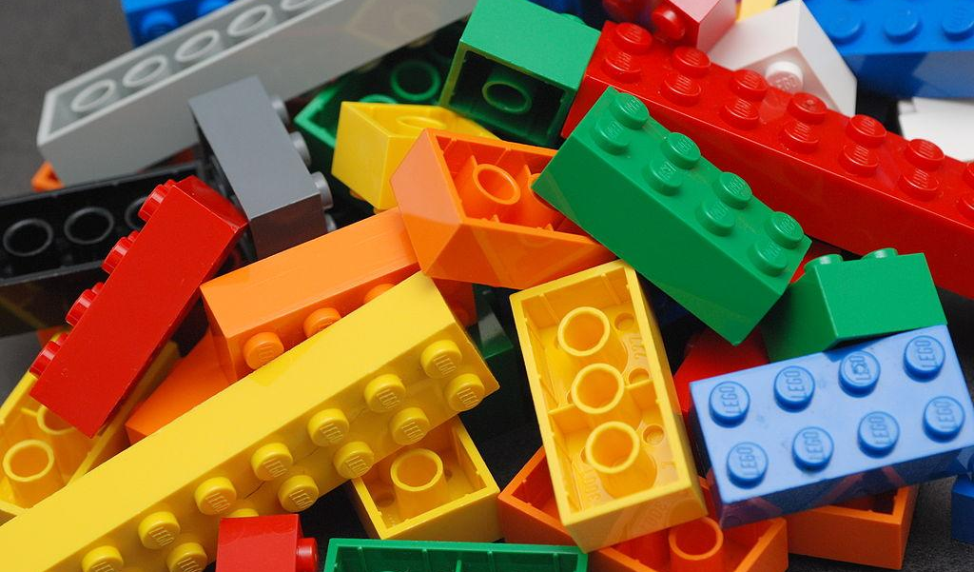
Rights of the copyright owner
Produce … any translation (3(1)(a))
Convert dramatic work into non-dramatic work (3(1)(b)
Convert non-dramatic work into dramatic work (3(1)(c))
To make a sound recording, etc. of a literary, etc. work (3(1)(d))
Reproduce, etc. a literary, etc. work as a cinematographic work (3(1)(e))
Communicate a work to the public by telecommunication (3(1)(f))
Present an artistic work at a public exhibition…. (3(1)(g))
Rent out a computer program, etc. (3(1)(h))
Rent out a sound recording of a musical work … (3(1)(i))
Sell or transfer ownership of tangible object … (3(1)(j)
Authorize any of above acts (3(1))

Slide 42
Building Block

Slide 43
Bridge to Users’ Rights
Copyright owner rights demonstrate the trend towards technological neutrality.
This can at first seem overbroad as against users EG. CBC v. SODRAC (2003) re “broadcast incidental copies”
This decision to not limit the scope of copyright through technology makes some policy sense.
From a policy perspective however, it appears that the scope of copyright is restricted primarily through user’s rights analyzed on a case-by-case basis

Slide 44
Users’ Rights

Slide 45
Users’ rights
Sequence of events in a copyright lawsuit
1) Unauthorized act occurs. Has an infringement prima facie occurred?
  27. (1) It is an infringement of copyright for any person to do, without the consent of the owner of the copyright, anything that by this Act only the owner of the copyright has the right to do.
2) Burden shifts to the Defense to establish a defense to copyright infringement.

Slide 46
Court needs to determine: Was something done that only the copyright owner has the right to do?
Reproduced a work in whole or in substantial part
Performed a work in public
Communicated a work to the public by telecommunication

Slide 47
Today: Two Defences to copyright infringement
Defence of public interest
Fair dealing

Slide 48
User rights: Public Interest Defence
Defence of public interest
R. v. Lorimer & Co. Ltd., [1984] 1 FC 1065
1. Crown published a report in 1981 entitled “The State of Competition in the Canadian Petroleum Industry.” 1748 pages. 7 volumes. $70 per set ($10 per volume).
2. Lorimer felt a condensed version “would enjoy good public distribution”. Lorimer sought permission to publish a condensed version of the report & was refused.
3.Nothing covert. Lorimer, ‘in his capacity as president of the Defendant company, wrote to the Minister of Supply and Services’ indicating that the Defendant company is ‘preparing … a version of the report for publication’, and that it was prepared to ‘pay to the Receiver General a royalty of eight per cent of the retail price on all copies sold’.
4. Lorimer’s abridged version was 626 pages and offered for $14.95.
5. Sold well. Crown sued for copyright infringement.

Slide 49
User rights: Public Interest Defence
Defence of public interest
R. v. Lorimer & Co. Ltd., [1984] 1 FC 1065
Defence of public interest argued – In the public interest that this information be disseminated as broadly as possible.
Court indicated that it has no doubt that a defence of public interest – as set out in the UK cases on which the Lorimer’s counsel relied – is available in proper circumstances against an assertion of Crown copyright.
But the facts don’t support the public interest defence here
  Great disclosure in report
  Free copies given out, put in libraries across the country
  No concern about the public not being informed
N.B. Act doesn’t mention “public interest”

Slide 50
User rights: Public Interest Defence
Defence of public interest
Lion Laboratories v Evans [1985] QB 526
Lion Laboratories manufactured and marketed the Lion Intoximeter which was used by the police for measuring blood alcohol levels of motorists.
Two ex-employees approached the Press with four documents taken from Lion.
Such reproduction was held to be justified, despite the nature of material, being confidential and protected by copyright.
Court agreed that the defence of public interest applied to the investigations regarding the accuracy of the equipment to avoid incorrect readings when used by the police on motorist.

Slide 51
Wrongdoing does not disqualify the public interest defence.
“I can see no sensible reason why this defence should be limited to cases in which there has been wrongdoing on the part of the plaintiffs.... No doubt it is in such circumstances that the defence will usually arise, but it is not difficult to think of instances where, although there has been no wrongdoing on the part of the plaintiff, it may be vital in the public interest to publish a part of his confidential information”

Slide 52
User rights: Fair Dealing
Fair dealing
Under fair dealing, individuals have the right to use a substantial part of another’s copyright-protected expression without that person’s permission, provided that the individual acts in furtherance of certain purposes, that the individual acts in a fair manner, and that - in some cases - certain attribution requirements are satisfied.
Broadest defence to copyright infringement set out in the Copyright Act.
If fair dealing is made out, an individual will not be found to have infringed copyright.
This defence exists in various forms in several jurisdictions – focus here is on the Canadian articulation of this defence.
We’ll start by looking at the language of the Copyright Act – and then we’ll look at how courts have interpreted these provisions.

Slide 53


Fair Dealing v. Fair Use

Slide 54
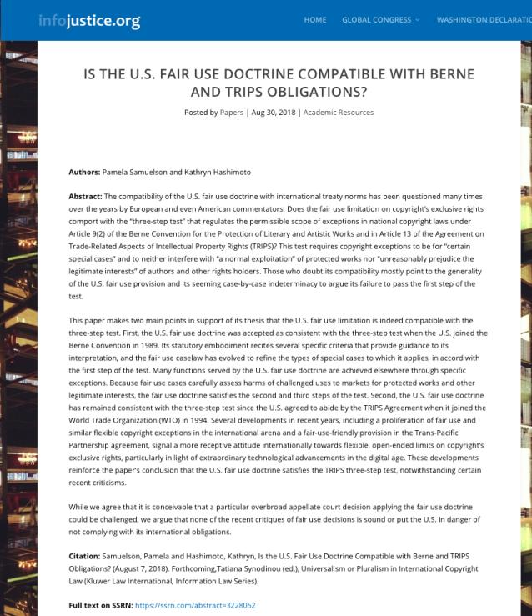
https://papers.ssrn.com/sol3/papers.cfm?abstract_id=3228052

Slide 55
Users’ rights: Fair Dealing
29. Fair dealing for the purpose of research, private study, education, parody or satire does not infringe copyright.

Slide 56
Fair Dealing: Criticism or Review
29.1 Fair dealing for the purpose of criticism or review does not infringe copyright if the following are mentioned:
(a) the source; and
  (b) if given in the source, the name of the (i) author, in the case of a work

Slide 57
Fair Dealing: News Reporting
29.2 Fair dealing for the purpose of news reporting does not infringe copyright if the following are mentioned:
(a) the source; and
  (b) if given in the source, the name of the (i) author, in the case of a work

Slide 58
Users’ rights: Fair Dealing
Eight fair dealing categories (exhaustive list)
No definition of “fair” in the Copyright Act, or of the fair dealing categories
For many years, fair dealing did not play a prominent role in copyright
During this time, fair dealing was interpreted restrictively
Why might this have been the case?

Slide 59
What changed?
CCH v. LSUC (SCC) endorsed “users’ rights”
Flows from Théberge , where copyright was found not to be only about about rewarding and protecting authors; but focussed on the balancing between the public interest in encouraging and disseminating creative and intellectual works and securing a just reward for the author.
Move from defence to copyright action to a more positive articulated User Right.
Means User Right’s can be a sword? How would that work/what would that look like?

Slide 60
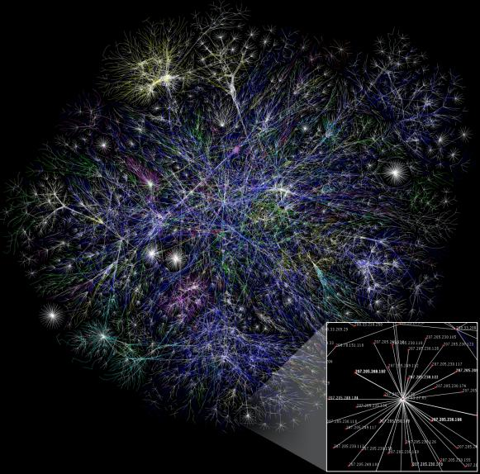
Other thing that has changed
Internet backbone

Slide 61

+ digital

Slide 62
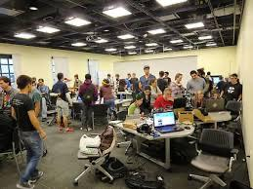

+ collaboration

Slide 63
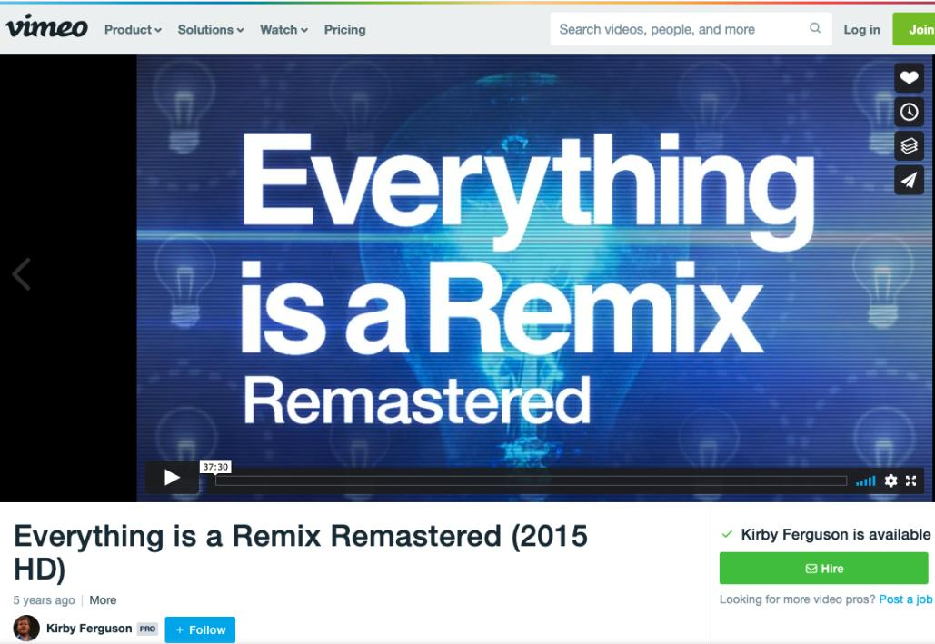
https://vimeo.com/139094998

Slide 64
Back to CCH on USERS’ RIGHTS
CCH Canadian et al v. LSUC (2004)
LSUC operates the Great Library. Within it is a custom photocopy service for lawyers who can’t make it to the Library. There is also a photocopy machine that the public can use. CCH Canadian (legal publisher) and others brought action against the LSUC for copyright infringement.

Slide 65
Users’ rights
Fair dealing in CCH:
An integral part of the Copyright Act - not just a defence
The fair dealing “exception”, like other exceptions in the Copyright Act, is a users’ right. In order to maintain the proper balance between the rights of a copyright owner and users’ interests, it must not be interpreted restrictively.
Always available. If other exceptions might also be available, argue fair dealing first, then turn to other exceptions and defences.
Two step process:
  1) Defence establishes the dealing was for one of the listed purposes.
  2) Defence establishes the dealing was fair.
Fair dealing category of research to be given a large and liberal interpretation in order to ensure users’ rights are not unduly constrained
Research is not limited to non-commercial or private contexts. Lawyers carrying on the business of law for profit are conducting research within the meaning of s. 29 of the Copyright Act.

Slide 66
Summary of CCH on USERS’ RIGHTS
CCH Canadian et al v. LSUC (SCC 2004)
  Fair dealing is an integral part of the Copyright Act
  Fair dealing is a users’ right; must not be interpreted restrictively
  Two step process: purpose; fairness analysis
  Categories must be given a large and liberal interpretation (i.e., research)

Slide 67
User rights: “Fair” in Fair Dealing
CCH Canadian et al v. LSUC (2004)
Whether something is fair is a question of fact and depends on the facts of each case.
Factors that can be considered to help assess whether a dealing is fair:
  Purpose of the dealing
  Character of the dealing
  Amount of the dealing
  Were there alternatives to the dealing?
  Nature of the work
  Effect of the dealing on the work

Slide 68
Purpose of the Dealing
Fair if for one of the allowable purposes under the Copyright Act
  S. 29 = research, private study, education, parody or satire
  S.29.1 = criticism or review
  S. 29.2 = news reporting
Some dealings may be more, or less, fair, than others - i.e., research for commercial purposes may not be as fair as research for charitable purposes

Slide 69
Character of the Dealing
How was the work dealt with? Multiple copies distributed, will tend towards being unfair, especially if more copies than necessary or otherwise gratuitous.
Single copy used for single legit purpose – easier to conclude it is fair.
Copies destroyed after use may also favour a finding of fairness.
Do consider customs, practices & norms in a particular industry or trade → However CBC v. SODRAC (SCC 2015) doesn’t – why not? CATEGORIES EXHAUSTIVE

Slide 70
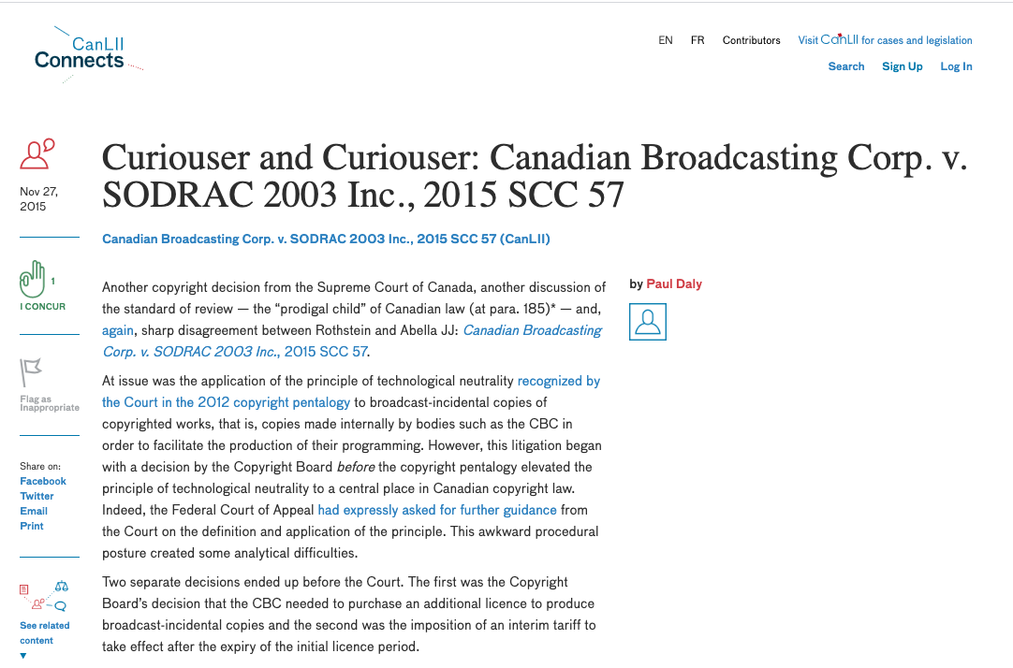
Criticism of Majority in CBC v. SODRAC not related to fair dealing

Slide 71
Amount of the Dealing
You can deal fairly with a whole work (i.e. photographs)
Amount taken may be more, or less, fair depending on the purpose - i.e. research, may be essential to copy an entire academic article

Slide 72
Alternatives to the Dealing
  Was there a non-copyrighted equivalent of the work that could have been used instead of the copyrighted work?
  Was the dealing reasonably necessary to achieve the ultimate purpose?
  Meaning not gratuitous.
  I.e., Would a criticism have been equally effective if it did not actually reproduce the copyrighted work it was criticizing? If yes, that weighs against a finding of fairness.

Slide 73
Nature of the Work
If a work is unpublished, dealing might actually be more fair because its reproduction could lead to a wider public dissemination for the work
Confidential work? May be unfair in the circumstances.

Slide 74
Effect of the dealing on the work
  Is the reproduced work likely to compete with the market of the original work?
  Not the only factor - not the most important factor - but can sometimes seem like the most important factor in the cases

Slide 75
Users’ rights
CCH Canadian et al v. LSUC (2004) Fair dealing applied: LSUC’s custom photocopying service
The law society can rely on its general practice to establish fair dealing; doesn’t have to provide evidence that every patron used the material provided for in a fair dealing manner
Purpose of the dealing:
  Custom photocopying service clearly for purposes of research, review, private study
  Retrieval, reproduction and photocopying of legal works are necessary and essential elements of the research process

Slide 76
Users’ rights
CCH Canadian et al v. LSUC (2004) Fair dealing applied: LSUC’s custom photocopying service
Dealings were fair
  Purpose of the dealing:
    Reasonable safeguards in Access Policy to ensure that materials are being used for research and private study
  Character of the dealing:
    Single copies of works provided; no evidence multiple copies provided to multiple members of public
  Amount of the dealing:
    Access Policy limits the amount to be copied

Slide 77
Users’ rights
CCH Canadian et al v. LSUC (2004) Fair dealing applied: LSUC’s custom photocopying service
Dealings were fair
  Alternatives of the dealing:
    No apparent alternatives
    Can’t reasonably expect constituency to research on-site at the Great Library
    Insufficient resources to satisfy demand if everyone were permitted to borrow materials
    Availability of licence irrelevant to deciding whether a dealing has been “fair”
  Nature of the work:
    In the public interest that access to judicial decisions and other legal resources not be unjustifiably restrained
  Effect of the dealing on the work:
    No evidence shown that the market for the publishers’ works had decreased as a result of copies being made under the custom photocopying service.

Slide 78
Users’ rights
SOCAN v. Bell (2012) - years later – What Is A “User’s Right”
Do iTunes previews constitute “fair dealing”?
If answer is no, those providing previews would be have to pay tariffs for each preview played as communication to the public by telecommunication
Note statements in paragraphs 8-10 regarding nature of copyright in Canada& significance of Théberge case
  Théberge: move away from author-centric approach to copyright
  Need to sensitively balance protection and access

Slide 79
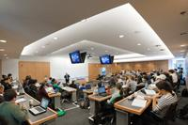
Next case: Imagine a classroom selfie

Slide 80
Users’ rights
Alberta (Education) v. Canadian Copyright Licensing Agency (Access Copyright) (2012)
Another “pentalogy” case
Main issue: Copies of works made at teachers’ initiatives with instructions to students that they read the material … fair dealing?
Category 4 of the proposed tariff dealt with copies of works made at the teachers’ initiative with instructions to students that they read the material. Teachers would photocopy short excerpts from textbooks and distribute those copies to students as a complement to the main textbook the students used.

Slide 81
Abella J.
“ The test for fair dealing was articulated in CCH as involving two steps. The first is to determine whether the dealing is for the allowable purpose of “research or private study” under s. 29 , “criticism or review” under s. 29.1 , or “news reporting” under s. 29.2 of the Act. The second step of CCH assesses whether the dealing is “fair”. The onus is on the person invoking “fair dealing” to satisfy all aspects of the test. To assist in determining whether the dealing is “fair”, this Court set out a number of fairness factors: the purpose, character, and amount of the dealing; the existence of any alternatives to the dealing; the nature of the work; and the effect of the dealing on the work.”

Slide 82
Abella J. understands pedagogy
[15] In my view, the key problem is in the way the Board approached the “purpose of the dealing” factor. The Board concluded that since the Category 4 copies were not made as a result of a student request, they were no longer for the purpose of research or private study at the second stage.
[23] In the case before us, however, there is no such separate purpose on the part of the teacher. Teachers have no ulterior motive when providing copies to students. Nor can teachers be characterized as having the completely separate purpose of “instruction”; they are there to facilitate the students’ research and private study. It seems to me to be axiomatic that most students lack the expertise to find or request the materials required for their own research and private study, and rely on the guidance of their teachers. They study what they are told to study, and the teacher’s purpose in providing copies is to enable the students to have the material they need for the purpose of studying. The teacher/copier therefore shares a symbiotic purpose with the student/user who is engaging in research or private study. Instruction and research/private study are, in the school context, tautological.

Slide 83
[27] With respect, the word “private” in “private study” should not be understood as requiring users to view copyrighted works in splendid isolation. Studying and learning are essentially personal endeavours, whether they are engaged in with others or in solitude. By focusing on the geography of classroom instruction rather than on the concept of studying, the Board again artificially separated the teachers’ instruction from the students’ studying.
[32] In my view, buying books for each student is not a realistic alternative to teachers copying short excerpts to supplement student textbooks. First, the schools have already purchased originals that are kept in the class or library, from which the teachers make copies. The teacher merely facilitates wider access to this limited number of texts by making copies available to all students who need them. In addition, purchasing a greater number of original textbooks to distribute to students is unreasonable in light of the Board’s finding that teachers only photocopy short excerpts to complement existing textbooks. Under the Board’s approach, schools would be required to buy sufficient copies for every student of every text, magazine and newspaper in Access Copyright’s repertoire that is relied on by a teacher. This is a demonstrably unrealistic outcome. Copying short excerpts, as a result, is reasonably necessary to achieve the ultimate purpose of the students’ research and private study.

Slide 84
PARODY

Slide 85
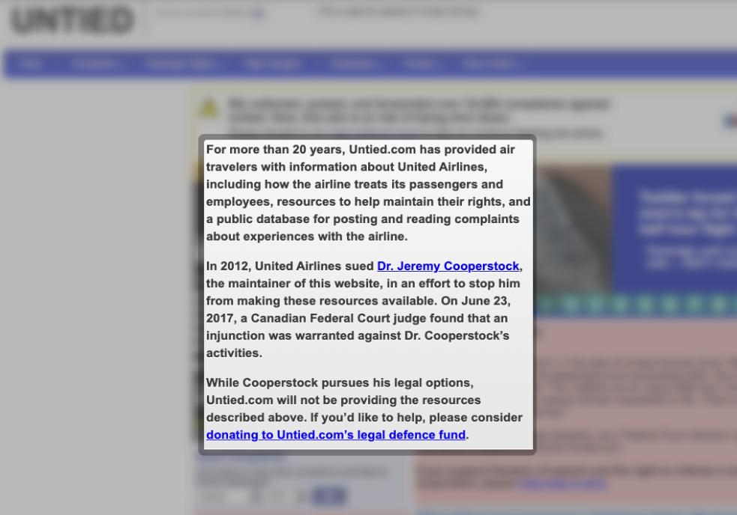

Slide 86
Users’ rights: later decisions create doubt
United Airlines, Inc. v. Cooperstock, 2017 FC 616
United Airlines is a commercial airline that operates in and out of Canada. United has used several trademarks in association with its services & also claims copyright in several logos and designs.
Dr. Jeremy Cooperstock had a negative experience with United. He was vocal about his complaints and disappointed with what he felt were inadequate responses.
Cooperstock launched a website called “Poor Show” that set out information about his experience and United’s responses.
This website resonated with many who provided information regarding their negative experiences with United.
Cooperstock posted this correspondence on his “Poor Show” website.
In 1997, he shifted this content to the website UNTIED.com.

Slide 87
Users’ rights
United Airlines, Inc. v. Cooperstock, 2017 FC 616
First case to define the fair dealing category of parody:
  Two basic elements to parody: the evocation of an existing work while exhibiting noticeable differences and the expression of mockery or humour
  Not required to identify source of work being parodied
  Parody does not require that the expression of mockery or humour to be directed at the exact thing being parodied

Slide 88
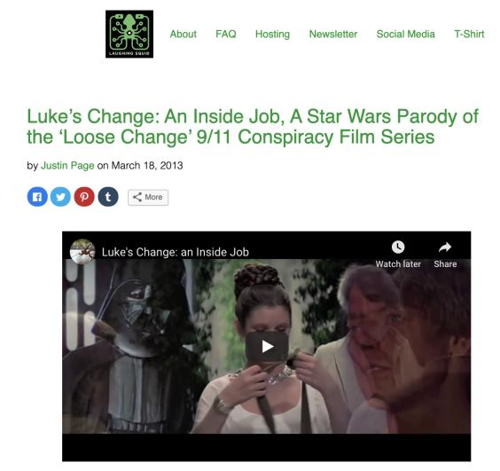
RE: Parody does not require that the expression of mockery or humour to be directed at the exact thing being parodied - CONSIDER…

Slide 89
Users’ rights: Parody found
United Airlines, Inc. v. Cooperstock, 2017 FC 616
Phelan J. relied on Deckmyn v. Vandersteen, a decision of the European Court of Justice, in defining parody for the purposes of the Canadian Copyright Act:
  [119] … Parody should be understood as having two basic elements: the evocation of an existing work while exhibiting noticeable differences and the expression of mockery or humour. I would also note that the fair dealing exception for the purpose of parody in s 29 of the Copyright Act does not require a user to identify the source of the work being parodied. In addition, in my view, parody does not require that the expression of mockery or humour to be directed at the exact thing being parodied. It is possible, for example, for a parody to evoke a work such as a logo while expressing mockery of the source company, or to evoke a well-known song while expressing mockery of another entity entirely.
  [120] In my view, UNTIED.com falls within the definition of parody described above: it evokes existing works (the United Website, the United Logo, and the Globe Design) while showing some differences (such as content and disclaimers), and it expresses mockery (and criticism) of the Plaintiff. Therefore, the first stage of the CCH test has been met in this case.

Slide 90
Users’ rights: Parody found BUT
United Airlines, Inc. v. Cooperstock, 2017 FC 616
Phelan J…
(3) Conclusion on Copyright Infringement
[141] Parody is not simply a defence to copyright infringement – it is also an aspect of free speech. However, like all free speech, it is not unrestricted. The Defendant’s website meets the first step of the CCH test, as it is for the allowable purpose of parody, but it does not meet the second step of the test. The questionable purpose of the dealing, amount of the dealing, and effect of the dealing all weigh in favour of the conclusion that this dealing is not fair.

Slide 91
1. “Questionable” purpose of the dealing
Court suggests “real purpose” was to defame or punish the Plaintiff, not to engage in parody. Suggested no humour to the site.
2. Amount of the dealing
Entirety of the home page of the United’s website was copied. Noted as well that consumers will usually have several interactions with digital platforms.
3. Effect of the dealing on the work
Suggested there was real ‘confusion’ caused by similarity between UNTIED.com & United Website??

Slide 92
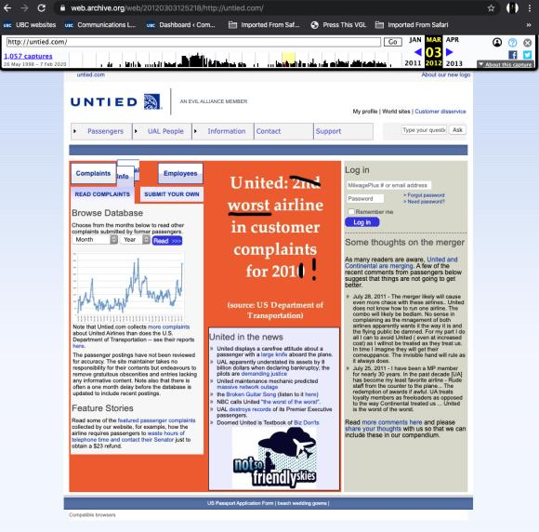
Site considered to be a parody, but not to be fair (fair dealing not made out)

Slide 93
Pause: Think about that….
Parody must be fair?
Conflating the fair in “fair use” with the category?
Does “Fair Education” make sense or “Fair Research”?
Thought Categories must be given a large and liberal interpretation per CCH v. LSUC
Look to “fair” in fair comment defamation defense → can’t be with malice, but otherwise fair
Should the motive matter to parody?????
Research with malice compared to the same research done the same way but without malice?????

Slide 94
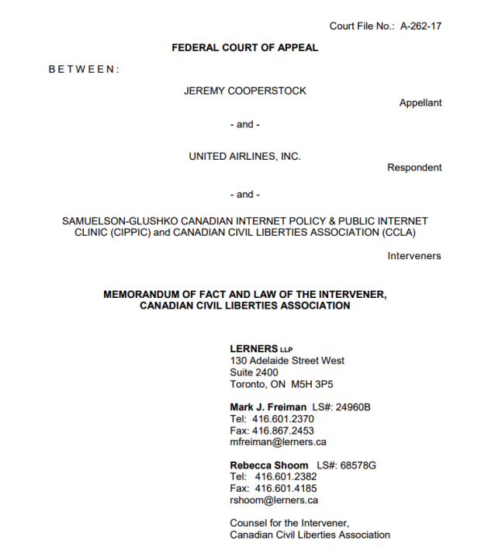
https://ccla.org/cclanewsite/wp-content/uploads/2018/07
/UA-v-Cooperstock-CCLA-Memo-of-Fact-Law-FINAL-July-3-2018.pdf

Slide 95
Users’ rights: another “at odds” case
The Canadian Copyright Licensing Agency v. York University, 2017 FC 669
Were York University’s Fair Dealing Guidelines fair?
Phelan J. concludes not
Is Phelan J.’s ruling consistent with the SCC’s fair dealing jurisprudence?

Slide 96
Not Phelan It J.
[28] A further and final factor of the fairness of the Guidelines is that York has made no real effort to review, audit, or enforce its own Guidelines. As became evident, educational efforts on setting their copyright rules are insufficient because there was no effective compliance mechanism. Even professors operating outside of the Guidelines are not held accountable. The complete abrogation of any meaningful effort to ensure compliance with the Guidelines – as if the Guidelines put copyright compliance on autopilot – underscores the unfairness of York’s Guidelines.

Slide 97
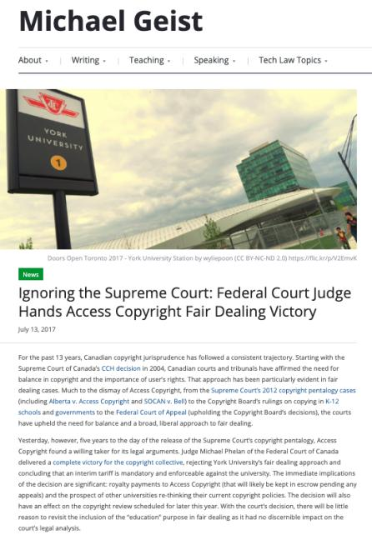
Significant Criticism…

Slide 98
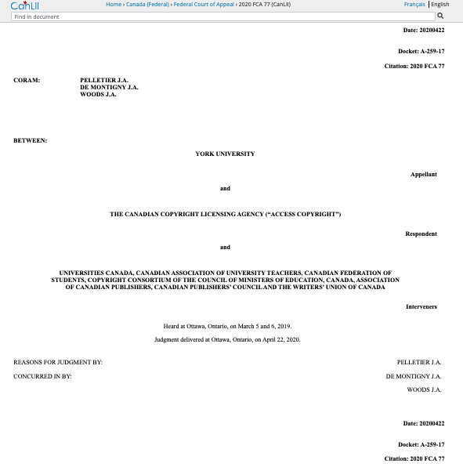
…Ignored (sort of) by…FCA
https://www.canlii.org/en/ca/fca/doc/2020/2020fca77/2020fca77.html

Slide 99
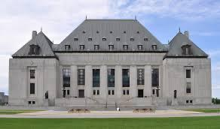
Coming up…S.C.C.

Slide 100
Users’ rights
Common carrier exception (s. 2.4(1)(b))
Applicable in the context of communication to the public by telecommunication
“Communication to the public by telecommunication
2.4 (1) For the purposes of communication to the public by telecommunication,
b) a person whose only act in respect of the communication of a work or other subject-matter to the public consists of providing the means of telecommunication necessary for another person to so communicate the work or other subject-matter does not communicate that work or other subject-matter to the public;…”

Slide 101
Policy behind s. 2.4(1)(b))
Historical question of whether internet service providers, as intermediaries, are participants in communicating some works to the public.
1988 amendments to the Copyright Act trying to clarify this point
The 1988 amendments specify participants in a telecommunication who provide “the means of telecommunication necessary”
Thus Intermediaries are deemed not to be communicators.

Slide 102
Policy behind s. 2.4(1)(b))
In part intermediaries are deemed not to be communicators to avoid unnecessary layering and possible effective duplication of copyright liability that would result from intermediary sales layers (“wholesalers”) also being liable for infringements.
Public policy decision to discourage lawsuits against intermediaries, encouraging them to expand and improve operations without the threat of infringement. Not doing so could chill growth in the communications sector where Canada (with some justification) has seen itself as a world leader.

Slide 103
In USA S.512 DMCA + S.230 Communications Decency Act
17 U.S. Code § 512.Limitations on liability relating to material online
(a)Transitory Digital Network Communications.—A service provider shall not be liable for monetary relief, or, except as provided in subsection (j), for injunctive or other equitable relief, for infringement of copyright by reason of the provider’s transmitting, routing, or providing connections for, material through a system or network controlled or operated by or for the service provider, or by reason of the intermediate and transient storage of that material in the course of such transmitting, routing, or providing connections, if—
(1)the transmission of the material was initiated by or at the direction of a person other than the service provider;
(2)the transmission, routing, provision of connections, or storage is carried out through an automatic technical process without selection of the material by the service provider;
(3)the service provider does not select the recipients of the material except as an automatic response to the request of another person;
(4)no copy of the material made by the service provider in the course of such intermediate or transient storage is maintained on the system or network in a manner ordinarily accessible to anyone other than anticipated recipients, and no such copy is maintained on the system or network in a manner ordinarily accessible to such anticipated recipients for a longer period than is reasonably necessary for the transmission, routing, or provision of connections; and
(5)the material is transmitted through the system or network without modification of its content.

Slide 104
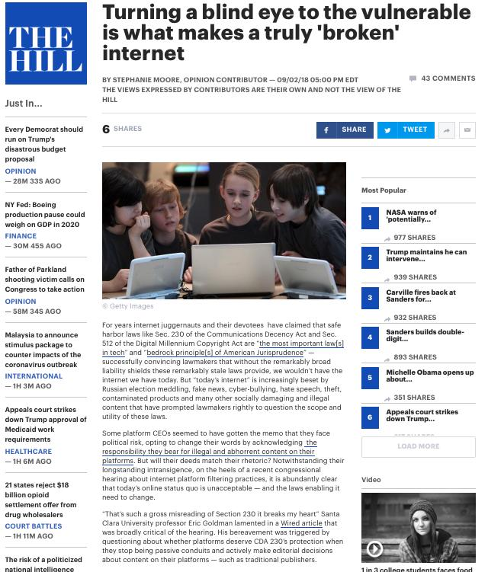

Slide 105
Users’ rights
Common carrier exception (s. 2.4(1)(b))
Bell Canada v. 1326030 Ontario Inc. (iTVBox.net)
2016 FC 612 affirmed 2017 FCA 55
Interlocutory Injunction application
“[8] The Plaintiffs specifically identified three types of pre-installed applications which they submit could be used to access copyrighted content:
A. KODI: with the proper add-on(s), the open-source media player KODI could be used to access online streaming websites;
B. Showbox: the media player software Showbox could be used to access online streaming websites and permanently download content such as television programming or motion pictures; and
C. Private IPTV Services: these are private Internet servers which re-transmit television broadcasts over the Internet, usually for a monthly fee.”

Slide 106
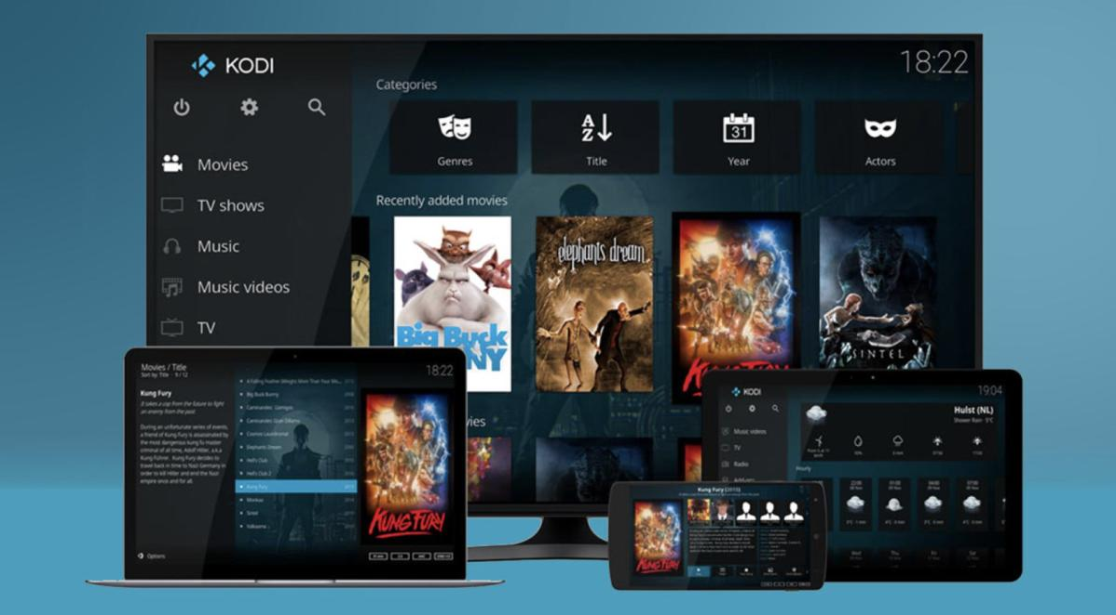

Slide 107
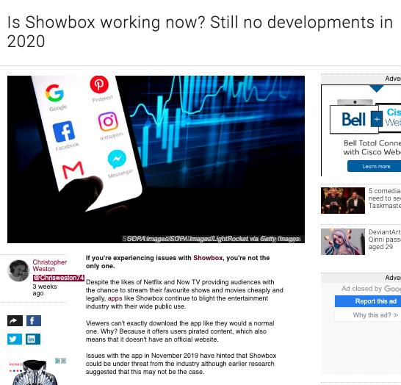
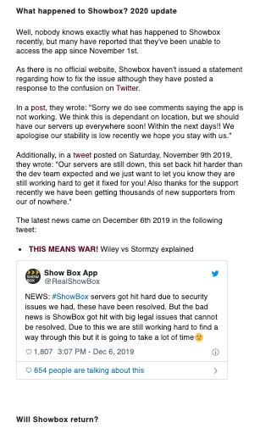

Slide 108
Should common carrier exception (s. 2.4(1)(b)) apply?
“[22] …This is not a case where the Defendants merely serve as the conduit, as was argued by Mr. Wesley. Rather, they deliberately encourage consumers and potential clients to circumvent authorized ways of accessing content – say, by a cable subscription or by streaming content from the Plaintiffs’ websites – both in the manner in which they promote their business, and by offering tutorials in how to add and use applications which rely on illegally obtained content. The statutory defence provided in paragraph 2.4(1)(b) of the Copyright Act does not apply to the Defendants who go above and beyond selling a simple “means of telecommunication”. They also engage in acts related to the content of the infringed communications (Society of Composers, Authors and Music Publishers of Canada v Canadian Assn of Internet Providers, 2004 SCC 45 at para 92). Consumers can consequently stream or download the Plaintiffs’ programs and store them on their device without authorization from the Plaintiffs. This constitutes prima facie copyright infringement pursuant to section 27 of the Copyright Act.”

Slide 109
N.B.: S. 31.1 Copyright Act (added to the Copyright Act, 2012 – complimentary to & broader than S. 2.4(1)(b)
While s. 2.4(1)(b) applies only to the right to communicate a work to the public, s. 31(2) right applies more broadly – to any rights that might have otherwise been infringed.

Slide 110
Users’ rights
1) Are there any defences not currently in the Copyright Act that you would like to see explicitly set out in the Act? Which ones and why?
2) Are there any defences currently in the Act that you feel are unnecessary or inappropriate, and that you would want to see removed? Which ones and why?

Slide 111
Appendices

Slide 112

Carpet Cosplay
Dragon Con Marriott hotel carpet
Copyright design

Slide 113
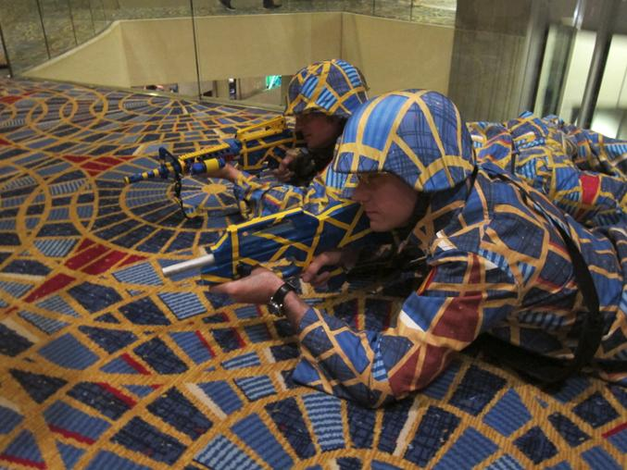

Slide 114
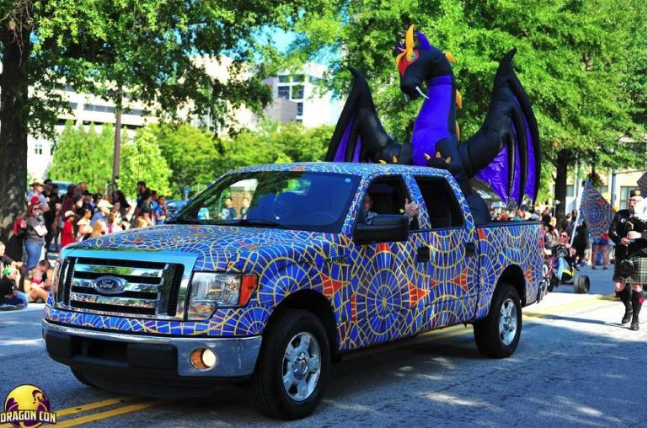

Slide 115
SCOTUS & Media Technology:
One Wedding & Two Funerals

Slide 116
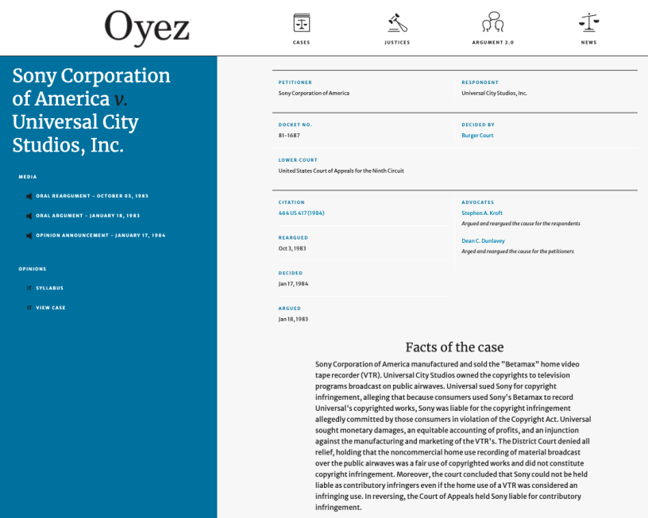
A time-shifted celebration…
https://www.oyez.org/cases/1982/81-1687

Slide 117
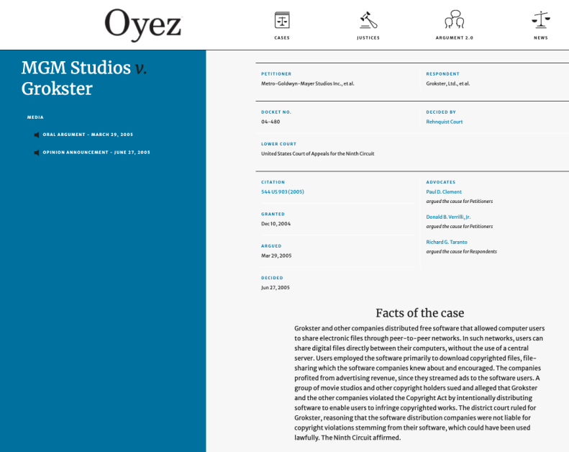
Killing peer-to-peer
https://www.oyez.org/cases/2004/04-480

Slide 118
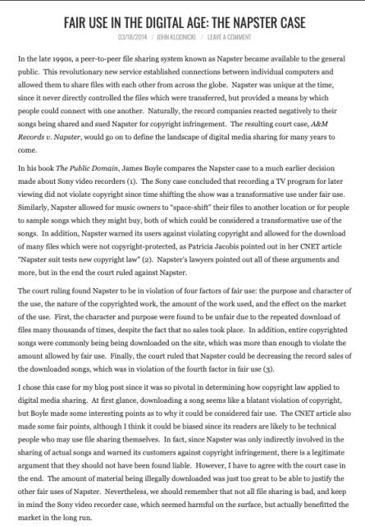
Preceded by Napster (not in SCOTUS)

Slide 119
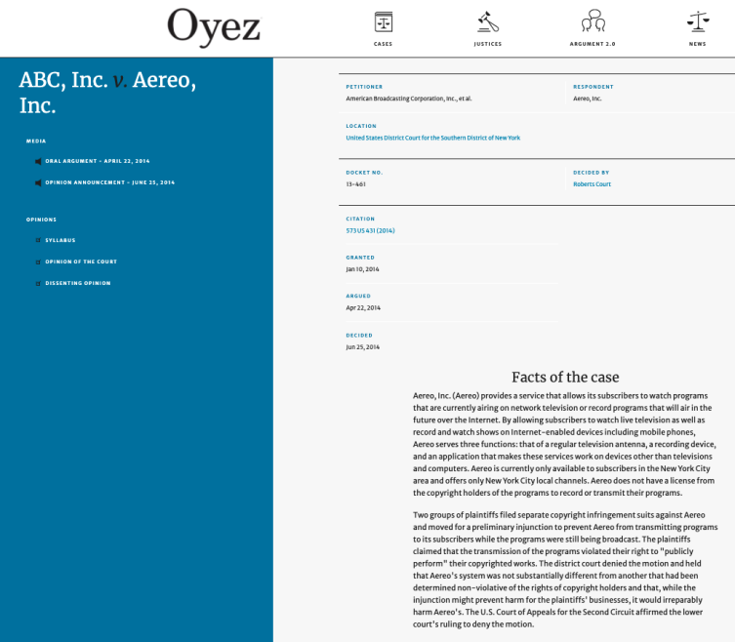
Another one bites the dust…
https://www.oyez.org/cases/2013/13-461

Slide 120
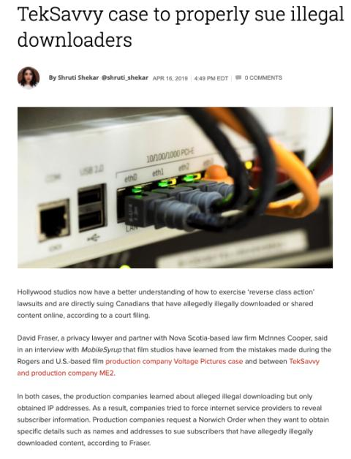
TekSavvy, Voltage, Rogers & downloaders…

Slide 121


Slide 122


Slide 123


Slide 124


Slide 125


Slide 126

Coming Soon
“Remedies”

Slide 127
SEE YOU NEXT WEEK!

Slide 128

Always include a cat picture

Slide 129
In learning you will teach
And in teaching you will learn
Phil Collins' Son of Man (1999)

Slide 130
Our Academic Partners

