Slide 1



The Rights of Copyright Owners
Week 3
LAW 424 002
Intellectual Property Law
Allard School of Law, UBC
Spring, 2021
Jon Festinger Q.C.
Centre for Digital Media
QMUL School of Law (CCLS)
Whiteboard Law
http://commlaw.allard.ubc
@jonfestinger
jon_festinger@thecdm.ca

Slide 2
Follow-up to
Last Week

Slide 3
Copyrighting Data?
Geophysical Service Incorporated v. Encana Corporation, 2016 ABQB 230
Indeed, it appears from the case that is not the raw data that is copyrightable as those would simply be facts, but how the data is presented.
  “[76] I find the seismic sections, i.e. the squiggly or zebra lines, fit within the definition of an artistic work, similar to a map, plan or chart, or a compilation of an artistic work, since the product is the result of selection or arrangement of the data, or sound recordings, from the geology of the subsurface.”
Do you agree? Alta. C.A. confirmed & SCC denied leave.

Slide 4

Pause

Slide 5
REVIEW OF WEEK 2
Overview of copyright
Definition of copyright
Purpose of copyright
Origins of copyright in Canada
Which level of government has legislative authority over copyright?

Slide 6
Copyright = set of exclusive rights in works of expression; performers’ performances; sound recordings; and communication signals.

Slide 7
Justifications For Copyright
Incentive
Labour
Personality
Protect human rights (& corresponding values – dignity, autonomy, etc.)
Apotheosis of free expression rights

Slide 8
Theberge:
Balance between promoting the public interest in the encouragement and dissemination of works of the arts and intellect and obtaining a just reward for the creator
Refined by Cinar Corp. v. Robinson:
Copyright act rewards creators in order to incentivize the creation of new works

Slide 9
Origins of copyright in Canada:
UK – utilitarian system – copyright system exists in order to encourage the creation of new works
France – natural rights system – copyright rewards, protects authors

Slide 10
Government authority
Federal government per 91(23), Constitution Act 1867
Current Copyright Act significantly amended in 2012 - Bill C-11
Ongoing process of reform…
No common law of copyright: Copyright is wholly statutory.

Slide 11
Subsistence of copyright: S.5
5 (1) Subject to this Act, copyright shall subsist in Canada, for the term hereinafter mentioned, in every original literary, dramatic, musical and artistic work if any one of the following conditions is met:
(a) in the case of any work, whether published or unpublished, including a cinematographic work, the author was, at the date of the making of the work, a citizen or subject of, or a person ordinarily resident in, a treaty country;
(b) in the case of a cinematographic work, whether published or unpublished, the maker, at the date of the making of the cinematographic work,
  (i) if a corporation, had its headquarters in a treaty country, or
  (ii) if a natural person, was a citizen or subject of, or a person ordinarily resident in, a treaty country; or
(c) in the case of a published work, including a cinematographic work,
  (i) in relation to subparagraph 2.2(1)(a)(i), the first publication in such a quantity as to satisfy the reasonable demands of the public, having regard to the nature of the work, occurred in a treaty country, or
  (ii) in relation to subparagraph 2.2(1)(a)(ii) or (iii), the first publication occurred in a treaty country.

Slide 12
Subsistence of copyright: Recap
Citizenship/subject/residence requirements
Registration is not a condition of subsistence of copyright
Talked about the fixation requirement – which is a requirement imposed by judicial interpretation (Canadian Admiral Corp. v. Rediffusion Inc., 1954)

Slide 13
REVIEW: What is copyrightable?
Facts and ideas
  Not entitled to copyright protection
  Kenrick & Co. v. Lawrence & Co. (1890)
    How is idea separated from expression in this decision?

Slide 14
IDEA/EPRESSION
DICHOTOMY

Slide 15
What is copyrightable?
Plaintiff printers drew a representation of hand holding a pencil completing a cross in a box as a method to instruct voters who couldn’t read on how to exercise their democratic franchise.
Plaintiffs duly registered their drawing under the copyright laws of the time.
Defendants created a similar but not identical drawing for the same purpose and were sued by the plaintiffs for infringement.
The plaintiffs action failed.

Slide 16
“It seems to me, therefore, that although every drawing of whatever kind may be entitled to registration, the degree and kind of protection given must vary greatly with the character of the drawing, and that with such a drawing as we are dealing with the copyright must be confined to that which is special to the individual drawing over and above the idea...there are scarcely more ways that one of drawing a pencil or the hand that holds it. If the particular arrangement of square, cross, hand, or pencil be relied upon it is nothing more than a claim of copyright for the subject, which in my opinion cannot possibly be supported.”

Slide 17
REVIEW: What is copyrightable?
  University of London Press, Ltd. v. University Tutorial Press, Ltd. [1916] 2 Ch. 601
  Literary merit and quality are not factors when assessing if something is a literary work

Slide 18
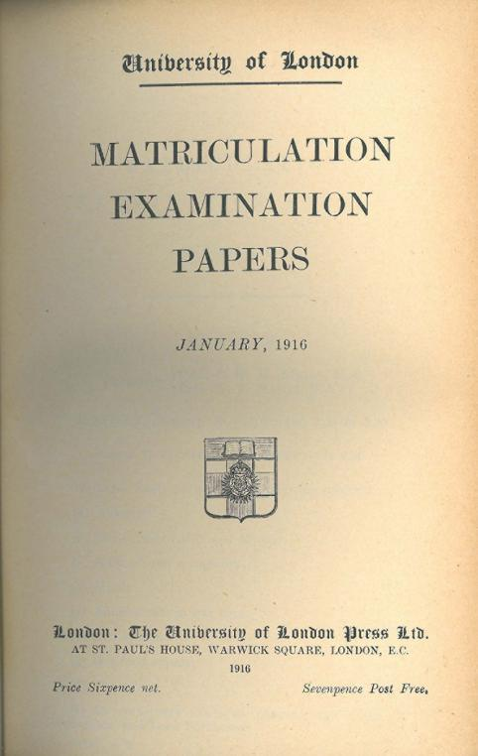
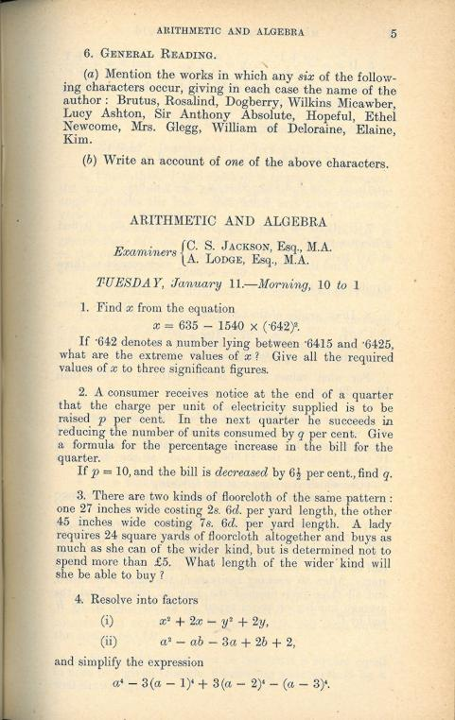

Slide 19
Peterson J. “Assuming that they are ``literary work'’, the question then is whether they are original…Copyright Acts are not concerned with the originality of ideas, but with the expression of thought, and, in the case of ``literary work'’, with the expression of thought in print or writing…In the present case it was not suggested that any of the papers were copied… If an author, for purposes of copyright, must not draw on the stock of knowledge which is common to himself and others who are students of the same branch of learning, only those historians who discovered fresh historical facts could acquire copyright for their works…The objections with which I have dealt do not appear to me to have any substance, and, after all, there remains the rough practical test that what is worth copying is prima facie worth protecting. In my judgment, then, the papers set by Professor Lodge and Mr. Jackson are "original literary work" and proper subject for copyright under the Act of 1911.”

Slide 20
Review
Works:
Dramatic:
  Definition: story, thread of consecutively related events (etc.); including … (see s. 2)
  No copyright in playing of a sports game; sports move
& including (set out in s. 2 of the Copyright Act):
  (a) any piece for recitation, choreographic work or mime, the scenic arrangement or acting form of which is fixed in writing or otherwise,
  (b) any cinematographic work, and
  (c) any compilation of dramatic works

Slide 21
Review
Works:
Literary:
  Work expressed in print or writing; some works are too short to be copyrightable works (Exxon); no separate copyright in the title of a work (but see s. 2) – Public policy why? Any analogy to A.I. as author questions?
Dramatic:
  Definition: story, thread of consecutively related events (etc.); including … (see s. 2)
  No copyright in playing of a sports game; sports move

Slide 22
Review
Works:
Artistic:
  Works that find expression in a visual medium
Musical works
  Any work of music or musical composition, with or without words, and includes any compilation thereof (s. 2)

Slide 23
Pause

Slide 24
A.I.I.P.

Slide 25
Broadly, three sperate questions
Can an A.I. independently own I.P. it has created? This is effectively a “Robot’s Rights” issue and is for practical purposes remote from this course.
Does a work built or created by an A.I./Robot qualify for copyright or patent protection? This very much a live issue being debated in various jurisdictions.
What are the practical risks of A.I./Robot creation (which due to computational power can generate almost unlimited permutations very efficiently) on I.P. Law, if any?

Slide 26
A.I. & Copyright
In CCH Canadian Ltd. v. Law Society of Upper Canada, 2004 SCC 13 McLachlin C.J. speaking to the standard of originality required for copyright stated:
  ”I conclude that the correct position falls between these extremes. For a work to be “original” within the meaning of the Copyright Act , it must be more than a mere copy of another work. At the same time, it need not be creative, in the sense of being novel or unique. What is required to attract copyright protection in the expression of an idea is an exercise of skill and judgment… This exercise of skill and judgment will necessarily involve intellectual effort.”
Query: Is any A.I. capable of judgment or intellectual effort or just their metaphorical cousin prediction?

Slide 27
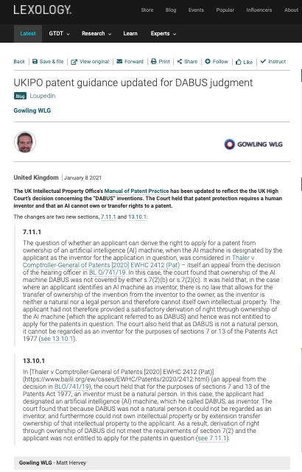

Slide 28
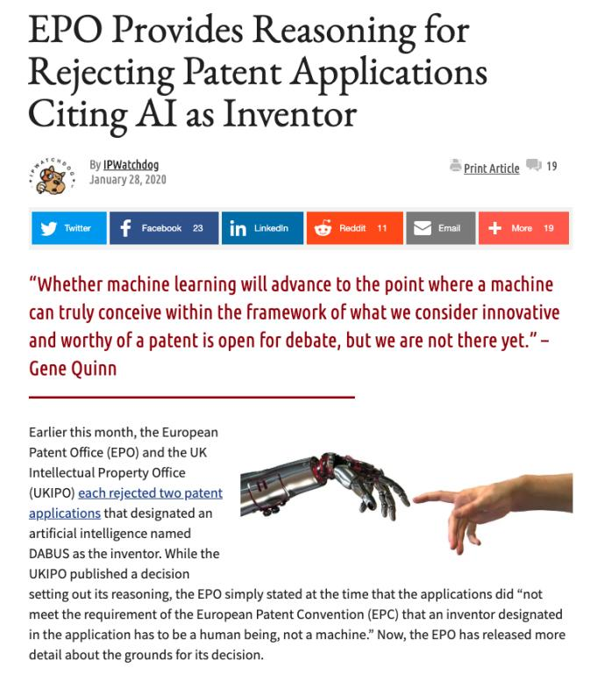

Slide 29
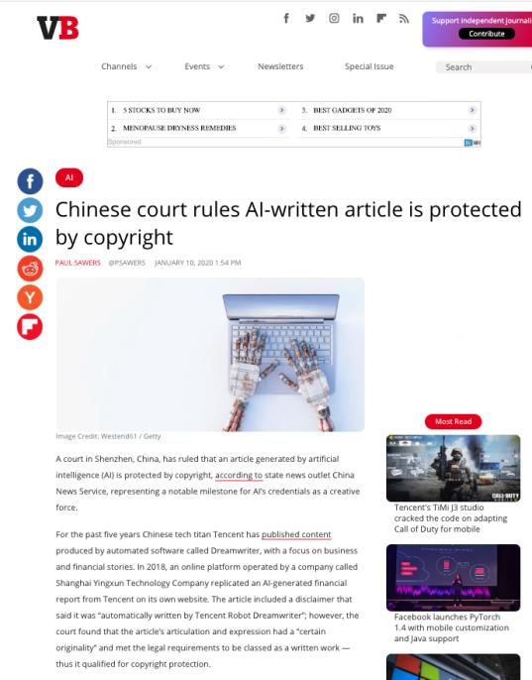
Question is: “Can Tencent have a copyright in works generated by it’s A.I.?”

Slide 30
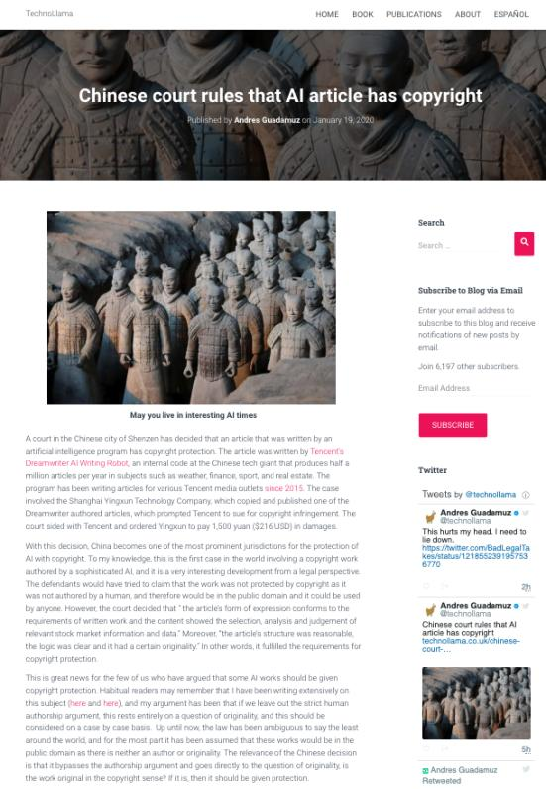

Slide 31
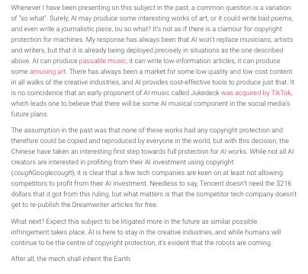

Slide 32


Slide 33
“The universe (which others call the Library) is composed of an indefinite and perhaps infinite number of hexagonal galleries, with vast air shafts between, surrounded by very low railings. From any of the hexagons one can see, interminably, the upper and lower floors. The distribution of the galleries is invariable.”

Slide 34
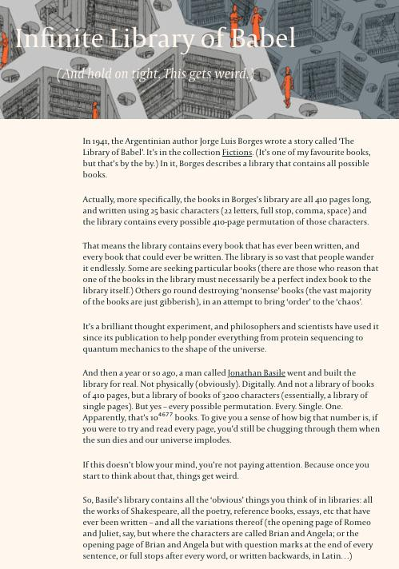

Slide 35
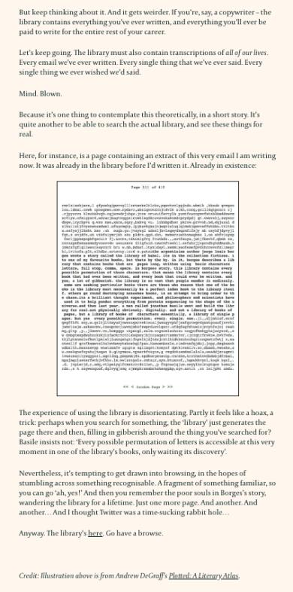

Slide 36
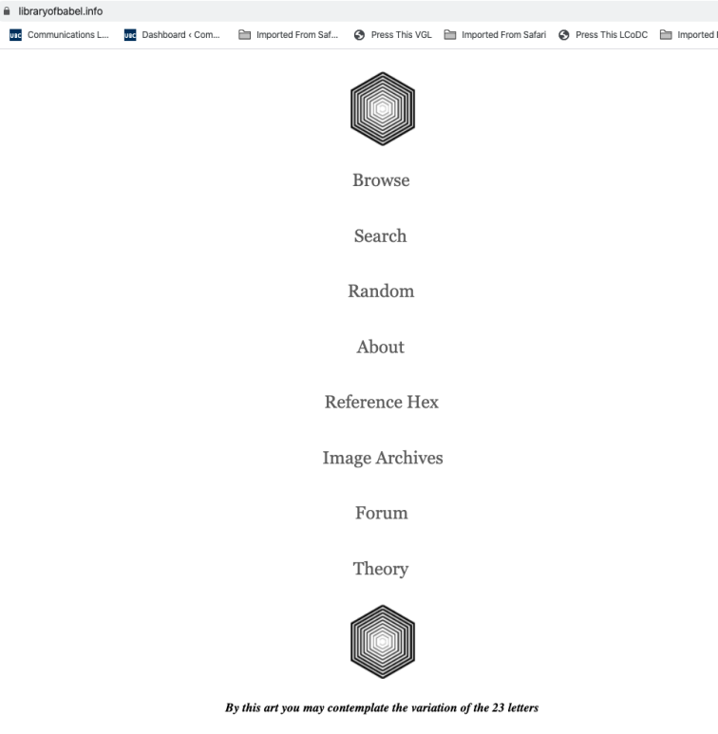

Slide 37
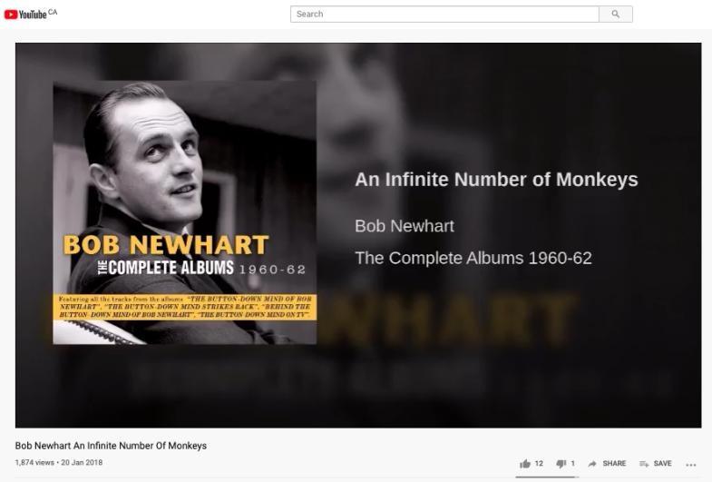
https://youtu.be/YGdMTLgU4hE

Slide 38
Monopoly in I.P. (especially in patents, particularly in drug patents) is a “thing”.
What of monopoly in I.P. through A.I. (Artificial Intelligence)?

Slide 39
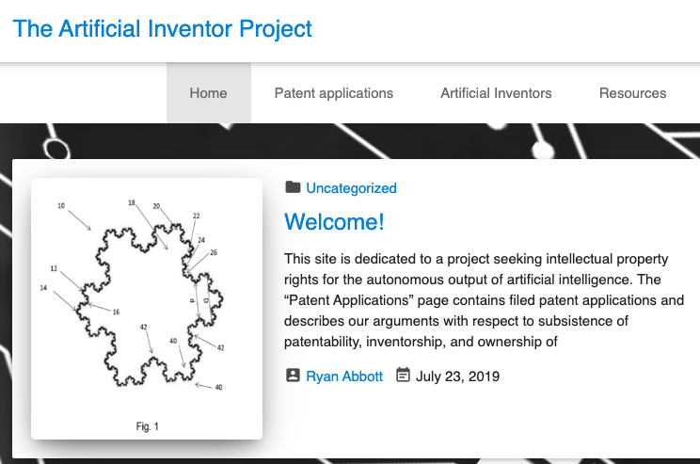

Slide 40
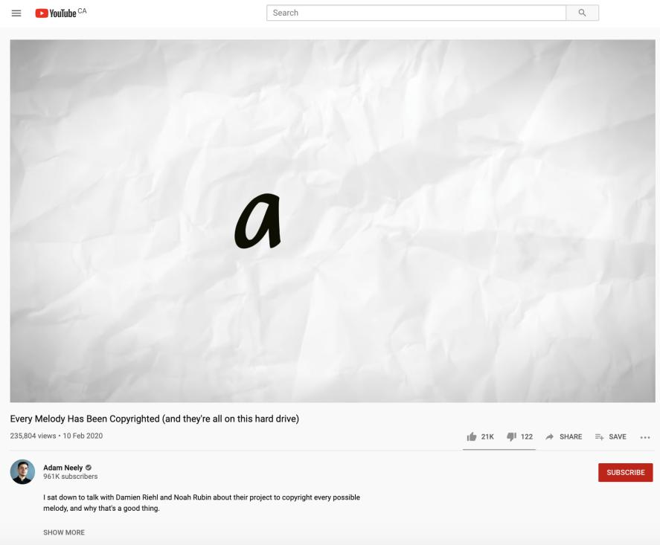

Slide 41
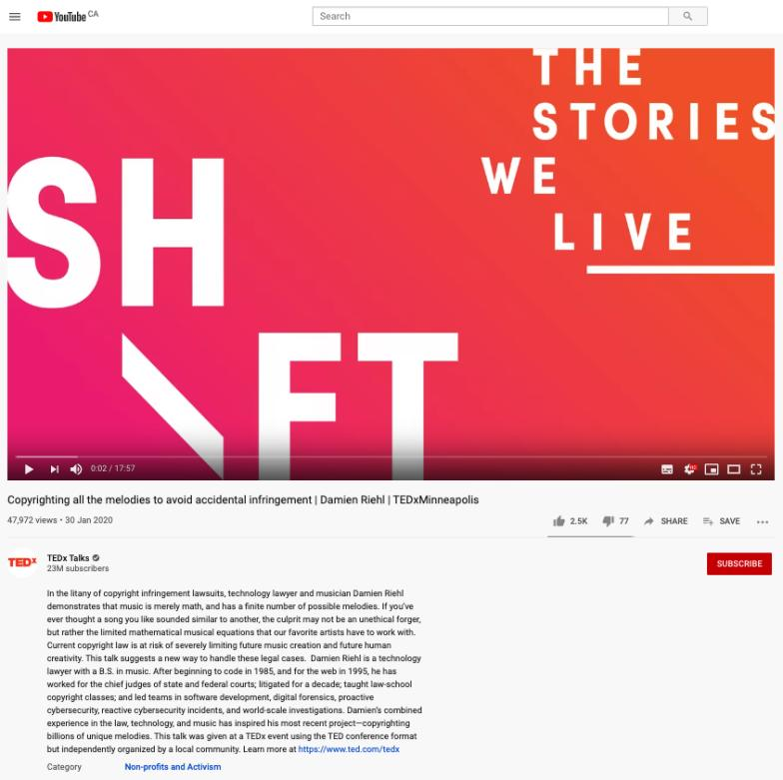

Slide 42
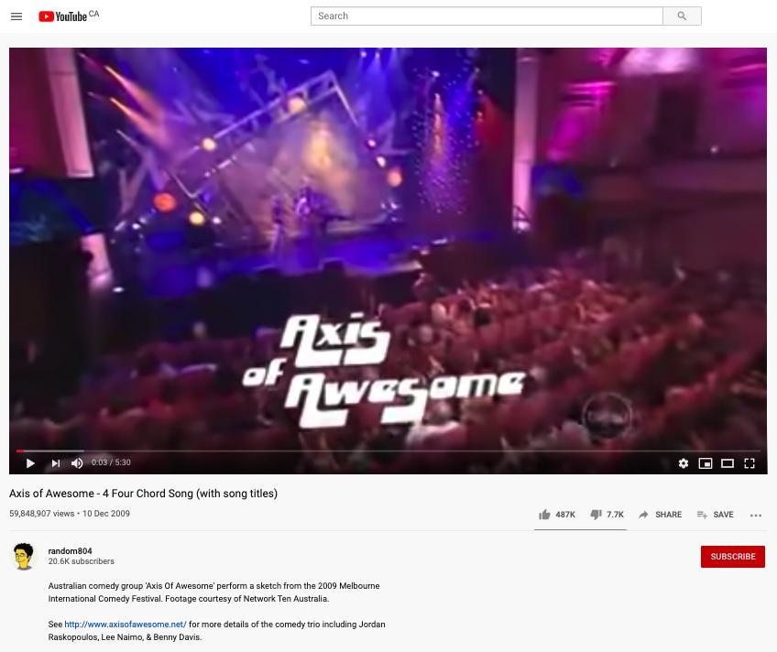

Slide 43
Solution?...
Doctrine of Independent Creation
To show infringement of copyright two elements must be present:
there must be sufficient objective similarity between the infringing work and the copyright work (or a substantial part of it).
the copyright work must be the source from which the infringing work was derived. Independent creation is a defence so long as there was no access to the copyright work or copying.

Slide 44
Pause

Slide 45
TODAY…
Rights of the copyright owner

Slide 46
Rights of the copyright owner
What rights should copyright owners have with respect to copyrighted works?

Slide 47
?

Slide 48
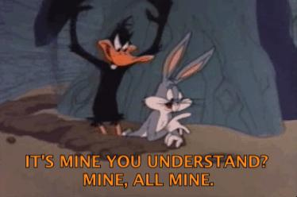
Proper mindset to approach from?

Slide 49
Rights of the copyright owner
Three fundamental rights:
Produce or reproduce the work (3(1))
Perform the work (including broadcasting rights) (3(1))
The right to publish (3(1))

Slide 50
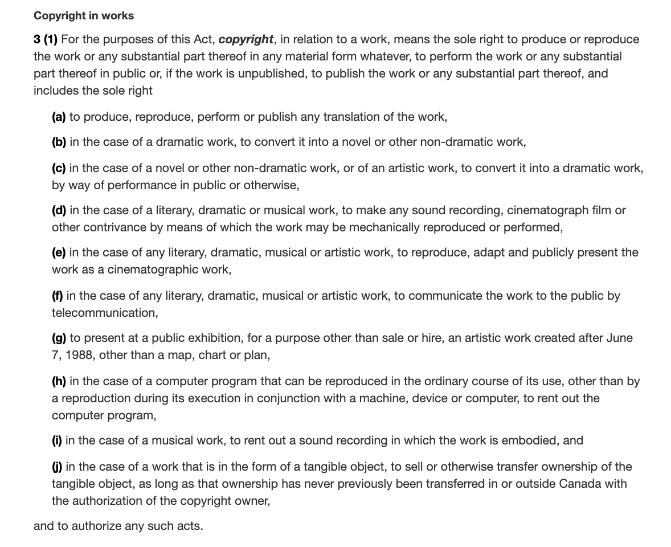

Slide 51
Rights of the copyright owner
Produce … any translation (3(1)(a))
Convert dramatic work into non-dramatic work (3(1)(b)
Convert non-dramatic work into dramatic work (3(1)(c))
To make a sound recording, etc. of a literary, etc. work (3(1)(d))
Reproduce, etc. a literary, etc. work as a cinematographic work (3(1)(e))
Communicate a work to the public by telecommunication (3(1)(f))
Present an artistic work at a public exhibition…. (3(1)(g))
Rent out a computer program, etc. (3(1)(h))
Rent out a sound recording of a musical work … (3(1)(i))
Sell or transfer ownership of tangible object … (3(1)(j)
Authorize any of above acts (3(1))

Slide 52
Anything missing?
Anything you would like to get rid of?

Slide 53
Derivative Rights

Slide 54
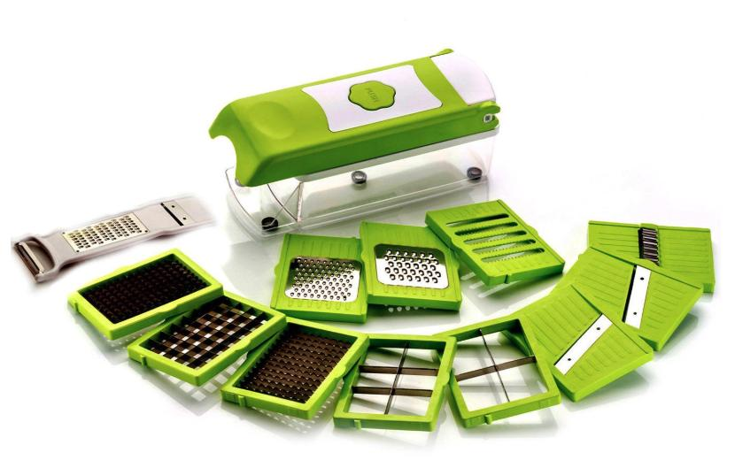
15 in One Slicer & Dicer

Slide 55
Rights of the copyright owner
For how long should these rights last?
What should be the term of copyright?

Slide 56
Options:
1. The Statute of Anne 1710 (UK) gave a limited term of protection to works of 28 years.
2. The Copyright Act 1842 (UK), for which a number of prominent authors lobbied, increased the term of protection to 42 years from publication, or seven years beyond the death of the author, whichever was the longer.
3. Berne Convention – life of the author plus 50 years.
4. USA approach: life of the author plus 70 years.
5. Renewable every 20 years (infinitely).
6. Renewable every 20 years (to a maximum).
7. Perpetual.

Slide 57
Rights of the copyright owner
Term of copyright in Canada (ss. 6-12)
General = Life of the author + 50 years from the end of the calendar year in which the author dies (s. 6)
Joint ownership?
  50 years runs from the end of the calendar year in which the last of the authors dies (s. 9)

Slide 58
Caveat:
New Canada–United States–Mexico Agreement (CUSMA)
CUSMA came into force July 1, 2020. Under CUSMA, copyright terms have been amended.
Canada has 2.5 years to revise legislation (the Copyright Act) to state the following:
  there is a general term of copyright protection of “life plus 70 years” for written works (increased from the current 50 years), and
  75 years for performances and sound recordings (increased from the current 70 years)

Slide 59
Rights of the copyright owner
Term of copyright in Canada (ss. 6-12)
Anonymous or pseudonymous works
  50 years from end of the year in which the work was published; or 75 years from the end of the year in which it was made (whichever ends earlier) (s. 6.1)
Crown
  50 years from end of the calendar year in which the work is first published (s. 12)
*NB: US-Mexico-Canada Free Trade Agreement, once ratified, will extend term of copyright – IE life plus 70

Slide 60
Crown need not keep track of the life spans of its employees in order to determine when copyright in any particular work expires.
Compare this to works created in the course of employment where employer owns copyright, but the term is the life of the author (or longest-living author in cases of multiple authorship) plus 50 years.

Slide 61
Rights of the copyright owner
Who owns the rights? (ss. 13, 14)
s. 13(1): the author is the first owner of copyright
s. 13(3): employment exception
“13(3) Where the author of a work was in the employment of some other person under a contract of service or apprenticeship and the work was made in the course of his employment by that person, the person by whom the author was employed shall, in the absence of any agreement to the contrary, be the first owner of the copyright, but where the work is an article or other contribution to a newspaper, magazine or similar periodical, there shall, in the absence of any agreement to the contrary, be deemed to be reserved to the author a right to restrain the publication of the work, otherwise than as part of a newspaper, magazine or similar periodical”

Slide 62
Rights of the copyright owner
Employee or contractor?
Factors to consider: Who owns the tools; control or direction (relationship of subordination); whether the author assumes all or part of the business risk; degree of integration of the author into the business of the employer (Amusements Wiltron Inc. v. Mainville (1991) RJQ 1930, 40 CPR 3d 521 (Que SC))
Work performed in the course of employment?

Slide 63
Consultant/Independent Contractor
If as an independent contractor you are paid to develop a product, you as independent contractor remain the proprietor of the copyright on that work.
The person paying for the service (client) obtains a license to use the copyrighted work, unless the first copyright owner transfers her rights in writing.

Slide 64
Amusements Wiltron Inc. v. Mainville (1991) RJQ 1930, 40 CPR 3d 521 (Que SC)
Courts apply similar criteria for distinguishing employees from independent contractors in the copyright context as they do for other areas of law (e.g. tax law)
In the copyright context, courts normally consider four factors to determine whether someone is an employee or an independent contractor:
  (1) ownership of the tools,
  (2) control or direction (relationship of subordination),
  (3) whether the author assumes all or part of the business risk (loss of profit), and
  (4) the degree of integration of the author into the business of the employer

Slide 65
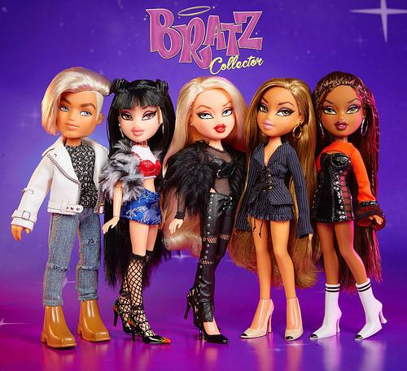
Mattel v. MGA (Bratz dolls)

Slide 66
Whether Bratz dolls creator Carter Bryant came up with the idea while he was working for Mattel.
Mattel had claimed that the name and design of Bratz dolls were based on drawings done by Carter Bryant while he was under a contract that entitled the world's biggest toymaker to the copyright in his designs.
(Legal dispute launched in 2006…wrapped up in 2013…Bratz dolls back on shelves in 2015).

Slide 67
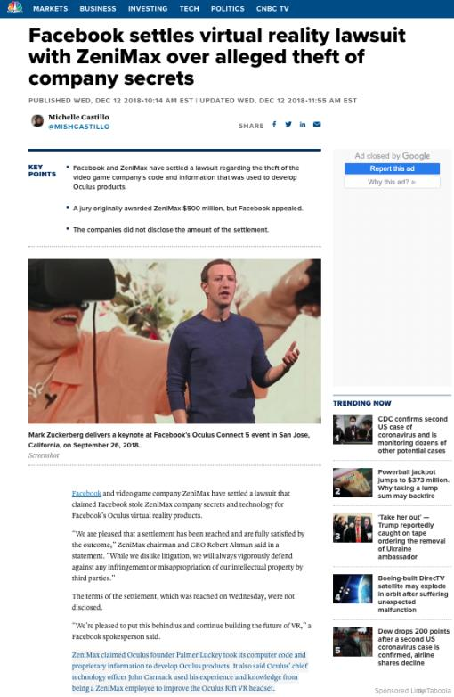

Slide 68
Rights of the copyright owner
Who owns the rights? (ss. 13, 14)
ss. 13(4): assignments; licenses
Assignment…parties can assign all or part of the rights in a work; can licence uses of the work; can do so either for the whole term of the copyright, or for a shorter period.

Slide 69
15 in One Slicer & Dicer

Slide 70
Rights of the copyright owner
Who owns the rights? (ss. 13, 14)
ss. 13(4), 13(7): assignments, exclusive licences need to be in writing; non-exclusive licences don’t need to be in writing (Robertson v. Thomson)
Benefit of copyright registration: If an assignment or licence not registered, and the assignor or licensor subsequently assigns or licences the copyright interest – for valuable consideration – to a different assignee or licensee who didn’t have ACTUAL NOTICE of the prior assignment – the prior assignment/licence can be declared void (57(3)). So, if you’re an assignee, licensee – it is to your benefit to register the assignment of copyright or the licence granting you an interest (57(1)).

Slide 71
Rights of the copyright owner
Who owns the rights? (ss. 13, 14)
s. 14: reversionary interest - where an author has been the first owner of copyright in a work, even though they’ve transferred that interest during their lifetime, the copyright interest will revert to the author’s estate 25 years after the death of the author.

Slide 72
s. 14: Reversionary Interest (con’d)
copyright interest will revert to the author’s estate 25 years after the death of the author.
Surprising lack of Canadian cases
Note following slides asking that the right continue and providing reasons.

Slide 73
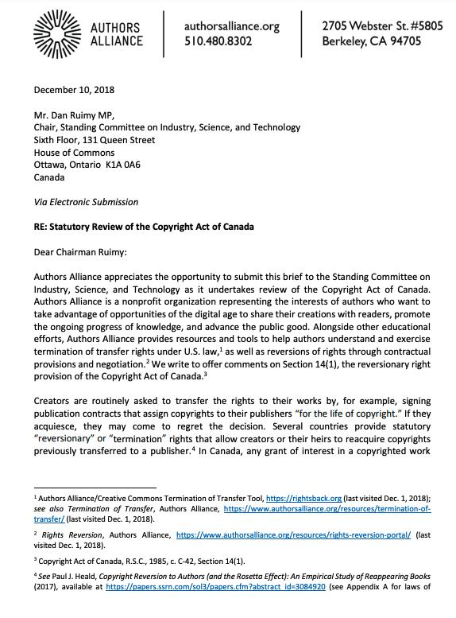

Slide 74
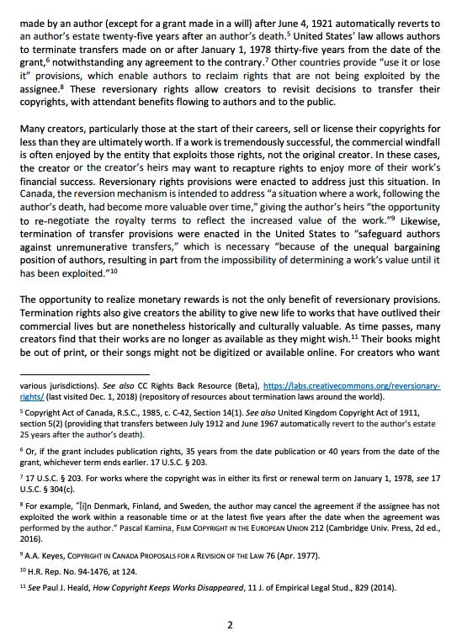

Slide 75
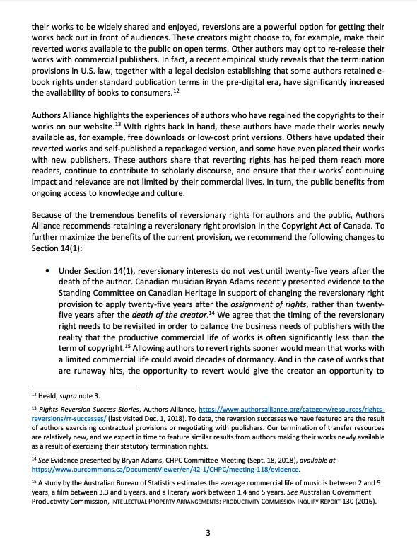

Slide 76
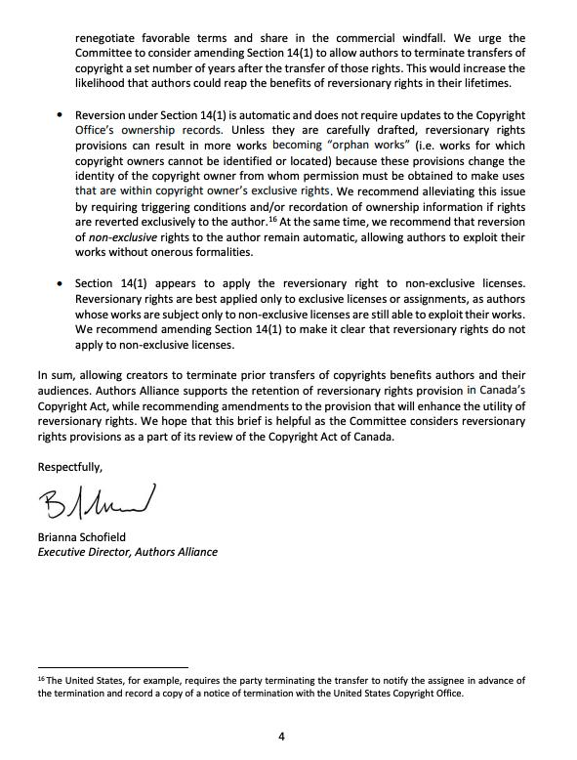

Slide 77
Pause

Slide 78


Slide 79
NOW WE COMPLETE…
Rights of the copyright owner

Slide 80
Rights of the copyright owner
Reproduction
Apple Computer Inc. v. Mackintosh Computers Ltd. (In Théberge)
  Opening words in s. 3 purposely drafted broadly enough to encompass new technologies which had not been thought of when the act was drafted
  Copy does not need to be in human readable form in order to be covered by copyright (must have readability)
  Copy of a copy is still a copy

Slide 81
The Defendants argued that the copyright protection that the Plaintiff Apple had in their computer programs did not extend to a computer program when embodied in a chip:
Hexidecimal code version of the program is not a translation of the source code version.
Since there is a one-to-one relationship between the source program and its embodiment in the chip, there is a merger of the idea/expression of the idea which copyright doesn’t cover
The Copyright Act doesn’t cover computer programs in their chip form
Compelling policy arguments for refusing to extend copyright protection in the present case (restrictions on commerce, possible overlap with patent law)

Slide 82
Court found for Apple; Found flexibility in the Act
Key wording to start from … s. 3: Copyright means the sole right to produce or reproduce the work or any substantial part thereof in any material form whatever.
Court looked to legislative history…
In the 1842 UK Copyright Act (which also applied in Canada), the analogous provision read as follows: ‘Copyright’ shall be construed to mean the sole and exclusive liberty of printing or otherwise multiplying copies of any … ‘book’.
Book = every volume, part or division of a volume, sheet of letter press, sheet of music, map, chart, or plan
This section was considered in 1899 in one of the earliest cases to question the suitability of Copyright Acts in the face of technological change …What was the technology in question? [A: Player piano]

Slide 83
Were piano rolls – perforated sheets created for use in player pianos – covered by the 1842 act?
No …‘Copyright’ shall be construed to mean the sole and exclusive liberty of printing or otherwise multiplying copies of any … ‘book’.
So, the Act was amended in 1911…Copyright means the right to produce and reproduce the work...in any material form whatsoever … (Also clarified that copyright shall subsist in records, perforated rolls, and other contrivances by means of which sounds may be mechanically reproduced).
Reed J agreed – In light of this discussion of the legislative history of this provision, that these opening words were purposely drafted broadly enough to encompass new technologies which had not been thought of when the Act was drafted
Also, the 1911 amendments did away with any requirement that in order to be covered by copyright the copy or reproduction of the work had to be in a human readable form
And that the 1911 amendments did away with any rule which would deny copyright protection to a work just because the copy could be characterized as being part of a machine (IE piano rolls)

Slide 84
All there has to be is:
Readability - a method by which the work in which copyright is claimed and the work which is alleged to infringe can be visually compared for the purpose of determining whether copying occurred. IE - for computer programs - print out, other documentary evidence
Another important point from this case: “A copy of a reproduction which reproduction exists in a different material form from the original is still an infringement of copyright in the original”
Prof Vaver phrases this as – a copy of a copy is still a copy.
So…the programs embodied in the chips were protected under the Copyright Act; and the Apple’s copyright was infringed….

Slide 85
Rights of the copyright owner
Reproduction
Théberge v. Galerie d’Art du Petit Champlain
Galerie d’Art purchased lawfully reproduced posters of Theberge’s paintings and used a chemical process that allowed them to lift the ink layer from the paper (leaving it blank) and to display it on canvas.
No additional copies yielded
Canvas painting more valuable than on paper

Slide 86
Rights of the copyright owner
Reproduction
Théberge v. Galerie d’Art du Petit Champlain
  Majority (Binnie J.): to have a reproduction, you need an increase in the number of copies. Could have prevented by contract. Moral rights remedy is not economic/financial.
  Dissent (Gonthier J.): all reproduction requires is re-fixation
  Whose reasoning is more persuasive? How would you have decided this case?

Slide 87
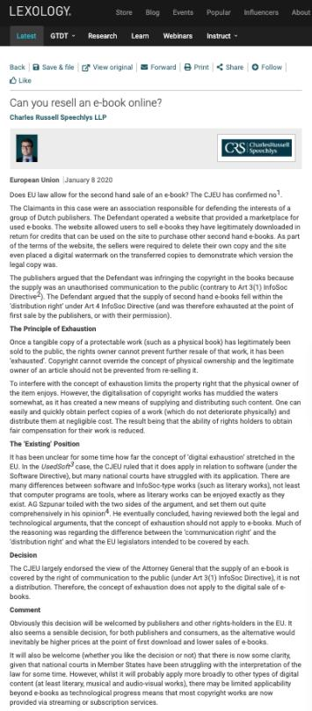

Slide 88
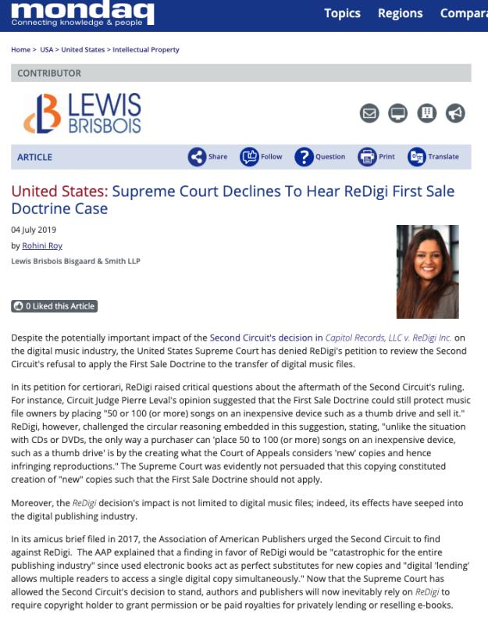

Slide 89
Rights of the copyright owner: CBC v. SODRAC 2003 Inc.
Reproduction of “broadcast incidental copies” - FACTS
“[9] A producer who wishes to use a musical work in an audiovisual program must incorporate that work into the production copy of the program, a process known in the industry as “synchronization.” … Once the synchronization process is complete, the final product is referred to as a “master” copy.…
[10] Once CBC is in possession of the master copy of a program, … the master copy is loaded into CBC’s digital content management system.… Digital systems generally involve the storage of copies as electronic files on hard drives. … CBC makes use of its digital content management system to perform a number of functions that help prepare a program for broadcast.
[11] These processes result in the creation of several copies, … [referred to by the parties] as “broadcast-incidental copies.” Broadcast-incidental copies may be made for several purposes[, including] to reformat the master copy to suit CBC’s technical requirements, or to edit the copy for timing, language or closed captioning purposes. One or more additional copies may also be made to allow for screening of the program by various teams within CBC before broadcast.”

Slide 90
Rights of the copyright owner
Reproduction of “broadcast incidental copies”
CBC v. SODRAC 2003 Inc.
CBC argued that:
“A proper balancing of user and right-holder interests favours finding that broadcast-incidental copies do not engage the reproduction right”.
& “…the principle of technological neutrality is a means of protecting the proper balance between users and right holders in a digital environment”

Slide 91
Rothstein J. for the majority
[47] … in neither case did the Court go so far as to allow these principles to override express statutory terms. The scope of a right under the Copyright Act is determined, first and foremost, by the Act itself. The principles at work in Théberge and ESA can inform the interpretation and application of the terms of the Act, but they cannot supplant them.
[49] The ordinary meaning of the text of the Copyright Act indicates that broadcast-incidental copying activities do engage the reproduction right. As this Court held in Bishop , the text of s. 3(1)(d) covers such activity by its terms. Making broadcast-incidental copies is the making of a “sound recording, cinematograph film or other contrivance by means of which the work may be mechanically reproduced or performed”: s. 3(1)(d). …
[50] The broader statutory context of the Act further provides strong indications that the legislature intended for broadcast incidental copies to engage the reproduction right. Most significantly, ss. 30.8 and 30.9 … , enacted as part of a series of amendments to the Act in 1997, establish specific circumstances in which “[i]t is not an infringement of copyright” to make copies to facilitate broadcasting: S.C. 1997, c. 24, s. 18(1).
[51] If it were true … that the Copyright Act should properly be read such that broadcast-incidental copying does not engage the reproduction right, there would have been no need for the legislature to enact ss. 30.8 and 30.9. Their existence is strong evidence that Parliament intended, as a baseline, that broadcast-incidental copies engage the reproduction right.

Slide 92
Rights of the copyright owner
Reproduction of “broadcast incidental copies”
CBC v. SODRAC 2003 Inc.
Should every instance of copying be considered to infringe the “reproduction” right?
Rothstein J. (majority):
  SCC’s understanding of the purpose of copyright has evolved; principle of technological neutrality now recognized to be a core copyright principle …
  But these principles don’t override express statutory terms.
  Broadcast-incidental copying activities engage the reproduction right
Abella J.’s dissent suggested Rothstein J. inappropriately “employs a literal approach to the interpretation of s. 3(1)(d), reading the words of the provision without the benefit of the purpose and context of the Act to ascertain its true meaning.”

Slide 93
Rights of the copyright owner
What constitutes taking a “substantial part” of a work?
  Applies to all rights, not just reproduction
  Cinar Corp. v. Robinson (2013, SCC)
    Matter of fact and degree; flexible notion
    Standard of review
    Decided by quality rather than quantity
    Q: “do the copied features constitute a substantial part of the plaintiff’s work?

Slide 94
Copyright in works
3 (1) For the purposes of this Act, copyright, in relation to a work, means the sole right to produce or reproduce the work or any substantial part thereof in any material form whatever, to perform the work or any substantial part thereof in public or, if the work is unpublished, to publish the work or any substantial part thereof, and includes the sole right…

Slide 95
“The issue of substantiality is one of mixed fact and law. Consequently, an appellate court should generally defer to the trial judge’s findings on substantiality, unless those findings are based on an error of law or palpable and overriding errors of fact”
“the cumulative effect of the features copied from the work must be considered, to determine whether those features amount to a substantial part of [the Plaintiff’s] skill and judgment expressed in [their] work as a whole.”
“A substantial part of a work is not limited to the words on the page or the brushstrokes on the canvas. The Act protects authors against both literal and non-literal copying, so long as the copied material forms a substantial part of the infringed work. “
“The need to strike an appropriate balance between giving protection to the skill and judgment exercised by authors in the expression of their ideas, on the one hand, and leaving ideas and elements from the public domain free for all to draw upon, on the other, forms the background against which the arguments of the parties must be considered.”

Slide 96
Rights of the copyright owner
What is a substantial part of a work?
Cinar Corp. v. Robinson (2013, SCC)
Consider “cumulative effect of the features copied from the work”.
Not limited to words on page or brushstrokes on the canvas; determined in relation to originality of the work that warrants protection
Need to balance between protecting authors and leaving ideas/elements free for all to draw upon

Slide 97
Rights of the copyright owner
What is a substantial part of a work?
Cinar Corp. v. Robinson (2013, SCC)
Might be appropriate to rely on expert evidence:
  For expert evidence to be admitted at trial, it must (a) be relevant; (b) be necessary to assist the trier of fact; (c) not offend any exclusionary rule; and (d) involve a properly qualified expert: R. v. Mohan, [1994] 2 S.C.R. 9.
  These criteria apply to trials for copyright infringement, as they do in other intellectual property cases

Slide 98
Summary of Cinar
A substantial part of a work is a flexible notion. It is a matter of fact and degree.
Whether a part is substantial must be decided by its quality rather than its quantity: Ladbroke (Football), Ltd. v. William Hill (Football), Ltd., [1964] 1 All E.R. 465 (H.L.), at p. 481, per Lord Pearce.
“The question of whether there has been substantial copying focuses on whether the copied features constitute a substantial part of the plaintiff’s work - not whether they amount to a substantial part of the defendant’s work”
“the cumulative effect of the features copied from the work must be considered, to determine whether those features amount to a substantial part of [the Plaintiff’s] skill and judgment expressed in [their] work as a whole.”

Slide 99
Summary of Cinar
“A substantial part of a work is not limited to the words on the page or the brushstrokes on the canvas. The Act protects authors against both literal and non-literal copying, so long as the copied material forms a substantial part of the infringed work. “
“The need to strike an appropriate balance between giving protection to the skill and judgment exercised by authors in the expression of their ideas, on the one hand, and leaving ideas and elements from the public domain free for all to draw upon, on the other, forms the background against which the arguments of the parties must be considered.”
Might be appropriate to use expert evidence to assist the court with questions of substantiality. Here: “Expert evidence was necessary to assist the trial judge in distilling and comparing the “intelligible” aspects of the works at issue [atmosphere, dynamics, motifs, and structure], which he would not otherwise appreciate.”

Slide 100
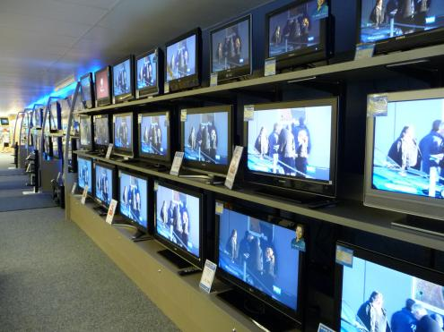
Rights of the copyright owner
Right to perform a work in public
Where to draw the line between public and private?

Slide 101
S.3 Copyright Act
3 (1) For the purposes of this Act, copyright, in relation to a work, means the sole right to produce or reproduce the work or any substantial part thereof in any material form whatever, to perform the work or any substantial part thereof in public or, if the work is unpublished, to publish the work or any substantial part thereof, and includes the sole right
  (a) to produce, reproduce, perform or publish any translation of the work,…

Slide 102
Rights of the copyright owner
Right to perform a work in public
Canadian Admiral Corp. v. Rediffusion Inc., [1954] Ex. C.R. 382
  Did the Defendant Redifusion perform the work in public when it rediffused the football telecast to its subscribers in their homes, and their showrooms/sales offices?
  If the audience considered in relation to the owners of the copyright can properly be described as the owner’s ‘public’ or part of their ‘public’, then anyone who performs the work before that audience without the consent of the author would be infringing their copyright (Jennings v. Stephens)

Slide 103
Rights of the copyright owner
Right to perform a work in public
Canadian Admiral Corp. v. Rediffusion Inc., [1954] Ex. C.R. 382
  Exception given where audience is not part of author’s public
  Main case is Jennings v. Stephens [1936] 1 All E.R. 228 & 413 where 600 workers listened to broadcast music in a factory. Held that everything depends on the character of the audience – Is the audience part of the copyright owner’s public? If the audience considered in relation to the owner of the copyright can properly be described as the owner's "public" or part of his "public," then anyone who performs the work before that audience without the consent of the author would be infringing his copyright.

Slide 104
Net Result
A performance in public means a performance to an audience which is not domestic or quasi domestic in character. The answer depends “solely upon the character of the audience” and factors such as whether visitors are present, whether an entrance fee is charged, or the number of people in the audience are not pre-determined.

Slide 105
Rights of the copyright owner
Right to perform a work in public
Canadian Admiral Corp. v. Rediffusion Inc., [1954] Ex. C.R. 382: Exception given where audience is not part of author’s public
  Other cases cited: Duck v. Bates (1884)
    Play performed to nurses, attendants, doctors, students, some of their families at Guy’s Hospital. It was held to be a domestic or quasi-domestic performance – not a performance in public.
    Could argue that Duck defines Performance In Public in a more narrowly than does Jennings

Slide 106
Rights of the copyright owner
Right to perform a work in public
Canadian Admiral Corp. v. Rediffusion Inc., [1954] Ex. C.R. 382
  Even 1M private performances does not constitute performance in public
  Rediffusion (cable) to private homes not in public.
Berri Street showroom however was open to the public. Nothing of a domestic or quasi-domestic nature. As a result, it can be viewed as a performance in public.

Slide 107
Harms Inc. and Chappel & Co v. Martan’s Club (1927): Performance at the Embassy Club at which club members, potential members and some guests were present. Held to be a performance in public.
Performing Right Society Ltd. v. Hawthorn’s Hotel Ltd (1933): An orchestral trio played in the lounge of Hawthorn’s Hotel. In the lounge were several guests of the hotel, among others. This was a performance by the hotel orchestra in public – it was open to any members of the public who cared to be guests of the hotel – either by eating or dining there.
Performing Right Society Ltd v. Gillette Industries (1943): Defendants installed loudspeakers in their factory and broadcast music in various departments to about 600 workers. All strangers were excluded from the factory. Was in public.

Slide 108
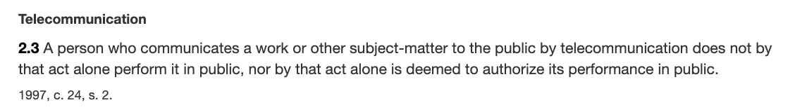
Rights of the copyright owner
Right to perform a work in public
Canadian Cable Television Association v. Canada (Copyright Board), [1993] 2 F.C. 138
  Held that a radio or television broadcast does amount to a performance of the work in public
  In public = openly, without concealment, and to the knowledge of all
  But consistent w. s. 2.3 of the Copyright Act?

Slide 109
Rights of the copyright owner
Right to perform a work in public
Canadian Cable Television Association v. Canada (Copyright Board), [1993] 2 F.C. 138
  Reference to “early conflicting decision” (Rediffusion)
  Letourneau J.: “I would have thought on a mere common sense basis that when the Prime Minister of Canada addresses the nation, either from his home or his private office, and reaches the citizens in their homes by means of radio and television, he appears in public and performs in public. I would have been content to leave it at that had it not been for early conflicting decisions on this issue.”

Slide 110
Rights of the copyright owner
Right to communicate a work to the public by telecommunication (s. 3(1)(f))
TV
Radio
Online
“3 (1) For the purposes of this Act, copyright, in relation to a work, means the sole right to produce or reproduce the work or any substantial part thereof in any material form whatever, to perform the work or any substantial part thereof in public or, if the work is unpublished, to publish the work or any substantial part thereof, and includes the sole right
(f) in the case of any literary, dramatic, musical or artistic work, to communicate the work to the public by telecommunication,…”

Slide 111
Rights of the copyright owner
Right to communicate a work to the public by telecommunication (s. 3(1)(f))
CCH Canadian v. LSUC (2004)
  Faxed transmissions of a single copy of a work to a single individual is not a communication to the public
  Emanated from a single point; & intended to be received at a single point

Slide 112
Rights of the copyright owner
Right to communicate a work to the public by telecommunication (s. 3(1)(f))
SOCAN v. CAIP (Tariff 22) 2004 SCC 45
Music industry brought an action seeking to compel Internet providers to pay a royalty to cover unauthorized copying by their subscribers.
  Q. 1:When does a communication to the public occur on the Internet?
  Q. 2: Who communicates in a copyright sense on the Internet?
  Q. 3: When does a communication on the Internet occur in Canada?

Slide 113
Rights of the copyright owner
Right to communicate a work to the public by telecommunication (s. 3(1)(f))
SOCAN v. CAIP (Tariff 22) 2004 SCC 45
  S. 2 Copyright Act definition of “telecommunication” …“means any transmission of signs, signals, writing, images or sounds or intelligence of any nature by wire, radio, visual, optical or other electromagnetic system;”

Slide 114
Q1:When does a communication to the public occur on the Internet?
Some content online content is accessible through “push” technologies (radio streams), other content is accessible through “pull” technologies.
Content is stored & cached on servers, and is only communicated to individuals when they access or “pull” it – when they access a stream that isn’t running constantly, download a file, etc.
So … when does a communication to the public occur?
The SCC decided that a telecommunication occurs on the internet at the point where the content is transmitted from the host server to the end user (each time that the content is transmitted).

Slide 115
Q2: Who communicates in a copyright sense on the Internet?
The person who communicates the work is the person who is the content provider – who uploads the work, creates the stream, posts the work
Do ISP’s (Internet Service Providers), as intermediaries, participate in the transmission of copyrighted works? Do they also communicate the work to the public? (Practical Ramifications → Deep Pockets $$$$$$$)
In answering SCC turned to s. 2.4(1)(b) – which states that participants in a telecommunication who only provide the “means of telecommunication necessary” (carriers) are deemed NOT to be communicators (follows Communications law doctrine of SEPARATION OF CONTENT FROM CARRIAGE).
Court noted that statute does not say intermediaries are engaged in communication BUT have a kind of immunity. RATHER it provides that intermediaries are deemed, for Copyright Act purposes, not to be communicating the work to the public at all. They are invisible.

Slide 116
Q3: When does a communication on the Internet occur in Canada?
Majority held Canada could exercise copyright jurisdiction in respect both of transmissions originating in Canada and transmissions originating abroad but received in Canada. This conclusion was said to be consistent with our general law as well as with national and international copyright practice. [Also consistent with many internet jurisdiction cases, many about defamation, of the time…until today]
But…this doesn’t mean “automatic copyright liability” on foreign content providers who communicate copyright works to Canadian end users. For copyright liability to be imposed on foreign content providers, there needs to be - in the context of a message or communication - a real and substantial connection.
Factors to be considered are situs of content provider, host server, intermediaries, end user

Slide 117
Rights of the copyright owner
Right to communicate a work to the public by telecommunication (s. 3(1)(f))
CWTA v. SOCAN (2008)
  Is the transmission of a musical ringtone to a cellphone a ‘communication to the public by telecommunication’?

Slide 118
Yes, it is. Court defines communication as – the passing of information from one person to another:
“A musical ringtone is information in the form of a digital audio file that is capable of being communicated. … The wireless transmission of a musical ringtone to a cellphone is a communication, whether the owner of the cellphone accesses it immediately in order to hear the music, or at some later time. … Communication completed once info is received.”
Next question: Is the communication by telecommunication of a ringtone from a wireless carrier’s website to a customer’s cell phone a communication to the public?
Court says yes.
FCA: If a wireless carrier were to transmit a particular ring-tone simultaneously to all customers who have requested it, that transmission would be a communication to the public. It would be illogical to reach a different result simply because the transmissions are done one by one, and thus at different times.]

Slide 119
Rights of the copyright owner
Right to communicate a work to the public by telecommunication (s. 3(1)(f))
ESA v. SOCAN (2012)
  Does the Copyright Act require a second royalty to be paid when games are downloaded as opposed to sold in stores?
  Conclusion: Internet delivery of copies of video games containing musical works does not constitute a communication to the public.

Slide 120
Entertainment Software Association v. Society of Composers, Authors and Music Publishers of Canada (Pentalogy case)
  Facts…
  Video games can be acquired several different ways. Buy the cartridge/disc in store. Have the game delivered mail/Amazon. Play online. Download a copy of the game (from STEAM etc.).
  Video games are composed of several different copyright works, including musical works.
  Reproduction royalties are paid for the use of music in video games. These royalties are negotiated before the game is distributed.
  Digital downloads (including subscriptions, digital full games, digital add-on content, mobile apps, social network gaming) started exceeding physical format sales in 2014.

Slide 121
Entertainment Software Association v. Society of Composers, Authors and Music Publishers of Canada (Pentalogy case)
  Issue is whether the Copyright Act requires a second royalty to be paid when games are downloaded as opposed to sold in store? A royalty is already paid to account for the reproduction of the musical work. However if a download of a video game is found to constitute a communication to the public by telecommunication IN ADDITION to a reproduction, then a second right would be engaged.
  Conclusion: SCC held that “the Internet delivery of copies of video games containing musical works” does not constitute a communication to the public – so doesn’t infringe s. 3(1)(f).

Slide 122
Rights of the copyright owner
Right to communicate a work to the public by telecommunication (s. 3(1)(f))
ESA v. SOCAN (2012)
  Reasoning/arguments employed by majority to reach their conclusion
    Principle of technological neutrality
    Need for consistency with purpose of copyright (Théberge)
    Preserve traditional balance in digital environment (Craig)
    Alternative proposal inefficient
    Legislative history & debates
    Case law
    Historic distinction between rights of performance and those of reproduction

Slide 123
1) Concluding that a download of a video game should attract both a reproduction royalty and a communication tariff would “violate the principle of technological neutrality, which requires that the Copyright Act apply equally between traditional and more technologically advanced forms of the same media”
2) Concluding that a download of a video game should attract both a reproduction royalty and a communication tariff would be inconsistent with the purpose of copyright in Théberge – need to balance; also need to recognize that creators’ rights are limited.
3) The traditional balance between authors and users should be preserved in the digital environment (Carys Craig) / non-digital environment – get one royalty (reproduction); Should not get an additional royalty in the digital environment.
4) An alternative proposal – by Rothstein J. in dissent – to adjust the two fees between collective agencies – would be inefficient.

Slide 124
5) Legislative history shows that the right to communicate is historically connected to the right to perform a work – not to the right to download – or “reproduce permanent copies of the work”. Legislative debates support this interpretation
6) Case law supports this interpretation
  Which case did they point to 1968 decision … Composers, Authors and Publishers Association of Canada Ltd v. CTV Television Network Ltd
  Which case(s) was distinguished? SOCAN v. CAIP, CWTA v. SOCAN.
7) Copyright Board’s interpretation ignores the historic distinction between rights of performance; and rights of reproduction
  Performances are impermanent – don’t leave user with durable copy; Reproductions do leave users with durable copies.
SO – single activity of downloading – cannot and does not infringe two rights.

Slide 125
Rights of the copyright owner
Right to communicate a work to the public by telecommunication (s. 3(1)(f))
Rogers Communications Inc. v. SOCAN 2012 SCC 35
Does individual streaming, triggered by the individual actions of individual users, constitute “communication to the public” or a “private communication” ?

Slide 126
YES, IT IS
‘COMMUNICATION TO THE PUBLIC’
(despite what was said in CCH v. LSUC that transmission of a single copy to a single person isn’t a communication to the public - also think about it → CCH photocopy and fax facts are reasonably distinguishable)

Slide 127
Any other conclusion could lead to weird results: Would mean that sending 1 email to 100 people (on the “To:” line amounts to ‘communication to the public’; while sending separate emails to 100 people saying the same thing would not be communication to the public.

Slide 128
Rights of the copyright owner
Right to communicate a work to the public by telecommunication (s. 3(1)(f))
Rogers Communications Inc. v. SOCAN (2012)
Reasoning/arguments employed to reach conclusion
  CCH distinguished; ruling limited to facts
  Other conclusion would lead to arbitrary, inconsistent results.
  Language of s. 3(1)(f)
  Legislative history
  Balance in copyright
  Developments at international level

Slide 129
Rights of the copyright owner
Right to communicate a work to the public by telecommunication (s. 3(1)(f))
S. 2.4(1.1) (amended)
  For the purposes of this Act, communication of a work or other subject-matter to the public by telecommunication includes making it available to the public by telecommunication in a way that allows a member of the public to have access to it from a place and at a time individually chosen by that member of the public.

Slide 130

Rights of the copyright owner
What modifications, if any, would you make to the bundle of rights available to copyright owners?

Slide 131
Pause

Slide 132
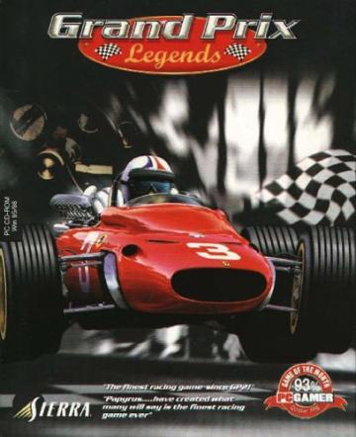
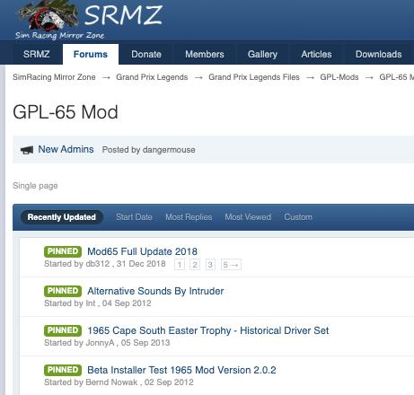
Next class
What should non-copyright owners be allowed do with respect to copyrighted works?
Should you have the “right” to engage in a creative way with copyrighted works? What does this mean?

Slide 133
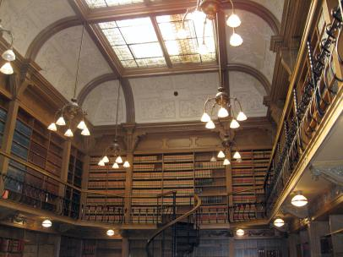
Coming Soon
“Rights of Non-Copyright Owners: Fair Dealing etc.”

Slide 134
SEE YOU NEXT WEEK!

Slide 135

Always include a cat picture

Slide 136
In learning you will teach
And in teaching you will learn
Phil Collins' Son of Man (1999)

Slide 137
Our Academic Partners

