Slide 1


Copyright Overview &
What is copyrightable?
Talk 2 Introduction
LAW 424 002
Intellectual Property Law
Allard School of Law, UBC
Spring, 2021
Jon Festinger Q.C.
Centre for Digital Media
QMUL School of Law (CCLS)
Whiteboard Law
http://commlaw.allard.ubc
@jonfestinger
jon_festinger@thecdm.ca

Slide 2
Logistics

Slide 3
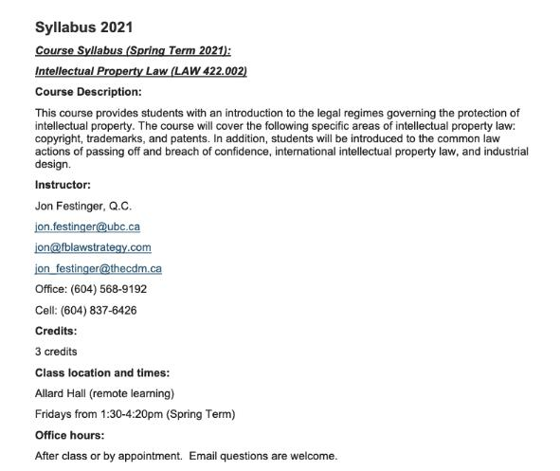
Any Questions?…

Slide 4
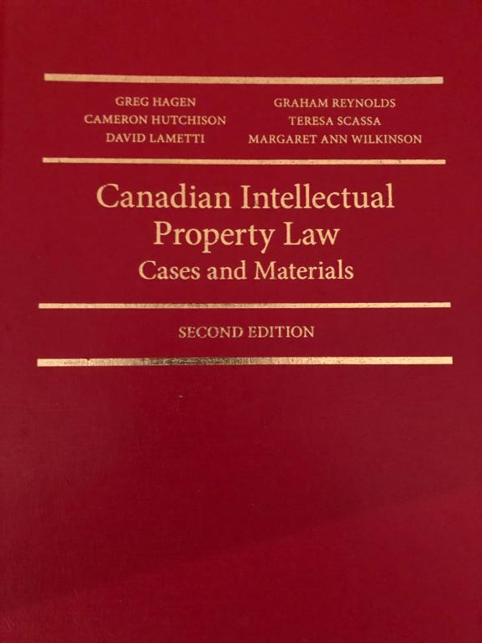

Slide 5

Office “Hours”: Ideally Fridays before or after class but am flexible…
Email me : jon.festinger@ubc.ca
Skype: jon.festinger
Phone:
o. 604-568-9192
c. 604-837-6426

Slide 6
Evaluation
(LLMCL students?)

Slide 7
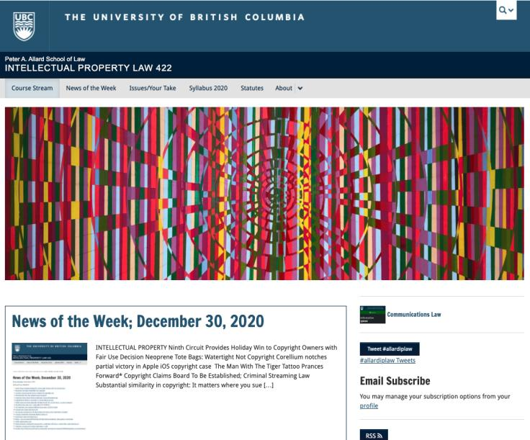
Course Website
https://iplaw.allard.ubc.ca/

Slide 8
PLEASE
SIGN UP

Slide 9
For full privileges on the website
1. Please create an account at http://cms.ubc.ca/ using your CWL.
2. Once you create an account and sign in at http://cms.ubc.ca/ you can click your name in the top right. Halfway down the following page will be your WordPress email address.
3. Send me your WordPress email address at jon.festinger@ubc.ca or at jon_festinger@thecdm.ca
4. Then, I will invite you to participate with authoring privileges via your WordPress email address.

Slide 10

Why post?
Engaging and engaging others is the key.
Because you don’t love speaking up in class.
Because you just saw or realized something, and you’ll never remember it unless you post it now.
# AllardIPLaw

Slide 11
Tips:
Don’t feel your posts have to be perfect. Engaging and engaging others is the key.

Slide 12

Anything & everything can be done via email if you prefer

Slide 13
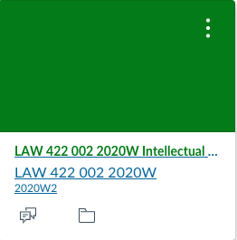
Don’t forget about UBC Canvas

Slide 14
Thank you for
your bios.
Much appreciated.

Slide 15
News of
the Week

Slide 16

Pause

Slide 17
QUESTIONS?
THOUGHTS?
DISCUSSION?

Slide 18
Have you thought about? …

Slide 19


Slide 20
Pause

Slide 21
QUESTIONS?
THOUGHTS?
DISCUSSION?

Slide 22
Outline of Class
1) Overview of copyright:
  A. Definition of copyright
  B. Purpose of copyright
  C. Origins of copyright
  D. Which level of government has legislative authority over copyright?

Slide 23
Outline
2) What is copyrightable?
  Subsistence of copyright in works
    Registration as a requirement for copyright protection?
    Fixation
    Originality
    Are facts and ideas protected?

Slide 24
Outline
  3) What does it mean to say that something is literary, artistic, dramatic, or musical?
  What should qualify as copyrightable “works”?

Slide 25
Pause

Slide 26
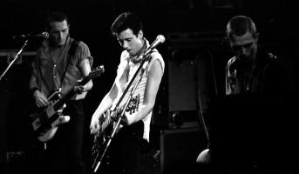
Overview of copyright
Definition of copyright:
  Set of exclusive rights in works of expression; performers’ performances; sound recordings; and communication signals.
The Clash, Chateau Neuf, Oslo, Norway
21 May 1980 Helge Øverås

Slide 27
Overview of copyright
Justifications
Economic incentive for creation (then why does copyright continue after death)?
Societal “progress in the arts & sciences”
Natural rights to one’s own labour & personality (→ personality = privacy or IP)
Reinforces free expression?

Slide 28

The Romantic Author (The “Unique Gift”)
* “The creative is the place where no one else has ever been. You have to leave the city of your comfort and go into the wilderness of your intuition. What you’ll discover will be wonderful. What you’ll discover is yourself.”
* Personal creation mythology deeply rooted in our psyches’: “And G-d said: ‘Let us make man in our image, after our likeness;”(Genesis, Chap. 1 Verse 26)
* View of creativity as uniquely personal (or not) impacts beliefs about copyright & IP

Slide 29
Please Self Identify
AUTHOR
or
CONNECTOR

Slide 30
Know Your
Bias!

Slide 31
Overview of copyright
Purpose of copyright as articulated by the SCC
  Former approach: “author-centric”
  Shift in Théberge
    “balance between promoting the public interest in the encouragement and dissemination of works of the arts and intellect and obtaining a just reward for the creator“ (para. 30)
  Refined in Cinar Corporation v. Robinson, 2013 SCC 73
    Copyright Act “seeks to ensure that an author will reap the benefits of his efforts, in order to incentivize the creation of new works” (para. 23)

Slide 32
Overview of copyright
Théberge v. Galerie d’Art du Petit Champlain Inc. (2002)
  Whether transferring the work from paper to canvas violated the Copyright Act by creating an unauthorized reproduction? 4/7 SCC found there was no copy made, only ink had been transferred. Moral rights claim could have been made to prevent but not for economic compensation
Cinar Corporation v. Robinson, 2013
  In 1982, Robinson drew sketches of the characters for a proposed children's television series to be called The Adventures of Robinson Curiosity. Presented to Cinar and others unsuccessfully. In 1994 the first episode of Robinson Sucroe was broadcast in Quebec.

Slide 33
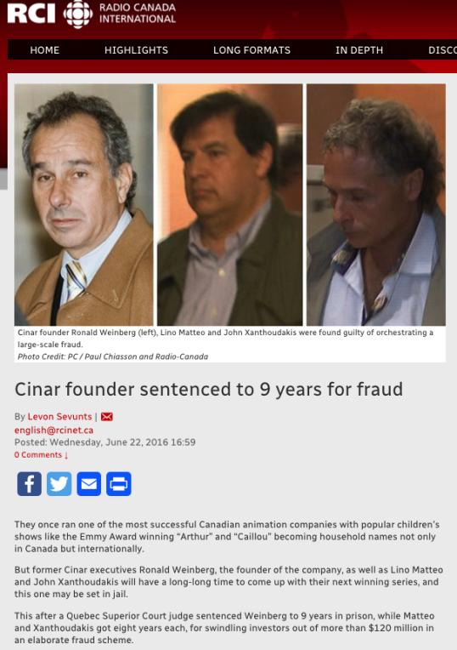

Slide 34
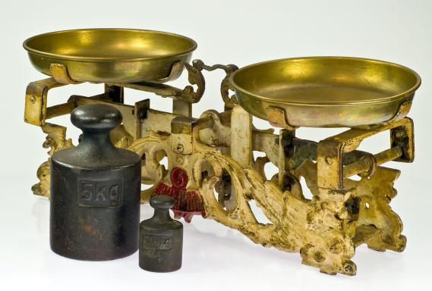
Théberge promotes “balance” between the public interest in connecting & just reward for the author

Slide 35
Overview of copyright
(my alternate perspective)
STATUTE OF ANNE (1710)
AS FREE SPEECH

Slide 36
Overview of copyright
Origins of copyright in Canada
Théberge:
  “[12] Generally speaking, Canadian copyright law has traditionally been more concerned with economic than moral rights.… The economic rights are based on a conception of artistic and literary works essentially as articles of commerce.” (Binnie J.)
But Cinar Corp. v. Robinson?
  [114] … the infringement of copyright in this case interfered with Robinson’s personal rights to inviolability and to dignity, recognized by ss. 1 and 4 of the [Quebec] Charter. (McLachlin CJ)

Slide 37
Overview of copyright
Legislative authority over copyright in Canada
  No common law copyright in Canada
  Théberge:
    [5] Copyright in [Canada] is a creature of statute and the rights and remedies it provides are exhaustive.
    Also see s. 89, Copyright Act: “No person is entitled to copyright otherwise than under and in accordance with this Act…”
  Relevant statute: Copyright Act, RSC 1985, c. C-42 as amended.

Slide 38
Copyright is Federal
91. It shall be lawful for the Queen, by and with the Advice and Consent of the Senate and House of Commons, to make Laws for the Peace, Order, and good Government of Canada, in relation to all Matters not coming within the Classes of Subjects by this Act assigned exclusively to the Legislatures of the Provinces; and for greater Certainty, but not so as to restrict the Generality of the foregoing Terms of this Section, it is hereby declared that (notwithstanding anything in this Act) the exclusive Legislative Authority of the Parliament of Canada extends to all Matters coming within the Classes of Subjects next hereinafter enumerated; that is to say,…
22. Patents of Invention and Discovery.
23. Copyrights

Slide 39
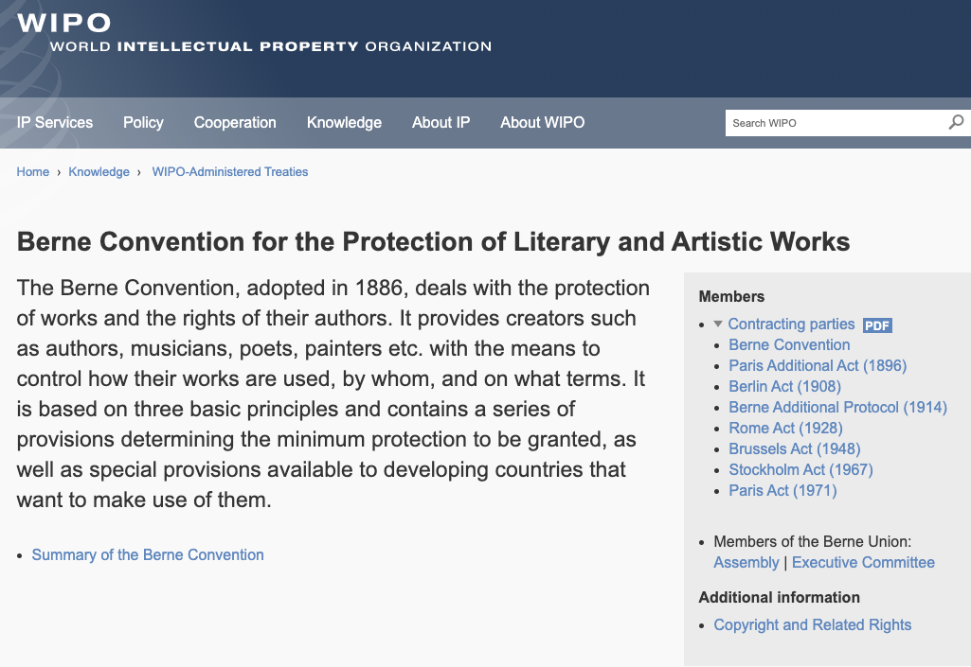
Role of International Treaties:

Slide 40
What is copyrightable
Subsistence of copyright
5. (1) Subject to this Act, copyright shall subsist in Canada, for the term hereinafter mentioned, in every original literary, dramatic, musical and artistic work if any one of the following conditions is met:
    (a) in the case of any work, whether published or unpublished, including a cinematographic work, the author was, at the date of the making of the work, a citizen or subject of, or a person ordinarily resident in, a treaty country;

Slide 41
What is copyrightable
Registration
  Not a condition for the subsistence of copyright
  Should it be?
  Possible to register your copyright (benefits to be discussed later in the term)

Slide 42
What is copyrightable
Fixation
A requirement for the subsistence of copyright imposed by judicial interpretation
  “The work, to be capable of copyright protection, must be fixed in a tangible form” (Canadian Admiral Corp. v. Rediffusion Inc., [1954] Ex. CR 382, 20 CPR 75
Is the fixation requirement beneficial?
Does add some certainty + more works in public domain

Slide 43
What is copyrightable: Originality
5. (1) Subject to this Act, copyright shall subsist in Canada, for the term hereinafter mentioned, in every original literary, dramatic, musical and artistic work if…

Slide 44
What is copyrightable
Originality in Canada
Pre-2004
  “Sweat of the brow”:
    Work receives copyright protection if it originates from an author and is more than a mere copy.
  “Creativity”
    A work must be the product of creativity in order to be original

Slide 45
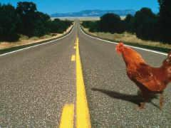
SCC takes the “middle way”

Slide 46
What is copyrightable
Originality
CCH Canadian Ltd. v. Law Society of Upper Canada, 2004 SCC 13
  For a work to be original, you need an exercise of skill and judgment that is more than a purely mechanical exercise
  Skill = use of one’s knowledge, developed aptitude or practiced ability in producing the work
  Judgment = use of one’s capacity for discernment or ability to form an opinion or evaluation by comparing different possible options in producing the work

Slide 47
McLachlin C.J.
[16] ”I conclude that the correct position falls between these extremes. For a work to be “original” within the meaning of the Copyright Act , it must be more than a mere copy of another work. At the same time, it need not be creative, in the sense of being novel or unique. What is required to attract copyright protection in the expression of an idea is an exercise of skill and judgment. By skill, I mean the use of one’s knowledge, developed aptitude or practised ability in producing the work. By judgment, I mean the use of one’s capacity for discernment or ability to form an opinion or evaluation by comparing different possible options in producing the work. This exercise of skill and judgment will necessarily involve intellectual effort. The exercise of skill and judgment required to produce the work must not be so trivial that it could be characterized as a purely mechanical exercise. For example, any skill and judgment that might be involved in simply changing the font of a work to produce “another” work would be too trivial to merit copyright protection as an “original” work.”

Slide 48
What is copyrightable
What about A.I. mediated creativity ?

Slide 49
Appendices

Slide 50
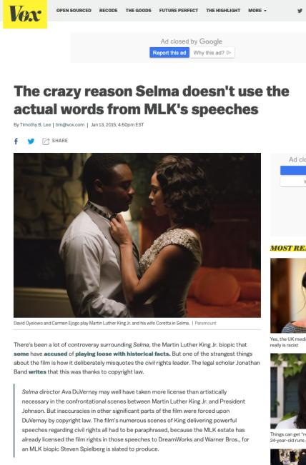
???????????????????????????

Slide 51
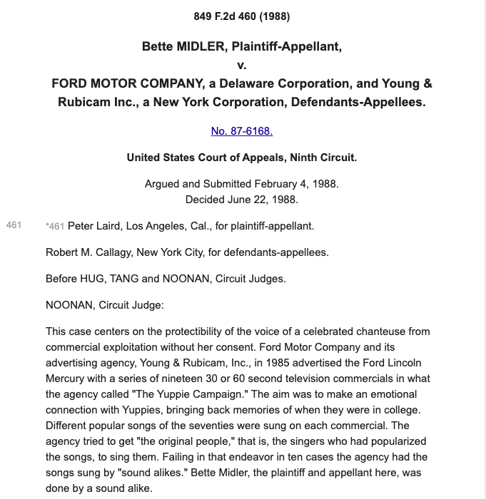
https://scholar.google.com/scholar_case?case=6021003493814451958

Slide 52
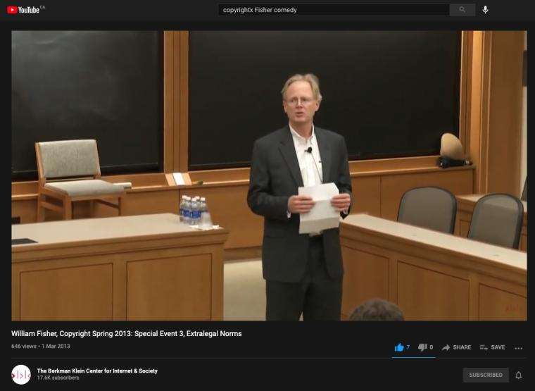
Re: Comedy & Copyright
https://youtu.be/8U7bUo1vChs

Slide 53
QUESTIONS?
THOUGHTS?
DISCUSSION?

Slide 54
Pause

Slide 55

Coming Soon
“Rights of Copyright Owners”
What rights should be part of the bundle of rights of copyright owners?

Slide 56
SEE YOU NEXT WEEK!

Slide 57

Always include a cat picture

Slide 58
In learning you will teach
And in teaching you will learn
Phil Collins' Son of Man (1999)

Slide 59
Our Academic Partners

