Slide 1


Intellectual Property Law:
Introducing the Course
Talk 1
LAW 424 001
Intellectual Property Law
Allard School of Law, UBC
Spring, 2021
Jon Festinger Q.C.
Centre for Digital Media
QMUL School of Law (CCLS)
Whiteboard Law
http://commlaw.allard.ubc
@jonfestinger
jon_festinger@thecdm.ca

Slide 2
Today’s Plan
1. Introductions (instructor and class)
2. Syllabus
3. Introduction of course material
4. Exercise

Slide 3
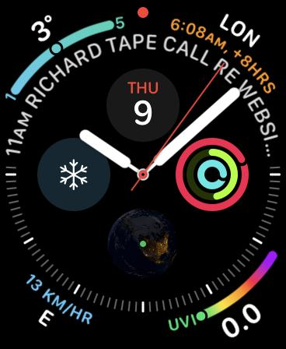
No, we will not spend the whole three hours…
Maybe an hour...

Slide 4
Copyright
Trademark
Patents

Slide 5
Intellectual Property Law is about:
What kinds of creations of the mind can one have rights in?
Who can have those rights?
What kinds of rights are there; and how are those rights enforced?

Slide 6
A.I.

Slide 7
Once a niche area, not anymore…

Slide 8
Logistics

Slide 9
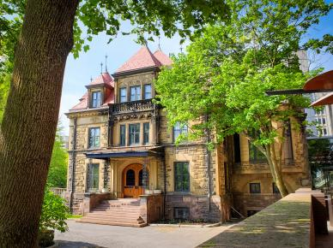



Me (briefly)

Slide 10
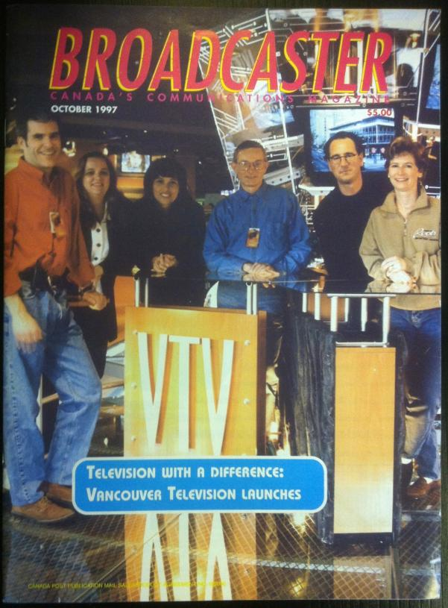

Slide 11
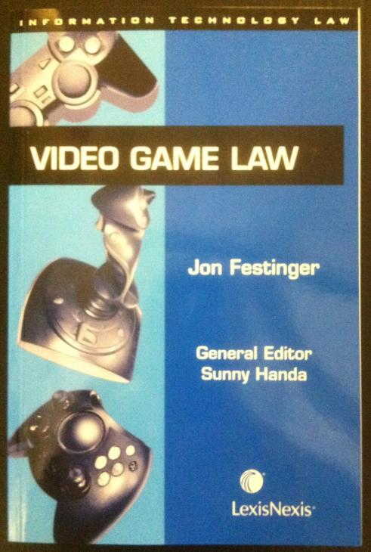

Slide 12


Slide 13


Slide 14
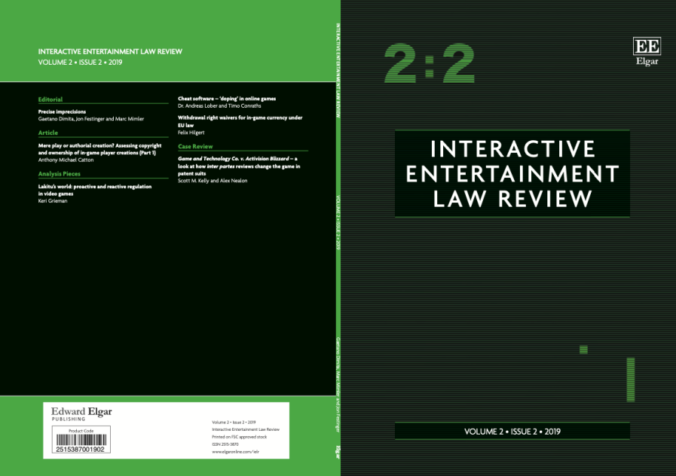

Slide 15
Favorite Intellectual Property
(current or all-time)?

Slide 16


Slide 17


Slide 18
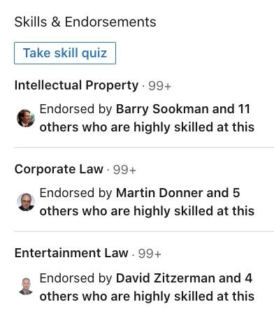
If you believe in Linked In

Slide 19
Now
You

Slide 20
Please, please…
By next week email me a short bio of yourself referencing:
Anything at all you want to say about yourself
Your academic interests
Interests outside of law you wish to mention
What you would like to get out of this course specifically (I.E. interest in a type of patent, or a copyright issue etc.) and law school more generally
Comments on evaluation & delivery schemes

Slide 21
+ Don’t Forget
Name
Year of law school
From Allard or Exchange or Visiting or LLMCL (& from where if not Allard)
Favorite Intellectual Property (current or all-time)

Slide 22
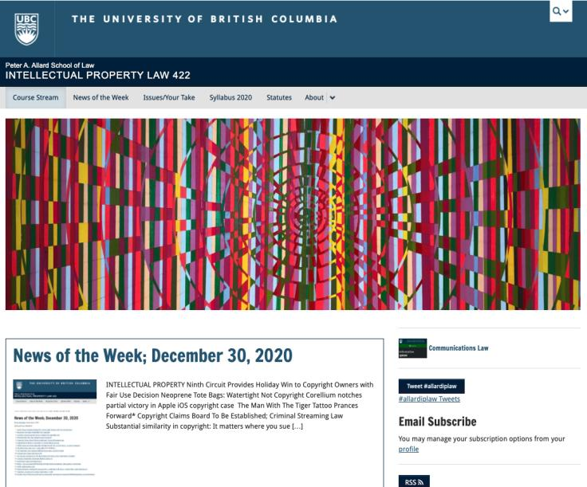
Course Website
https://iplaw.allard.ubc.ca/

Slide 23
News of
the Week

Slide 24
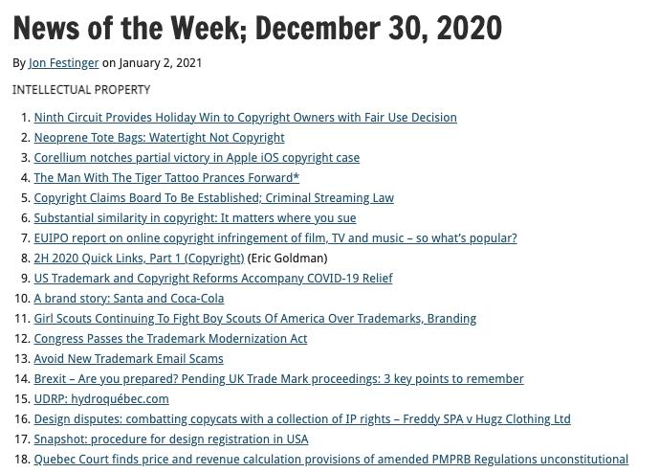

Slide 25
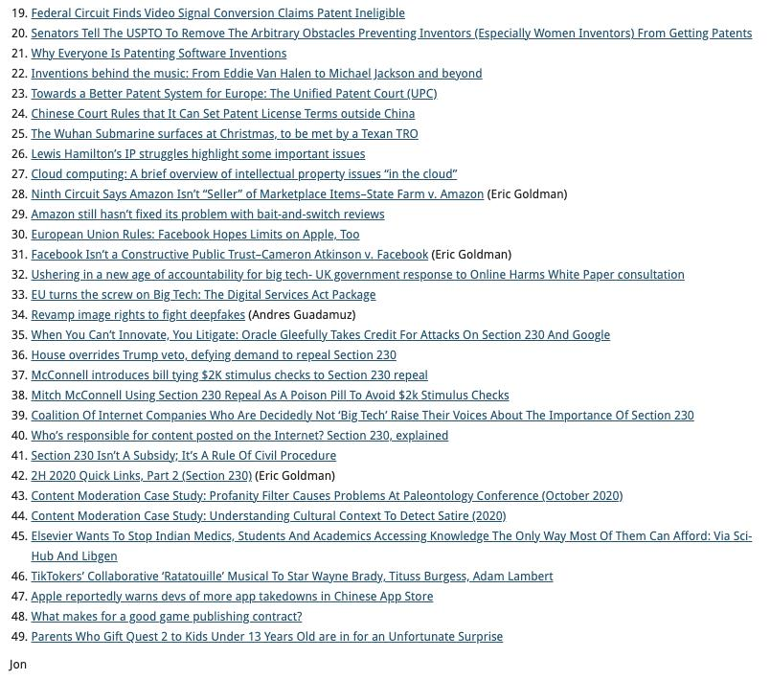

Slide 26
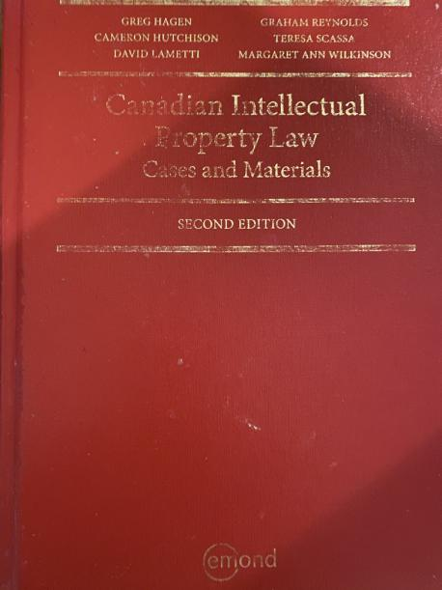
Text

Slide 27
New & Improved Features of the Course
70% Exam not 100%
IP Law ”In Context”
Website usage
Technology?

Slide 28
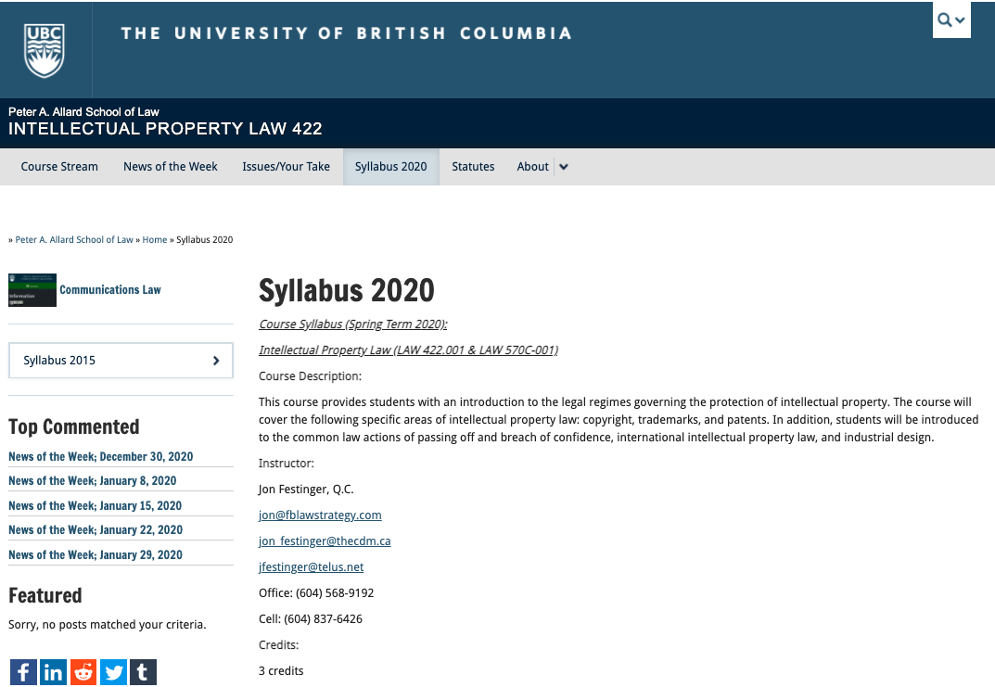
Syllabus: The Same But…

Slide 29
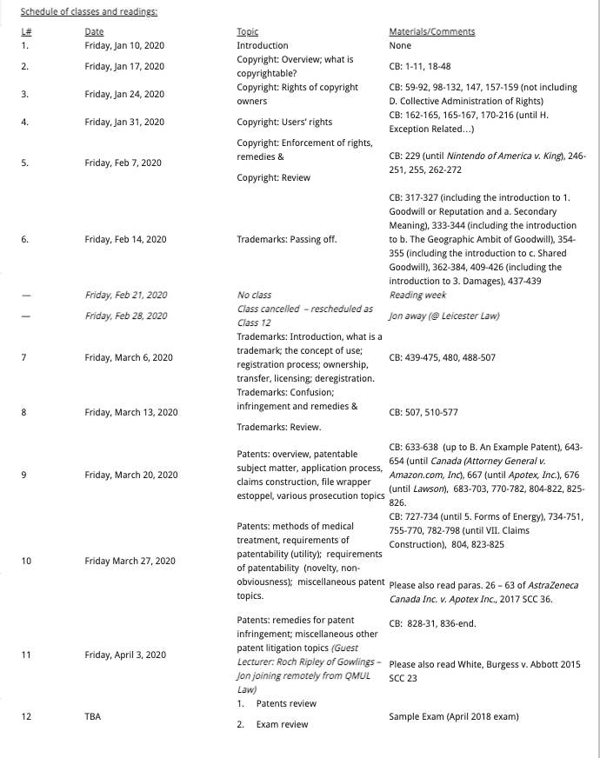

Slide 30

Office “Hours”: Ideally Fridays before or after class but am flexible…
Email me : jon.festinger@ubc.ca
Skype: jon.festinger
Phone:
o. 604-568-9192
c. 604-837-6426

Slide 31

Pause

Slide 32
QUESTIONS?
THOUGHTS?
DISCUSSION?

Slide 33
Evaluation
(LLMCL students?)

Slide 34
Let’s talk about…
The 30%

Slide 35
A modest proposal…
500-1000 words (or equivalent) per person
written, video, interpretive dance
Website or not
Groups or individually

Slide 36
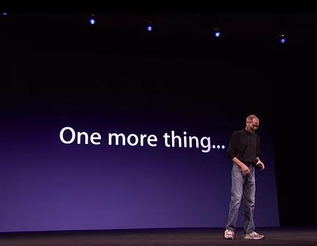

Slide 37
Course Delivery
1. Voice over slides or video of slides?
Recommend voice over slides (but)…
2. Live one hour class/Q&A weekly or bi-weekly; or simply 3-hour live lecture every week; or...?
Recommend Live one hour class/Q&A where class part introduces that week’s materials and Q&A is primarily related to previous weeks materials
3. Other ideas?

Slide 38
Think about for next week…

Slide 39


Slide 40
Also please, please…
By Thursday 1.14.21 email me a short bio of yourself referencing:
Anything at all you want to say about yourself
Your academic interests
Interests outside of law you wish to mention
What you would like to get out of this course specifically (I.E. interest in a type of patent, or a copyright issue etc.) and law school more generally
Comments on evaluation & delivery schemes

Slide 41
Name
Year of law school
From Allard or Exchange or Visiting or LLMCL (& from where if not Allard)
Favorite Intellectual Property (current or all-time)

Slide 42
QUESTIONS?
THOUGHTS?
DISCUSSION?

Slide 43
Pause

Slide 44
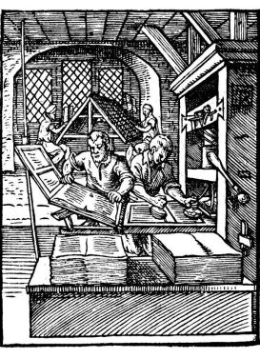
Coming Soon
“Copyright Law”

Slide 45
SEE YOU NEXT WEEK!

Slide 46

Always include a cat picture

Slide 47
In learning you will teach
And in teaching you will learn
Phil Collins' Son of Man (1999)

Slide 48
Our Academic Partners

