Slide 1
Bullet Tip Design
By: Liam Robertson

Slide 2
Inconsistent Bullet Tips

Slide 3
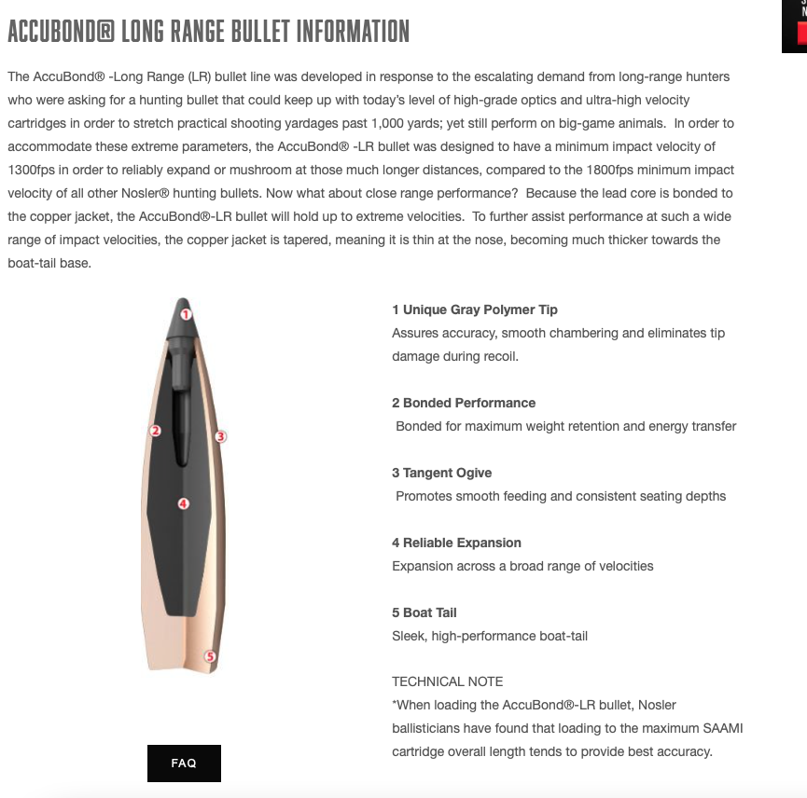
Registration Under: United States Patent and Trademark Office
Nosler
Hornady

Slide 4
Hornady

Slide 5
Nosler

Slide 6
Proprietary Bonding Process (Nosler) Highly Concentric AMP bullet Jackets (Hornady)
Nosler
Eliminates the bullet from separating upon impact. Flies true and retains weight.
Solid Base®: at the rear of the bullet acts as a platform for large mushrooms.
Hornady
AMP® Jackets: is a technological advancement in design, tooling and manufacturing to create the most consistently concentric bullet jackets
Heatshield Tip: Patent Pending heat resistant polymer tip that resists aerodynamic heating and provides consistent BC’s for the entire flight path. Also adds consistency.

Slide 7
IP Issues
Fighting over the use of the same technology
How can companies better protect their IP?
How can there be transparency in the marketplace?
What kind of information would companies have to disclose about their product when they sign large government contracts?
How do companies protect innovation within a company by their employees? Is it the employees IP or the companies?

Slide 8
Other Hornady Trademarks

Slide 9
Closing Remarks

