Slide 1


Right to CreaTE or Rights to the Creation
Talk 4
Part A “Creating”
Video Game Law - Fall 2015
UBC Law @ Allard Hall
Jon Festinger Q.C.
Centre for Digital Media
Festinger Law & Strategy
http://videogame.law.ubc.ca
@gamebizlaw
jon_festinger@thecdm.ca

Slide 2
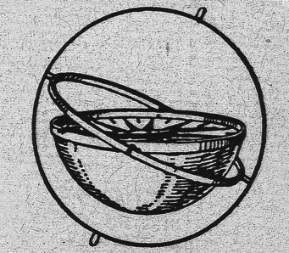
Where Are We?
*3rd and final Talk in Part A of the course under “Creating”
*Today:…(How) Can a Right to CREATe (Mod) be established?
*Next class – beginning of Part B: “Connecting”
(Part C. “Controlling”, Part D. “Conciliation”)

Slide 3
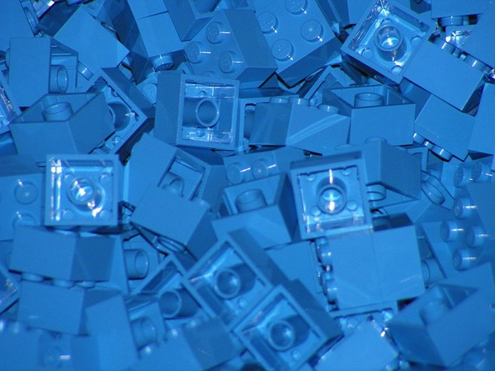
Today: Creating (meme) Part 3
Now that we have creativity, content & contradictions (partially) accounted for, what is the next horizon?
Remixing in games…
This week…

Slide 4
Back to…
Where is the
FREEDOM
TO
CREAtE ?

Slide 5
Restating a concept:
“What is perhaps most interesting about “moral rights” is that it is the (only) legal concept thaT directly incorporates the process of Creativity.”

Slide 6

Pause…

Slide 7
Copyright Act R.S.C., 1985, c. C-42
S. 2: “artistic work” includes paintings, drawings, maps, charts, plans, photographs, engravings, sculptures, works of artistic craftsmanship, architectural works, and compilations of artistic works;
“dramatic work” includes (a) any piece for recitation, choreographic work or mime, the scenic arrangement or acting form of which is fixed in writing or otherwise (b) any cinematographic work, and (c) any compilation of dramatic works;
“every original literary, dramatic, musical and artistic work” includes every original production in the literary, scientific or artistic domain, whatever may be the mode or form of its expression, such as compilations, books, pamphlets and other writings, lectures, dramatic or dramatico-musical works, musical works, translations, illustrations, sketches and plastic works relative to geography, topography, architecture or science;

Slide 8
What’s wrong with this picture?
THE “MECHANIC” IS BASED ON THE COMMODITY NOT THE CREATIVITY
(OUTCOME NOT PROCESS)
Policy statements are about “…encouraging creativity” but the law is essentially related to its commercial liquidity.
The only assumption is that creativity must exist, and that is only ever implied (also remember how low the threshold for creativity is – Atari v. Oman)

Slide 9
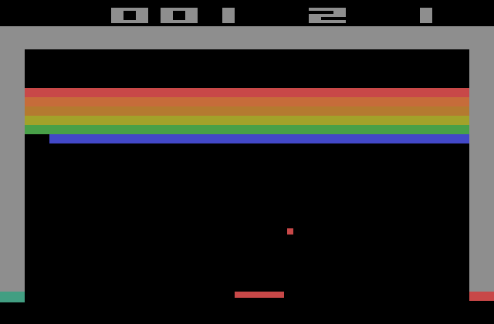
The “creativity standard” in copyright.
District court judge asked counsel for the Register, "If Picasso had painted a round object on a canvas, would you say because it depicts a familiar subject--namely, something that's round--it can't be copyrighted?”

Slide 10
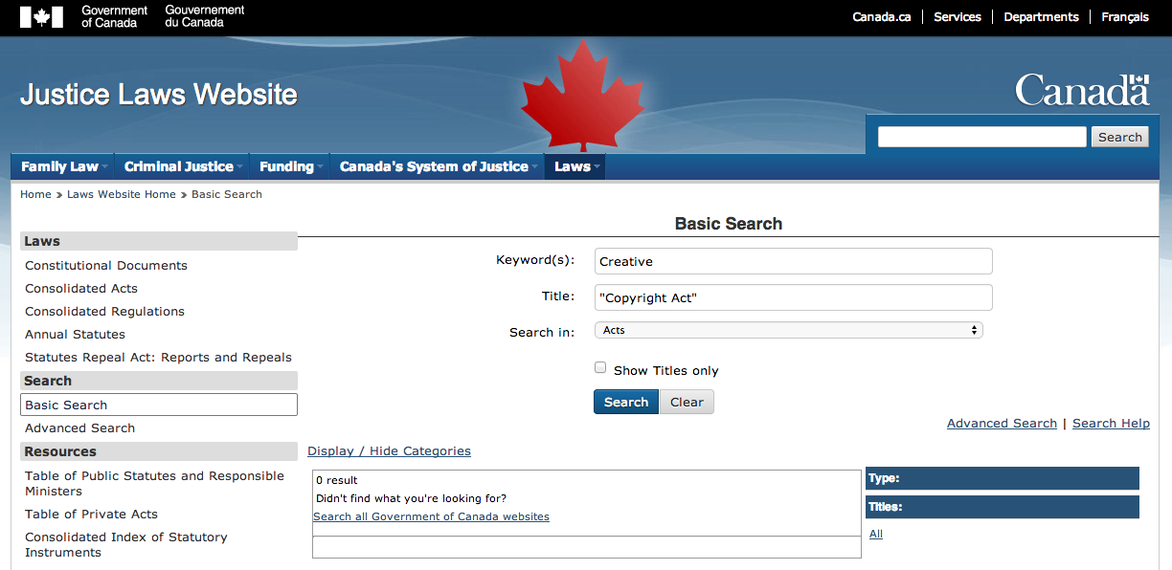
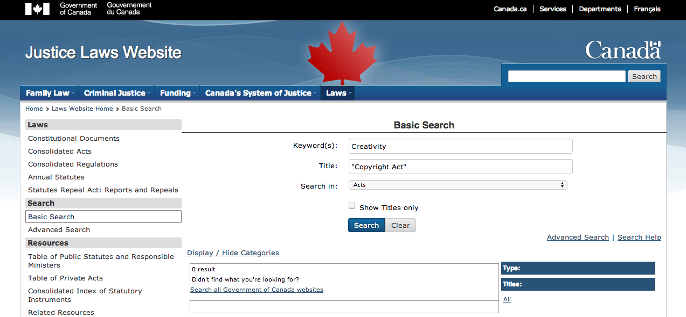

Slide 11

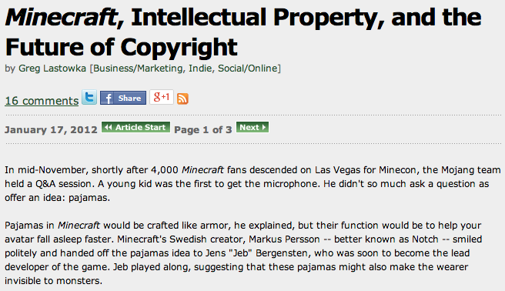
http://www.gamasutra.com/view/feature/134958/minecraft_intellectual_property_.php

Slide 12
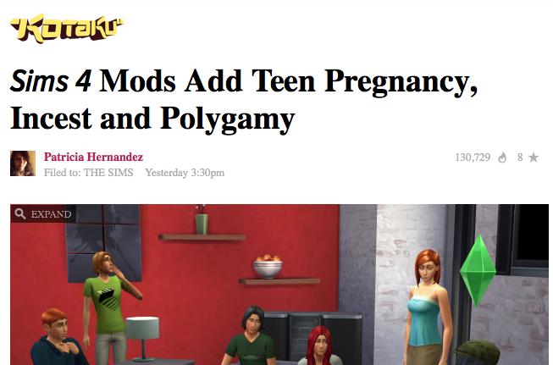
http://kotaku.com/preview/sims-4-mods-add-teen-pregnancy-incest-and-polygamy-1638223190

Slide 13
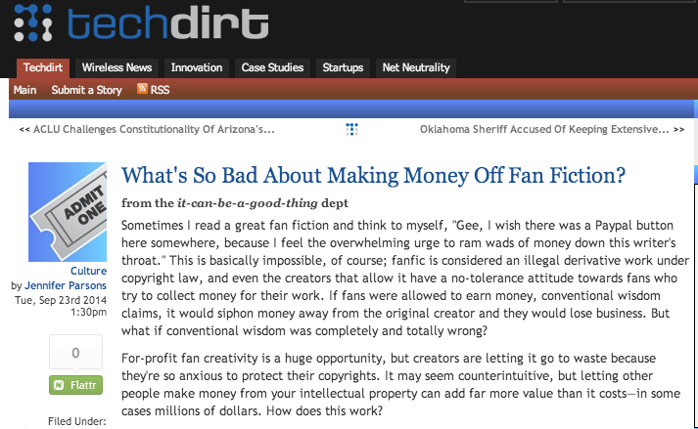
https://www.techdirt.com/articles/20140821/21532628289/whats-so-bad-about-making-money-off-fan-fiction.shtml

Slide 14
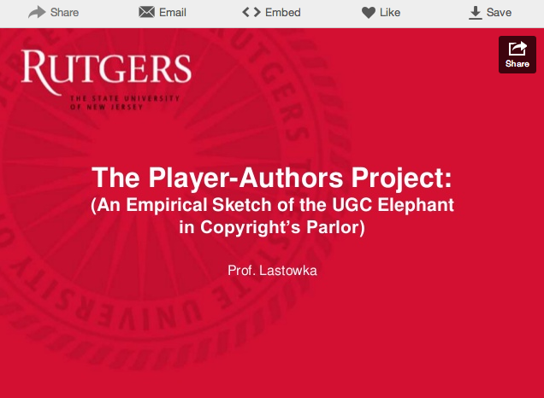
http://www.slideshare.net/greglas/the-player-authors-project

Slide 15
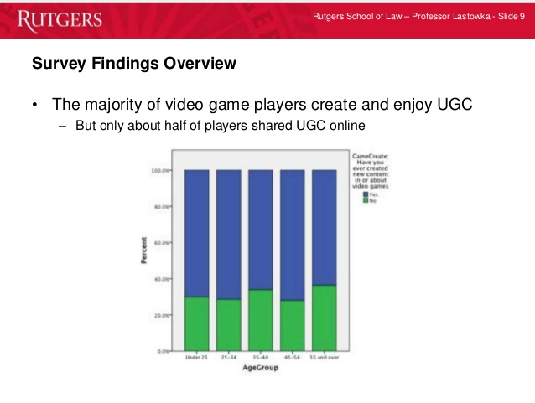

Slide 17
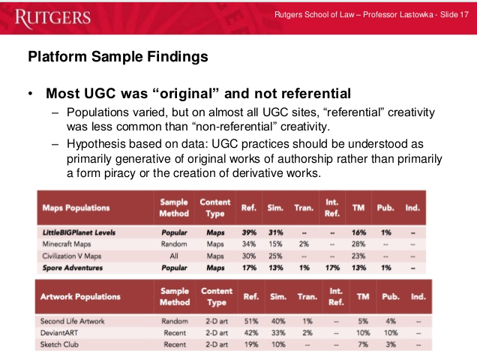

Slide 18
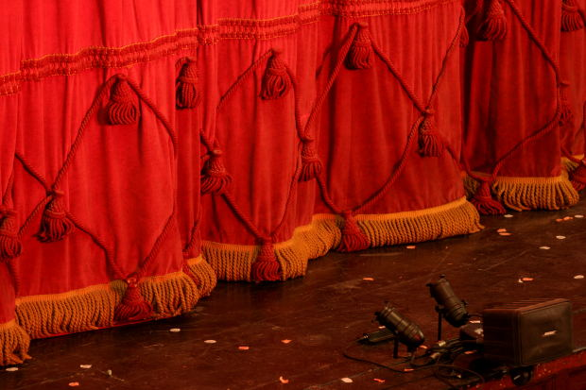
Follow Up to Talks 1, 2 & 3
An Emergent Theme Evolves?

Slide 19
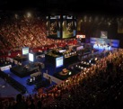
Evolving Theme 1?
What constitutes a “VIDEOGAME” & how is it to be differentiated?
Is Madden NFL a Sport?
“Examined, the Virtual Life Is Worth Living: Madden NFL 25 Portrays ‘Real’
Football” New York Times, August 26, 2013 http://www.nytimes.com/2013/08/27/arts/video-games/madden-nfl-25-portrays-real-football.html
& “Are Video Games a Sport?” (NYTimes video) http://nyti.ms/17cJXTO
2. “Game or be gamed: Douglas Rushkoff on prototyping democracy through play” (The Verge Dec. 12, 2012)
http://www.theverge.com/2012/12/12/3758576/douglas-rushkoff-gameplay-as-prototype
“By viewing our social, political, and economic structures through the lens of interactivity, Rushkoff says, we are beginning to "transition from the world of passively accepted narrative to one that invites our ongoing participation.”

Slide 20
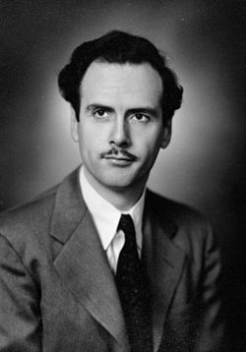
Evolving Theme 2?
“Why do we
(video) game?”
Answer:
A. Social reaction (McLuhan)

Slide 21
McLuhan, 1964
(Games as social reaction)
Games are popular art, collective, social reactions to the main drive or action of any culture. Games, like institutions, are extensions of social man and the body politic, as technologies are extensions of the animal organism. Both games and technologies are counter-irritants or ways of adjusting to the stress of the specialized actions that occur in any social group. As extensions of the popular response to the workaday stress, games become faithful models of a culture. They incorporate both the action and the reaction of whole populations in a single dynamic image.

Slide 22
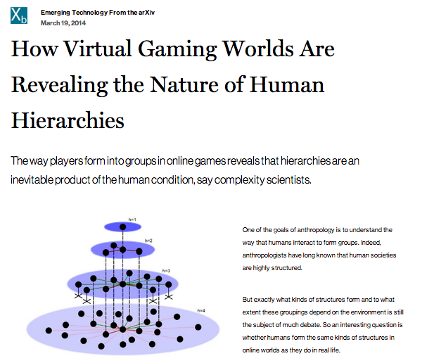

To overstate through repetition…
http://www.technologyreview.com/view/525696/how-virtual-gaming-worlds-are-revealing-the-nature-of-human-hierarchies/

Slide 23
Evolving Theme 3?
VIDEO - GAME
IP NOT IP
“Games and Other Uncopyrightable Systems” Bruce Boyden (2011) http://www.georgemasonlawreview.org/doc/Boyden_18-2_2011.pdf
“Games are systems in exactly the same way. A game, as sold, is only a game form; the content necessary for an instance of the game comes from the players. That is, the game form establishes the environment for play…”

Slide 24
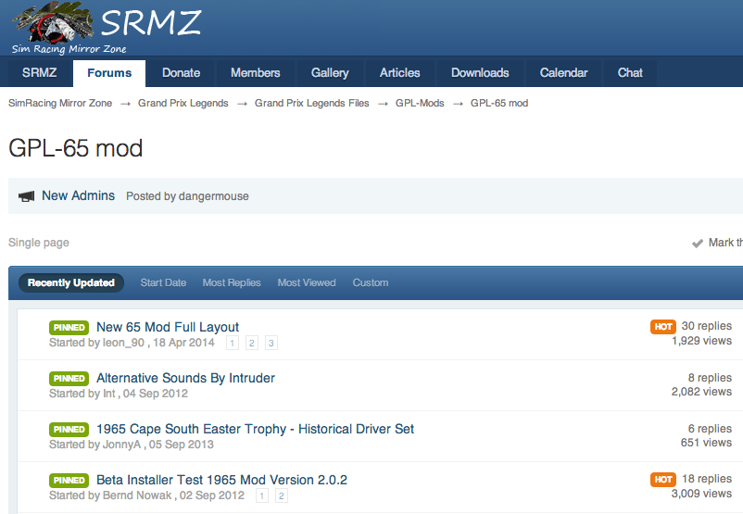
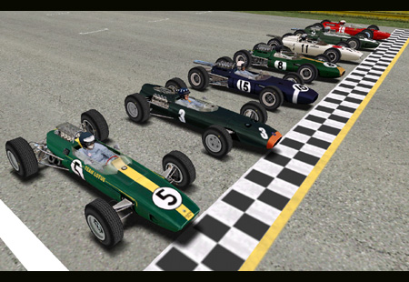
Mods (today’s topic)
Part of the evolution of
this Emergent Theme

Slide 25
Starting Point Conundrum:
IDEA/EXPRESSION DICHOTOMY
Paradoxical Thesis: The problem with “the Law” may not have anything to do with the Law
IDEA/EXPRESSION DICHOTOMY:
No IP in an idea.
Becomes IP as (fixated) expression.

Slide 26
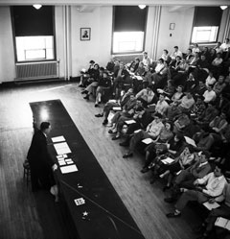
Contrast this “talk” to 70 years ago:

Slide 27
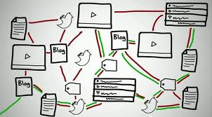
Now fixation happens @ digital speed..

Slide 28
...SO WHAT →????
Conundrum A (Literalist Dichotomy) =
What is Private v. What is Public
Conundrum B = Idea v. Expression
Once upon a time…a long time ago……
Private Public
Idea Expression

Slide 29

IN THE DIGITAL UNIVERSE
idea
private
EXPRESSION
PUBLIC

Slide 30
Not a Failure of Law:
A Failure of Balance
Some Ways to Rebalance???:
BY acknowledging the Right to CREaTe….
Mod
Use
Share
AS A PRIVATE RIGHT OF INDIVIDUALS
User Rights = S.C.C. “Pentalogy”
Right to Hyperlink = Crookes v. Newton (2011 SCC 47)

Slide 31
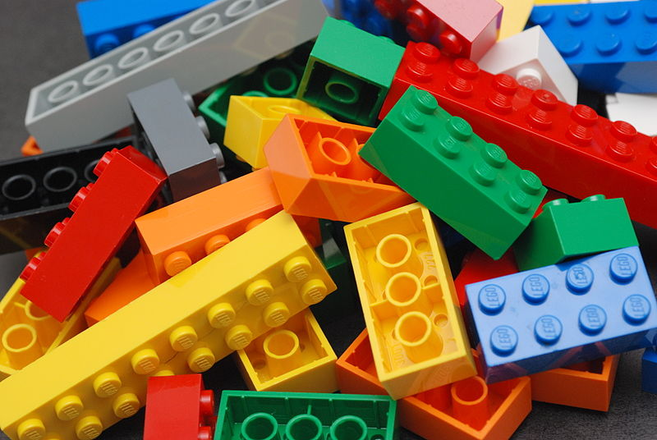
An Un-enumerated Right?
Where is the
FREEDOM TO
→MOD←/
CREAtE ?

Slide 32
Concept to Reflect On (for the next while)
PERSONAL CREATIVITY
as part of an
INTERACTIVE ENVIRONMENT
Same or different from books, TV, Film etc?
Same or different from sports, music etc?

Slide 33
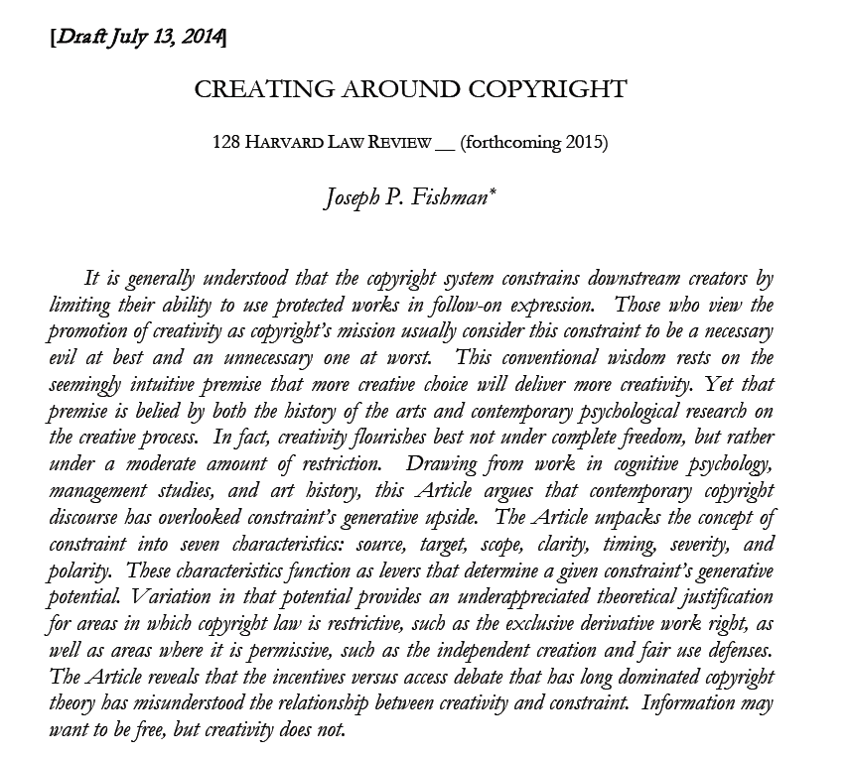
Problem to think about…
http://papers.ssrn.com/sol3/papers.cfm?abstract_id=2465590

Slide 34
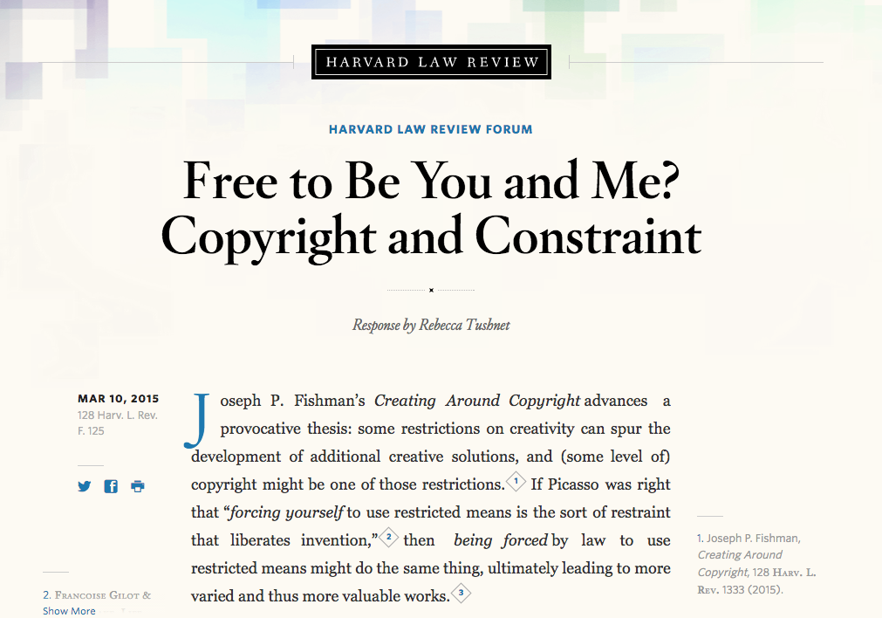
The formal answer…

Slide 35

Right to Mod/Right to CreaTe
Can these “right(s)” be established?
& if so through which legal pathways?
Core of anti-mod sentiment + attitude to overcome:
“[W]e believe it is our duty to uphold the integrity of our work.”
Statement by general manager of Tecmo Inc. re action against online forum members who released mod “skins” for (among other games) “Dead or Alive Xtreme Beach Volleyball”.

Slide 36
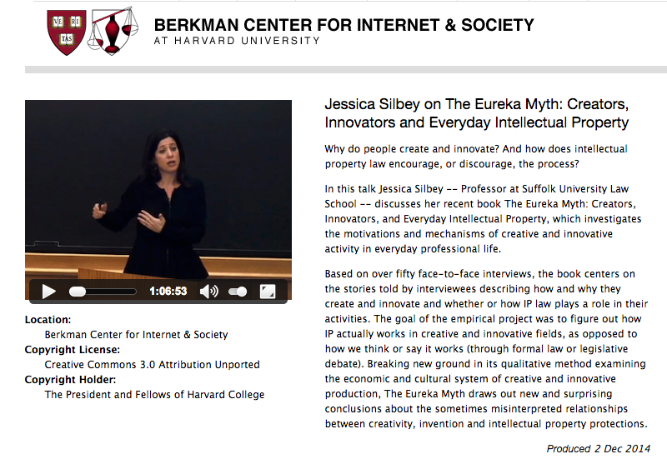
Creators do not need (nor want) additional constraints

Slide 37
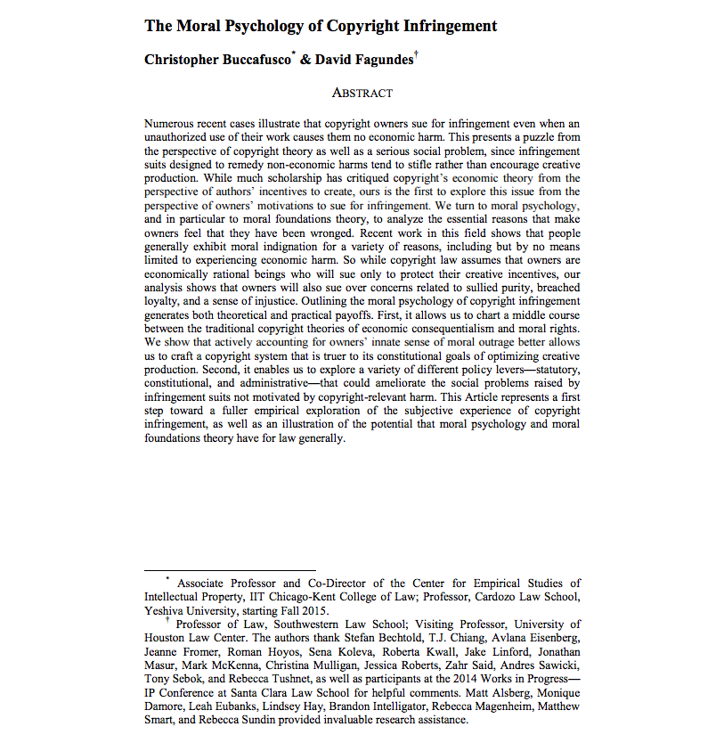
http://papers.ssrn.com/sol3/papers.cfm?abstract_id=2587339

Slide 38
“Numerous recent cases illustrate that copyright owners sue for infringement even when an unauthorized use of their work causes them no economic harm. This presents a puzzle from the perspective of copyright theory as well as a serious social problem, since infringement suits designed to remedy non-economic harms tend to stifle rather than encourage creative production…We turn to moral psychology…to analyze the essential reasons that make owners feel that they have been wronged. Recent work in this field shows that people generally exhibit moral indignation for a variety of reasons, including but by no means limited to experiencing economic harm. So while copyright law assumes that owners are economically rational beings who will sue only to protect their creative incentives, our analysis shows that owners will also sue over concerns related to sullied purity, breached loyalty, and a sense of injustice.”

Slide 39
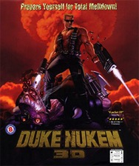

Cases to overcome*…
Micro Star v. FormGen 1998 USCA:
Micro Star commercially sold “Nuke It” – CD Rom
collection of 300 user created levels for Duke Nukem 3D
Did so without permission of community creators who had
previously released those levels for free.
EULA allowing “non-commercial” mods existed between
FormGen & Duke Nukem 3D purchasers.
Micro Star’s fair use argument failed.
2. Davidson & Associates, Inc. v. Internet Gateway
2005 USCA (D&A = Blizzard):
Free Battle.net community created competitor “bnetd”
EULA & TOU prohibited “reverse engineering”
“Blizzard” succeeds
* & one not to: Lewis Galoob Toys v. Nintendo of America 1992 USCA: “Game Genie” device allowed gameplay features to be modified (e.g. # of lives) but did not change data in Nintendo cartridge. Court found “fair use”.

Slide 40
Cases to overcome (con’d)
3. iRacing v. Robinson (2007 Mass. Dist. Ct.):
“Nascar 2003” mod which modified the “.exe” source code file contrary to EULA.
“No CD” patch also made available by Robinson.
iRacing “wins” but Court found: “A defendant may successfully raise a fair use defense against a copyright infringement claim while still being found in breach of a contract not to copy.”
4. MDY Industries, LLC v. Blizzard Entertainment, Inc. (2010 USCA):
Blizzard used technological protection measure (“TPM” to prevent “bots” in “WoW” and effectively prohibited them by TOU.
MDY developed & sold “Glider” which circumvented the TPM and allowed bots into the game.
USCA affirmed Dist. Ct. finding that MDY violated DMCA’s copy control (anti-circumvention) provisions…

Slide 41
MDY (con’d): Contract not Copyright
Court in MDY reaffirmed copyright/contract distinction:
“…A Glider user violates the covenants with Blizzard, but does not thereby commit copyright infringement because Glider does not infringe any of Blizzard’s exclusive rights. For instance, the use does not alter or copy WoW software…
We conclude that for a licensee’s violation of a contract to constitute copyright infringement, there must be a nexus between the condition and the licensor’s exclusive rights of copyright. Here, WoW players do not commit copyright infringement by using Glider in violation of the ToU. MDY is thus not liable for secondary copyright infringement, which requires the existence of direct copyright infringement. Grokster, 545 U.S. at 930.”
* EFF: “A Mixed Ninth Circuit Ruling in MDY v. Blizzard: WoW Buyers Are Not Owners – But Glider Users Are Not Copyright Infringers” https://www.eff.org/deeplinks/2010/12/mixed-ninth-circuit-ruling-mdy-v-blizzard-wow

Slide 42
Notice any common denominators?
Creativity is never in issue in any of the cases
Copyright Law is only directly relevant in Microstar (& Galoob “Game Genie”) - no contractual nexus, so sole “copyright only” case.
“Fair Use” to create mods question avoided by:
Contract Law (Davidson, iRacing & MDY all decided on EULA, ToS or ToU terms & obligations).
Nothing creative in what Micro Star did – they did not create a mod – they usurped mod creators without permission
Conclusion: No current precedent that game mods are not “Fair Use”.

Slide 43
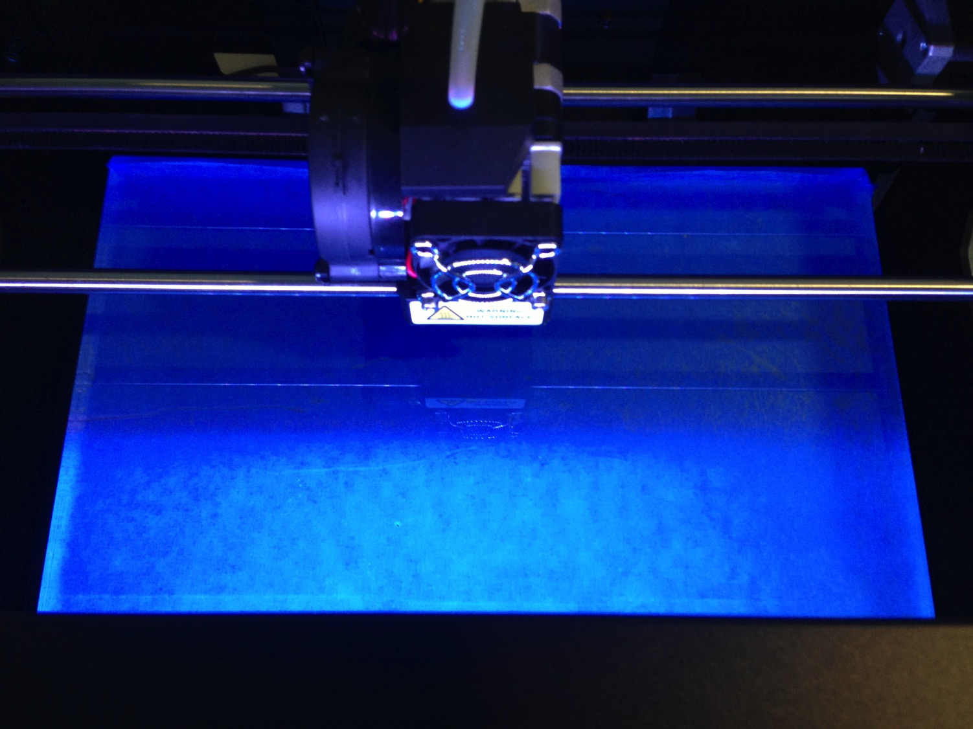
Does not mean Mods ARE “Fair Use”..
What’s at stake?
Mods
Machinima
Fan Fiction
Re-mix
Multi-source content
3D Printing
& (of course) Freedom to CREatE

Slide 44
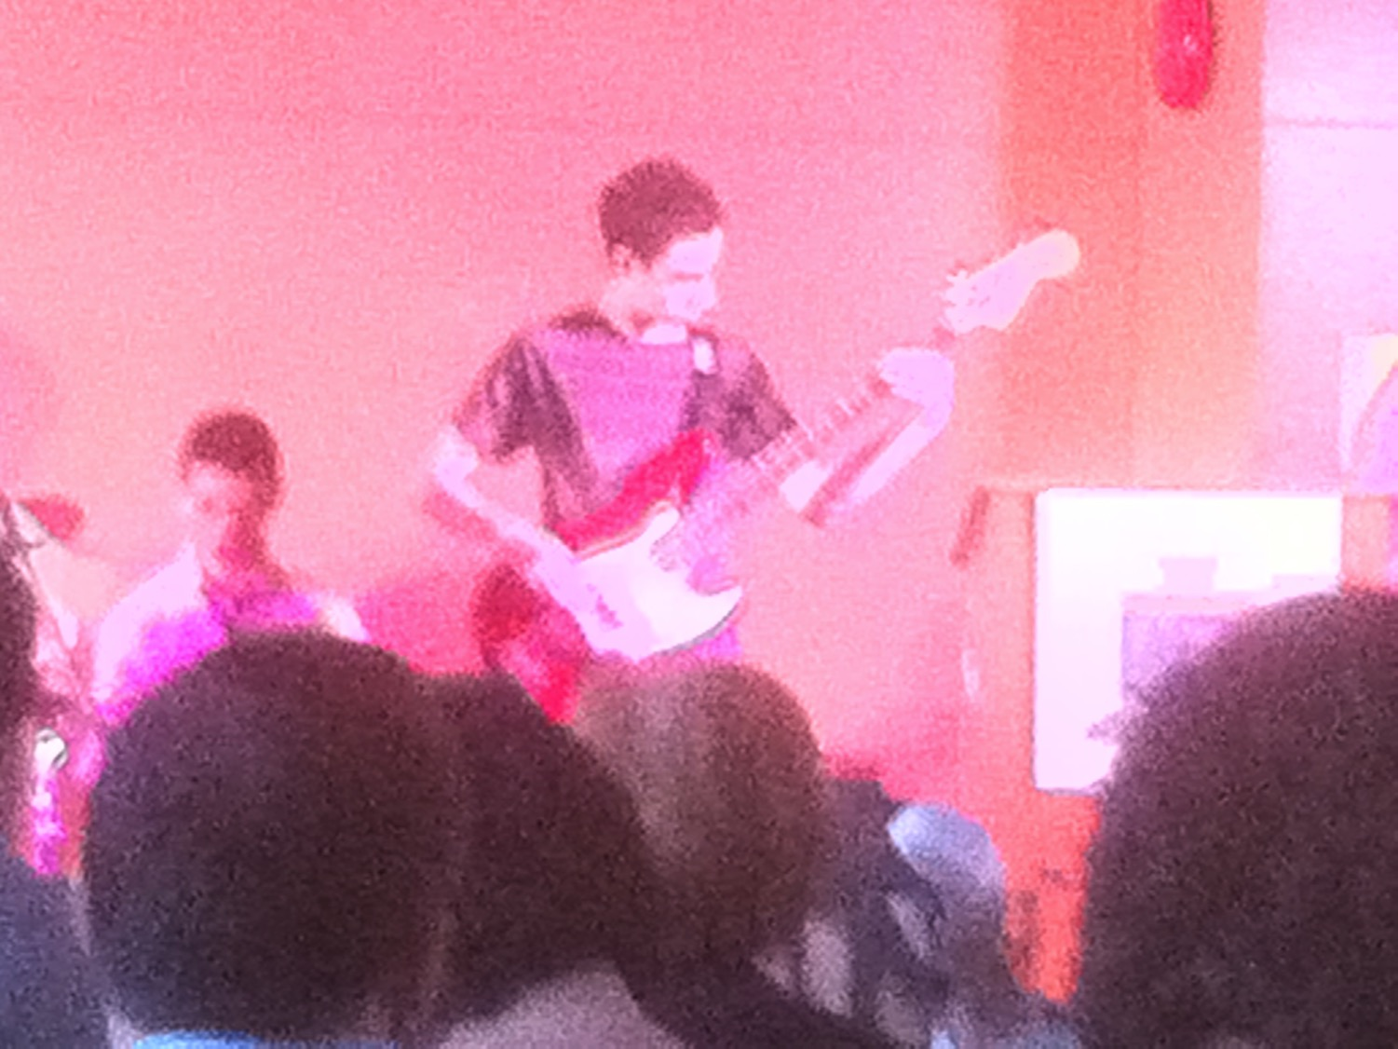
“Right to CreaTE” v. “Rights in the Creation”
Right to CreaTe: Think Freedom of Speech/Expression. A PERSONAL RIGHT.
“CREATORS RIGHT” has come to mean a “right in the creation”, which attaches to content; a “benefit” post facto creation. Think IP/Copyright. Attaches to the product, not the person (contrast to “moral rights”).

Slide 45
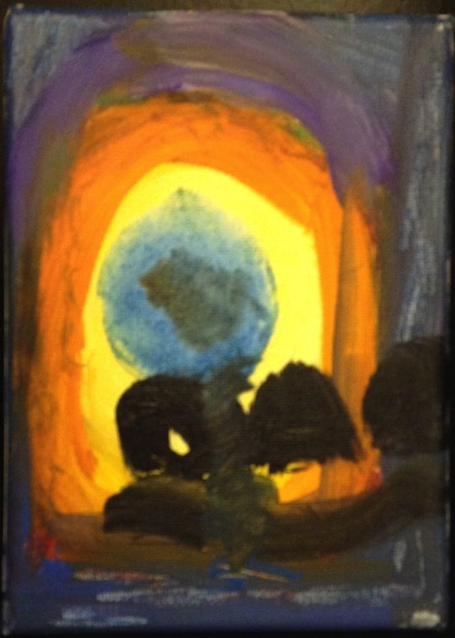
Right to Remix/Mod/CREAtE ?
“Right to CREAtE”
Not “Right in the
Creation”
Right to Remix-CREAtE-Mod as a creative/expressive right rather than an IP right/property protection.

Slide 46
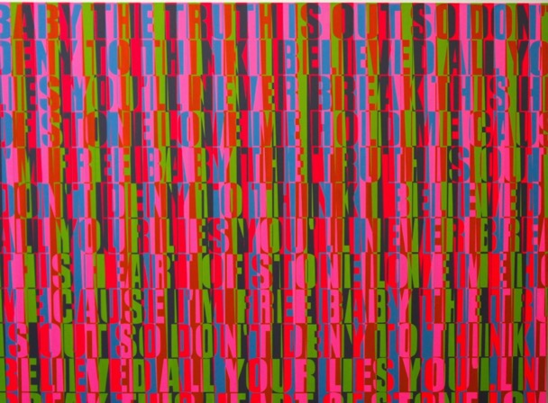
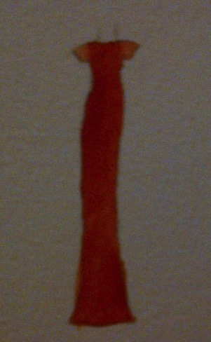
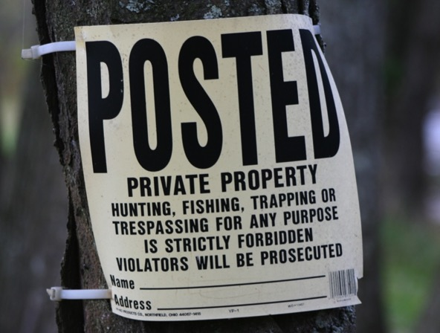
IS Creativity More
Important than Property?

Slide 47
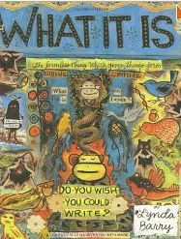
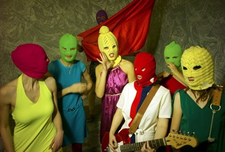
Cores of the Creative
The Personal Journey: “We don’t create a fantasy world to escape reality, we create it to be able to stay. I believe we have always done this, used images to stand and understand what otherwise would be intolerable.” Lynda Barry in “What It Is”.
Not Being Chilled: “The Creative Act requires not only freedom but also this assumption of freedom. If the creative artist worries if he will still be free tomorrow, then he will not be free today.” Salman Rushdie “On Censorship” http://www.newyorker.com/online/blogs/books/2012/05/on-censorship-salman-rushdie.html

Slide 48
“Intellectual Property” Paradoxes?
“Intellectual” + “Property”: Misnomer, contradiction, odd, oxymoronic?
Word “Intellectual” undermined by legal requirements of fixation/“actual-ness”/tangibility?
Word “Property” somewhat undermined by statutory limitations of impermanence: Property which expires????
Word “Property” undermined by statutory statements of “larger purpose.” Whose property is it if ultimately it belongs to us all in order to serve “progress”?
Is copyright “property” or “right”? Copyright Act: “property” appears only in ways unrelated to a “built in” right. Appears several times in true ownership context in Trade-marks Act and Patent Act.

Slide 49
More reasons Copyright are not “Property”
* Infinite slice-ability & dice-ability of IP makes it much less property like
*Higher Purpose = To increase the knowledge of mankind:
Statute of Anne, 1710: “An Act for the Encouragement of Learning”
U.S. Constitution (Article 1, Section 8, Clause 8): “To promote the Progress of Science and useful Arts, by securing for limited Times to Authors and Inventors the exclusive Right to their respective Writings and Discoveries;…”

Slide 50
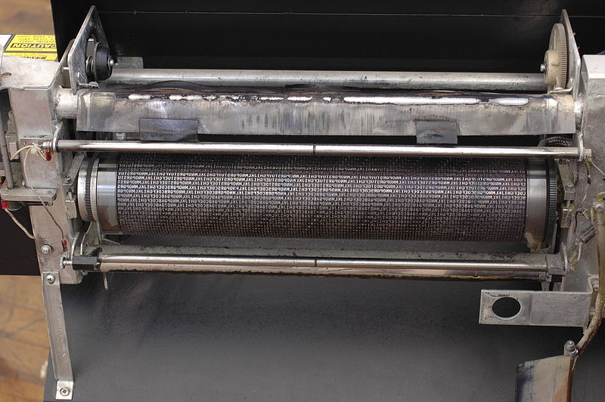
SHOULD…
“Copy”
in“Copyright”
just mean
“copy”?

Slide 51
How do we update “Derivative Rights” for the Digital Age? (current provisions)
3. (1) For the purposes of this Act, “copyright”, in relation to a work, means the sole right to produce or reproduce the work or any substantial part thereof in any material form whatever, to perform the work or any substantial part thereof in public or, if the work is unpublished, to publish the work or any substantial part thereof, and includes the sole right
  (a) to produce, reproduce, perform or publish any translation of the work,
  (b) in the case of a dramatic work, to convert it into a novel or other non-dramatic work,
  (c) in the case of a novel or other non-dramatic work, or of an artistic work, to convert it into a dramatic work, by way of performance in public or otherwise,
  (d) in the case of a literary, dramatic or musical work, to make any sound recording, cinematograph film or other contrivance by means of which the work may be mechanically reproduced or performed,
  (e) in the case of any literary, dramatic, musical or artistic work, to reproduce, adapt and publicly present the work as a cinematographic work,
  (f) in the case of any literary, dramatic, musical or artistic work, to communicate the work to the public by telecommunication,
  (g) to present at a public exhibition, for a purpose other than sale or hire, an artistic work created after June 7, 1988, other than a map, chart or plan,
  (h) in the case of a computer program that can be reproduced in the ordinary course of its use, other than by a reproduction during its execution in conjunction with a machine, device or computer, to rent out the computer program,
  (i) in the case of a musical work, to rent out a sound recording in which the work is embodied, and
  (j) in the case of a work that is in the form of a tangible object, to sell or otherwise transfer ownership of the tangible object, as long as that ownership has never previously been transferred in or outside Canada with the authorization of the copyright owner,
and to authorize any such acts.

Slide 52
U.S. Copyright Act
A “derivative work” is a work based upon one or more preexisting works, such as a translation, musical arrangement, dramatization, fictionalization, motion picture version, sound recording, art reproduction, abridgment, condensation, or any other form in which a work may be recast, transformed, or adapted. A work consisting of editorial revisions, annotations, elaborations, or other modifications which, as a whole, represent an original work of authorship, is a “derivative work”.

Slide 53
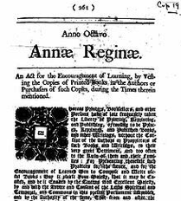
From Literal to Historical: Copyright within
TRAJECTORY OF CREATIVE FREEDOMS
* {KING..} Star Chamber (UK) abolished July 1641 - de facto cessation of
censorship; {TO PARLIAMENT..} replacement of Royal with Parliamentary censorship.
* {TO REGULATOR/EXCLUSIVE GUILD..} Licensing Order of 1643: Parliament
required authors to have a government license before a work could be published.
Restrictions enforced by the Stationers’ Company, a printers guild with the
exclusive power to print - and the responsibility to censor - literary works – in return
for monopoly on the printing trade.
* “Areopagitica”: “A speech of Mr. John Milton for the Liberty of
Unlicensed Printing to the Parliament of England”; 1644.
* “Licensing of the Press Act 1662”; "An Act for preventing the
frequent Abuses in printing seditious treasonable and unlicensed Bookes
and Pamphlets and for regulating of Printing and Printing Presses.”
* Then {TO PUBLISHERS/AUTHORS..} “The Statute of Anne” 1710 moved
control to the publishers/authors…

Slide 54
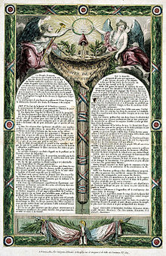
ONE MORE PIECE OF EVIDENCE
Did the evolution of a separate right to freedom of speech/
expression result in the recasting of “authors rights” into a
property right?
*Statute of Anne (copyright) 1710.
*Declaration of the Rights of Man (French Revolution
providing for free speech for the common man) 1789/1793.
“Timeline: a history of free speech”
http://www.theguardian.com/media/2006/feb/05/religion.news
THESIS STATED:
1. FREE SPEECH TO AUTHORS WAS COPYRIGHT!
2. THEN COPYRIGHT BECAME MORE INFUSED BY
“PROPERTY” TO GIVE IT MEANING AS FREEDOM
OF EXPRESSION EVOLVED.

Slide 55
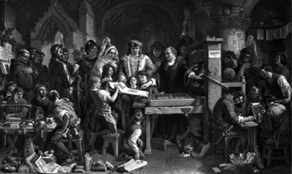
Understanding Copyright as part of the DEMOCRATIZATION OF THOUGHT?
Strange then that Copyright constrains Speech???
Right to Remix/Mod/CREATE perhaps the legitimate child of
both Free Speech & Copyright Laws
Meaning perhaps our understanding of copyright should prioritize the creative freedoms associated with content creation & use in preference to the “private ownership” aspects?
LEADING US BACK TO →

Slide 56
…the Creator (author) & some serious questions…
Has anything of conceptual consequence happened since this TRAJECTORY OF LIBERALIZATION & FREEDOM vested power over media in the creator/author which was a HUGE STEP towards the freedom/democratization of media (pretty good for 1710)?
Did the evolution of a separate right to freedom of speech/expression result in the recasting of “authors rights” into a property right?
Note: Not much new to be created from a book in 1710? Little or no new creativity out of old creativity? Only unauthorized printing of the same work distributed at a lower cost…

Slide 57
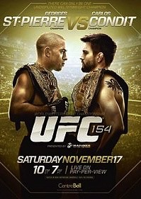
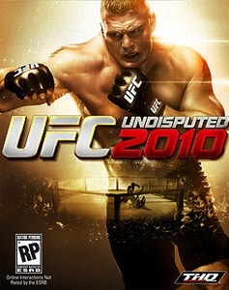
Think about Tatoos
Escobedo v. THQ, Inc.
Tattoo artist sues THQ, makers of UFC
video game for copyright
infringement. Artist claims to have
tattooed an originally created lion
on Carlos Condit’s body. Escobedo
and Condit had no written agreement.
See: “Copyright in Tattoo Case”
http://www.dmlp.org/blog/2012/copyright-tattoo-
case-escobedo-v-thq-inc
"Tatoos and Copyright Infringement” by
C. Harkins (L&C Law Review)
http://www.brinksgilson.com/files/190.pdf

Slide 58
IS LAW “AGILE”(enough)?
POSSIBLE
WAYS
FORWARD

Slide 59
POSSIBLE WAYS FORWARD:
Are we evading the deeper question?
SHOULD NOT
User Rights/Right to Remix really be a
independent creative/expressive right
rather than an IP right/protection/defense?
* Part of Freedoms of Thought/Conscience?
* Part of Free Speech/Expression (criticism & review/news reporting)?
* Or merely…an expanded “public interest” based Fair Dealing/Fair Use?
...NOT NOW..NOT YET?

Slide 60
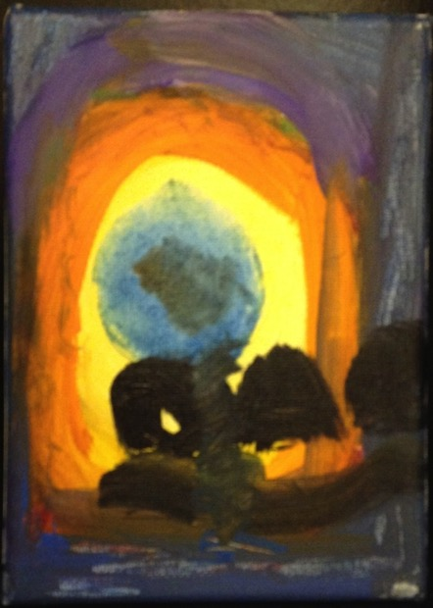
POSSIBLE WAYS FORWARD
Right to Remix/Mod/CREATE ?
Right to Remix-CREATe-Mod as a creative/expressive right rather than an IP right/protection?
“Right to CreaTe” v. “Right in the Creation”
Can we...evolve a single standard:
For CREATORS as USERS, &
For USERS as CREATORS
…….to match reality…..
“Right to CREATe”
Not “Right in the Creation”

Slide 61
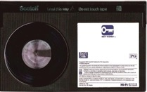
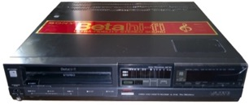
POSSIBLE WAYS FORWARD
“Context Shifting”
Imagine a world without Sony v. Universal SCOTUS
464 U.S. 417 (1984) (Betamax) time-shifting” fair use?
Why isn’t everything in digital world not a form
of tool enabled “time-shifting”
= “context shifting”
Key Factors in Sony:
a. enlarged audience;
b. did not impair copyright value.

Slide 62

Fair Dealing in Canada:
Enter User Rights…
Recent SCC “User” paradigm shifts
USERS ARE CREATORS TOO
August 2012 “Copyright Pentalogy” & previous cases
Moving from fair dealing as an exception to copyright infringement towards proactive “User Rights”
Right to Link (Crookes v. Newton)
Right to longer iTunes previews
Tech Neutrality
Fair dealing is to be assessed from the point of view of the purchaser/user
“Research” need not be associated with traditional intellectual pursuits

Slide 63

SCC Penatalogy...words
Abella J. for the majority in Alberta (Education) v. Canadian Copyright Licensing Agency (Access Copyright) 2012 SCC 37
“…fair dealing is a “user’s right”, and the relevant perspective when considering whether the dealing is for an allowable purpose…is that of the user…”
Abella J. for the Court in Society of composers, Authors and Music Publishers of Canada v. Bell Canada 2012 SCC 36
“Further, given the ease and magnitude with which digital works are disseminated over the Internet, focusing on the “aggregate” amount of the dealing in cases involving digital works could well lead to disproportionate findings of unfairness when compared with non-digital works.”
See also: “Copyright Fair Use Cases of the United States Supreme Court” http://www.ipwatchdog.com/2012/10/05/copyright-fair-use-cases-of-the-united-states-supreme-court/id=26225/
Abella J. for the majority in Alberta (Education) v. Canadian Copyright Licensing Agency (Access Copyright) 2012 SCC 37
“…fair dealing is a “user’s right”, and the relevant perspective when considering whether the dealing is for an allowable purpose…is that of the user…”
Abella J. for the Court in Society of composers, Authors and Music Publishers of Canada v. Bell Canada 2012 SCC 36
“Further, given the ease and magnitude with which digital works are disseminated over the Internet, focusing on the “aggregate” amount of the dealing in cases involving digital works could well lead to disproportionate findings of unfairness when compared with non-digital works.”
See also: “Copyright Fair Use Cases of the United States Supreme Court” http://www.ipwatchdog.com/2012/10/05/copyright-fair-use-cases-of-the-united-states-supreme-court/id=26225/

Slide 64

Non-commercial user-generated content
(Copyright Act, Canada)
29.21 (1) It is not an infringement of copyright for an individual to use an
existing work or other subject-matter or copy of one, which has been
published or otherwise made available to the public, in the creation of a
new work or other subject-matter in which copyright subsists and for the
individual — or, with the individual’s authorization, a member of their
household — to use the new work or other subject-matter or to authorize an
intermediary to disseminate it, if
(a) the use of, or the authorization to disseminate, the new work or other
subject-matter is done solely for non-commercial purposes;
(b) the source — and, if given in the source, the name of the author, performer,
maker or broadcaster — of the existing work or other subject-matter or copy of
it are mentioned, if it is reasonable in the circumstances to do so;
(c) the individual had reasonable grounds to believe that the existing work or
other subject-matter or copy of it, as the case may be, was not infringing
copyright; and
(d) the use of, or the authorization to disseminate, the new work or other
subject-matter does not have a substantial adverse effect, financial or
otherwise, on the exploitation or potential exploitation of the existing work or
other subject-matter — or copy of it — or on an existing or potential market for
it, including that the new work or other subject-matter is not a substitute for the
existing one.

Slide 65
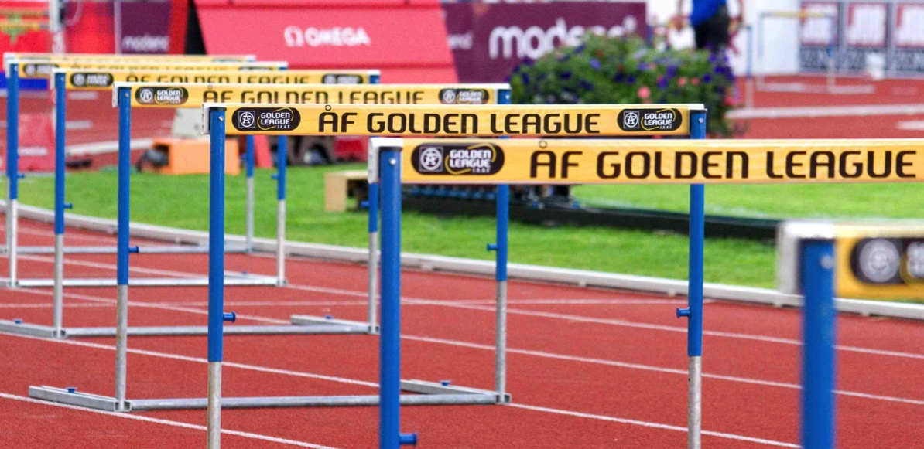
PWF: Raise Thresholds for IP Protection
“The Innovation Dilemma: Intellectual Property and the Historical Legacy of Cumulative Creativity” Dutﬁeld & Suthersanen (U.K.)
http://www.academia.edu/860340/

Slide 66
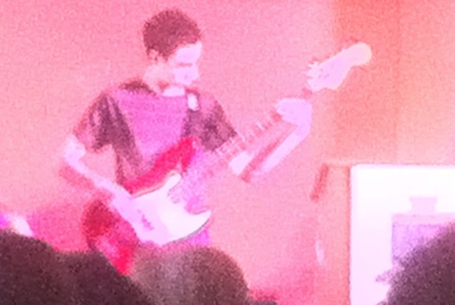
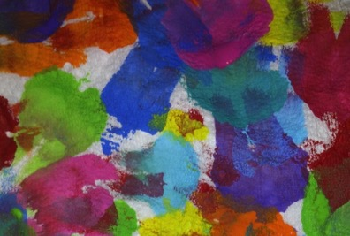
POSSIBLE WAYS FORWARD
Isn’t it Barter Not Theft
(Piracy) IF We Are All
Creators?

Slide 67

POSSIBLE WAYS FORWARD
Double Standard Test yields answer?
ETHICAL SOLUTION?: Embedding a “Do Unto Others” algorithm rule-set which permits us to use the digital bits of others if we share ours to the same standard.
Barter not infringement.

Slide 68
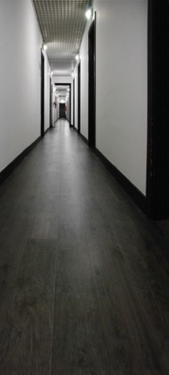
POSSIBLE WAYS FORWARD
Enter “Moral Rights”
Regime of ATTRIBUTION + INTEGRITY
IF TO IP = 1. commercial impact irrelevant;
2. right to be attributed
3. right to protect work’s integrity
IF TO PRIVACY = Attribution & Integrity
includes non-attribution (related to “right to be forgotten”?)
Berne Convention for the Protection of Literary and Artistic
Works (1886):“(1) Independently of the author's economic
rights, and even after the transfer of the said rights, the author
shall have the right to claim authorship of the work and to object to
any distortion, mutilation or other modification of, or other
derogatory action in relation to, the said work, which would be
prejudicial to his honor or reputation.”

Slide 69
Useful Authorities
Cariou v. Prince U.S.C.A. 2nd Circuit 2013 http://scholar.google.ca/scholar_case?case=5189514988129057173&hl=en&as_sdt=2&as_vis=1&oi=scholarr&sa=X&ei=RJxLUrzoHYaOigKinoGIAw&ved=0CCoQgAMoATAA
Seltzer v. Green Day, Inc. U.S.C.A. 9th Circuit 2013http://cdn.ca9.uscourts.gov/datastore/opinions/2013/08/07/11-56573.pdf
Acknowledging Copyright’s Illegitimate Offspring: User-Generated Content and Canadian Copyright Law - Teresa Scassa http://www.press.uottawa.ca/sites/default/files/9780776620848_14.pdf
Copyright in Ideas: Equitable Ownership of Copyright - Robert Tomkowicz http://papers.ssrn.com/sol3/papers.cfm?abstract_id=2213601
The Remixing Dilemma: The Trade-off Between Generativity and Originality - Benjamin Mako Hill, Andrés Monroy-Hernándezhttp://mako.cc/academic/hill_monroy-remixing_dilemma-DRAFT.pdf
Is Data Speech? - Jane Bambauerhttp://papers.ssrn.com/sol3/papers.cfm?abstract_id=2231821
Magic Modders: Alter Art, Ambiguity, and the Ethics of Prosumption - Aaron Trammell http://journals.tdl.org/jvwr/index.php/jvwr/article/view/7040

Slide 70
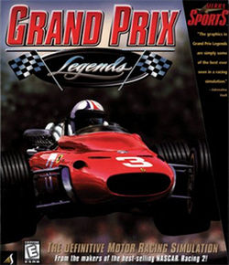
Can I Mod
Yet?

Slide 71
Quest De Integro Ludus (latin for “concerning the whole” Game)

Slide 72
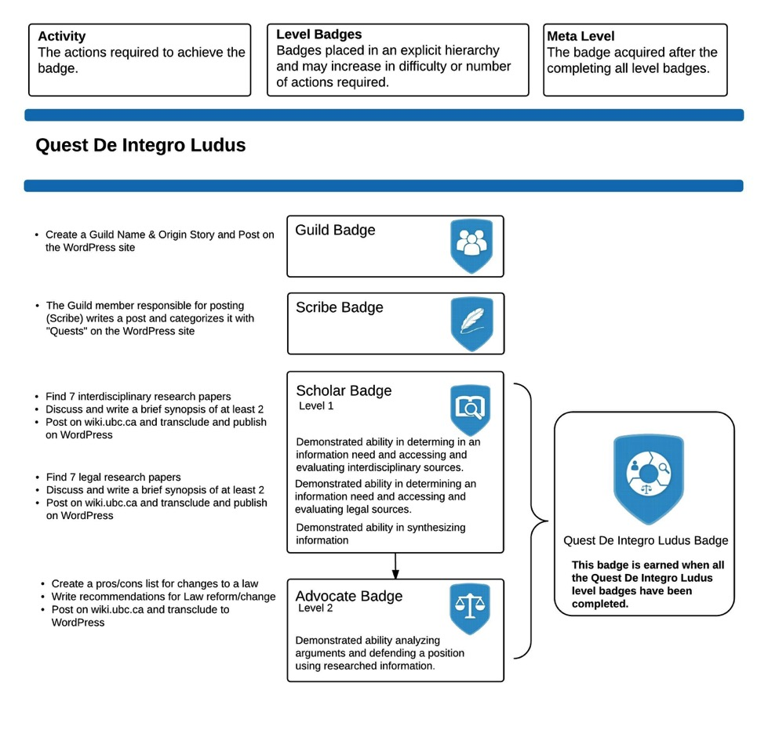

Slide 73
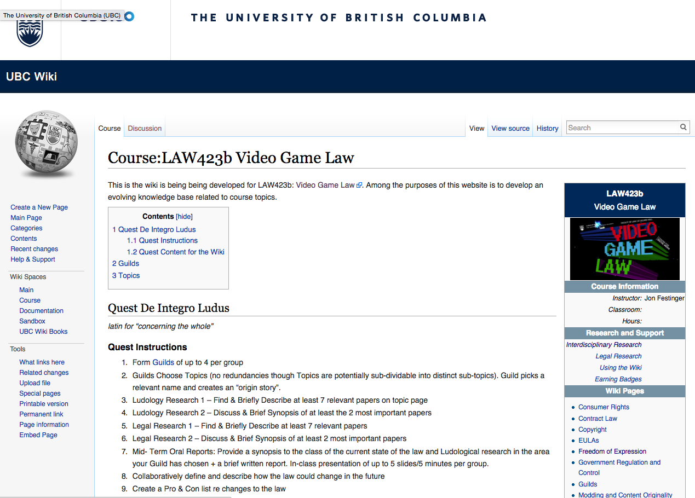

Slide 74
Topics (+Legal Aspects of + Video games)
Topic 1 (Class 2): Freedom of Expression
Topic 2 (Class 3): Copyright
Topic 3 (Classes 4 & 9): Modding & Content Originality
Topic 4 (Class 5): Consumer Rights
Topic 5 (Class 6): Contract Law
Topic 6 (Class 7): EULA’s - Good & Evil
Topic 7 (Class 8): Technology & Change
Topic 8 (Class 10): Violence, Misogyny & Social Issues
Topic 9 (Class 11): Privacy & Surveillance
Topic 10 (Class 11, 12 & 13): Government Regulation & Control

Slide 75
Class Activities
Class 1 Rules Explained: *Guilds of up to 4 per group; *All CC licensed and in Wiki.
Class 2 Guilds Formation Based on Topics (no redundancies though Topics are potentially sub-dividable into distinct sub-topics). Guild picks a relevant name and creates an “origin story”.
Class 3 Ludology Research 1 – Find & Briefly Describe at least 7 relevant papers
Class 4 Ludology Research 2 – Discuss & Brief Synopsis of at least the 2 most important papers
Class 5 Legal Research 1 – Find & Briefly Describe at least 7 relevant papers
Class 6 Legal Research 2 – Discuss & Brief Synopsis of at least 2 most important papers
Class 7 Mid- Term Oral Reports: Provide a synopsis to the class of the current state of the law and Ludological research in the area your Guild has chosen + a brief written report. In-class presentation of up to 5 slides/5 minutes per group.
Class 8 Collaboratively define and describe how the law could change in the future
Class 9 Create a Pro & Con list re changes to the law
Class 10 Recommendations for Law Reform/Change
Class 11 & 12 Oral Opinions/Presentation: 2 sub-groups of the same Guild present up to10 slides of alternating but responsible views on critical aspects of their legal quest in up to 10 minutes. This is not intended as a debate but rather as a technique to fairly illuminate different perspectives on a particular issue.

Slide 76
Next Class
We now done Part A (meme # 1): “Creating”
Entering into (drumroll please…)
Part B (meme#2) of the course:
>>>>>>>>>>>>>>>“CONNECTING”>>>>>>>>>>>>>>>>>
Talk: Creators, Consumers & Users
(sub-nom: intro to contractual conundrums)

Slide 77
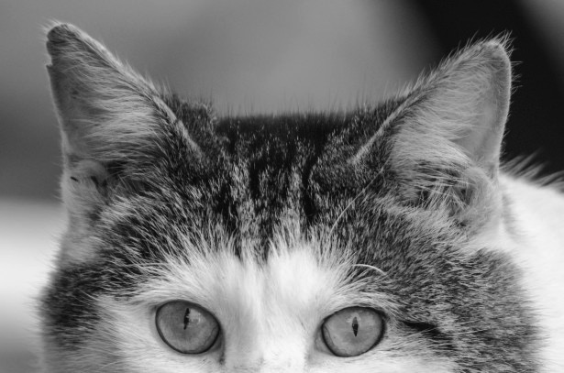
Always include a cat picture

Slide 78
Our Academic Partners

Slide 79

Now Back to Our Regularly Scheduled Programming…

