Slide 1


John Milton Plays Grand Prix Legends
Talk 3
Part A “Creating”
Video Game Law - Fall 2015
UBC Law @ Allard Hall
Jon Festinger Q.C.
Centre for Digital Media
Festinger Law & Strategy
http://videogame.law.ubc.ca
@gamebizlaw
jon_festinger@thecdm.ca

Slide 2

Notifications

Slide 3
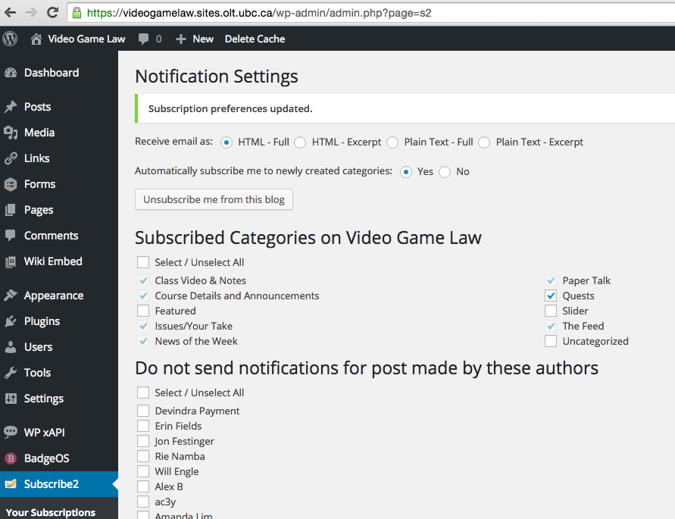
For NoW click-through emails..

Slide 4
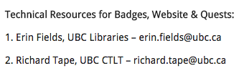
On Syllabus

Slide 5
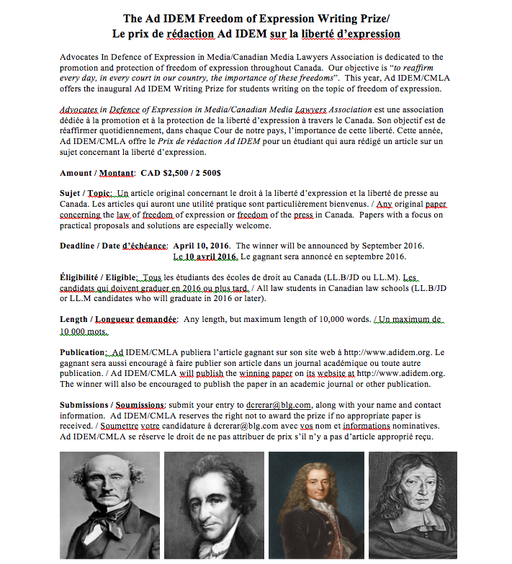
Freedom of Expression Writing Prize

Slide 6
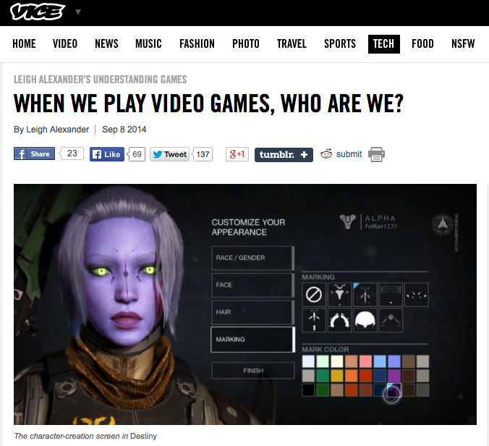
From where we were…
“But games, designed to let us act as some fantasy of ourselves, don’t often ask us to think about what someone else “would” do. That players have choices is considered one of the medium’s exciting traits, but I always struggled a little bit to connect to games that have that kind of openness—am I playing a character, or am I being me?”
http://www.vice.com/read/leigh-alexander-understanding-video-games-column-destiny-105

Slide 7
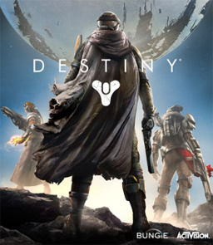
Relates to “social reaction”
(McLuhan-meme)?
Think of the “lens of identity” in relationship to:
Violence in games
Misogyny in games
Privacy & Surveillance in games
Who am I when I play “Destiny”? No idea.

Slide 8
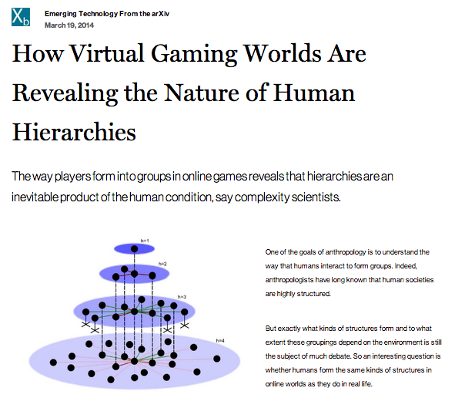

More Evidence
http://www.technologyreview.com/view/525696/how-virtual-gaming-worlds-are-revealing-the-nature-of-human-hierarchies/

Slide 9
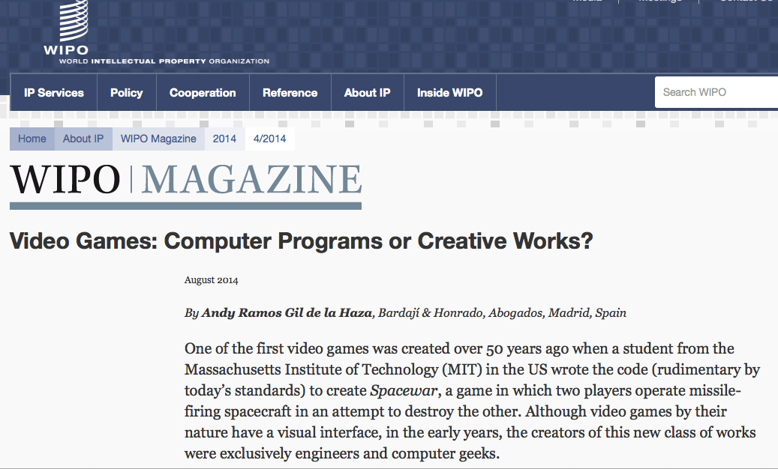
But does copyright law recognize the complexity of the relationships?
http://www.wipo.int/wipo_magazine/en/2014/04/article_0006.html

Slide 10
Computer Programs or Creative Works
“Are specific regulations for video games required?
…the time is ripe for an international discussion to evaluate the merits of adopting specific regulations for video games. Such a discussion might consider:
the legal nature of these modern and complex works;
the relationship between creators and producers;
how to determine who is the creator of a video game;
systems of presumption of transfer of rights to the producers;
fair and equitable compensation systems for creators;…”
However focus is primarily on: 1. “Audio elements”; 2.“Video elements”; 3. “Computer code”
NO MENTION OF ROLE OF THE GAMER – though
(carefully?) not excluded.

Slide 11
Which leads directly back to
“When is it a game (in IP terms)?”
“Games and Other Uncopyrightable Systems” Bruce Boyden (2011) http://www.georgemasonlawreview.org/doc/Boyden_18-2_2011.pdf
“Games therefore pose a number of challenges for copyright and patent law. Yet to date, intellectual property doctrine and scholarship has not really grappled with the slippery nature of games. Indeed, copyright has developed a very simple black-letter rule to handle them: games are not copyrightable. …What could be the purpose of such a rule?”
Two possibilities emerge from the cases. First, several cases describe games, and game rules, as unprotectable ideas… The other possible explanation that emerges from the case law is that games are uncopyrightable systems or processes.”

Slide 12
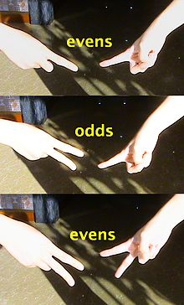
Game That Is Not IP?
Odds
&
Evens

Slide 13

Boyden – the key
Cases denied copyrights in:
(a) systems for the presentation of information;
(b) systems that are expressly designed to allow others to
organize information.
(c) systems of notation
(d) contests and betting systems.
“In all of these situations, the owners of a copyright in a form, description, or set of instructions were attempting to extend their copyright to material for which the user of the work provided the essential content, not its author. That is what made them systems. They were, without that input, empty shells, waiting to be filled.”

Slide 14
Boyden - Conclusion
“Games are systems in exactly the same way. A game, as sold, is only a game form; the content necessary for an instance of the game comes from the players. That is, the game form establishes the environment for play—the game space—and it defines permissible moves and the conditions for winning or drawing. But the game itself is supplied by the players. Games are systems in the same way that the excluded schemes in the cases above were systems.”
“For systems, the rule against the copyrightability of games demonstrates why systems are generally uncopyrightable and why that term has special significance. The term is not merely a synonym for “idea,” or “process.” Systems are shells into which users pour meaning. While they may contain expression themselves, that expression is there merely to facilitate the meaning added by the user. Copyright properly excludes them.”

Slide 15
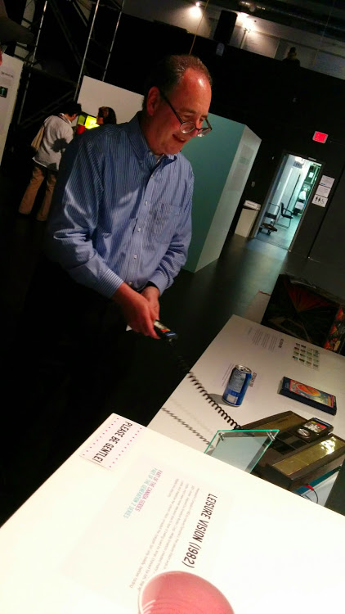
So the key is in the…
Creative Expression of Gamers

Slide 16

Pause…

Slide 17
Reflections?

Slide 18
Key is not in the…
IDEA/
EXPRESSION
DICHOTOMY

Slide 19
Key is not in the…
Holes/Overlaps/Definitions of IP
Copyright: literary, artistic, dramatic or musical works
(including computer programs)
Trade-mark: word, symbol, design (or combination) for wares
& services
Industrial Design: visual features of shape, pattern or ornament (or combination) applied to a finished manufactured article
Patents: new inventions (process, machine, manufacture, composition of matter) or new & useful improvements of an existing invention
“Software Patent”: controversies

Slide 20
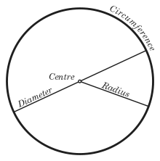
Key seems to be in the…
The “Magic Circle”
“All play moves and has its being within a play-ground marked off
beforehand either materially or ideally, deliberately or as a matter of course.
Just as there is no formal difference between play and ritual, so the
‘consecrated spot’ cannot be formally distinguished from the play-ground.
The arena, the card-table, the magic circle, the temple, the stage, the
screen, the tennis court, the court of justice, etc. are all in form and
function play-grounds, i.e. forbidden spots, isolated, hedged round,
hallowed, within which special rules obtain. All are temporary worlds
within the ordinary world, dedicated to the performance of an act apart.”
Johan Huizinga (1872-1945) in “Homo Ludens: A Study of the Play-Element in
Culture”. Applied to video games by Katie Salen & Eric Zimmerman in “Rules
of Play: Game Design Fundamentals” (2003)

Slide 21
But is Canadian IP Law…
..the same as Boyden’s
interpretations?
(WHAT AN AWESOME
PAPER IDEA)

Slide 22
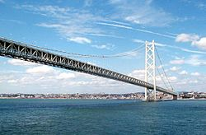
So Boyden is really about the role of creative expression
…creative speech/creative expression = the key
…including the player’s
Expression
…bridges to…

Slide 23
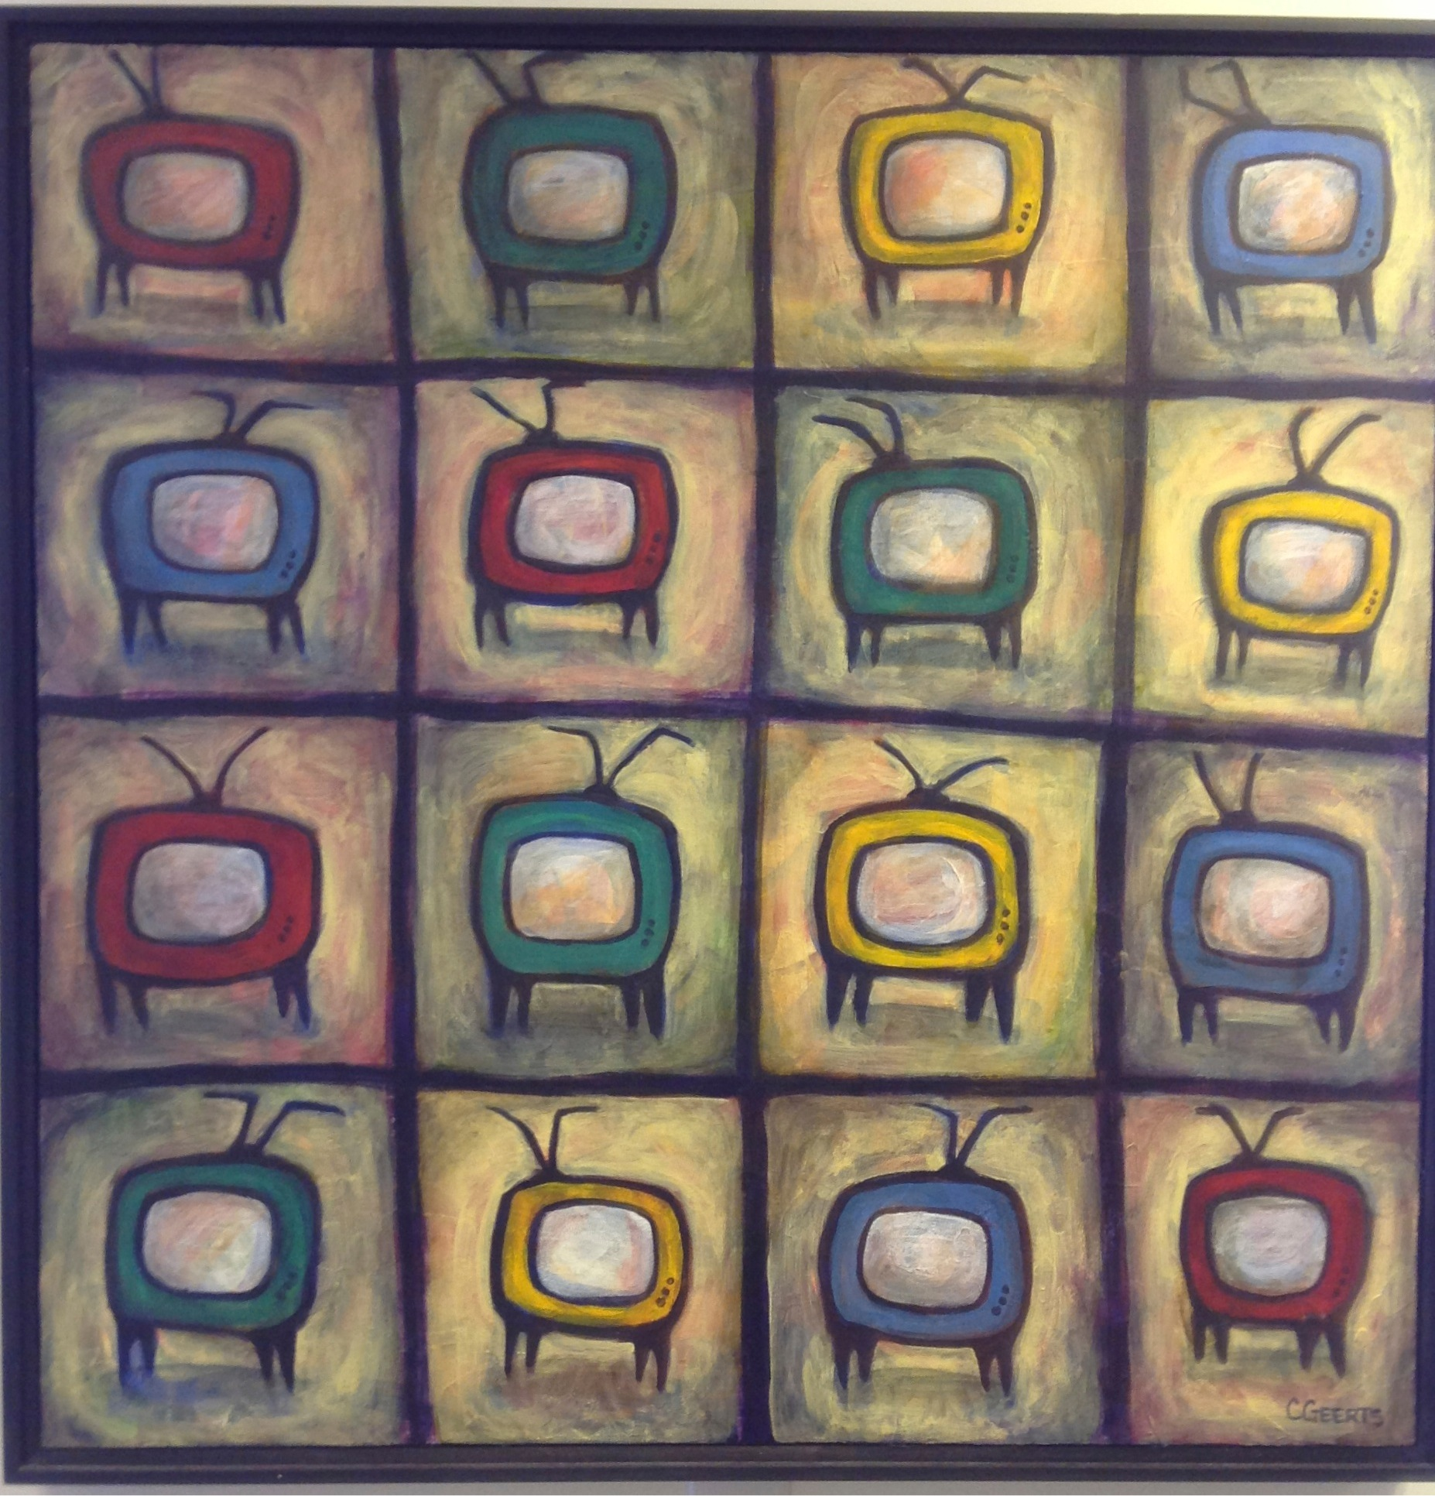
Dichotomies & Paradoxes of Free Expression
Why expression/speech might not be paramount?
Are the real censors legal concepts (or identities) we might not expect?…

Slide 24
Free Expression:
The Usual Suspects
Winters v. New York 68 S. Ct. 665 (U.S. 1948) – magazine case “…we find the specification of publications, prohibited from distribution, too uncertain and indefinite to justify the conviction of this petitioner.”
Montreal v. Arcade Amusements Inc. [1985] 1 SCR 368
By-law of the City of Montréal prohibiting gamers under 18 from being in “amusement arcades” was invalid as being discriminatory.
Brown v. Entertainment Merchants Association 131 S. Ct. 2729 (2011) - California law banning the sale of violent videogames to anyone under 18: “Like the protected books, plays, and movies that preceded them, video games communicate ideas—and even social messages—through many familiar literary devices…That suffices to confer First Amendment protection.”

Slide 25
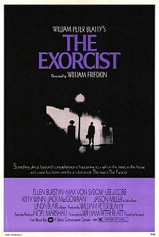
AN EXERCISE
(or an exorcis-m)

Slide 26
Please Self Identify
CREATOR
or
CONNECTOR

Slide 27
Who is a CREATOR?
“The creative is the place where no one else has ever been. You have to leave the city of your comfort and go into the wilderness of your intuition. What you’ll discover will be wonderful. What you’ll discover is yourself.”

Slide 28
Who is a CONNECTOR?
“Creativity is just connecting things. When you ask creative people how they did something, they feel a little guilty because they didn't really do it, they just saw something. It seemed obvious to them after a while. That's because they were able to connect experiences they've had and synthesize new things.”

Slide 29
Please Self Identify
CREATOR
or
CONNECTOR

Slide 30

“Connecting”(remixing)
*“If you wish to make an apple pie from scratch, you must first invent the universe.” – Carl Sagan
* “Creativity is just connecting things. When you ask creative people how
they did something, they feel a little guilty because they didn't really do it, they
just saw something. It seemed obvious to them after a while. That's because
they were able to connect experiences they've had and synthesize new things.”
Steve Jobs in a Wired Magazine interview (Feb. 1996)
http://www.wired.com/wired/archive/4.02/jobs_pr.html
* “Creativity is contagious. Pass it on.” – Albert Einstein
* “All Creative Work is Derivative” – Nina Paley
http://blog.ninapaley.com/2010/02/09/all-creative-work-is-derivative/
* “The great driver of scientific and technological innovation [in the last 600 years has been] the increase in our ability to reach out and exchange ideas with other people, and to borrow other people’s hunches and combine them with our hunches and turn them into something new.” – Steven Johnson “Where Good Ideas Come From: The Natural History of Innovation”

Slide 31
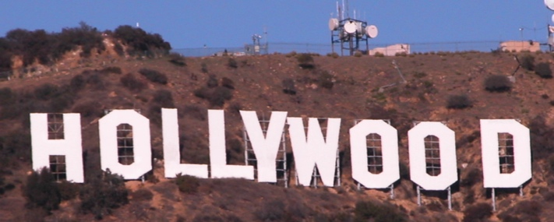
Creating (The “Unique Gift”)
* “The creative is the place where no one else has ever been. You have to leave the city of your comfort and go into the wilderness of your intuition. What you’ll discover will be wonderful. What you’ll discover is yourself.”
* Personal creation mythology deeply rooted in our psyches’: “And G-d said: ‘Let us make man in our image, after our likeness;”(Genesis, Chap. 1 Verse 26)
* View of creativity as uniquely personal (or not) impacts beliefs about copyright & IP (e.g. film & music business – T.V. more flexible?) – consequences of “specialness”

Slide 32
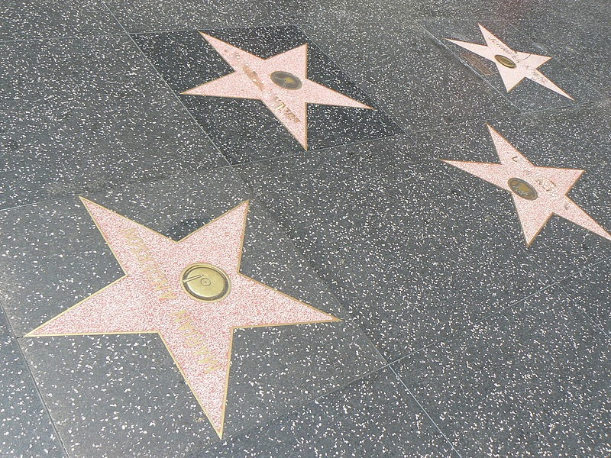
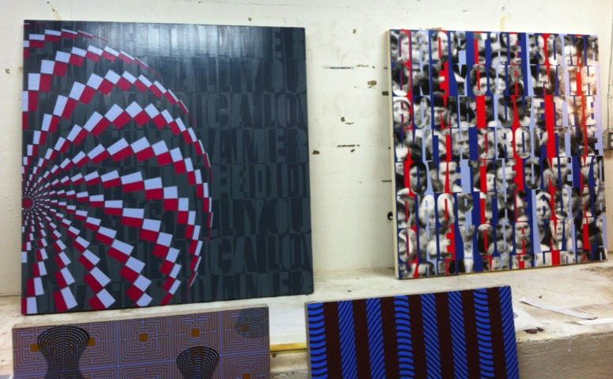
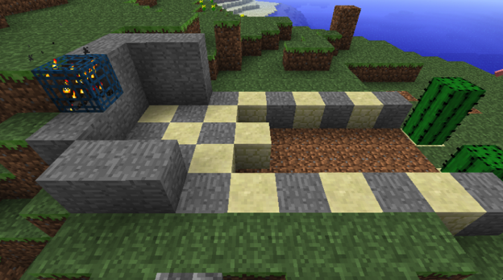
The Result?
* Role and consequences of IP law aligning along according to personal belief: Do Copyright literalists’ adopt “self” generated model of creativity? Do “Connection-ists” adopt open source model?
* the “Hollywood Model” v. the “Remix Model”

Slide 33
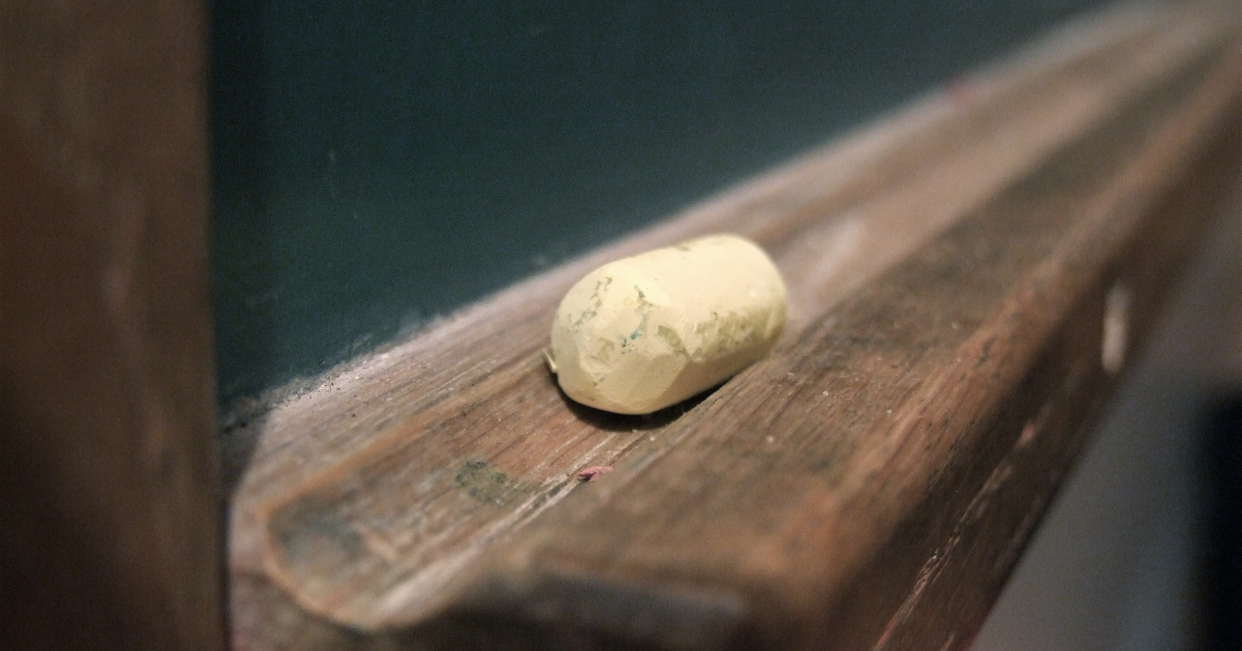
Education as remixing

Slide 34
Learning as Remix
“The Usefulness of Useless Knowledge” By Abraham Flexner, American educator (1939, Harpers)
http://library.ias.edu/files/UsefulnessHarpers.pdf
“…Marconi was inevitable. The real credit for everything that has been done in the field of wireless belongs, as far as such fundamental credit can be definitely assigned to anyone, to Professor Clerk Maxwell who in 1865 carried out certain abstruse and remote calculations in the field of magnetism and electricity…. Other discoveries supplemented Maxwell’s theoretical work during the next fifteen years. Finally in 1887 and 1888 the scientific problem still remaining — the detection and demonstration of the electromagnetic waves which are the carriers of wireless signals — was solved by Heinrich Hertz... The inventor in the legal sense was of course Marconi, but what did Marconi invent? Merely the last technical detail, mainly the now obsolete receiving device called coherer, almost universally discarded.”

Slide 35
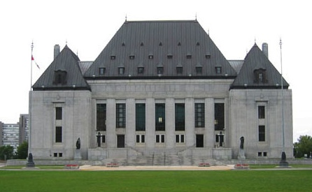
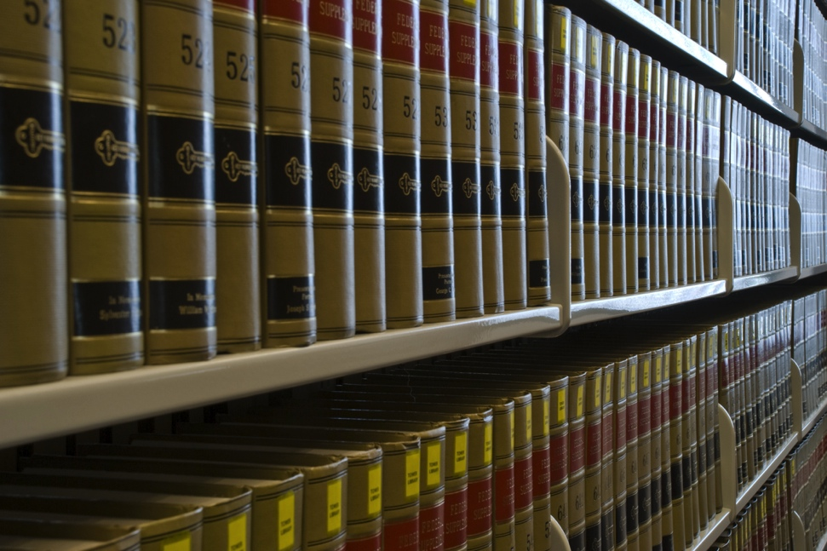
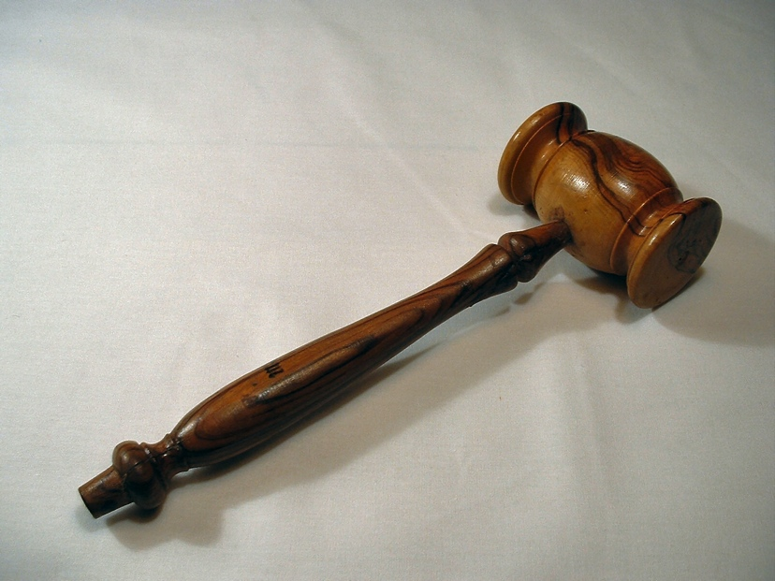
The Common Law as Remix

Slide 36
An Un-enumerated Right
Where is the
FREEDOM
TO
CREAtE ?

Slide 37

Charter of Rights (Canada)
1. The Canadian Charter of Rights and Freedoms guarantees the rights and freedoms set out in it subject only to such reasonable limits prescribed by law as can be demonstrably justified in a free and democratic society.
2. Everyone has the following fundamental freedoms:
(a) freedom of conscience and religion;
(b) freedom of thought, belief, opinion and expression, including freedom of the press and other media of communication;

Slide 38

U.S. Constitution, 1st Amendment
“Congress shall make no law respecting an establishment of religion, or prohibiting the free exercise thereof; or abridging the freedom of speech, or of the press; or the right of the people peaceably to assemble, and to petition the Government for a redress of grievances.”

Slide 39

The Universal Declaration of Human Rights
Article 18. Everyone has the right to freedom of thought, conscience and religion; this right includes freedom to change his religion or belief, and freedom, either alone or in community with others and in public or private, to manifest his religion or belief in teaching, practice, worship and observance.
Article 19. Everyone has the right to freedom of opinion and expression; this right includes freedom to hold opinions without interference and to seek, receive and impart information and ideas through any media and regardless of frontiers.

Slide 40

Closest to establishing a “Right to CREAtE”?
“Girls Lean Back Everywhere: The Law of Obscenity and the Assault on Genius” - Edward De Grazia
Query: Is all
Art political?

Slide 41
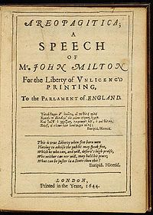
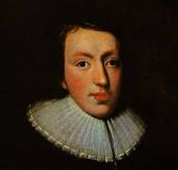
But always good to get back to basics:
Areopagitica by John Milton (1644)

Slide 42
“For Books are not absolutely dead things, but doe contain a potencie of life in them to be as active as that soule was whose progeny they are; nay they do preserve as in a violl the purest efficacie and extraction of that living intellect that bred them…
And though all the windes of doctrin were let loose to play upon the earth, so Truth be in the field, we do injuriously, by licencing and prohibiting to misdoubt her strength. Let her and Falshood grapple; who ever knew Truth put to the wors, in a free and open encounter
Lords and Commons of England, consider what Nation it is whereof ye are, and whereof ye are the governours: a Nation not slow and dull, but of a quick, ingenious, and piercing spirit, acute to invent, suttle and sinewy to discours, not beneath the reach of any point the highest that human capacity can soar to.”

Slide 43
The point being…
We are back to:
Boyden – games are “systems” that need the creative acts of gamers (otherwise no copyright)
McLuhan – games as “social reaction”
“Connector” – creativity neither arises nor has its destiny in isolation

Slide 44
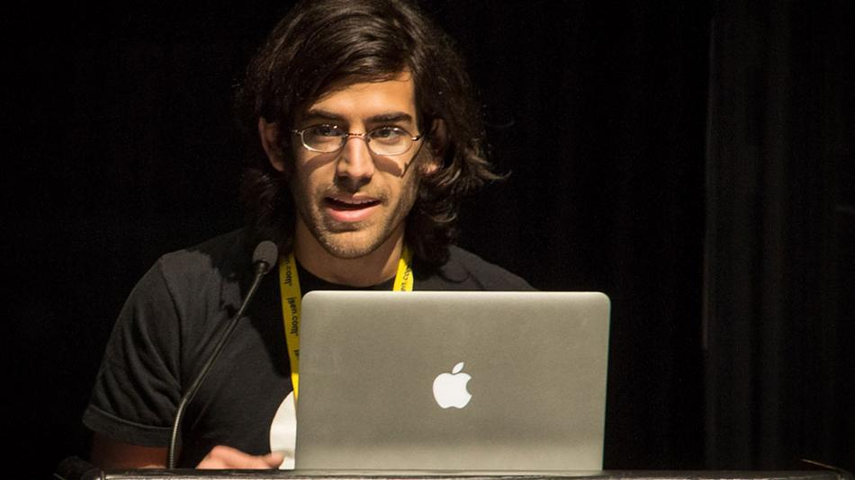
“RIGHTS” CAN BE LOADED….
…they can obscure the debate….
…encouraging literalism & dogma to take
root more easily:
“[s]tealing is stealing whether you use a computer command or a crowbar, and whether you take documents, data or dollars. It is equally harmful to the victim whether you sell what you have stolen or give it away.”*
*The United States Attorney’s Office, District of Massachusetts, Press Release, “Alleged Hacker Charged with Stealing over Four Million Documents from MIT Network” (19 July 2011), online: <http://www.justice.gov/usao/ma/news/2011/July/SwartzAaronPR.html>

Slide 45
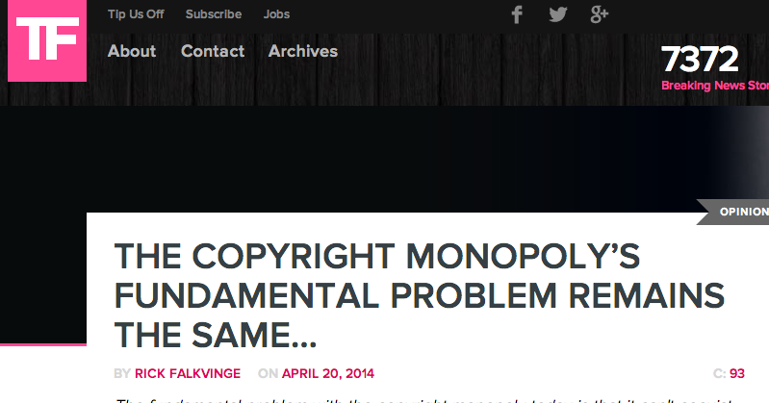
“So we’re at a crossroads where we as a society must determine which is more important – the right to communicate in private at all, or the obsolete distribution and manufacturing monopoly of an entertainment industry. These two are completely mutually exclusive and cannot coexist. This is, and has been, the problem since the cassette tape.”
https://torrentfreak.com/the-fundamental-problem-with-the-copyright-monopoly-140420/

Slide 46
THE LITTERALIST DICHOTOMY
The Symptom: Seemingly opposite positioning between privacy literalists and IP literalists – Double Standards Test
Privacy literalists tend to be more “open source” / “free info”
“IP literalists” tend to be more comfortable with commercial exploitation of personal data
IS THERE A Core Common Denominator?
"Feeling" those 1's and 0's "belong" to me.

Slide 47

This is the black hole?…

Slide 48
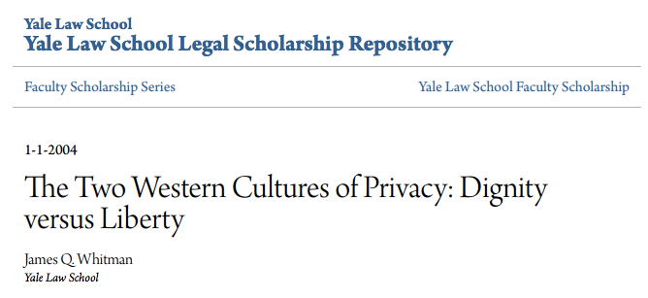
Perhaps “moral rights” as a model*
http://digitalcommons.law.yale.edu/cgi/viewcontent.cgi?article=1647&context=fss_papers
*Note: Aligns with “Right to be Forgotten” creating further conundrums as “Liberty” aligns with “Property”

Slide 49
Reconciling creativity, privacy & IP
What is perhaps most interesting about “moral rights” is that it is the (only) legal concept that assumes Creativity?
Privacy moves from being a physical concept based on proximity to a network concept based on audience “permissions”
Copyright moves from putative property right to a network concept based on audience “permissions” = AKA “Users Rights” limited by “Moral Rights”
Permissions revocable
Concept of
“Intellectual Property”:
Itself a “Bug” not a “Feature”?

Slide 50
The
Real
Question…

Slide 51
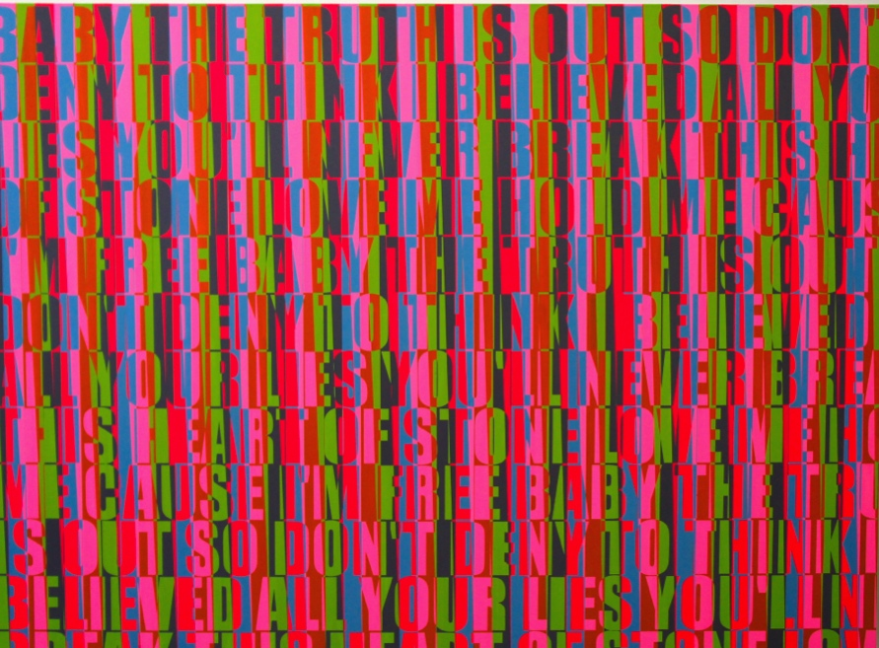
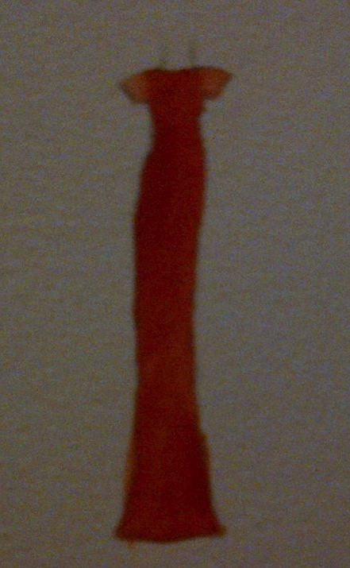
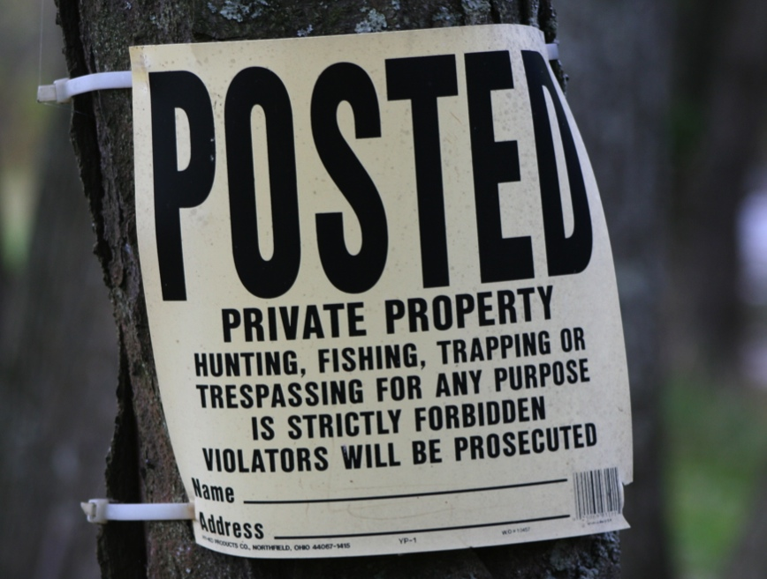
IS Creativity More
Important than Property?

Slide 52

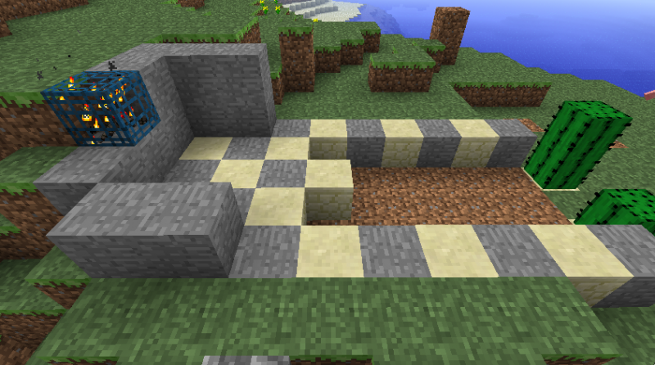
Videogames as Metaphor
Video Games as proof of mutually reliant and merged creativity?
Player’s creative input is necessary to the game & game designer. Game designer’s creativity is (obviously) necessary for the game to exist.
Video-games: Either exception where all creativity is connected (by design) or more proof that all creativity is connected generally???

Slide 53
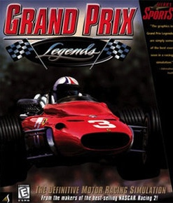
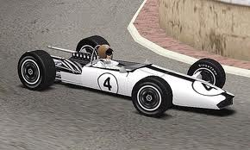

…Evolving a
single standard:
For CREATORS as USERS, &
For USERS as CREATORS

Slide 54
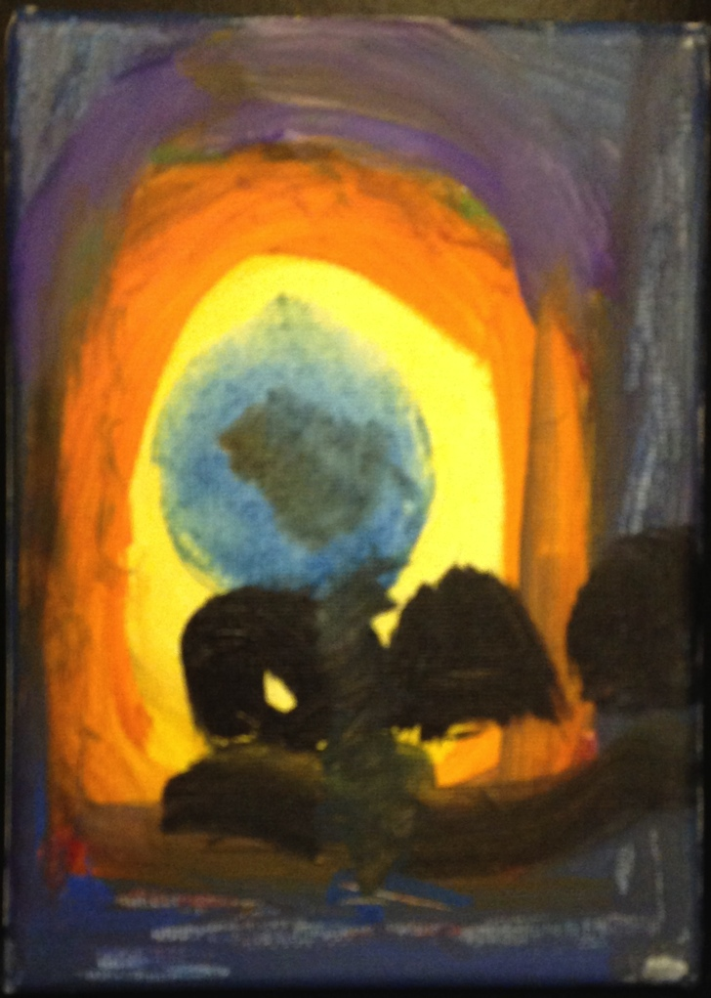
Right to Remix/Mod/CREAtE ?
“Right to CREAtE”
Not “Right in the
Creation”
Right to Remix-CREAtE-Mod as a creative/expressive right rather than an IP right/property protection.

Slide 55

Pause once again…

Slide 56
Reactions?

Slide 57
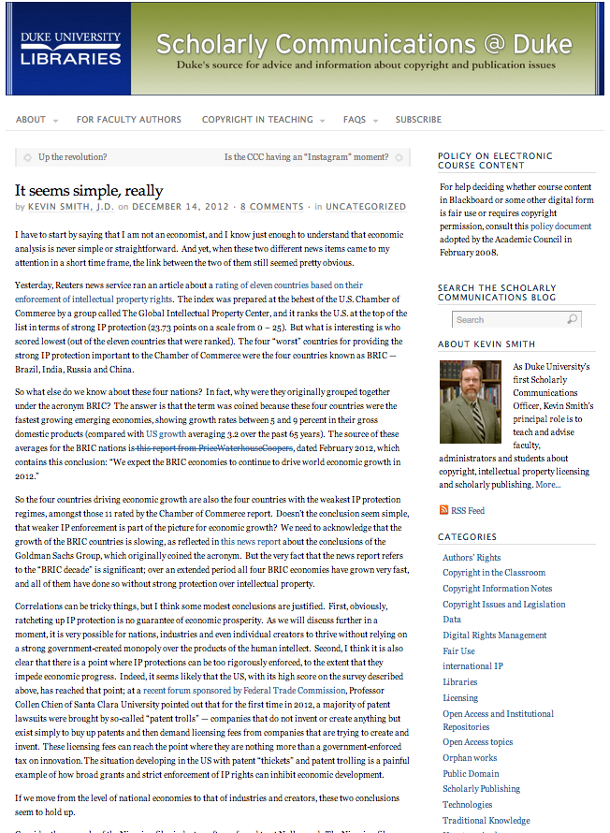
One more (wild & crazy) thing on freedoms
Economic growth & IP freedoms (freedom from IP) – Where would a data-crunch take us?
“It seems simple, really” (Kevin Smith @ Duke)
CORRELATES STRONG ECONOMIES & WEAK IP LAWS
(BRIC – Brazil, India, Russia and China)
http://blogs.library.duke.edu/scholcomm/2012/12/14/it-seems-simple-really/

Slide 58
My Version: attempt to correlate
Economic Success & Facilitating Creativity but add respect for Fundamental Rights
CAUTION: (entirely unscientific – gut and Google…)
1.The World Justice Project | Rule of Law Index 2012-2013 (241 pages): Highest Rankings in “Fundamental Rights” are Sweden, Denmark & Norway. Highest Rankings in “Open Government” are Sweden, Netherlands & Norway.
2. Worlds best economies in 2012 (World Economic Forum – Global Competitiveness Report): Finland (3rd), Sweden (4th) & the Netherlands (5th)
3. Global Creativity Index (Martin Prosperity Institute): Sweden (1st), Finland (3rd) & Denmark (4th)
WHAT LEVELS OF CREATIVE FREEDOMS ARE IN
THOSE COUNTRIES IP/COPYRIGHT REGIMES?

Slide 59
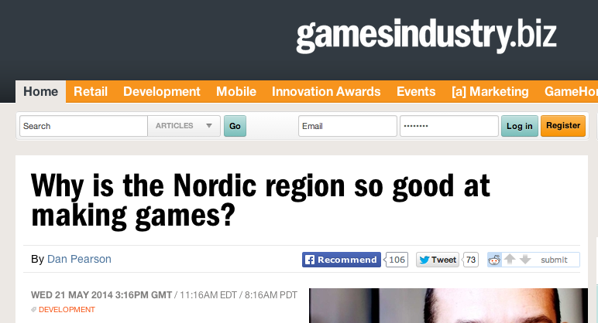
http://www.gamesindustry.biz/articles/2014-05-21-why-is-the-nordic-region-so-good-at-making-games

Slide 60
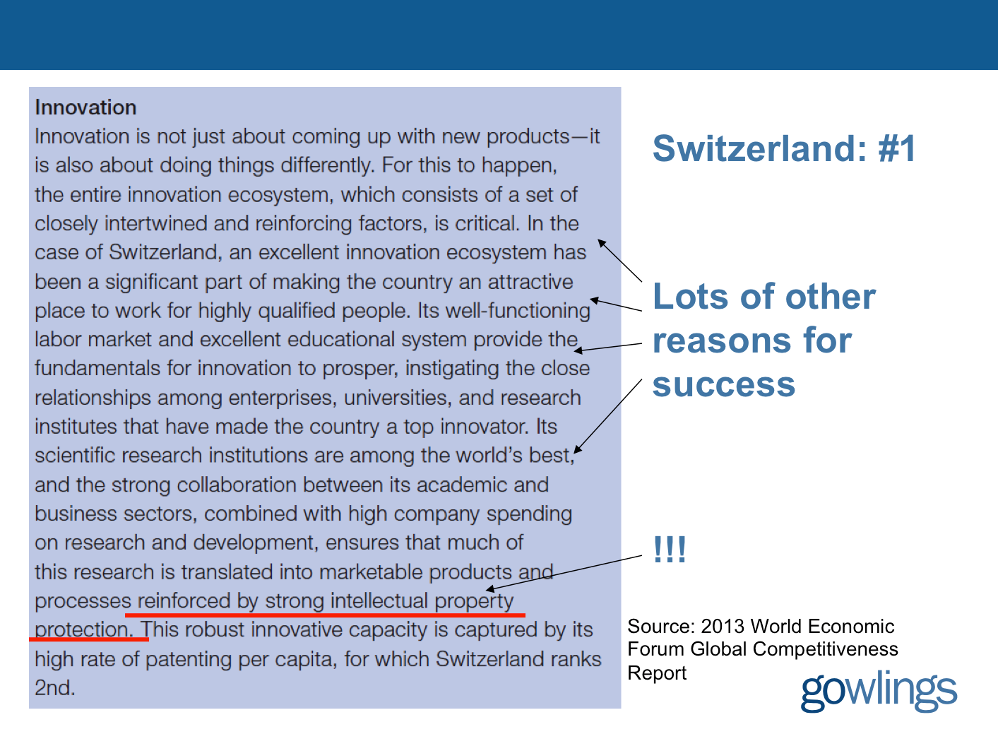
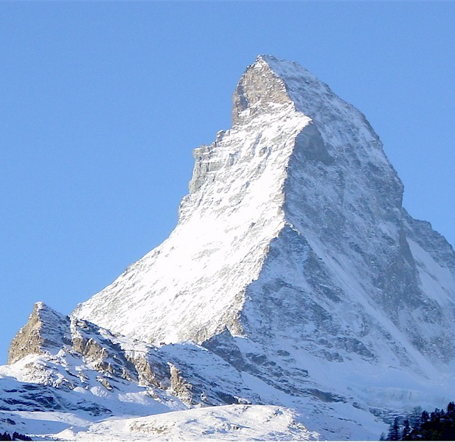
R^3 (Roch Ripley Response)
Switzerland

Slide 61
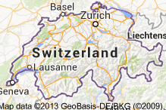

Not many video game companies..
“indexmundi” http://www.indexmundi.com/switzerland/industries.html
“Industries: machinery, chemicals, watches,
textiles, precision instruments, tourism, banking,
and insurance”

Slide 62
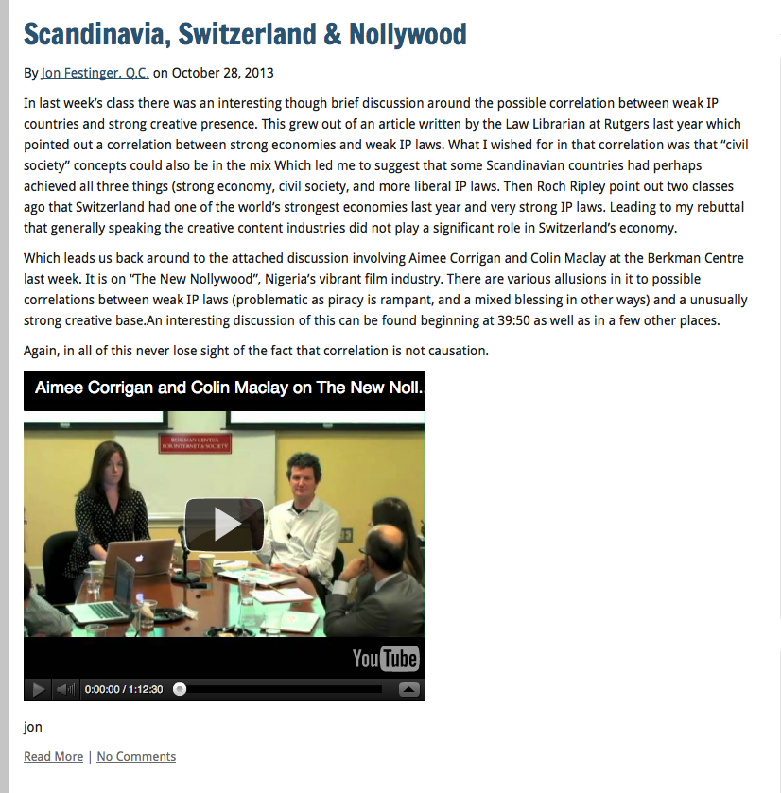
Connection
Between
Creativity &
Weak IP Laws?

Slide 63
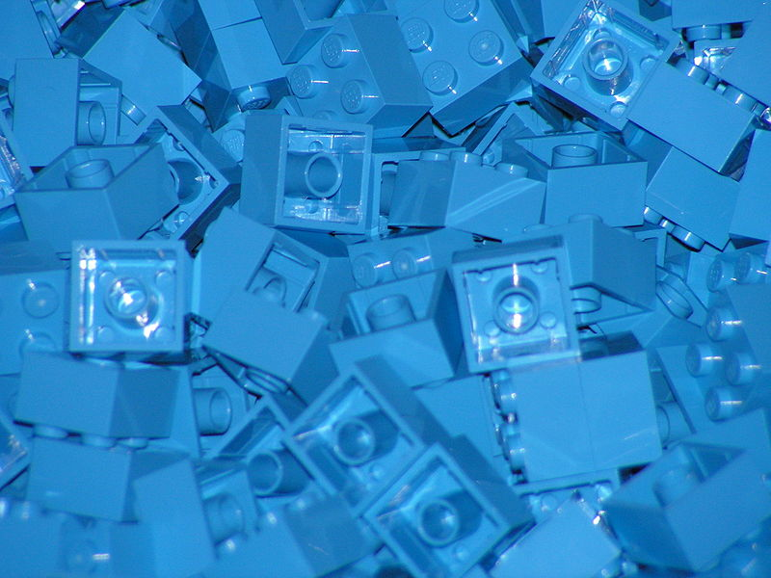
Next Class: Creating (meme) Part 3
Now that we have creativity, content & contradictions (partially) accounted for, what is the next horizon?
Remixing in games…
Next week…

Slide 64
Quest De Integro Ludus (latin for “concerning the whole” Game)

Slide 65
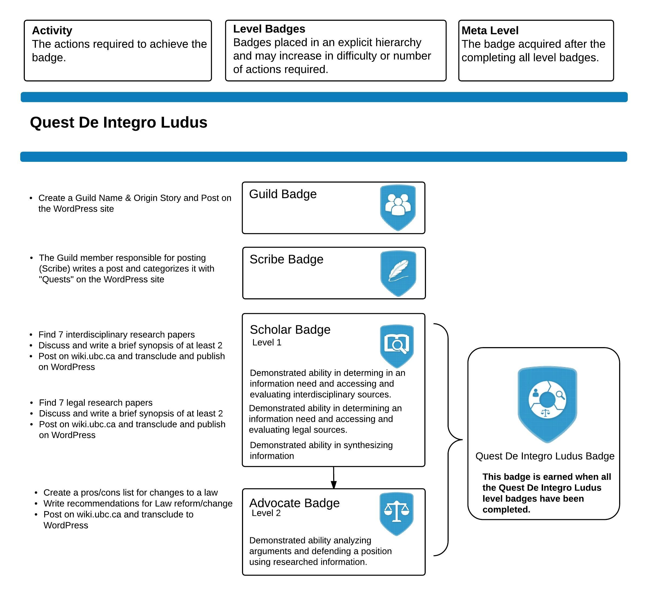

Slide 66
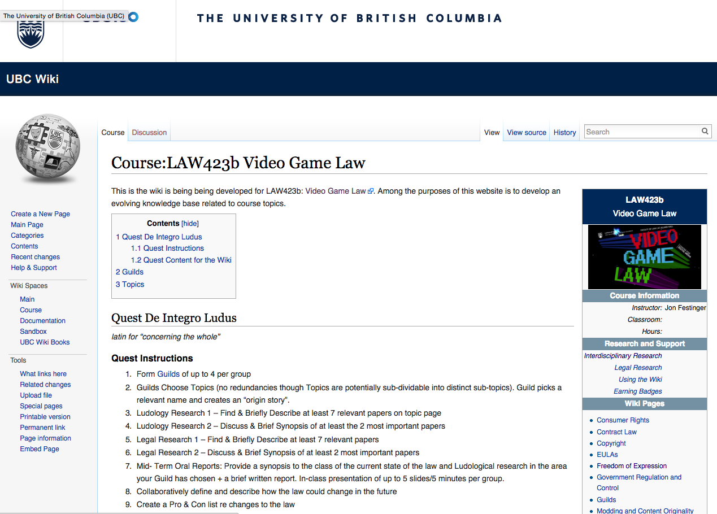

Slide 67
Topics (+Legal Aspects of + Video games)
Topic 1 (Class 2): Freedom of Expression
Topic 2 (Class 3): Copyright
Topic 3 (Classes 4 & 9): Modding & Content Originality
Topic 4 (Class 5): Consumer Rights
Topic 5 (Class 6): Contract Law
Topic 6 (Class 7): EULA’s - Good & Evil
Topic 7 (Class 8): Technology & Change
Topic 8 (Class 10): Violence, Misogyny & Social Issues
Topic 9 (Class 11): Privacy & Surveillance
Topic 10 (Class 11, 12 & 13): Government Regulation & Control

Slide 68
Class Activities
Class 1 Rules Explained: *Guilds of up to 4 per group; *All CC licensed and in Wiki.
Class 2 Guilds Formation Based on Topics (no redundancies though Topics are potentially sub-dividable into distinct sub-topics). Guild picks a relevant name and creates an “origin story”.
Class 3 Ludology Research 1 – Find & Briefly Describe at least 7 relevant papers
Class 4 Ludology Research 2 – Discuss & Brief Synopsis of at least the 2 most important papers
Class 5 Legal Research 1 – Find & Briefly Describe at least 7 relevant papers
Class 6 Legal Research 2 – Discuss & Brief Synopsis of at least 2 most important papers
Class 7 Mid- Term Oral Reports: Provide a synopsis to the class of the current state of the law and Ludological research in the area your Guild has chosen + a brief written report. In-class presentation of up to 5 slides/5 minutes per group.
Class 8 Collaboratively define and describe how the law could change in the future
Class 9 Create a Pro & Con list re changes to the law
Class 10 Recommendations for Law Reform/Change
Class 11 & 12 Oral Opinions/Presentation: 2 sub-groups of the same Guild present up to10 slides of alternating but responsible views on critical aspects of their legal quest in up to 10 minutes. This is not intended as a debate but rather as a technique to fairly illuminate different perspectives on a particular issue.

Slide 69

Always include a cat picture

Slide 70
Our Academic Partners

