Slide 1


Introduction
Talk 1
Video Game Law 2015
UBC Law @ Allard Hall
Jon Festinger Q.C.
Centre for Digital Media
Festinger Law & Strategy
http://videogame.law.ubc.ca
@gamebizlaw
jon_festinger@thecdm.ca

Slide 2
http://videogame.law.ubc.ca

Slide 3
For full privileges on the website
1. Please create an account at http://cms.ubc.ca/ using your CWL.
2. Once you create an account and sign in at http://cms.ubc.ca/ you can click your name in the top right. Half way down the following page will be your WordPress email address.
3. Send me your WordPress email address at jfestinger@telus.net or at jon@fblawstrategy.com
4. Then, I will invite you to participate with authoring privileges via your WordPress email address.

Slide 4

Guest: Megan Coyle

Slide 5
Megan grew up on Mayne Island where she enjoyed mastering the first 3 Mario games on Nintendo, as well as such classics as DigDug, Elevator Action and Excite Bike which came on one of those almost certainly modded and not sold in Canada "76 games in one" cartridges from Hong Kong.
On a high school exchange to Japan she fell in love with arcades generally and Dance Dance Revolution in particular, following which she lived in whistler for a year without TV, computer, or phone, let alone any games.
Megan did her undergrad at UBC in Linguistics and worked at the Law School as an administrative assistant for 4 years before eventually being inspired to apply here as a student. She graduated last May, and is articling at DLA Piper where she also summered.

Slide 6

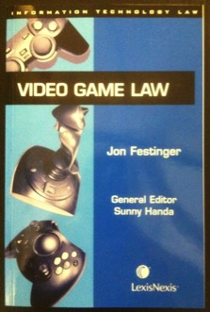
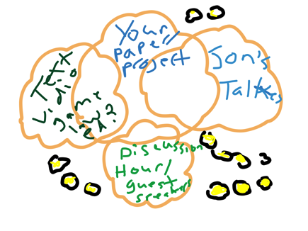
Origins
You are the 9th year cohort
Originally a book; but a course outline before a book..
Version 1.0: 2005/2006 UBC/UVic video experiment
Version 2.0: Started from scratch in Spring 2013
1st year – blog-site; 2nd year – website; last year –badges.
This year – Version 2.5 (or more)
http://videogame.law.ubc.ca Thanks to UBC CTLT

Slide 7
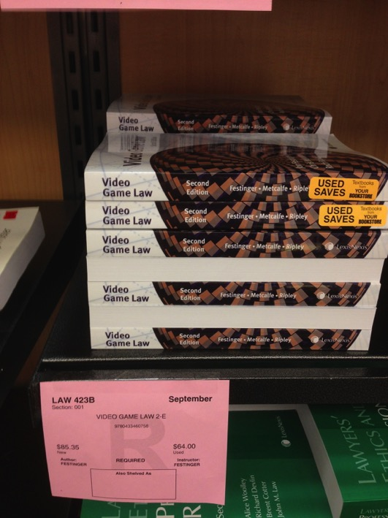
Textbook???

Slide 8
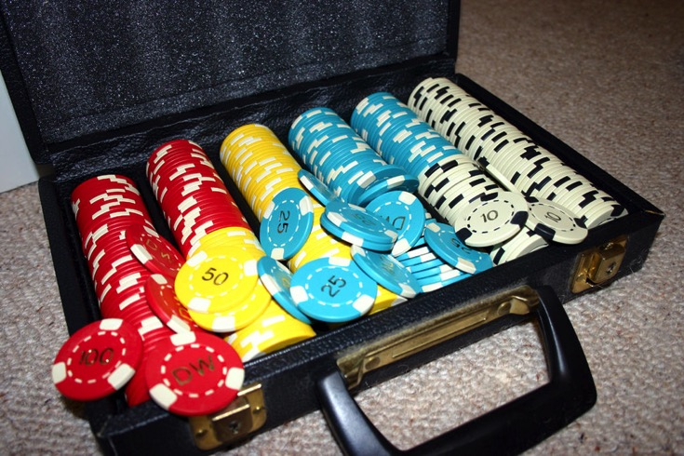
Why 2.5?
2 to 3 Credits

Slide 9

Meaning what exactly…

Slide 10

We’ll get there shortly…

Slide 11

Pedagogic Goals
One word: ENGAGEMENT
Two words: CREATING PERSPECTIVE
Three words: APPRECIATING (LEGAL)
COMPLEXITY
Eve Online

Slide 12
A Modest & Entirely Self Serving
Pedagogic Theory
Engagement is interactivity
What is the most engaging form of goal-oriented interactivity requiring skills growth, path choices & reflection?……
…GAMES (of course)
So think of this as the “MMORPG” of law courses (ok, it’s not quite massive…yet)
World of
LawyerCraft

Slide 13

Meaning what exactly?…
* “Quest” = Great paper, great contributions
* “Open World” = Vast terrain to be explored and navigated in your own way & on your unique (non-linear) path
* Can be played from a “1st or 3rd person” perspective
* Provide tools for “user generated content”
* Provide additional “downloadable content”
* Encourage “multiplayer” engagement
* In other words Assassin’s Creed IV

Slide 14

Irrelevant seeking cred moment
Fan-boy pilgrimage this summer to Monteriggioni, Italy (Assassin's Creed 2 & Assassin's Creed: Brotherhood)
August 26, 2015

Slide 15

Now Back to Our Regularly Scheduled Programming…

Slide 16
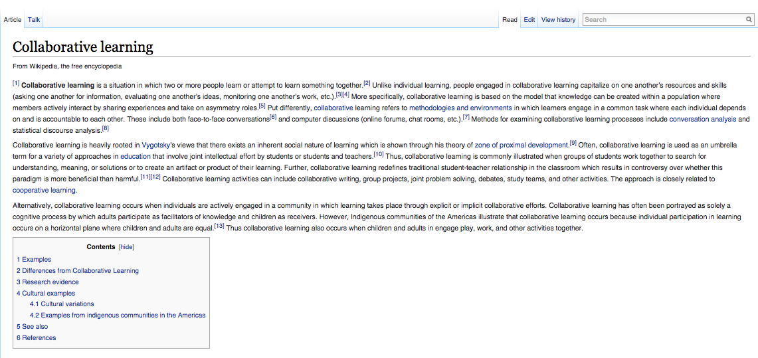
Oh yes…New Pedagogic Goals…
1. Collaborative learning…

Slide 17
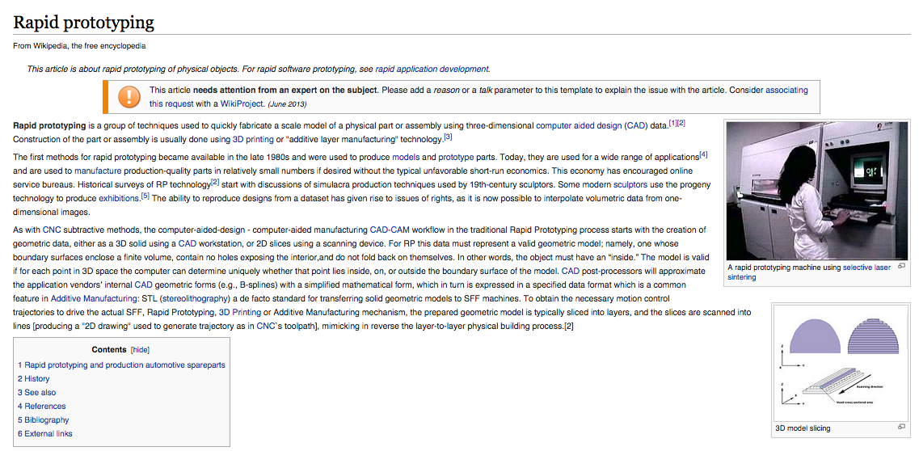
&…
2. Rapid Pro-typing

Slide 18
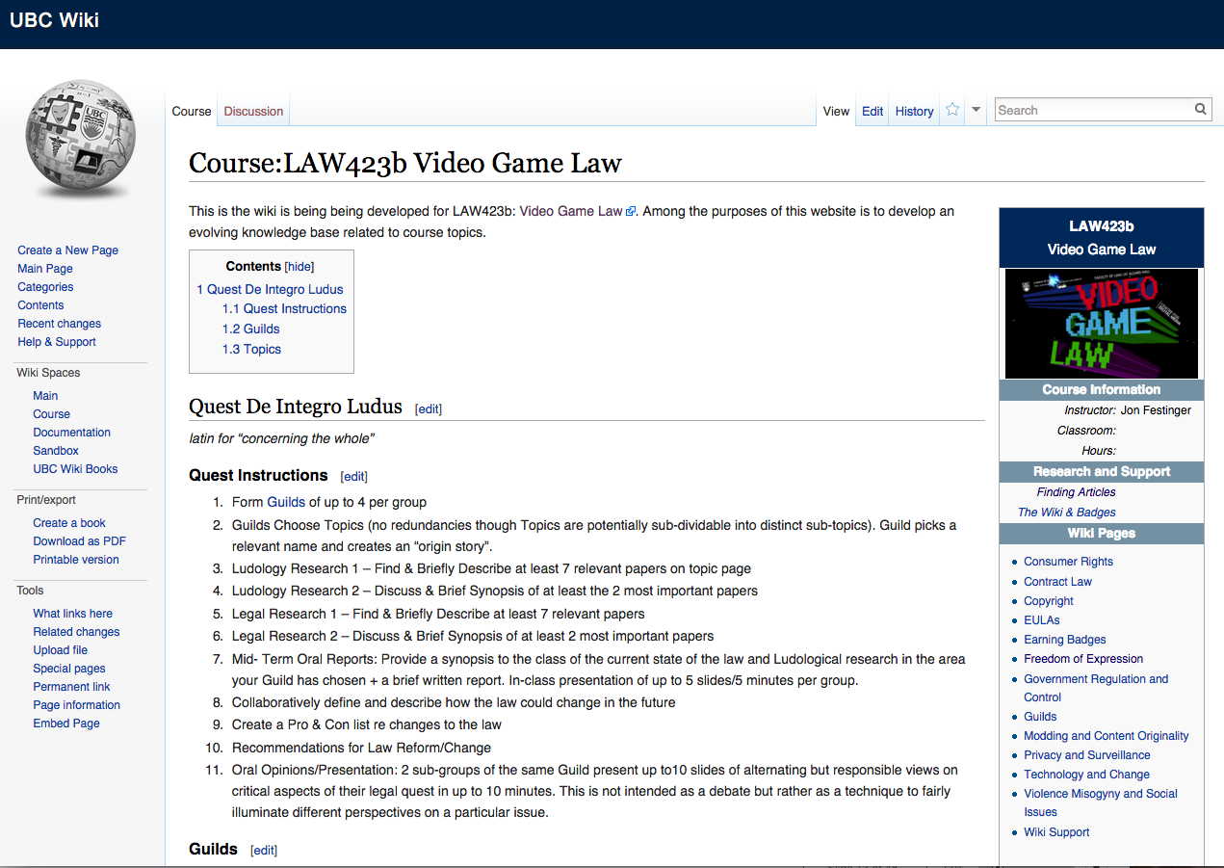
Welcome to…

Slide 19

DONE IN-CLASS…
(sigh…)
More next week…

Slide 20
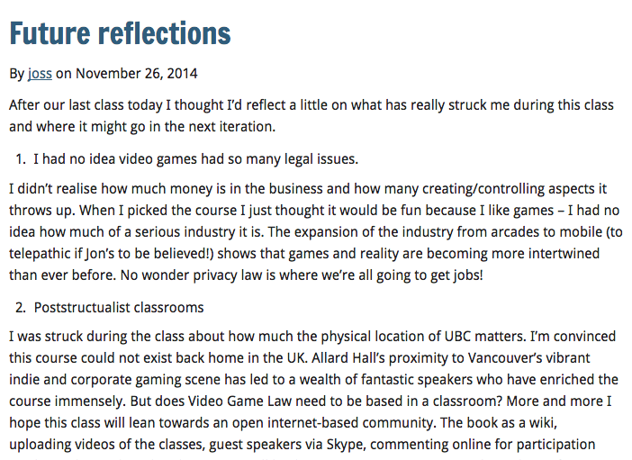

Slide 21

Notable (but formative) Failure…
The iTune U course that never was…

Slide 22
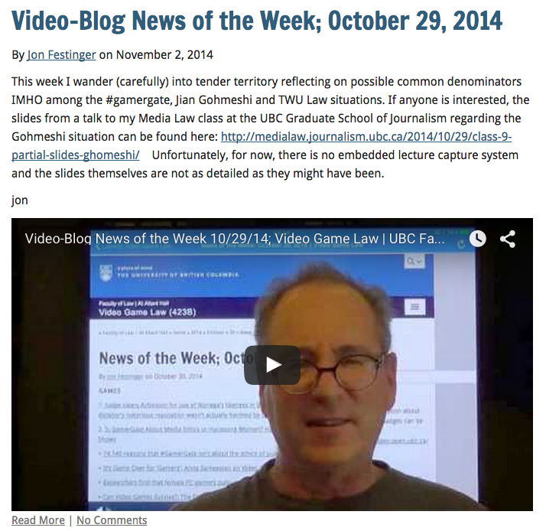
And maybe not a failure but…

Slide 23
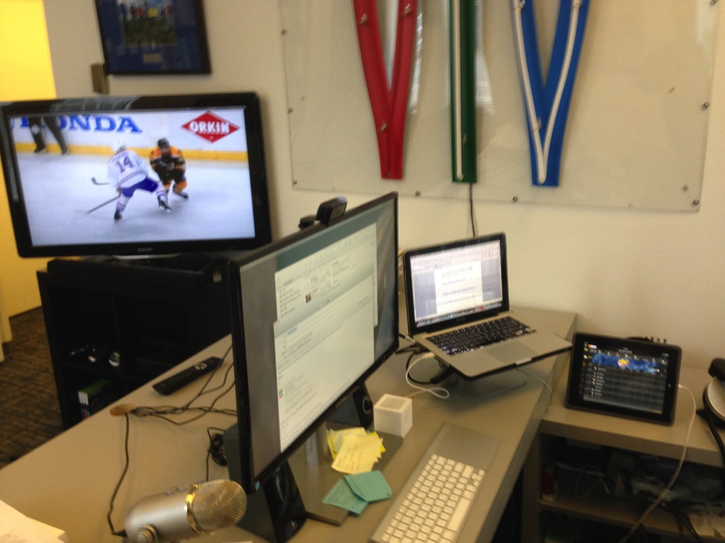
Computers Strongly Encouraged…

Slide 24
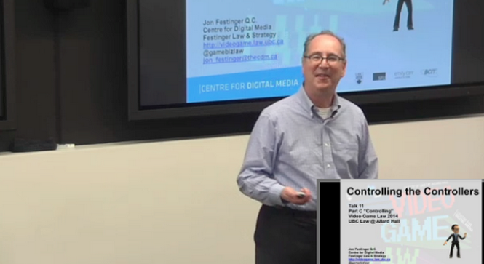
Lecture Capture

Slide 25

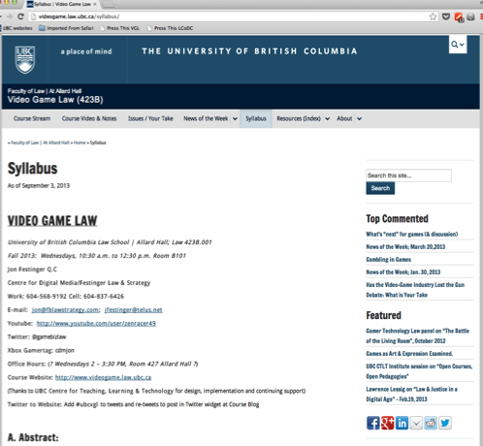
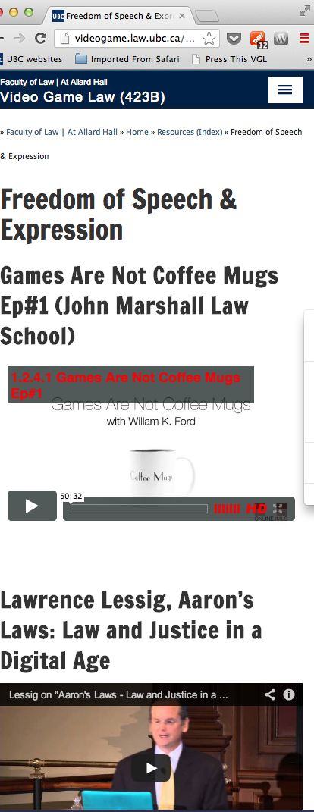
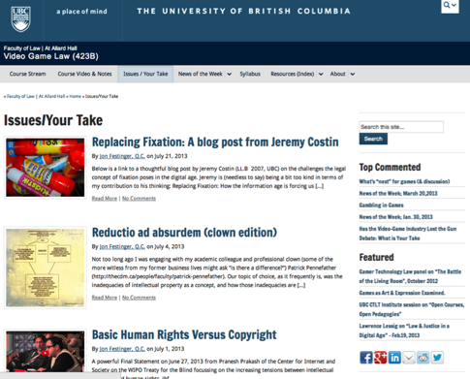

http://videogame.law.ubc.ca

Slide 26
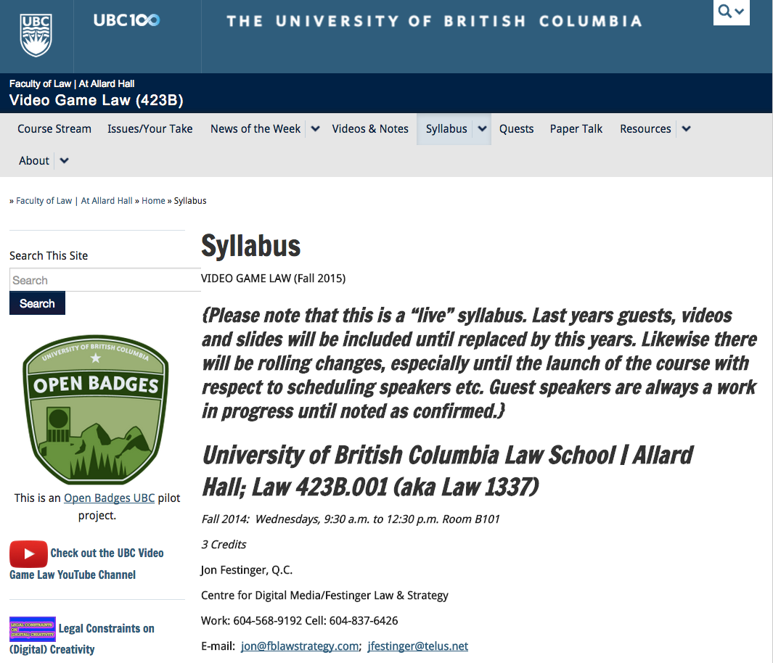
“Living” Syllabus is there…

Slide 27
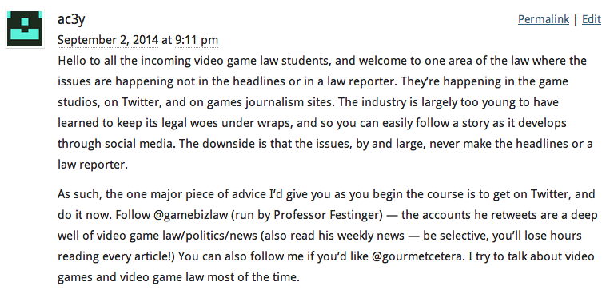
Three Tips:
Don’t feel your posts have to be perfect. Engaging and engaging others is the key.
Please tweet #ubcvgl
You can’t cover all the material – remember “this is an open world game – heed former students advice re News-of-the-Week

Slide 28
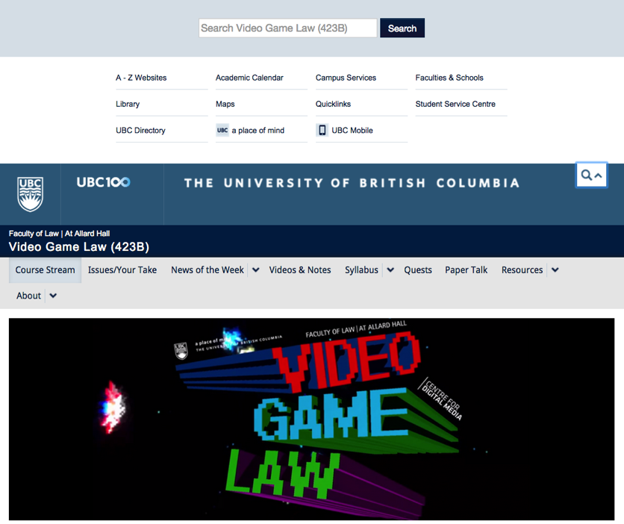

Real Search…

Slide 29


Slide 30


Slide 31
Why Open?
On-line is an on-going experiment in creating as much educational engagement as possible.
Open tools = easier to use, more scale-able with less obsolescence.
Philosophical advantage of being aligned with values of openness so important to both legal and educational institutions.
Naturally encourages a broader sense of the course and its subject matter. It also provides the potential to define the course and its educational mission in terms of the community of those interested in it.
Creative Commons Attribution License allowing all content to be reused and remixed.
Open Educational Resource – hopefully encouraging further contributions in the area.

Slide 32
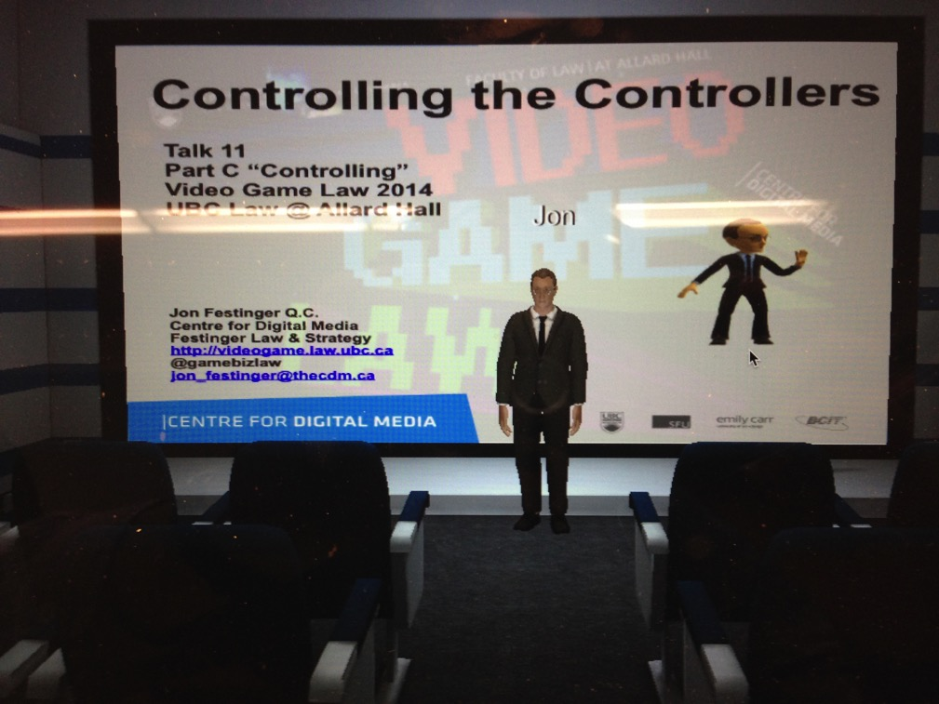
Project Oculus 2 ?

Slide 33
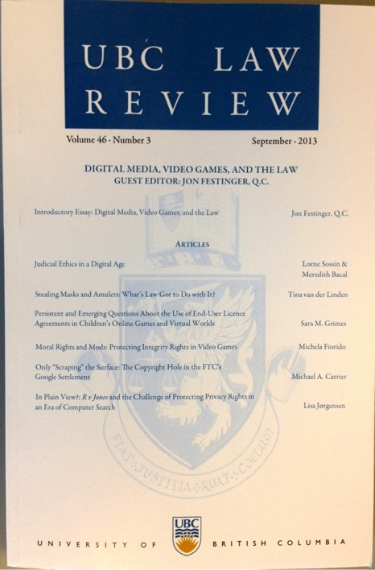
Special Issue of the UBC Law Review on “Digital Media, Video Games, And the Law” available…
http://ubclawreview.ca/issues/no3sept/

Slide 34
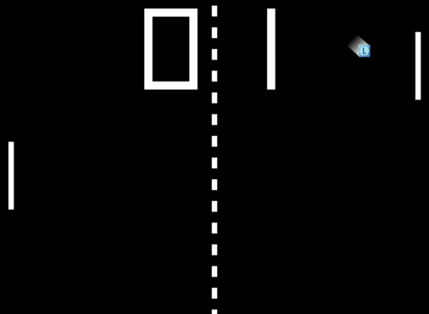



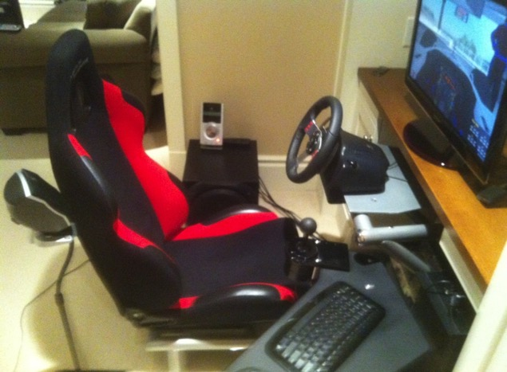
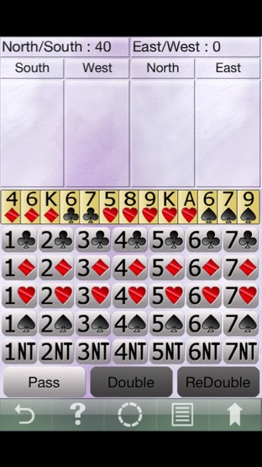
My Gaming Bio

Slide 35

But now…

Slide 36
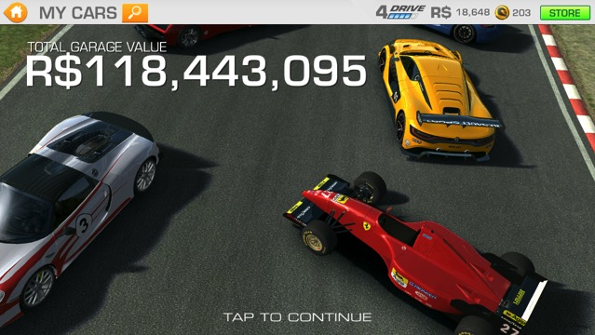
…purely as research into video game addiction (of course)…

Slide 37
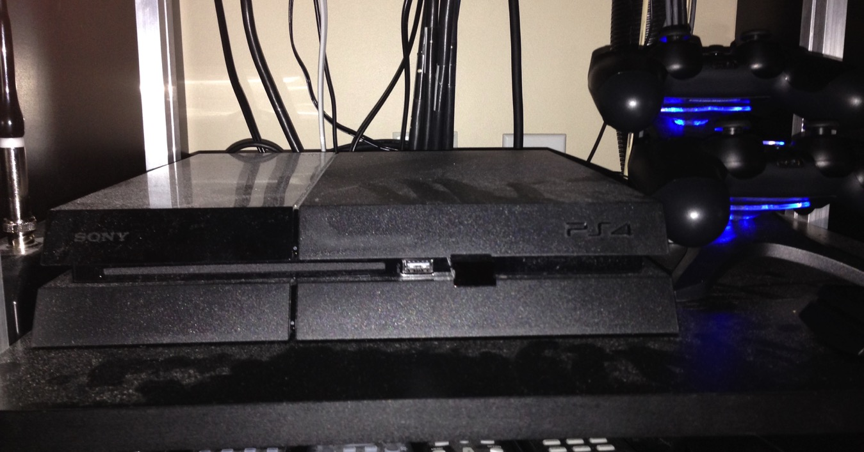
PS4…

Slide 38


…From Form to Substance
Is Video Game Law a Unique area?
“Law of the Horse” – Larry Lessig
Is Digital Media catching-up?
Relationship to Media & Entertainment Law ?
– Newtonian physics to “string theory”

Slide 39
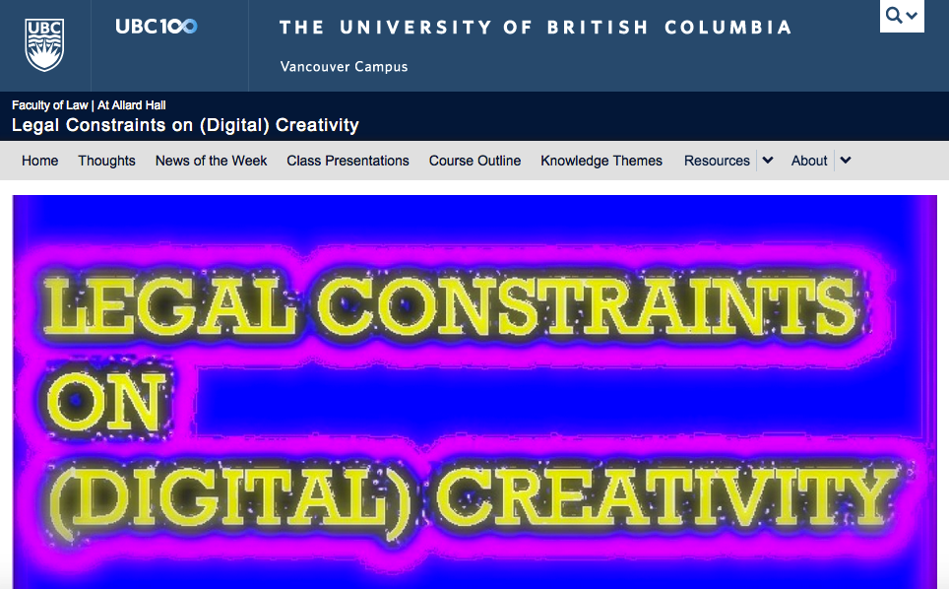
“Constraints”…

Slide 40
Video Game Leadership
Firsts & furthers, as well as barriers broken:
Interactivity (multiplayer “Spacewar”)
“Control”: mouse, controller, voice-command, Kinect, Google Glass
Augmented Reality
On-line “community”
Social (Media)
Voice Over IP
Open Worlds

Slide 41

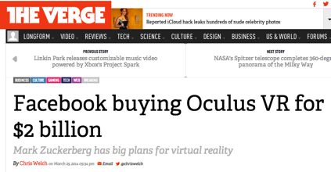
As well as…
Avatars (zeitgeist, memes, identity & equality)
3D
Portability (handhelds)
Micro-transactions
Game-Jams, now _____ Jams
AND VIRTUAL REALITY…

Slide 42
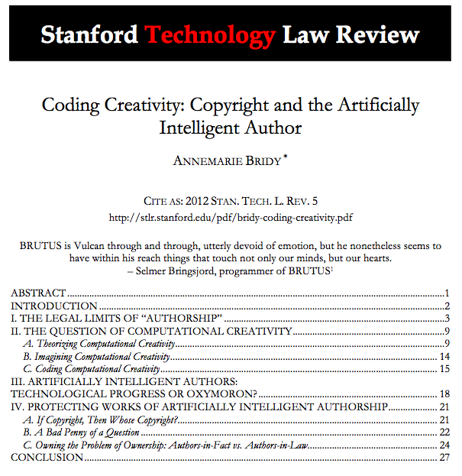
Evidence…

Slide 43
“As is often the case with copyright and innovation, however, litigants force issues on which policymakers demur, leaving courts to decide whether and how to reconcile old law with new technology. In the early 1980s, disputes arose concerning copyrights in electronic video arcade games and their audiovisual displays. In these cases, which almost altogether eschew sustained legal analysis, a number of courts held that game displays are copyrightable by the owner of the copyright in the game program that generates the displays. Moreover, the courts said, it doesn’t matter whether the displays are generated autonomously by the machine during the game’s “attract” mode, or through the actions of a player during the game’s “play” mode. In either case, the display is copyrightable, and the copyright belongs solely to the owner of the copyright in the game code.
These decisions, especially insofar as they address displays produced when games are operating all by themselves in “attract” mode, offer some clue as to how courts might decide cases involving works generated autonomously by programs like BRUTUS or the Cybernetic Poet. In all likelihood, courts would rely on the video game cases to hold that ownership of the copyright in generative code translates directly into ownership of the copyright in the works produced by it.”

Slide 44
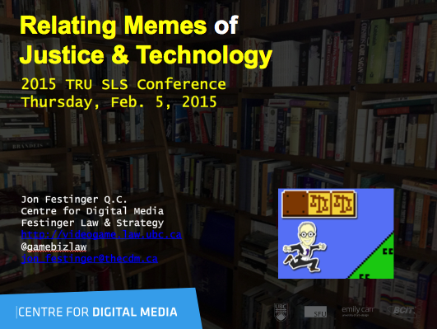
Evolving memes of the course…

Slide 45
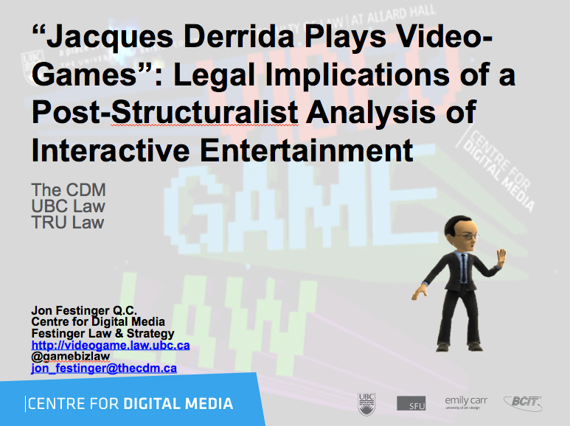

Slide 46
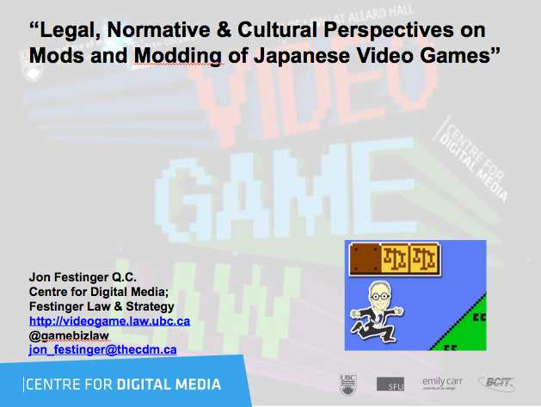

Slide 47
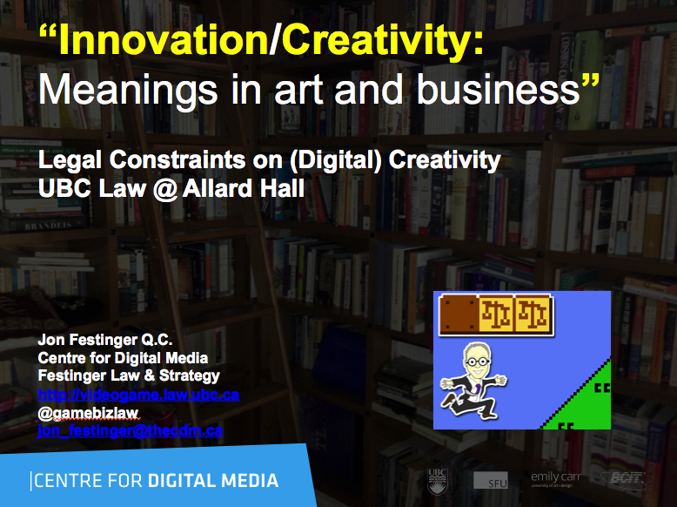

Slide 48
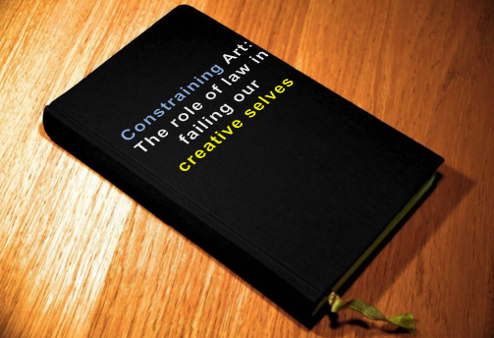
My next step*…
* (1st draft September 1, 2016)

Slide 49

What is a game?
Roots in play (fun)
+ Creativity
Always interactive
The digital journey “From documents to data”
Antecedents: comic books, pinball, D&D
Main metaphor: initiating content rather then receiving content (Television as “transmitter” to gamer as “transmitter’).
Strange thought: Gaming as Evolution (not the evolution of gaming). There must be a functional reason we are driven to play games…..Darwin was a gamer?
???

Slide 50
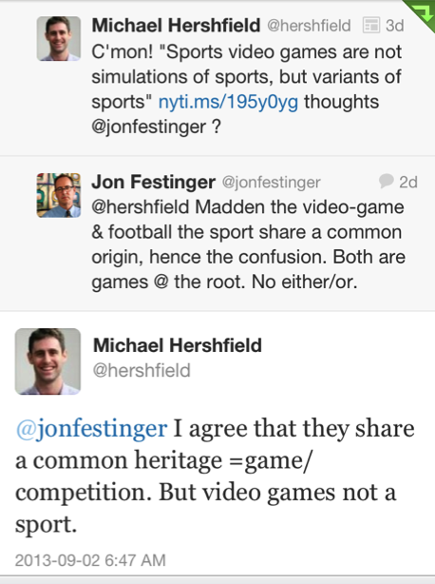
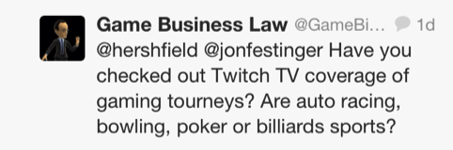
Is Madden NFL a Sport?
“Examined, the Virtual Life Is Worth Living: Madden NFL 25 Portrays ‘Real’ Football” New York Times, August 26, 2013 http://www.nytimes.com/2013/08/27/arts/video-games/madden-nfl-25-portrays-real-football.html
“And yet Madden NFL is largely ignored by the people who write about, and study, video games for a living; neither sport nor video game, And yet Madden NFL is largely ignored by the people who write about, and study, video games for a living; neither sport nor video game, I sit you out, they sneer. This quiet disdain for video game football is why it was shocking to so many, a decade ago when it emerged that National Football League players love to play Madden NFL. Why would real football players spend their time playing fake football?
Because it’s not fake. It’s football.”

Slide 51
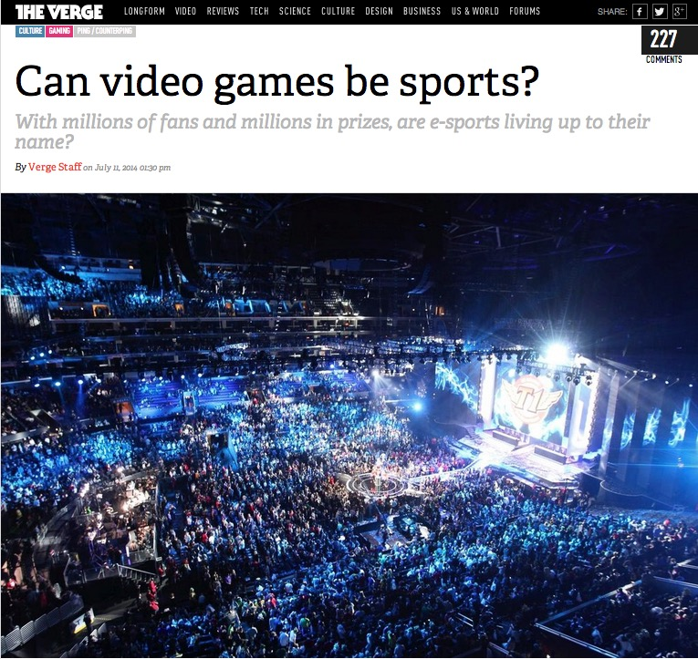
Whatever you may think…
http://www.theverge.com/2014/7/11/5890907/can-video-games-be-sports

Slide 52
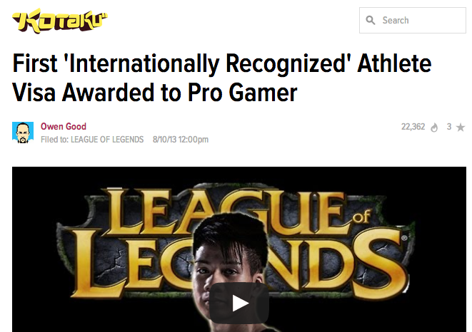
And…
http://kotaku.com/first-internationally-recognized-athlete-visa-awarded-1091077937

Slide 53

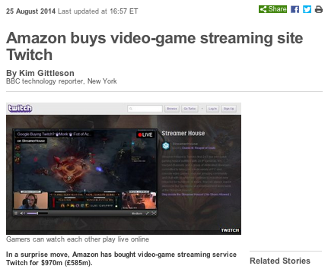
And…

Slide 54
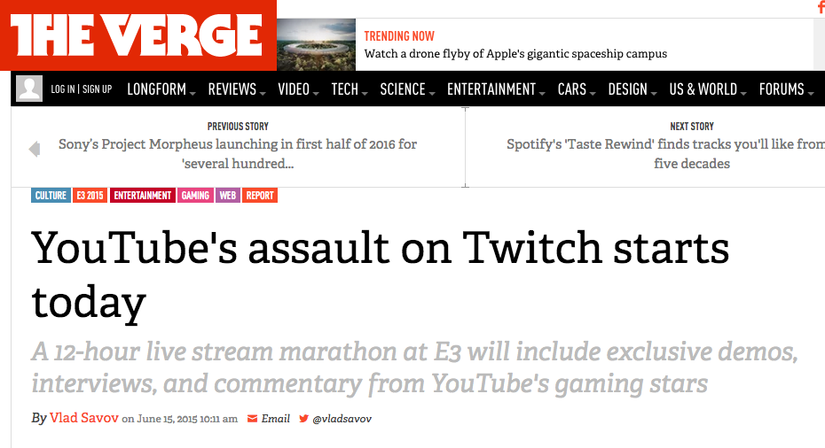
And…

Slide 55

WHY?
“Equally strange is our general addiction to games, both physical and mental. The profusion of games is truly startling: card games, board games, word games, ball games, electronic games….We even assemble in huge crowds to watch others playing games. What does all this mean? Do we simply get easily bored and cannot tolerate inactivity? I can find nothing in the literature of scientific psychology that helps me to understand such bizarre behavior.”
The Human Legacy (1982)
Leon Festinger

Slide 56
McLuhan, 1964
(Games as social reaction)
Games are popular art, collective, social reactions to the main drive or action of any culture. Games, like institutions, are extensions of social man and the body politic, as technologies are extensions of the animal organism. Both games and technologies are counter-irritants or ways of adjusting to the stress of the specialized actions that occur in any social group. As extensions of the popular response to the workaday stress, games become faithful models of a culture. They incorporate both the action and the reaction of whole populations in a single dynamic image.

Slide 57
Jung on Games & Instinct
“One of the most difficult tasks men can perform, however much others may despise it, is the invention of good games and it cannot be done by men out of touch with their instinctive selves.”
Jung and the Story of Our Time, Laurens van der Post (1977)

Slide 58

Play as Evolution
Does Gaming have an evolutionary purpose in the Darwinian sense?
Dr. Kimberly Voll (CDM/UBC) – From “Game Design” – DMED 521:
1. “neurons that fire together, wire together” (Donald Hebb, aka “Hebbian Learning”)
2. “..so “fun” seems to be something our brains use to keep us doing something to the point of mastery…makes sense if it is something that will help us live better and get our genes out into the gene pool again…”

Slide 59

Stepping Up
* “5,000-year-old gaming tokens found in Turkey” (Aug. 15, 2013)
http://archaeologynewsnetwork.blogspot.ca/2013/08/5000-year-old-gaming-tokens-found-
in.html#.UibUSBbE9TM
* “We are all hardwired for play” (Oct. 18, 2012)
http://vgalt.com/2012/10/18/we-are-all-hardwired-for-play/
* “Jailed Megaupload Founder Falls From Top Spot In Modern Warfare 3 Rankings” (Jan. 25, 2012)
https://www.gameinformer.com/b/news/archive/2012/01/25/jailed-megaupload-founder-falls-
from-top-spot-in-modern-warfare-3-rankings.aspx
* Playing With Life: Are Living Video Games Ethical? (Mashable July 14, 2013)
http://mashable.com/2013/07/14/living-video-games/

Slide 60
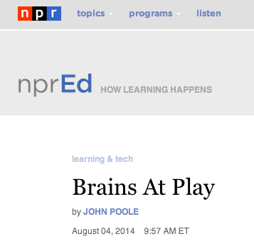
Play as social learning
The scientist who has perhaps done more research on brains at play than any other is a man named Jaak Panksepp. And he has developed a pretty good hypothesis.
In a nutshell, he, and many others, think play is how we social animals learn the rules of being social. Sort of counterintuitive when you think about it: Play is how you learn rules.
http://www.npr.org/blogs/ed/2014/08/04/337387726/brains-at-play

Slide 61
Evolution through interaction
* “Largest space battle in history claims 2,900 ships, untold virtual lives: The combat is fake, but the emotions are real”
(The Verge July 28, 2013)
http://www.theverge.com/2013/7/28/4565558/eve-online-biggest-space-battle-in-history
http://www.youtube.com/watch?v=h9x8eYjUQzg
* “Game or be gamed: Douglas Rushkoff on prototyping democracy through play” (The Verge Dec. 12, 2012)
http://www.theverge.com/2012/12/12/3758576/douglas-rushkoff-gameplay-as-prototype
“By viewing our social, political, and economic structures through the lens of interactivity, Rushkoff says, we are beginning to "transition from the world of passively accepted narrative to one that invites our ongoing participation.”

Slide 62
Why do we game?
A. Social reaction (McLuhan);
B. Social learning interaction (Panksepp);
C. To be in touch with our instinctive self (Jung);
D. As part of Evolution (Darwin, Voll).

Slide 63

Most significant legal implications are from which of the above?

Slide 64
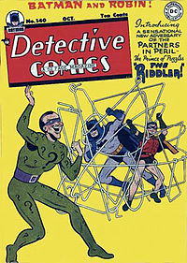
Answer:
A. Social reaction (McLuhan)
Why?
That is the rest of the course

Slide 65
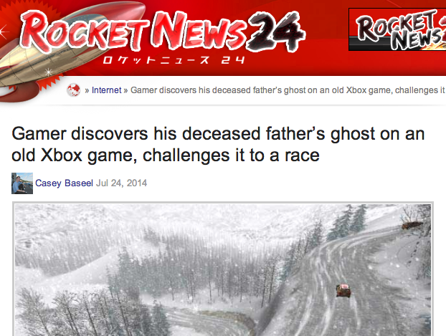
Best Reason to Game?

Slide 66
THANKS FOR
BEING PART
OF THIS …
Please post at
http://videogame.law.ubc.ca

Slide 67

Next Week
Games are not IP;
Video Games are IP;
Explain?
Part A. Creating
“If Picasso had painted a round object…”

Slide 68

Always include a cat picture

Slide 69
Our Academic Partners

