Slide 1


Controlling Originality
Part C “Controlling” | Talk 9
Video Game Law 2013
UBC Law @ Allard Hall
Jon Festinger Q.C.
Centre for Digital Media
Festinger Law & Strategy
http://videogame.law.ubc.ca
@gamebizlaw
jon_festinger@thecdm.ca

Slide 2
Where we are…
Creating Meme (Mods the theme)
Connecting Meme (EULA’s the theme)
Controlling Meme (? the theme)
* Today first class of Controlling
* Parallel to first class of Creating: “If Picasso had painted a round object…”
“Picasso…” explored paradoxes created by a low threshold of creativity for video game copyright…
Today: originality as the mechanism of legal enforcement (and double standard ?)

Slide 3

Follow-ups…
This week follows-up on
Jennifer Kelly’s presentation last week…
& follows-up to our “what is a video-game”
course meme…
All in the contexts of:
CREATIVITY
ORIGINALITY
& CONTROL

Slide 4
But First…
Technology /Justice (Parallels)?
Pre-literate => Justice as Revenge
2. Writing Instruments => Justice as Retribution
3. Printing Press => Justice as (Privileged) Rights
4. Mass Media => Justice as (Equality) Rights
5. Digital => Justice as Dispute Resolution
6. Big Data =>
-----FUTURE----
6 => Justice as Defining Boundaries
7. Virtual reality => ???

Slide 5
But 2nd First …
“From Wheelbarrows to Holodecks” (last week)
Parsing the law in new tech…
But…consider the possibility that …
Law (& Justice) can never adequately resolve
communications/tech based issues
precisely because…communications/tech
memes proactively define the future
meanings of Justice & the forms Law
will take.

Slide 6
More Bravely
Concepts of law & justice do not shape communications technologies nearly as much as they are shaped by the memes and meanings arising from communications technologies.

Slide 7
WITH THAT
BIG
CAVEAT…
Lets start small

Slide 8
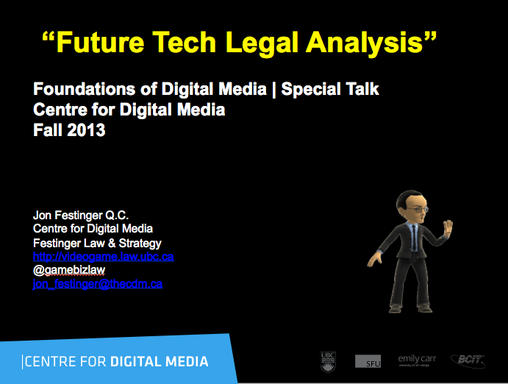
Simple Legal Analysis Process
@ TheCDM

Slide 9
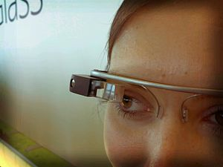
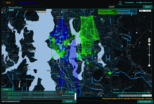
HARDWARE
Mobile/wearable =
shrinking magic circle
against legal intervention

Slide 10
Biz Model
Subscription + Ads
= Big Data/Privacy
M. Ryan Calo,
Digital Market Manipulation
82 Geo. Wash. L. Rev.
(forthcoming, 2014)

Slide 11

Distribution
Streaming/netflix =
Regulatory issues/
resistance from
domestic broadcast
systems

Slide 12

Experiences
Integrated TV/online/mobile/interactive
= Screen Merge
Issues

Slide 13
A partial example (defamation)
Hodgson v. Canadian Newspapers Co.
(1998) 39 O.R. (3d) 235
“…the plaintiff must prove three elements:…iii) that the words complained of, in their natural and ordinary meaning,…are defamatory of the plaintiff”
WHAT DOES “NATURAL AND ORDINARY MEANING” TRANSLATE INTO WHEN DEALING WITH UNIQUE BUT UBIQUOTOUS MERGED MEDIA SCREENS? [What if everything else on the screen is more insulting to others? Or sarcastic, humorous & funny? Etc. etc. Context is everything]

Slide 14
Harder Legal Analysis Process:
Sports Example Wish-list
1. VIRTUAL ARENA EXPERIENCE
“Who is in the crowd?”
“Pick your seat”: view the game from any any seat/any angle (emulated?).
Live Shared experience (Hangout). Friend and rival group options.
Scalability of closed to contact ranging to fully open (E.g. game v. between periods).
Fully interactive: voice, text, content sharing, search & content creation.
Play crowd games, trivia.
Infinite inputs including alternate audio feeds (plus “do your own”) & bonus video feeds
(E.g. USTREAM’s and/or extra broadcast cameras – “you compose your own “broadcast”).
Live feedback (Twitter, text, Skype etc.) loops to teams, leagues, (players), (coaches) –
the “techno heckle”.
2. “I KNOW SPORTS BETTER, LET ME PROVE IT.”
Infinite replays from infinite inputs.
Coaching tools (virtual Telestrator ).
Library of games & plays (by team, year & player).
Recreate or watch the game live in EA NHL 14 (watch replays in 1st person as any player).
3. SECOND SCREEN STUFF (Sx3)
Useable live in-arena on a tablet.
Full live stats including distance skated, shot-speeds, goalie.
Gamification for every possible challenge/bet.
Create your own sports music-video.

Slide 15
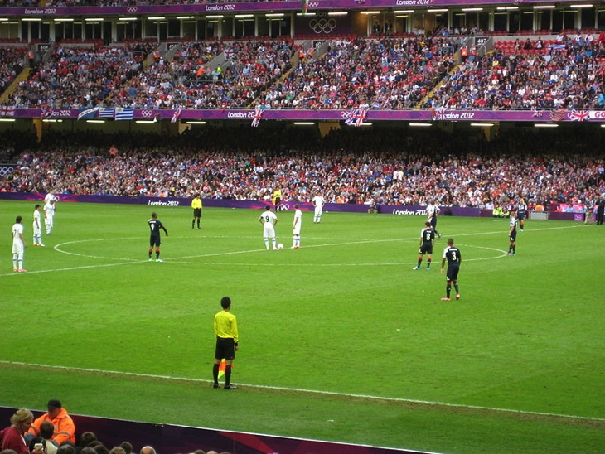
Analysis
Virtual Arena = Privacy issues – of/in crowd
Multiple Inputs/Merged Screen =
Copyright/Moral Rights (“I don’t want to be associated with THAT”);
Trademark Confusion. Controllable through EULA? Probably not. Only legally doable through equivalent of torrent-ing – distributed network architecture

Slide 16
Made Harder By:
Wheelbarrow & Screen Reversal
Reversing the directionality of games
From Bringing Reality into the Game
To Bringing the Game into Reality
= SHRINKING MAGIC CIRCLE

Slide 17
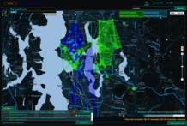
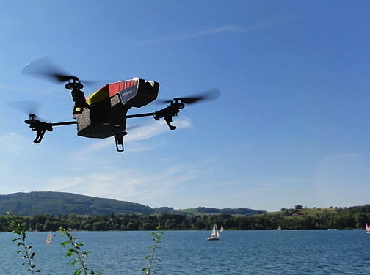
The new video game (hypothetical)
Real-world “play” (“Ingress” – Capture the Flag mechanic)
+ Immersive control mechanism (Google Glass)
+ Anywhere/any device capability (the “cloud”)
+ “Open World” design (literally & Google Earth)
+ Tools/weapons (AR Drone Quadra Copter; Google Car)
IS THIS REALLY A GAME?
+

Slide 18

Legal Consequences
* Necessary given transition of game into real world???
* What happens to the “Magic Circle”?
* What happens to the meaning of “original”?
* Leveling Up - If you are in the real world, does copyright apply to objects seen & thus incorporated in the “game” - are you “copying” anything?
* Bonus Level - Real-world jurisdiction issues:
“No presence in Australia? You may still be liable for patent infringement”
http://www.ajpark.com/media-centre/2013/02/no-presence-in-australia-you-may-still-be-liable-for-patent-infringement/
“Recent ECJ Decision Embraces Targeting Theory of Jurisdiction”
http://www.hldataprotection.com/2012/11/articles/international-eu-privacy/recent-ecj-decision-embraces-targeting-theory-of-jurisdiction/
“International Jurisdiction over Copyright Infringements in the Cloud”
http://papers.ssrn.com/sol3/papers.cfm?abstract_id=2181671

Slide 19
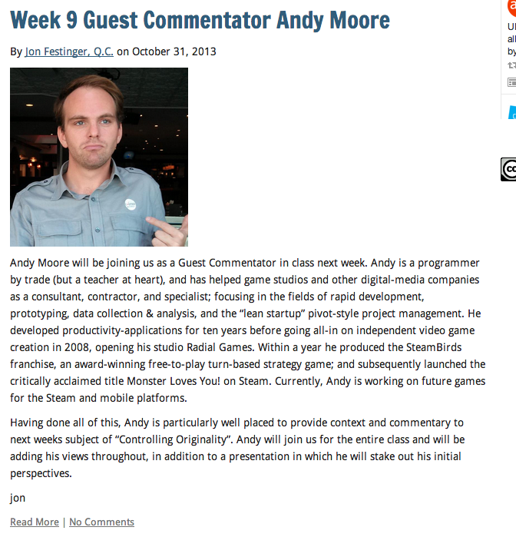
Which leads us to…
The Developer’s Perspective…
& Andy Moore

Slide 20

Thank You Andy

Slide 21
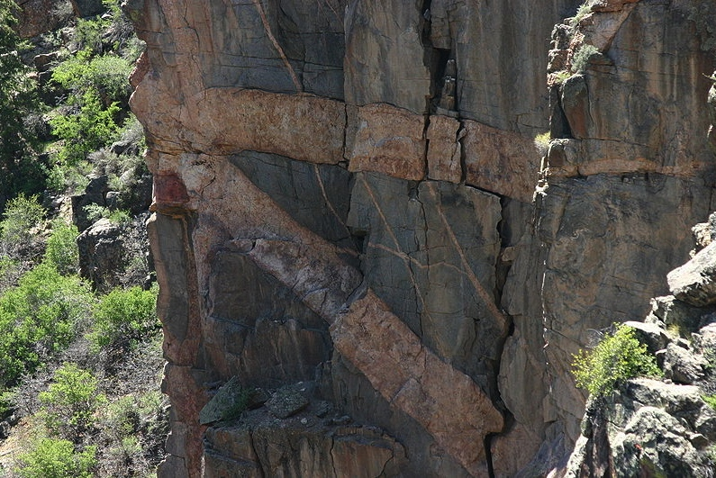
Back to our tech/legal cliffhanger

Slide 22
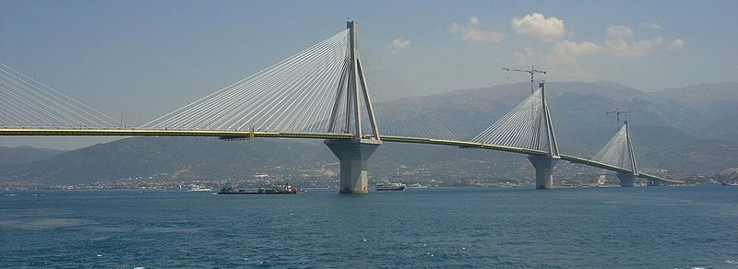
Future Tech Bridges
“Creating” &
“Controlling”
How?

Slide 23



Control issues arise…in the context of new (threatening) consumer technologies
“15 Technologies The Legacy Content
Companies Have Sued In The Past 15 Years” http://www.techdirt.com/blog/innovation/articles/20131008/11072724796/15-technologies-legacy-content-companies-have-sued-past-15-years.shtml
* not to mention the printing press, radio,
television etc.

Slide 24
What’s the point?
That Control Issues
&
Constraints on Creativity
END UP AS THE SAME THING
In that context back to “future video game tech & the law”…

Slide 25

So now the Really New/ Difficult: What is next…(& 2 b controlled?)
TELEPATHIC GAMING

Slide 26
Truly Immersive Virtual Reality
Start With Occulus Rift or MS Illumiroom
Add Physical Player Response Measurements
Add Neurogaming
Add Brain to Brain Interfaces
Add Big Data
Add “Lifestream”
Add 3D Printing
Add Smart Remote Control Vehicles (Anki)
Add (virtual?) monetization
Wrap it all into Augmented Reality (Google Glass/real- world interface)

Slide 27
MAIN ISSUES WILL BE
PRIVACY
PRIVACY (coming class 11)
PRIVACY
PRIVACY
PRIVACY
PRIVACY
CONSUMER PROTECTION
(DIGITAL MANIPULATION) – “Calo”

Slide 28
& Can the Magic Circle
EVEN SURVIVE?
NO QUESTION IT’S SHRINKINg

Slide 29
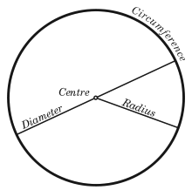
The “Magic Circle”
“All play moves and has its being within a play-ground marked off beforehand either materially or ideally, deliberately or as a matter of course. Just as there is no formal difference between play and ritual, so the ‘consecrated spot’ cannot be formally distinguished from the play-ground. The arena, the card-table, the magic circle, the temple, the stage, the screen, the tennis court, the court of justice, etc. are all in form and function play-grounds, i.e. forbidden spots, isolated, hedged round, hallowed, within which special rules obtain. All are temporary worlds within the ordinary world, dedicated to the performance of an act apart.”
Johan Huizinga (1872-1945) in “Homo Ludens: A Study of the Play-Element in Culture”. Applied to video games by Katie Salen & Eric Zimmerman in “Rules of Play: Game Design Fundamentals” (2003)

Slide 30
The legalities of the “Magic Circle” 1
1. “The Laws of the Virtual Worlds” - Greg Lastowka & Dan Hunter (2003)
http://papers.ssrn.com/sol3/papers.cfm?abstract_id=402860
“No doubt there will be time and litigation enough to soon make further observations. However there is one point
that is worth making in conclusion. It is not going to be a sufficient answer, either for property or avatar rights, to
say, “It’s just a game”. Nor can the company creating the world simply intone that the world is theirs to do with as
they wish. The issues are more complex than that, and the users and community will have a say in the outcome
of these questions…We will have to recognize that these are separate places, with a separate community, separate laws,
and separate rights. Sometimes the inhabitants of these worlds will come down to our world, to have
recourse to our law, and gain protections against their gods. But more and more they will live out their lives in a different
world, and they will eventually come to create their own laws, just as they are building their own community. In time perhaps they won’t care what we think or what our laws say. They will live and love and law for themselves.”
2. “Virtual Liberty: Freedom to Design and Freedom to Play in Virtual Worlds” Jack Balkin (2004) http://papers.ssrn.com/sol3/papers.cfm?abstract_id=555683
“In the future, virtual worlds are likely to become important spaces for innovation and free expression. Properly
drafted interration statutes can help promote these values. To this end, legislatures should prominently state the
public values these statutes are designed to serve in the statutes themselves as guides to interpretation by
courts, and courts, in turn, should interpret these statutes liberally to promote free speech values. We should view
interration statutes as applications and extensions of the central values of individual creativity and democratic
participation that we associate with the First Amendment.⁹⁶ That is to say, we should view them as “First
Amendment extension acts” appropriate for a digital world in which many of the most important spaces for
creative expression are held in private hands.”
3. “The Right to Play” - Edward Castronova (2005)
http://papers.ssrn.com/sol3/papers.cfm?abstract_id=733486
“A legal framework for make-believe places will not be very fun to create either. It will require numerous creditors,
theft victims, tax collectors, protestors, defeated warriors and impoverished wizards to simply go home empty
handed, unsatisfied, perhaps distraught. But it will allow everyone, all of us, to spend time in worlds where magic
is real. Goodness, we haven’t done anything like that in hundreds of years. We miss it.”

Slide 31
The legalities of the “Magic Circle” 2
4. “Virtual Property” - Joshua Fairfield (2005) http://papers.ssrn.com/sol3/papers.cfm?abstract_id=807966
“I propose a different answer: cyberspace is neither a bad analogy nor a metaphor. Cyberspace is a
descriptive term. It describes the degree to which some kinds of code act like spaces or objects…And
while the place and space language is routinely used by the courts and lawyers, again, legal academics
have either supported the place metaphor as merely psychologically useful, or have completely
rejected it as a bad analogy.”
5. “Virtual Borders: The Interdependence of Real and Virtual worlds” – James
Grimmelmann (2006) http://papers.ssrn.com/sol3/papers.cfm?abstract_id=868824
“In the end, talking about the real-money trade points out the deep interdependence of the virtual and the real. It is possible only because of their interrelationship. If avatars in virtual worlds were not so profoundly linked to people in the real one, there would be no real-money trade. To the extent that the real-money trade is a problem, its solution also must recognize the interdependence of the real and the virtual.”
6. “The Magic Circle” - Joshua Fairfield (2008)
http://papers.ssrn.com/sol3/papers.cfm?abstract_id=1304234
“The implications for the future of virtual worlds are complex. On one hand, denizens of virtual worlds
should hope that the law that ultimately govern virtual worlds will not only take their interests into account
in some sort of paternalistic fashion, but that courts will give the actual solutions worked out by online
communities the force of law. On the other hand, players in virtual worlds should understand that their
behavior online is not entirely free from real-world scrutiny. This is a bit saddening. It was wonderful to live
in the cyber Wild West. But every new frontier has its civilizing moments. And virtual worlds are an
enormous phenomenon, one that law cannot afford to ignore.”

Slide 32
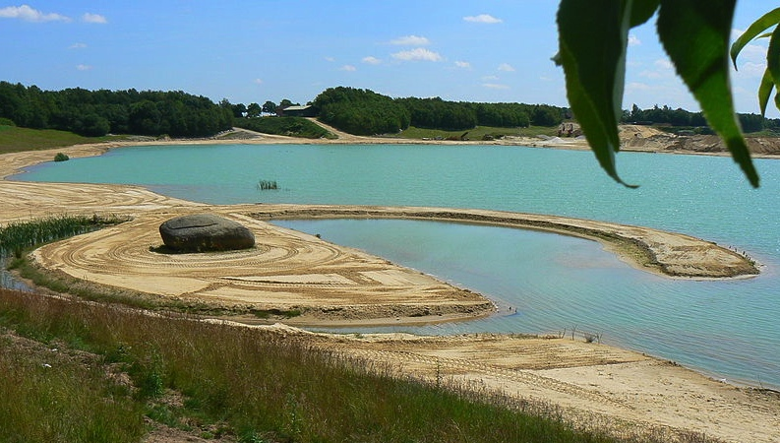
The “Magic Circle” exposed
“As stated previously, players never play a new game or fail to bring outside knowledge about games and gameplay into their gaming situations. The event is ‘‘tainted’’ perhaps by prior knowledge. There is no innocent gaming…Players also have real lives, with real commitments, expectations, hopes, and desires. That is also brought into the game world, here Azeroth. We can neither ignore such realities nor retreat to structuralist definitions of what makes or defines a game. Games are created through the act of gameplay, which is contingent on acts by players.”
“There is No Magic Circle” - Mia Consalvo (2009)http://www.academia.edu/654444/There_is_no_magic_circle
“An activity that occurs in a virtual environment is subject to real-world law if the user undertaking the activity reasonably understood, or should have reasonably understood, at the time of acting, that the act would have real-world implications.”
“Virtual Law: Navigating the Legal Landscape of Virtual Worlds” – Benjamin Duranske (Paperback, ABA, 2008)
BACK TO:
Real-world “play” (“Ingress” – Capture the Flag mechanic)
+ Immersive control mechanism (Google Glass)
+ Anywhere/any device capability (the “cloud”)
+ “Open World” design (literally & Google Earth)
+ Tools/weapons (AR Drone Quadra Copter; Google Car)
IS THIS REALLY A GAME?

Slide 33
So now..
With the magic circle shrinking or shrunk
What is original (& therefore IP) in a Video Game?
(Hint: not as much as you think..)

Slide 34
STEP 1 – not the “system”
“Games and Other Uncopyrightable Systems” Bruce Boyden (2011) http://www.georgemasonlawreview.org/doc/Boyden_18-2_2011.pdf
“Games are systems in exactly the same way. A game, as sold, is only a
game form; the content necessary for an instance of the game comes
from the players. That is, the game form establishes the environment for play
—the game space—and it defines permissible moves and the conditions for
winning or drawing. But the game itself is supplied by the players. Games
are systems in the same way that the excluded schemes in the cases above
were systems.”
“For systems, the rule against the copyrightability of games demonstrates why
systems are generally uncopyrightable and why that term has special
significance. The term is not merely a synonym for “idea,” or “process.”
Systems are shells into which users pour meaning. While they may contain
expression themselves, that expression is there merely to facilitate the meaning
added by the user. Copyright properly excludes them.”

Slide 35
Other Steps
*Not Ideas or General
Concepts
*Not Genres; scenes a faire
*Not Rules, play methods,
common moves
*Not stock characters

Slide 36
What’s left that is protectable?
ART - look & feel
& Atari v. Oman (Breakout) almost denied that
+
Underlying Code
+
Sound
+
Plagiarism (protected against)

Slide 37
…when considering what is “original”
Why isn’t everything a form of tool enabled “time-shifting”?
Sony v. Universal U.S. Supreme Court 464 U.S. 417 (1984)
Key Factors: a. enlarged audience; b. did not impair copyright value
Jumping off point for Fair Use discussion - Is digital “todays “tool” -
>>> “Context shifting” = Assuming Einstein was right &
time & space are one… ;)
2. SCC Pentalogy, Fair Dealing & User Rights
3. Bridging to Moral Rights: Regime of “attribution” + “integrity”
4. The cult of original-ism: (Recall “personal creation mythology” – the “Hollywood Model”)
5. Originalism as Neo-colonialism?: Are we “Culture bound”?

Slide 38
Original-ism cases
* “IGT v. Alliance Gaming Corp” (wheel of Fortune http://www.bakerlaw.com/alerts/patent-watch-igt-v-alliance-gaming-corp-12-20-2012/
* “Washington v. Take-two Interactive Software, Inc., et al.” (misappropriation of likeness in GTA) http://www.loeb.com/news/CaseList.aspx?Type=ip&case=1907
* “GSC Game World Claims Ownership of S.T.A.L.K.E.R. Game Rights”http://gamepolitics.com/2012/12/13/gsc-game-world-claims-ownership-stalker-game-rights#.UTb246XR2kU
* “SEGA Takes Legal Action Against Level-5 Over Nintendo DS Patent Dispute”http://www.nintendolife.com/news/2012/12/sega_takes_legal_action_against_level_5_over_nintendo_ds_patent_dispute
* “Court Tackles Copyright Issue of "Throwback" NFL Uniforms in Video Games” http://www.manatt.com/SportsLaw/Court_Tackles_Copyright_Issue_of_Throwback_NFL_Uniforms_in_Video_Games.aspx
* “Tweeria Struggles With Copyright Problems”http://www.gamepolitics.com/2012/12/27/tweeria-struggles-copyright-problems#.UTb6UaXR2kU
* “Tetricide” http://uttresl.wordpress.com/2013/02/01/tetricide-2/
* “Wizards of the Coast Sued for Magic: The Gathering Online Patent Infringement Claims”http://gamepolitics.com/2012/11/02/wizards-coast-sued-magic-gathering-online-patent-infringement-claims#.UTb8KKXR2kU
* “Scrabble 3D tile held to be invalid by High Court - JW Spear & Sons Ltd and Mattel Inc v Zynga” http://www.lexology.com/library/detail.aspx?g=c918285f-f721-4a1a-8b70-80dce5b422ba
* “British games company says it owns the idea of space marines”http://www.theregister.co.uk/2013/02/07/games_workshop_in_spurious_space_marines_claim/
* “Infringing World of Warcraft theme park built in China”http://the1709blog.blogspot.ca/2013/01/infringing-world-of-warcraft-theme-park.html
* “Tolkien estate unleashes legal Uruk-hai on LoTR online slot machines”
http://arstechnica.com/tech-policy/2012/11/tolkien-estate-unleashes-legal-uruk-hai-on-lotr-online-slot-machines/
* “Keller v. EA: visual elements mean game isn’t protected by First Amendment”
http://tushnet.blogspot.ca/2013/08/keller-v-ea-visual-elements-mean-game.html
* ”The First Amendment in play: Brown v. EAhttp://tushnet.blogspot.ca/2013/08/the-first-amendment-in-play-brown-v-ea.html

Slide 39
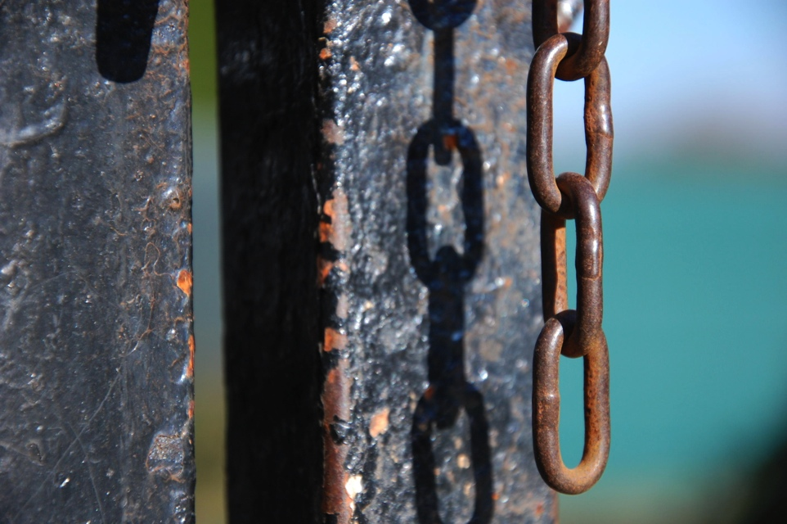
The “Missing (Ironic) Link”?
Were EULA & ToS originally considered the way to create community laws insulated from real – world laws?
Reinforcing ‘the magic circle’…

Slide 40
Which Laws? Layers of Control
11. Internet Governance & Surveillance (International Law)
10. Criminal & Obscenity Laws.
9. Taxation/Currency/Gambling (regulatory; quasi-criminal law)
8. Misleading promises/advertising, physical or psychological harm,
unfair competition/anti-trust (consumer protection)
7. Industry self regulation (delegated authority) & medium specific
regulation (constitutional)
Out of the Creation Norms
------------------------------------------------------------------------------------------------
In the Creation (Magic Circle) Ethics (of Originality, Creativity & Expression)
6. Privacy, Defamation & Personality law (tort, IP)
5. EULA/ToS & Contracts (contractual, private)
4. Trademark, Patents & the IP Business
3. Copyright & Users Rights (statutory)
2. Technology (quasi extra-legal)
1. Community (extra-legal)

Slide 41
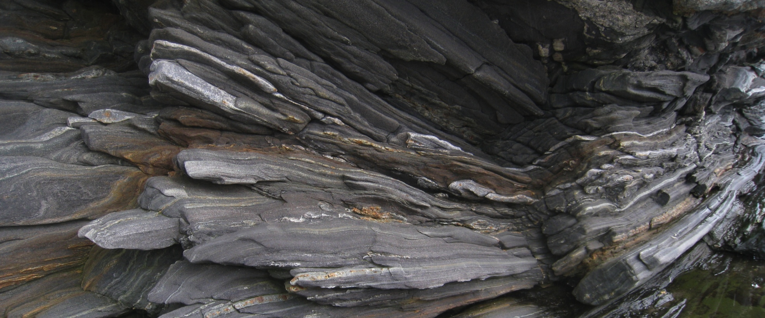
Legal Constraints on Digital Creativity:
Originalities & Behaviors
First 6 layers concern what is “original” in the game.
Final 5 concern limiting behaviors outside the game.
Examining the layers

Slide 42
Layers (A) - from “depth” to “surface”
*Community (extra-legal): William Fisher, Copyright Spring 2013: Special Event 3, Extralegal Norms (HLS) http://www.youtube.com/watch?v=8U7bUo1vChs&list=PLEqpzAExPV-xr9gIhSqLMxTSXrimGF6pA
* Technology & Tools (quasi extra-legal): “Sony patents tech to block used games” http://www.gamespot.com/news/sony-patents-tech-to-block-used-games-6401992
“Xbox 720 could block used software, says Eidos president”
http://www.gamespot.com/news/xbox-720-could-block-used-software-says-eidos-president-6404465
* IP (copyright, patent, trademark - statutory):
Thomas Macaulay,1841 U.K. House of Commons Debate on Term of Protection:
“Copyright is monopoly, and produces all the effects which the general voice of mankind attributes to monopoly…I believe, Sir, that I may with safety take it for granted that the effect of monopoly generally is to make articles scarce, to make them dear, and to make them bad.”

Slide 43
Layers (B)
* IP (copyright, patent, trademark - statutory) con’d:
“Three Myths about Copyright Law and Where to Start to Fix it” - The Republican Study Committee
1.The purpose of copyright is to compensate the creator of the contract
2. Copyright is free market capitalism at work
3. The current copyright legal regime leads to the greatest innovation and productivity
http://www.scribd.com/doc/113633834/Republican-Study-Committee-Intellectual-Property-Brief
“The Regulatory Turn in IP” - Mark Lemley (Harvard journal of Law & Public Policy)
http://www.harvard-jlpp.com/wp-content/uploads/2013/01/36_1_109_Lemley.pdf
“The Fashion of TV Show Formats” - Stefan Bechtoldhttps://papers.ssrn.com/sol3/papers.cfm?abstract_id=2191664
“Money from Music: Survey Evidence on Musicians’ Revenue and Lessons About Copyright Incentives” - Peter DiCola (Arizona Law Review)
http://papers.ssrn.com/sol3/papers.cfm?abstract_id=2199058
“Patent Assertion Entities” - Colleen Chien
http://www.justice.gov/atr/public/workshops/pae/presentations/290073.pdf

Slide 44


Layers (C)
* EULA/ToS (contractual, private): Talks 5 & 6 (NOT AGAIN!!)
* Personality rights (tort, IP): “Image Rights in Guernsey” (new form of IP – “registered personality”): http://www.collascrill.com/media/58715/4212_cc_image_rights_d4.pdf
* Industry self regulation: Entertainment Software Rating Board http://www.esrb.org
“Who spilled Hot Coffee” - Grand Theft Auto: San Andreas - “Hot Coffee” http://www.eurogamer.net/articles/2012-11-30-who-spilled-hot-coffee
in the game
-------------------------------------------------------------------------------------------------------------------------------------------------------------------------------------------------------------------------------------------------------------------------
out of the game
* Medium specific regulation - (constitutional):
Broadcasting Act (Canada) S.C. 1991, c. 11: “broadcasting” means any transmission of programs…by…means of telecommunication for reception by the public by means of broadcasting receiving apparatus… “program” means sounds or visual images, or a combination of sounds and visual images, that are intended to inform, enlighten or entertain…”
Canadian Broadcast Standards Council (delegated industry authority) http://www.cbsc.ca/

Slide 45
Layers (D)
*Unfair competition (competition/anti-trust): Is IP monopoly? – Judge Richard Posner “Do patent and copyright law restrict competition and creativity excessively?” http://www.becker-posner-blog.com/2012/09/do-patent-and-copyright-law-restrict-competition-and-creativity-excessively-posner.html
“New Research: Extending Copyright Massively Increases Prices, Limits Dissemination Of Knowledge”
http://www.techdirt.com/articles/20130114/20344621680/new-research-extending-copyright-massively-increases-prices-limits-dissemination-knowledge.shtml
“US State Unfair Competition Laws Create Increased Exposure for Misappropriated IP”
http://www.whitecase.com/files/Publication/2a113524-3319-4b80-b465-683b9a9b86b4/Presentation/PublicationAttachment/6609f8b9-be04-446e-b486-7185dcde1ca8/alerts-us-state-unfair-competition-laws-create-increased-exposure-for-misappropria.pdf
* Misleading promises/advertising, physical or psychological harm (consumer protection)
* Gambling (regulatory – criminal law): See Roxanne Christ PowerPoint (last week) “Online Gaming Meets Online Gambling”

Slide 46
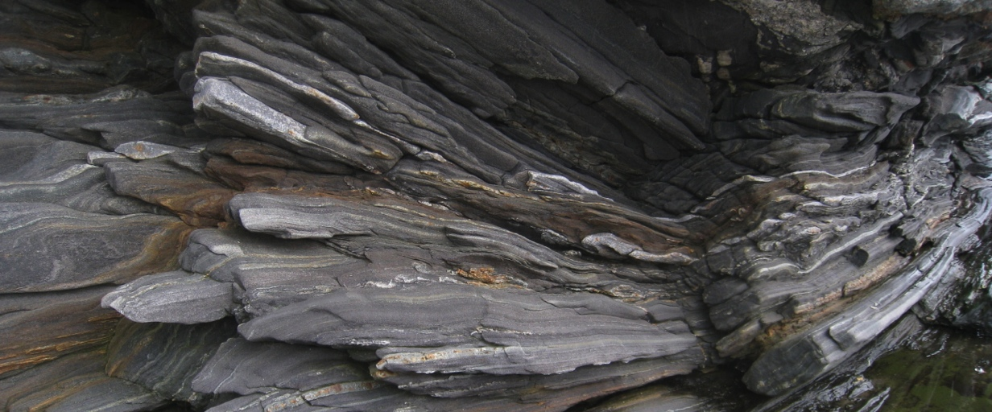
Layers (E)
* Currency/taxation (statutory/regulatory):
Refer to legalities of the “Magic Circle” just cited +
“Missouri lawmaker latest to propose “violent” games tax”
http://arstechnica.com/gaming/2013/01/missouri-lawmaker-latest-to-propose-violent-games-tax/
“DRAGON SLAYERS OR TAX EVADERS?” - Julian Dibbell
http://www.legalaffairs.org/issues/January-February-2006/feature_dibbell_janfeb06.msp
* Theft, assault (criminal law):
“A Rape in Cyberspace” - Julian Dibbellhttp://www.juliandibbell.com/articles/a-rape-in-cyberspace/

Slide 47
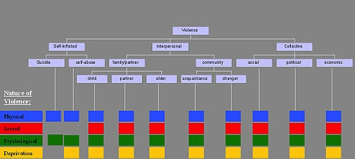
Next Class: “Mass Effect-s”
The Assault on Videogames
The Assault by Videogames
REMIXING VIOLENCE & CIVIL SOCIETY

Slide 48
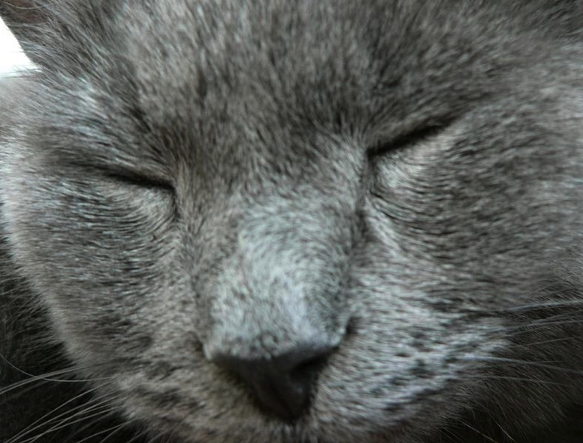

Slide 49
Our Academic Partners

