Slide 1


From Wheelbarrows to Holodecks
Part B “Connecting” | Talk 8
Video Game Law 2013
UBC Law @ Allard Hall
Jon Festinger Q.C.
Centre for Digital Media
Festinger Law & Strategy
http://videogame.law.ubc.ca
@gamebizlaw
jon_festinger@thecdm.ca

Slide 2
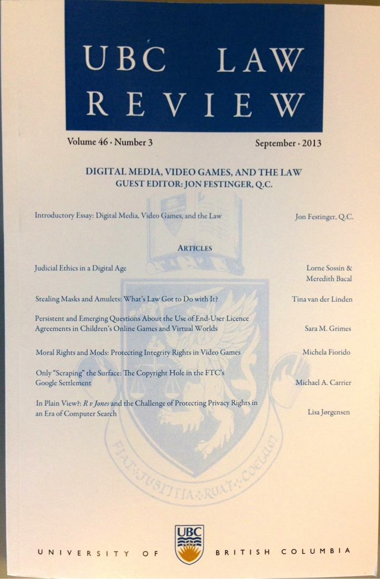
Follow Up 1
Special Issue of the UBC Law Review on “Digital Media, Video Games, And the Law” now available…
http://ubclawreview.ca/issues/no3sept/

Slide 3
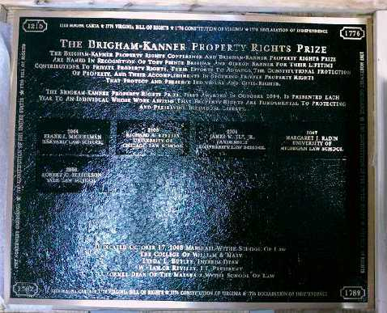
Follow Up 2: EULA’s etc.
“Boilerplate: The Fine Print, Vanishing
Rights, and the Rule of Law”
Princeton University Press
Margaret Jane Radin, Henry King Ransom Professor
of Law at the University of Michigan and the William
Benjamin Scott and Luna M. Scott Professor of Law,
emerita, at Stanford University

Slide 4
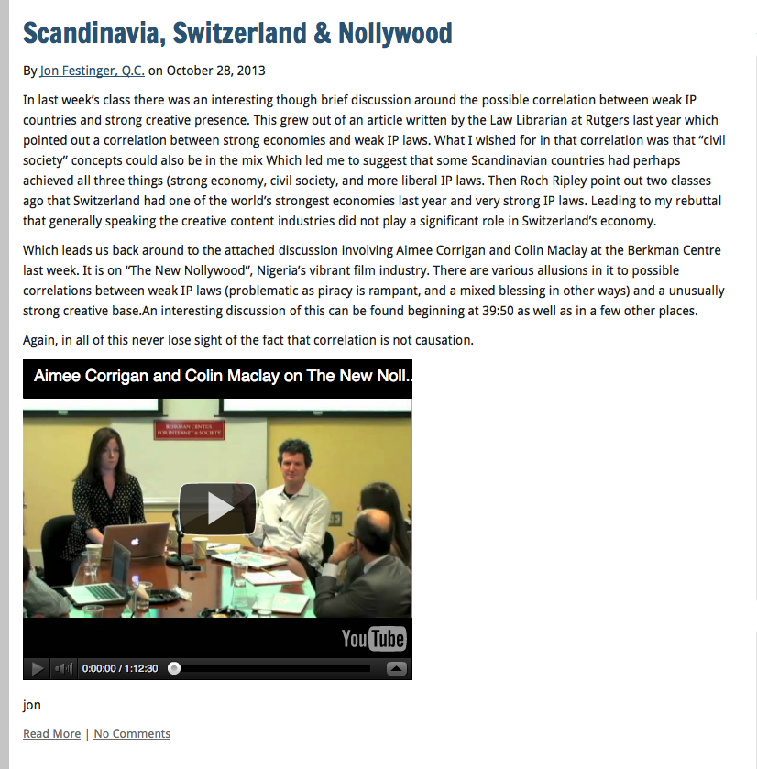
Follow Up 3
Connections
Between
Creativity &
Weak IP Laws?

Slide 5
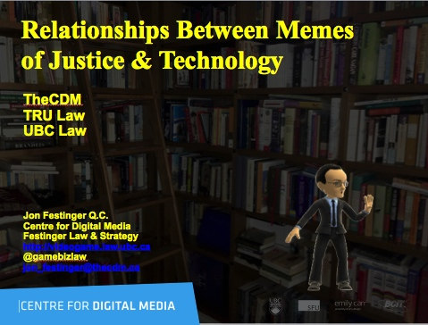
Follow Up 4
…

Slide 6
Technology /Justice (Parallels)?
1. Pre-literate => Justice as Revenge
2. Writing Instruments => Justice as Retribution
3. Printing Press => Justice as (Privileged) Rights
4. Mass Media => Justice as (Equal) Rights
5. Digital => Justice as Dispute Resolution
------------------------
6. Data Cloud ? => Individuation?

Slide 7
In today’s Digital Wars the Law is often seen as disconnected, incapable or too slow to do Justice…
“I may be one of very few people in this room who actually makes his living personally by creating what these gentlemen are pleased to call “intellectual property.” I don’t regard my expression as a form of property. Property is something that can be taken from me. If I don’t have it, somebody else does.
Expression is not like that. The notion that expression is like that is entirely a consequence of taking a system of expression and transporting it around, which was necessary before there was the internet, which has the capacity to do this infinitely at almost no cost.”
John Perry Barlow, May 2011

Slide 8
Consider the possibility..
That Law (& Justice) cannot
adequately resolve
Communications based issues
precisely because…
Communications memes
proactively define the future
meanings of Justice & the forms
Law will take.
(breathing hard…sweat falling off brow…this can’t
be right…can it?)

Slide 9
More Bravely
Concepts of law & justice do not shape communications technologies nearly as much as they are shaped by the memes and meanings arising from those technologies.

Slide 10
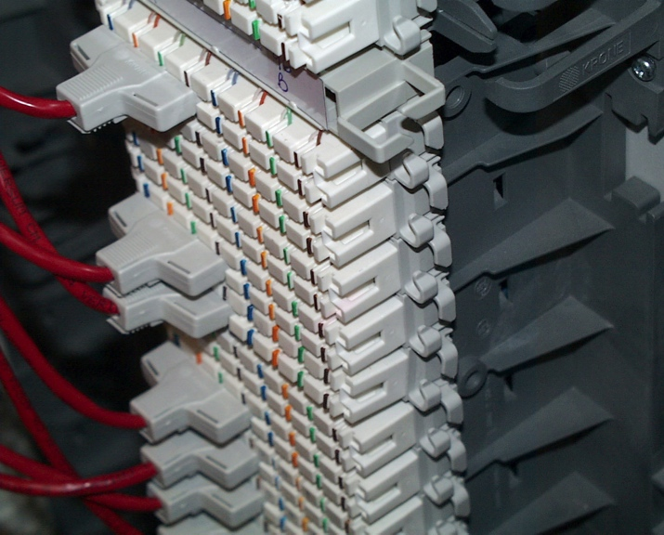
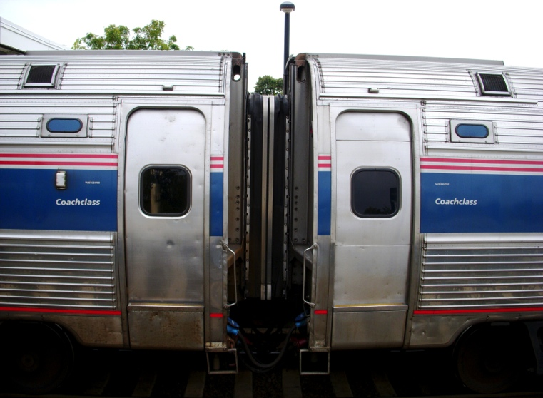

Where we are…(in the course)
4th & final talk under the “Connecting” rubric…
Creating>>>Connecting>>>Controlling>>>Conciliation
Today we focus on the technology that connects…

Slide 11
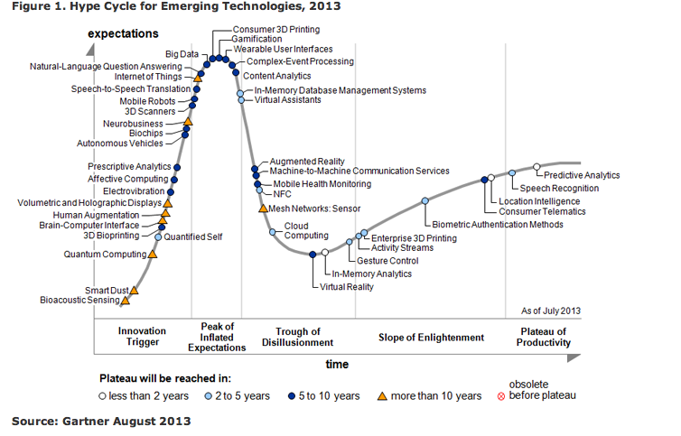

Slide 12

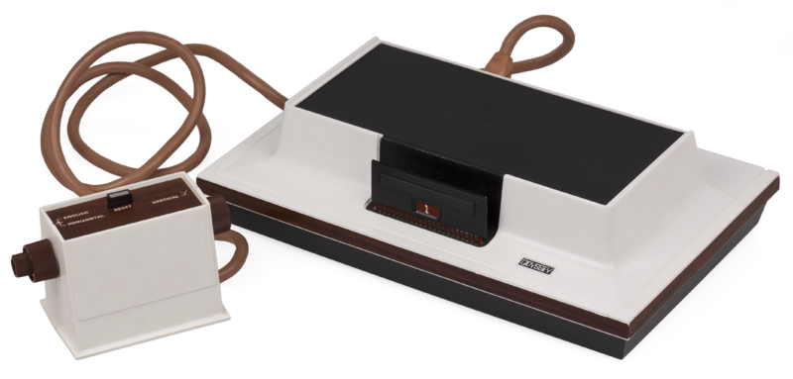
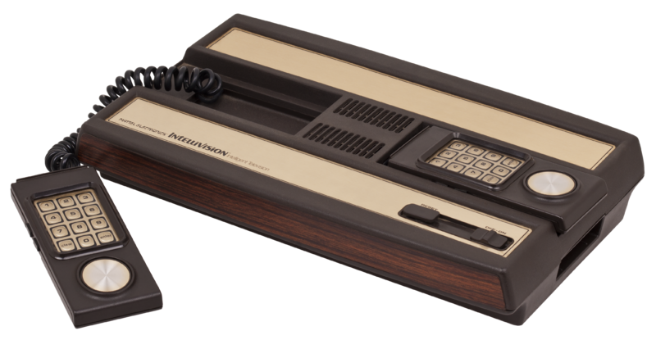
George Santayana played video-games?
“Those who cannot remember history are doomed to repeat it”
So start with the “507 patent”
No, not that 507…..
…“U.S. Reissue Patent No. 28507”
Our tale begins with Magnavox v. Mattel 1982 U.S. Dist. LEXIS 13773 (N.D. Ill.)

Slide 13

The Magnavox “apparatus”…
“The apparatus generated a display on the screen comprising a television picture including a symbol on the right side of the screen representing a first player, a symbol on the left side of the screen representing a second player, and a symbol which moved across the screen representing a ball. Player controls were provided so that each human player could move his corresponding player symbol on the face of the television screen. Each human player manipulated his corresponding player symbol to intercept the path of the ball as it moved across the screen. When the player symbol intercepted the ball symbol, i.e., two symbols appeared to be coincident on the screen, the motion of the ball was changed.”
Sounds like…??

Slide 14
Chronology
1962: Spacewar! released on DEC PDP-1 mainframe @ MIT
...’507 from experiments done by Rusch, employee of Sanders Associates in 1967/68
1971: Sanders & Magnavox enter into exclusive license
1972: Magnavox Odyssey introduced (analog circuitry)
1975: Atari introduces Pong game console for home use (analog)
1976 General Instruments introduces TV game microprocessor (digital circuitry)
Magnavox sues Atari for patent violation & infringing concept of electronic ping pong (settled by Atari becoming Magnavox exclusive licensee)
1978 Magnavox Odyssey 2 has a microprocessor (digital)
1979 Mattel introduces Intellivision with General Instruments microprocessor (digital). Magnavox sues Mattel.

Slide 15
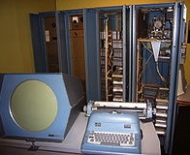
Court decided…
* No distinction between analog and digital:
“I regard analog and digital circuitry as two means which are interchangeable largely, which are equivalent, and which are, therefore, essentially the same means for achieving substantially the same results in substantially the same way.”
So far, so good…

Slide 16

But…OOPS!

Slide 17
Computer Game/TV Console Divide
* Mattel argued its console was not based on ’507 but on computer prior art, Space War!
* Court noted PDP-1 was 6’ tall by 7’ wide, & cost approximately $120K. Court found for Magnavox: “…it is clear from the evidence that Mattel did not in fact follow the prior art but, instead, followed developments in the television game industry, an industry which was created because of the work done at Sanders in developing the first television games and an industry which expanded and developed and become economically viable largely because of television games which followed the teachings of the ’507 Patent.”

Slide 18
Why is this a problem?
Consequences of legal bifurcation of
Computer Games & Console Games
“Those who cannot remember history
are doomed to repeat it”
Console/TV v. Computer v. Telephone/Mobile
Broadcasting Act: “broadcasting” means any
transmission of programs…by …means of telecommunication for
reception by the public by means of broadcasting receiving
apparatus…“program” means sounds or visual images…intended
to inform, enlighten or entertain…”

Slide 19
An example…what is W.O.W.?
Is “it” Broadcasting?
International issue
Gatekeeper political/legal reality
Canadian example:
“broadcasting” means any transmission of programs…by…means of telecommunication for reception by the public by means of broadcasting receiving apparatus…
“program” means sounds or visual images, or a combination of sounds and visual images, that are intended to inform, enlighten or entertain…
(Notes: 1. CRTC exemption order; & 2. SCC has held ISP’s are not broadcasting. Is W.O.W. an ISP or something else? See SCC in Rogers v. SOCAN – streaming on demand = communication to the public)

Slide 20
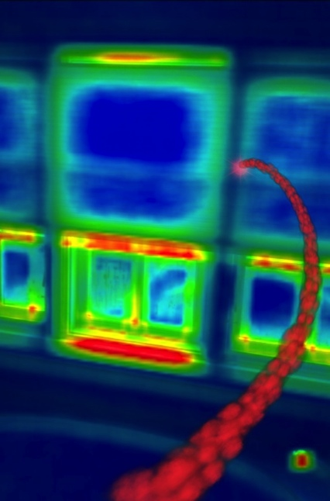
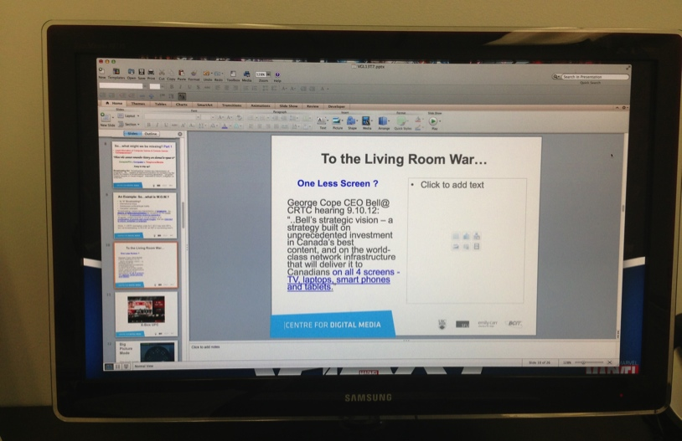
Tech case Study:
The Living Room War..
One Less Screen ?
George Cope CEO Bell@
CRTC hearing 9.10.12:
“..Bell’s strategic vision – a strategy built on unprecedented investment in Canada’s best content, and on the world-class network infrastructure that will deliver it to Canadians on all 4 screens - TV, laptops, smart phones and tablets.”

Slide 21

The Salvos
X-Box (One): Netflix (1st); UFC; NFL; video-switching; cloud calculations for Forza A.I.
Steam-Valve: Steam Box(es); Big Picture Mode (1touch toggle game to browser; Nvidia Sheild
Apple (ecosystem): App store; Apple TV; Airplay
Ouya: Android game-box
Sony PlayStation 4: cloud-gaming (Gaikai); Vita integration
Google: Glass + “Ingress”?
Nvidia: Shield + “Gamestream”
PC to Shield streaming.

Slide 22
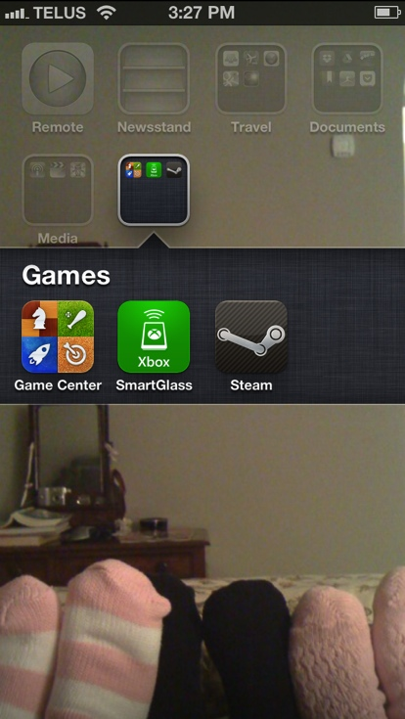
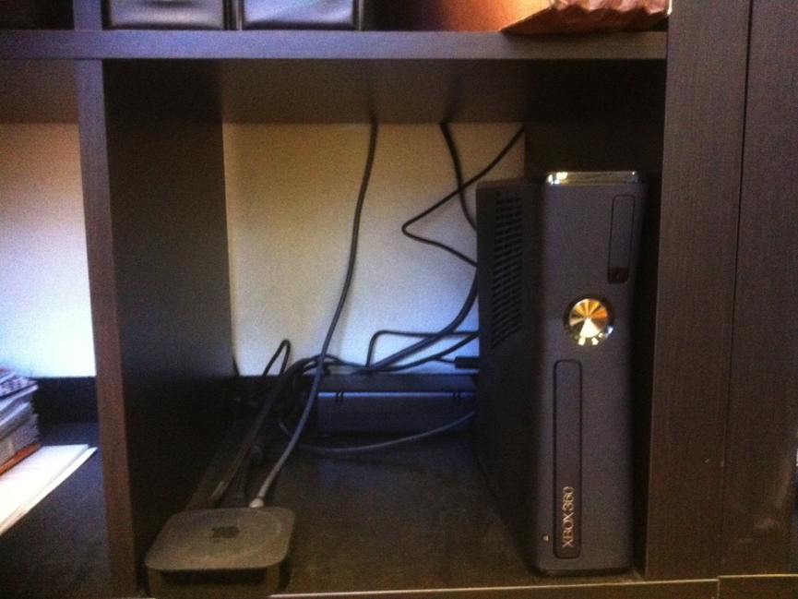
Ecosystem v. Inter-op: My Surprising Reality
Office - Cord cutter
MacBook Pro w/Steam
PC w/Ubuntu
Xbox 360
Ouya
Apple TV
Google Chromecast
Killer app wish = TiVo functionality
Home
Telco IPTV
Windows PC w/Steam
Xbox 360
Apple TV
Mobile
iPhone (Game Center)
Steam App
Xbox App
WIFI anywhere
iPad

Slide 23

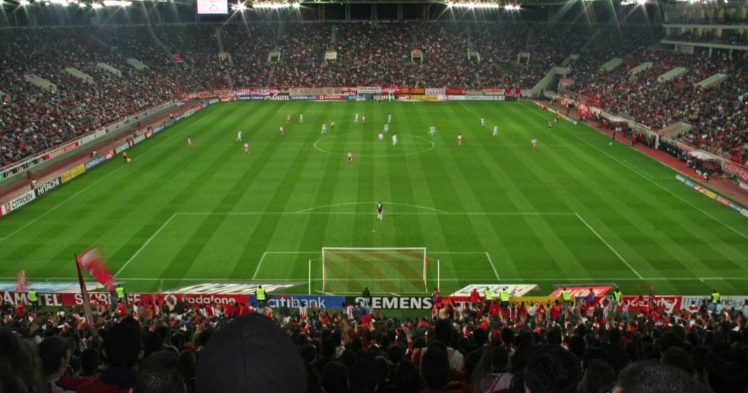
Test Case: Y-Sports?
Most compelling & accessible measure of living room interactivity
LIVE
Communal/tribal
Family embedded
Loyalty/passion/meaning/connection based
Infinite information/data & limitless appetite for it

Slide 24

Sports & Media`
1939 New York Worlds Fair
August 26, 1939: first televised major league baseball game on
W2XBS (later WNBC). Red Barber called the game.
“..the World's Fair became the catalyst for the historic broadcast. The television was one of fair’s prize exhibits, and organizers believed that the Dodgers-Reds doubleheader…. was the perfect event to showcase America’s grasp on the new technology.” (Source History.com)
Footnote: Canadian Admiral v. Reddifusion Inc. [1954] Ex. CR 382: Live rebroadcast through cable of a Montreal Allouetes football game. Was showcase for sale of cable service to consumers. Court held no fixation in live feed of game

Slide 25
Sports Example Wish-list
1. VIRTUAL ARENA EXPERIENCE
“Who is in the crowd?”
“Pick your seat”: view the game from any any seat/any angle (emulated?).
Live Shared experience (Hangout). Friend and rival group options.
Scalability of closed to contact ranging to fully open (E.g. game v. between periods).
Fully interactive: voice, text, content sharing, search & content creation.
Play crowd games, trivia.
Infinite inputs including alternate audio feeds (plus “do your own”) & bonus video feeds (E.g. USTREAM’s and/or extra broadcast cameras – “you compose your own “broadcast”).
Live feedback (Twitter, text, Skype etc.) loops to teams, leagues, (players), (coaches) - the “techno heckle”.
2. “I KNOW SPORTS BETTER, LET ME PROVE IT.”
Infinite replays from infinite inputs.
Coaching tools (virtual Telestrator ).
Library of games & plays (by team, year & player).
Recreate or watch the game live in EA NHL 14 (watch replays in 1st person as any player).
3. SECOND SCREEN STUFF (Sx3)
Useable live in-arena on a tablet.
Full live stats including distance skated, shot-speeds, goalie.
Gamification for every possible challenge/bet.
Create your own sports music-video.

Slide 26
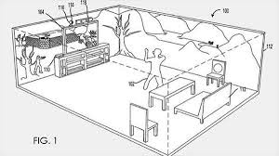
Advanced Issues List
Holographic Immersion
Microsoft Holodeck (patent)
Remote audio crowd feedback fed back into arena (If Porsche can enhance engine sounds, why not crowd sounds as determined by fair standards by the Leagues)

Slide 27
Selected Legal Issues…
Sponsor conflicts & exclusivities (rights-holder) especially audience/crowd - sourced input
Legal Ratatouille:
Second screen - non-rights holder IP strategies and limits
Screen merge issues: Expression rights v. safe harbor/takedown - To edit or not to edit? – Who is the ISP?; Who is the content provider?
Multiple input dilemma = split legal approach for split screens?; lowest common denominator?
Idea/expression dichotomy “threshold problem”: Stating the obvious – the amount of protected expression is directly proportional to the accessibility of digital tools.
& “Why Johnny can’t stream: How video copyright went insane” issues - awesome James Grimmelmann article: http://arstechnica.com/tech-policy/2012/08/why-johnny-cant-stream-how-video-copyright-went-insane

Slide 28

Screen Merge Issues Expanded
Multiple screen within screen issues (main content + additional supplier content + crowd-sourced content: text + audio + video + location ++++)
Multiple input dilemma = split legal approach for split screens? Which standard will a Court apply – lowest common denominator/ to each its own?
What standard applies? Expression rights/defamation liabilities v. safe harbor/takedown – To edit or not to edit?
Split regime – but why not both? One relates to defamation/other to copyright.

Slide 29

THAT WAS THE EASY STUFF…
* 1st ever website post: What’s next for games?...synthetic (as opposed to artificial) reality…with sophisticated inputs/outputs?
Are we are turning life into a game(gamification)?
*ARG’s e.g. EA’s 2001game “Majestic”: tagline = “It Plays You”; by phone, email, instant messaging, fax, and dedicated websites.
* Film Meme: “Inside the Game”
Tron (1982) & Tron Legacy (2010); Wargames (1983);
eXistenZ (1999); The Thirteenth Floor (1999);
The Matrix (1999);Avalon (2001); Gamer (2009);
Surrogates (2009); Wreck-It-Ralph (2012).

Slide 30

WHERE ARE WE NOW?
3D Printing:
Virtual Reality (Occulus Rift)
Complexities of virtual goods
Virtual Currencies (Bitcoin)
Augmented Reality
Google Glass
Kinnect/voice/motion control
Neurogaming
Wifi overtakes Cellular
The “Cloud”
“Self-driving” vehicles
The (Software) Patent Problem:
Patent Trolls
Fingerprint passwords

Slide 31
All Made More Complex By..
The challenges of anonymity: “The problems with anonymous trolls and accountability in the digital age”http://thenextweb.com/insider/2012/10/27/the-problems-with-anonymous-trolls-and-accountability-in-the-digital-age/
The complexities of virtual goods: “Can you actually own the Sword of Azeroth?” http://www.lexology.com/library/detail.aspx?g=34810a92-9fc4-41bb-8541-ca7ae2392dcf
The (Software) Patent Problem: “Let’s Go Back to Patenting the ‘Solution,’ Not the ‘Problem’ by Mark Lemley http://www.wired.com/opinion/2012/10/mark-lemley-functional-claiming/
Authorship Issues(of course): “Whose Game Is This Anyway? - Negotiating Corporate Ownership in a Virtual World” by T.L. Taylor (N.C. State) http://www.digra.org/dl/db/05164.58571.pdf
Big Data (& Minimal Privacy): “Digital Market Manipulation” by Ryan Calo http://papers.ssrn.com/sol3/papers.cfm?abstract_id=2309703

Slide 32

ALL LEADING TO…
Legal Ratatouille: THE BIG VERSION

Slide 33


Eve Online
“Due to the game's focus on freedom, consequence, and autonomy, many behaviours that are considered griefing inmost MMOs are allowed in Eve. This includes stealing from other players, extorting, and causing other players to be killed by large groups of NPCs.” (source: Wikipedia)
“In An Age of Free-to-Play, EVE Online Sets Records”http://www.forbes.com/sites/insertcoin/2012/12/17/in-an-age-of-f2p-eve-online-sets-records/
“EVE Online Workshop Submission Deadline Extended” http://eveonline.gamescholarship.org/
“How the Battle of Asakai Became One of the Largest Space Battles in Video Game History”http://io9.com/5980387/how-the-battle-of-asakai-became-one-of-the-largest-space-battles-in-video-game-history

Slide 34
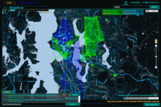

“Ingress” (Majestic2?)
“Inside Ingress, Google’s Augmented Reality Android Game” http://www.geekosystem.com/google-ingress-review/
“Augmented Reality Game Gets Player Busted: The First Of Many?”http://readwrite.com/2012/12/11/augmented-reality-game-gets-player-arrested-the-first-of-many
“Why Google's Ingress game is a data gold mine”
http://www.newscientist.com/article/mg21628936.200-why-googles-ingress-game-is-a-data-gold-mine.html

Slide 35
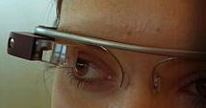
Add it up….
Ingress + Google Glass + Google
Car = Merger of real & virtual worlds
Notion that real laws shouldn’t apply to virtual world seem antiquated…where is that “magic circle” now?
But which laws & how to apply them???

Slide 36


The Wheelbarrow & the Screens:
Direction reversal - digital fantasy comes to reality?
From the Real World Digitized & Screen-ified
To the Digital World Reified
Now from screen to world
Not only from world to screen anymore…

Slide 37
What is beyond
TELEPATHIC GAMING
(but who will control & who will be controlled?)

Slide 38
Truly Immersive Virtual Reality
Start With Occulus Rift or MS Illumiroom
Add Physical Player Response Measurements
Add Neurogaming
Add Brain to Brain Interfaces
Add Big Data
Add “Lifestream”
Add 3D Printing
Add Smart Remote Control Vehicles (Anki)
Add (virtual?) monetization
Wrap it all into Augmented Reality (Google Glass/real- world interface)

Slide 39
SEE ANY LEGAL ISSUES?

Slide 40
Issues & Articles
3D Printing:
“What's the Deal with Copyright and 3D Printing?” (Public Knowledge) http://publicknowledge.org/Copyright-3DPrinting
“Patents, Meet Napster:3D Printing and the Digitization of Things” Deven
Desai & Gerard Magliocca http://papers.ssrn.com/sol3/papers.cfm?abstract_id=2338067
Virtual Reality:
“Virtual reality is going to be a platform…” says Palmer Luckey “Oculus Rift and the Virtual Reality Revolution”
http://www.gamesindustry.biz/articles/2012-12-18-oculus-rift-and-the-virtual-reality-revolution
“CES 2013: Microsoft Introduces Illumiroom”
http://www.geekexchange.com/ces-2013-microsoft-introduces-illumiroom-32547.html
Virtual Currency:
“Acquisition, retention and monetization in social and virtual spaces” http://vili.lehdonvirta.com/files/pbuc8001/ARMSFinalReport2012.pdf
“FarmVille 2 Ain’t No Game, It’s the Ultimate Perpetual-Motion Money Machine” http://www.wired.com/gamelife/2012/09/farmville-2/

Slide 41
Augmented Reality:
“Sony's EyePad patent shows off a controller that can bring real-world items into games”http://www.theverge.com/2013/2/19/4005890/sony-eyepad-controller-patent-shows-off-3d-mapping-cameras
“Sony abandoned plans to measure gamer sweat on PS4 controllers”
http://www.theverge.com/2013/7/16/4527736/sony-biometric-sensors-dualshock-4-ps4-controller
Google Glass:
“I used Google Glass: the future, but with monthly updates”http://www.theverge.com/2013/2/22/4013406/i-used-google-glass-its-the-future-with-monthly-updates
Neurogaming:
“Throw Trucks With Your Mind using this Kickstarter project” http://indiegames.com/2013/02/throw_trucks_with_your_mind_us.html
“When I think, you move: researchers achieve brain-to-brain interface”
http://www.theverge.com/2013/8/27/4664722/researchers-control-a-subjects-body-with-another-persons-brain
“Breakthrough Could Enable Others to Watch Your Dreams and Memories”
http://blogs.scientificamerican.com/observations/2011/09/22/breakthrough-could-enable-others-to-watch-your-dreams-and-memories-video/

Slide 42
Lifestream:
“The End of the Web, Search, and Computer as We Know It”http://www.wired.com/opinion/2013/02/the-end-of-the-web-computers-and-search-as-we-know-it/
Wifi v. Cellular Telephony:
“Open Wireless vs. Licensed Spectrum: Evidence from Market Adoption” Yochai Benkler (Harvard Journal of Law and Technology)
http://cyber.law.harvard.edu/publications/2012/unlicensed_wireless_v_licensed_spectrum
The “Cloud” & Big Data:
“Digital Market Manipulation” Ryan Calo
http://papers.ssrn.com/sol3/papers.cfm?abstract_id=2309703
“International Jurisdiction over Copyright Infringements in the Cloud”
http://papers.ssrn.com/sol3/papers.cfm?abstract_id=2181671
Google “self-driving” cars:
“Google expects its self-driving cars to be ready in three to five years”http://www.theverge.com/2013/2/11/3975988/google-expects-its-self-driving-cars-in-three-to-five-years

Slide 43
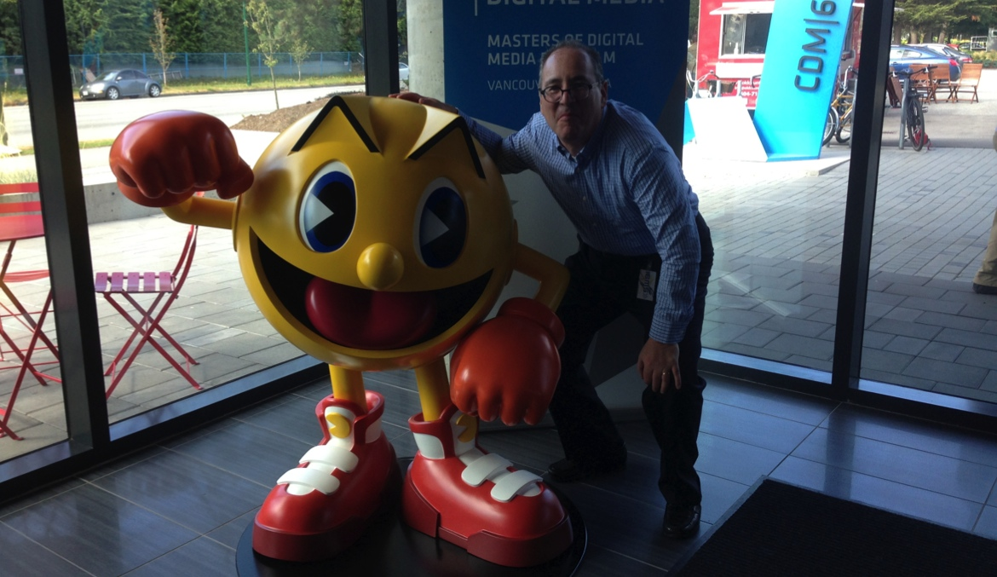
Which returns us
to…not knowing
what is real…

Slide 44

All the World is a Game
“ARE YOU LIVING IN A COMPUTER
SIMULATION?” Nick Bostrom – Faculty of
Philosophy, Oxford University. http://www.simulation-argument.com/simulation.html
“Physicists devise test to see if we're living in
'The Matrix”http://www.theverge.com/2012/10/11/3487710/computer-simulation-silas-beane-university-bonn
WE ARE ?

Slide 45
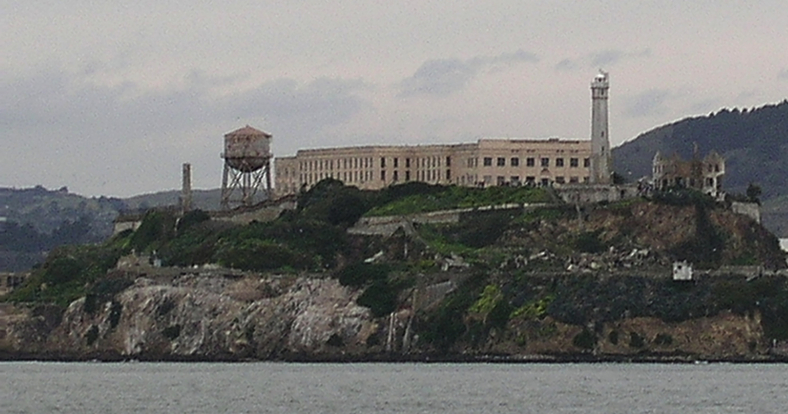
Next Class: “Part C. Controlling” begins

Slide 46

Almost forgot…

Slide 47
Our Academic Partners

