Slide 1


Mass Effect-s
Part C “Controlling” | Talk 10
Video Game Law 2013
UBC Law @ Allard Hall
Jon Festinger Q.C.
Centre for Digital Media
Festinger Law & Strategy
http://videogame.law.ubc.ca
@gamebizlaw
jon_festinger@thecdm.ca

Slide 2
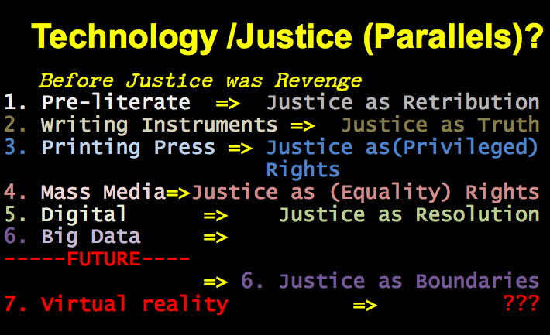
Updates

Slide 3
Which Laws: Layers of Control
11. Internet Governance & Surveillance (International Law)
10. Criminal & Obscenity Laws.
9. Taxation/Currency/Gambling (regulatory; quasi-criminal)
8. Misleading promises/advertising, physical or
psychological harm, unfair competition/anti-trust
(consumer protection)
7. Industry self regulation (delegated authority) & medium
specific regulation (constitutional)
Out of the Creation Norms (Censorship) ----------------------------------------------------------
In the Creation (Magic Circle) Ethics (of Originality, Creativity & Expression)
6. Privacy, Defamation & Personality law (tort, IP)
5. EULA/ToS & Contracts (contractual, private)
4. Trademark, Patents & the IP Business
3. Copyright & Users Rights (statutory)
2. Technology (quasi extra-legal)
1. Community (extra-legal)

Slide 4
Top half of chart
Not the Creator’s decisions
11. Internet Governance & Surveillance (International Law)
10. Criminal & Obscenity Laws.
9. Taxation/Currency/Gambling (regulatory; quasi-criminal)
8. Misleading promises/advertising, physical or
psychological harm, unfair competition/anti-trust
(consumer protection)
7. Industry self regulation (delegated authority) & medium
specific regulation (constitutional)
Out of the Creation Norms (Censorship) ----------------------------------------------------------

Slide 5
This Week..

Slide 6

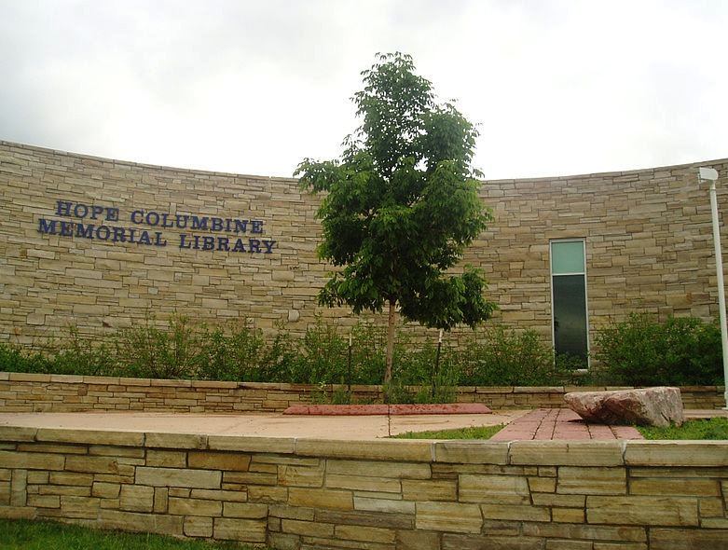
Assaults on Videogames
Assaults by Videogames
REMIXING VIOLENCE, SEXISM
& CIVIL SOCIETY

Slide 7

Special Guest

Slide 8
Intro: “Secrets” of contractual immunity
* Overall video game population is
about one third kids
ESA Game Player Data: “Sixty-eight percent of gamers are 18 years of age or older” http://www.theesa.com/facts/gameplayer.asp
See also “2012 Sales, Demographic and Usage Data”
http://www.theesa.com/facts/pdfs/ESA_EF_2012.pdf
“91 percent of kids are gamers, research says” (also kids responsible for 44% of physical software sales)http://news.cnet.com/8301-13506_3-20118481-17/91-percent-of-kids-are-gamers-research-says/

Slide 9
As irrelevant as they want to be…
* EULA’s & ToS do not mention underage
use & even more rarely mention
penalties (e.g. Check CoD EULA & ToU)
* EULA’s & ToS not really obvious in
violence debates
* WHY? Because EULA’s & ToS are legally
all but irrelevant here… “Gordion
Knot” - contracts don’t bind kids
* Example of how ineffectual EULA & ToS
can be…
* No Attempt to educate among the
wasted pages???

Slide 10

Industry Complicity? 1
“And here's another dirty little truth that the media try their best
to conceal: There exists in this country a callous, corrupt and
corrupting shadow industry that sells, and sows, violence against its
own people…Through vicious, violent video games with names like
Bulletstorm, Grand Theft Auto, Mortal Kombat and Splatterhouse. And
here’s one: it’s called Kindergarten Killers. It’s been online for 10
years…” --- Wayne LaPierre NRA --- http://home.nra.org/pdf/Transcript_PDF.pdf
(Bulletstorm=sci-fi; Grand Theft Auto=crime; Mortal
Kombat=fantasy; Splatterhouse=horror; Kindergarten
Killers=“flash”)
WHAT’S MISSING?... CALL of DUTY; BATTLEFIELD; America’s Army…
* “Shooters: How Video Games Fund Arms Manufacturers” - Simon Parkin http://www.eurogamer.net/articles/2013-02-01-shooters-how-video-games-fund-arms-manufacturers
* “EA removes links to gun sellers on ‘Medal of Honor’ page”
http://www.theverge.com/2012/12/27/3807900/ea-removes-links-to-gun-sellers-on-medal-of-honor-page
Double Standards Test?
-------------------------------------
See also: “Invading Your Hearts and Minds”:
Call of Duty and the (Re)Writing of Militarism
In U.S. Digital Games And Popular Culture” (2010)
http://ejas.revues.org/8831

Slide 11

Industry Complicity? 2
Industry maturity issue?
Actual maturity issue (young geeky
Males trying to be cool)?
Counter-culture roots become trendy
poseur rebellion ?
The “Grand Theft Auto San Andreas/Hot
Coffee” saga
* “Debate intensifies over Hot Coffee sex in GTA” (Gamespot June 2005) http://www.gamespot.com/news/debate-intensifies-over-hot-coffee-sex-in-gta-6128837
* “Hot Coffee controversy grows as Hilary Clinton weighs in” (Gamesindustry International July 14, 2005)http://www.gamesindustry.biz/articles/hot-coffee-controversy-grows-as-hilary-clinton-weighs-in
* “ESRB concludes investigation into Grand Theft Auto: San Andreas; Revokes M (Mature) Rating” http://www.esrb.org/about/news/7202005.jsp
* “BREAKING: RB Recalls San Andreas” (Kotaku July 2005) http://kotaku.com/113506/breaking-esrb-recalls-san-andreas

Slide 12

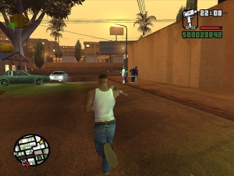
Industry Complicity? (2 – GTA continued)
“Who spilled Hot Coffee? The man who uncovered gaming's greatest sex scandal” http://www.eurogamer.net/articles/2012-11-30-who-spilled-hot-coffee
“Federal Trade Commission Complaint against Take-Two & Rockstar Games” (July 17, 2006) http://www.ftc.gov/os/caselist/0523158/0523158c4162TakeTwoInteractiveandRockstarComplaint.pdf
Settled June 8, 2006 http://www.ftc.gov/opa/2006/06/grandtheftauto.shtm
To “corporatize” - solution or greater problem?

Slide 13
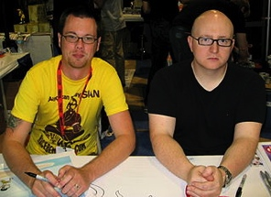
Industry Complicity? 3
Not a separate issue from industry sexism…
Very much the same issue of immaturities & insecurities
* “Every Misogynistic Argument You’ve
Ever Heard About Video Games” http://groupthink.jezebel.com/every-misogynistic-argument-youve-ever-heard-about-vid-756662565
* “Quit – Going To PAX Already, What is
Wrong With You” (re Penny Arcade principal)
http://elizabethsampat.com/quit-fucking-going-to-pax-already-what-is-wrong-with-you/

Slide 14

Industry Complicity? 4
EULA’s & ToS generally do not even mention
underage use
Avoiding the issue?
Not wanting to scare anyone off?
Confirming ineffectualness?
Looking the other way?
Confirming double standard?
"We consider it a good principle to explain the phenomena by the simplest hypothesis possible.” Ptolemy

Slide 15
Violent Games, Liability & Regulation: Cases
Watters v. TSR (D&D) 1990 USCA
James v. Meow (Heath High, Kentucky) 2002 USCA
Sanders v. Acclaim (Columbine) 2002 US Dist.
Wilson v. Midway (Mortal Kombat) 2002 US Dist.
----------------------------------------------------------
American Amusement v. Kendrick 2001 USCA
(protecting minors)
IDSA v. St. Louis 2003 USCA (protecting minors)
VSDA v. Maleng 2004 US Dist. (regulate games
depicting violence against law enforcement)
ESA v. Blagojevich 2006 USCA (protecting minors)
EMA v. Henry 2007 US Dist. (protecting minors)
ESA v. Swanson 2008 USCA (purchase contrary to
“rating”)
ESA v. Chicago Transit 2010 US Dist. (restricted
“M” game ads on CTA vehicles)
ESA v. Schwarzenegger 2011 SCOTUS (prohibited violent
video games) - Class 12 upcoming

Slide 16
Violent Games, Liability & Regulation: Rationales
Proximate cause (civil) not demonstrated - not
foreseeable - studies ambiguous re “actual harm”
Products liability claims inapplicable
Duty to exercise ordinary care
-----------------------------------------------------
Link of violent games to violence unproven – causality not demonstrated; correlation not cause
Thought control = totalitarianism = family
responsibility
Drafting not narrowly tailored to objective
Vague & ambiguous definitions/provisions
Classic literature/film, Bible, fairy-tale
comparisons

Slide 17



Canada - potentially quite different (if tested)
Montreal v. Arcade Amusements 1985 SCC – City By-Law 5156 (1977) cannot discriminate based on age (under 18) prohibiting entry to video arcade (narrowly construed decision)
Irwin Toy v. Quebec 1989 SCC - constitutionality of ban on commercial advertising directed at children under 13 upheld (no evidence or discussion of direct harm)
R. v. Sharpe 2001 SCC - reasoned apprehension of harm to children is sufficient (child pornography)

Slide 18
The Political Issue
Majority of Americans Believe Games Contribute to
Violence http://www.escapistmagazine.com/news/view/122351-Majority-of-Americans-Believe-Games-Contribute-to-Violence
Sen. Lamar Alexander: Games are a Bigger Problem Than Guns
http://www.gamepolitics.com/2013/01/30/sen-lamar-alexander-games-are-bigger-problem-guns
VERSUS
Former FBI Profiler: Video Games Do Not Cause Violence
http://gamepolitics.com/2013/02/25/former-fbi-profiler-video-games-do-not-cause-violence#.USwJD6XR0m0
25 Video Game Violence Studies, Summarized http://kotaku.com/5976781/25-video-game-violence-studies-summarized
I’m Mentally Ill, I Love Violent Video Games, And They’ve
Never Made Me Feel Like Killing Anyone
http://kotaku.com/5976286/im-mentally-ill-i-love-violent-video-games-and-theyve-never-made-me-feel-like-killing-Anyone
Video Games Hold No Answers http://www.huffingtonpost.com/paul-mones/video-games-violence_b_2480823.html
I was Adam Lanza http://www.thedailybeast.com/articles/2012/12/22/i-was-adam-lanza.html
Report: International Data Shows No Correlation Between Video Game Spending and Gun-Related Homicides
http://www.gamepolitics.com/2012/12/18/report-international-data-shows-no-correlation-between-video-game-spending-and-gun-relate#.UoG-hJRAShY
The Truth About Video Games and Gun Violence
http://www.motherjones.com/politics/2013/06/video-games-violence-guns-explainer
Video games don’t create violence in society, they reflect it
http://www.polygon.com/2013/1/14/3875420/video-game-violence

Slide 19

Evolving Memes & Cultural/Legal Choices
Areopagitica - John Milton 1644
Lady Chatterley’s Lover – D.H.
Lawrence 1928
Elvis on Ed Sullivan 1956
Lenny Bruce convicted for obscenity
1964 (posthumously pardoned)
The Pentagon Papers 1971
All in the Family 1971
Sony Betamax 1977 (Sony v. Universal
SCOTUS1984)
The Satanic Verses Salmon Rushdie 1988
Madonna “Like a Prayer” 1989
Anonymous 2003
GTA/Hot Coffee 2004
Aaron Swartz (1986 -2013)
WE LOOK BACK and LAUGH (& CRY)
Re Alberta Legislation (Alberta Press Act unconstitutional) SCC
1938
Roncarelli v. Duplessis (revoking liquor license of Jehovah’s
witness unconstitutional) SCC 1959
Irwin Toy (advertising directed at children constitutional) SCC
1989
R. v. Butler (sex with violence obscene) SCC 1992
Dagenais v. CBC (publication bans limited) SCC1994
Little Sisters (Customs Act power to exclude obscenity upheld
but implementation was discriminatory) SCC 2000
Crookes v. Newton (hyperlinking allowed) SCC 2011
ESA v. SOCAN (tech neutrality/fair dealing expansions &
Pentalogy) SCC 2012
A.B v.Bragg (anonymity for bullied complainant) SCC 2012
Privacy?
Remixing?
Interoperability?
Net Neutrality?
* part of cover
“The Selfish Gene”
Richard Dawkins
TRAJECTORY OF OPENNESS?

Slide 20

Perspective: A Law to know – but not a Legal Principle
2nd LAW OF THEROMODYNAMICS – ENTROPY
The total entropy of any isolated
thermodynamic system tends to
increase over time…
higher the entropy,
higher the chaos (disorder)
Yes, we are now in the puddle…
trying to make sense of the cube…
*Entropy = the only quantity in the physical sciences that implies the arrow of time
>>>>>See “Entropy as a Philosophy” George Saridis: http://www.dtic.mil/cgi-bin/GetTRDoc?AD=ADA515701

Slide 21
Examining ENTROPY starting with…
The Painful Truth
Watters v. TSR, Inc., 904 F. 2d 378 - Court of Appeals, 6th Circuit 1990 (Dungeons & Dragons):
“But if Johnny's suicide was not foreseeable to his own mother, there is no reason to suppose that it was foreseeable to defendant TSR…
…The fact is, unfortunately, that youth is not always proof against the strange waves of despair and hopelessness that sometimes sweep seemingly normal people to suicide, and we have no way of knowing that Johnny would not have committed suicide if he had not played Dungeons & Dragons…
…As far as the record discloses, no one had any reason to know that Johnny Burnett was going to take his own life. We cannot tell why he did so or what his mental state was at the time. His death surely was not the fault of his mother, or his school, or his friends, or the manufacturer of the game he and his friends so loved to play. Tragedies such as this simply defy rational explanation, and courts should not pretend otherwise.”

Slide 22

A Case For Absolutes (1)
(but not the one you expect)
One good that appears absolute is…
(drumroll please)...
…dialectics on issues of
…violence, censorship & fear
(as well as protecting ourselves from ourselves)
Proof: INCREASE in debate over censorship/freedom issues appears to parallel DECREASE in violence & crime
Parallels: Steven Pinker “The Better Angels of Our
Nature: Why Violence Has Declined”
*to paraphrase - our ability to reason has allowed us
to curtail the appeals of violence

Slide 23
A Case For Absolutes (2)
Another good that appears absolute is that addressing
problems at their extremes often makes for an odd &
inappropriate middle
Dealing with violent video games with a goal of preventing
Further New Town’s & Columbine’s mixes up causality &
Correlation
Seems likely that games don’t create killers but that
killers seek out killing games as an outlet (explains study
results where violent games and sexual outlets appear to
decrease “deviance”)
“Gun Control Debate: Violent Video Games Actually
Decrease Violence, Study Finds” http://www.policymic.com/articles/28280/violent-video-games-actually-decrease-violence-study-finds
“Research: As Violent Video Game Sales Climb,
Violent Crime Among Youths Decreases” http://www.gamepolitics.com/2013/02/13/research-violent-video-game-sales-climb-crime-among-
youths-decreases#.UR9AI6XR0m0

Slide 24
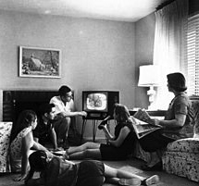
A Case For Absolutes (3)
3rd ABSOLUTE: historical truth (?) that we look back & laugh (and cry) at previous censorship
“What matters is not what Canadians think is right for themselves to see. What matters is what Canadians would not abide other Canadians seeing because it would be beyond the contemporary Canadian Standard of tolerance to allow them to see it.”
(1985 SCC Dickson CJ Towne Cinema)
THE “MRS. SMITH” PRINCIPLE
Human Instinct to Censor?
(non-dialectical- impedes progress)

Slide 25



A Case For Absolutes (4)
A BOLD QUESTION
Is all speech & creativity “political”?
(in the digital age)

Slide 26


Virtual v. Real GUNS: the obvious distinction
Guns are not the cause of violence
They are actually a part of the
violence.
It is for that reason guns are different from media influences, video-games and the rest.
Related: difference between ACTIONS (e.g. rampage killing) & INFLUENCES (video-games, movies). Between them lies INTERPRETATION
(which is about education)

Slide 27

Game Wars: Episode 4
A New Hope
Broader gaming audience; education; tasteless violence (E.g. Hitman 3 controversy?); mobile etc.
Leads to alienation of hardcore?
Leads to developer reaction against gratuitous sex & violence in games?
Leads to noticing these bad games aren't that good - - as opposed to censorship.
“Nine Signs That Video Games Grew Up a Bit in 2012”http://kotaku.com/5966587/nine-signs-that-video-games-grew-up-a-bit-in-2012

Slide 28
Additional Sources…
* “The Agony and the Exidy: A History of Video Game Violence and the Legacy of Death Race” http://gamestudies.org/1201/articles/carly_kocurek
* “How 4 Microsoft engineers proved that the “darknet” would defeat DRM”
http://arstechnica.com/tech-policy/2012/11/how-four-microsoft-engineers-proved-copy-protection-would-fail/
* “Violence and videogames: we look at the studies cited in the aftermath of Sandy Hook”http://www.pcgamer.com/2012/12/20/violence-and-videogames-we-look-at-the-studies-cited-in-the-aftermath-of-sandy-hook/
* “Don't Trust the Research Saying Video Games Cause Real-World Aggression”http://www.slate.com/blogs/crime/2012/12/21/wayne_lapierre_don_t_listen_to_the_nra_the_research_saying_video_games_cause.html
* “All Games Are (In A Sense) Violent” http://techcrunch.com/2012/12/22/all-games-are-in-a-sense-violent/
* “Video games don't create violence in society, they reflect it http://www.polygon.com/2013/1/14/3875420/video-game-violence
* “Expert: Violent Video Games Should Be For Adults Only” http://hereandnow.wbur.org/2013/02/21/video-games-guns

Slide 29

Women Gamers – Women in Games
“Video Games and Aestheticising Sexual Violence” http://gamingbolt.com/video-games-and-aestheticising-sexual-violence
“A Feminist Reviews Tomb Raider's Lara Croft” http://www.forbes.com/sites/carolpinchefsky/2013/03/12/a-feminist-reviews-tomb-raiders-lara-croft/
“Hitman Absolution: Trailer causes outrage”http://www.pocket-lint.com/news/45874/hitman-absolution-trailer-causes-outrage-io-games-producer-talks-violence-and-content
“In Virtual Play, Sex Harassment Is All Too Real” http://www.nytimes.com/2012/08/02/us/sexual-harassment-in-online-gaming-stirs-anger.html
“Image Based Harassment and Visual Misogyny”http://www.feministfrequency.com/2012/07/image-based-harassment-and-visual-misogyny/
“Fear of a Woman Warrior”http://www.gamespot.com/features/fear-of-a-woman-warrior-6404142/
“On being a girl in computer science - a confession” by Dr. Kimberly Vollhttp://zanytomato.tumblr.com/post/44978912674/on-being-a-girl-in-computer-science-a-confession

Slide 30

Self Identifying is a Right
– isn’t it?
“The most desirable thing in the world is freedom to be true to oneself, i.e., Honesty”, Susan Sontag (at 14 years old)
Many women playing hardcore (FPS) games pretend not to be.
Lets not pretend this is a choice. Never knew what that would feel like…Until I had to pick up some “binders”.
A Parable.

Slide 31

Why no legal actions?
EULA’s generally don’t preclude.
If they do, probably invalid.
Constitutional right against being
discriminated against in play.
Trumps private relationship (that isn’t).
Carriers/ISP’s regulated.
Multiple forums possible.

Slide 32
Something(s) utopian to reflect on..
Razing the virtual glass ceiling: Gendered economic disparity in two massive online games – Ratan, Lehdonvirta, Kennedy, Williams (2012) http://vili.lehdonvirta.com/files/wmtr2821/Ratan-2012-gender-virtual-wealth-gap.pdf
Online dating study shows racial prejudices can be easily altered
http://www.boston.com/news/science/blogs/science-in-mind/2013/11/04/online-dating-study-shows-racial-prejudices-can-easily-altered/UsN6Rc6oOEIQQTsUQFLdxM/blog.html
Modifying player behavior in League of Legends using positive reinforcement
http://www.gamasutra.com/view/news/184806/
You and Your Videogame Avatar Are More Moral Than You Realize
http://www.forbes.com/sites/carolpinchefsky/2012/11/28/you-and-your-videogame-avatar-are-more-moral-than-you-realize/
Computer Games Save Norwegian Youth
http://www.tnp.no/norway/panorama/3904-computer-games-save-norwegian-youth
Strong-female protagonist game jam kicks off in Vancouver to fight industry sexism
http://business.financialpost.com/2013/07/12/strong-female-protagonist-game-jam-kicks-off-in-vancouver-to-fight-industry-sexism/?__lsa=9ee1-db35
And a concern: Sexualized avatars affect the real
world, Stanford researchers find
http://news.stanford.edu/news/2013/october/virtual-female-avatars-100913.html

Slide 33
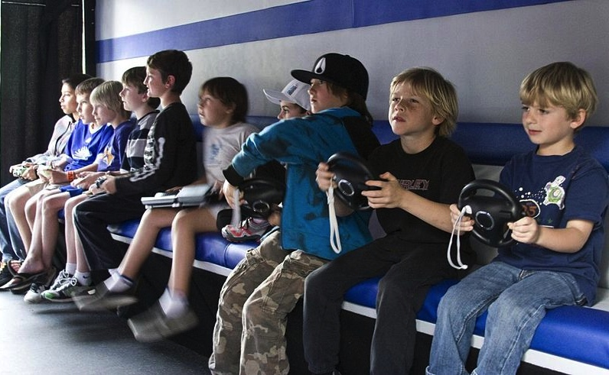
Kids & Video Games
Some Surprising
positives ??

Slide 34
…& adults too
9 Ways Video Games Can Actually Be Good For You
1. 'Mario' Is Like Steroids For Your Brain
2. 'Starcraft' May Make You Smarter
3. Video Games May Slow The Aging Process
4. They May Help Dyslexic Kids Read Better
5. Teen Gamers End Up Better At Virtual Surgery
Than Real Medical Residents
6. Video Games Can Be A Pain Reliever
7. 'Call Of Duty' Can Improve Your Eyesight
8. Video Games Can Be As Effective As One-On-One
Counseling
9. They Can Help Stroke Victims More Fully
Recover http://www.huffingtonpost.com/2013/11/07/video-games-good-for-us_n_4164723.html

Slide 35


But..Game Addiction
Researchers: Game Developers Need
to Put Limits on MMORPG Players to
Avoid Pathological Addiction’
http://www.gamepolitics.com/2013/08/06/researchers-game-developers-need-put-limits-mmorpg-players-avoid-pathological-addiction#.UoGlM5Fa_zc
“Top 10 Cases of Extreme Game Addiction”http://listverse.com/2010/11/07/top-10-cases-of-extreme-game-addiction/
“Problems with the Concept of Video Game “Addiction”: Some Case Study Examples” - Richard T. A. Wood
http://laurier.communicationstudies.ca/files/wood_problems_game_addiction.pdf
“A case study of Internet Game Addiction - Eun Jin Lee"http://wpblog.uncfsu.edu/fsu_news/files/2012/01/Journal-of-Addictions-Nursing-Article-on-A-Case-Study-of-Internet-Game-Addiction.pdf
“Computer and Video Game Addiction—A Comparison between Game Users and Non-Game Users”https://www.sfu.ca/cmns/courses/2011/325/class/13zachary/3_final_project/Misc_files/Computer%20and%20Video%20Game%20Addiction%20%20Weinstein.pdf
Video Game Addiction.Orghttp://www.video-game-addiction.org/video-game-addiction-articles/study-documents-prevalence-of-pathological-behavior-among-young-video-gamers.htm

Slide 36

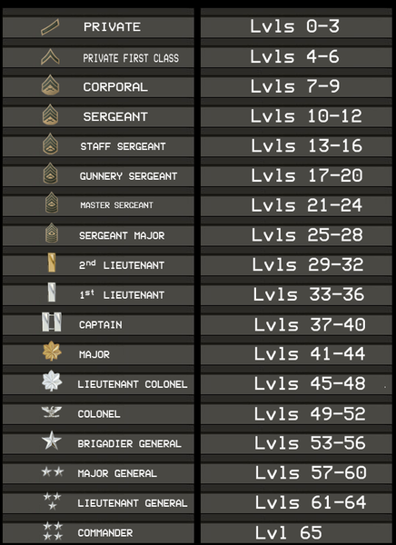

What’s Your Take?
“Gamers committing war crimes should suffer ‘virtual consequences,’ says Red Cross”
http://www.theverge.com/2013/10/8/4815090/gamers-committing-war-crimes-should-suffer-virtual-consequences-says

Slide 37

Next Class: Controlling the Controllers
The many meanings of “Privacy”
in/through Video Games
Contours of Video Game Regulation?

Slide 38


Slide 39
Our Academic Partners

